Slide 1

U.S. Trade and Trade Wars
<Author, Ph.D.>
<Affiliation>
<Audience>
April 30, 2019

Slide 2
National Economic Education Delegation
Vision
  One day, the public discussion of policy issues will be grounded in an accurate perception of the underlying economic principles and data.
Mission
  NEED unites the skills and knowledge of a
  vast network of professional economists to promote understanding of the economics of policy issues in the United States.
NEED Presentations
  Are nonpartisan and intended to reflect the consensus of the economics profession.

Slide 3
Who Are We?
Honorary Board: 47 members
  2 Fed Chairs: Janet Yellen, Ben Bernanke
  6 Chairs Council of Economic Advisers
    Furman (D), Rosen (R), Bernanke (R), Yellen (D), Tyson (D), Goolsbee (D)
  3 Nobel Prize Winners
    Akerlof, Smith, Maskin
Delegates: 500+ members
  At all levels of academia and some in government service
  All have a Ph.D. in economics
  Crowdsource slide decks
  Give presentations
Global Partners: 45 Ph.D. Economists
  Aid in slide deck development

Slide 4
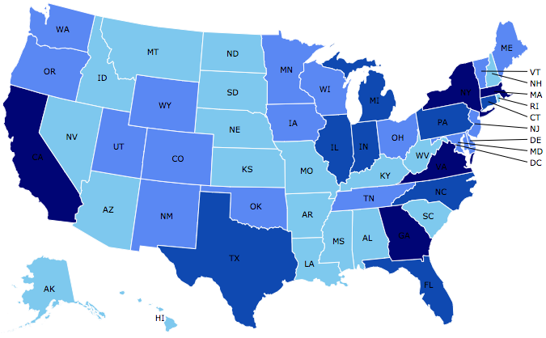
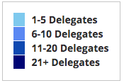
Where Are We?

Slide 5
Credits and Disclaimer
This slide deck was authored by:
  Alan Deardorff, University of Michigan
  Kadee Russ, University of California-Davis
This slide deck was reviewed by:
  Jon Haveman, NEED
Disclaimer
  NEED presentations are designed to be nonpartisan.
  It is, however, inevitable that the presenter will be asked for and will provide their own views.
  Such views are those of the presenter and not necessarily those of the National Economic Education Delegation (NEED).

Slide 6
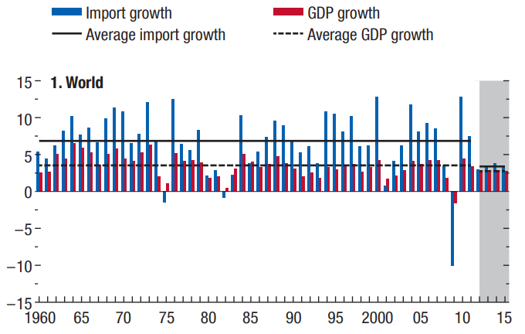
A slowdown in global trade since 2008
IMF 2016 World Economic Outlook, Chapter 2, Figure 2.1

Slide 7
Outline
U.S. Trade
President Trump’s 2018 Trade Actions
  Trade War
    Solar Panels and Washing Machines
    Steel and Aluminum
    Cars (threat)
    China
  Free Trade Agreements
    Korea-US Trade Agreement Amended
    NAFTA → USMCA

Slide 8
U.S. Trade

Slide 9
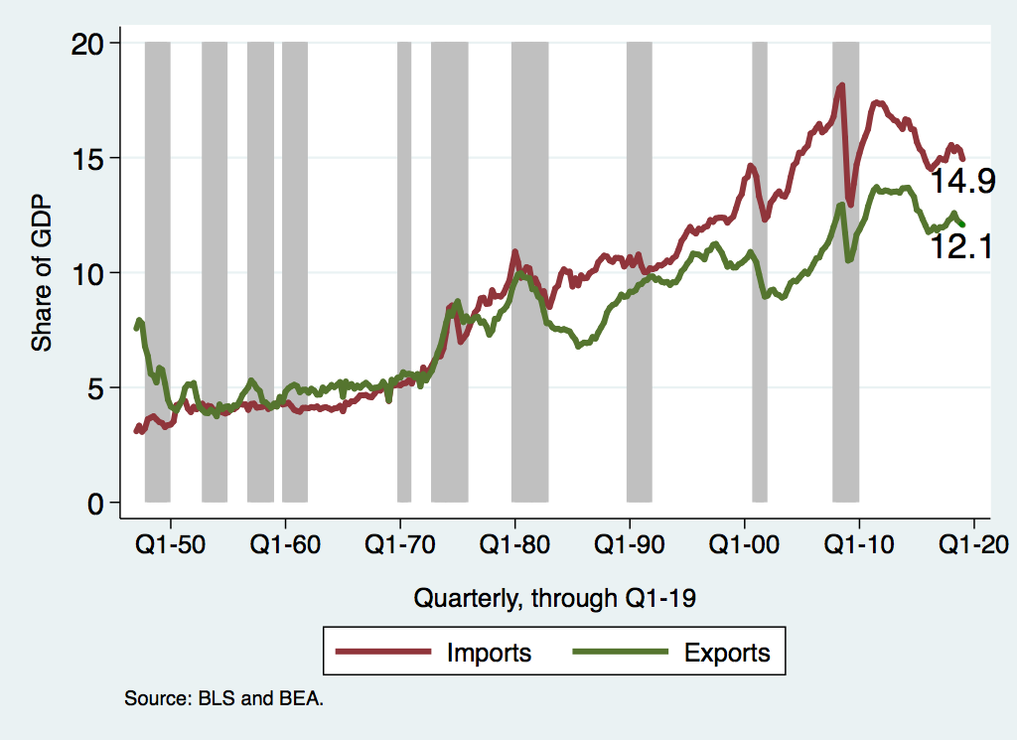
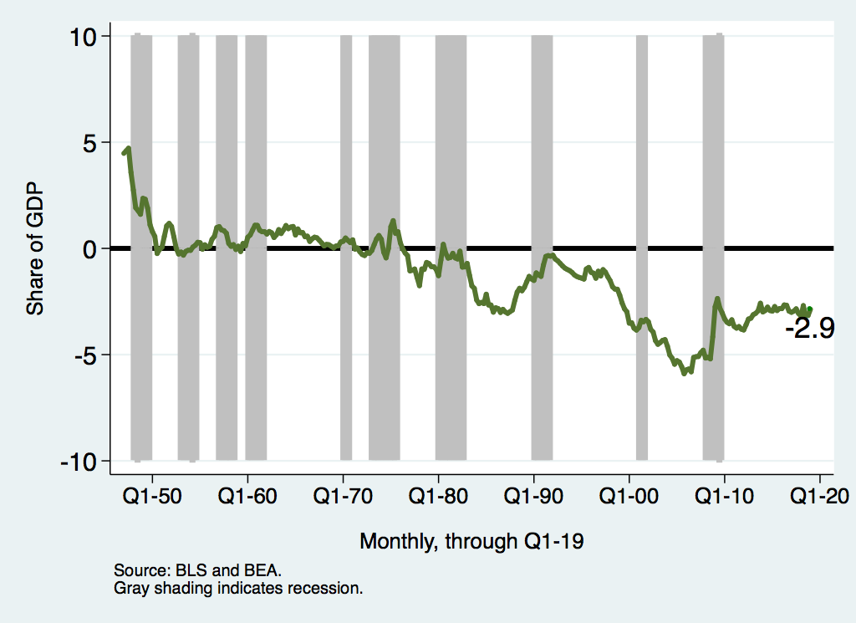
Importance of US Trade
US trade as % of GDP
US trade balance as % of GDP

Slide 10
What do we Export? ($1.6 Trillion)

Slide 11
What do we Import? ($2.4 Trillion)

Slide 12
Top US Trade Partners (Goods, 2016)
Top 10 US export destinations
Top 10 US import sources

Slide 13
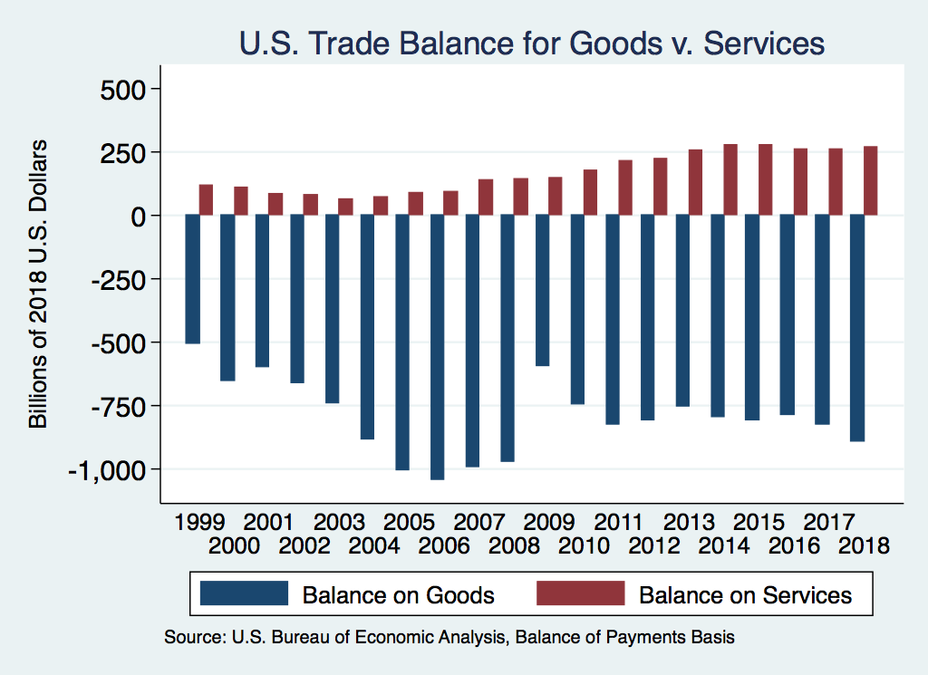
U.S. trade
$2.3 Trillion in exports and $2.9 Trillion in imports of goods and services in 2017, in total 27% of GDP
Overall, a nearly $570 Billion trade deficit (3% of GDP)
Goods trade deficit over $800 Billion
Services trade surplus about $250 Billion

Slide 14
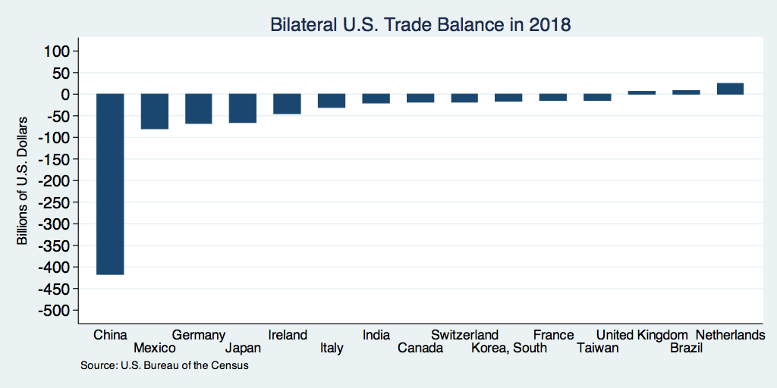
Bilateral trading relationships

Slide 15
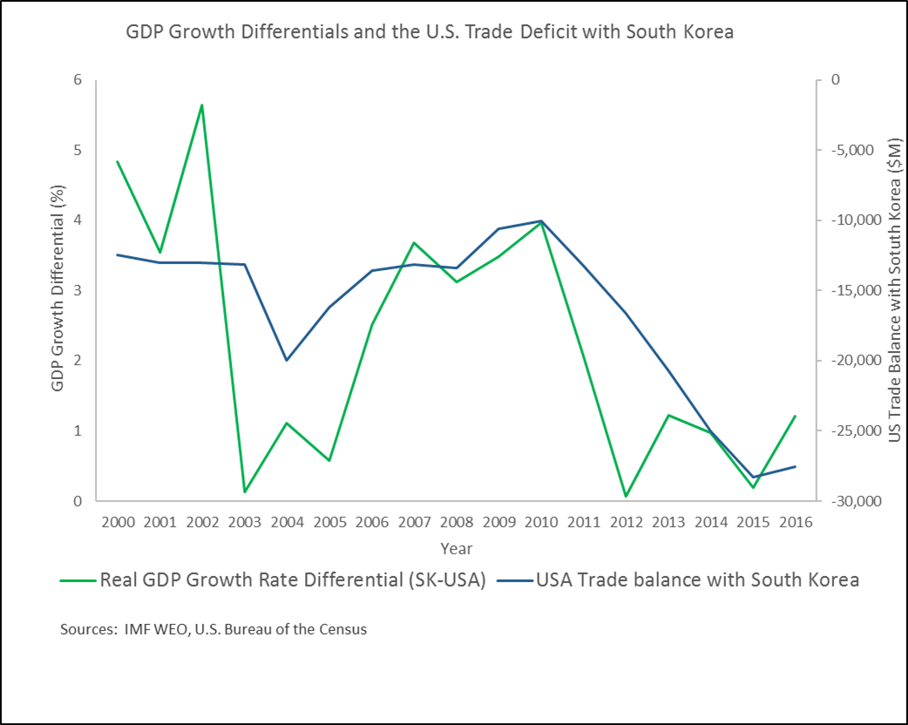
Trade imbalances
Driven by macroeconomic factors
  Trade deficits happen when a country’s firms, households, and government together consume more than the country produces.
  Trade deficits can happen when a country’s economy starts to expand faster than its trading partners
Example: U.S.-S.K. trade deficit roughly tracks the S.K.-U.S. real GDP growth differential

Slide 16
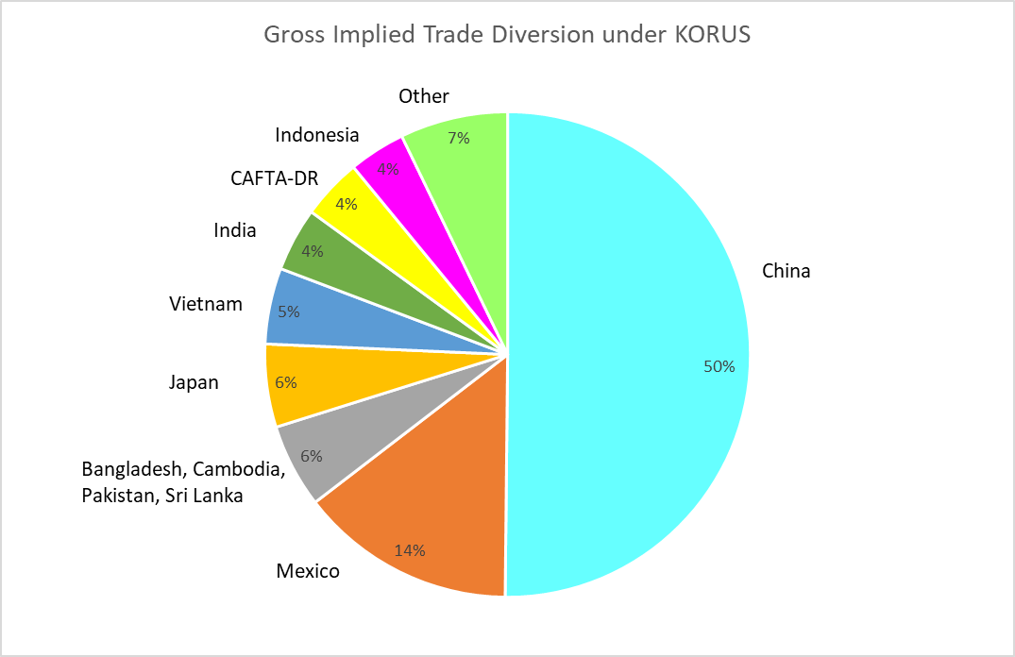
Trade agreements may re-route trade
Many observers were concerned that the U.S. bilateral trade deficit with South Korea increased more than $10 billion annually after the Korea-U.S. Free Trade Agreement went into force in 2012.
Recent research shows that KORUS just shifted about $13 billion of U.S. imports from other countries to South Korean suppliers (Russ and Swenson).
About half of the re-routed trade was from China.

Slide 17
U.S. now using some established and some new approaches to trade policy
Established
New
Barriers against import surges and imports of unfairly traded products
Bilateral and multilateral trade agreements to increase market access for U.S. exports
Leadership in GATT/WTO
Non-discrimination
Renegotiations of and withdrawal from existing trade agreements
Weakening of WTO trade dispute settlement mechanism
“Reciprocity”

Slide 18
Recent applications of established barriers against import surges and imports of unfairly traded products
Trade Act of 1974
  Section 201 (surges): solar cells, washing machines
  Section 301 (non-market activity): China forced technology transfer
Trade Expansion Act of 1962
  Section 232 (national security): steel and aluminum
Trade Act of 1930
  Anti-dumping and countervailing duties (cover about 80% of steel from China)

Slide 19
“What will be the effect of tariffs on the U.S. economy, workers, and households?”
Consumer impact
Higher costs for US businesses that rely on imported inputs may put these firms and their workers at risk
Risk of recession-- investment is a particularly import-intensive type of demand
Retaliatory tariffs will put firms and jobs in U.S. export industries at risk

Slide 20
“What will be the effect of tariffs on the U.S. economy, workers, and households?”
Consumer impact
Higher costs for US businesses that rely on imported inputs may put these firms and their workers at risk
Risk of recession-- investment is a particularly import-intensive type of demand
Retaliatory tariffs will put firms and jobs in U.S. export industries at risk
“Won’t tariffs start an investment and output boom, since companies that serve the U.S. market will want to produce in the U.S.?”
“Won’t tariffs bring back jobs?”
“Won’t tariffs help raise wages for U.S. workers and reduce inequality?”

Slide 21
Recent Research Suggests Trade Disrupts Job Markets
China Shock 1991-2011: ≈ 2 million jobs displaced in import-competing industries (Acemoglu, Autor, Dorn, Hanson, Price)
Impact on some communities absolutely devastating.
  Concentrated job losses, home prices fell, cuts to local services, reduced marriage and fertility.
Research suggests that nationally, jobs expanded in other industries by about the same number, or possibly more.
  Cheaper imported inputs allow import-using sectors to grow faster.
  Feenstra, Ma and Xu; Wang, Wei, Yu, and Zhu

Slide 22


Slide 23
Trump’s 2018 Trade Actions
Most were tariffs on imports
  Taxes levied by US on imports from others
  Taxes levied by others (in retaliation) on US exports
Normal effects of tariffs
  Raise prices for importers
  Lower prices for exporters
  Cause substitution
    To other products
    To other countries (if not on all)
Net economic effect is almost always negative
Net economic effect is always negative
Two recent studies of the 2018 Trade War found that exporter prices did not fall.

Slide 24
Trump’s 2018 Trade Actions
These slides will list only actions actually taken.
Most had plans and threats announced in the days and weeks beforehand.

Slide 25
Trump’s 2018 Trade Actions
Jan 22, 2018: Safeguard tariffs
  30% on solar panels
  50% on washing machines

Slide 26
Safeguards
WTO permits tariffs on imports that cause serious injury
Trump used the following:
  30% on solar panels
  50% on washing machines
  (both declining over 3 or 4 years)
Both were on exports of all countries
  Reason: previous China-only tariffs had been evaded by moving production elsewhere

Slide 27


Slide 28
Tariffs on Solar Panels
Why?
  Increased imports from China had driven US companies out
  Anti-dumping duties had failed to help, as companies moved production to other non-China and non-US locations
Notes:
https://www.greentechmedia.com/articles/read/trump-solar-tariffs-manufacturing-renaissance#gs.T145hk31

Slide 29
Tariffs on Solar Panels
Who benefits?
  Who requested
    Suniva, Chinese owned, manufactures in Georgia and in Saginaw, MI
    SolarWorld, was German owned but now French,
  14 US manufacturers, including
    CBS Solar, Copemish, MI
Notes:
https://www.greentechmedia.com/articles/read/trump-solar-tariffs-manufacturing-renaissance#gs.T145hk31

Slide 30
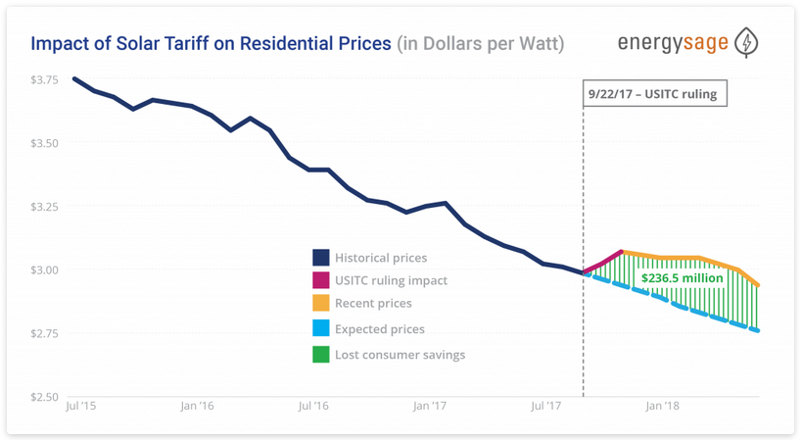
Notes:
Source: EnergySage.com: https://news.energysage.com/2018-us-solar-tariff-impact-prices/

Slide 31
Tariffs on Solar Panels
Who is hurt?
  Consumers
  Solar panel installers, led by Solar Energy Industry Association
    They estimate that the 30% tariff “would cause the loss of 23,000 in 2018, as well as the delay or cancellation of billions of dollars of investments in solar energy.”
Notes:
https://www.brookings.edu/blog/planetpolicy/2018/02/09/what-past-experience-tells-us-about-the-impact-of-new-american-solar-tariffs/

Slide 32


Slide 33
Tariffs on Washing Machines
Why?
  From 2012 to 2016, imports increased dramatically from two Korean firms LG and Sumsung
  Anti-dumping duties failed to stop this, as production moved to Thailand and Vietnam
Notes:
Section 201 Fact Sheet,

Slide 34
Tariffs on Washing Machines
Who benefits?
  Whirlpool, Benton Harbor, MI, which requested the tariffs
    Whirlpool brands include Amana, Maytag, & more
  Other US manufacturers, such as GE, Electrolux and Frigidaire (Swedish), Equator, Speed Queen
  In 2017, Samsung and LG announced plans to build factories in South Carolina and Tennessee
Notes:
https://www.greentechmedia.com/articles/read/trump-solar-tariffs-manufacturing-renaissance#gs.T145hk31

Slide 35
Tariffs on Washing Machines
Who is hurt?
  Consumers
    Washers (and dryers!) both increased in price by about 12% (per Flaaen et al. 2019)
      Note that the tariff was levied on washers only, not dryers]
      ”consumers bore between 125 percent and 225 percent of the costs” (NYT 4/21/19)
    US appliance prices (I don’t have graph for washing machines alone) rose 8.1% over the 12 months to Nov 2018
Notes:
https://www.marketwatch.com/story/buying-washing-machines-dishwashers-is-more-expensive-after-trump-tariffs-2018-11-14

Slide 36
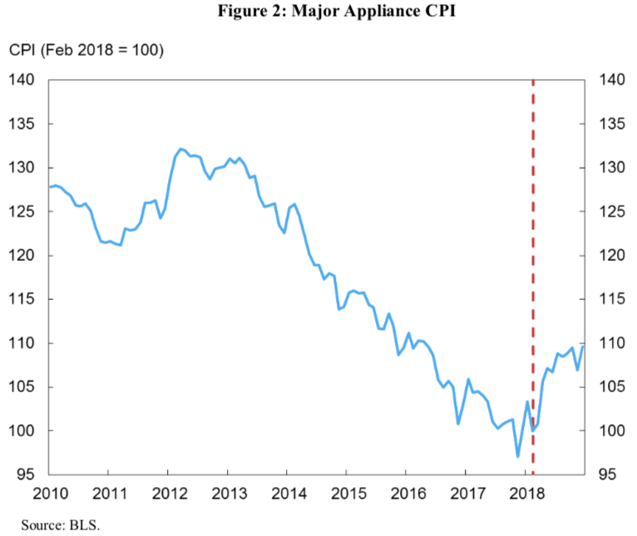
Tariffs on Washing Machines
Tariff
Source: Amiti, Redding, and Weinstein, “The Impact of the 2018 Trade War on U.S. Prices and Welfare,” CEPR Discussion Paper DP13564, March 1, 2019.
Notes:
https://www.marketwatch.com/story/buying-washing-machines-dishwashers-is-more-expensive-after-trump-tariffs-2018-11-14
https://www.nber.org/papers/w25767
https://www.nytimes.com/2019/04/21/business/trump-tariffs-washing-machines.html

Slide 37
Trump’s 2018 Trade Actions
Jan 22, 2018: Safeguard tariffs
Mar 1, 2018: Announces “national-security” tariffs on steel and aluminum
  25% on steel, 10% on aluminum
  Announced for all countries
    Some delayed (EU, Canada Mexico)
    Others later exempted (S. Korea)

Slide 38
National Security
Trump used Section 232 of US trade law to levy tariffs on imports of metals, based on national security
  “Economic security is national security”
                (Trump Dec 18, 2017)
  25% on steel, 10% on aluminum
  Mar 23: Tariffs start with some exemptions
  Mar 28: Korea exemption permanent in return for a quota cutting its exports to ~80% of 2017
  Jun 1: Tariffs extended to EU, Canada, Mexico

Slide 39


Slide 40
Tariffs on Steel and Aluminum
Responses to metals tariffs
  Retaliation by China, EU, Canada, & others
  WTO disputes
    May-Aug: Complaints filed AGAINST U.S.
    July: Complaints filed BY U.S.

Slide 41
Tariffs on Steel and Aluminum
Who benefits?
  US producers of steel and aluminum
    Steel: AISI lists 12 producers in Michigan
    Aluminum: Thomas lists 76 suppliers in Michigan
Notes:
https://www.thomasnet.com/nsearch.html?cov=MI&heading=1261809&loc=MI

Slide 42
Tariffs on Steel and Aluminum
Who is hurt?
  US users of steel and aluminum pay higher prices
    Most obviously the car companies but many others

Slide 43
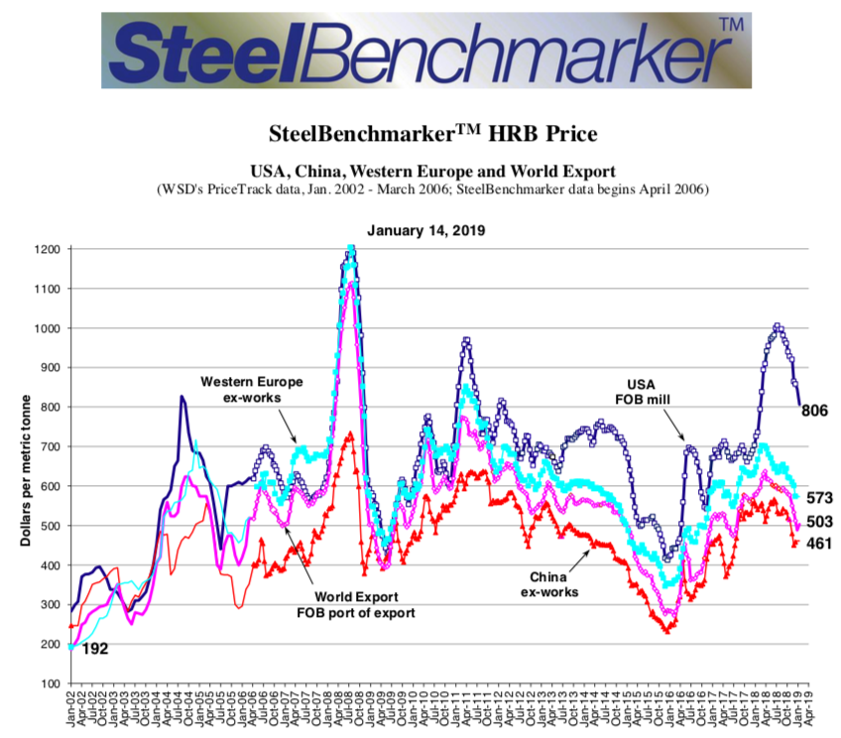
Steel Prices
US 25% Tariff
43

Slide 44
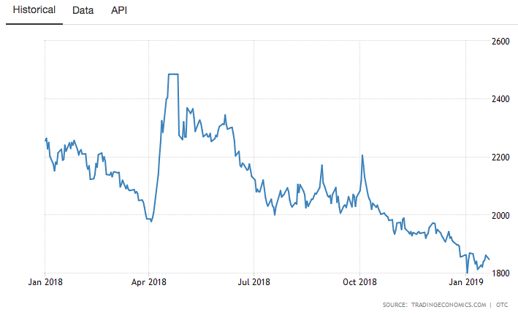
Aluminum Price
US 10% Tariff
25%

Slide 45
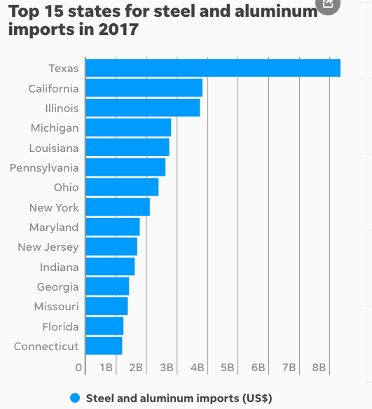

Slide 46
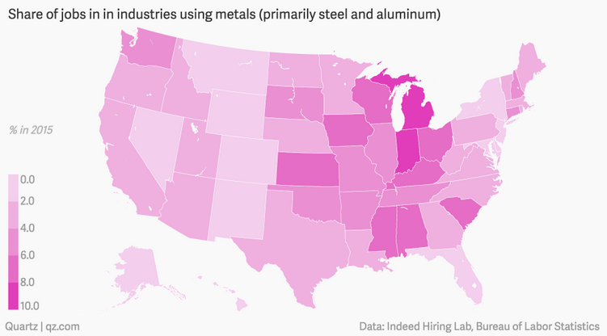
Source: Kopf (2018)
Notes:
Kopf, Dan, “The US states that will be helped and hurt by Trump’s tariffs,” Quartz, March 9, 2018.
https://qz.com/1224271/the-us-states-that-will-be-helped-and-hurt-by-trumps-tariffs/

Slide 47
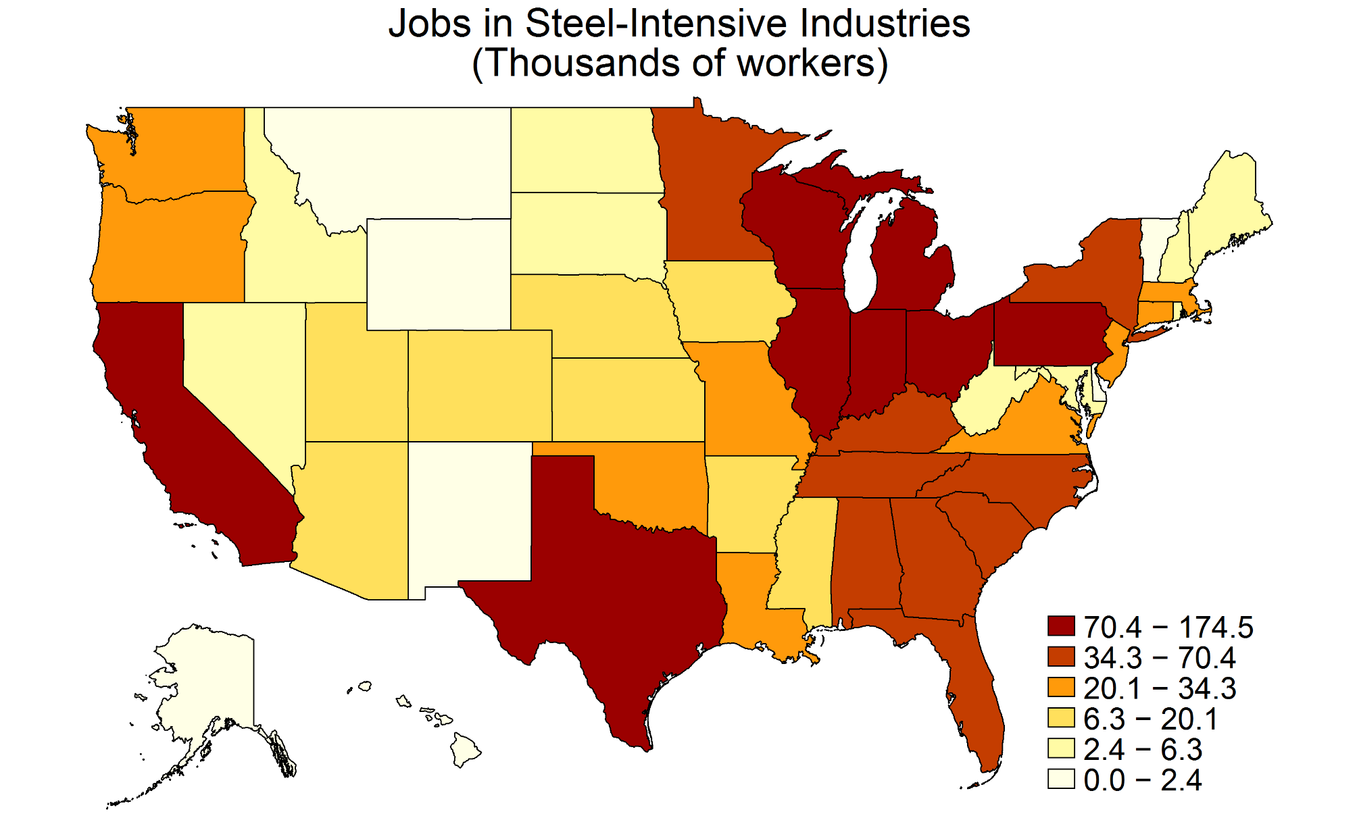
Tariffs on Imported Inputs Can Hurt Firms

Slide 48
Trump’s Trade Actions
Jan 22, 2018: Safeguard tariffs
Mar 1, 2018: Announces tariffs on steel and aluminum
May 23, 2018: Initiates Commerce Dept investigation of car and car part imports

Slide 49
National Security
Cars
  Trump initiated another national security investigation: on imported cars
  Trump said he’s considering a 25% tariff on cars and car parts
  This would be bigger than on metals:
    Tariffs on $48 billion of steel and aluminum imports
    Tariffs on $351 billion of car and car part imports
      (per NYT)
Notes:
https://www.nytimes.com/2018/07/19/us/politics/trump-car-import-tariffs.html

Slide 50


Slide 51
Tariff on Cars and Car Parts
Who would benefit?
  US car companies?
    Most (e.g., GM) are opposed
    I can’t find objection from Ford, but others list Ford among those who object
  US auto workers?
    UAW has spoken in favor of “target measures” with with understanding that broad tariffs or quotas “could cause harm” including “mass lay-offs for American workers.”
Notes:
https://www.freep.com/story/money/cars/2018/07/19/hearing-auto-import-taxes-get-underway-washington/797915002/
https://www.forbes.com/sites/jimhenry/2018/07/23/with-friends-like-these-auto-import-tariffs-do-not-need-enemies-trade-group-says/#1ebddc9669ab
https://www.politico.com/story/2018/06/26/us-automakers-trump-administration-car-tariffs-653654
https://www.businessinsider.com/trump-auto-car-tariffs-ford-bmw-gm-toyota-kia-reaction-2018-7

Slide 52
Tariff on Cars and Car Parts
Who would be hurt?
  Most car companies, including GM
  US car buyers

Slide 53
Tariff on Cars and Car Parts
Estimated Effects on Car Sales and Prices of 25% Tariff
 | Sales impact (units) | Average Price Increases ($/unit) on vehicles sold in US
Tariff on: |  | All | US-assembled | Imported
All imports | –2.0 M | $4,400 | $2,270 | $6,875
Canada & Mexico exempted | –1.2 M | 2,450 | 1,135 | 3,980
Source: Center for Automotive Research
Notes:
https://www.cargroup.org/wp-content/uploads/2018/07/NADA-Consumer-Impact-of-Auto-and-Parts-Tariffs-and-Quotas_July-2018.pdf
Schultz et al., “Trade Briefing: Consumer Impact of Potential U.S. Section 232 Tariffs and Quotas on Imported Automobiles & Automotive Parts,” July 2018

Slide 54
Tariff on Cars and Car Parts
Estimated Effects on Employment & GDP of 25% Tariff
Tariff on: | Total US Employment | US GDP
All imports | –714.7 K | –$59.2 B
Canada & Mexico exempted | –197.2 K | –15.3B
Source: Center for Automotive Research
Notes:
https://www.cargroup.org/wp-content/uploads/2018/07/NADA-Consumer-Impact-of-Auto-and-Parts-Tariffs-and-Quotas_July-2018.pdf
Schultz et al., “Trade Briefing: Consumer Impact of Potential U.S. Section 232 Tariffs and Quotas on Imported Automobiles & Automotive Parts,” July 2018

Slide 55
Tariff on Cars and Car Parts
Estimated Effects of a 25% Tariff on Revenue & Employment in New Car Dealerships
Tariff on: | Dealership Revenues |  | Dealership Employment
 | Total | Per D’ship | Total | Per D’ship
All imports | –66.5 B | –4.0 M | –117.5 K | –7
C & M exempted | –39.1 B | –2.3 M | –50.5 K | –4
Source: Center for Automotive Research
Notes:
https://www.cargroup.org/wp-content/uploads/2018/07/NADA-Consumer-Impact-of-Auto-and-Parts-Tariffs-and-Quotas_July-2018.pdf
Schultz et al., “Trade Briefing: Consumer Impact of Potential U.S. Section 232 Tariffs and Quotas on Imported Automobiles & Automotive Parts,” July 2018

Slide 56
Tariff on Cars and Car Parts
Where we stand:
  Commerce Dept. sent report to Trump Feb 17
    Not public, but said to include several options for tariffs
    Trump has 90 days to decide
  FT Jan 22: “president was leaning towards slapping tariffs on automotive imports, in the hope of forcing Brussels to further open the EU market to American farm products.”
Notes:
https://www.ft.com/content/a852539e-19d7-11e9-9e64-d150b3105d21
https://www.msci.org/commerce-department-recommends-section-232-tariffs-on-autos-auto-parts/

Slide 57
Trump’s Trade Actions
Mar 1, 2018: Announces tariffs on steel and aluminum
May 23, 2018: Initiates Commerce Dept investigation of car and car part imports
Jul 6, 2018: First tariffs on China, $34 billion
  On $34 billion of China exports to US
  Based on unfair trade practices in intellectual property (IP)

Slide 58


Slide 59
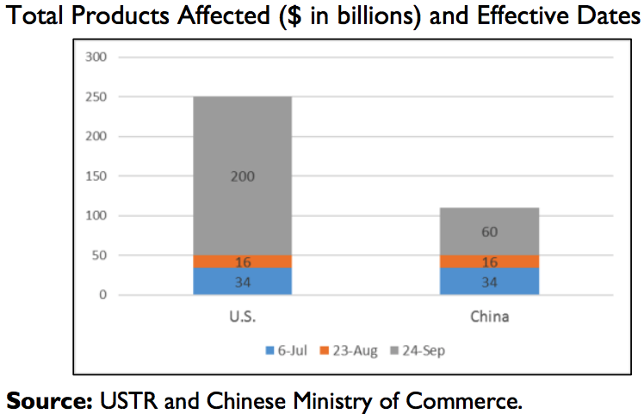
Three Rounds of Tariff Hikes in 2018
Source: Congressional Research Service, Enforcing U.S. Trade Laws: Section 301 and China, April 8, 2019

Slide 60
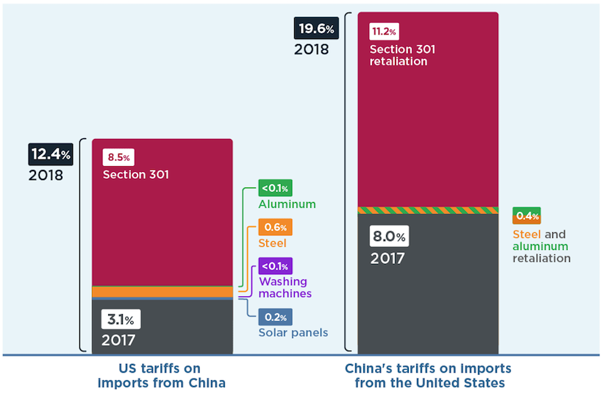
Average U.S. and China Tariffs: Before and After
Source: Chad P. Bown, 2019, The 2018 US-China Trade Conflict After 40 Years of Special Protection (PIIE Working Paper 19-7

Slide 61
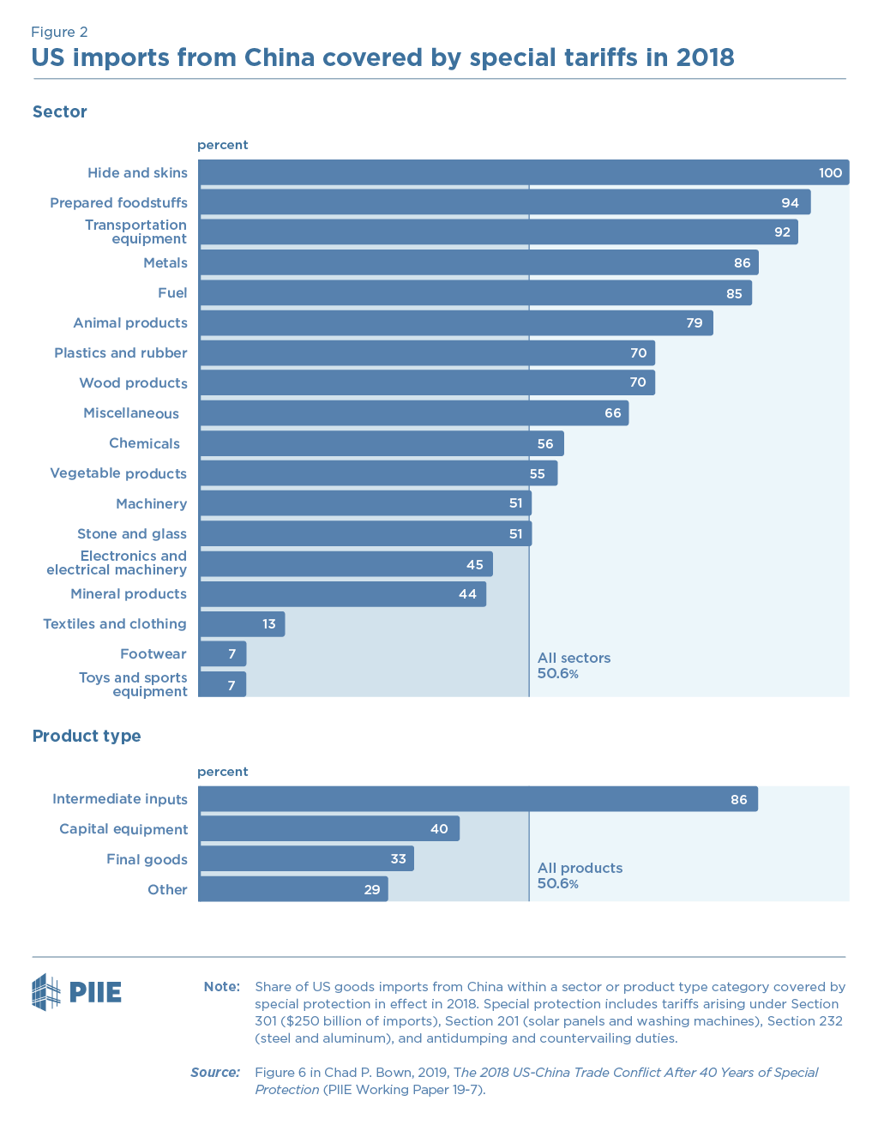

Slide 62
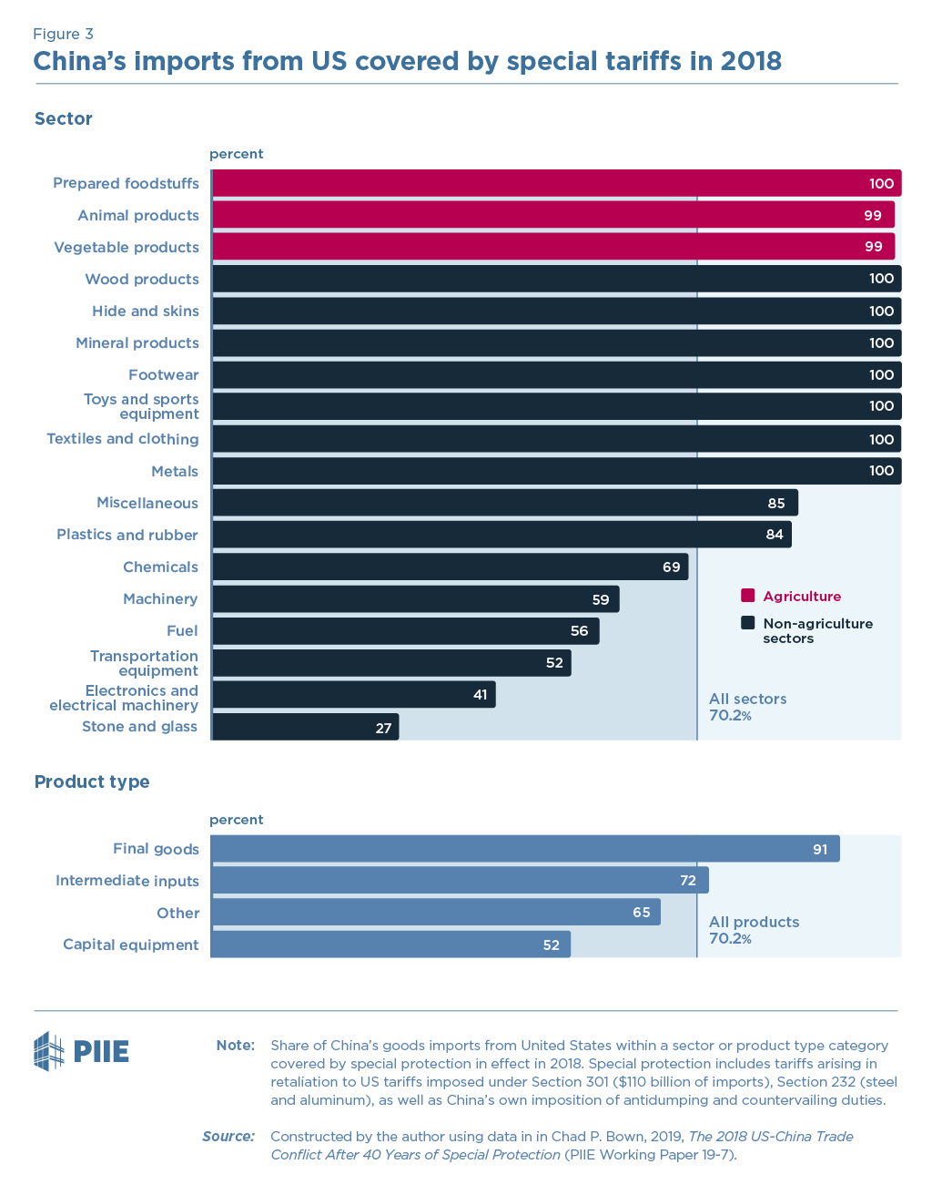

Slide 63
Trump’s Trade Actions
Mar 1, 2018: Announces tariffs on steel and aluminum
May 23, 2018: Initiates Commerce Dept investigation of car and car part imports
Jul 6, 2018: First tariffs on China, $34 billion
  On $34 billion of China exports to US
  Based on unfair trade practices in intellectual property (IP)

Slide 64
China
Concerns about China’s IP practices pre-existed Trump
  Theft of technology secrets
  Forcing investors in China into joint ventures and sharing technology
Prior to Trump, complaints had been voiced by US and EU, but nothing had been done
US initiated investigation under Section 301 of US trade law (unfair trade practices)
  Aug 18, 2017: Investigation initiated
  Mar 22, 2018: Report finds unfair trade and recommends tariffs
Since then, Trump has announced and then implemented multiple rounds of tariffs

Slide 65
Trump’s Trade Actions
Mar 1, 2018: Announces tariffs on steel and aluminum
May 23, 2018: Initiates Commerce Dept investigation of car and car part imports
Jul 6, 2018: First tariffs on China , $34 billion
Aug 23, 2018: Second tariffs on China, $16 billion
Sep 24, 2018: Third tariffs on China, $200 billion

Slide 66
China
This is a “Trade War”: Tariffs and retaliation
  US tariffs on $34 billion Jul 6 were matched that day by China tariffs on $34 billion of US exports
  US tariffs on $16 billion Aug 23 were matched that day by China tariffs on $16 billion of US exports
  US tariffs on $200 billion Sep 24 were less-than-matched by China on $60 billion of US exports
  Trump said he’d use tariffs on still more ($267 billion), approaching all of China’s exports to US
    Did not do that; delayed for China-US trade talks

Slide 67
China
What’s the point?
  To get China to stop its IP practices?
  To reduce the US bilateral trade deficit with China?
  To stop China’s rise as an economy and as a world power?
Who will “win”?
  Nobody! Everybody loses from tariffs
  Trump says it’s “easy to win” because he measures success from trade deficit

Slide 68
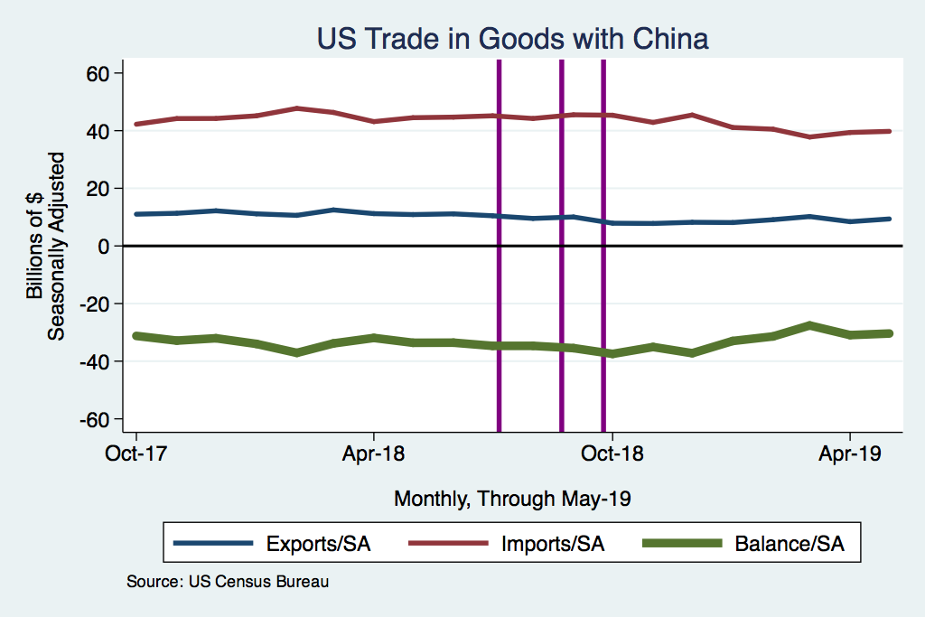
Tariffs

Slide 69
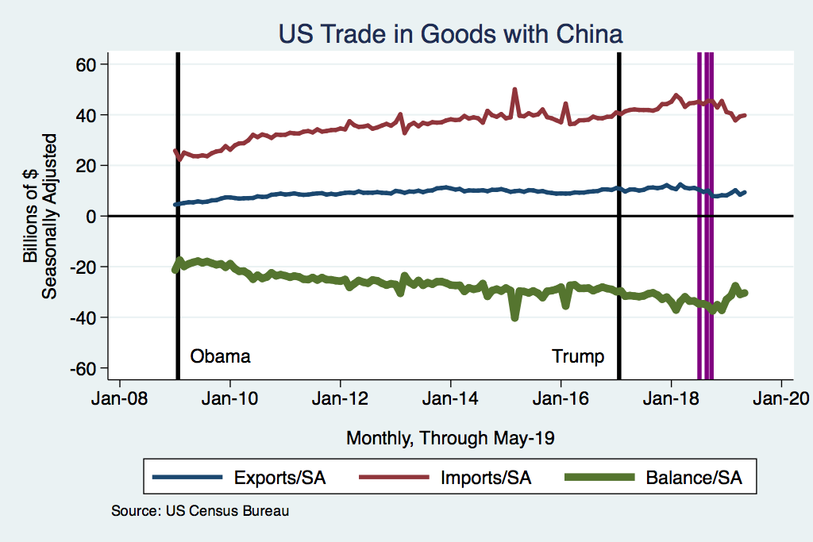
Tariffs

Slide 70
Makers of Top-20 US-Made Models Sold in China in 2017
 | Models | Cars
Ford/Lincoln | 5 | 44,487
BMW | 4 | 106,971
Mercedes-Benz | 4 | 72,187
Jeep | 3 | 15,831
Tesla | 2 | 14,779
Toyota | 1 | 7,460
Chevrolet | 1 | 977
Source: USA Today from LMC Automotive

Slide 71
States Producing Top-20 US-Made Models Sold in China in 2017
 | Models | Cars
South Carolina (BMW) | 4 | 106,971
Alabama (Mercedes) | 4 | 72,187
Michigan (Jeep, Chevy, Ford, Lincoln) | 4 | 21,873
Kentucky (Lincoln) | 2 | 19,517
California (Tesla) | 2 | 14,779
Illinois (Ford; Jeep) | 2 | 14,603
Indiana (Toyota) | 1 | 7,460
Ohio (Jeep) | 1 | 5,302
Source: USA Today from LMC Automotive + Wikipedia

Slide 72


Slide 73
Trade War
Effects of the 2018 Trade War
  US average tariffs rose, in 6 waves
  Prices of imports in US rose
  Quantity of imports fell
  Number of imported varieties fell
Source: Amiti, Redding, and Weinstein, “The Impact of the 2018 Trade War on U.S. Prices and Welfare,” CEPR Discussion Paper DP13564, March 1, 2019.

Slide 74
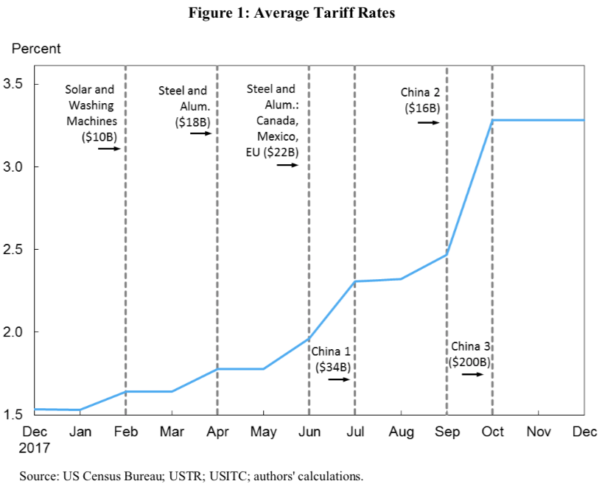
Trade War
Waves of tariffs:
1 2 3 4 5 6
Source: Amiti, et al. 2019.

Slide 75
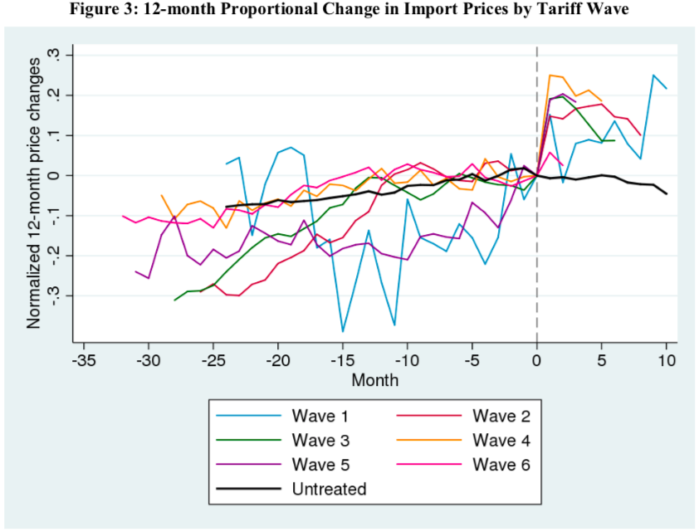
Trade War
Source: Amiti, et al. 2019.

Slide 76
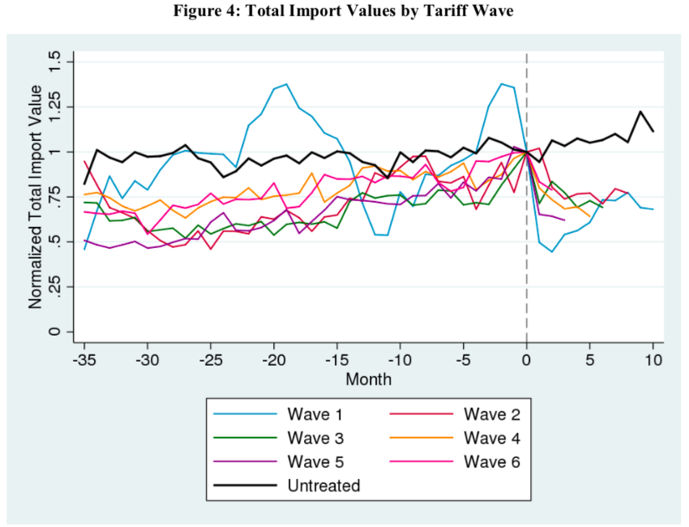
Trade War
Source: Amiti, et al. 2019.

Slide 77
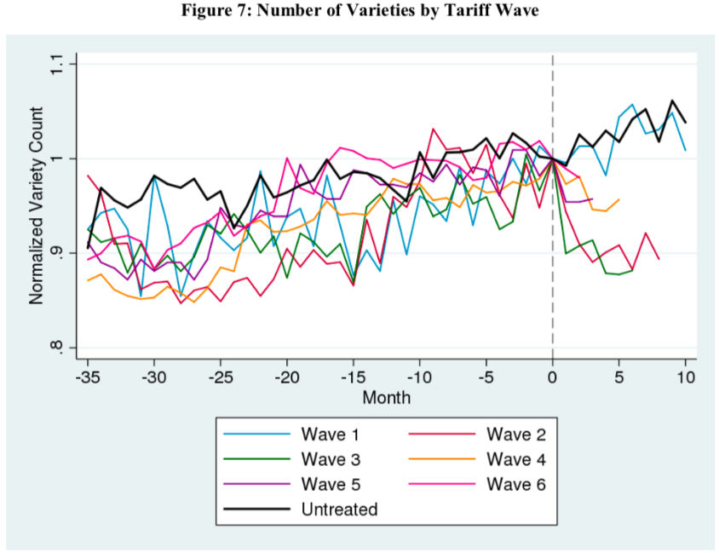
Trade War
Source: Amiti, et al. 2019.

Slide 78
Trade War
Effects of the 2018 Trade War
  Effects varied across US
    US tariffs hit Michigan, hard
    Foreign tariffs did not hit Michigan hard
    Real wages fell most in states other than Michigan
Source: Fajgelbaum, Goldberg, Kennedy, and Khandelwal, “The Return to Protectionism,” March 3, 2019.

Slide 79
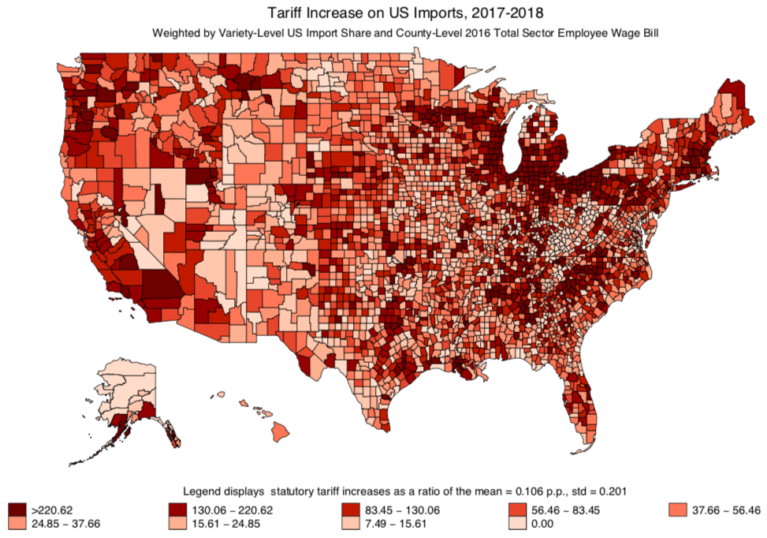
Trade War
Tariff Increase on US Imports
Source: Fajgelbaum, et al. 2019.

Slide 80
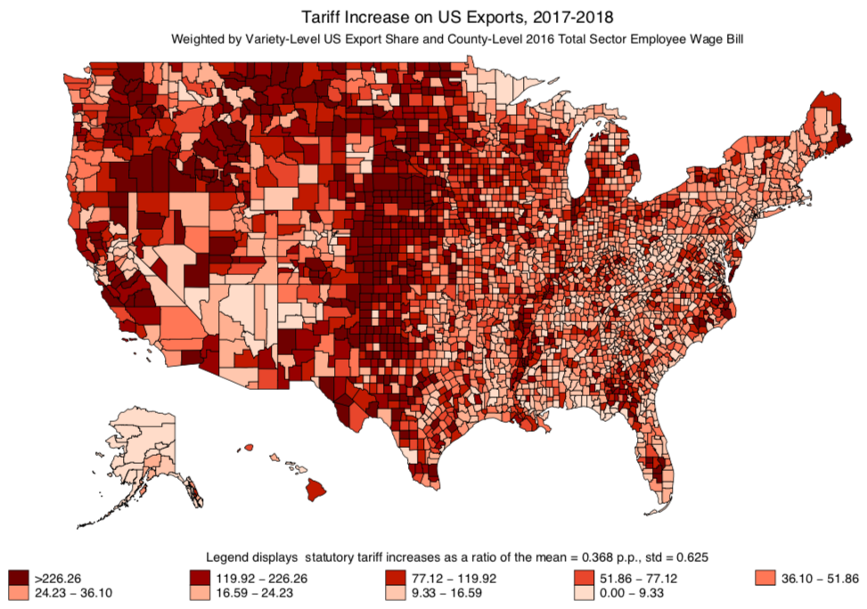
Trade War
Tariff Increase on US Exports
Source: Fajgelbaum, et al. 2019.

Slide 81
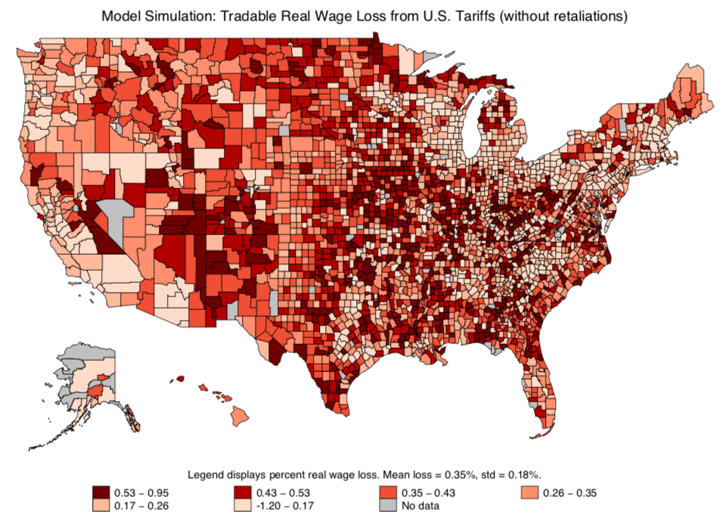
Trade War
Tradable Real Wage Loss from US Tariffs (without retaliation)
Source: Fajgelbaum, et al. 2019.

Slide 82
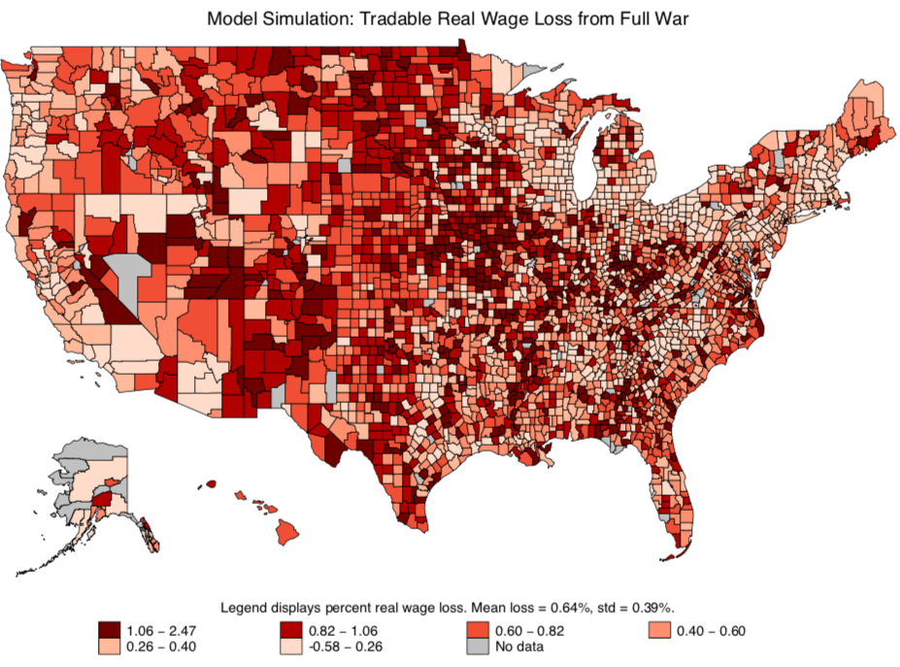
Trade War
Tradable Real Wage Loss from Full War
Source: Fajgelbaum, et al. 2019.

Slide 83
Talks

Slide 84
Trade War
Talks
China-US Trade Talks, I
  Talks began in May 2018, in response to Trump’s threat of tariffs
    China promised to import more from US and allow more foreign investment
    Said to have “averted trade war”
    But then talks broke off in early June
  Trade war with China Jul, Aug, Sep 2018

Slide 85
Trade War
Talks
China-US Trade Talks II
  Oct 2018: US and China postured about renewing trade talks
  Nov 1, 2018: New round of talks began with phone call from Trump to Xi
  Dec 2, 2018: G20 Summit dinner agrees truce: No more tariffs while talks continue
  Talks are still underway, but said to be approaching a deal

Slide 86

Trade War
Talks
China-US Trade Talks II: Calendar
  Nov 9: He & Mnuchin talk by phone
  Jan 7-9: Talks in Beijing
  Jan 30-31: Talks in DC
  Feb 11-15: Talks in Beijing
  Feb 21-24: Talks in DC
  Mar 28-29: Talks in Beijing
  Apr 3-5: Talks in DC
  Apr 23-?: Talks in Beijing
  May 8-?: Talks in DC
Source:
Notes:
https://www.china-briefing.com/news/the-us-china-trade-war-a-timeline/

Slide 87
Trade War
Talks
China-US Trade Talks II: Headlines
  Feb 21, FT: A potential new snag in the US-China trade talks
  Feb 23, WSJ: China Trade Talks Extended as Trump Pushes to Close the Deal
  Feb 28, WSJ: U.S. Drops Threat of 25% Tariffs on Chinese Goods in Sign That Accord Is Near
  Mar 4, WSJ: U.S., China Close In on Trade Deal
  Mar 8, FT: Trump prepared to walk away from ‘bad’ China trade deal
  Mar 8, NYT: Chinese Officials Becoming Wary of a Quick Trade Deal
  Mar 18, NYT: Trade Fight With China Enters Overtime, With Tariffs a Costly Sticking Point
  Mar 28, FT: US-China trade talks could stretch for ‘months’ — Kudlow
  Apr 3, FT: US and China draw closer to final trade agreement
  Apr 4, FT: US and China push back timing of possible trade deal
  Apr 14, NYT: Mnuchin Says China Trade Talks Are Nearing Final Round
  Apr 26, NYT: Trump Says Xi Jinping of China Will Visit Soon, Stirring Anticipation of a Completed Trade Deal
  Nov 29, WSJ: U.S., China Exploring Deal to Ease Trade Tensions
  Dec 4, WSJ: Trump Names Lighthizer to Run U.S.-China Negotiations
  Dec 30, FT: China and US hail ‘positive progress’ on trade talks
  Jan 7, WP: Trade talks open in Beijing amid optimism about an end to U.S.-China dispute
  Jan 9, FT: China and US strike upbeat tone after talks but offer few details
  Jan 22, FT: US turns down China offer of preparatory trade talks
  Jan 24, FT: US commerce secretary Ross says US ‘miles’ from a trade deal with China
  Jan 29, WSJ: Big Divides Remain as U.S.-China Trade Talks Resume
  Jan 31, FT: Donald Trump says US-China trade talks ‘going well’
  Feb 6, WSJ: Agriculture Execs Say U.S.-China Trade Deal Nearing
  Feb 13, WSJ: China, U.S. Seek Broad Outline of a Trade Pact This Week
  Feb 15, FT: US-China trade talks end with little sign of progress
  Feb 16, WSJ: Chinese, U.S. Trade Negotiators Inch Toward a Broad Agreement

Slide 88
Trade War
Talks
China-US Trade Talks II: Headlines
  Feb 21, FT: A potential new snag in the US-China trade talks
  Feb 23, WSJ: China Trade Talks Extended as Trump Pushes to Close the Deal
  Feb 28, WSJ: U.S. Drops Threat of 25% Tariffs on Chinese Goods in Sign That Accord Is Near
  Mar 4, WSJ: U.S., China Close In on Trade Deal
  Mar 8, FT: Trump prepared to walk away from ‘bad’ China trade deal
  Mar 8, NYT: Chinese Officials Becoming Wary of a Quick Trade Deal
  Mar 18, NYT: Trade Fight With China Enters Overtime, With Tariffs a Costly Sticking Point
  Mar 28, FT: US-China trade talks could stretch for ‘months’ — Kudlow
  Apr 3, FT: US and China draw closer to final trade agreement
  Apr 4, FT: US and China push back timing of possible trade deal
  Apr 14, NYT: Mnuchin Says China Trade Talks Are Nearing Final Round
  Apr 26, NYT: Trump Says Xi Jinping of China Will Visit Soon, Stirring Anticipation of a Completed Trade Deal
  Nov 29, WSJ: U.S., China Exploring Deal to Ease Trade Tensions
  Dec 4, WSJ: Trump Names Lighthizer to Run U.S.-China Negotiations
  Dec 30, FT: China and US hail ‘positive progress’ on trade talks
  Jan 7, WP: Trade talks open in Beijing amid optimism about an end to U.S.-China dispute
  Jan 9, FT: China and US strike upbeat tone after talks but offer few details
  Jan 22, FT: US turns down China offer of preparatory trade talks
  Jan 24, FT: US commerce secretary Ross says US ‘miles’ from a trade deal with China
  Jan 29, WSJ: Big Divides Remain as U.S.-China Trade Talks Resume
  Jan 31, FT: Donald Trump says US-China trade talks ‘going well’
  Feb 6, WSJ: Agriculture Execs Say U.S.-China Trade Deal Nearing
  Feb 13, WSJ: China, U.S. Seek Broad Outline of a Trade Pact This Week
  Feb 15, FT: US-China trade talks end with little sign of progress
  Feb 16, WSJ: Chinese, U.S. Trade Negotiators Inch Toward a Broad Agreement

Slide 89
Trade War
Trade talks open
Exploring deal
Accord is near
Talks
Closer to final trade agreement
China-US Trade Talks II: Headlines
  Feb 21, FT: A potential new snag in the US-China trade talks
  Feb 23, WSJ: China Trade Talks Extended as Trump Pushes to Close the Deal
  Feb 28, WSJ: U.S. Drops Threat of 25% Tariffs on Chinese Goods in Sign That Accord Is Near
  Mar 4, WSJ: U.S., China Close In on Trade Deal
  Mar 8, FT: Trump prepared to walk away from ‘bad’ China trade deal
  Mar 8, NYT: Chinese Officials Becoming Wary of a Quick Trade Deal
  Mar 18, NYT: Trade Fight With China Enters Overtime, With Tariffs a Costly Sticking Point
  Mar 28, FT: US-China trade talks could stretch for ‘months’ — Kudlow
  Apr 3, FT: US and China draw closer to final trade agreement
  Apr 4, FT: US and China push back timing of possible trade deal
  Apr 14, NYT: Mnuchin Says China Trade Talks Are Nearing Final Round
  Apr 26, NYT: Trump Says Xi Jinping of China Will Visit Soon, Stirring Anticipation of a Completed Trade Deal
  Nov 29, WSJ: U.S., China Exploring Deal to Ease Trade Tensions
  Dec 4, WSJ: Trump Names Lighthizer to Run U.S.-China Negotiations
  Dec 30, FT: China and US hail ‘positive progress’ on trade talks
  Jan 7, WP: Trade talks open in Beijing amid optimism about an end to U.S.-China dispute
  Jan 9, FT: China and US strike upbeat tone after talks but offer few details
  Jan 22, FT: US turns down China offer of preparatory trade talks
  Jan 24, FT: US commerce secretary Ross says US ‘miles’ from a trade deal with China
  Jan 29, WSJ: Big Divides Remain as U.S.-China Trade Talks Resume
  Jan 31, FT: Donald Trump says US-China trade talks ‘going well’
  Feb 6, WSJ: Agriculture Execs Say U.S.-China Trade Deal Nearing
  Feb 13, WSJ: China, U.S. Seek Broad Outline of a Trade Pact This Week
  Feb 15, FT: US-China trade talks end with little sign of progress
  Feb 16, WSJ: Chinese, U.S. Trade Negotiators Inch Toward a Broad Agreement
‘Miles’ from a trade deal
Talks could stretch for ‘months’
Trade deal nearing
Little sign of progress
Anticipationof a completed trade deal

Slide 90
Trade War
Talks
China-US Trade: Issues of Negotiation
  Government subsidies to state-owned companies
  Chinese purchases of U.S. farm and energy products and services
  China’s market-opening efforts in sectors such as financial services and manufacturing
  Improving its protection of U.S. intellectual-property rights
  Pressure on U.S. companies to share technology
  Industrial policies that favor state-controlled companies
  Currency stability
  Regulatory relief for foreign companies in China
  How to enforce any agreements on the above
    Reimpose tariffs, or
    Leave them in place

Slide 91
Trade War
Talks
What Might a China-US Trade Deal Include?
  US wants (per FT, 3/25/19):
    Huge Chinese purchases of US exports, to reduce US trade deficit
    Liberalization of market access for US goods and services
    Reform of Chinese industrial policy, especially “forced transfers” of IP
    US permitted to use punitive tariffs if these are violated, without China retaliating or complaining to WTO
  China wants:
    Removal of US tariffs
Notes:
https://www.ft.com/content/58f098fc-6201-11e9-b285-3acd5d43599e

Slide 92
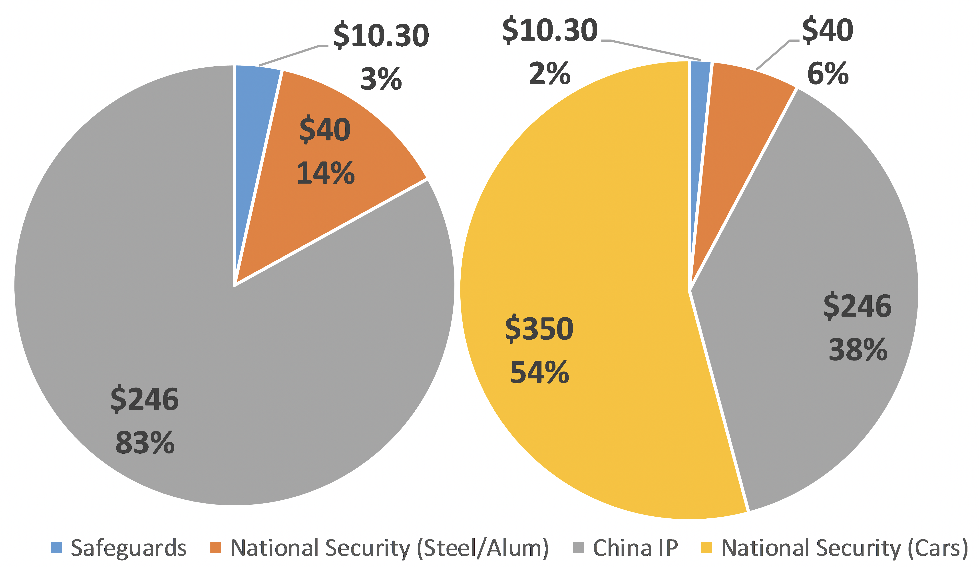
Overview of Trump’s Tariffs
Source: James Lake Presentation, April 2019

Slide 93
Trade War
Talks
Latest News
  On Sunday May 4, Trump tweeted that he would
    Raise tariffs on Friday from 10% to 25% on the $200 billion from last year
    Impose 25% tariffs on the rest of China exports if China does not accept his demands
    Reason: China backtracking on promise to reduce subsidies
  China’s negotiators are coming to DC anyway
Notes:
https://www.ft.com/content/58f098fc-6201-11e9-b285-3acd5d43599e

Slide 94
Trump’s Trade Actions
Jul 6, 2018: First tariffs on China , $34 billion
Aug 23, 2018: Second tariffs on China, $16 billion
Sep 24, 2018: Third tariffs on China, $200 billion
Sep 24, 2018: Amended KORUS signed
  Raises Korea quota for US-certified cars
  Extends years of US 25% tariff on light trucks

Slide 95


Slide 96
Korea
Increased quota for US cars that
    Do not meet Korean standards
    But do meet US standards
  Quota doubles from 25,000 to 50,000 cars per auto maker
  In fact, US companies have not usually reached the 25,000 limit

Slide 97
Korea
Trucks
  Original KORUS had US promise to remove its 25% ”chicken tax” on light trucks from Korea by 2019.
  This is now extended to 2041
  This seems important for US makers of pickup trucks, including in Michigan

Slide 98
Trump’s Trade Actions
Aug 23, 2018: Second tariffs on China, $16 billion
Sep 24, 2018: Third tariffs on China, $200 billion
Sep 24, 2018: Amended KORUS signed
Sep 30, 2018: USMCA agreed
  NAFTA renegotiation had completed previously with Mexico
  Now Canada signed on, and name changed (by Trump) to USMCA
  USMCA: U.S.-Mexico-Canada Trade Agreement

Slide 99


Slide 100
NAFTA → USMCA
NAFTA is
  Free Trade Agreement (FTA)
    Zero tariffs on goods traded by US, Canada, Mexico
    Only if they satisfy Rules of Origin (ROOs)
  Additional provisions regarding many things
    Services trade
    Foreign direct investment
    Intellectual property rights
    Dispute settlement
    Government procurement

Slide 101
NAFTA → USMCA
USMCA will be (if approved)
  FTA with stricter ROOs
  Some changes in NAFTA’s additional provisions
  New rules for environment, labor, financial services, digital trade
  Weakening of Canada’s dairy barriers
  Discouragement of trade with China
  Provision for renegotiation (sunset)

Slide 102
NAFTA → USMCA
Most important for Michigan: Tighter ROOs for cars and car parts
  North American content increased from 62.5% to 75%
    Intended to reduce inputs from outside N. America, likely benefiting Mexico
  New requirement that 40-45% of content must be from labor paid $16/hr or more (but does not rise with inflation)
    Intended to reduce inputs from low-wage Mexico, benefiting US and Canada

Slide 103
NAFTA → USMCA
Effects of tighter ROOs
  If ROOs are
    Satisfied: Higher costs of production
    Not satisfied: Tariffs on traded inputs and final products
  Either way
    Prices rise
    Demand falls
    Products become less competitive internationally
  Effects on demands for labor ambiguous throughout

Slide 104
NAFTA → USMCA
Will USMCA be ratified?
  Needs ratification in all three countries
  In US, there are problems
    Democrats want changes
      Stronger enforcement of labor provisions
      Remove tariffs on steel and aluminum
    Approval requires a report from USITC, delayed by government shutdown, but was issued Apr 18
  Trump threatens to issue six-month withdrawal notice from NAFTA
Notes:
https://www.ft.com/content/6f1b275a-1b43-11e9-9e64-d150b3105d21

Slide 105
NAFTA → USMCA
USITC Report Main Findings
  Positive impact on US real GDP and employment
    Raise GDP by 0.35%
    Raise employment by 0.12 %
  Most significant effects from
    Reduced uncertainty in digital trade
    Rules of origin in auto sector
  Auto sector
    Increase in US production
    Small increase in prices and reduced demand
Notes:
https://www.usitc.gov/press_room/news_release/2019/er0418ll1087.htm

Slide 106

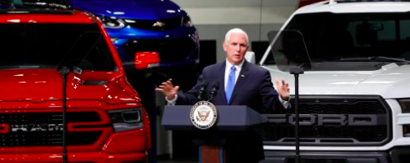
NAFTA → USMCA
News from Michigan
  April 24, MLive:
Notes:
https://www.mlive.com/news/2019/04/trumps-trade-deal-wins-big-praise-from-michigans-big-three-automakers.html?utm_source=am-newsletter&utm_medium=headline-link&utm_campaign=test&utm_content=headline

Slide 107


Slide 108
Conclusion
Trump’s trade actions in 2018
  Raise prices to consumers
  Raise costs to producers
  Alienate other countries

Slide 109
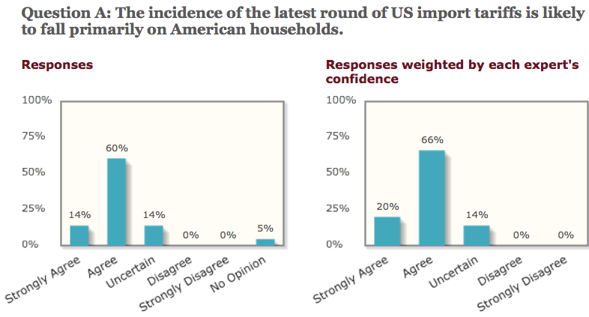
Agreement on Incidence

Slide 110
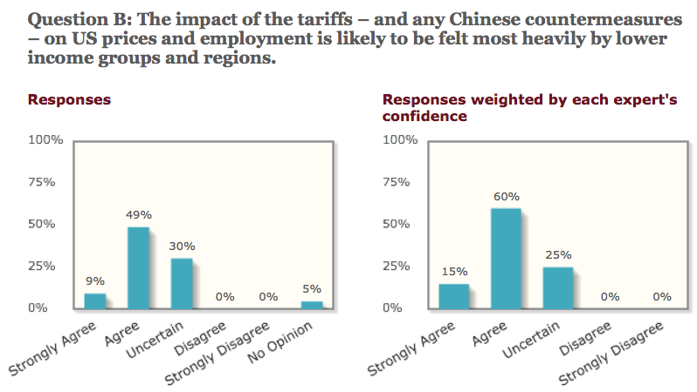
Likely to Impact Low Income Groups Heavily

Slide 111
Conclusion
May they serve any purpose?
  Not to reduce trade deficit(s)
    Tariffs may reduce both exports and imports
    They do not change overall trade balance
    Mar 6, 2019, NYT:
      “The United States trade deficit in goods ballooned to its largest level in history, reaching $891.3 billion in 2018, despite President Trump’s repeated promise to reduce that figure.”

Slide 112
Conclusion
May they serve any purpose?
  Perhaps to motivate other countries to change policies for the better
    US is negotiating with
      China, to change their IP policies and increase imports from US
      EU and Japan to open to more imports of agricultural goods from US

Slide 113
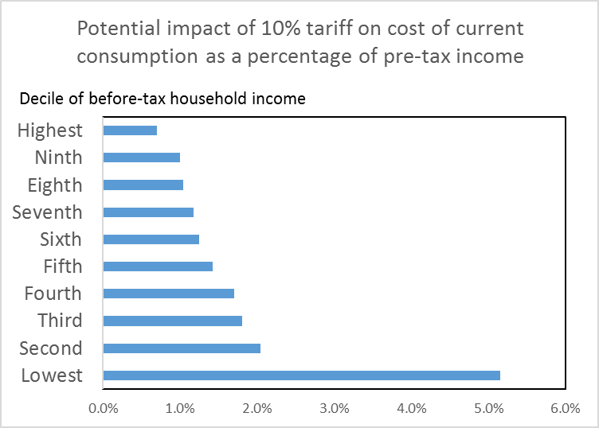
Risks from all-out trade war
Moody’s Mark Zandi estimated an all-out trade war would cost 4 million U.S. jobs.
Observed import share in U.S. consumption deceptively low due to unobserved competitive effects of rival suppliers.
Across-the-board increase in tariffs may fall heavily on the poor and families with children (Furman, Russ, and Shambaugh; USITC).
Source: Furman, Russ, and Shambaugh

Slide 114
Thank you!
Any Questions?
www.NEEDelegation.org
Kadee Russ, Ph.D.
KNRuss@UCDavis.edu
Contact NEED: Info@NEEDelegation.org
Submit a testimonial: www.NEEDelegation.org/testimonials.php

