Slide 1
Effects of Regulating International Trade on Firms and Workers
DT
Two options for the title slide, plz see next slide
<Audience>
Month, # 2018
<Your name, Ph.D.>

Slide 2
Effects of Regulating International Trade on Firms and Workers
<Audience>
Month, # 2018
<Your name, Ph.D.>

Slide 3
National Economic Education Delegation
Vision
One day, the public discussion of policy issues will be grounded in an accurate perception of the underlying economic principles and data.
Mission
NEED unites the skills and knowledge of a vast network of professional economists to promote understanding of the economics of policy issues in the United States
NEED Presentations
Are nonpartisan and intended to reflect the consensus of the economics profession

Slide 4
Who Are We?
Honorary Board: 44 members
2 Fed Chairs: Janet Yellen, Ben Bernanke
6 Chairs Council of Economic Advisers
Furman (D), Rosen (R), Bernanke (R), Yellen (D), Tyson (D), Goolsbee (D)
3 Nobel Prize Winners
Akerlof, Smith, Maskin
Delegates: 364 members
At all levels of academia and some in government service
All have a Ph.D. in economics
Crowdsource slide decks
Give presentations
Global Partners: 42 Ph.D. Economists
Aid in slide deck development

Slide 5
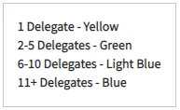
Where Are We?

Slide 6
Credits and Disclaimer
This slide deck was authored by:
Raymond Robertson, Texas A&M University
Jon Haveman, NEED
This slide deck was reviewed by:
<name>, <affiliation>
<name>, <affiliation>
Disclaimer
NEED presentations are designed to be nonpartisan
It is, however, inevitable that the presenter will be asked for and will provide their own views.
Such views are those of the presenter and not necessarily those of the National Economic Education Delegation (NEED).

Slide 7
International Trade Policy
Tariffs, trade agreements, trade deficits have taken central stage in recent policy debates
Tariffs, trade agreements, trade deficits have taken central stage in policy debates for the last 200 years
Economists have studied the topics extensively and intensively
Lessons from economics have had more success in policy…until lately
Goal of this presentation: to dispel current myths about globalization and help refocus the trade policy debate

Slide 8
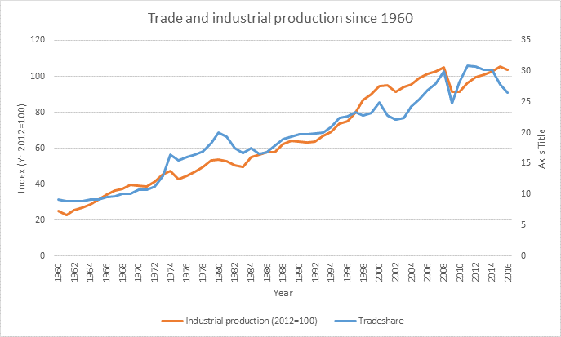
Trade is good! Globalization and Economic Growth are Closely and Positively Related
But global trade shares are falling

Slide 9
Trade Contributes to Growth
EFFICIENCY:
Allocates production across countries efficiently so that countries can specialize in what they are best at producing.
Varieties
More choice for consumers.
Better inputs for our production.
Competition
Brings in cheaper goods.
Makes consumers better off.
Economies of Scale
Trade makes some industries bigger, more cost efficient. Lowers prices.

Slide 10
Why is the public turning against trade?
Gains from trade are very large for the economy, BUT
Not always noticeable by consumers. Why are prices lower at WalMart?
Not always that large per consumer: consumers might save $50/year on some imported goods
For 300 million consumers, $50/year would be $15 billion per year savings to the country!
Costs of trade are very high for some workers and groups, and these costs have not been sufficiently appreciated or addressed by policymakers (or economists!)

Slide 11
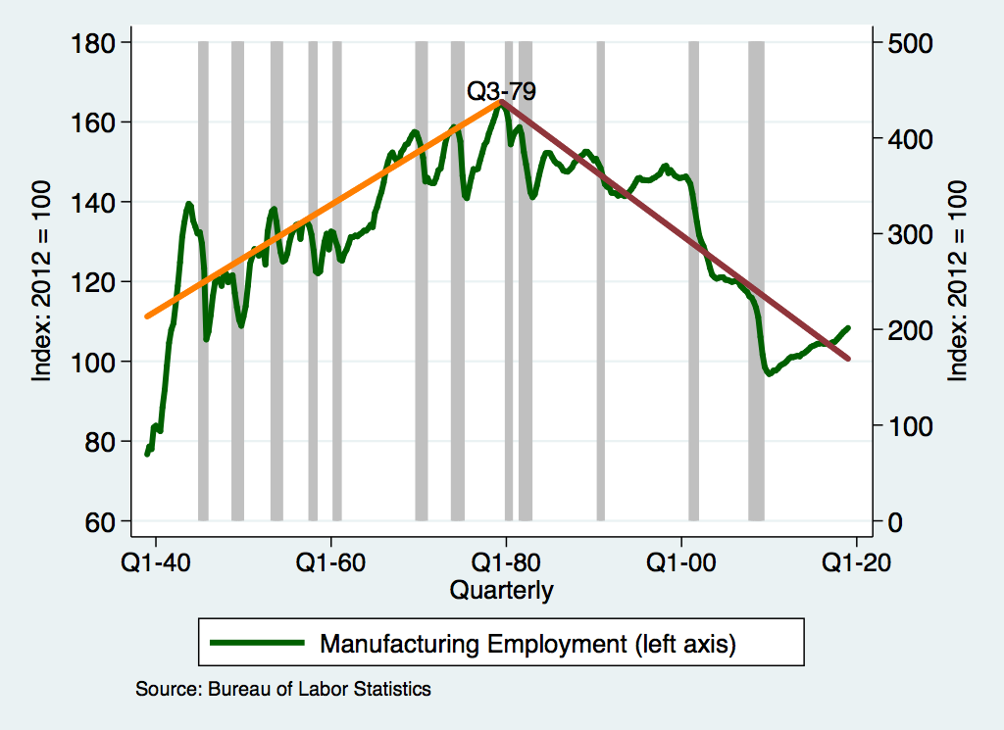
The Basic Issue: Inverted V of Jobs in Manuf.

Slide 12
“International Trade is Surely a Contributor!”

Slide 13
But There is No V in the Fraction of Jobs in Manufacturing

Slide 14
And Manufacturing Output Keeps on Growing

Slide 15
And Manufacturing Productivity is on the Rise

Slide 16
Not That Trade Has Been Absolved of all Ills

Slide 17
Costs of Trade
We have known for almost 80 years that trade with low-wage countries will lower the earnings of low-wage workers as a group in the U.S.A. (Stolper-Samuelson 1941)
Perhaps more importantly, however, is that the adjustment costs, or what some call transition costs, are much larger than previously thought. People do not like to move, and getting laid off can be very traumatic.
Recent economics studies have estimated the costs of trade across many different groups.
Inequality
Adjustment costs

Slide 18
Understanding adjustment costs
FIRMS
Searching for new workers
Training
Adjusting to the new employees/integration
Firing costs/severance pay
WORKERS
Psychological costs of leaving a job, friends
Loss of firm-specific or industry-specific skills
Search costs for a new job
Relocation costs (e.g. moving to a new location)

Slide 19
Estimates of Adjustment Costs
FIRMS
Estimates from developed countries suggests that costs are high
High adjustment costs cause firms to hire and fire in large groups, rather than gradually
Estimates from developing countries suggest that firm-level adjustment costs are much lower than in developed countries
WORKERS
New estimates in the last 10 years
Estimate costs by looking at wage differences and how many workers do NOT move. Adjustment costs must be at least that high

Slide 20
Estimated costs to workers of changing jobs

Slide 21
Characteristics of Adjustment Costs
Some regions get hit especially hard when imports increase
Production of some goods is highly concentrated geographically
USA: Detroit (autos), El Paso (apparel), South Carolina (Textiles)
Local unempl9yment rates can be very high, even when national rates are low
Term “adjustment costs” understates impact on affected workers
“Adjustment” may take a generation or more. Kids may take different jobs than parents
For affected workers, the impact may be permanent
Wages are never recovered
Psychic costs of job loss can be very long-lasting and affect families
Adjustment costs can reduce gains from trade significantly

Slide 22
Why Adjustment Costs Matter
Adjustment costs can undermine the popular support for trade
Falling popular support for trade in the face of concentrated losses threatens to “kill the goose that lays the golden egg”
Adjustment costs reduce welfare
Adjustment costs suggest potential for efficiency gains. If we can make (labor) markets more efficient, then the whole economy could realize significant gains

Slide 23
Common Myths about Trade

Slide 24
Myth 1: Trade Causes Unemployment
U.S. National Unemployment Rate
Import competition may contribute to factories closing and job loss, but there are many other factors that also contribute to job loss.
The national unemployment rate is driven by business cycles, and not by trade.
Over the same period shown in the graph, trade has been rising.

Slide 25
Myth 2: Trade Deficits are Driven by Trade Agreements and Tariffs Can “Fix” Them
Trade deficits are driven by imbalances in the capital account, which is the amount we borrow from other countries.
Since 1960, the U.S. trade deficit has followed the growth of the U.S. federal debt.
That is, U.S. borrowing from other countries drives our trade deficit.
Tariffs can NOT solve this problem!

Slide 26
The Budget Deficit-Trade Balance Link
When the U.S. government spends more than it receives in taxes, the shortfall is called the U.S. Federal Budget Deficit
The shortfall must be paid somehow. There are three policy options
Increasing Taxes and/or cutting spending
Both are politically unpopular
Printing money, which leads to inflation
Borrowing money
U.S. Citizens and/or Foreign Citizens
May “crowd out” domestic investment
Increases the demand for dollars
Rising demand for dollars makes imports cheaper and exports more expensive
Result: Larger trade deficits!

Slide 27
US Savings and the Trade Deficit
Savings
Trade Deficit

Slide 28
General Agreement Among Economists

Slide 29
Policy Solutions

Slide 30
Tariffs
Tariffs temporarily reduce imports of particular goods
Tariffs raise prices
Final goods (consumers)
Intermediate goods (producers who use imported inputs)
Rising prices distort consumption and production decisions
Tariffs invite retaliation, lowering demand for our exports
In the long run, the exchange rate adjusts to offset the tariffs because of the effects of borrowing: Tariffs, therefore, cannot correct a trade deficit
Tariffs lower overall welfare, while generating very large gains for small groups (e.g. A cost of 100 to many for a gain of 80 for a few).
Tariffs are generally considered to be an inefficient way to help those people who are hurt by trade

Slide 31
General Consensus of Economists on Tariffs

Slide 32
Directed Support: Adjustment Costs
The most efficient way to help those hurt by trade is through direct payments
Trade Adjustment Assistance (TAA) is an example of an attempt at this principle
TAA includes some retraining funds and extended unemployment benefits
Not generally considered to be very successful
Underfunded
Hard to determine who is hurt by trade and not other factors
Larger direct payments would be most effective and efficient

Slide 33
Balanced Budgets
Reducing federal borrowing would reduce pressure on trade deficits.
Size of debt – nearly 21 trillion in 2018 – means that some combination of cutting spending and rising taxes would be necessary.
Reducing the debt would also reduce the large share of the federal budget that is directed towards interest payments and free up money for other things.
Reducing the debt also increases our economic security because it could reduce foreign debt exposure.

Slide 34
Conclusions
Trade and growth are positively related
Gains from trade can be widespread (lower prices for consumers)
Losses from trade can be highly concentrated
Tariffs reduce trade overall, thus imposing widespread losses to both producers (who use imported inputs) and consumers (who buy lower-priced imported goods)
More direct policies can be more efficient and save gains from trade

Slide 35
Thank you!
Any Questions?
www.NEEDelegation.org
<presenter name>
<presenter email>
Contact NEED: NEEDelegation@gmail.com

