Slide 1
Racial Disparities
<Audience>
Month #, 2019
<Your name, Ph.D.>

Slide 2
National Economic Education Delegation
Vision
One day, the public discussion of policy issues will be grounded in an accurate perception of the underlying economic principles and data.
Mission
NEED unites the skills and knowledge of a vast network of professional economists to promote understanding of the economics of policy issues in the United States.
NEED Presentations
Are nonpartisan and intended to reflect the consensus of the economics profession.

Slide 3
Who Are We?
Honorary Board: 48 members
2 Fed Chairs: Janet Yellen, Ben Bernanke
6 Chairs Council of Economic Advisers
Furman (D), Rosen (R), Bernanke (R), Yellen (D), Tyson (D), Goolsbee (D)
3 Nobel Prize Winners
Akerlof, Smith, Maskin
Delegates: 500+ members
At all levels of academia and some in government service
All have a Ph.D. in economics
Crowdsource slide decks
Give presentations
Global Partners: 45 Ph.D. Economists
Aid in slide deck development

Slide 4
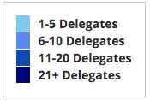
Where Are We?

Slide 5
Credits and Disclaimer
This slide deck was authored by:
Jon Haveman, National Economic Education Delegation
This slide deck was reviewed by:
<name>, <affiliation>
<name>, <affiliation>
Disclaimer
NEED presentations are designed to be nonpartisan.
It is, however, inevitable that the presenter will be asked for and will provide their own views.
Such views are those of the presenter and not necessarily those of the National Economic Education Delegation (NEED).

Slide 6
Outline
Age
Health Care
Education
Marital status
Mobility
Commute transportation

Slide 7
Age Distribution

Slide 8
Age Distribution, by Sex

Slide 9
Median Ages

Slide 10
Life Expectancy

Slide 11
Health Insurance

Slide 12
Maternal Mortality Rates, 2018
Source: https://www.cdc.gov/nchs/data/nvsr/nvsr69/nvsr69_02-508.pdf

Slide 13
Disabilities - All

Slide 14
Disabilities - Kids

Slide 15
Disabilities – Working Age

Slide 16
Disabilities – 65+

Slide 17
Household Type: Family

Slide 18
Household Type: Married

Slide 19
Births Out of Wedlock

Slide 20
Home Ownership

Slide 21
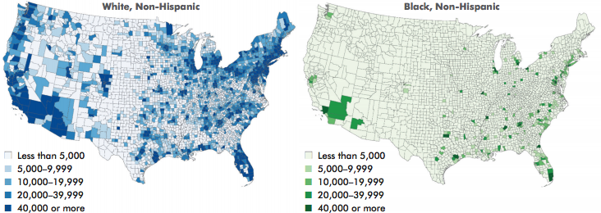
The Geography of Home Ownership
Source: Beyond Broke, 2014

Slide 22
Home Occupancy

Slide 23
Wealth
https://inequality.org/facts/racial-inequality/#racial-wealth-divide

Slide 24
Wealth: Zero
https://inequality.org/facts/racial-inequality/#racial-wealth-divide

Slide 25
Income Disparities: Introduction
Can arise from a variety of different sources
Educational differences
Connections - job opportunities
Discrimination

Slide 26
Income

Slide 27
Median Income

Slide 28
Median Income: Advanced Degree

Slide 29
Median Income: Bachelor’s Degree

Slide 30
Median Income: Some College

Slide 31
Median Income: High School Diploma

Slide 32
Median Income: Less Than High School

Slide 33
Median Income: Male FTFY

Slide 34
Median Income: Female FTFY

Slide 35
Wages by Race

Slide 36
Wages by Race: Women

Slide 37
Wages by Race: Men

Slide 38
Disparities in Lifetime Earnings

Slide 39
Disparities in Lifetime Earnings

Slide 40
Absolute Mobility: Race

Slide 41
Relative Mobility: Race

Slide 42
Upward and Downward Income Mobility

Slide 43
Children’s Incomes vs. Parents’ Incomes
Source: http://www.equality-of-opportunity.org/assets/documents/race_summary.pdf

Slide 44
Unemployment

Slide 45
Labor Force Participation

Slide 46
Sources: Labor Market Disparities
Unequal access to resources:
Education
Wealth
Discrimination:
By employers
Attitudes of coworkers
By attitudes of customers
Economists struggle to link this type of discrimination to labor market outcomes.

Slide 47
Education: College+

Slide 48
College Enrollment: College+

Slide 49
Poverty

Slide 50
Poverty: Kids < 5 Years Old

Slide 51
Mobility: Stayed Put

Slide 52
Mobility: Across State Lines

Slide 53
Commute: Car Alone

Slide 54
Commute: Carpool

Slide 55
Commute: Public Transportation

Slide 56
Sources: Criminal Justice System
Discrimination
Police actions
Court decisions

Slide 57
Models of Discrimination
Taste based
Reflects prejudice or preferences.
Invalid statistical inference
E.g., belief that immigrants are more likely to commit crimes, so won’t hire.
Statistical
Valid statistical inference
E.g., men and women and breast cancer – women get screened more often because they get it more often.
Still harmful to individuals and perhaps socially undesirable.
Inferring average behavior/characteristics to individuals.

Slide 58
Feedback Loop: Vicious Cycle
Discrimination reinforces social and residential distance
Reinforces between-group differences
Which creates additional discrimination and social distance.

Slide 59
Thank you!
Any Questions?
www.NEEDelegation.org
<presenter name>
<presenter email>
Contact NEED: info@needelegation.org
Submit a testimonial: www.NEEDelegation.org/testimonials.php
Become a Friend of NEED: www.NEEDelegation.org/friend.php

Slide 60
Available NEED Topics Include:
US Economy
Climate Change
Economic Inequality
Economic Mobility
US Social Policy
Trade and Globalization
Trade Wars
Immigration Economics
Housing Policy
Federal Budgets
Federal Debt
2017 Tax Law
Autonomous Vehicles

