Slide 1
Monetary Policy & the Fed: a Primer
<Audience>
Month #, 2019
<Your name, Ph.D.>

Slide 2
National Economic Education Delegation
Vision
One day, the public discussion of policy issues will be grounded in an accurate perception of the underlying economic principles and data.
Mission
NEED unites the skills and knowledge of a vast network of professional economists to promote understanding of the economics of policy issues in the United States.
NEED Presentations
Are nonpartisan and intended to reflect the consensus of the economics profession.

Slide 3
Who Are We?
Honorary Board: 54 members
2 Fed Chairs: Janet Yellen, Ben Bernanke
6 Chairs Council of Economic Advisers
Furman (D), Rosen (R), Bernanke (R), Yellen (D), Tyson (D), Goolsbee (D)
3 Nobel Prize Winners
Akerlof, Smith, Maskin
Delegates: 590+ members
At all levels of academia and some in government service
All have a Ph.D. in economics
Crowdsource slide decks
Give presentations
Global Partners: 44 Ph.D. Economists
Aid in slide deck development

Slide 4
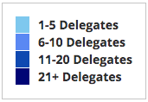
Where Are We?

Slide 5
Credits and Disclaimer
This slide deck was authored by:
Geoffrey Woglom, Amherst College
This slide deck was reviewed by:
Kenneth Kuttner, Williams College
<name>, <affiliation>
Disclaimer
NEED presentations are designed to be nonpartisan.
It is, however, inevitable that the presenter will be asked for and will provide their own views.
Such views are those of the presenter and not necessarily those of the National Economic Education Delegation (NEED).

Slide 6
The Evolution of the Fed’s Role in Macro Economy
Employment Act of 1946
“Full employment” is an Executive Branch Responsibility.
Council of Economic Advisors.
Economic Report of the President.
Humphrey Hawkins Act 1978 & the Fed’s “Dual” mandate
Full employment
Price stability

Slide 7
Humphrey-Hawkins Made the Fed the “Stabilizer in Chief”
The modern view is there is a division of labor
Fiscal Policy sets government spending and tax rates for non stabilization reasons.
Monetary policy through the Fed is given responsibility for price stability and full employment, except when it needs help in big recessions.
Reasons:
The Fed can act more quickly and is apolitical.
In the long run, monetary policy is neutral: does not affect the composition of GDP.
The Fed does can fix the rate of inflation in the long run.

Slide 8
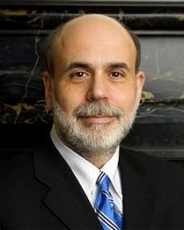
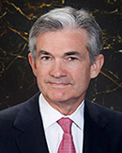
Monetary Policy at the Fed
0
Jerome Powell
February 2018
The Federal Reserve System consists of:
Board of Governors (7 members), located in Washington, DC
12 regional Fed banks, located around the U.S.
Federal Open Market Committee (FOMC), includes the Bd of Govs and presidents of some of the regional Fed banks
The FOMC has 8 scheduled meetings a year to set monetary policy.
Ben S. Bernanke Chair of FOMC, Feb 2006 – Jan 2014
Janet Yellen Chair of FOMC, Jan 2014 – Jan 2018
Notes:
8
In subsequent chapters (including the chapter immediately following this one), students will learn that the Federal Reserve’s monetary policy can have huge effects on many macroeconomic variables, like inflation, interest rates, unemployment, and even stock price indexes and exchange rates.
As chair of the FOMC, Ben Bernanke is in the news quite frequently.

Slide 9
Monetary Policy is About Interest Rates (Not the Money Supply)
The Minutes of the 12/10/2021 FOMC Meeting mentions:
Money Supply, M1, M2 – 0
Interest rate – over 20 times
Why: The relationship between the money supply and short-run macroeconomic variables was never very tight. With the advent of bit coin, it is almost non-existent.

Slide 10
Money Growth and Inflation

Slide 11
Economic Theory: Interest Rates and Economic Activity in the Short Run
The higher the interest rates:
The more saving and the less consumption.
The incentive to save goes up with the interest rate.
Stock prices fall with higher interest rates lowering wealth.
The less investment.
The higher the exchange value of the dollar which leads to higher exports and lower imports.
All 3 effects tend to lower total spending and real GDP.

Slide 12
Central Banking in One Slide
When total spending or aggregate demand is too high, raise interest rates to prevent rising inflation.
When aggregate demand is too low, lower interest rates to prevent rising unemployment.
Try to have as little effect as possible on the composition of spending in the short run.

Slide 13
Leave Small Footprints
Remember, in the long run, monetary policy does not affect the real economy.
To have as little influence as possible on the composition of GDP, the Fed primary tool is to control the shortest-term interest rate, the federal funds rate.
The federal funds rate is the rate on overnight loans of reserves between banks.
Longer-term and risky interest rates are determined by financial markets given the federal funds rate.

Slide 14
Monetary Policy Is About the Interest Rate
The FOMC does not set an exact number for the Federal funds rate. Instead, it sets an upper (green line) and lower (blue) range.
“The Committee decided to keep the target range for the federal funds rate at 0 to 1/4 percent…” (1/27/2021)

Slide 15
Interest Rates that the Fed Cares About
By controlling the Fed funds rate, the fed can influence the levels of other rates that are more connected to spending.
The other rates are determined by financial market perceptions of future short-term rates and risk

Slide 16
Other Tools: Forward Guidance
The Fed tells financial market participants what it thinks it will do to the funds rate in the future:
The Committee expects to maintain an accommodative stance of monetary policy until these outcomes are achieved. The Committee decided to keep the target range for the federal funds rate at 0 to 1/4 percent and expects it will be appropriate to maintain this target range until labor market conditions have reached levels consistent with the Committee’s assessments of maximum employment and inflation has risen to 2 percent and is on track to moderately exceed 2 percent for some time. FOMC Statement, Jan 26, 2021.
By telling markets that it will maintain a low funds rate for some time, it is hoping to affect expectations of future short-term rates, which affect long-term rates.

Slide 17
Quantitative Easing
The Fed can buy (or sell) long term Treasuries, or risky securities to raise (or lower) bond prices which are inversely related to interest rates.
In 2009, the Fed expanded its holding of longer-term Treasuries by $300 billion and bought overt $1 trillion in Mortgage-Backed Securities.
There were 2 more rounds of QE, ending in December 2012

Slide 18
Strategies for Making the Tools More Effective
Accountability and Transparency Lead to Credibility
Credibility means that financial markets have confidence that the Fed will follow through on what it says it will do
E.g.,
Forward guidance only works to affect long rates, if the private markets believe it.
The Fed’s job is much easier if financial markets expect that the Fed will hit its announced inflation target of 2%, i.e., if inflationary expectations are “well anchored.”

Slide 19
Accountability
Institutionalized: Chair appears before Congress twice a year to review monetary policy.
Less Formal:
After very meeting of the FOMC, the Chair holds a press conference and answers questions.
With a 5-year a complete record of FOMC meeting is released, including a transcript with attribution and all staff briefing materials.
Consistent record of achieving stabilizing the economy and achieving inflation objective.

Slide 20
Transparency of FOMC Meetings
The final day of an FOMC meeting a statement describing monetary policy is released including the identities of those voting for and against. The stamen includes “forward guidance.”
Three weeks later detailed minutes of the meeting are released without attribution.
At every other meeting, the minutes include detailed economic projections for all FOMC members (without attribution), including the future path of the federal funds rate.
In January of each year, the FOMC releases a brief statement on its longer-run goals and policy strategy.

Slide 21
Long-Run Goals (1/26/21)
The maximum level of employment is a broad based and inclusive goal that is not directly measurable and changes over time owing largely to nonmonetary factors that affect the structure and dynamics of the labor market. Consequently, it would not be appropriate to specify a fixed goal for employment,… (Long-run monetary policy neutrality)
The inflation rate over the longer run is primarily determined by monetary policy, and hence the Committee has the ability to specify a longer-run goal for inflation. The Committee reaffirms its judgment that inflation at the rate of 2 percent,…, is most consistent over the longer run with the Federal Reserve’s statutory mandate.

Slide 22
FOMC Minutes of 1/26-27 Meeting
Participants noted that the Committee’s current guidance was well suited to the current environment because it describes how policy would respond based on the path of the economy. For example, if progress toward the Committee’s goals proved slower than anticipated, the outcome-based guidance would convey the Committee’s intention to respond by increasing monetary policy accommodation through maintaining the current level of the target range of the federal funds rate for longer and raising the expected path of the Federal Reserve’s balance sheet. In addition, participants noted that the Committee’s current outcome-based guidance for both the federal funds rate and balance sheet appeared to be well understood by the public.

Slide 23
FOMC Statement Excerpt (1/27/2021)
The Committee would be prepared to adjust the stance of monetary policy as appropriate if risks emerge that could impede the attainment of the Committee's goals. The Committee's assessments will take into account a wide range of information, including readings on public health, labor market conditions, inflation pressures and inflation expectations, and financial and international developments.
Voting for the monetary policy action were Jerome H. Powell, Chair; John C. Williams, Vice Chair; Thomas I. Barkin; Raphael W. Bostic; Michelle W. Bowman; Lael Brainard; Richard H. Clarida; Mary C. Daly; Charles L. Evans; Randal K. Quarles; and Christopher J. Waller.

Slide 24
Economic Projections from December 2020

Slide 25
Controlling the Federal Funds Rates
Prior to 2008, the Fed would use open market operations to balance the supply and demand for reserves at federal funds rate within its target range.
The emergency lending and QE of the Great Recession, however, led to an explosion of reserves
In early September 2008 banks total reserves were under $50 billion.
By the end of that year, they were over $850 billion.
In January of 2021, they were over $3.1 trillion, in spite of the fact that the Fed eliminated reserve requirements the previous March.

Slide 26
The Funds Rate in a World of Excess Reserves
Normally, the demand for reserves depends on the volume of profitable bank lending.
But starting in October of 2008, the Fed started to pay interest on reserves (IOER), so that banks would stop lending when the risk-adjusted return on that lending was equal to the interest rate they would earn just by holding reserves.
In an environment with substantial reserves, the Fed felt that they could control the funds rate by changing the IOER without having to change the supply of reserves.

Slide 27
Fed Learns that it Works!
It worked so well that in January 2019, the Fed announced that it would “continue to implement monetary policy with an ample supply of reserves in the longer run.”

Slide 28
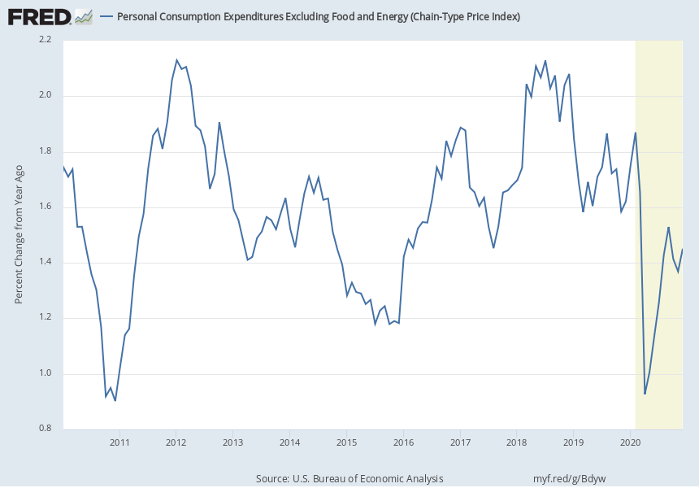
Current Issues: Is the Releasing the Inflation Genie Out of the Bottle
The Fed inflation target is the Price of Consumer Expenditures, or PCE.
It looks at a measure that excludes volatile food and energy prices because this a better indicator of future inflation.
But since the Great Recession this measure has been consistently below its target of 2%.

Slide 29
Too Low Inflation is also a Problem
It keeps interest rates low, so that the Fed has little room to cut rates to fight recessions.
It threatens Fed credibility.
Consequently, the Fed is aiming for higher inflation in the short run.
In order to anchor longer-term inflation expectations …, the Committee seeks to achieve inflation that averages 2 percent over time, and therefore judges that, following periods when inflation has been running persistently below 2 percent, appropriate monetary policy will likely aim to achieve inflation moderately above 2 percent for some time.

Slide 30
But Could the Economy Overheat in 2021
Over $3 trillion of fiscal stimulus was added to the economy since March, with possibly $1.9 trillion to come. This amounts to almost 25% of the total size of the economy.
Estimates are that up to $1.6 trillion of that stimulus was saved, but could lead to higher spending when the pandemic is under control.
At the moment the Fed is signaling near zero interest rates until it sees signs of inflation.
But, the Fed cannot turn the economies direction on a dime.
Finally, there are signs that inflation fears are rising.

Slide 31
Financial Markets Expectations of Inflation over the next 5 years
The graph shows the difference between the interest rate on 5-year Treasuries and 5-year inflation protected Treasuries (TIPs).
Economic theory suggests that this difference should be equal to expected inflation over the next 5 years plus an inflation risk premium.
Therefore, the spread is an upwardly biased measure of inflation expectations.

Slide 32
Thank you!
Any Questions?
www.NEEDelegation.org
<presenter name>
<presenter email>
Contact NEED: info@needelegation.org
Submit a testimonial: www.NEEDelegation.org/testimonials.php
Become a Friend of NEED: www.NEEDelegation.org/friend.php

Slide 33
Available NEED Topics Include:
US Economy
Climate Change
Economic Inequality
Economic Mobility
US Social Policy
Trade and Globalization
Minimum Wages
Immigration Economics
Housing Policy
Federal Budgets
Federal Debt
Black-White Wealth Gap
Autonomous Vehicles

