Slide 1
The US Housing Market: Facts, Trends, and Policy Questions
<Audience>
Month, # 2019
<Your name, Ph.D.>

Slide 2
National Economic Education Delegation
Vision
One day, the public discussion of policy issues will be grounded in an accurate perception of the underlying economic principles and data.
Mission
NEED unites the skills and knowledge of a vast network of professional economists to promote understanding of the economics of policy issues in the United States
NEED Presentations
Are nonpartisan and intended to reflect the consensus of the economics profession

Slide 3
Who Are We?
Honorary Board: 44 members
2 Fed Chairs: Janet Yellen, Ben Bernanke
6 Chairs Council of Economic Advisers
Furman (D), Rosen (R), Bernanke (R), Yellen (D), Tyson (D), Goolsbee (D)
3 Nobel Prize Winners
Akerlof, Smith, Maskin
Delegates: 364 members
At all levels of academia and some in government service
All have a Ph.D. in economics
Crowdsource slide decks
Give presentations
Global Partners: 42 Ph.D. Economists
Aid in slide deck development

Slide 4
Where Are We?

Slide 5
Credits and Disclaimer
This slide deck was authored by:
Daniel Marcin, George Washington University
Dmitriy Stolyarov, University of Michigan
This slide deck was reviewed by:
Jon Haveman, PhD, NEED
Disclaimer
The views presented today are those of the presenter and not necessarily those of the National Economic Education Delegation (NEED)

Slide 6
Outline
Introduction
Home prices
Housing as a store of wealth
Housing as an Investment
Understanding home prices
Affordability
Government Regulation of Housing

Slide 7
Total Value of Homes
The total value of owner-occupied homes in the US was about 27 trillion dollars in 2018
This is almost twice as large as 2018 consumer spending
Sources: Federal Reserve Board, BEA, FHFA

Slide 8
Home Price Trends
On average, home prices outpaced inflation by 1.4% per year
Sources: BEA, FHFA

Slide 9
Low Housing Starts Drive Price Increases

Slide 10
Price Appreciation Varies by City
Prices in coastal cities outpaced inflation by 2.7% per year
Source: S&P Dow Jones Indices LLC

Slide 11
Price Appreciation Varies by City
Prices in Atlanta, Chicago, and
Detroit, barely kept up with inflation
Source: S&P Dow Jones Indices LLC

Slide 12
Home Prices in Your County (or State)
For All Counties and States: www.needelegation.org/LocalGraphs

Slide 13
Rents in Your County (or State)
For All Counties and States: www.needelegation.org/LocalGraphs

Slide 14
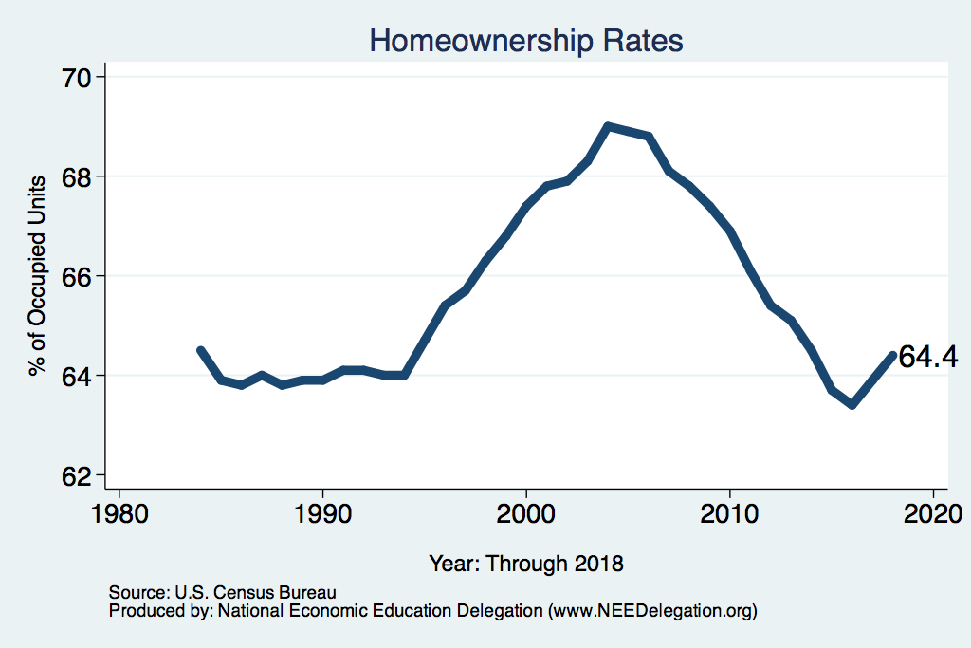
For All Counties and States: www.needelegation.org/LocalGraphs
Size: height 6.34

Slide 15
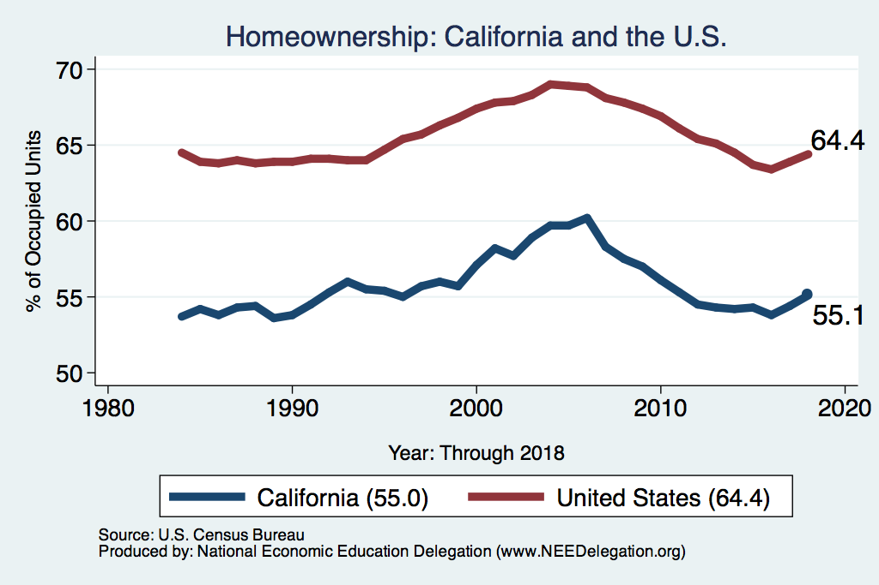
For All Counties and States: www.needelegation.org/LocalGraphs
Size: height 6.34

Slide 16
Homeownership by Age
Source: Survey of Consumer Finances, 2013
Notes:
Home value is roughly 3 times the annual income
Home equity rises with age
Homeownership rate rises with age, and it peaks at 65-74 age, then falls somewhat for 75 +

Slide 17
Homeownership by Income Group
Notes:
Homeownership rate rises with income, reaching 95% for the top tenth of incomes
The ratio of mortgage payment to income falls steeply with income, from more than 65% of income for the lowest income group to about 10% of income for the highest income group

Slide 18
Homes and Household Net Worth
Notes:
Home equity is quite low for households with low net worth. This is probably because they use the house as a collateral for borrowing. Annual household income is strongly positively correlated with net worth. However, households with negative new worth have a higher income than those in the zero net worth group. Households with negative net worth spend about 23% of their income on mortgage payment, whereas the top wealth group spends only about 10%.

Slide 19
Is Housing A “Good Investment”?
Most of the financial return on housing comes from the amount saved on rent
Sources: BEA, FHFA, OECD, S&P

Slide 20
Benefits and Costs of Homeownership
Financial benefits of homeownership
Money saved on rent
House price appreciation (if any)
Financial costs of homeownership
Maintenance/upkeep, insurance, property tax
Mortgage interest (if any)
House price depreciation (if any)

Slide 21
Benefits and Costs of Homeownership
Tax benefits of owning a home
Money saved on rent is not considered taxable income
Homeowners typically pay lower property taxes than landlords
Mortgage interest and property tax can sometimes be deducted from taxable income (same is true for landlords)
Capital gains from selling a primary house are tax-free (up to a point)

Slide 22
House as a Financial Asset: Illustration
Money saved on rent is not considered taxable income
Jane is a homeowner. A house similar to hers can be rented for 2,000 per month (24,000 per year).
Jane would need 30,000 in pre-tax income (24,000 rent + 6,000 income tax) to rent a house similar to hers.
Amount saved on rent: 30,000

Slide 23
House as a Financial Asset: Illustration
Financial rate of return on a 300,000 house bought with cash
Benefits |  | Costs
Amount saved on rent | 30,000 | Upkeep, maintenance | 6,000
Price appreciation (3.5% annual) | 10,500 | Property tax + insurance | 6,000
Total benefit | 40,500 | Total cost | 12,000

Slide 24
Leverage in a Rising Market
Rate of return on a 300,000 house bought with 20% (60,000) down
$$Rate of return \left(\%\right)=\frac{40,500−24,000}{60,000}∙100\%=27.5\%$$
Benefits |  | Costs
Amount saved on rent | 30,000 | Upkeep, maintenance | 6,000
Price appreciation (+3.5% annual) | 10,500 | Property tax + insurance | 6,000
 |  | Mortgage interest (6% rate) | 12,000
Total benefit | 40,500 | Total cost | 24,000

Slide 25
Leverage in a Falling Market
Rate of return on a 300,000 house bought with 20% (60,000) down
$$Rate of retrun \left(\%\right)=\frac{15,000−24,000}{60,000}∙100\%=−15\%$$
Benefits |  | Costs
Amount saved on rent | 30,000 | Upkeep, maintenance | 6,000
Price appreciation (– 5% annual) | – 15,000 | Property tax + insurance | 6,000
 |  | Mortgage interest (6% rate) | 12,000
Total benefit | 15,000 | Total cost | 24,000

Slide 26
Why are House Prices Rising?
SUPPLY AND DEMAND
Supply:
Is it becoming more expensive to build?
Productivity
Local fees
What are restrictions on building and how do they vary by location?
Demand:
Capacity to afford: income and interest rates

Slide 27
Is Construction Becoming More Efficient?
Source: Bureau of Labor Statistics
Notes:
https://www.bls.gov/opub/mlr/2018/article/measuring-productivity-growth-in-construction.htm
Construction productivity is very cyclical because output varies much more than hours of work do (some construction workers are unionized)
Multi-family construction is becoming more efficient, and yet house prices are soaring. Why?

Slide 28
Is Construction Becoming More Efficient?
Source: Bureau of Labor Statistics
Notes:
Multi-family construction is becoming more efficient, and yet house prices are soaring. Why?

Slide 29
Productivity Growth Comparisons
Source: Bureau of Labor Statistics

Slide 30
What About Building Materials Costs

Slide 31
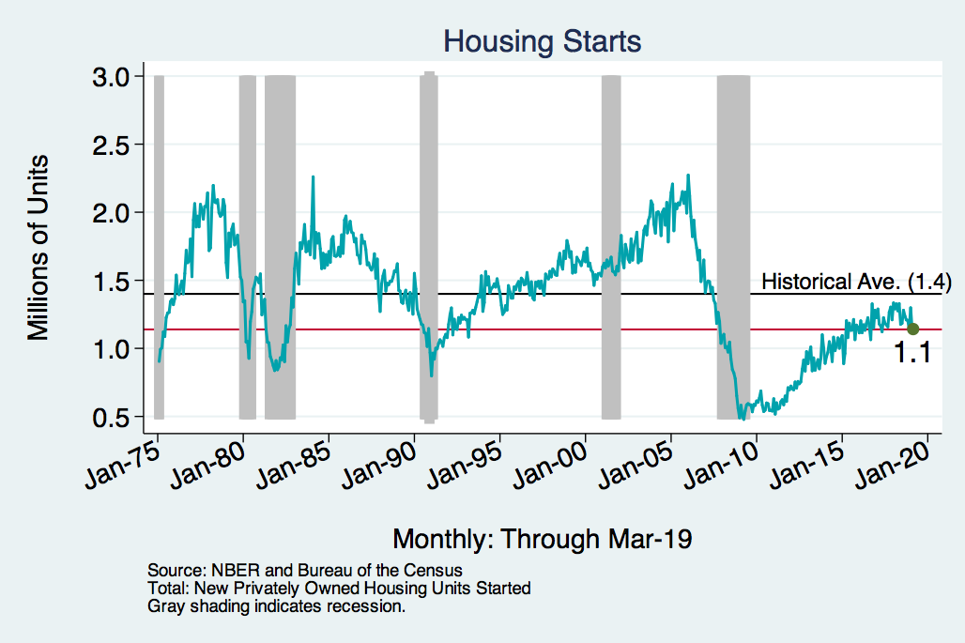
Housing Starts
Notes:
Charts:
homeprices_recession.png
housing.png

Slide 32
New Construction Permits and House Prices
House prices are generally higher where fewer permits are issued
Source: Glaeser and Gyouko (2018)

Slide 33
Marin is Not Keeping Up
For All Counties and States: www.needelegation.org/LocalGraphs

Slide 34
…And Prices Reflect it!
For All Counties and States: www.needelegation.org/LocalGraphs

Slide 35
The Relationship Between Prices and Income
San Francisco
New York
United States
Source: Zillow; The Economist

Slide 36
Policy Issues: Government Influence
Restrictions on new housing construction
Affordability
Government housing programs

Slide 37
Examples of Local Restrictions
Lot size requirements
Setbacks
Availability of on street parking
Multiplexes – du or triplex
Limits on # of people/lot
Cost increases through fees

Slide 38
Local Restrictions on New Construction
Why is there so little new construction in some areas?
Edward Glaeser (Harvard economist):
“Arguably, land use controls have a more widespread impact on the lives of ordinary Americans than any other regulation.
These controls, typically imposed by localities, make housing more expensive and restrict the growth of America’s most successful metropolitan areas.”
Notes:
https://www.brookings.edu/research/reforming-land-use-regulations/

Slide 39
Building Restrictions and Economic Inequality
Glaeser, continued:
“These regulations have accreted over time with virtually no cost-benefit analysis. Restricting growth is often locally popular.
Promoting affordability is hardly a financially attractive aim for someone who owns a home.
Yet the maze of local land use controls imposes costs on outsiders, and on the American economy as a whole.”
“There is no better way to reduce inequality than building more housing.”

Slide 40
The Vicious NIMBY Political Cycle
Zoning restrictions
Building restrictions
Exactment fees
Multiple layers of approval
Approval delays
Current residents granted political power
Short supply and high cost of new construction
Policy is decided at local level
Incentives to lobby for more restrictions
High home prices
Notes:
Some aspects of NIMBYism are a cost of democratic political system. The potential residents are not represented in local politics
The housing regulations are decided at local level, so only interests of current residents are taken into account

Slide 41
Home Prices: Summary
Housing market is not a free market
Differences in home prices across locations often have to do with local building restrictions in the face of economic growth
US coastal areas experienced an economic boom and tightening of building restrictions at the same time
For example, there were 13,000 new housing units permitted in Manhattan in the single year of 1960 alone. Compare this to 21,000 new units permitted throughout the entire decade of the 1990s.
Source: Glaeser, Gyourko and Saks 2005.

Slide 42
Economic Damage From Building Restrictions
National income would have been higher if workers could afford to move to high-wage locations.
The economists’ estimate of potential income lost to low housing affordability caused by building restrictions is 2-9 % of US output (400-1800 billion current dollars per year).
By way of comparison, the cost of the entire Medicare (health care for 65+ population) program is about 600 billion annually.

Slide 43
Inequality and Poverty
Policy Reforms and Debates:
Government Regulation of the Housing Market

Slide 44
Affordability
What is the best way to make affordable housing?
Free market?
Mandates?
Rent control?
Subsidies to low income households?

Slide 45
How Does Rent Control Work?
Sets limits on rent increases
Could set a cap on rent
Regulates frequency of rent increases
Usually w/in a tenancy
Limits reasons for evictions
E.g., non-payment or significant damage to the rental property
Implications:
Increases well-being of current tenants
Can reduce the supply of or lead to decay of rental housing stock
Can lower the value of nearby housing
Contribute to gentrification

Slide 46
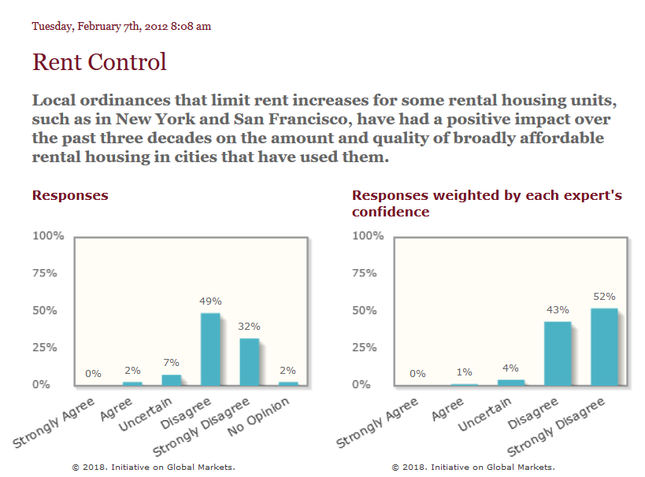
Rent Control – There is no “Other Hand”
Notes:
http://www.igmchicago.org/surveys/rent-control

Slide 47
Rent Control – What’s Not to Like?
Why don’t economists like rent control?
We usually think housing costs too much because there’s not enough of it to go around.
Landlords raise rent because they can; if somebody moves out, somebody else is willing to move in.
If there were more places to live, the landlord could not raise rent as easily.
Rent control does nothing to stop the increase in prices in uncontrolled units. And controlled units may see neglect, since they will often lose their owners money.

Slide 48
Rent Control – The San Francisco Experience
A 2018 study of San Francisco rent control showed:
Renters were 20% more likely to stay at their address
But, landlords stopped renting 15% of rent-controlled units
The lower number of units was related to a 5.1% citywide rent increase.
The Effects of Rent Control Expansion on Tenants, Landlords, and Inequality: Evidence from San Francisco
Rebecca Diamond, Timothy McQuade, Franklin Qian, NBER Working Paper No. 24181, Issued in January 2018, https://www.nber.org/papers/w24181
Notes:
A 2018 study of San Francisco rent control showed:
Renters were 20% more likely to stay at their address
But, landlords stopped renting 15% of rent-controlled units
The lower number of units was related to a 5.1% citywide rent increase.
The Effects of Rent Control Expansion on Tenants, Landlords, and Inequality: Evidence from San Francisco
Rebecca Diamond, Timothy McQuade, Franklin Qian, NBER Working Paper No. 24181, Issued in January 2018, https://www.nber.org/papers/w24181

Slide 49
Rent Control – The Cambridge Experience
Elimination of rent control in 1994.
Decontrolled properties’ market value increased by 45%.
Neighboring properties also increased in value.
Value of the changes is significant between 1994 and 2004.
Direct effect: $300 million for decontrolled properties
Indirect effect: $1.7 billion for nearby never controlled properties
Rent control is a VERY expensive way of increasing affordability.

Slide 50
Government Regulation
There is a federal agency involved in housing, commonly known as HUD (Department of Housing and Urban Development).
HUD has a few main ways in which it acts in the housing market
Public Housing
FHA Mortgage Insurance
Housing vouchers
Community Development Block Grants
Fair Housing
Some of these solve issues like discrimination, and some address affordability issues

Slide 51
HUD - Affordability
FHA Mortgage Insurance
Makes loans available to those who have lower credit scores, or cannot afford a 20% down payment
Section 8 Vouchers
Allows households to find rental housing, but the waiting lists are too long and many landlords do not accept the vouchers
Public Housing
Notes:
The complaint (https://www.hud.gov/sites/dfiles/PIH/documents/HUD_01-18-0323_Complaint.pdf) says, “Facebook unlawfully discriminates by enabling advertisers to restrict which Facebook users receive housing-related ads based on race, color, religion, sex, familial status, national origin and disability. Facebook mines extensive user data and classifies its users based on protected characteristics. Facebook’s ad targeting tools then invite advertisers to express unlawful preferences by suggesting discriminatory options, and Facebook effectuates the delivery of housing-related ads to certain users and not others based on those users’ actual or imputed protected traits.”

Slide 52
HUD - Discrimination
Fair Housing: the market may include discriminatory landlords, realtors, mortgage brokers, etc., and the government needs to correct this.
For example, HUD sued Facebook in April 2019, since Facebook was (allegedly) allowing landlords to only show their apartment listings to certain racial groups.
Notes:
The complaint (https://www.hud.gov/sites/dfiles/PIH/documents/HUD_01-18-0323_Complaint.pdf) says, “Facebook unlawfully discriminates by enabling advertisers to restrict which Facebook users receive housing-related ads based on race, color, religion, sex, familial status, national origin and disability. Facebook mines extensive user data and classifies its users based on protected characteristics. Facebook’s ad targeting tools then invite advertisers to express unlawful preferences by suggesting discriminatory options, and Facebook effectuates the delivery of housing-related ads to certain users and not others based on those users’ actual or imputed protected traits.”

Slide 53
HUD – Fair Housing and Local Land Use
Some argue that the Fair Housing Act allows the federal government to prohibit exclusionary and burdensome zoning regulations, as they disproportionately work against the classes protected by the FHA.
This has been a popular idea with both left-wing and right-wing HUD secretaries.

Slide 54
Local Government and Housing Policy
Public Housing Agencies
HUD leaves the administration of public housing and vouchers to local Public Housing Agencies; there are over 3,000 PHAs.
Other
Local government is far more involved in the housing market via land use policies like zoning.
Community input process
Historical designation
Permitting

Slide 55
Proposed Reforms - Federal
Further subsidization of more building?
Some reformers have proposed that rent is too expensive, and therefore should be subsidized.
However, it may make sense to spend that subsidy money building new public housing, to expand the supply, rather than demand.
Stronger anti-discrimination policies, including for discrimination against voucher holders.

Slide 56
Proposed Reforms – State and Local
Taxation on absentee owners, investors, AirBnB, etc.
These are attacking symptoms rather than causes. AirBnB is profitable because there are not enough hotel rooms. Investors buy properties because they expect the returns to be high.
States can give or take money from localities in their states
For example, a recent budget proposal in California would link transportation funding to housing production. Localities that don’t add enough housing would lose money.

Slide 57
Proposed Reforms – State and Local
Spread property tax revenue more equitably
Currently, parents essentially buy spaces in desirable public schools for their children. This method of school finance may perpetuate economic privilege across generations.
Loosen zoning
Minneapolis has recently made it legal to build triplexes almost citywide. In contrast, it is illegal to build a duplex or triplex in most space in most American cities.
Mixed use zoning: it is also currently illegal in many places to have a first floor grocery store (or any kind of commercial use) with apartments or condominiums on top. Why?

Slide 58
Proposed Reforms – Economists’ Take
Economists will, in general, support government intervention when free markets don’t work well, and support government restraint when free markets would work well, or too much government is causing a problem.
Most people can buy or rent housing in a market transaction with another person or corporation, with minimal government involvement (enforcement of contracts via courts, protection against overt fraud, health and safety protections for renters, etc.)
However, equity matters too. Some economists may support policies that alleviate the effects of racial discrimination which still persist.

Slide 59
Misguided Past Policies: Redlining
For example, the government “redlined” heavily minority neighborhoods.
Redlining occurred when maps were drawn to show how risky investment in certain areas would be. The “riskiest” areas usually had the highest concentrations of black people.
Some argue that the government merely drew these maps, and did not discriminate in their own lending practices, but others say private and public lenders relied on these maps to deny investment or loans in those areas.
Some relationships between redlined areas and outcomes still hold today in peer-reviewed economics research. Note this is a failure introduced by government!
Notes:
The 1936 FHA underwriting manual included explicit instructions to not lend in areas with “inharmonious racial groups” and to respect racially biased covenant restrictions; for example, if a deed said that no black person could occupy a house, the FHA manual of 1936 respected that.
For more, see https://www.jstor.org/stable/20108708?seq=1#page_scan_tab_contents or https://ncrc.org/holc/.

Slide 60
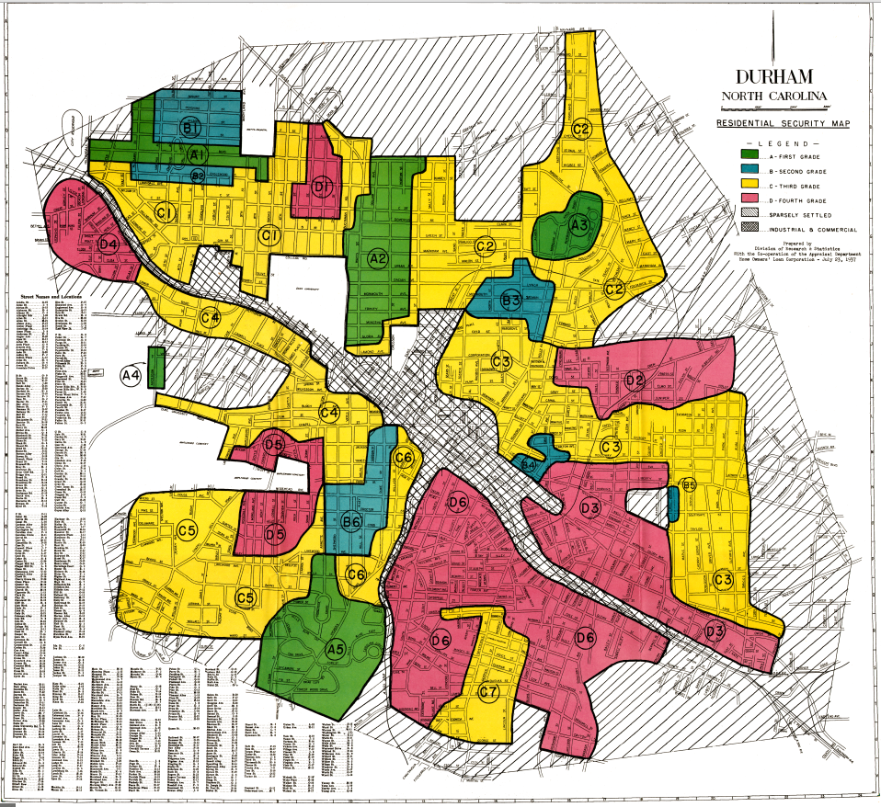
Misguided Past Policies: Redlining
Red areas were largely
African-American communities,
and considered to be too risky
for new home loans.

Slide 61
Conclusions
A modest-size house is a good investment that pays a great dividend.
Housing market is not a free market.
Government stimulates homeownership through tax policy and mortgage insurance.
Zoning and other building regulations contribute to economic inequality and may cause substantial economic damage.

Slide 62
Conclusions: More on Government Intervention
Policies need to be considered carefully – unintended consequences
Rent control can have an enormous impact on:
Supply – both quantity and quality
Nearby uncontrolled properties
Zoning and permitting
Can feed inequality of access to resources: housing/education
Government intervention is a likely contributor to home price appreciation.
May well achieve goals, but at lowest possible cost? Unclear.

Slide 63
Thank you!
Any Questions?
www.NEEDelegation.org
<presenter name>
<presenter email>
Contact NEED: Info@NEEDelegation.org
Submit a testimonial: www.NEEDelegation.org/testimonials.php
Get NEED Updates: www.NEEDelegation.org/friends.php

