Slide 1
The US Federal Budget
<Audience>
Month, # 2018
<Your name, Ph.D.>

Slide 2
National Economic Education Delegation
Vision
One day, the public discussion of policy issues will be grounded in an accurate perception of the underlying economic principles and data.
Mission
NEED unites the skills and knowledge of a vast network of professional economists to promote understanding of the economics of policy issues in the United States.
NEED Presentations
Are nonpartisan and intended to reflect the consensus of the economics profession.

Slide 3
Who Are We?
Honorary Board: 48 members
2 Fed Chairs: Janet Yellen, Ben Bernanke
6 Chairs Council of Economic Advisers
Furman (D), Rosen (R), Bernanke (R), Yellen (D), Tyson (D), Goolsbee (D)
3 Nobel Prize Winners
Akerlof, Smith, Maskin
Delegates: 500+ members
At all levels of academia and some in government service
All have a Ph.D. in economics
Crowdsource slide decks
Give presentations
Global Partners: 45 Ph.D. Economists
Aid in slide deck development

Slide 4
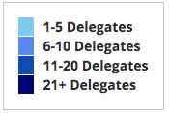
Where Are We?

Slide 5
Credits and Disclaimer
This slide deck was authored by:
Jon Haveman, NEED
This slide deck was reviewed by:
<name>, <affiliation>
<name>, <affiliation>
Disclaimer
NEED presentations are designed to be nonpartisan.
It is, however, inevitable that the presenter will be asked for and will provide their own views.
Such views are those of the presenter and not necessarily those of the National Economic Education Delegation (NEED).

Slide 6
What Does the U.S. Gov’t Budget Look Like?
2019 Budget Summary
Revenue | Billions |  | Expenditures | Billions
Income Taxes | $1,718 |  | Mandatory | $2,735
Payroll Taxes | $1,243 |  | Discretionary | $1,336
Corporate Taxes | $230 |  | Interest | $376
Other | $271
Total | $3,462 |  | Total | $4,447
Budget Deficit: $984 Billion
Source: Congressional Budget Office, The Budget and Economic Outlook: 2020 to 2030
Notes:
https://www.cbo.gov/publication/53627
https://www.cbo.gov/publication/53624

Slide 7
Outline
Government Spending
Government Revenues

Slide 8
U.S. Government Spending

Slide 9
Gov’t Expenditures and the US Economy

Slide 10
Recent Amounts

Slide 11
Where Does the Money Go?
Source: https://www.nationalpriorities.org/budget-basics/federal-budget-101/

Slide 12
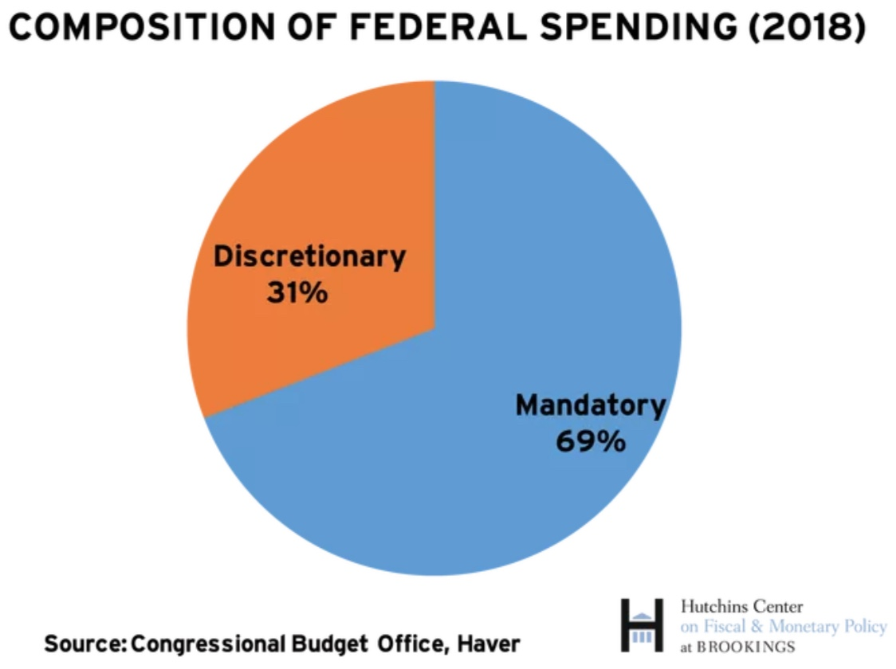
On What is the Money Spent? Complicated

Slide 13
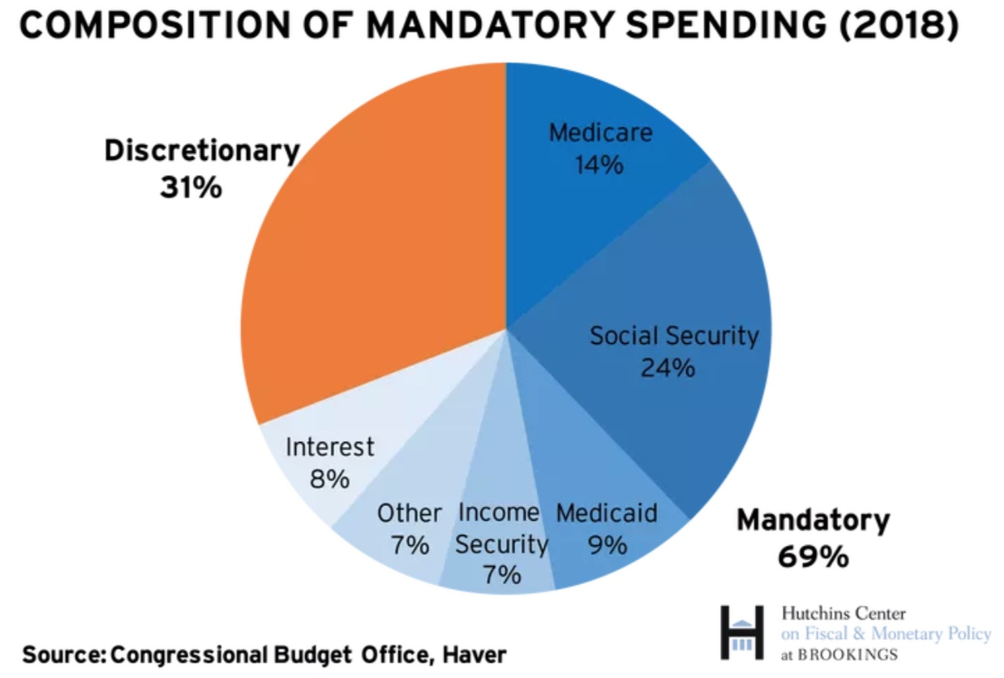
What is Mandatory Spending?
Medicare 14%
Social Security 24%

Slide 14
Mandatory Spending: Social Security (24%)
Retirement
Covers 96% of US workers.
Retirement age is increasing from 65-67.
Survivors
A worker's spouse and dependents may be eligible for survivors' benefits if the worker dies.
Disability
A medical condition expected to last at least one year or to be fatal.

Slide 15
Where Do Social Security Funds Come From?
Payroll taxes
Tax rates:
Employee: 6.2%
Employer: 6.2%
Self Employed: 12.4%
Cap in 2019: $132,900
Taxes on OASDI benefits
Not all benefits are taxed.
Interest earnings
Key Question:
Who pays?

Slide 16
Social Security Trust Fund
Spending in 2018
OASI: $854 billion
DI: $147 billion
Income in 2018
OASI: $831
DI: $172
Surplus in 2018
OASI: $-22
DI: $25
Total Surplus: $3 Billion
Source: https://www.ssa.gov/OACT/TRSUM/index.html

Slide 17
In 2018: Deficits As Far As the Eye Can See
Deficits Begin in 2020: Percent of Taxable Payroll
Trust Fund Solvency
Annual deficits after 2019
Fund insolvent after 2036
SOURCE: 2019 Annual Report of the Board of Trustees of the Federal Old-Age and Survivors Insurance and Disability Insurance Trust Funds, Table IV.B1

Slide 18
Options for Eliminating the Soc Sec Deficits
Problem is 1-1.5% of GDP
Raise the retirement age.
Increase the tax rate.
4 percentage pt. increase raises 0.6% of GDP.
Raise the amount of income subject to tax.
Tax all wages raises 1.1% of GDP.
Reduce benefits.
21% cut in benefits by 2034 would be necessary.

Slide 19
Mandatory Spending: Medicare (14%)
Part A: Hospital Insurance
Part B: Physician, outpatient, home health, and other services.
Part D: Subsidized access to pharmaceuticals.
Part C: Medicare Advantage Plans – offered by private companies approved by Medicare.
Medicare Advantage Plans may offer extra coverage, such as vision, hearing, dental, and/or health and wellness programs.

Slide 20
Where Do Medicare Funds Come From?
Payroll taxes
Tax rates:
Employee: 1.45%
Employer: 1.45%
Self Employed: 2.9%
No Cap
Interest earnings
General revenues
Beneficiary premiums

Slide 21
Medicare Finances in 2018
Part A:
Income in 2018: $299 billion
Expenses in 2018: $297 billion
Surplus: $2.8 billion
Part B and Part D:
Income in 2018: $406 billion
Expenses in 2018: $414 billion
Surplus: $-7.9 billion
Long term sustainability:
Deficits began in 2016
For as far as the eye can see
Insolvent in 2026 with current parameters.

Slide 22
Mandatory Spending: Medicaid (9%)
Medicaid provides medical insurance for those whose income and resources are insufficient to pay for health care.
It is a program with costs shared with the states.
Amount spent in 2017: $576.6 Billion
Federal: 61.5% or $354.6 Billion
States: 38.5% $222.0 Billion
People served in 2017: 72 million (22% of Americans)

Slide 23
Mandatory Spending: Income Security (7%)
EITC
SNAP
SSI
TANF
Housing
WIC
School Lunches
Head Start

Slide 24
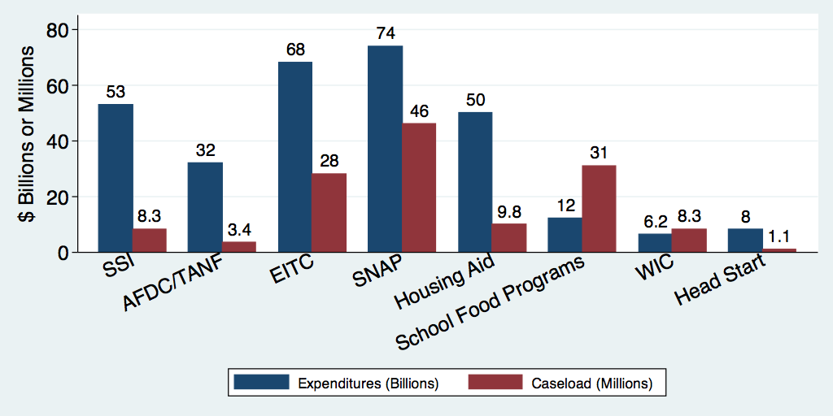
U.S. Safety Net Expenditures ($ Billions) and Caseload (Millions) – No Medicaid, 2014 or 2015

Slide 25
Income Security Spending Over Time

Slide 26
Mandatory Spending: Interest (8%)
Interest costs in 2019: $376 Billion
1.6% of GDP, or 8% of the Federal Budget
Forecast to increase to $1,323 Billion in 2050
6% of GDP, or 21% of the Federal budget
Source: CBO, January 2019 Budget Projections

Slide 27
Mandatory Spending: Other (7%)
Food and agriculture
Veterans’ Benefits
Transportation
Other

Slide 28
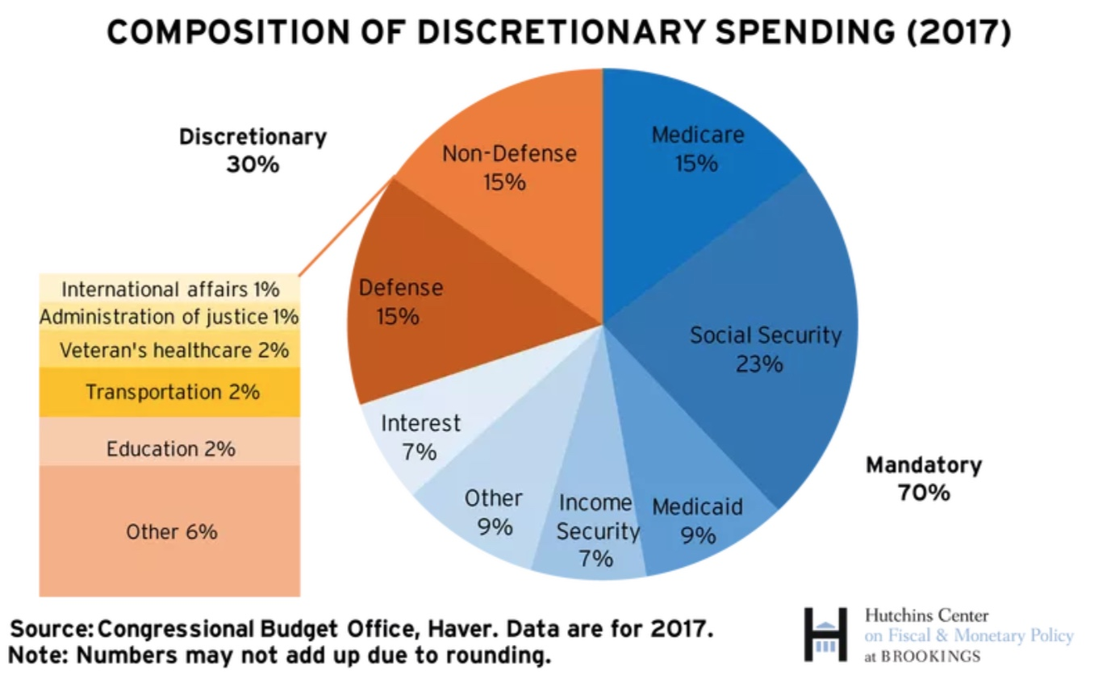
What is Discretionary Spending?
Int’l Affairs 1%

Slide 29
Discretionary Spending: Other (6%)
Category | Amount (Millions)
Energy | 4,412
Agriculture | 5,800
Medicare | 5,906
General government | 17,403
General science, space and tech | 30,289
Natural resources and environment | 36,766
Housing Assistance | 45,711
Health | 60,326

Slide 30
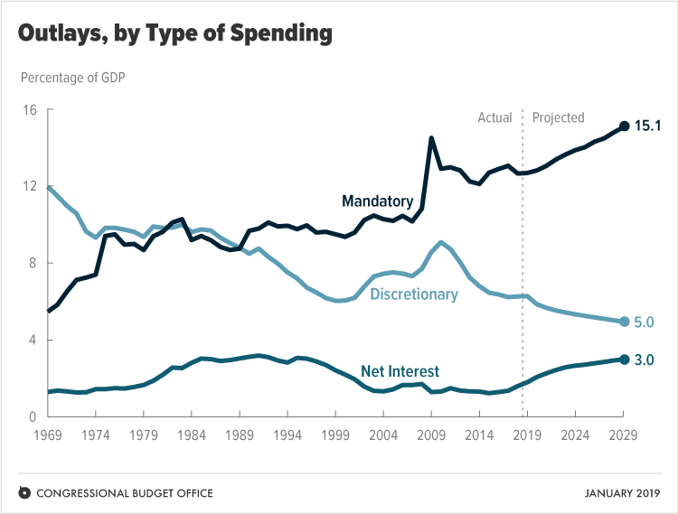
Mandatory Spending Dominates Forecasts
Source: Congressional Budget Office, The Budget and Economic Outlook: 2019 to 2029

Slide 31
Forecast Spending
Interest
What trends
do you see?
Other
Health
Social Security

Slide 32
Aging and Health Care Costs
Source: Congressional Budget Office, The Budget and Economic Outlook: 2020 to 2030

Slide 33
Another Category of Spending: Tax Expenditures
Description
Social policies that are implemented and paid for through the tax code.
List of the largest tax breaks:
Mortgage interest deduction - Low tax rates for Capital Gains
Retirement contributions - Child related tax credits
State and local taxes - Charitable gifts
Health insurance - Lifetime Learning
Evidence of who they benefit
Regressive

Slide 34
Tax Expenditures are Significant
$1.6 Trillion 200 different categories
7.8% of GDP and more than Discretionary Spending
Source: Congressional Budget Office, The Budget and Economic Outlook: 2020 to 2030

Slide 35
Tax Expenditures Tend to be Regressive
Income Group | Benefits
Bottom 20% | 7.0%
Top 20% | 12.8%

Slide 36
Important things that people get from gov’t
Roads and highways
Public education
Defense
Research and development
Space exploration
Income Security
Improved public health
Sanitation
Investments in communications
Energy
Many, many, inventions
Microchips - Touch screens
GPS - Internet
Wind turbines - Bar Codes
Tang - Wii

Slide 37
US Government Revenues

Slide 38
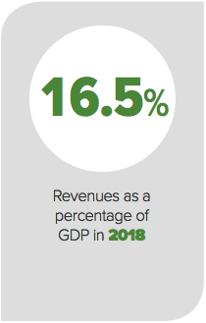
Federal Government Revenues in 2018
U.S. GDP: $20.6 Trillion
In 2018
Source: CBO – Revenues in 2018: An Infographic

Slide 39
International Comparison

Slide 40
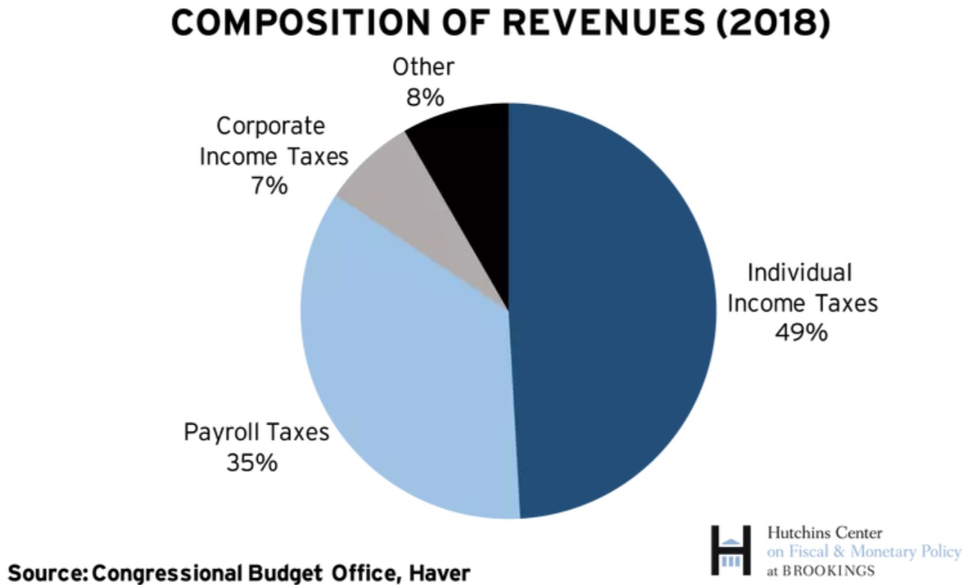
Where Do Government Revenues Come From?

Slide 41
Where Do Government Revenues Come From?
Billions of dollars in 2018 Budget Year
Source: CBO – Revenues in 2018: An Infographic

Slide 42
Individual Income Taxes
Marginal tax rates
Not all income is subject to the same tax rates
capital gains
Deductions
Talked about as Tax Expenditures

Slide 43
Marginal Tax Rates: Married Filing Jointly
Income Above | Tax Rate
0 | 10%
19,400 | 12%
78,590 | 22%
168,400 | 24%
321,450 | 32%
408,200 | 35%
612,350 | 37%
Income is taxed differently at different levels
Individuals are taxed the same way, regardless of overall income:
First dollar is taxed at 10%
19,401st dollar is taxed at 12%
Millionth dollar is taxed at 37%

Slide 44
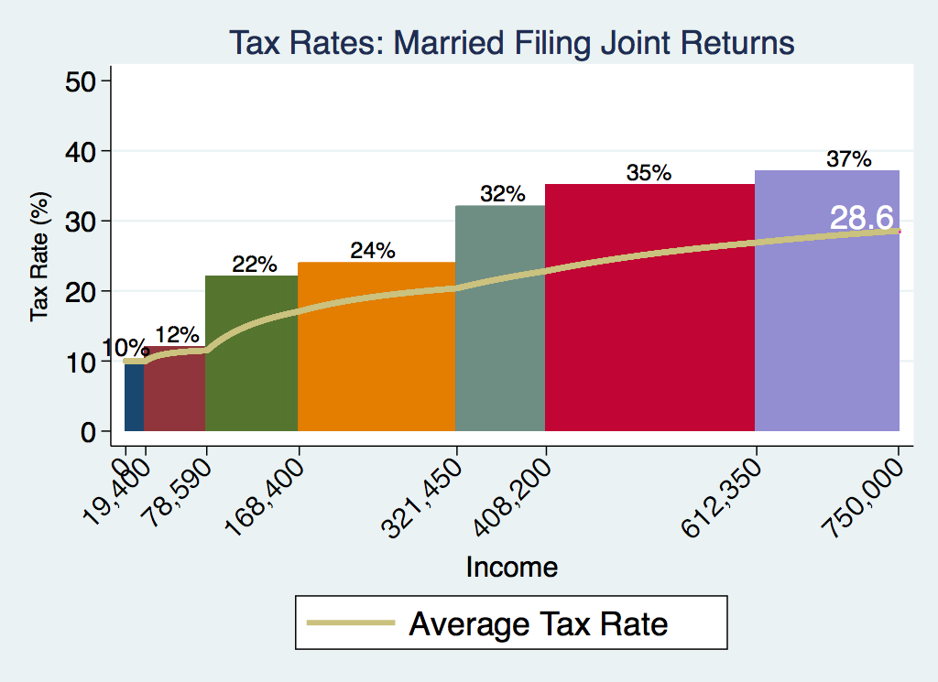
Marginal and Average Tax Rates

Slide 45
Top Income Tax Rates

Slide 46
Income at Which Top Rate Kicks In

Slide 47
Average Tax Rates Across Income Categories

Slide 48
Bottom Tax Rates

Slide 49
Tax Rates Over Time

Slide 50
Tax Deductions and Exemptions
Exemptions and Deductions
Standard deduction
Personal exemption
Child Tax Credit
Other tax expenditures
E.g., charitable giving, mortgage interest, state and local taxes, and many more.
Refundable Tax Credits
EITC: Earned Income Tax Credit

Slide 51
We have a Progressive Tax System
Our options are:
Progressive: increasing average tax with income
Neutral or flat: same share of income at all income levels
Regressive: decreasing average tax of income
Additional income is of greater consequence to those with lower incomes.
Other parts of the tax system are regressive.

Slide 52
Capital Gains Taxes (2020)
Capital gains taxes can apply on investments, such as stocks or bonds, real estate (though usually not your home), cars, boats and other tangible items.
Short term
Held for more or less than a year – taxed as regular income.
Graduated rate – for long term capital gains
0% < $38,600
15% $38,601 - $425,800
20% $425,801+

Slide 53
Capital Gains vs Income Taxes: Maximum Rates

Slide 54
Revenues: Other (8%)
Federal Reserve Remittances
Miscellaneous Fees and Fines
Customs Duties
Estate and Gift Taxes
Excise Taxes
Motor fuel
Airline tickets
Tobacco
Alcohol
Health-related goods

Slide 55
Estate Taxes
$23B in revenues in 2018
Exemption: $11.2 million for singles $22.4 million for couples
Tax rate: 40%
Top 10% pay more than 90%, Top 1% pays nearly 40%
1,900 estates (0.1% of all estates)
Businesses and farms: 140 subject to tax
No Small businesses or farms because of the $11.2 million exemption

Slide 56
Excise Taxes are Regressive

Slide 57
Revenue Sources: Share of GDP over Time
Source: Congressional Budget Office, The Budget and Economic Outlook: 2020 to 2030

Slide 58
What’s with the Bump up in Income Taxes?
Source: CBO – The Budget and Economic Outlook, 2019 to 2029

Slide 59
Revenue Source by Share of Total Revenues

Slide 60
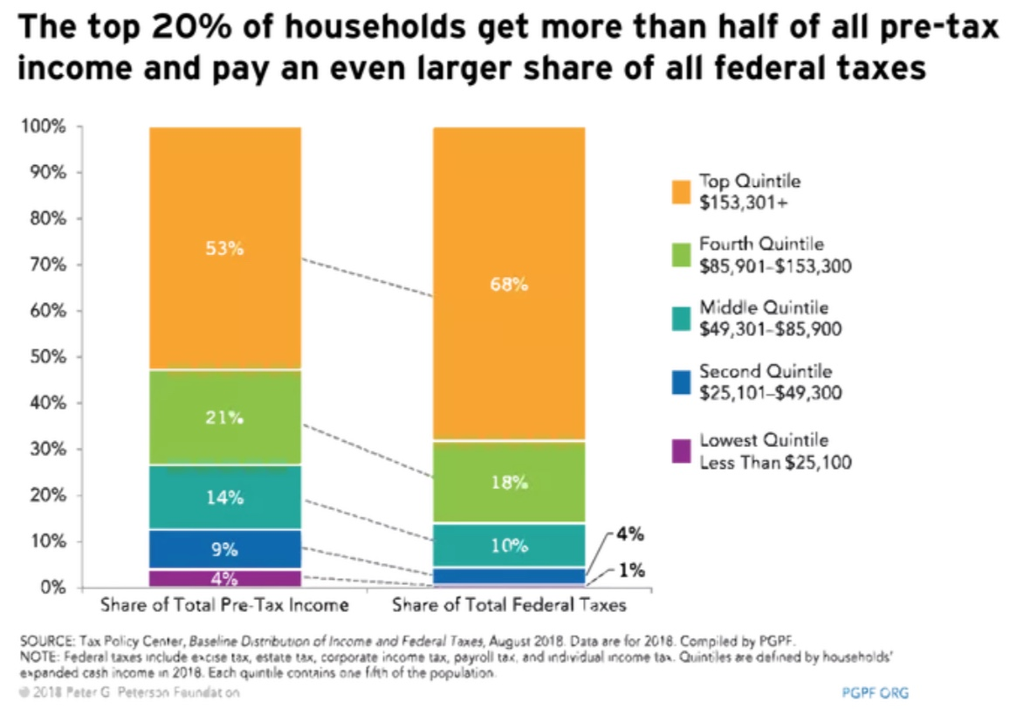
Who Pays?

Slide 61
The Bottom 40% Don’t Pay Income Taxes
There is a common narrative that the bottom 40% don’t pay income taxes.
But they pay other taxes and they also pay state and local taxes
Payroll
State and local taxes
Excise taxes – see the slide 4 slides ago
Does it matter from what tax revenues are derived?
Should the income tax be used to make the system progressive?

Slide 62
The Bottom 40% Does Pay Other Taxes
Q: Are we sure who pays the
Corporate Income Tax?
40%

Slide 63
Regressivity in Federal Taxes?

Slide 64
State and Local Taxes are Regressive

Slide 65
Overall, Taxes are (mostly) Progressive

Slide 66
What Does the U.S. Gov’t Budget Look Like?
2019 Budget Summary
Revenue | Billions |  | Expenditures | Billions
Income Taxes | $1,718 |  | Mandatory | $2,735
Payroll Taxes | $1,243 |  | Discretionary | $1,336
Corporate Taxes | $230 |  | Interest | $376
Other | $271
Total | $3,462 |  | Total | $4,447
Budget Deficit: $984 Billion
Source: Congressional Budget Office, The Budget and Economic Outlook: 2020 to 2030
Notes:
https://www.cbo.gov/publication/53627
https://www.cbo.gov/publication/53624

Slide 67
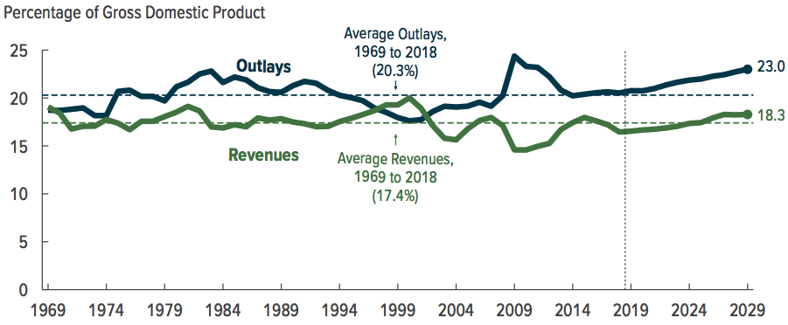
How has the Size of Government Changed?

Slide 68
How Does the U.S. Government Borrow?
It issues debt
Treasury marketable securities:
Treasury bills, notes, and bonds
TIPS: Treasury inflation-protected securities
Who buys the debt?
Other federal government agencies
Individuals and businesses
State and local governments
People, businesses, and governments from other countries.

Slide 69
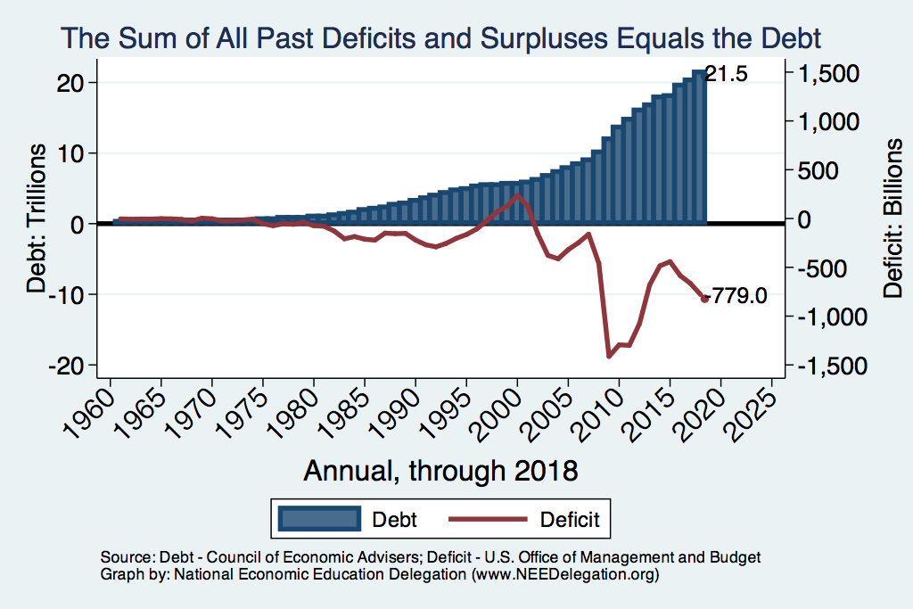
Debt vs. Deficit
Notes:
Debt2deficit.png

Slide 70
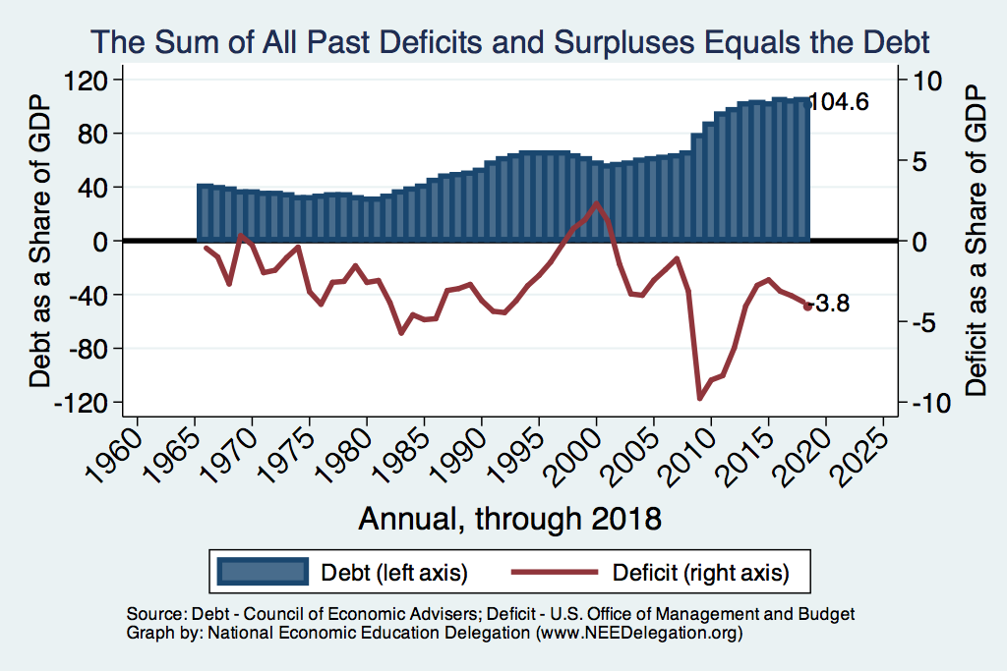
Debt vs. Deficit: Share of GDP
Notes:
Debt2deficit.png

Slide 71
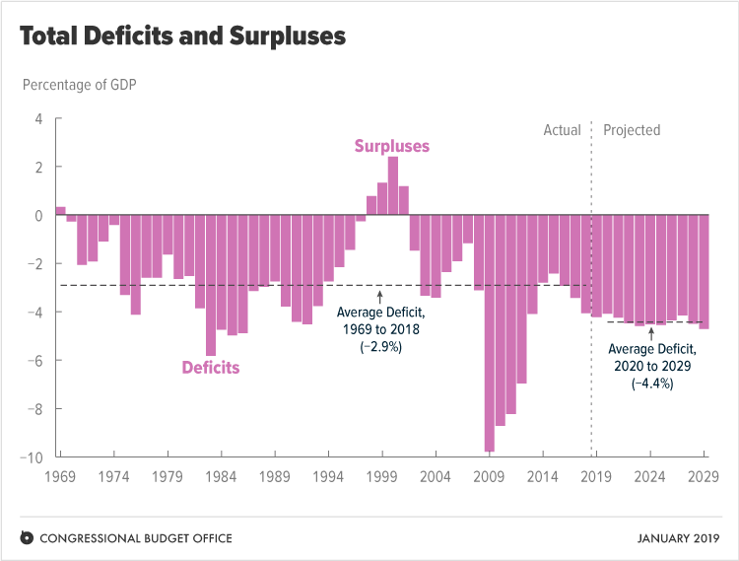
A Future of Deficits
Source: Congressional Budget Office, The Budget and Economic Outlook: 2019 to 2029

Slide 72
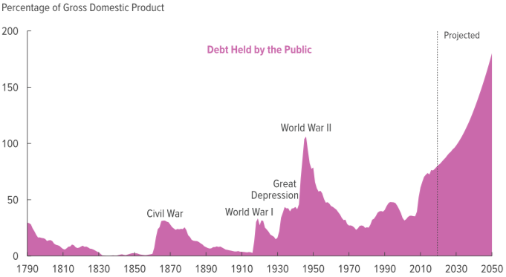
Record Levels of Debt are Forecast
180
Source: Congressional Budget Office, The Budget and Economic Outlook: 2020 to 2030

Slide 73
Mandatory Spending Dominates Forecasts
Source: Congressional Budget Office, The Budget and Economic Outlook: 2019 to 2029

Slide 74
Summary: Slide 1
Total Spending: $4.4 Trillion in 2019
There is remarkably little discretion in each budget:
Mandatory: 69%
Discretionary 31%
Fastest growing parts of the budget: Health Care and Interest
By 2050:
Debt is forecast to grow to 180% of GDP, from 80% today
Interest payments are forecast to grow from 8% to 22% of budget

Slide 75
Summary: Slide 2
Categories that get a lot of attention are relatively small
Foreign Aid: 1% of the budget
Income support/welfare: 8.7%
Or are not forecast to grow significantly
Social security
Most other categories of spending

Slide 76
Summary Slide: Tax Expenditures…
…Are policy enacted through the tax code.
…Are not explicitly on the books.
…Add > 25% to actual government expenditures.
…Reduce the progressive nature of the tax code.
…Are larger than all of “Discretionary Spending”.

Slide 77
Thank you!
Any Questions?
www.NEEDelegation.org
<presenter name>
<presenter email>
Contact NEED: Info@NEEDelegation.org
Submit a testimonial: www.NEEDelegation.org/testimonials.php

