Slide 1


The US Federal Debt
<Audience>
Date, 2020
<Your name, Ph.D.>

Slide 2
National Economic Education Delegation
Vision
  Someday, the public discussion of policy issues will be grounded in an accurate perception of the underlying economic principles and data.
Mission
  NEED unites the skills and knowledge of a vast network of professional economists to promote understanding of the economics of policy issues in the United States.
NEED Presentations
  Are nonpartisan and intended to reflect the consensus of the economics profession.

Slide 3
Who Are We?
Honorary Board: 48 members
  2 Fed chairs: Janet Yellen, Ben Bernanke
  6 chairs of the Council of Economic Advisers
    Furman (D), Rosen (R), Bernanke (R), Yellen (D), Tyson (D), Goolsbee (D)
  3 Nobel Prize-winners
    Akerlof, Smith, Maskin
Delegates: 500+ members
  At all levels of academia and some in government service
  All have a PhD in economics
  Crowdsource slide decks
  Give presentations
Global Partners: 45 PhD Economists
  Aid in slide deck development

Slide 4
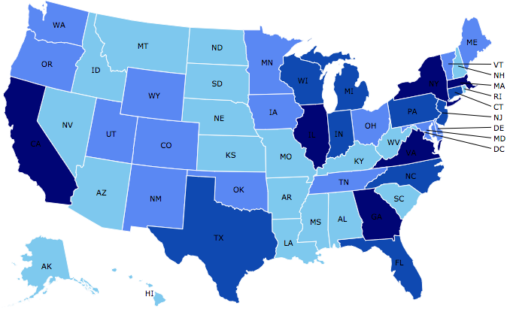
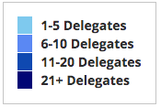
Where Are We?

Slide 5
Credits and Disclaimer
This slide deck was created by:
  Jon Haveman, Executive Director, NEED
  Geoffrey Woglom, Amherst College, Emeritus
This slide deck was reviewed by:
  <name>, <affiliation>
  <name>, <affiliation>
Disclaimer
  NEED presentations are designed to be nonpartisan.
  It is, however, inevitable that presenters will be asked for and offer their own views.
  Such views are those of the presenters and not necessarily those of the National Economic Education Delegation (NEED).

Slide 6
US Government Debt

Slide 7
What Does the US Govt. Budget Look Like?
2019 Budget Summary (in billions)
Revenue |  |  | Outlays
Income Taxes | $1,718 |  | Mandatory | $2,735
Payroll Taxes | $1,243 |  | Discretionary | $1,336
Corporate Taxes | $230 |  | Interest | $376
Other | $271
Total | $3,462 |  | Total | $4,447
Budget Deficit: $984 Billion
Source: Congressional Budget Office, The Budget and Economic Outlook: 2020 to 2030
Notes:
https://www.cbo.gov/publication/53627
https://www.cbo.gov/publication/53624

Slide 8
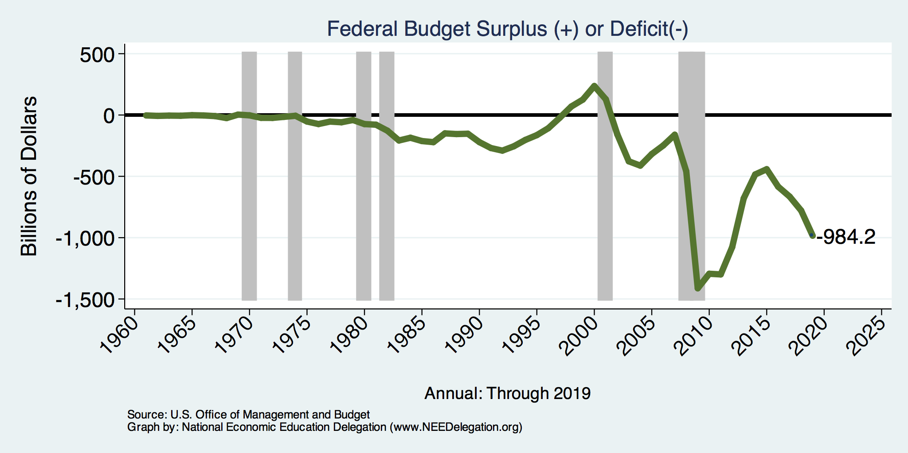
A History of Persistent Deficits
Notes:
Debt2deficit.png

Slide 9
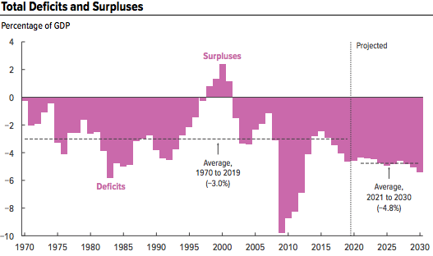
A Future of Deficits
Source: Congressional Budget Office, The Budget and Economic Outlook: 2020 to 2030

Slide 10
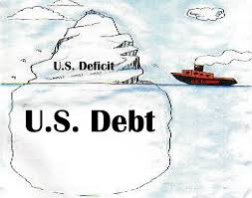
Of Debt, Deficits, and Surpluses
FLOW
  Deficit: The excess of outlays over revenues in a year.
  Surplus: The excess of revenues over outlays in a year.
STOCK
  Debt: The accumulation of debt over time.
      The sum of all past deficits and surpluses.

Slide 11
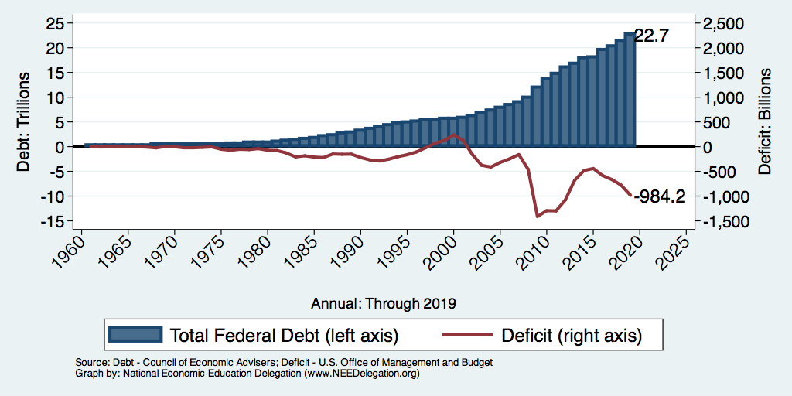
Debt vs. Deficit
Debt = The Sum of All Past Deficits Less Surpluses
Notes:
Debt2deficit.png

Slide 12
Major Takeaways: Talking Points
The current trajectory of federal debt is unsustainable.
Given the historically low interest rates, we can afford to wait until after the crisis to act.
After the crisis, we must enact plans to reduce the future (primary) deficits.
  These are driven by Medicare and Social Security spending.
The longer we postpone action, the greater the probability of a “fiscal crisis.”

Slide 13
How Does the US Government Borrow?
It issues debt.
  Treasury marketable securities:
    Treasury bills, notes, and bonds
    TIPS: Treasury inflation-protected securities
    Savings bonds
Who buys the debt?
  Other federal agencies
  Individuals and businesses
  State and local governments
  Foreign government and individuals
  Federal Reserve

Slide 14
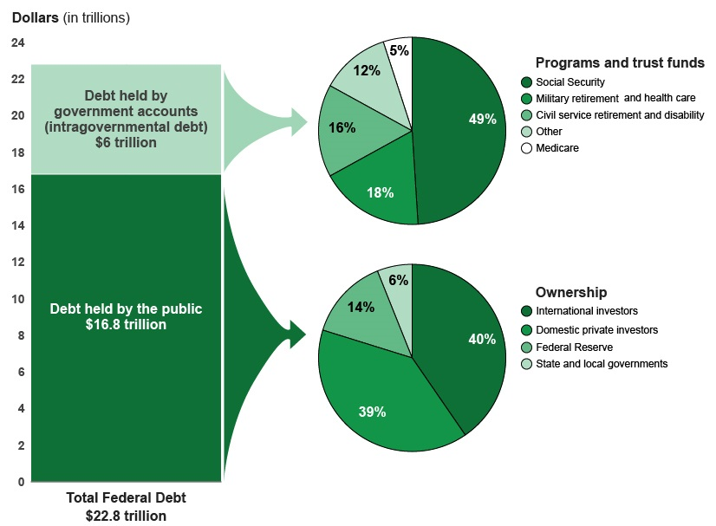
A Breakdown of Total Federal Debt
Share of US Public Debt
Foreign ownership is relatively recent – in 1990 foreign ownership was less than 20%
https://www.gao.gov/americas_fiscal_future?t=federal_debt

Slide 15
Not All Debt Is Created Equal
Some debt can reduce the availability of investment funds to other borrowers.
  Often referred to as “crowding out” private investment
Intragovernment debt is (important) bookkeeping.
  This debt DOES NOT crowd out private investment.
Debt held by the public
  This debt MIGHT crowd out private investment.
Most analyses of debt focus on federal debt held by the public.

Slide 16
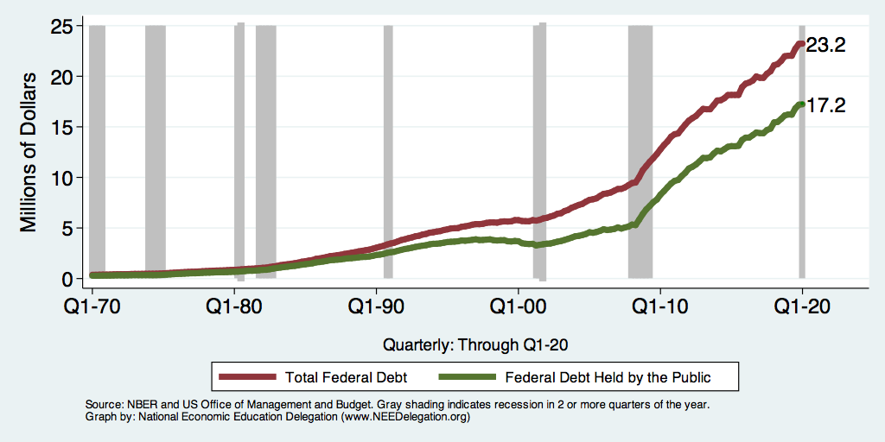
Two Measures of the Debt

Slide 17
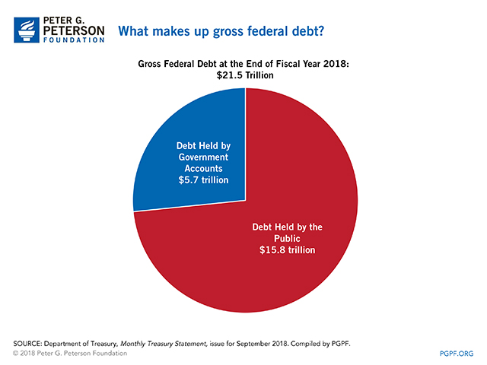

Slide 18
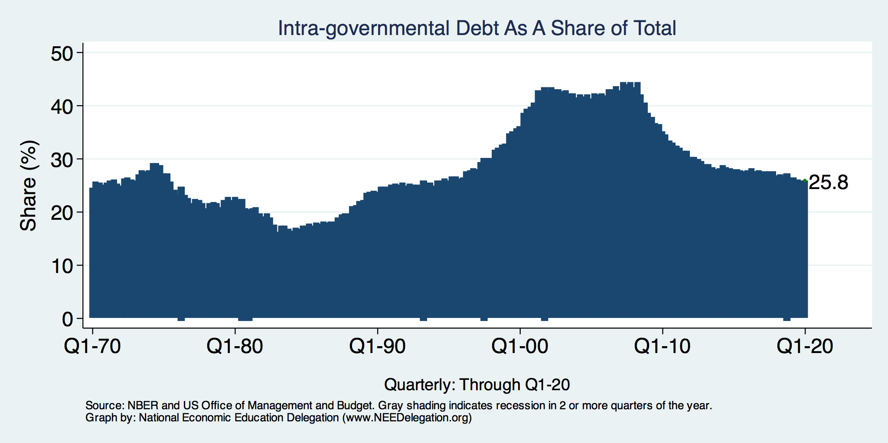
Trends in Intragovernment Debt

Slide 19
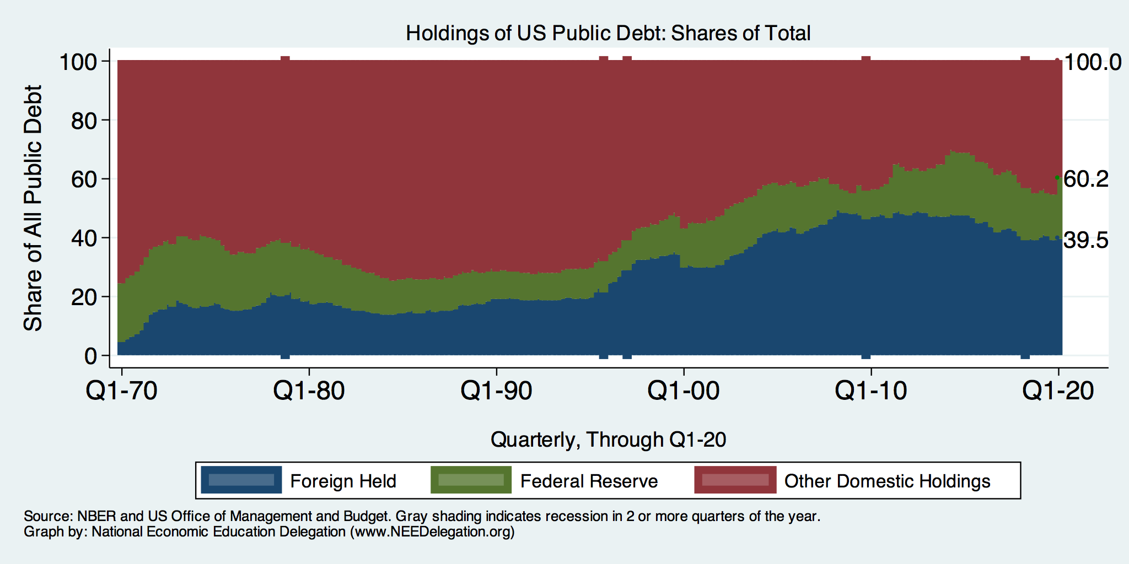
Trends in US Debt Over Time
2020, Q1: Other Domestic: 39.8%
Federal Reserve: 20.7%
Foreign: 39.5%

Slide 20
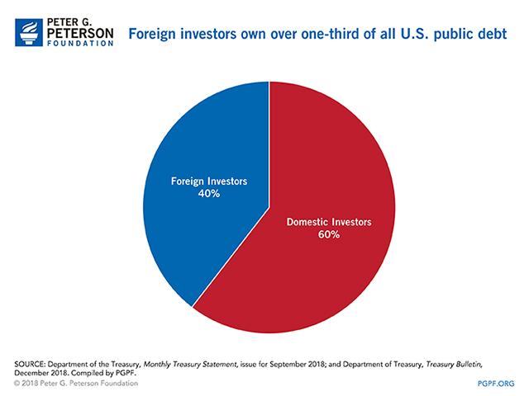

Slide 21
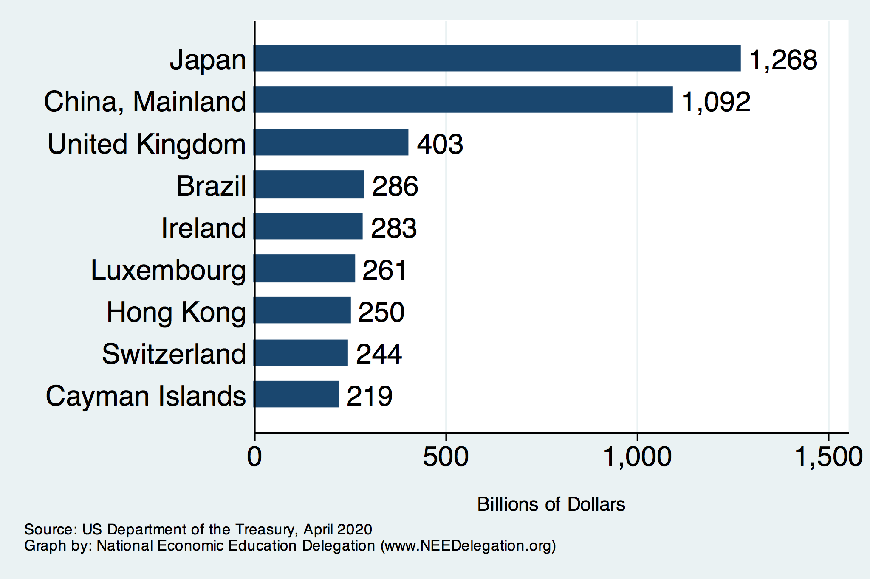
Who Holds Debt to Foreigners

Slide 22
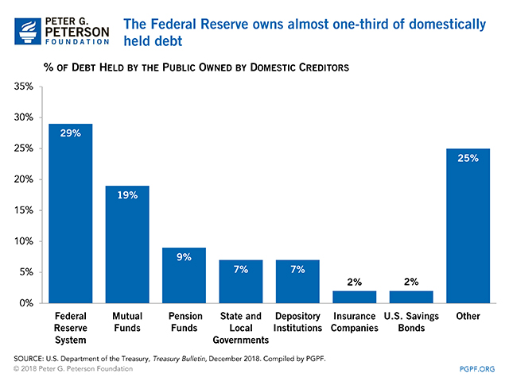

Slide 23
CBO: Budget Analysts in Chief
The Congressional Budget Office was founded in 1974 to provide Congress with information about the budgetary implications of legislation.
Two kinds of reports
  Cost Estimates: HR 6036 VA Family Leave Act of 2020
  Projections of Debt and Deficits: The Budget and Economic Outlook, 2020 to 2030

Slide 24
The All-Important Relative Debt
CBO analyzes the debt relative to GDP because:
  To the extent that debt and deficits have burdens, these burdens depend on the size of the debt relative to the size of the economy.
 | Total Public Debt | Relative Debt Debt/GDP
United States | $17.0 Trillion | 80%
Greece | $0.4 Trillion | 176%

Slide 25
Two Measures of the Debt

Slide 26
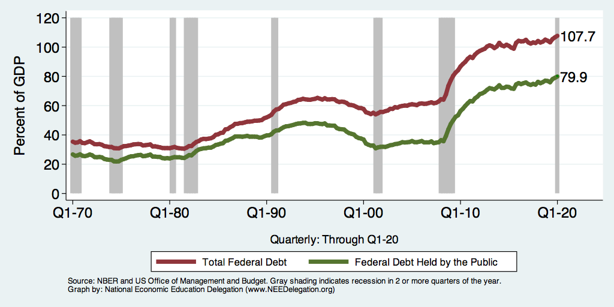
Two Measures of RELATIVE Debt

Slide 27
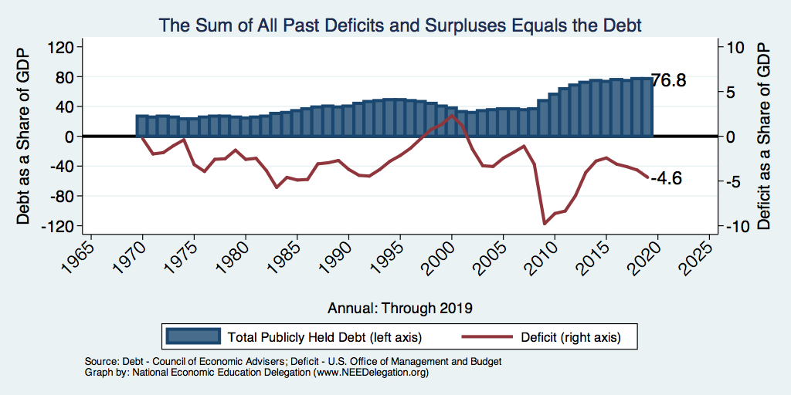
Relative Debt and Deficit
Notes:
Debt2deficit.png

Slide 28
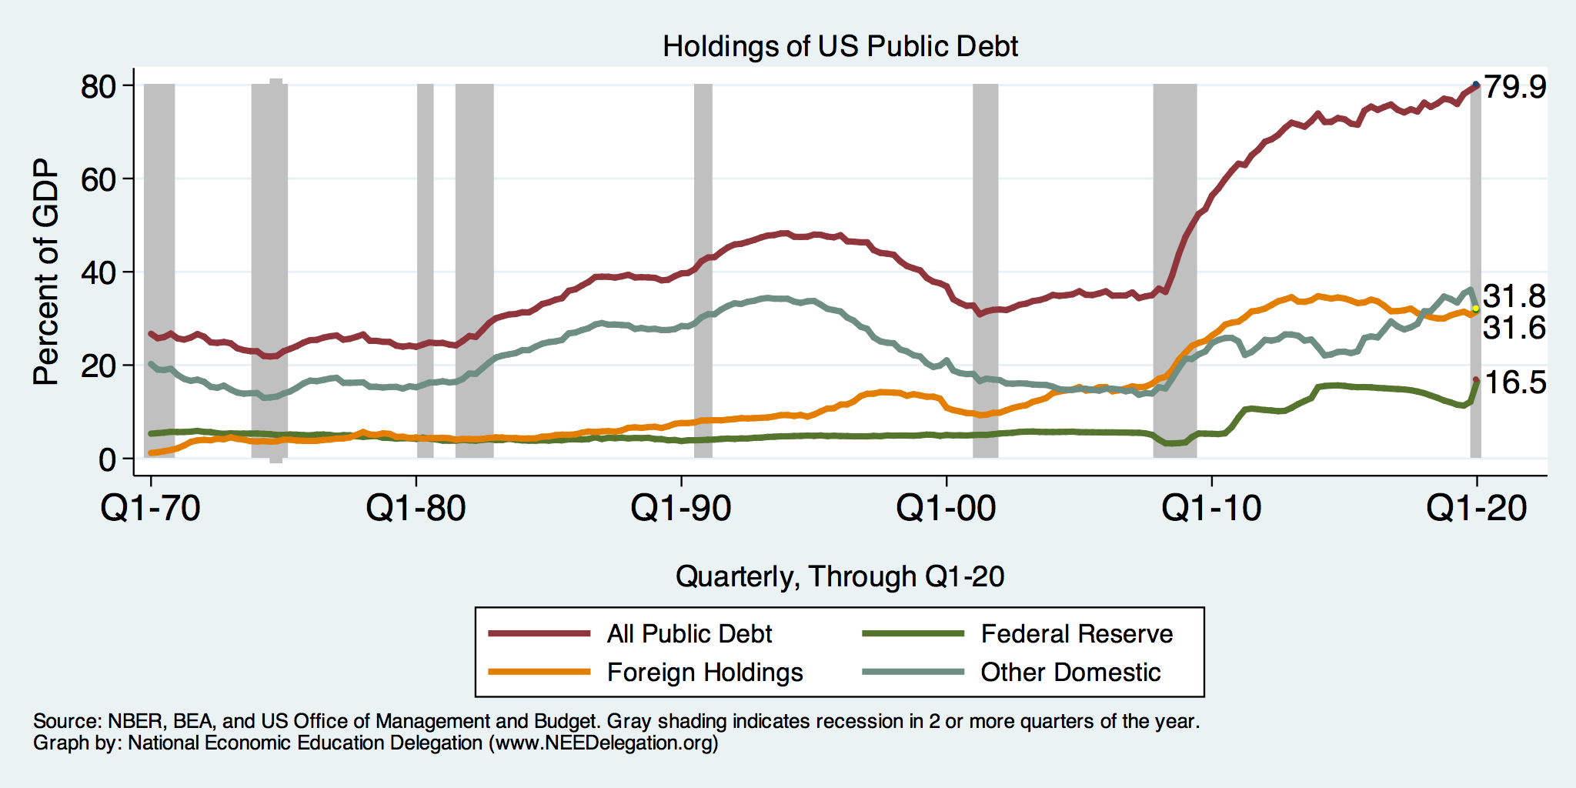
Summary: Who Holds US Public Debt?

Slide 29
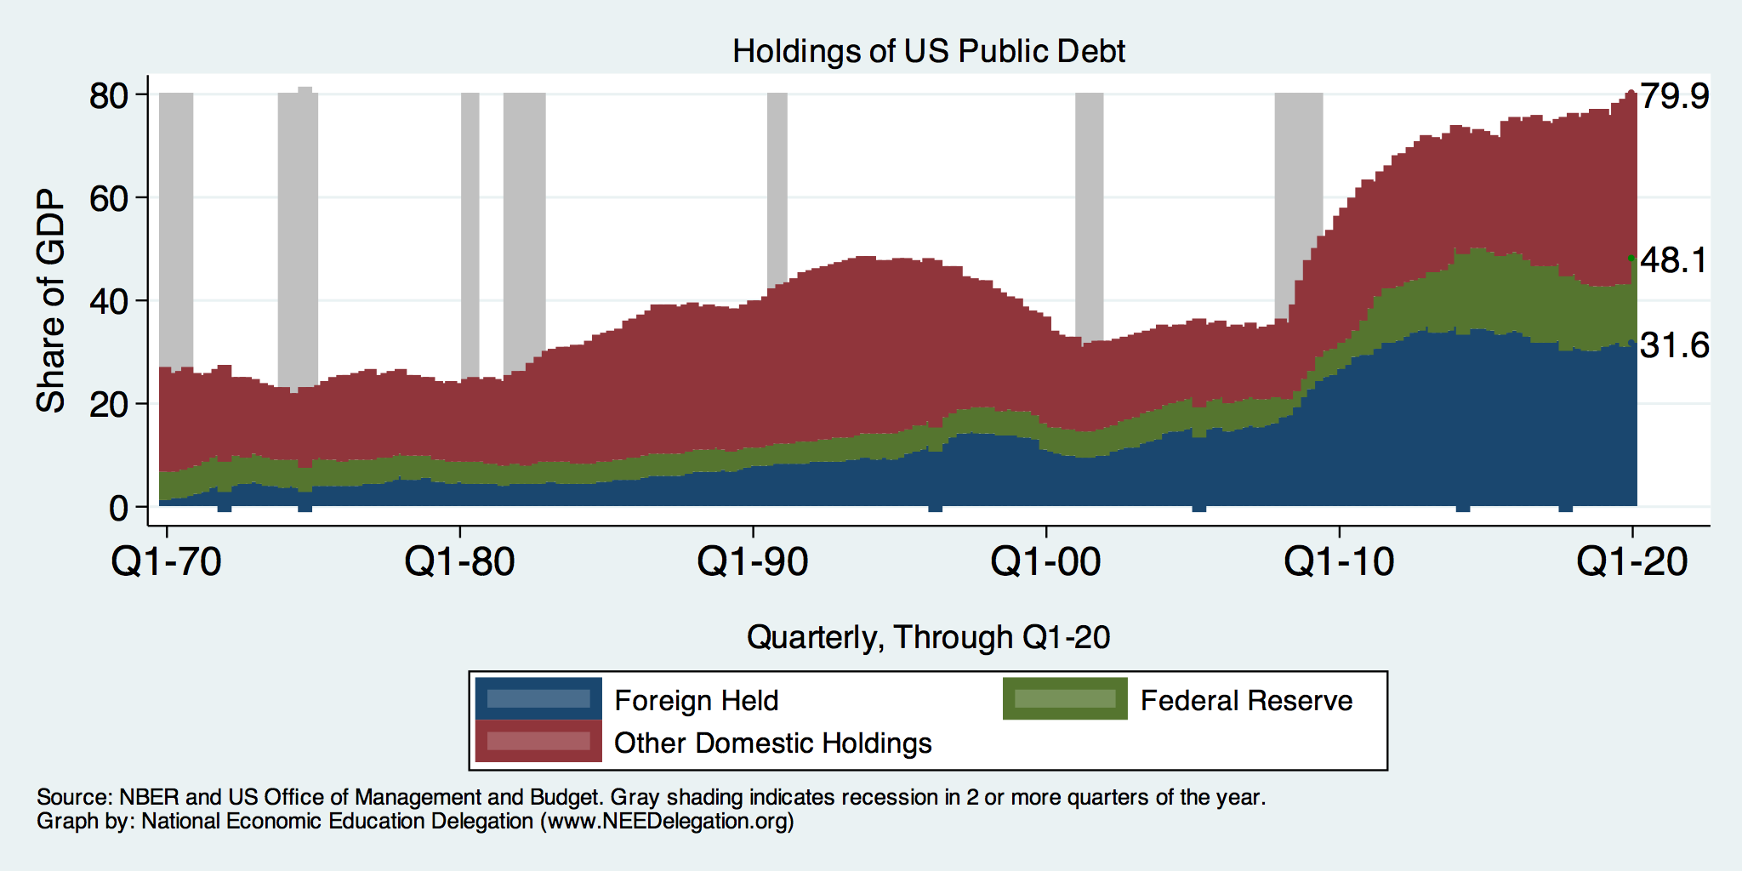
Summary: Who Holds US Public Debt?

Slide 30
Key Points About US Relative Debt
Prior to 1983, relative debt rose purposefully (wars and recessions) and then fell.
Relative debt peaked during World War II, followed by a long decline.
Relative debt has been and is expected to rise for the next 30 years w/o a strategic purpose.

Slide 31
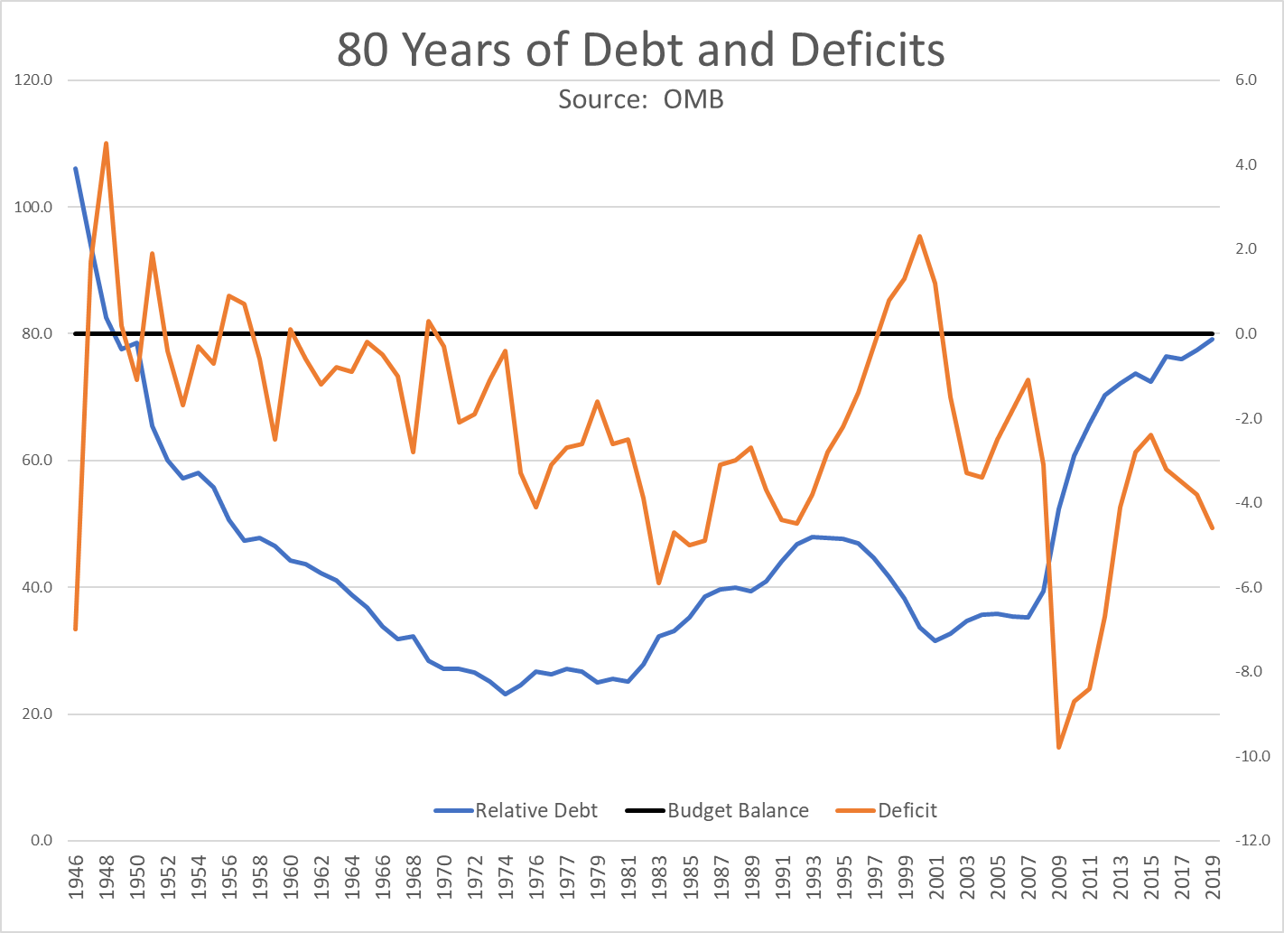
The Post-WWII Fall in Relative Debt

Slide 32
Debt Dynamics
Surprising (?) Facts
  From 1945 to 1979, relative debt fell from 100% of GDP to 25% of GDP.
  During this period, the federal budget was in surplus only once, in 1969.
Relative debt is a fraction: Debt/GDP; fractions fall if:
  The numerator falls (budget surplus)
  The denominator rises (nominal GDP growth)
  The denominator grows faster than the numerator

Slide 33
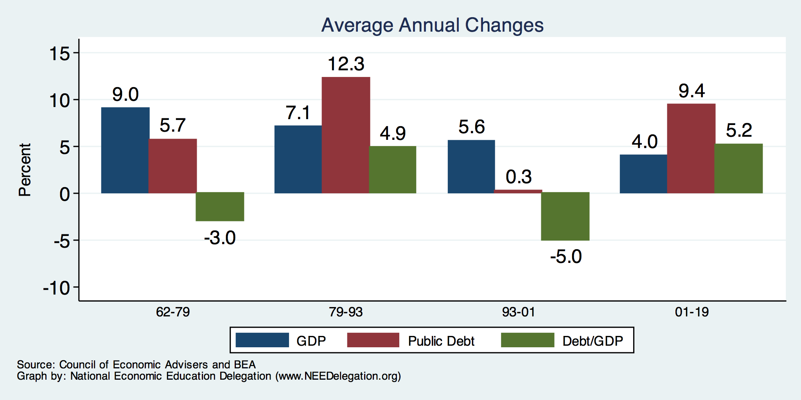
The Arithmetic of Changes in Relative Debt

Slide 34
Two Measures of the Deficit
(1) Primary deficit = current programmatic outlays – revenues
(2) Total deficit = primary deficit + interest
Interest on the debt is
  The part of the total deficit that is due to past deficits.
This distinction becomes important for understanding:
  The future course of relative debt.
  The costs borne by future generations because of the debt.

Slide 35
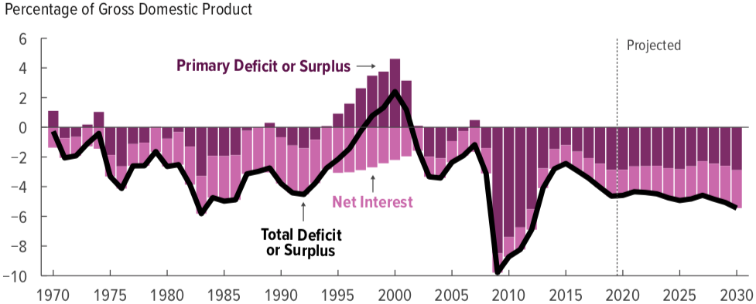
Rising Debt Levels Due to a Future of Deficits
This graph was done before Covid-19
Source: Congressional Budget Office, The Budget and Economic Outlook: 2020 to 2030

Slide 36
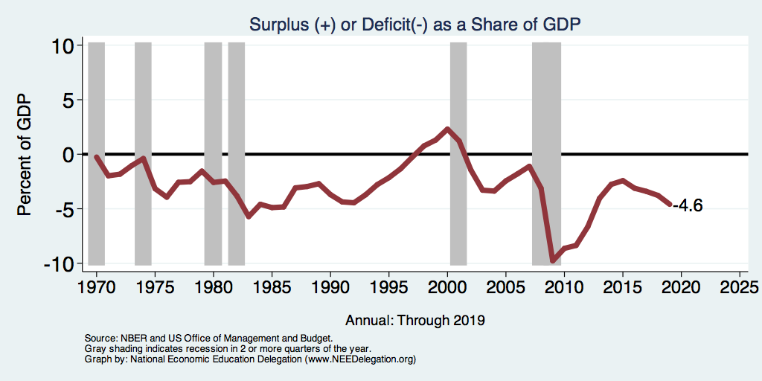
Deficits and Recessions
Notes:
Debt2deficit.png

Slide 37
How to Think About the Debt

Slide 38
Perspectives on Increased Debt
Government borrowing crowds out private capital and investments.
  Weakened by the ability to borrow from other countries.
Does debt impose a burden on future generations?
  Does it inevitably have to be paid off?
In time, debt service might crowd out other government spending.
  Diminishing policy priorities in the budget.
Is it reasonable to borrow at low interest rates for investment?
  For example, for infrastructure.

Slide 39
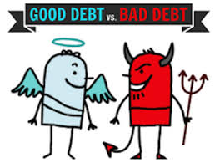
Not All Borrowing Is Bad!
Two good reasons to borrow:
  During a temporary crisis
    Recession
    War
    Pandemic
  Productive public investment
    Infrastructure
    Education
These deficits do not permanently increase relative debt.
  Great Depression, WWII
  Public investment expands GDP and tax revenue

Slide 40
Spending to Grow Much Faster Than Revenue
Interest, too!

Slide 41
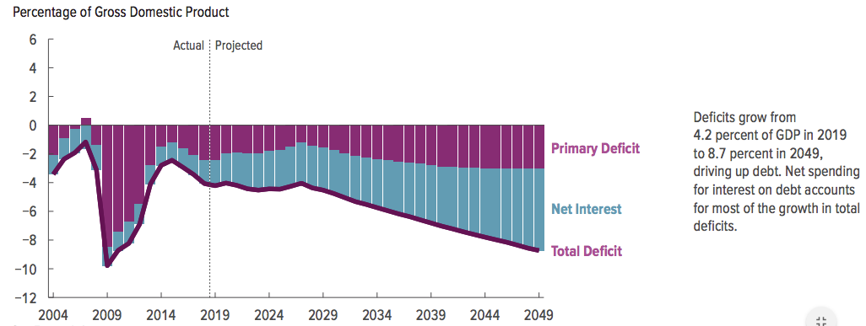
Interest Will Grow as a Share of the Deficit

Slide 42
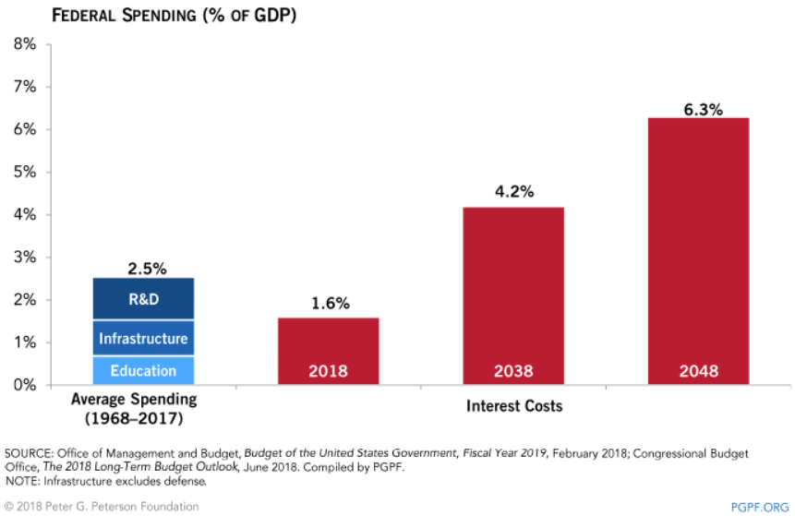
Interest Payments to Grow Significantly

Slide 43
Is The Debt a Problem Today? (Pre-COVID 19)
Currently borrow about $100 billion each month with little difficulty.
Very little evidence of ”crowding out.”
Interest rates are very low, less than 1% on 10-year notes.

Slide 44
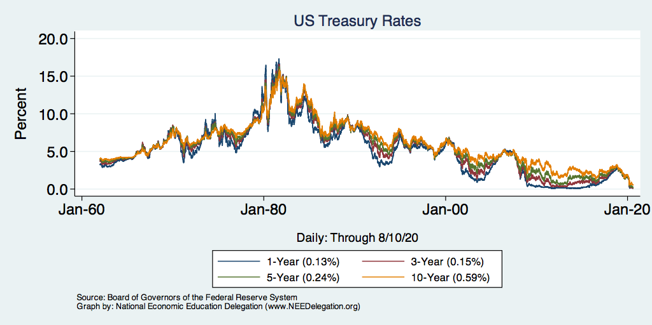
Interest Rates Are Historically Low

Slide 45
So, Why Worry About it?
If debt become too high:
  Investors might start questioning the creditworthiness of the US government.
    Problem: Nobody knows how high is too high.
  It becomes more difficult to borrow in times of crisis.
    War, severe recession
    “Fiscal space”
      Impossible to measure how much we have.
      Clearly, we have less now than in 2007.
  Could start to crowd out investment by consumers and businesses.
    Not currently a problem. No idea if/when it might become one.
  Could be inflationary.

Slide 46
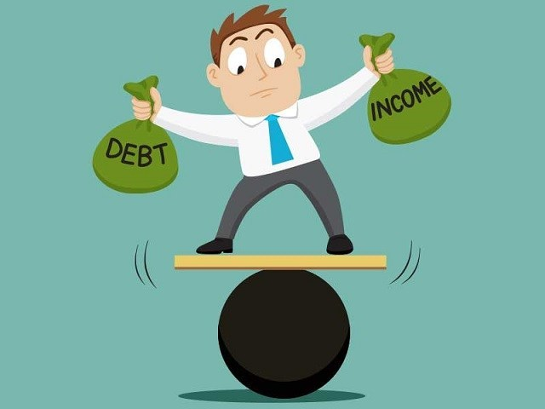
So, Why Worry About It?
If debt continues to grow:
  Interest payments will grow with it.
    8% of spending in 2018.
    22% of spending in 2048.
    Less room for using the budget for policy priorities.
    40% of payments go to other countries.
  The longer we wait to address it, the harder and more disruptive addressing it will be.
  Interest rates might increase.

Slide 47
Growth in Relative Debt
Remember:
  the denominator of relative debt is GDP
  the numerator is debt
The denominator grows at the rate of growth of GDP.
The numerator grows with:
  the interest rate on the debt plus (or minus)
  the effect of the primary deficit (surplus)
Notes:
  relative debt can fall, even with chronic deficits, if they cause the debt to grow more slowly than GDP.
  Relative debt can rise with a surplus if interest rates increase enough.

Slide 48
Economists’ Views on the Debt Evolve

Slide 49
Traditional View: A Non-Issue
The analogy between household and government debt is inaccurate.
  The government does not have to pay back the debt.
    Retirees cash in maturing bonds, which are financed with new bond issues sold to younger people.
    Interest on the debt is essentially paid by the young to their parents.
      When the young are old, their young will do the same for them.

Slide 50
Reagan’s Experiment in Supply-Side Economics
Tax cuts were supposed to be “investments.”
  Lower marginal tax rates, and people will work more/harder and save.
  Higher GDP will raise tax revenue to pay for the deficit.
Sadly, in 1981-89, debt rises from 25% to 40%.
  For the first time, relative debt rises during a nonrecessionary peacetime.
  Reignites concern about debt and deficits.
Failed experiment?

Slide 51
Traditional View: Four True Costs
Crowding out:
  The Treasury’s borrowing needs compete with private borrowers, so debt and deficits raise interest rates.
Higher interest rates lead to foreign capital inflows or foreign borrowing.
  With foreign borrowing, some of the interest on the debt goes to foreign countries.
Larger primary surpluses are needed to stabilize the relative debt.
  The larger the relative debt, the bigger the needed primary surplus.
  Thus higher taxes or programmatic outlays must be reduced.
Government bias toward higher inflation
  GDP grows if either prices rise or real output rises.
Source: CBO, Federal Debt: A Primer, March 2020 pp.24-5

Slide 52
Traditional View: Cost 1
Rising debt reduces investment.
  Deficits and debt raise aggregate demand.
    Direct government spending.
    Lower taxes lead households to spend more.
  To offset this increase in demand, the Fed has to raise interest rates, reducing investment and future GDP.
  By causing interest rates to rise:
    debt and deficits “crowd out” investment.

Slide 53
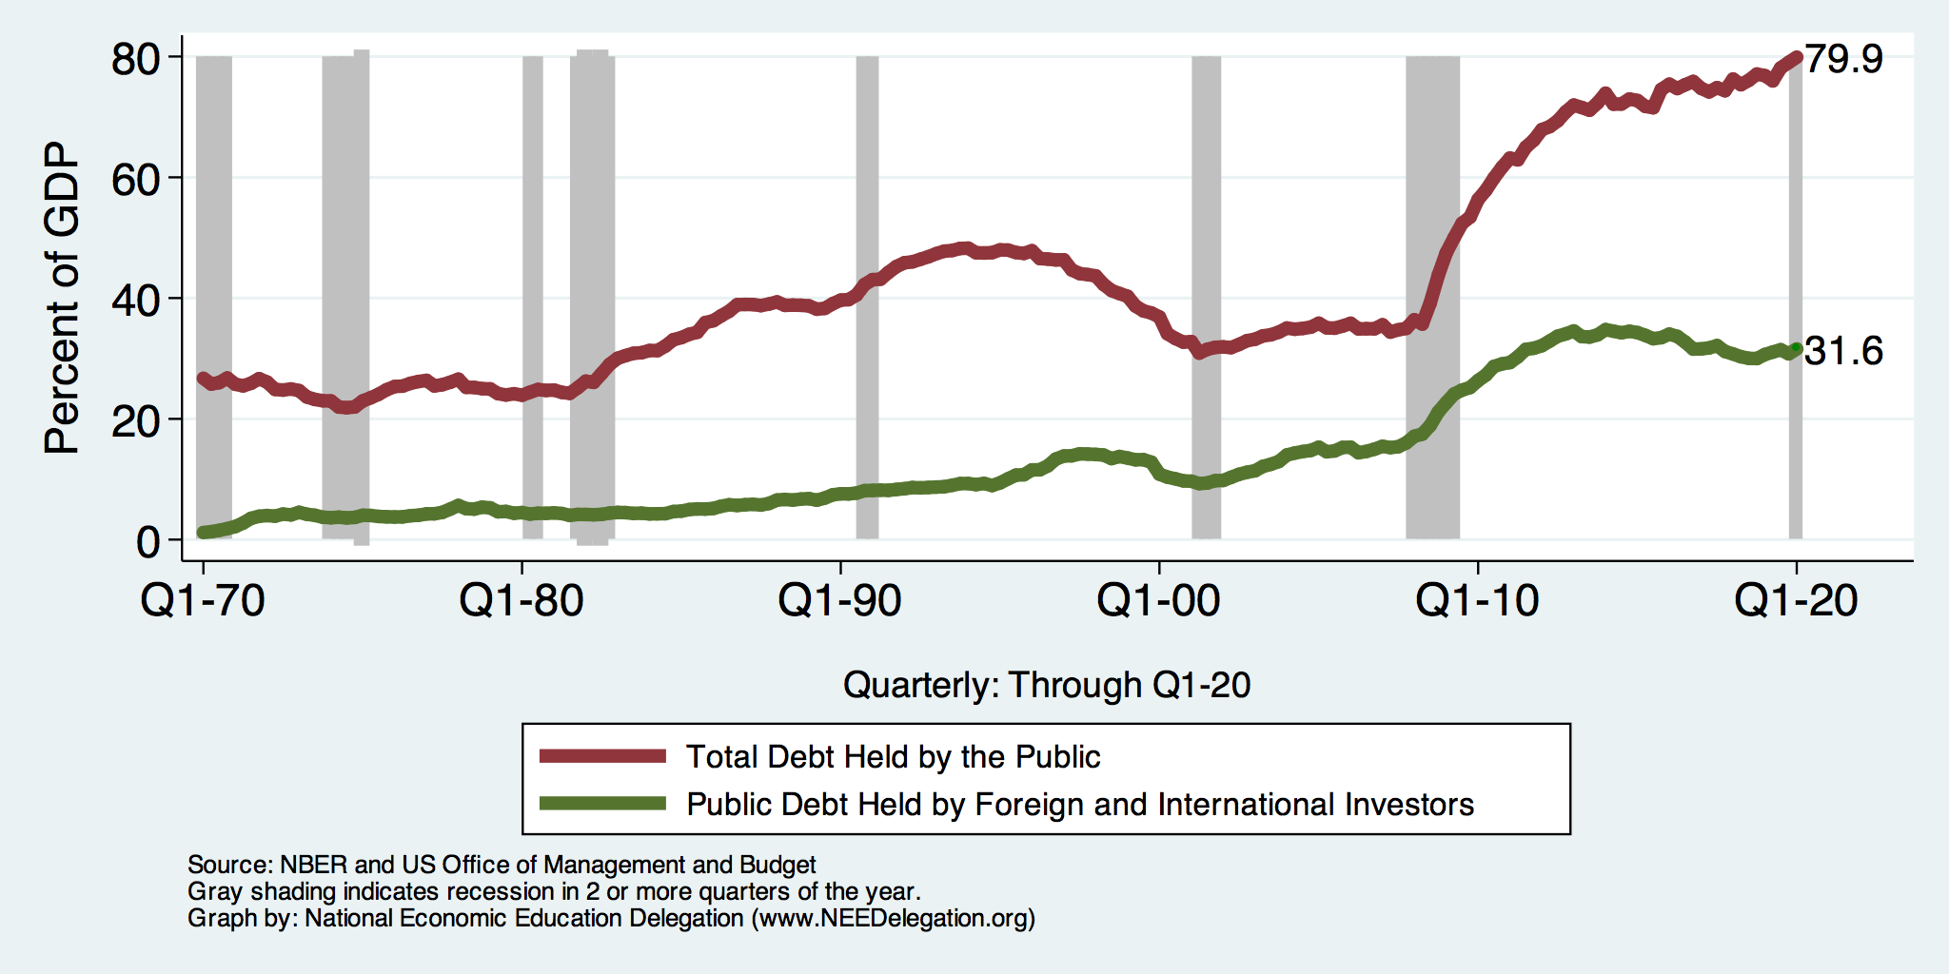
The International Appetite for US Treasuries

Slide 54
The International Appetite for US Treasuries

Slide 55
2005: The International Dimension to Debt
Interest on foreign-held debt reduces US residents’ welfare.
  Interest payments go to other countries.
When the Fed raises interest rates, the exchange rate of the dollar rises, causing:
  Increases in the trade deficit
  Foreign borrowing.
Sharp increases in interest rates and the cost of imports raises the possibility of a fiscal crisis or a “run on the dollar.”

Slide 56
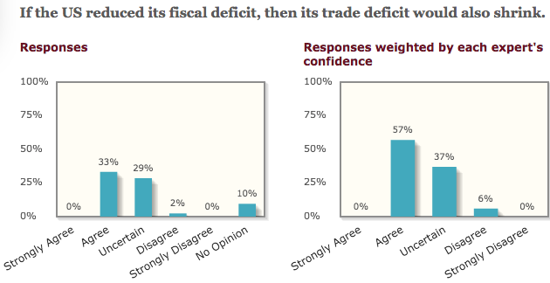
General Agreement Among Economists

Slide 57
Trade and Investment Flows Balance Out

Slide 58
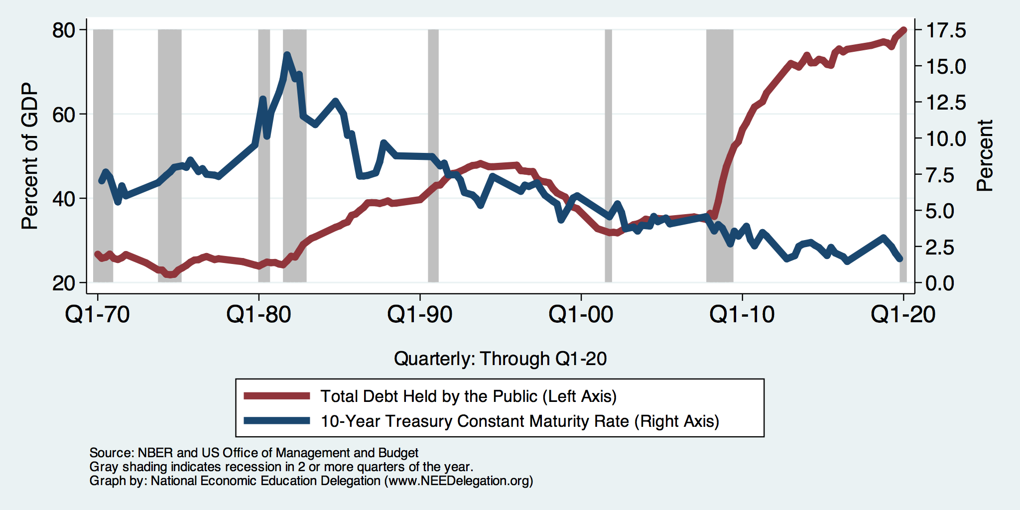
Costs 1–2: The Dog That Didn’t Bark

Slide 59
Traditional View: Cost 3
Rising debt reduces budgetary options.
  More debt means higher interest costs.
  Therefore, greater relative debt:
    requires a bigger primary surplus to stabilize the relative debt.
  Larger primary surplus means either higher tax rates or less government spending:
    “crowding out” of outlays and/or tax cuts.

Slide 60
Cost 3: No Primary Surplus Since 2007!
This graph was done before Covid-19
Source: Congressional Budget Office, The Budget and Economic Outlook: 2020 to 2030

Slide 61
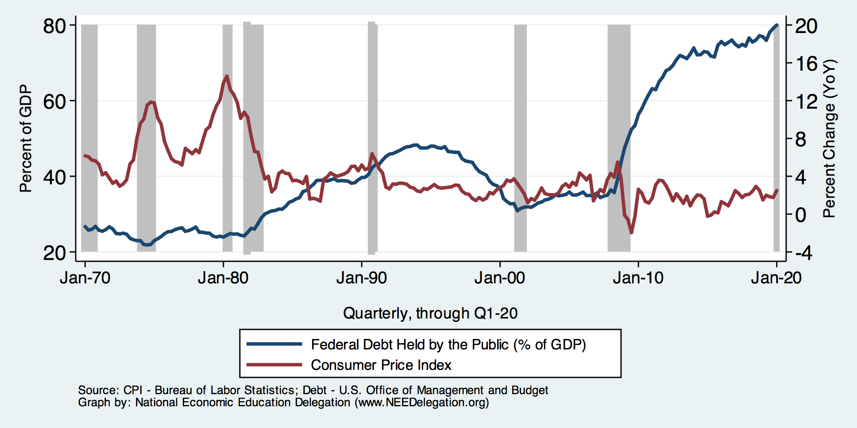
Cost 4: Anybody See Any Inflation?

Slide 62
Maybe Debt Isn’t a Problem After All: MMT
Stephanie Kelton provided a prominent and recent exposition of modern monetary theory in a NY Times op-ed on June 6, 2020:
  “Learn to Love Trillion-Dollar Deficits.”
Modern monetary theory
  US Treasury borrows in its own currency and therefore cannot default.
    As opposed to countries, such as Greece, which borrow in euros.
  Example: How did we ”find the money” for the recent increase in the deficit of about $1.9 trillion?
    Answer: The Fed purchased $1.7 trillion = 89% of financing
  More generally, MMT argues that we can always find the money to increase federal spending.

Slide 63
MMT’s Free Lunch
The only limit on deficit spending is when it leads to too much spending, thereby increasing current inflation.
Recognizing this fact, “could free policymakers not only to act boldly amid crises but also to invest boldly in times of more stability.”
  First part, acting boldly, is important and likely true.
  Second part, invest boldly, is suspect.

Slide 64
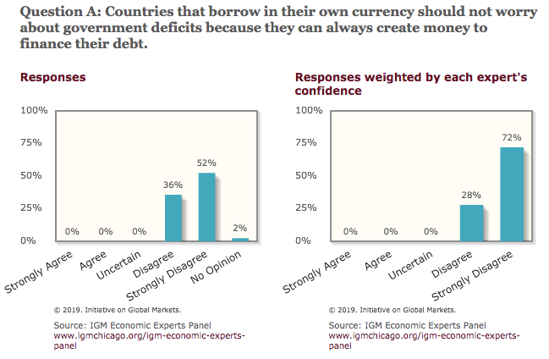
General Sense on Modern Monetary Theory

Slide 65
A More Reasonable, But Still Optimistic View
Olivier Blanchard:
Emeritus Professor at MIT
Chief Economist at the IMF, 2008–2015
President of the American Economic Association, 2018

Slide 66
AEA Presidential Address, January 2019
“If the future is like the past [with low interest rates], … the issuance of debt without a later increase in taxes may well be feasible. Put bluntly, public debt may have no fiscal cost.”
But,
“My purpose … is not to argue for more public debt, especially in the current political environment. It is to have a richer discussion of the costs of debt … than is currently the case.”

Slide 67
What the Traditional View Got Wrong
Stabilizing relative debt, debt/GDP, requires that the growth rate in debt equal the growth rate of GDP.
The growth rate in debt has two parts:
  The growth rate in interest on the debt, or just the interest rate.
  A contribution due to the primary surplus (–) or deficit (+).
The traditional view assumes that the interest rate on debt is greater than the growth rate of GDP
  So, 2 must be negative to offset excess of 1.
  i.e., debt stabilization requires a primary surplus.

Slide 68
An Almost Free Lunch
If the interest rate is less than the growth rate of GDP, then the contribution from the primary budget can be positive, or
Debt to GDP can be stabilized with a (small) primary deficit.
Blanchard is not MMT (when the crisis is over)
  Relative debt must be stabilized.
  Primary deficit must be reduced.
  But the level of debt at which we stabilize may not be crucial.

Slide 69
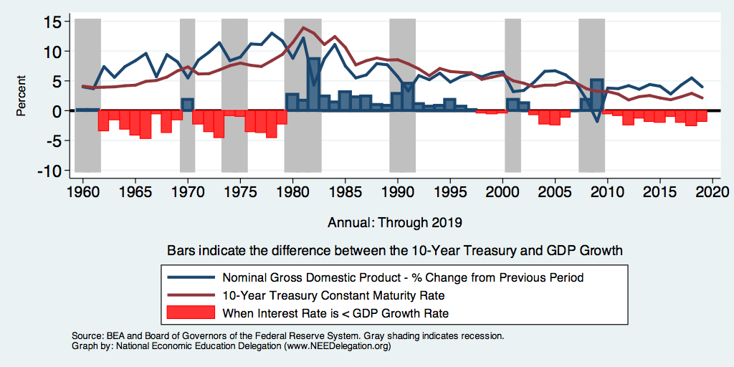
Evidence?

Slide 70
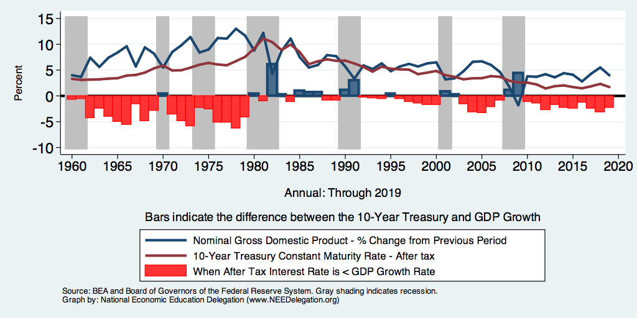
But Interest on the Debt Is Taxable

Slide 71
The Key: Stabilization of Relative Debt
Stabilization of relative debt might forestall the consequences of chronic deficits.
Problem: The US federal debt is in no way stable.
W/o stability, interest rates might rise, causing crowding out of:
  policy priorities
  domestic investment
Budget surpluses are not necessary, but budget control is.

Slide 72
A New and Possibly Catastrophic Cost
MMT is right that, for practicable purposes, the US cannot default on its debt, but …
International investors can still lose if the exchange rate of the dollar falls.
Remember, foreign holdings of public debt are 40 percent of the total.

Slide 73
Why Do Foreign Investors Buy US Treasuries?
Market for Treasuries is the deepest, most liquid capital market in the world.
The US economy has a history of political and economic stability.
We enjoy “an exorbitant privilege” (French President Valéry Giscard d’Estaing): The dollar is the largest international reserve currency.
  Most trade transactions are quoted in dollars, e.g., oil.
  With some exceptions, foreigners borrow in dollars, e.g., Yankee bonds

Slide 74
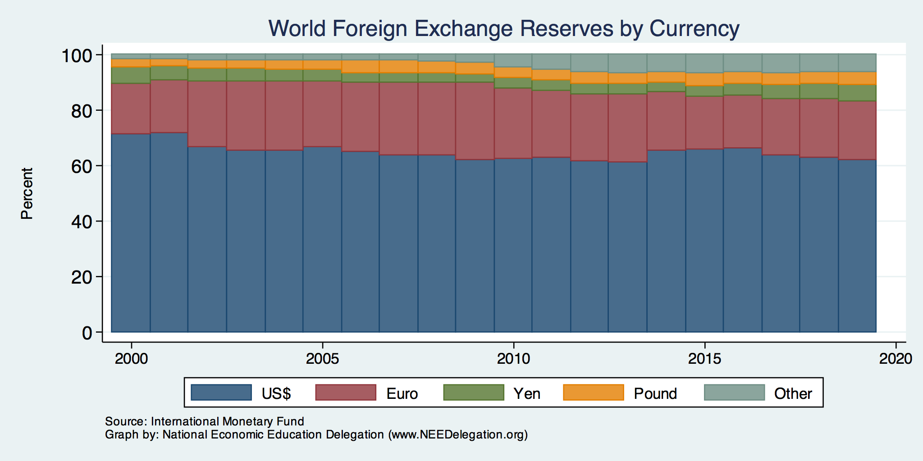
Will Our “Exorbitant Privilege” Last Forever?

Slide 75
Fiscal Crisis, or a Run on the Dollar
With an exploding relative debt, what happens if foreigners lose confidence in the stability of the dollar?
CBO (Federal Debt: A Primer, March 2020):
  because the United States currently benefits from the dollar’s position as the world’s reserve currency and because the federal government borrows in dollars, a financial crisis—similar to those that befell Argentina, Greece, or Ireland—is less likely in the United States.
Although no one can predict whether or when a fiscal crisis might occur or how it would unfold, the risk is almost certainly increased by high and rising federal debt.
Crises of confidence, in addition to being unpredictable, happen very quickly.

Slide 76
What Is a Fiscal Crisis?
Increased perception of risk in government debt.
Potential manifestations:
  Sudden major increase in interest rates
  Plunging exchange rates
Why?
  Increased expectation of default
Potential results:
  Dramatic budget reforms may be quickly necessary to stave off actual default.
  Recession from declines in:
    investment (interest rates)
    consumption (interest rates)
    Government spending
  Higher interest bill on existing debt

Slide 77
Bottom Line: We Need to Worry about the Debt
Interest rates will not stay this low forever.
A fiscal crisis should be avoided at all costs.
Stabilizing relative debt would substantially reduce the possibility of a crisis.
The good news is we might be able to stabilize relative debt without a primary surplus.
But (after the pandemic is over) we must substantially reduce primary deficits.

Slide 78
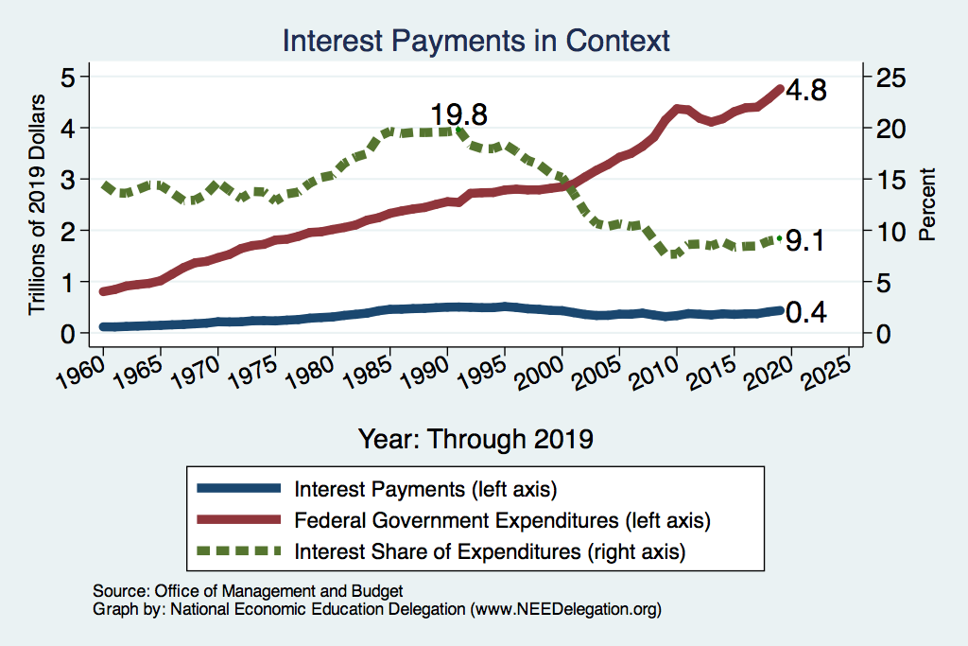
History: A Cautionary Tale of Interest Rates?
What happened
here?

Slide 79
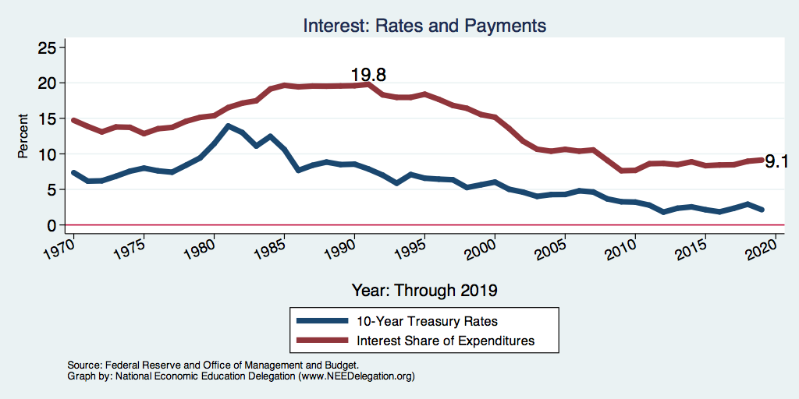
Interest Payments and Interest Rates

Slide 80
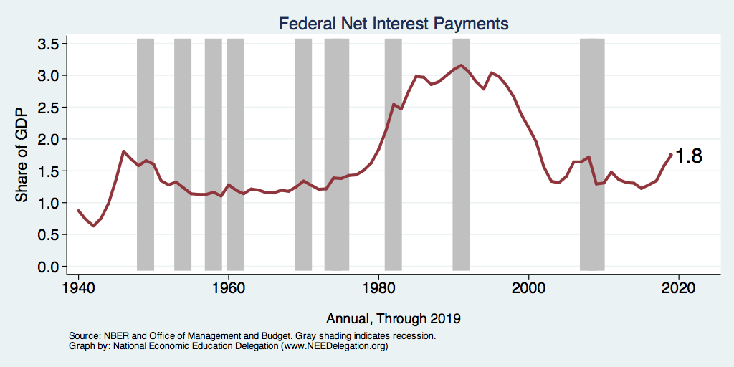
Rising Interest Expenses?

Slide 81
Covid-19 Update
CBO projections (as of 4/24) :
  The 2020 federal deficit will rise from $1 trillion to $3.7 trillion.
  Relative debt: will rise from 80 percent to 101 percent of GDP.
FY 2019–2020 ends September 30.

Slide 82
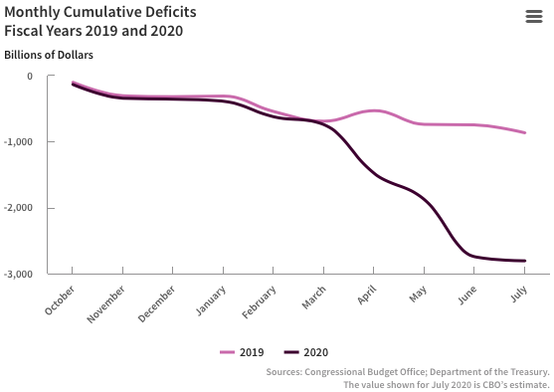
COVID-19’s Impact on the Deficit – to July
Source: https://www.cbo.gov/publication/56497

Slide 83
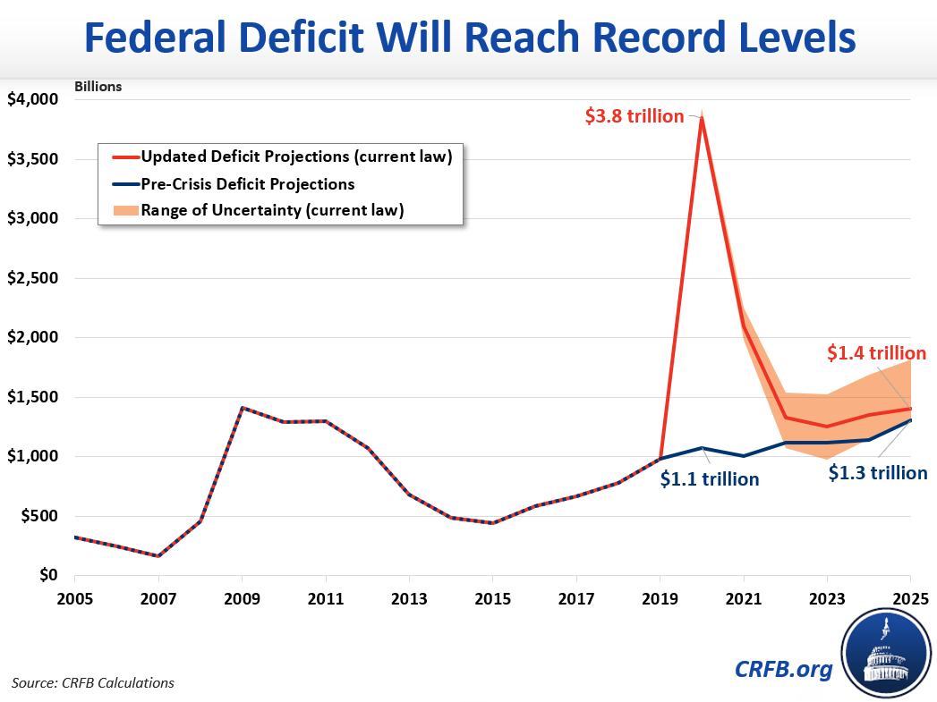
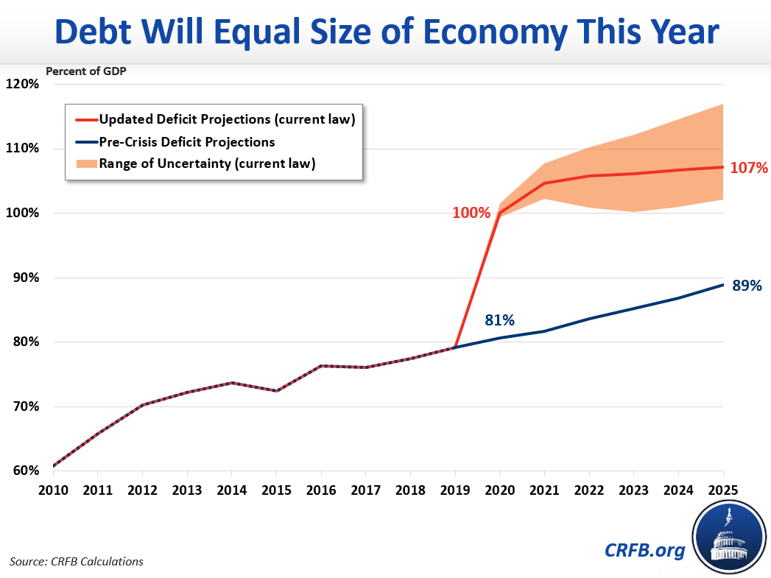
Very Large Deficit!
https://www.crfb.org/blogs/budget-projections-debt-will-exceed-size-economy-year

Slide 84
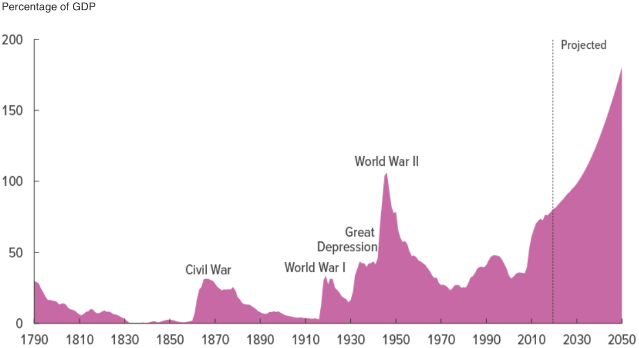
How Do We Pay for This?
Good News: Treasury interest rates are nearly 0.
Bad News: The long-term budget outlook was already a mess.
Don’t worry about the drought when the house is on fire!
CBO, “The Budget and Economic Outlet: 2020-2030,” 1/2020

Slide 85
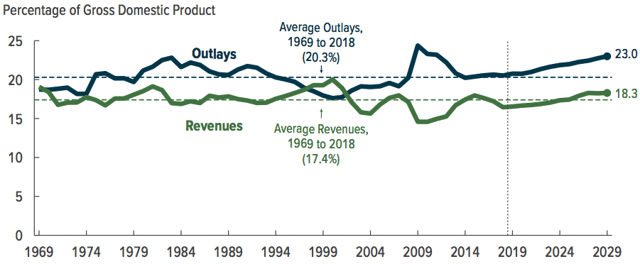
Why Has the Federal Debt Risen So Much?

Slide 86
Why Has the Federal Debt Risen So Much?

Slide 87
Why Has the Federal Debt Risen So Much?
Expenditures:
  Social Security
  Health-care costs
  Economic stimulus
    In particular, during the Great Recession.
  Military engagements overseas
Revenues
  Declining income tax revenues
    Stagnant wages
    Tax cuts
  Social security
    Declining revenues
  Corporate income taxes

Slide 88
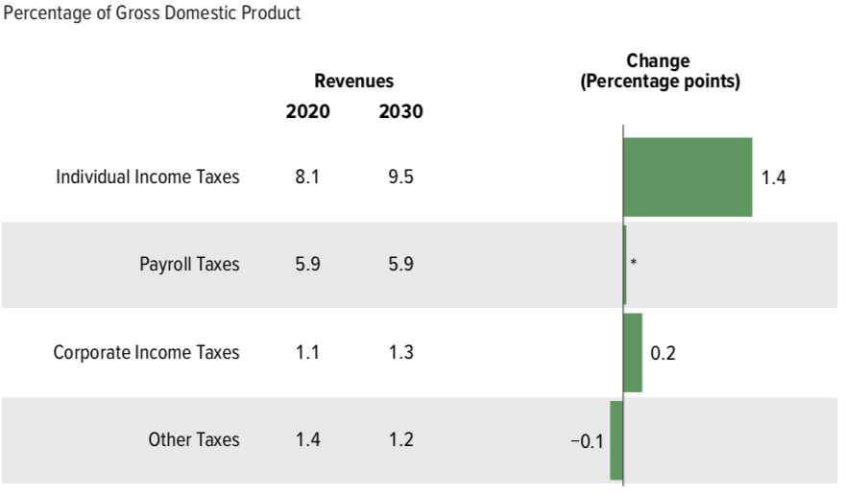
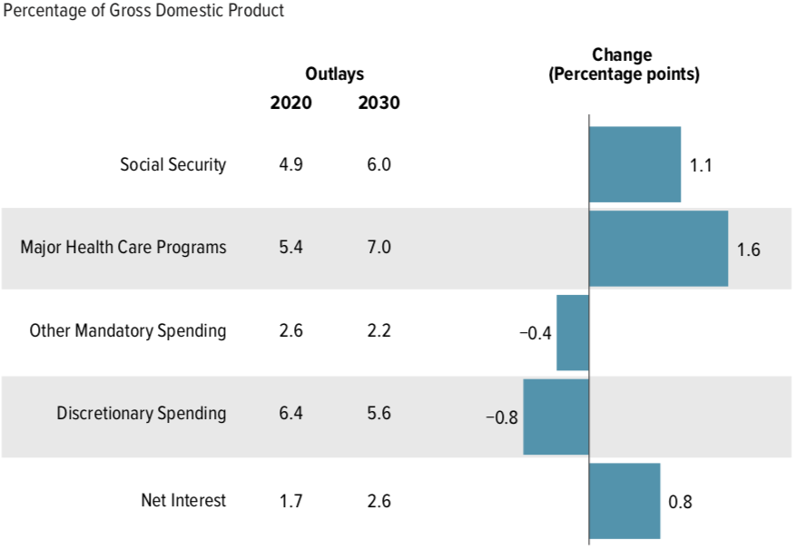
Growth in Outlays Exceeds Revenue

Slide 89
Budget Consequences of an Aging Population
Contributions to the Federal Deficit: % of GDP
 | 2020 | 2031–2040 | Change
Social Security | -0.4 | -1.7 | -1.3
Medicare | -1.7 | -3.4 | -1.7
Other | -2.5 | -1.9 | +0.6
Deficit | -4.6 | -7.0 | -2.4

Slide 90
Bottom-Line Takeaways
Herb Stein, an expert on fiscal policy and the chairman of the Council of Economic Advisors under Richard Nixon, is famous for observing: “If something cannot go on forever, it will stop.” A rising and accelerating ratio of debt to GDP cannot go on forever.
We have a choice largely between:
  Fiscal crisis.
  Reductions in the primary deficit.

Slide 91
OK: Relative Debt Cannot Grow Forever, But
Does it matter at what level we stabilize relative debt?
Relative debt stops growing:
  when the growth of debt is less the growth in GDP (on average).
Arithmetic: growth rate of the debt equals the interest rate plus the effect of the primary surplus or deficit.
The bigger the relative debt, the smaller the effect of the primary surplus or deficit.

Slide 92
CBO on the Possibility of a Fiscal Crisis
Moreover,
  because the United States currently benefits from the dollar’s position as the world’s reserve currency and
  because the federal government borrows in dollars,
  a financial crisis—similar to those that befell Argentina, Greece, or Ireland—is less likely in the United States.
Although no one can predict whether or when a fiscal crisis might occur or how it would unfold, the risk is almost certainly increased by high and rising debt.
Source: CBO – Federal Debt: A Primer, March 2020

Slide 93
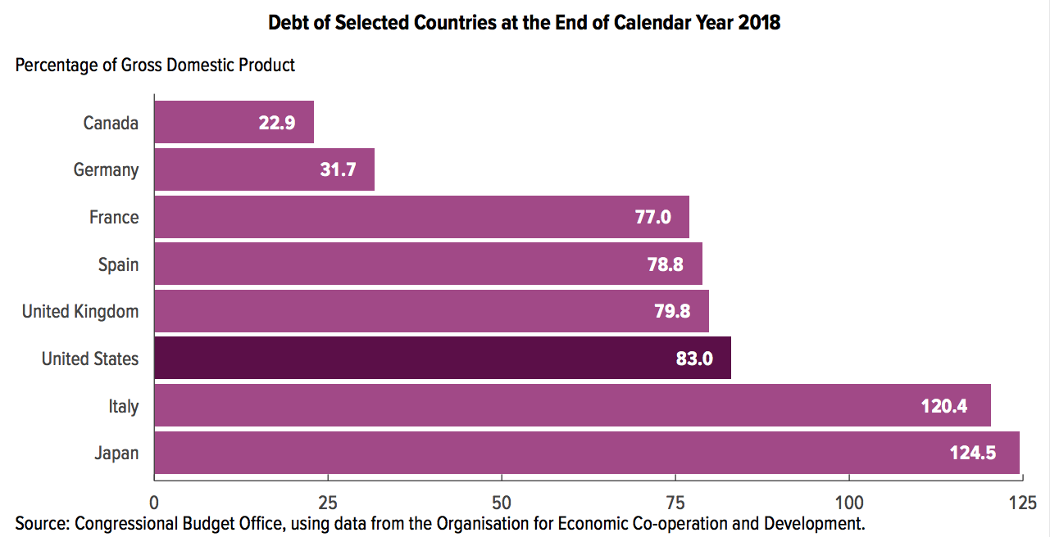
Other Countries Have Higher Debt Levels

Slide 94
Takeways (Continued)
After the virus is defeated, some combination of spending cuts and tax increases must be enacted.
The particular combination of spending cuts and revenue increases is a political question.
But high debt levels should not deter:
  Productive infrastructure investment.
  Fiscal responses to crises.
Given the fiscal challenges of an aging population and climate change, it is better to do this sooner rather than later.

Slide 95
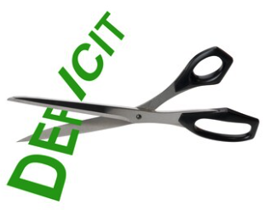
Bottom Line
Question is not WHETHER the US will have to act…
but WHEN.
Some combination of the following WILL be necessary:
  Raising taxes
  Cutting spending
  Reining in health-care costs

Slide 96
Are There Reasons to Wait?
Very little evidence of:
  Crowding out
  Inflationary impact
Uncertainty about the future
  Economic growth might render action today unnecessary.
There are a great many investments to be made by the govt.
  Infrastructure
  Education
  Much, much more …

Slide 97
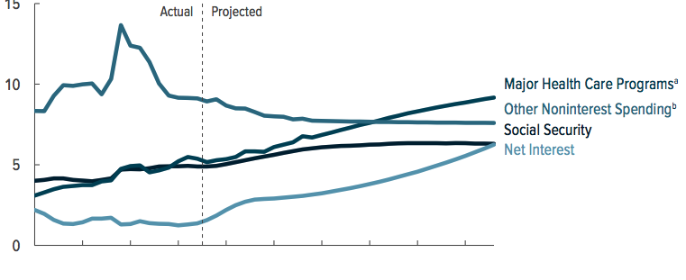
What Are the Primary Drivers Going Forward?

Slide 98
Proposals Do Exist
Simpson-Bowles
Domenici-Rivlin Task Force
Solutions Initiative – Peter G. Peterson Foundation
  American Action Forum
  American Enterprise Institute
  Bipartisan Policy Center
  Center for American Progress
  Economic Policy Institute

Slide 99
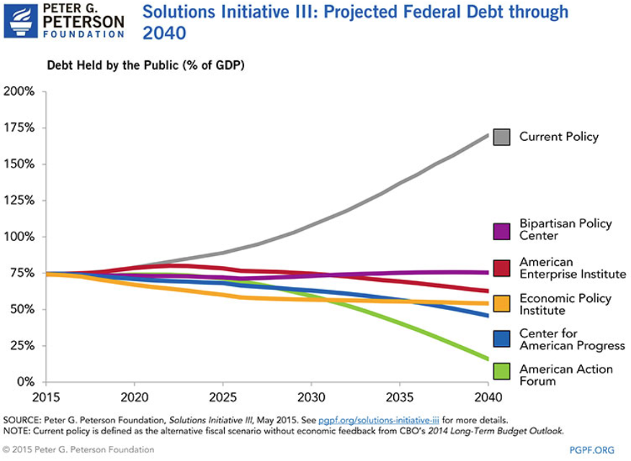

Slide 100
There Are Other (Bad/Costly) Solutions
Financial repression
  Using regulation to force down interest rates.
Paying the interest by printing money.
  Risks inflation, hyper or otherwise.
Or defaulting on the debt.
  This will forever raise the cost of government borrowing.

Slide 101
Summary: The Debt
The jury is (sort of) out on the debt.
Conventional wisdom is being challenged:
  Previously: inflationary and crowd out private investment
  New assertion: these things don’t matter for a country that can borrow in its own currency.
Upshot?
  This is a policy choice.
  The cautious approach is to rein in the debt.
  The cautious approach may lead to slower economic growth.

Slide 102
Summary
Debt: $22.9 Trillion
  Relative debt: 107% of GDP
  Publicly held debt: 79% of GDP
Deficits drive growth in the debt.
  Likely greater than $1 trillion per year.
Publicly held debt matters most.
  Will grow from 78% of GDP today to 180% in 2049 – pre-COVID-19 estimates.
  Could exceed 100% of GDP by the end of 2020 and 200% by 2050.
Multiple ways to offset this growth.
Growing interest payments can constrain budgets.

Slide 103
Summary: Address the Debt?
Reasons to wait:
  Interest rates are very low
  Lots of important investments to make
  Economic growth may take care of it
Risks:
  Inflation
  Slower economic growth
    Higher interest rates
    Crowding out
  Default

Slide 104
Bottom-Line Takeaways
Relative debt must be stabilized, so it is imperative to reduce primary deficits after the virus has been defeated.
Given the fiscal challenges of an aging population and climate change, it is better to do this sooner rather than later.
But high debt levels should not deter:
  Productive infrastructure investment.
  Fiscal responses to crises:
    “When the house is on fire, you don’t worry about being in a drought; you just put it out.”

Slide 105
Major Takeaways: Talking Points
The current trajectory for the federal debt is unsustainable.
Given historically low interest rates, we can afford to wait until after the crisis to act.
After the crisis, we must enact plans to reduce the future (primary) deficits.
  These are driven by Medicare and Social Security spending.
The longer we postpone action, the greater the probability of a “fiscal crisis.”

Slide 106
Thank you!
Any Questions?
www.NEEDelegation.org
<presenter name>
<presenter email>
Contact NEED: Info@NEEDelegation.org
Submit a testimonial: www.NEEDelegation.org/testimonials.php
Support NEED: www.NEEDelegation.org/donate.php

