Slide 1
COVID-19: Economic Implications and Policy Response
<Audience>
Month #, 2019
<Your name, Ph.D.>

Slide 2
National Economic Education Delegation
Vision
One day, the public discussion of policy issues will be grounded in an accurate perception of the underlying economic principles and data.
Mission
NEED unites the skills and knowledge of a vast network of professional economists to promote understanding of the economics of policy issues in the United States
NEED Presentations
Are nonpartisan and intended to reflect the consensus of the economics profession

Slide 3
Who Are We?
Honorary Board: 52 members
2 Fed Chairs: Janet Yellen, Ben Bernanke
6 Chairs Council of Economic Advisers
Furman (D), Rosen (R), Bernanke (R), Yellen (D), Tyson (D), Goolsbee (D)
3 Nobel Prize Winners
Akerlof, Smith, Maskin
Delegates: 520+ members
At all levels of academia and some in government service
All have a Ph.D. in economics
Crowdsource slide decks
Give presentations
Global Partners: 45 Ph.D. Economists
Aid in slide deck development

Slide 4
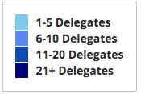
Where Are We?

Slide 5
Available NEED Topics Include:
US Economy
Climate Change
Economic Inequality
Economic Mobility
US Social Policy
Trade and Globalization
Trade Wars
Immigration Economics
Housing Policy
Federal Budgets
Federal Debt
2017 Tax Law
Autonomous Vehicles

Slide 6
Credits and Disclaimer
This slide deck was authored by:
Scott L. Baier, Clemson University
Jon D. Haveman, NEED
This slide deck was reviewed by:
<name>, <affiliation>
<name>, <affiliation>
Disclaimer
NEED presentations are designed to be nonpartisan.
It is, however, inevitable that the presenter will be asked for and will provide their own views.
Such views are those of the presenter and not necessarily those of the National Economic Education Delegation (NEED).

Slide 7
Outline
What is this?
What does economics offer?
Economic implications
Vulnerabilities
Evidence
Policy

Slide 8
What is this?
A natural disaster – with important twists
Global
Duration is unpredictable
Economic toll is enormous and potentially durable
A health crisis with enormous economic implications.
A perfect storm of economic difficulty
Supply side
Demand side
Financial
Without a culprit

Slide 9
What Does Economics Offer?
Insight into the transition of the virus from health to the economy.
Data on the magnitude of economic vulnerability.
Cost benefit analysis of social distancing.
Insight into government response:
Appropriate targets of government policy
Evaluation of current measures
Fiscal and monetary policies
What else might be done and why?

Slide 10
GDP Shares
Countries | Share of World GDP | Manufacturing as a Share of GDP | Services as a Share of GDP
United States | 24% | 11% | 77.4%
Canada | 2% | 10% | 66.7%
UK | 3% | 9% | 71.0%
Germany | 5% | 20% | 61.8%
France | 3% | 10% | 70.3%
Italy | 2% | 15% | 66.3%
Spain | 2% | 11% | 67.7%
Japan | 6% | 21% | 69.1%
China | 16% | 29% | 52.2%

Slide 11
Perception of Implications – Timeline
Initially
Limited geographically – hence fallout limited to Manufacturing
Supply and supply chains
Became clear not contained
Harder hit to supply chains
Demand side implications
Duration
Financial sector implications

Slide 12
Perfect Storm for the Economy
Supply side
Demand side
Financial

Slide 13
Economic Impact
Mechanisms of impact:
Consumer spending
Government spending
Business investment
Where does it show up?
GDP
Stock markets
Unemployment

Slide 14
Trade with China is Significant, but Small

Slide 15
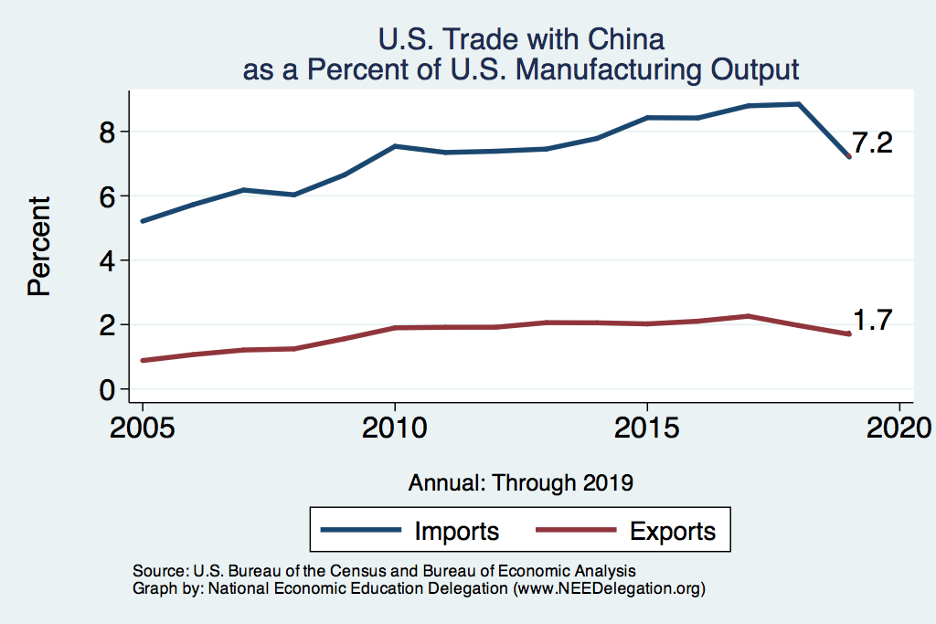
Initially: Impact Expected to be Small

Slide 16
Coronavirus: Supply Chains
Boeing 787 Dreamliner
Parts and components from suppliers all over the world:
Japan
Italy
China
Australia
…

Slide 17
Modest Impact on GDP of COVID-19
GDP
per Capita
Time

Slide 18
GDP Shares
Countries | Share of World GDP | Manufacturing as a Share of GDP | Services as a Share of GDP
United States | 24% | 11% | 77.4%
Canada | 2% | 10% | 66.7%
UK | 3% | 9% | 71.0%
Germany | 5% | 20% | 61.8%
France | 3% | 10% | 70.3%
Italy | 2% | 15% | 66.3%
Spain | 2% | 11% | 67.7%
Japan | 6% | 21% | 69.1%
China | 16% | 29% | 52.2%
Originally, believed that COVID-19
would be largely contained within
a few countries and would disrupt
manufacturing supply chains.
The more a country’s manufacturing
relied on these supply chains the
bigger the impact on GDP.
Still the effect was likely to be
to slow GDP by 0.25 to 0.50 from its
baseline prediction.

Slide 19
The Escalation of the Economic Effects

Slide 20
Coronavirus: Demand Side
Stock market
Postpone major purchases
Event cancellations
More broadly tourism
Universal pseudo-quarantine
Work from home
Eat at home
Watch movies at home

Slide 21
Gross Domestic Product

Slide 22
Plunge in Consumer Spending

Slide 23
Grocery Volatility

Slide 24
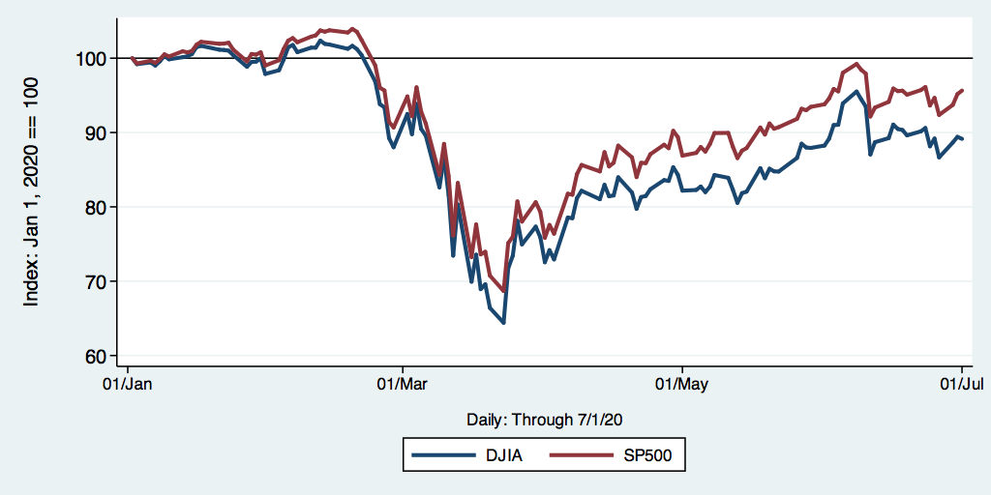
DJIA and S&P 500

Slide 25
NASDAQ: Then (Great Recession) and Now

Slide 26
Particularly Vulnerable Industries
Industry | Share of GDP
Arts, entertainment, and recreation | 1.1
Management of companies and enterprises | 1.9
Other services, except government | 2.1
Accommodation and food services | 3.1
Transportation and warehousing | 3.2
Retail trade | 5.5
Educational services, health care, and social assistance | 8.7
Manufacturing | 11.3
Real estate and rental and leasing | 13.3
Total | 50.2

Slide 27
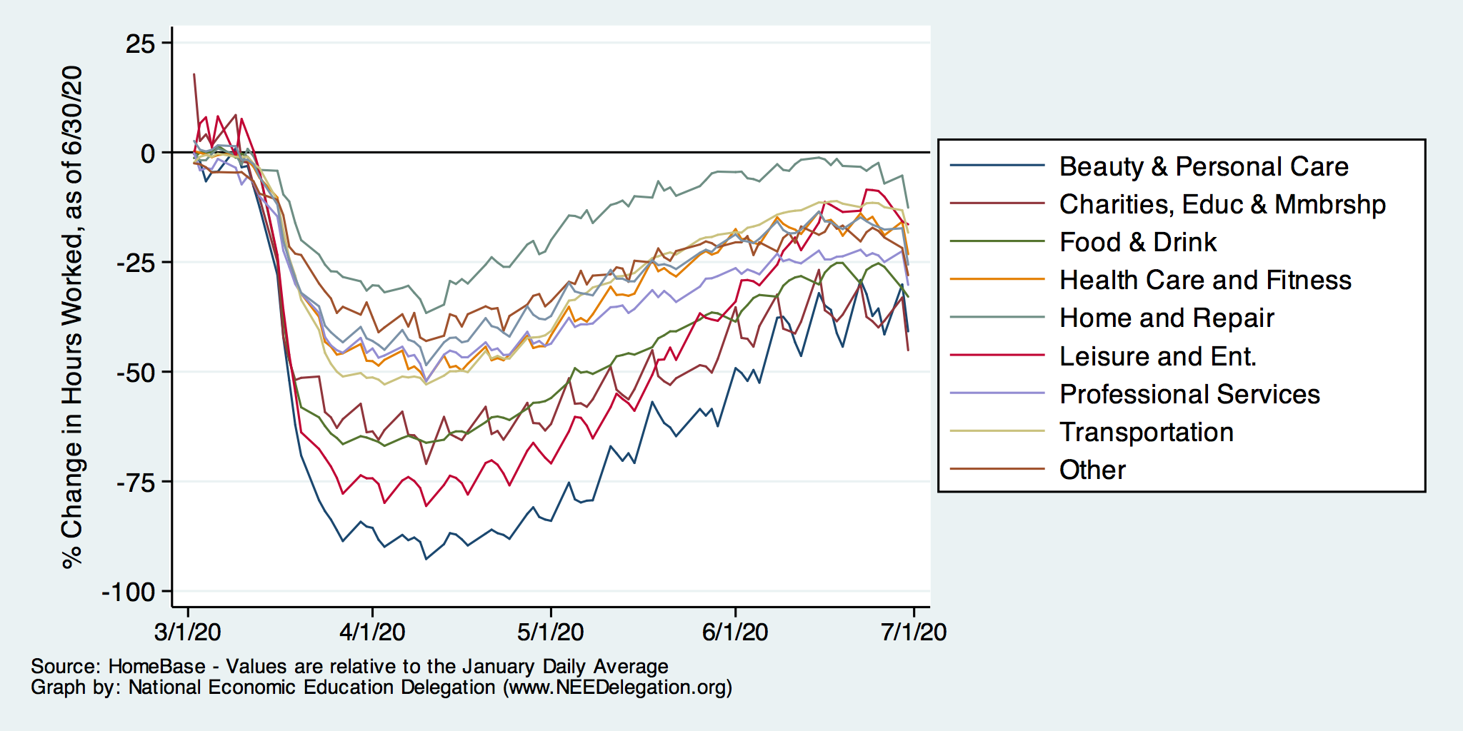
Percent Change Hours Worked
Data Source: Homebase

Slide 28
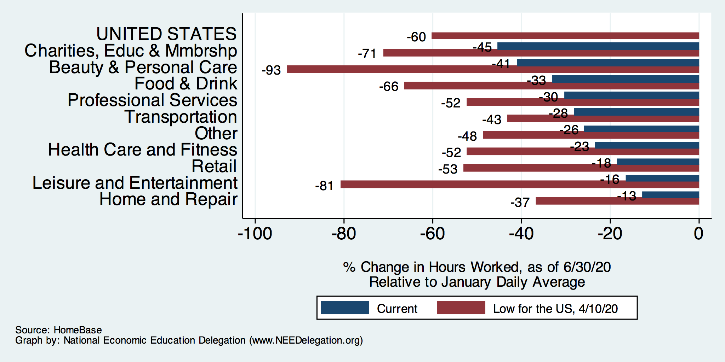
Percent Change Hours Worked

Slide 29
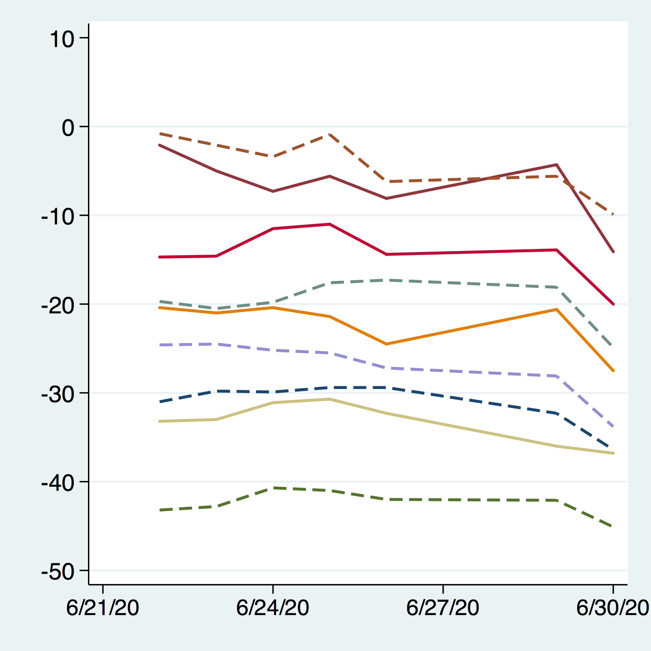
Change in Hours Worked: States

Slide 30
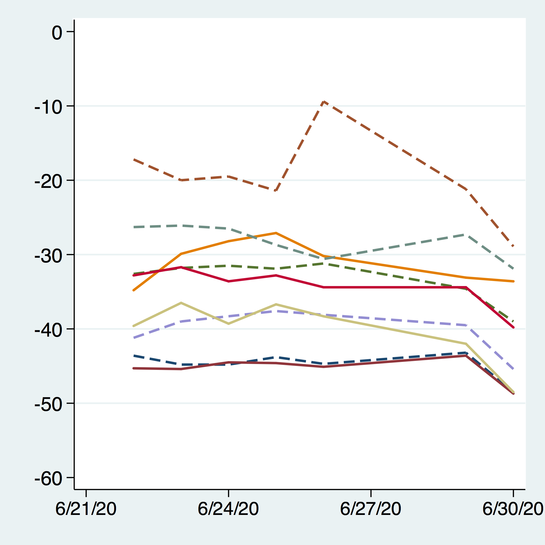
Change in Hours Worked: MSAs

Slide 31
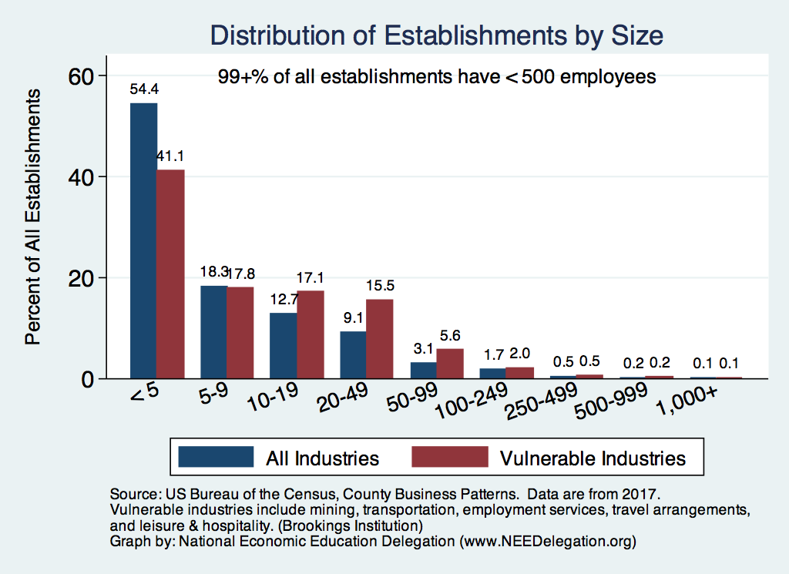
Size of Businesses in Vulnerable Industries

Slide 32
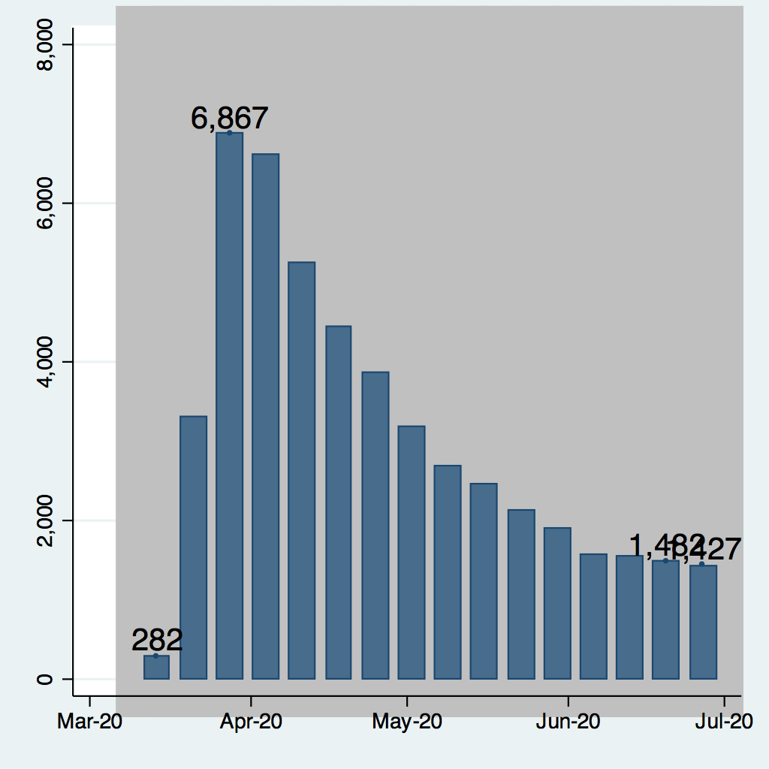
Weekly New Unemployment Claims
Since 3/21 40+ million new claims, which would increase the unemployment rate significantly to 20-22%
665k

Slide 33
Weekly New Unemployment Claims

Slide 34
Weekly New Unemployment Claims

Slide 35
Continuing Unemployment Claims

Slide 36
Continuing Unemployment Claims

Slide 37
Continuing Unemployment Claims

Slide 38
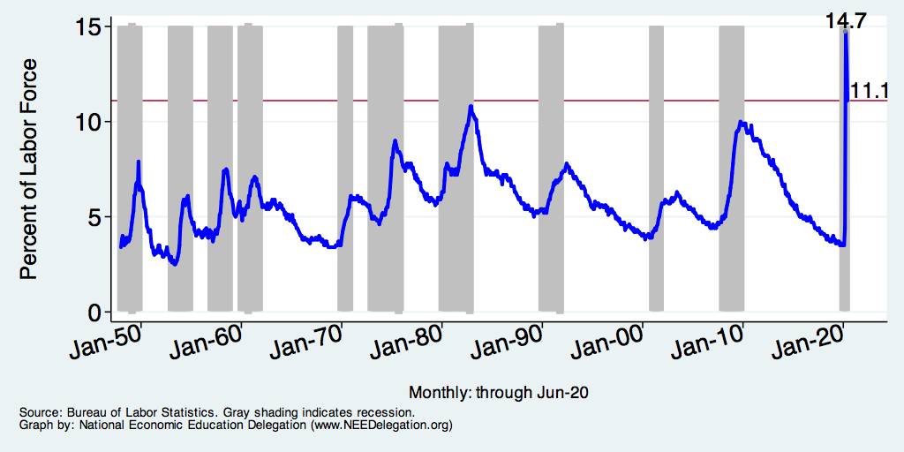
Unemployment Rate
Coding error caused underreporting:
April: 20%
May: 16%
Notes:
Unemployment rises during recessions and falls during economic expansions.
Unemployment peaked at the end of the 2009 recession.
The Fed worked to reduce the effects of the recession. Near the end of 2008, the FOMC reduced the federal funds rate to nearly zero and worked to reduce longer-term interest rates via large-scale asset purchase programs (late 2008 – 10/2014).
Unemployment is currently below the natural rate of unemployment. This is traditionally accompanied by economic growth and rising price levels. It’s also a major reason for FOMC’s decision to increase the federal funds rate.

Slide 39
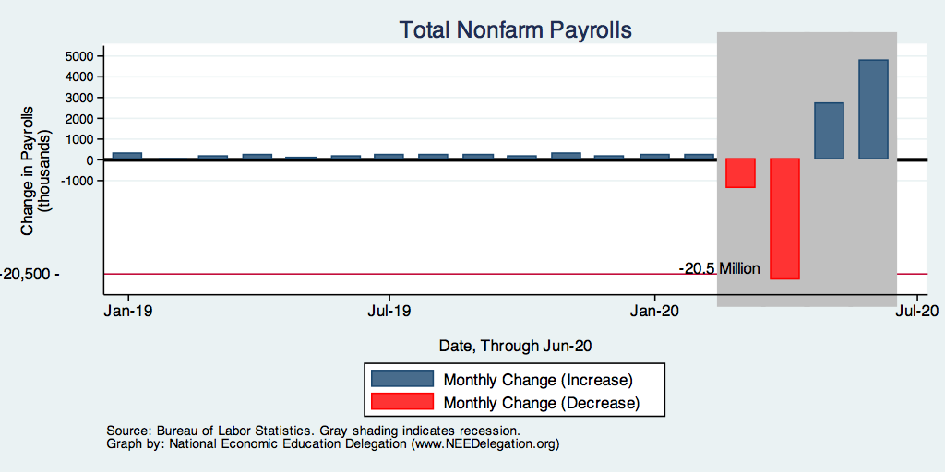
Monthly Changes in Nonfarm Employment
Notes:
PAYEMS_recent.png

Slide 40
Monthly Changes in Nonfarm Employment
Notes:
PAYEMS.png

Slide 41
Monthly Changes in Nonfarm Employment
Notes:
PAYEMS.png

Slide 42
Annual Changes in Nonfarm Employment

Slide 43
Part-Time Nonfarm Employment

Slide 44
Housing Starts Plummet: Down 25% in March

Slide 45
Retail Sales

Slide 46
Automobile and Light Truck Sales

Slide 47
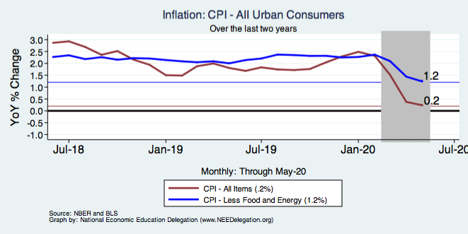
Inflation – Deflation is More Likely
Notes:
Cpi_recent.png

Slide 48
Particularly Vulnerable Workers
Source: BLS Contingent and Alternative Employment Arrangements Survey, DB Global Research

Slide 49
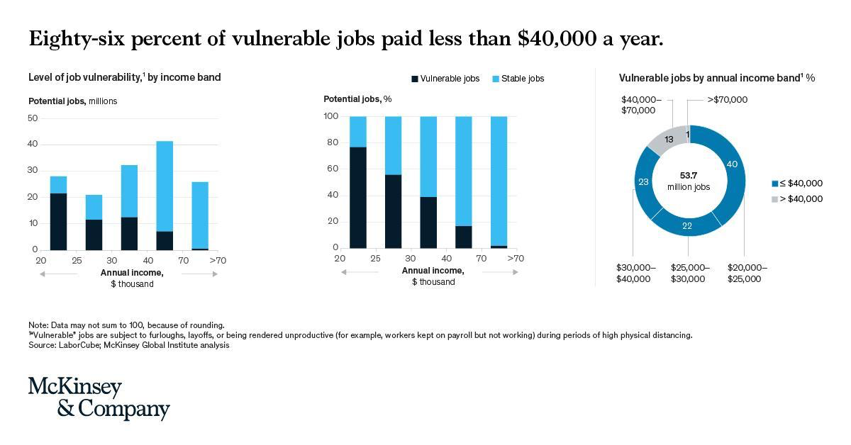

Slide 50
Financial Markets
Notes for content:
Are they seizing up?
Why are they seizing up?
What evidence?

Slide 51
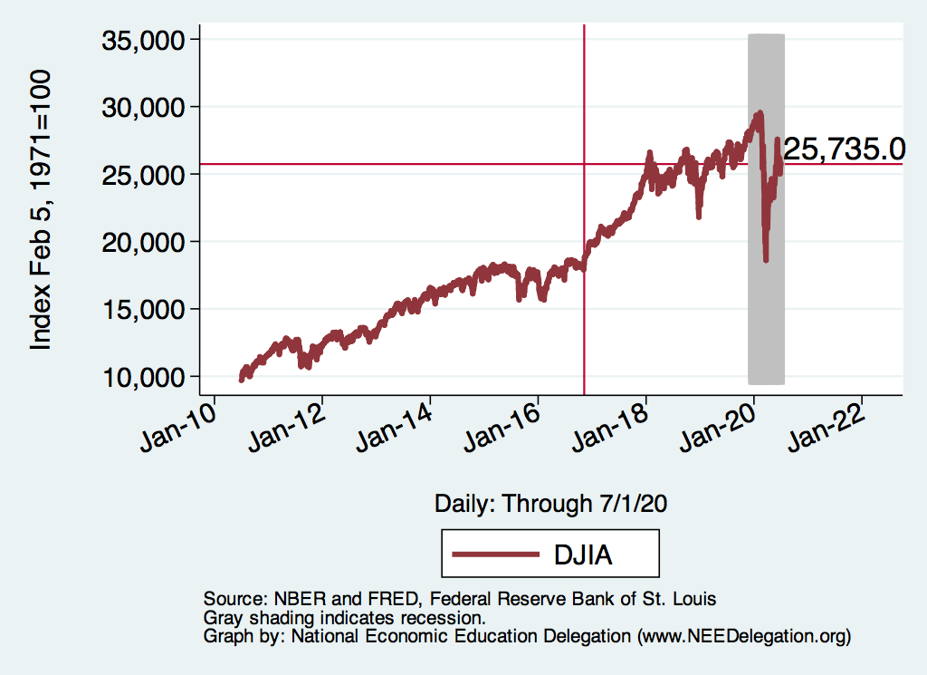
Financial Markets
Big Q: What happens to banks lending standards and credit markets generally?

Slide 52
DJIA and S&P 500

Slide 53
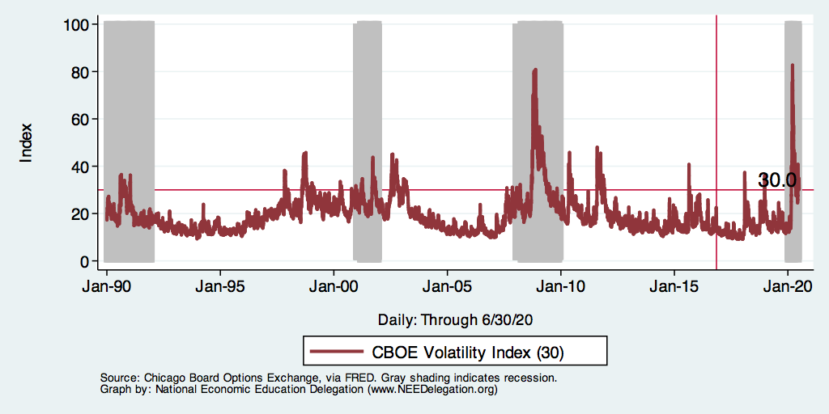
Market Risk and Stress: CBOE VIX

Slide 54
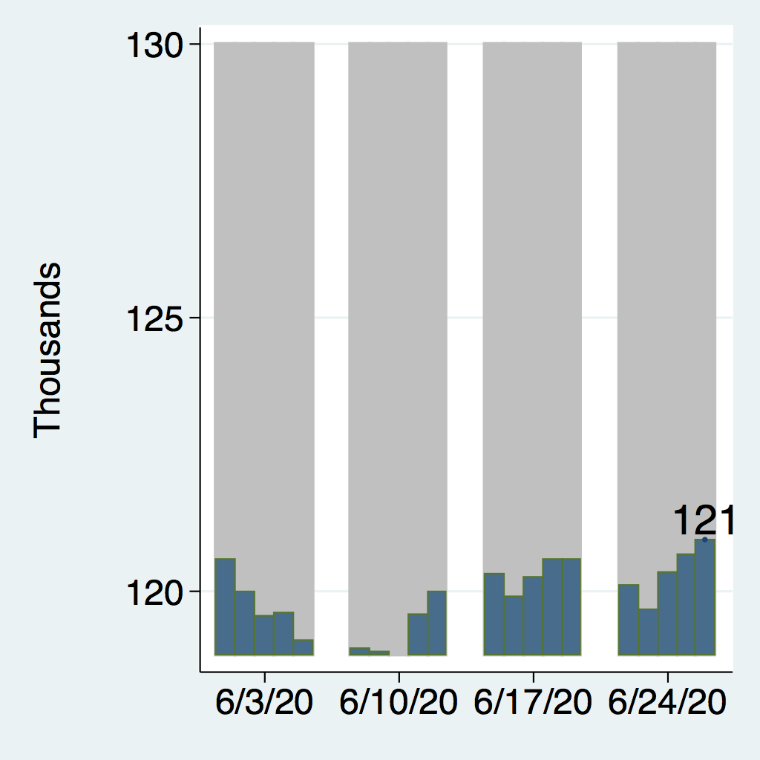
Exchange Rates

Slide 55
GDP Shares and Sudden Demand Stops
Countries | Share of World GDP | Manufacturing as a Share of GDP | Services as a Share of GDP
United States | 24% | 11% | 77.4%
Canada | 2% | 10% | 66.7%
UK | 3% | 9% | 71.0%
Germany | 5% | 20% | 61.8%
France | 3% | 10% | 70.3%
Italy | 2% | 15% | 66.3%
Spain | 2% | 11% | 67.7%
Japan | 6% | 21% | 69.1%
China | 16% | 29% | 52.2%

Slide 56
A Tale of Three Policies Efforts
Social policy: Social Distancing
Fiscal Policy
Monetary Policy

Slide 57
Process for Dealing with a Natural Disaster
Mitigation of effects
Social Policy
Tend to the vulnerable
Fiscal Policy
Shore up structures
Fiscal and Monetary
Rebuild
Stimulus
There are corrolarys in this crisis.

Slide 58
Impact on GDP of COVID-19 – No Social Distancing
GDP per capita
GDP
Per Capita
Supply Side Shock
w/Demand Side and
Financial Sector Shocks
Time

Slide 59
Epidemiology

Slide 60
Comparison of COVID-19: Fatality an R0
Fatality Rate
100%
(log scale)
Average # of People Infected by Each Sick Person

Slide 61
Epidemiology and Flattening the Curve
In order to understand the economic response, we need to understand the nature of the shock and COVID-19 spreads.

Slide 63
Exposed and Infected – Baseline Case
Exposed
Baseline case of the fraction
of the population exposed
and infected.
By practicing social distancing,
quarantining the sick, and self-
quarantining the exposed, you may
reduce the likelihood that (or when) a
member of the susceptible
population will be in contact with
a member of the exposed population.
Healthcare
capacity
Infected

Slide 64
Epidemiology and Flattening the Curve
The importance of testing and social distancing on containment.
Social Distancing
Vaccines &
Prophylaxis

Slide 65
Exposed and Infected and Social Distance
Exposed w/Modest
Social Distancing
Infected w/ Modest
Social Distancing
Exposed w/Aggressive
Social Distancing
Infected w/Aggressive
Social Distancing

Slide 66
Infected and the Impact of Social Distance
Healthcare
Capacity in 2 months
Healthcare
Capacity

Slide 67
Effective Social Distancing

Slide 68
Flattening the Curve and Lengthening the Recession
Without
Protective
Measures
Number or Cases
GOAL for Health Care Capacity
With Protective
Measures
Current Health Care Capacity
Time
GDP (Recession)

Slide 69
Cost Benefit Analysis: Tradeoffs
No containment policies
Reduced economic activity
More coronavirus deaths
Non-coronavirus deaths
Stringent containment policies
Dramatically reduced economic activity
Fewer coronavirus deaths
Non-coronavirus deaths(?)
???
Analysis of Containment Policies
Reduced economic activity < value of additional deaths
Complicated equation – both numerically and philosophically

Slide 70
Cost Benefit Analysis: Some Additional Info
Value of a statistical life: $5-14 million
Depends on what the right value of a life is.
Depends on net difference in # of deaths.
Size of the economy: ~$2 trillion per month
Depends on economic impact
Of containment polices
Of unabated virus

Slide 71
BOTE Cost Benefit Analysis
BOTE: Back Of The Envelope
If we evaluate the the value of a statistical life at $7 million, and
we think that social distancing reduces the number of deaths by 600,000
Benefit of Saved Lives is: $4.2 Trillion
Survivors may face long-term health effects – 2 million valued each at $500,000
Survivor Cost: $1 Trillion
Total Benefit of Social Distancing: $5.2 Trillion
https://twitter.com/BetseyStevenson/status/1242180499566669828

Slide 72
BOTE Cost Benefit Analysis
BOTE: Back Of The Envelope
Cost of “Shelter in Place” or “Lockdown”
The cost of a non-workday reduces unadjusted quarterly GDP by about 0.4%.
There are about 60+ workdays in a quarter and we lost about 1/8 or March.
The cost of a “lockdown” is roughly $1.3 Trillion
Benefit: $5.2 trillion > Cost: $1.3 trillion
http://caseymulligan.blogspot.com

Slide 73
BOTE Cost Benefit Analysis
BOTE: Back Of The Envelope
BENEFITS of social distancing:
$7 million/life and 600,000 lives saved ($4.2 trillion)
Long term health issues avoided: 2 million at $500,000 ($1 trillion)
Total Benefit of Social Distancing: $5.2 Trillion
COSTS of “Shelter in Place” or “Lockdown”
There are about 70+ workdays in a quarter (plus March).
The cost of a “lockdown” is roughly $1.3 Trillion
Benefit: $5.2 trillion > Cost: $1.3 trillion
https://twitter.com/BetseyStevenson/status/1242180499566669828

Slide 74
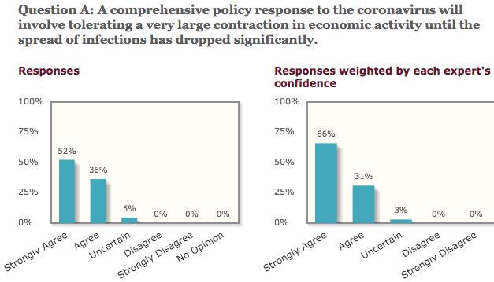
University of Chicago – Experts Poll

Slide 75
Potential Economic Costs of Shutdown
Unemployment
About one-quarter of workers are affected by stay-at-home orders.
Unemployment on this scale has not been seen since the Great Depression.
Cascading bankruptcies of small and large businesses.
Businesses face revenue shortfall and are unable to pay their fixed costs and service debt.
Long term: disruption from previous growth path.
Perhaps permanent.
Notes:
https://research.stlouisfed.org/publications/economic-synopses/2020/03/17/possible-fiscal-policies-for-rare-unanticipated-and-severe-viral-outbreaks

Slide 76
Impact on GDP of COVID-19 – W/Social Distancing
The response of GDP is likely to be a U-shaped recovery with social-distancing
The depth will depend on
The extent of social distancing, and
The length of time spent social distancing.
GDP
Per Capita
L-Shaped Recovery – to be avoided
With social distancing, then we can expect a reduction in GDP because:
Some services are most effective when delivered face-to-face,
Working remotely is likely to reduce the productivity of most workers
Disrupted supply chains
Time

Slide 77
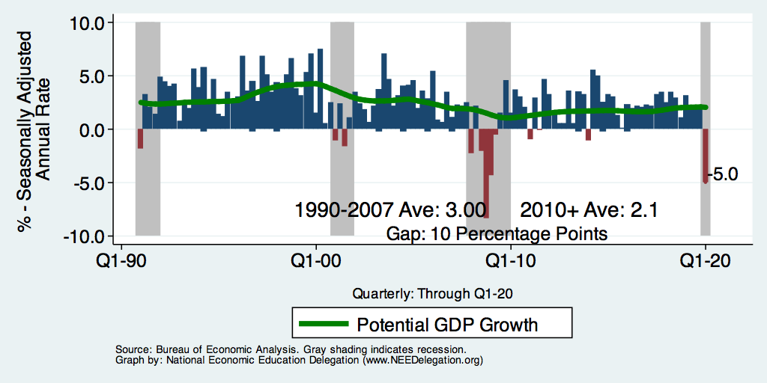
Quarterly Real GDP Growth (1990-2019)
Since 2000, there have only been 26 quarters where GDP growth has exceeded 3% -- (33% of the time)

Slide 78
What “Accounts” for GDP Growth?
Expenditures Relationship to GDP growth.
GDP is the sum of four categories of spending:
Consumption ( C )
Investment ( I )
Government spending ( G )
Net Exports: Exports – Imports ( NX )
Productivity and Inputs as Drivers for GDP Growth.
Employment
Productivity
Concern: Supply side -- slower growth from disrupted value chains.
Concern: Demand Side -- Sudden Stop fueled by increased difficulty
in transactions that typically require face-to-face interactions as well as
uncertainty (economic and policy)
Notes:
Recall: GDP is measures production of an economy; we often measure GDP as the sum of spending on final goods/services produced within an economy. The first three categories (C,I,G) contain spending on both domestically and foreign produced goods. To accurately measure domestic production, we subtract domestic consumption of foreign goods (imports).
The Point: Analysis of components of GDP as well as the production side of the economy should provide a comprehensive picture of the US economic landscape

Slide 79
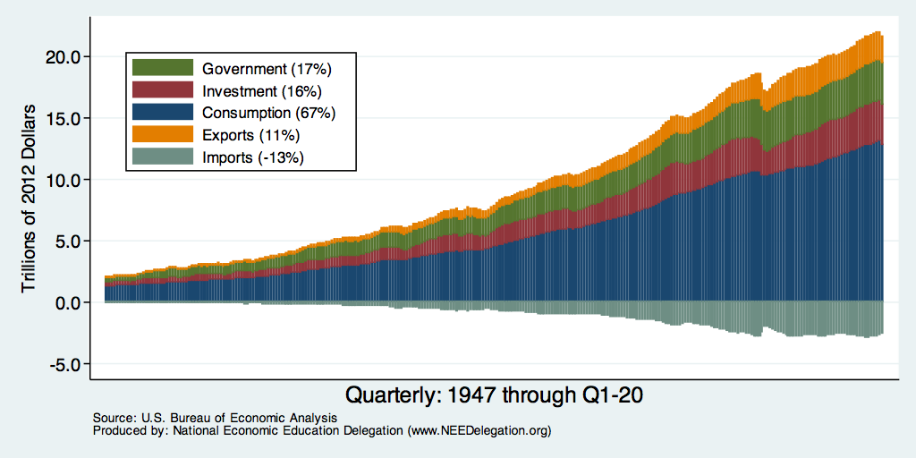
Composition of Real GDP
Notes:
Components sum to GDP
Average % of GDP for each component from 1960-Present: C = 64%, I=15%, G=24%, NX = 2% (X = 7%, M=9%)
Net Exports as a % of GDP has increased over the sample period, but it’s contribution to GDP is relatively small

Slide 80
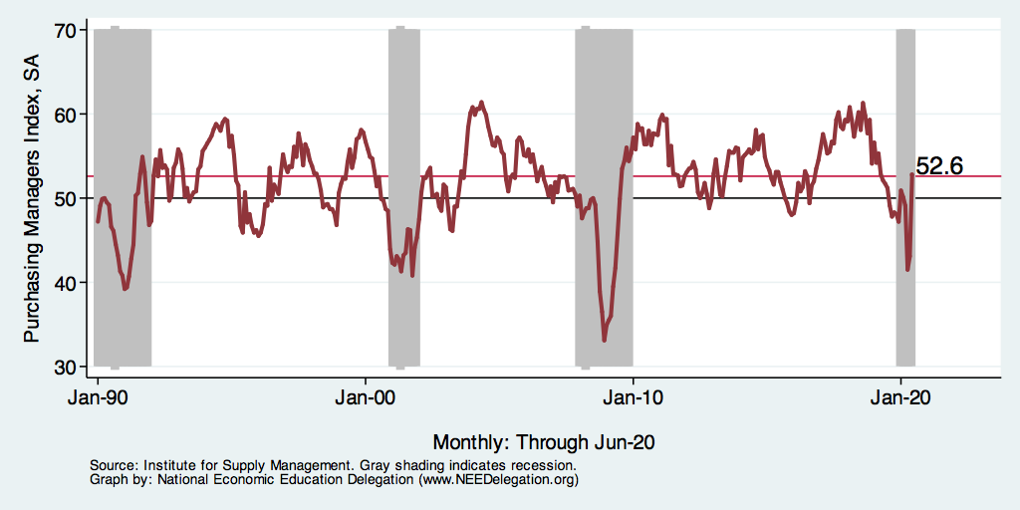
ISM Manufacturing Index

Slide 81
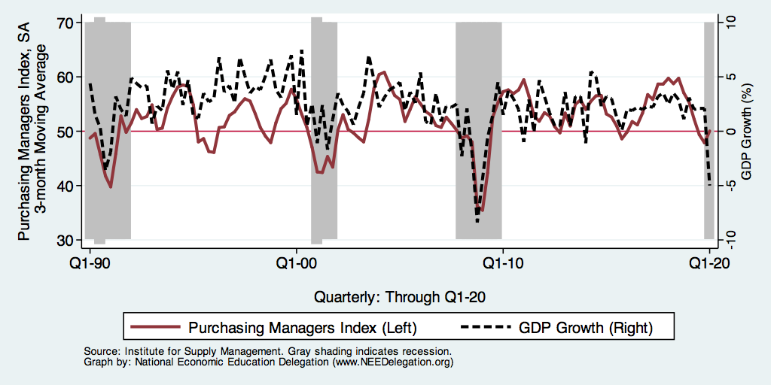
ISM Manufacturing Index and Real GDP Growth

Slide 82
China’s PMI Manufacturing Index

Slide 83
Unemployment Rate: 1950-2020

Slide 84
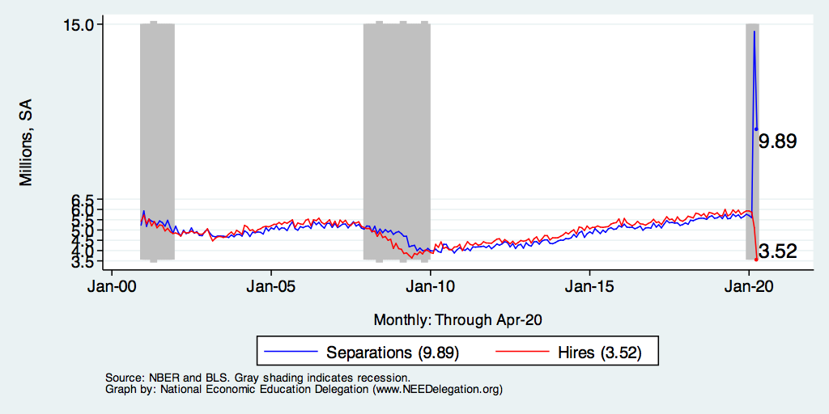
Job Separations and Hires

Slide 85
GDP Shares and Impact of COVID-19
Countries | Share of World GDP | Manufacturing as a Share of GDP | Services as a Share of GDP | Confirmed Cases | Deaths
United States | 24% | 11% | 77.4% | 238,823 | 5,768
Canada | 2% | 10% | 66.7% | 11,118 | 134
UK | 3% | 9% | 71.0% | 33,718 | 2,921
Germany | 5% | 20% | 61.8% | 84,636 | 1,099
France | 3% | 10% | 70.3% | 59,105 | 4,503
Italy | 2% | 15% | 66.3% | 115,242 | 13,915
Spain | 2% | 11% | 67.7% | 110,238 | 10,096
Japan | 6% | 21% | 69.1% | 2,384 | 57
China | 16% | 29% | 52.2% | 81,589 | 3,318
Source: World Bank, Johns Hopkins Coronavirus Resource Center, Worldometer

Slide 86
Confirmed Cases by Country

Slide 87
Per Capita Incidence Cases per 100,000

Slide 88
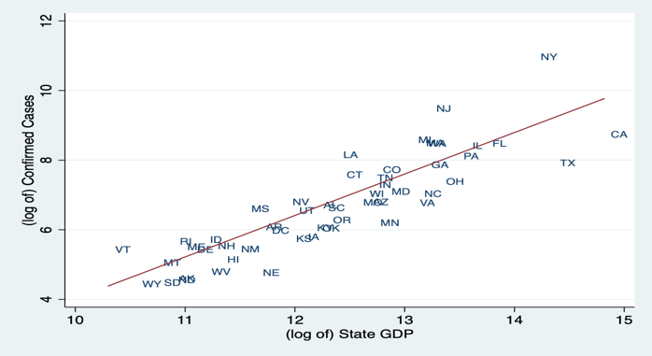
Confirmed Cases and State GDP

Slide 89
Social Distancing by State

Slide 90
Economic Crisis Tools
Fiscal and Monetary Policy

Slide 91
Consumer Confidence

Slide 92
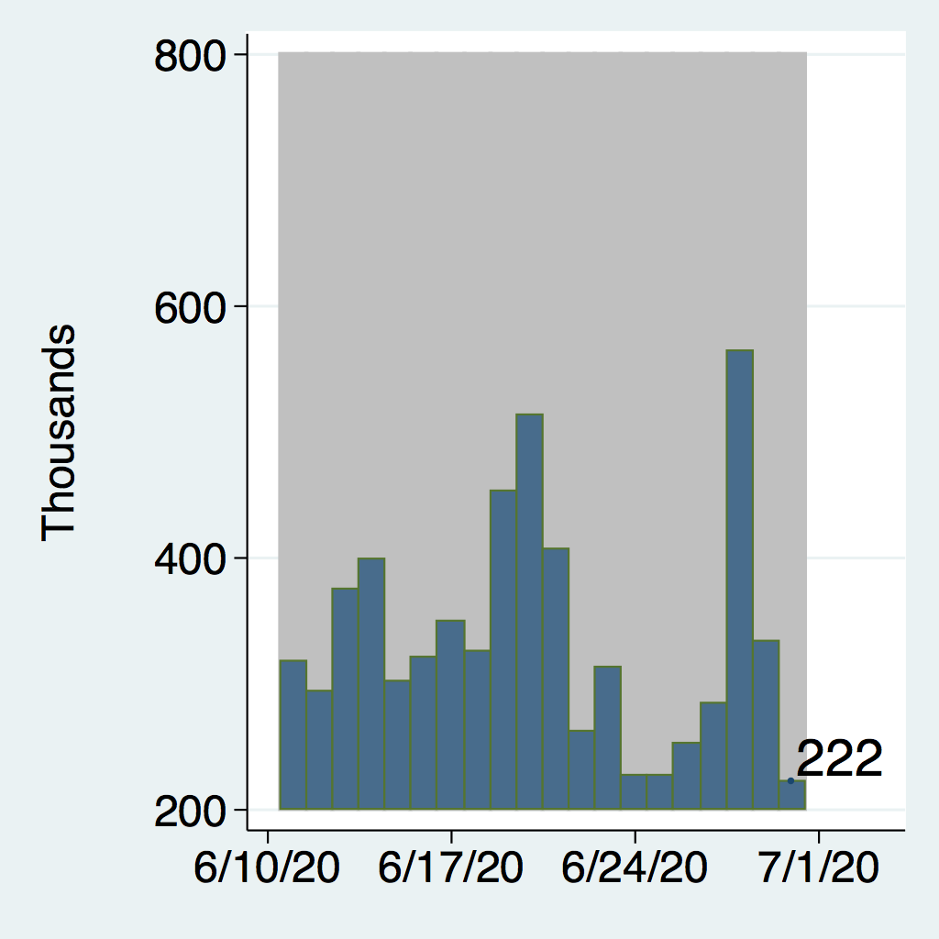
Economic Policy Uncertainty

Slide 93
Fiscal Policy
Government spending
Occurs as a matter of course, but is often increased in a time of crisis – economic or otherwise.
Its role in a health crisis:
Infection fighting
Disaster relief
Stimulate the economy

Slide 94
Fiscal Policy: This Shock is Different
Classical response: Stimulate the economy!
This economic shock is different: “health shock”
with large macroeconomic consequences.
Response should be:
target the cause of the problem
provide financial support for individuals and for firms.
When the crisis is under control -> classical stimulus.

Slide 95
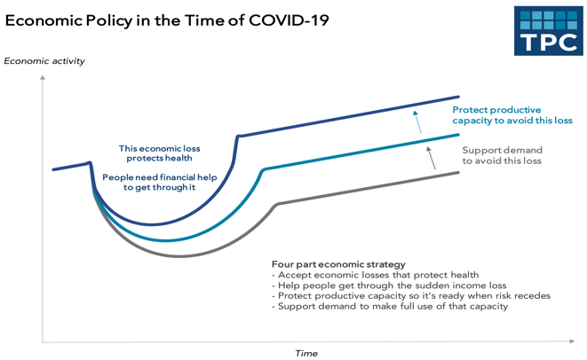

Slide 96
Priorities for Policy
Policies to protect public health
Long run benefits for the economy.
Though there may well be short run pain.
Policies to:
Protect the economically vulnerable.
Policies to maintain structure of the economy.
Help firms stay in business, maintain ties with workers
Policies to stimulate aggregate demand
Long run – once the economic switch is turned back on

Slide 97
Government Response: Fiscal Response
Respond to the impacted sector(s) – health crisis.
Disaster relief
Provide income support for the lower income and most vulnerable.
Provide support to maintain employer - employee matches, and
Provide support for the sectors that are most exposed to the shock.
Economic stimulus
Not yet time.

Slide 98
Government Response (Phase 2): H.R. 6201
Free testing for anyone whose doctor recommends testing.
Expand family and medical leave
Paid emergency sick leave
Additional unemployment benefits
Food assistance: Supplemental Nutrition Assistance Program (SNAP) and Home-Delivered Nutritional Services
Clearly this is designed to increase testing and support social distancing and (self) quarantines.

Slide 99
Paid Leave by Income Category
Paid
Sick
Leave

Slide 100
Fiscal Response: CARES Act (Phase 3)
Direct payment to households $1,200 for every adult and $500 for every child – similar to the 2008 rebate but purpose is different.
Small business loans -- $300 billion
<500 employees and designed to cover six (6) weeks of payroll.
Assistance for airlines and other industries where revenues have been impacted -- $50 billion.
Additional support for distressed industries -- $150 billion
Payroll tax cut (not in any recent proposal).

Slide 101
Fiscal Policy Timeline
Phase | Amount ($ bn) | Action
Phase 1 March 6 | $8 | Emergency response, health care, vaccine development, prevention
Phase 2 March 18 | $100 | Paid sick leave, unemployment insurance, free virus testing
Phase 3 Pending | $250 $250 $350 $100 $17 $500 $180 $100 | Direct cash payments to families with income cap; $1,200 per adult, $500 per child Enhanced unemployment benefits Small business loans up to 250% of monthly payroll Corporate tax changes Community lending Loans & loan guarantees for businesses, incl. airlines State and local governments & Education Hospitals
TOTAL | $1.5-2.5 Trillion | 7-12% of GDP
Source: J.P. Morgan Asset Management. Data are as of March 23, 2020.

Slide 102
Thoughts on Policies to Date
Direct cash payments
Are they really getting into the hands of those most in need?
Payments to large corporations:
Airlines and car and airplane manuf.
How effective are these at maintaining the structure of the economy?
Enough to maintain employee-employer ties?
Enough for medical care?
The amount spent fighting the virus is relatively small.
Offer to pay for all coronavirus related health care expenses?

Slide 103
Fiscal Policy: Phase 4
Stimulate the economy or more economic support?
Duration of “shelter in place” will determine the answer.
Stimulate: Plenty of options:
Spending for government programs:
Infrastructure, worker training, social programs
Expanded unemployment benefits.
Cash payments to individuals and businesses.
What form should it take?
Depends on why the economy is slow to recover.
Supply side: businesses having trouble flipping the on switch?
Demand side: consumers reluctant to spend?

Slide 104
OHMIGOSH: How Do We Pay For It!
Controversy: Can we afford it?
Deficit is already running at $1T/year.
Debt forecast to increase to 180% of GDP by 2050 (80% today).
How much debt is too much?
Most economists agree: It doesn’t matter!
An important government function is to protect public health.
This is currently priority #1.
The added debt will be a problem later, but it should also be dealt with later.

Slide 105
European Timeline
Date |  | Date
2/7 | EU Health Minister Video Conference | 3/16 | G7 agreement / EU sets out coordinated policy response
2/13 | Health Council Risk Assessment | 3/17 | President of Euro Council holds s2nd video conference with other members
2/27 | Ministers look at impact on industries | 3/18 | Support EU budget
3/2 | IPCR to full activation mode | 3/19 | Discuss Social and Employment Consequences
3/4 | Discuss impact on Economy | 3/20 | Suspend Slot requirements for airlines
3/10 | President of Euro Council holds video conference with other members | 3/23 | Ease Fiscal rules Discuss international repatriation

Slide 106
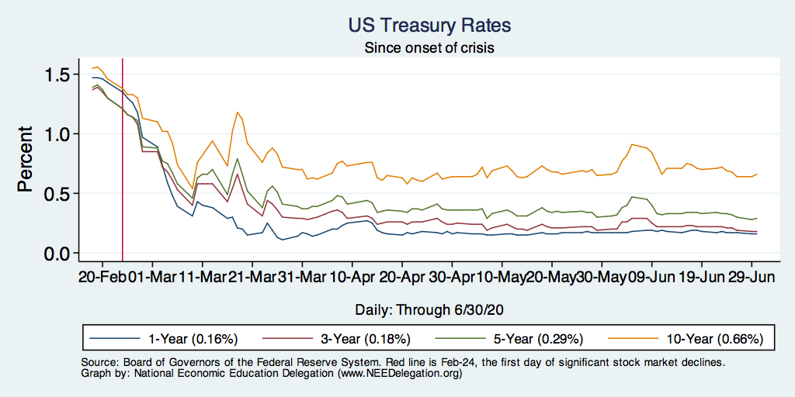
US Treasury Rates: A Safe Haven?
Run to Safety
Cash Grab
Liquidity Working

Slide 107
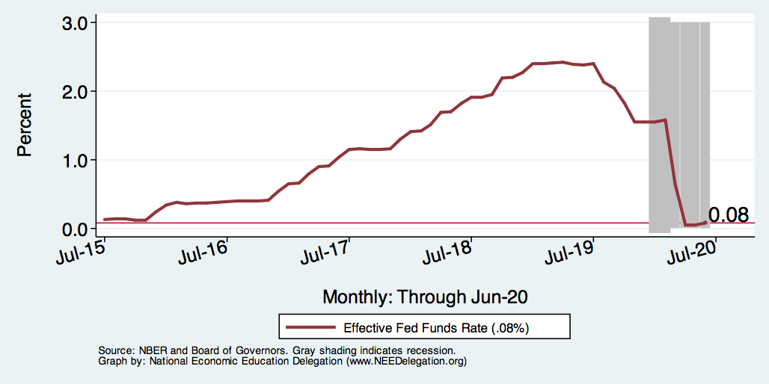
Federal Reserve Response: Federal Funds Rate

Slide 108
Runs Again

Slide 109
The Most Important Roles of Monetary Policy Na
Macroeconomic Stabilization
Raise aggregate demand by lowering interest rates.
Federal Funds Rate
Quantitative Easing (QE)
“Lender of Last Resort” - Insuring Liquidity in Lending Markets
The Fed has unlimited access to dollars and can:
Make loans directly or buy new debt issues (“market liquidity”)
Provide loans to intermediaries (“funding liquidity”)

Slide 110
A Repeat of 2008
Macroeconomic Stabilization
In December of 2009, the Fed lowered the federal funds rate to essentially zero.
In November of 2010, the Fed started the first of 3 waves of QE, which saw the Fed acquire over $2 trillion in long-term Treasuries and mortgage-backs securities
Insuring Liquidity in Lending Markets by acting as the “Lender of Last Resort”
During late 2008 and into 2009, the Fed used, so-called, section 13(3) authority to make direct loans to banks and other companies.
Starting in March of 2008 (TALF), the Fed started a myriad of programs to help lenders finance maintain their lending activities

Slide 111
Only Much Bigger and Faster: Macroeconomic Stabilization:
Short-term Interest Rates
March 3, the Fed lowers the target range for the federal funds rate from 1.75-1.5 percent to 1.25-1.0 percent.
March 15, the Fed lowers the target range to 0.25-0.0 percent, essentially 0.
QE
March 15, the Fed announces a QE program
$500 billion in Treasuries and
$200 billion in agency mortgage-backed securities.
March 23, QE is unlimited and should include commercial mortgage-backed securities

Slide 112
Insuring Market Liquidity
March 17-23, the Fed announced
The Primary and Secondary Market Credit Facilities which will allow the Fed to buy corporate bonds so that companies can continue to pay workers.
The Commercial Paper Funding Facility which will allow the Fed to buy short-term debt of companies.
A Main Street Business Lending Program where the Fed will aid the Small Business Administration in making loans.

Slide 113
Insuring Funding Liquidity
March 17-23, Lending Facilities for
Money Market Mutual Funds who buy commercial paper.
Primary Dealers who provide short-term financing in may different asset markets, such as repurchase agreements (repos).
Financial Institutions that trade state and local municipal bonds.
Foreign central banks, so that they can be “lenders of last resort” for foreign financial institutions who want dollar liquidity.

Slide 114
Government Response: Federal Reserve
Lower (targeted) Federal Funds Rate and “Forward Guidance”.
QE-2020: Buy $500 billion of Treasuries and $200 billion of Mortgage Backed Securities.
Discount rate cut to 0.25%
Encourage banks to use intraday credit
Loan guidance: encourage banks to loan to firms and HHLDS
Eliminates reserve requirement.
Create the Money Market Mutual Fund Liquidity Facility designed to help meet the demands for redemption by households and firms.

Slide 115
Monetary Policy Timeline
Date | Action
March 3 | Fed Funds Rate Lowered 1.75-1.5 to 1.25-1
March 15 | Fed Funds Rate Lowered to 0.25-0 Announced QE of $700 billion
March 17 | Commercial Paper Funding Facility Primary Dealer Credit Facility
March 18 | Money Market Mutual Fund Liquidity Facility
March 23 | Primary Market Corporate Credit Facility Secondary Market Corporate Credit Facility Term Asset-Backed Securities Loan Facility Unlimited QE
TBA | Main Street Business Lending Program
Stabilization
Liquidity

Slide 116
What is next and what else can be done?
How do we pay for it?
Run larger deficits
Run the printing press MMT
Firms and/or individuals borrow through Treasury
Additional fiscal measures.
Buyer of last resort (Piketty and Zucman)
Employer of last resort (MMT)
Additional cash disbursements.
Ultimately: more fiscal policy to restart the economy.

Slide 117
Big Open Questions
When will the dust settle?
When the dust settles:
How close will ties be between businesses and their pre-CV employees?
How much will the business environment change?
More automation?
More telecommuting?
Broadly speaking: How quickly can things bounce back?
What will the overall economic cost be.

Slide 118
What have we learned? Positive Take-Aways
May improve the delivery of some services.
Encourage firms, households, governments to have a business continuity plan.
In an integrated world, this will likely not be the last pandemic…
Improve social insurance for these types of events.
Allow more flexibility to governments and firms to respond.
Potential learning to be carried forward:
Telecommuting
Telehealth
The value of the ”walk around the block”.

Slide 119
Conclusion
COVID-19 is a health crisis that has extreme macroeconomic implications.
Negative GDP growth likely for several quarters
Fiscal and monetary response:
First: targeted at health crisis.
Second: income and employment maintenance.
Third: stimulate the economy when health crisis is over.
Broad agreement among economists: Cure < Disease
Entirely likely that the economy will be stronger on the other side.
Might take some time to get there.

Slide 120
Thank you!
Any Questions?
www.NEEDelegation.org
<presenter name>
<presenter email>
Contact NEED: info@needelegation.org
Submit a testimonial: www.NEEDelegation.org/testimonials.php
Become a Friend of NEED: www.NEEDelegation.org/friend.php

