Slide 1
Trade and Globalization
<Audience>
Month, # 2019
<Your name, Ph.D.>

Slide 2
National Economic Education Delegation
Vision
One day, the public discussion of policy issues will be grounded in an accurate perception of the underlying economic principles and data.
Mission
NEED unites the skills and knowledge of a vast network of professional economists to promote understanding of the economics of policy issues in the United States.
NEED Presentations
Are nonpartisan and intended to reflect the consensus of the economics profession.

Slide 3
Who Are We?
Honorary Board: 54 members
2 Fed Chairs: Janet Yellen, Ben Bernanke
6 Chairs Council of Economic Advisers
Furman (D), Rosen (R), Bernanke (R), Yellen (D), Tyson (D), Goolsbee (D)
3 Nobel Prize Winners
Akerlof, Smith, Maskin
Delegates: 645+ members
At all levels of academia and some in government service
All have a Ph.D. in economics
Crowdsource slide decks
Give presentations
Global Partners: 48 Ph.D. Economists
Aid in slide deck development

Slide 4
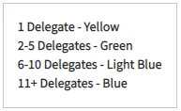
Where Are We?

Slide 5
Credits and Disclaimer
This slide deck was authored by:
Peter Eppinger, University of Tübingen
James Lake, Southern Methodist University
Michael Plouffe, University College London
Swati Verma, ISID, New Delhi
This slide deck was reviewed by:
Alan Deardorff, University of Michigan
Ed Leamer, UCLA
Disclaimer
NEED presentations are designed to be nonpartisan.
It is, however, inevitable that the presenter will be asked for and will provide their own views.
Such views are those of the presenter and not necessarily those of the National Economic Education Delegation (NEED).

Slide 6
Outline
Globalization
International Trade
Foreign Direct Investment
Offshoring

Slide 7
What is Globalization?
The growing interdependence of the world’s:
Economies
Cultures
Populations
Brought about by cross-border flows of:
Goods and services
Technology
Investment
People
Information

Slide 8
What Drives Globalization?
Transportation
Technology
International Cooperation

Slide 9
Transportation

Slide 10
Technology

Slide 11
International Cooperation

Slide 13
International Cooperation – Ending?

Slide 14
Western Globalization in Historical Context
The first wave of globalization:
Roots in the 1830s, height in 1870s, end in 1913
American trade policy protected industry, but not other sectors.

Slide 15
Interwar Isolationism
After WWI, many countries focused policy efforts internally.
The Great Depression led to the highest levels of trade barriers in the 20th century.
Embodied by the 1930 Smoot-Hawley Tariff
Eventual backlash over Smoot-Hawley led to the 1934 Reciprocal Trade Agreement Act.

Slide 16
Post-war Liberal Institutionalism
Initiated before World War II had ended
Roots in the Atlantic Charter and Bretton Woods Conference
General Agreement on Tariffs and Trade (GATT)
Nondiscrimination and reciprocity
Repeated multilateral negotiating rounds
GATT did create allowances for exceptions to nondiscrimination
Generalized System of Preferences
Preferential/regional trade agreements
National security and remedies (antidumping and countervailing duties)

Slide 17
US Tariffs, 1891-2017
Tokyo Round tariff cuts
Smoot-Hawley
GATT
established
Kennedy Round tariff cuts begin
Uruguay Round

Slide 18
International Trade
Exports and Imports

Slide 19
Exports and Imports
Exports: goods or services sold to another country
Imports: goods or services bought from another country
US exports (2016 shares) |  |  |  | US imports (2016 shares)
Goods |  | Services |  | Goods |  | Services
Planes | 4.5% | Bus/Fin/Ins | 34% | Cars | 8.2% | Bus/Fin/Ins | 34%
Crude Petroleum | 4.3% | Travel | 27% | Crude Petroleum | 4.7% | Travel | 24%
Cars | 4.2% | Royalties | 17% | Computers | 4.1% | Transport | 19%

Slide 20
What do we Export? ($1.6 Trillion)

Slide 21
What do we Import? ($2.4 Trillion)

Slide 22
Top US Trade Partners (Goods, 2018)
Top 10 US export destinations
Top 10 US import sources

Slide 23
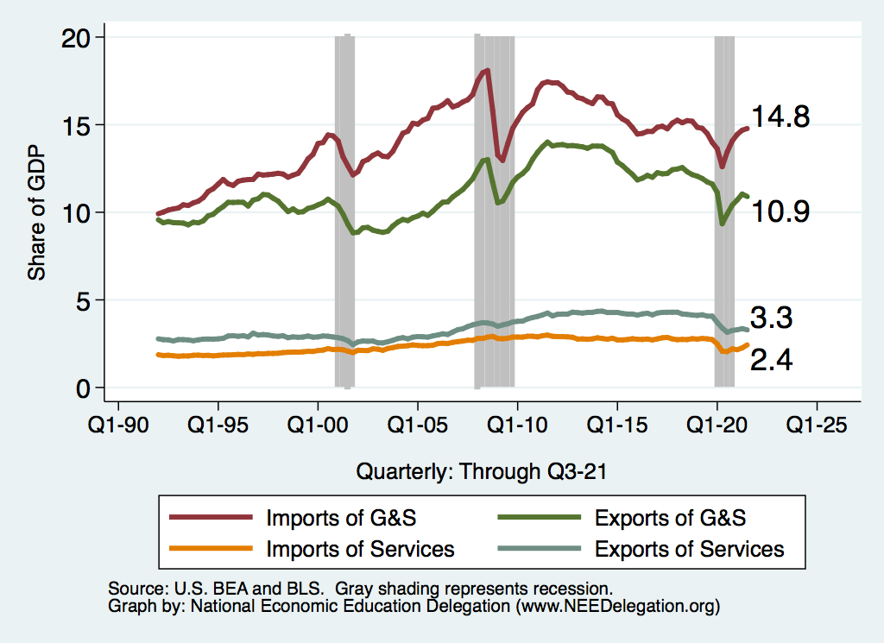
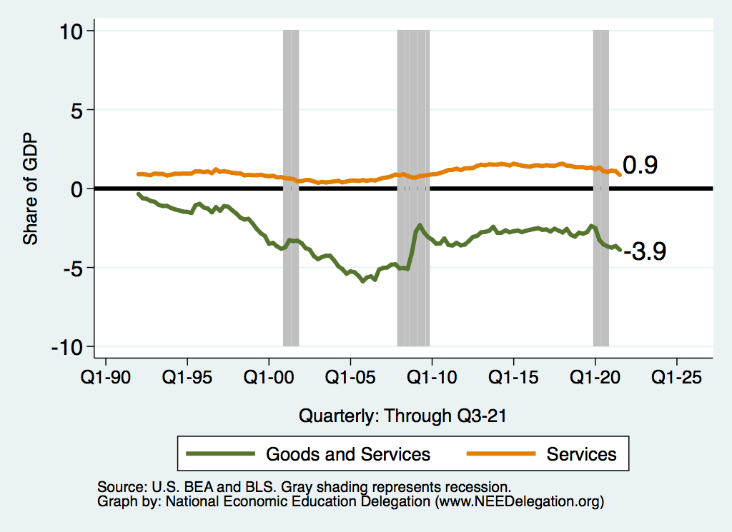
Importance of US Trade
US trade as % of GDP
US trade balance as % of GDP

Slide 24
U.S. Trade Deficits: to 2020
Overall, a nearly $627 Billion trade deficit (3% of GDP)
Goods trade deficit over $887 Billion
Services trade surplus of about $250 Billion

Slide 25
Why Do Countries Trade?
Competition
Varieties
Efficiency

Slide 26
Why Might Efficiency Differ Across Countries?
Labor
Skilled or unskilled
Technology
Some countries have firms that produce some goods well
Other countries have firms that produce other goods well
Environment
Cold/Warm Wet/Dry Sunny/Cloudy
Land
Rocky, soil, fertile, barren
Tundra, desert, grasslands, forest

Slide 27
Comparative Advantage and Specialization
Comparative advantage
Scarce resources: can't produce unlimited amounts of goods
Export goods where production advantage largest (or disadvantage weakest)
Non-econ example: Babe Ruth
Top pitcher during 1916-1918. But best hitter of all time!
Scarce resources: training time
Post 1918, Babe Ruth specialized as hitter
Econ example: US-UK trade in 1951
For same output, US used less resources than UK in each of 26 manuf sectors!
But, US net exporter to UK only for sectors where it’s advantage largest
UK net exporter to US for goods where it’s disadvantage weakest

Slide 28
Benefits of Specialization
For goods where US production advantage weakest…
US can consume these goods by either
Importing them from UK
Producing them and reducing production of goods exported to UK
Key point
US can consume more of these goods by importing them from UK
Analogous story true for UK
Trade increases size of economic pie for both countries

Slide 29
Comparative Advantage – Key Notion
Two kinds of advantage: absolute and relative
E.g., Babe Ruth vs Madison Bumgarner
Babe Ruth: ERA – 2 Batting average - .350
Madison Bumgarner ERA – 3 Batting average - .185
Babe is better at both
Absolute advantage
If only one can bat and one can pitch, who does what?
Relative advantage

Slide 30
Relative Advantage
Babe has an absolute advantage in both activities.
He is better at both pitching and hitting
Is he RELATIVELY better at one than the other?
Pitching: Babe is 33% better (era of 2 vs 3)
Hitting: Babe is 100% better (.350 vs .185)
Babe has a relative advantage in hitting
So: Babe should hit and Madison should pitch
Relative advantage determines comparative advantage
Babe has a COMPARARTIVE ADVANTAGE in hitting
Madison has a COMPARATIVE ADVANTAGE in pitching

Slide 31
Same Holds True for Countries
Every country has a good or a set of goods that it is RELATIVELY better at producing.
Those are the goods that it will export.
It will import the other goods.
There are exceptions.
Varieties and competition
May find countries trading the same goods back and forth.
Every country…

Slide 32
Trade Contributes to Growth
EFFICIENCY:
Allocates production across countries efficiently so that countries can specialize in what they are best at producing.
Varieties
More choice for consumers.
Better inputs for our production.
Competition
Brings in cheaper goods.
Makes consumers better off.
Economies of Scale
Trade makes some industries bigger, more cost efficient. Lowers prices.

Slide 33
How to Think About Imports
Think about international trade as the introduction of a new technology.
Soy Beans
(Exports)
Laptops/iPhones
(Imports)

Slide 34
What Does the Data Say? Trade Lowers Prices for Consumers
Effect of import surge from China: 2000-2007
Prices would be about 10% higher without this import surge.
Benefits for U.S. consumers of $100,000 per lost manufacturing job.
Do rich or poor benefit more from lower import prices?
Evidence is mixed.

Slide 35
Why is the public turning against trade?
Gains from trade are very large for the economy, BUT
Not always noticeable by consumers. Why are prices lower at WalMart?
Not always that large per consumer: consumers might save $50/year on some imported goods
For 300 million consumers, $50/year would be $15 billion per year savings to the country!
Costs of trade are very high for some workers and groups, and these costs have not been sufficiently appreciated or addressed by policymakers (or economists!)

Slide 36
Distributional Impacts of Trade: Basic Insights
Previous slides
Trade increases “the size of the pie” for each country
Ignores how trade impacts distribution of the pie in each country
Basic insights from trade theory
If trade decreases demand for a factor, it generally loses from trade
Factors “stuck” in import-competing locations/industries
Mobile factors but used intensively in import-competing locations/industries
If trade increases demand for a factor, it generally benefits from trade
Factors “stuck” in exporting locations/industries
Mobile factors but used intensively in exporting locations/industries
Trade benefits consumers via lowers prices of imported goods
Some consumers may benefit more than others

Slide 37
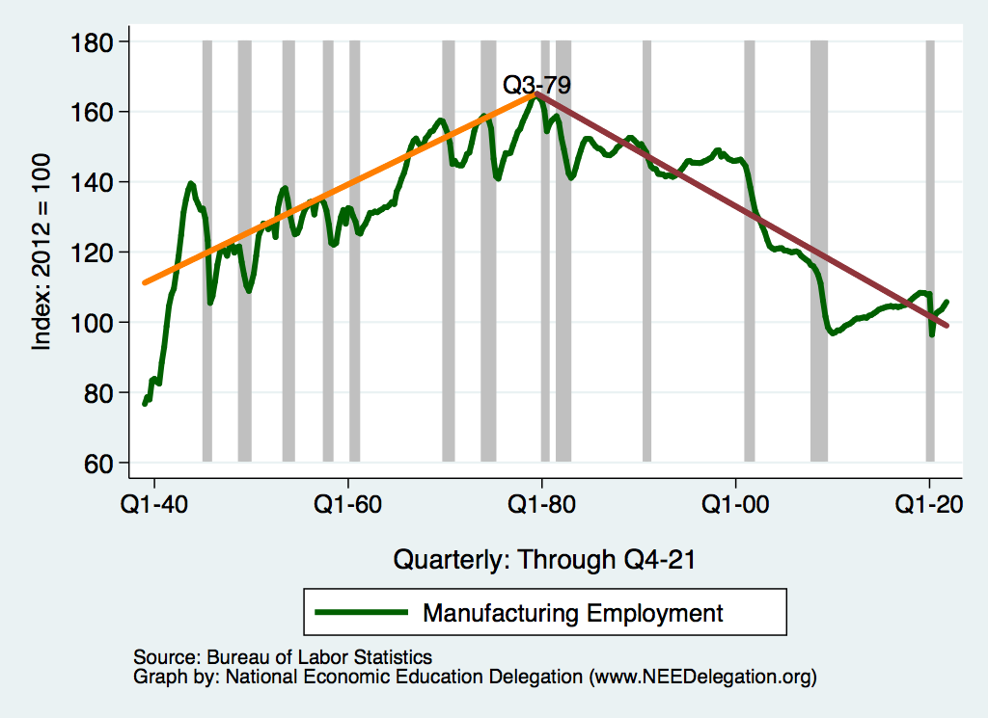
The Basic Issue: Inverted V of Jobs in Manuf.

Slide 38
“International Trade is Surely a Contributor!”

Slide 39
But There is No V in the Fraction of Jobs in Manufacturing

Slide 40
And Manufacturing Output Keeps on Growing

Slide 41
And Manufacturing Productivity is on the Rise

Slide 42
Another Problem: Trade Deficit
Massive Trade Deficit
2.9% of US GDP
$893 Billion in 2018 for goods
Massive Trade Deficit with China
2/3 of US Trade Deficit

Slide 43
How to Think About the Trade Deficit
A trade deficit is when:
VALUE of imports > VALUE of exports.
Why does this happen?
International transactions include:
Imports and exports of goods and services - Current Account
ALSO: imports and exports of assets (investments) - Capital Account
The TRADE DEFICIT only looks at the Current Account

Slide 44
Trade and Investment Flows Balance Out

Slide 45
Exchange Rates Prevent an Overall Deficit
As the trade deficit grows:
The price of the dollar declines.
As the price of the dollar declines:
Investing in the United States becomes more attractive.
As investing in the US is more attractive:
The financial account surplus grows.
The financial account surplus offsets the trade deficit.
Balance on international accounts is restored.

Slide 46
Balanced Budgets & Increased Savings
Reducing federal borrowing would reduce pressure on trade deficits.
More savings would mean more domestic investment and less borrowing from abroad.

Slide 47
US Savings and the Trade Deficit
Savings
Trade Deficit

Slide 48
General Agreement Among Economists

Slide 49
Trade With China: 63% of US Trade Deficit

Slide 50
Bilateral Trading Relationships

Slide 51
Bilateral Trade Deficits are Unimportant
Natural result of an overall trade deficit.
Likely result from specialization.
Can be exaggerated by mismeasurement of bilateral trade flows.
Value added vs total value
Are unlikely to be a result of foreign country’s trade policies.

Slide 52
Not That Trade Has Been Absolved of all Ills: DISTRIBUTIONAL IMPACTS

Slide 53
Intuition on Distributional Impacts
Jobs
U.S. imports more of some goods
Reduces jobs on those industries
U.S. exports more of other goods
Creates jobs in those industries
Are there different kinds of workers in these different industries?
Creates adjustment costs
Prices
LOWERS the price on imported products
RAISES the price on exported products
Who buys which products?

Slide 54
What Does the Data Say? Trade Benefits Some Workers
Trade liberalization raises wages at “most globalized” firms
Wages higher because
lower tariffs on imported inputs used by firm
lower tariffs on products sold by exporting firms

Slide 55
What Does the Data Say? Trade Hurts Some Workers
Some parts of US highly exposed to import competition.
Workers tend to be “stuck” in these locations and/or industries.
So they suffer
Effects of Chinese import competition: 1990-2007
Higher unemp, lower labor force participation & wages in exposed locations
Accounts for nearly 25% of manuf employment decline
Effects of NAFTA-led US tariff cuts on Mexico
For workers without a college degree
Up to 8% point lower 1990s wage growth in highly exposed locations
Up to 17% point lower 1990s wage growth in highly exposed industries

Slide 56
Costs of Trade
We have known for almost 80 years that trade with low-wage countries will lower the earnings of low-wage workers as a group in the U.S.A. (Stolper-Samuelson 1941)
Perhaps more importantly, however, is that the adjustment costs, or what some call transition costs, are much larger than previously thought. People do not like to move, and getting laid off can be very traumatic.
Recent economics studies have estimated the costs of trade across many different groups.
Inequality
Adjustment costs

Slide 57
Understanding Adjustment Costs
FIRMS
Searching for new workers
Training
Adjusting to the new employees/integration
Firing costs/severance pay
WORKERS
Psychological costs of leaving a job, friends
Loss of firm-specific or industry-specific skills
Search costs for a new job
Relocation costs (e.g. moving to a new location)

Slide 58
Estimates of Adjustment Costs
FIRMS
Estimates from developed countries suggests that costs are high
High adjustment costs cause firms to hire and fire in large groups, rather than gradually
Estimates from developing countries suggest that firm-level adjustment costs are much lower than in developed countries
WORKERS
New estimates in the last 10 years
Estimate costs by looking at wage differences and how many workers do NOT move. Adjustment costs must be at least that high

Slide 59
Estimated Costs to Workers of Changing Jobs

Slide 60
Characteristics of Adjustment Costs
Some regions get hit especially hard when imports increase
Production of some goods is highly concentrated geographically
USA: Detroit (autos), El Paso (apparel), South Carolina (Textiles)
Local unempl9yment rates can be very high, even when national rates are low
Term “adjustment costs” understates impact on affected workers
“Adjustment” may take a generation or more. Kids may take different jobs than parents
For affected workers, the effect may be permanent
Wages are never recovered
Psychic costs of job loss can be very long-lasting and affect families
Adjustment costs can reduce gains from trade significantly

Slide 61
Why Adjustment Costs Matter
Adjustment costs can undermine the popular support for trade
Falling popular support for trade in the face of concentrated losses threatens to “kill the goose that lays the golden egg”
Adjustment costs reduce welfare
Adjustment costs suggest potential for efficiency gains. If we can make (labor) markets more efficient, then the whole economy could realize significant gains

Slide 62
Distributional Impacts of Trade: Unemployment
Generally, trade theory has nothing to say about unemployment.
Trade is primarily about reallocating resources
Some sectors expand, other sectors decline
Labor, capital, land etc. move from import-competing to exporting sector
Typical assumption in trade theory models…
this reallocation happens costlessly and immediately
However, recent empirical evidence suggests otherwise.
Workers can face very large costs of moving between sectors or locations
Rising exposure to import competition can…
Increase unemployment, reduce labor force participation

Slide 63
Trade is Not a Driving Force of Unemployment
U.S. National Unemployment Rate
Import competition may contribute to factories closing and job loss, but there are many other factors that also contribute to job loss.
The national unemployment rate is driven by business cycles, and not by trade.
Over the same period shown in the graph, trade has been rising.

Slide 64
Policy Solutions

Slide 65
Tariffs
Tariffs temporarily reduce imports of particular goods
Tariffs raise prices
Final goods (consumers)
Intermediate goods (producers who use imported inputs)
Rising prices distort consumption and production decisions
Tariffs invite retaliation, lowering demand for our exports
In the long run, the exchange rate adjusts to offset the tariffs because of the effects of borrowing: Tariffs, therefore, cannot correct a trade deficit
Tariffs lower overall welfare, while generating very large gains for small groups (e.g. A cost of 100 to many for a gain of 80 for a few).
Tariffs are generally considered to be an inefficient way to help those people who are hurt by trade

Slide 66
General Consensus of Economists on Tariffs

Slide 67
Directed Support: Adjustment Costs
The most efficient way to help those hurt by trade is through direct payments
Trade Adjustment Assistance (TAA) is an example of an attempt at this principle
TAA includes some retraining funds and extended unemployment benefits
Not generally considered to be very successful
Underfunded
Hard to determine who is hurt by trade and not other factors
Larger direct payments would be most effective and efficient

Slide 68
Balanced Budgets
Reducing federal borrowing would reduce pressure on trade deficits.
Size of debt – nearly 21 trillion in 2018 – means that some combination of cutting spending and raising taxes would be necessary.
Reducing the debt would also reduce the large share of the federal budget that is directed towards interest payments and free up money for other things.
Reducing the debt also increases our economic security because it could reduce foreign debt exposure.

Slide 69
Trade Summary
Trade and growth are positively related.
Gains from trade can be widespread (lower prices for consumers).
Losses from trade can be highly concentrated.
Tariffs reduce trade overall, thus imposing widespread losses to both producers (who use imported inputs) and consumers (who buy lower-priced imported goods).
More direct policies can be more efficient and save gains from trade.

Slide 70
U.S. Trade Policy

Slide 71
US Trade Policy in Practice: Congress
Constitution gives Congress exclusive power over trade policy
Frequently passes “Miscellaneous tariff bills” (MTB)
Temporarily remove tariffs on thousands of products
Sept 2018 MTB: chemicals, footwear, toasters, 1600 other products
Tariff Act of 1930 implemented the Smoot-Hawley tariffs
50% increase in US tariffs
Highest US tariffs over 1828-2018 period
Congress has delegated much authority to the Executive
Main historical uses of Executive authority
Negotiating reciprocal trade agreements (e.g. WTO and FTAs)
1934 Reciprocal Trade Agreements Act, now “trade promotion authority”
Temporary trade barriers (TTBs) via Tariff Act of 1930

Slide 72
US Trade Policy in Practice: Congress & WTO
Congress passed legislation committing US to WTO rules
1994 Uruguay Round Agreements Act
WTO built on 1947 GATT rules
Basic rule: Most Favored Nation (MFN) principle
Impose same tariff, the “MFN tariff”, on all WTO members
Committed to upper bounds on these MFN tariffs
Average 2017 US MFN tariff (upper bound or applied): 3.4%

Slide 73
US Trade Policy in Practice: Congress & WTO
Key exceptions to principle of MFN tariffs
Free Trade Agreements (FTAs, e.g. NAFTA)
Eliminate tariffs between FTA members (for nearly all products in US FTAs)
Other rules: non-tariff barriers, product standards, trade disputes
US trade with FTA partners: 35% of imports, 42% of exports
Below MFN tariffs for developing countries
“GSP” program & other similar programs
TTBs
TTB tariffs can violate non-discrimination and upper bounds

Slide 74
US Trade Policy in Practice: Bureaucracy
Until recently, most frequent use of new US tariffs: TTBs
Anti-dumping duties (AD)
Tariffs imposed on foreign firms selling below fair value
Countervailing duties (CVD)
Tariffs imposed on foreign firms receiving foreign government subsidies
ADs and CVDs processes managed by bureaucracy
Congress delegated this power in Tariff Act of 1930
Department of Commerce and USITC both have veto power
USITC: US International Trade Commission
ADs and CVDs imposed on 928 occasions 1980-2016
Sep 2018: USITC rules against ADs in the Boeing-Bombardier CS100 dispute
Aug 2018: AD on large diameter welded pipe from Canada & other countries
Sept 2018: CVD on Vietnamese laminated woven sacks

Slide 75
US Trade Policy in Practice: Executive
Trump administration use of executive authority
Safeguard tariffs (Trade Act of 1974, Section 201)
If USITC agree import surge → major injury to industry: Executive power for temporary tariffs
Today: tariffs on imports of $8.5bn solar panels, $1.8bn washing machines
Historically: rare, used 11 previous times, last was 2002 Bush steel tariffs
National security tariffs (Trade Expansion Act of 1962, Section 232)
If Commerce Department investigation finds evidence, Executive can impose tariffs
Today: tariffs on $48bn of steel & aluminum imports
Public hearings into over $200bn of auto and auto part imports
Historically: excluding oil imports, only used once
1986 Reagan administration: metal-cutting and metal-forming machine tools

Slide 76
US Trade Policy in Practice: Executive
Unfair trade practices tariffs (Trade Act of 1974, Section 301)
USTR established by the Trade Expansion Act of 1962
and elaborates policies for the President and conducts negotiations
USTR investigates unfair trade practices by foreign countries
Aug. 2017: investigation into Chinese practices over US IP and technology
Today: 25% on $50bn (>Aug. 23/2018) and 10% on $200bn (>Sep. 24/2018) of Chinese imports.
Historically: used systematically pre-WTO, but rarely since WTO (122 since 1974; 1 since 2001)

Slide 77
US Trade Policy in Practice: Retaliation
National security tariffs on steel & aluminum
EU, CAN, MEX, CHN have already retaliated with tariffs
Proportionate to their US exports of steel & aluminum
Targeted retaliation
Industries reliant on foreign markets (e.g. pork)
Farmers (fruits & nuts), household goods (ketchup, mowers)
Politics: KY bourbon, WI ginseng & Harleys, CA Levi jeans
Unfair trade practices tariffs on China
Proportionate: 25% tariff on $50bn of imports from US
EX: Soybeans and cars (largest and 3rd largest US exports to China)
Extension as of Sep. 24/2018: 5-10% on $60bn of US imports
EX: Chemicals, medical equip, oil

Slide 78
US Trade Policy in Practice: Winners and Losers
Tariffs: basic insights from trade theory
US tariffs = tax on US imports. So, higher consumer prices in US
Winners: US producers and (at least some of) their workers
Losers: US “consumers”, including any “consuming” firms and their workers
Safeguard tariffs on solar panels & washing machines
Presumed winners: US solar panel & washing machine producers
Suniva, SolarWorld, Whirlpool…
But #1: China cuts consumption subsidies → massive fall in Chinese demand
But #2: LG and Samsung relocating washing machine production to the US
Losers: US “consumers” of solar panels and washing machines
“Consumers” can be firms
Solar panels: 85% of employment in distribution and installation

Slide 79
US Trade Policy in Practice: Winners and Losers
National security tariffs on steel & aluminum
Winners: US steel producers (Nucor, United States Steel, AK Steel) & workers
BEA: 140,000 jobs in steel producing industries
Losers #1: US consumers, including steel-consuming US firms
BEA: 2 million jobs in US industries where steel >= 5% of inputs
US industries targeted by foreign retaliation
Industry | Countries | Share of US exports
Pork | China, Mexico | 44%
Apples | China, Mexico, India | 37%
Nuts | China, India | 12%
Whiskies (e.g. KY bourbon) | EU, Canada, Mexico | 53%
Mineral water, coffee, ketchup | Canada | About 50%

Slide 80
US Trade Policy in Practice: Winners and Losers
Proposed national security tariffs on autos & auto parts
US car producers are winners… wait, they’re actually losers!
Large consumers of imported autos and auto parts
Large exporters & fear foreign retaliation
Strong opposition from GM, BMW, Toyota, Honda, Nissan, Mitusbishi…
US auto parts producers are winners… wait, they’re actually losers!
Lower production of autos means less demand for auto parts
Strong opposition: auto parts association (MEMA)
Losers: US consumers
Estimated price increases for new cars of 10-20%
Winners: auto workers union (UAW) supports tariffs
Auto & auto parts firms say they’ll scale back US production
Union claims these firms will scale up US production

Slide 81
US Trade Policy in Practice: Winners and Losers
Unfair trade practices tariffs on China
25% tariff on $50bn and 10% on $200bn of Chinese imports
About 85% of $50bn and 47% of $200bn are inputs and capital equipment
Winners: US producers where tariffs in place
US producers pushing for protection included steel, furniture, textiles
Losers: US consumers (including firms using inputs & capital equipment)
Retaliation ($46bn of US exports, $14bn as of Aug 23)
Industry | US exports to China | Share of US exports
Soybeans | $12.4bn | 57%
Vehicles | $11.3bn | 10%
Crude oil | $4.4bn | 20%
Shellfish | $1.2bn | 23%
Sorghum | $0.8bn | 78%

Slide 82
China: The Problem? The Solution?
China
NOT China

Slide 83
Foreign Direct Investment (FDI)

Slide 84
FDI: Definition
Investment made by an entity (firm/individual) of one country into business interests located in another country
Controlling ownership, At least 10 percent equity (OECD, IMF definition)
Long term usually
Distinguished from foreign portfolio investment (FPI)
Mere purchase of equity of foreign-based company, no control
Short term
Global FDI flows: $1.52 trillion (2017)
Main destinations: Developing Asia, EU, North America
FDI in US
Inward Stock: $3.7 trillion in 2016; Growth rate: 7.8% per year
Largest recipient in 2017 ($311 billion)

Slide 85
Types of FDI
Method of Entry:
Greenfield (establishing new production capacity)
Brownfield (Purchase of existing production facility; Mergers/Acquisitions)
Production Strategy:
Horizontal FDI:
Roughly similar production activity duplicated in multiple countries
- McDonalds, Starbucks, Coca-cola expansion (Ex.)
Vertical FDI
Different stages of production located in different countries {trade-creating}
Forward vertical FDI (movement towards market)
- Toyota acquiring car distributorship in US
Backward Vertical FDI (moving back towards raw materials)
- Toyota acquiring rubber plantation

Slide 86
Why Invest in Foreign Countries?
OLI Advantages
Ownership: To exploit firm specific advantages
Locational: Country specific features (geographical/ political space/ market) for
profit maximization
Internalization: To exploit ownership advantages internally
Response to trade barriers / tariffs {FDI substitutes trade}
Response to favorable tax policies {Tax haven FDI }
Common FDI motivations (Large MNCs):
Combination of Resource / Market / Efficiency seeking FDI

Slide 87
Who Engages in FDI?
Mainly corporate sector; Multinational corporations
Firms that operate production facility / business in several countries
Most productive firms
MNCs are large, significant
Account for 25% of world GDP; two-third of world trade
Revenue higher than GDP of most economies
- Combined sales of Top 200 corporations > combined economies of 182 countries

Slide 88
FDI & TRADE
FDI involves trade within highly complex MNC production Networks
Risk of mispricing for tax optimization; Loss of global tax revenue (4-10%)
Policy Response : OECD initiated Base Erosion & Profit Shifting project (2013) with
15 Action Plans
: Adopted by many countries
US Case:
Intra-MNC trade: 30.8 % of Exports; 35% of Imports
Risk of mispricing, profit shifting (little evidence)

Slide 89
FDI & Market Competition
MNCs can: Make competition imperfect, Reallocate market share
MNCs can: Make competition imperfect, Reallocate market share
Engage in anticompetitive practices, Buy out local rivals (mergers, acquisitions)
Local firms forced out of business
Least productive firm may exit market
Evidence is mixed:
Positive association between FDI & industrial concentration; Acquisition of rivals by MNC (some evidence)
FDI reduces market concentration (few studies)

Slide 90
FDI & Productivity
FDI generates positive spillovers to host economy
Foreign subsidiaries have high productivity (produce more product per input of capital or labor)
Stimulates improvement of technology & productivity by local firms
( Exposure to foreign skills, knowledge / Foreign competition / backward- forward linkages )
Evidence is mixed:
Higher productivity of foreign firms than local firms (many studies, also for US firms)
Productivity spillovers to local firms: Horizontal FDI - Little evidence
: Vertical FDI - Mostly positive (positive in US, some studies)
- Negative (few studies)
Technology/ Productivity gap with foreign firms affect spillover (some evidence)

Slide 91
FDI & Growth
FDI Enhances economic growth of host economy
Transfers production knowhow, skills, technology via productivity spillovers, local linkages
Improvement in productivity of capital stock, human capital
Evidence:
Many studies find positive effect of FDI on growth only when other characteristics are present in host nation (eg. Advanced development,technology,financial markets,Qualified labour force, Trade openness)
No Effect (few studies)
Supportive business environment, minimum economic development required for positive effect (commonly argued)

Slide 92
FDI & Employment
FDI leads to rise of employment, wages in host country
Reallocation of resources from capital to other factors including labour
Foreign firms offer higher wages; wage spillovers
Rise in average wages may result
Evidence is mixed
Higher wages by foreign firms (much evidence, also for US )
Wage spillover to local firms (mixed evidence)
Impact on average wages (sparse positive evidence, negligible for US)
FDI contributes significantly to employment in US (8.5 % of labor force)

Slide 93
Competition for FDI
Fierce competition to attract FDI through policies & incentives (fiscal, financial)
Mostly among developing nations, also severe at sub-national level
Varying levels of success: China, Singapore, Ireland attracted FDI post 1980s
Issues:
Competition distorts markets, trade; high price for incentives; exacerbate regional disparities
Developed nations : Mostly adopt neutral policy stance (Right of establishment, National treatment)
: Some exceptions for national security
Developing nations: Face budget constraint; resources diverted away from welfare activity
: Significant sovereignty concerns (powerful global corporations control public policy)
Few efforts towards regulation (global, sub-national level)

Slide 94
How is FDI Governed?
Absence of multilateral principles & formal institution to regulate FDI
Risk largely governed through Investment protection clauses in Bilateral Investment Treaties (BITs), economic integration agreements (NAFTA, ECT, CETA, CPTPP, RCEP)
Concerns:
Host governments face undue vulnerability under dispute settlement system; risk of litigation for compensatory claims by foreign investor
Scope for foreign investor only to file claims; Can avoid domestic legal system
Developing / host countries face high legal costs, risk limited gains
Opposition to TPP (in US), TTIP & CETA (in Europe): corporations may sue the state (key concern)

Slide 95
Offshoring

Slide 96
Offshoring – A New Form of Globalization

Slide 97
What is Offshoring?
Definition:
“Offshoring is defined as the movement of a business process done at a company in one country to the same or another company in another, different country.” (Source: Wikipedia, emphasis added)
The “business process” may refer to a production stage or a service
Offshoring is often labeled “outsourcing” in the public debate, but economists distinguish between the two:
Offshoring to a different country vs. outsourcing to a different firm
Outsourcing may also take place within the domestic economy
Note: Offshoring may take place within the firm, to a foreign subsidiary

Slide 98
Related to Trade and FDI
Offshoring overlaps with trade and FDI (discussed above) because it
… typically involves imports of intermediate goods (components) or services
… may coincide with FDI, in case of a vertically integrated supplier abroad and intra-firm imports
Still: Offshoring is important by itself
Hard to imagine almost any manufactured consumer good in the US without offshoring (imported inputs)
Has distinct implications for US firms, employment, and welfare

Slide 99
An example: The Boeing 787 Dreamliner
Parts and components from suppliers all over the world:
Japan
Italy
China
Australia
…

Slide 100
How Much Offshoring Has Happened?
Offshoring is hard to measure
Three indicators for its rise:
Share of foreign value added in US exports increased from 11% to 15% (1995-2011)
Import share of other business services rose from 12% to 20% in the US (1999-2016)
Related party trade: Intra-firm offshoring makes up 51-53% of US imports (2005-16)

Slide 101
Why Do Firms Engage in Offshoring?
Main motive for offshoring: Costs savings
Firms benefit from international specialization along global value chains
Typically US firms seek cheap labor → Prime offshoring destinations: Low-wage countries like China (14%) and Mexico (10% of US imports of intermediate goods in 2011)
Classic examples:
Automotive parts offshored to Mexico
Call centers offshored to India
But also: Access to raw materials, intermediate goods, or specific technologies → EU (20%) and Canada (17%)

Slide 102
What Are The Effects of Offshoring on Employment and Wages in the U.S.?
Two main effects on US workers expected in theory:
Negative relocation effect → Job losses and lower wages
Positive productivity effect: Cost savings increase competitiveness → Job growth and higher wages
Ambiguous net effect in theory
Extreme example for the productivity effect: Apple Inc.
Has offshored most production activities and become a “factoryless” firm
Employs 80,000 US workers in R&D, design, marketing,… (and growing)
Other concerns: inequality (skill bias), national security

Slide 103
Empirical Evidence on The Effects of Offshoring
Offshoring of manufactured goods and components
… might have positive or negative employment effects → mixed evidence
… tends to reduce domestic wages in offshored occupations
… hurts low-skilled workers more and → can increase income inequality
… boosts industry output and firm productivity
Offshoring of services
… is a much smaller phenomenon (little data)
… seems to have more favorable, non-negative employment effects

Slide 104
Policy Responses to FDI and Offshoring
Policies aiming to improve the attractiveness of producing in the US:
E.g.: R&D tax credit, reducing business costs, etc.
Policies supporting affected firms and workers
Prime example: Trade adjustment assistance (TAA) program
Financial support and retraining for affected workers, firms, and farmers
Around 1,000 petitions, covering around 100,000 workers in 2017
Policies inhibiting offshoring or FDI altogether
E.g.: Committee on Foreign Investment in the United States (CFIUS)
Reviews national security concerns related to FDI into the US
Rising number of reviews (79 in 2016), but few presidential decisions (1)
Example: Blocked takeover of Qualcomm by Singapore’s Broadcom Ltd (2018)

Slide 105
Thank you!
Any Questions?
www.NEEDelegation.org
<presenter name>
<presenter email>
Contact NEED: Info@NEEDelegation.org
Submit a testimonial: www.NEEDelegation.org/testimonials.php
Follow NEED: www.NEEDelegation.org/friends.php

