Slide 1

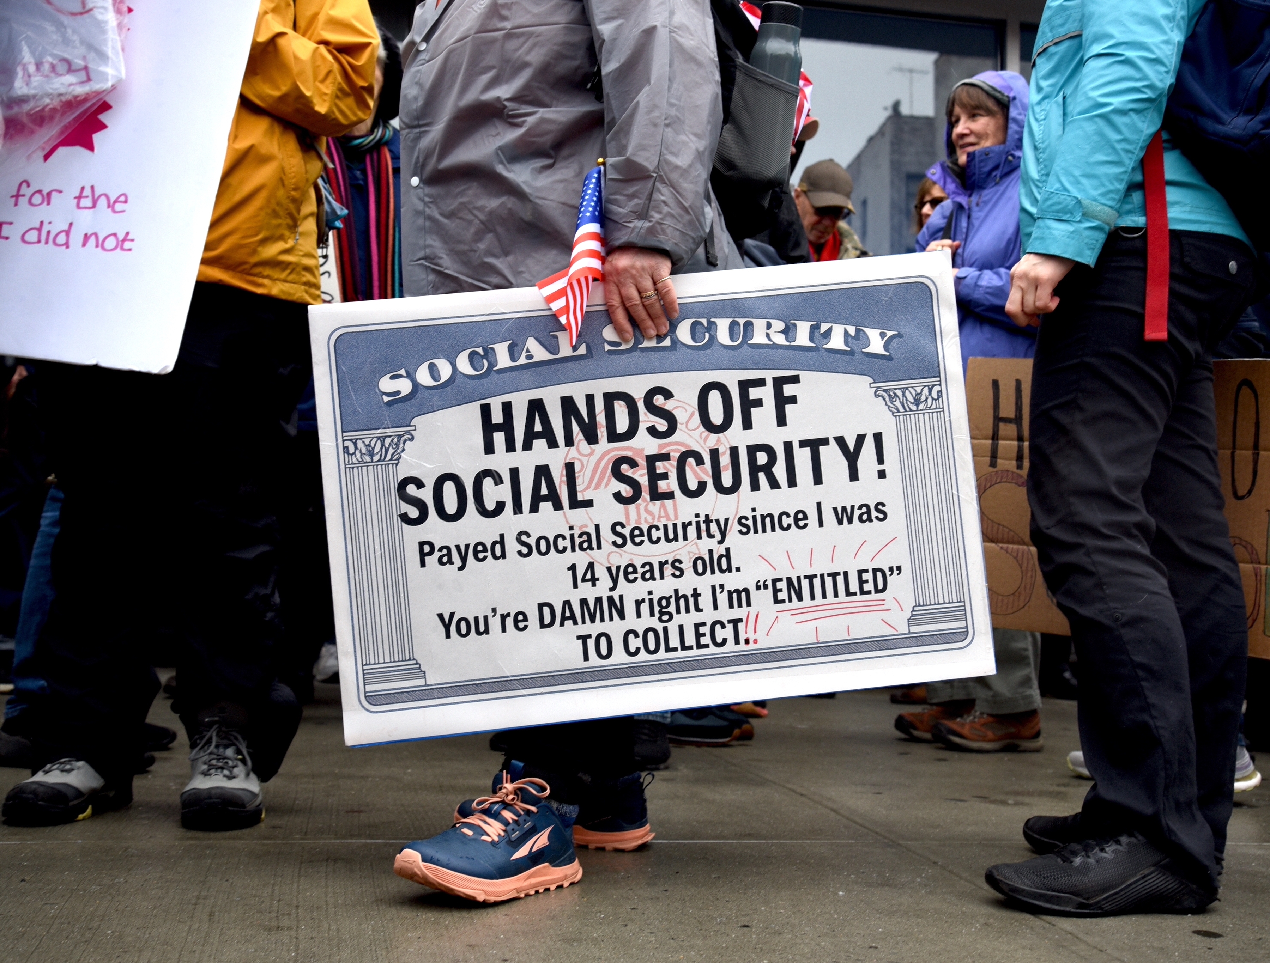
Social Security – Hard Choices (?)
<venue>
<date>
<name>, Ph.D.
<affiliation>

Slide 2
National Economic Education Delegation
Vision
  One day, the public discussion of policy issues will be grounded in an accurate perception of the underlying economic principles and data.
Mission
  NEED unites the skills and knowledge of a vast network of professional economists to promote understanding of the economics of policy issues in the United States.
NEED Presentations
  Are nonpartisan and intended to reflect the consensus of the economics profession.

Slide 3
Who Are We?
Honorary Board: 54 members
  2 Fed Chairs: Janet Yellen, Ben Bernanke
  6 Chairs Council of Economic Advisers
    Furman (D), Rosen (R), Bernanke (R), Yellen (D), Tyson (D), Goolsbee (D)
  4 Nobel Prize Winners
    Akerlof, Smith, Maskin, Bernanke
Delegates: 652+ members
  At all levels of academia and some in government service
  All have a Ph.D. in economics
  Crowdsource slide decks
  Give presentations
Global Partners: 49 Ph.D. Economists
  Aid in slide deck development

Slide 4
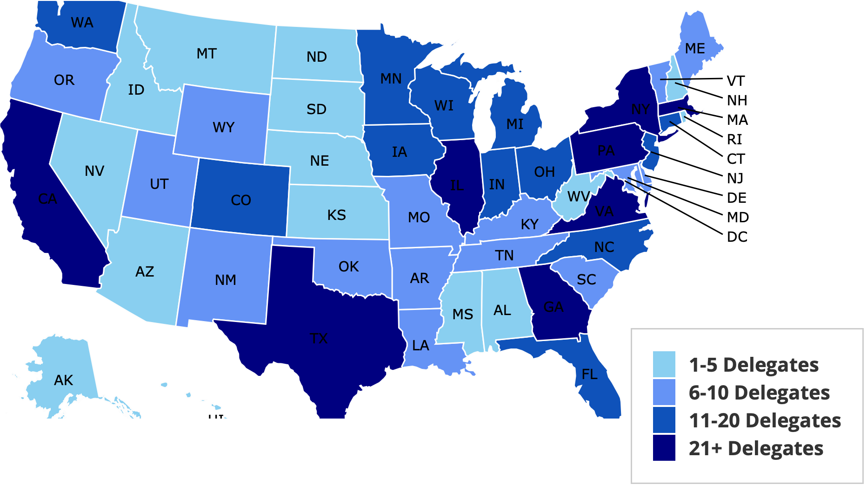
Where Are We?

Slide 5
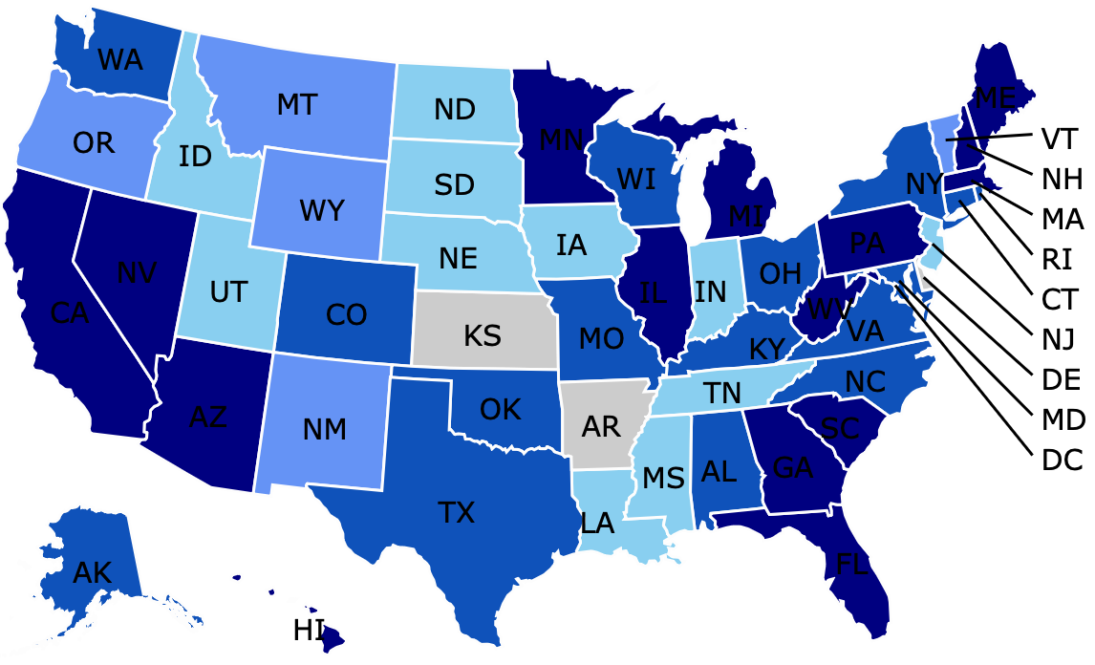
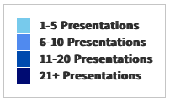
Where Have We Presented? (1,374 Talks)

Slide 6
Credits and Disclaimer
This slide deck was authored by:
  Jon Haveman, NEED
This slide deck was reviewed by:
  Alicia Munnell, Boston College
Disclaimer
  NEED presentations are designed to be nonpartisan.
  It is, however, inevitable that the presenter will be asked for and will provide their own views.
  Such views are those of the presenter and not necessarily those of the National Economic Education Delegation (NEED).

Slide 7
Outline
What is Social Security?
How Does Social Security Work?
What is The Trouble with Social Security?
Available Solutions

Slide 8
What is Social Security?

Slide 9
What is Social Security?
Social Security is a federal social insurance program that provides financial support to workers and their families.
Different benefits:
  Retirement Benefits: Social Security provides monthly payments to qualified retirees based on their lifetime earnings.
  Disability Benefits: It provides financial support to individuals who are unable to work due to a disability.
  Survivor Benefits: Social Security offers benefits to the families of deceased workers, including spouses and children.

Slide 10
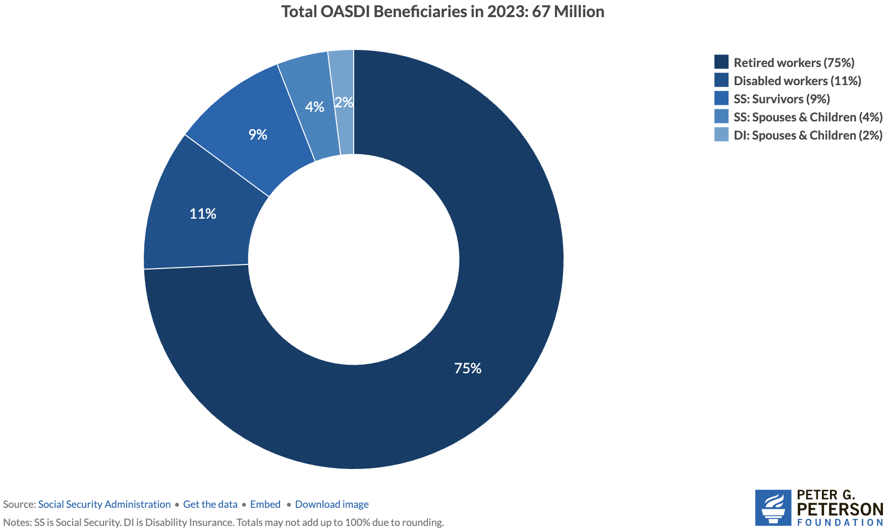
Numbers of Different Types of SS Beneficiaries
6.0 million
7.4 million
52.3 million

Slide 11
Social Security’s Origins
A part of the social safety net.
Created in 1935 to provide economic security to the nation’s elderly.
Expanded in 1939 to include dependent benefits.
  Benefits to families that have lost a breadwinner.
Expanded in 1950 to provide support for people with disabilities.
Expanded in 1974 to provide Supplemental Security Income.
  Can supplement regular social security benefits.
Today, it is the largest federal program.
  In FY 2024, spending was $1.25 trillion, or 22.4% of total federal spending.
  By comparison, national defense was $997 billion.

Slide 12
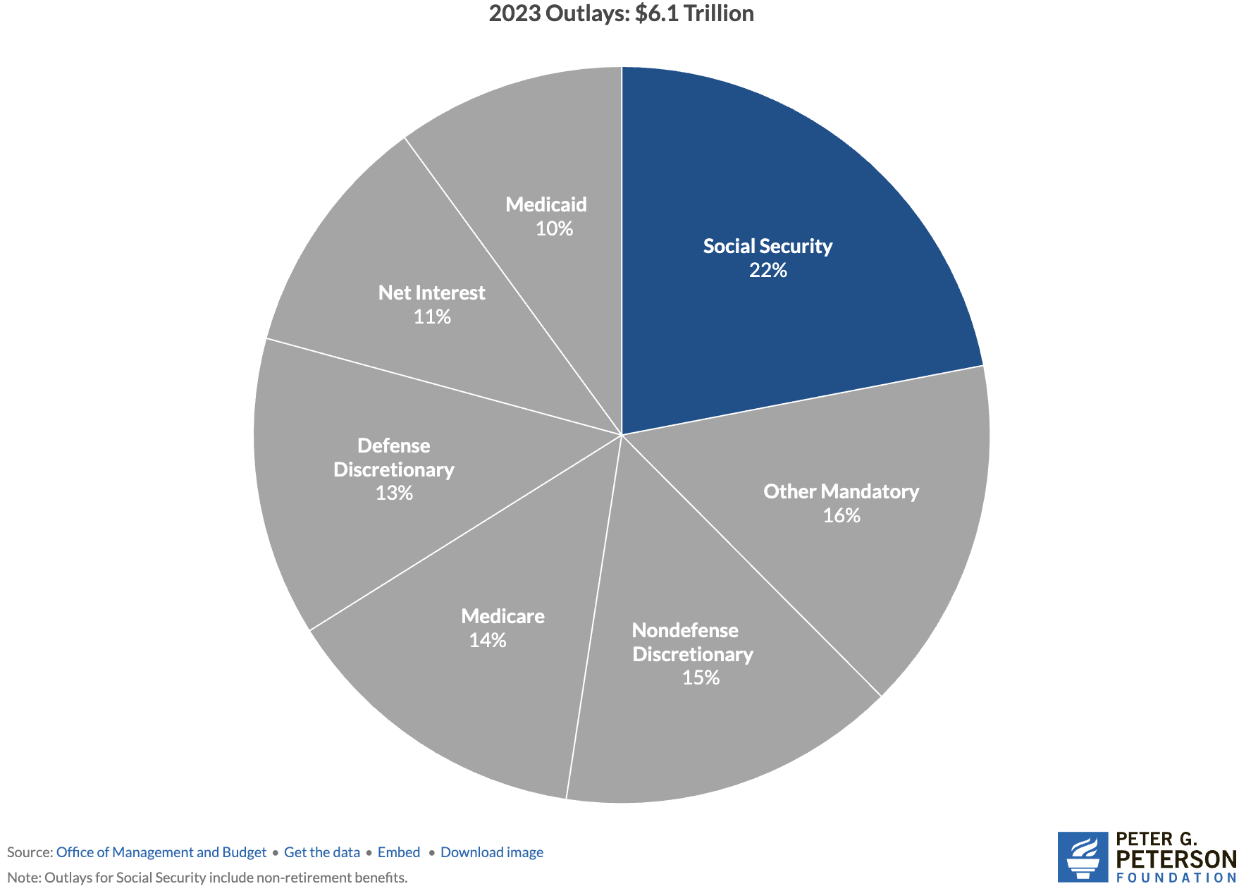
Soc Sec is The Single Largest Gov’t Program
Source: https://www.pgpf.org/article/9-facts-about-social-security-and-the-need-to-strengthen-it/

Slide 13
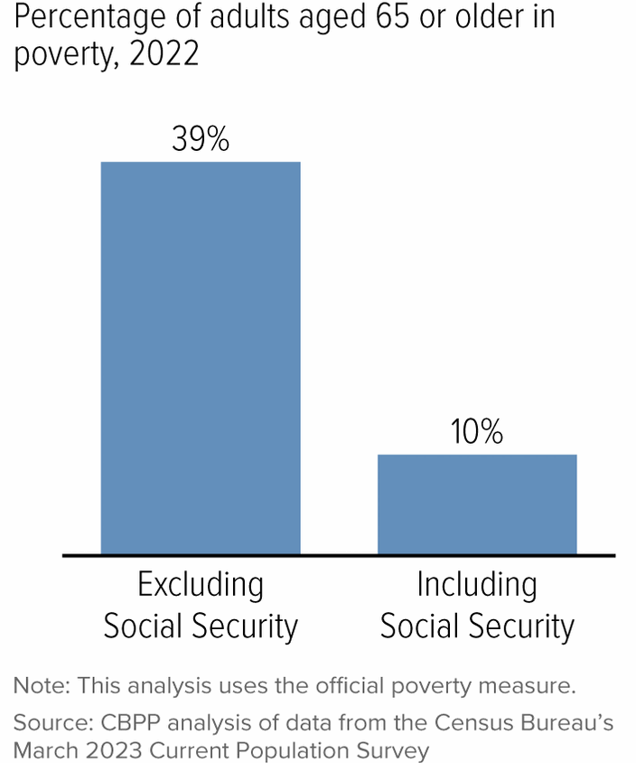
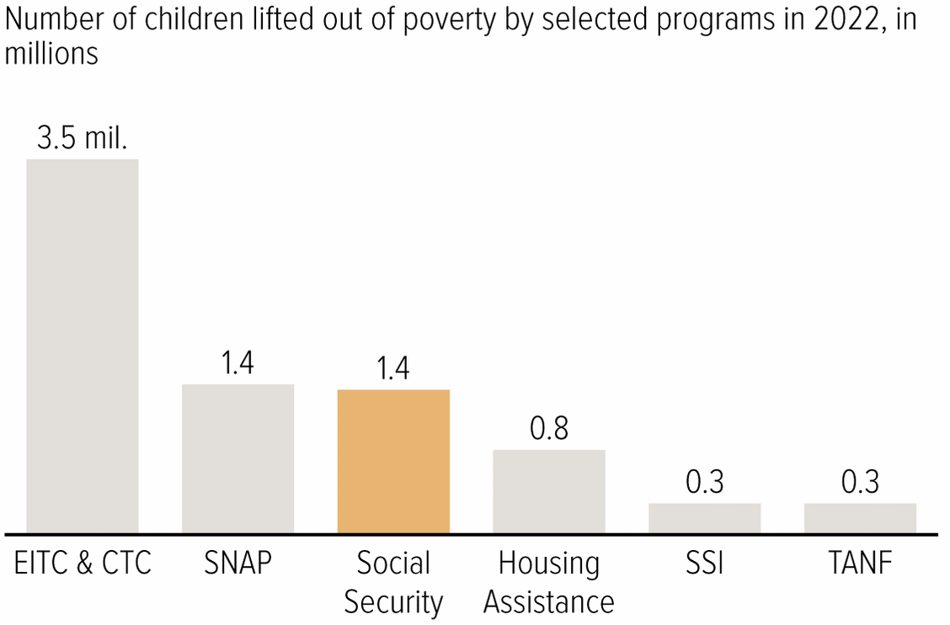
Soc Sec Significantly Reduces Poverty

Slide 14
Is Social Security Good for Just The Beneficiaries?
No, it also benefits broader society.

Slide 15
Economic Impacts on Individuals and Families
Poverty reduction
  Good investment for society.
Reduces income inequality among the elderly
Increases social mobility
Income stability
  Helps households plan for the future.
Enables older adults to maintain independence
  Reduces caregiving burdens on family members.
Consumer spending
  Supports businesses and the local economy.

Slide 16
How Does it Work?

Slide 17
The Mechanics of Social Security
“pay-as-you-go” system
  Payroll taxes are collected from current workers.
  These pay for the benefits of the currently retired, or otherwise eligible.
Taxes
  Payroll taxes amount to 12.4% of earnings.
    Workers pay 6.2% of earnings as payroll taxes.
    Employers also pay 6.2% of worker’s earnings.
  Earnings Cap. Not all earnings are subject to payroll taxes.
    In 2026, only the first $184,500 of earnings are taxed.
    Earnings above that level are not taxed.

Slide 18
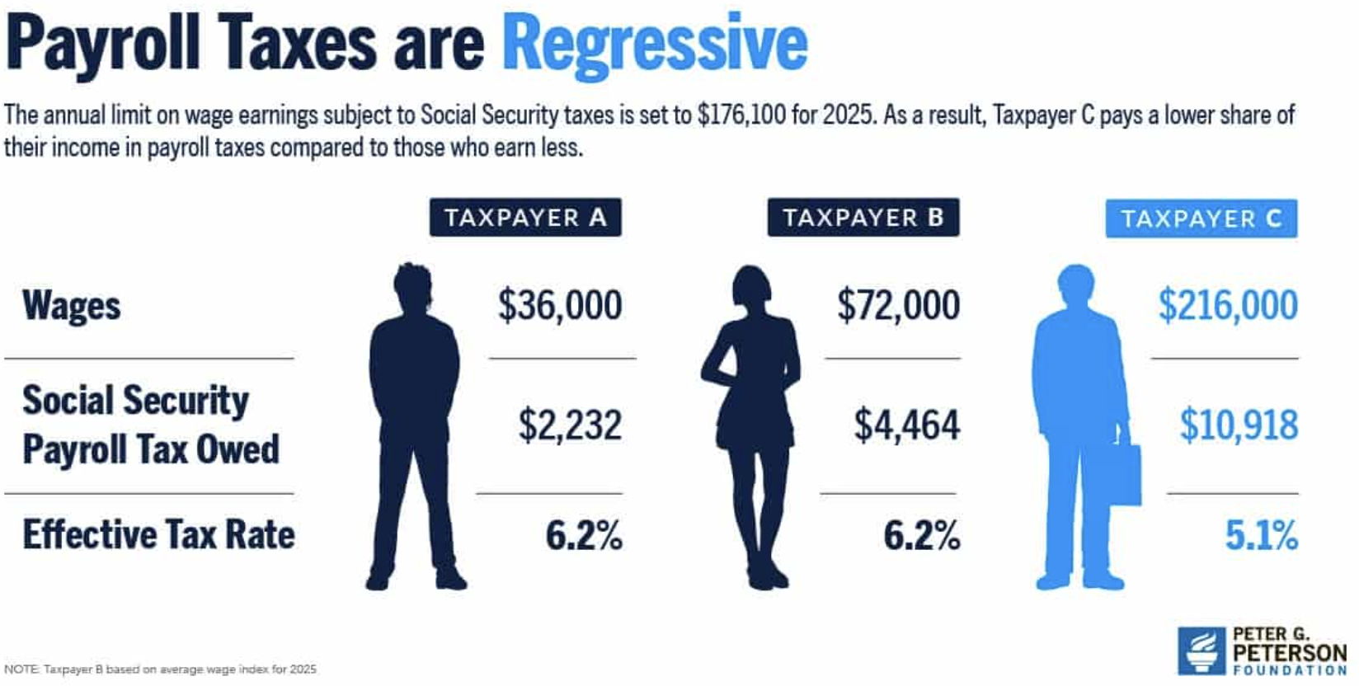
The Cap Causes The Tax Rate to Fall w/Income

Slide 19
Caveat on Taxes: Who REALLY Pays Them?
Tax Incidence:
  Statutory Incidence: Who has to write the check to the government.
  Economic Incidence: Who ACTUALLY pays the tax.
    The employer might have the statutory incidence for 6.2% of earnings, but if they pay the employee 6.2% less in earnings, the employee bears the full economic incidence of the tax.
Many studies confirm that the economic incidence of payroll taxes and other benefits (health insurance, for example) is largely born by the employee.

Slide 20
What if Payroll Taxes Don’t Match Benefits?
The Trust Fund
  If revenues exceed benefits, the excess is placed in a trust fund.
  If benefits exceed revenues, the excess is taken out of the trust fund.
  The funds in the trust are invested in nonmarketable U.S. Treasuries.
    So, really just bookkeeping.
When did the Trust Fund start?
  The OASI Trust Fund was created in 1939. (Old Age & Survivors Ins)
  The Disability Trust Fund was created in 1956.

Slide 21
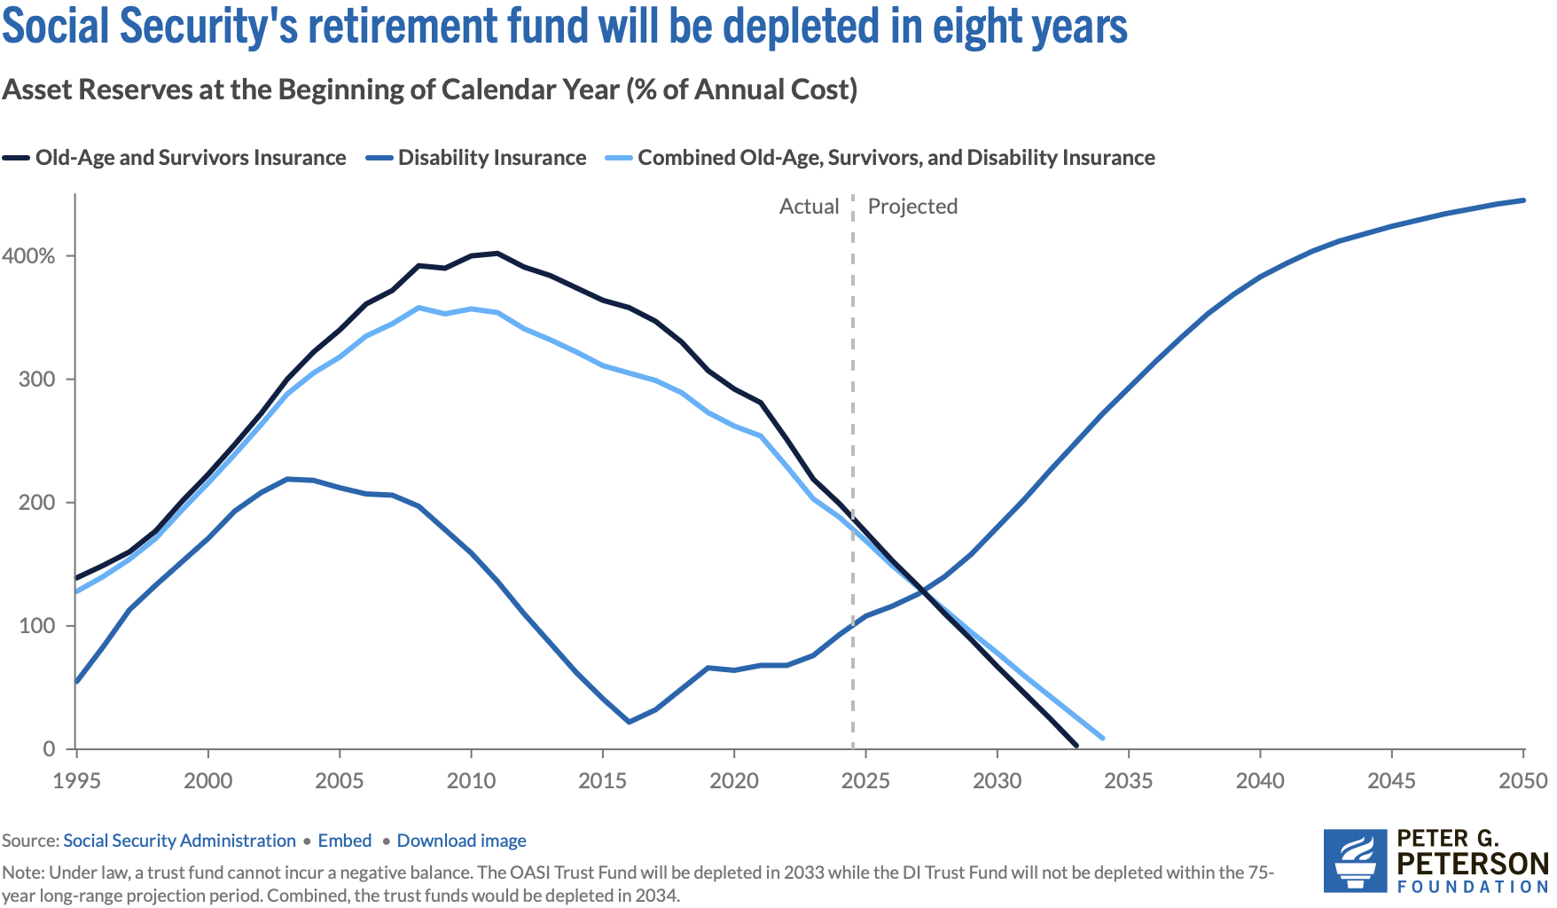
State of the Trust Funds
Source: https://www.pgpf.org/article/social-security-faces-serious-financial-shortfalls-and-other-takeaways-from-the-trustees-report/

Slide 22
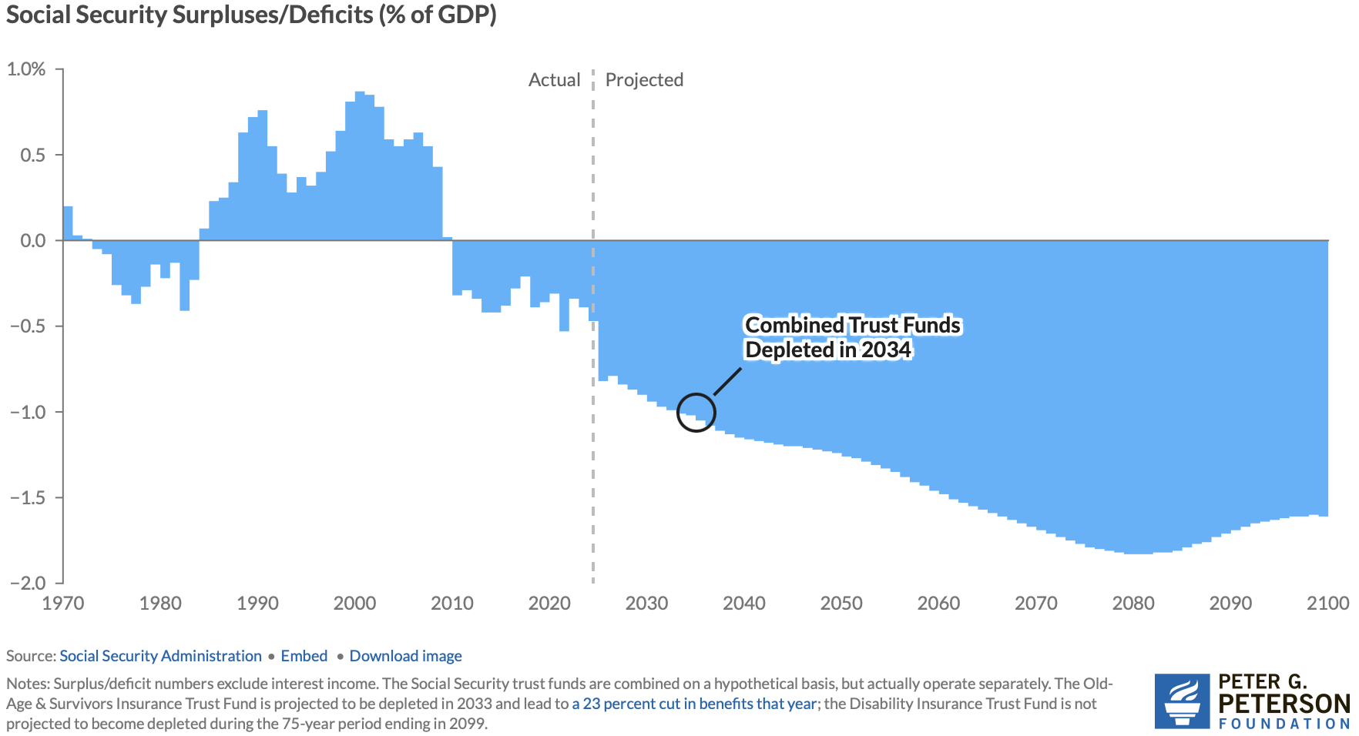
Annual Contributions to the Fund Vary
Social Security
Amendments Act
Of 1983

Slide 23
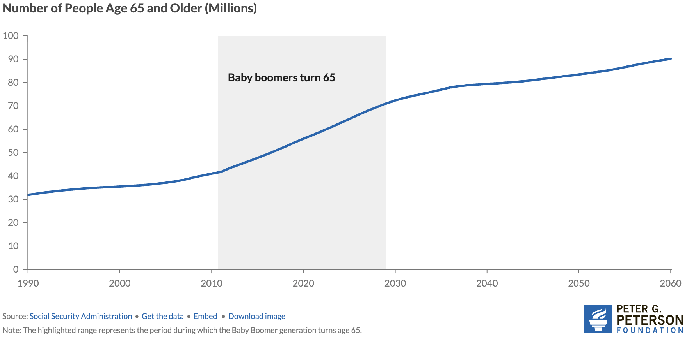
Why the Change in Direction? Aging Population
Source: https://www.pgpf.org/article/how-does-social-security-work/

Slide 24
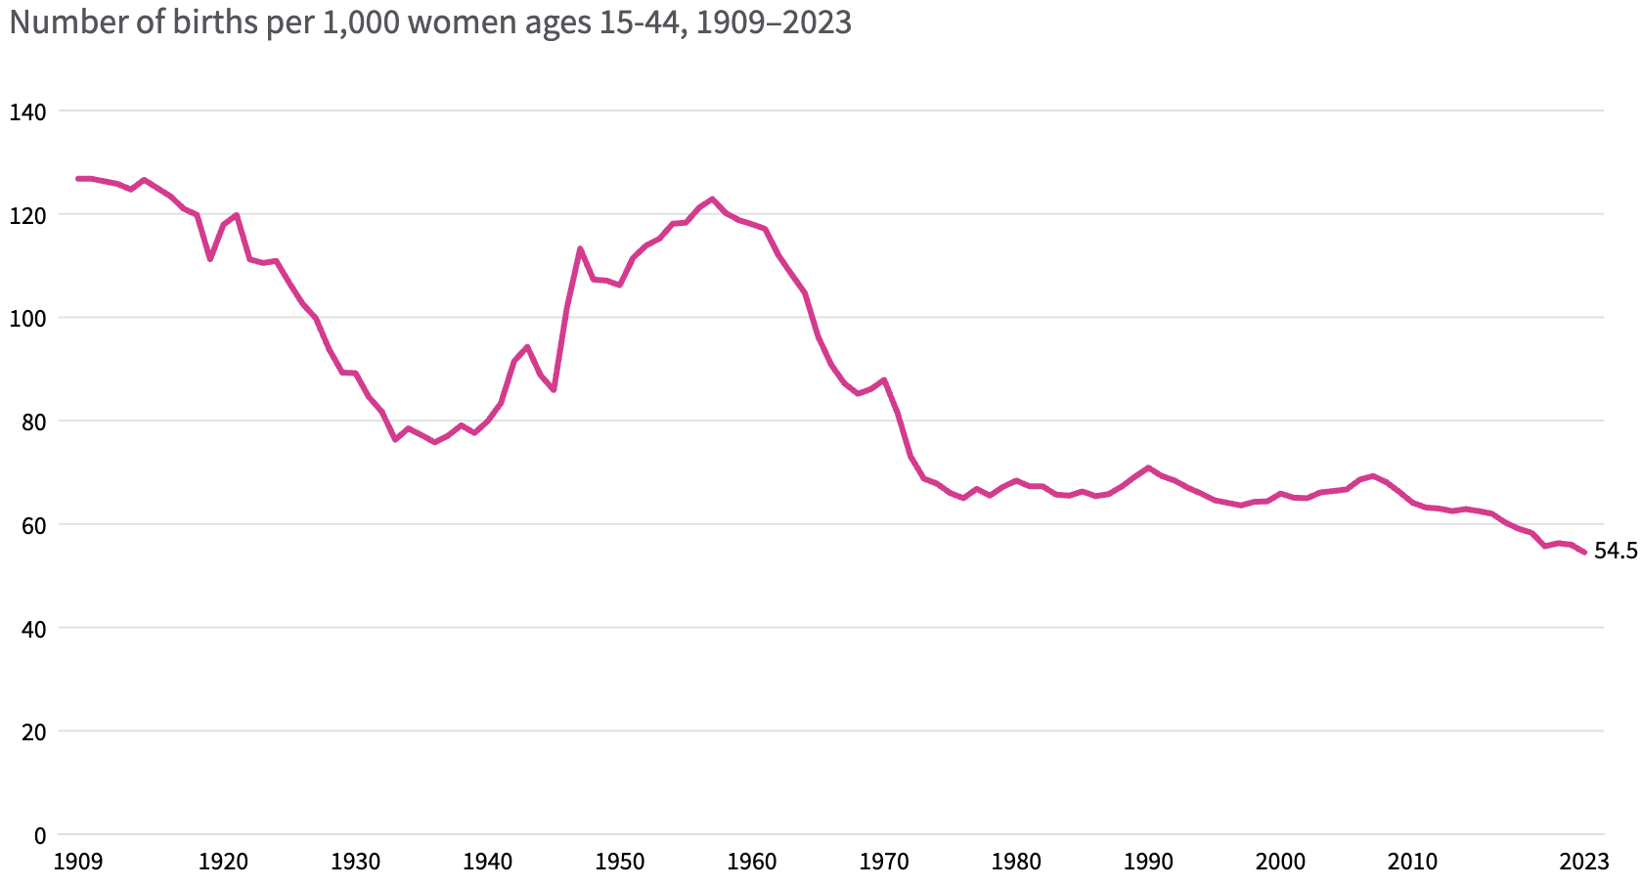
Lower Births = Slower Labor Force Growth
Source: https://usafacts.org/articles/how-have-us-fertility-and-birth-rates-changed-over-time/

Slide 25
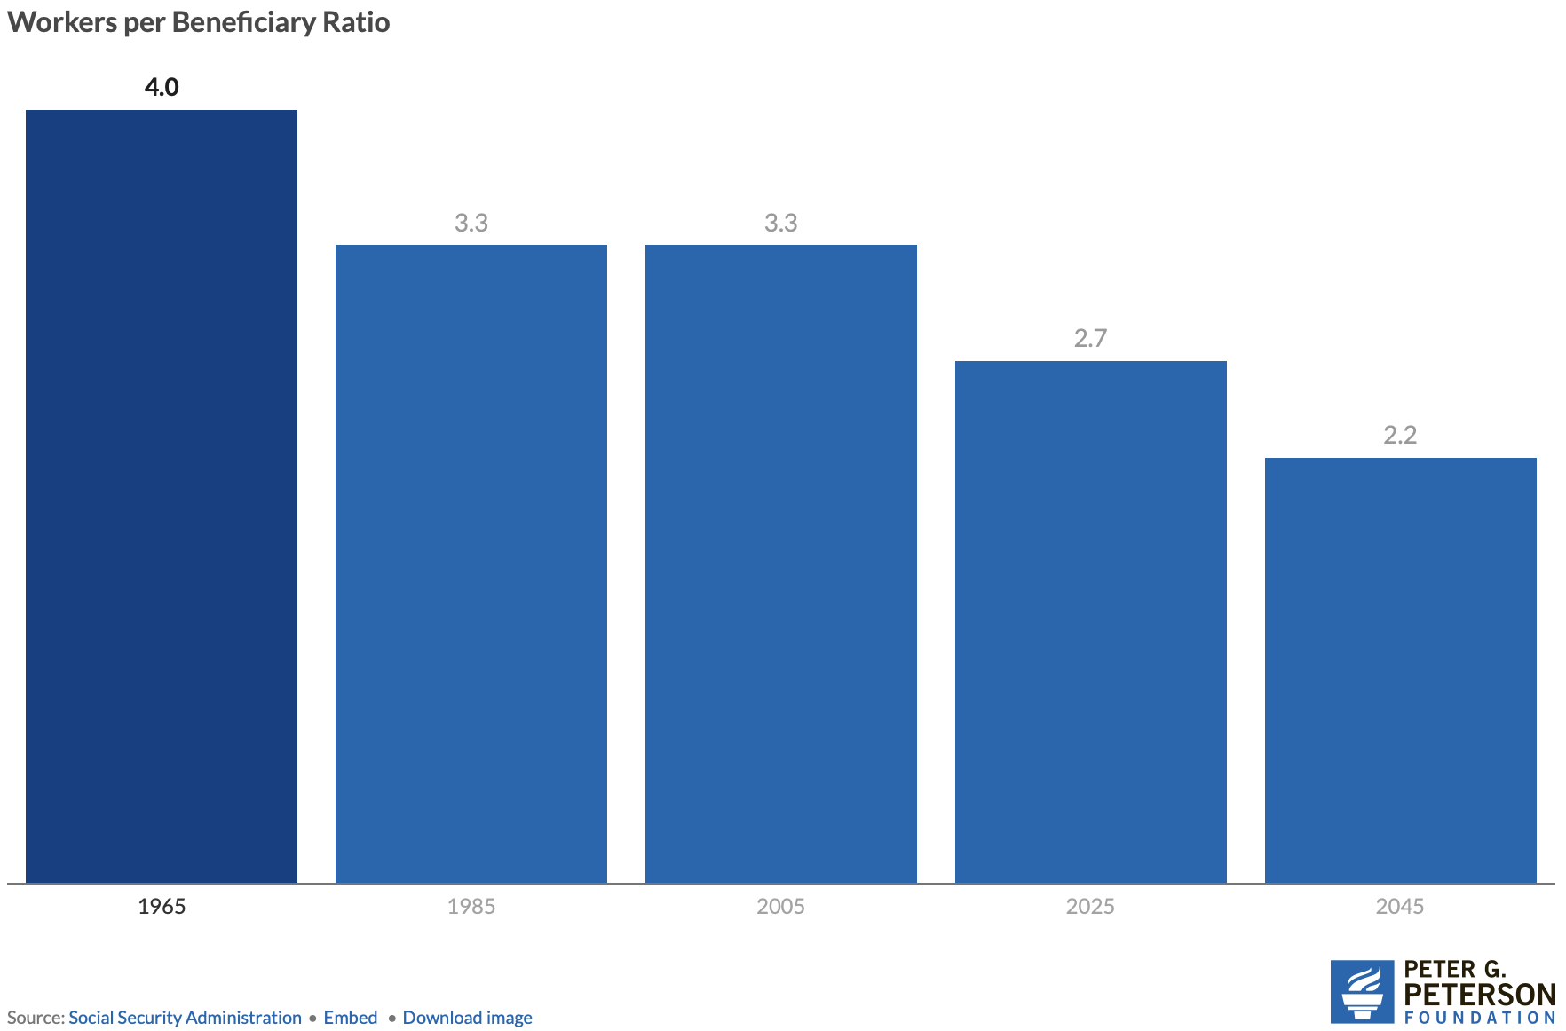
Number of Covered Workers per Beneficiary
Now

Slide 26
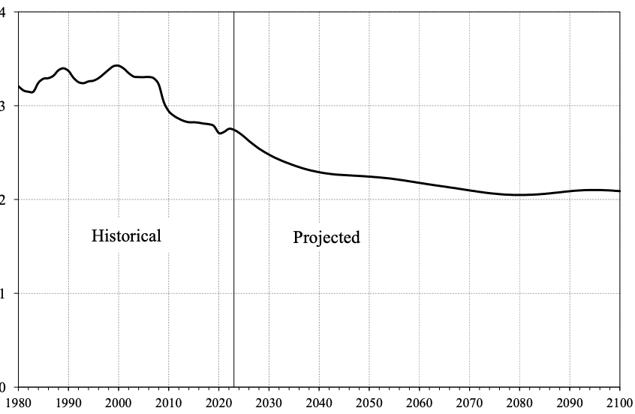
Number of Covered Workers per Beneficiary
Baby boomers started retiring.
Source: https://www.ssa.gov/OACT/TR/2024/tr2024.pdf

Slide 27
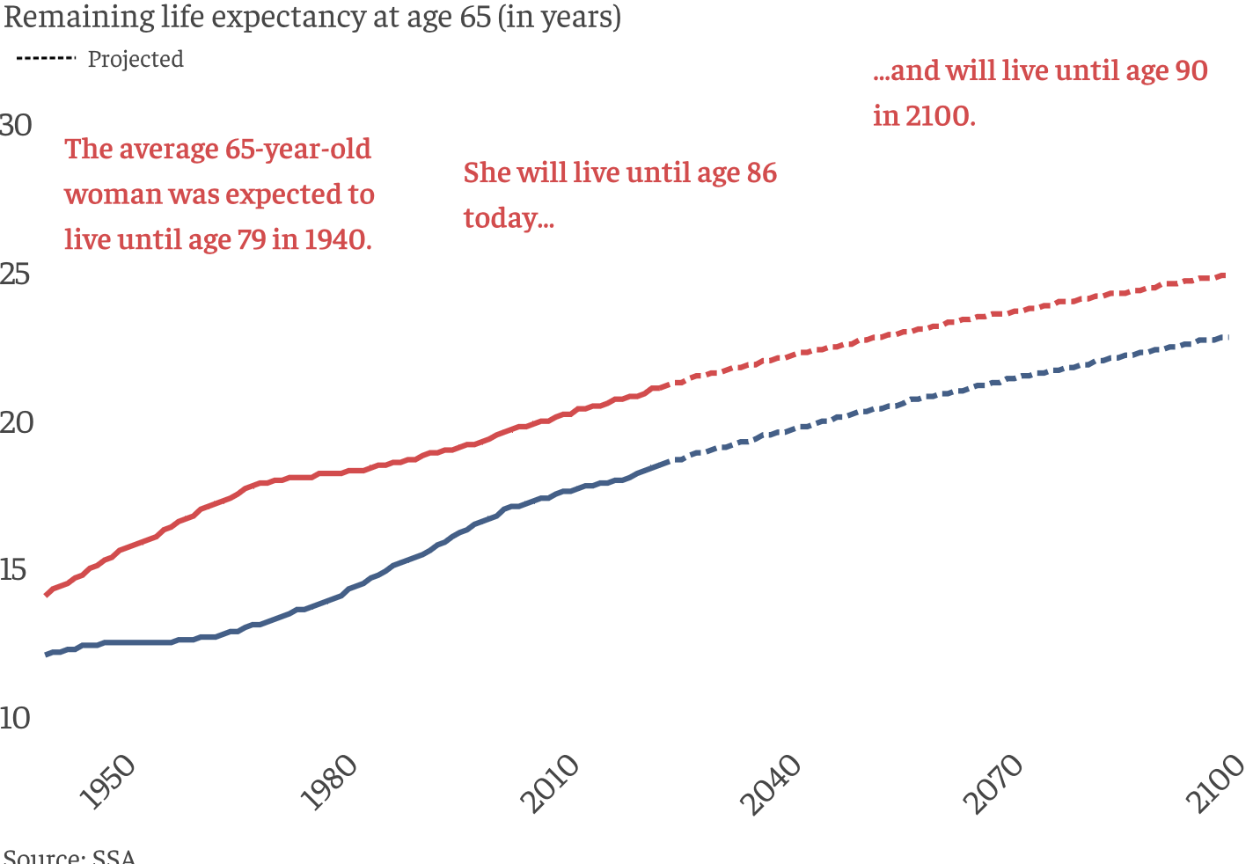
Life Expectancy Continues to Rise

Slide 28
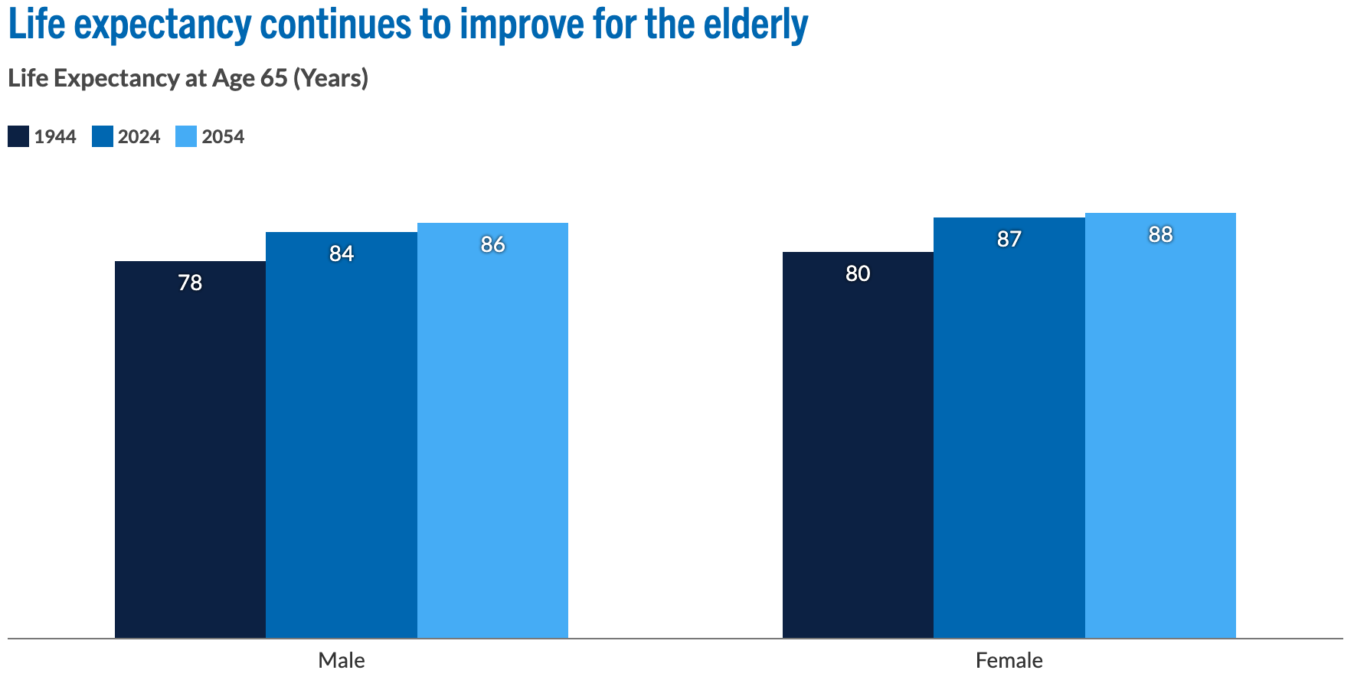
Life Expectancy Continues to Rise
Source: https://www.pgpf.org/article/how-does-social-security-work/

Slide 29
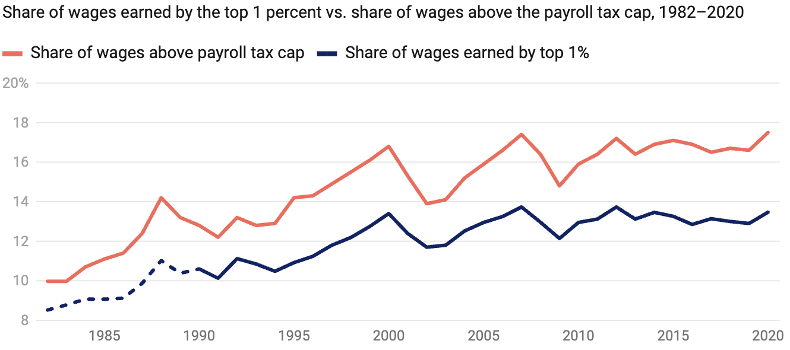
Increased Wage Inequality Is A Problem
Source: https://www.americanprogress.org/article/increased-wage-inequality-has-reduced-social-securitys-revenue
Notes:
The effect on net revenues is to reduce them.
https://www.americanprogress.org/article/the-effect-of-rising-inequality-on-social-security/#:~:text=Rising%20income%20inequality%20poses%20a,that%20higher%2Dearning%20workers%20receive.

Slide 30
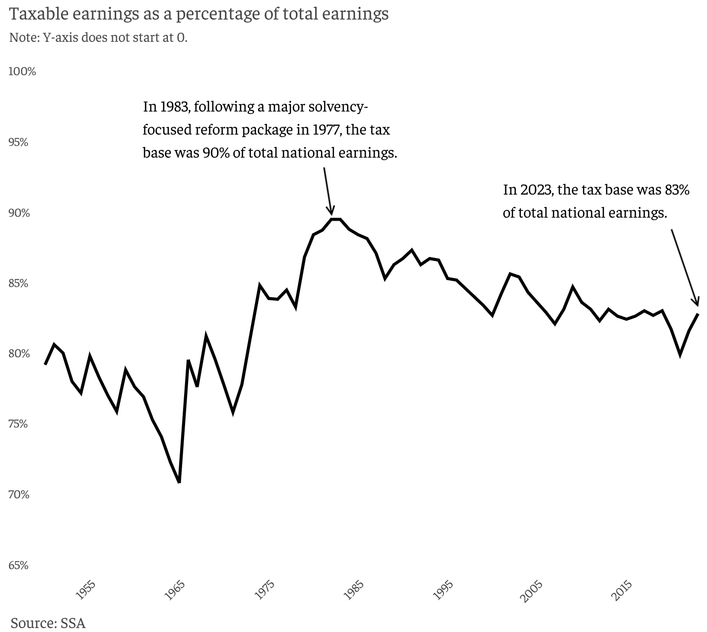
Tax Base is Dwindling
90%
83%

Slide 31
Trajectory of Funds

Slide 32
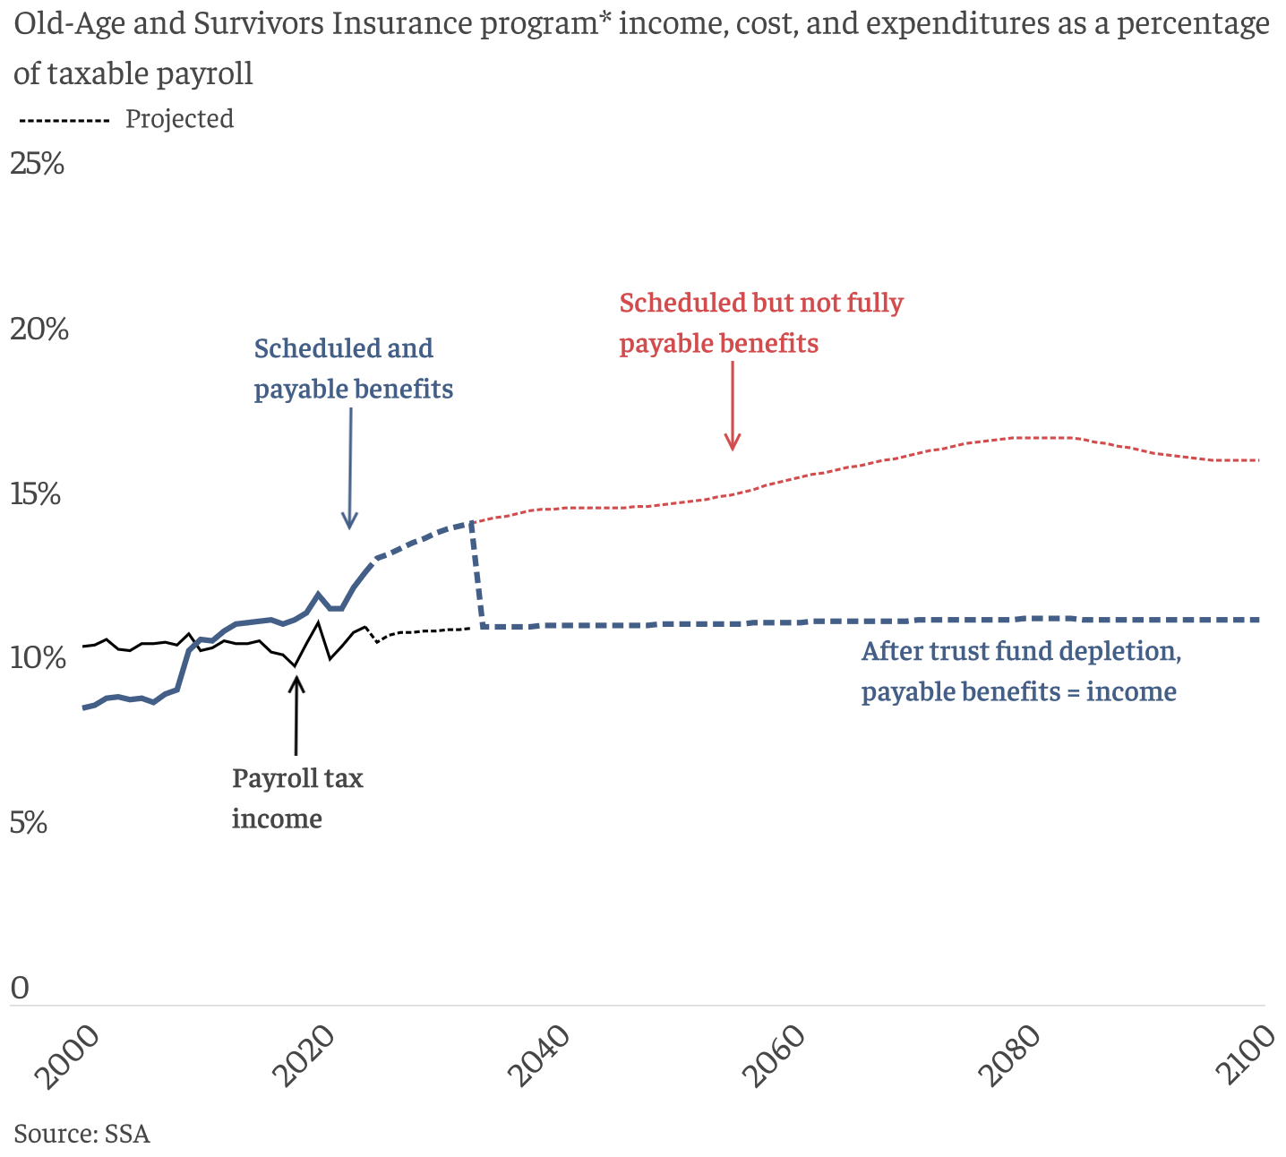
What Happens When The Trust Funds Run Out?
Benefit Cut: 26%
2098
Trust Fund Exhaustion, 2033
Benefit Cut: 18%

Slide 33
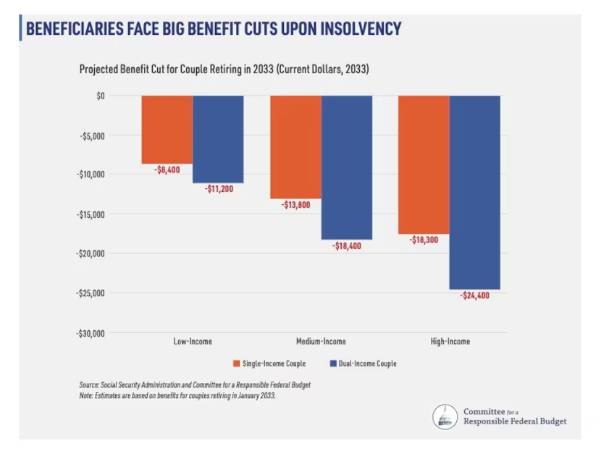
An Idea of the Implications

Slide 34
Where Does the Money Come From?
Payroll taxes
Taxes on benefits
Interest earnings
Trust funds

Slide 35
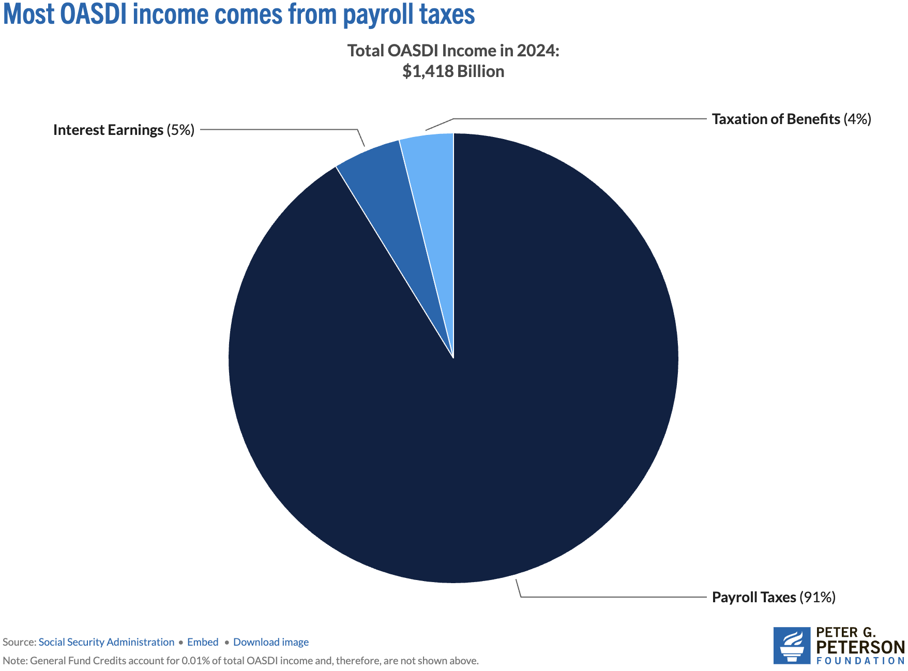
Sources of SS Revenue

Slide 36
Where Does The Money Go?

Slide 37
Where Does The Money Go?
Different benefits:
  Retirement Benefits
  Disability Benefits
  Survivor Benefits
  Supplemental Security Income (SSI)
We will focus on retirement benefits.

Slide 38
What Determines my SS Benefit (PIA)?
(Primary Insurance Amount)
Your work history.
  You need 40 work credits to qualify.
  In 2025, 1 credit = $1,810 in earnings.
  Put another way: 10 years with social security earnings in each year of $21,720.
Your (capped) earnings history.
  Indexed (to wages) earnings from the 35 highest-earning years.
Your birth year.
  Determines your FRA – Full Retirement Age.
  Born before 1960, it is 66-67, after 1960, it is 67.
Your claiming age.
  Claiming at 62 instead of 67 reduces your benefit by 30%.
  Higher if you wait until 70.
  Increases approximately 8% each year that you wait.

Slide 39
What Determines my SS Payment Size (PIA)?
(Primary Insurance Amount – PIA)
(Adjusted Indexed Monthly Earnings - AIME)
Earnings History
Age at Which You Start Receiving SS
AIME is calculated using your 35 highest years of indexed earnings.
These earnings are then adjusted for wage inflation.
The AIME is used to determine your PIA, which is the amount you would receive if you start receiving benefits at your full retirement age.
You can start receiving benefits as early as age 62, but your monthly payment will be reduced if you choose to start before your full retirement age.
Waiting to start benefits until after your full retirement age (between 66 and 67, depending on your year of birth) will increase your monthly payment.
You receive the highest possible benefit by waiting until age 70.

Slide 40
How Big are Payments?
In 2025:
  the average payment was $2,002.
  Maximum if claim at age 62 was $2,831.
  Maximum if claim at age 70 was $5,108.
Special minimum Social Security benefit:
  For long-term, low-wage workers.
  Minimum for 11 years of work: $52.10
  Maximum for 30 years of work: $1,093.10

Slide 41
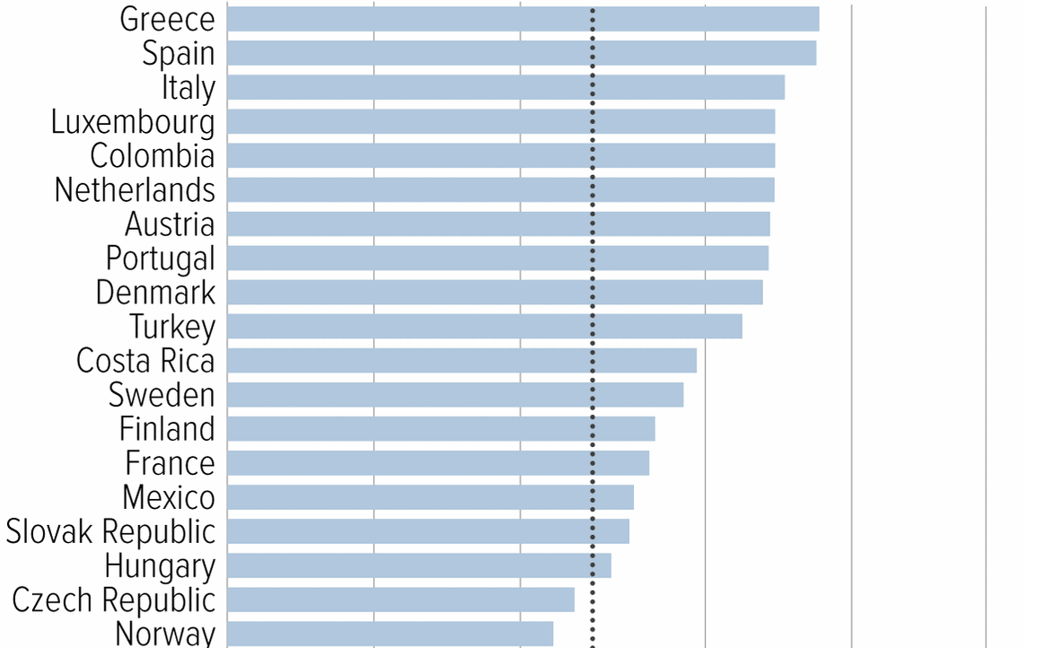
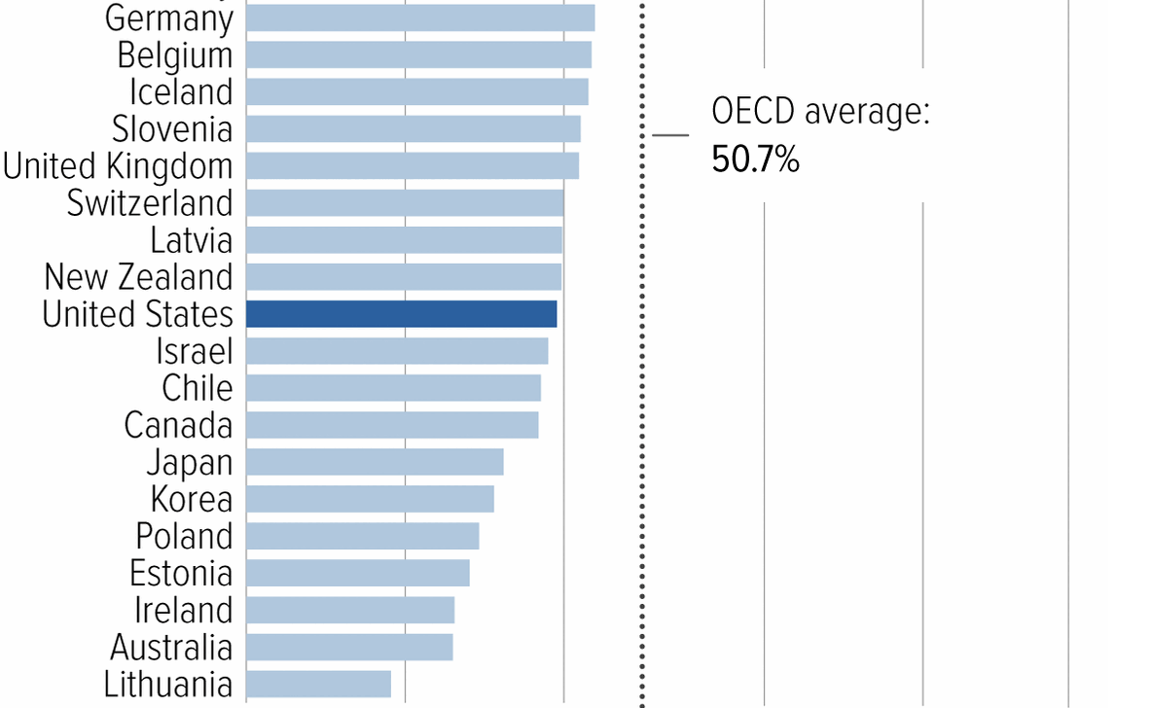
Social Security Benefits are Comparatively Low
Source: https://www.cbpp.org/research/social-security/top-ten-facts-about-social-security

Slide 42
Remember: We Have A Problem

Slide 43
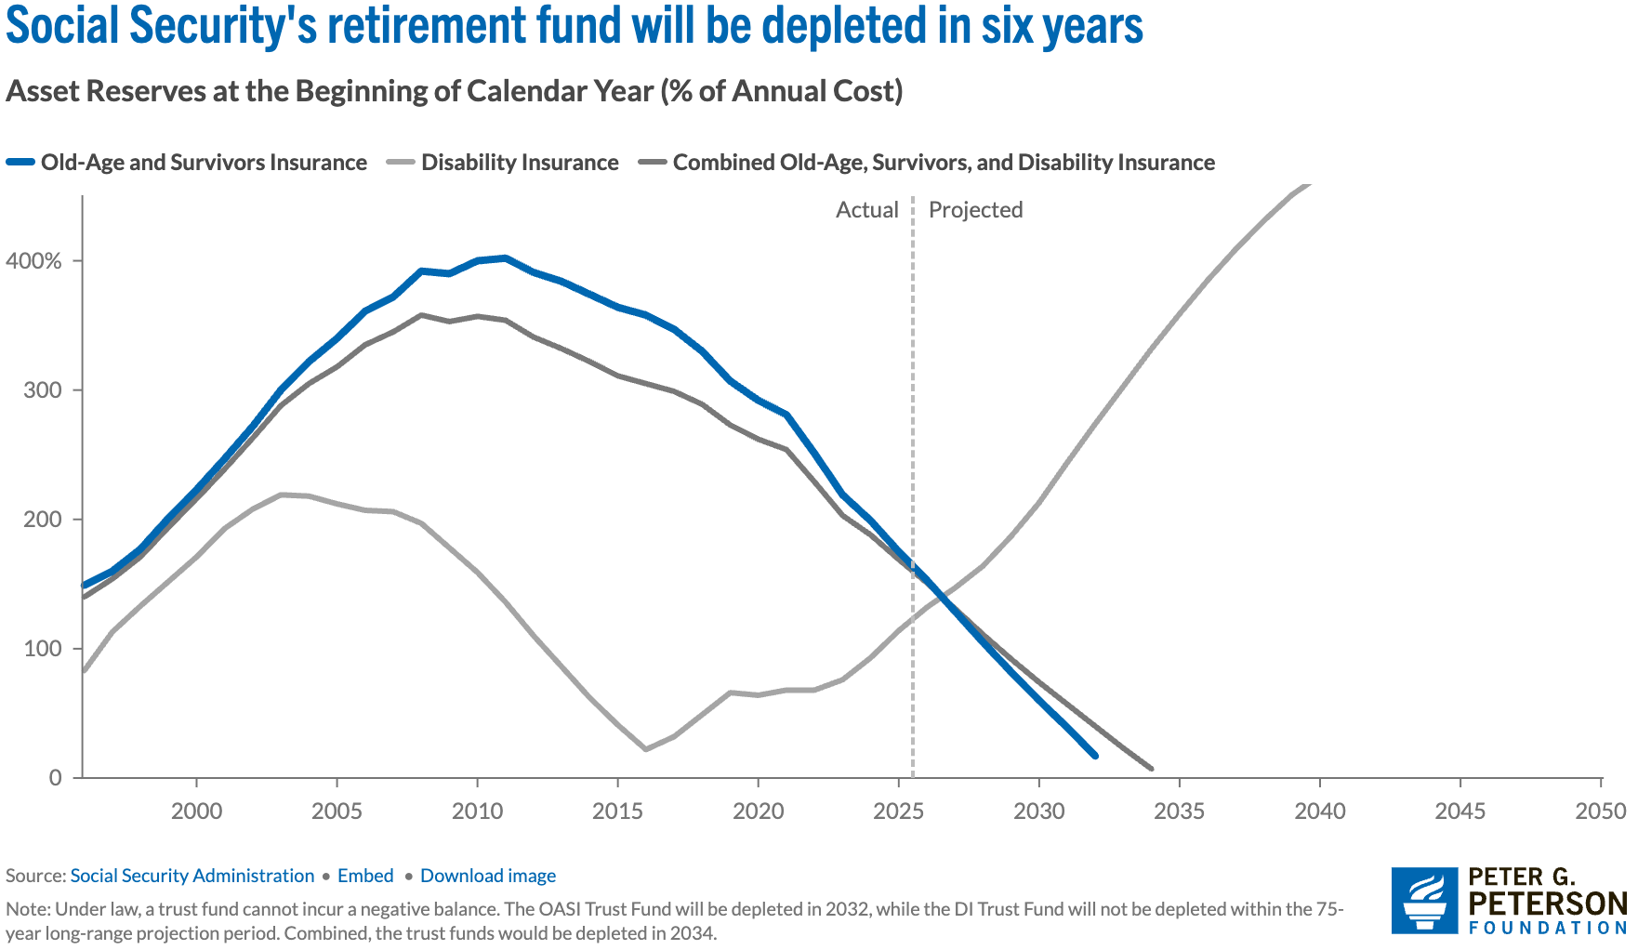
Trust Funds Are Running Out
Source: https://www.pgpf.org/article/social-security-faces-serious-financial-shortfalls-and-other-takeaways-from-the-trustees-report/

Slide 44
So, We Have A Problem
Benefit Cut: 26%
2098
Trust Fund Exhaustion, 2033
Benefit Cut: 18%

Slide 45
Hard Choices (?)

Slide 46
Let’s Cut to the Chase…
Solving the social security problem is simple:
Backfill out of general revenues!
Why won’t this happen?
Politics!
Our debt situation.
Maybe it shouldn’t.

Slide 47
SS as Social Insurance vs Welfare?

Slide 48
Let’s Consider Some Other Options
Changes to revenues
Changes to benefits

Slide 49
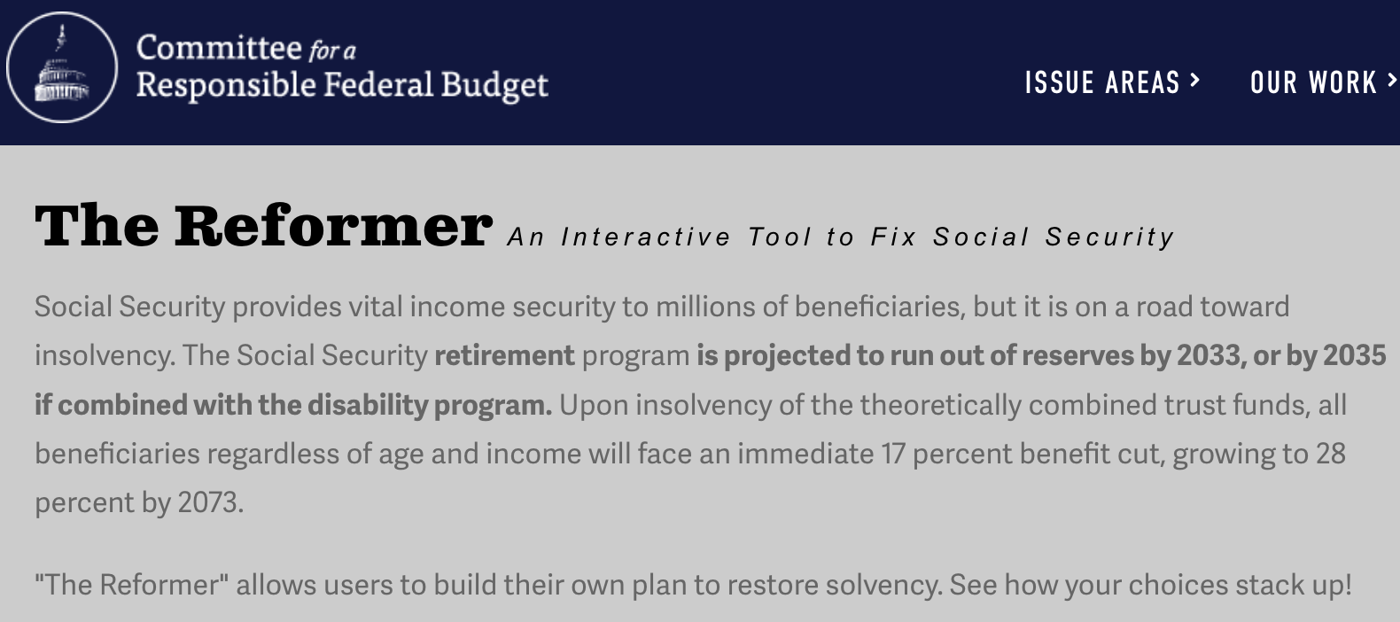
The Following Simulations Brought to you by:
https://www.crfb.org/socialsecurityreformer/

Slide 50
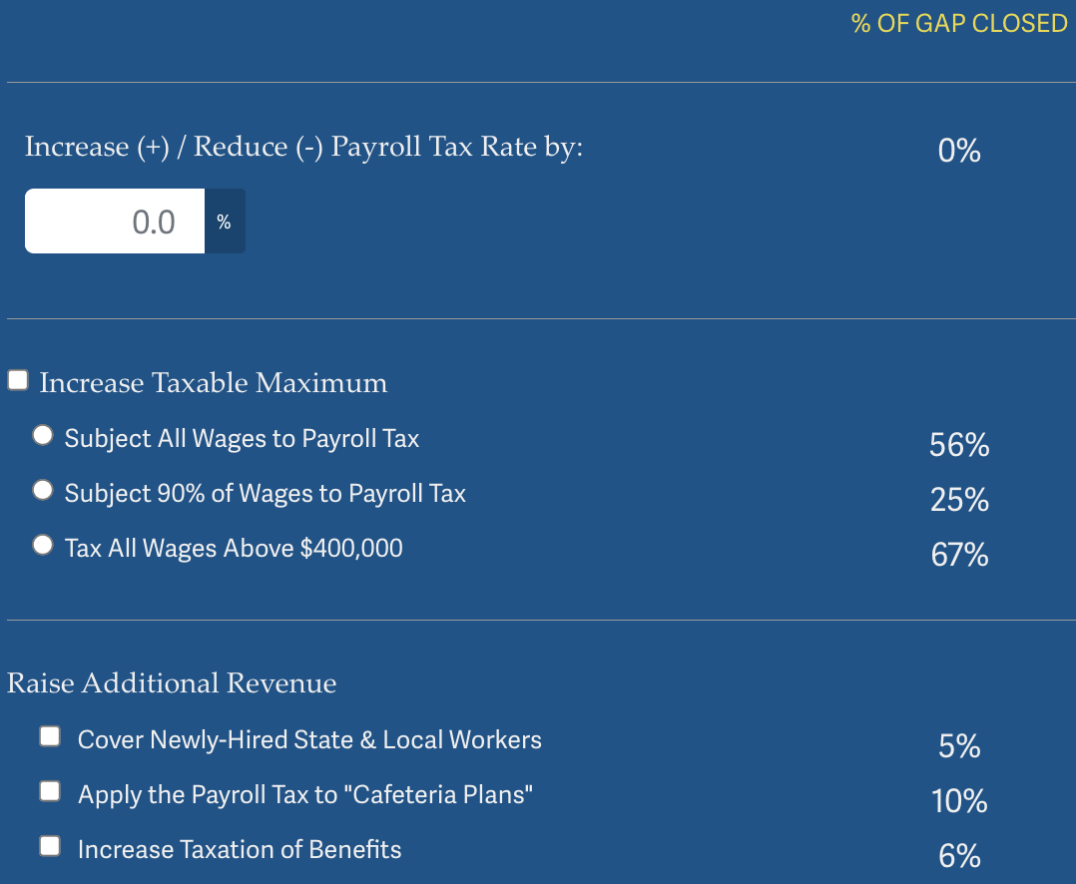
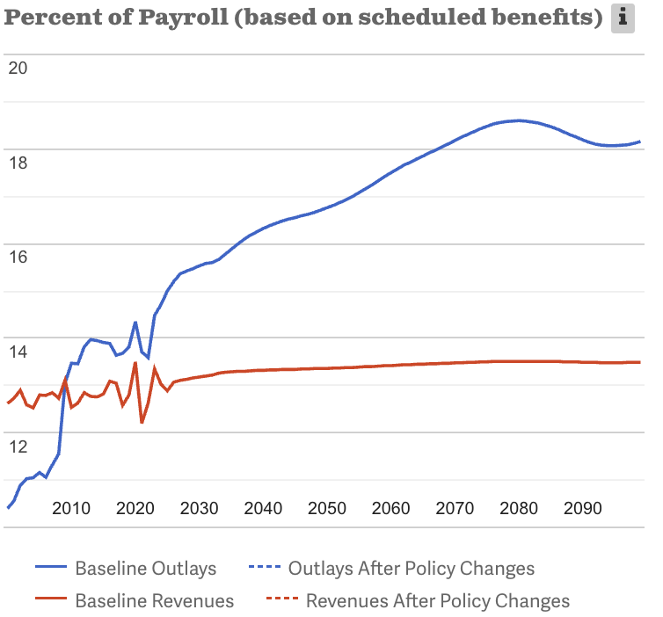
Possible Changes to Revenues
Source: https://www.crfb.org/socialsecurityreformer/

Slide 51
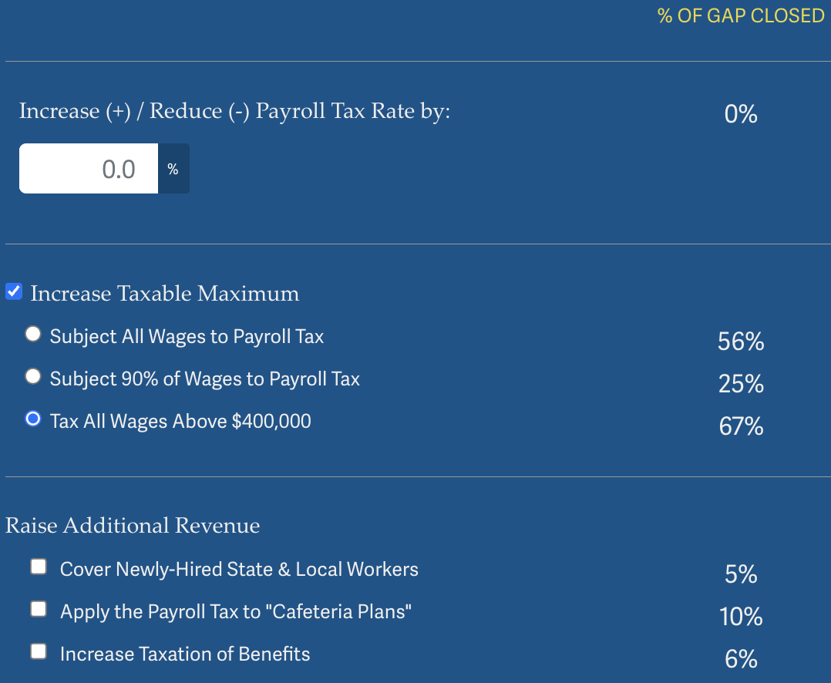
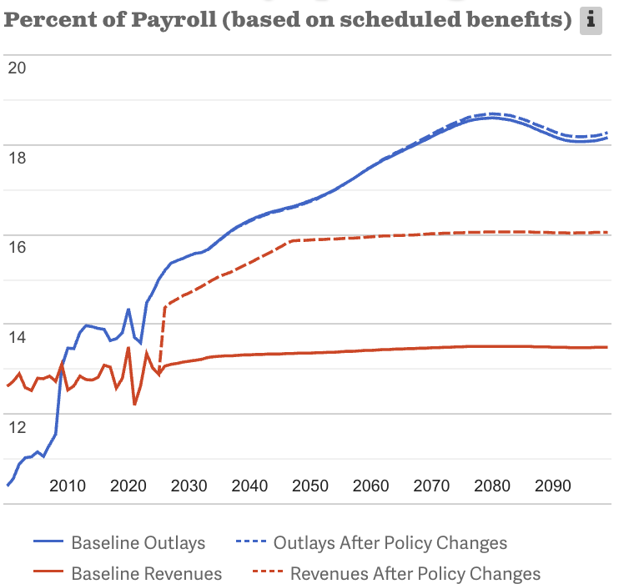
Possible Changes to Revenues: Example
Source: https://www.crfb.org/socialsecurityreformer/

Slide 52
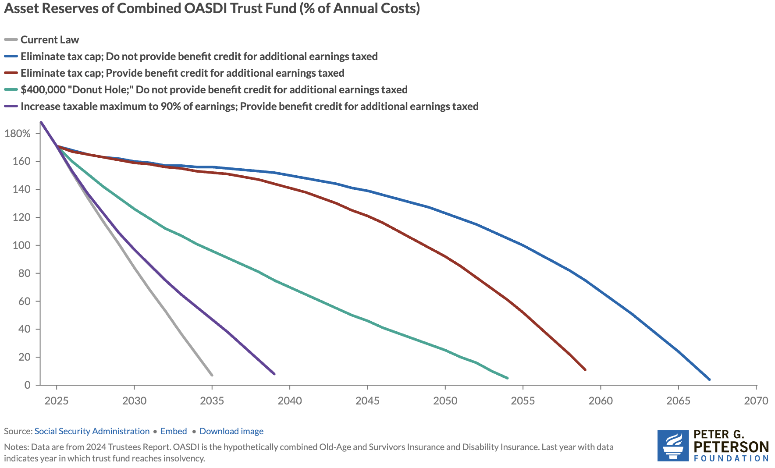
Changing the Cap Can Go A Long Way…

Slide 53
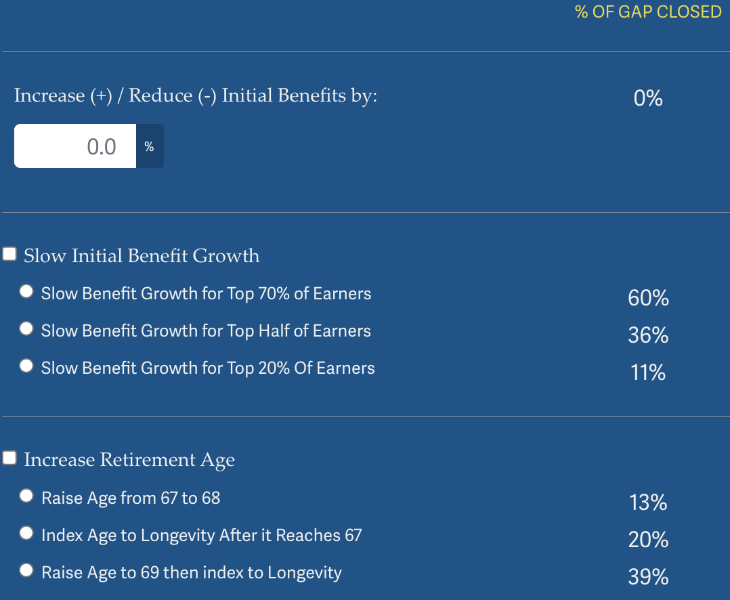
Possible Changes to Benefits
Source: https://www.crfb.org/socialsecurityreformer/

Slide 54
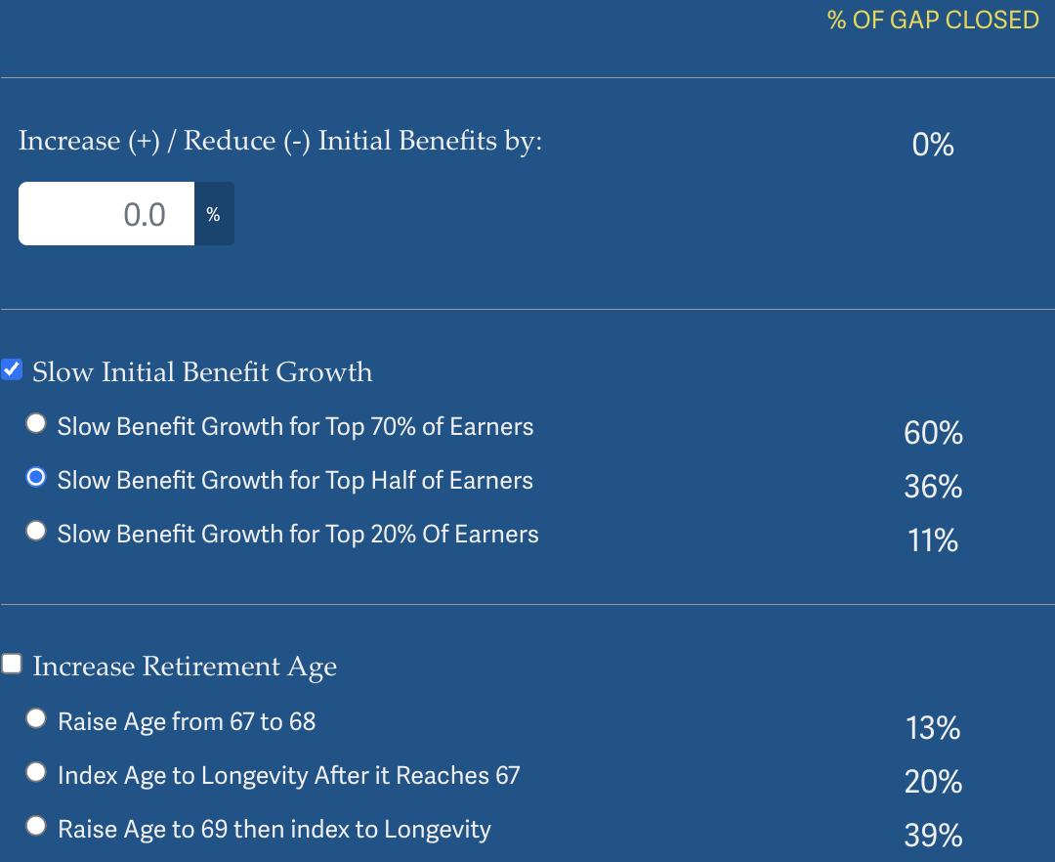
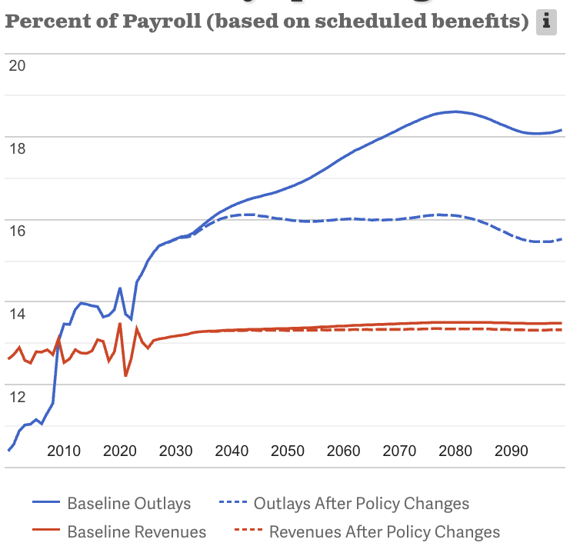
Possible Changes to Benefits: Example
Source: https://www.crfb.org/socialsecurityreformer/

Slide 55
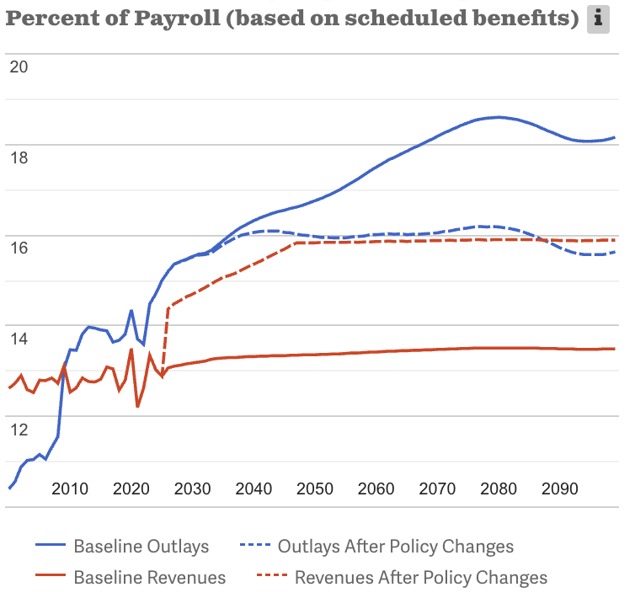
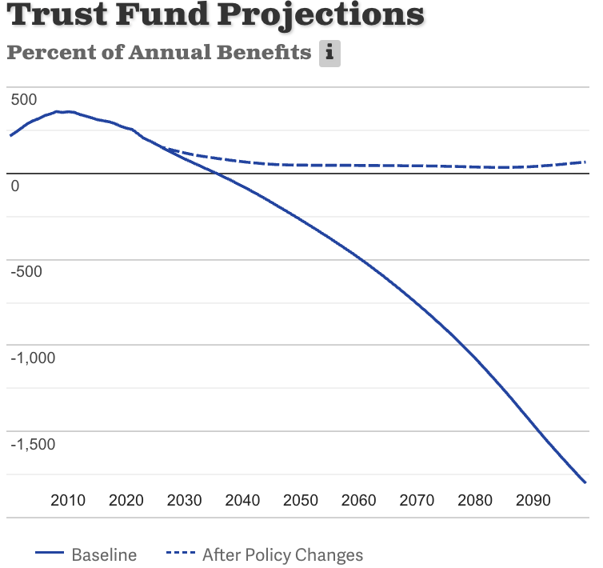
Suppose We Do Both! Problem Solved
Source: https://www.crfb.org/socialsecurityreformer/

Slide 56
Some Additional Thoughts on Options
COLAs – cost of living adjustments
  Merely another way of reducing benefits
Raising the retirement age
Investing in the stock market

Slide 57
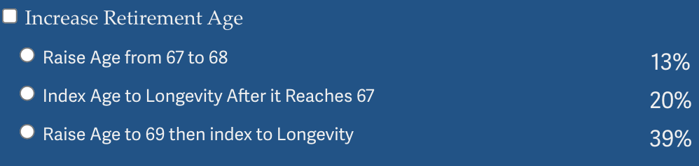
Raising the Retirement Age
Very regressive.
  Larger tax on low-income workers than high income workers.

Slide 58
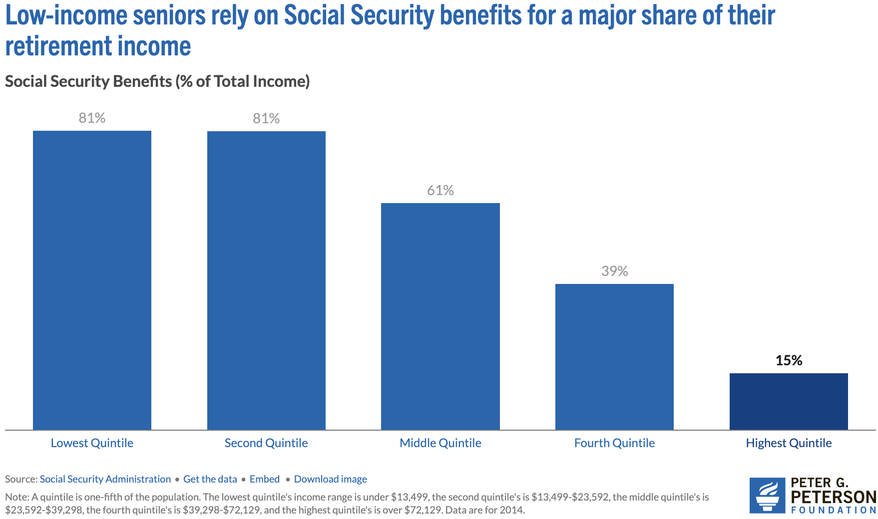
Program is VERY Important for Low-Income Retirees
Source: https://www.pgpf.org/article/9-facts-about-social-security-and-the-need-to-strengthen-it/

Slide 59
Raising the Retirement Age
Sex | Income Category | Life Expectancy (Years) | Difference High vs Low
Women | Highest Incomes (top 1%) | 88.9 | 10.1 years
 | Lowest Incomes (bottom 1%) | 78.8
Men | Highest Incomes (top 1%) | 87.3 | 14.6 years
 | Lowest Incomes (bottom 1%) | 72.7

Slide 60
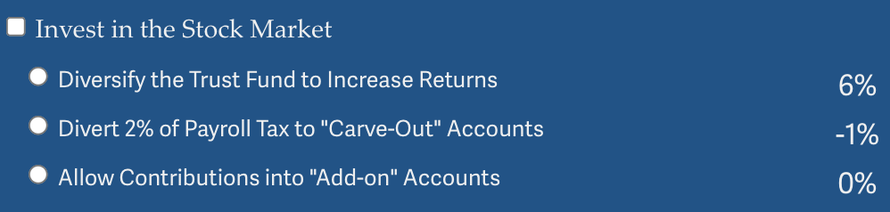
Investing in the Stock Market
Doesn’t do much to solve the problem.
Concerns with government investing in the stock market.
Logistics of allowing individuals to customize are enormous.
  And subject to political influence.
May increase the fragility of the system.

Slide 61
Other Solution? Tax More Than Just Earnings
Social Security is funded through payroll taxes.
Broadening the base would increase programmatic revenues.
This begs the question of why the program is funded only by a tax on earnings.
Other sources of income: capital gains.
Social security is an economic security program.
  Yet its revenue source is earnings.
  Is income a better indication of economic security?

Slide 62
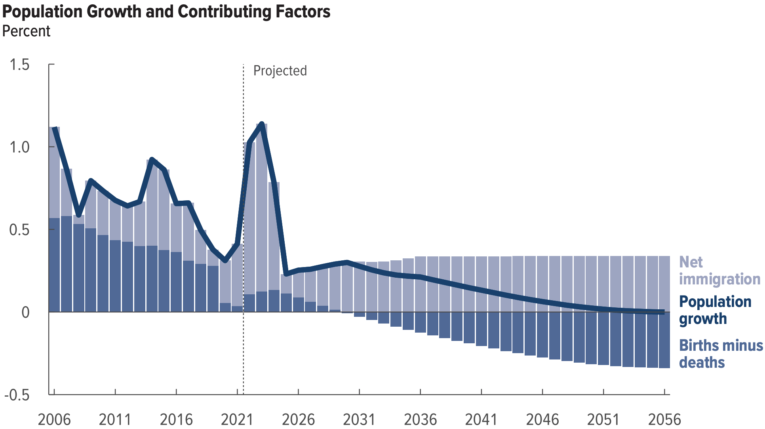
Another Solution?
Increase legal immigration of prime working age.
Source: https://www.cbo.gov/system/files/2026-01/61879-Demographic-Outlook.pdf

Slide 63
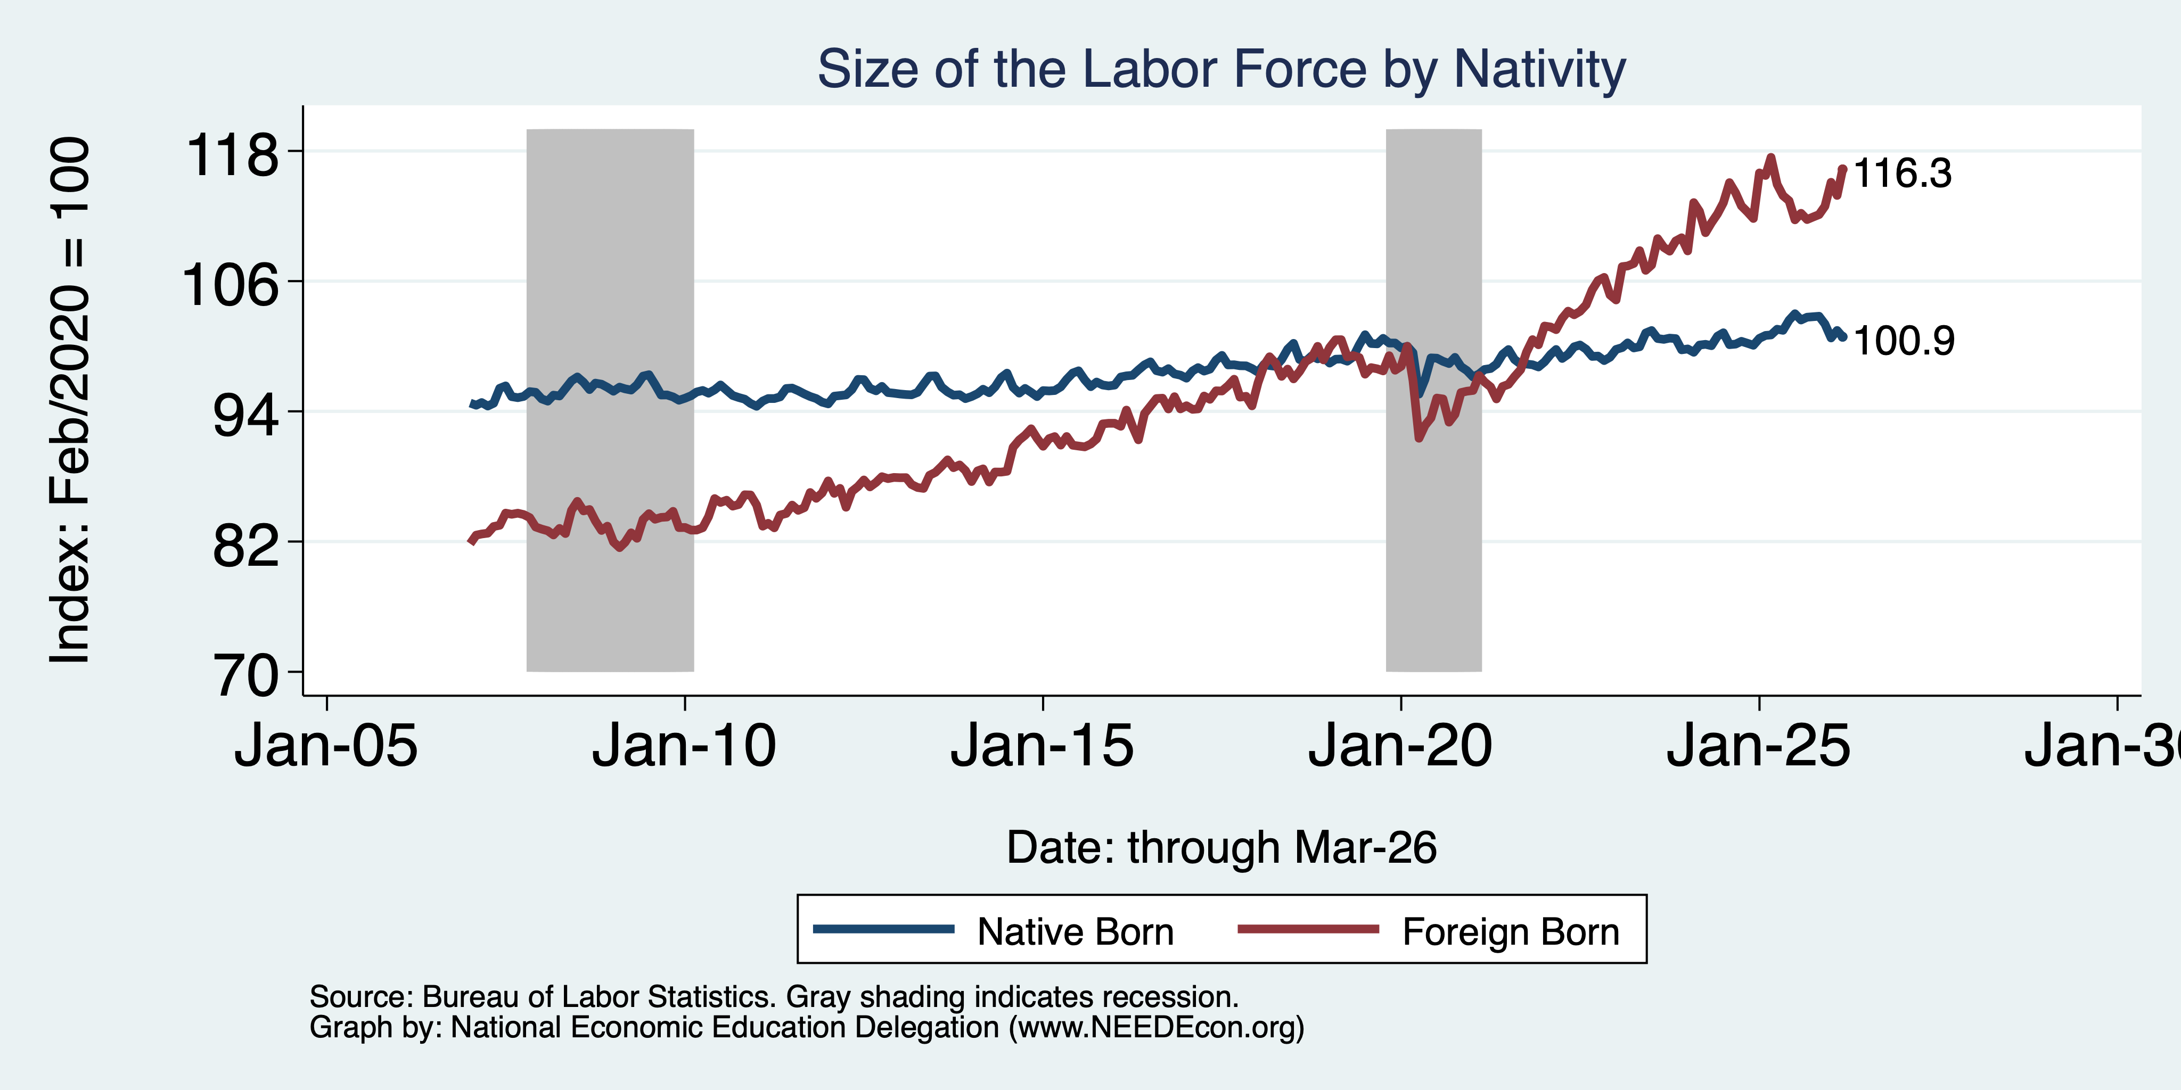
Immigrants to the Rescue?

Slide 64
General Principle of Solutions
Social security was originally created (primarily) to reduce economic instability among the elderly.
Shouldn’t solutions to the shortfall respect that original intent?
Regressive solutions are anathema to the original intent, disproportionately reducing the program’s effects on those most at risk of economic instability.
Equality of contributions to the solution increase economic instability among the elderly.
Progressive solutions are more likely to respect the original intent.

Slide 65
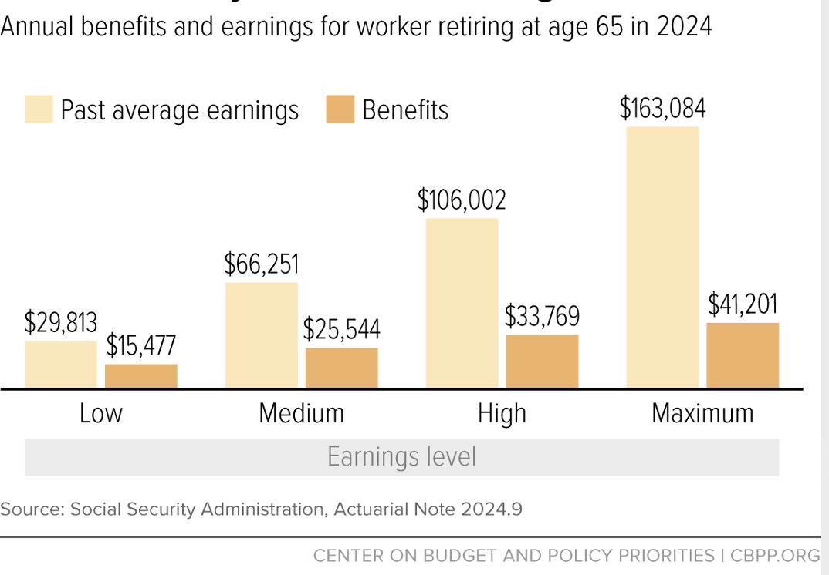
Social Security Benefits are Progressive

Slide 66
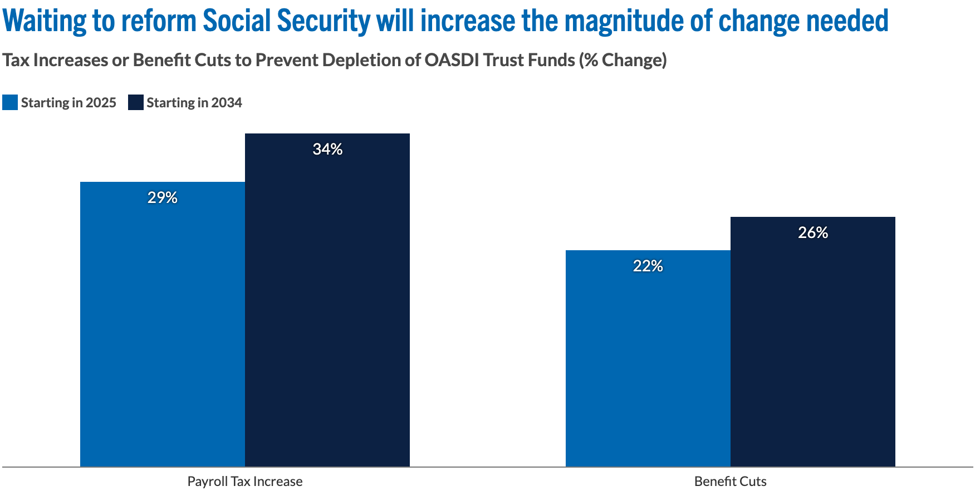
Important Note:
Source: https://www.pgpf.org/article/social-security-faces-serious-financial-shortfalls-and-other-takeaways-from-the-trustees-report

Slide 67
Summary
Social Security is an important part of the social safety net.
The OASDI Trust Fund is likely to be exhausted in 2033.
Why are the funds being depleted?
  An aging population – fewer paying in and more taking out.
  Declining birth rates - slowing the growth of the labor force.
  Wage inequality – more and more wages are above the wage cap.
What happens when the funds are depleted?
  Benefits may have to be reduced by 18%.
  The system will continue!
Solutions abound. The problem is political will.
  The needed changes will be unpopular, but they are very manageable.

Slide 68
Thank you!
Any Questions?
www.NEEDEcon.org
<presenter name>
<presenter email>
Contact NEED: info@needecon.org
Submit a testimonial: www.NEEDEcon.org/testimonials.php
Become a Friend of NEED: www.NEEDEcon.org/friend.php

