Slide 1
Inequality and Poverty
Financial Crisis and Government Policy Response: Lessons for the Next Crisis

Slide 2
Objectives of this presentation
Review briefly origins of the 2007-2009 crisis.
Explain the numerous monetary policy and fiscal policy interventions undertaken to mitigate the recession and spur economic recovery.
Assess the impacts of these policies:
Effects on financial markets and major macro variables such as growth, unemployment and inflation;
Costs to tax payers;
Assess some of the relative differences in benefits and costs of these policies.
Draw lessons for the future.

Slide 3
Origins of the 2007-2009 crisis: Triggers
The first well-known trigger is the collapse in house prices:
Myopic housing market valuation, irresponsible mortgage lending and securitization practices fueled in early 2000s a run-up in house prices that did not reflect housing market fundamental value (so called house-price bubble);
This run-up came to an abrupt end in 2006-2007 when house prices started to decline sharply.
Decline in house prices triggered concerns about the quality of subprime mortgages and, consequently, about the quality of securities deriving their value from those loans: mortgage backed securities (MBS).
Home owners and security holders suffered huge losses:
By 2012 the 30% decline in house prices eliminated nearly $7 trillion in paper wealth.
Subsequent declines in residential construction and house prices, and rising mortgage defaults and foreclosures weighed on the U.S. economy.

Slide 4
Origins of the 2007-2009 crisis: Amplifiers
Initial losses to home owners and subprime mortgage holders caused a deep crisis because magnified by key amplifying factors:
Vulnerabilities in the financial system:
High levels of leverage (debt/equity), excessive dependence on unstable short-term funding, and the use of exotic financial instruments that obscured concentrations of risk.
Gaps in government regulation:
Regulatory structure allowed some systemically important firms and markets to escape comprehensive supervision.
Reckless and excess borrowing by companies and individuals with inadequate credit credentials that had to deleverage quickly
Banks borrowed mostly from depositors and creditors (who can demand their money back) rather than from shareholders (who cannot demand repayment);
Most of the largest financial institutions borrowed short and lent at long maturity, investing in relatively less liquid securities.
Pre-crisis, household debt was 73% of GDP (now it is around 51%) and household debt service payments as percent of disposable personal income was 13.3%, it has been picking up and it is now at around 10.3%.

Slide 5
Origins of the 2007-2009 crisis: Amplifiers continue
Blind spots in the financial regulatory structures of the United States proved particularly damaging.
Before the crisis, regulatory structures were designed for earlier eras and did not adequately adapt to rapid change and innovation in the financial sector, such as
Increasing financial intermediation taking place outside of regulated depository institutions through the so-called shadow banking system (i.e., set of institutions and markets that carry out traditional banking functions but do so outside the traditional regulated system of depository institutions. Examples: money market mutual funds, markets for repurchase agreements (repos), investment banks, and mortgage companies);
Shadow banks being not regulated by the Fed had no access to Fed’s credit and liquidity facilities;
This strongly undermined market confidence in parts of shadow banking system at crisis’ onset;
Lack of and delay in oversight of most common and dangerous derivatives and financial leverage.
Potentially, pre-crisis deregulation of financial institutions.

Slide 6
Fiscal policy interventions during the crisis
The logic behind fiscal stimulus is simple: the Government temporarily increases its own spending to increase aggregate demand for goods and jobs; and/or cuts taxes to induce households and businesses to spend more and hire more;
It has the purpose to mitigate the recession and/or propel a recovery, but it is not intended to speed up longer-term economic growth
Few policies stand out among the many complex policies approved by Congress:
Trouble Asset Relief Program (TARP) passed in early October 2008, which established a $700 billion bailout fund to provide capital to banks that needed to survive;
American Recovery and Reinvestment Act (ARRA) passed in mid-February 2009 and provided about $830 million in stimulus measures such as: infrastructure spending, transfers to state and local governments (e.g., Medicaid, education), transfers to persons (e.g., unemployment assistance, food stamps), and tax cuts;

Slide 7
Fiscal policy interventions during the crisis, continue
TARP: one of the most common rhetoric was/still is that this policy was meant to save “Wall Street” and not to protect “Main Street”
But if Banks had failed, credit to businesses and households would have dried up pushing the economy in an ever deeper recession.
Most banks that received capital under the TARP, with the exception of a few small banks, repaid the loans with interests and capital gains, so tax payers actually made money on the part of TARP that consisted of banks’ bailouts.

Slide 8
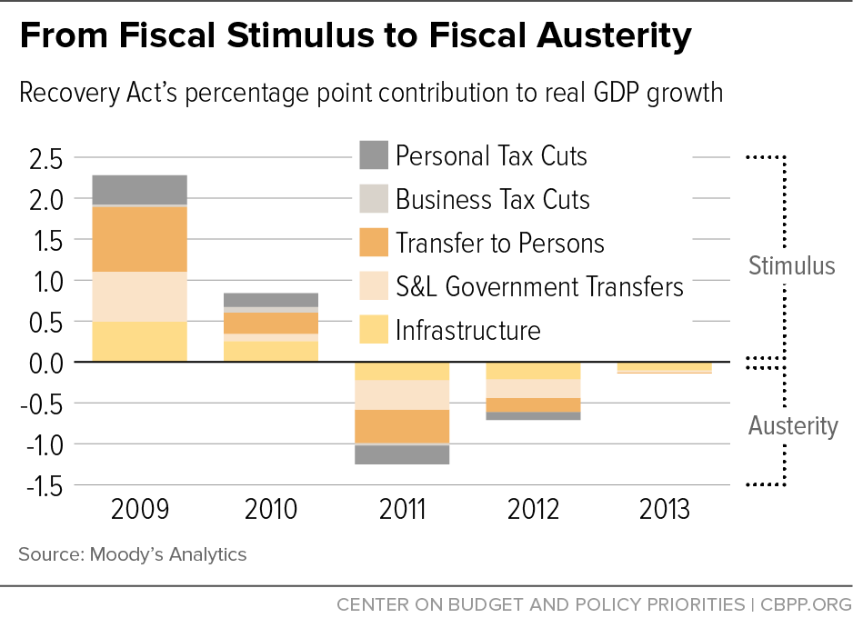

Slide 9
Macroeconomic effect of fiscal policy
Add estimates on unemployment and inflation

Slide 10
Monetary policy interventions during the crisis
The Federal Reserve slashed the short-term policy rate, FFR, to practically zero by December 2008:
Usually, a lower FFR pushes longer-term government bond yields lower; the decline in those yields, in turn, get transmitted to private yields such as mortgage rates and corporate bond yields thereby reducing the cost of credit for households and businesses.
Since the FFR was stuck at zero, the Fed lost its conventional monetary policy tool to stimulate the economy, then it had to come up with new tools to lower longer-term rates:
Explicit forward guidance: Fed communication meant to manipulate expectations of short-term rates at longer horizons;
Large Scale Asset Purchases, also known as Quantitative Easing: direct purchases of longer-term Treasury and agency securities (MBS) to push up their prices and down their yields.
Maturity Extension Program: purchases of longer-term Treasury securities financed by the sales of an equivalent amount of short-term Treasury securities, to shorten the average maturity of securities left in the portfolios of private investors.

Slide 11
Estimates of impact on longer-term rates (FEDS notes April 2017, by Bonis, Irhig, and Wei)
Make Full Screen
LSAP Policies | Estimated Decline in 10-Year Treasury Yield (basis points) at onset of the program | Other Studies
LSAP 1 | 34 | 91 - (Event Studies); 36 to 82 (Regressions) - Gagnon et al. (2011) 100 - Krishnamurthy and Vissing-Jørgensen (2011) 20 to 30 - (Treasury security purchases only) - D'Amico and King (2013) 35 - (Treasury security purchases only) - D'Amico et al. (2012)
LSAP 2 | 12 | 25 - Krishnamurthy and Vissing-Jørgensen (2011) 55 – D'Amico et al. (2012) 21 – Meaning and Zhu (2011) 15 – Swanson (2011)
MEP | 28 | 22 - Hamilton and Wu (2012) 17 – Meaning and Zhu (2012)
LSAP 3 | 31 | 60 - Engen, Laubach, and Reifschneider (2015)

Slide 12
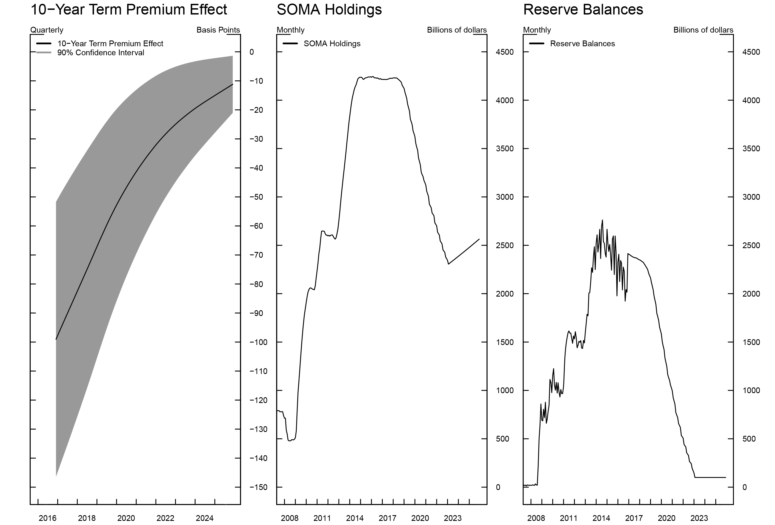

Slide 13
Transmission mechanism to the economy

Slide 14
Macroeconomic effect of unconventional monetary policy
Various models are used to estimate to examine the effects of balance sheet policies and forward guidance on the macroeconomy.
Engen, Laubach, and Reifschneider (2015) use FRB/US to study the effects of the Federal Reserve’s asset purchases and forward guidance for the federal funds rate through 2014.
They translate the balance sheet programs into a fall in longer-term Treasury yields and find that the collective effect of all of the Federal Reserve’s asset purchase programs and forward guidance policies had a peak effect of subtracting 1.2 percentage points from the unemployment rate in early 2015 and would have had a peak effect of raising inflation by 0.5 percentage point in 2016.
Baumeister and Benati (2013) use an SVAR in which they define an unconventional policy as one that moves the spread between long and short rates while leaving the level of short rates unchanged.
They find the level of GDP was about 3 percent higher at its peak than it would have been absent the intervention, while the inflation rate was about 1 percentage point higher. Moreover, their estimates indicate that policy also mitigated the risk of a severe recession accompanied by large deflation.

Slide 15
Federal Reserve’s remittance to Treasury
How unconventional monetary policy has been less costly than fiscal policy (WSJ article, January 10, 2018):
The Fed regularly transfers remittances, which are derived from profits on its bond holdings, to the Treasury in what amounts to payments to U.S. taxpayers, so it reduces the public deficit it does not increase it.
It transferred a record $97.7 billion in 2015, but the amount has declined since then and should continue to do so as the Fed shrinks its $4.4 trillion balance sheet.
For 2016, the Fed sent $91.5 billion to the Treasury as the interest paid by the Fed to major banks was $12 billion.
In 2017, the Fed sent $80.2 billion to the Treasury Department as the interest paid by the Fed to major banks last year rose to $26 billion.

Slide 16
Size of Fiscal and Monetary Policy Stimulus
 |  | Billions | Deficit impact: |  |  |  | Billions | Deficit impact:
 |  | committed | ultimate cost to tax payers*** |  |  |  | committed | ultimate cost to tax payers***
Fiscal Policy Stimulus |  |  |  |  | Monetary Policy Stimulus (not including rate cuts and forward guidance)
Treasury |  |  | 55 |  |  | Federal Reserve
TARP (non-finacial) |  | 151 | 55 |  |  | TALF* | 55 | -1
auto bailout |  | 84 | 17
small business aid |  | 15 | 0 |  |  | Measures but QE** | 4975 | 15
housing bailout |  | 52 | 28
 |  |  |  |  |  | QE1 | 1725 | 0
Congress |  | 1,460 | 1,484 |  |  | QE2 | 600 | 0
ESA of 2008 |  | 170 | 170 |  |  | QE3 | 1700 | 0
ARRA of 2009**** |  | 808 | 832 |  |  | MEP | 667 | 0
Tax Relief, UI, JCA2010 |  | 189 | 189
Middle Class Tax Relief |  | 125 | 125
and JCA 2012 |  |  |  |  |  | Total | 9,722 | 14
Others* |  | 189 | 189
Total** |  | 1,611 | 1,539
 |  |  |  |  |  | Note: We still need to account for IOER as a cost and
ESA=Economic Stimulus Act; JCA=Job Creation Act |  |  |  |  |  | subtract Remittance to Treasury
ARRA=American Recovery and Reinvestment Act |  |  |  |  |  | *Part of TARP
UI=Unemplyment Insurance |  |  |  |  |  | **Includes: Term auction credit, AIG rescue, Bear Sterns rescue,
*Includes: Calsh for clunkers; additional UI benefits; |  |  |  |  |  | Term Securities Lending Facility, Commercial Paper Funding Facility,
Education Jobs and Medicaid Assistance Act; Temporary |  |  |  |  |  | TALF not in TARP, MMF Funding Facility, Guarantee of BoA assets,
Payroll Tax Cut Continuation Act 2011 |  |  |  |  |  | Guarantee of Citigroup assets
**I am not including measures undertaken by the FDIC |  |  |  |  |  | ***Cost to tax payers in the form of higher inflation is not included
and the Federal Housing Administration (about $100bn) |  |  |  |  |  | for both fiscal and monetary poicy stimulus
****In part based on CBO estimates |  |  |  |  |  | and however inflation was very low over this period

Slide 17
Most notable differences between policies
Monetary policy stimulus much larger than fiscal stimulus: $9.7Tr versus $1.6Tr
But impact on GDP of fiscal stimulus in 2009-2010 estimated to be at least as large as monetary policy stimulus.
Monetary policy stimulus so far vastly less costly than fiscal stimulus: $14bn versus $1.5Tr
If Fed’s remittance to Treasury will decrease further, it will do so while the economy is booming.
In contrast, Fed’s remittance to Treasury was positive and large when economy was in recession, so tax payers needed money the most.

Slide 18
Lessons for Next Crisis

