Slide 1
2017 Tax Cuts and Jobs Act
<Audience>
Month, # 2018
<Your name, Ph.D.>

Slide 2
National Economic Education Delegation
Vision
  One day, the public discussion of policy issues will be grounded in an accurate perception of the underlying economic principles and data.
Mission
  NEED unites the skills and knowledge of a
  vast network of professional economists to promote understanding of the economics of policy issues in the United States.
NEED Presentations
  Are nonpartisan and intended to reflect the consensus of the economics profession.

Slide 3
Who Are We?
Honorary Board: 45 members
  2 Fed Chairs: Janet Yellen, Ben Bernanke
  6 Chairs Council of Economic Advisers
    Furman (D), Rosen (R), Bernanke (R), Yellen (D), Tyson (D), Goolsbee (D)
  3 Nobel Prize Winners
    Akerlof, Smith, Maskin
Delegates: 371 members
  At all levels of academia and some in government service
  All have a Ph.D. in economics
  Crowdsource slide decks
  Give presentations
Global Partners: 42 Ph.D. Economists
  Aid in slide deck development

Slide 4
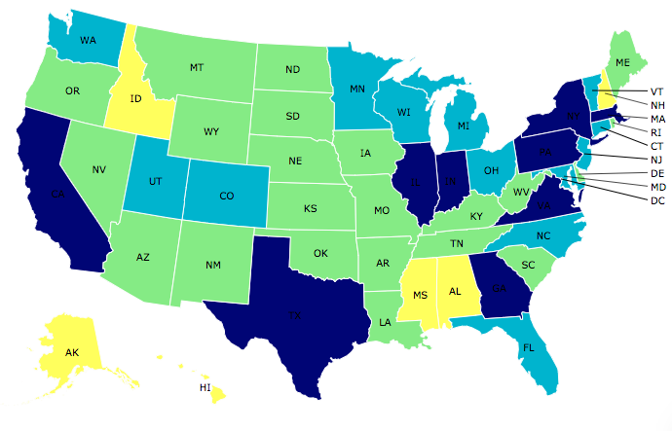
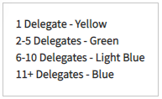
Where Are We?

Slide 5
Credits and Disclaimer
This slide deck was authored by:
  Jon Haveman, Executive Director of NEED
  Linus Yamane, Pitzer College
  Joseph Cordes, The George Washington
This slide deck was reviewed by:
Disclaimer
  NEED presentations are designed to be nonpartisan.
  It is, however, inevitable that the presenter will be asked for and will provide their own views.
  Such views are those of the presenter and not necessarily those of the National Economic Education Delegation (NEED).

Slide 6
Outline
What are the changes involved?
Implications for the economy
Budget implications
Other implications
  National debt
  Spending cuts
  Inequality
Evidence of benefits
Good policy for economic growth?
Summary

Slide 7
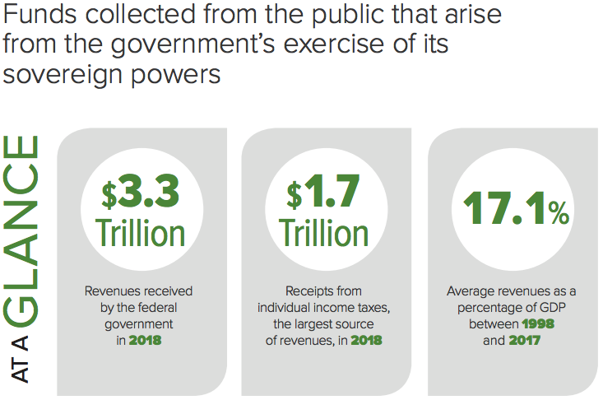
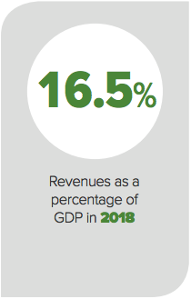
Federal Government Revenues in 2018
U.S. GDP: $20.6 Trillion
In 2018
Source: CBO – Revenues in 2018: An Infographic

Slide 8
Where Do Government Revenues Come From?
Billions of dollars in 2018 Budget Year
Source: CBO – Revenues in 2018: An Infographic

Slide 10
What Does the U.S. Gov’t Budget Look Like?
2018 Budget Summary
Revenue | Billions |  | Expenditures | Billions
Income Taxes | $1,684 |  | Mandatory | $2,520
Payroll Taxes | $1,171 |  | Discretionary | $1,263
Corporate Taxes | $205 |  | Interest | $325
Other | $270
Total | $3,329 |  | Total | $4,108
Budget Deficit: $779 Billion
Source: CBO, The Federal Budget in 2018: An Infographic
Notes:
https://www.cbo.gov/publication/53627
https://www.cbo.gov/publication/53624

Slide 11
Major Changes in the 2017 Tax Law
Permanent:
  Corporate Tax
    Flattens corporate tax rate at 21%.
    Changes taxation for foreign income of U.S. companies.
  Individual Income Tax
    Eliminates Affordable Care Act health insurance mandate.
    Changes inflation measures for changing tax parameters.
Temporary: 8 years
  Individual Income Tax
    Lowers individual tax rates and broadens the amount subject to tax.
    Changes exemptions to income taxation.
    Increased exemptions on wealth transfers at death.
Source: The Tax Cuts and Jobs Act, as Reported by Conference Committee (12/15/17): Static and Dynamic Effects on the Budget and the Economy,
Penn Wharton University of Pennsylvania Budget Model

Slide 12
Corporate Income Tax Changes: Summary
Tax Rate and Alternative Minimum Tax
  Was progressive (15-35%) and is now just a flat tax at 21%.
  Eliminates the Alternative Minimum Tax.
Corporate Tax Base
  Limited deductions for business interest, net operating losses.
  Changes expensing allowances.

Slide 13
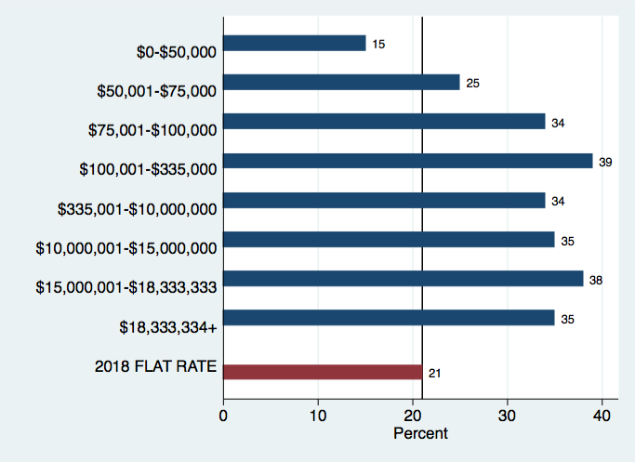
How Did Corporate Income Tax Rates Change?
Source:RMS Consulting, 2017 Federal Tax Rates

Slide 14
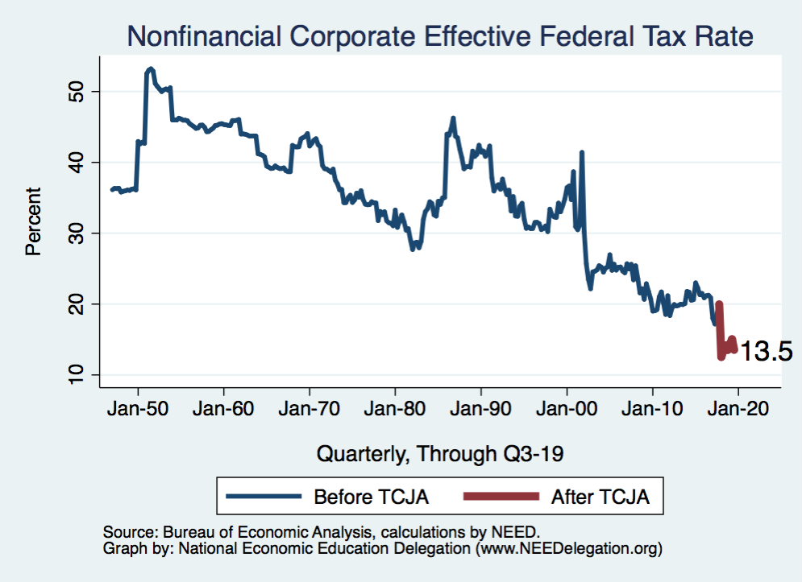
What about Effective Tax Rates?
Source: Bureau of Economic Analysis

Slide 15
Taxation of Foreign Earnings of U.S. Corporations
Worldwide System (prior U.S. Law)
  Foreign earnings taxed U.S., but deferred until repatriated
Modified Territorial System
  Most foreign earnings will not taxable in the United States (2017 Tax Act).
  With provisions to reduce tax avoidance:
    GILTI – Global Intangible Low-Taxed Income
      10.5% tax on earnings above a 10% return after credit for foreign taxes paid.
    FDII - Foreign-Derived Intangible Income
      Some foreign income, derived from domestic intangible assets, taxed at a reduced rate.
    BEAT – Base Erosion and Anti-abuse Tax
      Taxes excessive royalties paid to foreign affiliates.
Source: CBO 2018-28 budget and economic outlook – box B-1

Slide 16
Repatriation
Repatriation
  Currently $2.6 trillion now (2015) held abroad.
  Mandatory repatriation of existing foreign profits.
  15.5% on cash and 8% on illiquid assets.
Why?
  Bump up in revenues in the near term.
  Belief that funds will be used to invest in the U.S. economy.

Slide 17
Individual Income Tax
Not every dollar is taxed the same.
Tax systems can be progressive, flat, or regressive.
    Progressive: average effective tax rate increases with income.
    Proportional: average effective tax rate is the same at all levels of income.
    Regressive: average effective tax rate decreases with income.
Different for single people and married couples
Deductions
  For yourself, and for dependents
  Numerous others….

Slide 18
Individual Income Taxes: Other Deductions
State and local taxes
  Income and real estate and property taxes
Mortgage interest
Charitable donations
Medical and dental expenses
Tax preparation fees
Gambling losses
Retirement plan contributions
And still many more….
BUT: You can only make these deductions if
  you don’t use the standard deduction

Slide 19
Changes to Individual Rates
Tax rate changes at different levels of income.
Tax rates revert to 2017 levels in 2026.

Slide 20
Lowered Individual Rates: Single Filers
Marginal tax rates (percent) – rate varies according to income amount
Old Income Levels ($) | Old Tax Rate | New Income Levels ($) | New Tax Rate
Up to 9,525 | 10 | Up to 9,525 | 10
9,525 to 38,700 | 15 | 9,525 to 38,700 | 12 *
38,700 to 93,700 | 25 | 38,700 to 82,500 * | 22 *
93,700 to 195,450 | 28 | 82,500 to 157,500 * | 24 *
195,450 to 424,950 | 33 | 157,500 to 200,000 * | 32 *
424,950 to 426,700 | 35 | 200,000 to 500,000 * | 35
426,700 and over | 39.6 | 500,000 and over * | 37 *
* Indicates a change
Notes:
Source: https://www.brookings.edu/wp-content/uploads/2018/06/ES_20180608_tcja_summary_paper_final.pdf

Slide 21
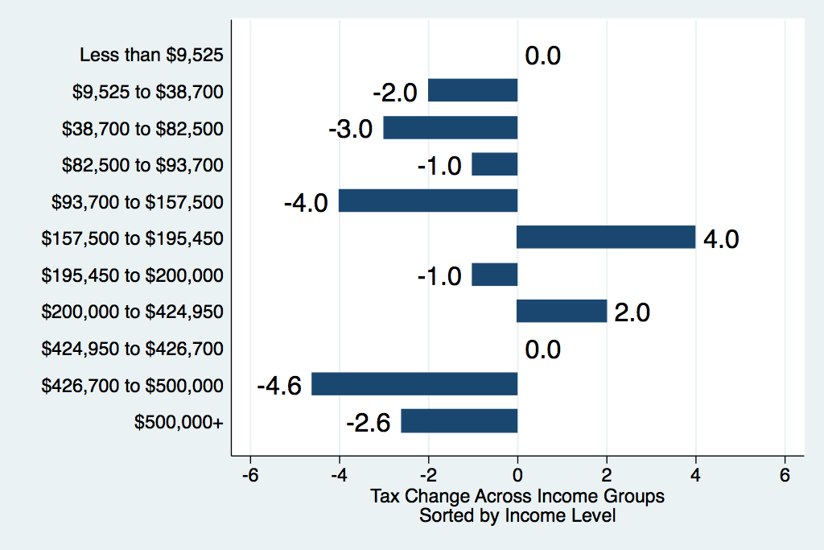
Individual Tax Rate Changes (Single Filers)

Slide 22
The Standard Deduction and
Personal Exemption
What is the “standard deduction”?
  People can either itemize their deductions or use the standard deduction.
  Itemized deductions are deductions for payments that were made for things like home mortgage interest and charitable donations.
  The standard deduction is an amount of your income that is not taxed, but if you claim it, you cannot itemize your other deductions.
What is the “personal exemption”?
  This is an amount of your income that will be exempt from taxation.
  The exemption was intended to eliminate from taxation the minimal amount that somebody would need to live at a subsistence level.
Why does it matter?

Slide 23
The Doubling of the Standard Deduction and
Eliminate of the Personal Exemption
Standard deduction is increased from $6,500 to $12,000 for single filers.
  This will reduce the number of filers choosing to itemize their deductions.
Personal exemption of $4,150 is eliminated.
Why does it matter?
  Potentially to simplify taxes.
  Exemption is more than offset by increased standard deduction.
  Tax on those who continue to itemize.
    They used to get the exemptions and now they don’t.
  Reduces deductions for larger families.

Slide 24
Caps on State and Local Tax Deductions
What is this?
  When filing federal taxes, you get to deduct the amount of state and local taxes that you paid.
Why does it matter?
  Reduces the potential of being taxed by the federal government on funds that you had to pay in state taxes.
Now
  These deductions are capped at $10,000 for both single and joint filers.
Is this equitable?
  It causes people who live in states with high taxes and high housing costs to pay federal taxes on funds that were paid to state and local governments.

Slide 25
Other Changes
Itemized Deductions
  Reduces mortgage interest deductions
  Increases out-of-pocket medical expense deductibility
    But for just 2018
  Increases allowable itemized deductions generally
Eliminated Affordable Care Act Penalty Tax
Doubles the Estate Tax Exemption
  To $11.2 million for single filers and $22.4 million for couples
Pass-through Entities
  Subject to new tax laws for corporations and special 20% deduction.
Child Care Tax Credit
  Generally increased credit – offsets reduced exemptions

Slide 26
Changes in Effective Individual Tax Rates
Urban-Brookings Joint Tax Policy Center

Slide 27
Indexing Tax brackets: Consumer Price Index
Chained CPI instead of garden-variety CPI
  Accounts for the fact that when the price of something increases, people buy less of it.
    Adjusts the basket of goods that are in the CPI.
    Makes inflation look slower.
    Accelerates bracket creep relative to the old CPI, and increases taxes.
$134 billion in increased revenues
Notes:
.

Slide 28
Important Notes: Sunsets
Corporate tax changes do not sunset.
Almost all individual tax provisions expire after 2025.
  Changes in tax rates
  Estate tax changes
  Medical expense changes – sunset in 2019
  Why?
    Helps to comply with Senate budget rules that require no increase in the federal budget deficit after the 10th year.

Slide 29
Review of the Changes
 | Old Rate/Amount | New Rate/Amount
Corporate tax rate reductions | 35% | 21%
Repatriation of corporate cash | 35% | 8%
Lower top individual tax rate | 39.6% | 37%
Double standard deduction | $6,350 | $12,000
Eliminate personal exemption | $4,050 | $0
Caps on State and local tax deductions (SALT) | $unlimited | $10,000
Expand child care tax credit | $1,000 | $2,000
Reduces mortgage interest deduction | $unlimited | $750,000
Health insurance mandate is gone | Fine | No fine
Reduces estate tax | $5.6 million exempted | $11.2 million exempted

Slide 30
Reminder of Tax Changes
Tax cuts
  Corporate taxes
  Individual rates
  Standard deduction
  Child care tax credit
  Alternative Minimum Tax (AMT)
  Estate Tax
  Health insurance mandate
  Repatriation of corporate cash
    On cash that would have come back regardless
Tax increases
  Removes personal exemption
  State and local income tax cap
  Mortgage interest deduction
  Repatriation of corporate cash
    On cash that would have sat overseas for a long time

Slide 31

Tax Cuts or Tax Reform?
Tax Reform – Fundamental Principles and Characteristics
  Horizontal equity: people with similar incomes/wealth should pay similar taxes.
  Vertical equity: people with more income/wealth should pay more taxes.
  Efficiency: taxes should minimize distortions to people’s behavior—doing less or more of something they would otherwise do.
  Economic Growth: taxes should be structured in a way to minimize their impact on economic growth.
  Simplicity: taxes should be administered in simpler rather than more complex ways.

Slide 32
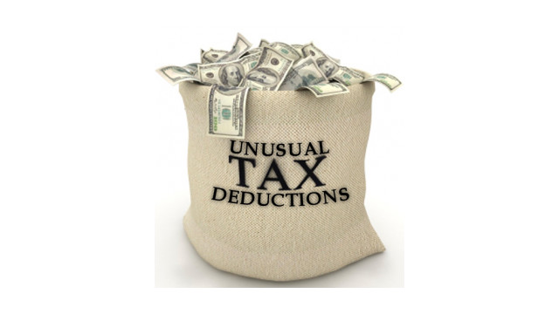

Elements of Tax Reform
Who pays the corporate tax?
  Stockholders through lower dividends
  Employees through lower wages
  Customers through higher prices
State and local tax deduction
  Residents of high-tax states receive more government services.
  Residents of low-tax states must buy these services from private markets.
Mortgage interest deduction
  Why favor homeowners over home renters?
  Homeownership policy amplified 2008 financial crisis.

Slide 33
Effects of 2017 TCJA
Who Benefits?
Economic Effects
Budgetary Effects

Slide 34
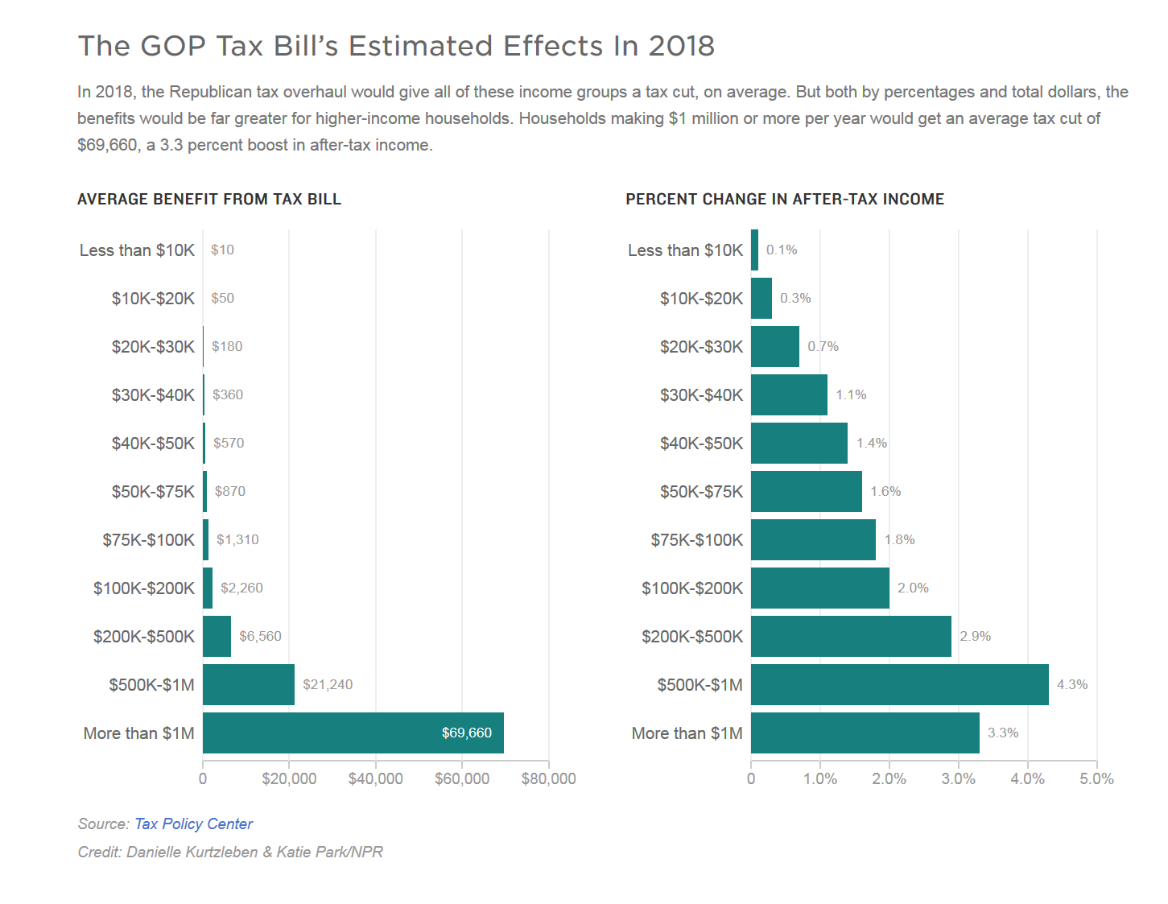
Distribution of Benefits: 2018

Slide 35
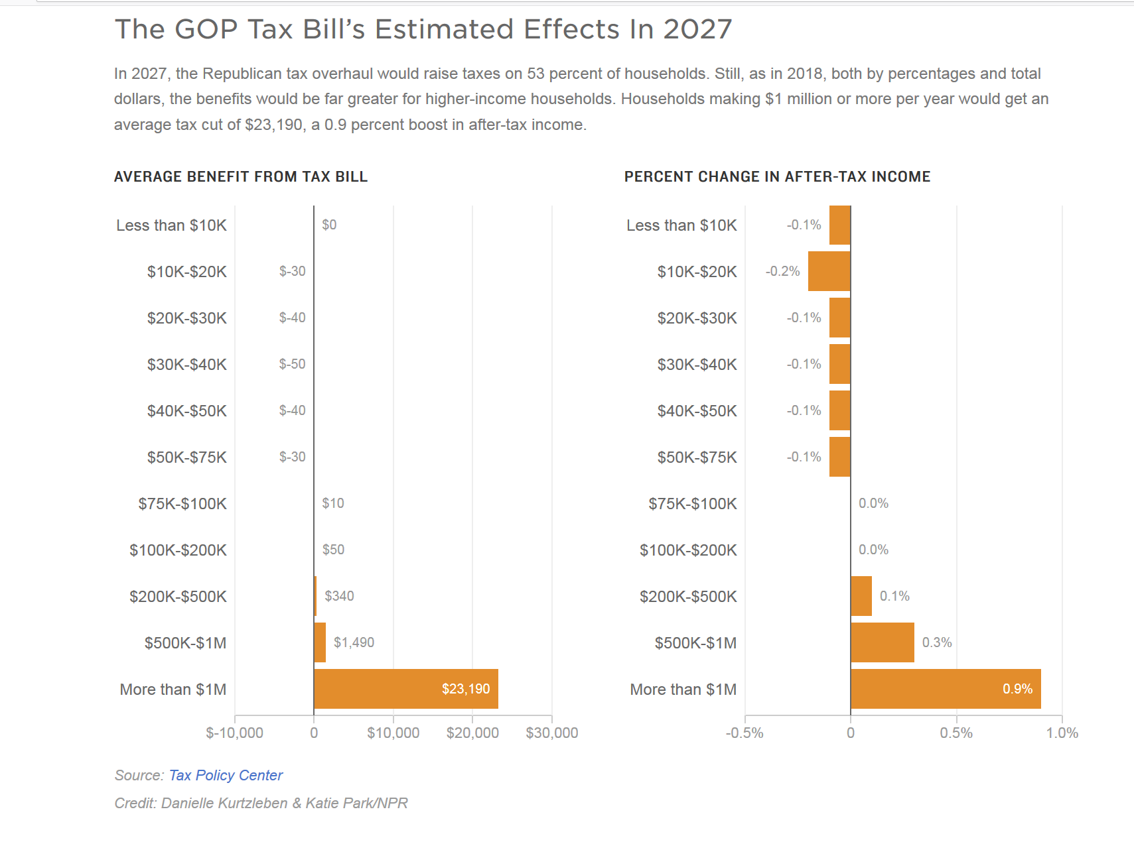
Distribution of Benefits: 2027

Slide 36
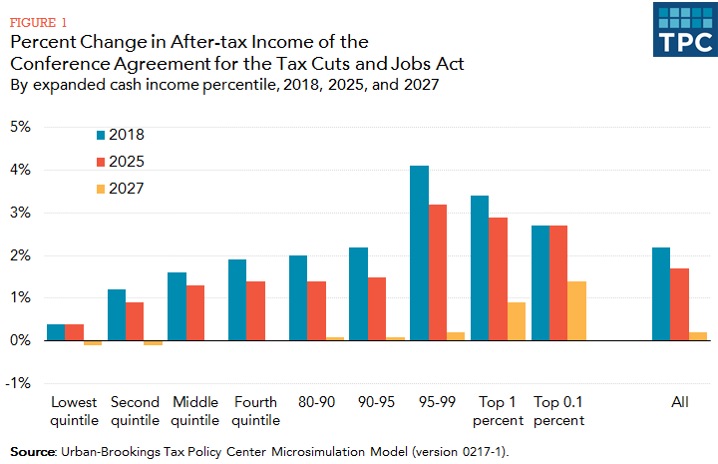
Distribution of Benefits Over Time

Slide 37
Child Tax Credit - Most Benefits to Well To Do
Basic changes:
  Amount of the credit: $1,000 to $2,000 per qualifying child
  Income top limit: $110,000 to $400,000 for joint filers
  Refundable portion:
    Starts at $2,500 instead of $3,000
    Remains 15% of income in excess of that number
    Maximum credit now capped at $1,400
Implications of changes:
  Significantly higher amounts going to high income households
  Increased credit to some low-income households
  Continues to leave many low-income parents with no credit
    35% of children get less than $2,000
      70% are kids with single mothers
    10% of those get nothing

Slide 38
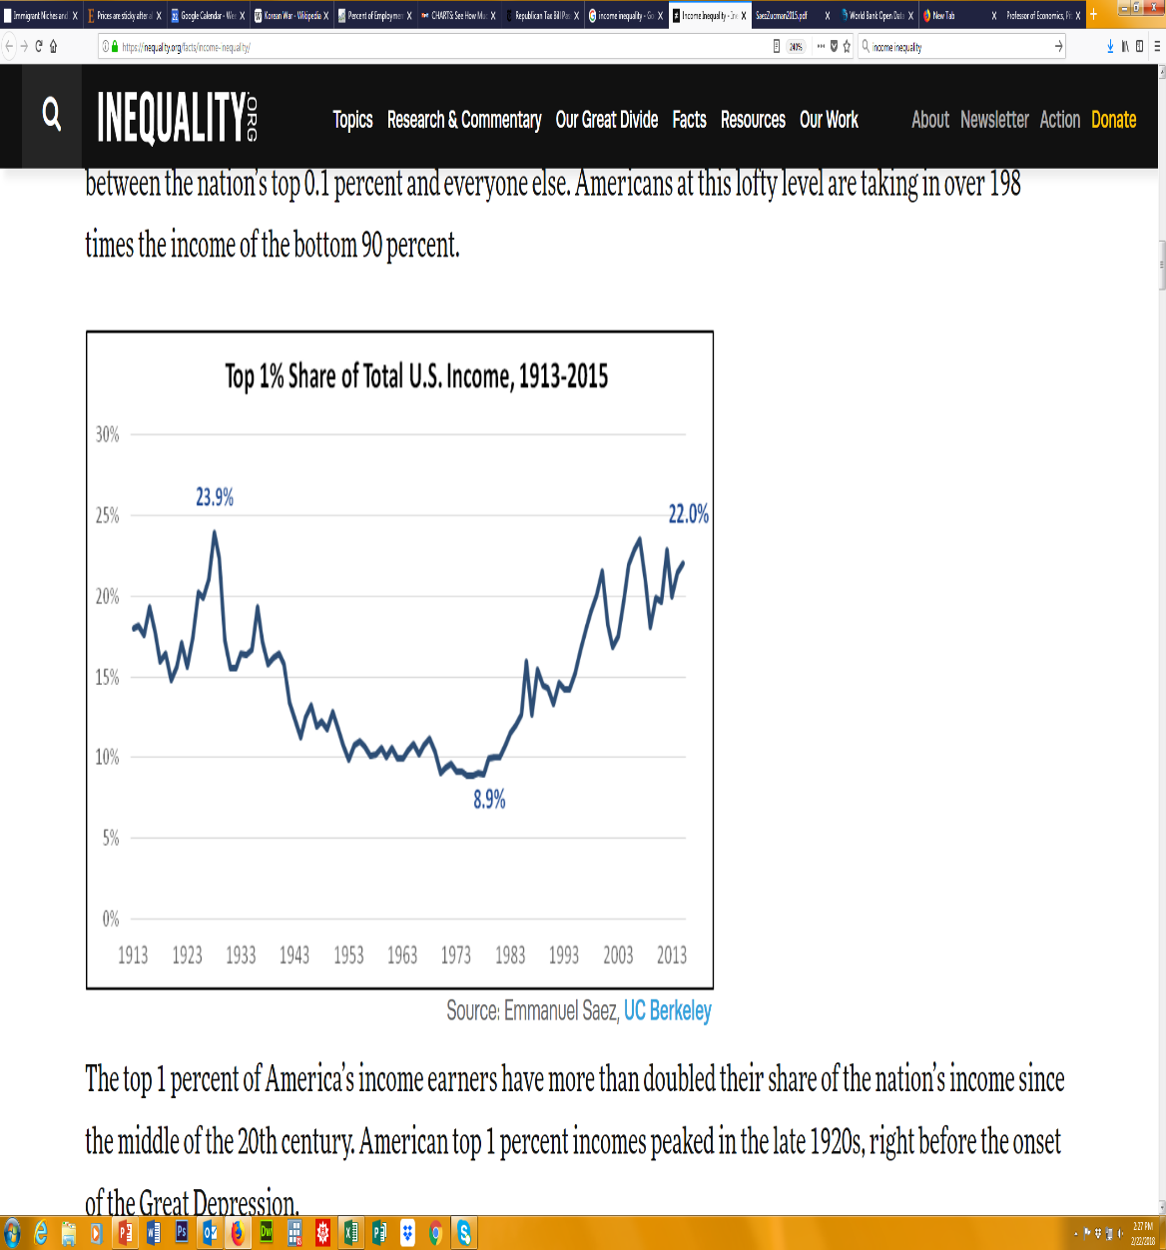
Are the Implications for Income Inequality Important?
Gini coefficient
  Percent of income (wealth) we need to redistribute to achieve perfect equality (0 is perfect equality, 100 is perfect inequality).
Income inequality
  Among the highest in the OECD (Organization of Economic Cooperation and Development) with Mexico, Chile, and Turkey.
  Income Gini coefficient = 48.6
Wealth inequality
  Among the highest in the world with
  Oman, Namibia, Zimbabwe.
  Wealth Gini coefficient = 80.6

Slide 39
Federal Income Tax is Still Progressive
Tax Policy Center: Are Federal Taxes Progressive?

Slide 40
Economic Effects
Tax law will likely raise real GDP.
  Provides significant fiscal stimulus to the demand for goods and services
Tax law will likely raise real potential GDP.
  Incentives to work, save and invest will boost the supply of goods and services
Tax law will likely increase federal borrowing.
  Some private investment will be crowded out
  Foreign investment in the U.S. will increase
What about interest rates, prices, and the exchange value of the dollar?
  All will likely increase over the long term

Slide 41
Economic Effects of the 2017 Tax Act
Increase in Real GDP Because of the 2017 Tax Act in Each Year
Source: https://www.cbo.gov/system/files?file=115th-congress-2017-2018/reports/53651-outlook.pdf

Slide 42
Comparison of Estimates of Effects on GDP

Slide 43
CBO Estimates of Economic Effects
Higher: investment, employment, and GDP
  Corporate tax breaks - spur investment
  Individual tax breaks – labor force participation, hours, and hence employment
  Limits on deductions: push down residential investment
    State and Local Taxes (SALT) and mortgage interest
  GDP: up 0.7% in 2028, about $710 per person.
    Largest effects occur during the middle of this time period

Slide 44
GDP vs. GNP
CBO’s estimates of average annual effects, 2018-2028
Real gross domestic product (GDP): 0.7 percent
Real gross national product (GNP): 0.4 percent
The Tax Act shrinks U.S. net international income
The estimated effect on real GNP declines to 0.1 percent in 2028

Slide 45
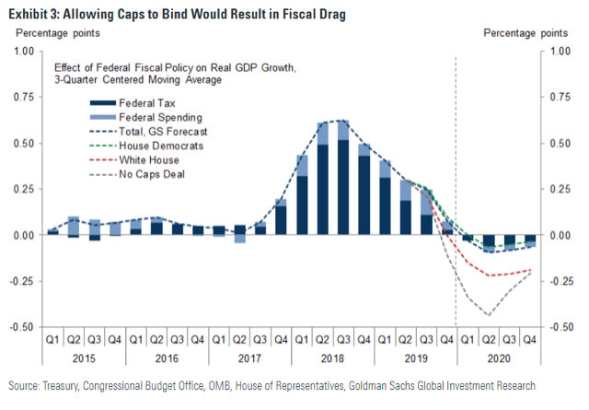
Fiscal Bump in GDP from TCJA

Slide 46
What Are the Budget Implications?
Primarily touches revenues
  Direct
    Generally cuts taxes dramatically
    Raises some revenues
  Indirect
    Increased revenues through additional growth
What about expenditures?
  Affects interest payments owed

Slide 47
Revenue Changes: Summary (2018-2028)
Provision | Change in Revenue
Individual Tax Cuts | -$2.9 trillion
Individual Tax Increases | $1.8 trillion
Business Tax Cuts | -$1.5 trillion
Business Tax Increases | $0.8 trillion
Total | -$1.5 trillion
Source: The Tax Cuts and Jobs Act, as Reported by Conference Committee (12/14/18): Static and Dynamic Effects on the Budget and the Economy.
Notes:
http://www.crfb.org/blogs/tax-cut-and-jobs-act-will-cost-15-trillion

Slide 48
Revenue Changes: Cuts (2018-2028)
Provision | Declines in Revenue ($ Billions)
Reduce corporate taxes | $1,389
Individual tax cuts | $1,214
Relax the Alternative Minimum Tax | $637
Expanded Child Tax Credit | $573
Pass-through business deduction | $415
Territorial system changes | $224
Other | $169
Total | $4,621
Notes:
Other Business: pass-through business income and 100percent of shrot-lived investments groader increase in expensing amounts
https://files.taxfoundation.org/20171115144820/Tax-Foundation-SR239-HOUSE-TCJA1.pdf, pg 6

Slide 49
Revenue Changes: Increases (2018-2028)
Provision | Increases in Revenue ($ Billions)
Repeal personal exemptions | $668
Expand standard deduction and repeal personal deductions | $491
Special one time repatriation | $339
Other individual tax reforms, including ACA | $328
Corporate interest deduction cap | $253
Other | $1,097
Total | $3,176
Notes:
Other Business: pass-through business income and 100percent of shrot-lived investments groader increase in expensing amounts
https://files.taxfoundation.org/20171115144820/Tax-Foundation-SR239-HOUSE-TCJA1.pdf, pg 6

Slide 50
Revenue Sources: Share of GDP
Source: https://www.cbo.gov/system/files?file=115th-congress-2017-2018/reports/53651-outlook.pdf

Slide 51
Tax Reform or Tax Cuts?
Traditional income tax reform
  Emphasize horizontal equity and efficiency
  Broaden the tax base
  Reduce marginal tax rates
  Revenue-neutral
2017 Tax Act
  Reduces marginal income tax rates, which promotes efficiency
  Some broadening of the tax base
  Addresses some issues in the taxation of multinational corporations
  Not revenue-neutral
Sources: Steuerle, Contemporary U.S. Tax Policy, and Slemrod, “Is This Tax Reform, or Just Confusion?”

Slide 52
Implications for the Federal Budget
Without Economic Feedback:
Raises the deficits by a combined $1.8 trillion through 2028
Debt servicing increases by $450 billion
Total: $2.25 trillion
With Economic Feedback:
Raises the deficits by a combined $1.3 trillion through 2028
Debt servicing increases by $600 billion
Total: $1.9 trillion in additional debt
Source: https://www.cbo.gov/publication/53787

Slide 53
Behind the Revenue Estimates
Static effects: -$1.5 trillion
Dynamic effects:
  Because of the tax cuts, it is likely that work, savings, and investment incentives will cause the economy to grow.
  Has the tax law lived up to expectations?
    Many in favor of the law indicated an expectation that the tax cuts would pay for themselves. That revenues gains would offset the static losses.

Slide 54
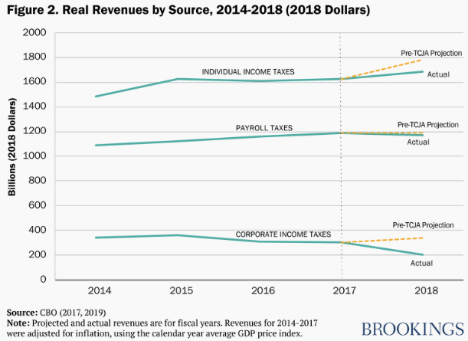
Have the Dynamic Effects Materialized?
Source: Gale and Krupkin, Did the Tax Cuts and Jobs Act Pay for Itself in 2018?

Slide 55
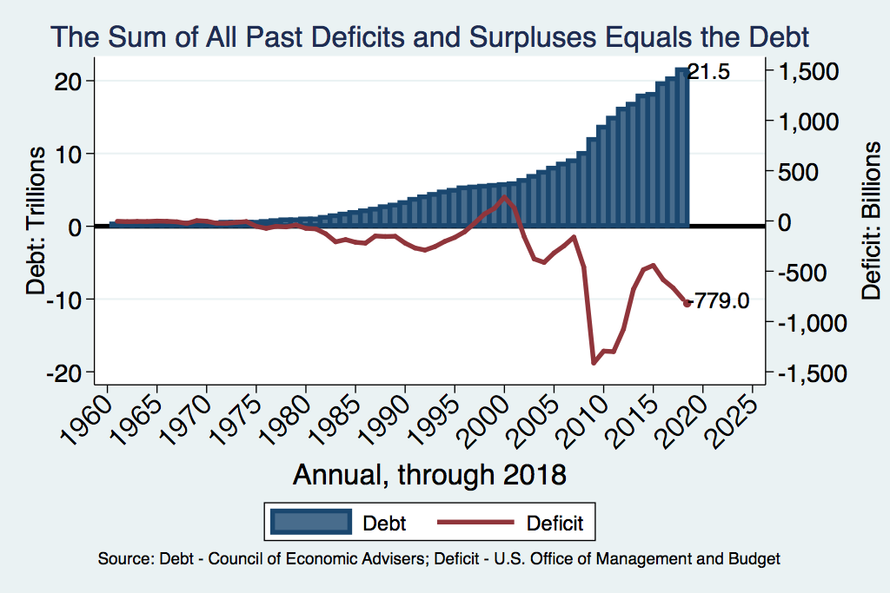
Debt vs. Deficit
Notes:
Debt2deficit.png

Slide 56
Debt
Notes:
Debt2deficit.png

Slide 57
Perspective on Increased Debt
Government borrowing crowds out private capital and investments.
  Weakened by ability to borrow from abroad
It is reasonable to borrow at low interest rates for investments.
  For example, infrastructure
Debt imposes a burden on future generations.
  Does it inevitably have to be paid off?

Slide 58
Uncertainties with the Estimates
How will households, businesses, and foreign investors respond to changes in incentives to work, save, and invest in the U.S.?
Do households expect the temporary provisions to expire or to be extended?
How will monetary and fiscal policy be altered in the future to deal with projected deficit increases?

Slide 59
What Do the Early Data Suggest?

Slide 60
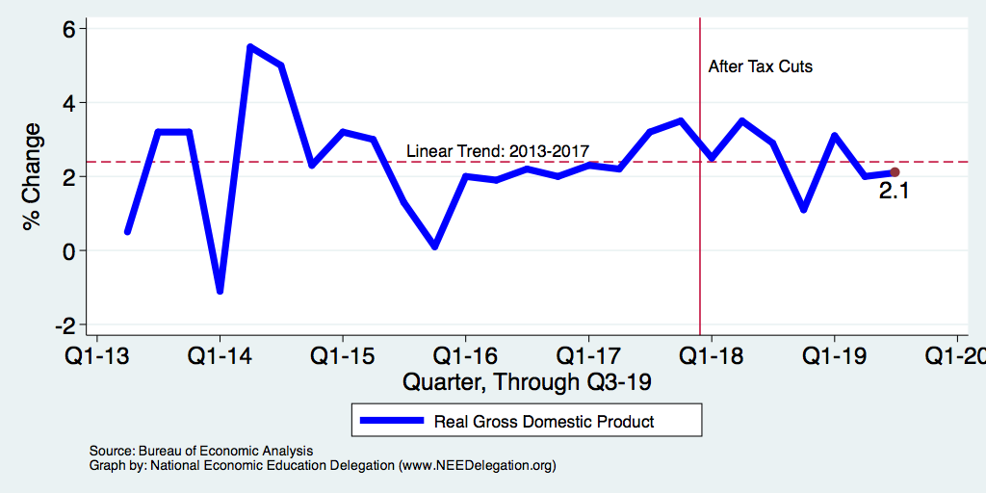
Real GDP Growth in the Wake of Tax Cuts

Slide 61
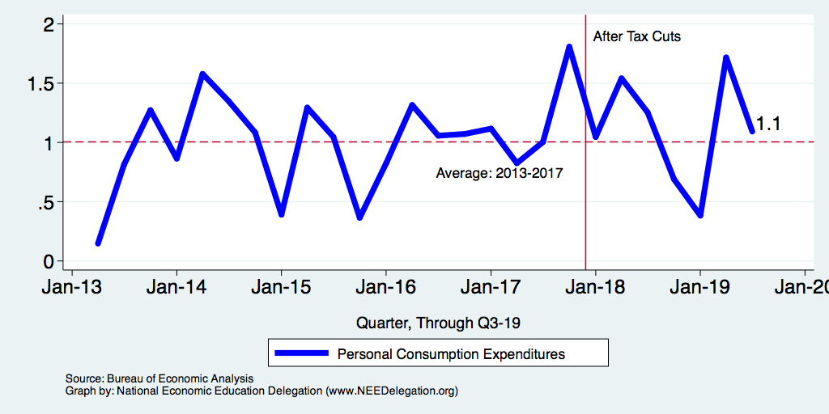
Growth in Real Consumption

Slide 62
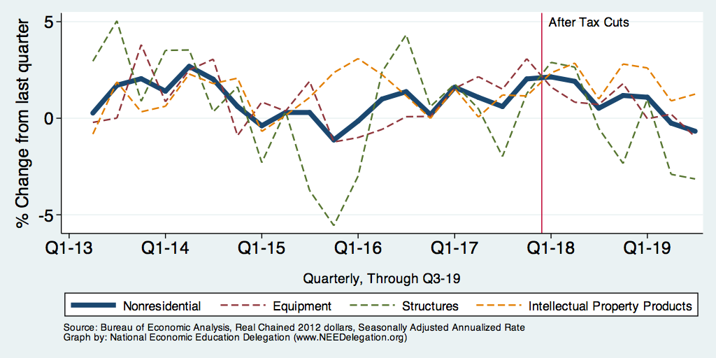
Nonresidential Investment and Subcomponents

Slide 63
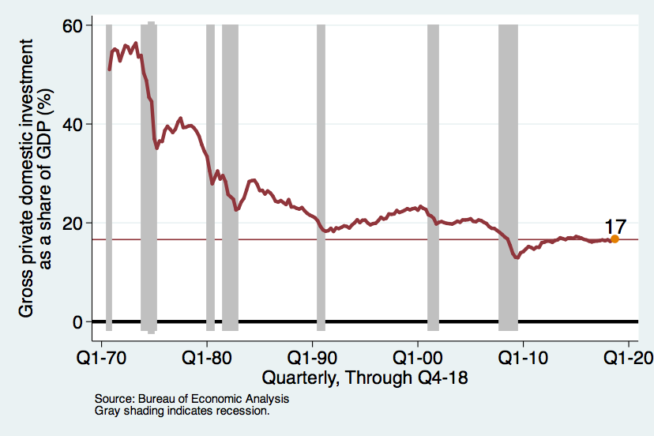
Long-Term Investment Growth

Slide 64
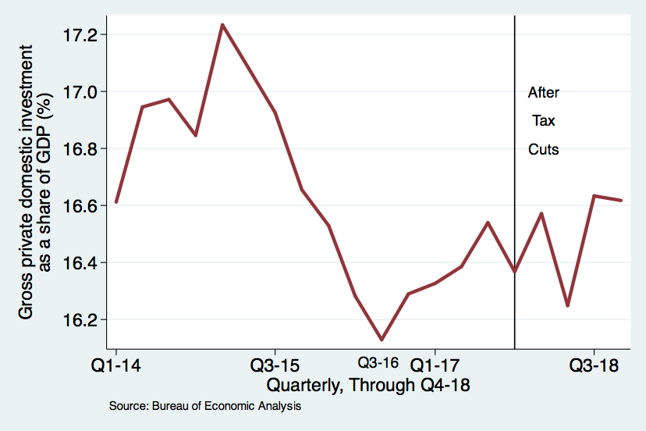
Recent Investment Trends
Notes:
What was the impetus behind the corporate tax cuts? To stimulate growth through increases in investment

Slide 65
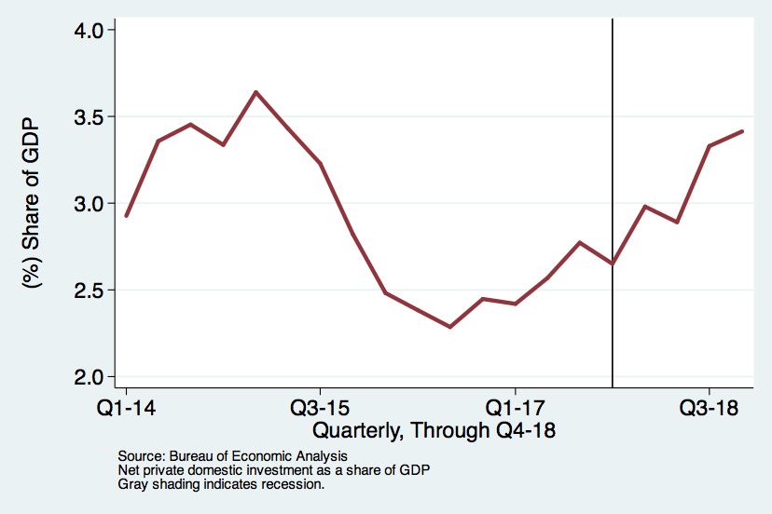
Net Investment Trends

Slide 66
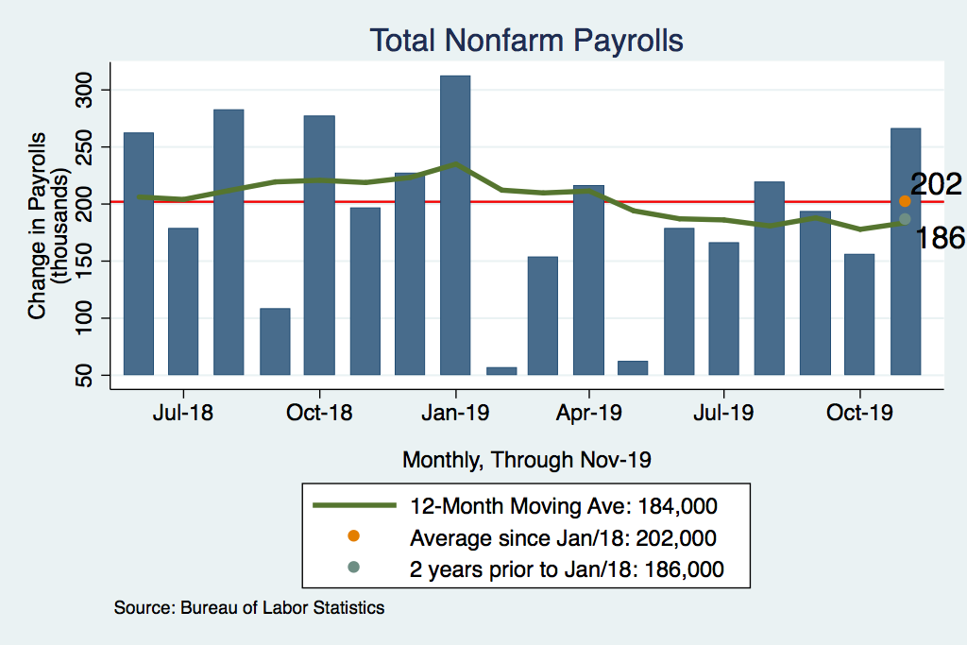
Job Growth

Slide 67
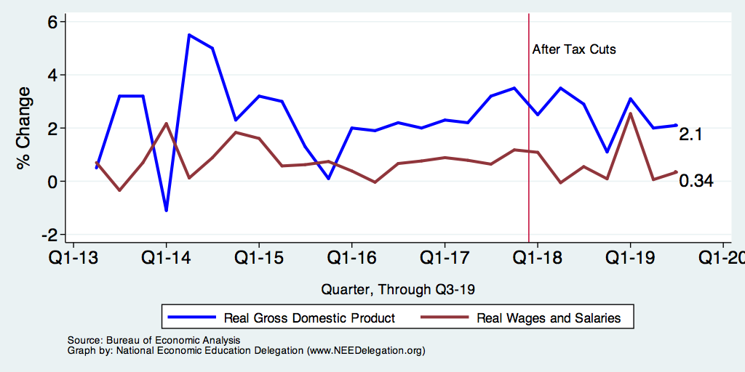
Growth in Real Wages and Real GDP

Slide 68
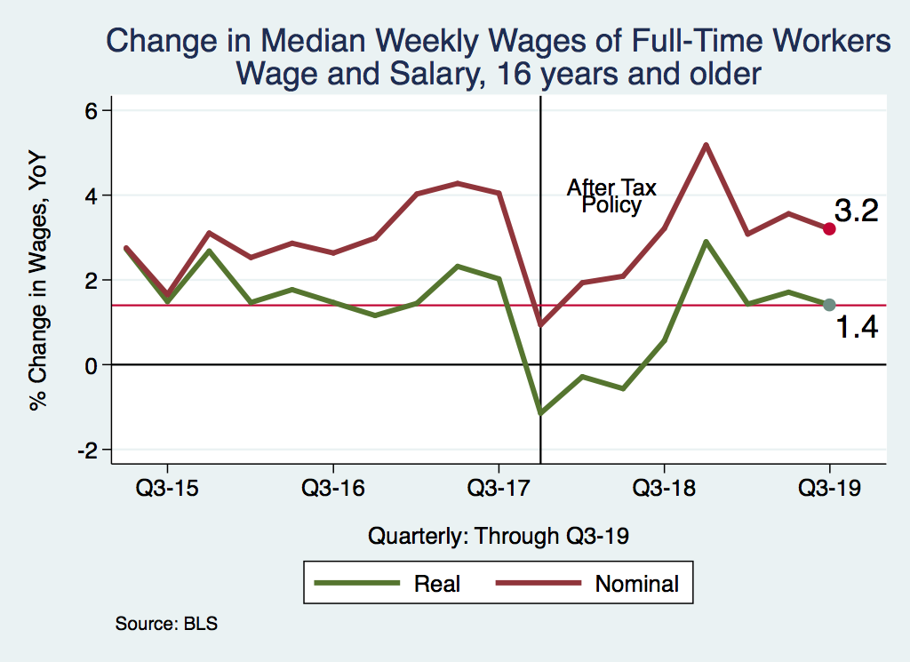
Wage Growth after 2017 Tax Policy
Notes:
../Charts/Wages_recessionChange_taxlaw.png

Slide 69
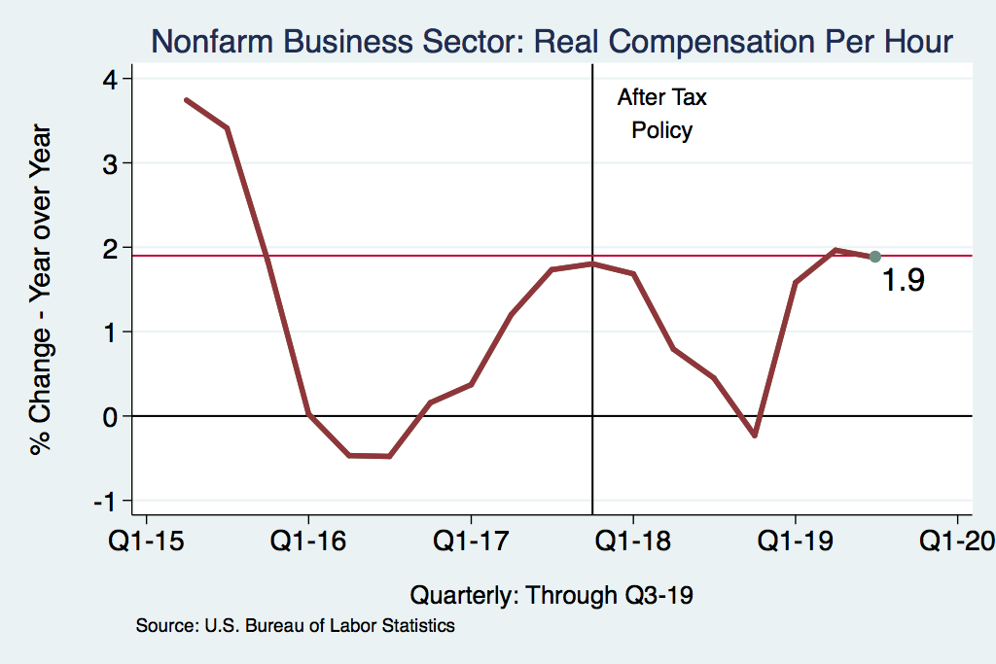
Labor Compensation Growth

Slide 70
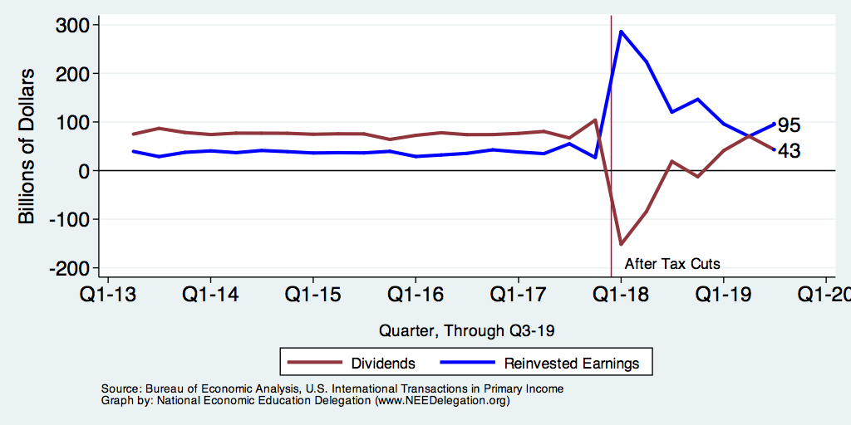
Foreign Earnings Are Coming Home

Slide 71
How Companies Will Use Repatriated Funds

Slide 72
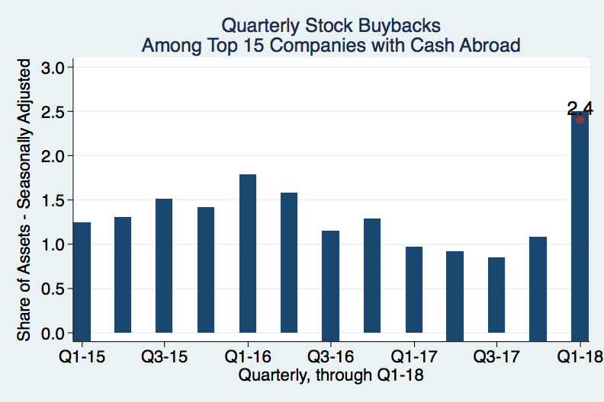
Stock Buybacks

Slide 73
Important Question:
The federal government just spent $1.5 Trillion.
  But it’s not really spending.
    It is giving money back to taxpayers.
    It is investing in economic growth.
We won’t address the efficacy of giving money back to taxpayers.
But, is this the best way to invest in economic growth?

Slide 74
Growth Potential of the Tax Cuts
Lowering corporate taxes:
  Increases investment
  Increases entrepreneurship
  Increase employment
  Increase wages
How are the revenue losses accommodated?
  Increased debt?
  Reduced spending?
  Increasing other taxes?
  Reduced progressivity of overall taxation?

Slide 75
Why Tax Corporate Income?
Arguments in favor of a corporate income tax:
  Revenues have to come from somewhere.
  Adds to the progressivity of the overall tax system.
  Absent the tax, corporations could be used for tax avoidance.
Arguments against a corporate income tax:
  Distorts economic activity: reduced investment and entrepreneurship
  Compliance costs of an additional tax.
  It’s a hidden tax of unknown size on workers.
  The tax leads to tremendous spending on avoidance strategies.

Slide 76
Other Ways to Invest in Economic Growth
Infrastructure
  Ports, bridges, roads, airports
  Infrastructure in the United States routinely receives poor marks. Improvements would likely result in increased economic growth.
Health care
  A healthier workforce is a more productive workforce.
Education
  Education is increasingly important for growth of the U.S. economy.

Slide 77
Summary
Primary effects of the Tax Cuts and Jobs Act of 2017
  Promotes economic growth, but not very much
    Increased incentives for investments in the economy
    Encourages entrepreneurship
  Reduces the progressivity of the overall tax structure
  Generates significant additional debt
  Constrains government spending

Slide 78
Thank you!
Any Questions?
www.NEEDelegation.org
<presenter name>
<presenter email>
Contact NEED: info@needelegation.org
Submit a testimonial: www.NEEDelegation.org/testimonials.php
Become a Friend of NEED: www.NEEDelegation.org/friend.php

Slide 79
Available NEED Topics Include:
US Economy
Economic Inequality
Climate Change
US Social Policy
Trade and Globalization
Economic Mobility
Trade Wars
Housing Policy
Federal Budgets
Federal Debt
2017 Tax Law
Autonomous Vehicles

