Slide 1
Osher Lifelong Learning Institute, Summer 2025
The Economics of Public Policy Issues
Northwestern University
Host: Geoffrey Woglom
Director, National Economic Education Delegation

Slide 2
Available NEED Topics Include:
US Economy
Healthcare Economics
Climate Change
Economic Inequality
Economic Mobility
Trade and Globalization
Minimum Wages
Immigration Economics
Housing Policy
Federal Budgets
Federal Debt
Black-White Wealth Gap
Autonomous Vehicles
US Social Policy

Slide 3
Course Outline
The Economics of Public Policy Issues
  Week 1 (7/8): Economic Update (including tariffs) (Geoffrey Woglom, Amherst College)
  Week 2 (7/15): Climate Change Economics (Sarah Jacobson, Williams College)
  Week 3 (7/22) The Economics of the Minimum Wage (Veronika Dolar Pace University)
  Week 4 (7/29): Cryptocurrencies (Joan Nix Queens College (CUNY))
  Week 5 (8/5): Saving Social Security (Jon Haveman, Exec Director, NEED)
  Week 6 (8/12): Federal Debt and Deficits (Geoffrey Woglom, Amherst College)

Slide 4
Submitting Questions
Handle this as you would like. With well over 100 students, the questions come fast and furious
Submit questions in the chat. I will try to address questions as they come up.
We will do a verbal Q&A once the material has been presented.
Slides will be available from the NEED website tonight https://needecon.org/delivered_presentations.php.

Slide 5
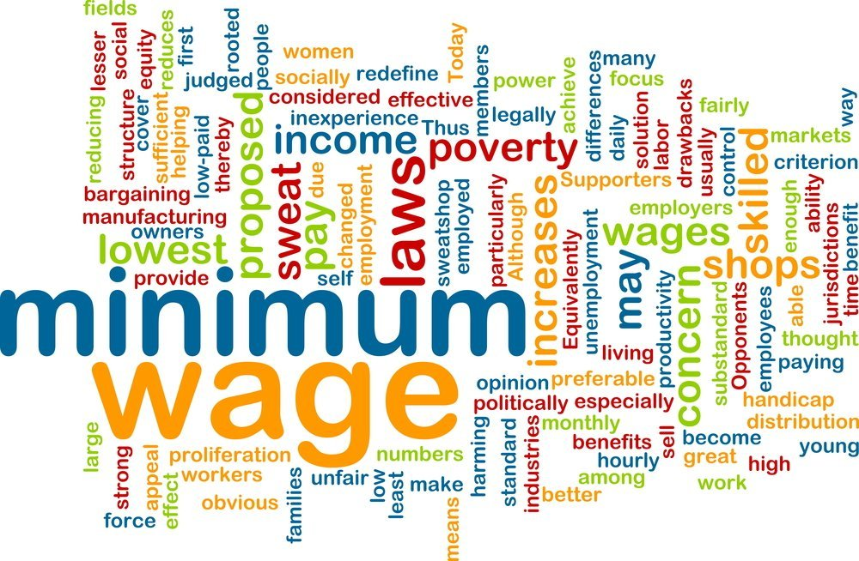
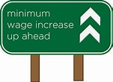
Minimum Wage

Slide 6
National Economic Education Delegation
Vision
  One day, the public discussion of policy issues will be grounded in an accurate perception of the underlying economic principles and data.
Mission
  NEED unites the skills and knowledge of a vast network of professional economists to promote understanding of the economics of policy issues in the United States.
NEED Presentations
  Are nonpartisan and intended to reflect the consensus of the economics profession.

Slide 7
Who Are We?
Honorary Board: 54 members
  2 Fed Chairs: Janet Yellen, Ben Bernanke
  6 Chairs Council of Economic Advisers
    Furman (D), Rosen (R), Bernanke (R), Yellen (D), Tyson (D), Goolsbee (D)
  3 Nobel Prize Winners
    Akerlof, Smith, Maskin
Delegates: 600+ members
  At all levels of academia and some in government service
  All have a Ph.D. in economics
  Crowdsource slide decks
  Give presentations
Global Partners: 44 Ph.D. Economists
  Aid in slide deck development

Slide 8
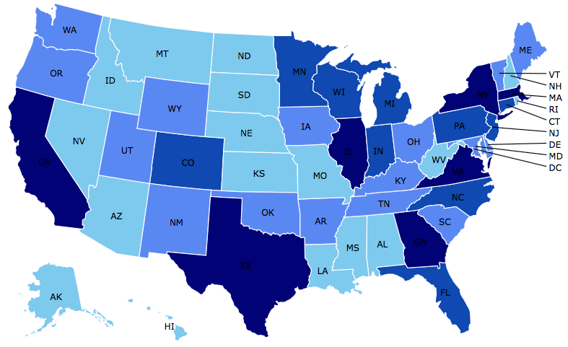
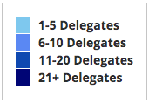
Where Are We?

Slide 9
Available NEED Topics Include:
Coronavirus Economics
US Economy
Climate Change
Economic Inequality
Economic Mobility
Trade and Globalization
Healthcare Economics
Immigration Economics
Housing Policy
Federal Budgets
Federal Debt
Black-White Wealth Gap
Autonomous Vehicles
US Social Policy

Slide 10
Credits and Disclaimer
This slide deck was authored by:
  Jon Haveman, NEED
  Veronika Dolar, Pace University
This slide deck was reviewed by:
  Jeffrey Clemens, UC– San Diego
  David Neumark, UC - Irvine
Disclaimer
  NEED presentations are designed to be nonpartisan.
  It is, however, inevitable that the presenter will be asked for and will provide their own views.
  Such views are those of the presenter and not necessarily those of the National Economic Education Delegation (NEED).

Slide 11
Outline
What is the Federal minimum wage?
Origin story
Limitations
  Excluded occupations/sectors
  Different mins for diff occupations
Effects of increasing
Economist’s perspective

Slide 12
What Is The Federal Minimum Wage?
The minimum wage is an example of a price control and sets a wage floor.
  It is unlawful for businesses in covered industries to pay a wage below the minimum.
The Federal minimum wage is currently $7.25.
Minimum wage of $2.13 for tipped workers with the expectation that wages plus tips total no less than $7.25 per hour. The employer must pay the difference if total income does not add up to $7.25 per hour.

Slide 13
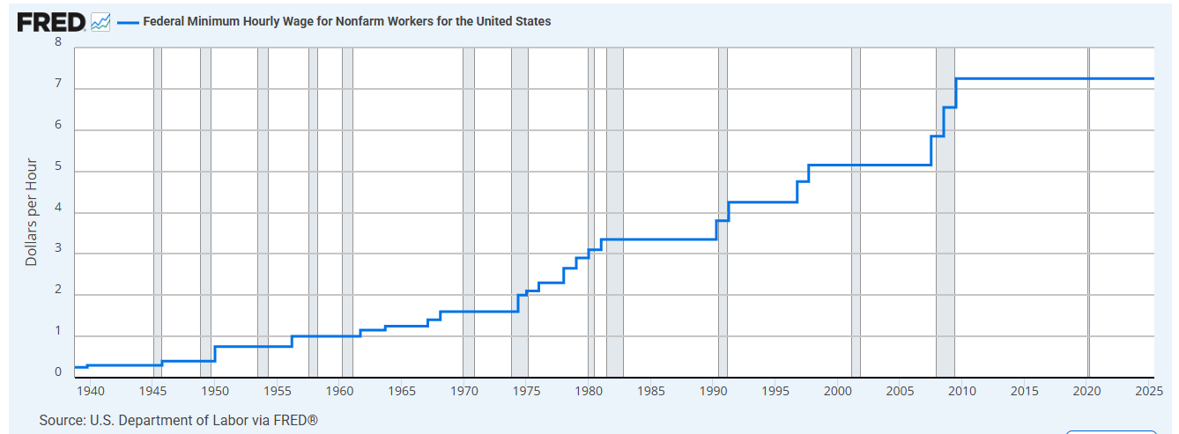

Slide 14
Correcting Variables for Inflation:
Comparing Dollar Figures from Different Times
Inflation makes it harder to compare dollar amounts from different times.
Example: the minimum wage
  $1.60 in March 1968
  $7.25 in July 2025
Did min wage have more purchasing power in March 1968 or July 2025?
To compare, use CPI to convert 1968 figure into “today’s dollars”…
CPI is Consumer Price Index: a measure of the overall cost of the goods and service bought by a typical consumer

Slide 15
Correcting Variables for Inflation:
Comparing Dollar Figures from Different Times
Amount
in today’s dollars
Amount
in year T dollars
CPI is Consumer Price Index: a measure of the overall cost of the goods and service bought by a typical consumer
CPI today
=
x
CPI in year T
In our example,
  “year T” is March 1968, “today” June 2025
  Min wage was $1.60 in year T
  CPI = 34.3 in year T, CPI = 321.5 today
The minimum wage
in 1968 was $15.00
in today’s (2025) dollars.
321.5
$15.00
=
$1.60
x
34.3

Slide 16
Correcting Variables for Inflation:
Comparing Dollar Figures from Different Times
Researchers, business analysts, and policymakers often use this technique to convert a time series of current-dollar (nominal) figures into constant-dollar (real) figures.
They can then see how a variable has changed over time after correcting for inflation.
Example: the minimum wage, from Jan 1960 to 2025…

Slide 17
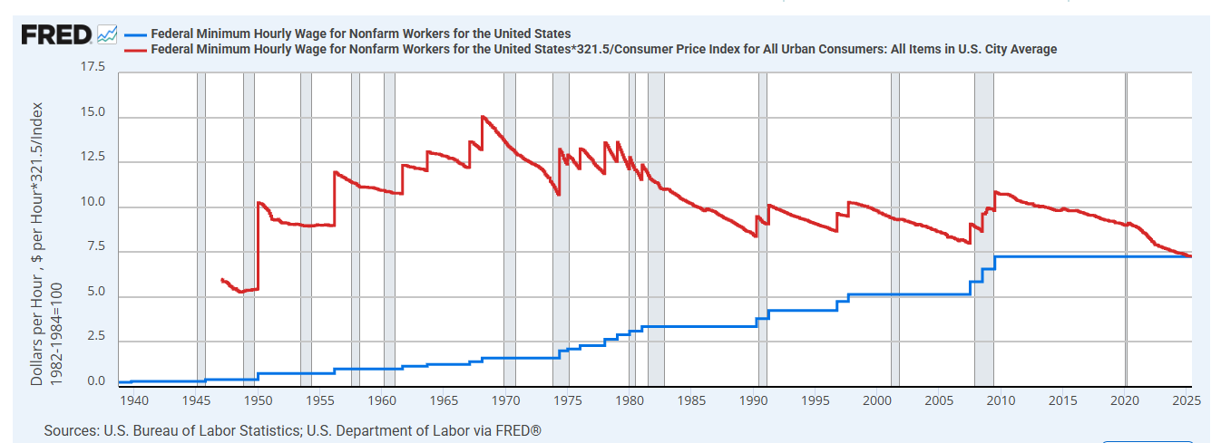

Slide 18
From Hourly to Approx. Annual Minimum Wage
Real Annual Minimum Wage in 1968 was
$15.00 x 40 hours per week x 52 weeks = $31,200
Real Annual Minimum Wage today is
$7.25 x 40 hours per week x 52 weeks = $15,080

Slide 19
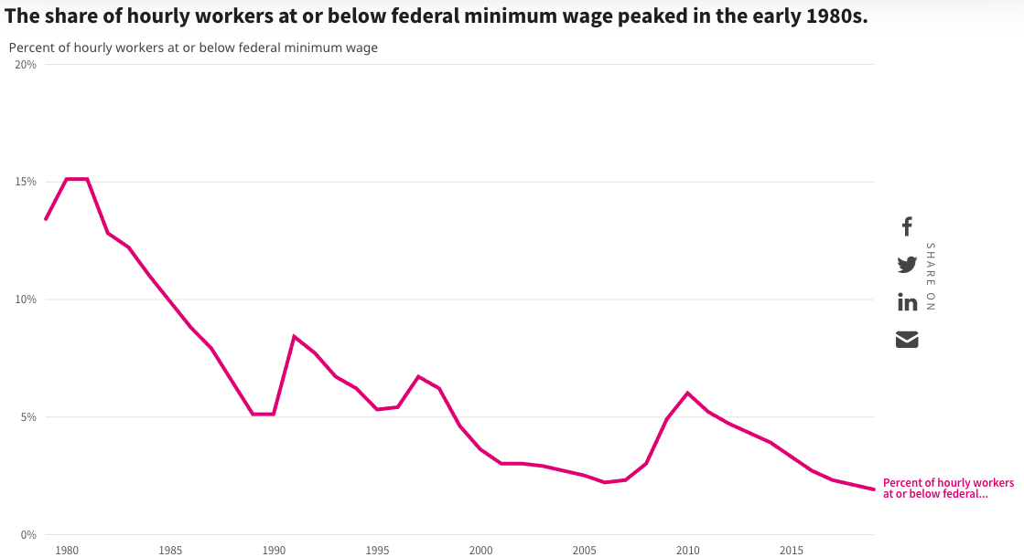
How Many are Paid At or Below Min. Wage?
1980: 15%
1991: 8.4%
2010: 6%
2019: 1.9%

Slide 20
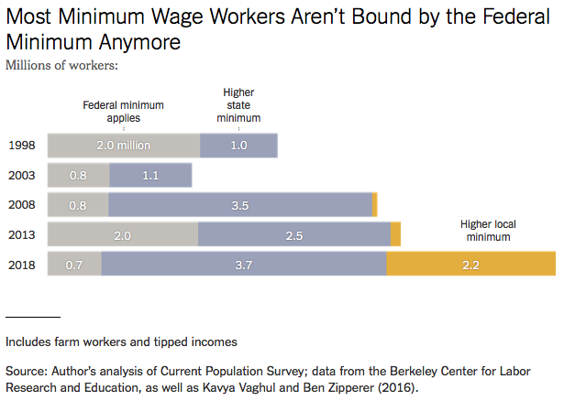
Notes:
https://www.nytimes.com/2019/04/24/upshot/why-america-may-already-have-its-highest-minimum-wage.html?action=click&module=RelatedLinks&pgtype=Article

Slide 21
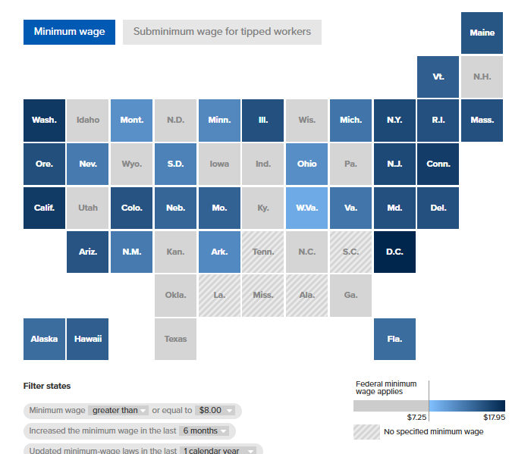

Slide 22
There are 30 states and D.C. that have a minimum wage higher than the federal minimum wage.
Alaska, Arizona, Arkansas, California, Colorado, Connecticut, Delaware, Florida, Hawaii, Illinois, Maine, Maryland, Massachusetts, Michigan, Minnesota, Missouri, Montana, Nebraska, Nevada, New Jersey, New Mexico, New York, Ohio, Oregon, Rhode Island, South Dakota, Vermont, Virginia, Washington, Washington D.C., and West Virginia

Slide 23
67 localities have adopted minimum wages above their state minimum wage
Alameda, California; Bellingham, Washington; Belmont, California; Berkeley, California; Birmingham, Alabama; Boulder City, Colorado; Boulder County, Colorado; Burien, Washington; Burlingame, California; Chicago, Illinois; Cupertino, California; Daly City, California; Denver, Colorado; East Palo Alto, California; Edgewater, Colorado; El Cerrito, California; Emeryville, California; Flagstaff, Arizona; Foster City, California; Fremont, California; Half Moon Bay, California; Hayward, California; Howard County, Maryland; King County, Washington; Las Cruces, New Mexico; Los Altos, California; Los Angeles County, California; Los Angeles, California; Malibu, California; Menlo Park, California; Milpitas, California; Minneapolis, Minnesota; Montgomery County, Maryland; Mountain View, California; Nassau, Suffolk, and Westchester Counties, New York; New York City, New York; Novato, California; Oakland, California; Palo Alto, California; Pasadena, California; Petaluma, California; Portland Urban Growth Boundary, Oregon; Portland, Maine; Redwood City, California; Renton, Washington; Richmond, California; Rockland, Maine; San Carlos, California; San Diego, California; San Francisco, California; San Jose, California; San Mateo County, California; San Mateo, California; Santa Clara, California; Santa Fe City, New Mexico; Santa Fe County, New Mexico; Santa Monica, California; Santa Rosa, California; SeaTac, Washington; Seattle, Washington; Sonoma, California; South San Francisco, California; St. Paul, Minnesota; Sunnyvale, California; Tucson, Arizona; Tukwila, Washington; and West Hollywood, California

Slide 24
The minimum wage is indexed for inflation in 19 states and D.C., meaning it is automatically adjusted each year for increases in prices
Alaska, Arizona, Colorado, Connecticut, Florida, Maine, Michigan, Minnesota, Montana, Nebraska, Nevada, New Jersey, New York, Ohio, Oregon, South Dakota, Vermont, Virginia, Washington, and Washington D.C.
On January 1, 2025, the state minimum wage increased by $0.50 to $16.50 per hour in New York City, Long Island and Westchester County and by $0.50 to $15.50 per hour for the rest of the state.
The minimum wage is scheduled to increase by another $0.50 in 2026 as part of New York’s historic multiyear agreement between Governor Hochul and the New York State Legislature to index the minimum wage to inflation.
Then starting in 2027, the minimum wage will increase annually at a rate determined by the Consumer Price Index for Urban Wage Earners and Clerical Workers (CPI-W) for the Northeast Region — the most accurate regional measure of inflation. An "off-ramp" is available in the event of certain economic or budget conditions.

Slide 25
There are 7 states that have no minimum-wage law or a minimum wage below the federal minimum wage.
The federal minimum wage applies in all of these states.
Alabama, Georgia, Louisiana, Mississippi, South Carolina, Tennessee, and Wyoming

Slide 26
Illinois
Beginning January 1, 2025 - Guarantees a minimum wage of $15.00 per hour for workers 18 years of age and older.
Effective July 1, 2025, the Chicago minimum wage for employers with 4 or more employees will be $16.60 per hour, while the tipped employee minimum wage will be $12.62 per hour. For youth workers, subsidized temporary youth employment programs, and subsidized transitional employment programs, the minimum wage will be $16.50 per hour.

Slide 27
Important Questions:
What is the purpose of a minimum wage?
What is the purpose of a FEDERAL minimum wage?
Why do we have one?
What are the implications of having one?
Should we have one?
How high should it be?

Slide 28
Minimum Wage: Purpose
International Labor Organization:
  The purpose of minimum wages is to protect workers against unduly low pay. They help ensure a just and equitable share of the fruits of progress to all, and a minimum living wage to all who are employed and in need of such protection.
  Minimum wages can also be one element of a policy to overcome poverty and reduce inequality, including those between men and women, by promoting the right to equal remuneration for work of equal value.

Slide 29
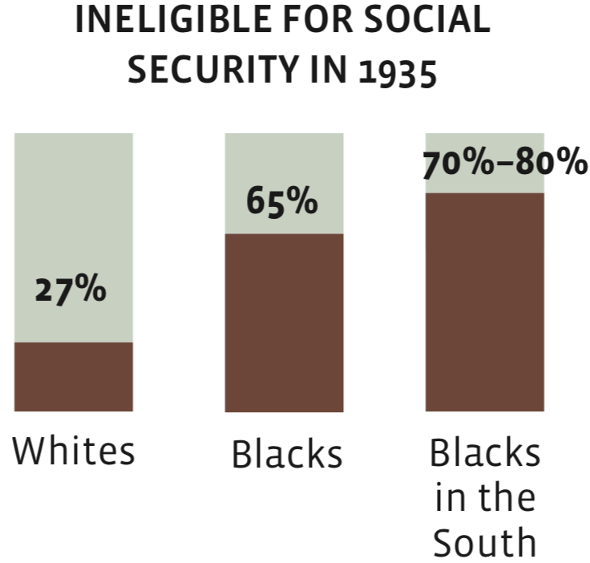
Origin Story: The New Deal
Minimum wages
Social Security
Unemployment

Slide 30
Fair Labor Standards Act of 1938
Minimum wage: $0.25 – raised 22 times
“Covered” only about 23% of workers at the time.
  The law did not apply universally.
  11 million out of 48 million gainful workers were covered.
  The provisions of the Act affect employees who are engaged in (interstate) commerce or the production of goods for (interstate) commerce.
  Not covered were:
    Farm labor, retail trade, domestic and personal service, governmental service, or the self-employed.
Source: Daugherty, The Economic Coverage of the Fair Labor Standards Act

Slide 31
Minimum Wages
1960s – great equalizer - MW increased in real terms 37% (10.95 to 15.00)
  The 1966 Fair Labor Standards Act extended federal minimum wage coverage to agriculture, restaurants, nursing homes, and other services which were previously uncovered and where nearly a third of black workers were employed.
Since 1968 – has fallen 52% (15.00 to 7.25)
  Exacerbating the Black-White wage gap.

Slide 32
Should There be A Federal Minimum Wage?
Abolish a FEDERAL minimum wage?
  Argument in favor:
    Cost of living differs across states.
  Arguments against:
    Could result in very different living standards across states.
    Racial differences are a particular concern.
30% of labor force will already be under a $15 min wage by 2025.
  California, Connecticut, Illinois, Maryland, Massachusetts, New Jersey, New York

Slide 33
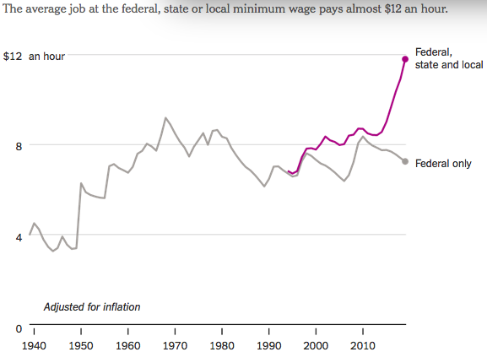
States and Local Gov’ts are Raising Min Wages
Notes:
https://www.nytimes.com/2019/04/24/upshot/why-america-may-already-have-its-highest-minimum-wage.html?action=click&module=RelatedLinks&pgtype=Article

Slide 34
Common View of Minimum Wage
Wages go up.
Labor costs go up.
Employment falls and Unemployment increases.
Bottom line: are the increased wages worth the drop in employment?
This is a very SIMPLE view of the minimum wage.
  Economics is complicated.

Slide 35
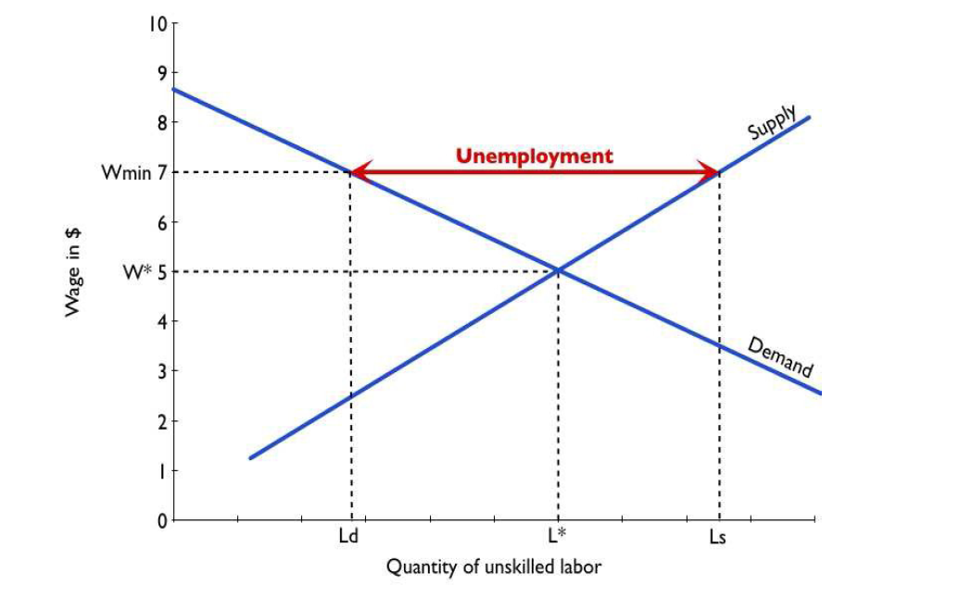
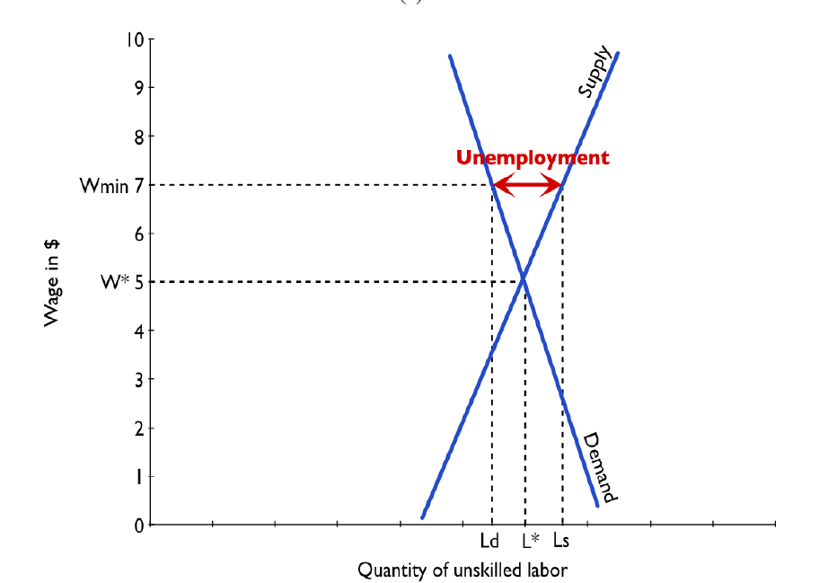
How Much Job Loss Might Result?
Very Elastic Supply and Demand
  Quantity changes a lot with price.
Very Inelastic Supply and Demand
  Quantity changes little with price.

Slide 36
Empirical Evidence
The empirical research on the effects of min wage on employment is actually difficult to do.
For example, over the past two decades hundreds of papers have been published on this topic, with different results.
To summarize the evidence we can look at a meta-analysis performed by Belman and Wolfson (2010). They find that a 10 percent increase in the minimum wage is associated with a reduction in employment or hours of employment is close to zero.
More recently, Neumark and Shirely (2021) look at about 70 studies. They use a bit unconventional methods but find that majority of studies report negative employment effects. However, they also conclude that the data supports relatively inelastic labor demand curve where a 10 percent increase in the minimum wage is associated with a reduction in employment around −1.45%.

Slide 37
Market Structure
The previous graphs and analysis using Supply and Demand assumes perfectly competitive labor market.
  Numerous employers
  Numerous workers
  Each behaving as price taker and with no market power
Labor markets may be monopsonistic
  Monopsony is when there is only one buyer or a single buyer that dominates the market.
  Similar to monopoly, where there is only one seller.
  Both monopoly and monopsony are an example of a market failure and provide inefficient market allocations.

Slide 38
Monopsony in the Labor Market and MW
Examples of Monopsony in the Labor Market:
  Coal mine owner in town where coal mining is the primary source of employment.
  The government in the employment of civil servants, nurses, police and army officers.
  Walmart, Amazon, Uber
  Universities
  Hospitals
  Even if a firm is not a pure monopsony, it may have a degree of monopsony power, due to geographical and occupational immobilities, which make it difficult for workers to switch jobs and find alternative employment.
A higher, well chosen minimum wage can raise employment in a labor market where firms enjoy monopsony power.

Slide 39
Simple Views are Incomplete
A minimum wage need not reduce employment.
An increase in the minimum wage can hurt its intended beneficiaries - even with no employment effect.
This incompleteness comes from potential firm responses:
  Output prices
  Nonwage compensation
  Other job attributes:
    Effort requirements, safety measures, quality of working environment.
Because business settings vary, the responses across these areas will differ across industries and between firms within an industry.
  No single answer is possible.

Slide 40
Responses by Employer
Reduce employment of low wage workers.
  Produce less.
  Reduce dependence on low skilled labor
    Using more capital or more of labor with higher skills.
Raise prices to consumers.
  Offsets the increase in labor costs, blunting the drop in employment.
  However, it also erodes the income gains of min wage increase.
Reduce nonwage compensation.
  Health care, paid leave, etc.
Alter other job attributes.
  Effort requirements, safety, general quality of the work environment, flexibility of schedules.
Offshore production.
Experience lower profits.
Close down.

Slide 41
Responses by Employee
Increase their supply of labor.
  Growing the labor force.
Value the job more highly.
  Increased effort.
  Reduced job search.
Use the increased income to:
  Better the lives of their family.
  Invest in training and education.

Slide 42
Arguments FOR a Minimum Wage
Basic:
  It raises the standard of living for minimum wage workers.
    In 2019, CBO projected increases for 17 million people with an increase to $15/hour by 2025.
Secondary - Less consensus:
  Improved employee morale.
    Less turnover, greater productivity.
  Economic growth potential.
    Increased purchasing power among low wage workers may increase aggregate demand.
  Reduce gender disparities in wages.
    A greater proportion of female workers are paid the minimum wage.
    Proportions across race and ethnicity do not differ significantly.
Source: https://www.investopedia.com/articles/markets-economy/090516/what-are-pros-and-cons-raising-minimum-wage.asp

Slide 43
Arguments AGAINST a Minimum Wage Hike
Basic:
  Increased labor costs lowers employment among low wage workers.
    Particular effect on:
      Small businesses.
      Labor intensive industries.
Secondary:
  Increases the cost of living – inflation.
    Producers may raise prices to offset the increase in labor costs.
  May change the nature of the workplace environment.
Source: https://www.investopedia.com/articles/markets-economy/090516/what-are-pros-and-cons-raising-minimum-wage.asp

Slide 44
Who Wins? No Clear Answer
Minimum wage is more likely to be beneficial at lower wages and with smallish changes.
The spillover effects of an increase in the minimum wage are not well understood:
  Increased effort and employee retention.
  Increase in prices/inflation.
  Reduction of nonmonetary compensation.
  Less attractive work environment.
    E.g., more variable work schedules, fewer safety measures.
“Conservative/Liberal” divide in the profession
  Conservatives – emphasize job losses
  Liberals – minimize job losses
  Both are incomplete…..

Slide 45
Consensus of Employment Effects?
Short answer: No!
Longer answer:
  Trend in the literature is toward finding progressively smaller NEGATIVE employment effects.
  Most analyses indicate negative employment effects.
  Some confirmation that the negative implications for employment, or hours, translates into negative implications for compensation.

Slide 46
Raise the Wage Act 2021 (RWA)
Raise the federal minimum wage from $7.25 to $15 by 2025;
Index the federal minimum wage to median wage growth;
Eliminate multiple minimum wages:
  End tipped workers lower minimum wage;
  End teen worker lower minimum wage;
  End subminimum wage certificates for workers with disabilities.

Slide 47
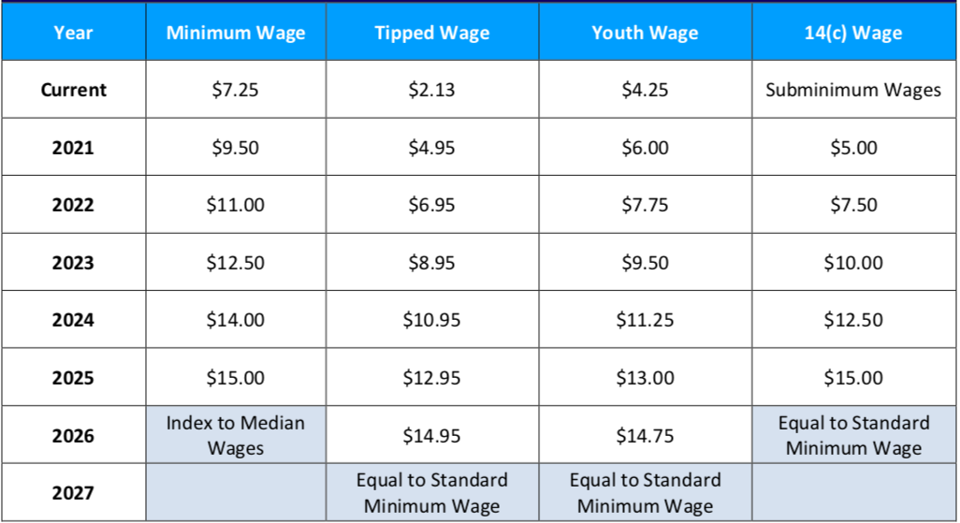
Scheduled Min Wage Increases Under RWA

Slide 48
Economic Consensus on $15/hour? NO
Increases are well outside the range of previous experience.
Ambiguous impact on affected worker’s living standards:
  Negative: unemployment, lower on the job amenities, inflation
  Positive: higher wages
Likely NOT an improvement for business owners.
  Unless it induces implausibly high levels of increased worker effort.
Implications for broader society are unclear.
  But the minimum wage is implemented as an efficiency tradeoff for equity.
  It is a policy that reflects society’s values regarding the welfare of workers.

Slide 49
CBO Analysis
Effects of increase to $15 – summary:
  Increased wages for 27 million people in 2025.
    17 million who would be below $15/hour.
    10 million who would have earned just above $15/hour.
    Increased labor compensation of $333 billion between 2021 and 2031.
      $509B in increased pay.
      $175B less because of job losses.
  Put 1.4 million out of work (0.9% of workers).
    Primarily young, less educated workers.
  Lift 900,000 out of poverty.
    2019: 34 million people lived in poverty.
https://www.cbo.gov/system/files/2021-02/56975-Minimum-Wage.pdf

Slide 50
What to make of the CBO results?
Primary Results
  Increased wages for 27 million people.
  1.4 million fewer low wage jobs.
  900,000 lifted out of poverty.
Reasonable people can, and do, disagree about whether or not the tradeoff is worth it.
Important question: Is there a better policy instrument?
  Up for consideration: expanding the Earned Income Tax Credit.
    Also raises the incomes of low wage workers, but puts taxpayers on the hook instead of businesses.
      Again, reasonable people can, and do disagree about whether this is better.
  Up for consideration: Can trade unions do a better job in wage negotiation?

Slide 51
The Impact on Poverty and Wage Inequality
MW can help “working poor”.
MW is not great in decreasing poverty. A large number of individuals that are poor (i.e. children or disabled) do not work. In this way, no matter how high the minimum wage is, if you do not work, you do not get any benefits from it.
Many who earn MW also do not live in poor households (i.e. teenagers in wealthier households).
There is evidence that increase in MW can decrease wage inequality

Slide 52
Other Options?
Why Federal MW and not simply State or Local?
Why not rely more on the use of collective bargaining agreements and unions
Earned Income Tax Credit (EITC): provides an income subsidy (in the form of a tax credit) to low-income working families. The tax credit benefits are phased out slowly so that workers are not penalized as they earn more income.

Slide 53
EITC superior on many grounds
MW
  May costs some jobs (or hours worked).
  Does not target benefits on the poor.
  Does not redistribute from the richest.
EITC
  Targets the poor effectively.
  Encourages work.
    Better long-term effects.
  Financed by taxes (hence can decrease inequality).
  We can make it more generous.
Notes:
Redistribution through government policy is, in my view, an appropriate response to rising inequality.
Touch on Israel tax data work.

Slide 54
Summary
The minimum wage has been around since 1938.
  The comprehensiveness of its coverage has steadily increased.
The Federal minimum wage is currently $7.25/hour.
  It’s level has fluctuated, both up and down in inflation adjusted terms.
    It is currently 41% below it’s peak in the 1960s.
There are perfectly valid arguments for and against it.
  Economics is not currently able to provide a definitive answer.
  Depends on the tradeoff between higher wages and employment.
The textbook exposition (price up -> quantity down) is a gross simplification.
  The reality of its evaluation is much more complicated.
The FEDERAL minimum wage is waning in importance.
  States take up the mantel.
Economists do not have a clear position or anything like consensus on the issue.
  But the research is trending in the direction toward benefits (improved living standards) and away from direct costs (unemployment).

Slide 55
Most Important Point: It’s Complicated
Minimum wage helps some (many?) workers, but has negative consequences.
Little or no evidence of net benefits for low-income families.
There are winners and losers from a higher minimum wage.
Policymakers and the public then have to decide if enough of the gains are going to those they want to help, to offset the losses for others.
There are other policies that likely work better.

Slide 56

Next Week: Bitcoin mine

Slide 57
Thank you!
Any Questions?
www.NEEDEcon.org
Veronika Dolar, Ph.D.
vdolar@pace.edu
Contact NEED: info@NEEDEcon.org
Submit a testimonial: www.NEEDEcon.org/testimonials.php
Become a Friend of NEED: www.NEEDEcon.org/friend.php

