Slide 1
Osher Lifelong Learning Institute, Winter 2022
Contemporary Economic Policy
University of Southern Maine
Ryan Herzog, Ph.D.
Gonzaga University

Slide 2
National Economic Education Delegation
Vision
  One day, the public discussion of policy issues will be grounded in an accurate perception of the underlying economic principles and data.
Mission
  NEED unites the skills and knowledge of a vast network of professional economists to promote understanding of the economics of policy issues in the United States.
NEED Presentations
  Are nonpartisan and intended to reflect the consensus of the economics profession.

Slide 3
Credits and Disclaimer
This slide deck was authored by:
  Geoffrey Woglom, Jon Haveman,
This slide deck was reviewed by:
  Jon Haveman
Disclaimer
  NEED presentations are designed to be nonpartisan.
  It is, however, inevitable that the presenter will be asked for and will provide their own views.
  Such views are those of the presenter and not necessarily those of the National Economic Education Delegation (NEED).

Slide 4
Course Outline
Contemporary Economic Policy
  Week 1 (1/11): US Economy & Coronavirus Economics
  Week 2 (1/18): Federal Debt (Ryan Herzog, Gonzaga University)
  Week 3 (1/25): Economics of Immigration (Jennifer Alix-Garcia, Oregon St.)
  Week 4 (2/1): Health Economics (Me)
  Week 5 (2/8): Minimum Wage (Me)
  Week 6 (2/15): Cryptocurrencies (Geoffrey Woglom, Amherst College)

Slide 5
Who Are We?
Honorary Board: 54 members
  2 Fed Chairs: Janet Yellen, Ben Bernanke
  6 Chairs Council of Economic Advisers
    Furman (D), Rosen (R), Bernanke (R), Yellen (D), Tyson (D), Goolsbee (D)
  3 Nobel Prize Winners
    Akerlof, Smith, Maskin
Delegates: 600+ members
  At all levels of academia and some in government service
  All have a Ph.D. in economics
  Crowdsource slide decks
  Give presentations
Global Partners: 45 Ph.D. Economists
  Aid in slide deck development

Slide 6
US Government Debt

Slide 7
A Fun Website
Brookings Institute
  The Fiscal Ship - https://fiscalship.org

Slide 8
The Federal Budget in 2020
Programmatic Outlays
less
Equals
Deficit
$3.2 Trillion
15% of GDP
Source: CBO, 4/30/2021

Slide 9
Fiscal 2021 (no fancy graphics yet)
Deficit, 2.8t (12.4% of GDP) =Outlays, 6.8t – Receipts, 4.0t
$250b more outlays; $600b more in taxes.

Slide 10
Past and Future of Deficits
Useful Deficit Decompositions:
Total Deficit= (Spending on Programs +
Interest Expense)-Revenue
=(Programmatic Outlays – Revenue)+Interest Expense
=Primary Deficit + Net Interest
Source: CBO, Updated Budget and Econo9mic Projections, 7/15/2021

Slide 11
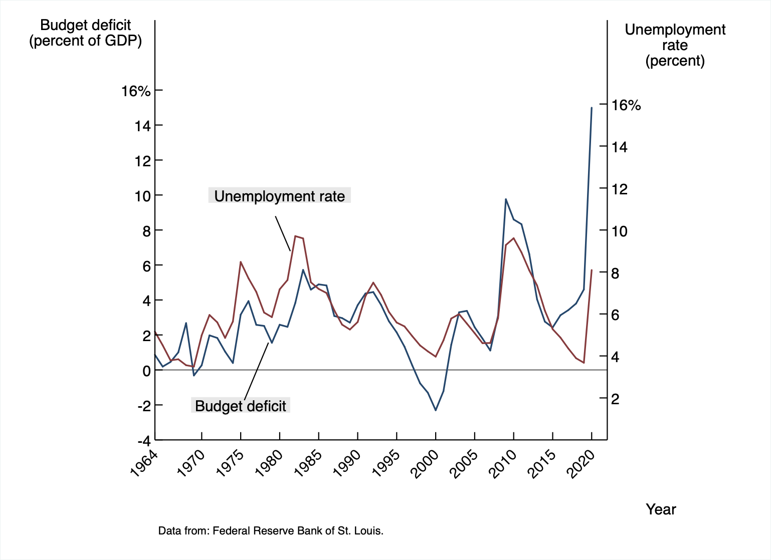
Deficits and Recessions
Notes:
Debt2deficit.png

Slide 12
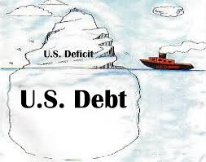
Of Debt, Deficits, and Surpluses
FLOW
  Deficit: The excess of outlays over revenues in a year.
  Surplus: The excess of revenues over outlays in a year.
STOCK
  Debt: The accumulation of debt over time.
      The sum of all past deficits and surpluses.

Slide 13
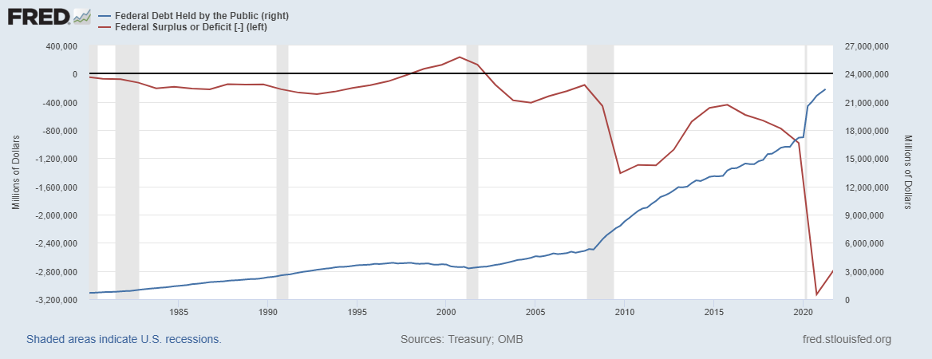
Debt vs. Deficit
The Sum of All Past Deficits Less Surpluses Equals the Debt
Blue Line Debt; Red Line Deficit
Shaded areas are recessions
Notes:
Debt2deficit.png

Slide 14
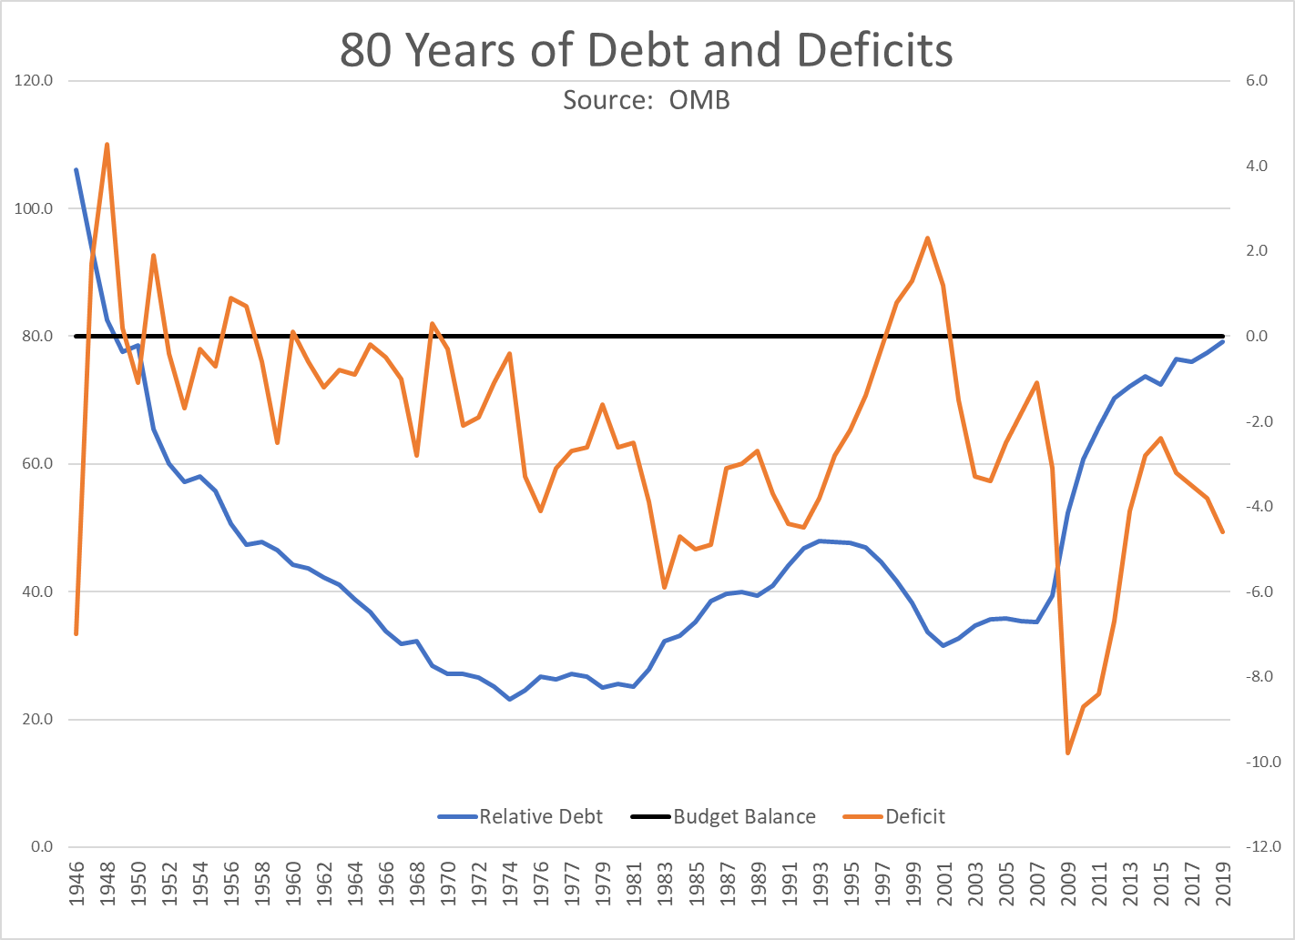
The Post-WWII Fall in Relative Debt

Slide 15
Key Points About the U.S. Relative Debt
1946-1974
Relative debt peaked during WWII (106%) - followed by a steady decline until the 1980s.
Prior to 1983, relative debt rose purposefully (wars, recessions, public investment) and then fell.
What can we learn from the 46-74 period, where the relative debt fell continuously?

Slide 16
Debt Dynamics
The relative debt fell in spite of deficits in 21 of the 29 years, with the debt increasing by 42%. How?
1946-1974, deficits caused the debt to grow, but not as fast as the economy was growing.
While the debt grew by 42%, GDP (nominal) grew by 550%
You don’t need a surplus to reduce the relative debt

Slide 17
Debt Dynamics
Surprising (?) Facts
  From 1945 to 1979, relative debt fell from 100% of GDP to 25% of GDP.
  During this period, the federal budget was in surplus only once, in 1969.
Relative debt is a fraction: Debt/GDP; fractions fall if:
  The numerator falls (budget surplus)
  The denominator rises (nominal GDP growth)
  The denominator grows faster than the numerator

Slide 18
A Breakdown of the Total Federal Debt
Sources: US Treasury, Federal Reserve Board

Slide 19
Not All Debt Is Created Equal
Intra-governmental debt is important bookkeeping.
  This debt DOES NOT require funding on credit markets
Debt held by the public
  This debt is funded by borrowing on credit markets and competes with private funding.
Most analyses focus on the publicly debt relative to GDP because:
  To the extent that debt and deficits have burdens these burdens depend on the size of the debt relative to the size of the economy.

Slide 20
How Does the US Government Borrow?
It issues debt.
  Treasury marketable securities:
    Treasury bills, notes, and bonds
    TIPS: Treasury inflation-protected securities
    Savings bonds
Who buys the debt?
  Other federal agencies
  Individuals and businesses
  State and local governments
  Foreign government and individuals
  Federal Reserve

Slide 21
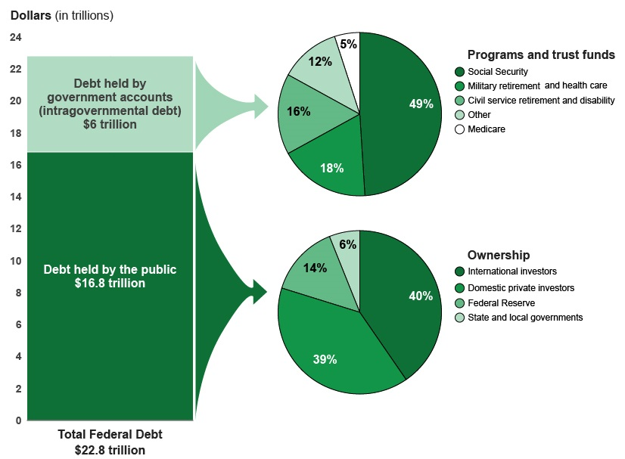
A Breakdown of Total Federal Debt
Share of US Public Debt
Foreign ownership is relatively recent – in 1990 foreign ownership was less than 20%
https://www.gao.gov/americas_fiscal_future?t=federal_debt

Slide 22
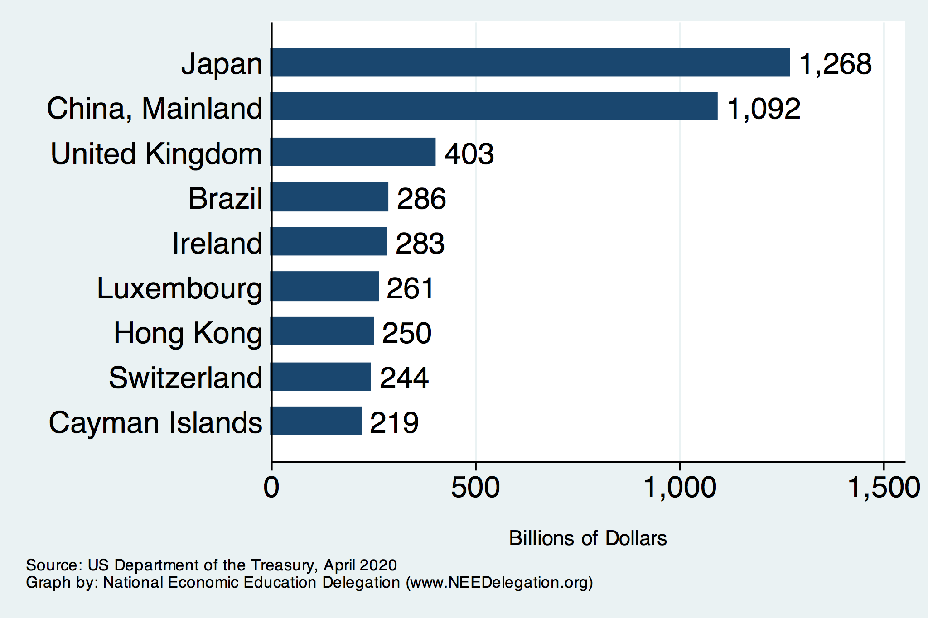
Who Holds Debt to Foreigners

Slide 23
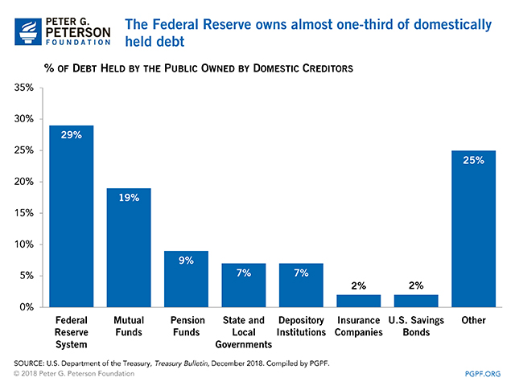

Slide 24
Not All Debt Is Created Equal
Some debt can reduce the availability of investment funds to other borrowers.
  Often referred to as “crowding out” private investment
Intragovernment debt is (important) bookkeeping.
  This debt DOES NOT crowd out private investment.
Debt held by the public
  This debt MIGHT crowd out private investment.
Most analyses of debt focus on federal debt held by the public.

Slide 25
Major Takeaways: Talking Points
The current trajectory of federal debt is unsustainable.
Given the historically low interest rates, we can afford to wait until after the crisis to act.
After the crisis, we must enact plans to reduce the future (primary) deficits.
  These are driven by Medicare and Social Security spending.
The longer we postpone action, the greater the probability of a “fiscal crisis.”

Slide 26
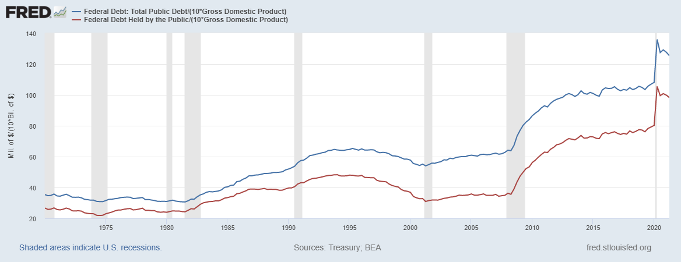
Two Measures of the Relative Debt
Blue Line Total Debt; Red Line Deficit
SSN & Medicare Trust Funds

Slide 27
CBO: Budget Analysts in Chief
The Congressional Budget Office was founded in 1974 to provide Congress with information about the budgetary implications of legislation.
Two kinds of Reports
  Cost Estimates – H.R. 486 Ukraine Religious Freedom Support Act
  Build Back Better Scoring this Friday!
  Projections of Debt and Deficits – The Budget and Economic Outlook: 2020 to 2030

Slide 28
Traditional Views of the Cost of the Debt
First a non-issue: There is no analogy between household and government debt.
  The government does not have to pay back the debt.
  Retirees cash in maturing bonds which are financed with new bond issues sold to younger people.
  Interest on the debt is essentially paid by the young to their parents
Economist View of the Debt circa 1980, very little cost because relative debt was falling. That changes in 1983.

Slide 29
Traditional View: Debt and Deficits Raise Interest Rates
Crowding Out: Higher interest rates lead to less investment and over time to a smaller capital stock and reduced future output.
Foreign Borrowing: Higher interest rates lead to foreign capital inflows or foreign borrowing. With foreign borrowing, some of our GDP is paid to foreigners as interest.

Slide 30
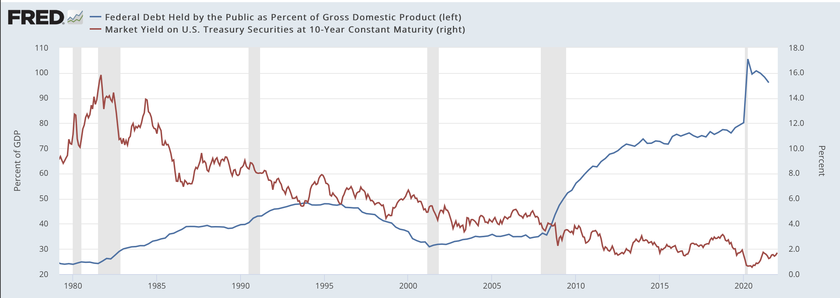
The Dog that Didn’t Bark; Rising Interest Rates?
Blue Line Debt; Red Line Rate on 10-Yr Treasury
10-yr: 1.30%

Slide 31
Maybe Debt Isn’t a Problem After All: MMT
Stephanie Kelton provided a prominent and recent exposition of modern monetary theory in a NY Times op-ed on June 6, 2020:
  “Learn to Love Trillion-Dollar Deficits.”
Modern monetary theory
  US Treasury borrows in its own currency and therefore cannot default.
    As opposed to countries, such as Greece, which borrow in euros.
  Example: How did we ”find the money” for the recent increase in the deficit of about $1.9 trillion?
    Answer: The Fed purchased $1.7 trillion = 89% of financing
  More generally, MMT argues that we can always find the money to increase federal spending.

Slide 32
MMT’s Free Lunch
The only limit on deficit spending is when it leads to too much spending, thereby increasing current inflation.
Recognizing this fact, “could free policymakers not only to act boldly amid crises but also to invest boldly in times of more stability.”
  First part, acting boldly, is important and likely true.
  Second part, invest boldly, is suspect.
The Trump experiment…
  From 2017q1 – 2019q4 (pre-Covid), public debt increased from $19.8t to $23.3t
    An increase of $3.5t
  Federal Reserve holdings remained steady at $2.8t

Slide 33
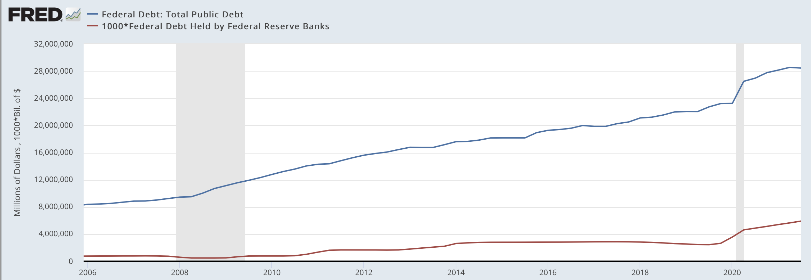
“Monetizing the Debt”

Slide 34
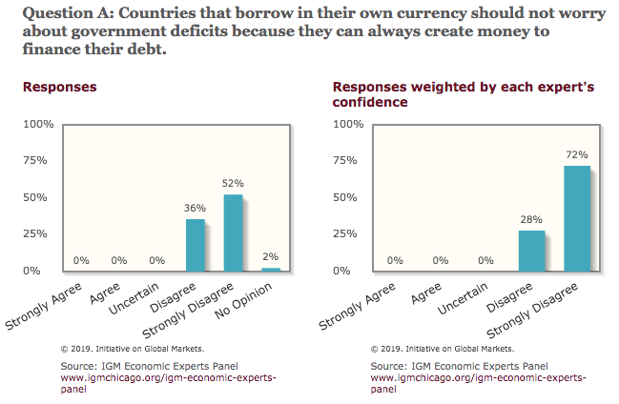
General Sense on Modern Monetary Theory

Slide 35
Olivier Blanchard’s Presidential Address to the AEA 1/2019
“If the future is like the past [with low interest rates],…the issuance of debt without a later increase in taxes may well be feasible. Put bluntly, public debt may have no fiscal cost.”
But,
“My purpose…is not to argue for more public debt, especially in the current political environment. It is to have a richer discussion of the costs of debt…than is currently the case.”

Slide 36
Bottom Line: We Need to Worry about the Debt
Interest rates will not stay this low forever.
A fiscal crisis should be avoided at all costs.
Stabilizing relative debt would substantially reduce the possibility of a crisis.
The good news is we might be able to stabilize relative debt without a primary surplus.
But (after the pandemic is over) we must substantially reduce primary deficits.

