Slide 1


The US Federal Debt
OLLI
April 20, 2021
Geoffrey Woglom
Amherst College
Professor of Economics (Emeritus)

Slide 2
Credits and Disclaimer
This slide deck was authored by:
  Jon Haveman, Executive Director, NEED
  Geoffrey Woglom, Amherst College, Emeritus
Disclaimer
  NEED presentations are designed to be nonpartisan.
  It is, however, inevitable that the presenter will be asked for and will provide their own views.
  Such views are those of the presenter and not necessarily those of the National Economic Education Delegation (NEED).

Slide 3
Outline
Debt Basics
  Definitions and Data.
  Not all deficits are bad, but since 1982, deficits have not served economic purpose.
  Debt Dynamics
  Traditional View (1980) of the costs of the debt, based on rising interest rates
Break!!
Three New Views on the Costs of Debt:
  Modern Monetary Theory: There are no costs.
  Olivier Blanchard: Stable debt has little cost.
  Furman and Summers: Given Blanchard, lets increase the debt now!
  But there still are still big risks.
Your Questions (I hope)

Slide 4
What Does the U.S. Gov’t Budget Look Like?
Fiscal 2020 Budget Summary
Revenue | Billions |  | Outlays | Billions
Income Taxes | $1,609 |  | Mandatory | $2,315
Payroll Taxes | $1,310 |  | Discretionary | $3,850
Corporate Taxes | $212 |  | Interest | $387
Other | $289
Total | $3,420 |  | Total | $6,552
Programmatic
Outlays
Budget Deficit: $3,132
Source: Congressional Budget Office, Monthly Budget Review, Nov 2020
Notes:
https://www.cbo.gov/publication/53627
https://www.cbo.gov/publication/53624

Slide 5
Past and Future of Deficits
Useful Deficit Decompositions:
Total Deficit= (Programmatic Outlays +
Interest Expense)-Revenue
=(Programmatic Outlays – Revenue)+Interest Expense
=Primary Deficit + Net Interest
N.B. Does not include American Rescue Plan.
Polls 1 &2
Source: Congressional Budget Office, The Budget and Economic Outlook: 2020 to 2030, 9/20

Slide 6
The Effect of the American Rescue Plan
Good News (?); 2021 deficit is still less than the 30% deficit in 1943

Slide 7
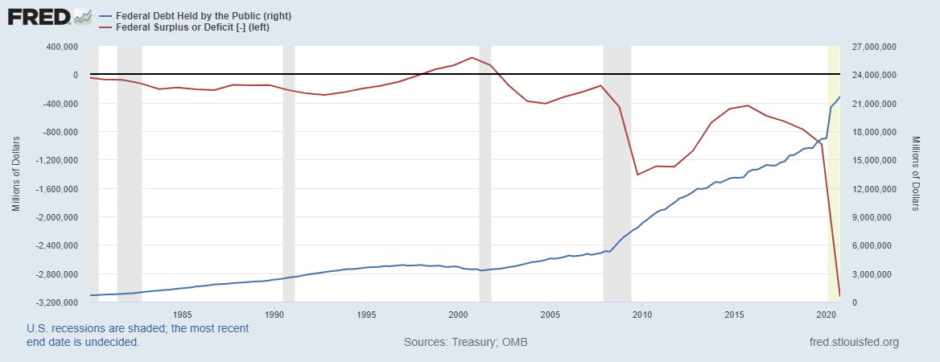
Debt vs. Deficit
The Sum of All Past Deficits Less Surpluses Equals the Debt
Shaded areas are recessions
Poll 3
Notes:
Debt2deficit.png

Slide 8
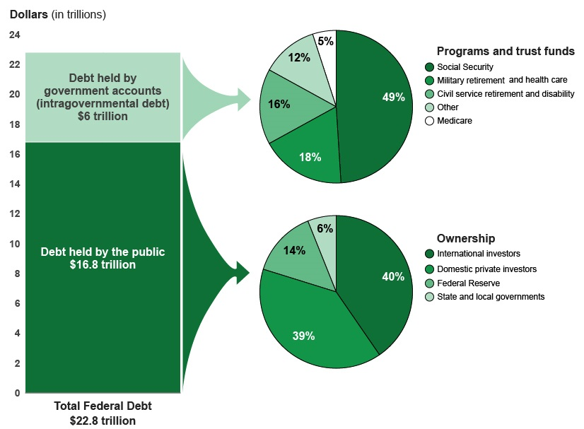
A Breakdown of the Total Federal Debt
Share of US Public Debt
As of Feb, Japan holds $1.26 tr
China Holds $1.10 tr: https://ticdata.treasury.gov/
As of 4/16: total public debt, $28.1 tr, held by the public, $22.0 tr.
https://www.cbo.gov/system/files/2020-03/56165-CBO-debt-primer.pdf

Slide 9
Not All Debt Is Created Equal
Intra-governmental debt is important bookkeeping.
  This debt DOES NOT require funding on credit markets
Debt held by the public
  This debt is funded by borrowing on credit markets and competes with private funding.
Most analyses focus on the publicly debt relative to GDP because:
  To the extent that debt and deficits have burdens these burdens depend on the size of the debt relative to the size of the economy.

Slide 10
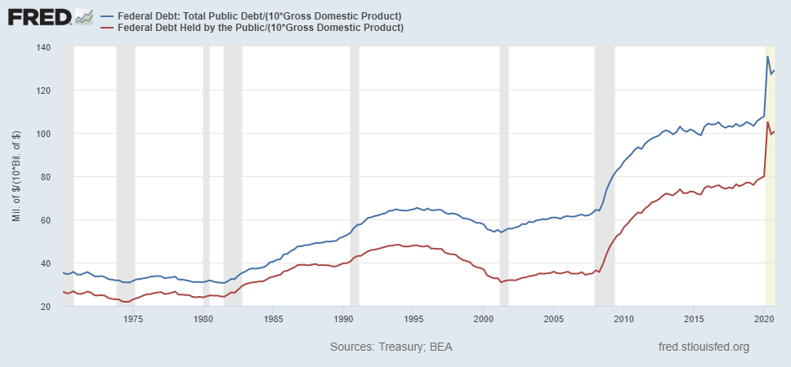
Two Measures of the Debt
Presently, debt held by the public is slightly more than GDP
SSN & Medicare Trust Funds
Poll 2

Slide 11
CBO: Budget Analysts in Chief
The Congressional Budget Office was founded in 1974 to provide Congress with information about the budgetary implications of legislation.
Two kinds of Reports
  Cost Estimates – HR 6036 VA Family Leave Act of 2020
  Projections of Debt and Deficits – The Budget and Economic Outlook: 2020 to 2030

Slide 12
Key Points About the U.S. Relative Debt
Relative debt peaked during WWII (106%) - followed by a steady decline until the 1980s.
Prior to 1983, relative debt rose purposefully (wars, recessions, public investment) and then fell.

Slide 13
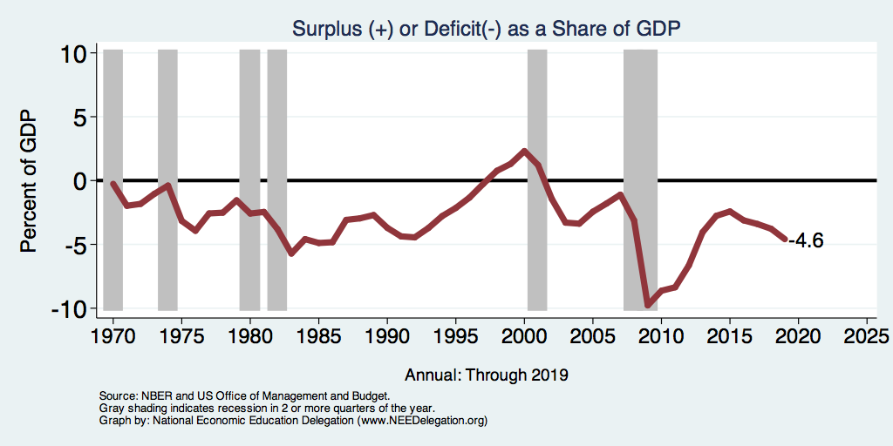
Purposeful Deficits #1: Recessions
Notes:
Debt2deficit.png

Slide 14
Purposeful Deficits #2: Good Reasons to Borrow
To Meet a Temporary need: e.g. WWII. Spread the costs over a number of years.
To Finance Profitable Investment Projects:
  In the late 1970s, improvements to water systems mandated by the Clean Water Act;
  In the late 1990s and early 2000s, research and development for health-related programs; and
  In the late 2000s and early 2010s, Obama stimulus fostered the development of infrastructure for transportation and boosted spending for education at all levels.
  Biden’s American Jobs Plan?

Slide 15
Relative Debt since 1940 to 2020
Relative Debt Rises without strategic purpose.
What can we learn from the long period of falling relative debt?
Source: CBO, 9/2020

Slide 16
Debt Dynamics
Between 1946-1974, relative debt fell continuously in spite of deficits in 21 of the 29 years, with the debt increasing by 42%. How?
1946-1974, deficits caused the debt to grow, but not as fast as GDP.
While the debt grew by 42%, GDP (nominal) grew by 550%
You don’t need a surplus to reduce the relative debt

Slide 17
More Generally:
Relative Debt falls when the debt is growing more slowly than the economy (Growth in GDP).
Relative Debt rises when the debt grows faster than GDP.
Stabilizing the Relative Debt requires deficits that cause the debt to grow at the same rate as GDP
Poll 4

Slide 18
A little bit more on Debt Dynamics
How fast does the debt grow?
  Suppose that programmatic outlays were just equal to total revenue (i.e. the primary deficit is zero), then the deficit would be the interest expense, and the growth rate in the would be in the interest rate.
  E.g, debt equals 200, interest rate equals 5% and the primary deficit is zero. The deficit is 10 (.05X200) and the debt grows by 10, which is 5% of 200.
  If the primary deficit is greater than zero, then we know that the grow rate in the debt is greater than the interest rate.
  If the primary deficit is less than zero (primary surplus) then the debt grows at a rate less than the rate of interest.

Slide 19
Traditional Views of the Cost of the Debt
First a non-issue: The analogy between household and government debt is inaccurate.
  The government does not have to pay back the debt.
  Retirees cash in maturing bonds which are financed with new bond issues sold to younger people.
  Interest on the debt is essentially paid by the young to their parents
Economist View of the Debt circa 1980, very little cost because relative debt was falling and rising debt served a purpose. But that changed in 1983

Slide 20
Traditional View: Debt and Deficits Raise Interest Rates
Investment Crowding Out: Higher interest rates lead to less investment and over time to a smaller capital stock and reduced future output.
Foreign Borrowing: Higher interest rates lead to foreign capital inflows or foreign borrowing. With foreign borrowing, some of our GDP is paid to foreigners as interest.

Slide 21
Traditional View: Debt and Deficits Raise Interest Rates (Cont.)
Government Crowding Out: For any overall deficit, the higher the interest expense the less government spending or the higher taxes.
  The deficit was 2.8% of GDP in 1994 and 2014.
  1994: interest expense was 2.8% and PD =0;
  2014 interest expense was 1.3% and PD = 1.5% (lower interest rates).

Slide 22
Don’t Deficits Cause Inflation?
No, inflation is caused by excessive aggregate (total) demand.
Competent central banks will offset too much aggregate demand by raising interest rates.
But incompetent central banks may be tempted (or forced) to cause inflation to help the Treasury by generating inflation
  Hyperinflation, Weimar Germany; Zimbabwe in the 2000s.
  Government may be tempted to “inflate away” high debt levels. Raise the rate of growth of the denominator with inflation

Slide 23
Summary Part I.
Debt is the accumulation of past deficits.
The costs of the debt are proportional to the size of the economy; i.e. to the relative debt.
The debt that matters is the publicly held debt, 40 percent of which is owned by foreigners.
Prior to 1980 relative debt fell except during wars and recessions.
The relative debt falls when the economy (GDP) grows faster than the debt.
Costs of the debt are primarily due to rising interest rates.
Questions?

Slide 24
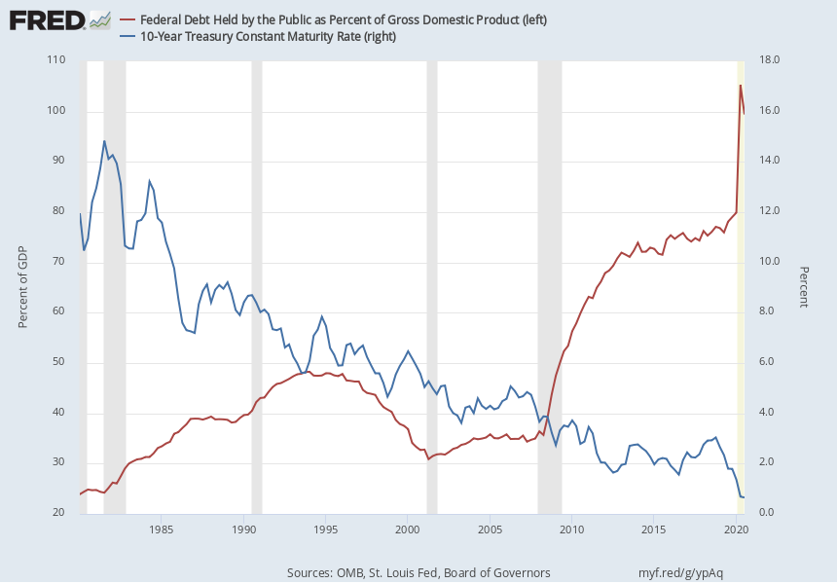
The Dog that Didn’t Bark; Rising Interest Rates?
N.B Since the beginning of 2021, this rate has risen by about 1 percentage point.
As of Monday, 1.61%

Slide 25
Maybe Debt Isn’t a Problem After All: MMT
Stephanie Kelton provided a prominent and recent exposition of Modern Monetary Theory in her June 6th NYTimes op-ed, “Learn to Love Trillion-Dollar Deficits.”
  US Treasury borrows in dollars and therefore cannot default (as opposed to Greece).
  Example: How did we “find the money” for the recent increase in the debt (about $4.2t)?
  Answer: Fed increased its holding of Treasuries by $3.3 t, providing 79% of the financing.
  More generally, she argues that we can always find the money to increase federal spending, or turn to the Fed.
Sources, Daily Treasury Statements and Federal Reserve Board

Slide 26
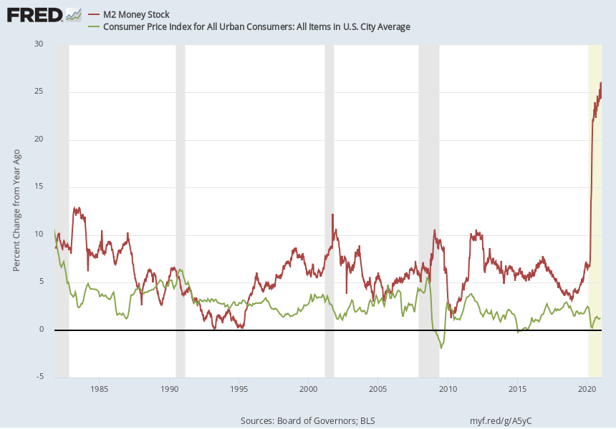
Isn’t the Fed creating Money?
Yes, but there is no (at the moment) excess aggregate demand. And, more generally the link between money growth and inflation is pretty weak.

Slide 27
MMT’s Free Lunch
The only limit on deficit spending is if it leads to too much spending thereby increases current inflation.
Recognizing this fact, “…could free policymakers not only to act boldly amid crises but also to invest boldly in times of more stability.”
Too bad the second part isn’t true

Slide 28
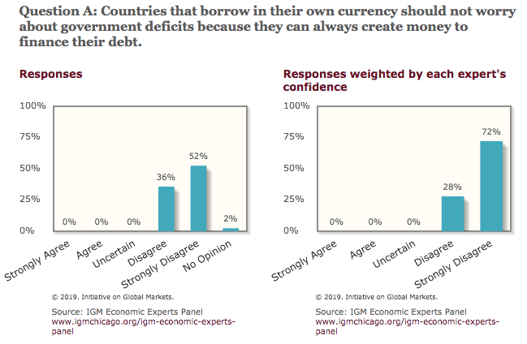
Don’t Just Take My Word for It
Poll 5

Slide 29
More on Consensus Criticism of MMT
What happens when “not worrying about deficits” leads to excess aggregate demand and inflation.
Dr. Kelton: At that point, Fed stops buying bonds leading to a rise in interest rates; if that is not sufficient the deficit should be reduced to cut aggregate demand.
Economic point: The economy has a lot of momentum and stopping inflation takes time.
Political economic point: Will there be the political will to raise interest rates and cut government spending and raise taxes in time?

Slide 30
A More Reasonable, But Still Optimistic View
Olivier Blanchard:
Emeritus Professor MIT
Chief Economist at the IMF, 2008-2015
President of the American Economic Association, 2018

Slide 31
Olivier Blanchard’s Presidential Address to the AEA 1/2019
“If the future is like the past [with low interest rates],…the issuance of debt without a later increase in taxes may well be feasible. Put bluntly, public debt may have no fiscal cost.”
But,
“My purpose…is not to argue for more public debt, especially in the current political environment. It is to have a richer discussion of the costs of debt…than is currently the case.”

Slide 32
What the Traditional View Got Wrong
Stabilizing the Relative Debt, Debt/GDP, requires that the growth rate in debt equals the growth rate of GDP.
The traditional view assumes that the interest rate on debt is greater than the growth rate of GDP
  So the primary deficit must be negative (primary surplus) to lower the growth rate of the debt

Slide 33
Blanchard’s Evidence
CBO, 4/19/2021

Slide 34
An Almost Free Lunch
If the interest rate is less than the growth rate of GDP, then Debt to GDP can be stabilized with a (small) deficit in programmatic outlays relative to revenues.
E.g., Suppose that the growth of GDP is 4% and the interest on the debt is 3%. If the primary deficit were zero, the relative debt would fall.
Blanchard does believe that the relative debt must be stabilized
  At some point deficits must be reduced.
  But it may not be crucial at what level the debt is stabilized.

Slide 35
Taking It One Step Further: (St. Augustine)
Jason Furman and Larry Summers, 12/1 presentation to Brookings
Low Interest Rates are Here to Stay, but not clear why.
  private saving higher due to longer retirement periods, increased inequality, and rising uncertainty.
  Bernanke’s “Savings Glut” from China and Japan
Low Interest Rates Are a Problem:
  Fed fights recessions by lowering interest rates. This time by 2.25 pct. pts, vs. 6.3 pct. pts on average in the past recessions.
  Low interest rates lead to financial instability in “search for yield.”
https://www.brookings.edu/wp-content/uploads/2020/11/furman-summers-fiscal-reconsideration-discussion-draft.pdf

Slide 36
Furman & Summers Conclude
Low Interest Rates Imply Public Investment may be quite profitable.
Expand Debt-Financed Public Investment as long as there are profitable investments and interest rates are at moderate levels (Good Reason to Borrow #2).
Kerfuffle over the American Rescue Plan

Slide 37
But why must the relative debt be stabilized
For practical purposes, the US cannot default on its debt, but…
International investors, however, can still lose if the exchange value of the dollar falls.
Remember, foreign holdings of the public debt amount to 40 percent of the total

Slide 38
Why do Foreigners Buy US Treasuries?
Market for Treasuries is the deepest, (usually) the most liquid capital market in the world.
US economy has a history of political and economic stability.
The dollar is the largest international reserve currency.
  Most international transactions are quoted in dollars, e.g., oil.
  With some exceptions, foreigners borrow in dollars. E.g., Yankee bonds
What would happen if foreigners lost confidence in the stability of the dollar?

Slide 39
CBO: Debt and Fiscal Crisis
The risk of [such] a fiscal crisis appears to be low in the short run despite the higher deficits and debt stemming from the pandemic…. Nonetheless, the much higher debt over time would raise the risk of a fiscal crisis in the years ahead.
CBO, The 2020 Long-Term Budget Outlook, 9/2020

Slide 40
What would a Fiscal Crisis Look Like?
Foreigners lose confidence in the dollar and sell Treasuries in exchange for assets denominated in their own currency,
  Sale of Treasuries raises interest rates, worsening or fiscal outlook.
  Trading of Foreign for US assets lowers US exchange rate.
    Raising the price of imports thereby increasing inflation.
    Lowering the foreign currency returns on all US assets, exacerbating 1.
Could the Fed Bail us Out?
  It could buy Treasuries and prevent the rise in interest rates.
  Insufficient foreign assets to prevent the fall in the exchange rate,

Slide 41
Bottom Line: We Need to Worry about the Debt
Interest rates may not stay this low forever.
A fiscal crisis should be avoided at all costs.
The good news is we may be able to stabilize the relative debt without a running a primary surplus.
Stabilizing the relative debt would substantially reduce the possibility of the crisis

Slide 42
But is this Problem Impossible?

Slide 43
And it Gets Worse: Updated Projections
The Wisdom of Herb Stein, “If something can’t go on forever, it will…
stop
Great Herb, but how?

Slide 44
CBO to the Rescue (The 2020 Long-Term Budget Outlook, 9/2020):
First a note on CBO projections:
  The “baseline projections” (such as on the previous slide) are based on the law as currently written; they are not forecasts of what will happen.
  E.g., when the social security trust fund is depleted in 2035 social security will continue to pay full benefits even though it will only collect about 75% in fica taxes.
But, CBO is allowed to project alternate scenarios
By 2025, deficit must go from projected 5% to about 3%
By 2030, deficit must go from 5.5% to about 2%

Slide 45
Bending the Curves!
Don’t be Fooled
We have some time, but it won’t be easy.

Slide 46
We Have Some Time CBO’s Crystal Ball

Slide 47
Do We Need More Public Investment?

Slide 48
What Is Infrastructure?

Slide 49
Thank you!
Any Questions?
www.NEEDelegation.org
Geoffrey Woglom
grwoglom@amherst.edu
Contact NEED: Info@NEEDelegation.org
Submit a testimonial: www.NEEDelegation.org/testimonials.php
Support NEED: www.NEEDelegation.org/donate.php

