Slide 1

Cryptocurrencies Update!
San Jose Kiwanis Club
6/20/2022
Geoffrey Woglom
Amherst College
Professor of Economics (emeritus)

Slide 2
National Economic Education Delegation
Vision
  One day, the public discussion of policy issues will be grounded in an accurate perception of the underlying economic principles and data.
Mission
  NEED unites the skills and knowledge of a vast network of professional economists to promote understanding of the economics of policy issues in the United States.
NEED Presentations
  Are nonpartisan and intended to reflect the consensus of the economics profession.

Slide 3
Who Are We?
Honorary Board: 54 members
  2 Fed Chairs: Janet Yellen, Ben Bernanke
  6 Chairs Council of Economic Advisers
    Furman (D), Rosen (R), Bernanke (R), Yellen (D), Tyson (D), Goolsbee (D)
  3 Nobel Prize Winners
    Akerlof, Smith, Maskin
Delegates: 600+ members
  At all levels of academia and some in government service
  All have a Ph.D. in economics
  Crowdsource slide decks
  Give presentations
Global Partners: 44 Ph.D. Economists
  Aid in slide deck development

Slide 4
Available NEED Topics Include:
Coronavirus Economics
US Economy
Climate Change
Economic Inequality
Economic Mobility
Trade and Globalization
Minimum Wages
Immigration Economics
Housing Policy
Federal Budgets
Federal Debt
Black-White Wealth Gap
Autonomous Vehicles
US Monetary Policy

Slide 5
Credits and Disclaimer
This slide deck was authored by:
  Geoffrey Woglom, Amherst College, Emeritus
Disclaimer
  NEED presentations are designed to be nonpartisan.
  It is, however, inevitable that the presenter will be asked for and will provide their own views.
  Such views are those of the presenter and not necessarily those of the National Economic Education Delegation (NEED).

Slide 6
Where We Left Off
Facts about Bitcoin: Volatile with some outsized returns.
Bitcoin and crypto have become ubiquitous: for better or worse
Bitcoin is not used for transactions, but is a highly speculative asset with little or no fundamental value.
Blockchain technology has promise, but needs a crypto medium-of-exchange, i.e., stablecoin.
Good regulations needed, but require legislation.
Fed is behind the curve on providing a digital dollar

Slide 7
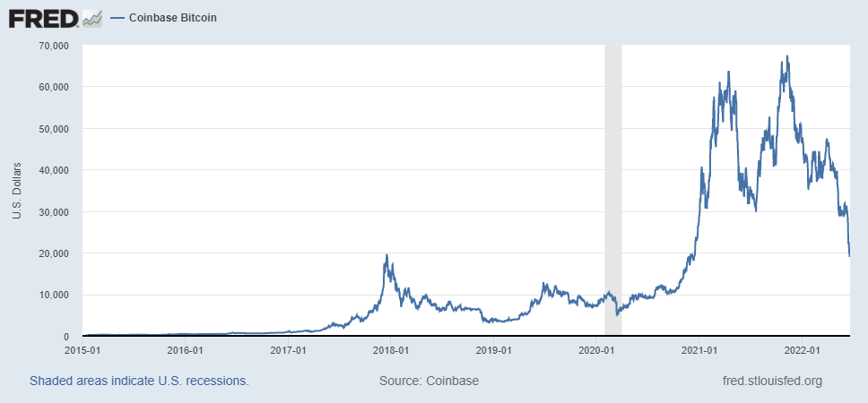
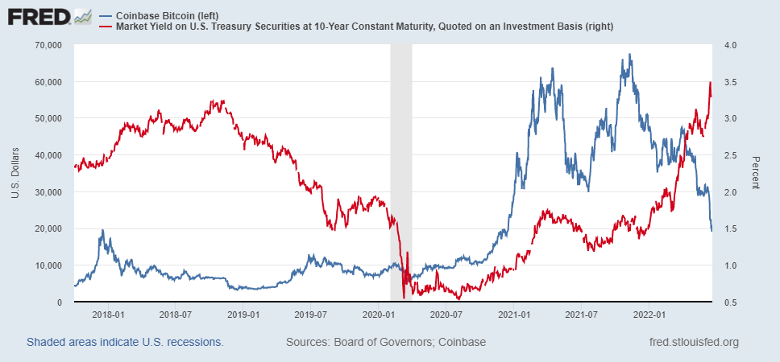
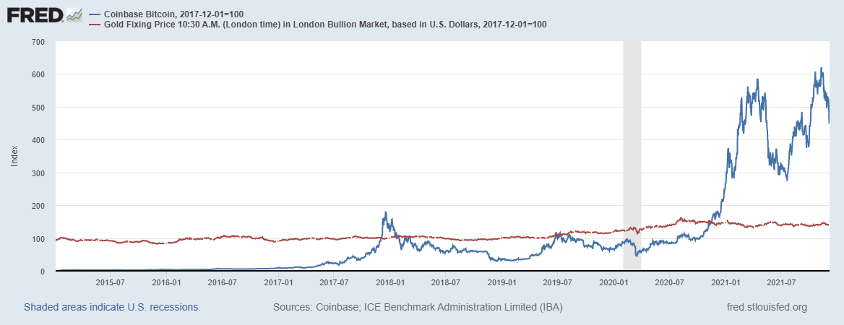
Bitcoins: What is the Excitement About?
Almost 500% increase in 6 months
Coincidence?
Blue Line Price of Bitcoin
Red Line: Price of Gold
On, 12/3
1 bitcoin = $49k
Notes:
Bitcoin was trading at $56,850. No $20,000

Slide 8
One of the Over 40,000 Bitcoin ATMs
50,000

Slide 9
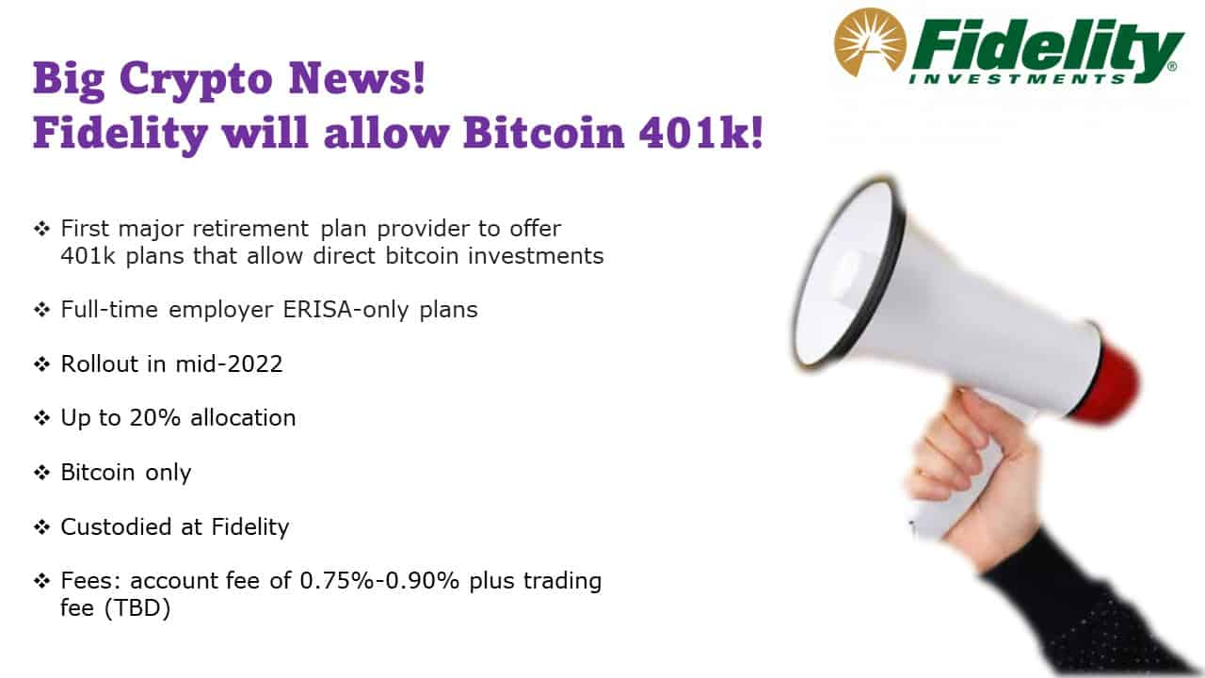
Give Me a Break?

Slide 10
Facts about Cryptocurrencies (as of 12/5)
As of 11AM, ET
Bitcoin was the first and is the largest in terms of market cap (total value of all bitcoins) of about $930 billion.
Ethereum is in second place with a market cap of about $500 billion.
Presently, thousands of different varieties with a total market cap of about $2.4 trillion (https://www.coingecko.com/en)
NY stock exchange market cap is about $25 trillion
$396
$138
Presently, 19,000 different varieties with a total market cap of
$952 billion (https://www.coingecko.com/en)

Slide 11
But What about as an Investment?
Question: Private, unbacked crypto assets serve no economic purpose.

Slide 12
Question #2: The Value of the New Technology?
The value cryptographically protected digital-tokens is nuanced:
Blockchain technologies have significant promise which is already being realized.
SAT analogy? Uber is to taxi as DEFI is to Traditional Finance?
Not yet, most of the applications stay in the crypto universe: e.g., crypto derivatives; borrowing and lending crypto
Still lots of fraud and chaos: Pick Your Disaster: (https://web3isgoinggreat.com/)
Notes:
Cryptographic protection is a tougher call and depends on your views of privacy rights, as well as what information is being kept private (e.g., medical records versus financial transactions) Supply Chains (Walmart IBM)
Smart Contracts (Xbox royalties)

Slide 13
E.G., The Demise of Terra/Luna
Algorithmic stablecoin.
  Start a typical crypto currency: luna.
  Later create another crypto currency called terra, which always can be exchanged for $1 worth of luna and vice versa
  Where do you get needed luna? Just create new ones.
As long as luna has value, terra should trade close to $1.
What could go wrong?

Slide 14
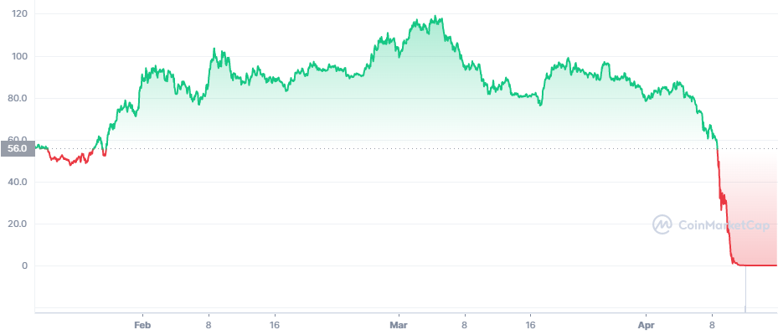
Luna’s Price This Year
https://coinmarketcap.com/

Slide 15
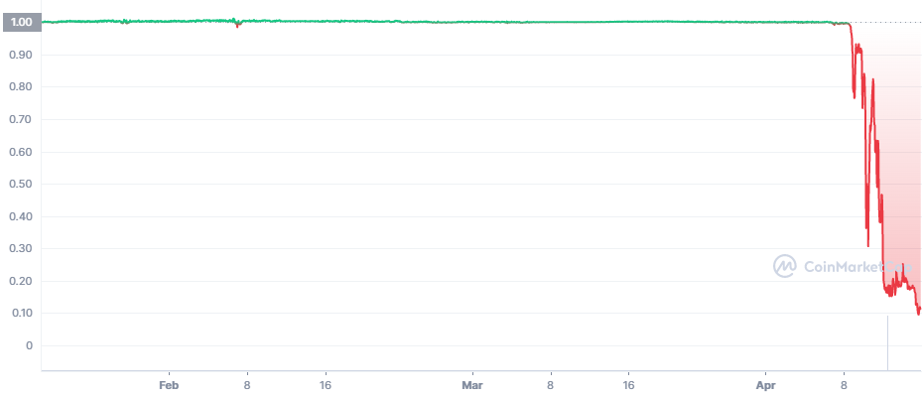
Terra’s Price
Death SpiRal!!!
Notes:
Wiped out $45 billion in face value.in less than a month

Slide 16
What about Tether: “$Backed” Stablecoin?
“The Coin That Could Wreck Crypto” (NYTIMES, 6/17): “In 2021, New York’s attorney general fined Tether $18.5 million and said the company had lied about its reserves, calling it ‘a stablecoin without stability.’”
Market cap of $68 billion; daily volume of $50 billion.
What could go wrong?
Notes:
WSJ, Headline, 8/11/2021, “Poly Network Hackers Steal More Than $600 Million in Cryptocurrency” Bloomberg 7/27/2021: “Tether and the Facebook Inc.-backed Diem token were a main focus of a recent meeting of U.S. regulators held on the financial risks posed by stablecoins.
Facebook NOVI wallets for holding Pax dollars ($1.1 billion in market cap)

Slide 17
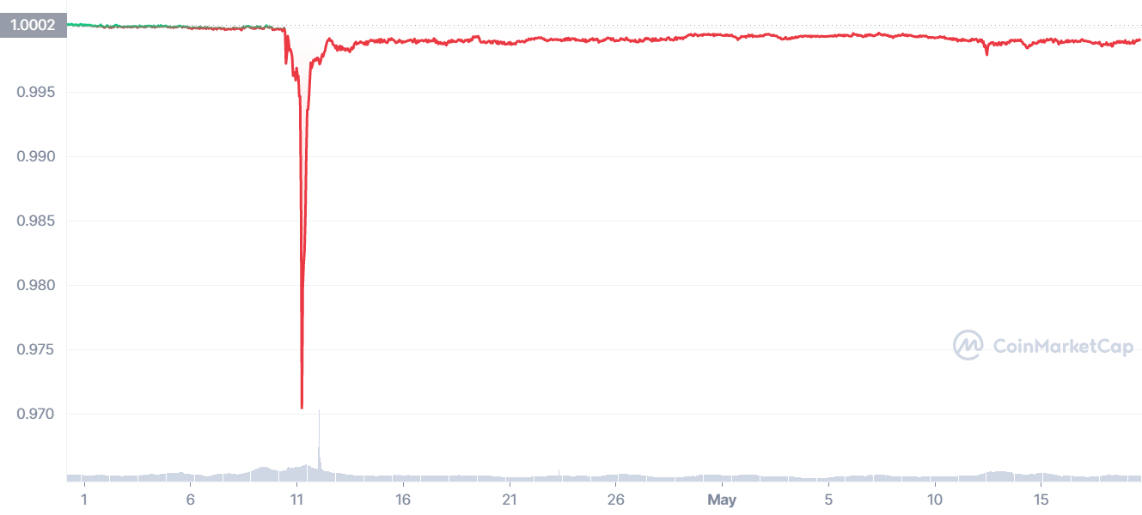
“Breaking the Buck?”

Slide 18
Three Recent US Government Reports
Presidential Working Group on Financial Markets on Stable Coins and CBDC, 11/2021.
Federal Reserve Discussion Paper on CBDCs, 1/2022
  Congress needs to authorize action
  Digital Dollar should be offered by the Fed but managed by commercial banks and other regulated, insured firms.
Executive Order of the President, 3/09/2022
  Encouraging or Discouraging?: “Objectives:”
  (a)-(C) same old, same old tough language.
  (d): “We must reinforce United States leadership in the global financial system and in technological and economic competitiveness.”
  (e)-(f)

Slide 19
Resources to Learn More
N. Mehta, et.al. Blockchain Bubble or Revolution
E Prasad, The Future of Money (https://youtu.be/o3NuHb7V1IA)
Presidential Working Group on Financial Markets, 11/1/21 (https://home.treasury.gov/system/files/136/StableCoinReport_Nov1_508.pdf)
Federal Reserve White paper
(https://www.federalreserve.gov/publications/files/money-and-payments-20220120.pdf)
Executive Order: https://www.whitehouse.gov/briefing-room/statements-releases/2022/03/09/fact-sheet-president-biden-to-sign-executive-order-on-ensuring-responsible-innovation-in-digital-assets/

Slide 20
Glossary
Traditional Money is currency plus bank checking accounts.
Currency is paper and coin issued by the government. Currency is legal tender and must be accepted for all debts. Transactions using currency are immediate and final (can’t be undone without the agreement of both parties.)
Digital Payments are used for purchases where no physical money is exchanged. Examples include many online banking payments, credit card payments, PayPal.
Digital Currency or Virtual currency is a form of money that exists solely in digital form, such as a digital token (i.e., as data on a computer). Examples: cryptocurrencies, central bank digital currencies and virtual currencies used in online gaming.
Cryptographic identity protection assigns people two account numbers, or keys, one public and one private. Public record keeping is done using the public key and transactions are authorized using the private key.
Cryptocurrency is a digital currency where the owner’s identity is protected using cryptographic encryption and where record keeping is done with a public blockchain, e.g., Bitcoin.
Stablecoin is a cryptocurrency with a stable value of $1, somewhat like a money market mutual fund.

Slide 21
Glossary (Cont.)
Distributed ledger is a database for recording transactions or other information, where the information or ledger is shared on a network of many computers simultaneously.
Blockchains are distributed ledgers where new transactions (new blocks) are added to the chain sequentially when a consensus of the network agrees that the transactions are valid.
Decentralized Finance (DeFi) is peer-to-peer financial activity conducted through public blockchains and smart contracts.
Smart Contracts are computer programs that execute automatically based on external conditions. Example, travel insurance that pays off automatically when a flight is cancelled.
Central Bank Digital Currency (CBDC) is a digital currency issued by a central bank. Different central banks are experimenting with various forms of CBDCs, including some using blockchain technology, electronic wallets and cryptography.

Slide 22
Questions?
www.NEEDelegation.org
Geoffrey Woglom
grwoglom@amherst.edu
Contact NEED: Info@NEEDelegation.org
Submit a testimonial: www.NEEDelegation.org/testimonials.php
Support NEED: www.NEEDelegation.org/donate.php

