Slide 1

Cryptocurrencies & The Future of Money
UT Austin Rotary Club
9/13/2021
Geoffrey Woglom
Amherst College
Professor of Economics (emeritus)

Slide 2
National Economic Education Delegation
Vision
  One day, the public discussion of policy issues will be grounded in an accurate perception of the underlying economic principles and data.
Mission
  NEED unites the skills and knowledge of a vast network of professional economists to promote understanding of the economics of policy issues in the United States.
NEED Presentations
  Are nonpartisan and intended to reflect the consensus of the economics profession.

Slide 3
Who Are We?
Honorary Board: 54 members
  2 Fed Chairs: Janet Yellen, Ben Bernanke
  1 Secretary of the Treasury: Yellen (D)
  6 Chairs Council of Economic Advisers
    Furman (D), Rosen (R), Bernanke (R), Yellen (D), Tyson (D), Goolsbee (D)
  3 Nobel Prize Winners
    Akerlof, Smith, Maskin
Delegates: 590+ members
  At all levels of academia and some in government service
  All have a Ph.D. in economics
  Crowdsource slide decks
  Give presentations
Global Partners: 45 Ph.D. Economists
  Aid in slide deck development

Slide 4
Available NEED Topics Include:
US Economy
Climate Change
Economic Inequality
Economic Mobility
US Social Policy
Trade and Globalization
Trade Wars
Immigration Economics
Housing Policy
Federal Budgets
Federal Debt
2017 Tax Law
Autonomous Vehicles

Slide 5
Credits and Disclaimer
This slide deck was authored by:
  Geoffrey Woglom, Amherst College, Emeritus
Disclaimer
  NEED presentations are designed to be nonpartisan.
  It is, however, inevitable that the presenter will be asked for and will provide their own views.
  Such views are those of the presenter and not necessarily those of the National Economic Education Delegation (NEED).

Slide 6
Takeaways
The way we buy and sell things, our “payments system,” can be improved to lower transactions costs, increase security and better meet the needs of the “unbanked.”
Bitcoin has not and cannot meet these needs.
The technologies underlying Bitcoin, however, have the potential to make the payments system better.
Changes to the payments system are coming: should it be driven by the private sector or by the Fed?

Slide 7
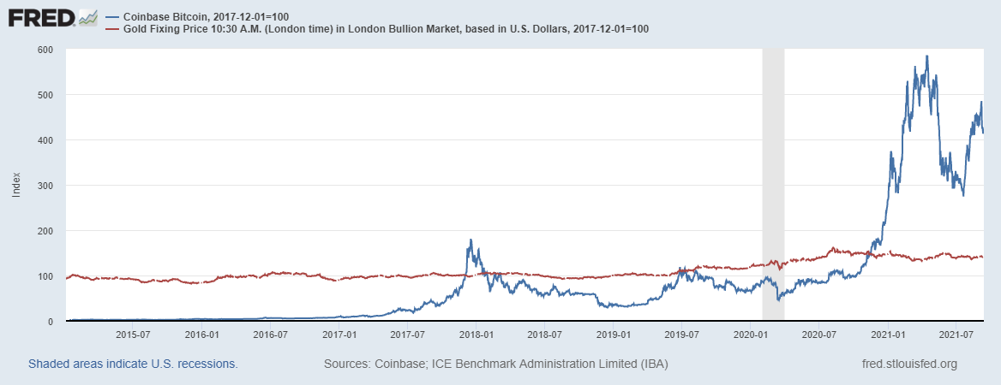
Bitcoins: What is the Excitement About?
Almost 500% increase in 6 months
Blue Line Price of Bitcoin
Red Line: Price of Gold

Slide 8
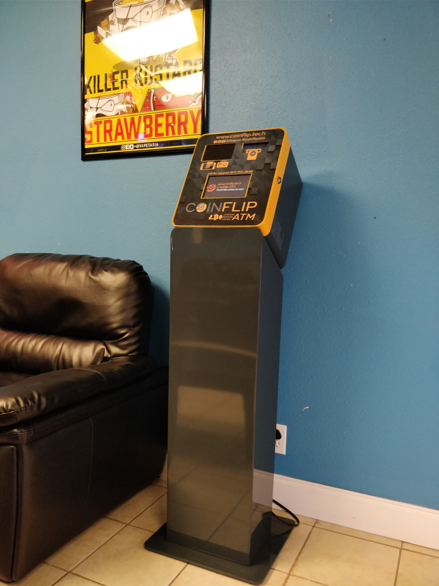
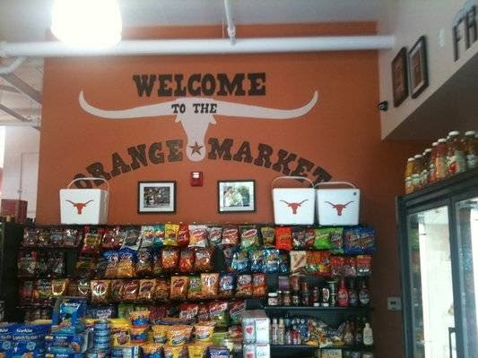
One of the Over 42,000 Bitcoin ATMs

Slide 9
And an Origin Story Worthy of Pulp Novel!
The Mysterious Satoshi Nakamoto:
  Lehman Brothers Bankruptcy, 9/2008
  Halloween 2008: a white paper is published on the Internet laying out the idea and design for Bitcoin. The author (or authors) used Satoshi Nakomoto as a pseudonym.
  January 2009: Satoshi releases the first version of the Bitcoin software.
  2009-2010: Satoshi releases new versions of the software and is actively involved in Internet Chatter about Bitcoin.
  April 2011: Satoshi ceases all known and/or verified communications.
To this date the identity or identities of Satoshi are unknown.

Slide 10
Sorry, Economists Focus on Economic Role
Possible Economic Role of Cryptocurrencies:
Facilitate payments at low costs with safety and security.
Meet the needs of previously unbanked.
Key Questions:
Are cryptocurrencies serving an economic role?
Can the underlying new technologies embedded in cryptocurrencies lead financial innovations that meet unmet opportunities

Slide 11
Opportunities: Reduce Transaction Costs
Transactions Costs Example:
Online bill payments charge an extra fee if you use a credit card.
More generally, merchants pay fees, which are passed on to consumers in higher prices
international transactions cost are particularly high.
Bank for International Settlements (BIS), Annual Report 2021, Chapter III

Slide 12
Opportunities: Serve Unmet Need
Federal Reserve (2020)estimates that 5% of US adults are “unbanked,” and another 13% are underbanked, over 50 million
World Bank, Global Findex Database, 2017

Slide 13
Reduce Cyber Risk
BIS, Annual Report 2021, Chapter III

Slide 14
Economic Opportunities
Reduce transactions fees (particularly cross country).
Meet the needs of the underbanked, both domestically and abroad.
Increase cybersecurity.
If nothing else, Bitcoin has alerted economists and policymakers to the importance of these problems and to new and exciting technologies.

Slide 15
What is Cryptocurrency such as Bitcoin?
Individual bitcoins are digital tokens (online computer records).
The owner of a bitcoin can transfer ownership to another party using publicly available Bitcoin Software.
In this way, as Satoshi hoped, Bitcoin could become: “A purely peer-to-peer version of electronic cash [that] would allow online payments to be sent directly from one party to another without going through a financial institution.”

Slide 16
Facts about Cryptocurrencies (as of 9/13)
Bitcoin was the first and is the largest in terms of market cap at about $850 billion.
Ethereum is in second place with a market cap of about $380 billion.
Presently, thousands of different varieties with a total market cap of about $2.1 trillion (https://www.coingecko.com/en)
 | Market Cap | Trading Volume | Trading Value
Bitcoin | $850 billion | 600,000 | $20-40 billion
NY Stock Exchange | $25 trillion | 2-6 billion shares | $200 billion
Credit Card Payments |  | 100 million | $10 billion

Slide 17
So, how does it work?
Jack, the owner of a bitcoin has been given a public number or key and a private encrypted key.
Jack can trade his bitcoin with Jill by using Jill’s public key and verifying the transaction with his private key.
The transaction is then posted on a website available to all.
The record of the transaction is then entered into database called a blockchain through a process know as bitcoin mining.

Slide 18
Mining for Bitcoin
Bitcoin Miners gather about 3000 new transactions into a “block.”
The miners compete for who gets to add the new block to the chain of blocks by generating long random numbers (“hashing”) until one of the numbers fits precise set of attributes.
Miners must come to a consensus that the transactions in the block are legitimate; e.g., the owner of a bitcoin hasn’t tried to spend it twice.
The new block is then linked to the previous block and added to the chain. The total process takes about 10 minutes
The incentive for miners is that the winner of the competition gets compensated with new bitcoins and transaction fees.

Slide 19
Bitcoins Two Innovations:
Cryptographically, protected digital tokens (although the cryptography predates Bitcoin).
  Peer-to-peer transactions , which are
  Irreversible or final (like paying in cash)
Public Blockchain record keeping.
  Decentralized “trust system” that is built into the software protocols.
  Transactions are validated through a consensus, not a “trusted third oarty.”.
  Blockchain ledger is available to anyone, so the transactions are transparent.

Slide 20
Question #1: Is Bitcoin serving an economic role
Bitcoin is not and cannot be widely used to make transactions
Scalability?
Price Instability.
Transactions costs
Cash ATM vs. Bitcoin ATM
BIS, Annual Report 2018, Chapter V

Slide 21
Bitcoin Operates at a Substantial Cost
Presently, Bitcoin mining requires 80.7 terawatt-hours per year, a little less than Belgium’s energy consumption (although less than is used in gold mining). (Note there are other consensus mechanisms that do not use as much energy.)
China currently has 46 percent of the computer power devoted to mining with the US second with 16.8%
But the Chinese government vowed to put an end to bitcoin mining. (The Economist, 7/10/2021)
Source: https://cbeci.org/

Slide 22
What Role Does Bitcoin Play?
For some it plays the same role as $100 bills: 32.8% of all bills in circulation (more than the number of $1 bills) and 80.2% of the value of all bills.
Illegal Activity:
  Trading of banned goods; e.g, Silk Road
  Ransomware Payments.
  Money Laundering.
  Tax Evasion.
This claim is disputed: https://www.newsweek.com/illegal-use-bitcoin-dropped-50-2020-citibank-reports-1573263

Slide 23
But What about as an Investment?
It is hard to argue with the fact that Bitcoin has provided outsized returns for many, albeit very volatile.
As an economist, however, I think about the fundamental value of an asset:
  Discounted future cash flows that the stock, bond or derivative promises.
  For currencies, promise of future use in exchange with stable values.
Bitcoin only promises the possibility of capital gains, but not based on future cashflows.
To me it is a purely speculative investment.

Slide 24
And, Most Economists Agree (IGM Forum)
A bitcoin has a fundamental value of at least $1000 (12/20/2017)
A substantial source of the value of …Bitcoin, arises from … use in illegal activities (7/31/2019)
https://www.igmchicago.org/surveys/

Slide 25
Question #2: The Value of the New Technology?
The value cryptographically protected digital-token technology is nuanced:
  Digital tokens are already serving the needs of the unbanked, particularly in Africa.
  Cryptographic protection is a tougher call and depends on your views of privacy rights, as well as what information is being kept private (e.g., medical records versus financial transactions)
Blockchain technologies have significant promise which is already being realized.
  Supply Chains (Walmart IBM)
  Smart Contracts (Xbox royalties)
See: Mehta N,. Agashe A., P. Detroja Blockchain Bubble or Revolution, 2021

Slide 26
Two Blockchain Applications:
Walmart’s Blockchain (with help from IBM) for fresh produce
  Walmart requires providers to enter their deliveries into a blockchain.
  The blockchain then traces the shipment through the supply chain to the point of final sale.
  Benefit? Think Romaine. Walmart can trace the origin of its produce in 2.2 seconds as opposed to the 7 days pre-blockchain

Slide 27
Second Blockchain Applications:
Smart Contracts: simple computer programs that run when predetermined conditions are met, typically maintained on a blockchain.
Xbox and Intellectual Property Rights:
  Smart Contract on blockchains which specify payouts based on sales and other criteria.
  Sales information is fed continuously and transparently into the smart contract, which then disburse funds.
  Access times to royalties was reduced from 45 days to 4 minutes and Xbox’s accounting workload by 70%
Source for 2 examples: Mehta N,. Agashe A., P. Detroja Blockchain Bubble or Revolution, 2021

Slide 28
What about Digital Payments More Generally?
Who pays for their lattes with cash?
Economic Opportunities Don’t Go Unmet for Long
Meeting the Banking Needs in Less Developed Countries: Mobile Money.
In the developed world perfecting a crytpo-medium of exchange: stablecoins.

Slide 29
Mobile (as in cellphone) Money
M-Pesa:
  Started in Kenya in 2007 and now available in 10 countries.
  Buy M-Pesa credits from “agents” (local shop) which can be transferred to others with an M-Pesa account via cellphone.
  96 percent of Kenyan households have a mobile account
Grameen Foundation:
Making Cash Digital is the Key to Possibility
When Poor Women Control their own money, it no longer controls them.
https://www.vox.com/future-perfect/21420357/kenya-mobile-banking-unbanked-cellphone-money

Slide 30
Stablecoins
2014 “Tether”: cryptocurrency supposed to be backed by dollars so its price would always have a value of $1.
All sorts of operational and legal problems, including
WSJ, Headline, 8/11/2021, “Poly Network Hackers Steal More Than $600 Million in Cryptocurrency”
Enter Facebook and Diem: Proposed blockchain enabled stablecoin
Bloomberg 7/27/2021: “Tether and the Facebook Inc.-backed Diem token were a main focus of a recent meeting U.S. regulators held on the financial risks posed by stablecoins.
Elizabeth Warren: Cryptocurrency is the wild west of our financial system”

Slide 31
Do We Need More Than (Good) Regulation?
“The monetary system is a public good that permeates people’s everyday lives.” “The overriding criterion when evaluating a change to… the monetary system should be whether it serves the public interest.”
Should we leave the development of innovations to the monetary systems solely to the private market.
The Band for International Settlement (BIS) and a number of central banks are exploring how the development of Central Bank Digital Currency (CBDC) “contribute to an open, safe and competitive monetary environment that supports innovation and serves the public interest.”
Source of quotes, BIS Annual Report 2021

Slide 32
CBDCs and Other Central Bank Liabilities
The Fed and most Central Banks presently have two financial liabilities:
  Currency.
  Bank Reserves.
Bank Reserves are Balances that Commercial Banks hold at the Fed and that are used in check clearing. They are already digital!
CBDCs would permit wider access to the Fed’s digital assets to other financial institutions and possibly to the public
In addition, CBDCs could be designed for rapid settlement, finality, privacy and security (perhaps using blockchain technology)

Slide 33
The Devil Is In the Details
Countries as Diverse as China, Sweden, Ecuador have begun experiments with CBDCs.
Recently, the Bank of England and the European Central Bank have announced intentions to investigate different kinds of CBDCs.
Where’s the Fed?
Source: E. Prasad, The Future of Money

Slide 34
The Fed’s Response: Lukewarm at Best
In the next couple of months, The Fed will issue a public discussion paper on a digital dollar.
"I am legitimately undecided on whether the benefits outweigh the costs or vice versa," Powell said during a hearing before the Senate Banking Committee, Reuters, 7/15/21
Governor Christopher Waller in a 8/5/2021 Speech, “ I am left with the conclusion that a CBDC remains a solution in search of a problem.”

Slide 35
Questions?
Learn More
E Prasad, The Future of Money (https://youtu.be/o3NuHb7V1IA)
N. Mehta, et.al. Blockchain Bubble or Revolution
www.NEEDelegation.org
Geoffrey Woglom
grwoglom@amherst.edu
Contact NEED: Info@NEEDelegation.org
Submit a testimonial: www.NEEDelegation.org/testimonials.php
Support NEED: www.NEEDelegation.org/donate.php

