Slide 1
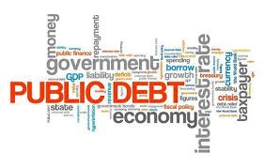
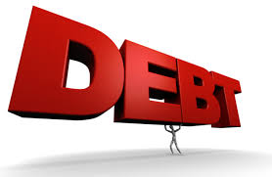
The US Federal Debt
Viamonte
May 8, 2024
Jon Haveman, Ph.D.
NEED

Slide 2
National Economic Education Delegation
Vision
One day, the public discussion of policy issues will be grounded in an accurate perception of the underlying economic principles and data.
Mission
NEED unites the skills and knowledge of a vast network of professional economists to promote understanding of the economics of policy issues in the United States.
NEED Presentations
Are nonpartisan and intended to reflect the consensus of the economics profession.

Slide 3
Who Are We?
Honorary Board: 54 members
2 Fed Chairs: Janet Yellen, Ben Bernanke
6 Chairs Council of Economic Advisers
Furman (D), Rosen (R), Bernanke (R), Yellen (D), Tyson (D), Goolsbee (D)
4 Nobel Prize Winners
Akerlof, Smith, Maskin, Bernanke
Delegates: 652+ members
At all levels of academia and some in government service
All have a Ph.D. in economics
Crowdsource slide decks
Give presentations
Global Partners: 49 Ph.D. Economists
Aid in slide deck development

Slide 4
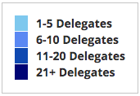
Where Are We?

Slide 5
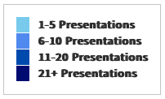
Where Have We Presented? (1,141 Talks)

Slide 6
Available NEED Topics Include:
US Economy
Healthcare Economics
Climate Change
Economic Inequality
Economic Mobility
Trade and Globalization
Minimum Wages
Immigration Economics
Housing Policy
Federal Budgets
Federal Debt
Black-White Wealth Gap
Autonomous Vehicles
Healthcare Economics

Slide 7
Credits and Disclaimer
This slide deck was created by:
Jon Haveman, Executive Director, NEED
Geoffrey Woglom, Amherst College, Emeritus
This slide deck was reviewed by:
Olivier Blanchard, Brookings Institution
Disclaimer
NEED presentations are designed to be nonpartisan.
It is, however, inevitable that presenters will be asked for and offer their own views.
Such views are those of the presenters and not necessarily those of the National Economic Education Delegation (NEED).

Slide 8
Outline
First: A Budget Review
The Debt
Important Points About the Debt
How to Think About the Debt
Summary

Slide 9
First: A Budget Review

Slide 10
What Does the US Govt. Budget Look Like?
2023 Budget Summary (in trillions)
Revenue |  |  | Outlays
Income Taxes | $2.2 |  | Mandatory | $3.8
Payroll Taxes | $1.6 |  | Discretionary | $1.7
Corporate Taxes | $0.4 |  | Interest | $0.7
Other | $0.2
Total | $4.4 |  | Total | $6.1
Budget Deficit: $1.7 Trillion
https://www.cbo.gov/publication/59727
Notes:
https://www.cbo.gov/publication/53627
https://www.cbo.gov/publication/53624

Slide 11
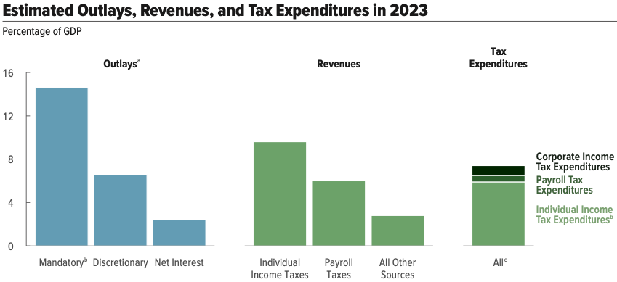
But There is More to The Budget!
Source: https://www.cbo.gov/system/files/2023-02/58848-Outlook.pdf

Slide 12
What Are Tax Expenditures?
Total: About $1.2 TRILLION in 2019
Source: https://www.pgpf.org/Chart-Archive/0199_distribution_tax_expenditures

Slide 13
And Now: The Debt

Slide 15
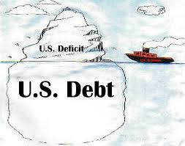
Of Debt, Deficits, and Surpluses
FLOW
Deficit: The excess of outlays over revenues in a year.
Surplus: The excess of revenues over outlays in a year.
STOCK
Debt: The accumulation of debt over time.
The sum of all past deficits and surpluses.

Slide 16
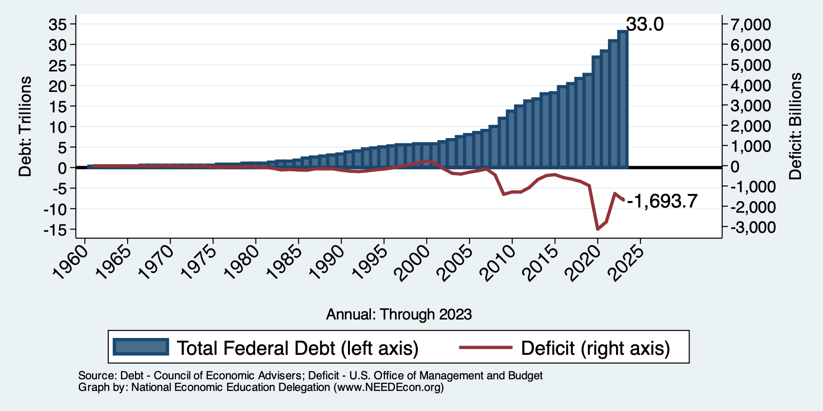
Debt vs. Deficit
Debt = The Sum of All Past Deficits Less Surpluses
Notes:
Debt2deficit.png

Slide 17
Major Takeaways: Talking Points
The debt is not currently a significant problem.
The current trajectory of federal debt is unsustainable.
We must enact plans to reduce the future (primary) deficits.
These are driven by Medicare and Social Security spending.
The longer we postpone action, the greater the probability of a “fiscal crisis.”

Slide 18
How Does the US Government Borrow?
It issues debt.
Treasury marketable securities:
Treasury bills, notes, and bonds
TIPS: Treasury inflation-protected securities
Savings bonds
Who buys the debt?
Other federal agencies
Individuals and businesses
State and local governments
Foreign government and individuals
Federal Reserve

Slide 19
Trends in US Debt Holdings Over Time
2023, Q4: Other Domestic: 50.7%
Federal Reserve: 19.4%
Foreign: 29.9%

Slide 20
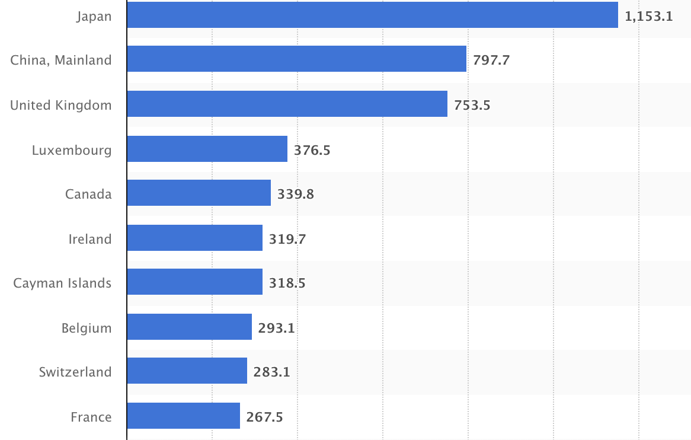
Who Holds Debt to Foreigners, 1/24
Foreign ownership is relatively recent
– in 1990 foreign ownership was less than 20%
– peaked at 40+%
– now is 29.9%
Billions of U.S. Dollars
Source: https://www.statista.com/statistics/246420/major-foreign-holders-of-us-treasury-debt/

Slide 21
Why Do Foreign Investors Buy US Treasuries?
Market for Treasuries is the deepest, most liquid capital market in the world.
The US economy has a history of political and economic stability.
The dollar is the largest international reserve currency.
Most trade transactions (e.g., oil) are quoted in dollars.
88% of international transactions involve the dollar.
With some exceptions, foreign governments borrow in dollars.

Slide 22
Important Points:
Not all debt is created equal.
What is the right measure of the debt?

Slide 23
Not All Debt Is Created Equal
Some debt can reduce the availability of investment funds to other borrowers.
Often referred to as “crowding out” private investment.
IntRAgovernmental debt is (important) bookkeeping.
This debt DOES NOT crowd out private investment.
Debt held by the public.
This debt MIGHT crowd out private investment.
Most analyses of debt focus on federal debt held by the public.

Slide 24
U.S. Publicly Held Debt, December 31, 2022
Source: PGPF.org

Slide 25
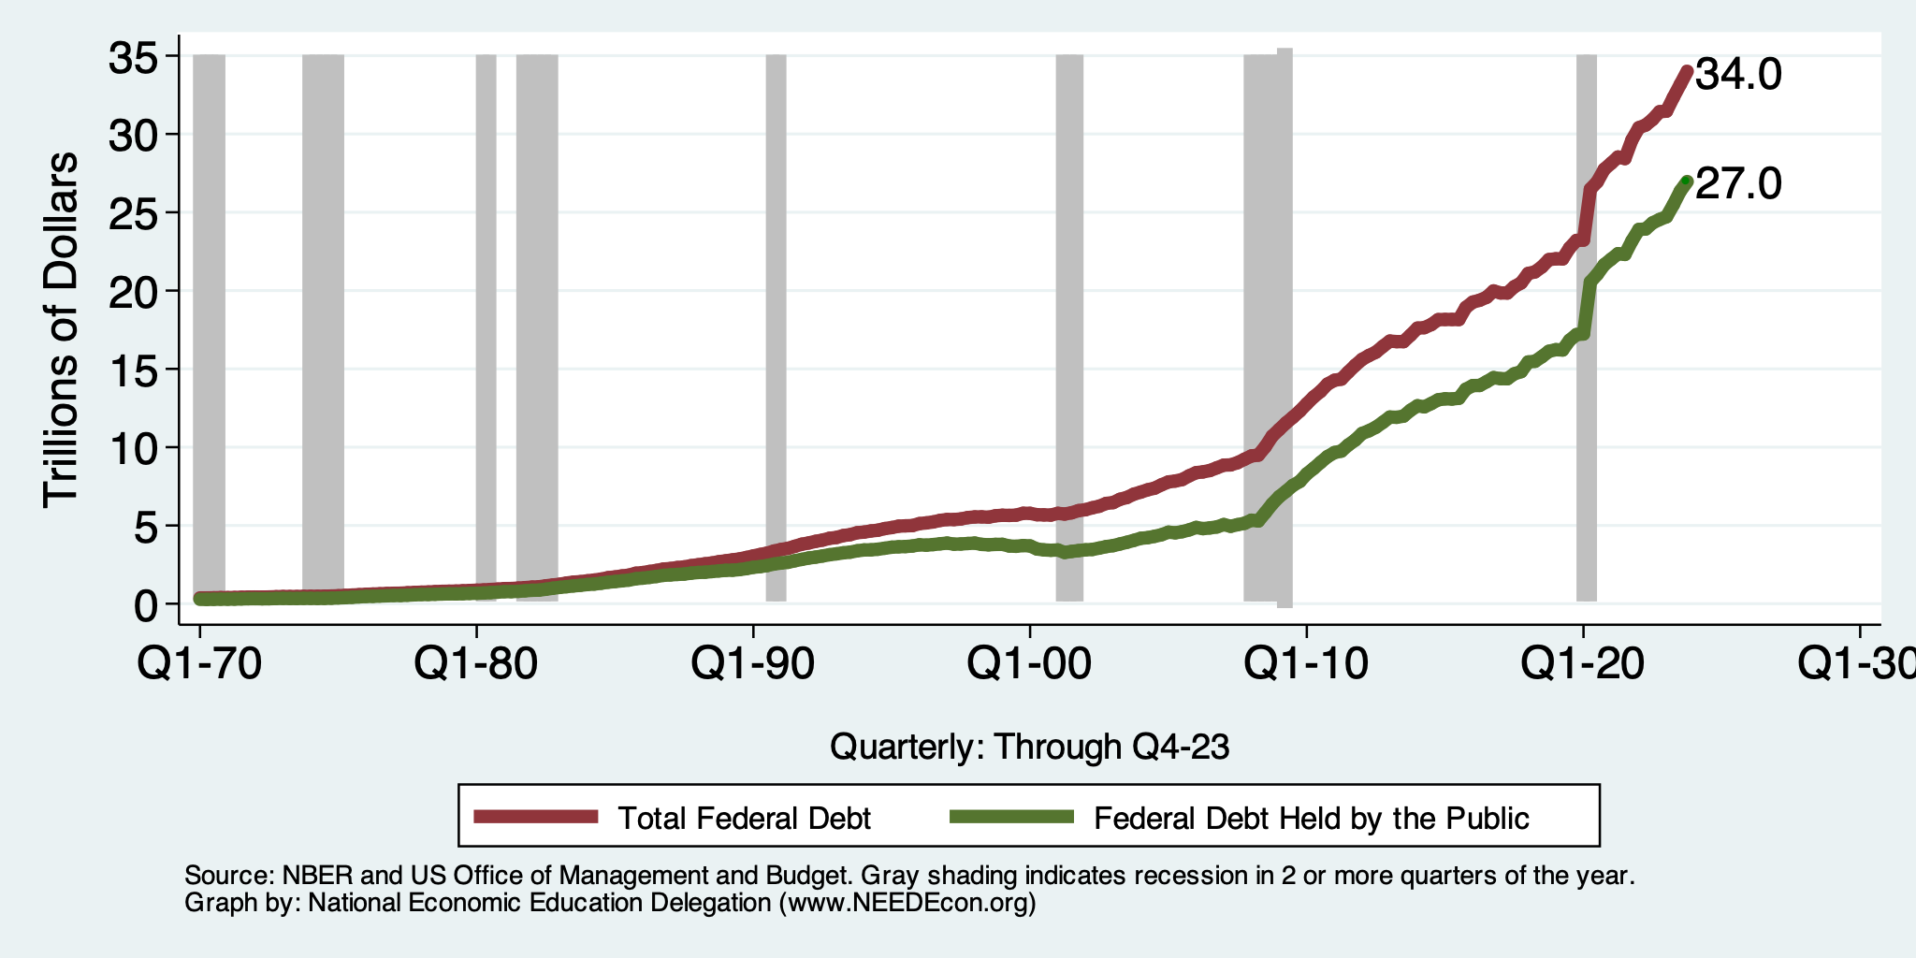
Two Measures of the Debt

Slide 26
The All-Important Relative Debt
CBO analyzes the debt relative to GDP because:
To the extent that debt and deficits have burdens, these burdens depend on the size of the debt relative to the size of the economy.
 | Total Public Debt | Relative Debt Debt/GDP
United States | $27.0 Trillion | 96.4%
Greece | $0.215 Trillion | 170%

Slide 27
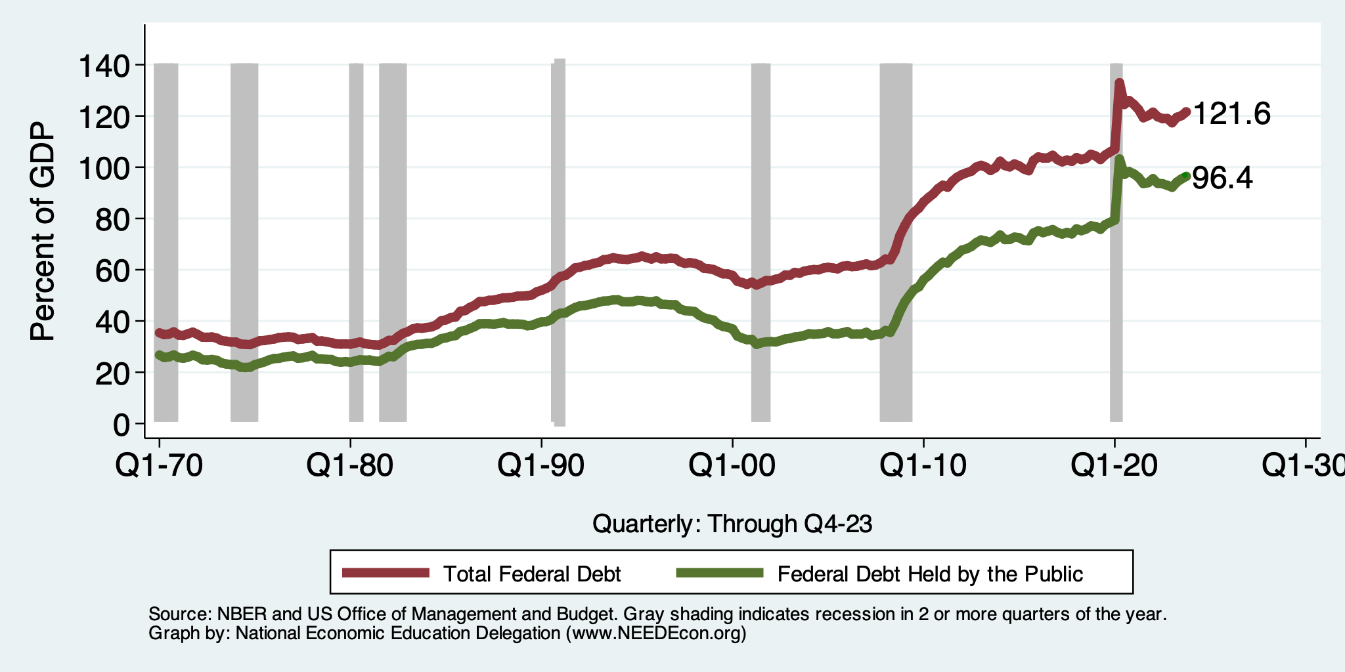
Two Measures of RELATIVE Debt

Slide 28
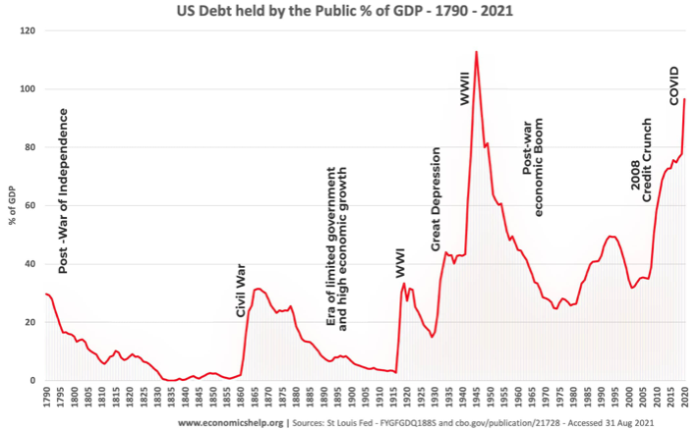
Key Points About US Relative Debt
1983
Relative debt peaked during World War II, followed by a long decline.
Prior to 1983, relative debt rose purposefully (wars and recessions) and then fell.
Relative debt has been and is expected to rise for the next 30 years w/o a strategic purpose.

Slide 29
Debt Dynamics
Surprising (?) Facts
From 1945 to 1979, relative debt fell from 100% of GDP to 25% of GDP.
During this period, the federal budget was in surplus only 8/35 years!
Relative debt is a fraction: Debt/GDP; fractions fall if:
The numerator falls (budget surplus)
The denominator rises (nominal GDP growth)
The denominator grows faster than the numerator
GDP growth is greater than the interest rate on borrowing.
CAN still run deficits and reduce the relative debt.

Slide 30
An Almost Free Lunch
If the interest rate is less than the growth rate of GDP, then the contribution from the primary budget can be positive, hence…
Debt to GDP can be stabilized with a (small) primary deficit.

Slide 31
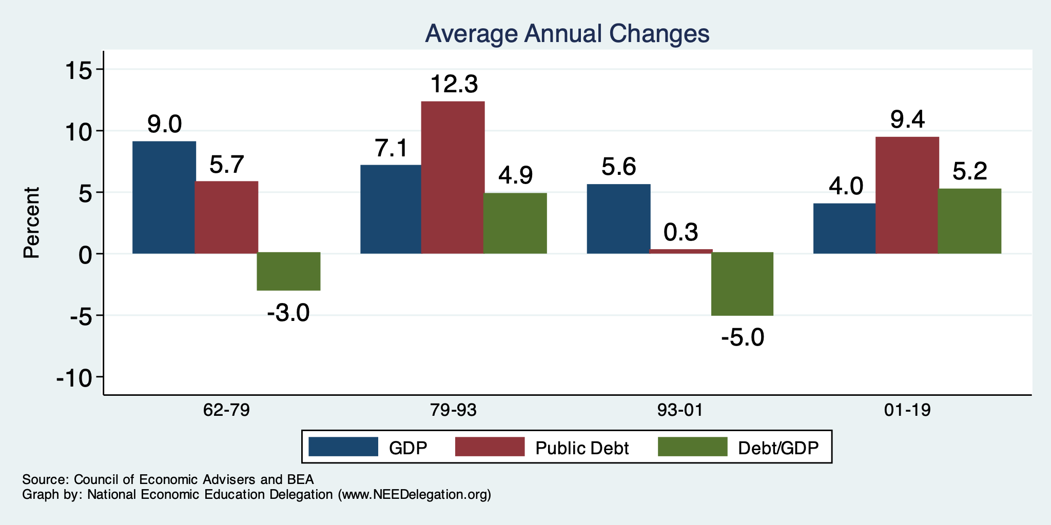
The Arithmetic of Changes in Relative Debt

Slide 32
Is Stabilizing Relative Debt Good Enough?
This means that the absolute level of the debt would continue to increase.
Yes, it is probably good enough.
It is a reflection of the economy’s ability to support the debt.
Stability will avoid bond market scares.
More on this later.

Slide 33
But Let’s Think About Today
WWII
Coronavirus
Pandemic
Great
Recession
Great
Depression
WWI

Slide 34
Why Has the Federal Debt Risen So Much?
Expenditures UP:
Social Security
Health-care costs
Economic stimulus
In particular, during the Great Recession & COVID.
Military engagements overseas
Revenues DOWN:
Declining income tax revenues
Stagnant wages
Tax cuts
Social security
Declining revenues

Slide 35
Tax Cuts Have Driven The Debt Increases
Trump Tax Cuts: 6% of GDP
Bush Tax Cuts: 32% of GDP
Great Recession & COVID: 26% of GDP
The rest: 34% of GDP
Up from 31% in 2001

Slide 36
Thinking About Today….
Do we have:
A spending problem?
A revenue problem?
Both?

Slide 37
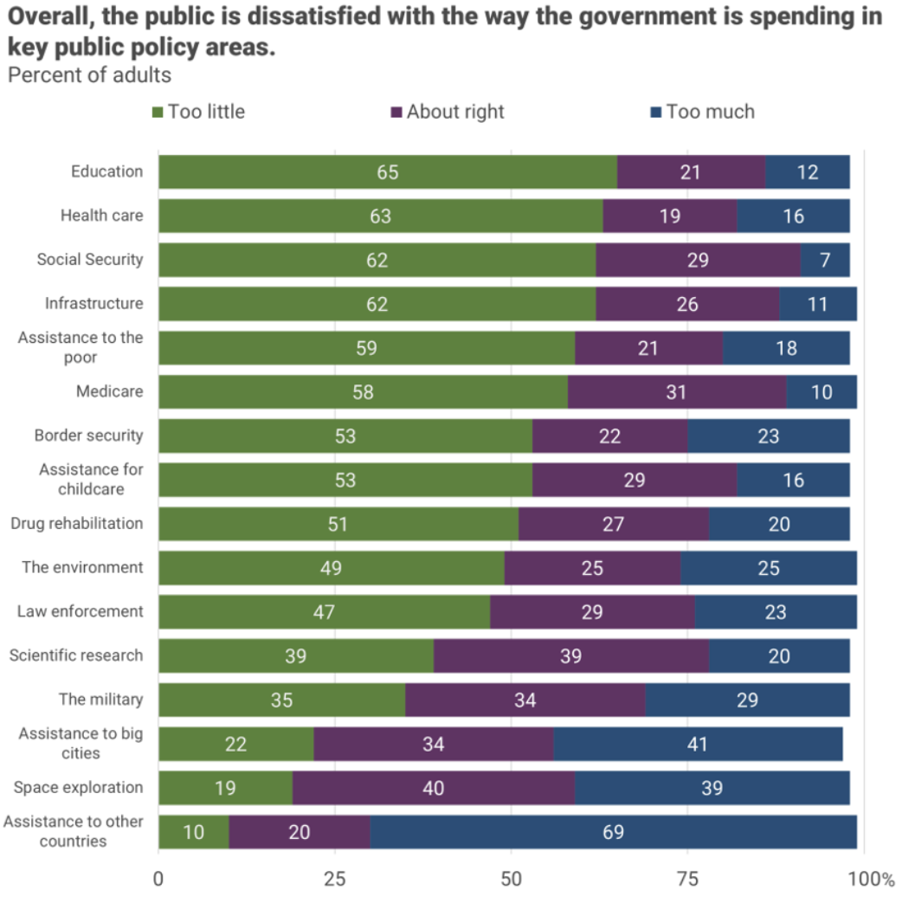
There is very little
enthusiasm for
cutting anything.
Source, NYTimes, Paul Krugman, “Why We Should, but Won’t, Reduce the Budget Deficit”

Slide 38
Thinking About Today….
Do we have:
A spending problem?
A revenue problem?
Both?
Not much support for it being a spending problem.

Slide 39
How To Address the Debt?
The question isn’t taxes vs spending cuts.
The question is:
Who should bear the burden of solving the problem?
Spending cuts will mean primarily lower-income households.
Tax increases will mean primarily high-income households.
Soc Sec benefit cuts (age limit, actual payments, etc.) will mean primarily lower-income households.

Slide 40
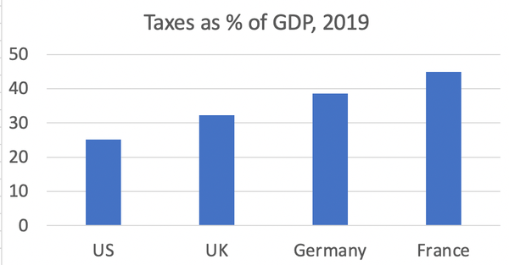
Source, NYTimes, Paul Krugman, “Why We Should, but Won’t, Reduce the Budget Deficit”

Slide 41
What? It’s not 40%? No, it’s 24.1%.
The 400 highest income households:
Paid an average tax rate of 8%.
https://nymag.com/intelligencer/article/fact-check-richest-1-dont-pay-40-of-the-taxes.html

Slide 42
Can’t Stop…Thinking About Tomorrow

Slide 43
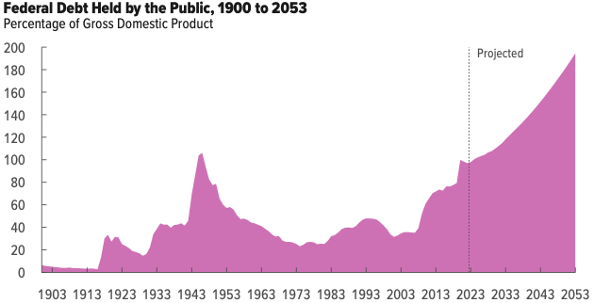
Now Let’s Think About Today and the Future
WWII
Coronavirus
Pandemic
Great
Recession
Great
Depression
WWI

Slide 44
What Are the Primary Drivers Going Forward?
Social Security
And Medicare
Source: CBO 2023 Long Term Budget Outlook

Slide 45
Interest Will Grow as a Share of the Deficit
Primary
Interest
Source: CBO 2023 Long Term Budget Outlook

Slide 46
How to Think About the Debt

Slide 47
Perspectives on Increased Debt
Does debt impose a burden on future generations?
Does it inevitably have to be paid off? No.
Government borrowing crowds out private capital and investments.
Weakened by the ability to borrow from other countries.
In time, debt service might crowd out other government spending.
Diminishing policy priorities in the budget.
Is it reasonable to borrow at low interest rates for investment?
For example, for infrastructure.

Slide 48
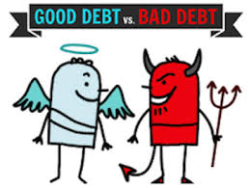
Not All Borrowing Is Bad!
Two good reasons to borrow:
During a temporary crisis
Recession
War
Pandemic
Productive public investment
Infrastructure
Education
These deficits did not and do not permanently increase relative debt.
Great Depression, WWII, Great Recession, COVID
Public investment expands GDP and tax revenue

Slide 49
Is The Debt a Problem Today?
Federal government borrows each month with little difficulty.
Very little evidence of ”crowding out.”
Interest rates are elevated – this is becoming a concern.
So, no, other than the debt ceiling, it’s not a problem today.

Slide 50
So, Why Worry About it?
If debt becomes too high:
Investors might start questioning the creditworthiness of the US government.
Problem: Nobody knows how high is too high.
It becomes more difficult to borrow in times of crisis.
War, severe recession
“Fiscal space”
Impossible to measure how much we have.
Clearly, we have less now than in 2007.
Could start to crowd out investment by consumers and businesses.
Not currently a problem. No idea if/when it might become one.
Could be inflationary.

Slide 51
Growth in Relative Debt
Can be scary to….
International investors
Bond markets

Slide 52
What Is a Fiscal Crisis?
Increased perception of risk in government debt.
Potential manifestations:
Sudden significant increase in interest rates
Plunging exchange rates
Why?
Increased expectation of default
Potential results:
Dramatic budget reforms may be quickly necessary to stave off actual default.
Recession from declines in:
investment (interest rates)
consumption (interest rates)
Government spending
Higher interest bill on existing debt

Slide 53
Summary

Slide 54
Bottom-Line Takeaways
Relative debt must be stabilized, so it is imperative to reduce primary deficits.
Given the fiscal challenges of an aging population and climate change, it is better to do this sooner rather than later.
But high debt levels should not deter:
Productive infrastructure investment.
Fiscal responses to crises:
“When the house is on fire, you don’t worry about being in a drought; you just put it out.”

Slide 55
Major Takeaways: Talking Points
The debt is not currently a significant problem.
The current trajectory for the federal debt is unsustainable.
The primary drivers are an aging population and interest.
We must enact plans to reduce the future (primary) deficits.
These are driven by Medicare and Social Security spending.
The longer we postpone action, the greater the probability of a “fiscal crisis.”

Slide 56
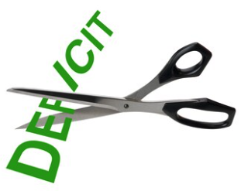
Bottom Bottom Line
Question is not WHETHER the US will have to act…
but WHEN.
Some combination of the following WILL be necessary:
Raising taxes
Cutting spending
Reining in health-care costs
The longer we wait, the harder it will be!

Slide 57
Thank you!
Any Questions?
www.NEEDEcon.org
Jon Haveman, Ph.D.
Jon@NEEDEcon.org
Contact NEED: info@NEEDEcon.org
Submit a testimonial: www.NEEDEcon.org/testimonials.php
Become a Friend of NEED: www.NEEDEcon.org/friend.php

