Slide 1
Osher Lifelong Learning Institute, Spring 2025
Contemporary Economic Policy
University of Minnesota
Host: Geoffrey Woglom, Ph.D.
Director, National Economic Education Delegation

Slide 2
Course Outline
Contemporary Economic Policy
  Week 1 (4/3): Economic Update (Geoffrey Woglom, Amherst College)
  Week 2 (4/10): Health Economics (Robert Rebelein, Vassar College)
  Week 3 (4/17): ): Immigration (Jon Haveman, Exec Director, NEED)
  Week 4 (4/24): The New Inequality (Geoffrey Woglom, Amherst College)
  Week 5 (5/1): Federal Debt and Deficits (Dmitriy Stolyarov U of Michigan)

Slide 3
Asking Questions
Ask questions in the chat or by raising your digital hand.
  I will try to handle them as they come up
  I will also make pauses and invite questions
We will do a verbal Q&A once the material has been presented.
Slides will be available from the NEED website tomorrow (https://needelegation.org/delivered_presentations.php).

Slide 4
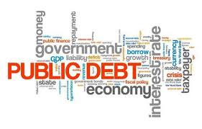
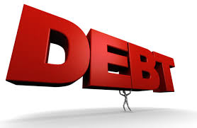
The US Federal Debt
February 6, 2025
Dmitriy Stolyarov
University of Michigan

Slide 5
Credits and Disclaimer
This slide deck was created by:
  Jon Haveman, Executive Director, NEED
  Geoffrey Woglom, Amherst College, Emeritus
This slide deck was reviewed by:
  Olivier Blanchard, Brookings Institution
Disclaimer
  NEED presentations are designed to be nonpartisan.
  It is, however, inevitable that presenters will be asked for and offer their own views.
  Such views are those of the presenters and not necessarily those of the National Economic Education Delegation (NEED).

Slide 6
Outline
Budget and Deficits
Government Borrowing
Important Points About the Debt
How to Think About the Debt
Summary
Notes:
We will first learn the basics about the US federal budget, the concept of deficit and the relation between deficit and debt; I will fill in some details about how the US government does its borrowing. To understand the drivers of US debt amount, it will be informative to look at what happened to federal budget deficits over time. As we will learn, the debt reflects the past borrowing behavior that manifested in deficits. To understand debt, it will be useful to spend some time discussing the trends in deficit and its components and the reasons behind deficits.

Slide 7
First: A Budget Review

Slide 8
Glossary
Revenue: taxes received from individuals and businesses and other government income
Outlays: expenditures on government programs and interest payments
  61% Mandatory expenditures are required by existing law (e.g. Social Security, Medicare, unemployment insurance)
  28% Discretionary expenditures require an appropriations act (e.g. defense, education, funding for federal agencies)
  11% Interest payments on debt
Surplus or Deficit: difference between revenues and outlays
  If revenues exceed outlays, we have a surplus
  If outlays exceed revenues, we have a deficit
Primary Deficit: difference between expenditures and revenues
Notes:
50%,40%,10% ere 1974-2024 50-year averages
https://www.cbo.gov/publication/60039
Other government income may include income from leasing federal land for mining, logging or grazing, leasing radio spectrum etc.

Slide 9
What Does the US Govt. Budget Look Like?
2023 Budget Summary (in billions)
Revenue |  |  | Outlays
Income Taxes | $2,176 |  | Mandatory | $3,747
Payroll Taxes | $1,614 |  | Discretionary | $1,719
Corporate Taxes | $420 |  | Interest | $658
Other | $230
Total | $4,441 |  | Total | $6,123
Revenue |  |  | Outlays
Income Taxes | $2,176 |  | Mandatory | $4,134
Payroll Taxes | $1,614 |  | Discretionary | $1,661
Corporate Taxes | $420 |  | Interest | $475
Other | $230
Total | $4,897 |  | Total | $6,270
Total Deficit: $1,683 Billion
https://www.cbo.gov/publication/60339
Notes:
www.cbo.gov/publication/60039
Mandatory expenditures include mostly social security and public health care programs; Social security 1.35 trn, Medicare, 830 bn Medicaid and related 725 bn
Half of discretionary is defense at around 800 bn

Slide 10
What Does the US Govt. Budget Look Like?
2023 Budget Summary (as % of GDP)
Revenue |  |  | Outlays
Income Taxes | 8.1 |  | Mandatory | 13.9
Payroll Taxes | 6.0 |  | Discretionary | 6.4
Corporate Taxes | 1.6 |  | Interest | 2.4
Other | 0.9
Total | 16.5 |  | Total | 22.7
Revenue |  |  | Outlays
Income Taxes | 8.1 |  | Mandatory | $4,134
Payroll Taxes | 6.0 |  | Discretionary | $1,661
Corporate Taxes | 1.6 |  | Interest | $475
Other | 0.9
Total | 16.5 |  | Total | $6,270
Total Deficit: 6.2
https://www.cbo.gov/publication/60339
Notes:
www.cbo.gov/publication/60039
Mandatory expenditures include mostly social security and public health care programs; Social security 1.35 trn, Medicare, 830 bn Medicaid and related 725 bn
Half of discretionary is defense at around 800 bn

Slide 11
Mechanics of government borrowing
US Department of the Treasury issues bonds (i.e. debt contracts)
  T-bills maturity up to 1 year (a T-bill that pays $1,000 1 year from now costs approximately $960)
  T-notes maturity up to 1-10 years
  T-bonds maturity more than 10 and up to 30 years
Sells bonds via auction, at market interest rates
  Proceeds deposited in the Treasury’s account at the Federal Reserve
Notes:
The interest rate on Treasury securities is set in the free market. When interest rates are higher, bond prices are lower, because the Treasury bonds have to be competitive with other assets that pay interest.
If bonds are sold to investors, the result is passing the money from investors to the government and passing the bonds to investors. This transaction does not create new money.

Slide 12
More Detail on borrowing by US Government
A multitude of debt contracts
    Treasury bills, notes, and bonds
    TIPS: Treasury inflation-protected securities
    Savings bonds
Who buys the debt?
  Other federal agencies
  Individuals and businesses
  State and local governments
  Foreign governments and individuals
  Federal Reserve (existing debt only)

Slide 13
Borrowing discipline
Appropriations process
    Discretionary spending requires annual approval by Congress
Debt ceiling
    Legal limit on the total amount of debt the federal government can incur. Congress must pass specific legislation to increase or suspend the limit
Market discipline
    The interest rate on US debt is set in the free market
    Interest rates are a gauge of investor confidence in the safety of US debt
Notes:
Market discipline is especially harsh if the country is integrated in the international capital markets. This is because foreign investors can pull out of the US and domestic investors can switch to foreign assets if US debt is not perceived as safe.
Previous debt ceiling was 31.5 tn, Congress suspended it until 2025

Slide 14
Borrowing discipline
Why doesn’t the US Treasury sell bonds directly to the Fed?
    Selling bonds to the Fed creates money in the government account without removing money from anywhere else
    This can cause inflation
    In the US, government borrowing is distinct from “printing money”
Principle of separation of monetary and fiscal policy
  The Fed independently decides how much existing US debt it holds
  The Fed buys and sells bonds to regulate the amount of money in the US banking system
  Federal Reserve independence contributes to financial stability and investor confidence
Notes:
The US financial system is based on the principle of separation of monetary and fiscal policy

Slide 15
Deficits have been chronic

Slide 16
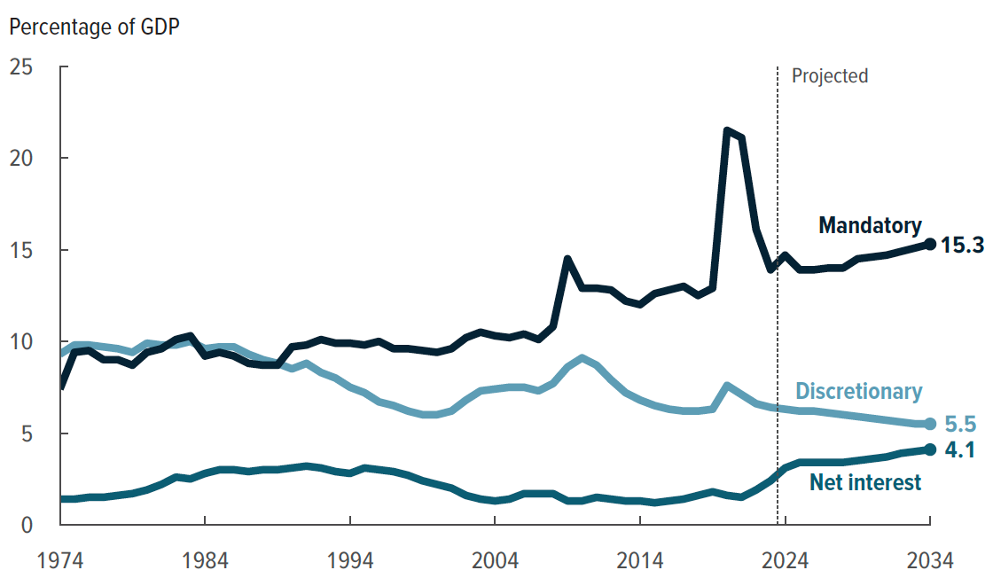
Notes:
https://www.cbo.gov/publication/60039#section1
Spending for Social Security and Medicare would be pushing up mandatory outlays, interest cost in relation to GDP will be about double its 50 year average

Slide 17
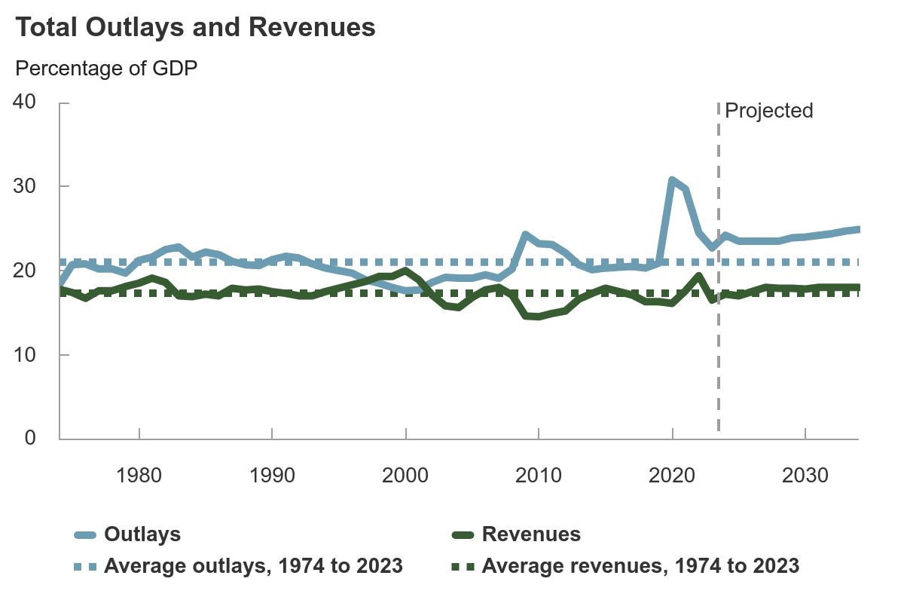
Notes:
Revenue percentage is projected to be stable and in line with its 50 year average (17.3)
Outlays will rise above the average of 21 percent to 25 percent. Deficits will be between 6.5 and 7 percent in the next decade

Slide 18
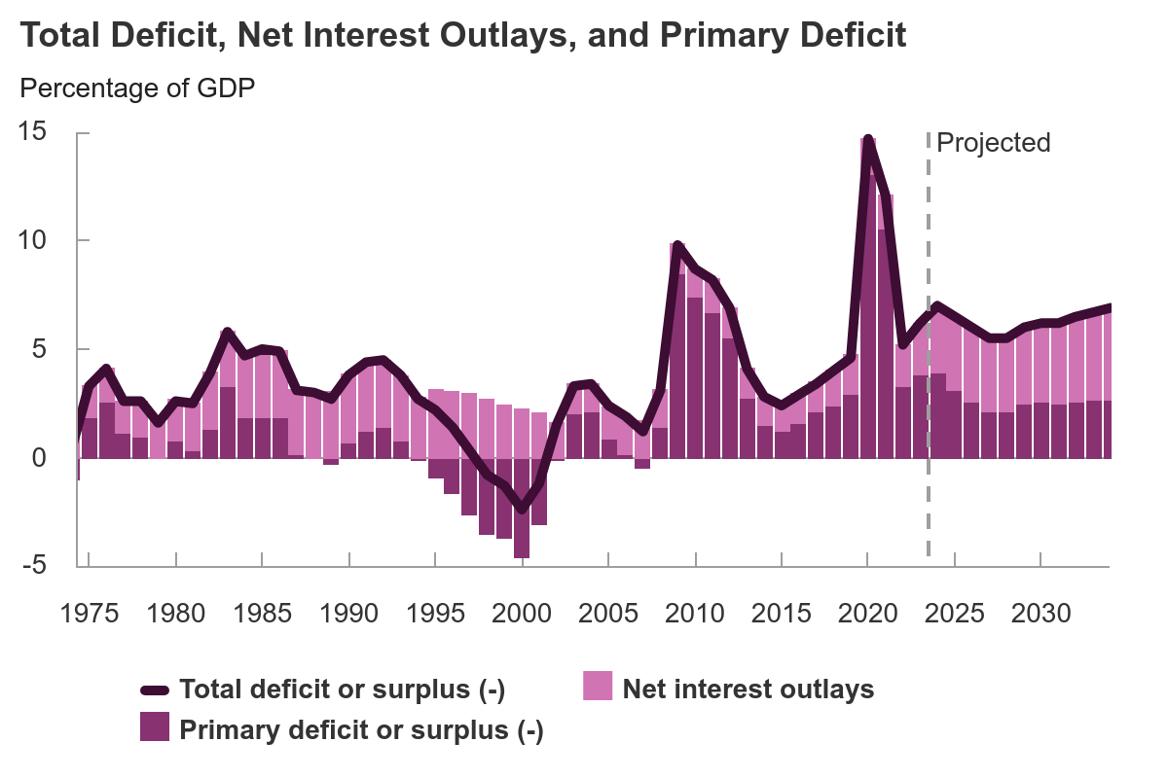
Notes:
https://www.cbo.gov/publication/60039#section1
The government ran a primary surplus 1995-2001; Largest deficits align with great financial crisis and COVID. No reduction in total deficit percentage over the next decade is projected. This means that total deficit will actually grow a little faster than output.
Interest was really high in the 1980s, in the aftermath of high interest rates
Interest was really low in the 2010, because interest rates were super-low
Interest going forward is going to be the majority of the deficit, because debt is ballooning (more on this later)

Slide 19
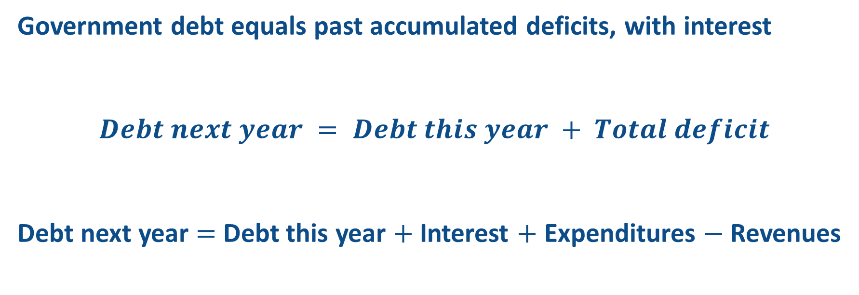
Debt accumulation
Government debt equals past accumulated deficits, with interest
$$Debt next year = Debt this year + Total deficit$$
Debt next year $=$ Debt this year $+$ Interest $+$ Expenditures $−$ Revenues
Primary deficit
Notes:
Accumulation of government debt parallels accumulation of credit card debt. Government expenditures play the same role as charges to the credit card and tax revenues play the same role as monthly payments on the account

Slide 20
And Now: The Debt

Slide 21
US federal debt as of Apr 29, 2025
$36,214,714,517,961
Total debt over 36 trillion dollars
This is about 269,000 per full time worker
Or about 283,000 per US household

Slide 22
Not All Debt Is Created Equal
As of 2025, 20% is within-government debt holdings, a form of bookkeeping
  This debt DOES NOT affect private asset markets
80% Debt held by the public
Most analyses of debt focus on federal debt held by the public.
7.3 trn
29 trn
Notes:
Some government programs such as Social Security, Medicare and military pensions do not have a perfect match between revenues and outlays. They are like households with a saving account. They earn interest on what they do not spend by letting the Treasury borrow their funds. An example of intragovernmental debt is the Social Security Trust Fund. Social Security Administration loans the excess of payroll taxes over benefits payments to the Treasury and collects market-determined interest on this loan.

Slide 23
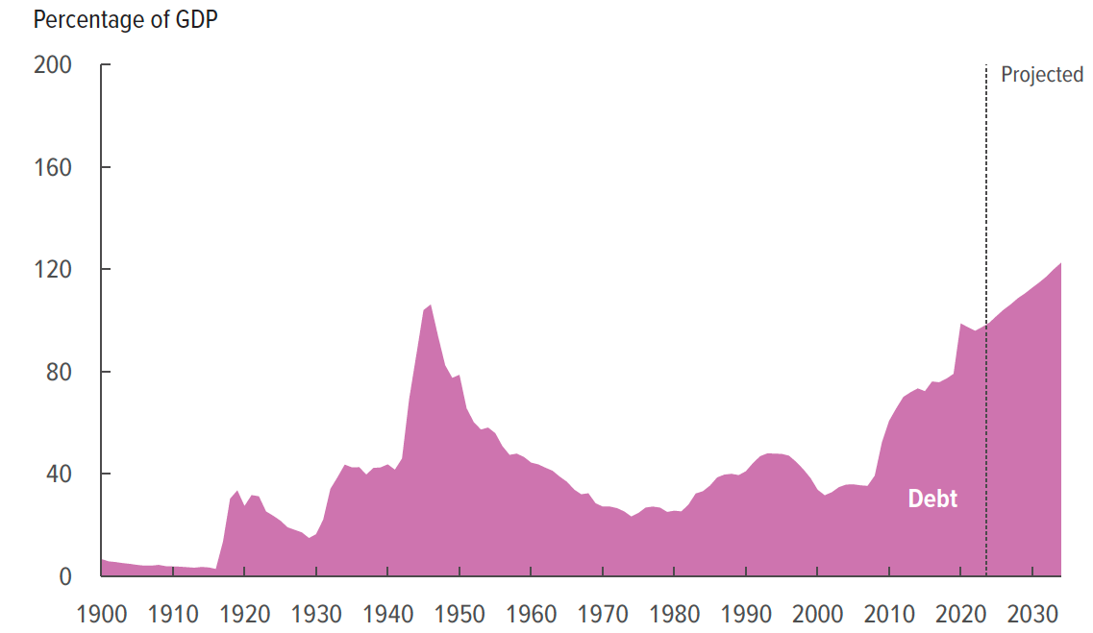
US Debt held by the public, relative to GDP
Notes:
Right now the relative debt held by the public stands at 97% of GDP. This means that in order to repay this debt right away, every worker, retiree and every business in the US economy needs to give up their entire income for one year. In another extreme example, the government will have to discontinue spending on Social Security, Medicare, defense, education etc. entirely for 8 years to repay the debt. Of course, this is not going to happen, so the debt as percentage of GDP keeps growing.
The previous debt peak was in 1946 at 103% of GDP. This debt was paid down in the 1950s and 1960s because the economy grew relatively fast, tax rates were high and mandatory spending was not as big.

Slide 24
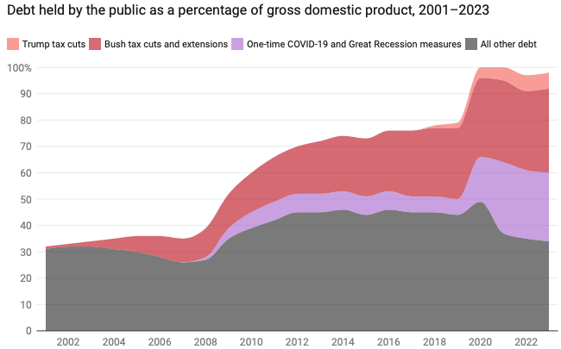
Recent contributors to Debt Increases
Trump Tax Cuts: 6% of GDP
Bush Tax Cuts: 32% of GDP
Great Recession & COVID: 26% of GDP
The rest: 34% of GDP
Up from 31% in 2001
Notes:
Bush tax cuts lowered individual income tax rates, reduced the top marginal tax rate from 39.6% to 35%, tax rates on long-term capital gains and qualified dividends to a maximum of 15%

Slide 25
Who holds US debt

Slide 26
50% domestic private
30% foreign
20% Fed
Notes:
FDHBFRBN Federal Debt Held by Federal Reserve Banks, Billions of Dollars, Annual, Not Seasonally Adjusted
FDHBFIN Federal Debt Held by Foreign and International Investors, Billions of Dollars, Annual, Not Seasonally Adjusted
FYGFDPUN Federal Debt Held by the Public, Millions of Dollars, Annual, Not Seasonally Adjusted

Slide 27
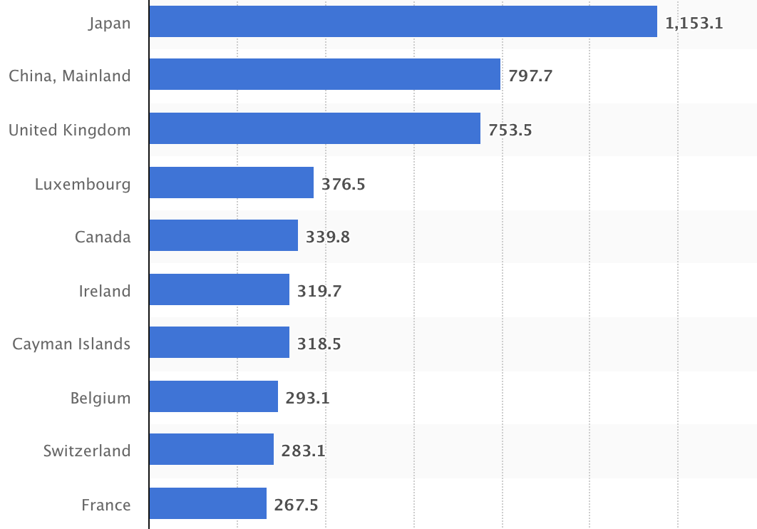
Who Holds Debt to Foreigners, Jan. 2024
Billions of U.S. Dollars
Source: https://www.statista.com/statistics/246420/major-foreign-holders-of-us-treasury-debt/

Slide 28
Why Do Foreign Investors Buy US Treasuries?
Market for Treasuries is the deepest, most liquid capital market in the world.
The US debt is perceived as a safe asset
The dollar is the largest international reserve currency.
  Most trade transactions (e.g., oil) are quoted in dollars.
  88% of international transactions involve the dollar.
  With some exceptions, foreign governments borrow in dollars.
Notes:
https://www.brookings.edu/articles/the-dollars-international-role-an-exorbitant-privilege-2/
The combination of safety and liquidity

Slide 29
Is the US too deeply in debt?
And why do we care?

Slide 30
Notes:
https://www.imf.org/external/datamapper/GG_DEBT_GDP@GDD/CAN/FRA/DEU/ITA/JPN/GBR/USA
Japan: aging, fiscal stimulus, lack of discipline

Slide 31
Growth in Debt Relative to GDP
Can be scary to….
  International investors
  Bond markets
No one knows when US borrowing will be perceived as too much
Crises of confidence are unpredictable and happen very quickly
If a fiscal crisis happens
  Scared international investors will sell US assets, weakening the dollar
  US debt selloff will make interest rates spike

Slide 32
How can a Fiscal Crisis unfold?
Increased perception of risk in government debt.
Potential manifestations:
  Spike in interest rates
  Weak dollar
Why?
  Shift away from US assets, higher risk of future inflation
Potential results:
  Dramatic budget reforms may be quickly necessary to control future deficits.
  Recession from declines in:
    investment (interest rates)
    consumption (interest rates)
    Government spending
  Higher interest bill on existing debt

Slide 33
Case study: Liz Truss “mini-budget” Sep 2022
Trigger: a tax cut bypassing usual budget scrutiny
Market reaction due to confidence collapse
The pound plunged to $1.03, its lowest level in history
Long-term bond rates spiked from 3.5 to 5.1 percent (highest since 2008)
Pension funds that used bonds as collateral for borrowing risked insolvency
Policy response: BoE emergency intervention
BoE had to buy about 3 percent of total government debt to prevent a systemic collapse of pension funds and broader financial system.
Aftermath: The "Idiot Premium"
Government borrowing costs rose by 50-100 basis points
Debt service costs rose from 4.4 to 4.9 percent of GDP
Mortgage rates rose from 4.75 to 6.65 percent
Notes:
The tax cut proposed was actually modest, 45 bn pounds compared to 715 bn total tax revenues (a 6 percent reduction in tax revenues). No independent cost analysis from the Office for Budget Responsibility (OBR) was provided, branded a “fiscal event” to bypass scrutiny.
Key Flaws: Unfunded Spending: Markets saw the plan as fiscally irresponsible, fearing unsustainable borrowing.
Simon French (Panmure Gordon) estimated the crisis added 50–100 basis points to UK borrowing rates—dubbed the “idiot premium”—costing the Treasury £7–14 billion annually in extra debt servicing.

Slide 34
Perspectives on Debt

Slide 35
Perspectives on Increased Debt
Does debt impose a burden on future generations?
  Does it inevitably have to be paid off?
Government borrowing crowds out funding for investment.
  Less of an issue if foreign investors need safe assets
In time, debt service might crowd out other government spending.
  Diminishing policy priorities in the budget.
Is it reasonable to borrow at low interest rates for investment?
  For example, for infrastructure.

Slide 36
Is Stable Debt Relative to GDP Good Enough?
Stable means that the debt level rises in step with the size of the economy
Yes, it probably is good enough.
  It is a reflection of the economy’s ability to support the debt.
  Stability will avoid bond market scares.
Stable relative debt should not be a burden on future generations
Notes:
We expect future generations to be more numerous or better off or both, that that’s how they can support larger future debt in the same way as we do currently.

Slide 37
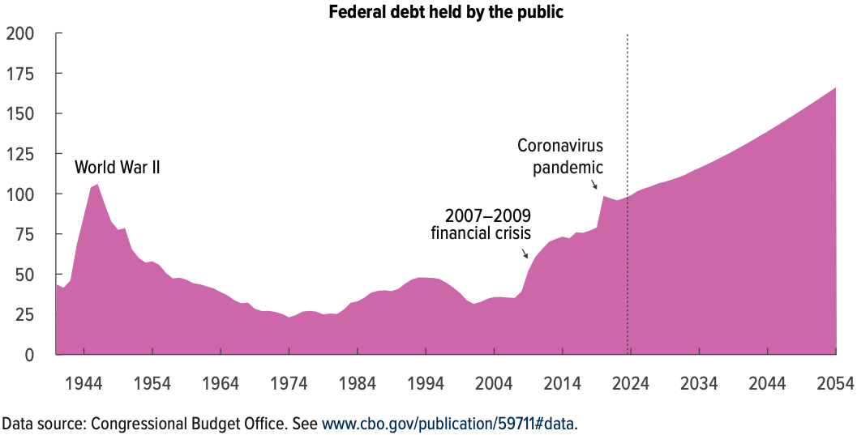
Now Let’s Think About Today and the Future
166% of GDP
Percent of GDP

Slide 38
Why Has the Federal Debt Risen So Much?
Revenues DOWN:
  Declining income tax revenues
    Weaker wage growth
    Tax cuts
  Social security
    Weaker wage growth
Expenditures UP:
  Social Security, aging
  Health-care costs, aging
  Economic stimulus
    In particular, during the Great Recession & COVID.
  Military engagements overseas

Slide 39
Is The Debt a Problem Today?
Federal government still borrows with little difficulty.
So, not (yet) a problem. But …
10-year interest rates are still moderate, but rising inflation expectations are becoming a concern.
10-year US interest rates are higher than those in Canada, Germany, Japan
Notes:
It is important to maintain investor confidence by enhancing the transparency and credibility of fiscal policy. Independent fiscal oversight and binding debt/GDP ceilings with escape clauses for genuine emergencies

Slide 40
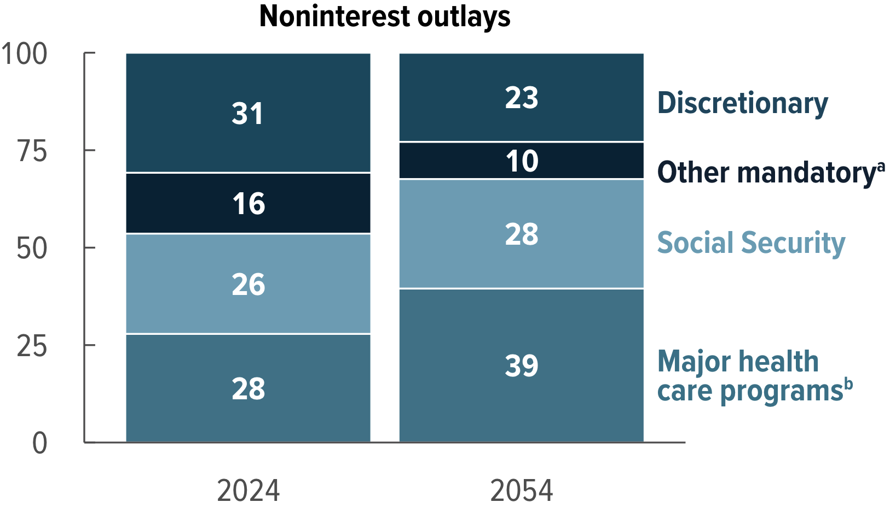
What Are the Primary Drivers Going Forward?
Social Security
And Medicare
Source: CBO 2024 Long Term Budget Outlook
Notes:
US spends 18 cents on the dollar on health care. Relative to GDP, the US spends 40% more than the CAN and 70% more than Japan. And yet, life expectancy at 65 is 2.5 years longer in Canada. In Japan, female life expectancy is a full 5 years longer than it is in the US.
Costs of health care have outpaced general rises in the cost of living for decades. US health care focuses less on prevention, delivery is more fragmented, less coordinated, financial incentives to provide specialized care and not preventative care. Health care delivery is considered inefficient.

Slide 41
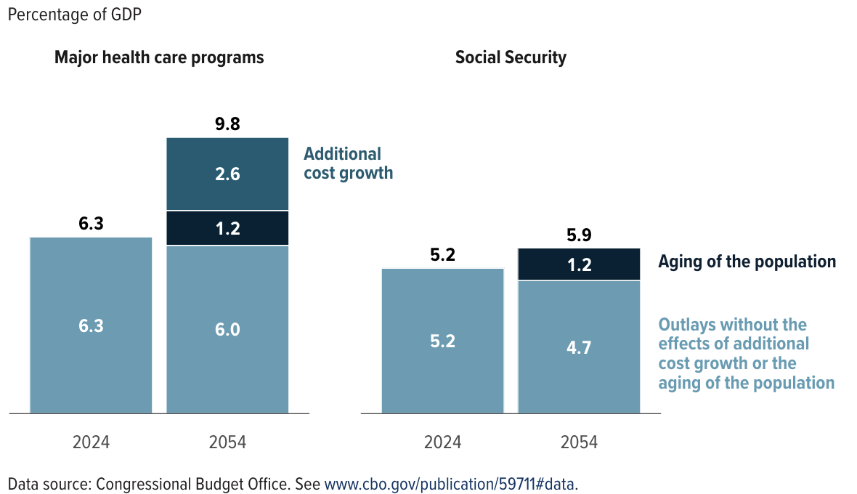
Mostly Healthcare
Notes:
Utilization will grow because of aging but on top of that, cost will grow as well.
US spends 18 cents on the dollar on health care. Relative to GDP, the US spends 40% more than the CAN and 70% more than Japan. And yet, life expectancy at 65 is 2.5 years longer in Canada. In Japan, female life expectancy is a full 5 years longer than it is in the US.
Costs of health care have outpaced general rises in the cost of living for decades. US health care focuses less on prevention, delivery is more fragmented, less coordinated, financial incentives to provide specialized care and not preventative care. Health care delivery is considered inefficient.
A survey of 2,106 physicians found that 20.6% of overall medical care is unnecessary, including 24.9% of tests, 22% of prescriptions, and 11.1% of procedures. Fear of malpractice lawsuits drives unnecessary tests and procedures. 84.7% of physicians cite this as a key factor, 59% of physicians report patient pressure as a driver. https://pmc.ncbi.nlm.nih.gov/articles/PMC5587107/
Imaging studies Cost: Up to $1 million per year of life extension for low-risk patients, with minimal clinical benefit https://pmc.ncbi.nlm.nih.gov/articles/PMC9426758/
Examples: Nearly 33% of U.S. births are via C-section https://www.statnews.com/2023/11/08/health-care-overtreatment-overdiagnosis/
60% of ICU patients receive invasive treatments (e.g., mechanical ventilation) near death, contrary to their preferences. https://psnet.ahrq.gov/perspective/overuse-patient-safety-problem

Slide 42
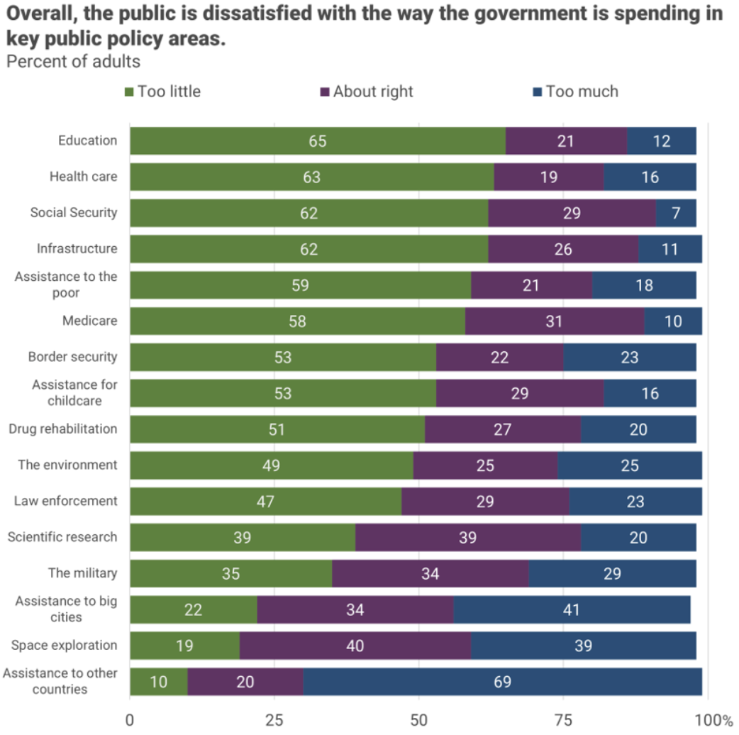
There is very little
enthusiasm for
cutting anything.
Source, NYTimes, Paul Krugman, “Why We Should, but Won’t, Reduce the Budget Deficit”

Slide 43
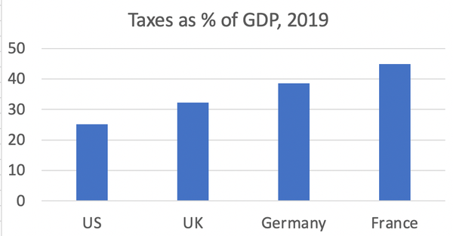
Source, NYTimes, Paul Krugman, “Why We Should, but Won’t, Reduce the Budget Deficit”

Slide 44
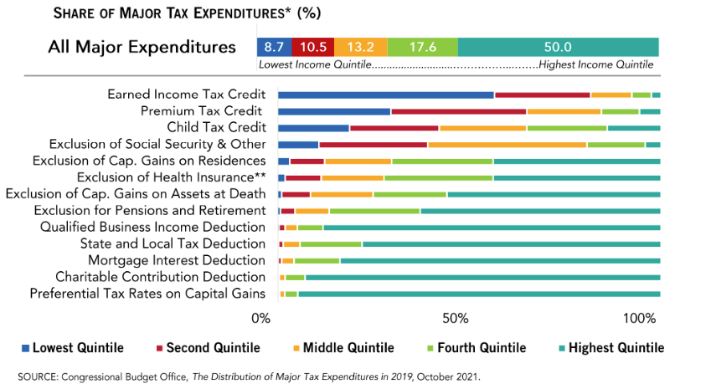
What Are Tax Expenditures?
Total: About 8% of GDP in 2023
Source: https://www.pgpf.org/Chart-Archive/0199_distribution_tax_expenditures

Slide 45
Summary

Slide 46
Major Takeaways
The debt is not currently a significant problem.
The current trajectory for the federal debt is unsustainable.
  The primary drivers are healthcare cost growth, an aging population, and interest.
We must enact plans to reduce the future (primary) deficits.
  Deficits are driven by health care and Social Security spending.
The longer we postpone action, the greater the probability of a “fiscal crisis.”

Slide 47
Bottom-Line Takeaways
Relative debt must be stabilized, so it is imperative to reduce primary deficits.
Given the fiscal challenges of an aging population and climate change, it is better to do this sooner rather than later.
But high debt levels should not deter:
  Productive infrastructure investment.
  Fiscal responses to crises:
    “When the house is on fire, you don’t worry about being in a drought; you just put it out.”

Slide 48
Thank you!
Any Questions?
www.NEEDEcon.org
Dmitriy Stolyarov
stolyar@umich.edu
Contact NEED: info@NEEDEcon.org
Submit a testimonial: www.NEEDEcon.org/testimonials.php
Become a Friend of NEED: www.NEEDEcon.org/friend.php

