Slide 1
Osher Lifelong Learning Institute, Summer 2024
Contemporary Economic Policy
OLLI – UNLV
June, 2024
Jon Haveman, Ph.D.
National Economic Education Delegation

Slide 2
Available NEED Topics Include:
US Economy
Healthcare Economics
Climate Change
Economic Inequality
Economic Mobility
Trade and Globalization
Minimum Wages
Immigration Economics
Housing Policy
Federal Budgets
Federal Debt
Black-White Wealth Gap
Autonomous Vehicles
Healthcare Economics

Slide 3
Course Outline
Contemporary Economic Policy
Week 1 (6/3): US Economic Update (Jon Haveman, NEED)
Week 2 (6/10): Healthcare Economics
Week 3 (6/17): Federal Debt
Week 4 (6/24): Economics of Immigration (Kelley Cullen, E. Washington Univ.)
Week 5 (7/1): Taxes: Rebellion, Rascals, and Revenue
Week 6 (7/8): Climate Change Economics
Week 7 (7/15): International Institutions (Alan Deardorff, Univ. of Michigan)

Slide 4
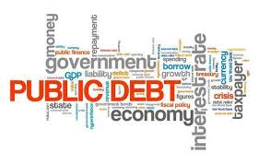
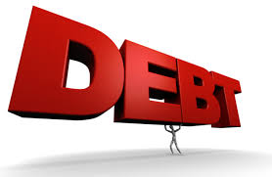
The US Federal Debt
June 17, 2024
Jon Haveman, Ph.D.
NEED

Slide 5
Credits and Disclaimer
This slide deck was created by:
Jon Haveman, Executive Director, NEED
Geoffrey Woglom, Amherst College, Emeritus
This slide deck was reviewed by:
Olivier Blanchard, Brookings Institution
Disclaimer
NEED presentations are designed to be nonpartisan.
It is, however, inevitable that presenters will be asked for and offer their own views.
Such views are those of the presenters and not necessarily those of the National Economic Education Delegation (NEED).

Slide 6
Outline
First: A Budget Overview
The Debt
Important Points About the Debt
How to Think About the Debt
Summary

Slide 7
First: A Budget Review

Slide 8
What Does the US Govt. Budget Look Like?
2022 Budget Summary (in billions)
Revenue |  |  | Outlays
Income Taxes | $2,632 |  | Mandatory | $4,134
Payroll Taxes | $1,484 |  | Discretionary | $1,661
Corporate Taxes | $425 |  | Interest | $475
Other | $356
Total | $4,897 |  | Total | $6,270
Revenue |  |  | Outlays
Income Taxes | $2,632 |  | Mandatory | $4,134
Payroll Taxes | $1,484 |  | Discretionary | $1,661
Corporate Taxes | $425 |  | Interest | $475
Other | $356
Total | $4,898 |  | Total | $6,271
Budget Deficit: $1,375 Billion
https://www.cbo.gov/publication/58888
Notes:
https://www.cbo.gov/publication/53627
https://www.cbo.gov/publication/53624

Slide 9
But There is More to The Budget!
Source: https://www.cbo.gov/system/files/2023-02/58848-Outlook.pdf

Slide 10
What Are Tax Expenditures?
Total: About 8% of GDP in 2023
Source: https://www.pgpf.org/Chart-Archive/0199_distribution_tax_expenditures

Slide 11
And Now: The Debt

Slide 13
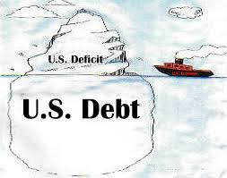
Of Debt, Deficits, and Surpluses
FLOW
Deficit: The excess of outlays over revenues in a year.
Surplus: The excess of revenues over outlays in a year.
STOCK
Debt: The accumulation of debt over time.
The sum of all past deficits and surpluses.

Slide 14
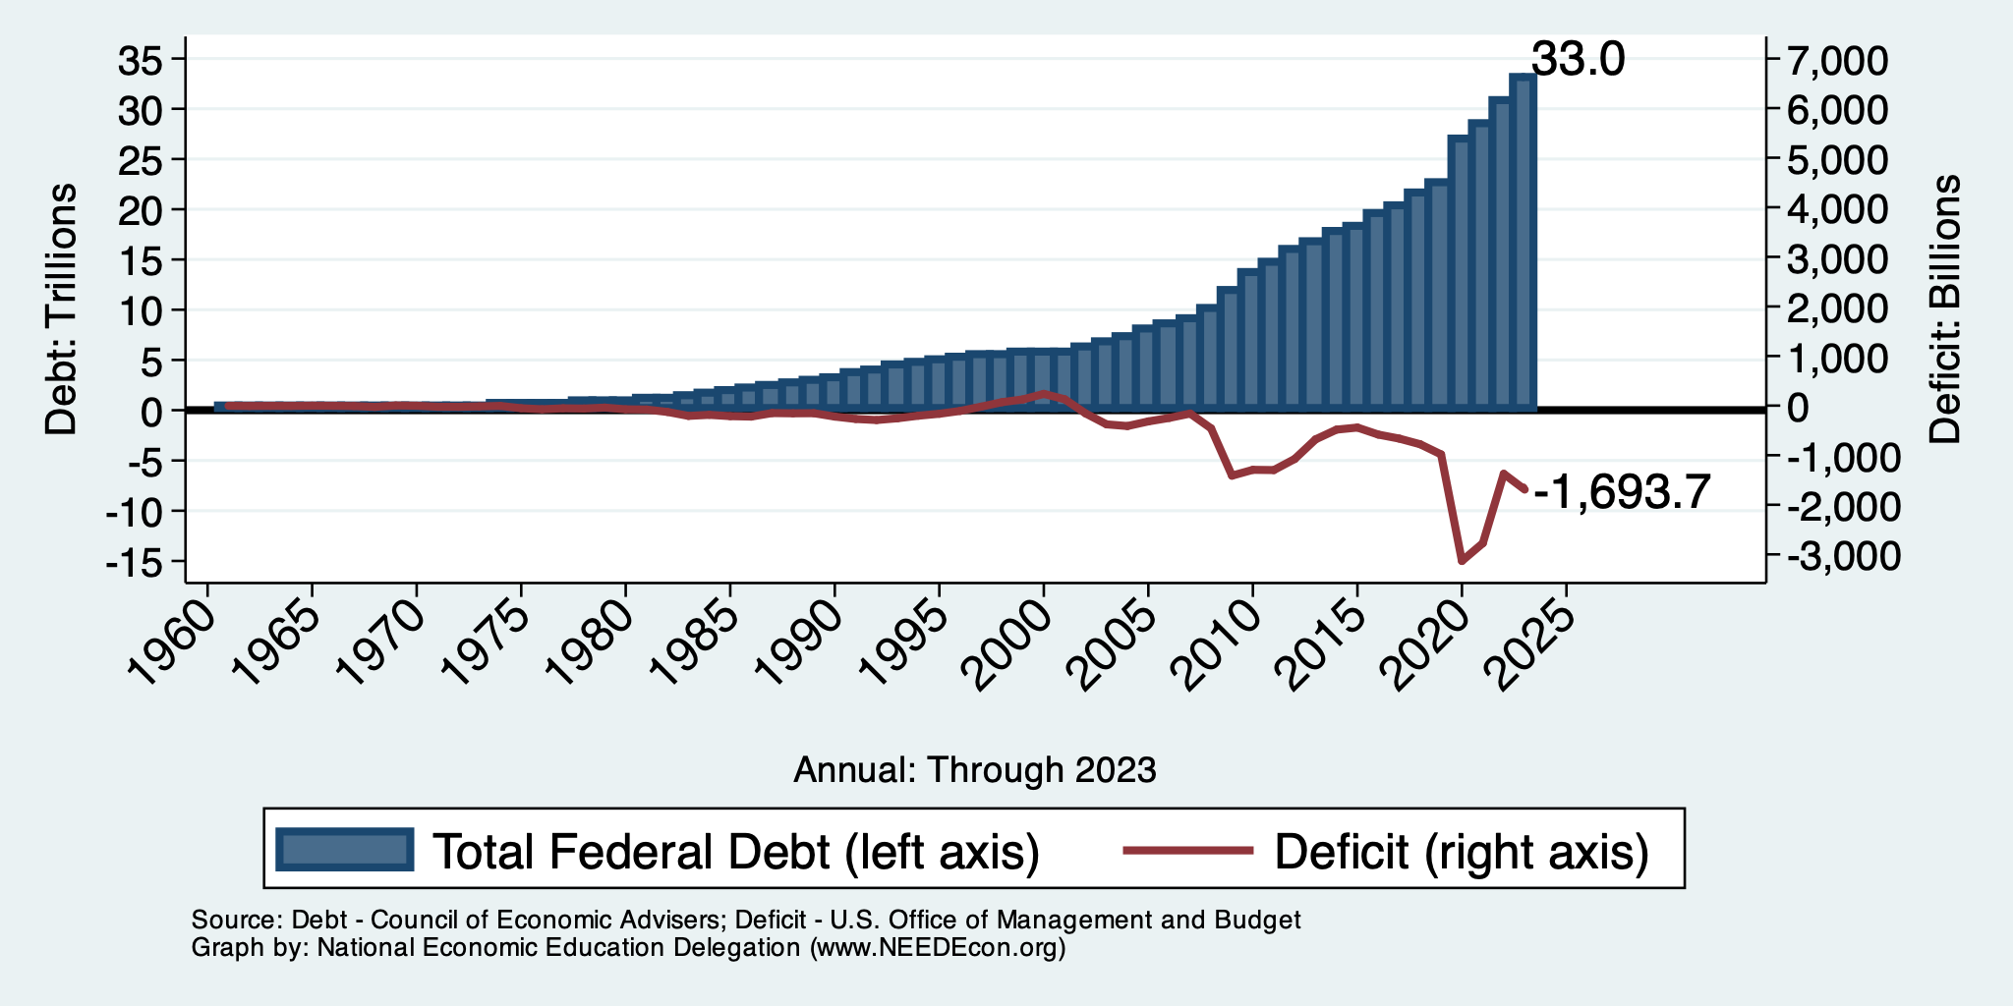
Debt vs. Deficit
Debt = The Sum of All Past Deficits Less Surpluses
Notes:
Debt2deficit.png

Slide 15
Major Takeaways: Talking Points
The debt is not currently a significant problem.
The current trajectory of federal debt is unsustainable.
Given the historically low interest rates, we can afford to wait until after the crisis to act.
We must enact plans to reduce the future (primary) deficits.
These are driven by Medicare and Social Security spending.
The longer we postpone action, the greater the probability of a “fiscal crisis.”

Slide 16
How Does the US Government Borrow?
It issues debt.
Treasury marketable securities:
Treasury bills, notes, and bonds
TIPS: Treasury inflation-protected securities
Savings bonds
Who buys the debt?
Other federal agencies
Individuals and businesses
State and local governments
Foreign government and individuals
Federal Reserve

Slide 17
Trends in US Debt Holdings Over Time
2024, Q1: Other Domestic: 52.5%
Federal Reserve: 18.1%
Foreign: 29.4%

Slide 18
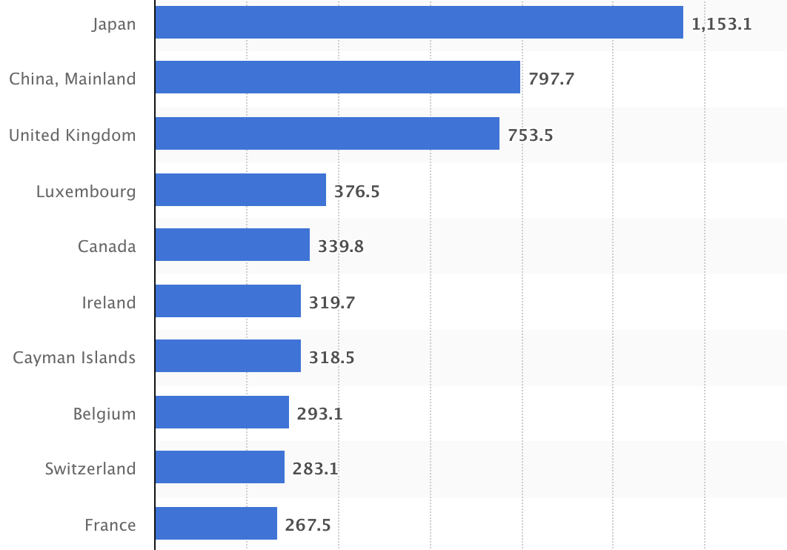
Who Holds Debt to Foreigners, Jan. 2024
Foreign ownership is relatively recent
– in 1990 foreign ownership was less than 20%
– peaked at 40+%
– now is 29.4%
Billions of U.S. Dollars
Source: https://www.statista.com/statistics/246420/major-foreign-holders-of-us-treasury-debt/

Slide 19
Why Do Foreign Investors Buy US Treasuries?
Market for Treasuries is the deepest, most liquid capital market in the world.
The US economy has a history of political and economic stability.
The dollar is the largest international reserve currency.
Most trade transactions (e.g., oil) are quoted in dollars.
88% of international transactions involve the dollar.
With some exceptions, foreign governments borrow in dollars.

Slide 20
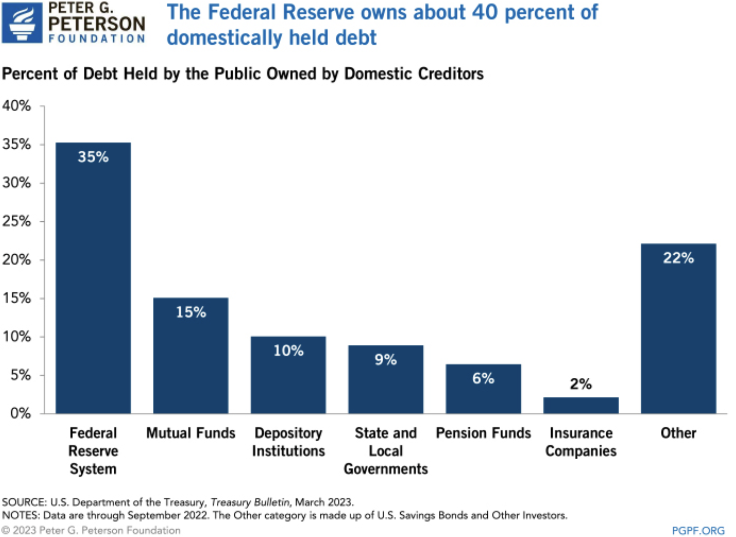
35

Slide 21
Important Points:
Not all debt is created equal.
What is the right measure of the debt?

Slide 22
Not All Debt Is Created Equal
Some debt can reduce the availability of investment funds to other borrowers.
Often referred to as “crowding out” private investment.
IntRAgovernmental debt is (important) bookkeeping.
This debt DOES NOT crowd out private investment.
Debt held by the public.
This debt MIGHT crowd out private investment.
Most analyses of debt focus on federal debt held by the public.

Slide 23
U.S. Publicly Held Debt, December 31, 2022
Source: PGPF.org

Slide 24
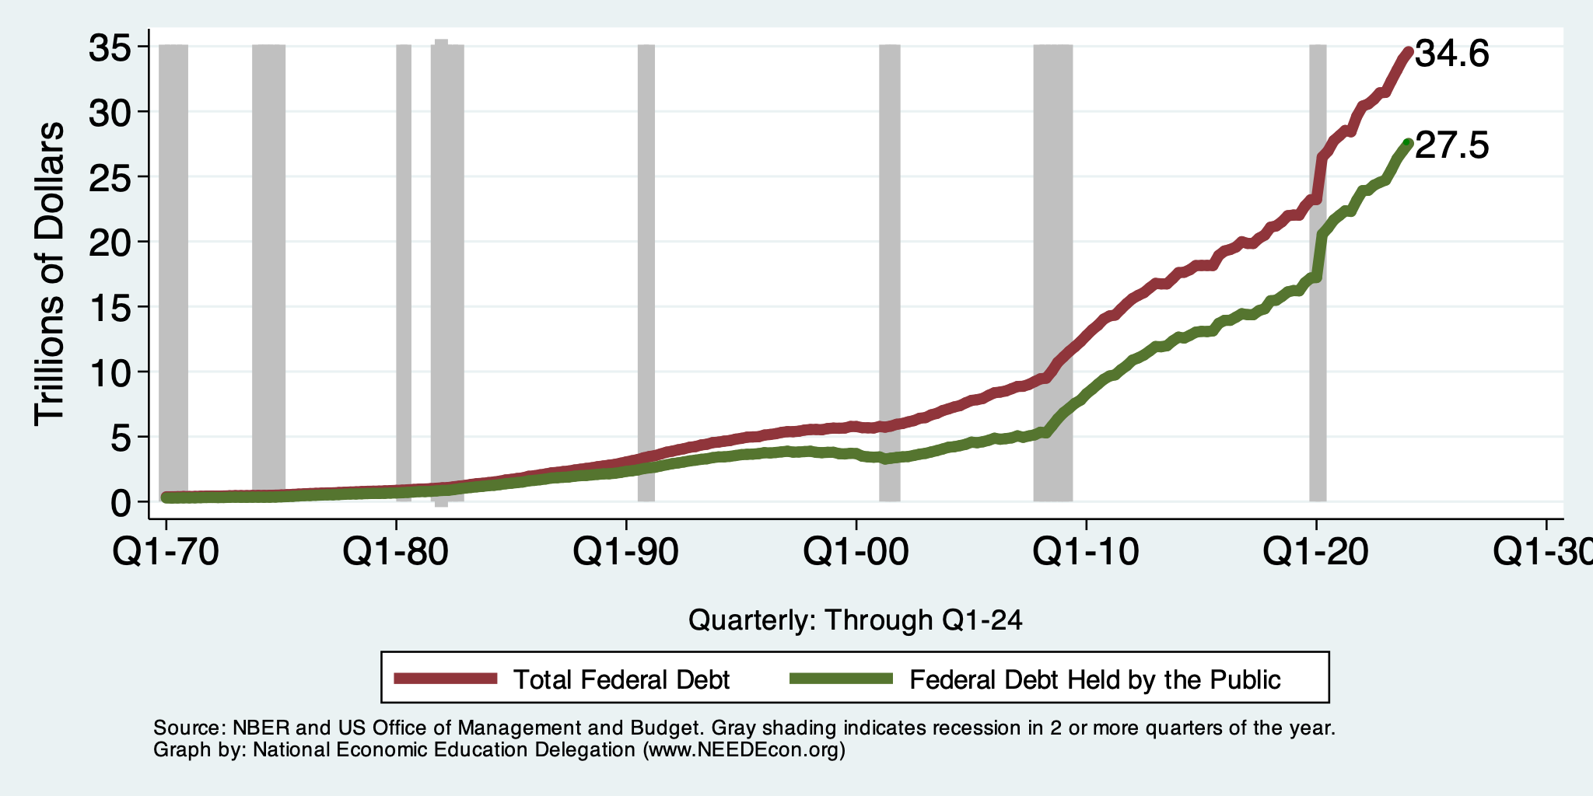
Two Measures of the Debt

Slide 25
Trends in Intragovernmental Debt

Slide 26
A Breakdown of Total Federal Debt, 2020
https://www.gao.gov/americas_fiscal_future?t=federal_debt

Slide 27
The All-Important Relative Debt
CBO analyzes the debt relative to GDP because:
To the extent that debt and deficits have burdens, these burdens depend on the size of the debt relative to the size of the economy.
 | Total Public Debt | Relative Debt Debt/GDP
United States | $27.5 Trillion | 97.4%
Greece | $0.215 Trillion | 170%

Slide 28
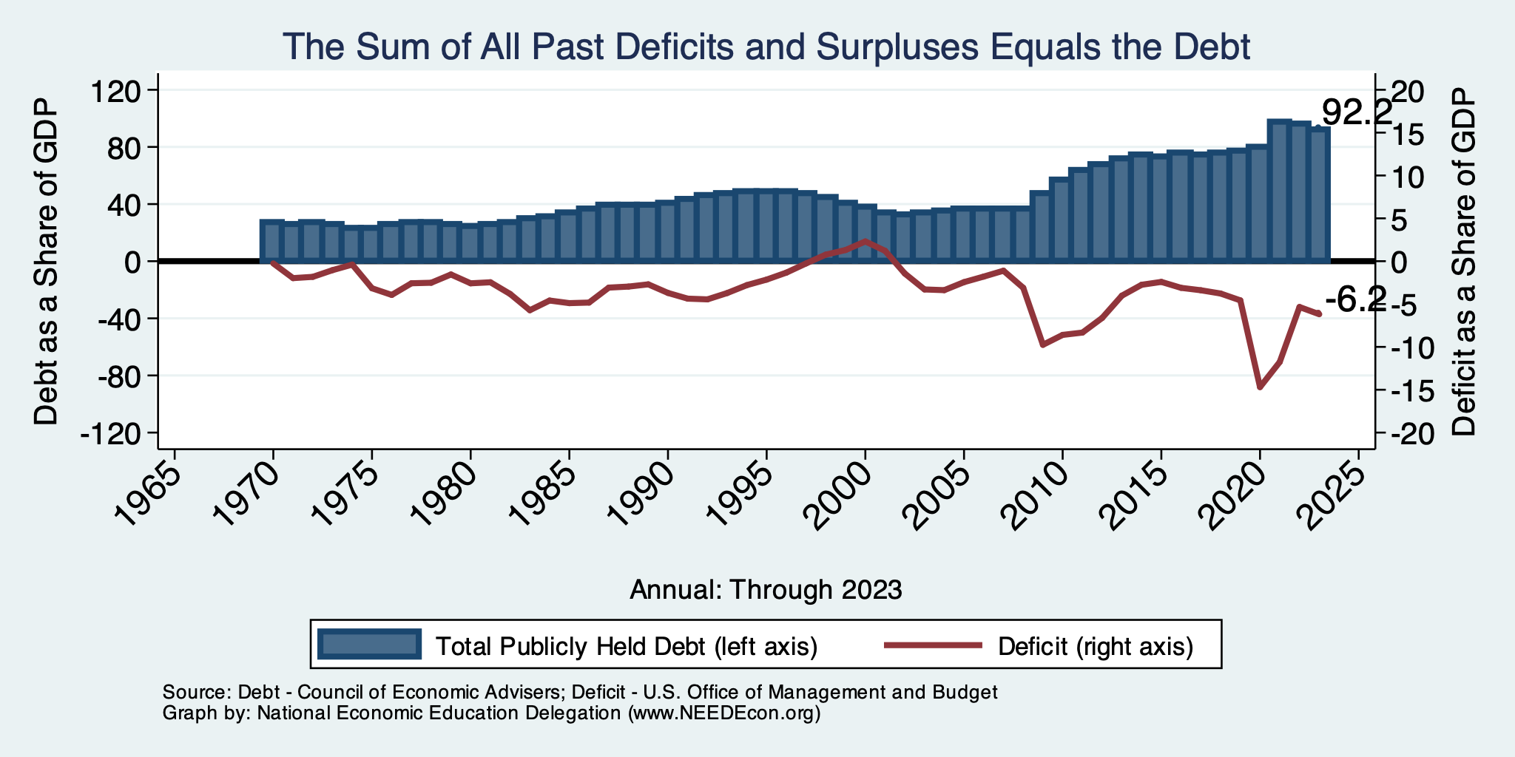
Relative Debt and Deficit
Notes:
Debt2deficit.png

Slide 29
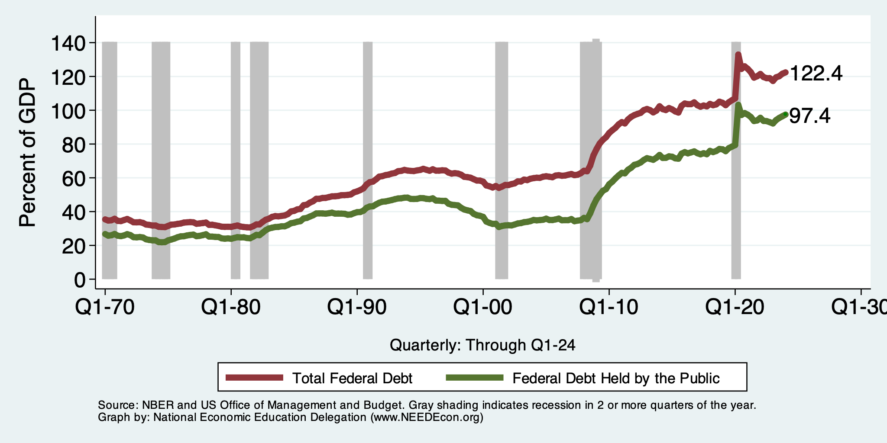
Two Measures of RELATIVE Debt

Slide 30
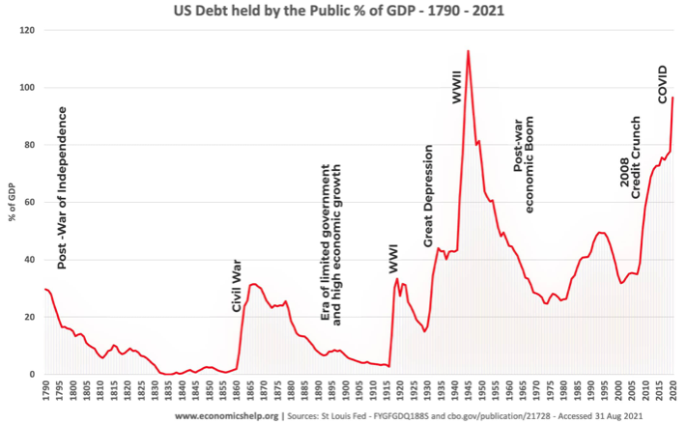
Key Points About US Relative Debt
1983
Relative debt peaked during World War II, followed by a long decline.
Prior to 1983, relative debt rose purposefully (wars and recessions) and then fell.
Relative debt has been and is expected to rise for the next 30 years w/o a strategic purpose.

Slide 31
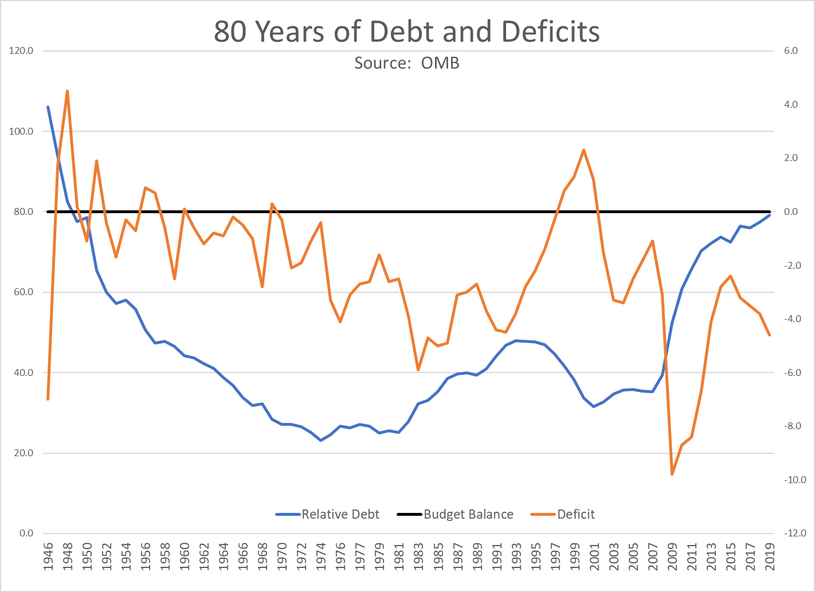
The Post-WWII Fall in Relative Debt

Slide 32
Debt Dynamics
Surprising (?) Facts
From 1945 to 1979, relative debt fell from 100% of GDP to 25% of GDP.
During this period, the federal budget was in surplus only 8/35 years!
Relative debt is a fraction: Debt/GDP; fractions fall if:
The numerator falls (budget surplus)
The denominator rises (nominal GDP growth)
The denominator grows faster than the numerator
GDP growth is greater than the interest rate on borrowing.
CAN still run deficits and reduce the relative debt.

Slide 33
An Almost Free Lunch
If the interest rate is less than the growth rate of GDP, then the contribution from the primary budget can be positive, hence…
Debt to GDP can be stabilized with a (small) primary deficit.

Slide 34
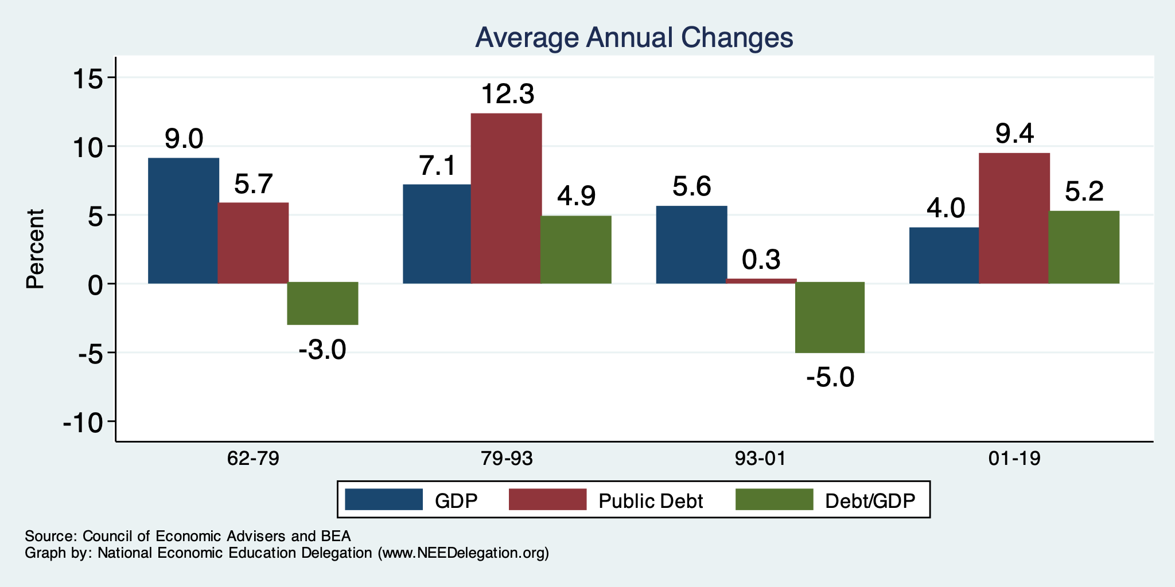
The Arithmetic of Changes in Relative Debt

Slide 35
Is Stabilizing Relative Debt Good Enough?
This means that the absolute level of the debt would continue to increase.
Yes, it probably is good enough.
It is a reflection of the economy’s ability to support the debt.
Stability will avoid bond market scares.
More on this later.

Slide 36
But Let’s Think About Today
Percent of GDP

Slide 37
Why Has the Federal Debt Risen So Much?
Expenditures UP:
Social Security
Health-care costs
Economic stimulus
In particular, during the Great Recession & COVID.
Military engagements overseas
Revenues DOWN:
Declining income tax revenues
Stagnant wages
Tax cuts
Social security
Declining revenues

Slide 38
Tax Cuts Have Driven The Debt Increases
Trump Tax Cuts: 6% of GDP
Bush Tax Cuts: 32% of GDP
Great Recession & COVID: 26% of GDP
The rest: 34% of GDP
Up from 31% in 2001

Slide 39
Thinking About Today….
Do we have:
A spending problem?
A revenue problem?
Both?

Slide 40
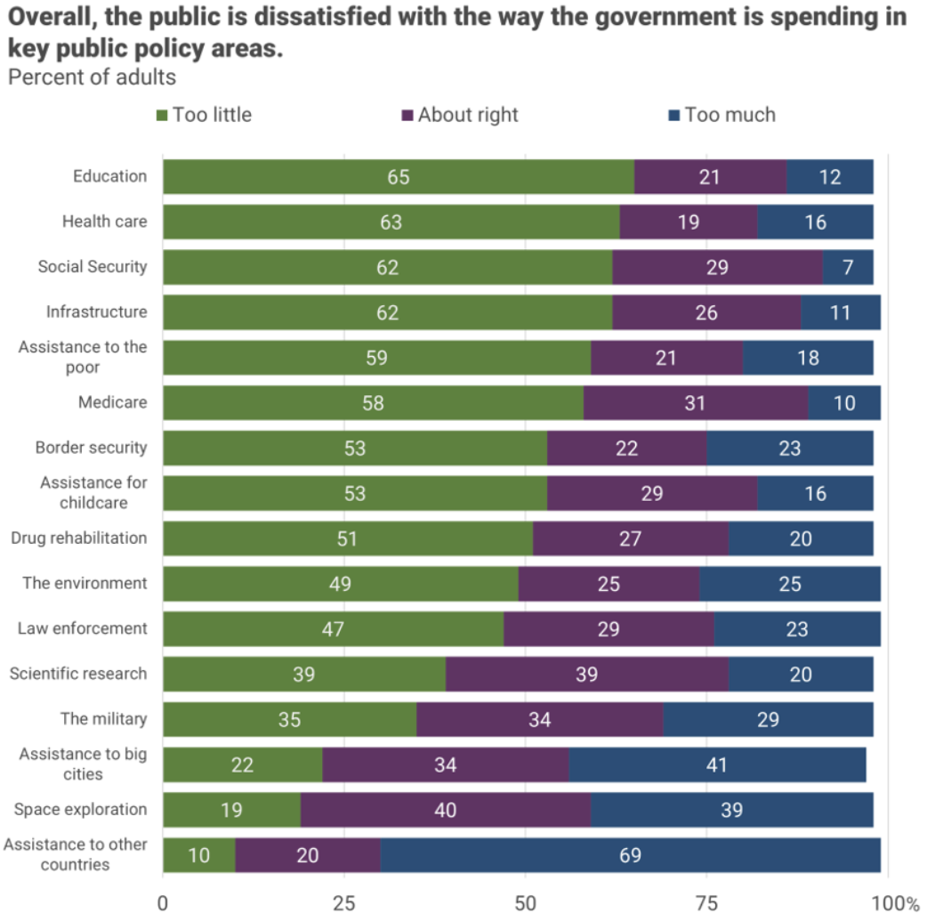
There is very little
enthusiasm for
cutting anything.
Source, NYTimes, Paul Krugman, “Why We Should, but Won’t, Reduce the Budget Deficit”

Slide 41
Thinking About Today….
Do we have:
A spending problem?
A revenue problem?
Both?
Not much support for it being a spending problem.

Slide 42
How To Address the Debt?
The question isn’t taxes vs spending cuts.
The question is:
Who should bear the burden of solving the problem?
Spending cuts will mean primarily lower-income households.
Tax increases will mean primarily high-income households.
Soc Sec benefit cuts (age limit, actual payments, etc.) will mean primarily lower-income households.

Slide 43
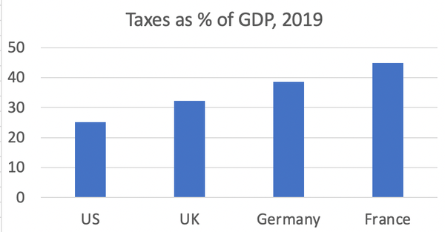
Source, NYTimes, Paul Krugman, “Why We Should, but Won’t, Reduce the Budget Deficit”

Slide 44
What? It’s not 40%? No, it’s 24.1%.
The 400 highest income households:
Paid an average tax rate of 8%.
https://nymag.com/intelligencer/article/fact-check-richest-1-dont-pay-40-of-the-taxes.html

Slide 45
Can’t Stop…Thinking About Tomorrow

Slide 46
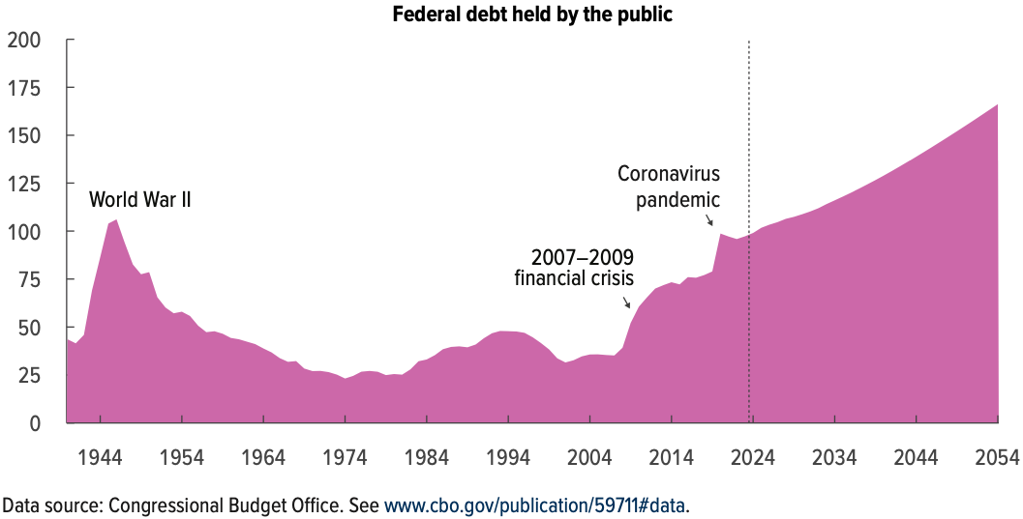
Now Let’s Think About Today and the Future
166% of GDP
Percent of GDP

Slide 47
Spending to Grow Much Faster Than Revenue
Interest, too!

Slide 48
Two Measures of the Deficit
(1) Primary deficit = current programmatic outlays – revenues
(2) Total deficit = primary deficit + interest
Interest on the debt is
The part of the total deficit that is due to past deficits.
This distinction becomes important for understanding:
The future course of relative debt.
The costs borne by future generations because of the debt.

Slide 49
Interest Will Grow as a Share of the Deficit
Primary
Interest
Source: CBO 2024 Long Term Budget Outlook

Slide 50
Interest Will Grow as a Share of the Deficit
Primary
Interest
2024 2054
Source: CBO 2023 Long Term Budget Outlook

Slide 51
What Are the Primary Drivers Going Forward?
Social Security
And Medicare
Source: CBO 2022 Long Term Budget Outlook

Slide 52
The Population is Aging

Slide 53
Mostly Healthcare

Slide 54
How to Think About the Debt

Slide 55
Perspectives on Increased Debt
Does debt impose a burden on future generations?
Does it inevitably have to be paid off? No!
Government borrowing crowds out private capital and investments.
Weakened by the ability to borrow from other countries.
In time, debt service might crowd out other government spending.
Diminishing policy priorities in the budget.
Is it reasonable to borrow at low interest rates for investment?
For example, for infrastructure.

Slide 56
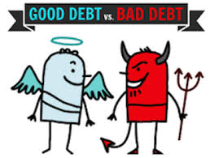
Not All Borrowing Is Bad!
Two good reasons to borrow:
During a temporary crisis
Recession
War
Pandemic
Productive public investment
Infrastructure
Education
These deficits did not and do not permanently increase relative debt.
Great Depression, WWII, Great Recession, COVID
Public investment expands GDP and tax revenue

Slide 57
Is The Debt a Problem Today?
Federal government borrows each month with little difficulty.
Very little evidence of ”crowding out.”
Interest rates are low, but rising – this is becoming a concern.
So, no, other than the debt ceiling, it’s not a problem today.

Slide 58
So, Why Worry About it?
If debt becomes too high:
Investors might start questioning the creditworthiness of the US government.
Problem: Nobody knows how high is too high.
It becomes more difficult to borrow in times of crisis.
War, severe recession
“Fiscal space”
Impossible to measure how much we have.
Clearly, we have less now than in 2007.
Could start to crowd out investment by consumers and businesses.
Not currently a problem. No idea if/when it might become one.
Could be inflationary.

Slide 59
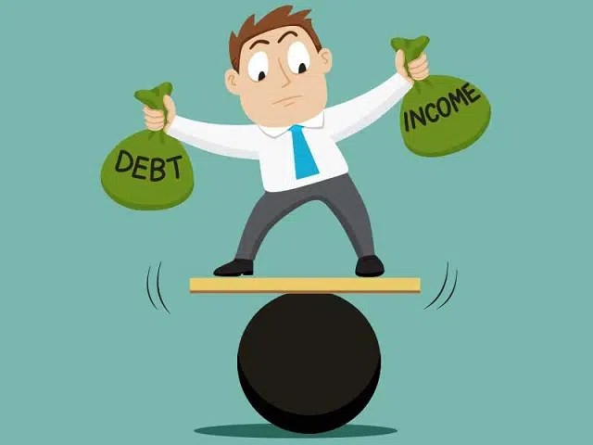
So, Why Worry About It?
If debt continues to grow:
Interest payments will grow with it.
11% of spending in 2024.
23% of spending in 2054.
Less room for using the budget for policy priorities.
30% of payments go to other countries.
The longer we wait to address it, the harder and more disruptive addressing it will be.
Interest rates are increasing.

Slide 60
Growth in Relative Debt
Can be scary to….
International investors
Bond markets

Slide 61
Fiscal Crisis, or a Run on the Dollar
With an exploding relative debt, what happens if foreigners lose confidence in the stability of the dollar?
CBO (Federal Debt: A Primer, March 2020):
because the United States currently benefits from the dollar’s position as the world’s reserve currency and because the federal government borrows in dollars, a financial crisis—similar to those that befell Argentina, Greece, or Ireland—is less likely in the United States.
Although no one can predict whether or when a fiscal crisis might occur or how it would unfold, the risk is almost certainly increased by high and rising federal debt.
Crises of confidence, in addition to being unpredictable, happen very quickly.

Slide 62
What Is a Fiscal Crisis?
Increased perception of risk in government debt.
Potential manifestations:
Sudden significant increase in interest rates
Plunging exchange rates
Why?
Increased expectation of default
Potential results:
Dramatic budget reforms may be quickly necessary to stave off actual default.
Recession from declines in:
investment (interest rates)
consumption (interest rates)
Government spending
Higher interest bill on existing debt

Slide 63
Other Countries Have Higher Debt Levels

Slide 64
Summary

Slide 65
Bottom-Line Takeaways
Relative debt must be stabilized, so it is imperative to reduce primary deficits.
Given the fiscal challenges of an aging population and climate change, it is better to do this sooner rather than later.
But high debt levels should not deter:
Productive infrastructure investment.
Fiscal responses to crises:
“When the house is on fire, you don’t worry about being in a drought; you just put it out.”

Slide 66
Major Takeaways: Talking Points
The debt is not currently a significant problem.
The current trajectory for the federal debt is unsustainable.
The primary drivers are an aging population, healthcare costs and interest.
We must enact plans to reduce the future (primary) deficits.
These are driven by Medicare and Social Security spending.
The longer we postpone action, the greater the probability of a “fiscal crisis.”

Slide 67
Bottom Line: We Need to Worry about the Debt
Interest rates are rising.
A fiscal crisis should be avoided at all costs.
Stabilizing relative debt would substantially reduce the possibility of a crisis.
The good news is we might be able to stabilize relative debt without a primary surplus.
But we must substantially reduce primary deficits.
We MUST MUST MUST continue raising the debt ceiling.

Slide 68
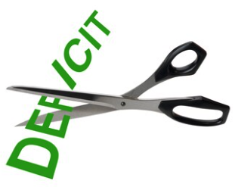
Bottom Bottom Line
Question is not WHETHER the US will have to act…
but WHEN.
Some combination of the following WILL be necessary:
Raising taxes
Cutting spending
Reining in health-care costs
The longer we wait, the harder it will be!

Slide 69
Thank you!
Any Questions?
www.NEEDEcon.org
Jon Haveman, Ph.D.
Jon@NEEDEcon.org
Contact NEED: info@NEEDEcon.org
Submit a testimonial: www.NEEDEcon.org/testimonials.php
Become a Friend of NEED: www.NEEDEcon.org/friend.php

Slide 70
Maybe Debt Isn’t a Problem After All: MMT
Stephanie Kelton provided a prominent and recent exposition of modern monetary theory in a NY Times op-ed on June 6, 2020:
“Learn to Love Trillion-Dollar Deficits.”
Modern monetary theory
US Treasury borrows in its own currency and therefore cannot default.
As opposed to countries, such as Greece, which borrow in euros.
Example: How did we ”find the money” for the recent increase in the deficit of about $1.9 trillion?
Answer: The Fed purchased $1.7 trillion = 89% of financing
More generally, MMT argues that we can always find the money to increase federal spending.

Slide 71
MMT’s Free Lunch
The only limit on deficit spending is when it leads to too much spending, thereby increasing current inflation.
Recognizing this fact, “could free policymakers not only to act boldly amid crises but also to invest boldly in times of more stability.”
First part, acting boldly, is important and likely true.
Second part, invest boldly, is suspect.

Slide 72
General Sense on Modern Monetary Theory

Slide 73
A More Reasonable, But Still Optimistic View
Olivier Blanchard:
Emeritus Professor at MIT
Chief Economist at the IMF, 2008–2015
President of the American Economic Association, 2018

Slide 74
The Key: Stabilization of Relative Debt
Stabilization of relative debt might forestall the consequences of chronic deficits.
Problem: The US federal debt is in no way stable.
W/o stability, interest rates might rise, causing crowding out of:
policy priorities
domestic investment
Budget surpluses are not necessary, but budget control is.

Slide 75
But Let’s Think About Today

