Slide 1
Osher Lifelong Learning Institute, Spring 2023
Contemporary Economic Policy Issues
Duke University
May-June 2023
Host: Jon Haveman, Ph.D.
National Economic Education Delegation

Slide 2
Available NEED Topics Include:
US Economy
Healthcare Economics
Climate Change
Economic Inequality
Economic Mobility
Trade and Globalization
Minimum Wages
Immigration Economics
Housing Policy
Federal Budgets
Federal Debt
Black-White Wealth Gap
Autonomous Vehicles
Healthcare Economics

Slide 3
Course Outline
Contemporary Economic Policy
  Week 1 (5/2): US Economic Update (Geoffrey Woglom, Amherst College)
  Week 2 (5/9): Monetary Policy (Geoffrey Woglom)
  Week 3 (5/16): Healthcare Economics (Kelley Cullen, E. Washington University)
  Week 4 (5/23): Climate Change Economics (Sarah Jacobson, Williams College)
  Week 5 (5/30): The Black-White Wealth Gap (Mike Shor, Univ. of Connecticut)
  Week 6 (6/6): Federal Debt (Jon Haveman, NEED)

Slide 4
Submitting Questions
Please submit questions of clarification in the chat.
  I will try to handle them as they come up.
We will do a verbal Q&A once the material has been presented.
Slides will be available from the NEED website shortly after the talk (https://NEEDEcon.org/delivered_presentations.php)

Slide 5


The US Federal Debt
OLLI – Duke University
June 6, 2023
Jon Haveman, Ph.D.
National Economic Education Delegation

Slide 6
Credits and Disclaimer
This slide deck was created by:
  Jon Haveman, Executive Director, NEED
  Geoffrey Woglom, Amherst College, Emeritus
This slide deck was reviewed by:
  Olivier Blanchard, Brookings Institution
Disclaimer
  NEED presentations are designed to be nonpartisan.
  It is, however, inevitable that presenters will be asked for and offer their own views.
  Such views are those of the presenters and not necessarily those of the National Economic Education Delegation (NEED).

Slide 7
US Government Debt

Slide 8
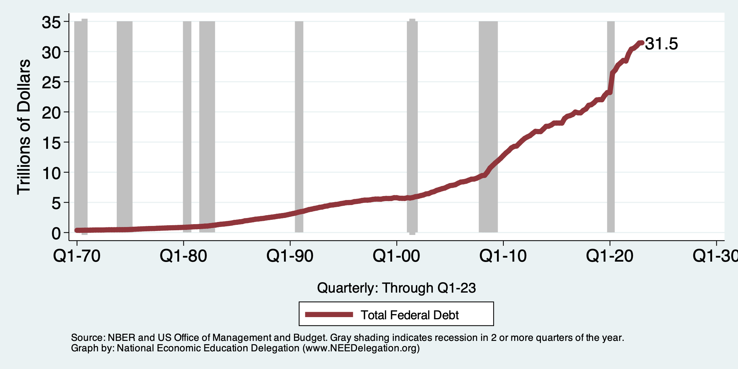
A Brief History of The Debt
Hit the ceiling on January 19, 2023: $31.458 Trillion.

Slide 9
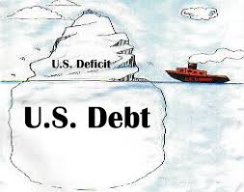
Of Debt, Deficits, and Surpluses
FLOW
  Deficit: The excess of outlays over revenues in a year.
  Surplus: The excess of revenues over outlays in a year.
STOCK
  Debt: The accumulation of debt over time.
      The sum of all past deficits and surpluses.

Slide 10
What Does the US Govt. Budget Look Like?
2022 Budget Summary (in billions)
Revenue |  |  | Outlays
Income Taxes | $2,632 |  | Mandatory | $4,135
Payroll Taxes | $1,483 |  | Discretionary | $1,662
Corporate Taxes | $425 |  | Interest | $475
Other | $356
Total | $4,896 |  | Total | $6,271
Budget Deficit: $1,376 Billion
https://www.cbo.gov/data/budget-economic-data#2
Notes:
https://www.cbo.gov/publication/53627
https://www.cbo.gov/publication/53624

Slide 11
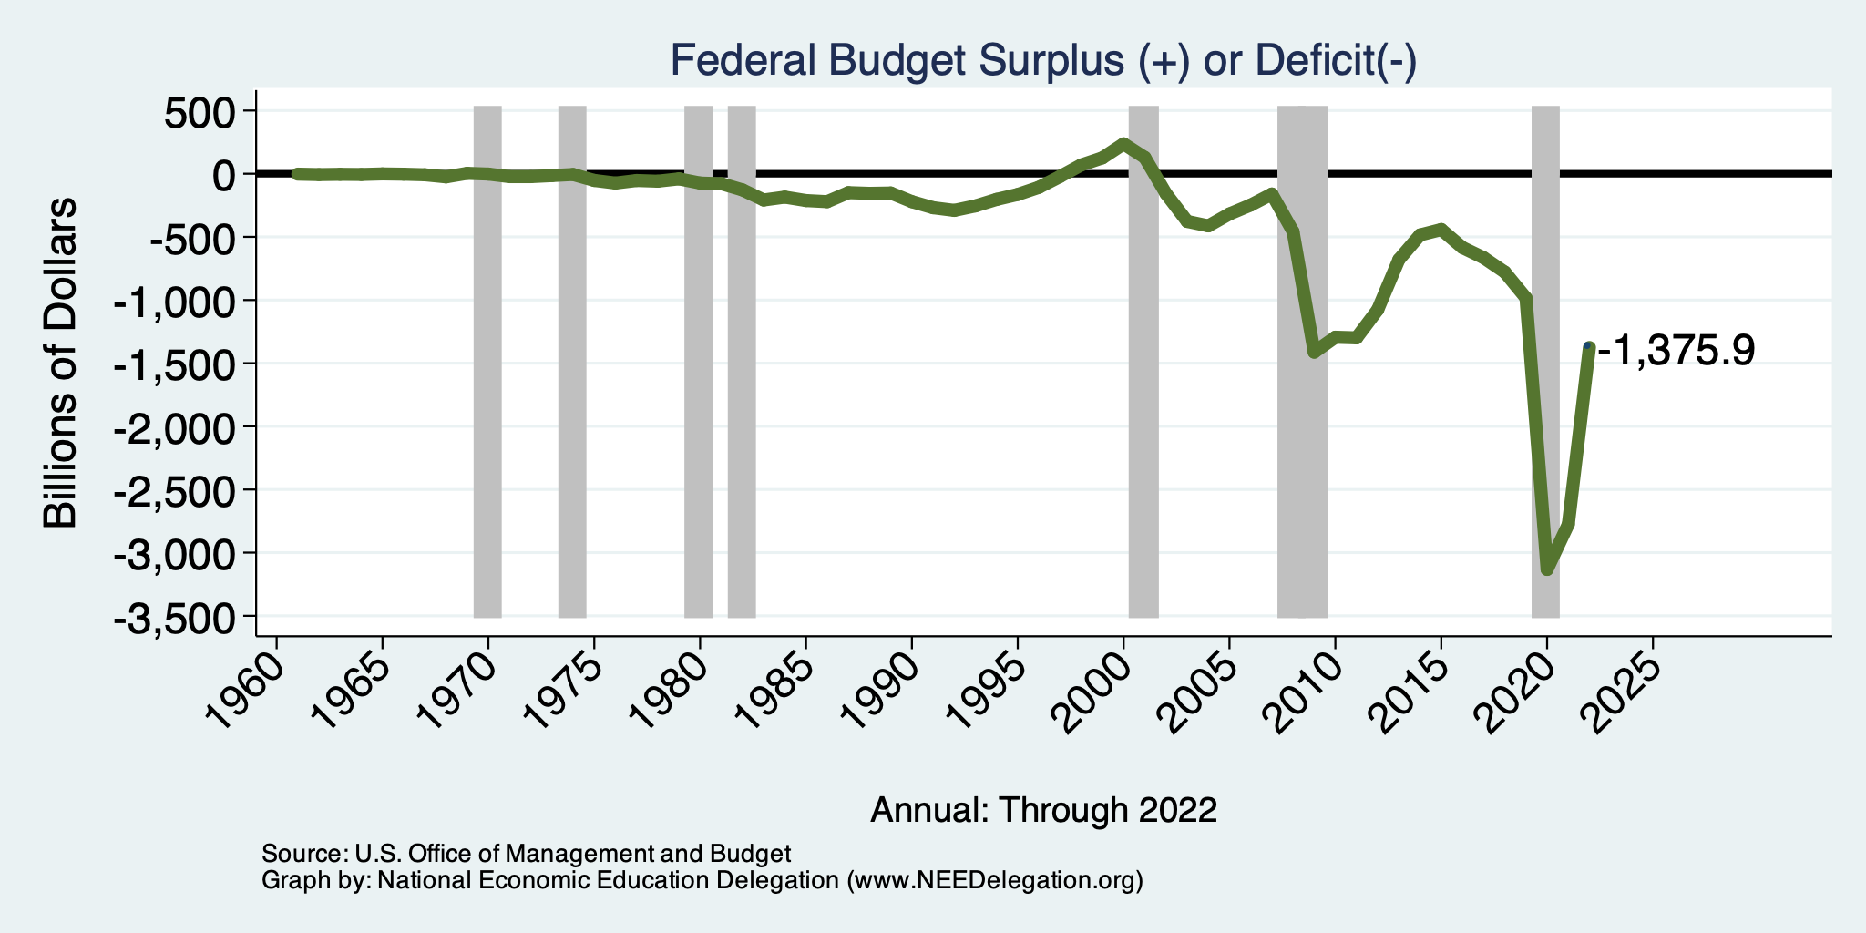
A History of Persistent Deficits
Notes:
Debt2deficit.png

Slide 12
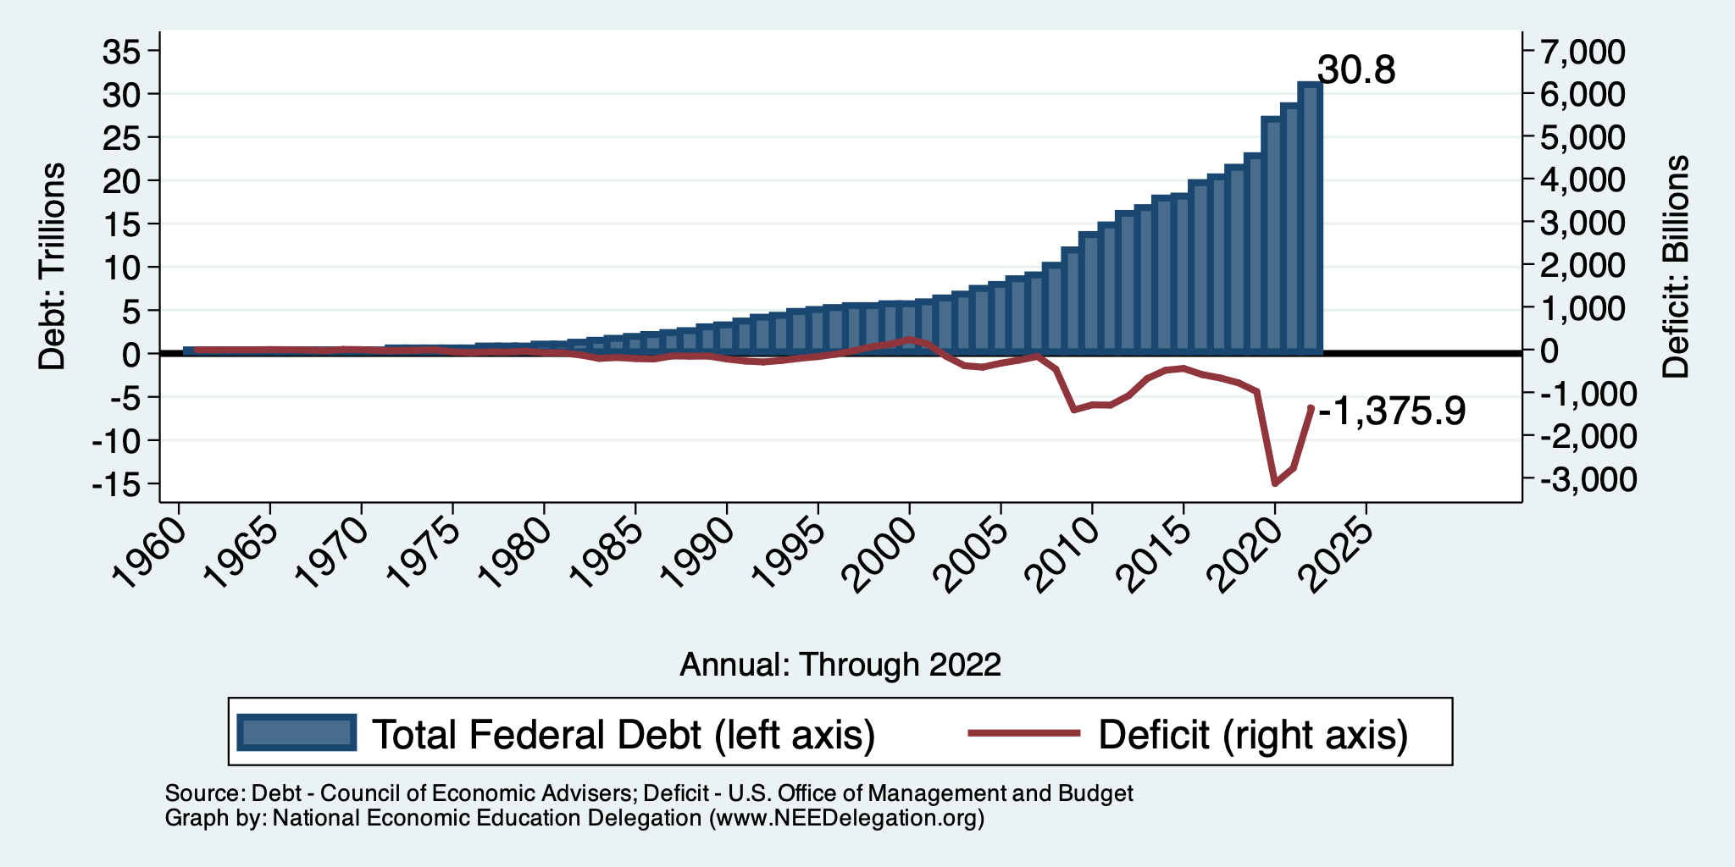
Debt vs. Deficit
Debt = The Sum of All Past Deficits Less Surpluses
Notes:
Debt2deficit.png

Slide 13
Roughly Speaking…
The debt:
  Rises with a deficit.
  Falls with a surplus.
Interest rates might get in the way of this relationship.
  High interest rates raise the level of interest payments.

Slide 14
How Does the US Government Borrow?
It issues debt.
  Treasury marketable securities:
    Treasury bills, notes, and bonds
    TIPS: Treasury inflation-protected securities
    Savings bonds
Who buys the debt?
  Other federal agencies
  Individuals and businesses
  State and local governments
  Foreign government and individuals
  Federal Reserve

Slide 15
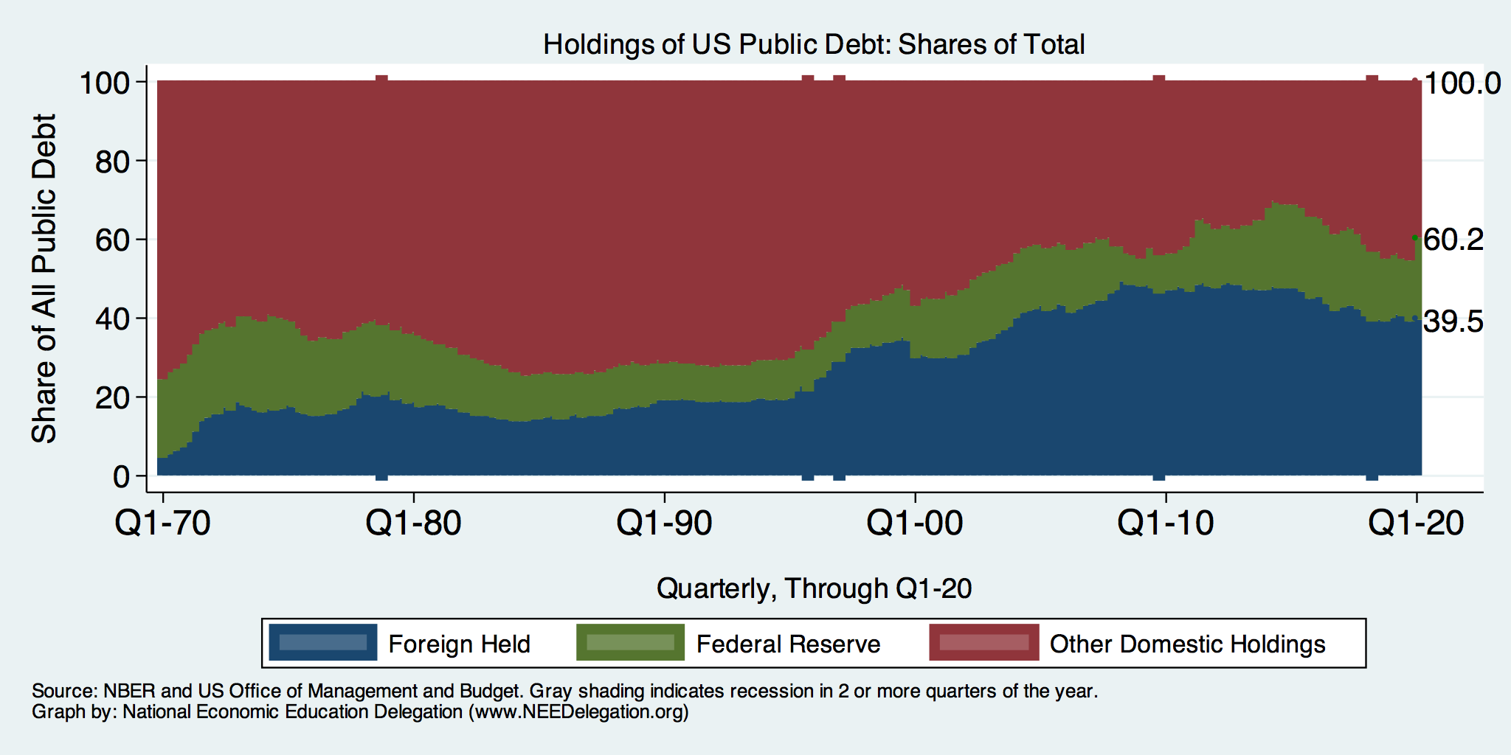
Trends in US Debt Holdings Over Time
2020, Q1: Other Domestic: 39.8%
Federal Reserve: 20.7%
Foreign: 39.5%

Slide 16
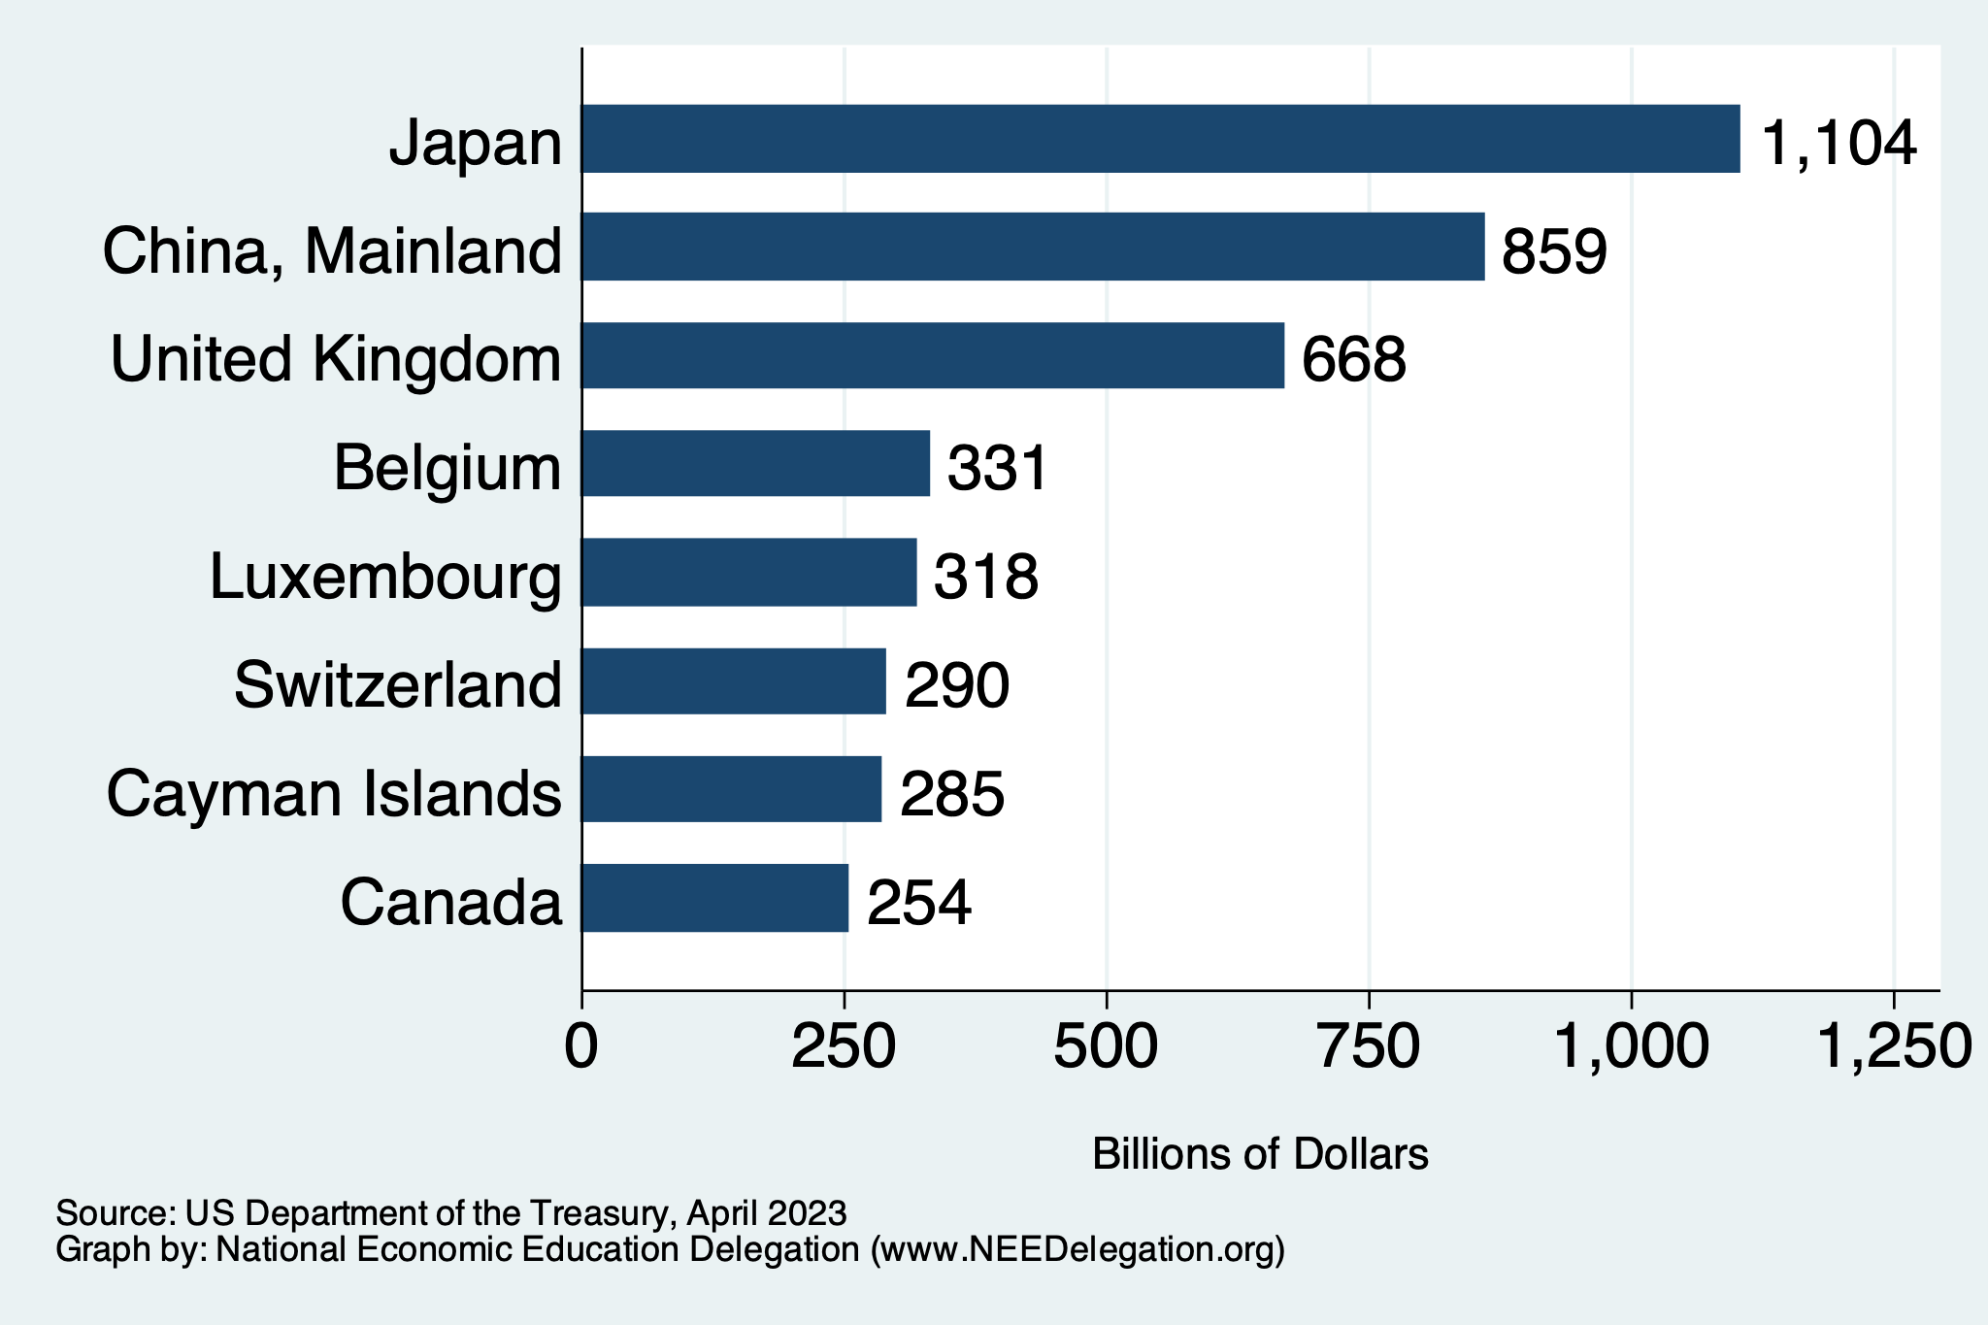
Who Holds US Foreign Debt?
https://ticdata.treasury.gov/Publish/mfh.txt

Slide 17
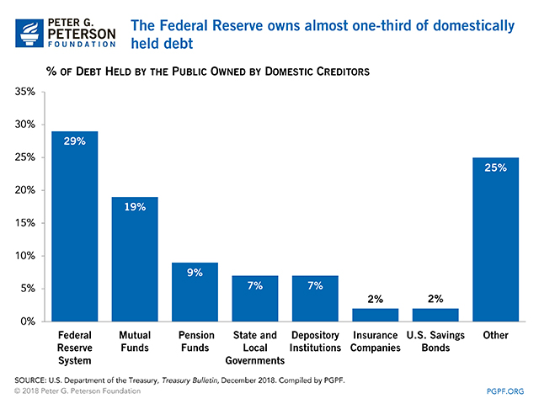

Slide 18
Not All Debt Is Created Equal
Some debt can reduce the availability of investment funds to other borrowers.
  Often referred to as “crowding out” private investment
Intragovernment debt is (important) bookkeeping.
  This debt DOES NOT crowd out private investment.
Debt held by the public
  This debt MIGHT crowd out private investment.
Most analyses of debt focus on federal debt held by the public.

Slide 19
Important Points:
Not all debt is created equal.
What is the right measure of the debt?
Components of the debt.

Slide 20
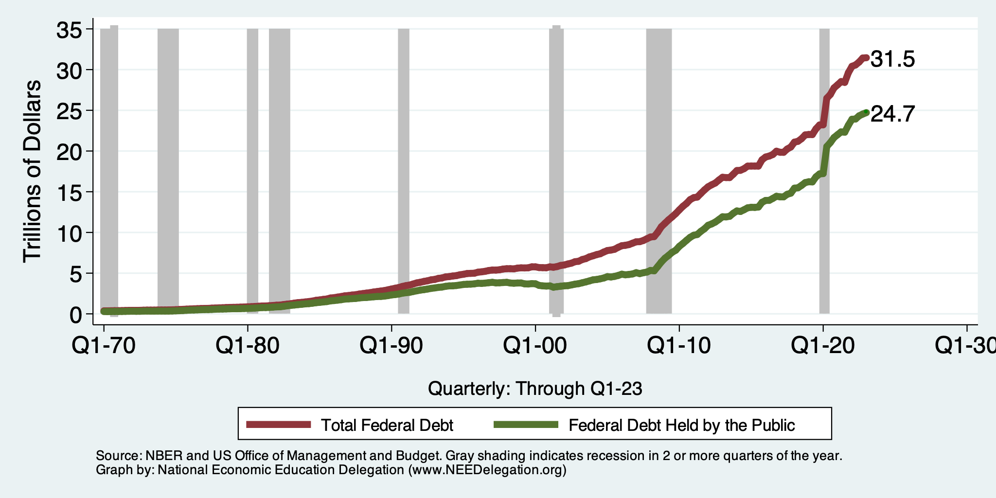
Two Measures of the Debt
SSN & Medicare Trust Funds

Slide 21
The All-Important Relative Debt
CBO analyzes the debt relative to GDP because:
  To the extent that debt and deficits have burdens, these burdens depend on the size of the debt relative to the size of the economy.
 | Total Public Debt | Relative Debt Debt/GDP
United States | $24.7 Trillion | 93.3%
Greece | $0.215 Trillion | 170%

Slide 22
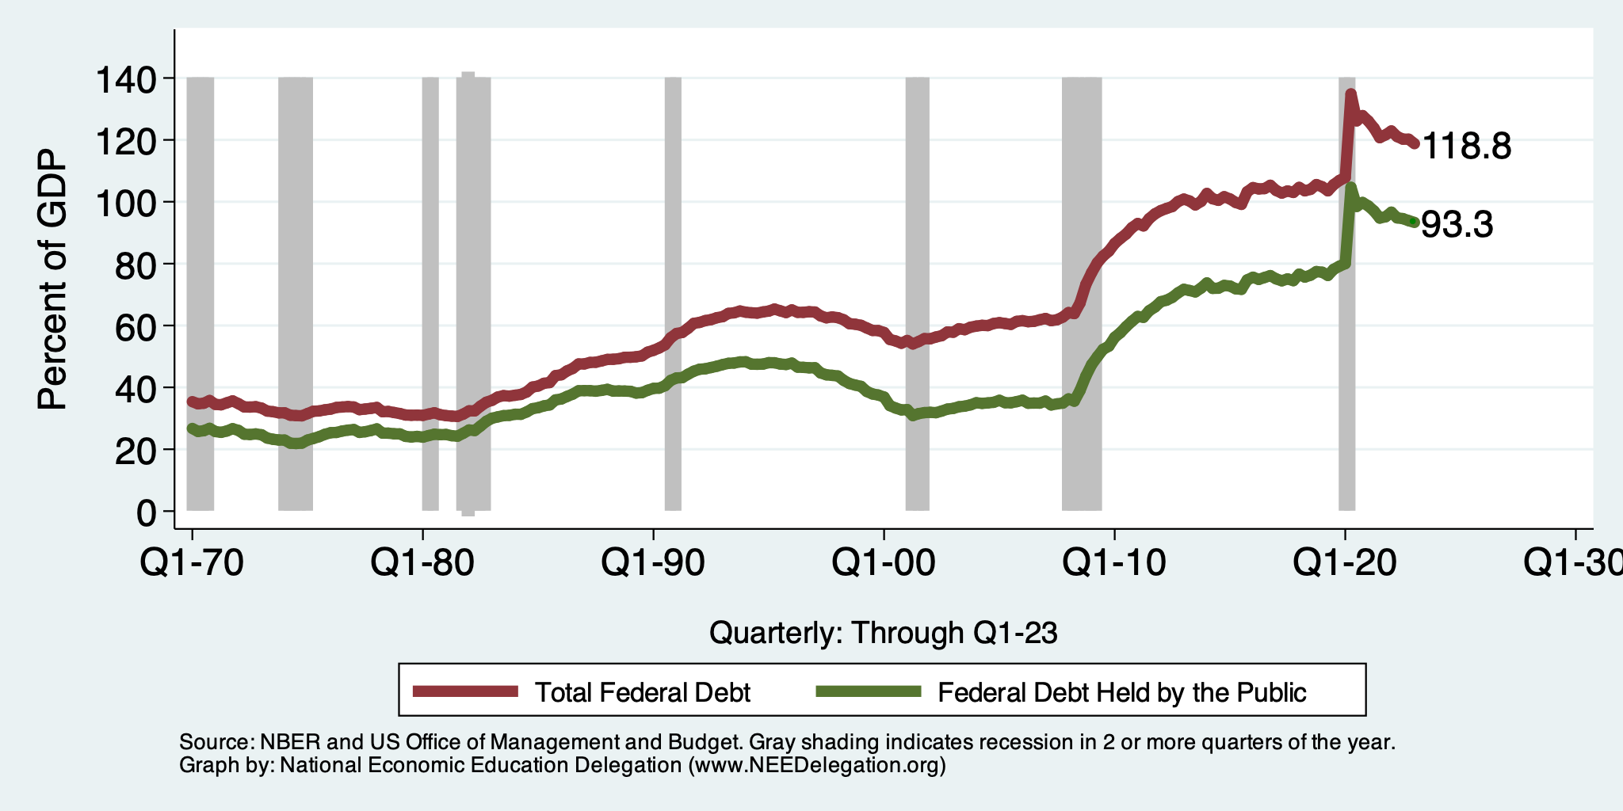
Two Measures of RELATIVE Debt

Slide 23
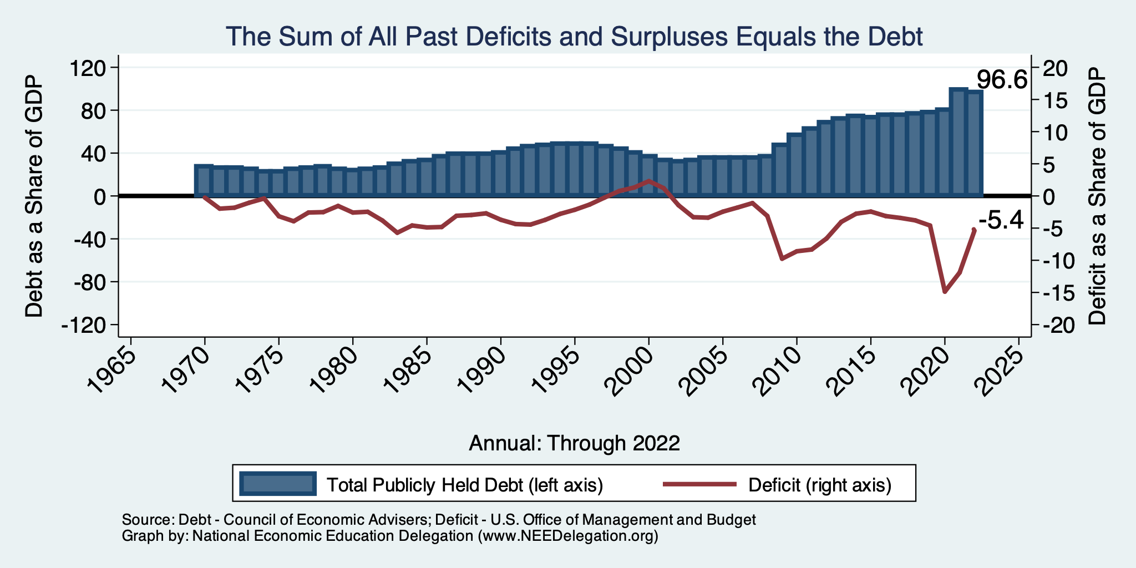
Relative Debt and Deficit
Notes:
Debt2deficit.png

Slide 24
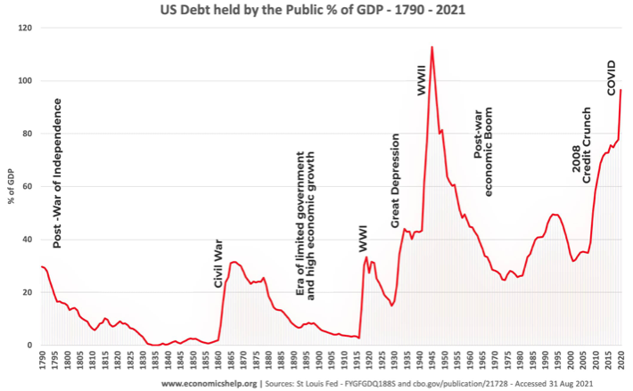
Key Points About US Relative Debt
1983
Prior to 1983, relative debt rose purposefully (wars and recessions) and then fell.
Relative debt peaked during World War II, followed by a long decline.
Relative debt has been and is expected to rise for the next 30 years w/o a strategic purpose.

Slide 25
Debt Dynamics
Surprising (?) Facts
  From 1945 to 1979, relative debt fell from 100% of GDP to 25% of GDP.
  During this period, the federal budget was in surplus only once, in 1969.
Relative debt is a fraction: Debt/GDP; fractions fall if:
  The numerator falls (budget surplus)
  The denominator rises (nominal GDP growth)
  The denominator grows faster than the numerator

Slide 26
An Almost Free Lunch
If the interest rate is less than the growth rate of GDP, then the contribution from the primary budget can be positive, hence…
Debt to GDP can be stabilized with a (small) primary deficit.

Slide 27
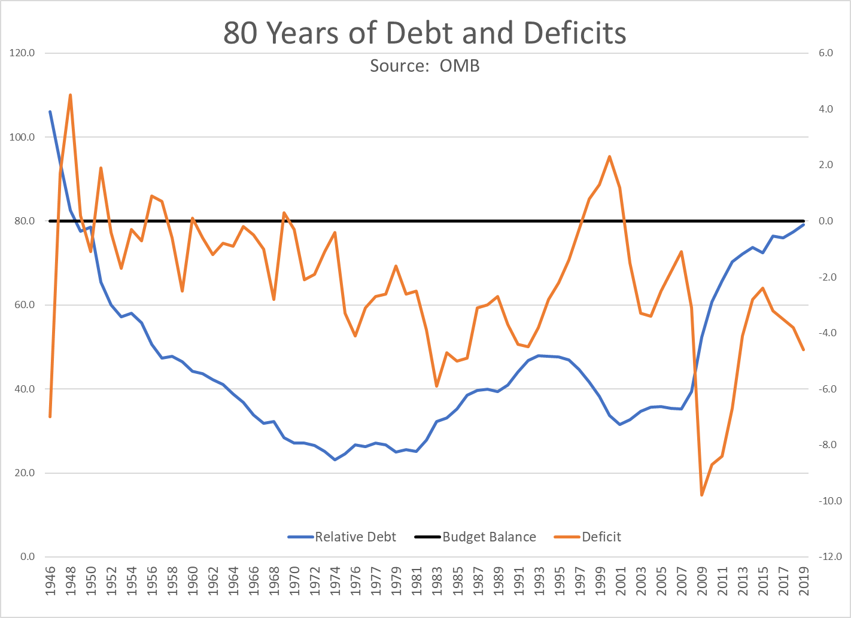
The Post-WWII Fall in Relative Debt

Slide 28
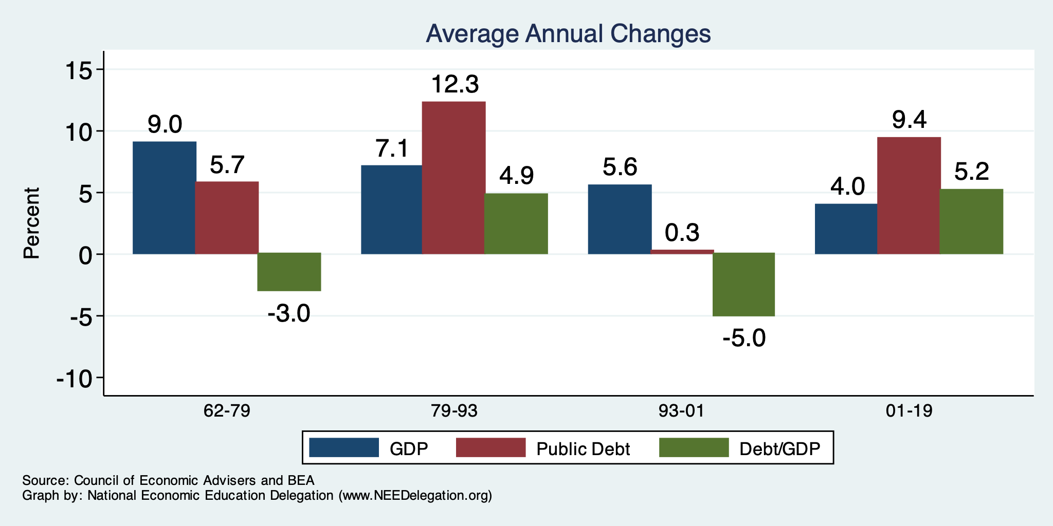
The Arithmetic of Changes in Relative Debt

Slide 29
How did we get here?

Slide 30
How Did We Get Here?
Deficits before the Pandemic were Unsustainable

Slide 31
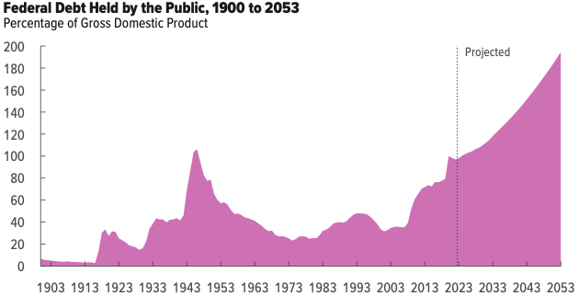
But Let’s Think About Today

Slide 32
Why Has the Federal Debt Risen So Much?
Expenditures UP:
  Aging population
    Social Security
    Health-care costs
  Economic stimulus
    In particular, during the Great Recession & COVID.
  Military engagements overseas
  Rising interest payments
Revenues DOWN:
  Declining income tax revenues
    Stagnant wages
    Tax cuts
  Social security
    Declining revenues

Slide 33
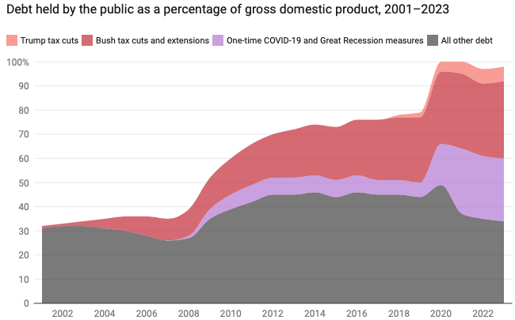
Tax Cuts Have Driven The Debt Increases
Trump Tax Cuts: 6% of GDP
Bush Tax Cuts: 32% of GDP
Great Recession & COVID: 26% of GDP
The rest: 34% of GDP
Up from 31% in 2001

Slide 34
Now Let’s Think About Today and the Future

Slide 35
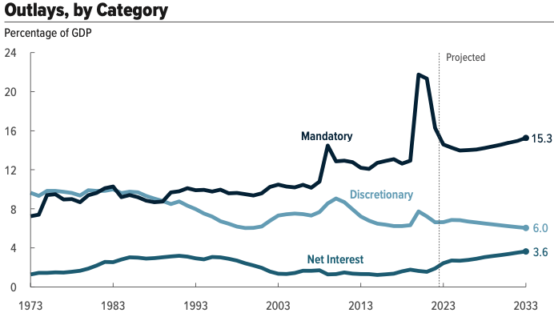
What Are the Primary Drivers Going Forward?
Social Security
And Medicare

Slide 36
Spending to Grow Much Faster Than Revenue
Interest, too!

Slide 37
Two Measures of the Deficit
(1) Primary deficit = current programmatic outlays – revenues
(2) Total deficit = primary deficit + interest
Interest on the debt is
  The part of the total deficit that is due to past deficits.
This distinction becomes important for understanding:
  The future course of relative debt.
  The costs borne by future generations because of the debt.

Slide 38
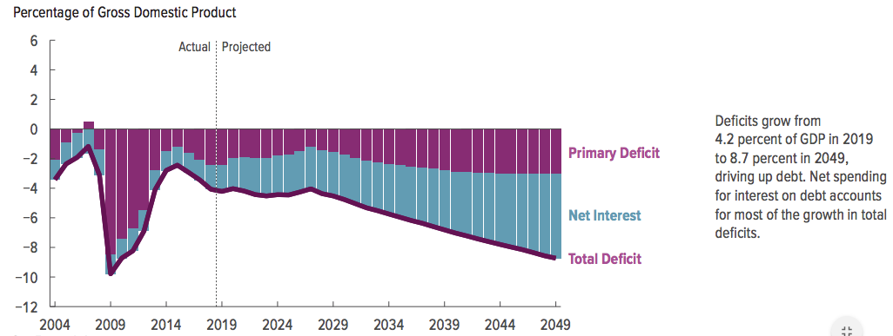
Interest Will Grow as a Share of the Deficit

Slide 39
How to Think About the Debt

Slide 40
Perspectives on Increased Debt
Government borrowing “crowds out” private capital and investments.
  Weakened by the ability to borrow from other countries.
Does debt impose a burden on future generations?
  Does it inevitably have to be paid off?
In time, debt service might crowd out other government spending.
  Diminishing policy priorities in the budget.
Is it reasonable to borrow at low interest rates for investment?
  For example, for infrastructure.

Slide 41
Is The Debt a Problem Today?
Federal government borrows each month with little difficulty.
Very little evidence of ”crowding out.”
Interest rates are low, but rising – this is becoming a concern.
So, no, other than the debt ceiling, it’s not a problem today.

Slide 42
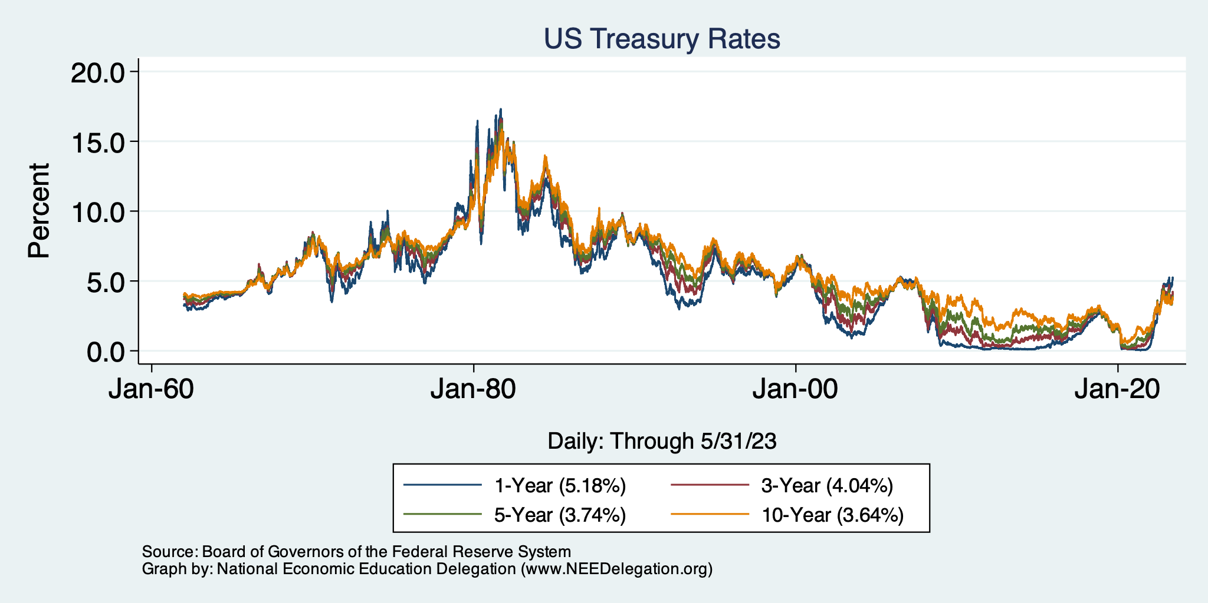
Interest Rates Are Still Historically Low

Slide 43
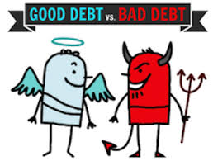
Not All Borrowing Is Bad!
Two good reasons to borrow:
  During a temporary crisis
    Recession
    War
    Pandemic
  Productive public investment
    Infrastructure
    Education
These deficits do not permanently increase relative debt.
  Great Depression, WWII
  Public investment expands GDP and tax revenue

Slide 44
So, Why Worry About it?
If debt becomes too high:
  Investors might start questioning the creditworthiness of the US government.
    Problem: Nobody knows how much debt is too much debt.
  It becomes more difficult to borrow in times of crisis.
    War, severe recession, pandemic
    “Fiscal space”
      Impossible to measure how much we have.
      Clearly, we have less now than in 2007.
  Could start to crowd out investment by consumers and businesses.
    Not currently a problem. No idea if/when it might become one.
  Could be inflationary.

Slide 45
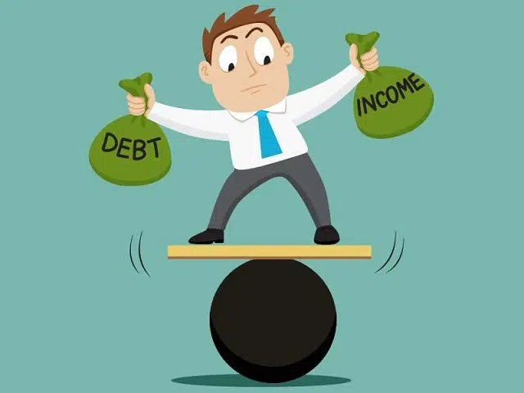
So, Why Worry About It?
If debt continues to grow:
  Interest payments will grow with it.
    8% of spending in 2018.
    22% of spending in 2048.
    Less room for using the budget for policy priorities.
    40% of payments go to other countries.
  The longer we wait to address it, the harder and more disruptive addressing it will be.
  Interest rates might increase.

Slide 46
Growth in Relative Debt
Can be scary to….
  International investors
  Bond markets

Slide 47
Fiscal Crisis, or a Run on the Dollar
With an exploding relative debt, what happens if foreigners lose confidence in the stability of the dollar?
CBO (Federal Debt: A Primer, March 2020):
  because the United States currently benefits from the dollar’s position as the world’s reserve currency and because the federal government borrows in dollars, a financial crisis—similar to those that befell Argentina, Greece, or Ireland—is less likely in the United States.
Although no one can predict whether or when a fiscal crisis might occur or how it would unfold, the risk is almost certainly increased by high and rising federal debt.
Crises of confidence, in addition to being unpredictable, happen very quickly.

Slide 48
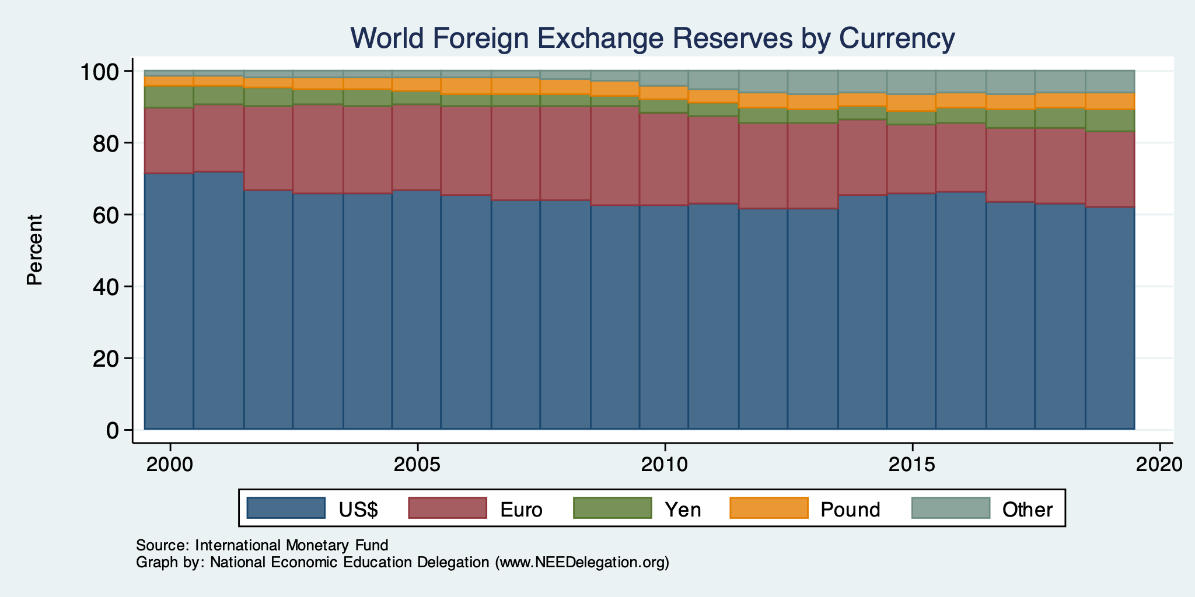
Will Our “Exorbitant Privilege” Last Forever?

Slide 49
What Is a Fiscal Crisis?
Increased perception of risk in government debt.
Potential manifestations:
  Sudden significant increase in interest rates.
  Plunging exchange rates.
Why?
  Increased expectation of default.
Potential results:
  Dramatic budget reforms may be quickly necessary to stave off actual default.
  Recession from declines in:
    investment (interest rates)
    consumption (interest rates)
    Government spending
  Higher interest bill on existing debt.

Slide 50
The Key: Stabilization of Relative Debt
Stabilization of relative debt might forestall the consequences of chronic deficits.
Problem: The US federal debt is in no way stable.
W/o stability, interest rates might rise, causing crowding out of:
  policy priorities
  domestic investment
Budget surpluses are not necessary, but budget control is.

Slide 51
But Wait!

Slide 52
Maybe Debt Isn’t a Problem After All: MMT
Stephanie Kelton provided a prominent and recent exposition of modern monetary theory in a NY Times op-ed on June 6, 2020:
  “Learn to Love Trillion-Dollar Deficits.”
Modern monetary theory
  US Treasury borrows in its own currency and therefore cannot default.
    As opposed to countries, such as Greece, which borrow in euros.
  Example: How did we ”find the money” for the recent increase in the deficit of about $1.9 trillion?
    Answer: The Fed purchased $1.7 trillion = 89% of financing
  More generally, MMT argues that we can always find the money to increase federal spending.

Slide 53
MMT’s Free Lunch
The only limit on deficit spending is when it leads to too much spending, thereby increasing current inflation.
Recognizing this fact, “could free policymakers not only to act boldly amid crises but also to invest boldly in times of more stability.”
  First part, acting boldly, is important and likely true.
  Second part, invest boldly, is suspect.
  Third part? Could encourage imprudent spending….

Slide 54
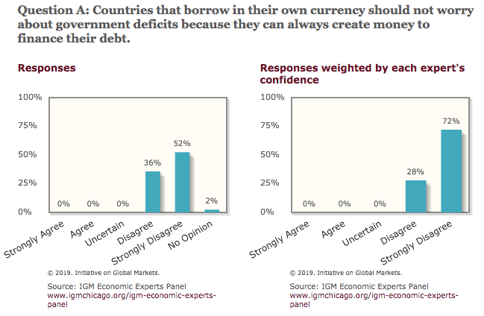
General Sense on Modern Monetary Theory

Slide 55
Shall we manufacture our own fiscal crisis?

Slide 56
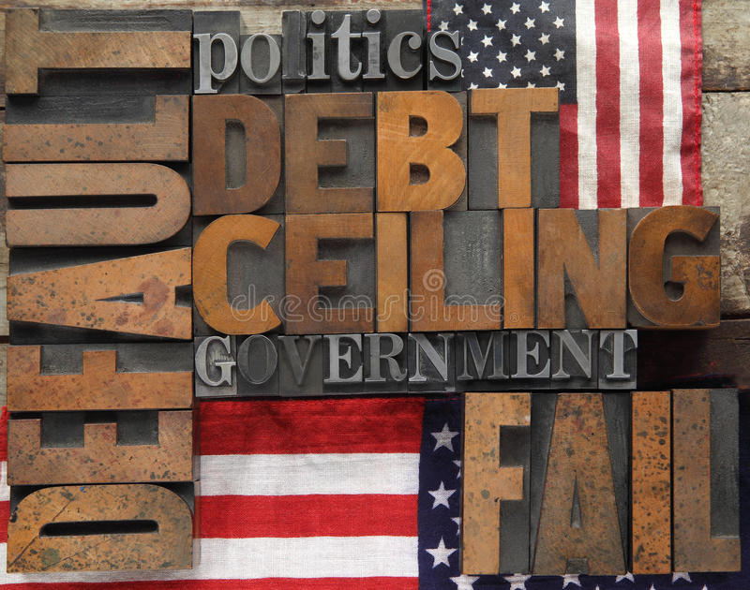
Existential Threat: Averted/Postponed!

Slide 57
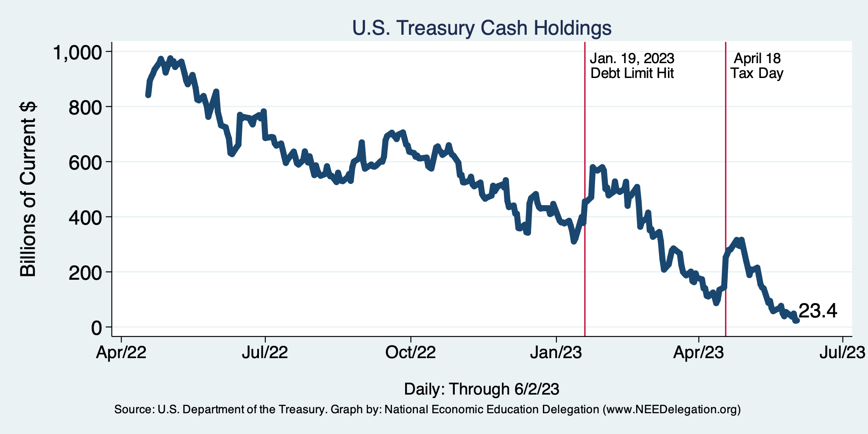

Countdown to Default – Halted!

Slide 58
5 Things to Know about the Debt Ceiling
The debt limit has been raised continually for more than a century.
Raising the debt limit is not about new spending; it is about paying for previous choices policymakers legislated.
The uselessness of a debt limit is exhibited by the fact that only one other advanced country—Denmark—has a separate debt limit rule like ours.
After the debt hit the ceiling, the Treasury Department used several accounting gimmicks to postpone the day of reckoning, but these typically last only a few months.
The economic consequences of a large-scale, intentional default are unknown, but predictions range from bad to catastrophic.
Souce: https://www.brookings.edu/2023/01/19/7-things-to-know-about-the-debt-limit/

Slide 59
Lessons from 1979 & 2011
Accidental partial default in 1979:
  Increased borrowing costs by $40 Billion.
2011 Government shutdown was very costly:
  Stock markets plunged (17%).
  Employment growth stuttered.
  Treasuries – downgraded credit ratings.
  Borrowing costs rose – perhaps by as much as $20 Billion.
There were likely costs to the recent mini-crisis.
  Economists will evaluate and get back to us.
  Also, think about what politicians, treasury employees, and journalists could have been doing with their time.

Slide 60
More Generally…

Slide 61
We Need to Worry about the Debt
Interest rates are rising.
A fiscal crisis should be avoided at all costs.
Stabilizing relative debt would substantially reduce the possibility of a crisis.
The good news is we might be able to stabilize relative debt without a primary surplus.
But we must substantially reduce primary deficits.

Slide 62
Bottom-Line Takeaways
Relative debt must be stabilized, so it is imperative to reduce primary deficits.
Given the fiscal challenges of an aging population and climate change, it is better to do this sooner rather than later.
But high debt levels should not deter:
  Productive infrastructure investment.
  Fiscal responses to crises:
    When the house is on fire, you don’t worry about being in a drought; you just put it out.
Debt ceiling – what is it good for?

Slide 63
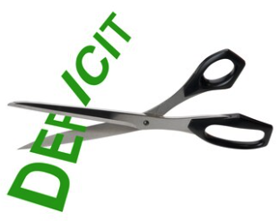
Bottom Bottom Line
Question is not WHETHER the US will have to act…
but WHEN.
Some combination of the following WILL be necessary:
  Raising taxes
  Cutting spending
  Reining in health-care costs
The longer we wait, the harder it will be!

Slide 64
Course Outline
Contemporary Economic Policy
  Week 1 (5/2): US Economic Update (Geoffrey Woglom, Amherst College)
  Week 2 (5/9): Monetary Policy (Geoffrey Woglom)
  Week 3 (5/16): Healthcare Economics (Kelley Cullen, E. Washington University)
  Week 4 (5/23): Climate Change Economics (Sarah Jacobson, Williams College)
  Week 5 (5/30): The Black-White Wealth Gap (Mike Shor, Univ. of Connecticut)
  Week 6 (6/6): Federal Debt (Jon Haveman, NEED)

Slide 65
Thank you!
Any Questions?
www.NEEDEcon.org
Jon Haveman, Ph.D.
Jon@NEEDEcon.org
Contact NEED: info@NEEDEcon.org
Submit a testimonial: www.NEEDEcon.org/testimonials.php
Become a Friend of NEED: www.NEEDEcon.org/friend.php

Slide 66
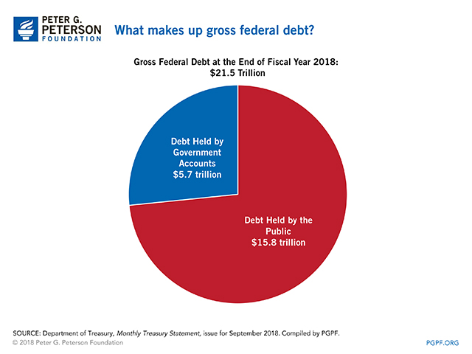

Slide 67
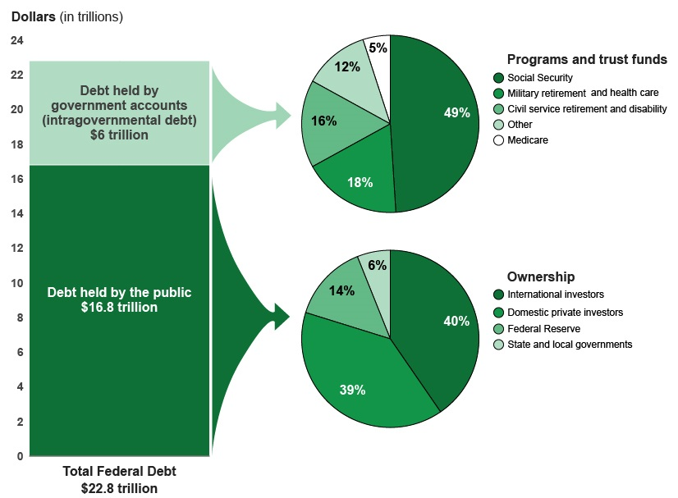
A Breakdown of Total Federal Debt
Share of US Public Debt
Foreign ownership is relatively recent – in 1990 foreign ownership was less than 20%
https://www.gao.gov/americas_fiscal_future?t=federal_debt

Slide 68
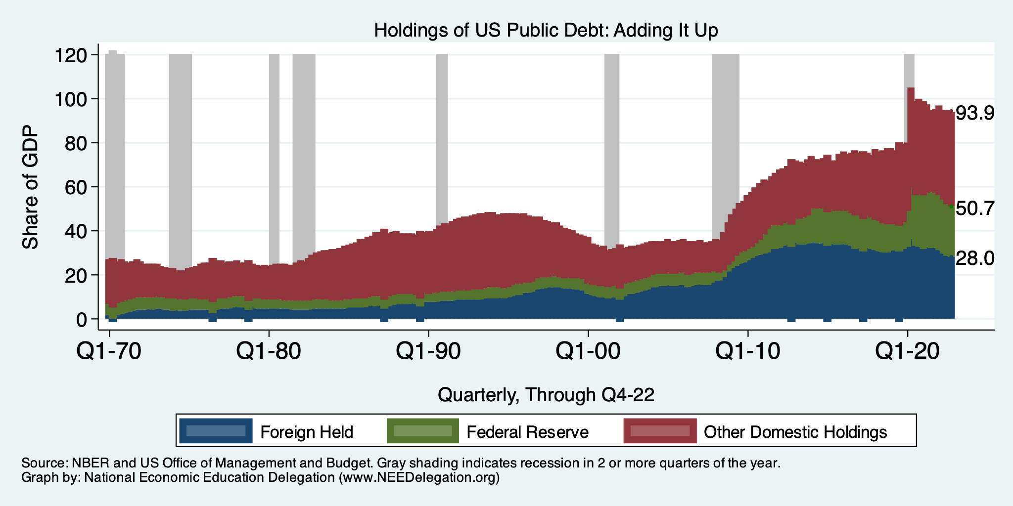
Summary: Who Holds US Public Debt?

Slide 69
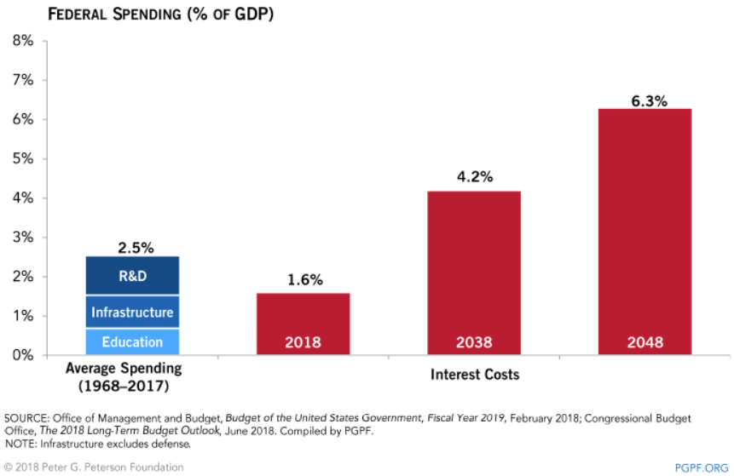
Interest Payments to Grow Significantly

