Slide 1
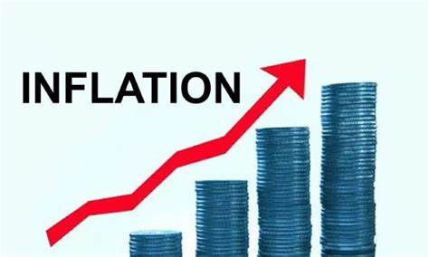
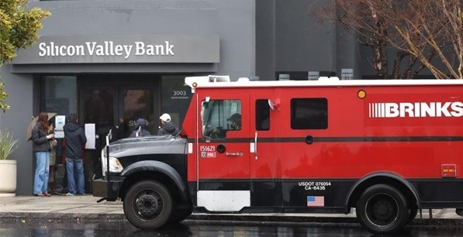
US Economic Update
Walnut Creek Rotary Club
June 20, 2023
Jon Haveman, Ph.D.
NEED

Slide 2
National Economic Education Delegation
Vision
One day, the public discussion of policy issues will be grounded in an accurate perception of the underlying economic principles and data.
Mission
NEED unites the skills and knowledge of a vast network of professional economists to promote understanding of the economics of policy issues in the United States.
NEED Presentations
Are nonpartisan and intended to reflect the consensus of the economics profession.

Slide 3
Who Are We?
Honorary Board: 54 members
2 Fed Chairs: Janet Yellen, Ben Bernanke
6 Chairs Council of Economic Advisers
Furman (D), Rosen (R), Bernanke (R), Yellen (D), Tyson (D), Goolsbee (D)
3 Nobel Prize Winners
Akerlof, Smith, Maskin
Delegates: 652+ members
At all levels of academia and some in government service
All have a Ph.D. in economics
Crowdsource slide decks
Give presentations
Global Partners: 48 Ph.D. Economists
Aid in slide deck development

Slide 4
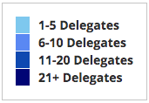
Where Are We?

Slide 5
Available NEED Topics Include:
US Economy
Healthcare Economics
Climate Change
Economic Inequality
Economic Mobility
Trade and Globalization
Minimum Wages
Immigration Economics
Housing Policy
Federal Budgets
Federal Debt
Black-White Wealth Gap
Autonomous Vehicles
Healthcare Economics

Slide 6
Credits and Disclaimer
This slide deck was authored by:
Jon D. Haveman, NEED
Scott Baier, Clemson University
Geoffrey Woglom, Amherst College (Emeritus)
Brian Dombeck, Lewis & Clark College
Doris Geide-Stevenson, Weber State
Disclaimer
NEED presentations are designed to be nonpartisan.
It is, however, inevitable that the presenter will be asked for and will provide their own views.
Such views are those of the presenter and not necessarily those of the National Economic Education Delegation (NEED).

Slide 7
Outline
Economic Indicators
Inflation/Federal Reserve
Federal Debt

Slide 8
Economic Indicators

Slide 9
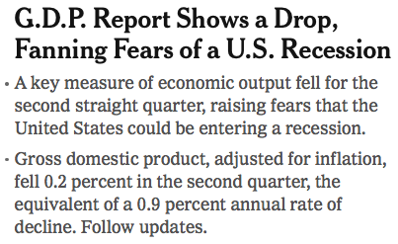
Headline: July 28, 2022
Old news….

Slide 10
GDP: Quarterly Growth
Q3-2022: 3.2%
Q4-2022: 2.6%
Q1-2023: 1.3%
Notes:
Graph: gdp_pot_grow.png
The Point: From 1990 – 2007, average annual US GDP growth pre-crisis is 2.94%. However, post-crisis US GDP growth is 2.19% (0.75 percentage points lower). Why is has the recovery been sluggish?
Note: At the recession’s height, the gap between quarterly GDP growth and potential growth was 2.5 percentage points.

Slide 11
GDP Trajectory: Pandemic Plunge!
GDP is:
$0.4 Trillion below 2019 forecast.
$1.2 Trillion ABOVE 2019-Q4 level.

Slide 12
Retail Sales Remain Elevated!

Slide 13
Contributions to GDP: Government
Notes:
Since 2010, average government spending growth is shrinking, resulting in a negative average contribution to GDP growth post-recession of -0.8 percentage points
Note that average quarterly government spending growth is 0.42% from 1990-2007 and -0.17% in 2010+ (annualized, 1990-2007 = 1.68%; 2010+ = -0.70%).

Slide 14
Employment

Slide 15
Monthly Changes in Nonfarm Employment
March: 217,000
April: 294,000
May: 339,000
NYT Recession Q
Notes:
PAYEMS.png

Slide 16
Employment Gap
3.7 Million ABOVE February, 2020.
4.9 Million BELOW where we should be.
Notes:
payroll_recent.png

Slide 17
Where Have All the Workers Gone?
2.8 million below where we should be

Slide 18
How Are Things Where You Are?

Slide 19
More slides like this:
www.NEEDEcon.org/LocalGraphs

Slide 20
Inflation

Slide 21
Inflation: Latest Figures – 4%
Source: NYTimes.com, Bureau of Labor Statistics

Slide 22
Inflation in the Last 6 Months – Close to 3%!

Slide 23
Inflation is Not just a U.S. Problem

Slide 24
Supply Chains

Slide 25
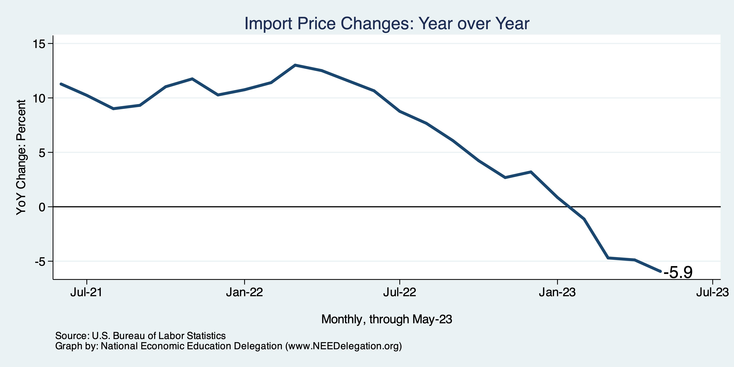
Import Price Inflation WAS High
Inflation – Imported Products: 9-10%

Slide 26
Corporations Have Pricing Power!
Corporate Profits

Slide 27
My Thoughts on the Sources of Inflation
Supply Chain issues were significant – less so now.
Import price inflation was high – negative now.
Composition of spending changed significantly.
Is now bouncing back, as are prices.
Corporations have used the cover of inflation to raise prices more.
But there was too much total spending.
Fiscal stimulus led households to increase saving over 2021 by more than $2 trillion. Strong retail sales numbers suggest they are prepared to spend it.
Whose to Blame: ARP possibly too big, but the Fed could have acted sooner.
Bottom line: Recovery from a dramatic economic disruption is seldom painless.

Slide 28
What’s the Fed Doing About It?

Slide 29
Federal Funds Rate – Recent Activity
Expect a Pause in Rate Increases

Slide 30
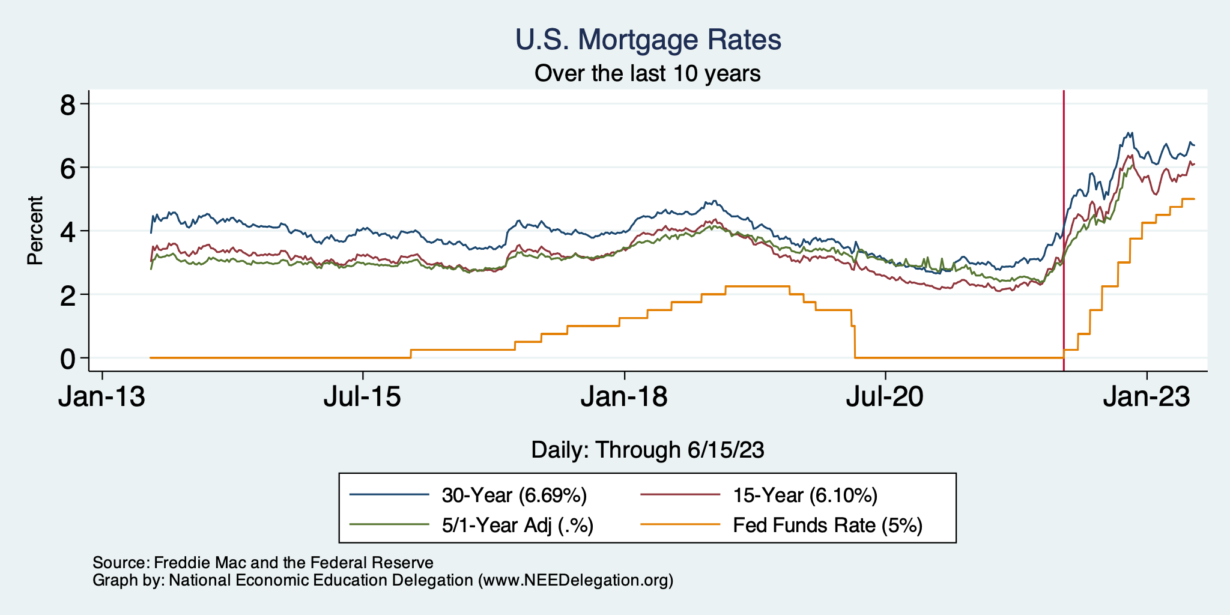
Mortgage Rates

Slide 31
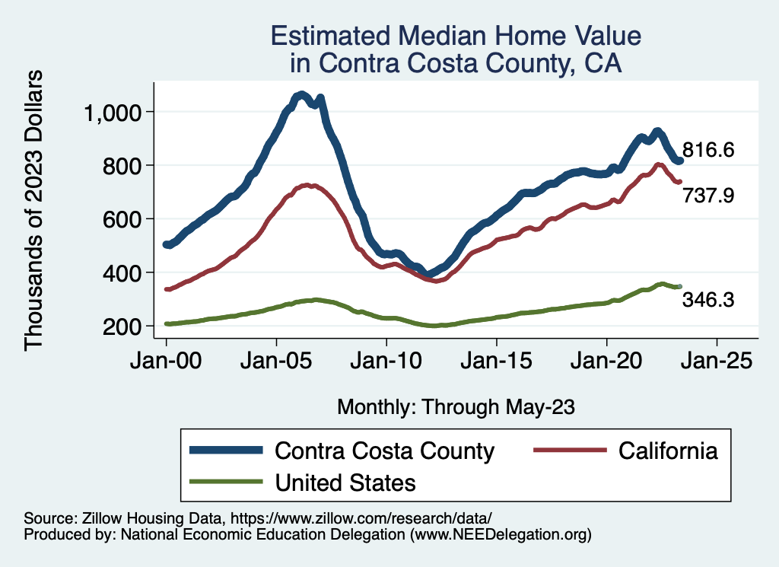
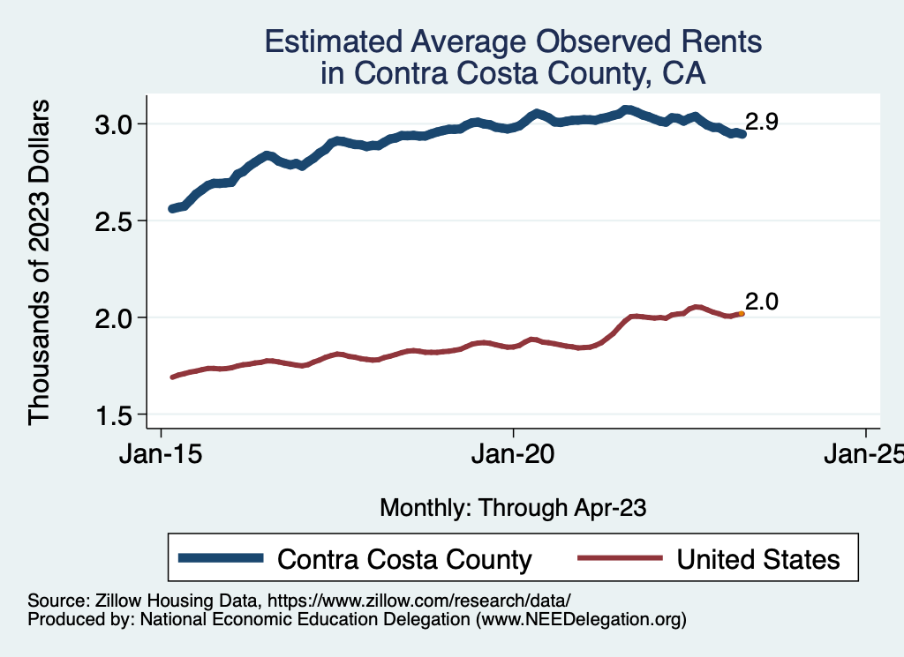
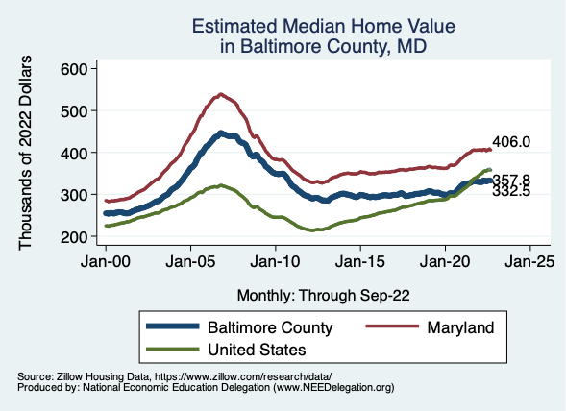
Home Prices … Depends on Where You Are
Notes:
Charts:
homeprices_recession.png
housing.png

Slide 32
What About the Debt?

Slide 33
Aftermath of Debt Conflict

Slide 34
The Federal Debt is Becoming A Problem

Slide 35
Takeaways
Is a recession on the horizon?
Perhaps, but shallow?
Many indicators are still in the black.
2021-Q1 GDP growth was ok!
Employment growth is solid.
Threats to continued growth:
If inflation starts to rise again, which seems unlikely.
Layoff contagion.
Bullets dodged:
Debt negotiations.
Banking crisis.
Inflation (shhh….)

Slide 36
Thank you!
Any Questions?
www.NEEDEcon.org
Jon Haveman, Ph.D.
Jon@NEEDEcon.org
Contact NEED: info@NEEDEcon.org
Submit a testimonial: www.NEEDEcon.org/testimonials.php
Become a Friend of NEED: www.NEEDEcon.org/friend.php

