Slide 1
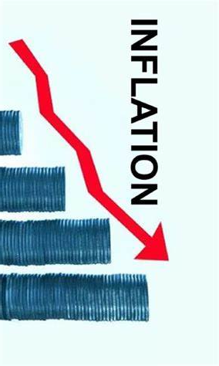
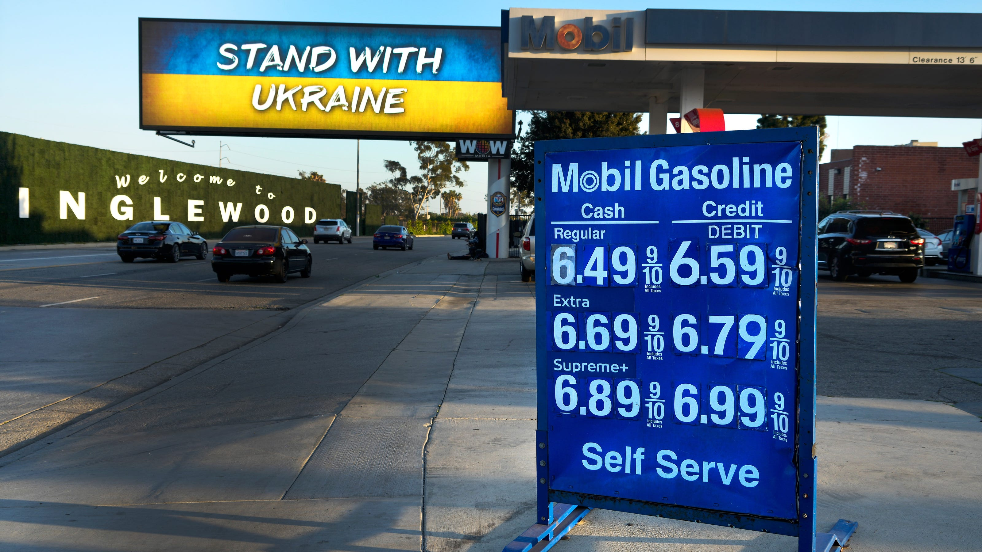
U.S. Economic Update
Provisors – SF1
April 10, 2024
Jon Haveman, Ph.D.
Executive Director, NEED

Slide 2
Outline
Economic Indicators
Inflation
Federal Reserve

Slide 3
Economic Indicators

Slide 4
GDP Trajectory: Pandemic Recovery Complete!
GDP is:
< $0.1 Trillion below 2019 forecast.
$1.8 Trillion ABOVE 2019-Q4 level.

Slide 5
GDP: Quarterly Growth
Notes:
Graph: gdp_pot_grow.png
The Point: From 1990 – 2007, average annual US GDP growth pre-crisis is 2.94%. However, post-crisis US GDP growth is 2.19% (0.75 percentage points lower). Why is has the recovery been sluggish?
Note: At the recession’s height, the gap between quarterly GDP growth and potential growth was 2.5 percentage points.

Slide 6
Contributions to GDP: Government
Notes:
Since 2010, average government spending growth is shrinking, resulting in a negative average contribution to GDP growth post-recession of -0.8 percentage points
Note that average quarterly government spending growth is 0.42% from 1990-2007 and -0.17% in 2010+ (annualized, 1990-2007 = 1.68%; 2010+ = -0.70%).

Slide 7
Contributions to GDP: Consumption
Notes:
Since 2010, average government spending growth is shrinking, resulting in a negative average contribution to GDP growth post-recession of -0.8 percentage points
Note that average quarterly government spending growth is 0.42% from 1990-2007 and -0.17% in 2010+ (annualized, 1990-2007 = 1.68%; 2010+ = -0.70%).

Slide 8
Monthly Changes in Nonfarm Employment
January: 256,000
February: 270,000
March: 303,000
Notes:
PAYEMS.png

Slide 9
Employment Gap
5.8 Million ABOVE February, 2020.
5.0 Million BELOW where we should be.
Notes:
payroll_recent.png

Slide 10
Where Have All the Workers Gone?
3.0 million below where we should be

Slide 11
Is Immigration Saving the Day?
Source: https://www.axios.com/2024/03/13/immigration-economy-jobs-growth-good#

Slide 12
Household Debt: Change During the Pandemic

Slide 13
Inflation

Slide 14
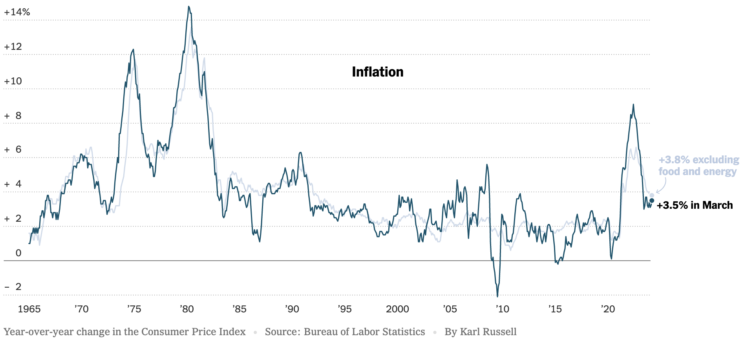
Inflation: Latest Figures
Source: NYTimes.com

Slide 15
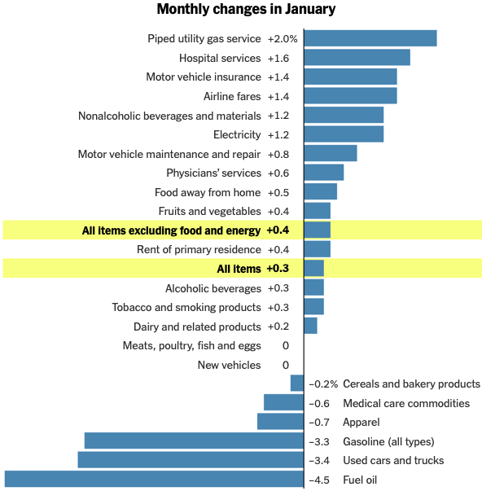
Which Prices?

Slide 16
Housing is the Primary Problem

Slide 17
Oil Prices Are Also Contributing

Slide 18
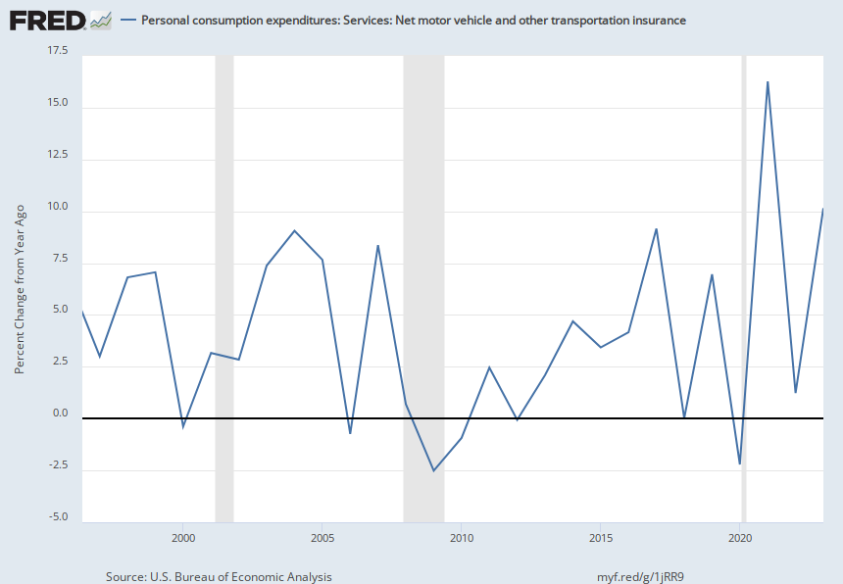
Automobile Insurance
Year over Year Change
10%

Slide 19
Food…Is Not

Slide 20
Wage Growth – Exceeds Inflation
Notes:
Is this necessary given the previous slide?

Slide 21
Fed’s Preferred Measure: PCE

Slide 22
My Thoughts on the Future of Inflation
Last couple of months have been counterproductive.
Market expectations are starting to waver.
Return to 2% might take a little longer.
Federal Funds rate may stay high for some time.

Slide 23
The Fed: Conservative

Slide 24
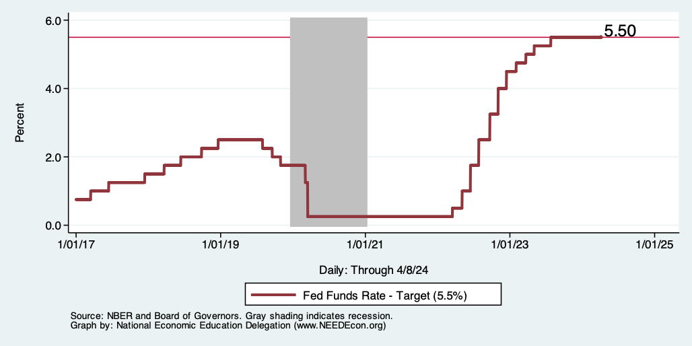
Federal Funds Rate
Notes:
The fed funds rate is the interest rate on overnight loans between banks. Think of it as the baseline interest rate on which banks base all other interest rates (e.g. mortgage rates)
FOMC lowers the fed funds rate during recessions and raises the fed funds rate during expansions
Fed funds rate peaked in the 1980s as then Chairman Paul Volcker sought to reign in “run away” inflation of the 1970s; doing so resulted in a recession in the early 1980s.
Since the 2008-09 recession, the fed funds rate has been kept near zero.
During the 2008-09 recession, Federal Reserve turned to unconventional tools to influence longer term interest rates to further stimulate the economy - QE
FedFunds.png

Slide 25
Fed: Reducing its Asset Holdings
Quantitative Tightening

Slide 26
Takeaways
Is a recession on the horizon?
No.
Many indicators are in the black.
2023 2nd half GDP growth was pretty good
Threats to continued growth:
If inflation continues to reverses course.
Global conflict (double-edged sword).
Can consumers keep it up?
Inflation
Certainly trending in the wrong direction.
Not worried about it.
Fed policy will continue to push against it.
Likely to recover 2%ish by middle of next year.

Slide 27
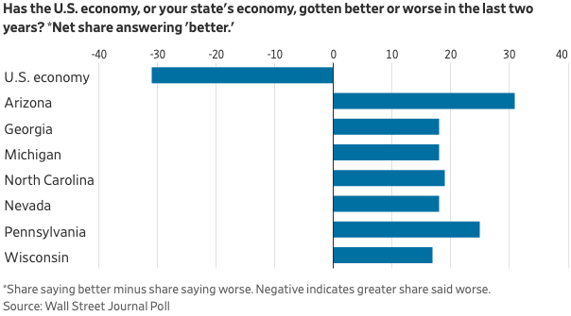
Mismatch: Feelings About the Economy
Source: What’s Wrong With the Economy? It’s You, Not the Data

Slide 28
Thank you!
Any Questions?
www.NEEDEcon.org
Jon D. Haveman
Jon@NEEDEcon.org
Contact NEED: info@NEEDEcon.org
Submit a testimonial: www.NEEDEcon.org/testimonials.php
Become a Friend of NEED: www.NEEDEcon.org/friend.php

Slide 29
GDP Growth is Historically Low

Slide 30
A Little Provocative: How do we drive growth?
Allow more immigration.
Develop a pro-growth immigration policy.
Invest:
In people – education and safety net.
In infrastructure.
In knowledge – basic R&D.
In a clean economy
Fix health care.

