Slide 1
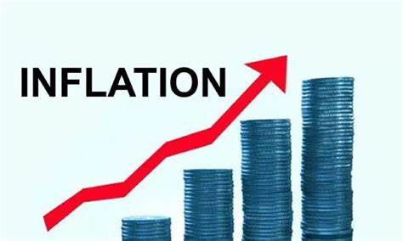
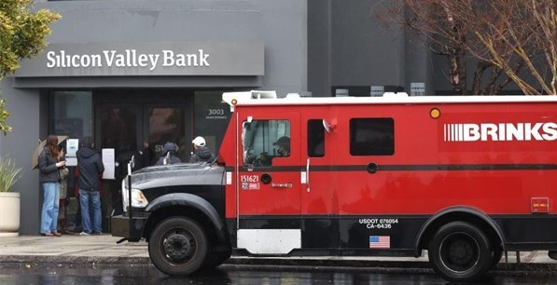
US Economic Update
Provisors – SF1
May 10, 2023
Jon Haveman, Ph.D.
Executive Director, NEED

Slide 2
Outline
The U.S. Economy
Inflation/The Fed/Banks
The Debt Ceiling
The Budget

Slide 3
The U.S. Economy

Slide 4
GDP: Quarterly Growth
Q3-2022: 3.2%
Q4-2022: 2.6%
Q1-2023: 1.1%
Notes:
Graph: gdp_pot_grow.png
The Point: From 1990 – 2007, average annual US GDP growth pre-crisis is 2.94%. However, post-crisis US GDP growth is 2.19% (0.75 percentage points lower). Why is has the recovery been sluggish?
Note: At the recession’s height, the gap between quarterly GDP growth and potential growth was 2.5 percentage points.

Slide 5
GDP Trajectory: Pandemic Plunge!
GDP is:
$0.4 Trillion below 2019 forecast.
$0.6 Trillion ABOVE 2019-Q4 level.

Slide 6
Monthly Changes in Nonfarm Employment
February: 248,000
March: 165,000
April: 253,000
Notes:
PAYEMS.png

Slide 7
Inflation

Slide 8
Inflation: Latest Figures
Source: NYTimes.com, Bureau of Labor Statistics

Slide 9
Inflation in the Last 6 Months – Close to 3%!

Slide 10
Inflation is Not just a U.S. Problem

Slide 11
What’s the Fed Doing About It?

Slide 12
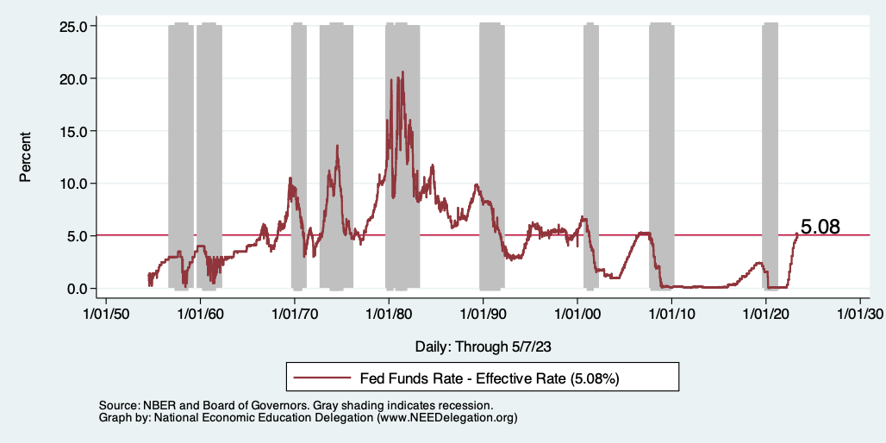
Raising the Federal Funds Rate
Notes:
The fed funds rate is the interest rate on overnight loans between banks. Think of it as the baseline interest rate on which banks base all other interest rates (e.g. mortgage rates)
FOMC lowers the fed funds rate during recessions and raises the fed funds rate during expansions
Fed funds rate peaked in the 1980s as then Chairman Paul Volcker sought to reign in “run away” inflation of the 1970s; doing so resulted in a recession in the early 1980s.
Since the 2008-09 recession, the fed funds rate has been kept near zero.
During the 2008-09 recession, Federal Reserve turned to unconventional tools to influence longer term interest rates to further stimulate the economy - QE
FedFunds.png

Slide 13
Banks…
Silicon Valley Bank
Signature Bank
First Republic Bank
Rising interest rates are like the tide going out….
They expose who is swimming with no clothes on.
The tide isn’t completely out.
Bank balance sheets seem ok, it’s stocks that are not.

Slide 14
Existential Threat: Coming This June!

Slide 15
What is the Debt Ceiling?
An amount of debt that the federal government can not exceed without congressional approval.
From the Constitution: only Congress can authorize the borrowing of money on credit of the United States (Article I, Section 8).
During WWI, requests came so fast and furiously, that Congress put in place the Debt Ceiling.
Approvals then occurred only periodically.
And it continues today.

Slide 16
5 Things to Know about the Debt Ceiling
The debt limit has been raised continually for more than a century.
Raising the debt limit is not about new spending; it is about paying for previous choices policymakers legislated.
Only one other advanced country—Denmark—has a separate debt limit rule like ours (but theirs isn’t binding).
Now that the debt hit the ceiling, the Treasury Department is using several extraordinary measures to postpone the day of reckoning.
The economic consequences of a large-scale, intentional default are unknown, but predictions range from bad to catastrophic.
Souce: https://www.brookings.edu/2023/01/19/7-things-to-know-about-the-debt-limit/

Slide 17
How Bad Could It Be?

Slide 18
Lessons from 1979 & 2011
Accidental partial default in 1979:
Increased borrowing costs by $40 Billion!
Government shutdown was very costly:
Stock markets plunged (17%).
Employment growth stuttered.
Treasuries – downgraded credit ratings.
Borrowing costs rose.

Slide 19
An Estimate of the Potential Damage:
Moody’s Analytics
A prolonged breach could lead to
Could cost up to 7 million jobs,
Drive unemployment up to 8%, and,
Wipe out $10 trillion in household wealth.

Slide 20
Countdown to Default

Slide 21
Takeaways
Is a recession on the horizon?
Perhaps, but shallow?
Many indicators are still in the black.
2022-Q4 GDP growth was pretty good!
Threats to continued growth:
If inflation starts to rise again, which seems unlikely.
Layoff contagion.
Broader banking crisis.
Borrowing and lending seem to be low and shrinking.
Debt ceiling negotiations
Significant cuts to government budgets may well result.
Everything changes with a default on the U.S. debt.

Slide 22
Thank you!
Any Questions?
www.NEEDEcon.org
Jon D. Haveman
Jon@NEEDelegation.org
Contact NEED: info@NEEDelegation.org
Submit a testimonial: www.NEEDEcon.org/testimonials.php
Become a Friend of NEED: www.NEEDEcon.org/friend.php

