Slide 1
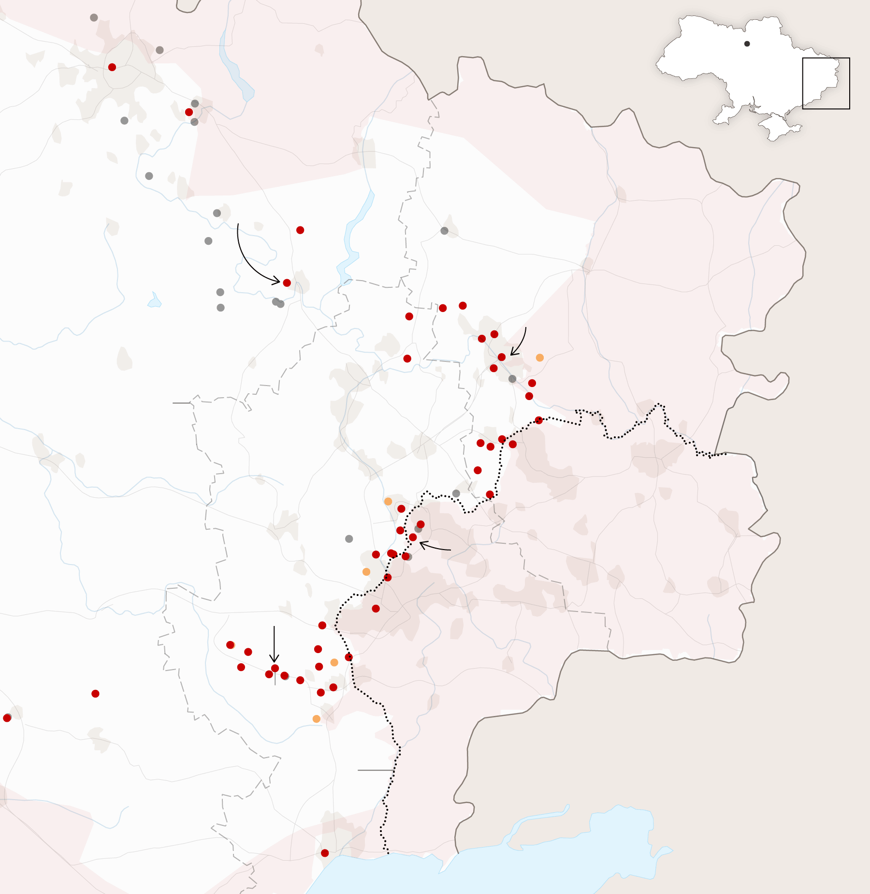
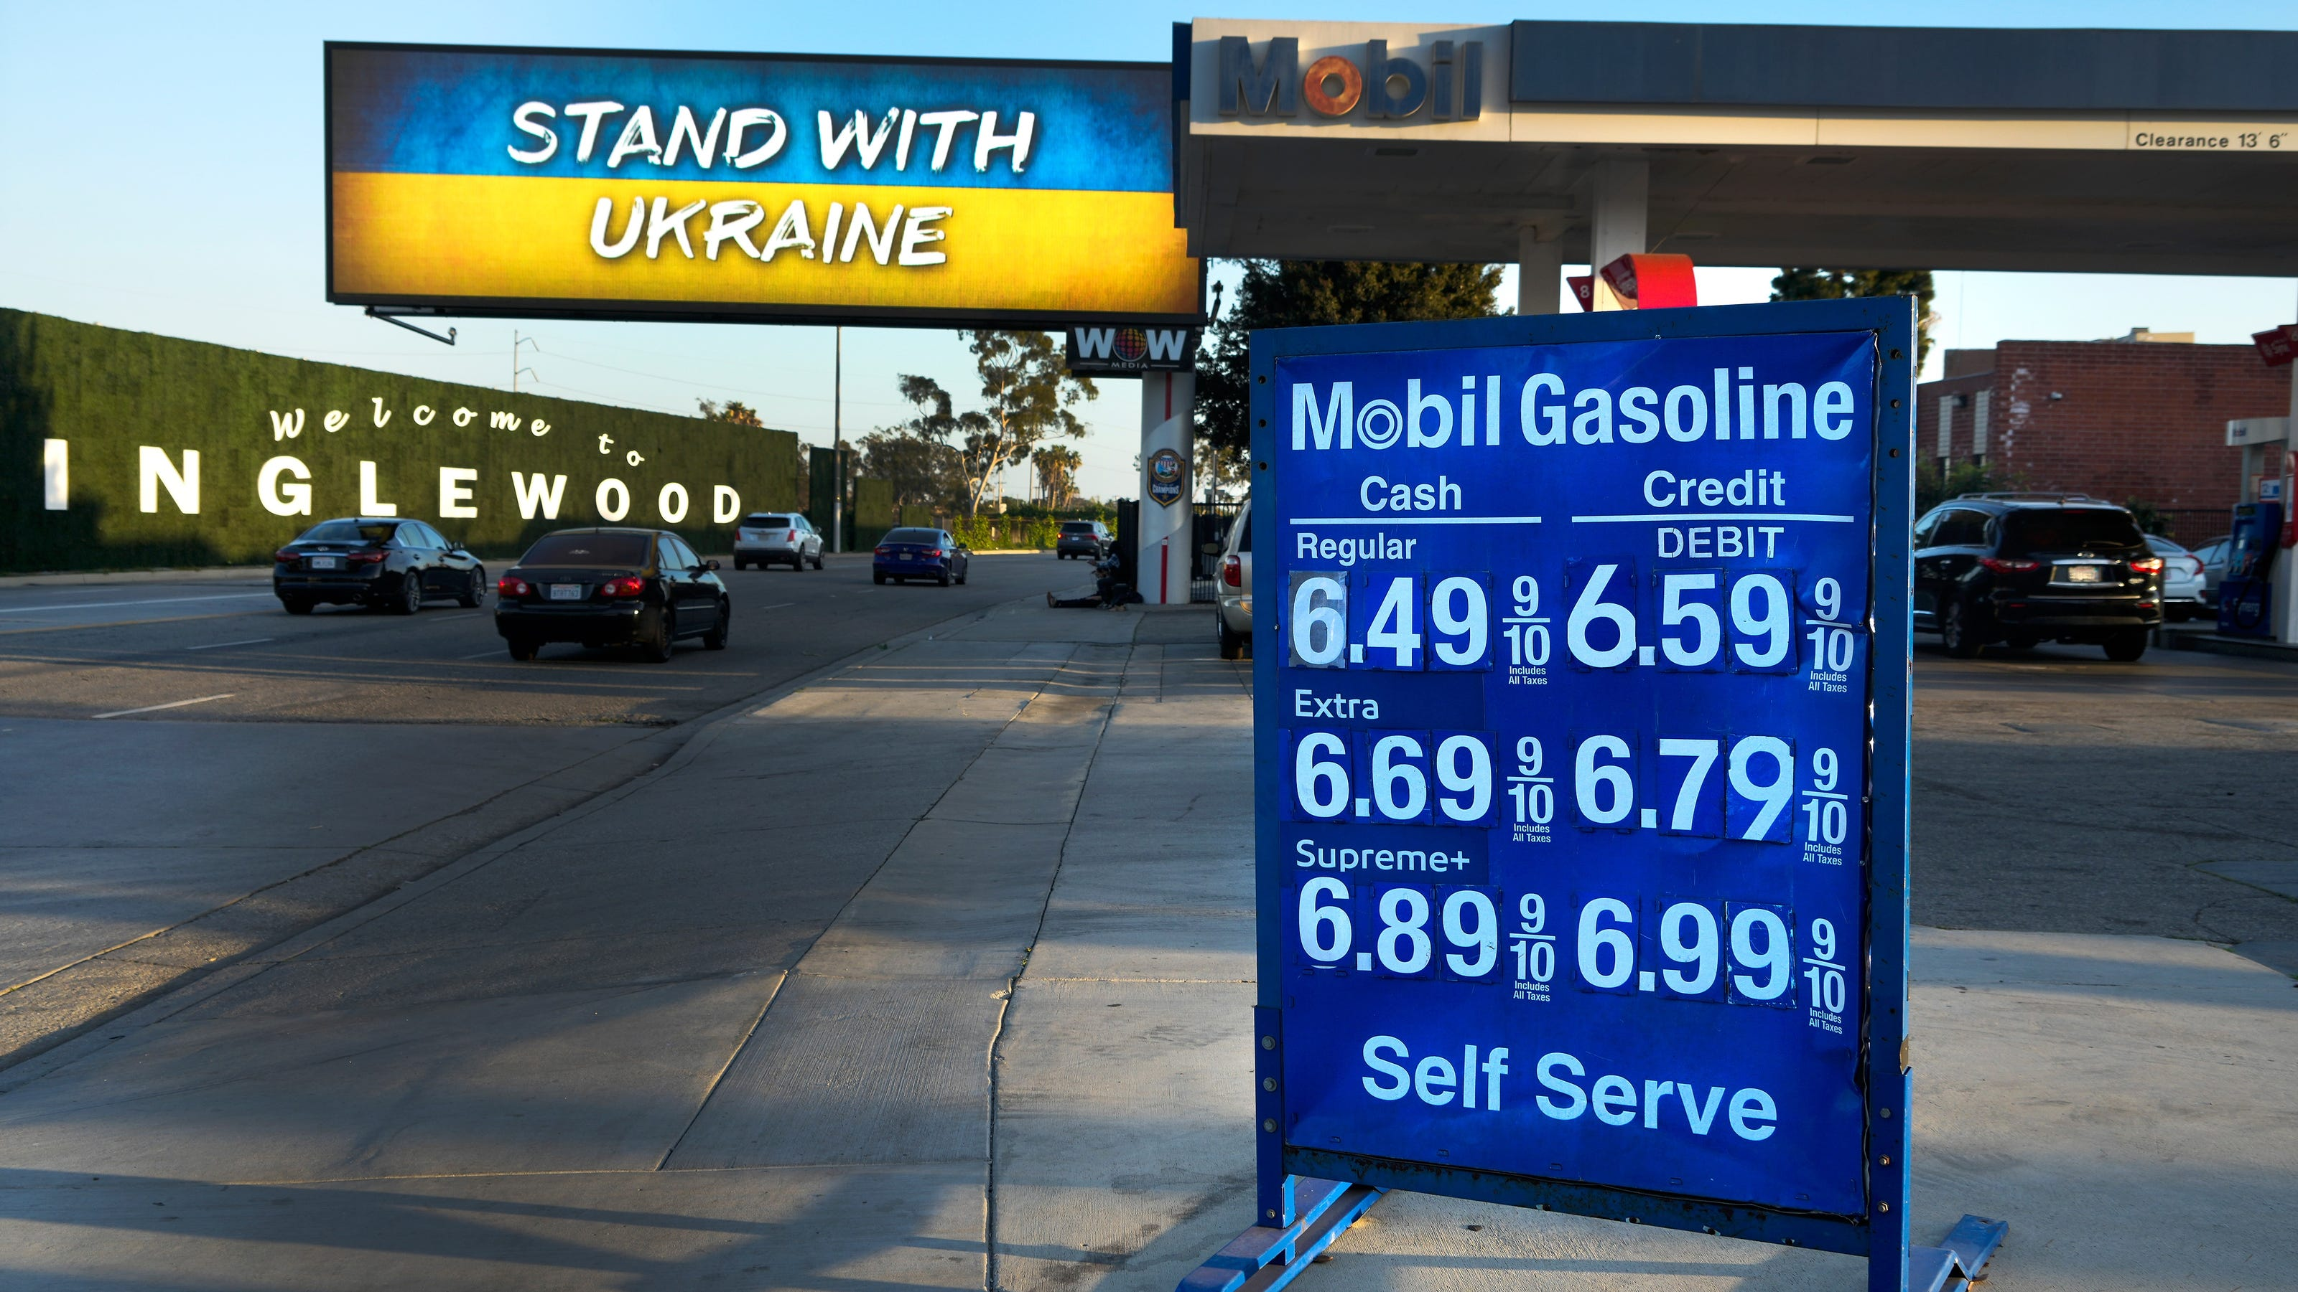
Economic Update
US & Santa Cruz County
Economic Forum
Santa Cruz Chamber of Commerce
& UC Santa Cruz
Jon Haveman, Ph.D.
NEED
February 15, 2023

Slide 2
Outline
Economic Indicators
Inflation/Federal Reserve
The Local Economy

Slide 3
Economic Indicators

Slide 4
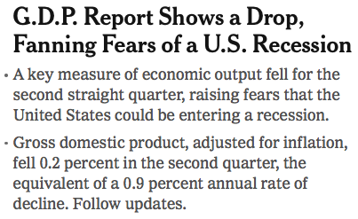
Headline:

Slide 5
GDP: Quarterly Growth
Notes:
Graph: gdp_pot_grow.png
The Point: From 1990 – 2007, average annual US GDP growth pre-crisis is 2.94%. However, post-crisis US GDP growth is 2.19% (0.75 percentage points lower). Why is has the recovery been sluggish?
Note: At the recession’s height, the gap between quarterly GDP growth and potential growth was 2.5 percentage points.

Slide 6
Personal Consumption Expenditures
Trouble?
Notes:
Chart: ../Charts/personalconsumption_recession.png
Real consumption remains significantly lower than trend consumption since 2008 (actual is 89% of trend).
Since the recession, consumption growth has fallen. From 1990-2007, average annual consumption growth is 3.34%; Post-recession average annual consumption growth is 2.38%.

Slide 7
Retail Sales Rose 3% in January

Slide 8
Contributions to GDP: Government
Notes:
Since 2010, average government spending growth is shrinking, resulting in a negative average contribution to GDP growth post-recession of -0.8 percentage points
Note that average quarterly government spending growth is 0.42% from 1990-2007 and -0.17% in 2010+ (annualized, 1990-2007 = 1.68%; 2010+ = -0.70%).

Slide 9
Monthly Changes in Nonfarm Employment
December: 260,000
January: 517,000
Notes:
PAYEMS.png

Slide 10
Employment Gap
2.6 Million ABOVE February, 2020.
5.1 Million BELOW where we should be.
Notes:
payroll_recent.png

Slide 11
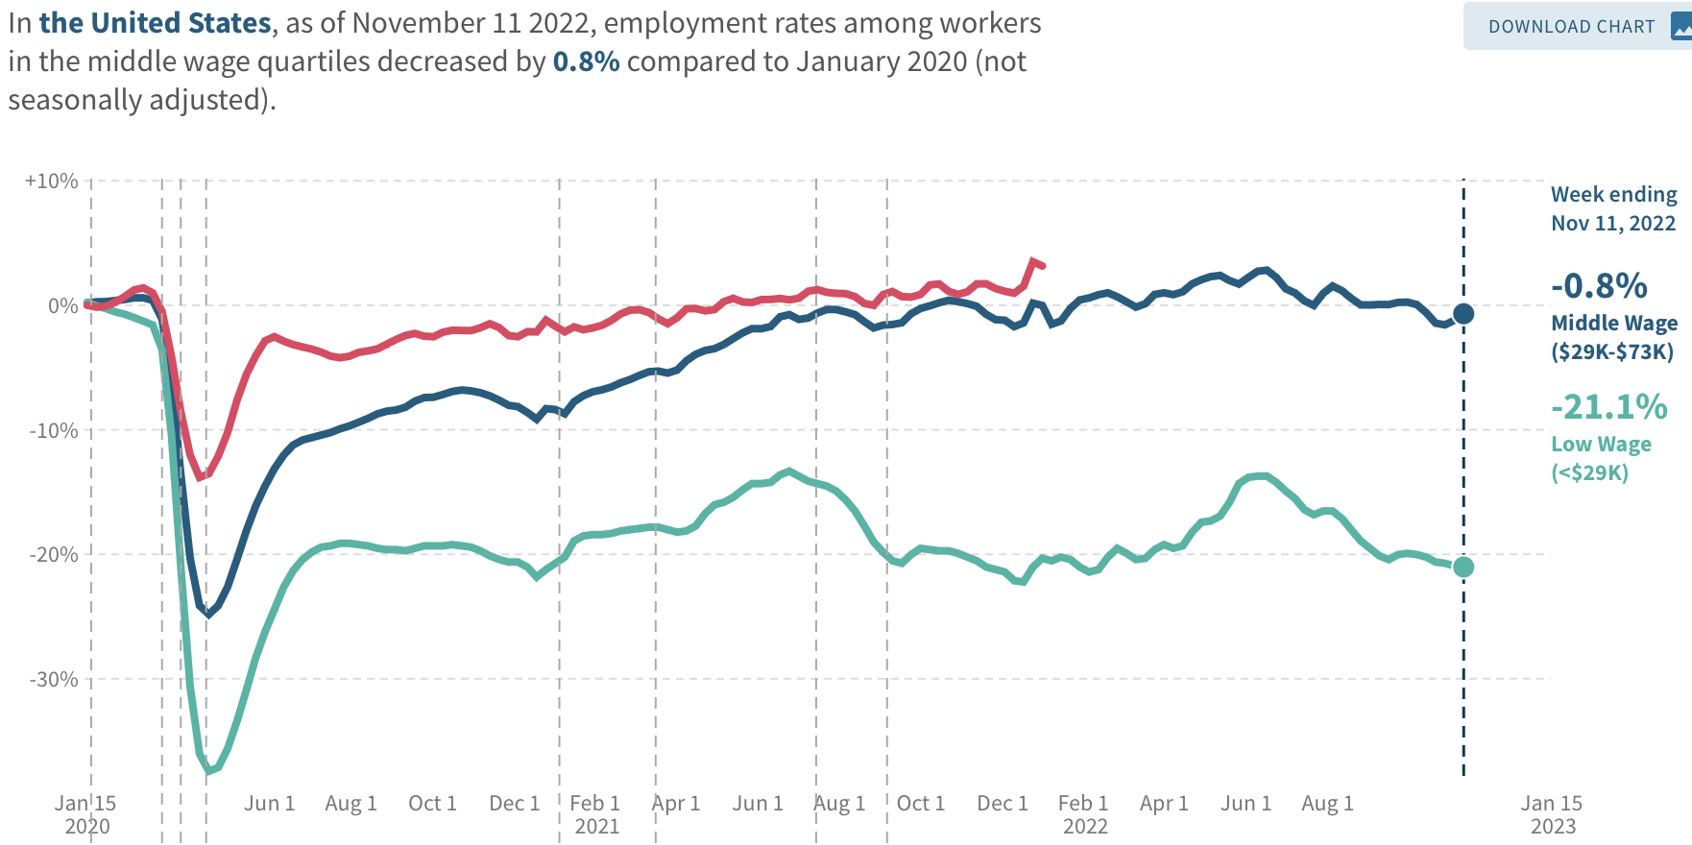
Low Wage Employment is Lagging
Source: https://tracktherecovery.org

Slide 12
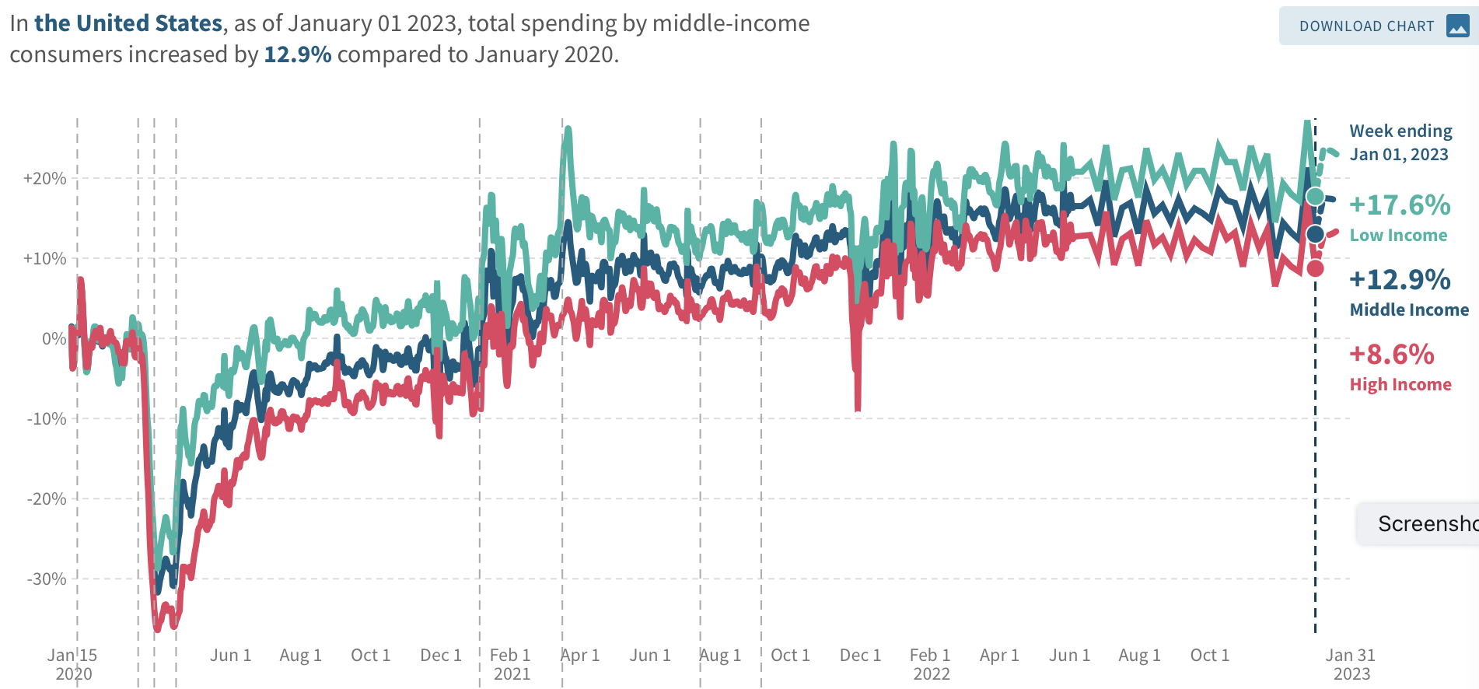
Low Wage Spending is NOT!
Source: https://tracktherecovery.org

Slide 13
Nor is Borrowing on Credit
Notes:
Data/National/FederalReserve/Credit/Programs/rev.png

Slide 14
Where Have All the Workers Gone?
3.3 million below where we should be

Slide 15
Wage Growth
Notes:
Is this necessary given the previous slide?

Slide 16
Inflation

Slide 17
Inflation: Latest Figures

Slide 18
Inflation in the Last 6 Months – Closer to 2%!
Source: https://www.nytimes.com/2023/01/13/opinion/cpi-inflation-fed.html

Slide 19
Which Prices?
Oct-Nov: +0.10
Nov-Dec: -0.08
Dec-Jan: +0.5

Slide 20
Gas Prices: National Average at the Pump
Why rising?
Refinery outages.
No more from strategic oil reserves.

Slide 21
Inflation: Not just a US Problem
United States: 8.5
Netherlands: 12.0
Spain: 10.4
United Kingdom: 10.1
Denmark: 8.9
Sweden: 8.5
Germany: 7.9
Norway: 6.5
France: 5.8
Source: TradingEconomics.com, 9/12/22

Slide 22
Supply Chains

Slide 23
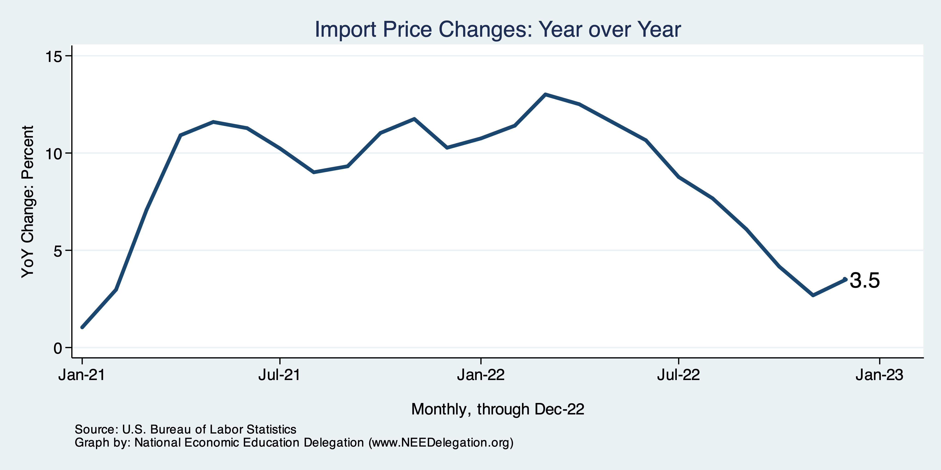
Import Price Inflation was Very High
Inflation – Imported Products: 9-10%

Slide 24
Corporations Have Pricing Power!
Corporate Profits
Up 40%

Slide 25
My Thoughts on the Sources of Inflation
Supply Chain issues were significant – less so now.
Composition of spending changed significantly.
Is now bouncing back, as are prices.
Corporations have used the cover of inflation to raise prices more.
But there was too much total spending.
Fiscal stimulus led households to increase saving over 2021 by more than $2 trillion. Strong retail sales numbers suggest they are prepared to spend it.
Whose to Blame: ARP probably too big, but the Fed could have acted sooner.
Bottom line: Recovery from a dramatic economic disruption is seldom painless.

Slide 26
What’s the Fed Doing About It?

Slide 27
Fed: Reducing its Asset Holdings
Reducing the Money Supply – A Little
Jun-Aug: $47.5 billion roll off its portfolio every 30 days
Sep: $85 billion.
Quantitative Tightening

Slide 28
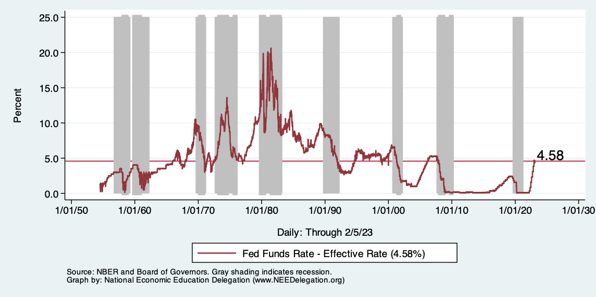
Raising the Federal Funds Rate
Notes:
The fed funds rate is the interest rate on overnight loans between banks. Think of it as the baseline interest rate on which banks base all other interest rates (e.g. mortgage rates)
FOMC lowers the fed funds rate during recessions and raises the fed funds rate during expansions
Fed funds rate peaked in the 1980s as then Chairman Paul Volcker sought to reign in “run away” inflation of the 1970s; doing so resulted in a recession in the early 1980s.
Since the 2008-09 recession, the fed funds rate has been kept near zero.
During the 2008-09 recession, Federal Reserve turned to unconventional tools to influence longer term interest rates to further stimulate the economy - QE
FedFunds.png

Slide 29
Implications for Demand
Investment borrowing
Home loans – tied to 10-year Treasury
Car loans
Credit cards
Savings accounts – positive
And more….
All of which slows the economy.

Slide 30
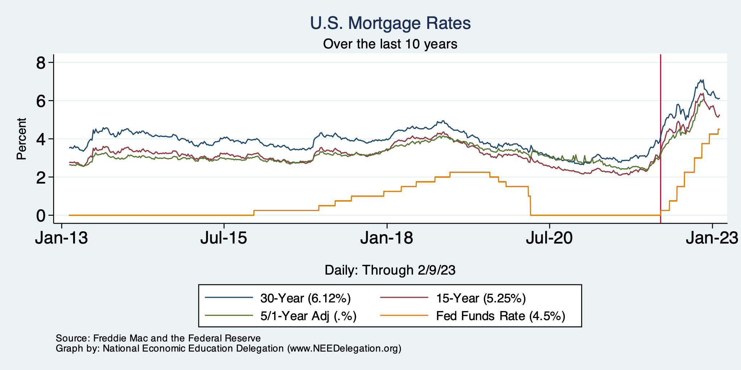
Mortgage Rates

Slide 31
Home Sales Falling

Slide 32
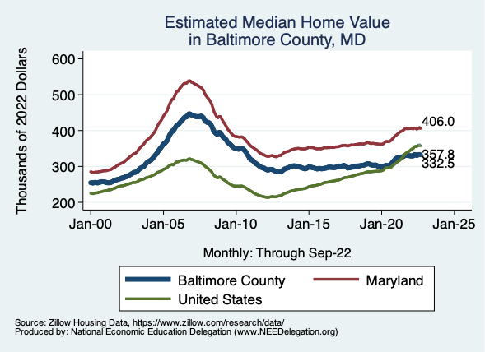
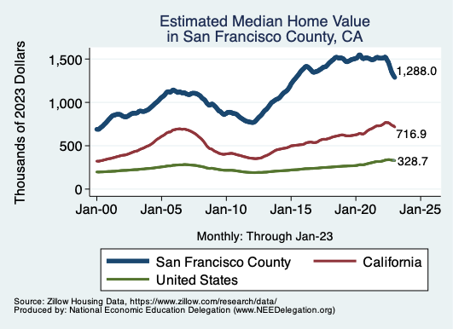
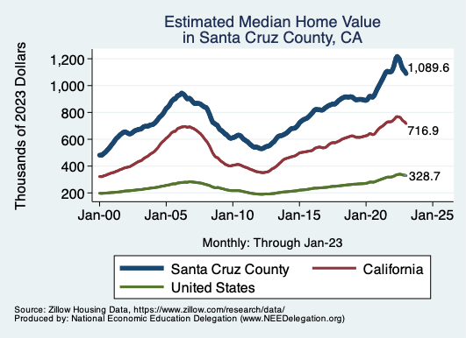
Home Prices … Falling Throughout CA
Notes:
Charts:
homeprices_recession.png
housing.png

Slide 33
Takeaways
Is a recession on the horizon?
Perhaps, but no reason to think that it will be anything more than shallow.
Many indicators are still in the black.
2022-Q4 GDP growth was pretty good!
Threats to continued growth:
If inflation stays high, which seems unlikely.
Layoff contagion.
Debt ceiling negotiations
Significant cuts to government budgets may well result.
Inflation
Is both a supply and demand side issue. Fed can only work on demand side.
But there are many supply side issues: war, weather, avian flu….
Certainly trending in the right direction.

Slide 34
Santa Cruz Economy

Slide 35
Employment in Santa Cruz County?

Slide 36
Santa Cruz Economy: GDP

Slide 37
The Pandemic Effect: GDP

Slide 38
Santa Cruz Economy: Employment

Slide 39
The Pandemic Effect: Employment

Slide 40
Local Population Change

Slide 41
Working From Home

Slide 42
Santa Cruz County: Summary
Home prices are falling as they are elsewhere in CA.
Santa Cruz County has been altered by the pandemic.
Lots of working from home.
An economy more focused on manufacturing relative to ag.
GDP has grown faster than in CA or the US.
Employment has not.
If this shift is permanent, that could be good for Santa Cruz County.
However, countywide population declines are concerning.

Slide 43
Thank you!
Any Questions?
www.NEEDelegation.org
Jon D. Haveman
Jon@NEEDelegation.org
Contact NEED: info@NEEDelegation.org
Submit a testimonial: www.NEEDelegation.org/testimonials.php
Become a Friend of NEED: www.NEEDelegation.org/friend.php

Slide 44
Existential Threat: Coming This June!

Slide 45
5 Things to Know about the Debt Ceiling
The debt limit has been raised continually for more than a century.
Raising the debt limit is not about new spending; it is about paying for previous choices policymakers legislated.
The uselessness of a debt limit is exhibited by the fact that only one other advanced country—Denmark—has a separate debt limit rule like ours.
If debt hits the ceiling, the Treasury Department uses several accounting gimmicks to postpone the day of reckoning, but these typically last only a few months.
The economic consequences of a large-scale, intentional default are unknown, but predictions range from bad to catastrophic.
Souce: https://www.brookings.edu/2023/01/19/7-things-to-know-about-the-debt-limit/

Slide 46
Lessons from 2011
Government shutdown was very costly:
Stock markets plunged (17%).
Employment growth stuttered.
Treasuries – downgraded credit ratings.
Borrowing costs rose.
The Debt Ceiling may be a very effective bargaining tool, but…
It is costly.
It is unnecessary.
Accidental partial default in 1979:
increased borrowing costs by $40 Billion!

Slide 47
www.NEEDelegation.org/LocalGraphs
For every state and county in the United States.
Detailed graphs on employment, housing, moves, and other statistics.

Slide 48
GDP Trajectory: Pandemic Plunge!
GDP is:
$0.3 Trillion below 2019 forecast.
$1.2 Trillion ABOVE 2019-Q4 level.

Slide 49
Industrial Production (Manuf, Util, Mining)

Slide 50
Monthly Changes in Nonfarm Employment
Notes:
PAYEMS.png

Slide 51
Some Explanations
500 Thousand: Long COVID Exits
1-2%: Long Social Distancing

Slide 52
But SUPER High to Begin With!

Slide 53
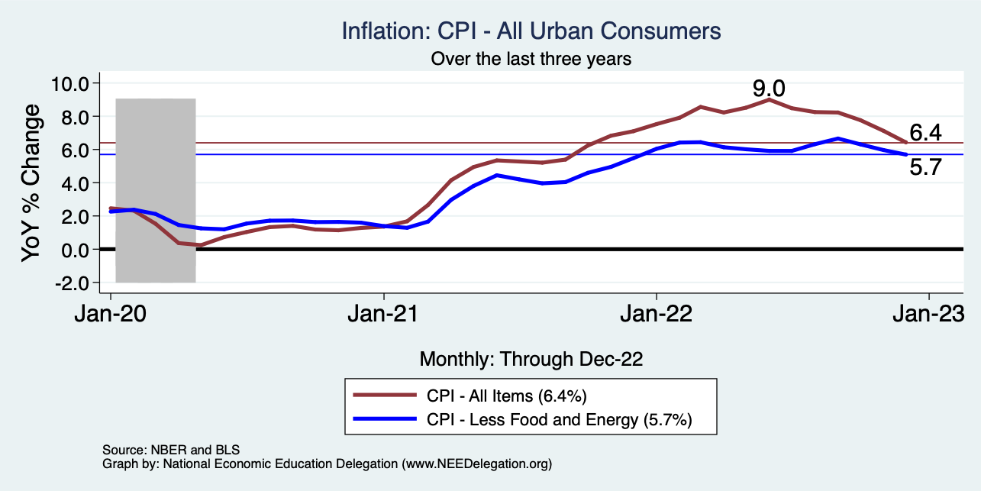
Inflation – Falling! Job is not done.
Notes:
Cpi_recent.png

Slide 54
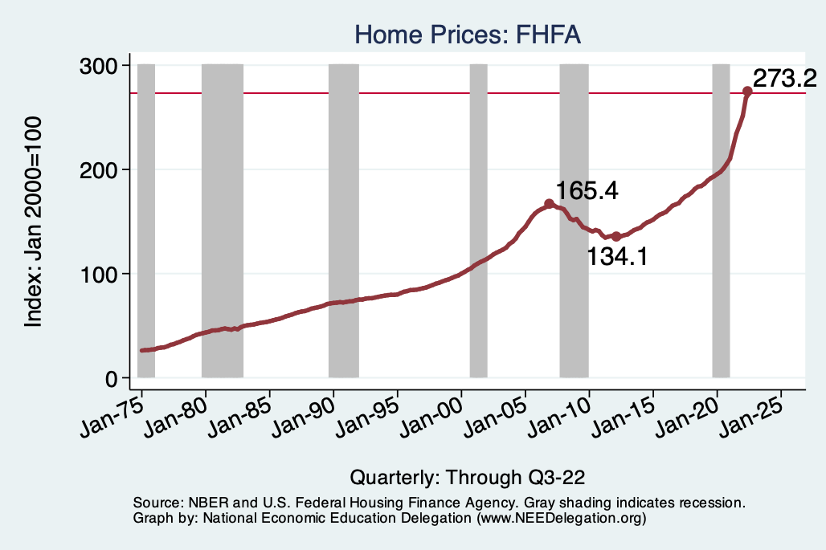
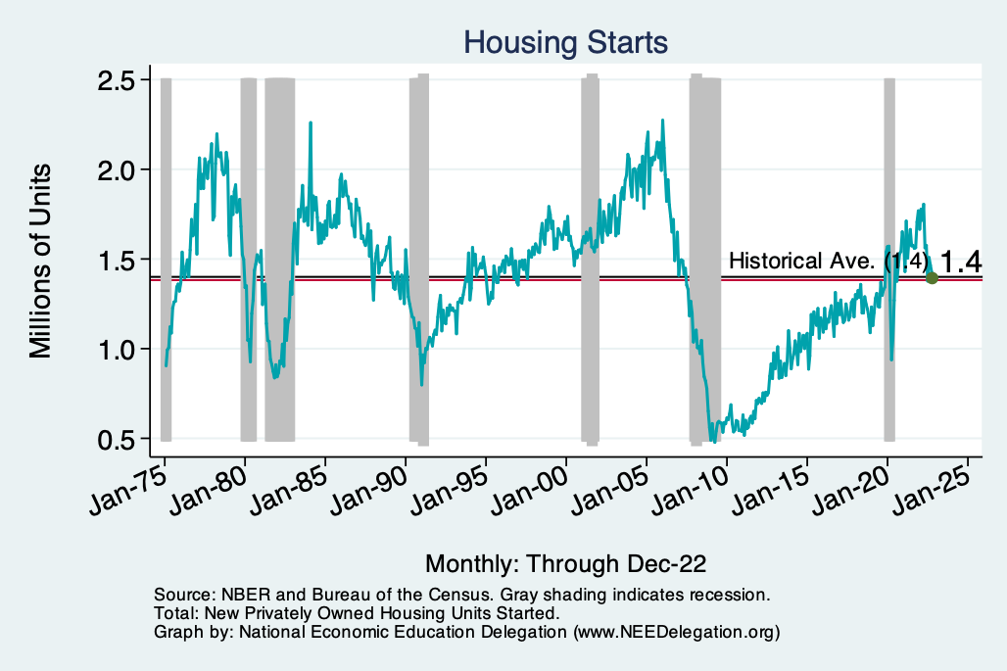
Home Prices and Housing Starts
Notes:
Charts:
homeprices_recession.png
housing.png

