Slide 1
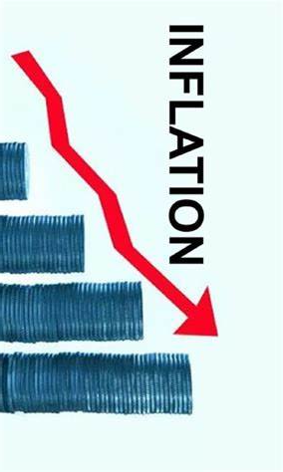
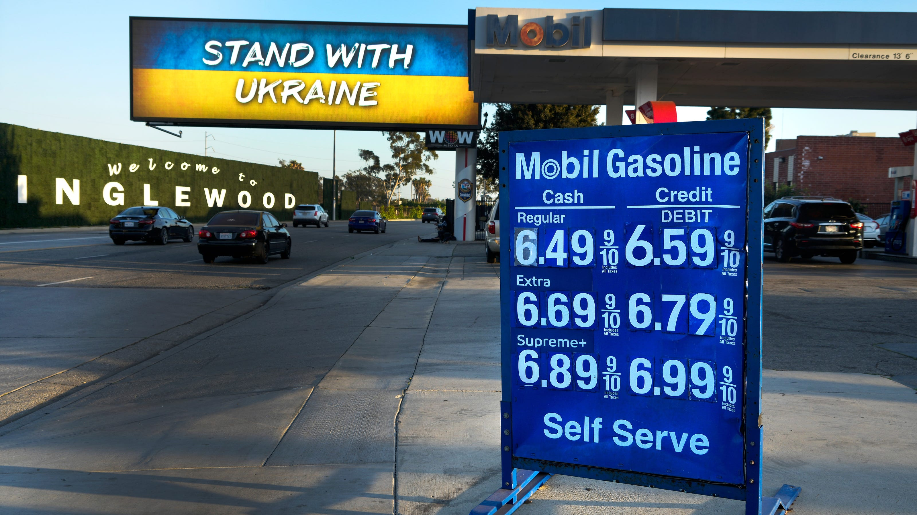
Economic Update
US & Santa Cruz County
Economic Forum
Santa Cruz Chamber of Commerce
& UC Santa Cruz
Jon Haveman, Ph.D.
NEED
February 15, 2024

Slide 2
Outline
Economic Indicators
Inflation/Federal Reserve
The Local Economy

Slide 3
Economic Indicators

Slide 4
GDP Trajectory: Pandemic Recovery Complete!
GDP is:
$0.1 Trillion below 2019 forecast.
$1.8 Trillion ABOVE 2019-Q4 level.

Slide 5
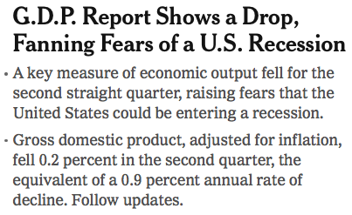
Headline:
July 2022

Slide 6
GDP: Quarterly Growth
Notes:
Graph: gdp_pot_grow.png
The Point: From 1990 – 2007, average annual US GDP growth pre-crisis is 2.94%. However, post-crisis US GDP growth is 2.19% (0.75 percentage points lower). Why is has the recovery been sluggish?
Note: At the recession’s height, the gap between quarterly GDP growth and potential growth was 2.5 percentage points.

Slide 7
Personal Consumption Expenditures
Trouble?
Notes:
Chart: ../Charts/personalconsumption_recession.png
Real consumption remains significantly lower than trend consumption since 2008 (actual is 89% of trend).
Since the recession, consumption growth has fallen. From 1990-2007, average annual consumption growth is 3.34%; Post-recession average annual consumption growth is 2.38%.

Slide 8
Retail Sales Fell -0.8% in January

Slide 9
Retail Sales Fell -0.8% in January

Slide 10
Contributions to GDP: Government
Notes:
Since 2010, average government spending growth is shrinking, resulting in a negative average contribution to GDP growth post-recession of -0.8 percentage points
Note that average quarterly government spending growth is 0.42% from 1990-2007 and -0.17% in 2010+ (annualized, 1990-2007 = 1.68%; 2010+ = -0.70%).

Slide 11
Monthly Changes in Nonfarm Employment
December: 333,000
January: 353,000
Notes:
PAYEMS.png

Slide 12
Employment Gap
5.4 Million ABOVE February, 2020.
5.0 Million BELOW where we should be.
Notes:
payroll_recent.png

Slide 13
Where Have All the Workers Gone?
3.3 million below where we should be

Slide 14
Borrowing on Credit
Notes:
Data/National/FederalReserve/Credit/Programs/rev.png

Slide 15
Household Debt as a Share of GDP
Notes:
US household debt relative to GDP rose until the latest recession.
Households have reduced debt relative to GDP 11% since it’s peak in 2008 (at 99%).
Conclusion: Falling household debt likely contributes to slower consumption growth since the recession.
Chart: HHPERCT.png

Slide 16
Household Debt: Other Sources

Slide 17
Household Debt: Other Sources - Pandemic

Slide 18
Household Debt: Change During the Pandemic

Slide 19
Inflation

Slide 20
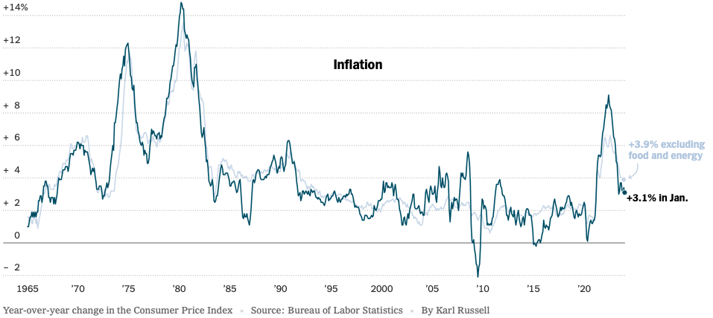
Inflation: Latest Figures
Source: NYTimes.com

Slide 21
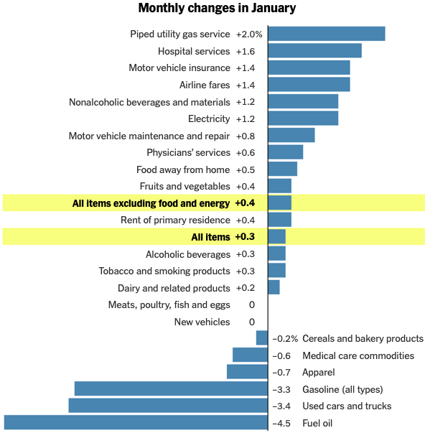
Which Prices?

Slide 22
Inflation in the Last 3/6 Months – Still 3%
Source: https://www.nytimes.com/2023/01/13/opinion/cpi-inflation-fed.html

Slide 23
Inflation Expectations
Source: https://www.nytimes.com/2023/01/13/opinion/cpi-inflation-fed.html

Slide 24
Supply Chains

Slide 25
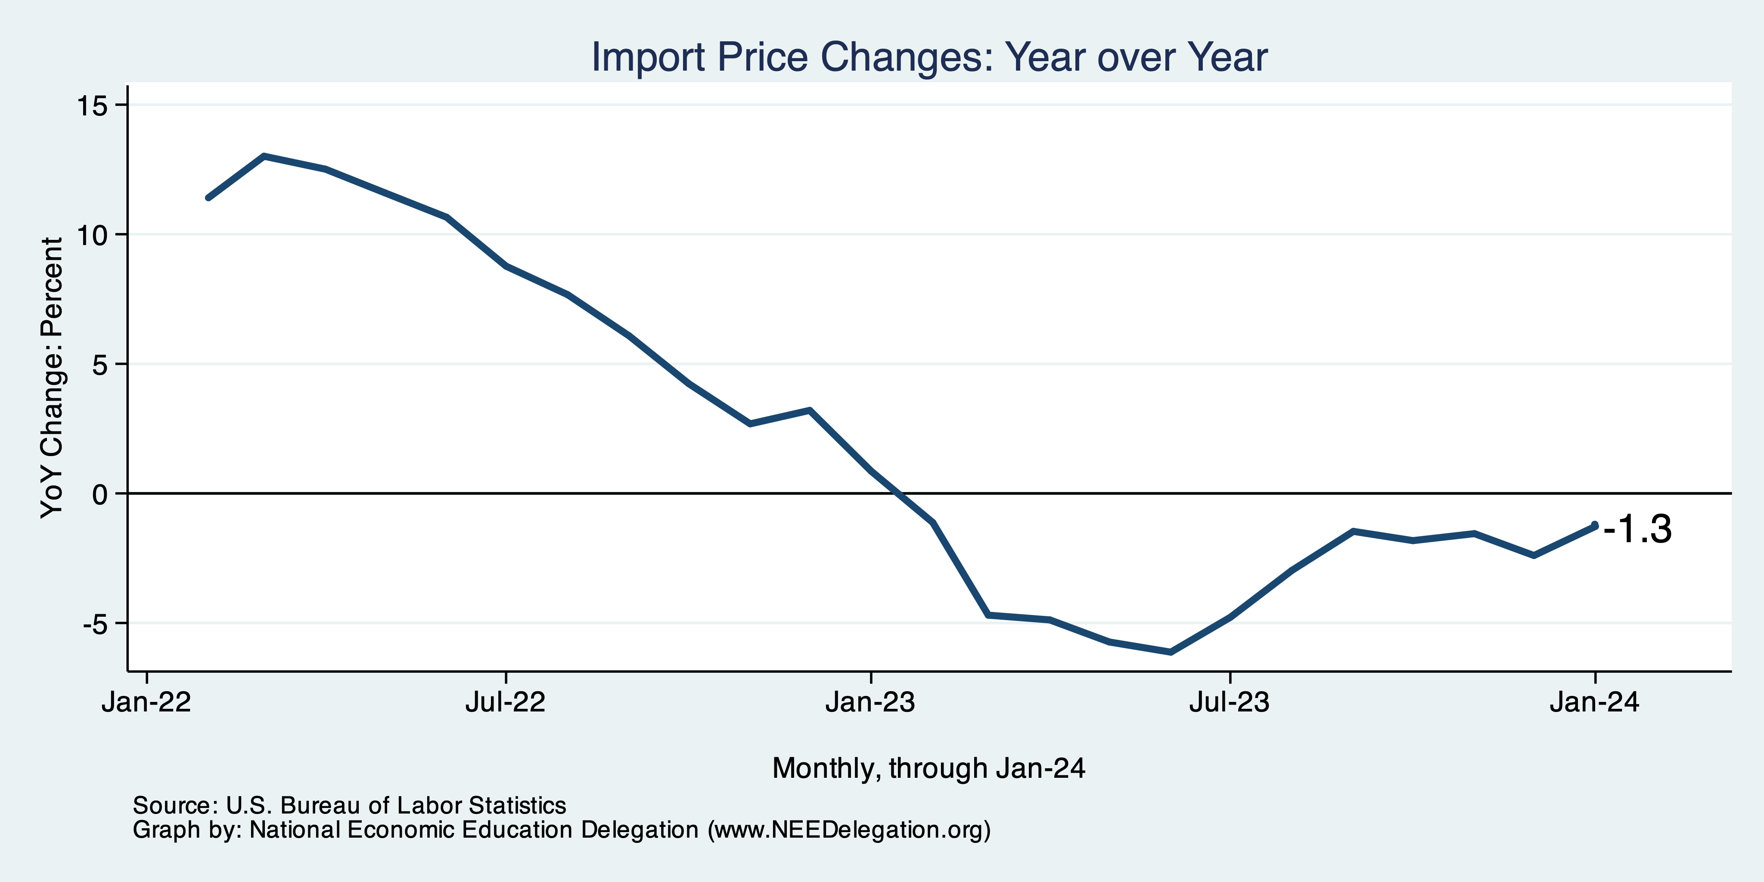
Import Price Inflation was Very High
Inflation – Imported Products: 9-10%

Slide 26
My Thoughts on the Future of Inflation
Most indicators suggests continued declines.
Last couple of months have been counterproductive.
Market expectations are solid.
Return to 2% might take a little longer.
Federal Funds rate to stay high for some time.
Popular expectations may take a little while to catch up.

Slide 27
Wage Growth – Exceeds Inflation
Notes:
Is this necessary given the previous slide?

Slide 28
The Fed: Conservative

Slide 29
Fed: Reducing its Asset Holdings
Quantitative Tightening

Slide 30
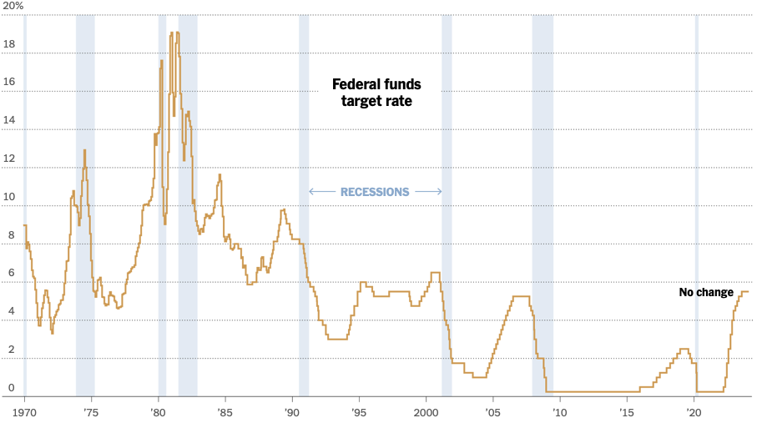
Federal Funds Rate
Holding at 5.5%
Notes:
The fed funds rate is the interest rate on overnight loans between banks. Think of it as the baseline interest rate on which banks base all other interest rates (e.g. mortgage rates)
FOMC lowers the fed funds rate during recessions and raises the fed funds rate during expansions
Fed funds rate peaked in the 1980s as then Chairman Paul Volcker sought to reign in “run away” inflation of the 1970s; doing so resulted in a recession in the early 1980s.
Since the 2008-09 recession, the fed funds rate has been kept near zero.
During the 2008-09 recession, Federal Reserve turned to unconventional tools to influence longer term interest rates to further stimulate the economy - QE
FedFunds.png

Slide 31
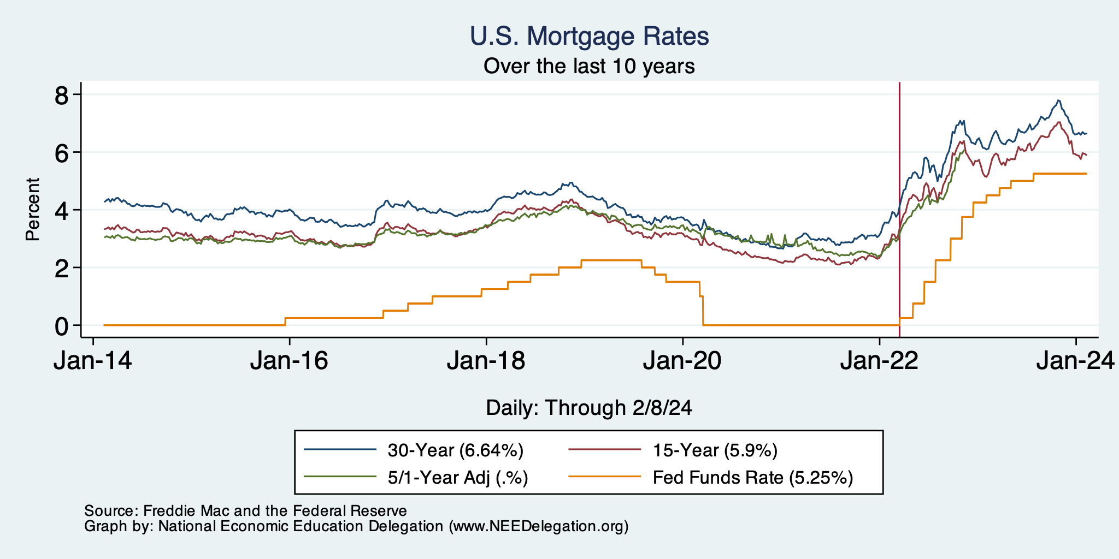
Mortgage Rates

Slide 32
Home Sales Falling

Slide 33
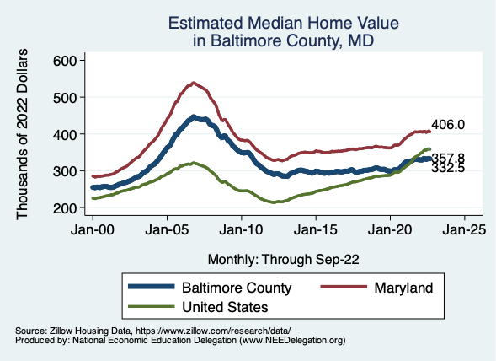
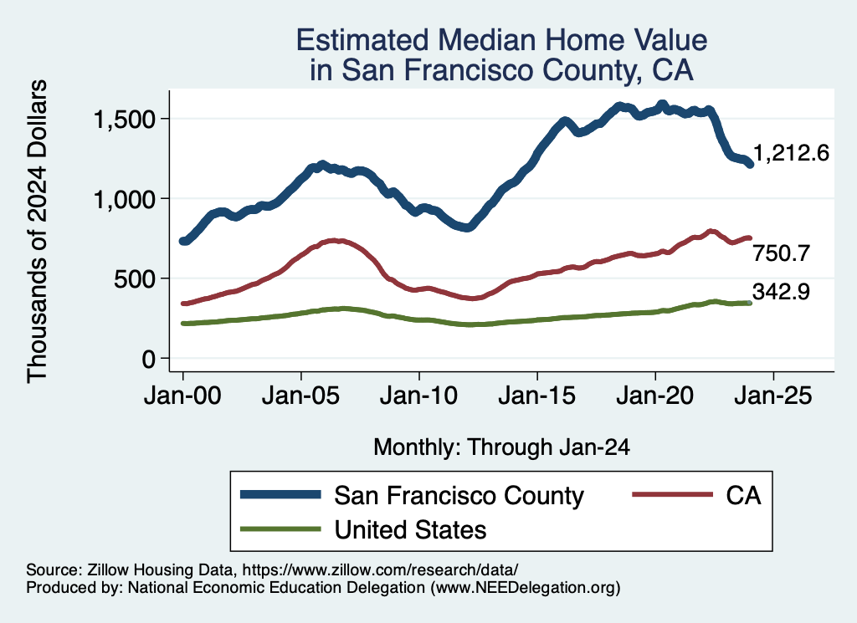
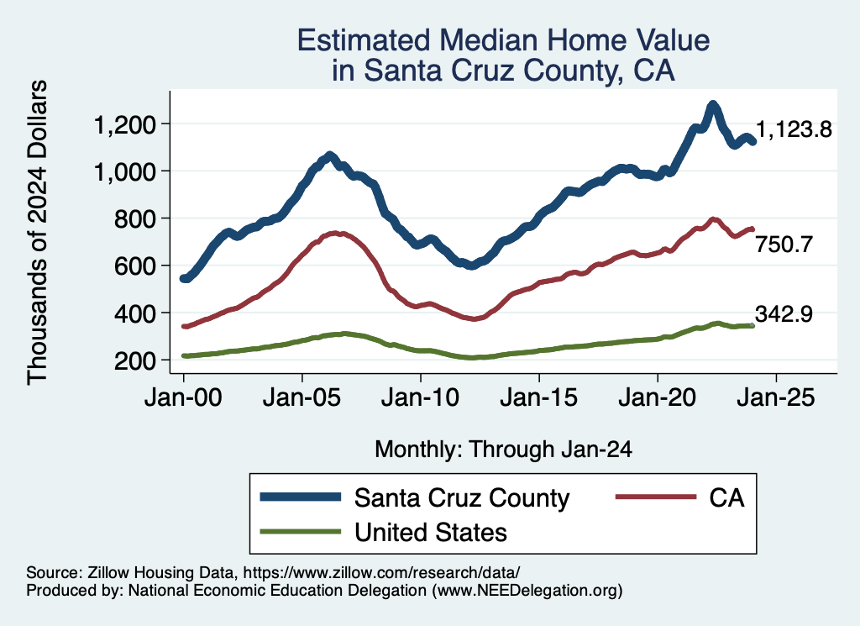
Home Prices … Falling Throughout CA
Notes:
Charts:
homeprices_recession.png
housing.png

Slide 34
Takeaways
Is a recession on the horizon?
Perhaps, but no reason to think that it will be anything more than shallow.
Many indicators are still in the black.
2023 2nd half GDP growth was pretty good
Threats to continued growth:
If inflation reverses course, which seems unlikely.
Global conflict (double-edged sword)
Inflation
Certainly trending (slightly) in the wrong direction.
Not worried about it.
Fed policy will continue to push against it.
Likely to recover 2% by year’s end.

Slide 35
Santa Cruz Economy

Slide 36
Employment in Santa Cruz County?

Slide 37
The Pandemic Effect: Employment

Slide 38
Santa Cruz Economy: Employment

Slide 39
Santa Cruz Economy: GDP Growth

Slide 40
CalTrans Forecast: Employment

Slide 41
Local Population Change
City
County

Slide 42
Santa Cruz County Migration Patterns
Natural Change is Nearly Negative

Slide 43
CalTrans Forecast: Population

Slide 44
Working From Home

Slide 45
Santa Cruz County: Summary
Home prices are falling as they are elsewhere in CA.
Santa Cruz County has been altered by the pandemic.
Lots of working from home.
An economy more focused on manufacturing relative to ag.
GDP has grown faster than in CA or the US.
Employment has not.
If this shift is permanent, that could be good for Santa Cruz County.
However, countywide population declines are concerning.

Slide 46
Thank you!
Any Questions?
www.NEEDelegation.org
Jon D. Haveman
Jon@NEEDelegation.org
Contact NEED: info@NEEDelegation.org
Submit a testimonial: www.NEEDelegation.org/testimonials.php
Become a Friend of NEED: www.NEEDelegation.org/friend.php

Slide 47
www.NEEDelegation.org/LocalGraphs
For every state and county in the United States.
Detailed graphs on employment, housing, moves, and other statistics.

Slide 48
GDP Trajectory: Pandemic Plunge!
GDP is:
$0.3 Trillion below 2019 forecast.
$1.2 Trillion ABOVE 2019-Q4 level.

Slide 49
Industrial Production (Manuf, Util, Mining)

Slide 50
Monthly Changes in Nonfarm Employment
Notes:
PAYEMS.png

Slide 51
Some Explanations
500 Thousand: Long COVID Exits
1-2%: Long Social Distancing

Slide 52
But SUPER High to Begin With!

Slide 53
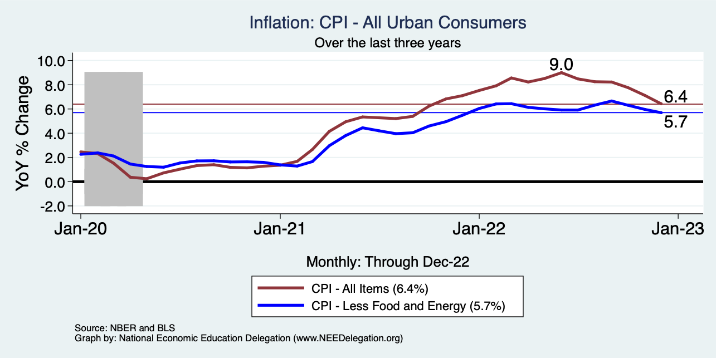
Inflation – Falling! Job is not done.
Notes:
Cpi_recent.png

Slide 54
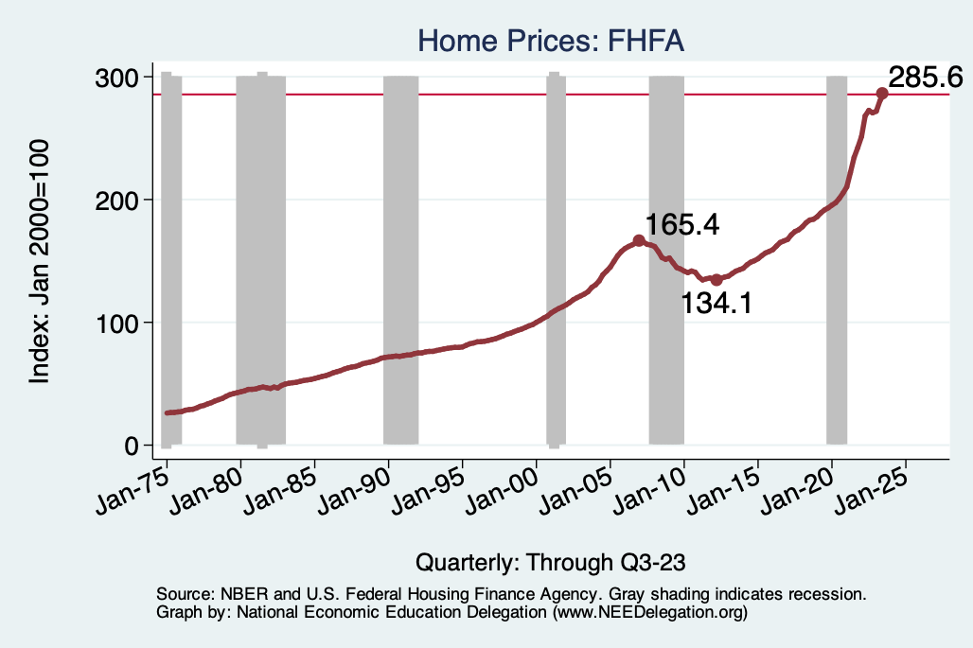
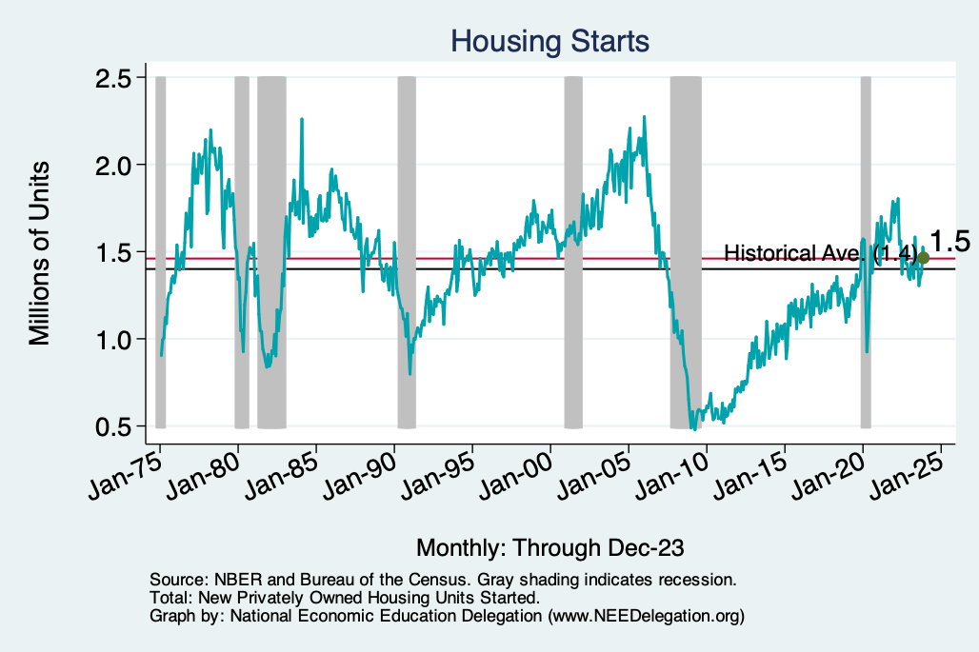
Home Prices and Housing Starts
Notes:
Charts:
homeprices_recession.png
housing.png

