Slide 1
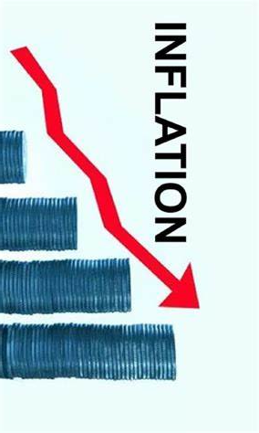

Economic Update
US & San Mateo County
SAMCEDA
Public Policy Committee
Jon Haveman, Ph.D.
NEED
June 11, 2024

Slide 2
Outline
Economic Indicators
Inflation/Federal Reserve
The Local Economy

Slide 3
Economic Indicators

Slide 4
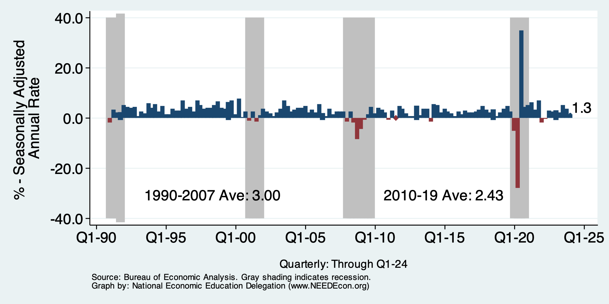
GDP: Quarterly Growth
Q2-2023: 2.1%
Q3-2023: 4.9%
Q4-2023: 3.4%
Q1-2024: 1.3%
Notes:
Graph: gdp_pot_grow.png
The Point: From 1990 – 2007, average annual US GDP growth pre-crisis is 2.94%. However, post-crisis US GDP growth is 2.19% (0.75 percentage points lower). Why is has the recovery been sluggish?
Note: At the recession’s height, the gap between quarterly GDP growth and potential growth was 2.5 percentage points.

Slide 5
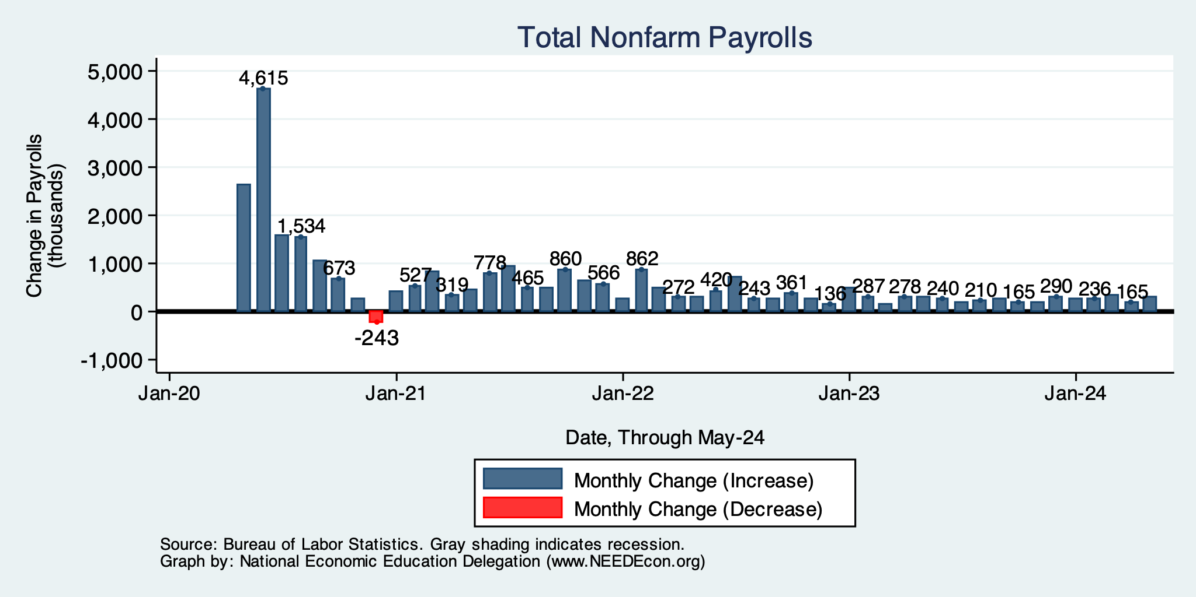
Monthly Changes in Nonfarm Employment
March: 310,000
April: 165,000
May: 272,000
Notes:
PAYEMS.png

Slide 6
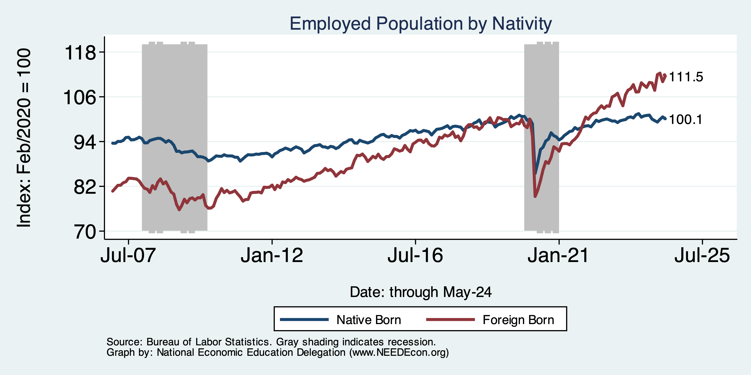
Immigrants to the Rescue?

Slide 7
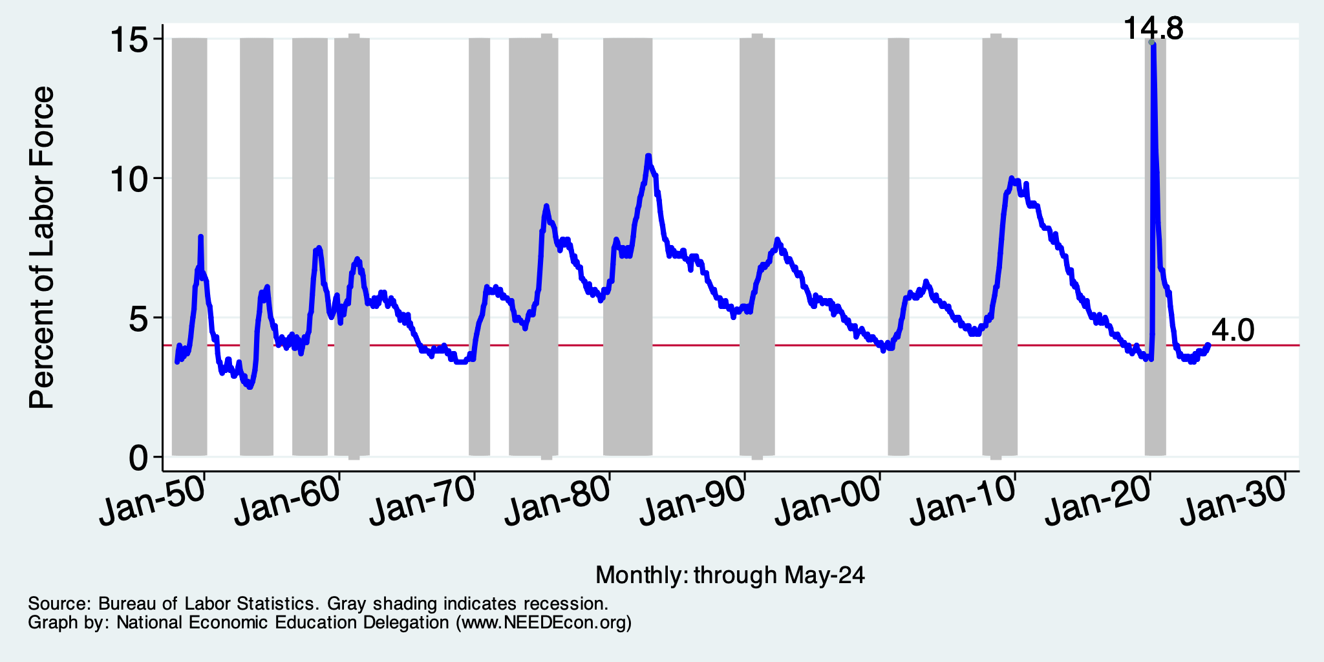
What About Unemployment?

Slide 8
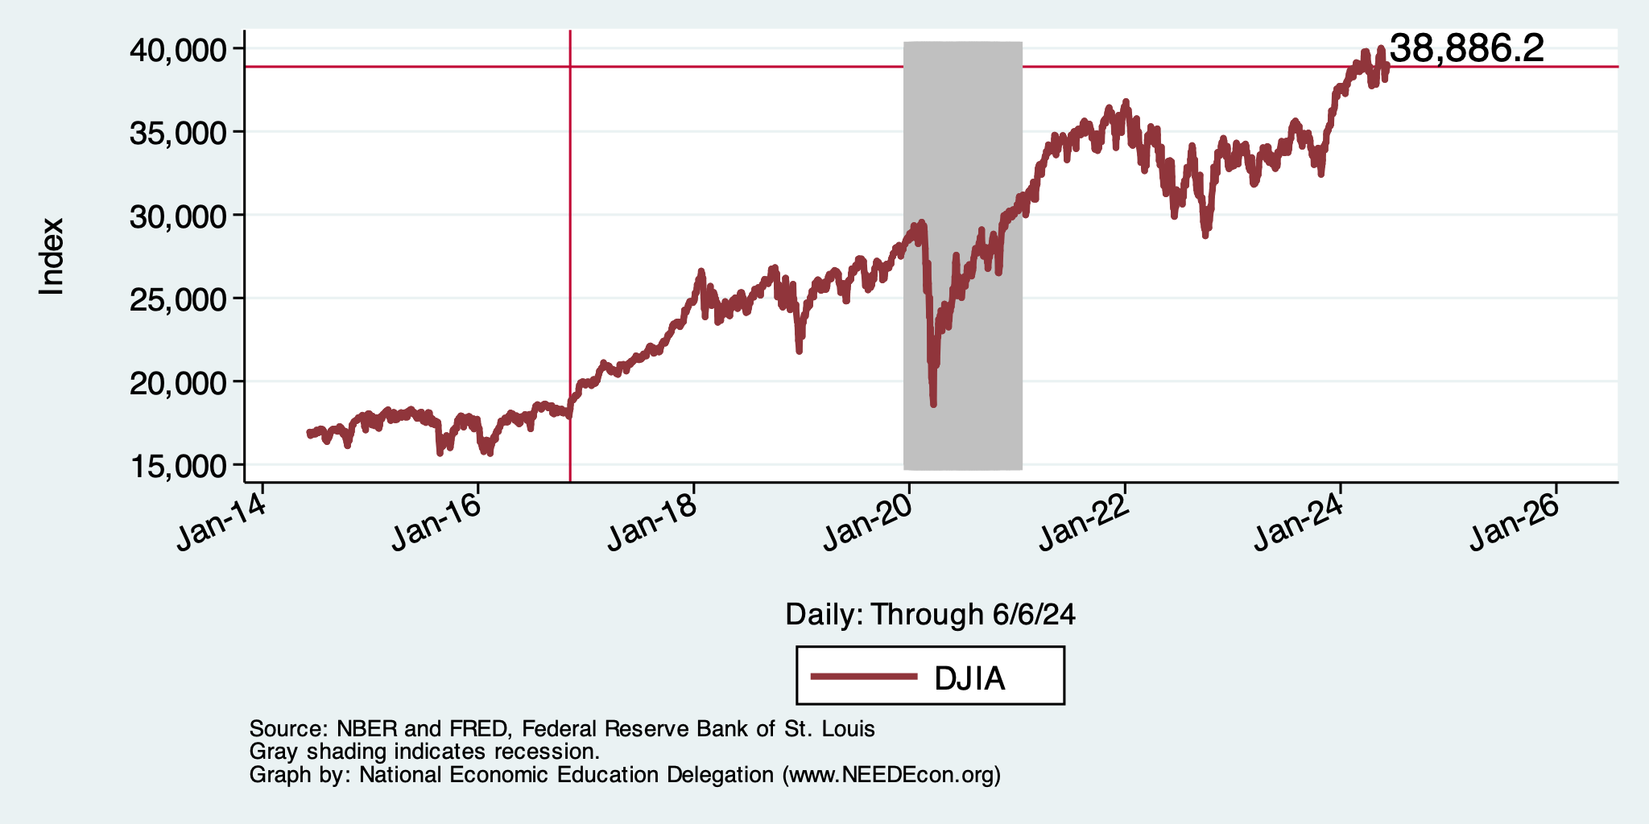
And Stocks? Way up!

Slide 9
Inflation

Slide 10
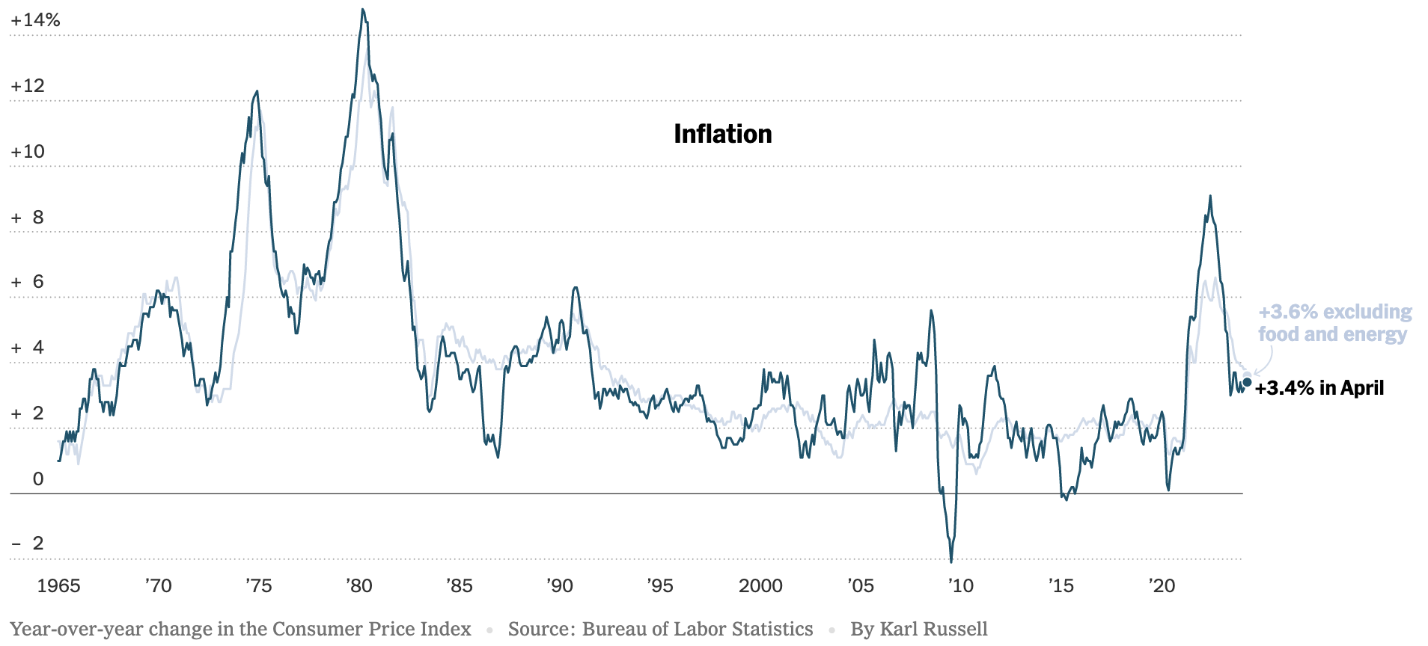
Inflation: Latest Figures – Headline - CPI

Slide 11
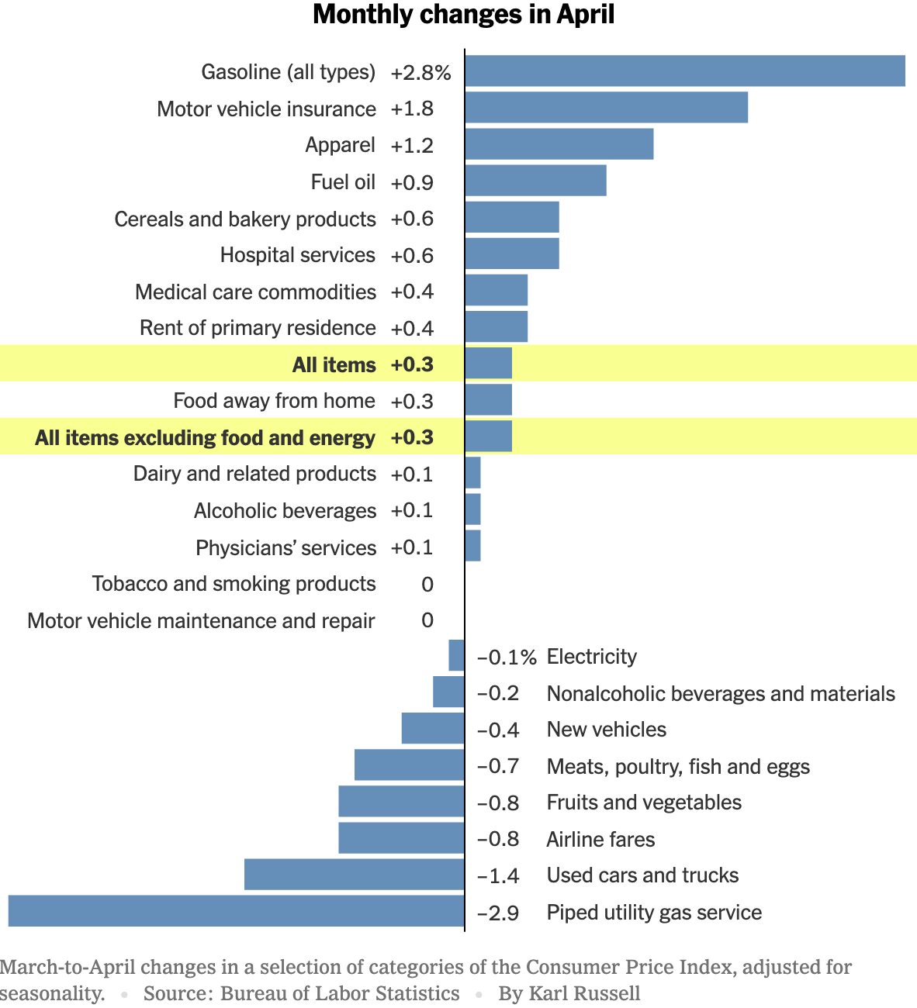
Which Prices?
Car Costs
Housing Costs

Slide 12
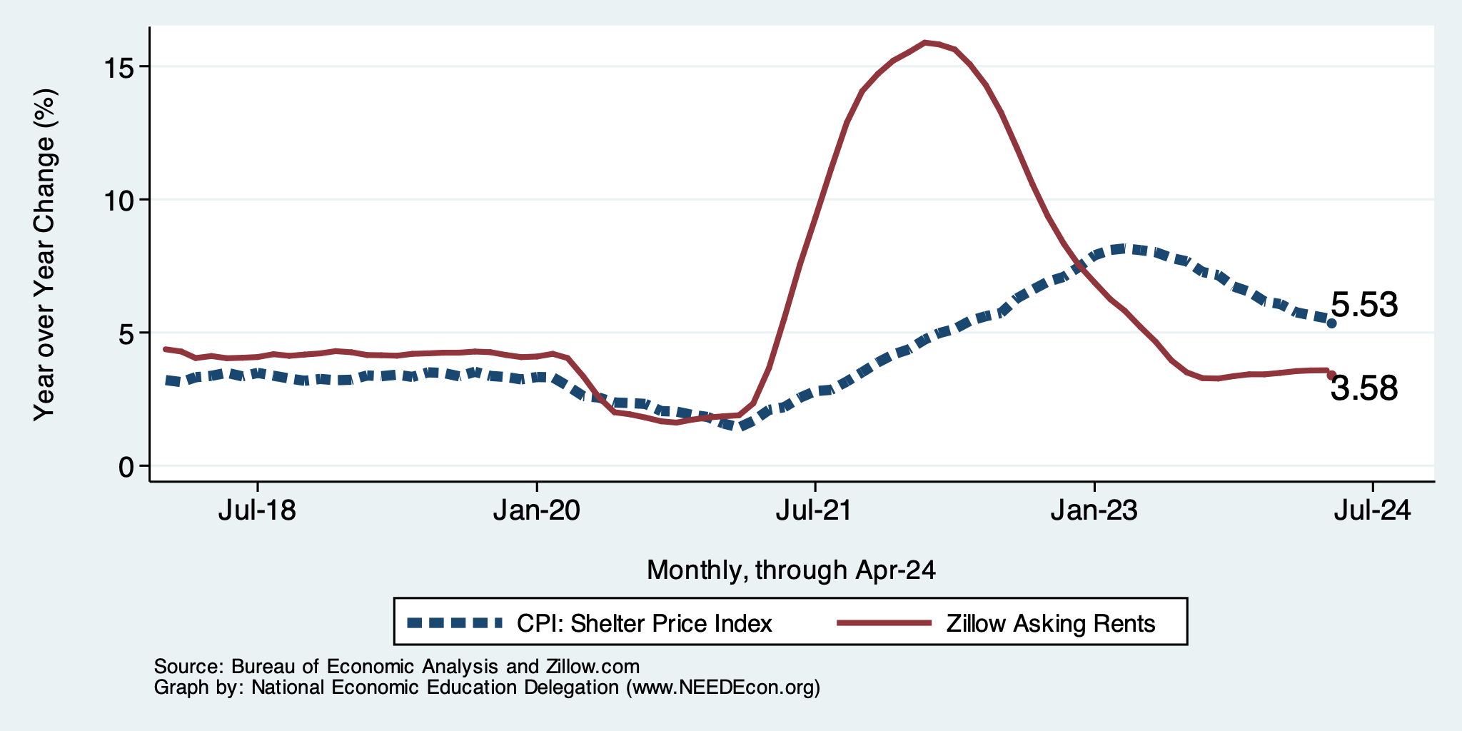
The Importance & Problems with Rents
Shelter is 36% of CPI
- 45% of Core CPI.
About half as much in PCE.
Notes:
Shelter is 36% of CPI and 45% of Core CPI. About half as much in PCE. CPI less shelter is 2.3% sine March of last year. Shelter is up 5.8%

Slide 13
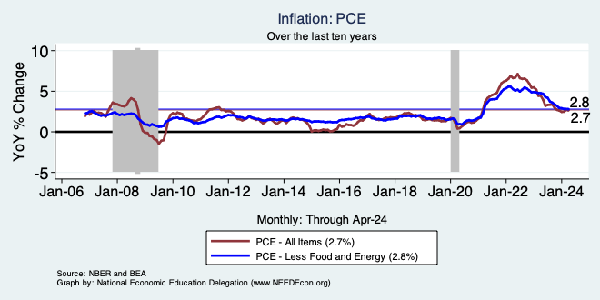
Inflation Looks Better by the PCEPI

Slide 14
My Thoughts on Inflation
PCE is more accurate than the CPI: 2.7 vs 3.4
Most indicators suggests continued declines.
Return to 2% - next year.
Federal Funds rate to stay high for some time.

Slide 15
What’s the Fed Doing About It?

Slide 16
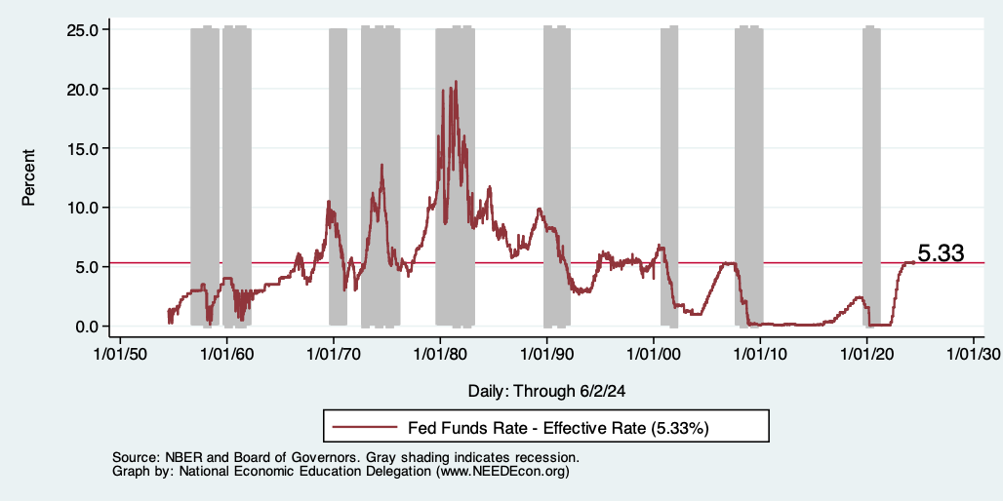
Raising the Federal Funds Rate
Notes:
The fed funds rate is the interest rate on overnight loans between banks. Think of it as the baseline interest rate on which banks base all other interest rates (e.g. mortgage rates)
FOMC lowers the fed funds rate during recessions and raises the fed funds rate during expansions
Fed funds rate peaked in the 1980s as then Chairman Paul Volcker sought to reign in “run away” inflation of the 1970s; doing so resulted in a recession in the early 1980s.
Since the 2008-09 recession, the fed funds rate has been kept near zero.
During the 2008-09 recession, Federal Reserve turned to unconventional tools to influence longer term interest rates to further stimulate the economy - QE
FedFunds.png

Slide 17
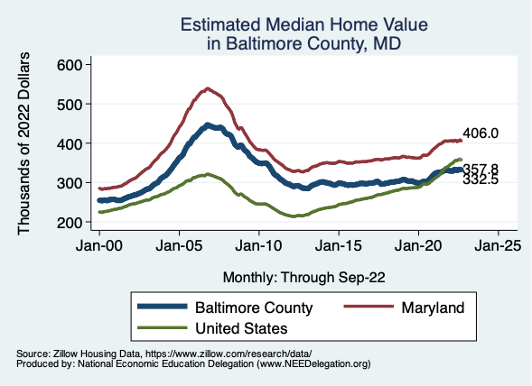
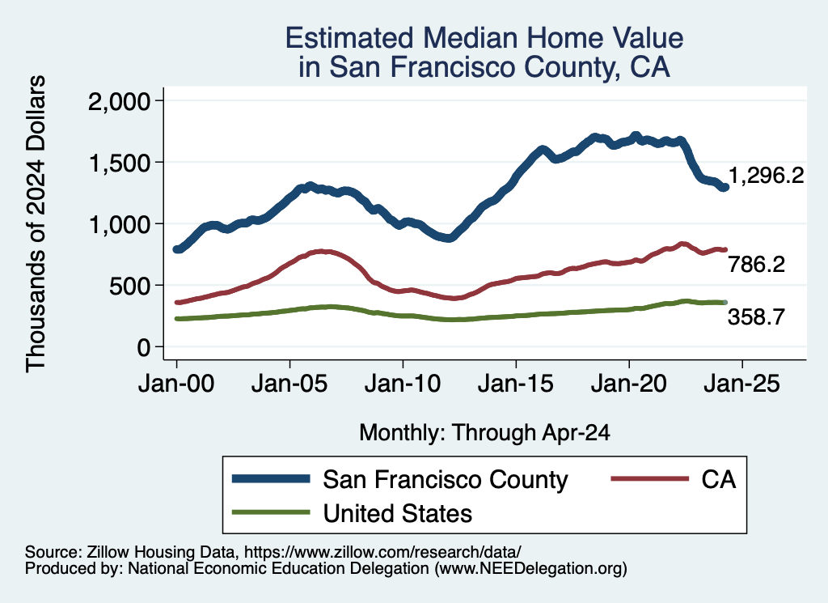
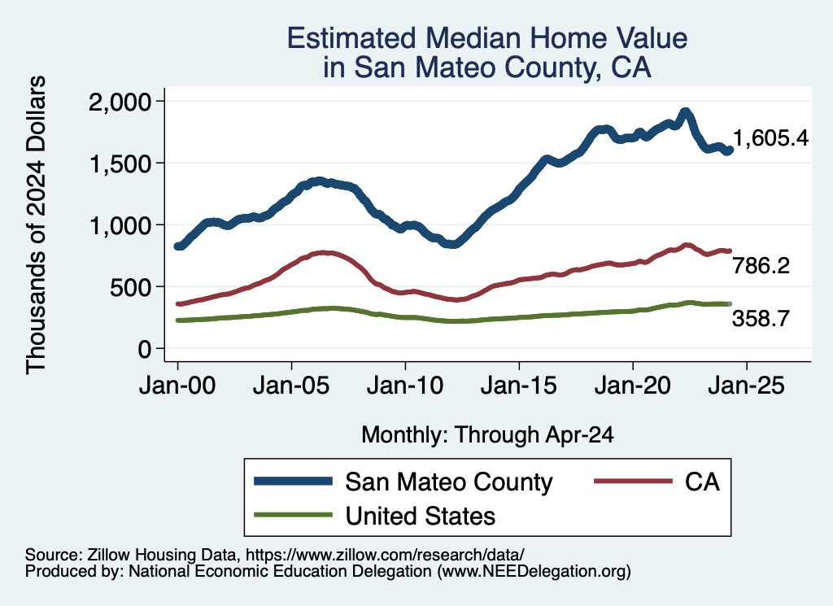
Home Prices … Falling Throughout CA
Notes:
Charts:
homeprices_recession.png
housing.png

Slide 18
Takeaways
Is a recession on the horizon?
  No. Potentially a slowdown.
  Many indicators are well in the black.
    2024-Q1 GDP growth was ok.
Inflation has been tamed.
Fed will hold steady for a while.
Threats to continued growth:
  Conflicts in Ukraine and Israel.
    Global Supply Chains?
    Oil Prices?
  Asset prices (stocks)
  Household balance sheets
  Fed Actions in a Political Year.

Slide 19
San Mateo Economy

Slide 20
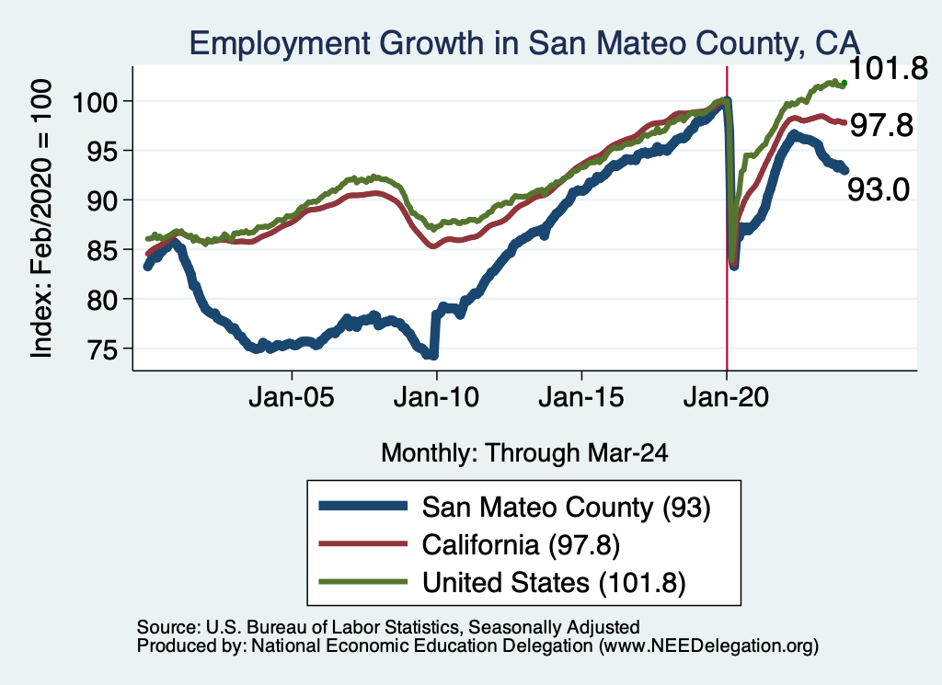
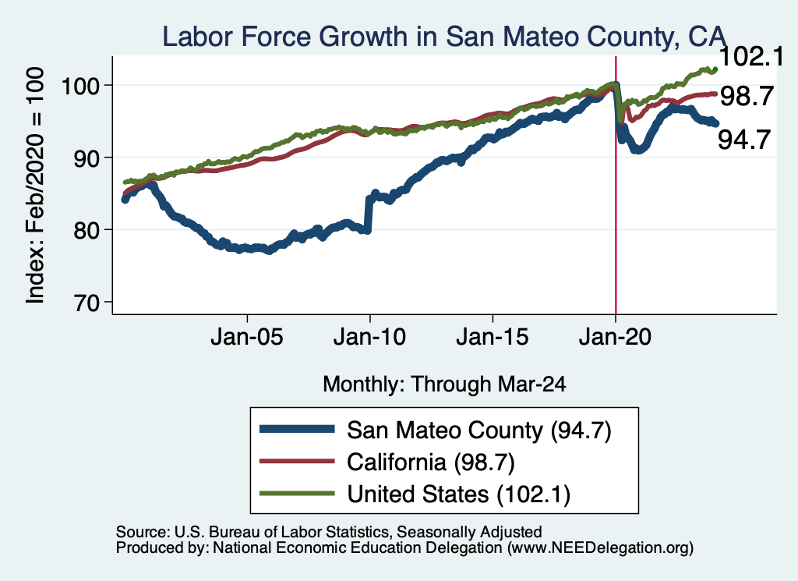
Employment in San Mateo County?

Slide 21
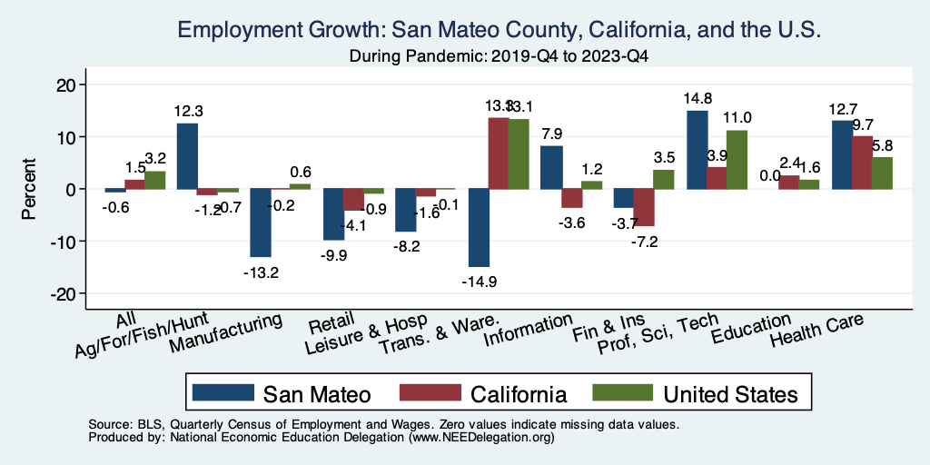
The Pandemic Effect: Employment

Slide 22
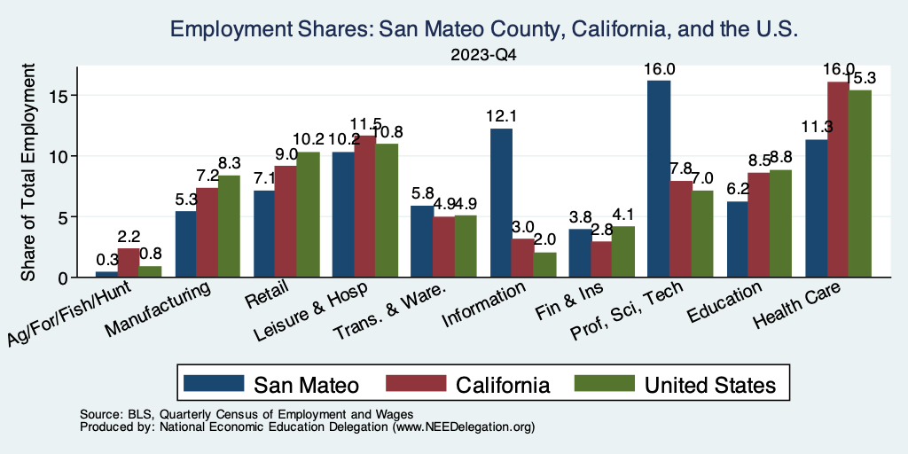
San Mateo Economy: Employment

Slide 23
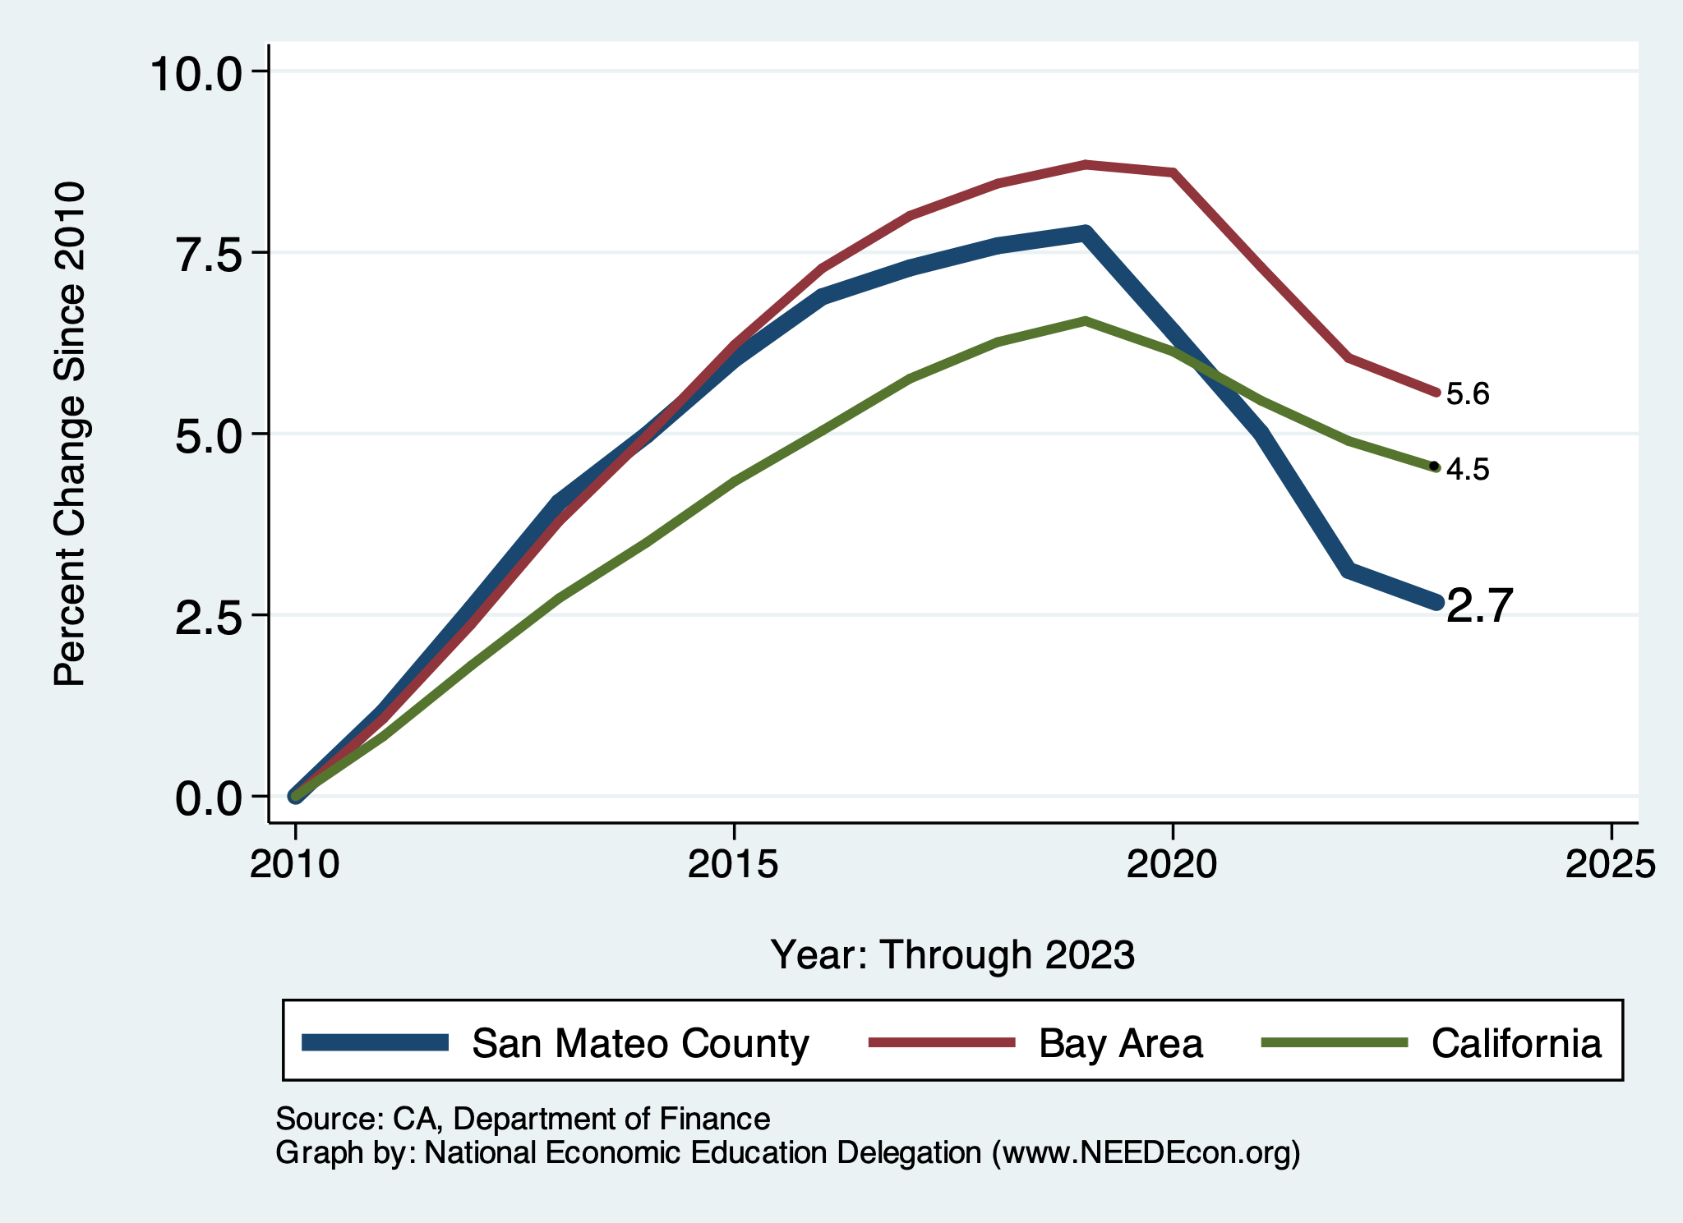
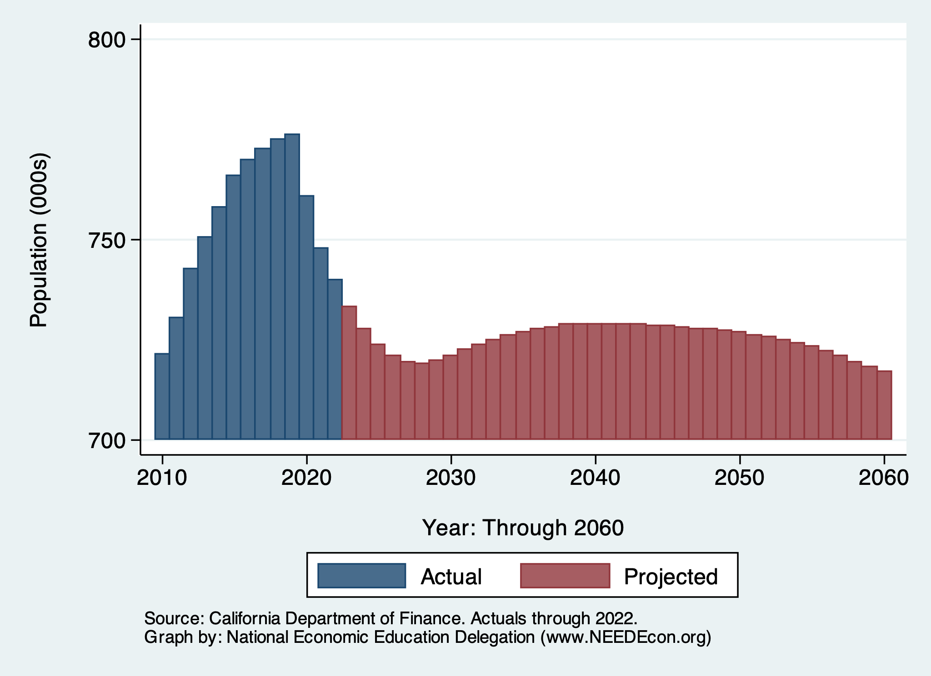
Local Population Change

Slide 24
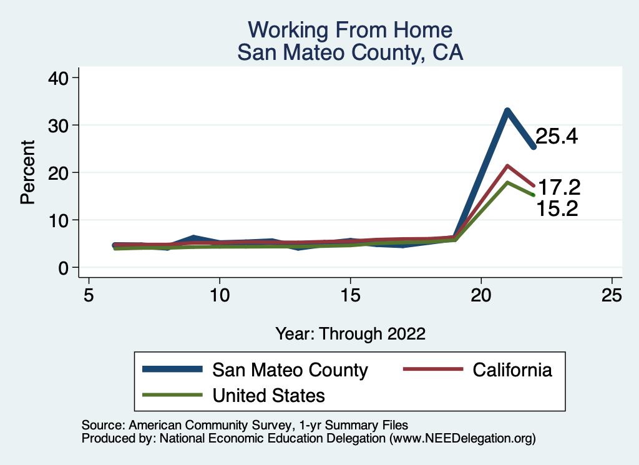
Working From Home

Slide 25
San Mateo County: Summary
Home prices have stabilized (?).
San Mateo County has been altered by the pandemic.
  Lots of working from home.
    But 25% have returned to the office/workplace over the last year.
  An economy doubling down on Tech
    Service economy has shrunk.
    Information and PSTS are growth sectors.
If this shift is permanent – a more volatile economy.
Another concern: population declines.
  Primarily among low-income households.

Slide 26
Thank you!
Any Questions?
www.NEEDEcon.org
Jon Haveman, Ph.D.
Jon@NEEDEcon.org
Contact NEED: info@NEEDEcon.org
Submit a testimonial: www.NEEDEcon.org/testimonials.php
Become a Friend of NEED: www.NEEDEcon.org/friend.php

Slide 27
www.NEEDelegation.org/LocalGraphs
For every state and county in the United States.
Detailed graphs on employment, housing, moves, and other statistics.

Slide 28
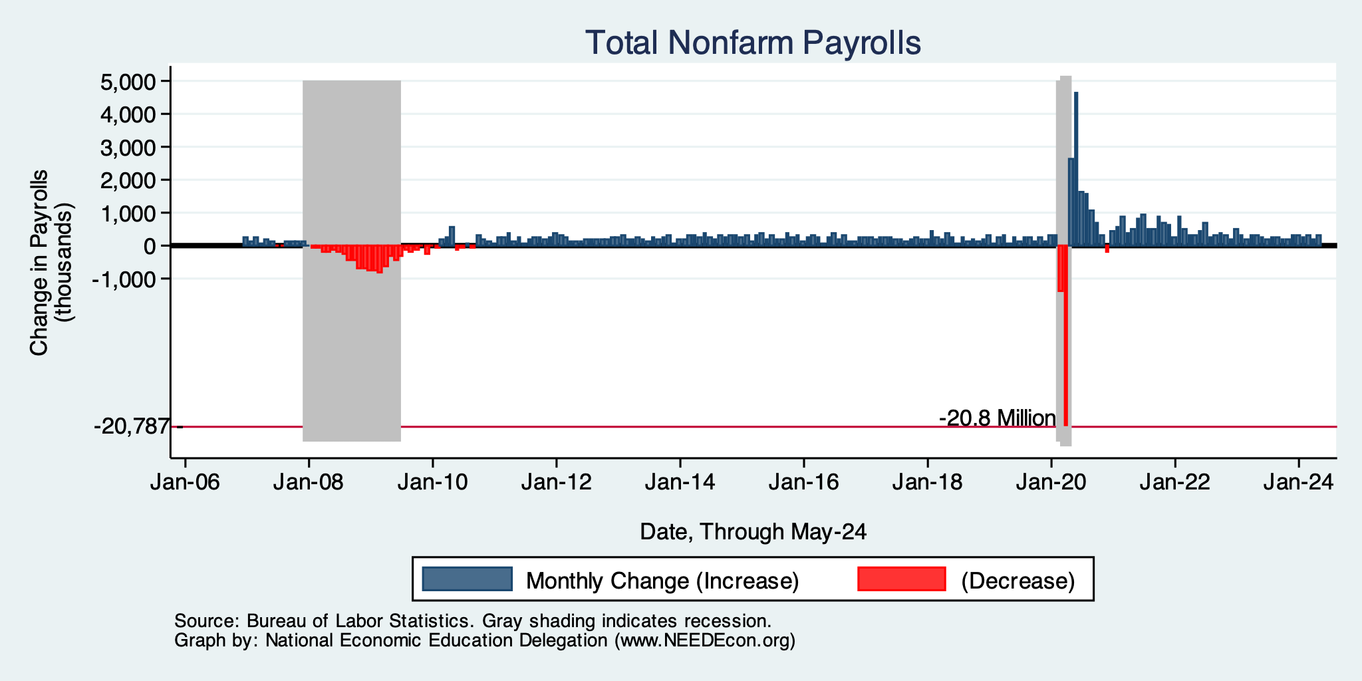
Monthly Changes in Nonfarm Employment
Notes:
PAYEMS.png

Slide 29
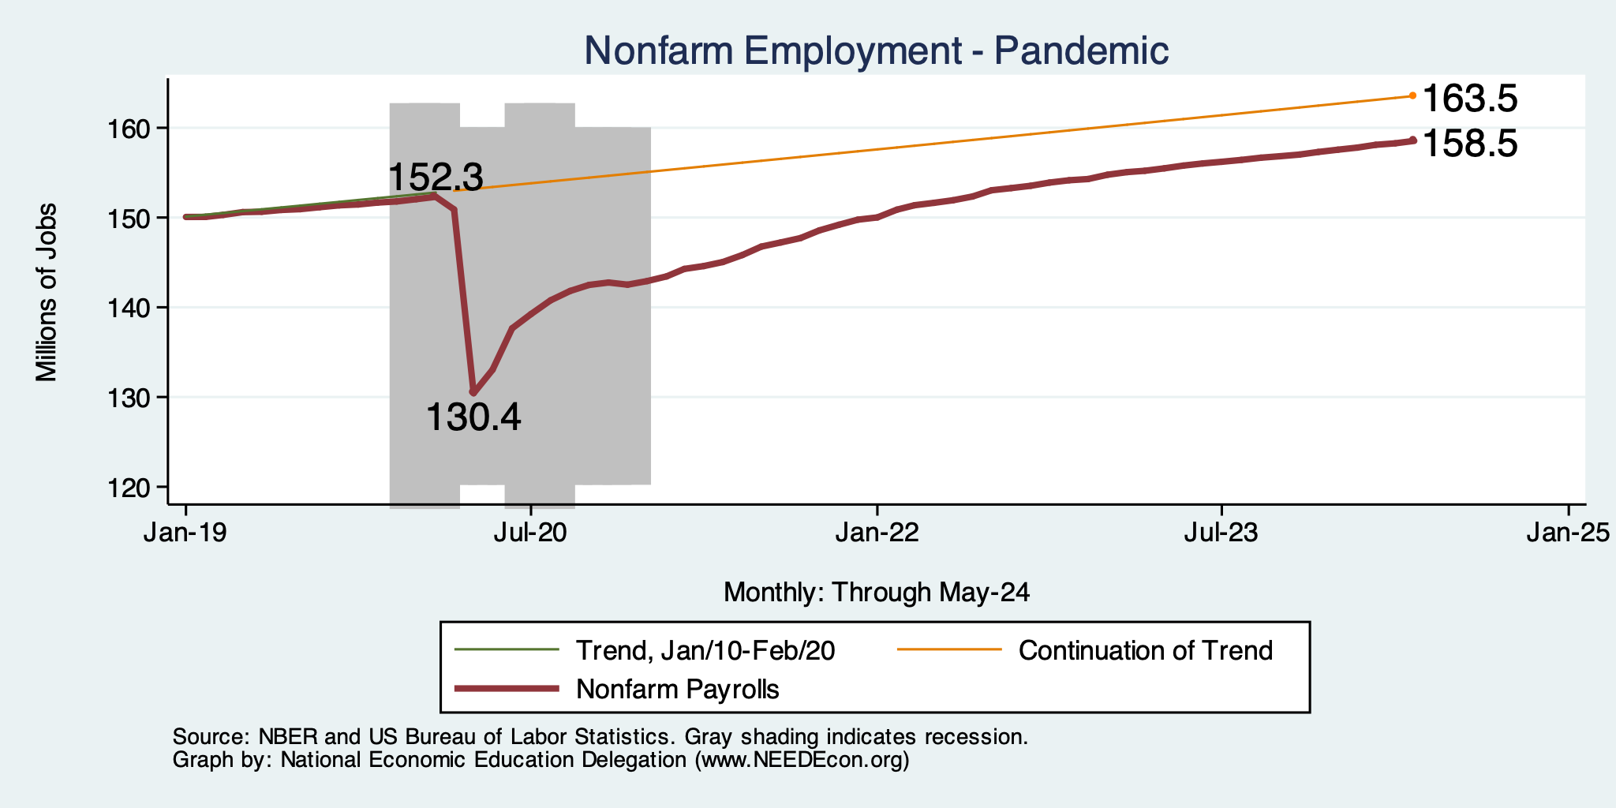
Employment Gap
6.2 Million ABOVE February, 2020.
5.0 Million BELOW where we should be.
Notes:
payroll_recent.png

Slide 30
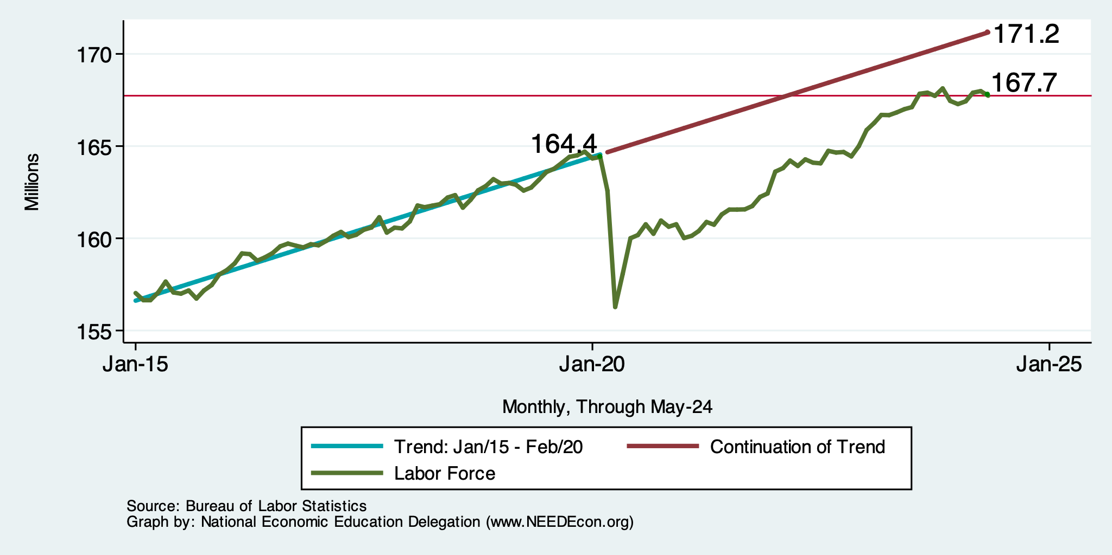
Where Have All the Workers Gone?
3.5 million below where we should be

Slide 31
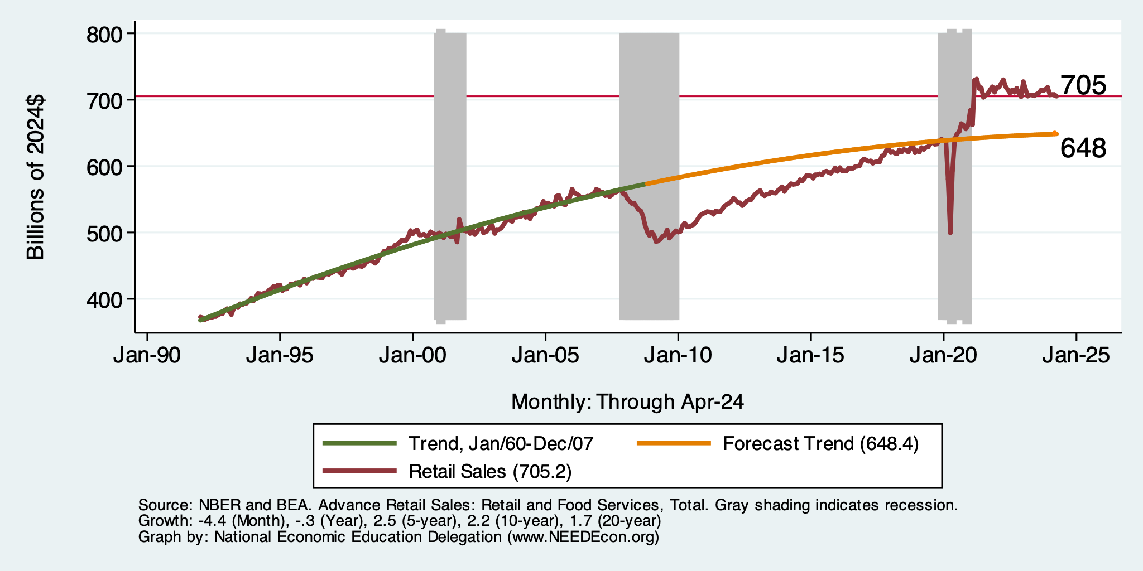
But SUPER High to Begin With!

Slide 32
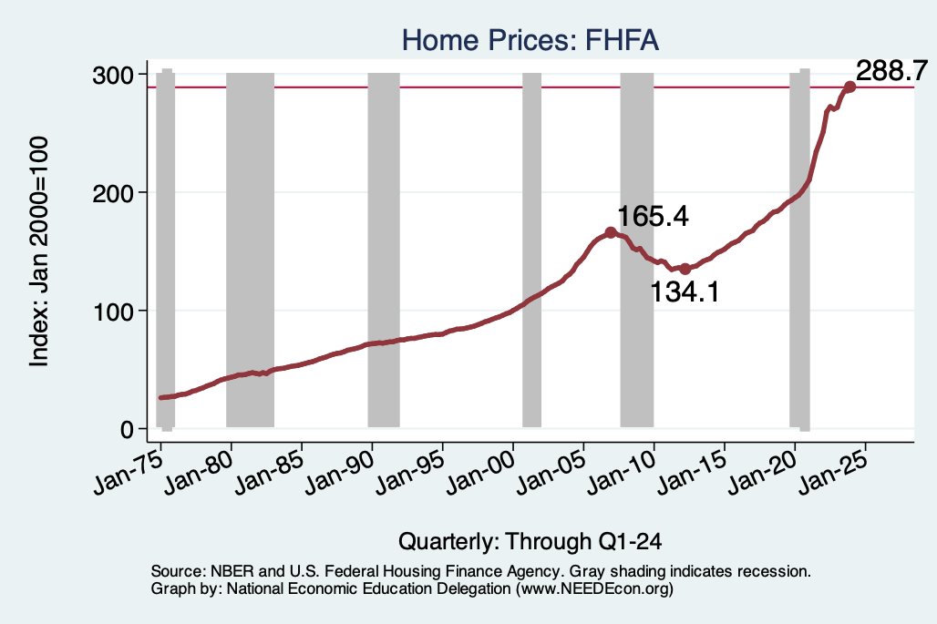
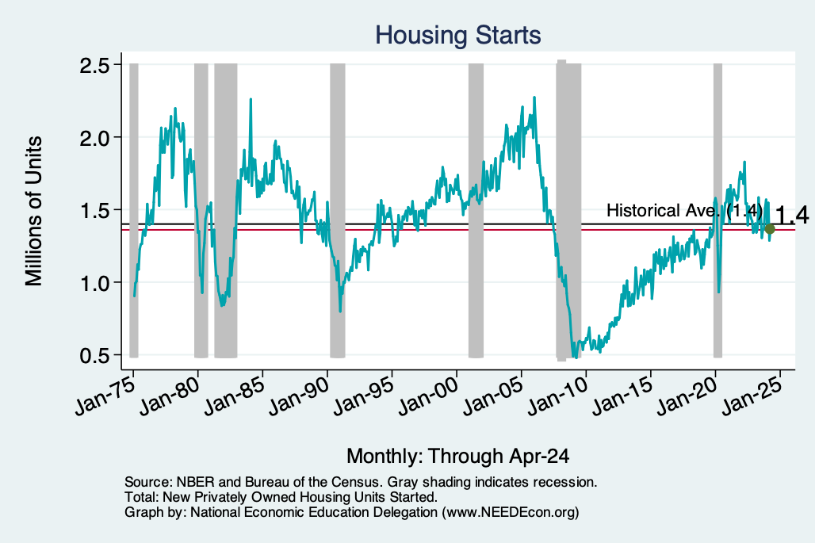
Home Prices and Housing Starts
Notes:
Charts:
homeprices_recession.png
housing.png

Slide 33
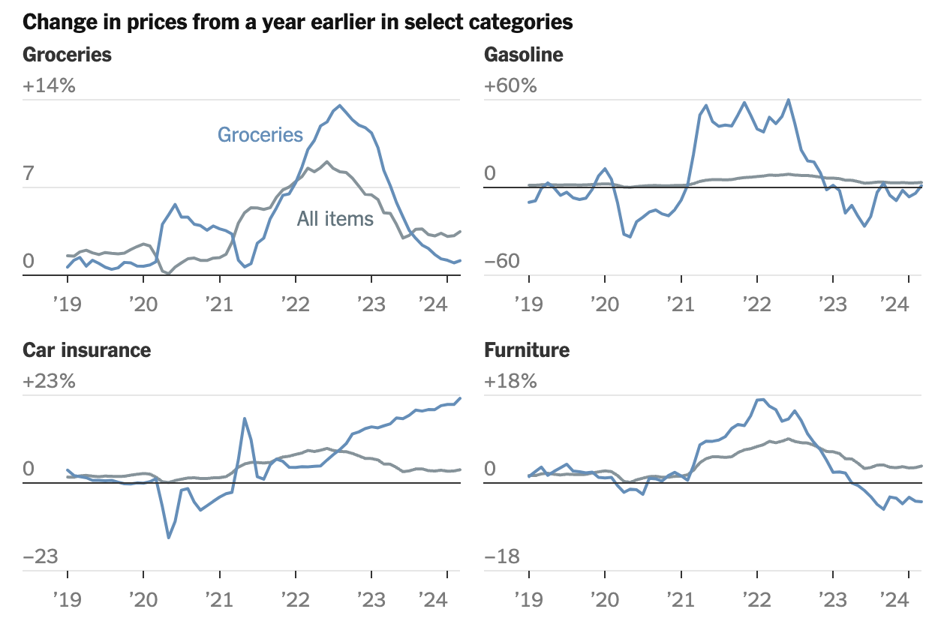

Slide 34
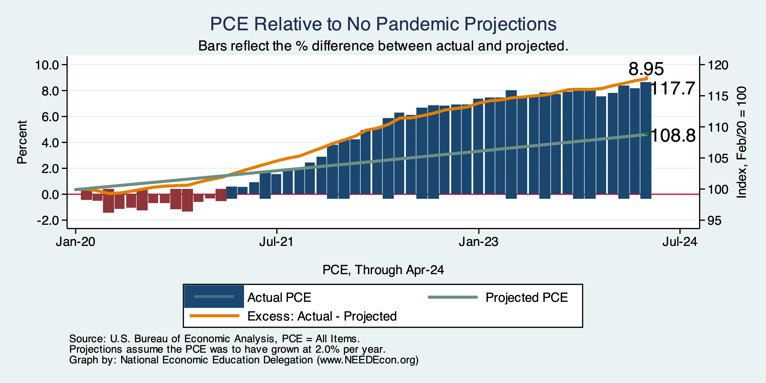
Inflation: Prices up About 9%

Slide 35
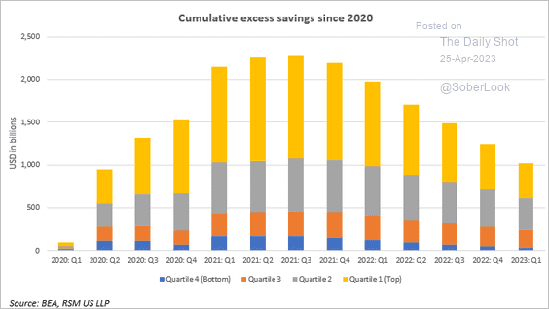
Policy Effects: Fiscal
2020-2021: massive stimulus, $4.6t: Cares Act, 3 rounds of stimulus checks, expanded unemployment benefits, Payroll Protection Loans.

Slide 36
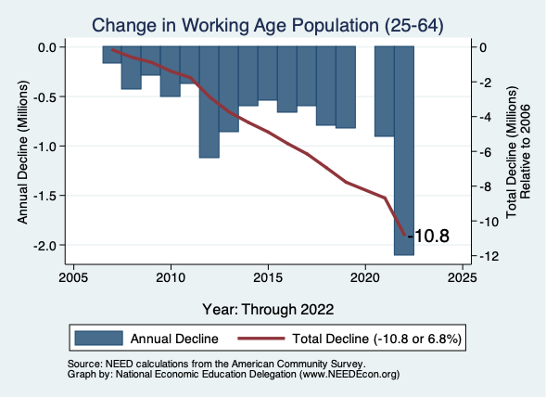
Early Retirements Among Native Born

Slide 37
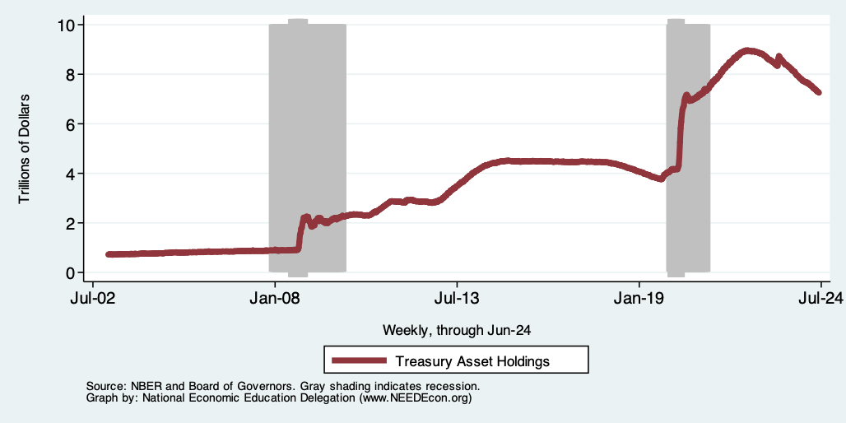
Fed: Reducing its Asset Holdings
Quantitative Tightening

