Slide 1
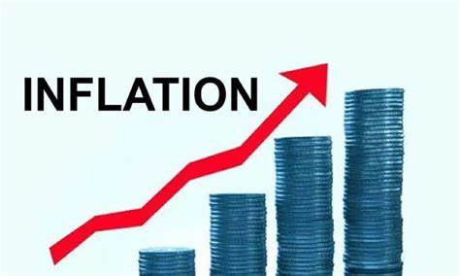
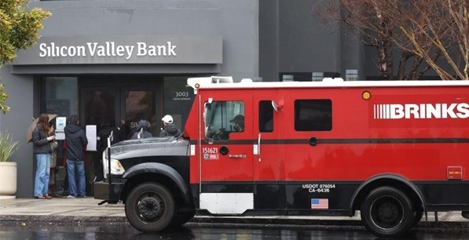
Economic Update
US & San Mateo County
SAMCEDA
Public Policy Committee
Jon Haveman, Ph.D.
NEED
April 11, 2023

Slide 2
Outline
Economic Indicators
Inflation/Federal Reserve/Banks
The Debt Ceiling
The Local Economy

Slide 3
Economic Indicators

Slide 4
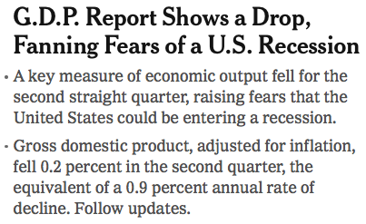
Headline (9 months ago…):

Slide 5
GDP: Quarterly Growth
Notes:
Graph: gdp_pot_grow.png
The Point: From 1990 – 2007, average annual US GDP growth pre-crisis is 2.94%. However, post-crisis US GDP growth is 2.19% (0.75 percentage points lower). Why is has the recovery been sluggish?
Note: At the recession’s height, the gap between quarterly GDP growth and potential growth was 2.5 percentage points.

Slide 6
Monthly Changes in Nonfarm Employment
February: 326,000
March: 236,000
Notes:
PAYEMS.png

Slide 7
Employment Gap
3.1 Million ABOVE February, 2020.
5.0 Million BELOW where we should be.
Notes:
payroll_recent.png

Slide 8
Where Have All the Workers Gone?
2.6 million below where we should be

Slide 9
Borrowing on Credit Has Recovered

Slide 10
Inflation

Slide 11
Inflation: Latest Figures

Slide 12
Inflation is Not just a U.S. Problem

Slide 13
Inflation in the Last 6 Months – Closer to 4%!
Source: https://www.nytimes.com/2023/01/13/opinion/cpi-inflation-fed.html

Slide 14
Supply Chains

Slide 15
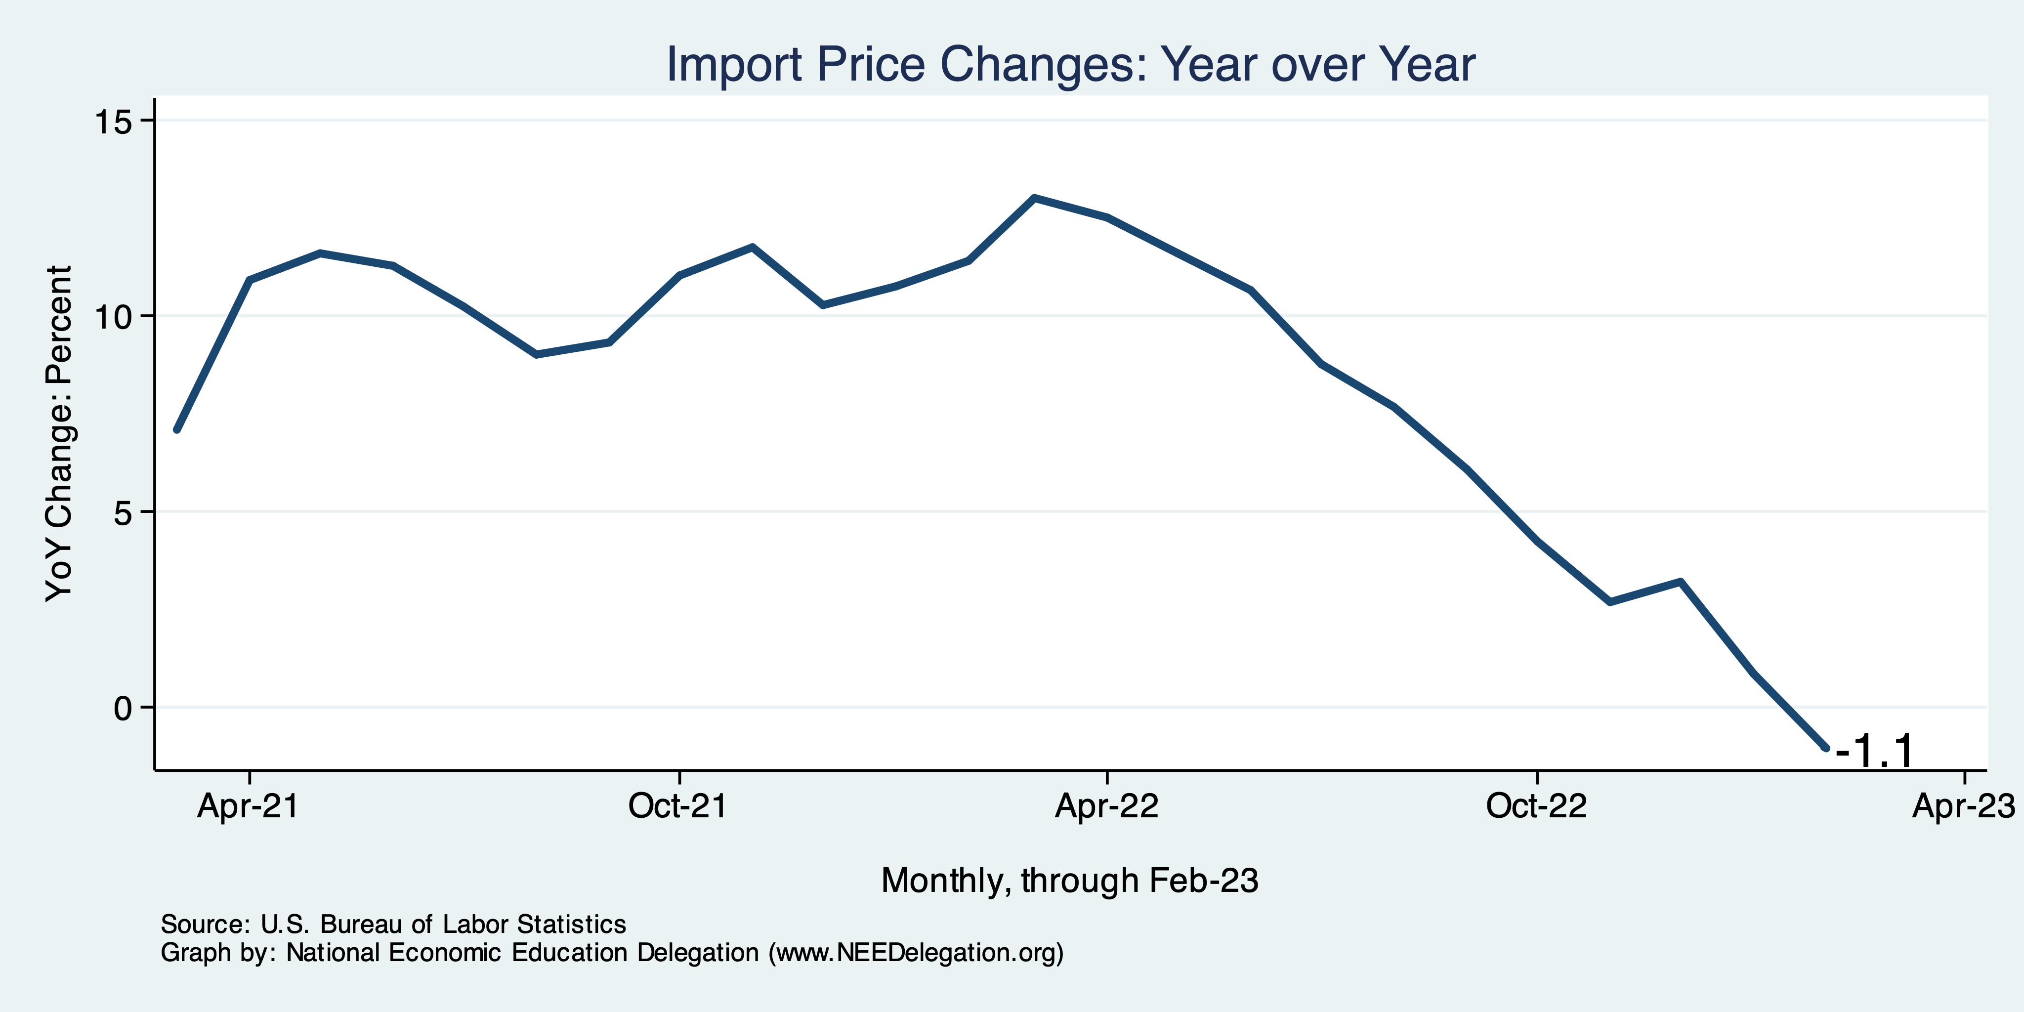
Import Price Inflation WAS Very High
Inflation – Imported Products: 9-10%

Slide 16
My Thoughts on the Sources of Inflation
Supply Chain issues were significant – less so now.
Composition of spending changed significantly.
Is now bouncing back, as are prices.
Corporations have used the cover of inflation to raise prices more.
But there was too much total spending.
Fiscal stimulus led households to increase saving over 2021 by more than $2 trillion. Strong retail sales numbers suggest they are prepared to spend it.
Who is to Blame: ARP probably too big, but the Fed could have acted sooner.
Bottom line: Recovery from a dramatic economic disruption is seldom painless.

Slide 17
What’s the Fed Doing About It?

Slide 18
Fed: Reducing its Asset Holdings
Reducing the Money Supply – A Little
Jun-Aug: $47.5 billion roll off its portfolio every 30 days
Sep: $85 billion.
Quantitative Tightening

Slide 19
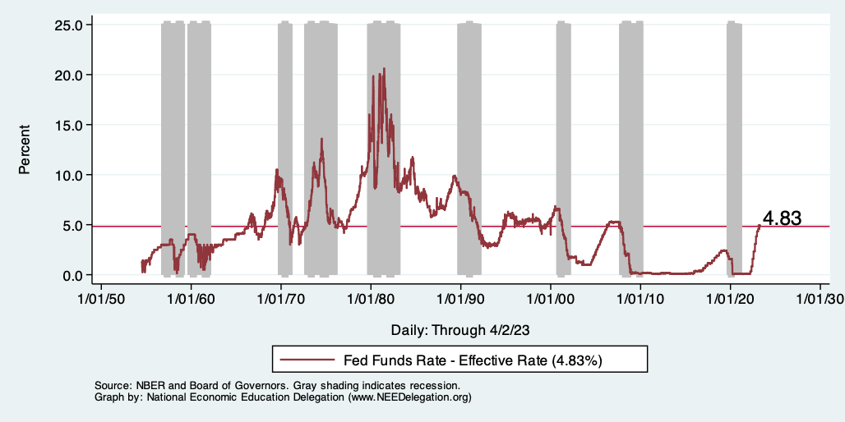
Raising the Federal Funds Rate
Notes:
The fed funds rate is the interest rate on overnight loans between banks. Think of it as the baseline interest rate on which banks base all other interest rates (e.g. mortgage rates)
FOMC lowers the fed funds rate during recessions and raises the fed funds rate during expansions
Fed funds rate peaked in the 1980s as then Chairman Paul Volcker sought to reign in “run away” inflation of the 1970s; doing so resulted in a recession in the early 1980s.
Since the 2008-09 recession, the fed funds rate has been kept near zero.
During the 2008-09 recession, Federal Reserve turned to unconventional tools to influence longer term interest rates to further stimulate the economy - QE
FedFunds.png

Slide 20
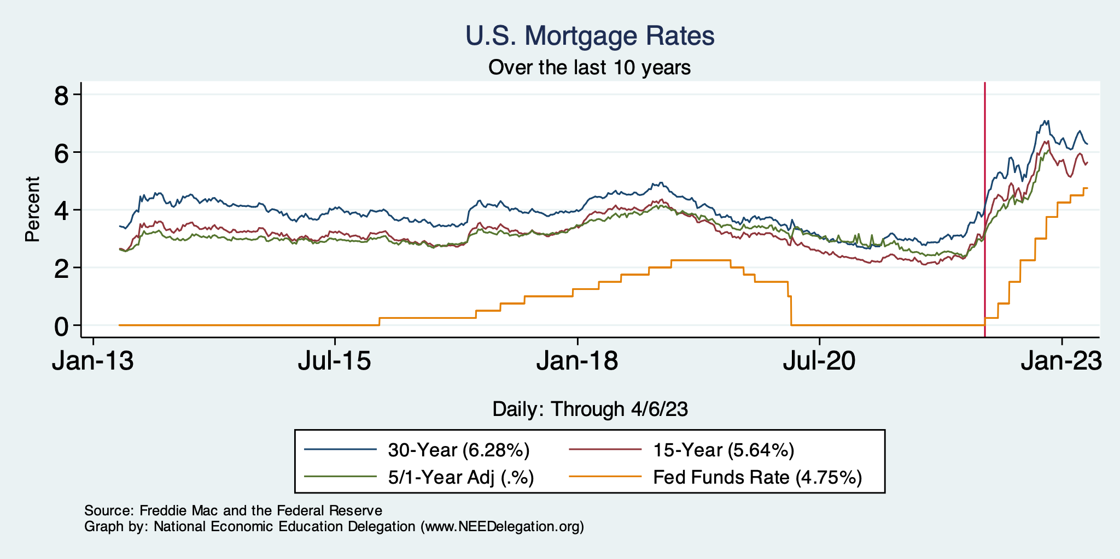
Mortgage Rates

Slide 21
Home Sales Falling…Well, They Had Been

Slide 22
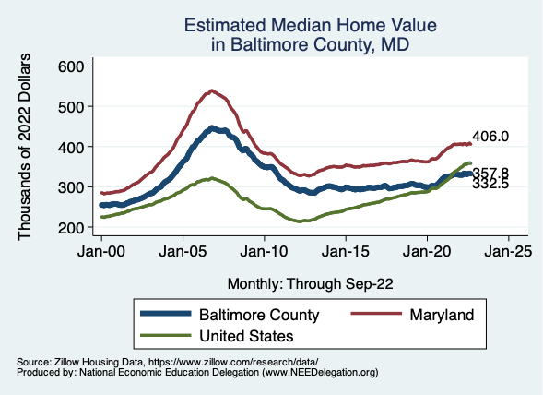
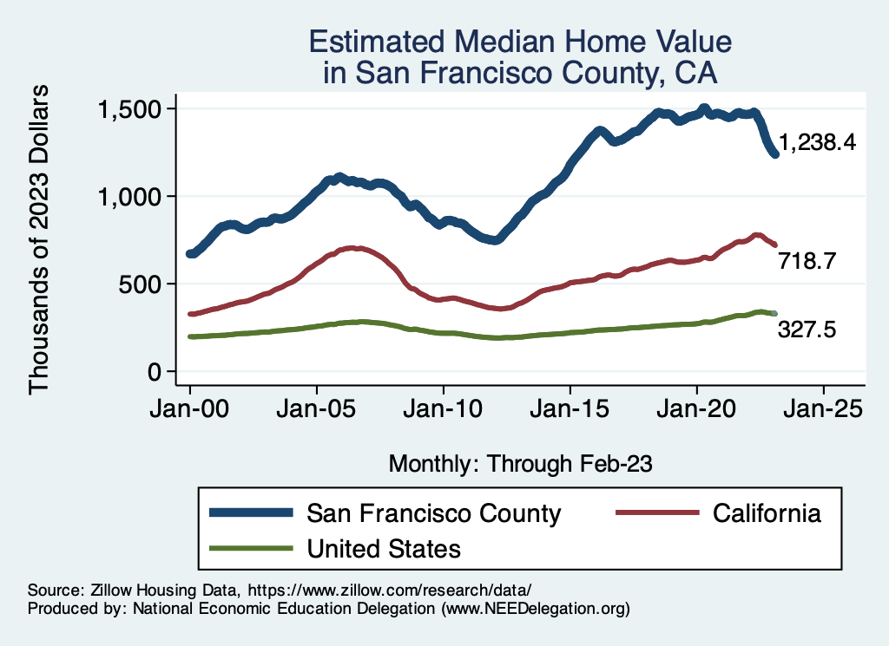
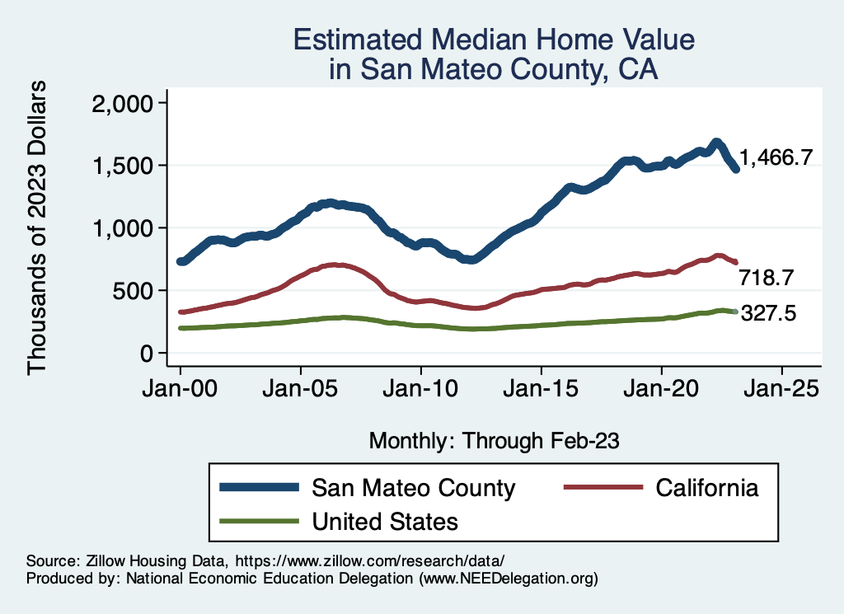
Home Prices … Falling Throughout CA
Notes:
Charts:
homeprices_recession.png
housing.png

Slide 23
And Then Banks Started Falling…

Slide 24
Silicon Valley Bank
Regional mid-sized bank with $212b in assets; $6billion in capitalization (15th largest).
Focused on loans to venture capital and managing the deposit accounts of startups.
Very rapid growth in deposits and assets between 2021 and 2022, which led to big investments in “safe” long-term Treasury bond.
The market value of these bonds fell drastically due to the Fed’s rise in interest rates.
No problem! The bank does not incur “losses” unless it sells the bonds before maturity.
Notes:
JP morgan chase 3.7 trillion

Slide 25
Whoops!
Concentrated and sophisticated depositors see the problem and want to get their money out (FDIC insurance guarantees deposits up to $250 thousand, and 90% above this amount!).
Deposit withdrawals force SVB to sell those bonds.
Precipitating a classic bank run and leading to the FDIC seizing the bank on Friday, a month ago.

Slide 26
FDIC Bank Closures, in General
“Auction” off the failed bank; all depositors paid in full.
Payoff insured deposits and liquidate bank assets
Under Dodd-Frank, the FDIC is supposed to use the cheaper procedure.
In either case, funding comes from banks payments of deposit insurance premium.

Slide 27
But, in This Case:
Janet Yellen announced that all depositors would be paid in full, and there would be complete insurance of all bank deposits for a year.
Senior Executives all fired.
Fed created a new lending program, so that banks can borrow against Treasury bonds without realizing losses.
The rationale was to prevent bank run spreading to other midsize banks.
One other bank recently closed, others were struggling.
Stock prices of a number of similar sized banks have plummeted, but are recovering.

Slide 28
Problems with the Bailout
Political:
Did political favoritism play a role in bailing out well connected, sophisticated silicon valley depositors.
Why didn’t bank regulators see this coming?
Economic: has the moral hazard of “too big to fail” been increased.
For the Fed: Will the Fed have to scale back its interest rate increases to prevent wide scale financial crisis?

Slide 29
Is This a Problem?
Commercial and Industrial Lending - Falling

Slide 30
What About This?

Slide 31
DC: Shall We Create Our Own Financial Crisis?

Slide 32
Existential Threat: Coming This June!

Slide 33
5 Things to Know about the Debt Ceiling
The debt limit has been raised continually for more than a century.
Raising the debt limit is not about new spending; it is about paying for previous choices policymakers legislated.
The uselessness of a debt limit is exhibited by the fact that only one other advanced country—Denmark—has a separate debt limit rule like ours.
If debt hits the ceiling, the Treasury Department uses several accounting gimmicks to postpone the day of reckoning, but these typically last only a few months.
The economic consequences of a large-scale, intentional default are unknown, but predictions range from bad to catastrophic.
Souce: https://www.brookings.edu/2023/01/19/7-things-to-know-about-the-debt-limit/

Slide 34
Lessons from 2011
Government shutdown was very costly:
Stock markets plunged (17%).
Employment growth stuttered.
Treasuries – downgraded credit ratings.
Borrowing costs rose.
The Debt Ceiling may be a very effective bargaining tool, but…
It is costly.
It is unnecessary.
Accidental partial default in 1979:
increased borrowing costs by $40 Billion!

Slide 35
Takeaways
Is a recession on the horizon?
Perhaps, but shallow?
Many indicators are still in the black.
2022-Q4 GDP growth was pretty good!
Threats to continued growth:
If inflation stays high, which seems unlikely.
Layoff contagion.
Debt ceiling negotiations
Significant cuts to government budgets may well result.
Broader banking crisis.
Inflation
Is both a supply and demand side issue. Fed can only work on demand side.
But there are many supply side issues: war, weather, avian flu….
Certainly trending in the right direction.

Slide 36
San Mateo Economy

Slide 37
Employment in San Mateo County?

Slide 38
San Mateo Economy: GDP

Slide 39
The Pandemic Effect: GDP

Slide 40
San Mateo Economy: Employment

Slide 41
The Pandemic Effect: Employment

Slide 42
Local Population Change

Slide 43
Working From Home

Slide 44
San Mateo County: Summary
Home prices are falling as they are elsewhere in CA.
San Mateo County has been altered by the pandemic.
Lots of working from home.
An economy more focused on manufacturing relative to ag.
GDP has grown faster than in CA or the US.
Employment has not.
If this shift is permanent, that could be good for San Mateo County.
However, countywide population declines are concerning.

Slide 45
Thank you!
Any Questions?
www.NEEDelegation.org
Jon D. Haveman
Jon@NEEDelegation.org
Contact NEED: info@NEEDelegation.org
Submit a testimonial: www.NEEDelegation.org/testimonials.php
Become a Friend of NEED: www.NEEDelegation.org/friend.php

Slide 46
www.NEEDelegation.org/LocalGraphs
For every state and county in the United States.
Detailed graphs on employment, housing, moves, and other statistics.

Slide 47
GDP Trajectory: Pandemic Plunge!
GDP is:
$0.3 Trillion below 2019 forecast.
$1.2 Trillion ABOVE 2019-Q4 level.

Slide 48
Industrial Production (Manuf, Util, Mining)

Slide 49
Monthly Changes in Nonfarm Employment
Notes:
PAYEMS.png

Slide 50
Some Explanations
500 Thousand: Long COVID Exits
1-2%: Long Social Distancing

Slide 51
But SUPER High to Begin With!

Slide 52
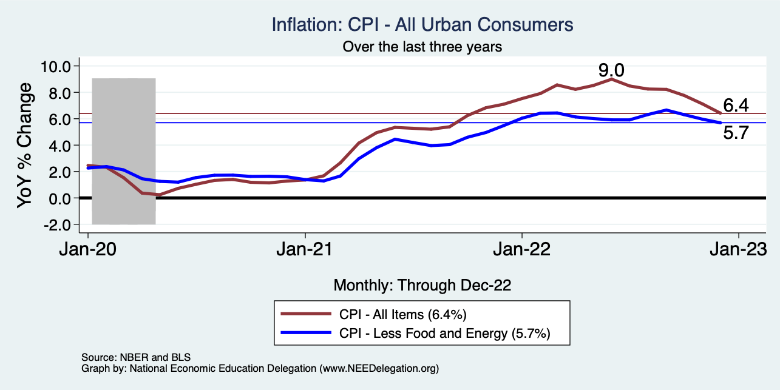
Inflation – Falling! Job is not done.
Notes:
Cpi_recent.png

Slide 53
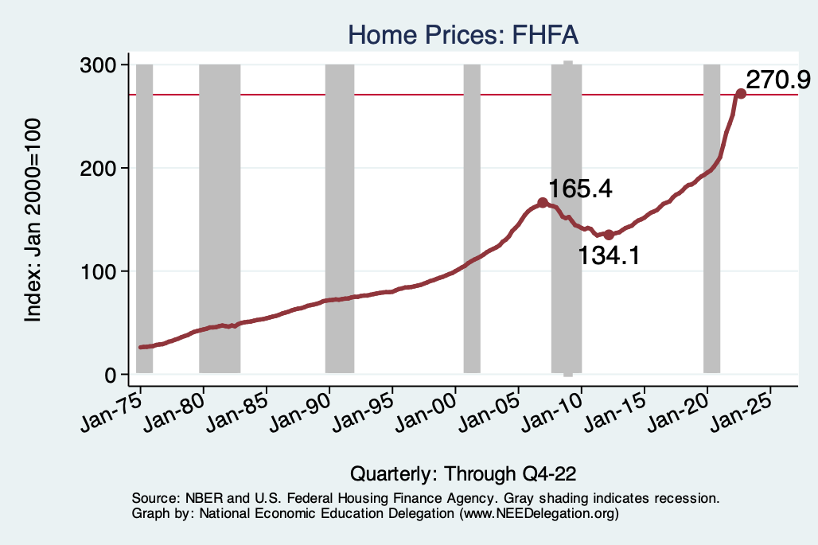
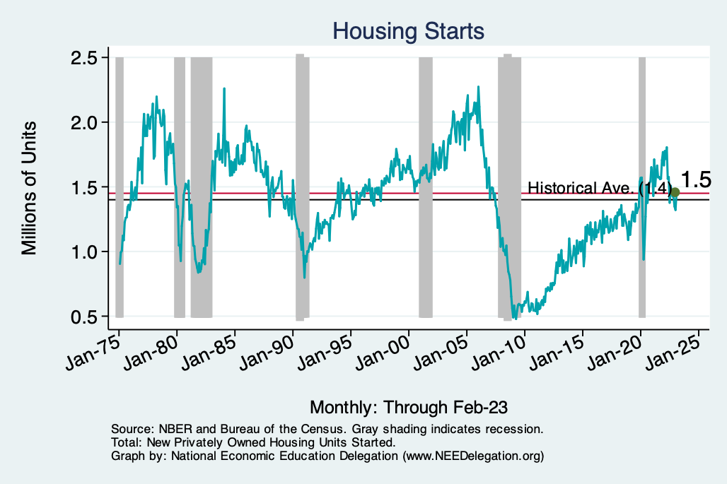
Home Prices and Housing Starts
Notes:
Charts:
homeprices_recession.png
housing.png

Slide 54
Banking Crisis and Bank Credit

Slide 55
Banking Crisis has Hit Commercial Loans

