Slide 1
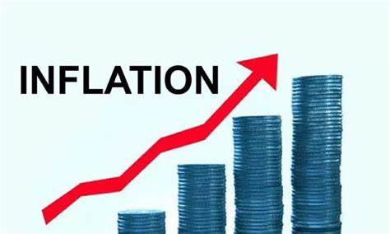
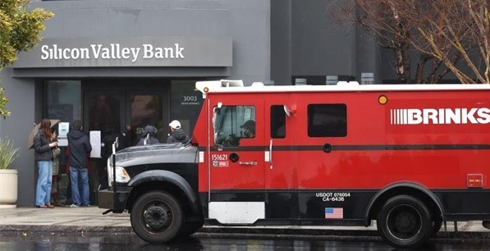
The Federal Debt, The Economy,
and Social Programs
Financial Forum, Rossmoor
July 23, 2023
Jon Haveman, Ph.D.
NEED

Slide 2
National Economic Education Delegation
Vision
One day, the public discussion of policy issues will be grounded in an accurate perception of the underlying economic principles and data.
Mission
NEED unites the skills and knowledge of a vast network of professional economists to promote understanding of the economics of policy issues in the United States.
NEED Presentations
Are nonpartisan and intended to reflect the consensus of the economics profession.

Slide 3
Who Are We?
Honorary Board: 54 members
2 Fed Chairs: Janet Yellen, Ben Bernanke
6 Chairs Council of Economic Advisers
Furman (D), Rosen (R), Bernanke (R), Yellen (D), Tyson (D), Goolsbee (D)
3 Nobel Prize Winners
Akerlof, Smith, Maskin
Delegates: 652+ members
At all levels of academia and some in government service
All have a Ph.D. in economics
Crowdsource slide decks
Give presentations
Global Partners: 48 Ph.D. Economists
Aid in slide deck development

Slide 4
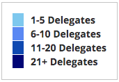
Where Are We?

Slide 5
Available NEED Topics Include:
US Economy
Healthcare Economics
Climate Change
Economic Inequality
Economic Mobility
Trade and Globalization
Minimum Wages
Immigration Economics
Housing Policy
Federal Budgets
Federal Debt
Black-White Wealth Gap
Autonomous Vehicles
Healthcare Economics

Slide 6
Credits and Disclaimer
This slide deck was authored by:
Jon D. Haveman, NEED
Scott Baier, Clemson University
Geoffrey Woglom, Amherst College (Emeritus)
Brian Dombeck, Lewis & Clark College
Doris Geide-Stevenson, Weber State
Disclaimer
NEED presentations are designed to be nonpartisan.
It is, however, inevitable that the presenter will be asked for and will provide their own views.
Such views are those of the presenter and not necessarily those of the National Economic Education Delegation (NEED).

Slide 7
Outline
Federal Debt, Briefly
The State of the Economy
Inflation
Federal Debt & Social Programs

Slide 8
Federal Debt: Big and Getting Bigger

Slide 9
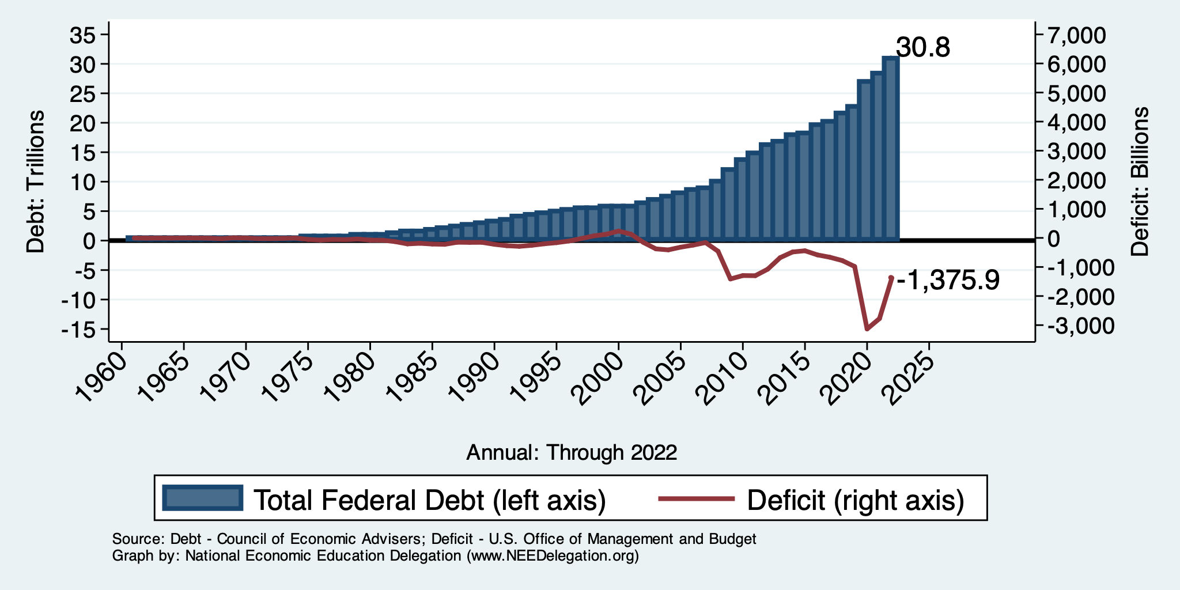
Debt vs. Deficit
Debt = The Sum of All Past Deficits Less Surpluses
Notes:
Debt2deficit.png

Slide 10
The Debt Over Time

Slide 11
Federal Debt: One Important Caveat

Slide 12
The Debt Over Time: 2 Types

Slide 13
Federal Debt: A Second Important Caveat
CBO analyzes the debt relative to GDP because:
To the extent that debt and deficits have burdens, these burdens depend on the size of the debt relative to the size of the economy.
 | Total Public Debt | Relative Debt Debt/GDP
United States | $24.7 Trillion | 96.6%
Greece | $0.215 Trillion | 170%
We care about public debt RELATIVE to GDP, not it’s ABSOLUTE level.

Slide 14
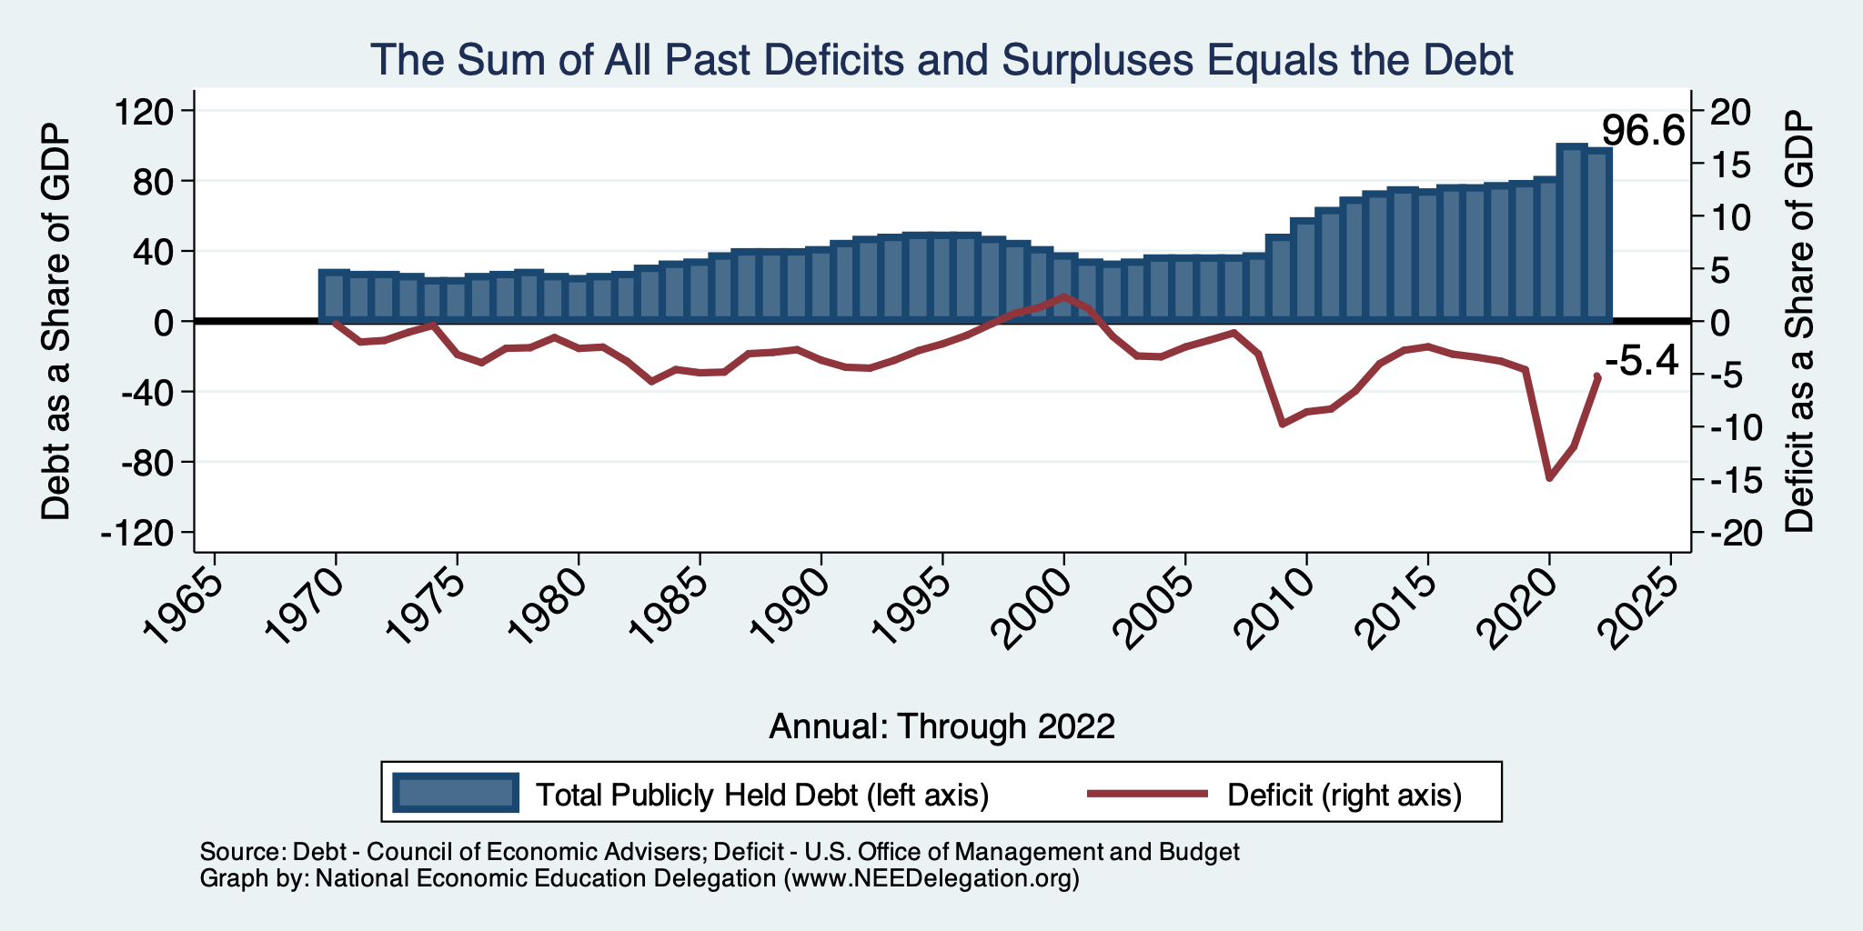
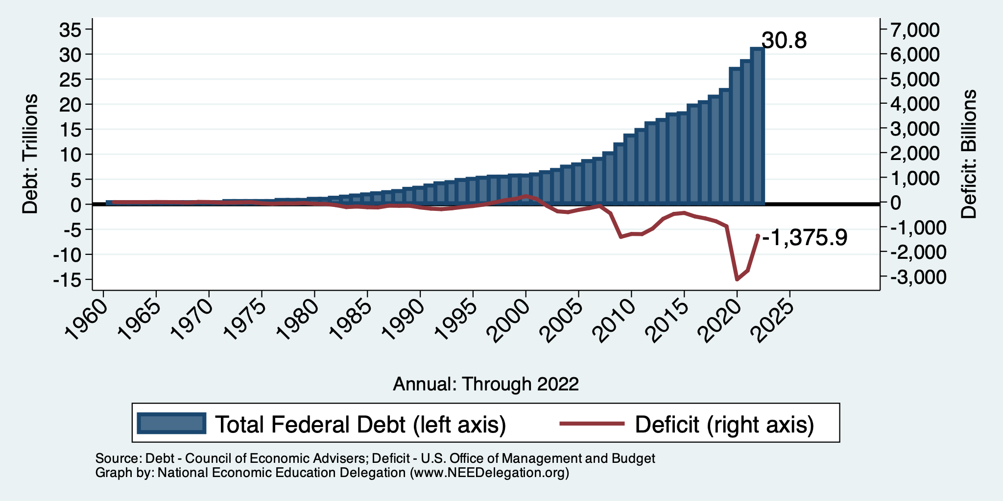
Relative Debt and Deficit
Notes:
Debt2deficit.png

Slide 15
The U.S. Economy

Slide 16
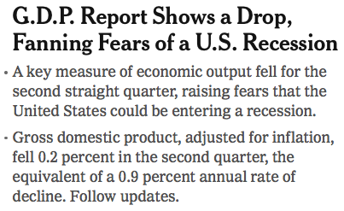
Headline: July 28, 2022
Old news….

Slide 17
GDP: Quarterly Growth
Q3-2022: 3.2%
Q4-2022: 2.6%
Q1-2023: 2.0%
Notes:
Graph: gdp_pot_grow.png
The Point: From 1990 – 2007, average annual US GDP growth pre-crisis is 2.94%. However, post-crisis US GDP growth is 2.19% (0.75 percentage points lower). Why is has the recovery been sluggish?
Note: At the recession’s height, the gap between quarterly GDP growth and potential growth was 2.5 percentage points.

Slide 18
Monthly Changes in Nonfarm Employment
April: 217,000
May: 306,000
June: 209,000
NYT Recession Q
Notes:
PAYEMS.png

Slide 19
Employment Gap
3.8 Million ABOVE February, 2020.
5.0 Million BELOW where we should be.
Notes:
payroll_recent.png

Slide 20
Where Have All the Workers Gone?
2.7 million below where we should be

Slide 21
How Are Things Where You Are?

Slide 22
More slides like this:
www.NEEDEcon.org/LocalGraphs

Slide 23
Inflation

Slide 24
Inflation: Latest Figures – 3%
Source: NYTimes.com, Bureau of Labor Statistics

Slide 25
Inflation is Not just a U.S. Problem

Slide 26
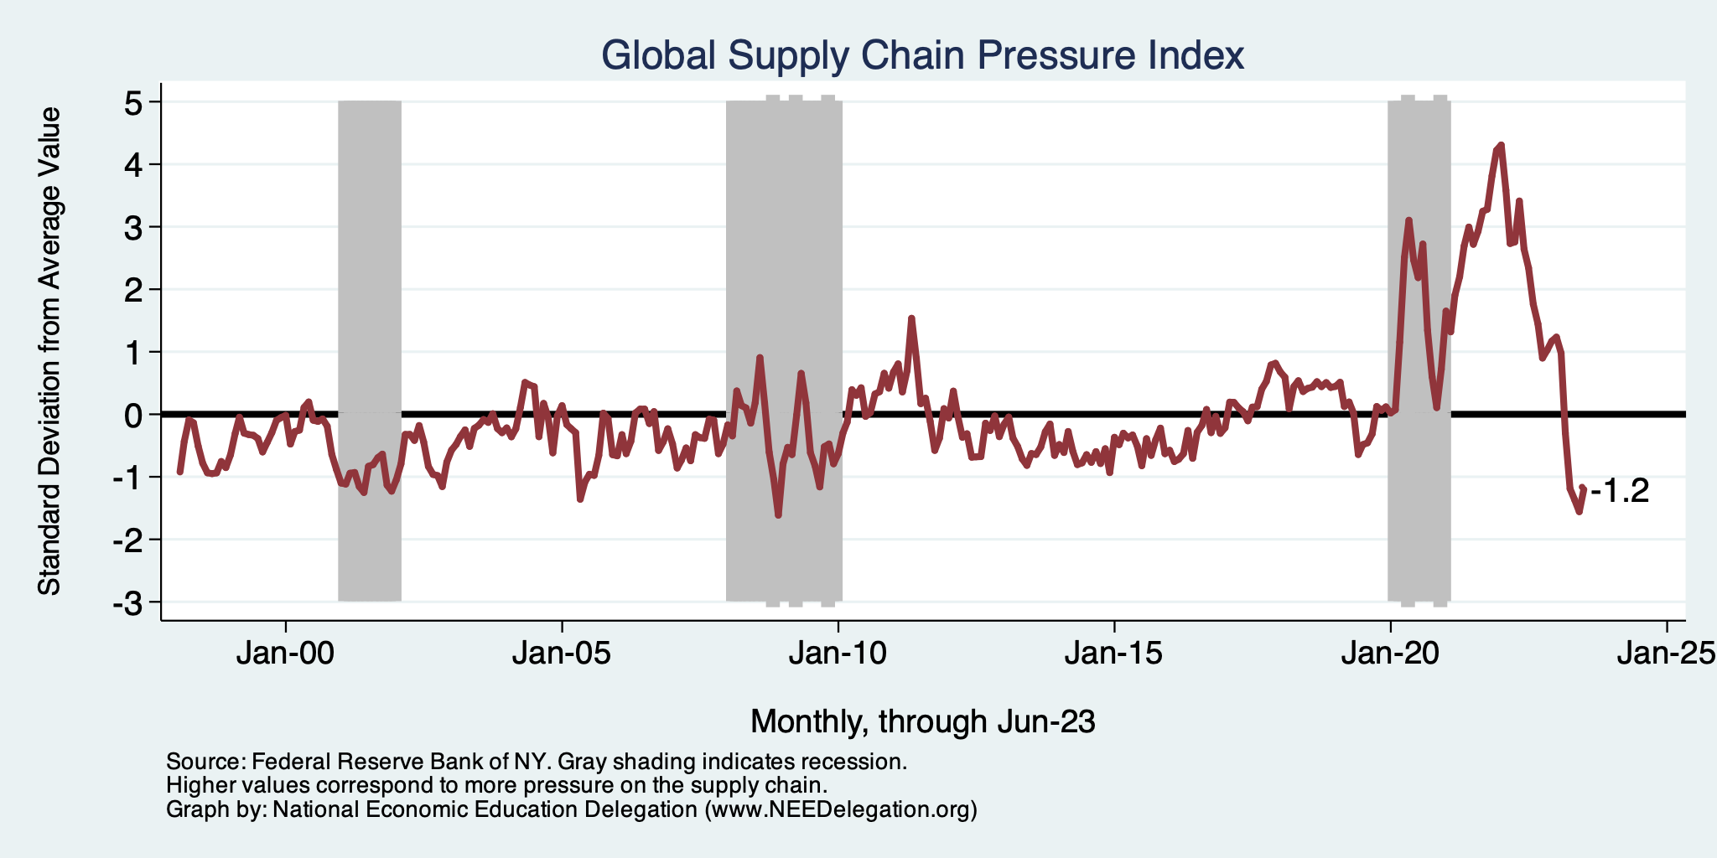
Supply Chains

Slide 27
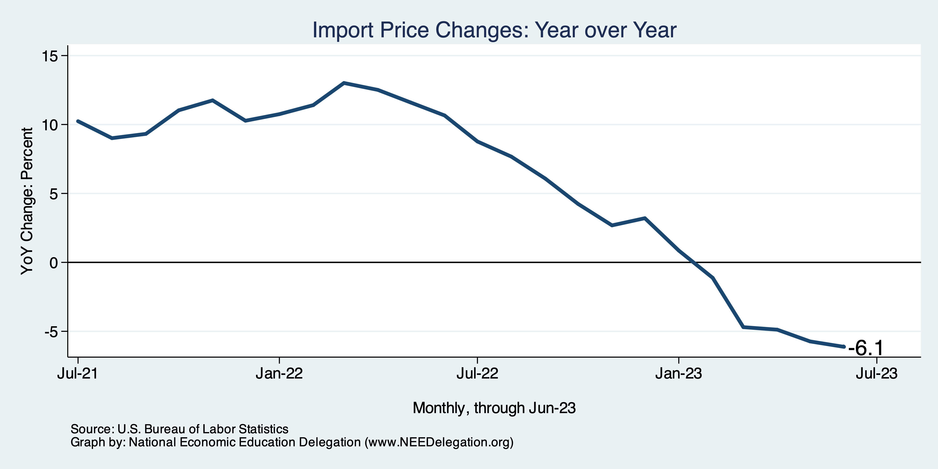
Import Price Inflation WAS High
Inflation – Imported Products: 9-10%

Slide 28
Corporations Had Pricing Power!
Corporate Profits

Slide 29
My Thoughts on the Sources of Inflation
Supply Chain issues were significant – not at all now.
Import price inflation was high – negative now.
Corporations have used the cover of inflation to raise prices more.
Composition of spending changed significantly.
Is now bouncing back, as are prices.
But there was too much total spending.
Fiscal stimulus led households to increase saving over 2021 by more than $2 trillion.
Strong retail sales numbers suggest they are prepared to spend it.
Whose to Blame: ARP possibly too big, but the Fed could have acted sooner.
Bottom line: Recovery from a dramatic economic disruption is seldom painless.

Slide 30
What’s the Fed Doing About It?

Slide 31
Federal Funds Rate – Recent Activity
Expect a Pause in Rate Increases 🤞

Slide 32
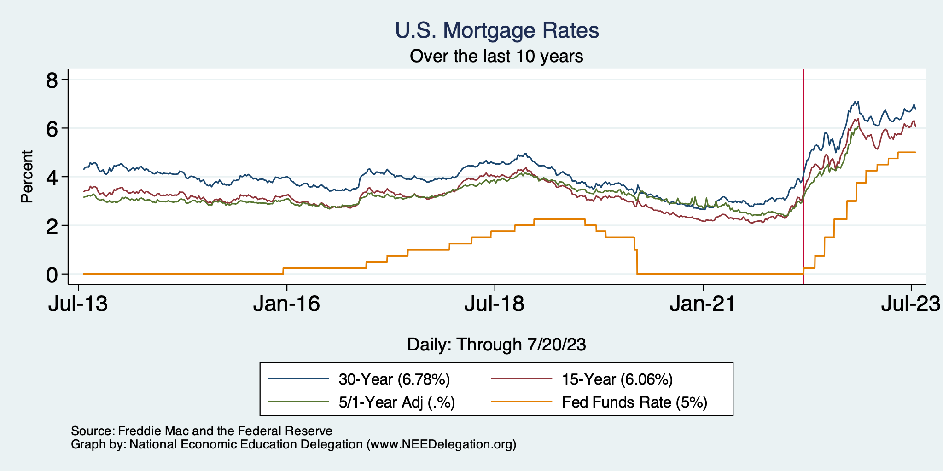
Mortgage Rates

Slide 33
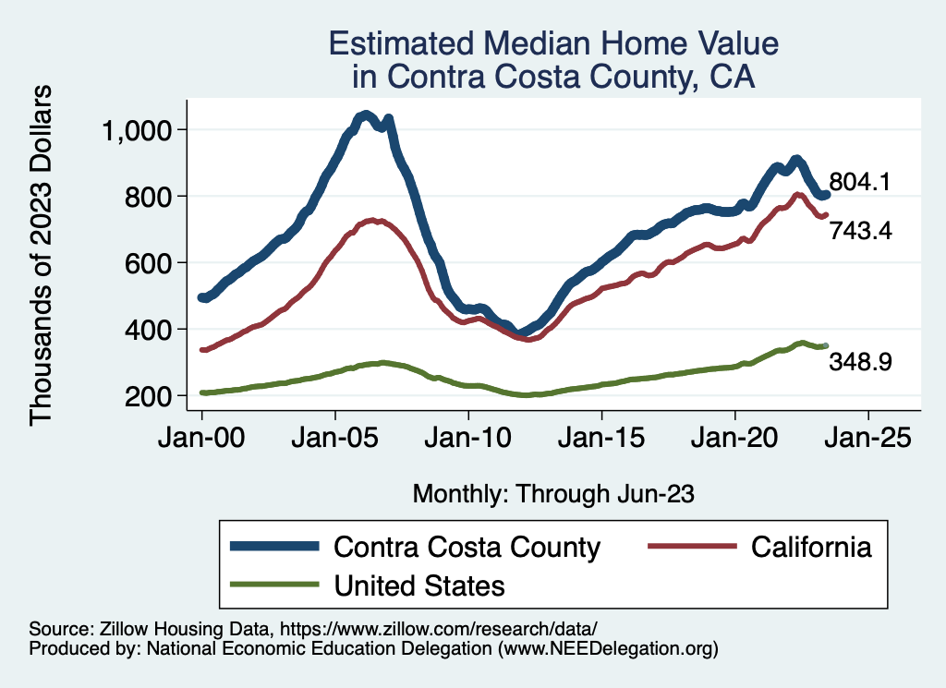
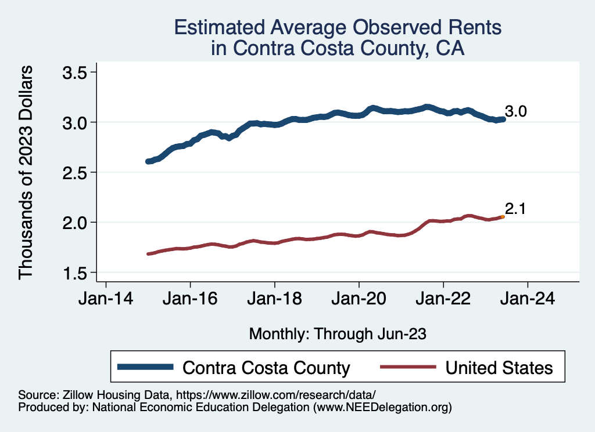
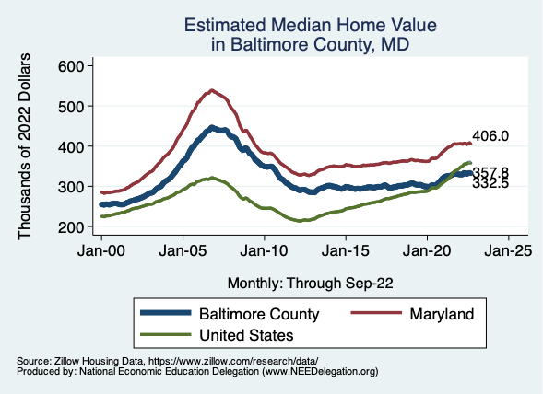
Home Prices … Falling as Interest Rates Rise
Notes:
Charts:
homeprices_recession.png
housing.png

Slide 34
Takeaways
Is a recession on the horizon?
Perhaps, but shallow?
Many indicators are still in the black.
2023-Q1 GDP growth was solid.
Employment growth is solid.
Threats to continued growth:
If inflation starts to rise again, which seems unlikely.
Higher interest rates.
Bullets dodged:
Debt negotiations.
Banking crisis.
Inflation (shhh….)
Other than the debt ceiling, the debt is not currently a threat to the economy.

Slide 35
What About the Debt?

Slide 36
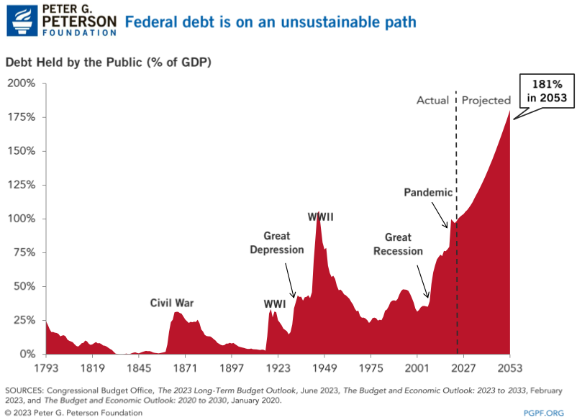
The Federal Debt is Becoming A Problem

Slide 37
Why? Expenditures Exceed Revenues

Slide 38
So, The Answer is:
CUT EXPENDITURES!!!!
Not so fast. Revenues have been slashed…..

Slide 39
Tax Cuts Have Driven The Debt Increases
Trump Tax Cuts: 6% of GDP
Bush Tax Cuts: 32% of GDP
Great Recession & COVID: 26% of GDP
The rest: 34% of GDP
Up from 31% in 2001

Slide 40
So, The Answer is:
RAISE REVENUES!!!!
Not so fast. Worth looking at expenditures as well…..
Mostly to get a broader perspective on how to solve the problem.

Slide 41
Interest Will Grow as a Share of the Deficit
Percent
Primary
Interest
Source: CBO 2022 Long Term Budget Outlook

Slide 42
What Are the Primary Drivers Going Forward?
Social Security
And Medicare
Source: CBO 2022 Long Term Budget Outlook

Slide 43
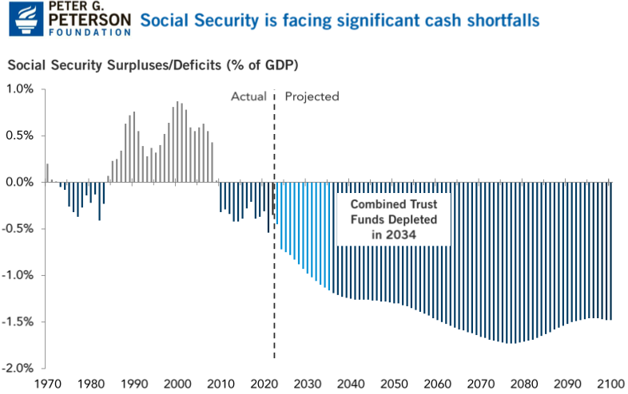

Slide 44
Medicare Trust Fund Balance

Slide 45
Will These Programs Become Insolvent?
No. They just have a revenue shortfall.

Slide 46
These Revenue Shortfalls …
Don’t need to be fixed.
Can be handled by allocations from general revenues.
Or, we can use them to provide insights into how to solve the growing debt problem!

Slide 47
For Example: Social Security Solutions
Raise the retirement age.
I don’t like this as it has real equity implications.
Raise the level of taxation above 12.4%.
I don’t like this as it has real equity implications and we could…
Raise the income limit on social security contributions.
Currently $160,200.
Tax $400,000+ and non-wage sources of income.
Surpluses for more than 75 years.

Slide 48
Solutions to the Debt Problem
Can NOT just look at expenditures.
Revenues have been slashed over the last 25 years.
Which is the primary source of the debt problem.
However, important to look at specific categories of expenditures for the best solutions.

Slide 49
Do We Really Have A Debt Problem?
Probably: Growing unsustainably.
Is the current level, or even the level in 2053 a “Problem”?
I don’t know.
But the instability of the debt is surely a problem.
One that needs to be addressed ASAP.
The problem grows over time, and solutions become more painful.

Slide 50
Thank you!
Any Questions?
www.NEEDEcon.org
Jon Haveman, Ph.D.
Jon@NEEDEcon.org
Contact NEED: info@NEEDEcon.org
Submit a testimonial: www.NEEDEcon.org/testimonials.php
Become a Friend of NEED: www.NEEDEcon.org/friend.php

