Slide 1



U.S. & Sonoma County
Economic Update
Leadership Santa Rosa
Business & Economy Day
Jon Haveman, Ph.D.
NEED
July 16, 2026

Slide 2
Available NEED Topics Include:
US Economy
Healthcare Economics
Climate Change
Economic Inequality
Economic Mobility
Trade and Globalization
Minimum Wages
Immigration Economics
Saving Social Security
Federal Budgets
Federal Debt
Black-White Wealth Gap
Autonomous Vehicles
Healthcare Economics

Slide 3
Outline
Economic Indicators
Big Picture: Uncertainty
Sonoma County

Slide 4
Economic Indicators

Slide 5
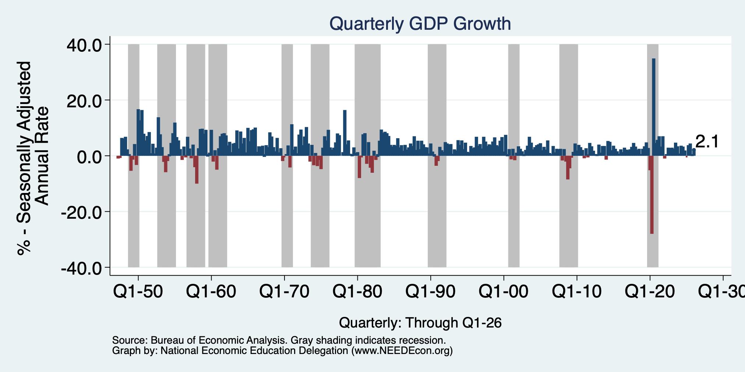
GDP: Quarterly Growth
Q2-2025: 3.8%
Q3-2025: 4.4%
Q4-2025: 0.5%
Q1-2026: 2.1%
Growth in 2025: 2.1%
Notes:
Graph: gdp_pot_grow.png
The Point: From 1990 – 2007, average annual US GDP growth pre-crisis is 2.94%. However, post-crisis US GDP growth is 2.19% (0.75 percentage points lower). Why is has the recovery been sluggish?
Note: At the recession’s height, the gap between quarterly GDP growth and potential growth was 2.5 percentage points.

Slide 6
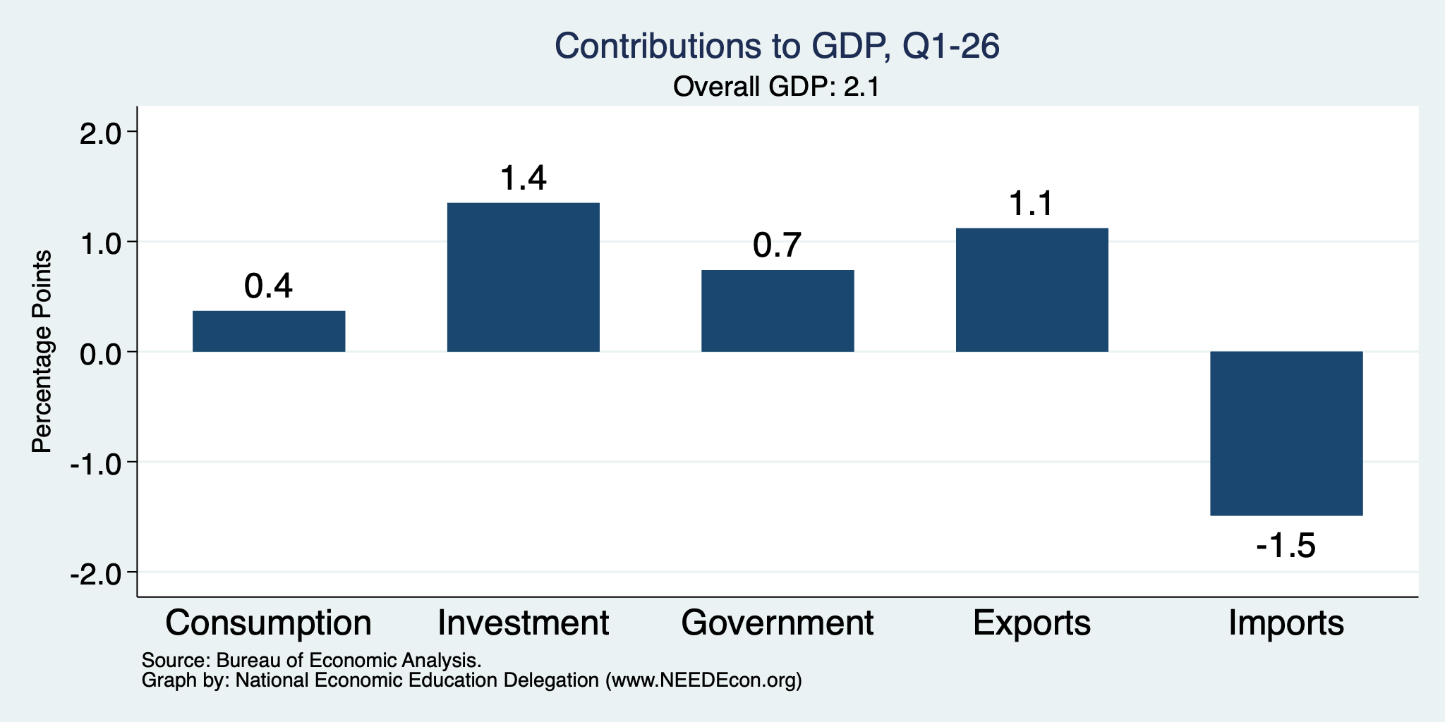
What Drove GDP to Such Growth?
Normally
1.6%
Normally
0.9%

Slide 7
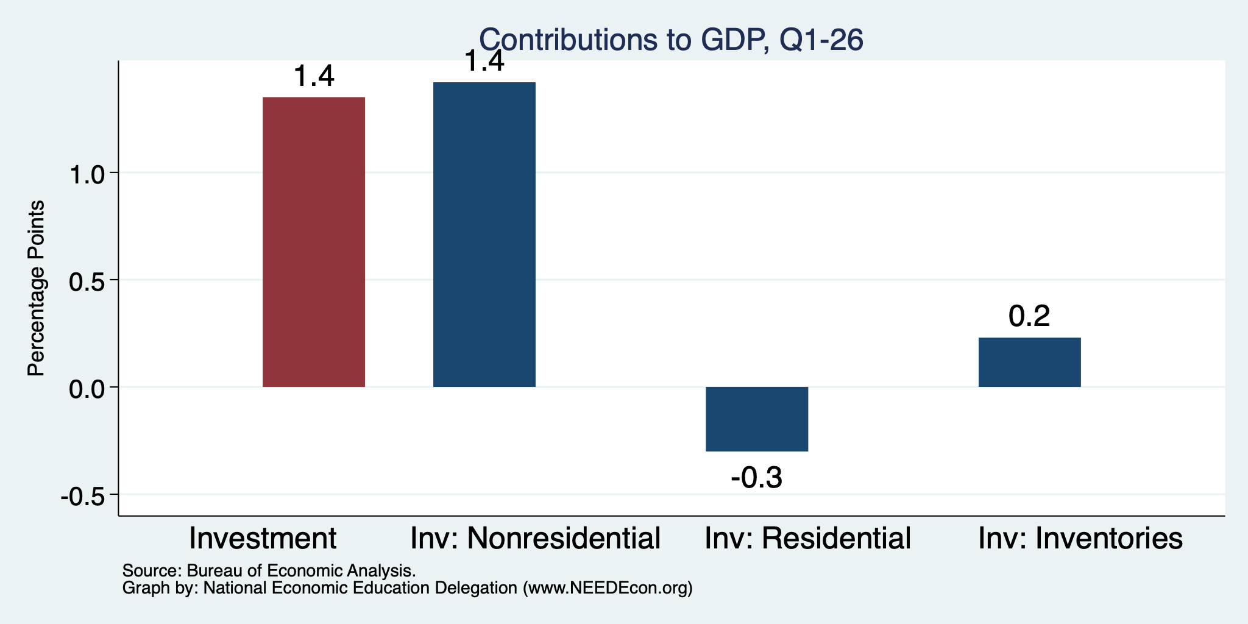
Investment: It’s All About AI
Normally
0.7%

Slide 8
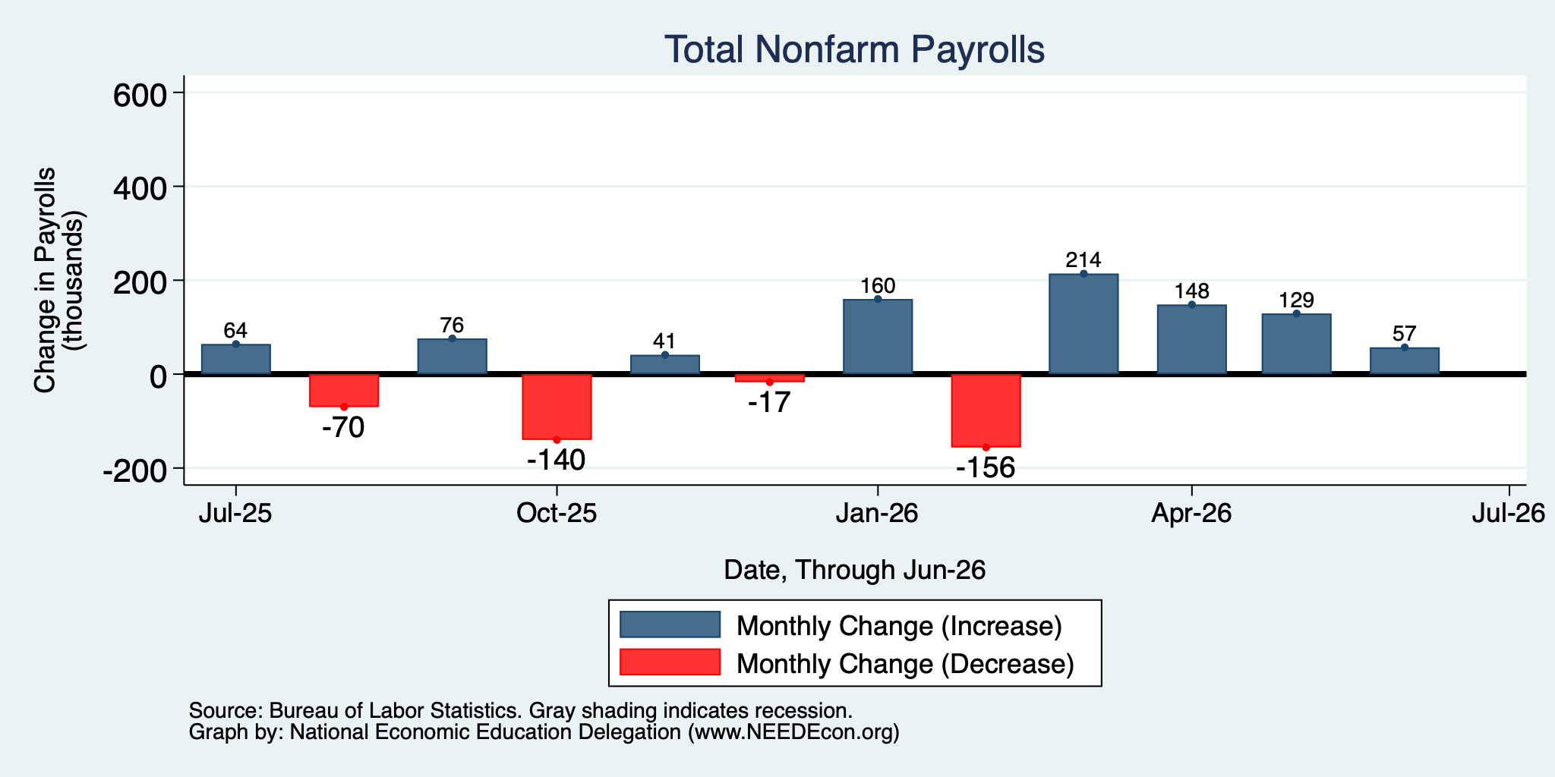
Monthly Changes in Nonfarm Employment
Apr: 148,000
May: 129,000
June: 57,000
Notes:
PAYEMS.png

Slide 9
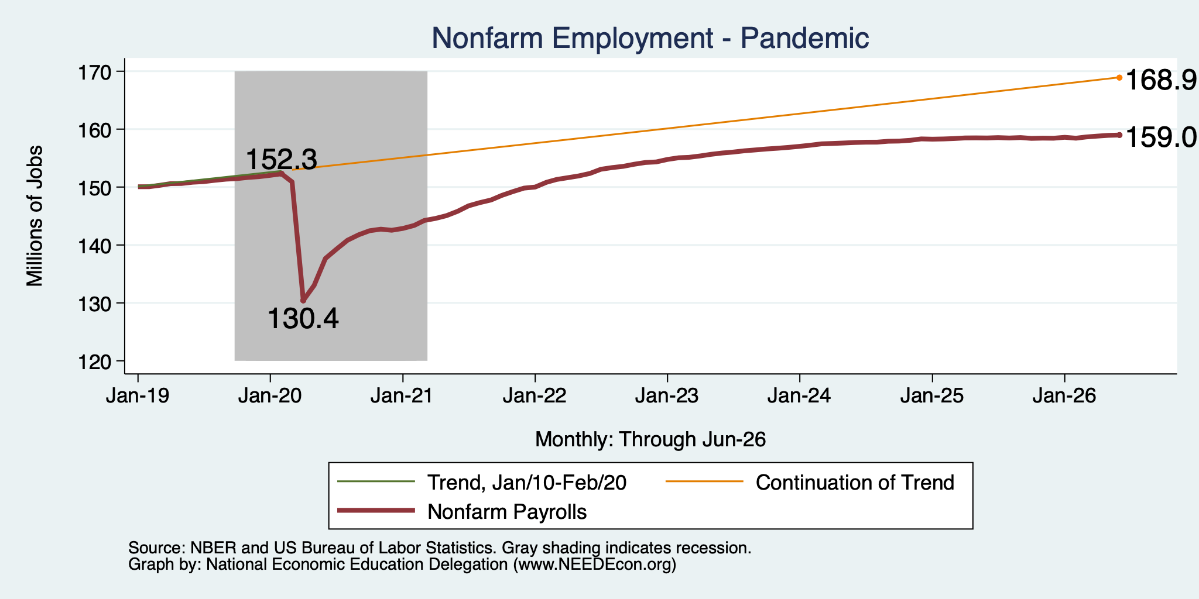
Employment Gap … is Growing
6.7 Million ABOVE February, 2020.
9.9 Million BELOW where we should be.
Notes:
payroll_recent.png

Slide 10
Where Are The Workers Going?
Boomer retirements
Deportations
Discouraged workers
4.9 million ABOVE Feb 2020
5.0 million BELOW where we should be

Slide 11
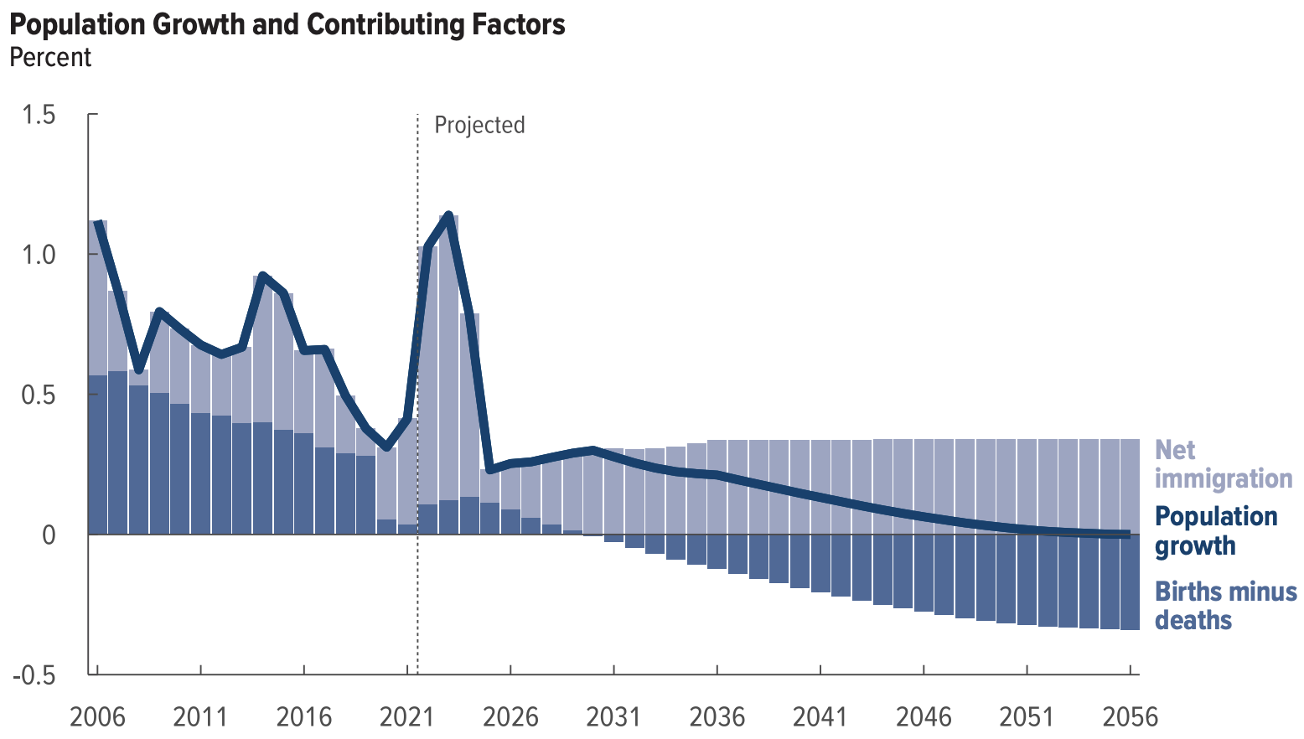
Is Immigration Saving the Day?
The majority of additions to the
Population in recent years
Have come from immigration.
Source: CBO – The Demographic Outlook, 2026-2056

Slide 12
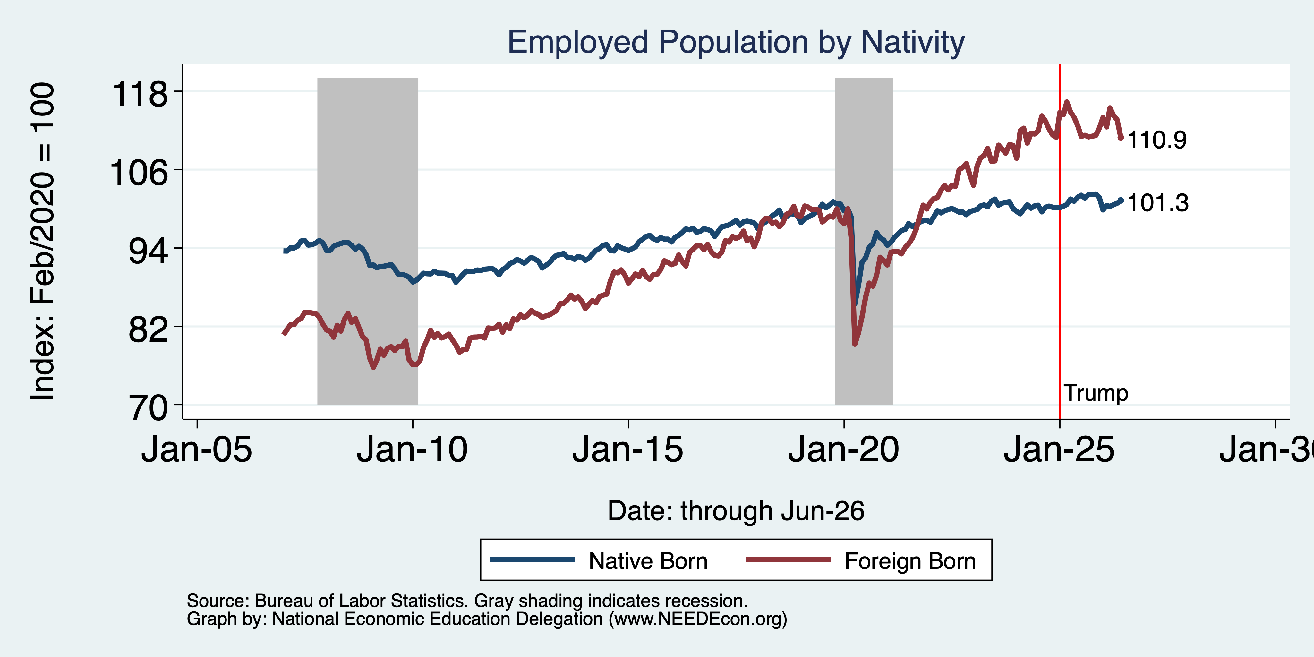
Immigrants to the Rescue? Less So Now
Feb/20 to Now:
Native Growth: 2,810
Foreign Growth: 3,153
Notes:
Feb 2020: 130,320 Native born 27,697 foreign born
Aug 2025: 132,474 Native 30,816 foreign born March 2025 peak: 32,225

Slide 13
Some Notes on Employment Growth
Slowing over the last couple of months.
  Ragged before that.
  Likely connected to slow labor force growth.
The slower pace is ok: Just have to keep up with population growth.
Growth is primarily coming from among the foreign born.
ALL growth is coming from Healthcare and Social Services.
Women now occupy more nonfarm jobs than men.

Slide 14
Inflation

Slide 15
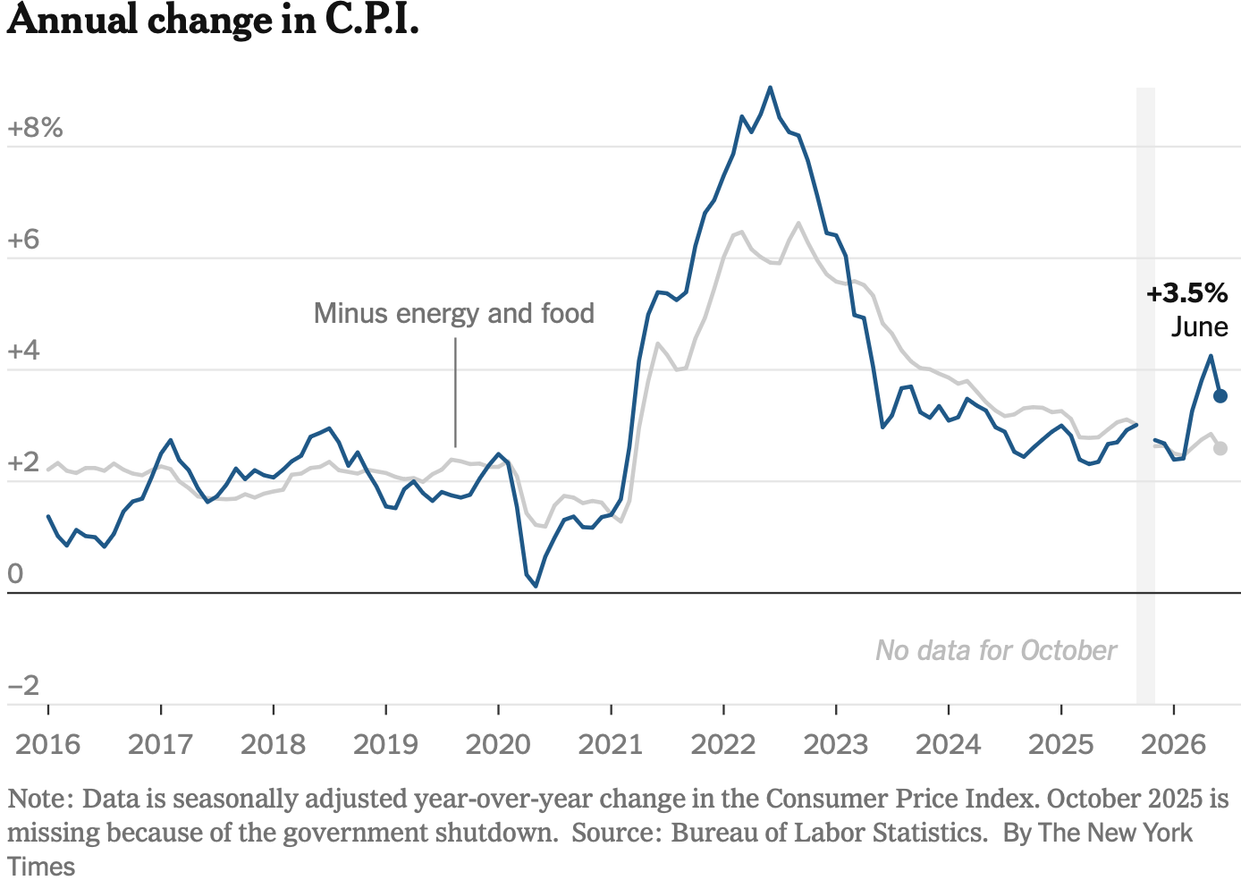
Inflation: Latest Figures – to June/26
The uptick is entirely because of the war.
Source: NYTimes.com

Slide 16
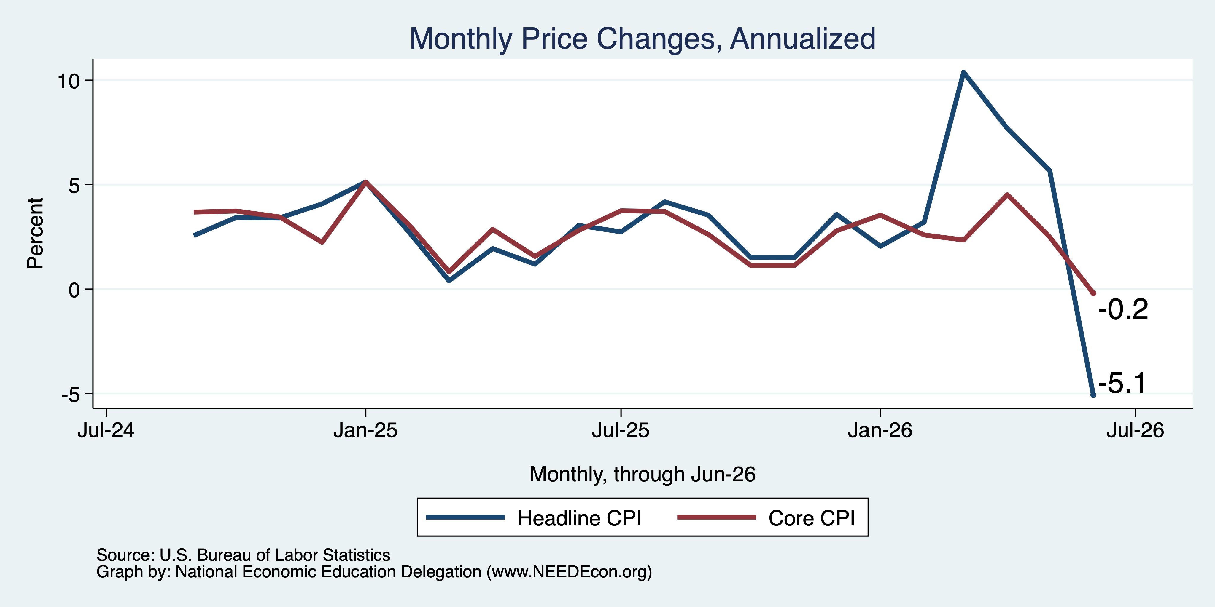
CPI – Big Price Declines in Last Month

Slide 17
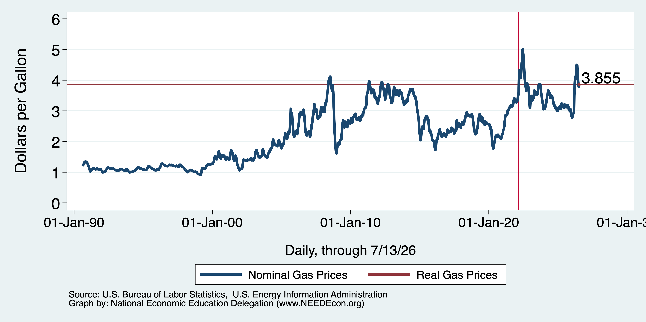
Inflation: Gas Prices

Slide 18
The Fed: Reining in Inflation?

Slide 19
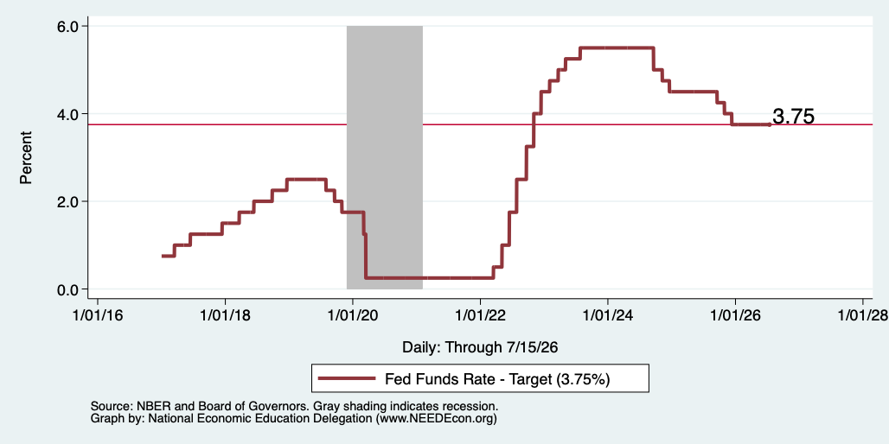
Federal Funds Rate – Recent Activity

Slide 20
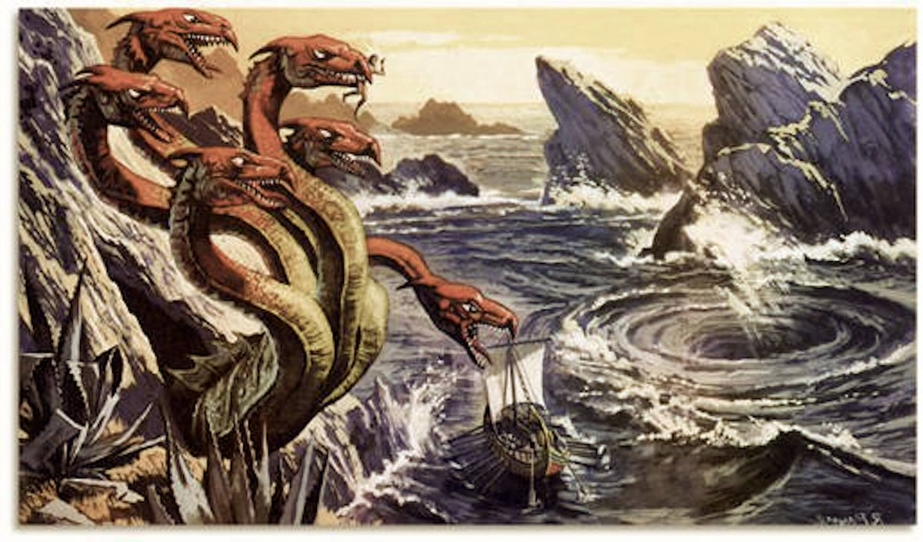
Scylla and Charybdis: “A Rock and a Hard Place”
Inflation
Jerome Powell
And now
Kevin Warsh
Recession
(Unemployment)

Slide 21
Bigger Picture: Uncertainty

Slide 22
Uncertainties
What effect will continued deportations have?
Will AI continue to drive growth?
Will tariffs continue to drive inflation?
  Fed says that ALL of the inflation above 2% is from tariffs, until…
Will the war drive inflation beyond fuel prices?
  It is clear in fuel prices, but every other sector of the economy depends on fuel. Higher fuel prices drive prices in the rest of the economy up.
Will consumers continue to hold up?
  Evidence that spending is in decline.
What happens to Fed policy now that Jerome Powell is gone?

Slide 23
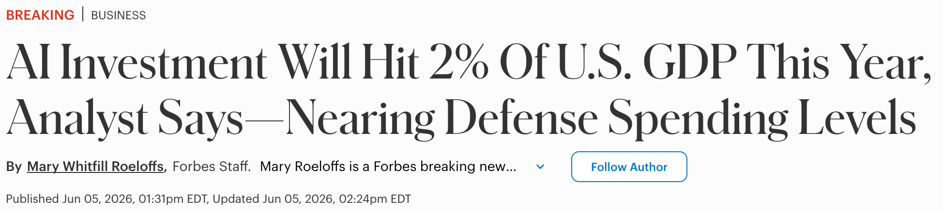
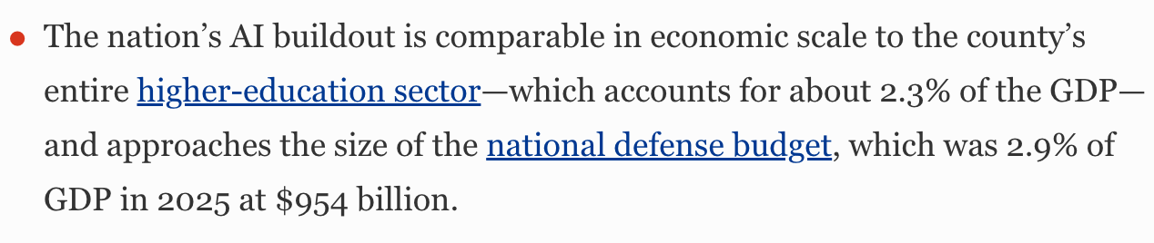

Slide 24
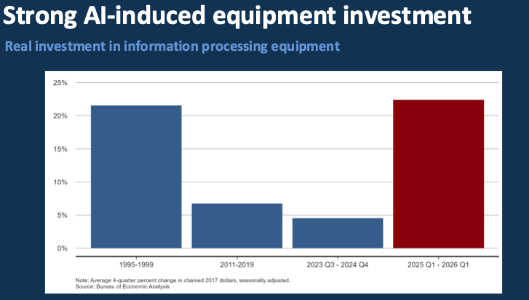
Source: Presentation given by Sylvain Leduc to the Monterey Bay Economic Partnership

Slide 25
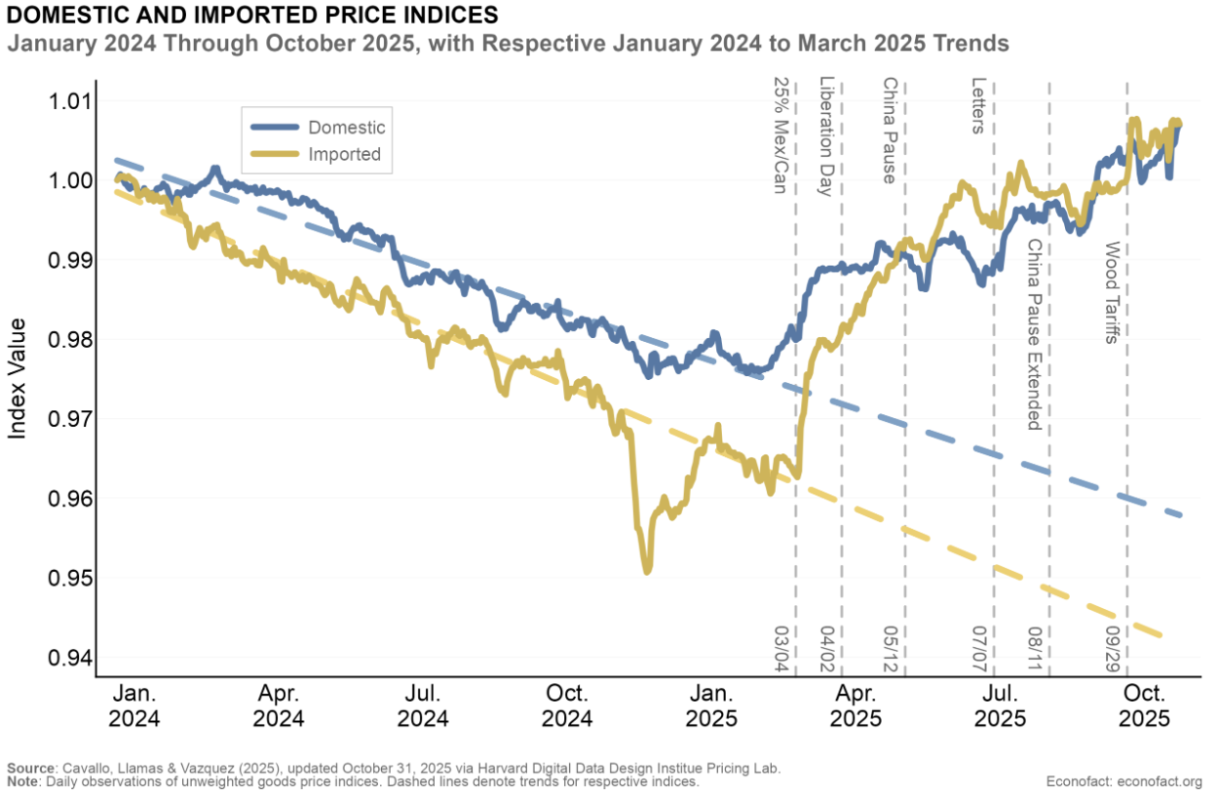
Tariffs and Price Effects

Slide 26
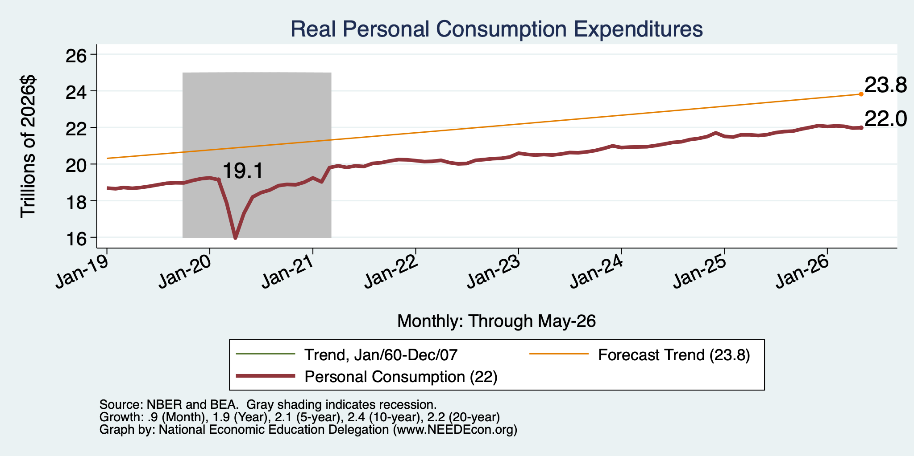
Personal Consumption Expenditures Are Slowing

Slide 27
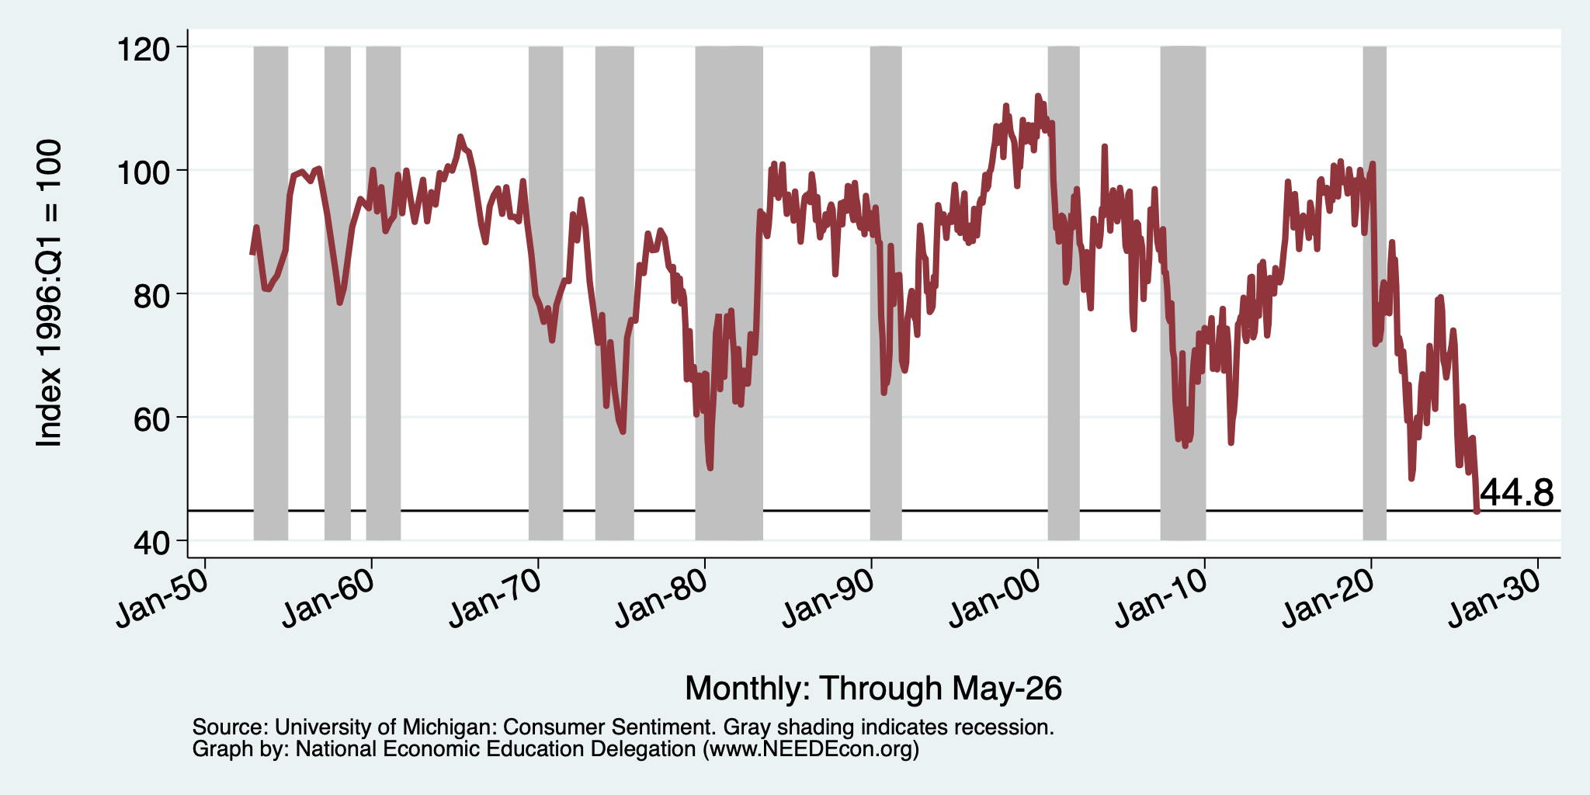
Consumer Confidence is Waning
At its lowest level ever!
(56-year history)

Slide 28

Monetary Policy after Jerome Powell?
Kevin Warsh: replaced Jerome Powell as the Chair of the Fed in May.

Slide 29
Summary
Inflation: was getting close to Fed’s 2% target.
  But is now going in the wrong direction
Current immigration and trade policies will exacerbate inflation.
Immigration: deportations tax the economy and are expensive.
  Many, MANY ag workers are unauthorized immigrants. (50% of Central Valley)
Tariffs: are a tax.
  Taxes raise prices. Period. Full Stop.
  Taxes often cost jobs. Tariffs likely will.
The war is going to drive up prices and uncertainty.
  Nobody invests into uncertainty.
What if the AI bubble bursts?

Slide 30
Are We Headed for A Recession?
Probably not.
Forecasts are all over the place.
  IMF forecasting 2.4% in 2026.
  30-50% chance of a recession by some models.
A slowdown in economic growth seems inevitable.
  But the economy has been proving remarkably resilient!
A bout of stagflation unlikely, but possible.

Slide 31
Locally

Slide 32
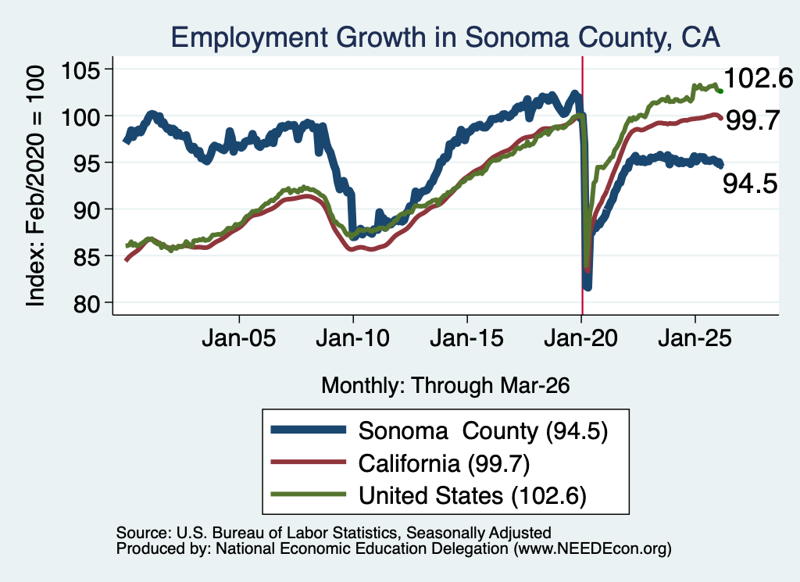
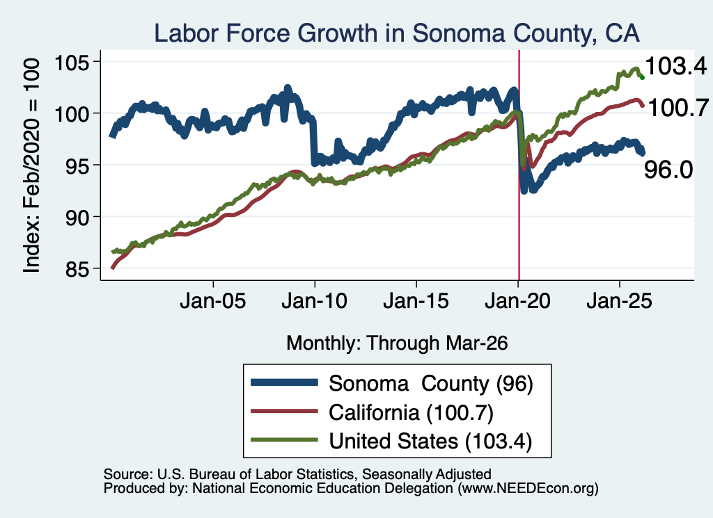
Employment and Labor Force

Slide 33
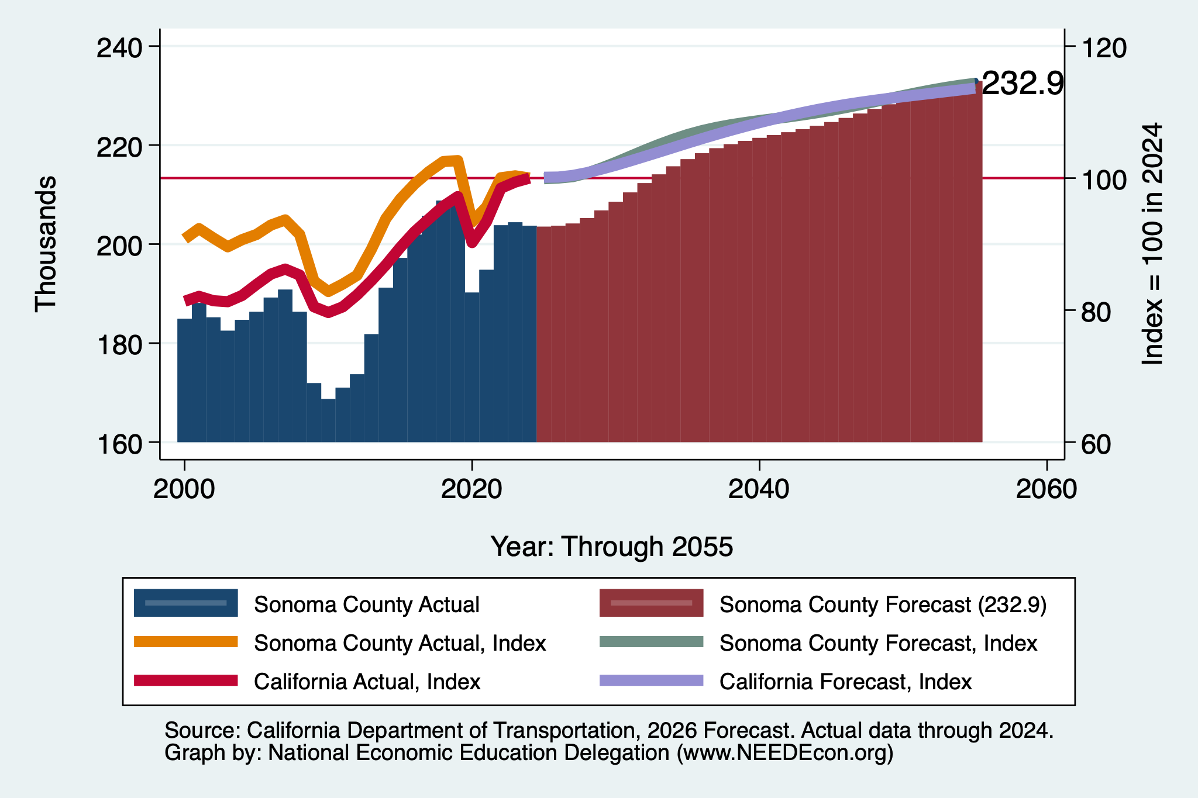
DOT Forecast: Employment

Slide 34
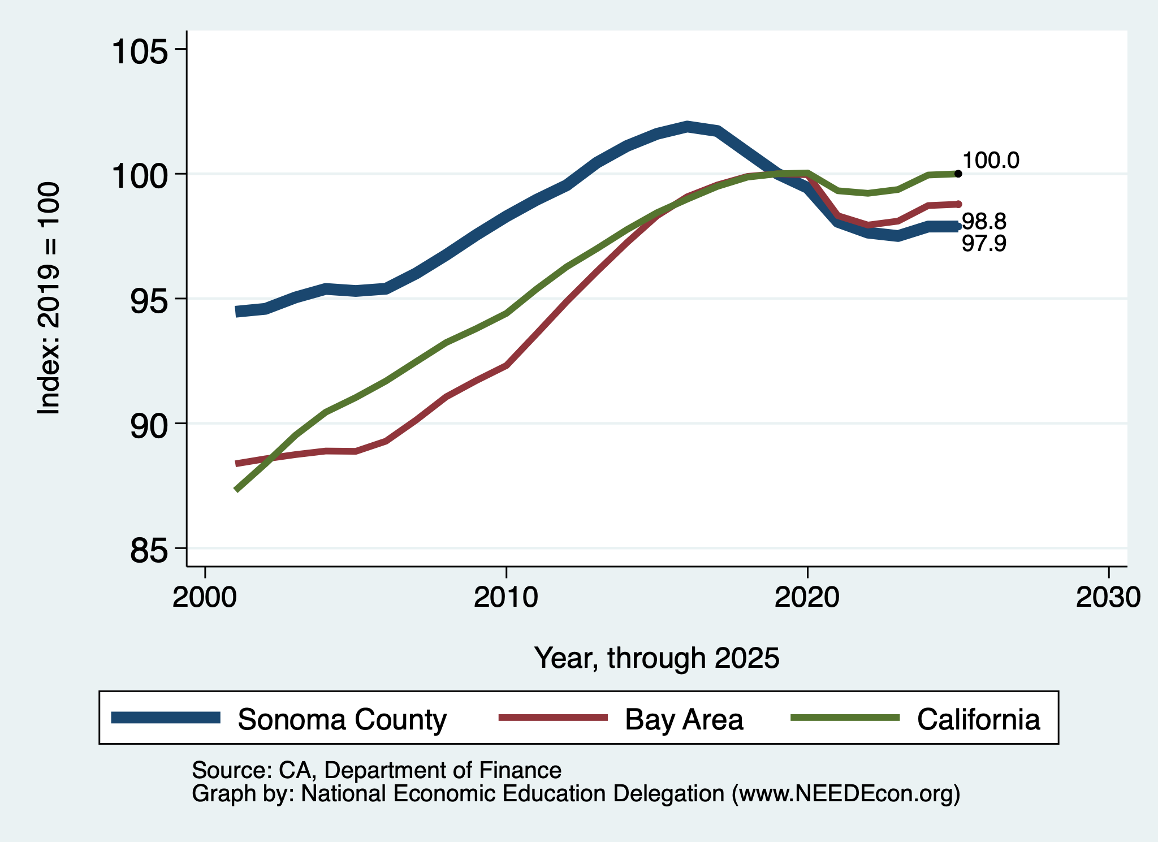
Population Declining

Slide 35
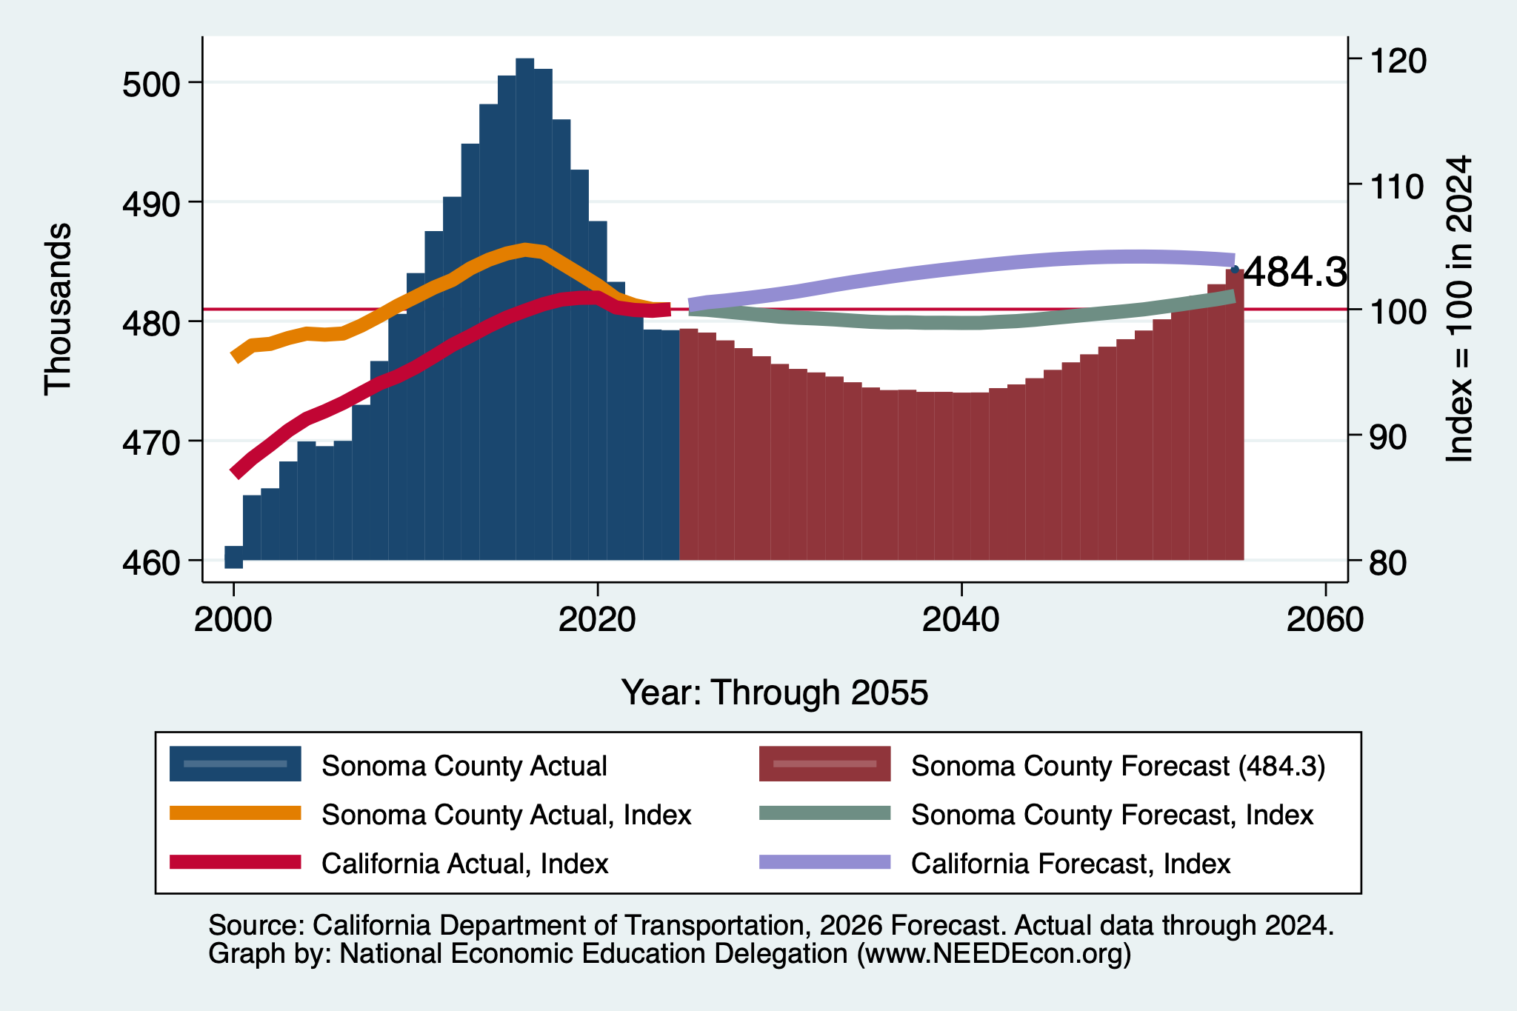
DOF Forecast: Population

Slide 36
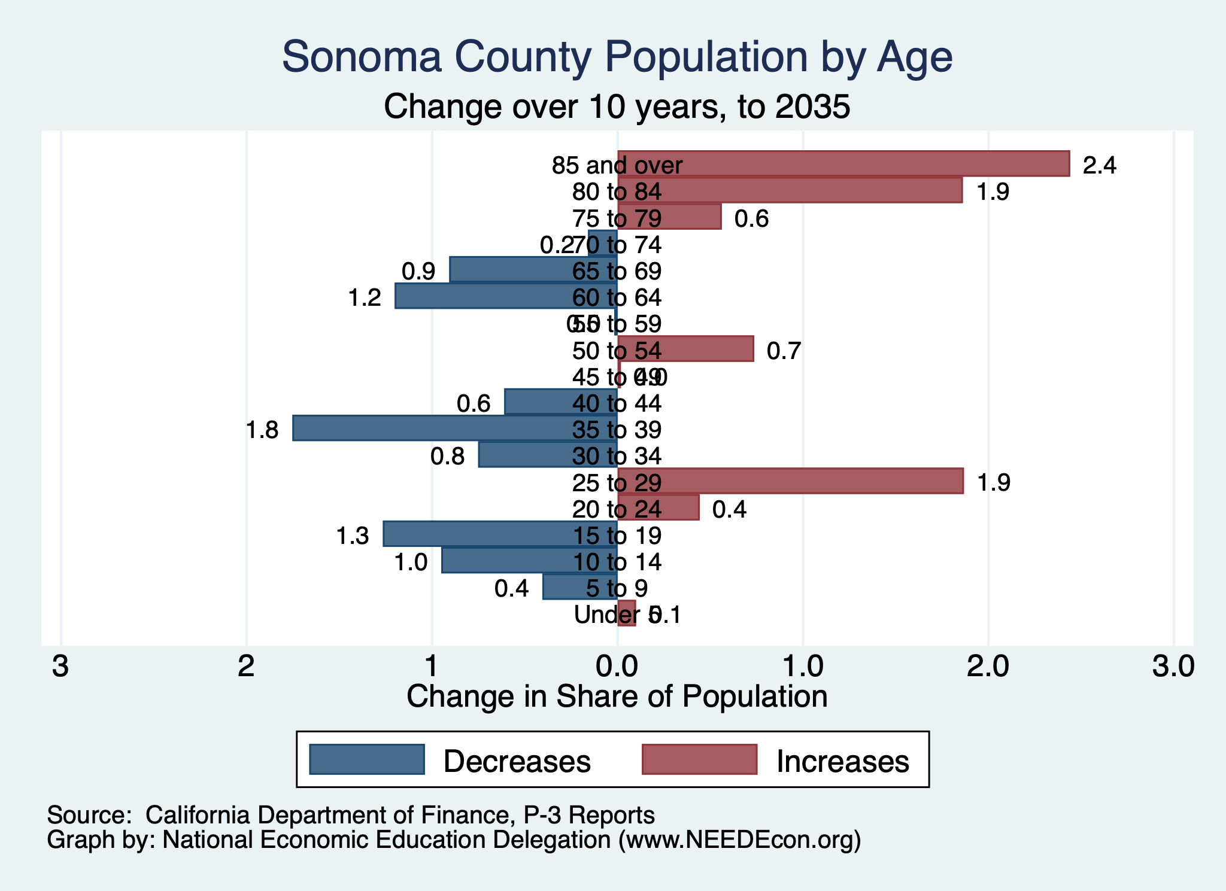
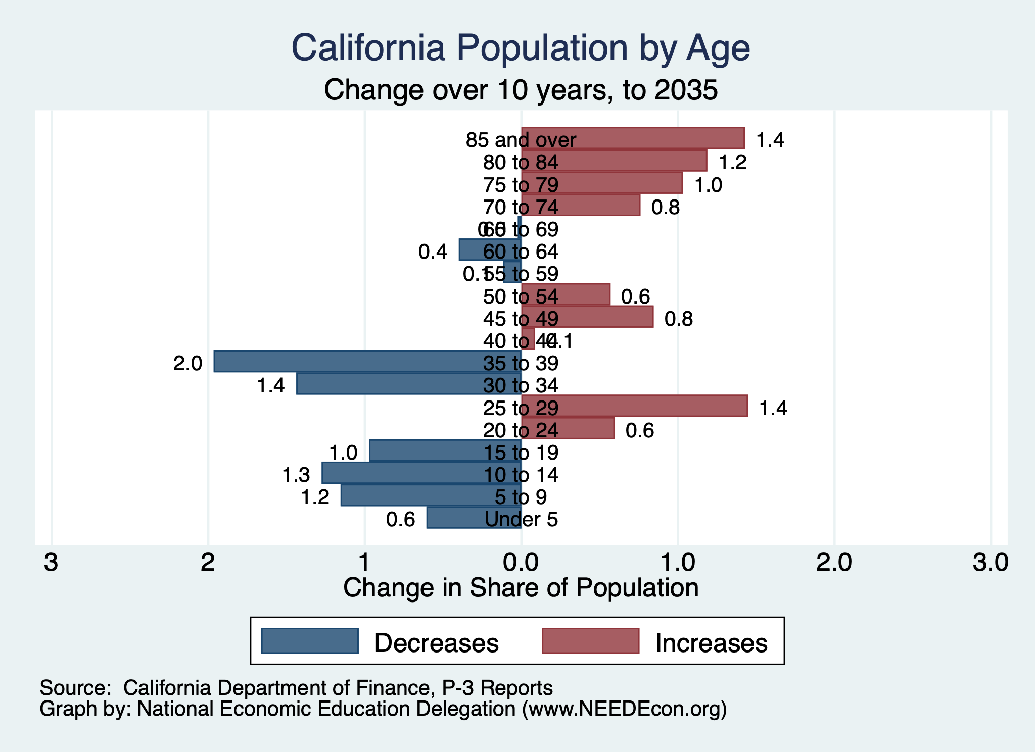
Aging Population

Slide 37
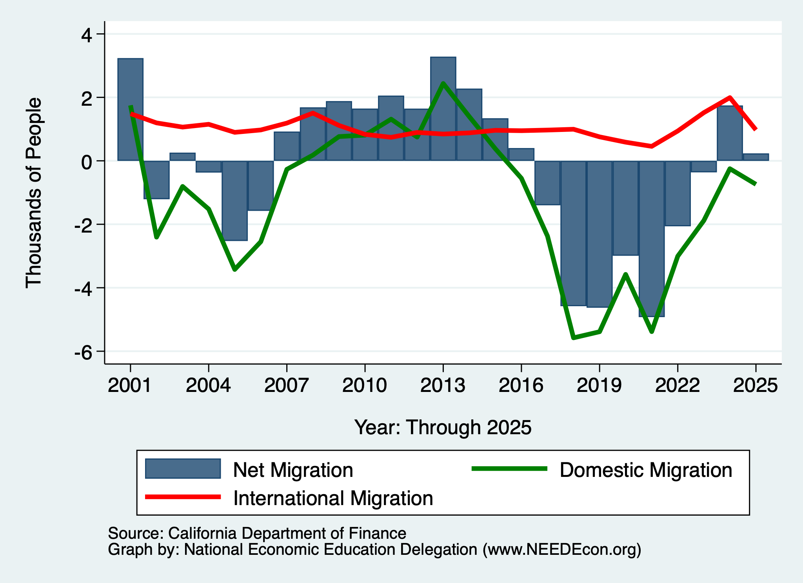
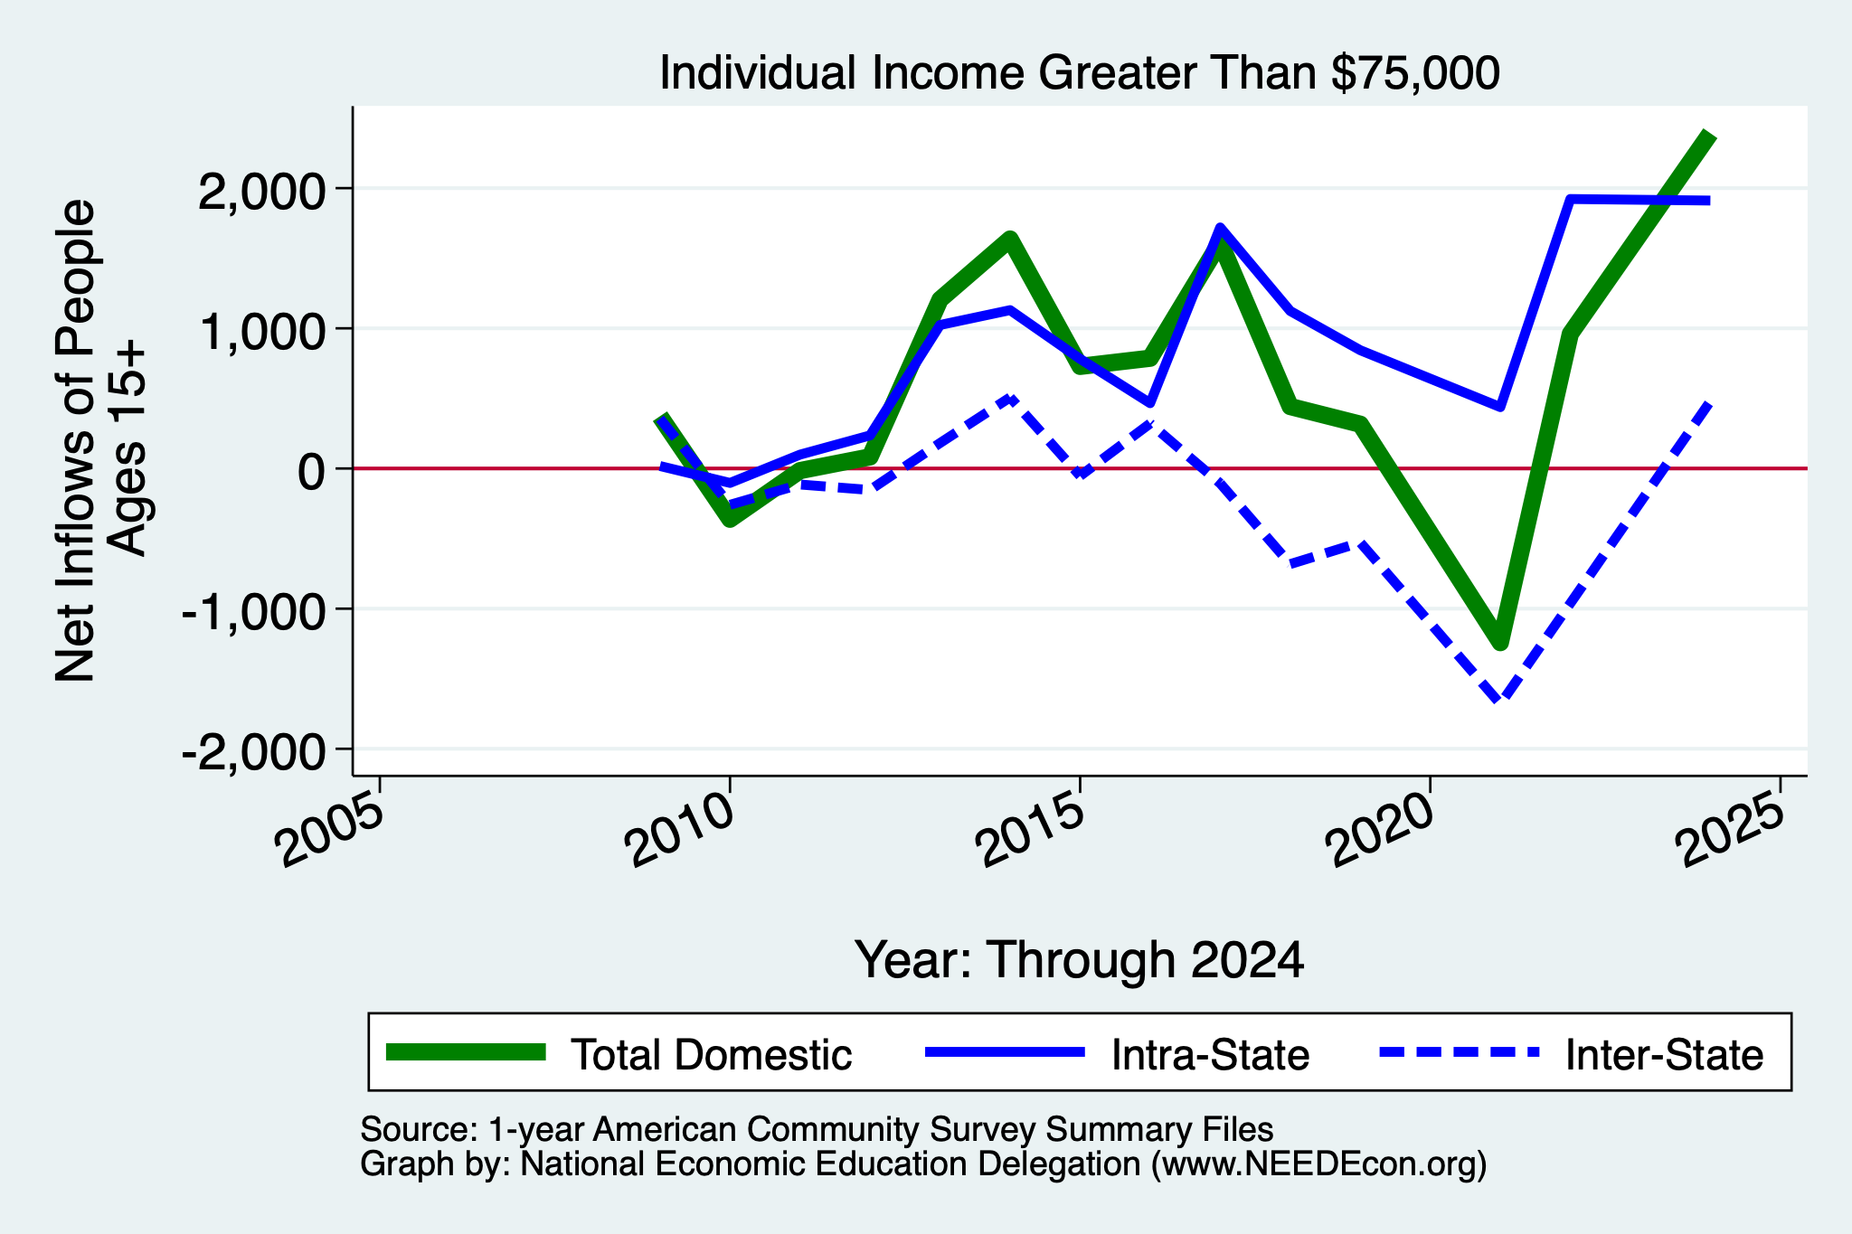
Migration: High Income Inflows
Sonoma County

Slide 38
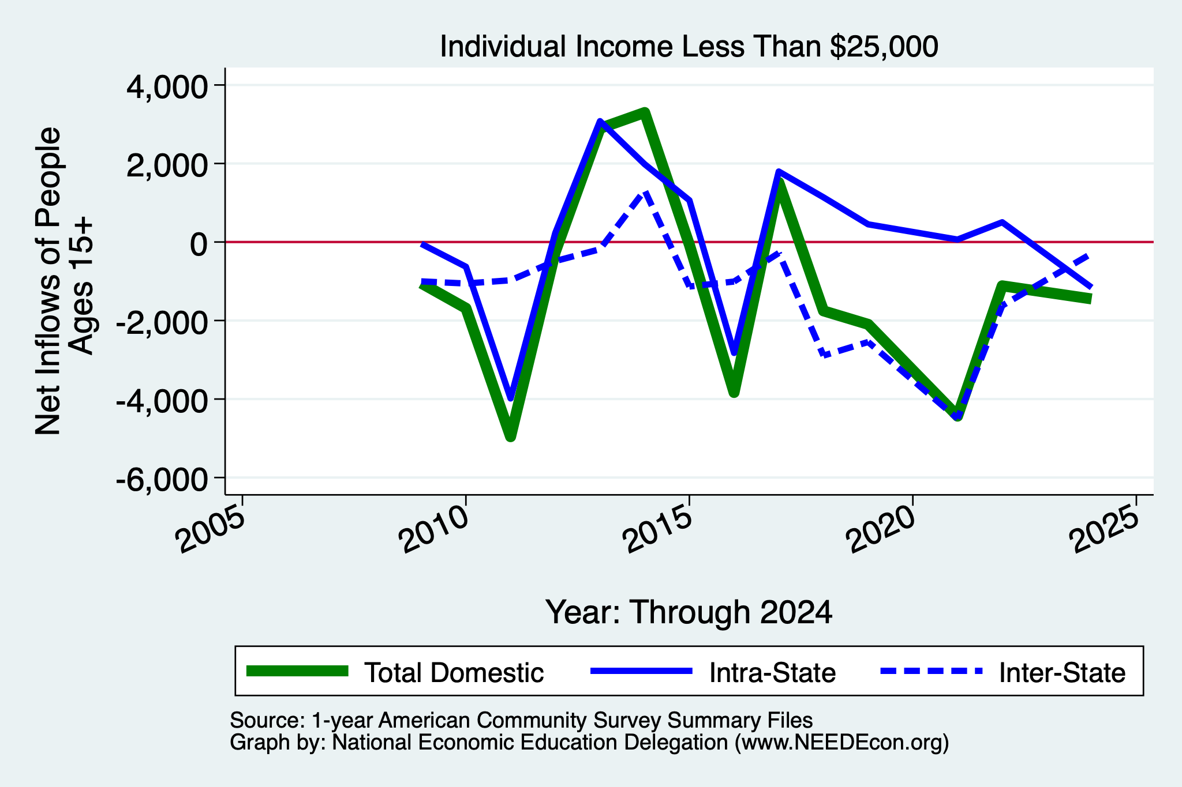
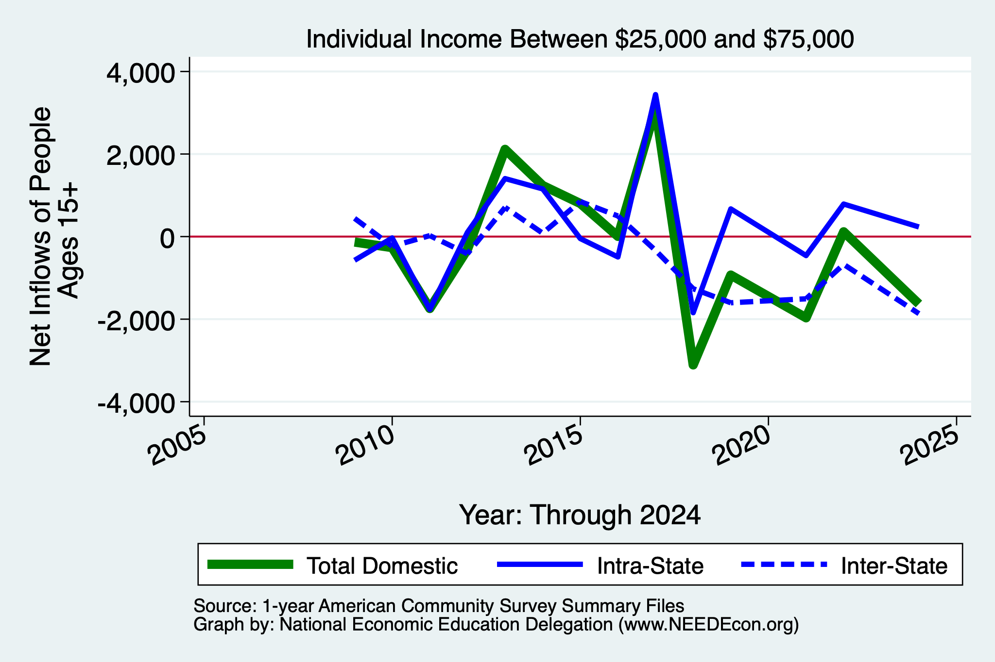
Migration: Outflows of Mid/Lower-Income
Sonoma County

Slide 39
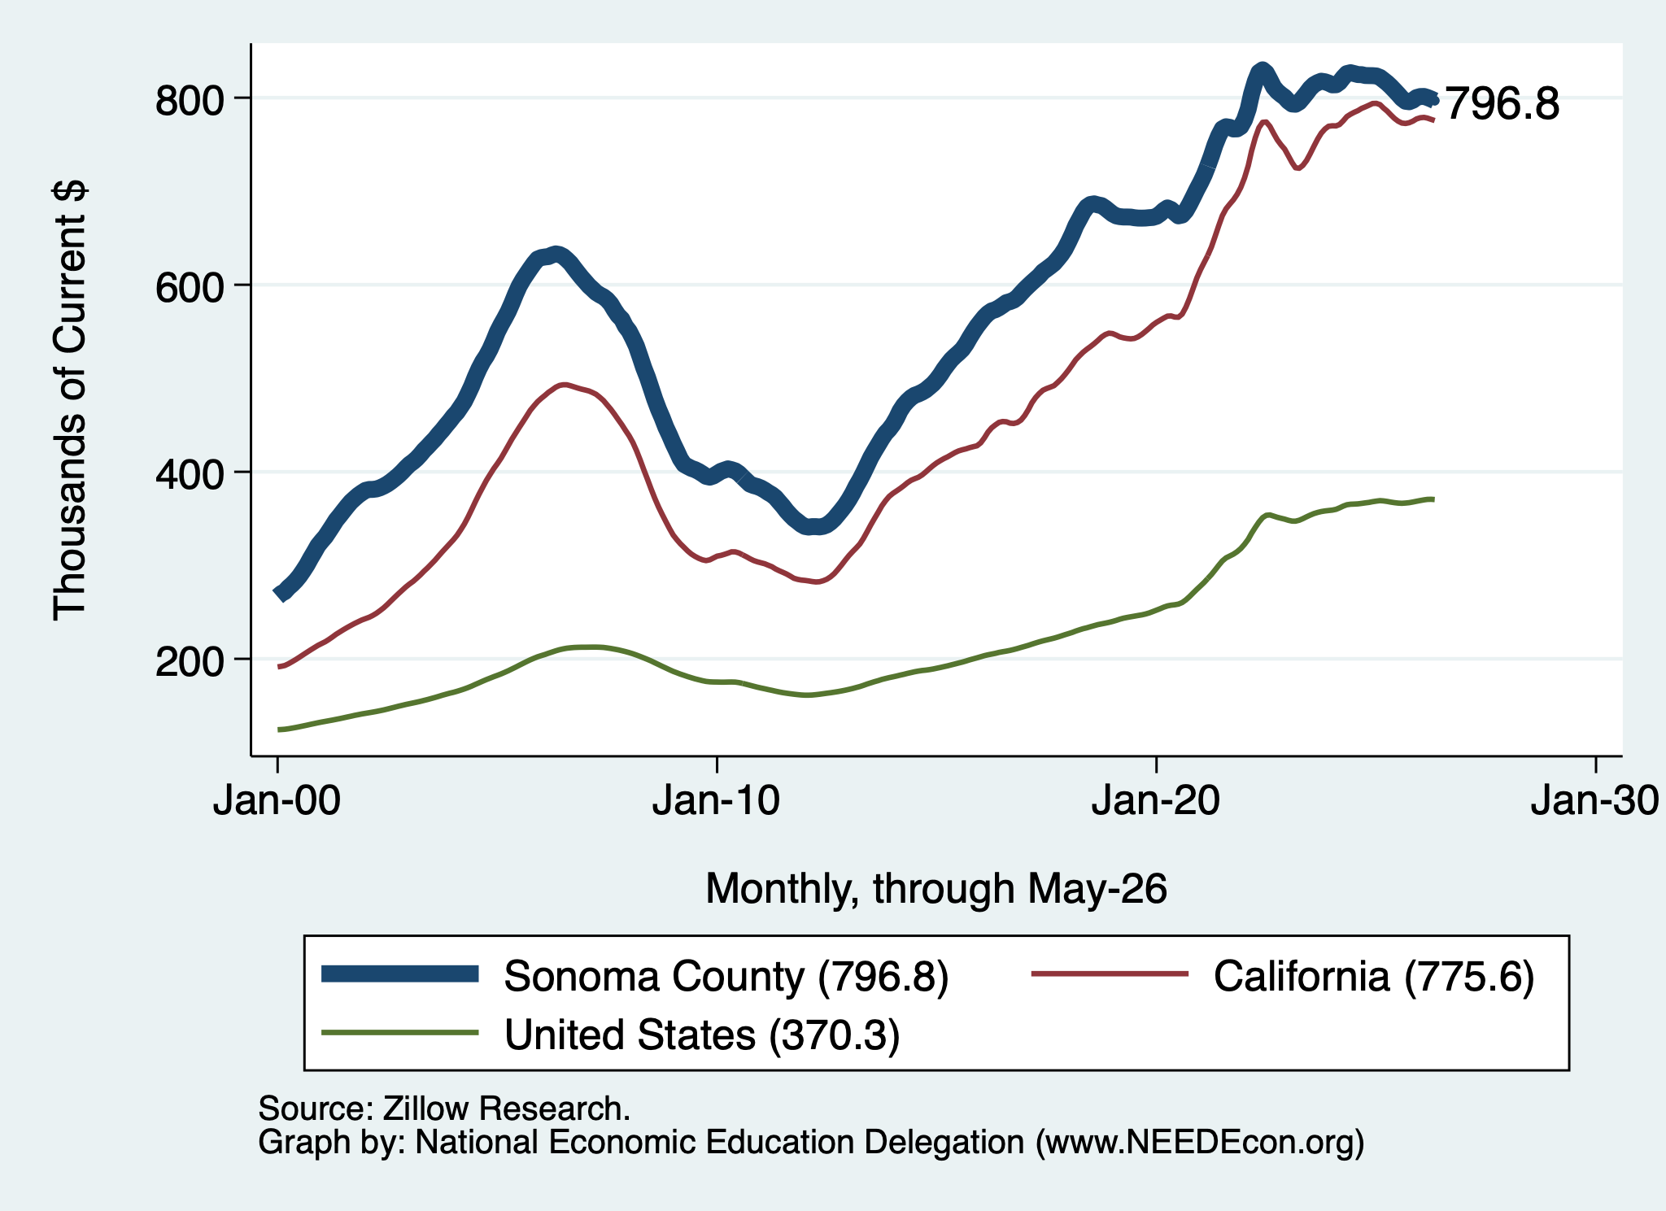
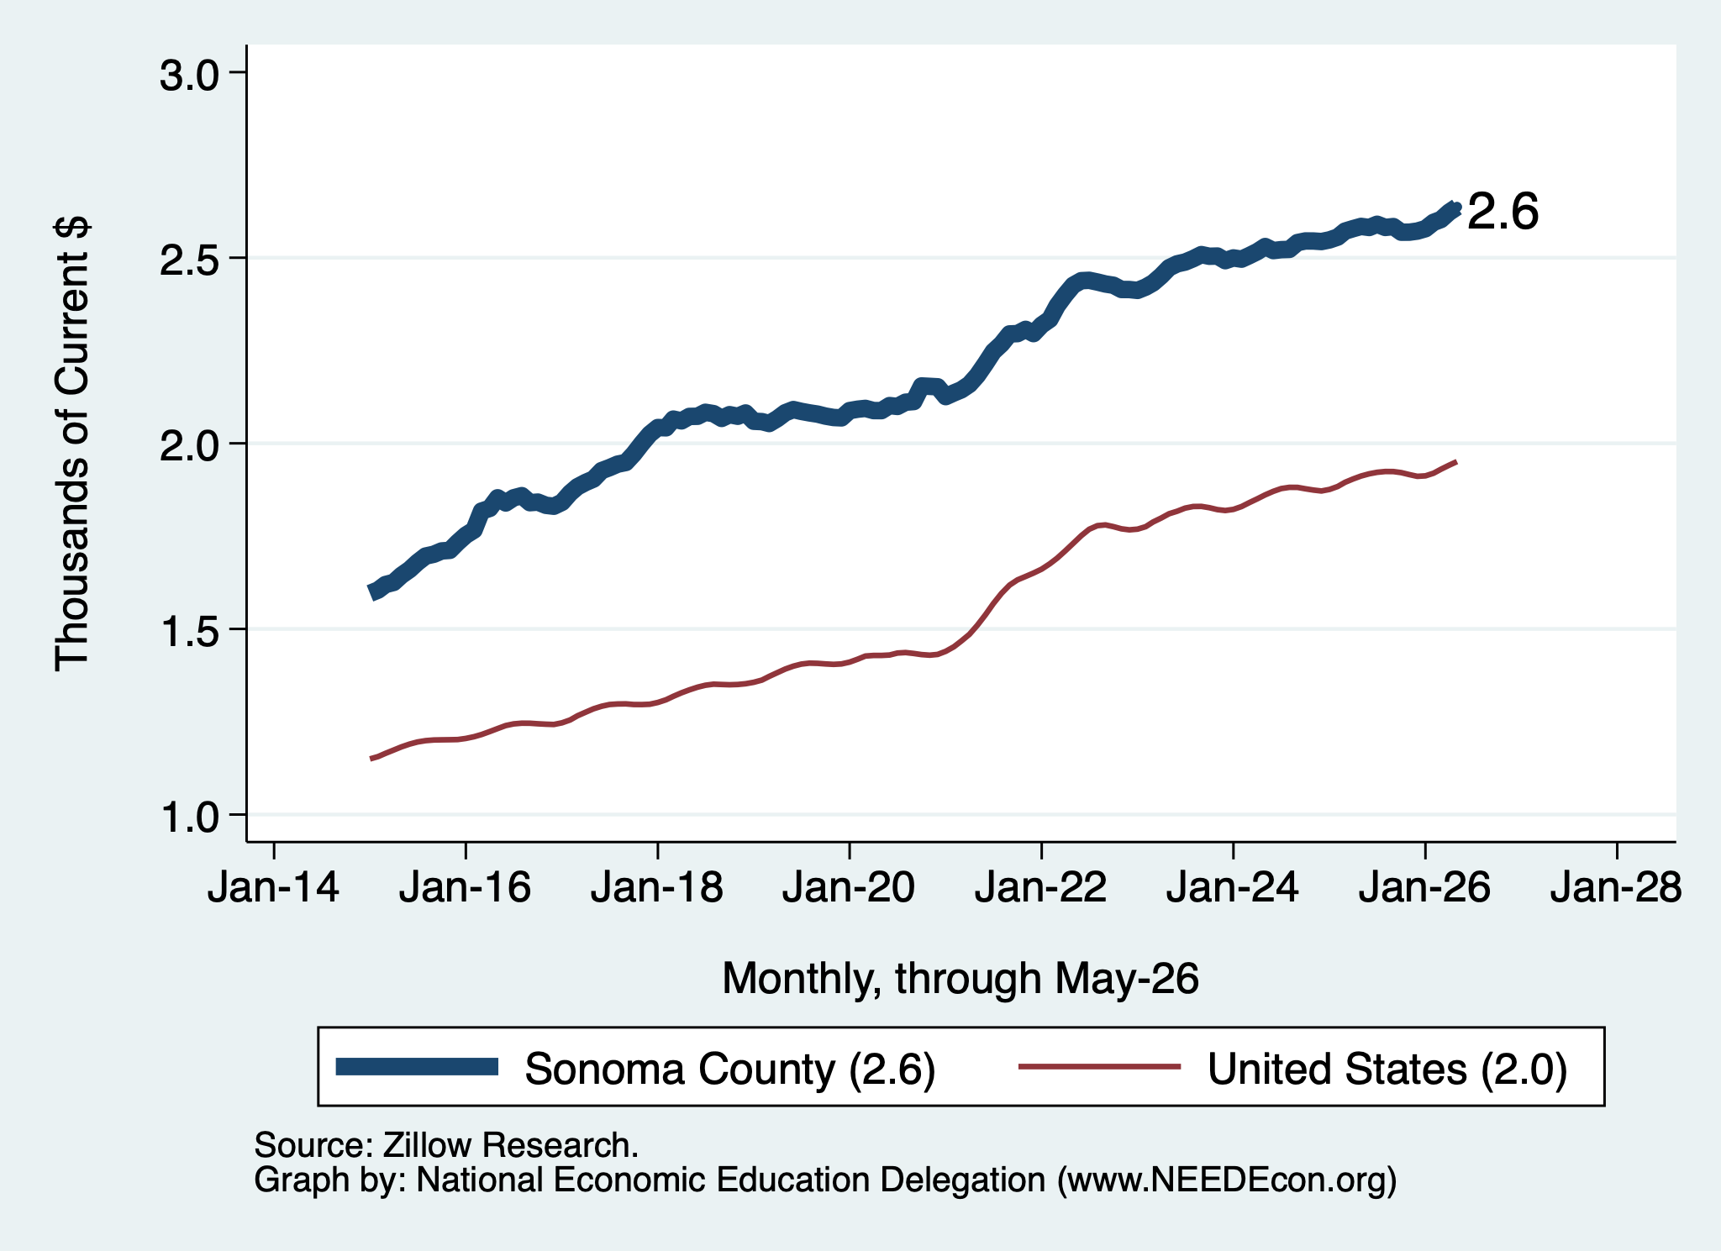
Housing Costs
Home Prices
Rents

Slide 40
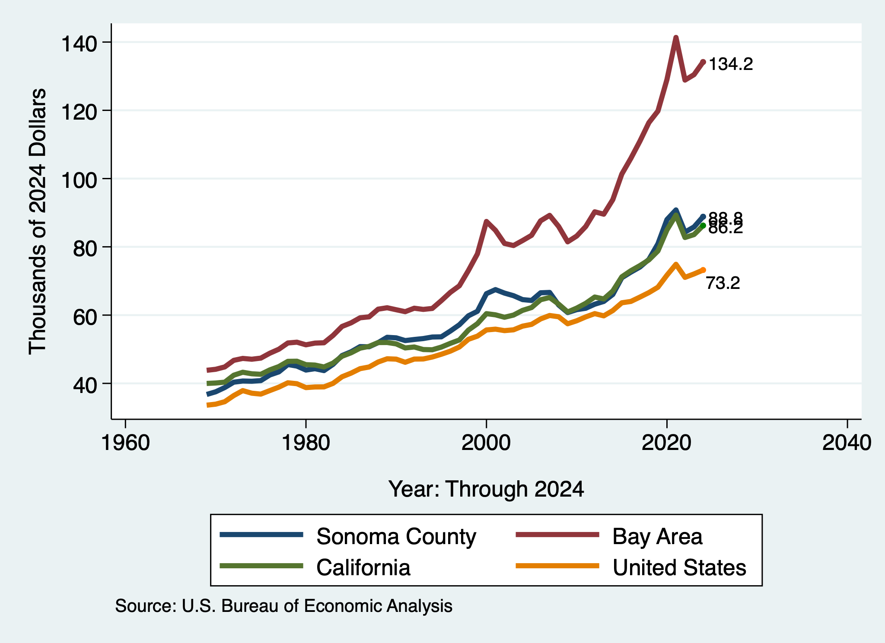
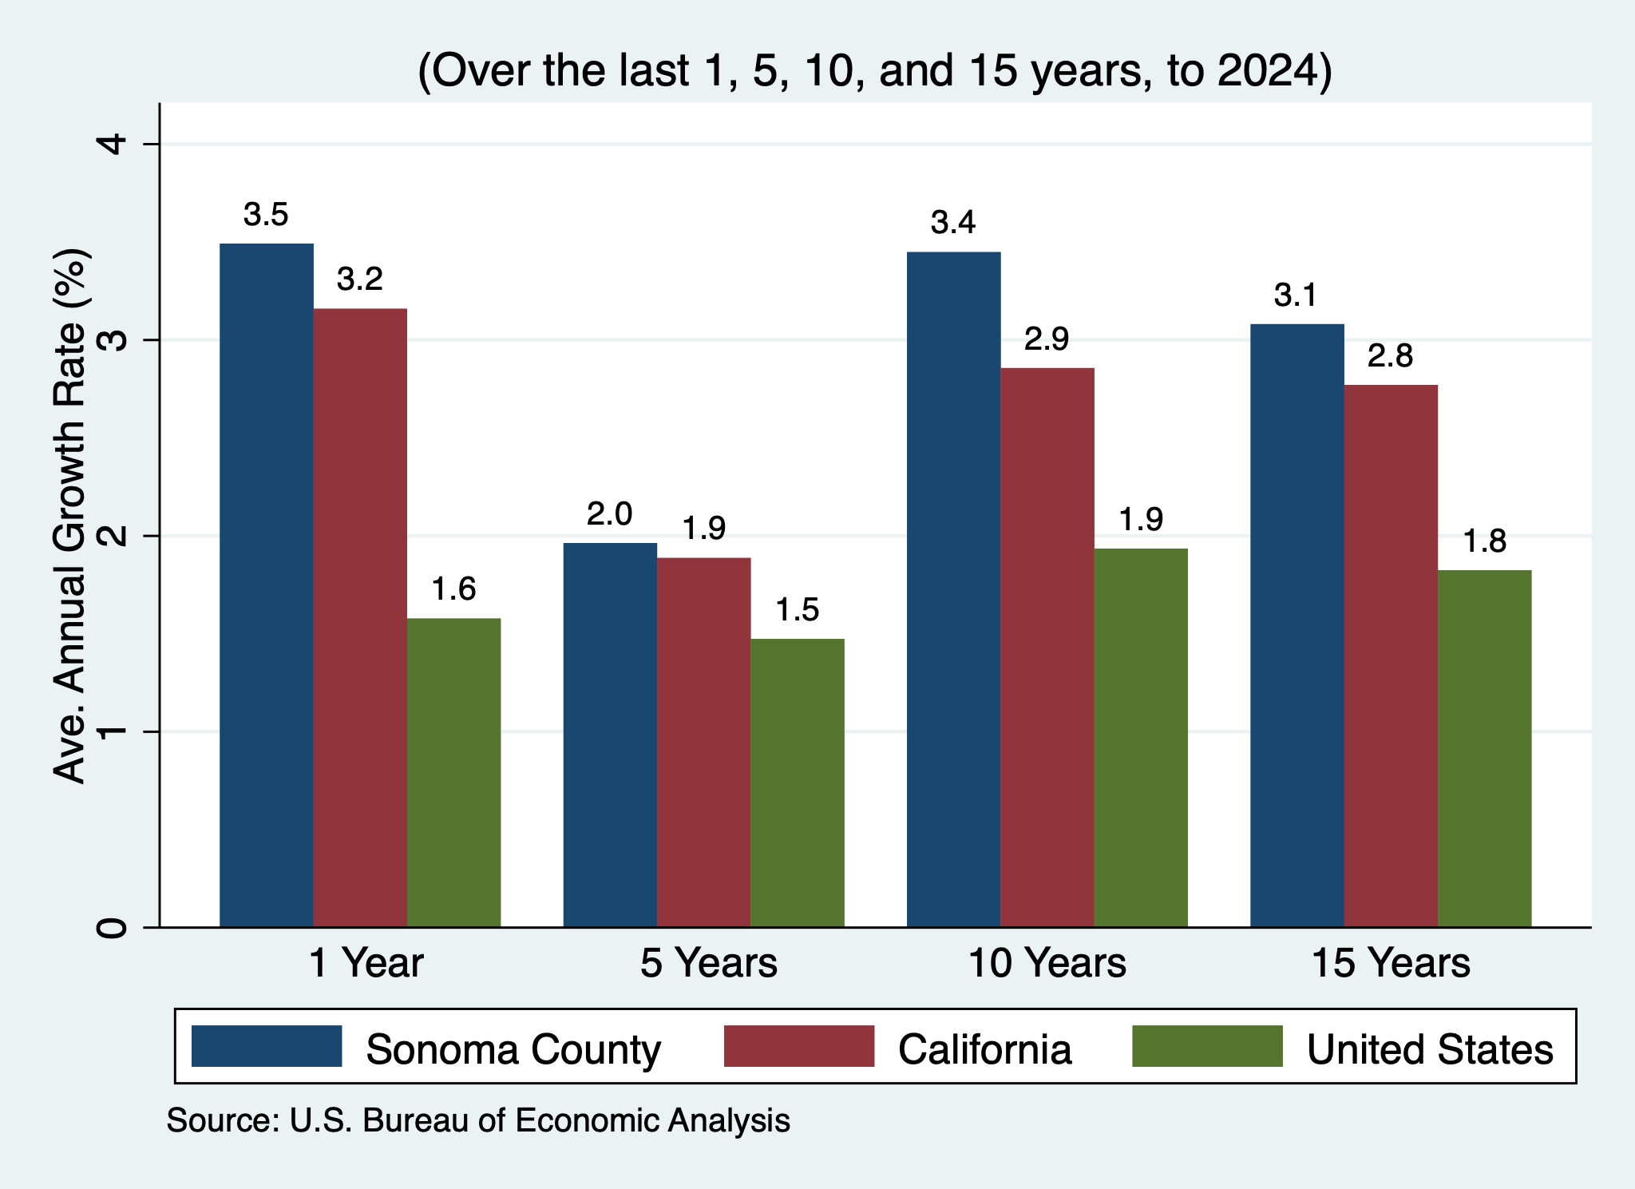
Personal Income – Sonoma County
Per Capita Personal Income
Per Capita Personal Income - Growth

Slide 41
Sonoma County: Summary
Home prices are coming down.
Aging population will require in-migration to grow the local economy.
  However, recent years have seen more out-migration than in.
Employment recovery is (might be) picking up.
  Leisure and hospitality is source of significant job losses.
Per capita income is rising – driven by exodus of lower-income residents?
The county appears to be quite healthy.
  What will come to dominate:
    Forecasts for employment growth?
    Declining population?

Slide 42
For More on the Local Economy:
Sonoma County Regional Report:
  https://www.needecon.org/RegionalReports/Sonoma_County/
Sonoma County Graphs:
  https://www.needecon.org/LocalGraphs/list_counties_graph.php?state=CA&nm=U29ub21h
City Reports:
  Santa Rosa: https://needecon.org/CityReports/Santa_Rosa.pdf
  Petaluma: https://needecon.org/CityReports/Petaluma.pdf
  Sonoma: https://needecon.org/CityReports/Sonoma.pdf
  Others: https://www.needecon.org/CityReports/

Slide 43
Big Questions!
What economic indicators should local business leaders be watching most closely right now and why?
What are the three biggest economic opportunities for Sonoma County over the next decade?
How will AI change the workforce in Northern California over the next five years?
If Sonoma County wants to thrive in 2040, what should we start doing today?

Slide 44
Economic Development Recommendations
Business Diversification: Provide assistance to high-impact sectors like manufacturing and creative economies.
Workforce Development: Partner with Santa Rosa Junior College and local agencies to upskill workers in healthcare, craft production, and technology to retain talent.
Housing and Infrastructure: Address workforce stability by prioritizing mixed-use developments near transportation hubs and supporting large-scale projects like the Eldridge redevelopment.

Slide 45
Thank you!
Any Questions?
www.NEEDEcon.org
Jon D. Haveman
Jon@NEEDEcon.org
Contact NEED: info@NEEDEcon.org
Submit a testimonial: www.NEEDEcon.org/testimonials.php
Donate to NEED: www.NEEDEcon.org/donate.php

