Slide 1
Osher Lifelong Learning Institute, Fall 2023
Contemporary Economic Policy
Santa Clara University, CA
Sep-Oct, 2023
Jon Haveman, Ph.D.
National Economic Education Delegation

Slide 2
National Economic Education Delegation
Vision
One day, the public discussion of policy issues will be grounded in an accurate perception of the underlying economic principles and data.
Mission
NEED unites the skills and knowledge of a vast network of professional economists to promote understanding of the economics of policy issues in the United States.
NEED Presentations
Are nonpartisan and intended to reflect the consensus of the economics profession.

Slide 3
Who Are We?
Honorary Board: 54 members
2 Fed Chairs: Janet Yellen, Ben Bernanke
6 Chairs Council of Economic Advisers
Furman (D), Rosen (R), Bernanke (R), Yellen (D), Tyson (D), Goolsbee (D)
4 Nobel Prize Winners
Akerlof, Smith, Maskin, Bernanke
Delegates: 652+ members
At all levels of academia and some in government service
All have a Ph.D. in economics
Crowdsource slide decks
Give presentations
Global Partners: 48 Ph.D. Economists
Aid in slide deck development

Slide 4
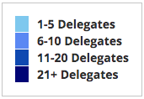
Where Are We?

Slide 5
Available NEED Topics Include:
US Economy
Healthcare Economics
Climate Change
Economic Inequality
Economic Mobility
Trade and Globalization
Minimum Wages
Immigration Economics
Housing Policy
Federal Budgets
Federal Debt
Black-White Wealth Gap
Autonomous Vehicles
Healthcare Economics

Slide 6
Course Outline
Contemporary Economic Policy
Week 1 (9/21): US Economic Update (Jon Haveman, NEED)
Week 2 (9/28): US Federal Budget (Jon Haveman)
Week 3 (10/5): Monetary Policy (Geoffrey Woglom, Amherst College)
Week 4 (10/12): Federal Debt (Jon Haveman)

Slide 7
What Does the U.S. Gov’t Budget Look Like?
Fiscal Year 2022 Budget Summary
Revenue | Billions |  | Expenditures | Billions
Income Taxes | $2,632 |  | Mandatory | $4,010*
Payroll Taxes | $1,484 |  | Discretionary | $1,787*
Corporate Taxes | $425 |  | Interest | $475
Other | $356
Total | $4,896 |  | Total | $6,272
19.8%
25.4%
Budget Deficit: $1,375 Billion
5.5%
Source: Monthly Treasury Statement. 9/22 . *Estimates based on OMB Forecasted Breakdown
Notes:
https://www.cbo.gov/publication/53627
https://www.cbo.gov/publication/53624

Slide 8
The Fed and Monetary Policy
Blue is the fed funds rate.
Green is the prime bank lending rate.
Red is the rate on 3 month Treasuries.
Notes:
Take note over the redline peeking above the others

Slide 9
The Federal Debt is Becoming A Problem

Slide 10
Submitting Questions
Please submit questions of clarification in the chat.
I will try to handle them as they come up.
We will take a 10 minute break in the middle.
We will do a verbal Q&A once the material has been presented.
Slides will be available from the NEED website shortly after the talk (https://NEEDEcon.org/delivered_presentations.php)

Slide 11
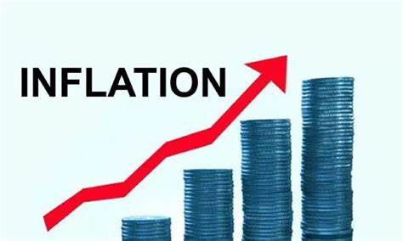
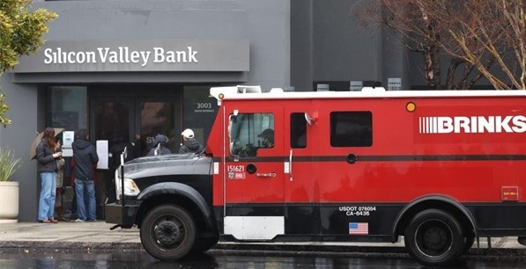
US Economic Update
OLLI – Santa Clara University
September 21, 2023
Jon Haveman, Ph.D.
NEED

Slide 12
Credits and Disclaimer
This slide deck was authored by:
Jon D. Haveman, NEED
Scott Baier, Clemson University
Geoffrey Woglom, Amherst College (Emeritus)
Brian Dombeck, Lewis & Clark College
Doris Geide-Stevenson, Weber State
Disclaimer
NEED presentations are designed to be nonpartisan.
It is, however, inevitable that the presenter will be asked for and will provide their own views.
Such views are those of the presenter and not necessarily those of the National Economic Education Delegation (NEED).

Slide 13
Outline
About the U.S. Economy
Economic Indicators
Inflation/Federal Reserve

Slide 14
The U.S. Economy

Slide 15
Some Basic Statistics, September 2023
Statistic: | Value
Population | 335.3 Million
Labor Force | 167.8 Million
Employment | 155.4 Million
Gross Domestic Product (GDP) | $26.8 Trillion
Income per Capita | $67,911
Ave. Hourly Earnings | $33.82
Source: fred.stlouisfed.org

Slide 16
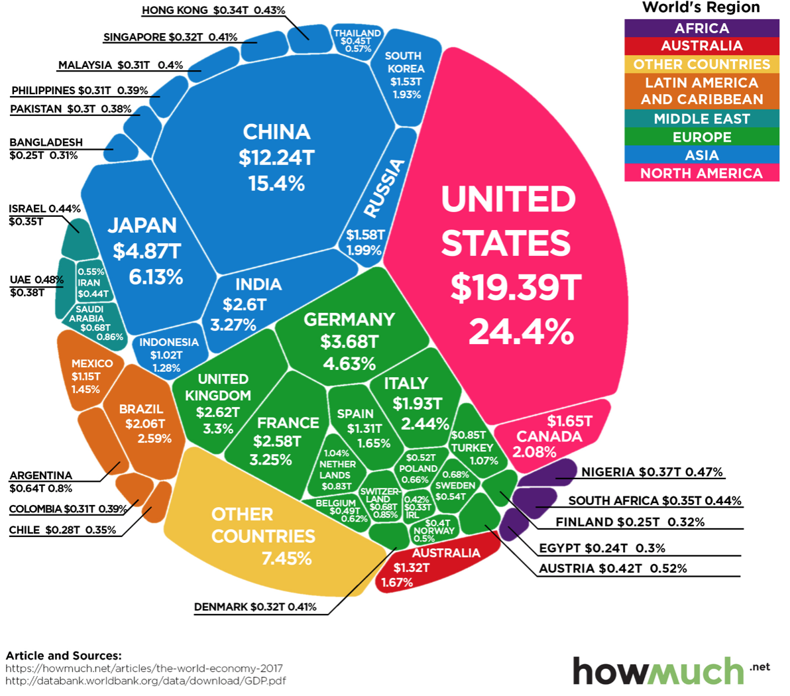
U.S. Economy in Global Perspective
U.S. Nominal GDP:
$21.538 trillion in 2019-Q4
$19.637 trillion in 2020-Q2
$26.819 trillion in 2023-Q2
Notes:
https://www.investopedia.com/insights/worlds-top-economies/#countries-by-gdp

Slide 17
Composition of the U.S. Economy: GDP

Slide 18
Composition of the U.S. Economy: Employment
Manufacturing
GDP Share = 10.7%
Health GDP Share = 7.4%
Note: Does not add to 100% because of omitted sectors.

Slide 19
Composition of the Santa Clara Economy: Employment
Note: Does not add to 100% because of omitted sectors.

Slide 20
Composition of the Santa Mateo Economy: Employment
Note: Does not add to 100% because of omitted sectors.

Slide 21
More Local Charts
www.NEEDEcon.org/LocalGraphs

Slide 22
Economic Indicators

Slide 23
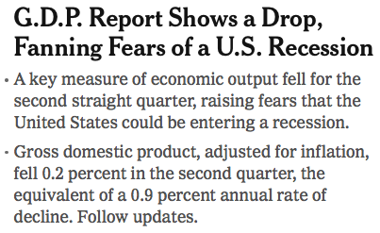
Headline: July 28, 2022
Old news….

Slide 24
GDP: Quarterly Growth
Q3-2022: 3.2%
Q4-2022: 2.6%
Q1-2023: 2.0%
Q2-2023: 2.1%
Notes:
Graph: gdp_pot_grow.png
The Point: From 1990 – 2007, average annual US GDP growth pre-crisis is 2.94%. However, post-crisis US GDP growth is 2.19% (0.75 percentage points lower). Why is has the recovery been sluggish?
Note: At the recession’s height, the gap between quarterly GDP growth and potential growth was 2.5 percentage points.

Slide 25
GDP Trajectory: Pandemic Plunge!
GDP is:
$0.3 Trillion below 2019 forecast.
$1.4 Trillion ABOVE 2019-Q4 level.

Slide 26
“Accounting” for GDP
Expenditures drive GDP growth.
GDP is the sum of four categories of spending:
Consumption
Investment
Plant and equipment, residential real estate, and inventories.
Government spending
Net Exports: Exports – Imports
GDP = Consumption + Investment + Government + Net Exports
Notes:
Recall: GDP is measures production of an economy; we often measure GDP as the sum of spending on final goods/services produced within an economy. The first three categories (C,I,G) contain spending on both domestically and foreign produced goods. To accurately measure domestic production, we subtract domestic consumption of foreign goods (imports).
The Point: Analysis of components of GDP as well as the production side of the economy should provide a comprehensive picture of the US economic landscape

Slide 27
A Note on Imports and GDP
GDP = Consumption + Investment + Government + Net Exports
Net Exports = Exports – Imports
Gives the impression that IMPORTS are bad for GDP
They are not.
They are merely subtracted from the equation because the measurement of consumption, investment, and government all include imports.
Calculating Gross DOMESTIC Production must exclude IMPORTS
It is merely an accounting identity.

Slide 28
Composition of GDP
Notes:
Components sum to GDP
Average % of GDP for each component from 1960-Present: C = 64%, I=15%, G=24%, NX = 2% (X = 7%, M=9%)
Net Exports as a % of GDP has increased over the sample period, but it’s contribution to GDP is relatively small

Slide 29
Contribution to GDP Growth: Consumption
Notes:
Average GDP growth from 1990-2007 is 2.99% and from 2010+ is 2.19%
Average Consumption contribution from 1990-2007 is 2.16 percentage points and from 2010+ is 1.67 percentage points

Slide 30
Personal Consumption Expenditures
Notes:
Chart: ../Charts/personalconsumption_recession.png
Real consumption remains significantly lower than trend consumption since 2008 (actual is 89% of trend).
Since the recession, consumption growth has fallen. From 1990-2007, average annual consumption growth is 3.34%; Post-recession average annual consumption growth is 2.38%.

Slide 31
Retail Sales Remain Elevated!

Slide 32
Contributions to GDP: Residential Investment
Notes:
Contribution of residential investment to GDP growth has risen post-2009

Slide 33
Contribution to GDP Growth: Inventories
Notes:
Average GDP growth from 1990-2007 is 2.99% and from 2010+ is 2.19%
Average Consumption contribution from 1990-2007 is 2.16 percentage points and from 2010+ is 1.67 percentage points

Slide 34
Contributions to GDP: Government
Notes:
Since 2010, average government spending growth is shrinking, resulting in a negative average contribution to GDP growth post-recession of -0.8 percentage points
Note that average quarterly government spending growth is 0.42% from 1990-2007 and -0.17% in 2010+ (annualized, 1990-2007 = 1.68%; 2010+ = -0.70%).

Slide 35
Industrial Production (Manuf, Util, Mining)

Slide 36
Employment

Slide 37
Monthly Changes in Nonfarm Employment
Notes:
PAYEMS.png

Slide 38
Monthly Changes in Nonfarm Employment
June: 105,000
July: 157,000
Aug: 187,000
Notes:
PAYEMS.png

Slide 39
Employment Gap
4.0 Million ABOVE February, 2020.
5.2 Million BELOW where we should be.
Notes:
payroll_recent.png

Slide 40
Where Have All the Workers Gone?
2.2 million below where we should be

Slide 41
Some Explanations
500 Thousand: Long COVID Exits
1-2%: Long Social Distancing

Slide 42
Baby Boomers Are Retiring!

Slide 43
Wage Growth
Notes:
Is this necessary given the previous slide?

Slide 44
Compensation Growth: Not Great, but OK

Slide 45
Excess Savings – Still Positive!

Slide 46
How Are Things Where You Are?

Slide 47
How Are Things Where You Are?

Slide 48
Economy Overall
Continues to chug along
GDP growth has been consistent with the last decade.
But not really catching up to where we should be.
Employment continues to grow, but slowing
Hampered by lots of baby boomer retirements!
Labor force is still too small.
Wages are up in inflation adjusted terms, but probably not as much as they would have been.
Inflation…..

Slide 49
Inflation

Slide 50
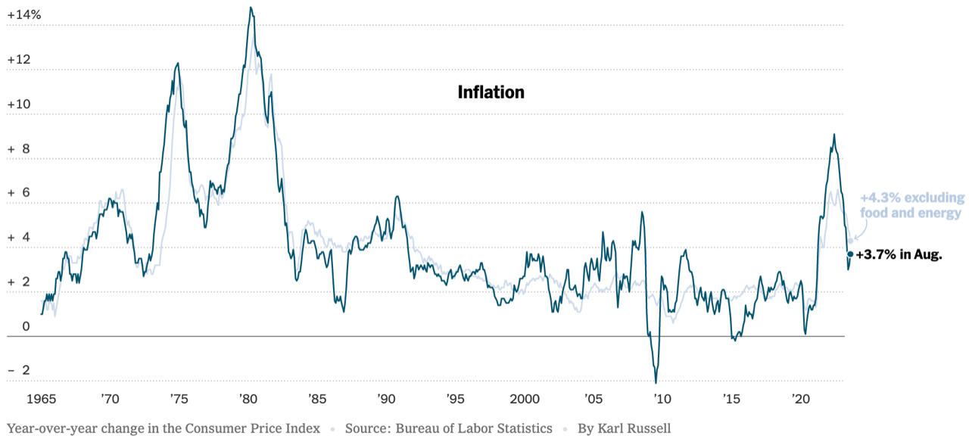
Inflation: Latest Figures
Source: NYTimes.com, Bureau of Labor Statistics

Slide 51
Inflation in the Last 6 Months – Close to 3%!

Slide 52
Inflation: Core Inflation is Stubbornly High

Slide 53
Sources of Recent Inflation

Slide 54
Food Prices are Stabilizing

Slide 55
Housing Inflation is Still Pulling up the CPI

Slide 56
How Much Higher Are Prices?

Slide 57
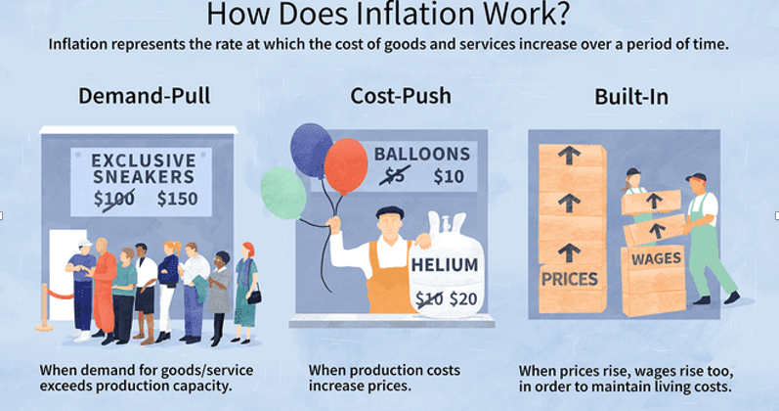
Source: Investopedia

Slide 58
Gas Prices: National Average at the Pump

Slide 59
What is Happening With Oil Prices?
First, global economy is stronger than anticipated.
Except for China.
Recession is EU will be shallower than expected.
Second, inflation in the US is slowing.
Reduced expectation of a recession.
Finally, OPEC+ has restricted supply.
In support of Russia?

Slide 60
We Have Particularly High Gas Prices!

Slide 61
Inflation is Not just a U.S. Problem

Slide 62
Supply Chains

Slide 63
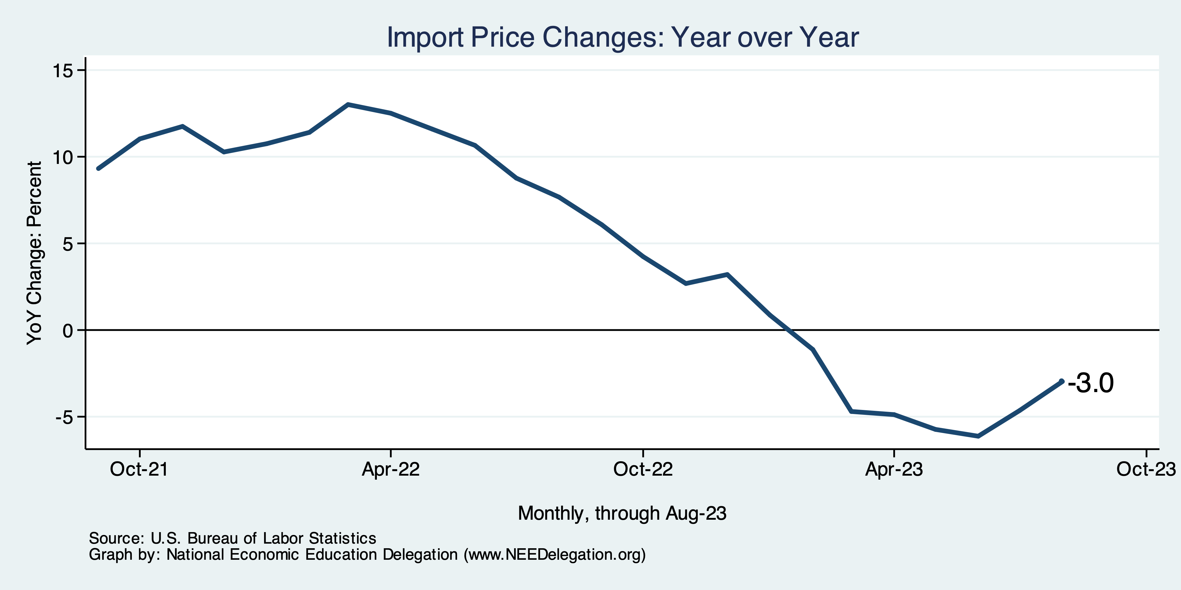
Import Price Inflation WAS High
Inflation – Imported Products: 9-10%

Slide 64
Two New Types of Inflation
Excuseflation
“The cost of my inputs is going up, so I have to raise my prices.”
You rarely hear: “I’m lowering my prices because costs are going down.”
Premiumization
Taking your product and spicing it up so that you can raise your margins.
Together, have led to a Profit-Price Spiral
Raising prices to cover costs plus a little extra.
Raising margins with extra frills.

Slide 65
Corporations Have Pricing Power!
Corporate Profits

Slide 66
My Thoughts on the Sources of Inflation
Supply Chain issues were significant – less so now.
Import price inflation was high – negative now.
Composition of spending changed significantly.
Is now bouncing back, as are prices.
Corporations have used the cover of inflation to raise prices more.
But there was too much total spending.
Fiscal stimulus led households to increase saving over 2021 by more than $2 trillion. Strong retail sales numbers suggest they are prepared to spend it.
Whose to Blame: ARP possibly too big, but the Fed could have acted sooner.
Bottom line: Recovery from a dramatic economic disruption is seldom painless.

Slide 67
What’s the Fed Doing About It?

Slide 68
Federal Funds Rate – Recent Activity
Expect a Pause in Rate Increases

Slide 69
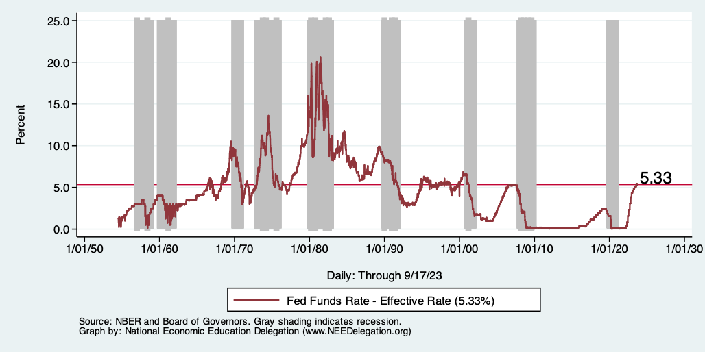
Raising the Federal Funds Rate
Notes:
The fed funds rate is the interest rate on overnight loans between banks. Think of it as the baseline interest rate on which banks base all other interest rates (e.g. mortgage rates)
FOMC lowers the fed funds rate during recessions and raises the fed funds rate during expansions
Fed funds rate peaked in the 1980s as then Chairman Paul Volcker sought to reign in “run away” inflation of the 1970s; doing so resulted in a recession in the early 1980s.
Since the 2008-09 recession, the fed funds rate has been kept near zero.
During the 2008-09 recession, Federal Reserve turned to unconventional tools to influence longer term interest rates to further stimulate the economy - QE
FedFunds.png

Slide 70
Fed: Also Reducing its Asset Holdings
Quantitative Tightening

Slide 71
Implications for Demand
Investment borrowing
Home loans – tied to 10-year Treasury
Car loans
Credit cards
Savings accounts – positive
And more….
All of which slows the economy.

Slide 72
Treasuries
Notes:
treas_recent.png

Slide 73
Alarming Compression of Interest Rates
Notes:
Yield_curve.png

Slide 74
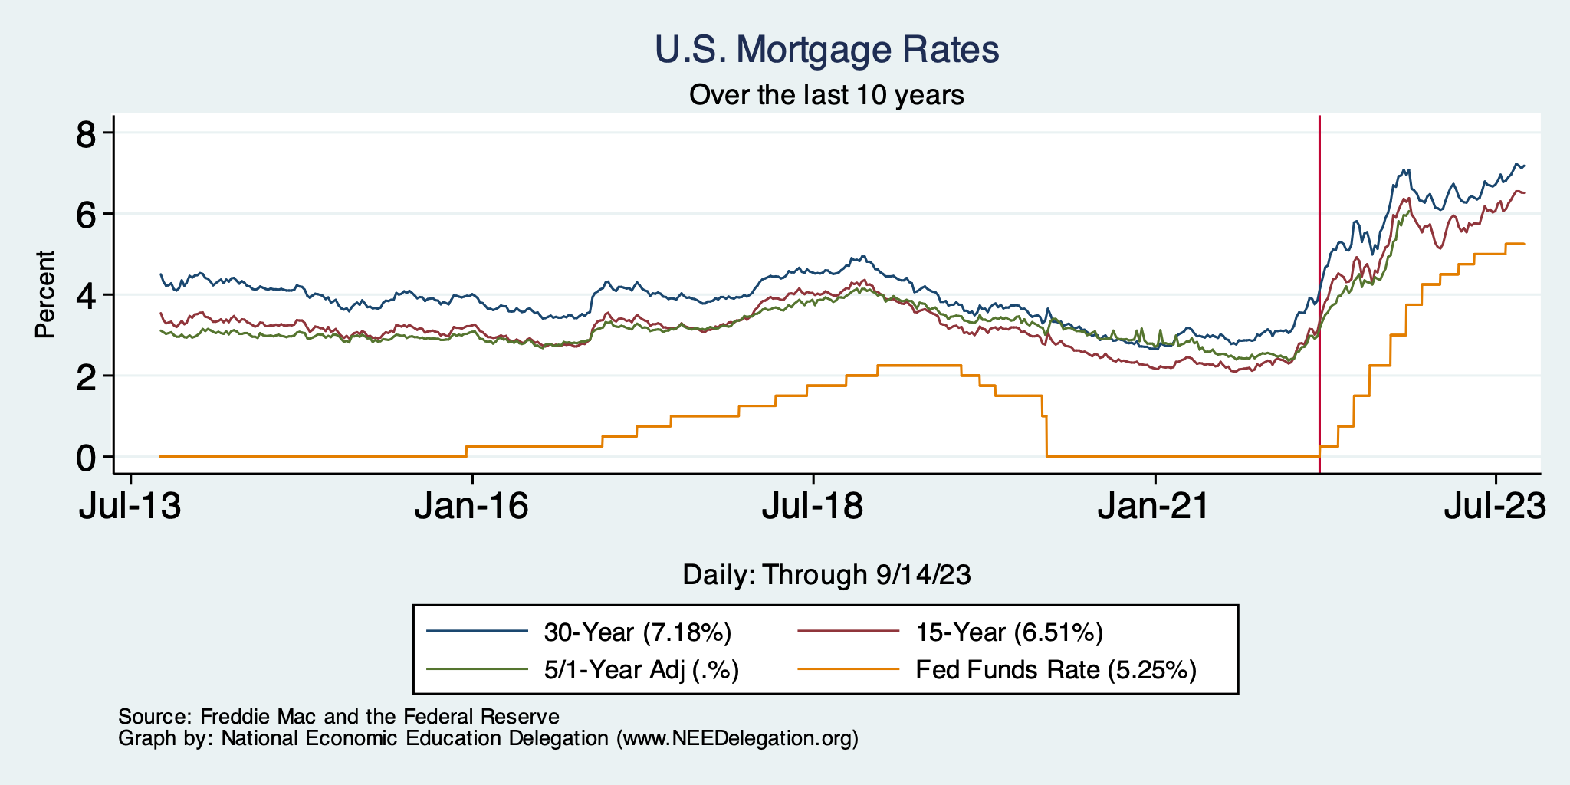
Mortgage Rates

Slide 75
Contributions to GDP: Residential Investment
Notes:
Contribution of residential investment to GDP growth has risen post-2009

Slide 76
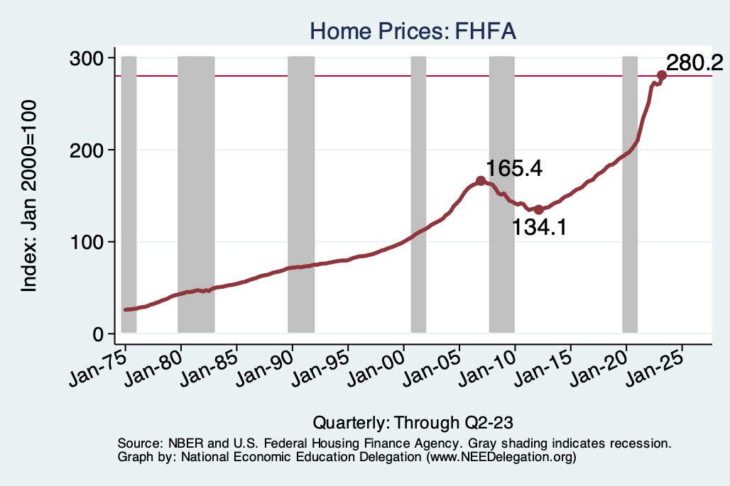
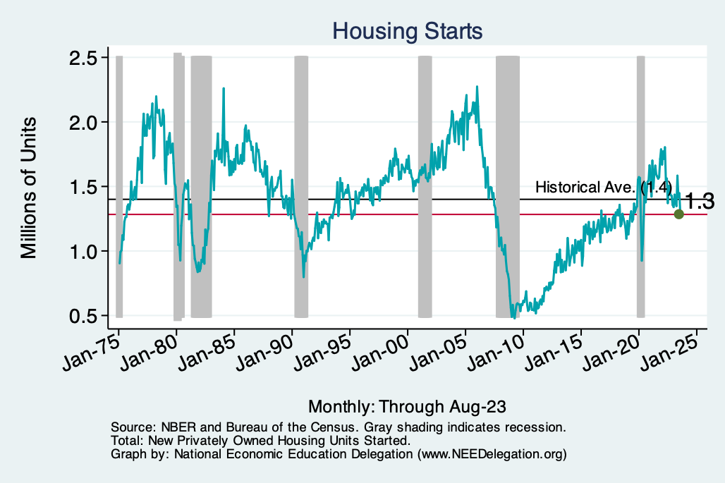
Home Prices and Housing Starts
Notes:
Charts:
homeprices_recession.png
housing.png

Slide 77
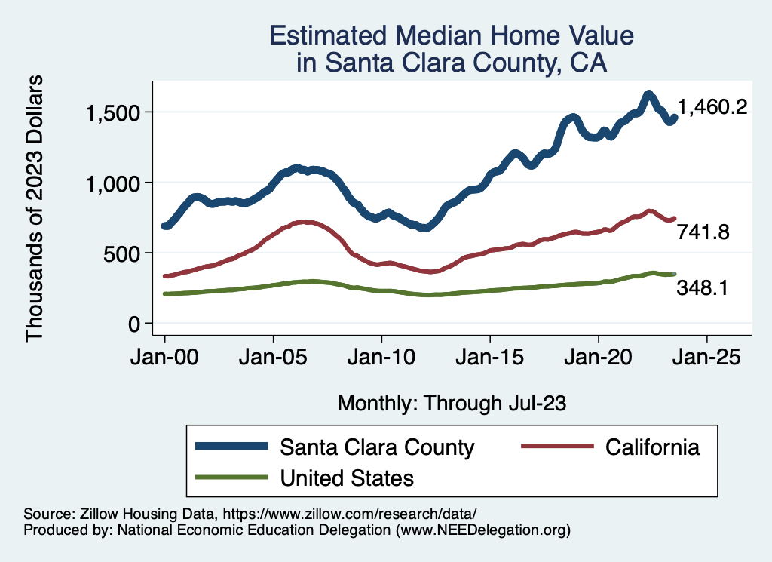
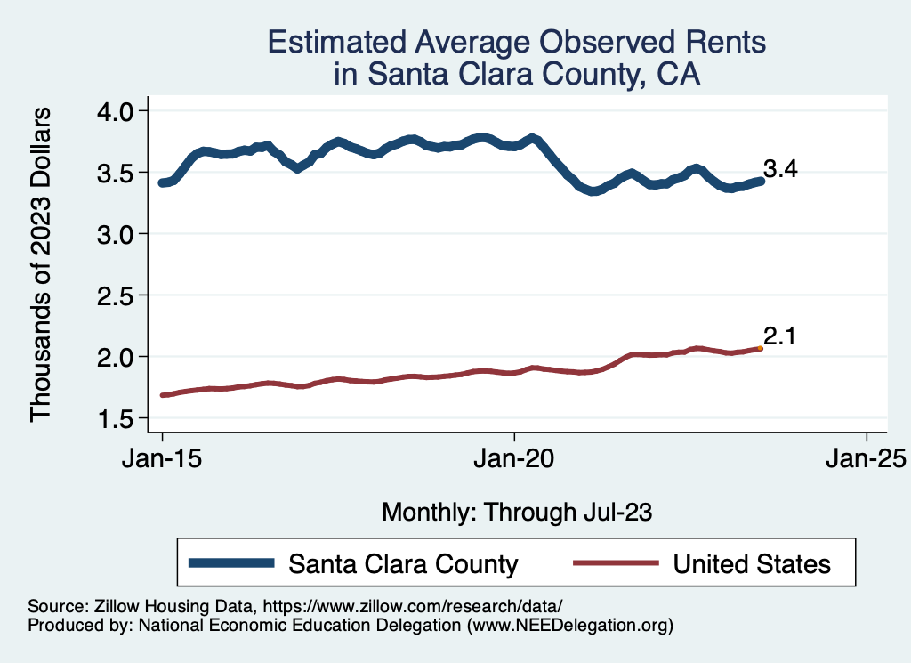
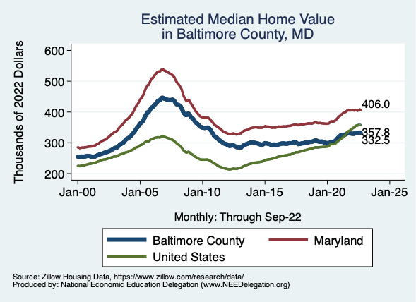
Home Prices … Depends on Where You Are
Notes:
Charts:
homeprices_recession.png
housing.png

Slide 78
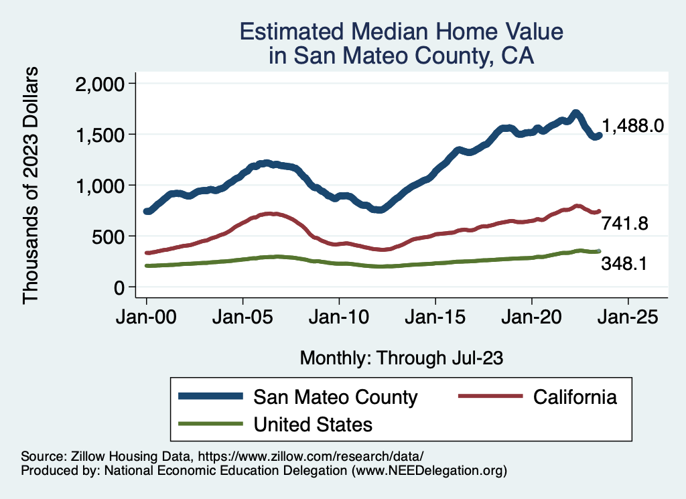
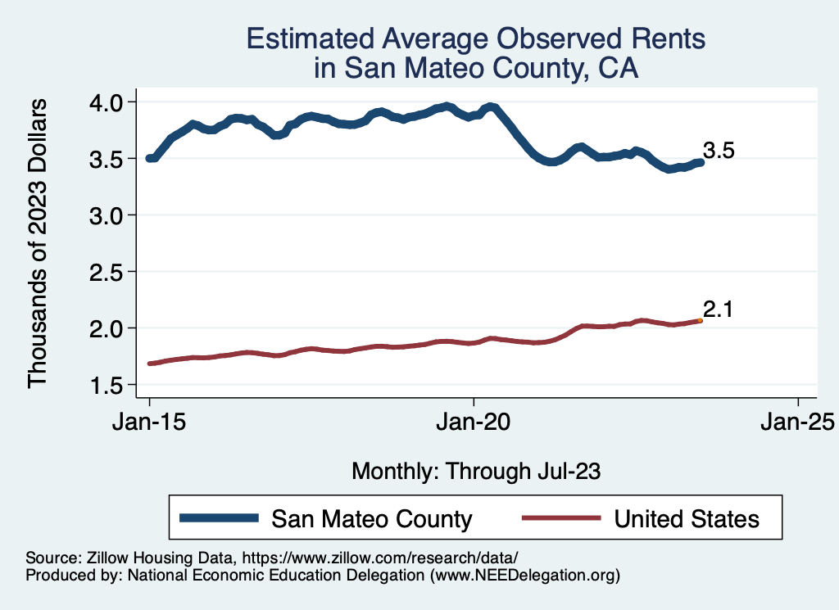
Home Prices … Depends on Where You Are
Notes:
Charts:
homeprices_recession.png
housing.png

Slide 79
Home Sales are Still Low

Slide 80
Takeaways
Is a recession on the horizon?
Unlikely, but shallow if it happens.
Many indicators are still in the black.
2023-Q2 GDP growth was ok!
Inflation has been tamed.
Fed is slowing its activity.
Threats to continued growth:
If inflation starts to rise again, which seems unlikely.
UAW Strikes – if prolonged.
Government budget negotiations.
Shutdown?

Slide 81
Thank you!
Any Questions?
www.NEEDEcon.org
Jon Haveman, Ph.D.
Jon@NEEDEcon.org
Contact NEED: info@NEEDEcon.org
Submit a testimonial: www.NEEDEcon.org/testimonials.php
Become a Friend of NEED: www.NEEDEcon.org/friend.php

