Slide 1
Osher Lifelong Learning Institute, Summer 2023
Contemporary Economic Policy
Oklahoma State University, OK
May-June, 2023
Jon Haveman, Ph.D.
National Economic Education Delegation

Slide 2
National Economic Education Delegation
Vision
One day, the public discussion of policy issues will be grounded in an accurate perception of the underlying economic principles and data.
Mission
NEED unites the skills and knowledge of a vast network of professional economists to promote understanding of the economics of policy issues in the United States.
NEED Presentations
Are nonpartisan and intended to reflect the consensus of the economics profession.

Slide 3
Who Are We?
Honorary Board: 54 members
2 Fed Chairs: Janet Yellen, Ben Bernanke
6 Chairs Council of Economic Advisers
Furman (D), Rosen (R), Bernanke (R), Yellen (D), Tyson (D), Goolsbee (D)
3 Nobel Prize Winners
Akerlof, Smith, Maskin
Delegates: 652+ members
At all levels of academia and some in government service
All have a Ph.D. in economics
Crowdsource slide decks
Give presentations
Global Partners: 48 Ph.D. Economists
Aid in slide deck development

Slide 4
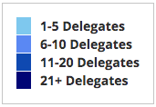
Where Are We?

Slide 5
Available NEED Topics Include:
US Economy
Healthcare Economics
Climate Change
Economic Inequality
Economic Mobility
Trade and Globalization
Minimum Wages
Immigration Economics
Housing Policy
Federal Budgets
Federal Debt
Black-White Wealth Gap
Autonomous Vehicles
Healthcare Economics

Slide 6
Course Outline
Contemporary Economic Policy
Week 1 (5/24): US Economic Update (Jon Haveman, NEED)
Week 2 (5/31): Healthcare Economics (Jon Haveman)
Week 3 (6/7): Federal Debt (Brian Peterson, Lagrange College)
Week 4 (6/14): Trade Deficits and Exchange Rates (Alan Deardorff, Univ. Michigan)

Slide 7
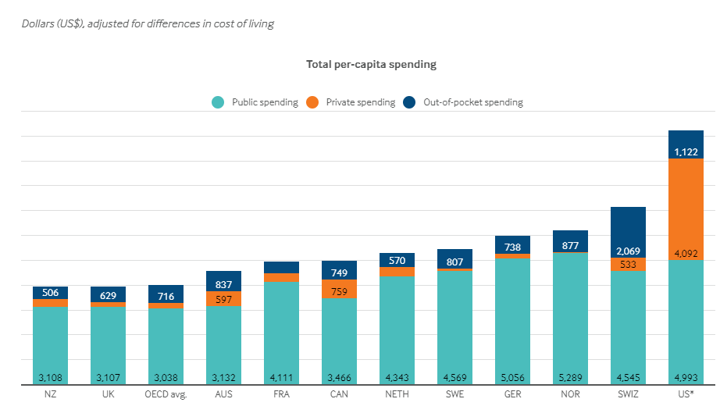
International Comparison: Health Spending
Notes:
Some good resources:
https://www.commonwealthfund.org/publications/issue-briefs/2020/jan/us-health-care-global-perspective-2019
A bit older report: https://www.commonwealthfund.org/publications/issue-briefs/2015/oct/us-health-care-global-perspective
https://www.healthsystemtracker.org/chart-collection/quality-u-s-healthcare-system-compare-countries/#item-overall-age-specific-potential-years-of-life-lost-per-100000-population-1990-2017
https://axenehp.com/international-healthcare-systems-us-versus-world/

Slide 8
The Federal Debt is Becoming A Problem

Slide 9
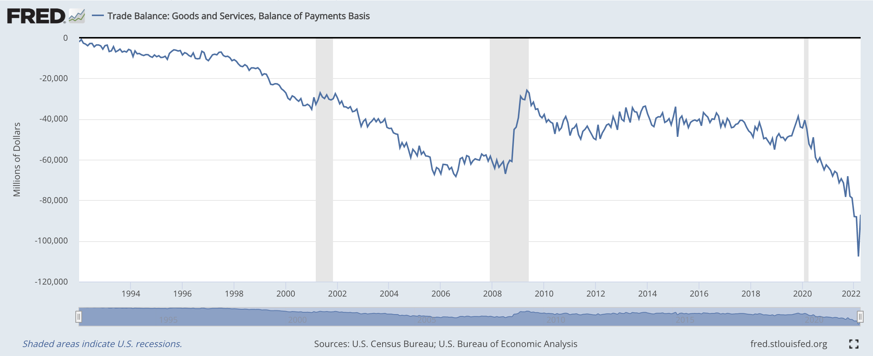
Trade Deficits and Exchange Rates

Slide 10
Submitting Questions
Please submit questions of clarification in the chat.
I will try to handle them as they come up.
We will do a verbal Q&A once the material has been presented.
Slides will be available from the NEED website shortly after the talk (https://NEEDEcon.org/delivered_presentations.php)

Slide 11
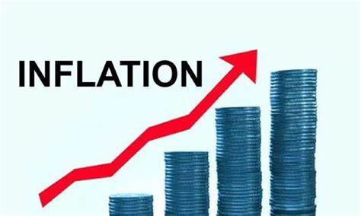
US Economic Update
OLLI – Oklahoma State University
May 24, 2023
Jon Haveman, Ph.D.
NEED

Slide 12
Credits and Disclaimer
This slide deck was authored by:
Jon D. Haveman, NEED
Scott Baier, Clemson University
Geoffrey Woglom, Amherst College (Emeritus)
Brian Dombeck, Lewis & Clark College
Doris Geide-Stevenson, Weber State
Disclaimer
NEED presentations are designed to be nonpartisan.
It is, however, inevitable that the presenter will be asked for and will provide their own views.
Such views are those of the presenter and not necessarily those of the National Economic Education Delegation (NEED).

Slide 13
Outline
About the U.S. Economy
Economic Indicators
Inflation/Federal Reserve/Banks
Debt Ceiling

Slide 14
The U.S. Economy

Slide 15
Some Basic Statistics, April 2023
Statistic: | Value
Population | 334.8 Million
Labor Force | 166.7 Million
Employment | 155.7 Million
Gross Domestic Product (GDP) | $26.5 Trillion
Income per Capita | $67,676
Ave. Hourly Earnings | $33.36
Source: fred.stlouisfed.org

Slide 16
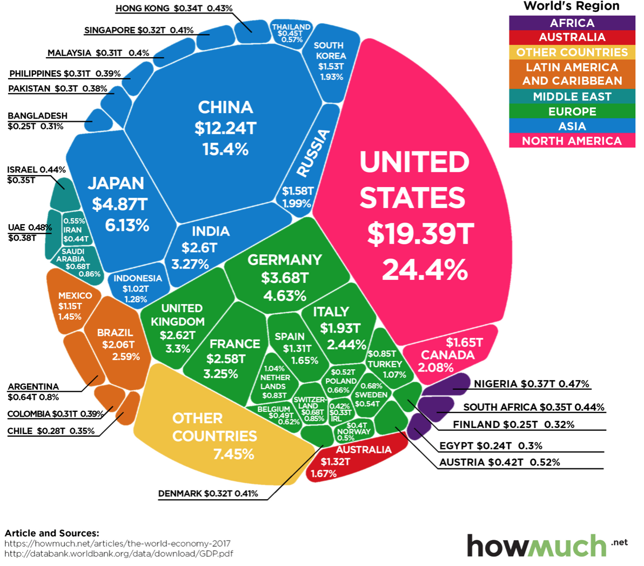
U.S. Economy in Global Perspective
U.S. Nominal GDP:
$21.538 trillion in 2019-Q4
$19.637 trillion in 2020-Q2
$26.466 trillion in 2023-Q1
Notes:
https://www.investopedia.com/insights/worlds-top-economies/#countries-by-gdp

Slide 17
Composition of the U.S. Economy: GDP

Slide 18
Composition of the U.S. Economy: Employment
Manufacturing
GDP Share = 10.7%
Health GDP Share = 7.4%
Note: Does not add to 100% because of omitted sectors.

Slide 19
Composition of the Payne Economy: Employment
Note: Does not add to 100% because of omitted sectors.

Slide 20
Economic Indicators

Slide 21
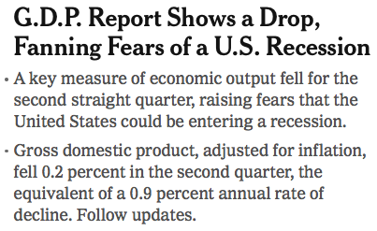
Headline: July 28, 2022
Old news….

Slide 22
GDP: Quarterly Growth
Q3-2022: 3.2%
Q4-2022: 2.6%
Q1-2023: 1.1%
Notes:
Graph: gdp_pot_grow.png
The Point: From 1990 – 2007, average annual US GDP growth pre-crisis is 2.94%. However, post-crisis US GDP growth is 2.19% (0.75 percentage points lower). Why is has the recovery been sluggish?
Note: At the recession’s height, the gap between quarterly GDP growth and potential growth was 2.5 percentage points.

Slide 23
GDP Trajectory: Pandemic Plunge!
GDP is:
$0.4 Trillion below 2019 forecast.
$1.2 Trillion ABOVE 2019-Q4 level.

Slide 24
“Accounting” for GDP
Expenditures drive GDP growth.
GDP is the sum of four categories of spending:
Consumption
Investment
Plant and equipment, residential real estate, and inventories.
Government spending
Net Exports: Exports – Imports
GDP = Consumption + Investment + Government + Net Exports
Notes:
Recall: GDP is measures production of an economy; we often measure GDP as the sum of spending on final goods/services produced within an economy. The first three categories (C,I,G) contain spending on both domestically and foreign produced goods. To accurately measure domestic production, we subtract domestic consumption of foreign goods (imports).
The Point: Analysis of components of GDP as well as the production side of the economy should provide a comprehensive picture of the US economic landscape

Slide 25
A Note on Imports and GDP
GDP = Consumption + Investment + Government + Net Exports
Net Exports = Exports – Imports
Gives the impression that IMPORTS are bad for GDP
They are not.
They are merely subtracted from the equation because the measurement of consumption, investment, and government all include imports.
Calculating Gross DOMESTIC Production must exclude IMPORTS
It is merely an accounting identity.

Slide 26
Composition of GDP
Notes:
Components sum to GDP
Average % of GDP for each component from 1960-Present: C = 64%, I=15%, G=24%, NX = 2% (X = 7%, M=9%)
Net Exports as a % of GDP has increased over the sample period, but it’s contribution to GDP is relatively small

Slide 27
Contribution to GDP Growth: Inventories
Notes:
Average GDP growth from 1990-2007 is 2.99% and from 2010+ is 2.19%
Average Consumption contribution from 1990-2007 is 2.16 percentage points and from 2010+ is 1.67 percentage points

Slide 28
Contribution to GDP Growth: Consumption
Notes:
Average GDP growth from 1990-2007 is 2.99% and from 2010+ is 2.19%
Average Consumption contribution from 1990-2007 is 2.16 percentage points and from 2010+ is 1.67 percentage points

Slide 29
Personal Consumption Expenditures
Trouble?
Notes:
Chart: ../Charts/personalconsumption_recession.png
Real consumption remains significantly lower than trend consumption since 2008 (actual is 89% of trend).
Since the recession, consumption growth has fallen. From 1990-2007, average annual consumption growth is 3.34%; Post-recession average annual consumption growth is 2.38%.

Slide 30
Retail Sales Remain Elevated!

Slide 31
Contributions to GDP: Government
Notes:
Since 2010, average government spending growth is shrinking, resulting in a negative average contribution to GDP growth post-recession of -0.8 percentage points
Note that average quarterly government spending growth is 0.42% from 1990-2007 and -0.17% in 2010+ (annualized, 1990-2007 = 1.68%; 2010+ = -0.70%).

Slide 32
Industrial Production (Manuf, Util, Mining)

Slide 33
Employment

Slide 34
Monthly Changes in Nonfarm Employment
Notes:
PAYEMS.png

Slide 35
Monthly Changes in Nonfarm Employment
February: 248,000
March: 165,000
April: 253,000
Notes:
PAYEMS.png

Slide 36
Employment Gap
3.3 Million ABOVE February, 2020.
5.1 Million BELOW where we should be.
Notes:
payroll_recent.png

Slide 37
Where Have All the Workers Gone?
2.8 million below where we should be

Slide 38
Some Explanations
500 Thousand: Long COVID Exits
1-2%: Long Social Distancing

Slide 39
How Are Things Where You Are?

Slide 40
Inflation

Slide 41
Inflation: Latest Figures
Source: NYTimes.com, Bureau of Labor Statistics

Slide 42
Inflation in the Last 6 Months – Close to 3%!

Slide 43
Inflation: Core Inflation is Stubbornly High

Slide 44
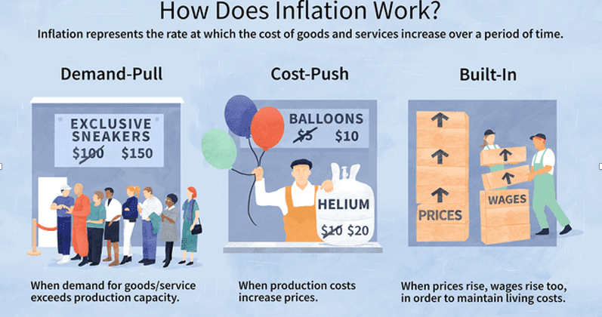
Source: Investopedia

Slide 45
Gas Prices: National Average at the Pump

Slide 46
Inflation is Not just a U.S. Problem

Slide 47
Supply Chains

Slide 48
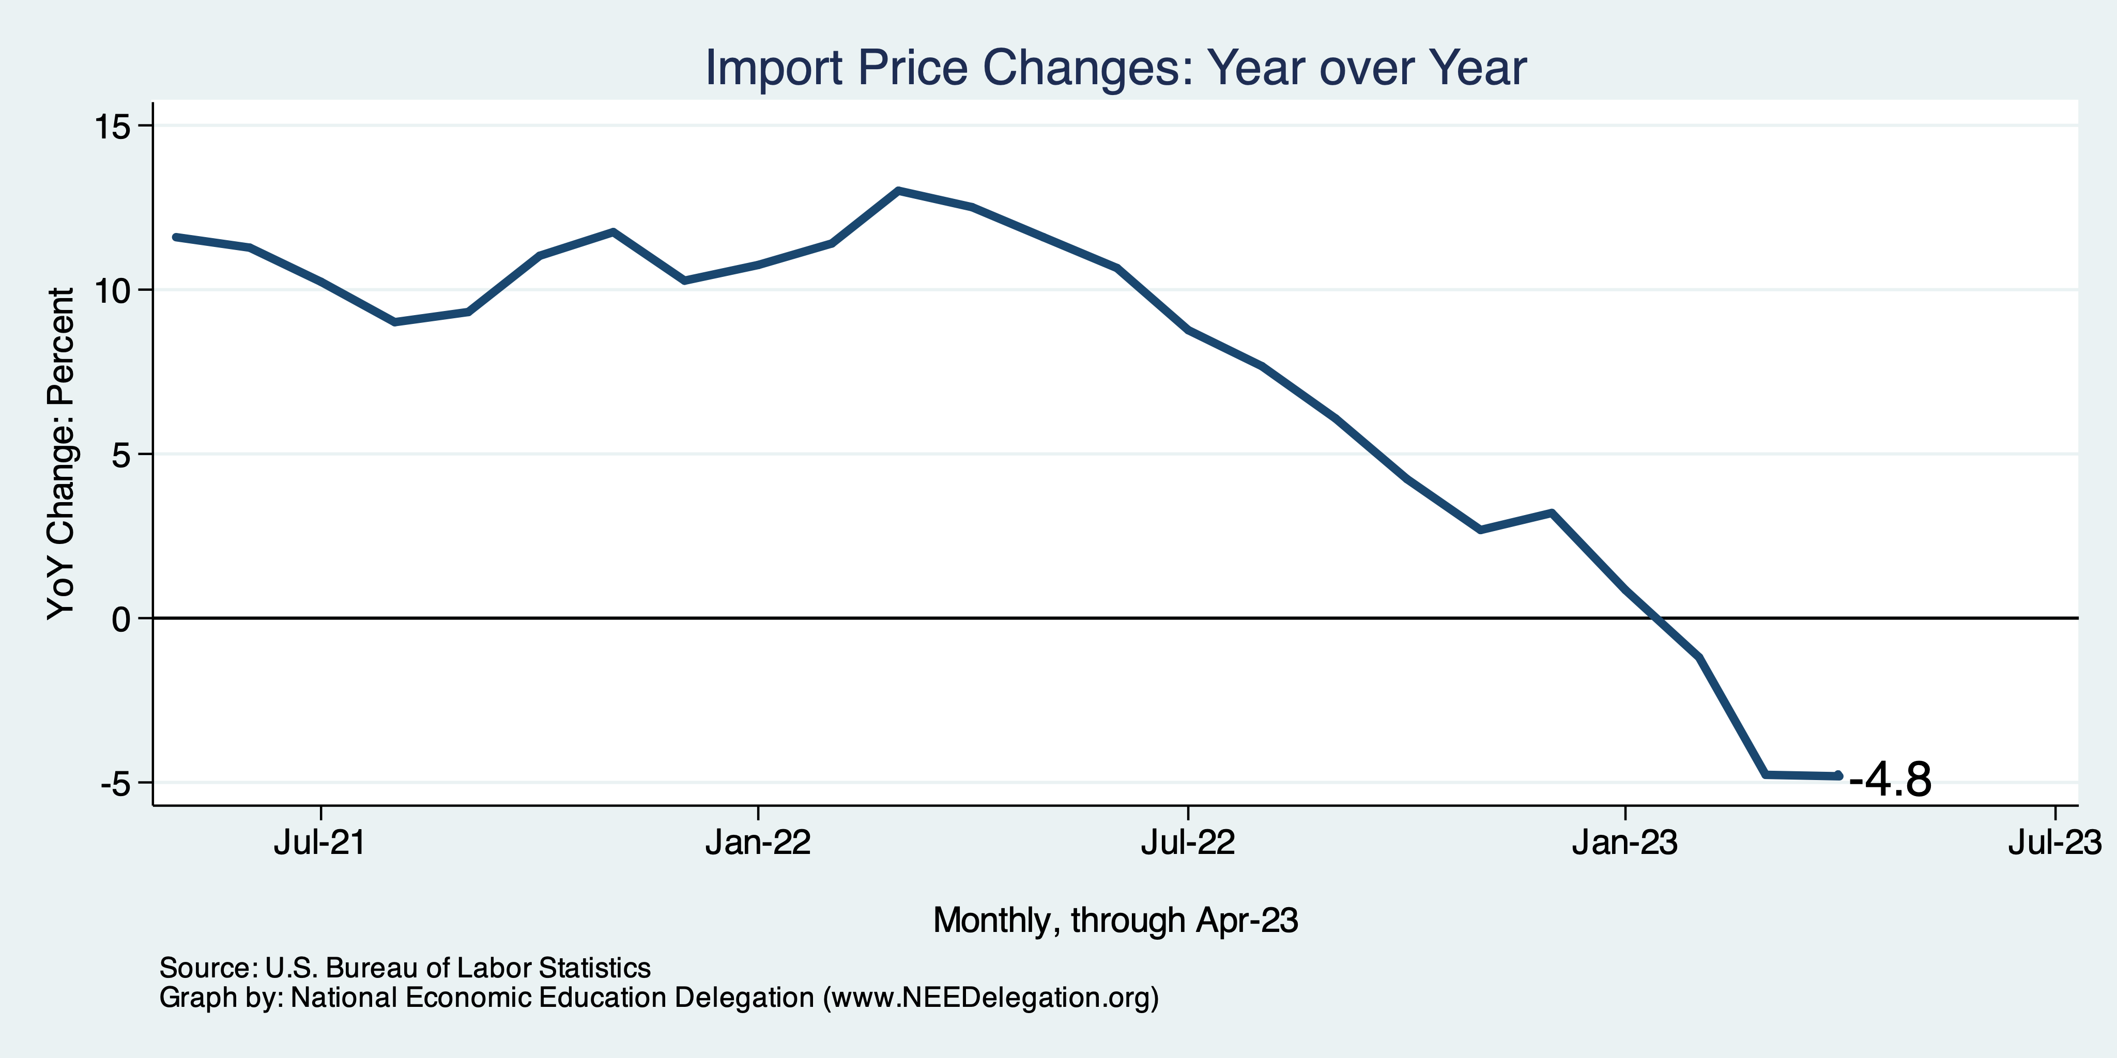
Import Price Inflation WAS High
Inflation – Imported Products: 9-10%

Slide 49
Two New Types of Inflation
Excuseflation
“The cost of my inputs is going up, so I have to raise my prices.”
You rarely hear: “I’m lowering my prices because costs are going down.”
Premiumization
Taking your product and spicing it up so that you can raise your margins.
Together, have led to a Profit-Price Spiral
Raising prices to cover costs plus a little extra.
Raising margins with extra frills.

Slide 50
Corporations Have Pricing Power!
Corporate Profits

Slide 51
My Thoughts on the Sources of Inflation
Supply Chain issues were significant – less so now.
Import price inflation was high – negative now.
Composition of spending changed significantly.
Is now bouncing back, as are prices.
Corporations have used the cover of inflation to raise prices more.
But there was too much total spending.
Fiscal stimulus led households to increase saving over 2021 by more than $2 trillion. Strong retail sales numbers suggest they are prepared to spend it.
Whose to Blame: ARP possibly too big, but the Fed could have acted sooner.
Bottom line: Recovery from a dramatic economic disruption is seldom painless.

Slide 52
What’s the Fed Doing About It?

Slide 53
Federal Funds Rate – Recent Activity
Expect a Pause in Rate Increases

Slide 54
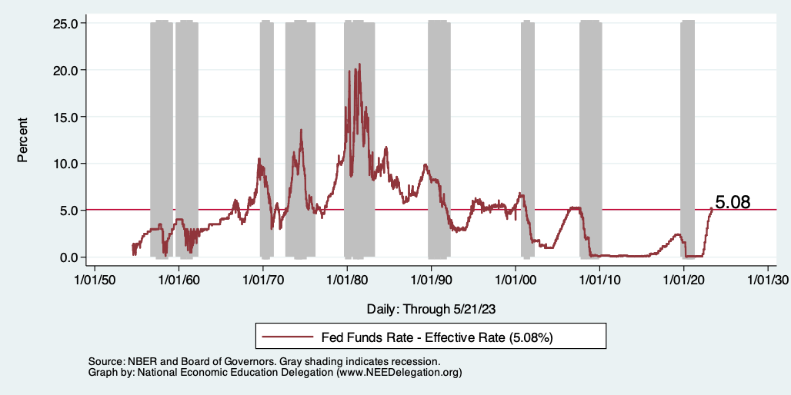
Raising the Federal Funds Rate
Notes:
The fed funds rate is the interest rate on overnight loans between banks. Think of it as the baseline interest rate on which banks base all other interest rates (e.g. mortgage rates)
FOMC lowers the fed funds rate during recessions and raises the fed funds rate during expansions
Fed funds rate peaked in the 1980s as then Chairman Paul Volcker sought to reign in “run away” inflation of the 1970s; doing so resulted in a recession in the early 1980s.
Since the 2008-09 recession, the fed funds rate has been kept near zero.
During the 2008-09 recession, Federal Reserve turned to unconventional tools to influence longer term interest rates to further stimulate the economy - QE
FedFunds.png

Slide 55
Fed: Also Reducing its Asset Holdings
Quantitative Tightening

Slide 56
Implications for Demand
Investment borrowing
Home loans – tied to 10-year Treasury
Car loans
Credit cards
Savings accounts – positive
And more….
All of which slows the economy.

Slide 57
Treasuries
Notes:
treas_recent.png

Slide 58
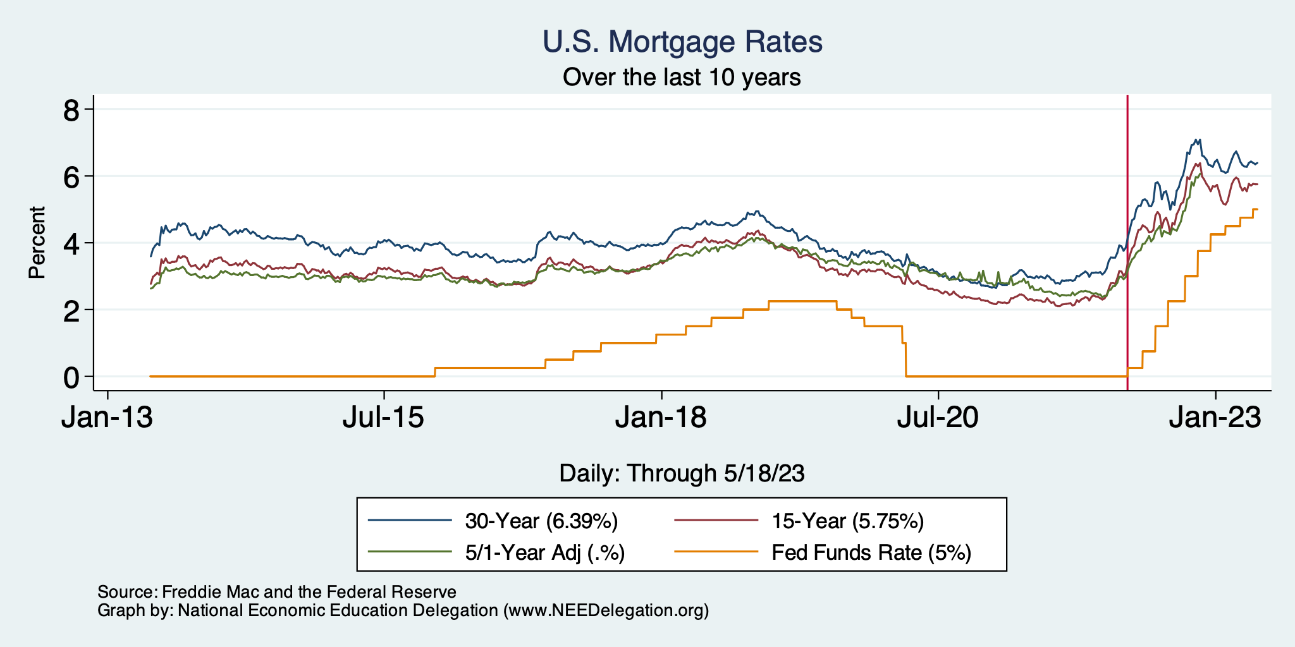
Mortgage Rates

Slide 59
Contributions to GDP: Residential Investment
Notes:
Contribution of residential investment to GDP growth has risen post-2009

Slide 60
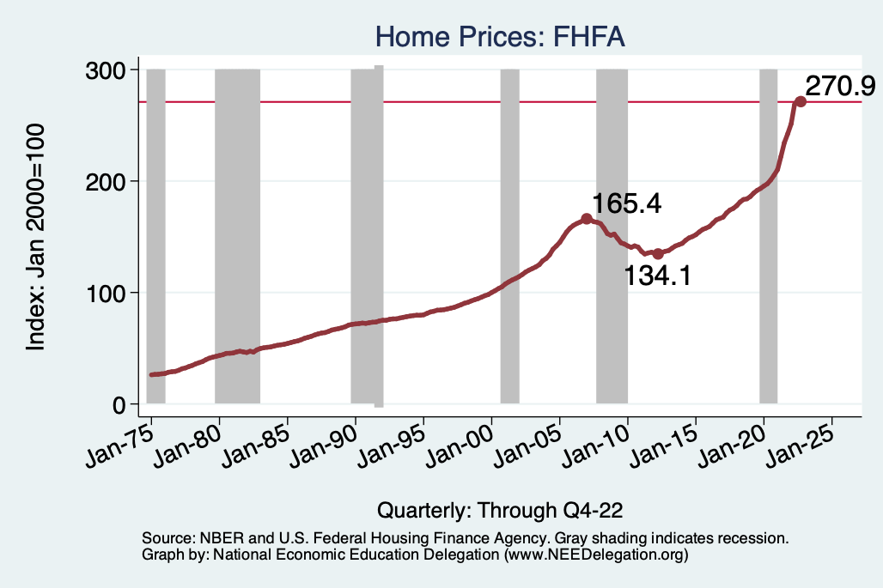
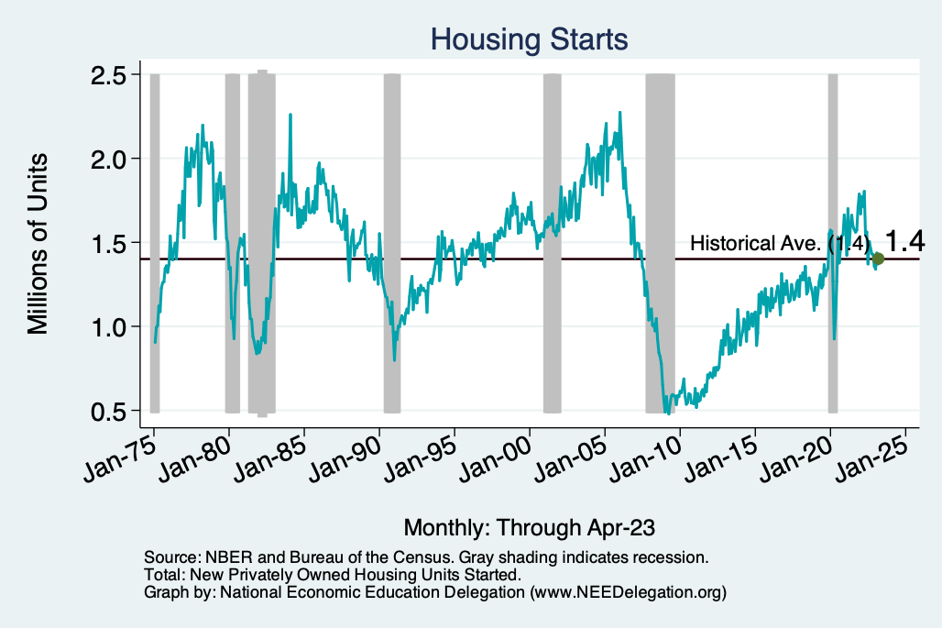
Home Prices and Housing Starts
Notes:
Charts:
homeprices_recession.png
housing.png

Slide 61
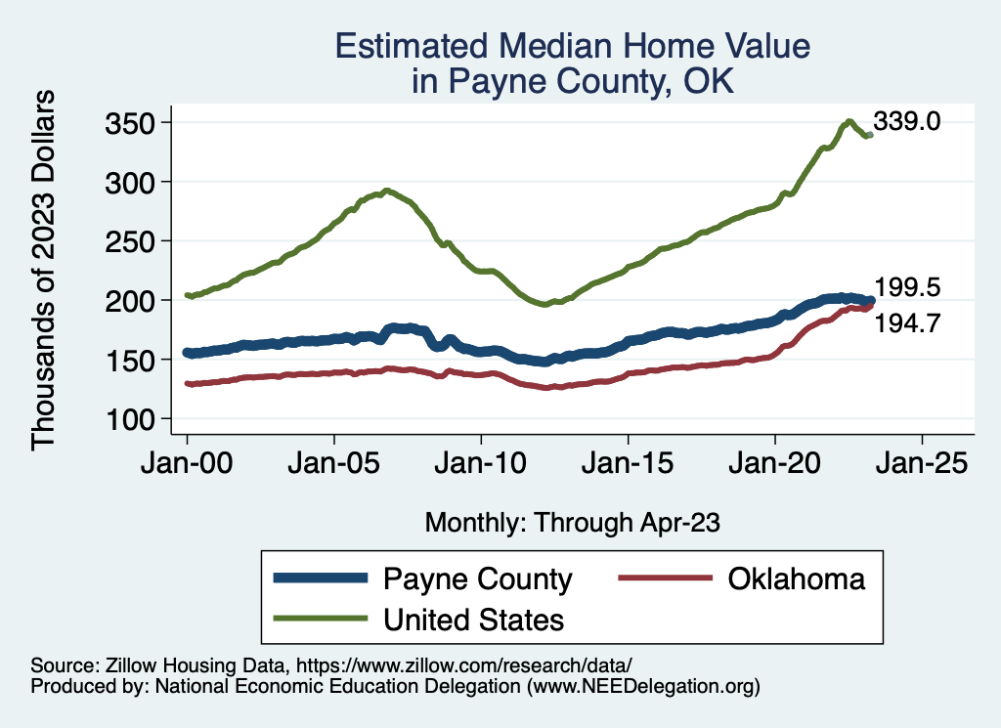
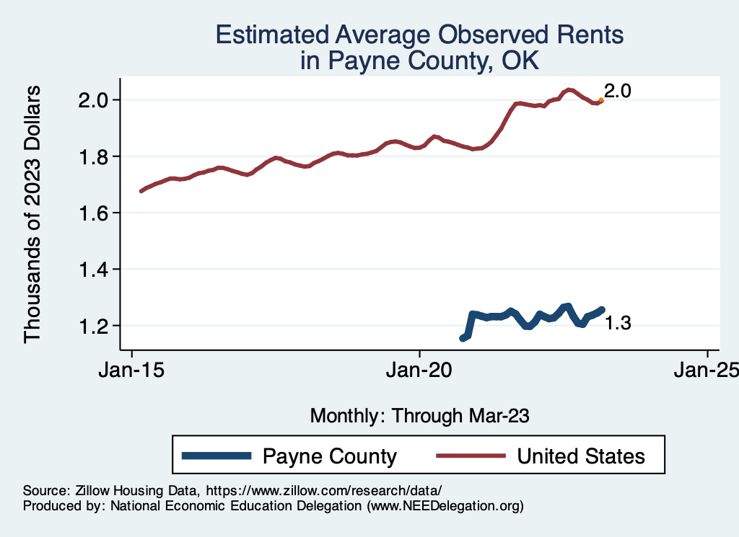
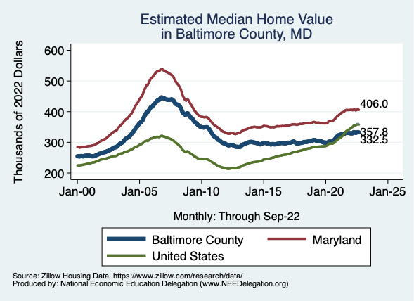
Home Prices … Depends on Where You Are
Notes:
Charts:
homeprices_recession.png
housing.png

Slide 62
Home Sales are Turning Around…Maybe

Slide 63
What About the Banks?

Slide 64
Banks…
Silicon Valley Bank
Signature Bank
First Republic Bank
Banks were too long on long-term Treasuries.
Have we reached the end?
Rising interest rates are like the tide going out….
They expose who is swimming with no clothes on.
The tide isn’t completely out.
Bank balance sheets seem ok, it’s stocks that are not.

Slide 65
A Couple of Notes on the Banking Scare
Banks like their customers to be:
Sticky – they won’t leave.
Sleepy – they’ll accept close to zero interest rates.
Silicon Valley Bank’s customers….
Were neither.
It’s likely that none of this would have happened if they didn’t have mobile/connected customers with LOTS of uninsured deposits.
Regulation surrounding the share of uninsured deposits is likely coming.
Small bank stocks are rebounding, so we may have dodged this bullet.

Slide 66
They May Present A Challenge to Growth

Slide 67
Existential Threat: Coming This June!

Slide 68
What is the Debt Ceiling?
An amount of debt that the federal government can not exceed without congressional approval.
From the Constitution: only Congress can authorize the borrowing of money on credit of the United States (Article I, Section 8).
During WWI, requests came so fast and furiously, that Congress put in place the Debt Ceiling.
Approvals then occurred only periodically.
And it continues today.

Slide 69
5 Things to Know about the Debt Ceiling
The debt limit has been raised continually for more than a century.
Raising the debt limit is not about new spending; it is about paying for previous choices policymakers legislated.
Only one other advanced country—Denmark—has a separate debt limit rule like ours (but theirs isn’t binding).
Now that the debt hit the ceiling, the Treasury Department is using several extraordinary measures to postpone the day of reckoning.
The economic consequences of a large-scale, intentional default are unknown, but predictions range from bad to catastrophic.
Souce: https://www.brookings.edu/2023/01/19/7-things-to-know-about-the-debt-limit/

Slide 70
How Bad Could It Be?

Slide 71
Lessons from 1979 & 2011
Accidental partial default in 1979:
Increased borrowing costs by $40 Billion!
Government shutdown was very costly:
Stock markets plunged (17%).
Employment growth stuttered.
Treasuries – downgraded credit ratings.
Borrowing costs rose.

Slide 72
An Estimate of the Potential Damage:
Moody’s Analytics
A prolonged breach could lead to
Could cost up to 7 million jobs,
Drive unemployment up to 8%, and,
Wipe out $10 trillion in household wealth.

Slide 73
Countdown to Default

Slide 74
What Are the Available Options?
A clean debt ceiling lift.
And perhaps default if other side doesn’t capitulate.
A debt ceiling lift with budget cuts.
And perhaps default if other side doesn’t capitulate.
Plead the 14th Amendment.
The validity of the public debt of the United States, authorized by law, including debts incurred for payment of pensions and bounties for services in suppressing insurrection or rebellion, shall not be questioned.
Mint a platinum coin.

Slide 75
Economics of the Options
What about tax increases?
Nothing in economics remotely suggests that revenue cuts are NECESSARILY preferred to tax increases.
Just defaulting isn’t enough.
Our monthly expenditures are more than the interest on the debt.
Some bills would go unpaid, or perhaps a partial shutdown would be necessary.
The cuts being proposed are also not enough.
Saves $4.8 Trillion over 10 years.
CBO projects deficits of $22 Trillion over 10 years.

Slide 76
In Order to Solve the Problem…
We must address the major contributors to the debt going forward:
Between 2025 and 2033, Social Security and Medicare are the largest contributors to growing debt.
These may well be third rails, but they are also the source of the problem.

Slide 77
Takeaways
Is a recession on the horizon?
Perhaps, but shallow?
Many indicators are still in the black.
2021-Q1 GDP growth was ok!
Threats to continued growth:
If inflation starts to rise again, which seems unlikely.
Layoff contagion.
Broader banking crisis – too much tightening.
Borrowing and lending seem to be low and shrinking.
Debt ceiling negotiations
Significant cuts to government budgets may well result.
Everything changes with a default on the U.S. debt.

Slide 78
The Federal Debt is Becoming A Problem
Next week: Brian Peterson

Slide 79
Thank you!
Any Questions?
www.NEEDEcon.org
Jon Haveman, Ph.D.
Jon@NEEDEcon.org
Contact NEED: info@NEEDEcon.org
Submit a testimonial: www.NEEDEcon.org/testimonials.php
Become a Friend of NEED: www.NEEDEcon.org/friend.php

