Slide 1
Osher Lifelong Learning Institute, Fall 2022
Contemporary Economic Policy Issues
University of New Mexico
November, 2022
Jon Haveman, Ph.D.
National Economic Education Delegation

Slide 2
National Economic Education Delegation
Vision
One day, the public discussion of policy issues will be grounded in an accurate perception of the underlying economic principles and data.
Mission
NEED unites the skills and knowledge of a vast network of professional economists to promote understanding of the economics of policy issues in the United States.
NEED Presentations
Are nonpartisan and are intended to reflect the consensus of the economics profession.

Slide 3
Who Are We?
Honorary Board: 54 members
2 Fed Chairs: Janet Yellen, Ben Bernanke
6 Chairs Council of Economic Advisers
Furman (D), Rosen (R), Bernanke (R), Yellen (D), Tyson (D), Goolsbee (D)
3 Nobel Prize Winners
Akerlof, Smith, Maskin
Delegates: 652+ members
At all levels of academia and some in government service
All have a Ph.D. in economics
Crowdsource slide decks
Give presentations
Global Partners: 49 Ph.D. Economists
Aid in slide deck development

Slide 4
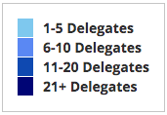
Where Are We?

Slide 5
Available NEED Topics Include:
US Economy
Healthcare Economics
Climate Change
Economic Inequality
Economic Mobility
Trade and Globalization
Minimum Wages
Immigration Economics
Housing Policy
Federal Budgets
Federal Debt
Black-White Wealth Gap
Autonomous Vehicles
Healthcare Economics

Slide 6
Course Outline
Contemporary Economic Policy:
Week 1 (11/1): US Economic Update (Jon Haveman, NEED)
Week 2 (11/8): Economic Inequality (Adina Ardelean, Santa Clara University)
Week 3 (11/15): The Black-White Wealth Gap (Jon Haveman, NEED)
Week 4 (11/22): Economic Mobility (Kathryn Wilson, Kent State University)

Slide 7
Income Inequality: Share of Top 10%
Stock Market Crash
WWII
Housing Bubble
Dot-com Bubble

Slide 8
Evidence of the B-W Wealth Gap
Mean is
7x Greater
Median is 8x Greater

Slide 9
Mobility
9 out of 10 of those born in the early 1940s could expect to earn more than their parents
1 in 2 Millennials (born after 1980) earn more than their parents.

Slide 10
Submitting Questions
Please submit questions of clarification in the chat.
I will try to handle them as they come up.
We will do a verbal Q&A once the material has been presented.
We can also do 5 minutes of verbal Q&A following the break.
Slides will be available from the NEED website soon. (https://needelegation.org/delivered_presentations.php)

Slide 11
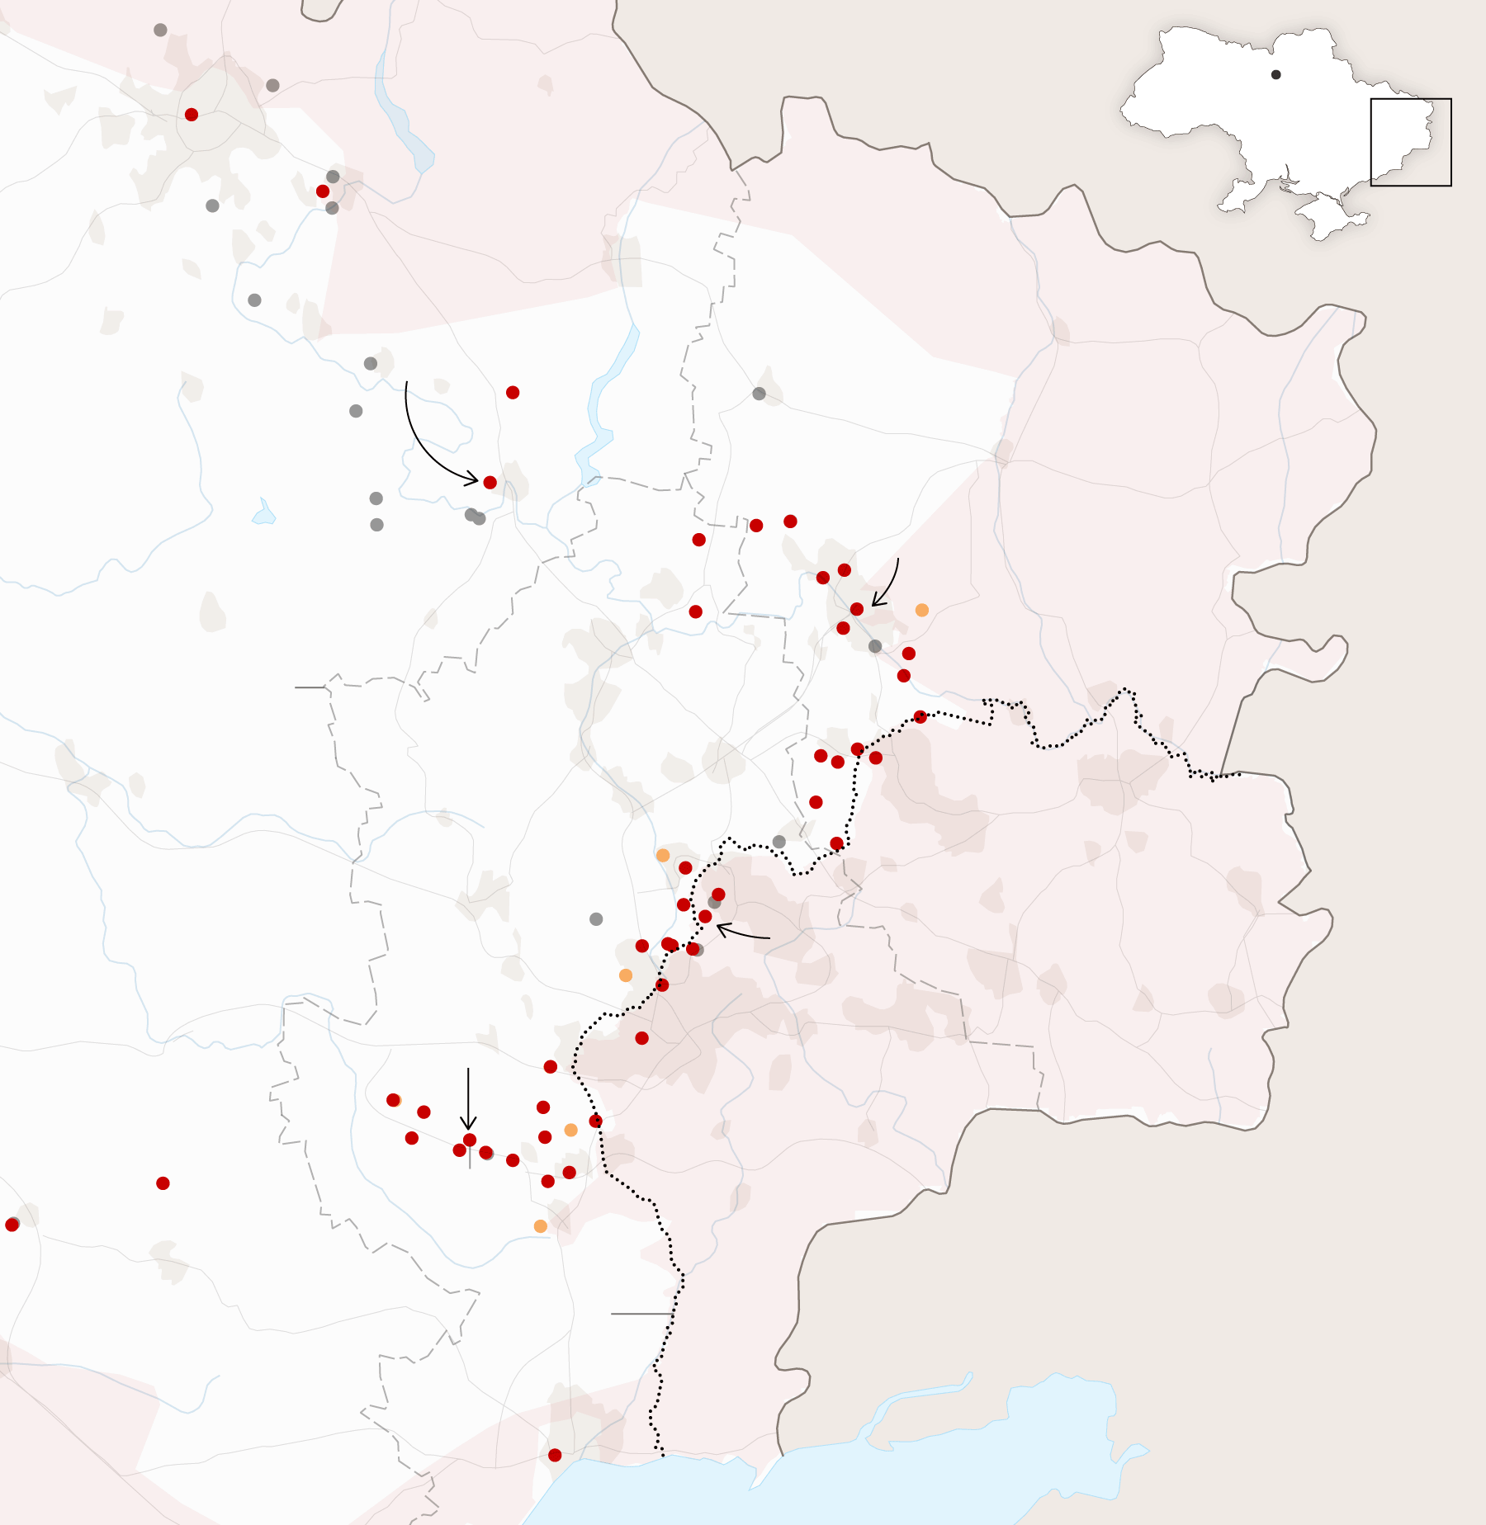
US Economic Update
Jon Haveman, Ph.D.
NEED
November 1, 2022

Slide 12
Credits and Disclaimer
This slide deck was authored by:
Jon Haveman, Executive Director of NEED
Allison Roehling, DePauw University
This slide deck was reviewed by:
Jeffrey Frankel, Harvard University
Scott Baier, Clemson University
Rob Eyler, Sonoma State University
Disclaimer
NEED presentations are designed to be nonpartisan
It is, however, inevitable that the presenter will be asked for and will provide their own views.
Such views are those of the presenter and not necessarily those of the National Economic Education Delegation (NEED).

Slide 13
Credits and Disclaimer
This slide deck was authored by:
Jon D. Haveman, NEED
Scott Baier, Clemson University
Geoffrey Woglom, Amherst College (Emeritus)
Brian Dombeck, Lewis & Clark College
Doris Geide-Stevenson, Weber State
Disclaimer
NEED presentations are designed to be nonpartisan.
It is, however, inevitable that the presenter will be asked for and will provide their own views.
Such views are those of the presenter and not necessarily those of the National Economic Education Delegation (NEED).

Slide 14
Outline
About the U.S. Economy
Recession – The State of the US Economy
Global Comparisons
Inflation
Summary

Slide 15
Some Basic Statistics
Statistic: | Value
Population | 333.2 Million
Labor Force | 164.7 Million
Employment | 153.0 Million
Gross Domestic Product (GDP) | $25.7 Trillion
Income per Capita | $65,769
Ave. Hourly Earnings | $32.46
Source: fred.stlouisfed.org

Slide 16
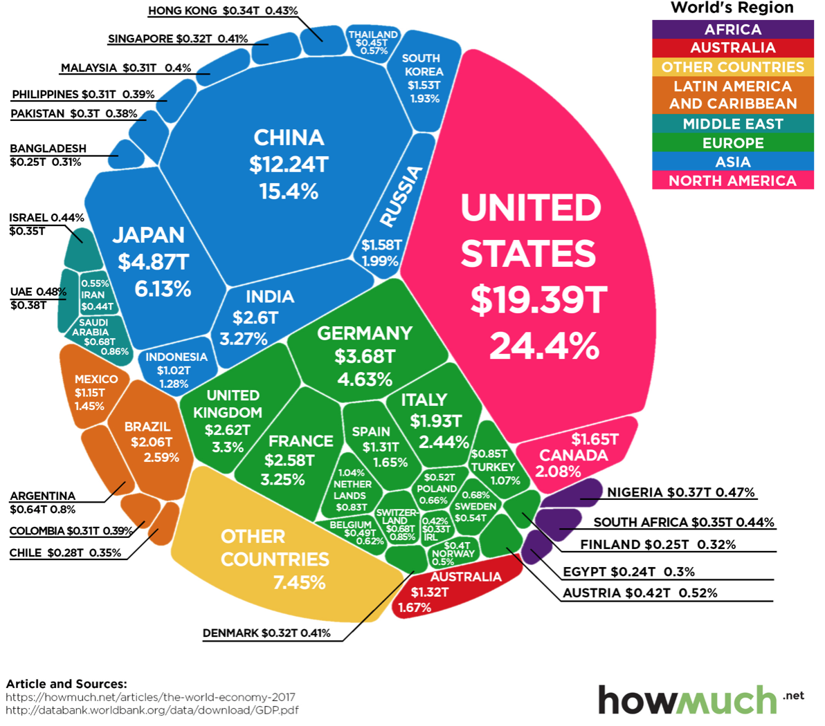
U.S. Economy in Global Perspective
U.S. Nominal GDP:
$21.538 trillion in 2019-Q4
$19.637 trillion in 2020-Q2
$25.663 trillion in 2022-Q3
Notes:
https://www.investopedia.com/insights/worlds-top-economies/#countries-by-gdp

Slide 17
Composition of the U.S. Economy: 2020

Slide 18
Composition of the U.S. Economy: Employment
Manufacturing
GDP Share = 10.6%
Health GDP Share = 7.7%
Note: Does not add to 100% because of omitted sectors.

Slide 19
Employment in Bernalillo County
Note: Does not add to 100% because of omitted sectors.

Slide 20
Recession(?)

Slide 21
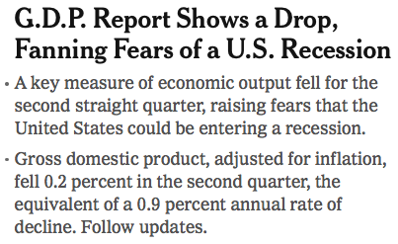
Headline:

Slide 22
GDP: Quarterly Growth
Notes:
Graph: gdp_pot_grow.png
The Point: From 1990 – 2007, average annual US GDP growth pre-crisis is 2.94%. However, post-crisis US GDP growth is 2.19% (0.75 percentage points lower). Why is has the recovery been sluggish?
Note: At the recession’s height, the gap between quarterly GDP growth and potential growth was 2.5 percentage points.

Slide 23
GDP During the Pandemic: Annual Growth

Slide 24
GDP Trajectory: Pandemic Plunge!
GDP is:
$0.4 Trillion below 2019 forecast.
$1.0 Trillion ABOVE 2019-Q4 level.

Slide 25
What “Accounted” for the Decline in Q1 & Q2?
Expenditures drive GDP growth.
GDP is the sum of four categories of spending:
Consumption
Investment – housing/business/inventories
Government spending
Net Exports: Exports – Imports
Notes:
Recall: GDP is measures production of an economy; we often measure GDP as the sum of spending on final goods/services produced within an economy. The first three categories (C,I,G) contain spending on both domestically and foreign produced goods. To accurately measure domestic production, we subtract domestic consumption of foreign goods (imports).
The Point: Analysis of components of GDP as well as the production side of the economy should provide a comprehensive picture of the US economic landscape

Slide 26
Recession? Two Quarters….
Depends on what is driving the drop.
Inventories
Housing
Government spending
Consumer spending is still ok.
Employment growth is solid.
Other indicators are still ok.

Slide 27
Contribution to GDP Growth: Consumption
Notes:
Average GDP growth from 1990-2007 is 2.99% and from 2010+ is 2.19%
Average Consumption contribution from 1990-2007 is 2.16 percentage points and from 2010+ is 1.67 percentage points

Slide 28
Personal Consumption Expenditures
Trouble?
Notes:
Chart: ../Charts/personalconsumption_recession.png
Real consumption remains significantly lower than trend consumption since 2008 (actual is 89% of trend).
Since the recession, consumption growth has fallen. From 1990-2007, average annual consumption growth is 3.34%; Post-recession average annual consumption growth is 2.38%.

Slide 29
Retail Sales
Notes:
Graph: RSAFT.png (slides_20.do)
Retail sales fells dramatically during the recession
Sales appear to be returning to forecasted trend; 7 billion 2018 USD gap
Conclusion: Retail sales do not appear to contribute to sluggish consumption growth.
Chart: RSAFS.png

Slide 30
Household Debt: Change During the Pandemic

Slide 31
Contribution to GDP Growth: Inventories
Notes:
Average GDP growth from 1990-2007 is 2.99% and from 2010+ is 2.19%
Average Consumption contribution from 1990-2007 is 2.16 percentage points and from 2010+ is 1.67 percentage points

Slide 32
Contributions to GDP: Residential Investment
Notes:
Contribution of residential investment to GDP growth has risen post-2009

Slide 33
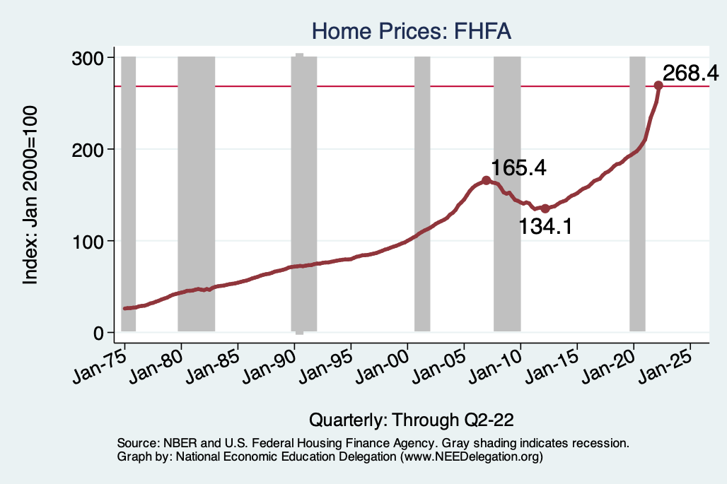
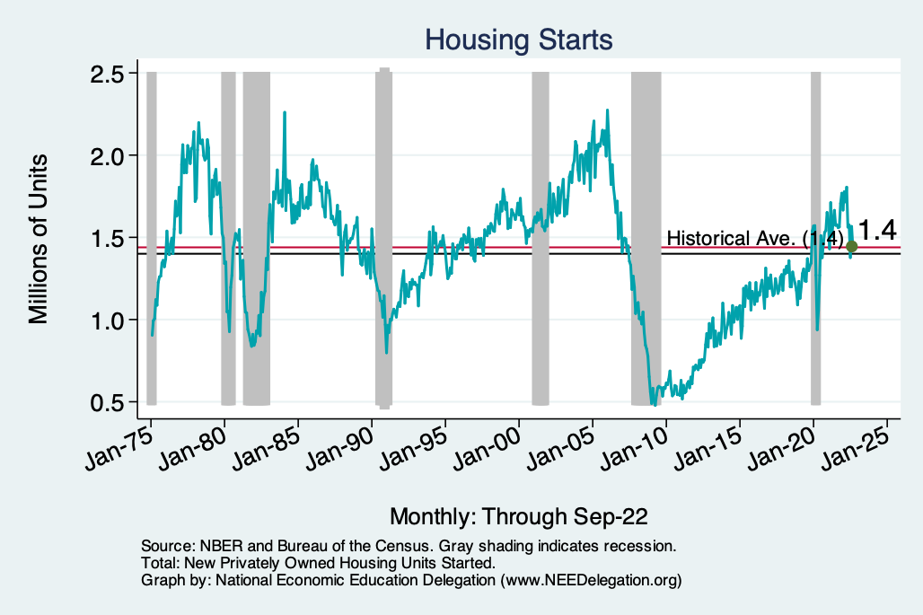
Home Prices and Housing Starts
Notes:
Charts:
homeprices_recession.png
housing.png

Slide 34
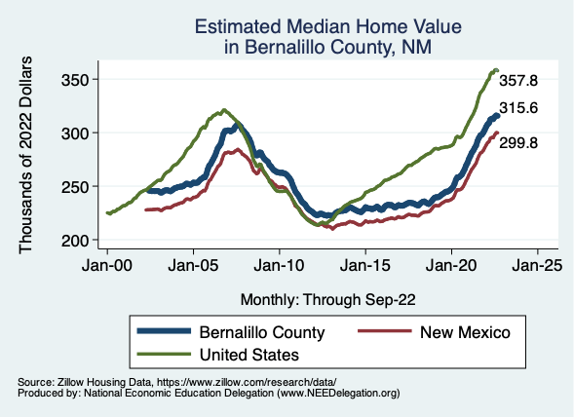
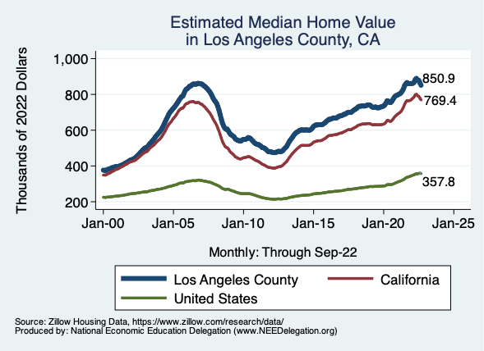
Home Prices … Depends on Where You Are
Notes:
Charts:
homeprices_recession.png
housing.png

Slide 35
Contributions to GDP: Government
Notes:
Since 2010, average government spending growth is shrinking, resulting in a negative average contribution to GDP growth post-recession of -0.8 percentage points
Note that average quarterly government spending growth is 0.42% from 1990-2007 and -0.17% in 2010+ (annualized, 1990-2007 = 1.68%; 2010+ = -0.70%).

Slide 36
Industrial Production (Manuf, Util, Mining)

Slide 37
Monthly Changes in Nonfarm Employment
Notes:
PAYEMS.png

Slide 38
Monthly Changes in Nonfarm Employment
August: 315,000
September: 263,000
Notes:
PAYEMS.png

Slide 39
Employment Gap
0.5 Million ABOVE February, 2020.
6.3 Million below where we should be.
Notes:
payroll_recent.png

Slide 40
Job Openings: Share of Total Employment
Notes:
During expansions, job openings rise.
Reinforces previous slide demonstrating higher separation and hiring rates during expansions

Slide 41
Job Hires and Separations

Slide 42
Separations: Quits and Layoffs
Notes:
(1) As expected during periods of low unemployment (booms) – workers seek higher paying or better fitting positions (higher quit rate) while firms require more workers for higher production (lower layoff rate).

Slide 43
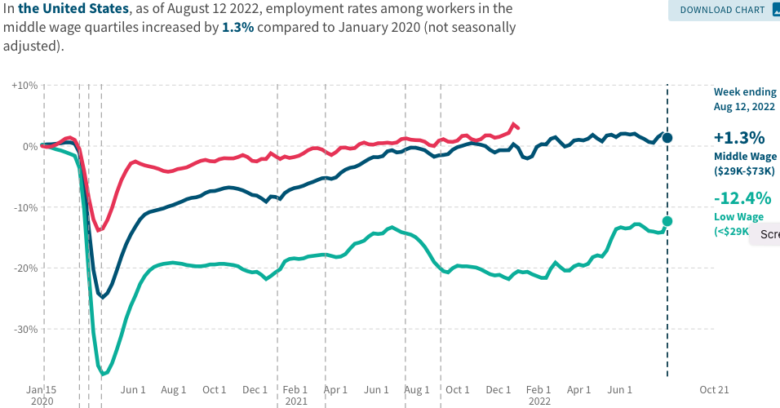
Low Wage Employment is Lagging
Source: https://tracktherecovery.org

Slide 44
Wage Growth
Notes:
Is this necessary given the previous slide?

Slide 45
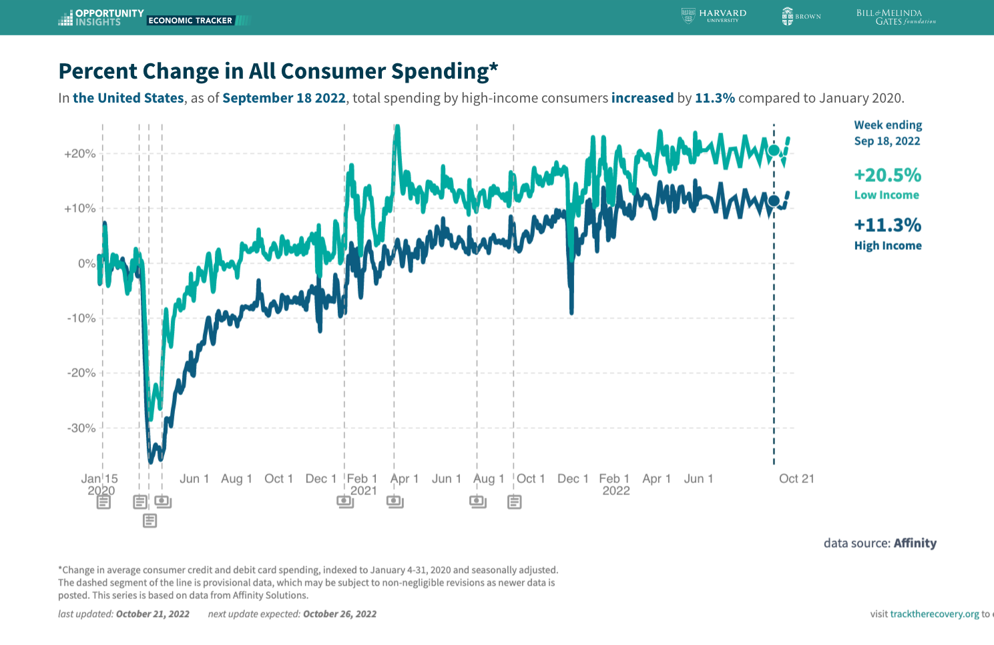
Stimulus Payments Saved Low Wage Workers
Source: https://tracktherecovery.org

Slide 46
Where Have All the Workers Gone?
3.9 million below where we should be

Slide 47
Some Explanations
500 Thousand: Long COVID Exits
1-2%: Long Social Distancing

Slide 48
How Are Things Where You Are?

Slide 49
Inflation

Slide 50
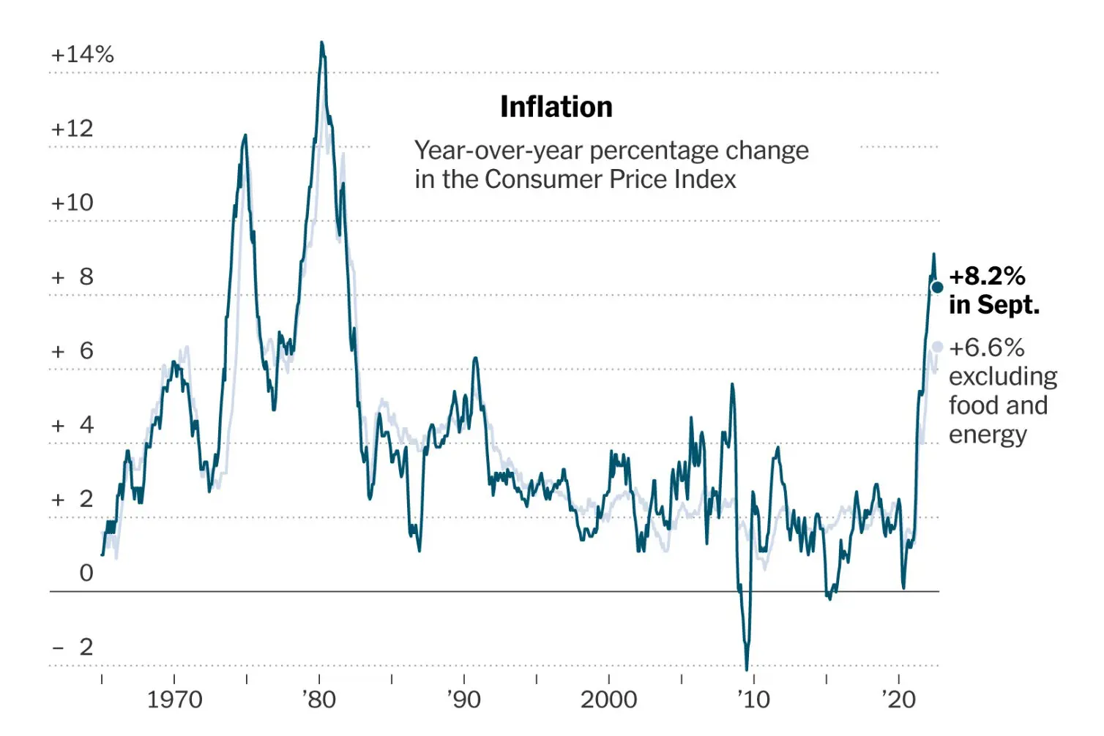
Inflation: Latest Figures
Source: NYTimes.com

Slide 51
Which Prices?
Food
Aug-Sep: +0.4
July-Aug: 0
June-July: 0
Gas

Slide 52
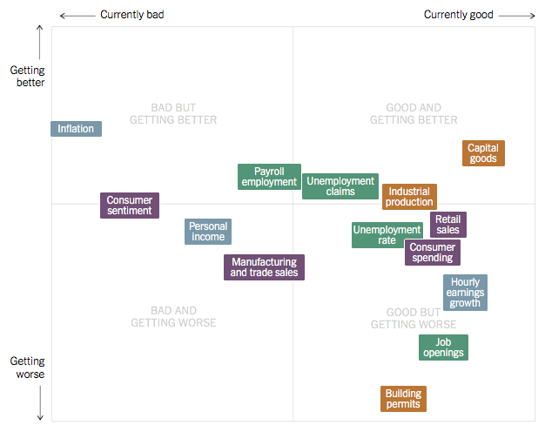
Summing Up The US Economy
Source: NYTimes.com

Slide 53
Global Evidence

Slide 54
Inflation: Not just a US Problem
United States: 8.5
Netherlands: 12.0
Spain: 10.4
United Kingdom: 10.1
Denmark: 8.9
Sweden: 8.5
Germany: 7.9
Norway: 6.5
France: 5.8
Source: TradingEconomics.com, 9/12/22

Slide 55
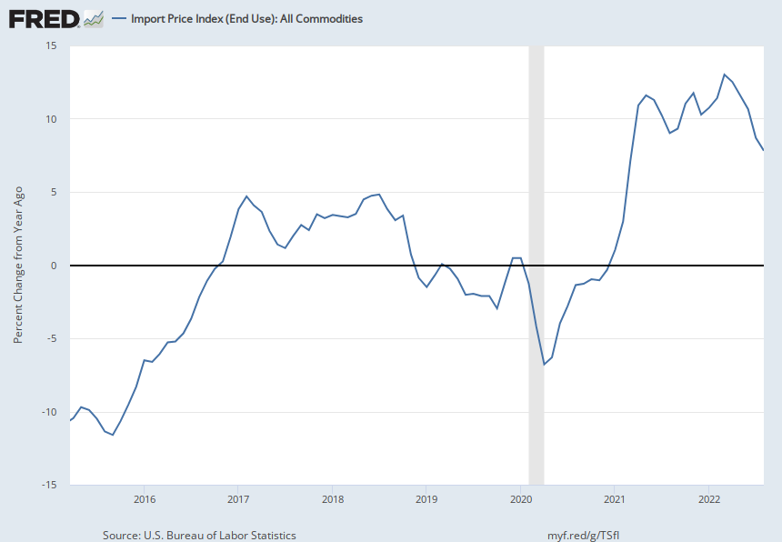
Import Prices Are Elevated
Inflation – Imported Products: 9-10%

Slide 56
GDP: U.S. Stands Out, But Not Alone
United States: -0.6
Netherlands: 2.6
Spain: 1.1
United Kingdom: -0.1
Denmark: 0.9
Sweden: 0.9
Germany: 0.1
Norway: 0.7
France: 0.5
Source: TradingEconomics.com, 9/12/22

Slide 57
Global Summary
Developed economies are uniformly down.
Not entirely a surprise. Went through the same pandemic gyrations:
Supply chain issues.
Import prices are way up.
Somewhat surprising because the economic responses varied across countries.
All used stimulus, but US used MUCH more.
Inflation – tale of two sources:
United States – much more one of elevated demand.
Europe – much more one of food and energy prices (war).

Slide 58
Inflation: A Closer Look

Slide 59
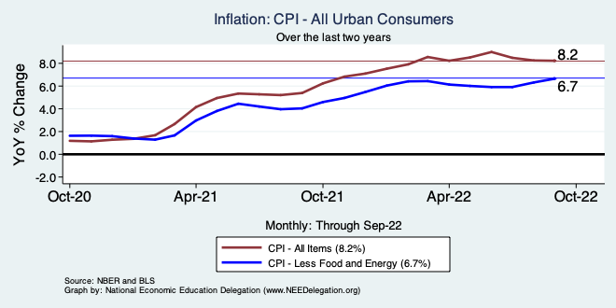
Inflation – Climbing! Or Turning Around?
Notes:
Cpi_recent.png

Slide 60
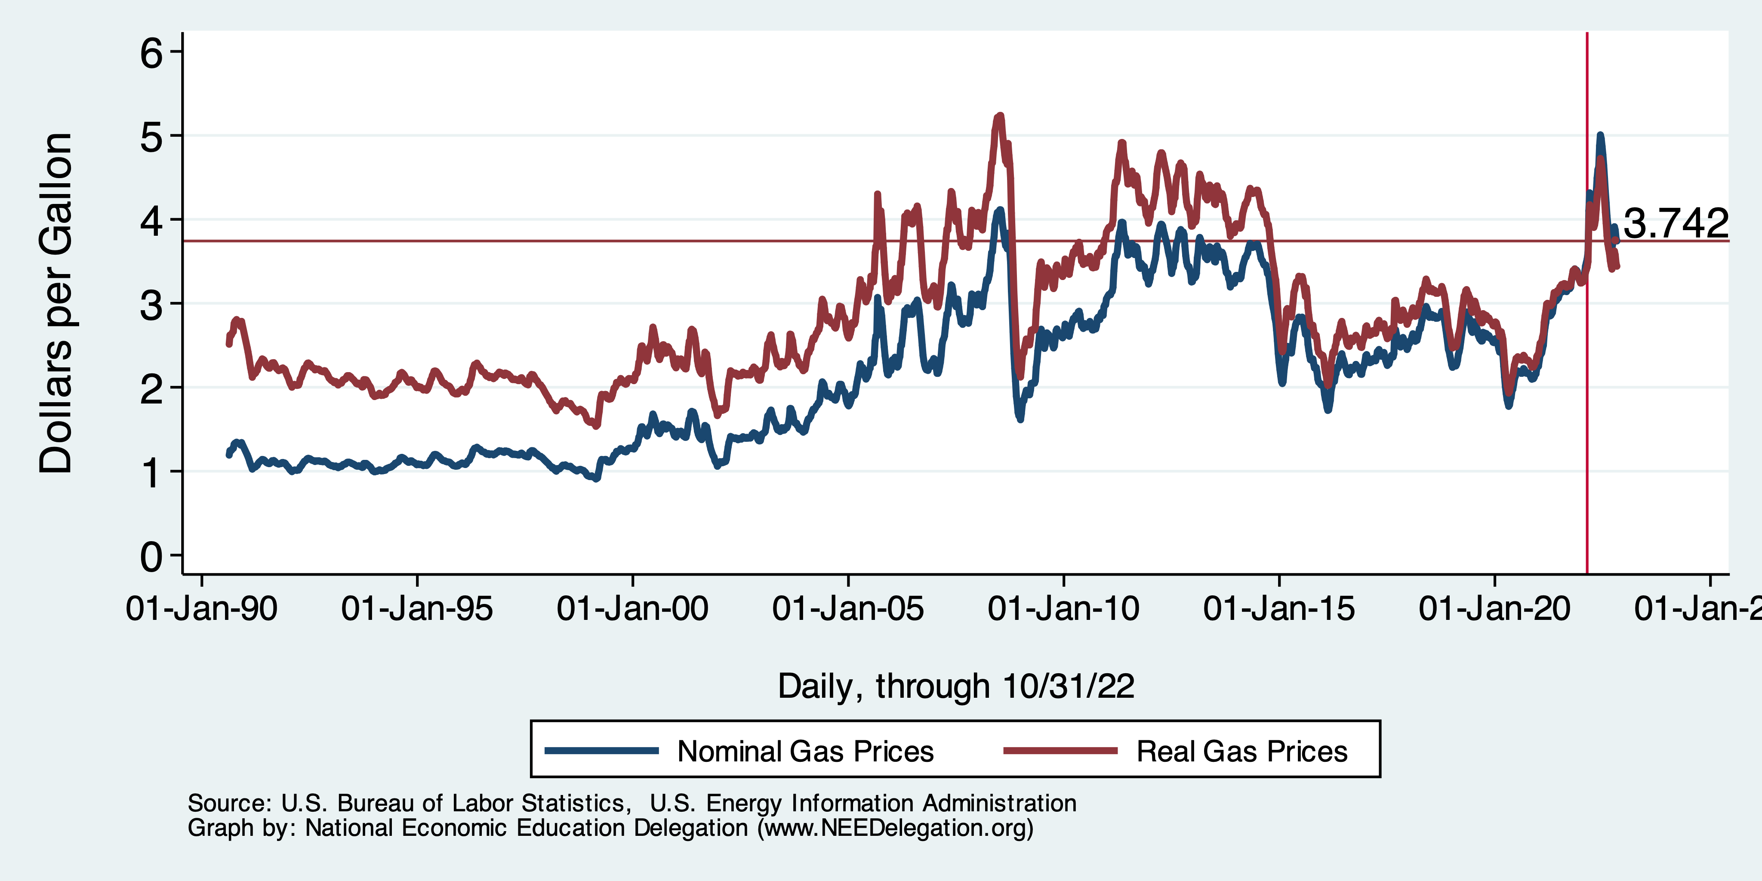
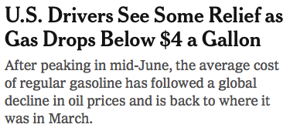
Gas Prices: National Average at the Pump

Slide 61
Fuel Costs Are Still Elevated

Slide 62
Food Costs Continue to Rise

Slide 63
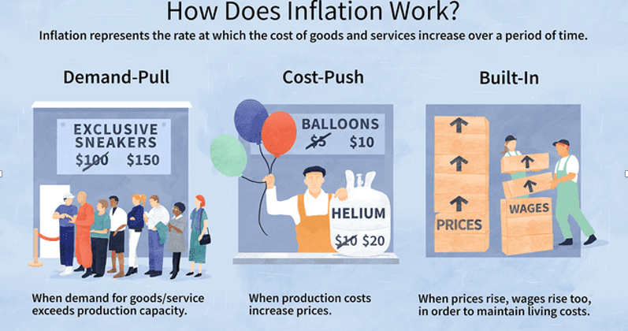
Source: Investopedia

Slide 64
Spending Patterns Changed - More Goods!
Demand-Pull
Goods spending up 14.9%
- And coming down.
Services spending up 2.9%
- And going up.

Slide 65
Inflation: Concentrated
Cost-Push

Slide 66
Supply Chains
Cost-Push

Slide 67
Corporations Have Pricing Power!
Corporate Profits

Slide 68
My Diagnosis for the Uptick in Inflation
Spending patterns have changed dramatically.
Yes, there were supply chain issues that affected some areas in particular (e.g., computer chips).
Corporations have used the cover of inflation to raise prices more.
But there was also too much total spending.
Fiscal stimulus led households to increase saving over 2021 by more than $2 trillion. Strong retail sales numbers suggest they are prepared to spend it.
Whose to Blame: ARP probably too big, but the Fed could have acted sooner.
International forces.

Slide 69
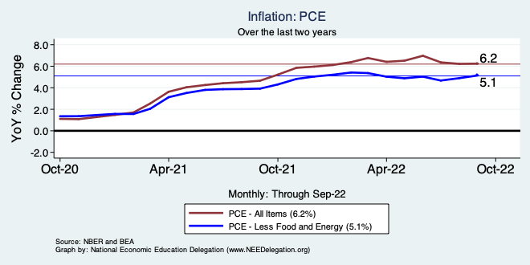
Inflation – The Fed’s Metric
Notes:
Cpi_recent.png

Slide 70
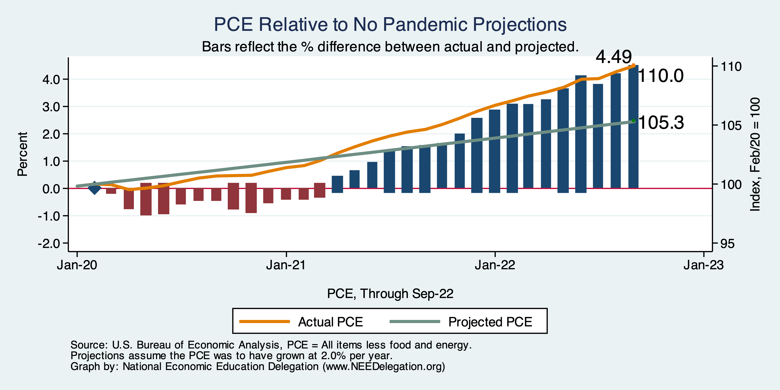
Inflation – PCE and Fed Suggest: I don’t know.
Notes:
Cpi_recent.png

Slide 71
Measure of Inflation Expectations
Breakeven Inflation Rate = Difference between
nominal and real 5-year and 10-year Treasury
constant maturity securities.
Market participants expect around 2.5%
inflation annually over the next 10 years and
2.7% over the next 5 years.
Inflation expectations are calming down.

Slide 72
What’s the Fed Doing About It?

Slide 73
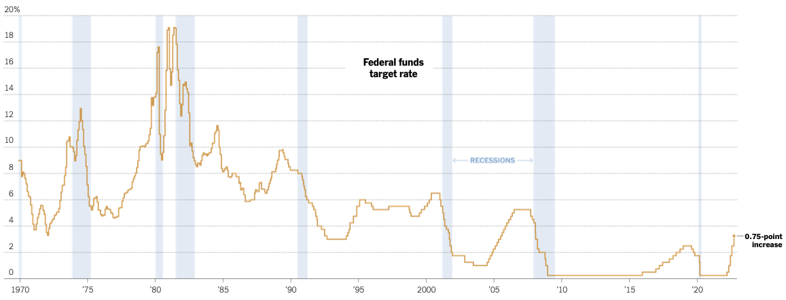
Federal Funds Rate
Source: NYTimes.com
Notes:
The fed funds rate is the interest rate on overnight loans between banks. Think of it as the baseline interest rate on which banks base all other interest rates (e.g. mortgage rates)
FOMC lowers the fed funds rate during recessions and raises the fed funds rate during expansions
Fed funds rate peaked in the 1980s as then Chairman Paul Volcker sought to reign in “run away” inflation of the 1970s; doing so resulted in a recession in the early 1980s.
Since the 2008-09 recession, the fed funds rate has been kept near zero.
During the 2008-09 recession, Federal Reserve turned to unconventional tools to influence longer term interest rates to further stimulate the economy - QE
FedFunds.png

Slide 74
Federal Funds Rate – Recent Activity
Expect 2 more increases of .75%, at least.
- One coming this week.

Slide 75
Fed: Also Reducing its Asset Holdings
Reducing the Money Supply – A Little
Jun-Aug: $47.5 billion roll off its portfolio every 30 days
Sep: $85 billion.
Quantitative Tightening

Slide 76
Implications for Demand
Investment borrowing
Home loans – tied to 10-year Treasury
Car loans
Credit cards
Savings accounts – positive
And more….

Slide 77
Treasuries
Notes:
treas_recent.png

Slide 78
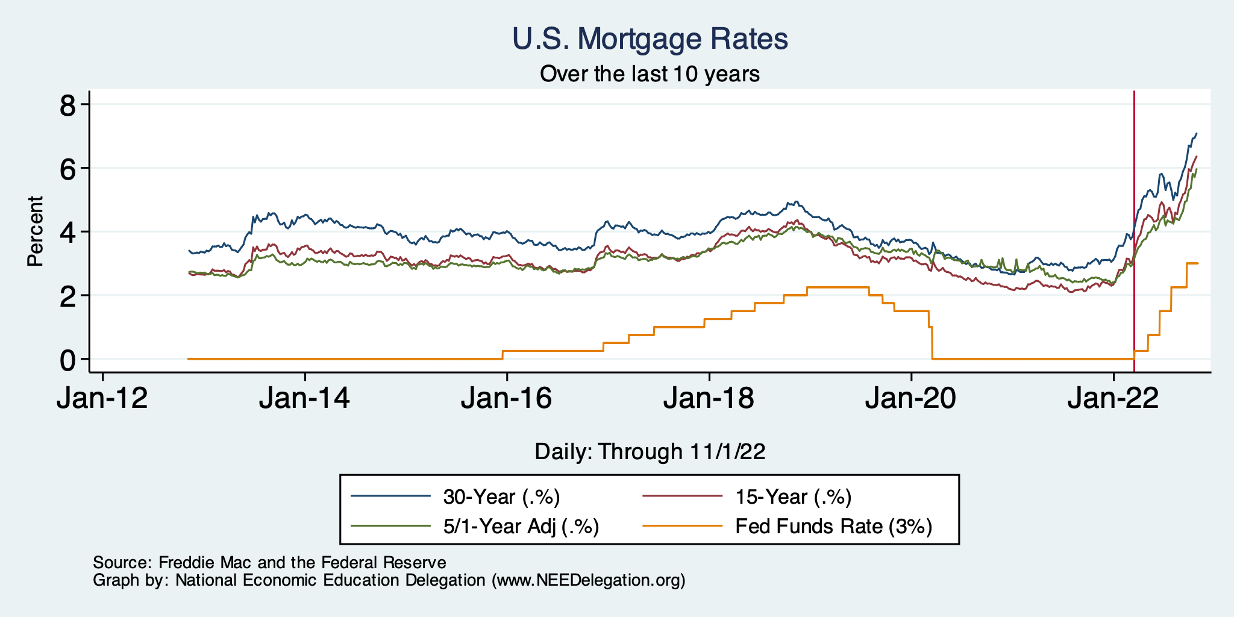
Mortgage Rates

Slide 79
Home Sales Falling

Slide 80
Takeaways
Is a recession on the horizon?
Larry Summers, Jamie Dimon, and Elon Musk are worried about a recession.
While the chances of slipping into a recession have increased, I think on many dimensions the economy is doing quite well.
Consumers have been driving the recovery, and consumers account for two-thirds of GDP.
Job creation remains robust – 263k in September.
What about GDP? Looking OK!
2022:Q1 was -1.6%, 2022:Q2 was -0.6.
Much of this lower growth was driven by lower inventory.
Inventories led GDP growth in 2021:Q4, didn’t sell, so production in Q1&Q2 fell.
Housing markets – very tightly linked to interest rates – softened … A LOT.
Government spending is now rising!
Q3 – came in ok!
Other Indicators suggest slowing.
A real mixed bag. Great uncertainty. News reports aren’t helping.

Slide 81
Income Inequality: Adina Ardelean
Stock Market Crash
WWII
Housing Bubble
Dot-com Bubble

Slide 82
Thank you!
Any Questions?
www.NEEDelegation.org
Jon D. Haveman
Jon@NEEDelegation.org
Contact NEED: info@NEEDelegation.org
Submit a testimonial: www.NEEDelegation.org/testimonials.php
Become a Friend of NEED: www.NEEDelegation.org/friend.php

Slide 83
www.NEEDelegation.org/LocalGraphs
For every state and county in the United States.
Detailed graphs on employment, housing, moves, and other statistics.

