Slide 1
Osher Lifelong Learning Institute, Fall 2022
Contemporary Economic Policy Issues
Johns Hopkins University
November-December, 2022
Jon Haveman, Ph.D.
National Economic Education Delegation

Slide 2
Available NEED Topics Include:
US Economy
Healthcare Economics
Climate Change
Economic Inequality
Economic Mobility
Trade and Globalization
Minimum Wages
Immigration Economics
Housing Policy
Federal Budgets
Federal Debt
Black-White Wealth Gap
Autonomous Vehicles
Healthcare Economics

Slide 3
Course Outline: Johns Hopkins University
Contemporary Economic Policy
Week 1 (11/3): The Black-White Wealth Gap (Jon Haveman, NEED)
Week 2 (11/10): Economic Inequality (Adina Ardelean, Santa Clara Univ.)
Week 3 (11/17): Economics of Immigration (Jennifer Alix-Garcia, Oregon State Univ.)
Week 4 (12/1): U.S. Economic Update (Jon Haveman, NEED)
Week 5 (12/8): Trade and Globalization (Adina Ardelean, Santa Clara Univ.)
Week 6 (12/15): Climate Change Economics (Sarah Jacobson, Williams College)

Slide 4
Submitting Questions
Please submit questions of clarification in the chat.
I will try to handle them as they come up.
We will do a verbal Q&A once the material has been presented.
We can also do 5 minutes of verbal Q&A following the break.
Slides will be available from the NEED website soon. (https://needelegation.org/delivered_presentations.php)

Slide 5
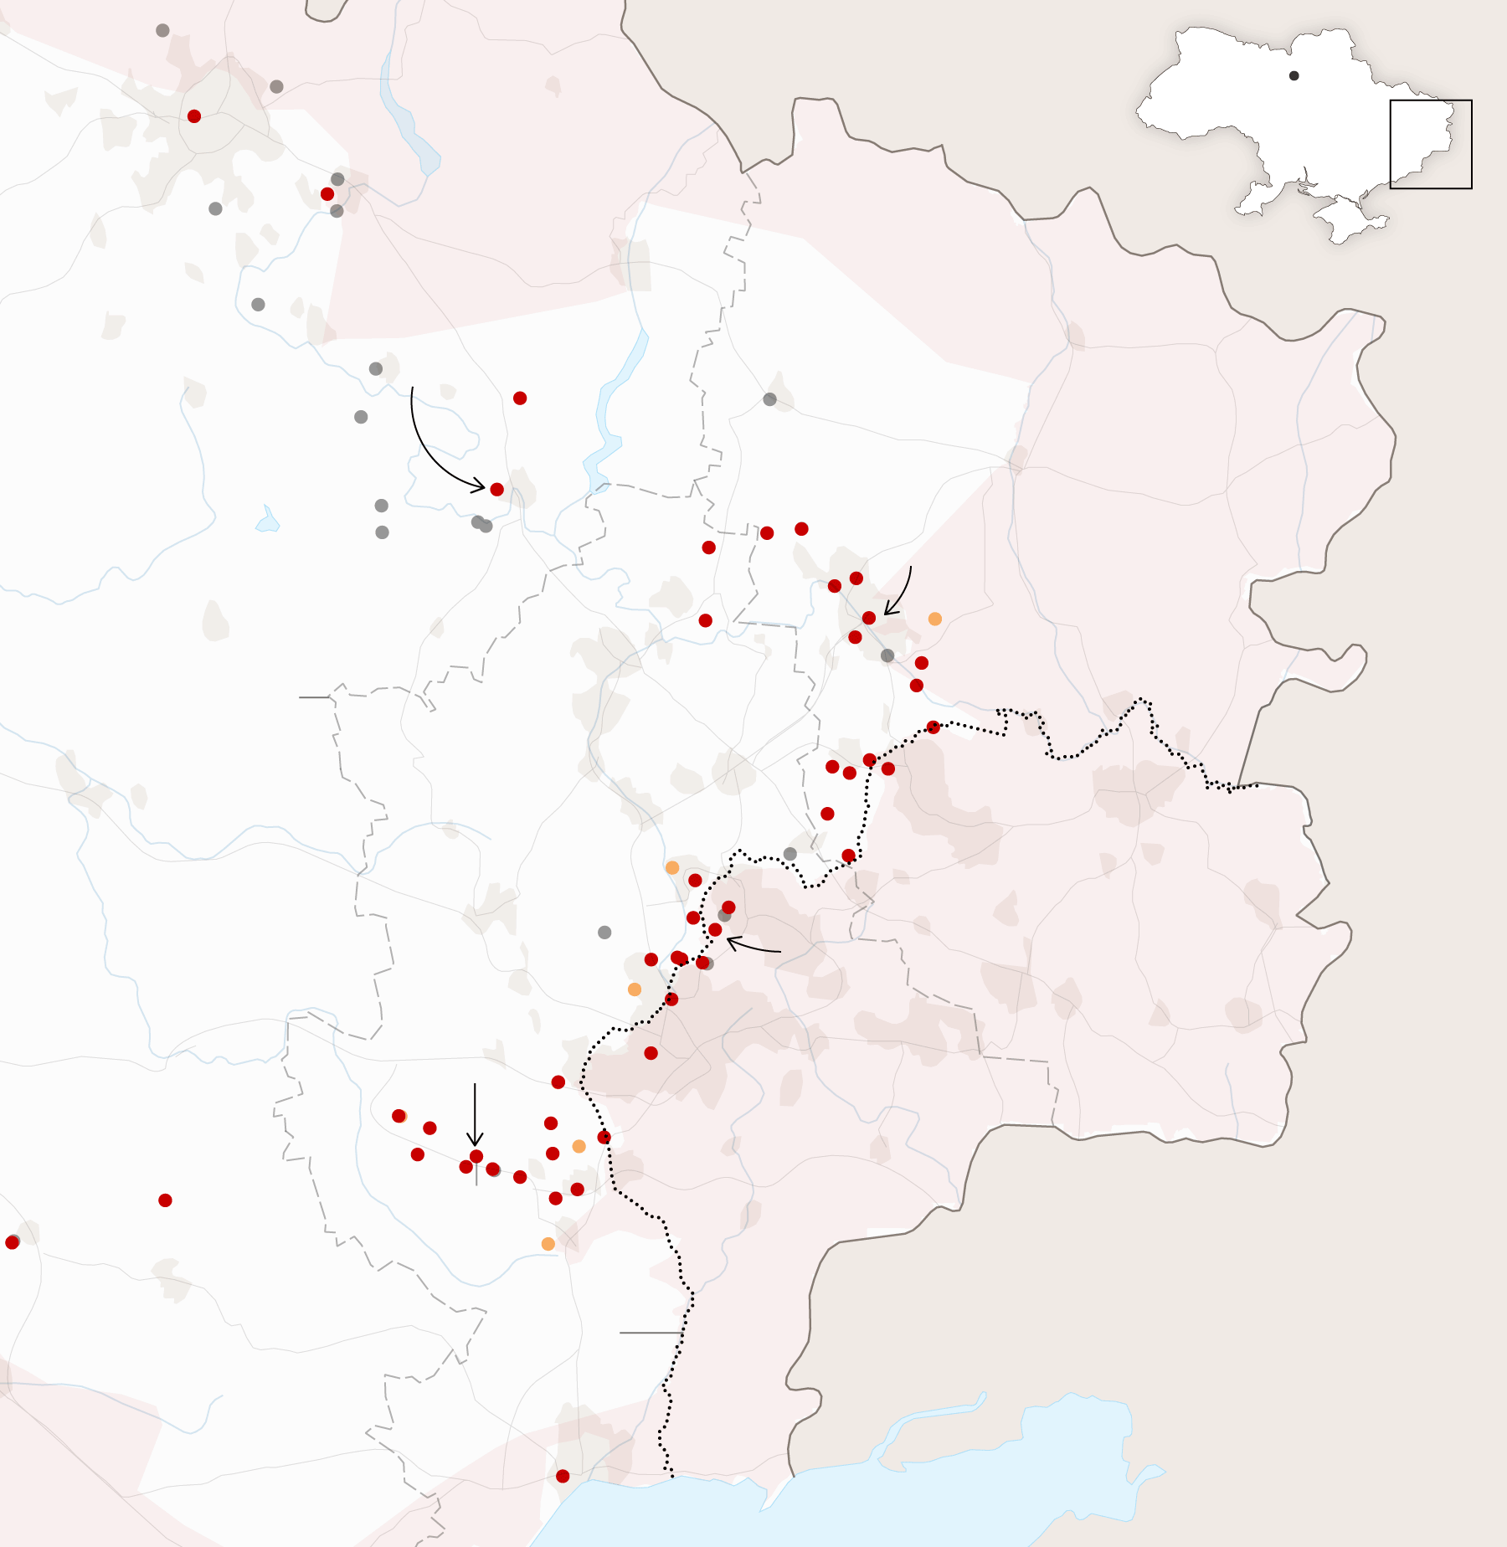
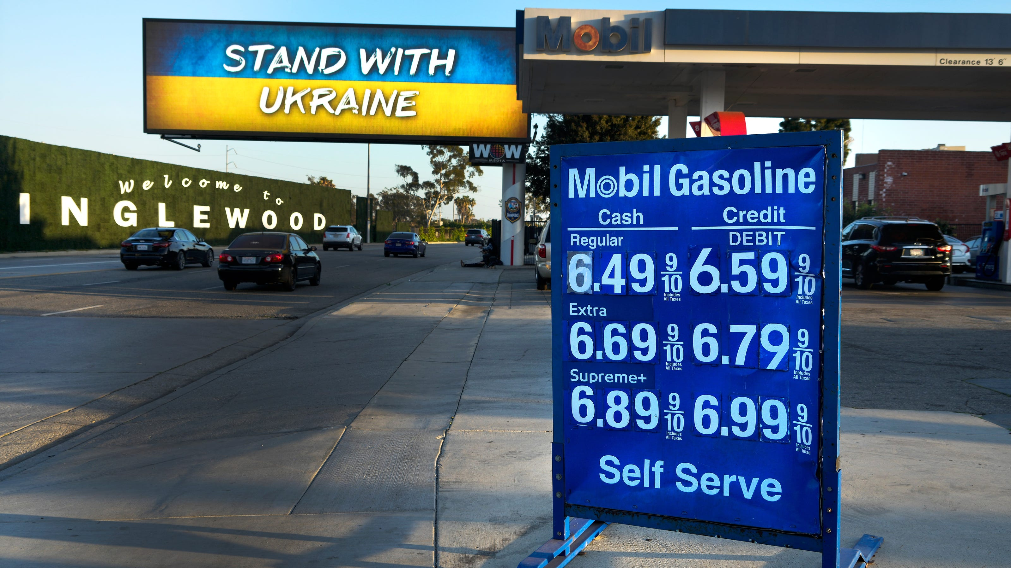
US Economic Update
Jon Haveman, Ph.D.
NEED
December 1, 2022

Slide 6
Credits and Disclaimer
This slide deck was authored by:
Jon D. Haveman, NEED
Scott Baier, Clemson University
Geoffrey Woglom, Amherst College (Emeritus)
Brian Dombeck, Lewis & Clark College
Doris Geide-Stevenson, Weber State
Disclaimer
NEED presentations are designed to be nonpartisan.
It is, however, inevitable that the presenter will be asked for and will provide their own views.
Such views are those of the presenter and not necessarily those of the National Economic Education Delegation (NEED).

Slide 7
Outline
About the U.S. Economy
Recession – The State of the US Economy
Global Comparisons
Inflation
Summary

Slide 8
Some Basic Statistics
Statistic: | Value
Population | 333.3 Million
Labor Force | 164.7 Million
Employment | 153.3 Million
Gross Domestic Product (GDP) | $25.7 Trillion
Income per Capita | $65,627
Ave. Hourly Earnings | $32.58
Source: fred.stlouisfed.org

Slide 9
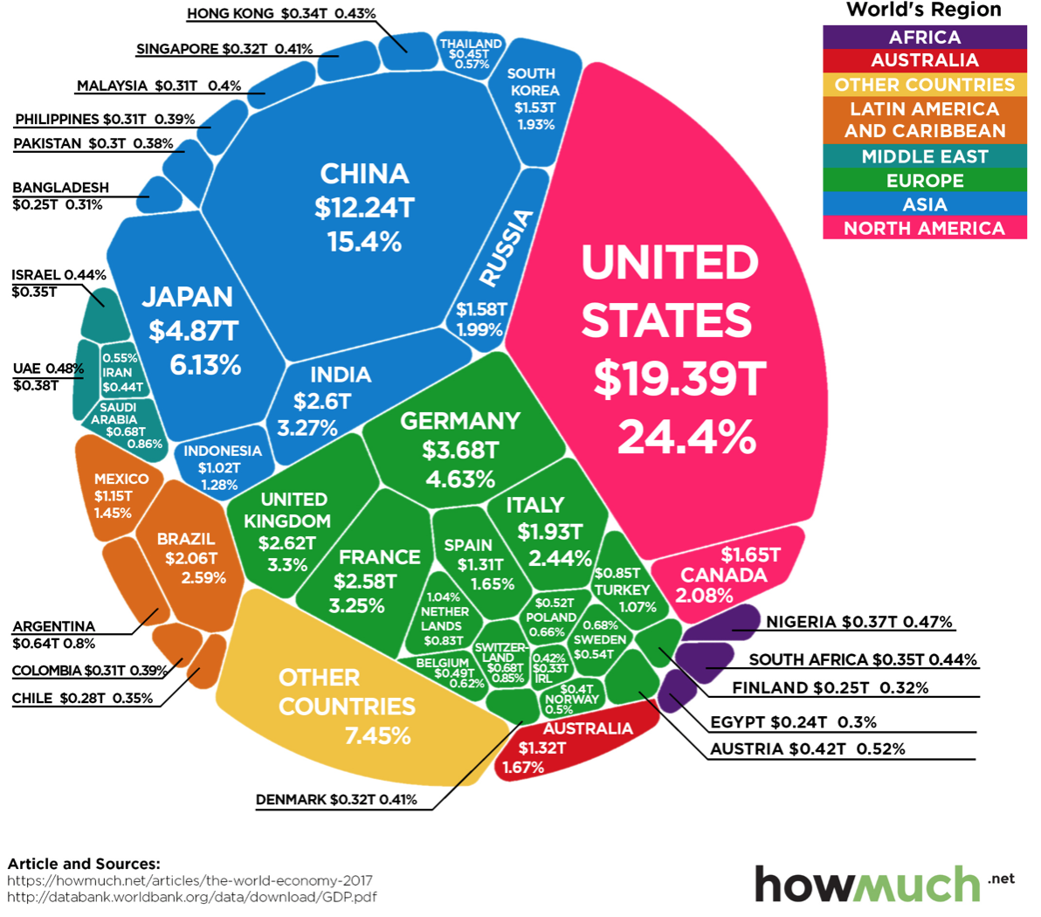
U.S. Economy in Global Perspective
U.S. Nominal GDP:
$21.538 trillion in 2019-Q4
$19.637 trillion in 2020-Q2
$25.699 trillion in 2022-Q3
Notes:
https://www.investopedia.com/insights/worlds-top-economies/#countries-by-gdp

Slide 10
Composition of the U.S. Economy: 2021

Slide 11
Composition of the U.S. Economy: Employment
Manufacturing
GDP Share = 10.6%
Health GDP Share = 7.7%
Note: Does not add to 100% because of omitted sectors.

Slide 12
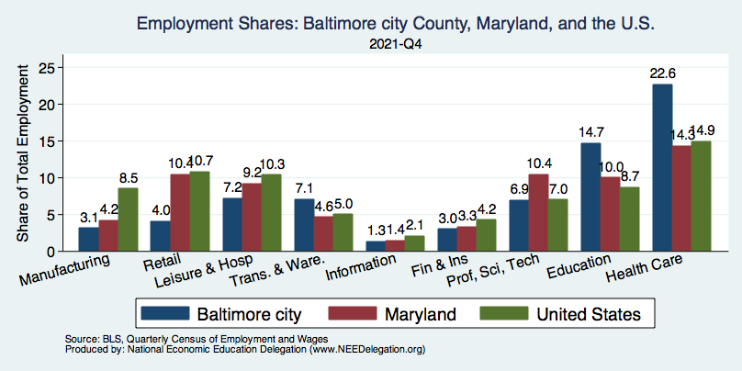
Employment in Baltimore CITY
Note: Does not add to 100% because of omitted sectors.

Slide 13
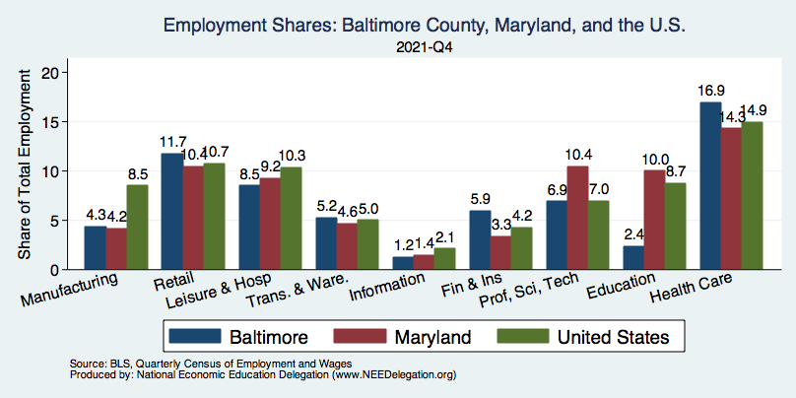
Employment in Baltimore COUNTY
Note: Does not add to 100% because of omitted sectors.

Slide 14
Recession(?)

Slide 15
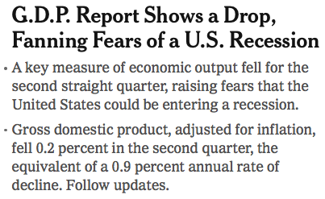
Headline:

Slide 16
GDP: Quarterly Growth
Notes:
Graph: gdp_pot_grow.png
The Point: From 1990 – 2007, average annual US GDP growth pre-crisis is 2.94%. However, post-crisis US GDP growth is 2.19% (0.75 percentage points lower). Why is has the recovery been sluggish?
Note: At the recession’s height, the gap between quarterly GDP growth and potential growth was 2.5 percentage points.

Slide 17
GDP During the Pandemic: Annual Growth

Slide 18
GDP Trajectory: Pandemic Plunge!
GDP is:
$0.3 Trillion below 2019 forecast.
$1.0 Trillion ABOVE 2019-Q4 level.

Slide 19
What “Accounted” for the Decline in Q1 & Q2?
Expenditures drive GDP growth.
GDP is the sum of four categories of spending:
Consumption
Investment – housing/business/inventories
Government spending
Net Exports: Exports – Imports
Notes:
Recall: GDP is measures production of an economy; we often measure GDP as the sum of spending on final goods/services produced within an economy. The first three categories (C,I,G) contain spending on both domestically and foreign produced goods. To accurately measure domestic production, we subtract domestic consumption of foreign goods (imports).
The Point: Analysis of components of GDP as well as the production side of the economy should provide a comprehensive picture of the US economic landscape

Slide 20
Recession? Two Quarters….
Depends on what is driving the drop.
Inventories
Housing
Government spending
Consumer spending is still ok.
Employment growth is solid.
Other indicators are still ok.

Slide 21
Contribution to GDP Growth: Consumption
Notes:
Average GDP growth from 1990-2007 is 2.99% and from 2010+ is 2.19%
Average Consumption contribution from 1990-2007 is 2.16 percentage points and from 2010+ is 1.67 percentage points

Slide 22
Personal Consumption Expenditures
Trouble?
Notes:
Chart: ../Charts/personalconsumption_recession.png
Real consumption remains significantly lower than trend consumption since 2008 (actual is 89% of trend).
Since the recession, consumption growth has fallen. From 1990-2007, average annual consumption growth is 3.34%; Post-recession average annual consumption growth is 2.38%.

Slide 23
Retail Sales
Notes:
Graph: RSAFT.png (slides_20.do)
Retail sales fells dramatically during the recession
Sales appear to be returning to forecasted trend; 7 billion 2018 USD gap
Conclusion: Retail sales do not appear to contribute to sluggish consumption growth.
Chart: RSAFS.png

Slide 24
Household Debt: Change During the Pandemic

Slide 25
Contribution to GDP Growth: Inventories
Notes:
Average GDP growth from 1990-2007 is 2.99% and from 2010+ is 2.19%
Average Consumption contribution from 1990-2007 is 2.16 percentage points and from 2010+ is 1.67 percentage points

Slide 26
Contributions to GDP: Residential Investment
Notes:
Contribution of residential investment to GDP growth has risen post-2009

Slide 27
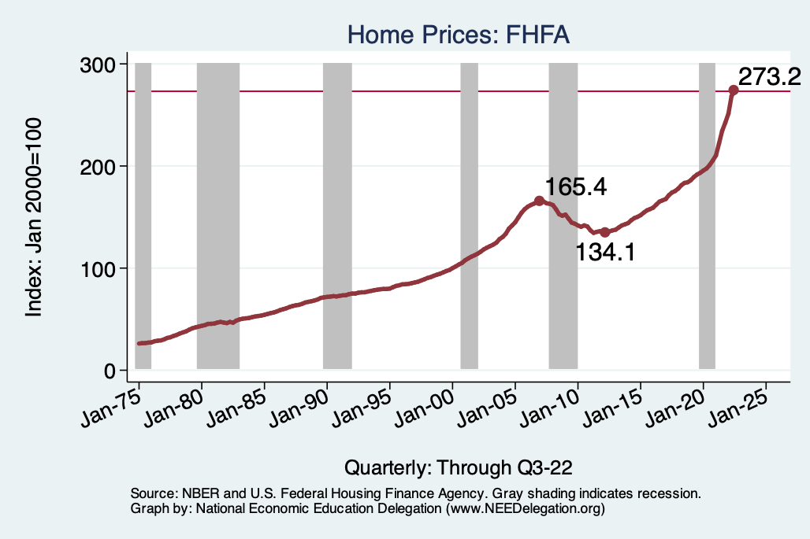
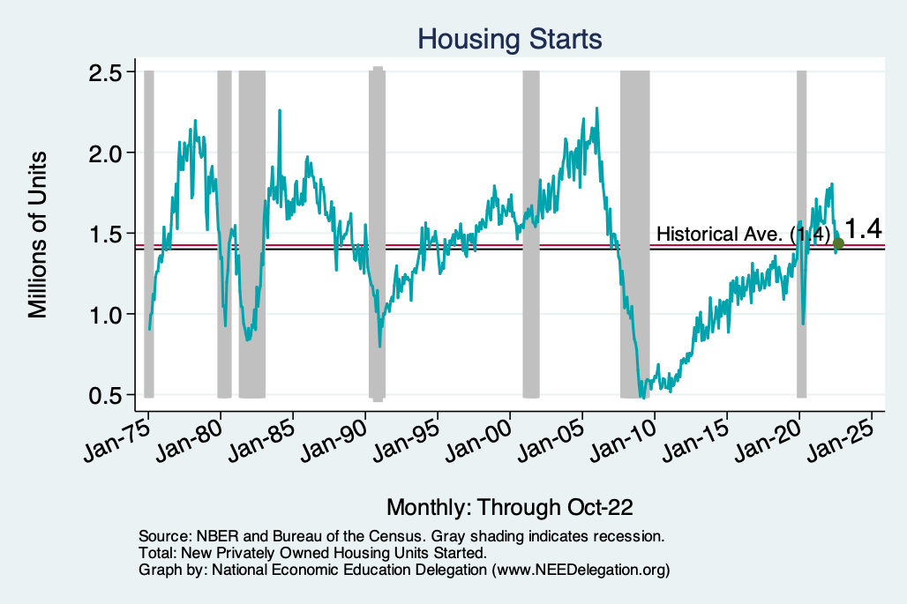
Home Prices and Housing Starts
Notes:
Charts:
homeprices_recession.png
housing.png

Slide 28
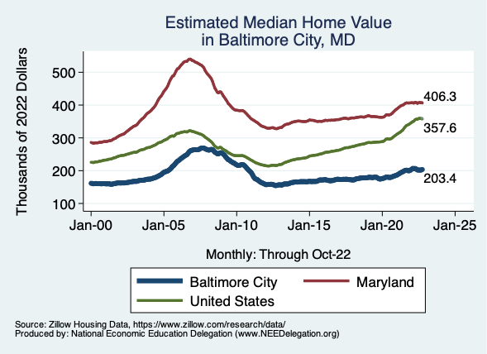
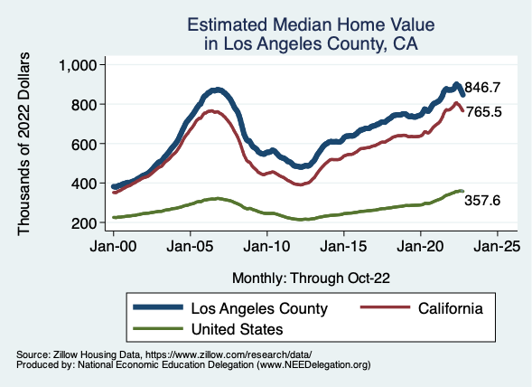
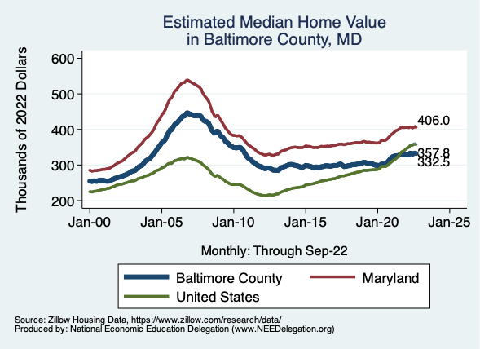
Home Prices … Depends on Where You Are
Notes:
Charts:
homeprices_recession.png
housing.png

Slide 29
Contributions to GDP: Government
Notes:
Since 2010, average government spending growth is shrinking, resulting in a negative average contribution to GDP growth post-recession of -0.8 percentage points
Note that average quarterly government spending growth is 0.42% from 1990-2007 and -0.17% in 2010+ (annualized, 1990-2007 = 1.68%; 2010+ = -0.70%).

Slide 30
Industrial Production (Manuf, Util, Mining)

Slide 31
Monthly Changes in Nonfarm Employment
Notes:
PAYEMS.png

Slide 32
Monthly Changes in Nonfarm Employment
October: 261,000
September: 315,000
Notes:
PAYEMS.png

Slide 33
Employment Gap
0.8 Million ABOVE February, 2020.
6.2 Million below where we should be.
Notes:
payroll_recent.png

Slide 34
Job Openings: Share of Total Employment
Notes:
During expansions, job openings rise.
Reinforces previous slide demonstrating higher separation and hiring rates during expansions

Slide 35
Job Hires and Separations

Slide 36
Separations: Quits and Layoffs
Notes:
(1) As expected during periods of low unemployment (booms) – workers seek higher paying or better fitting positions (higher quit rate) while firms require more workers for higher production (lower layoff rate).

Slide 37
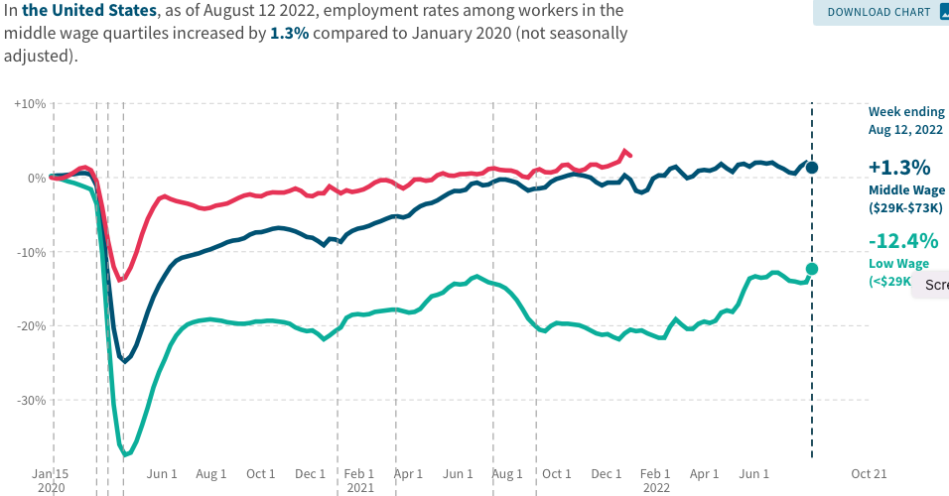
Low Wage Employment is Lagging
Source: https://tracktherecovery.org

Slide 38
Wage Growth
Notes:
Is this necessary given the previous slide?

Slide 39
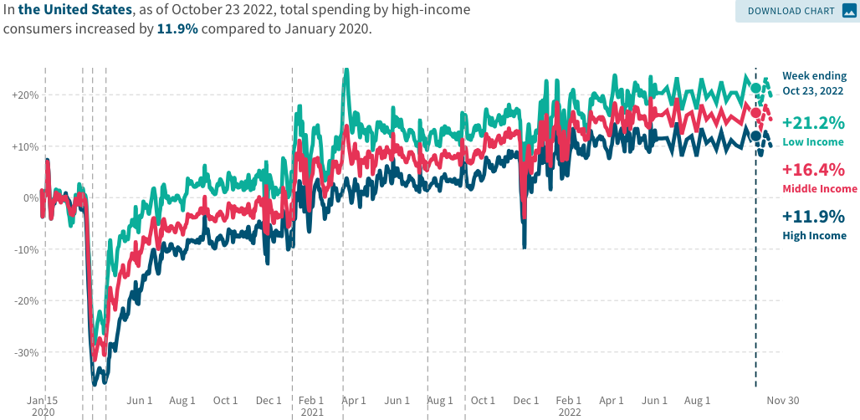
Stimulus Payments Saved Low Wage Workers

Slide 40
Where Have All the Workers Gone?
4.0 million below where we should be

Slide 41
Some Explanations
500 Thousand: Long COVID Exits
1-2%: Long Social Distancing

Slide 42
How Are Things Where You Are?

Slide 43
How Are Things Where You Are?

Slide 44
Inflation

Slide 45
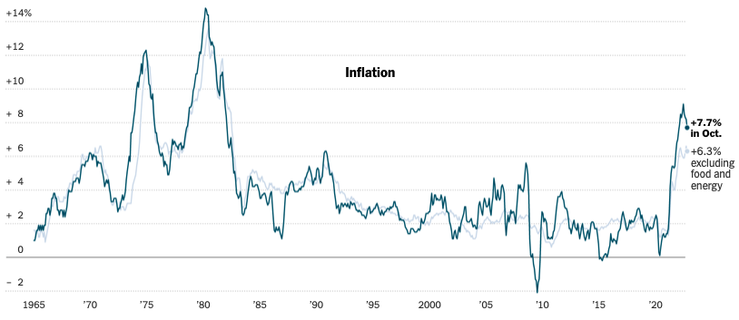
Inflation: Latest Figures
Source: NYTimes.com

Slide 46
Which Prices?
Sep-Oct: +0.4
Aug-Sep: +0.4
July-Aug: 0
June-July: 0

Slide 47
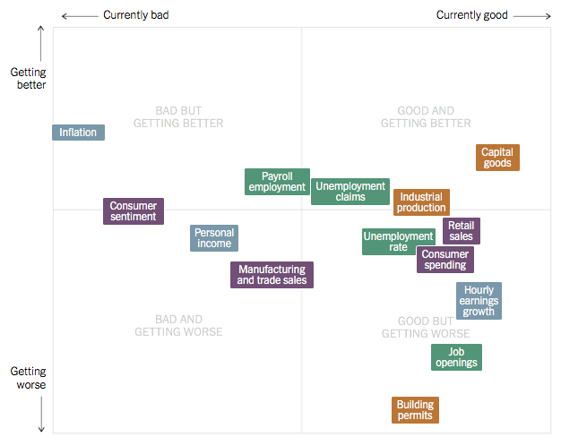
Summing Up The US Economy
Source: NYTimes.com

Slide 48
Global Evidence

Slide 49
Inflation: Not just a US Problem
United States: 8.5
Netherlands: 12.0
Spain: 10.4
United Kingdom: 10.1
Denmark: 8.9
Sweden: 8.5
Germany: 7.9
Norway: 6.5
France: 5.8
Source: TradingEconomics.com, 9/12/22

Slide 50
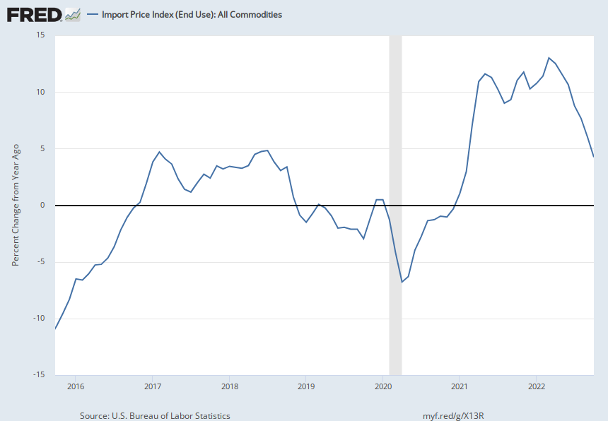
Import Prices Are Elevated
Inflation – Imported Products: 9-10%

Slide 51
GDP: U.S. Stands Out, But Not Alone
United States: -0.6
Netherlands: 2.6
Spain: 1.1
United Kingdom: -0.1
Denmark: 0.9
Sweden: 0.9
Germany: 0.1
Norway: 0.7
France: 0.5
Source: TradingEconomics.com, 9/12/22

Slide 52
Global Summary
Developed economies are uniformly down.
Not entirely a surprise. Went through the same pandemic gyrations:
Supply chain issues.
Import prices are way up.
Somewhat surprising because the economic responses varied across countries.
All used stimulus, but US used MUCH more.
Inflation – tale of two sources:
United States – much more one of elevated demand.
Europe – much more one of food and energy prices (war).

Slide 53
Inflation: A Closer Look

Slide 54
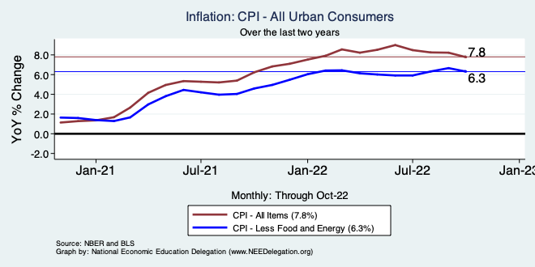
Inflation – Climbing! Or Turning Around?
Notes:
Cpi_recent.png

Slide 55
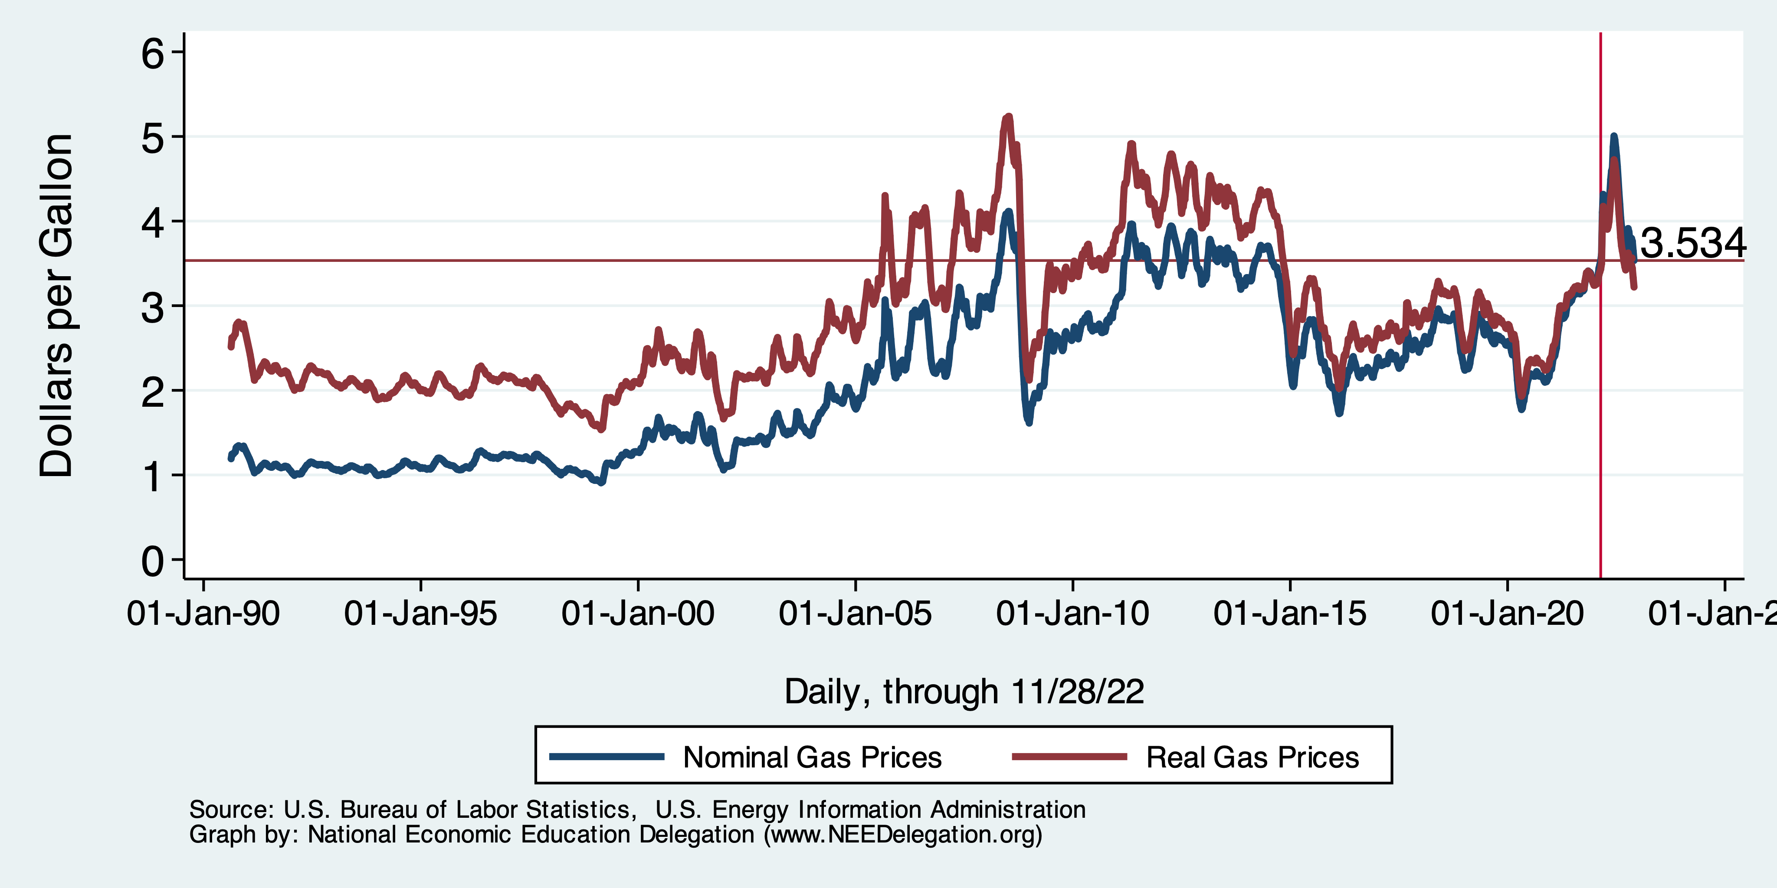
Gas Prices: National Average at the Pump

Slide 56
Fuel Costs Are Still Elevated

Slide 57
Food Costs Continue to Rise

Slide 58
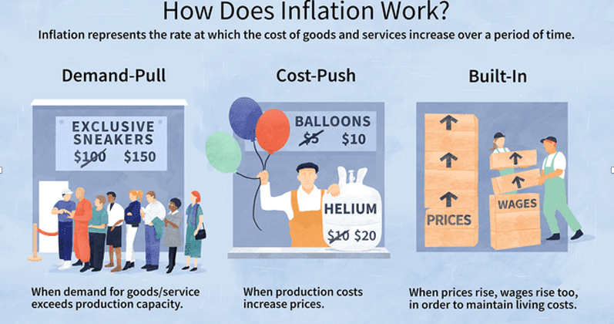
Source: Investopedia

Slide 59
Spending Patterns Changed - More Goods!
Demand-Pull
Goods spending up 16.7%
- And stable.
Services spending up 3.1%
- And going up.

Slide 60
Inflation: Concentrated
Cost-Push

Slide 61
Supply Chains
Cost-Push

Slide 62
Corporations Have Pricing Power!
Corporate Profits

Slide 63
My Diagnosis for the Uptick in Inflation
Spending patterns have changed dramatically.
Yes, there were supply chain issues that affected some areas in particular (e.g., computer chips).
Corporations have used the cover of inflation to raise prices more.
But there was also too much total spending.
Fiscal stimulus led households to increase saving over 2021 by more than $2 trillion. Strong retail sales numbers suggest they are prepared to spend it.
Whose to Blame: ARP probably too big, but the Fed could have acted sooner.
International forces.

Slide 64
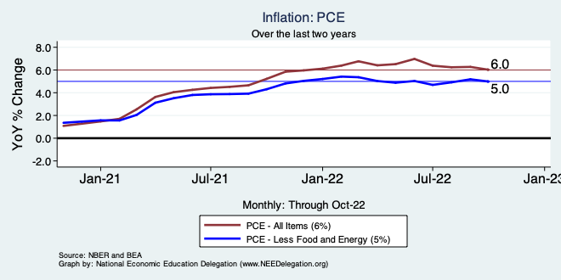
Inflation – The Fed’s Metric
Notes:
Cpi_recent.png

Slide 65
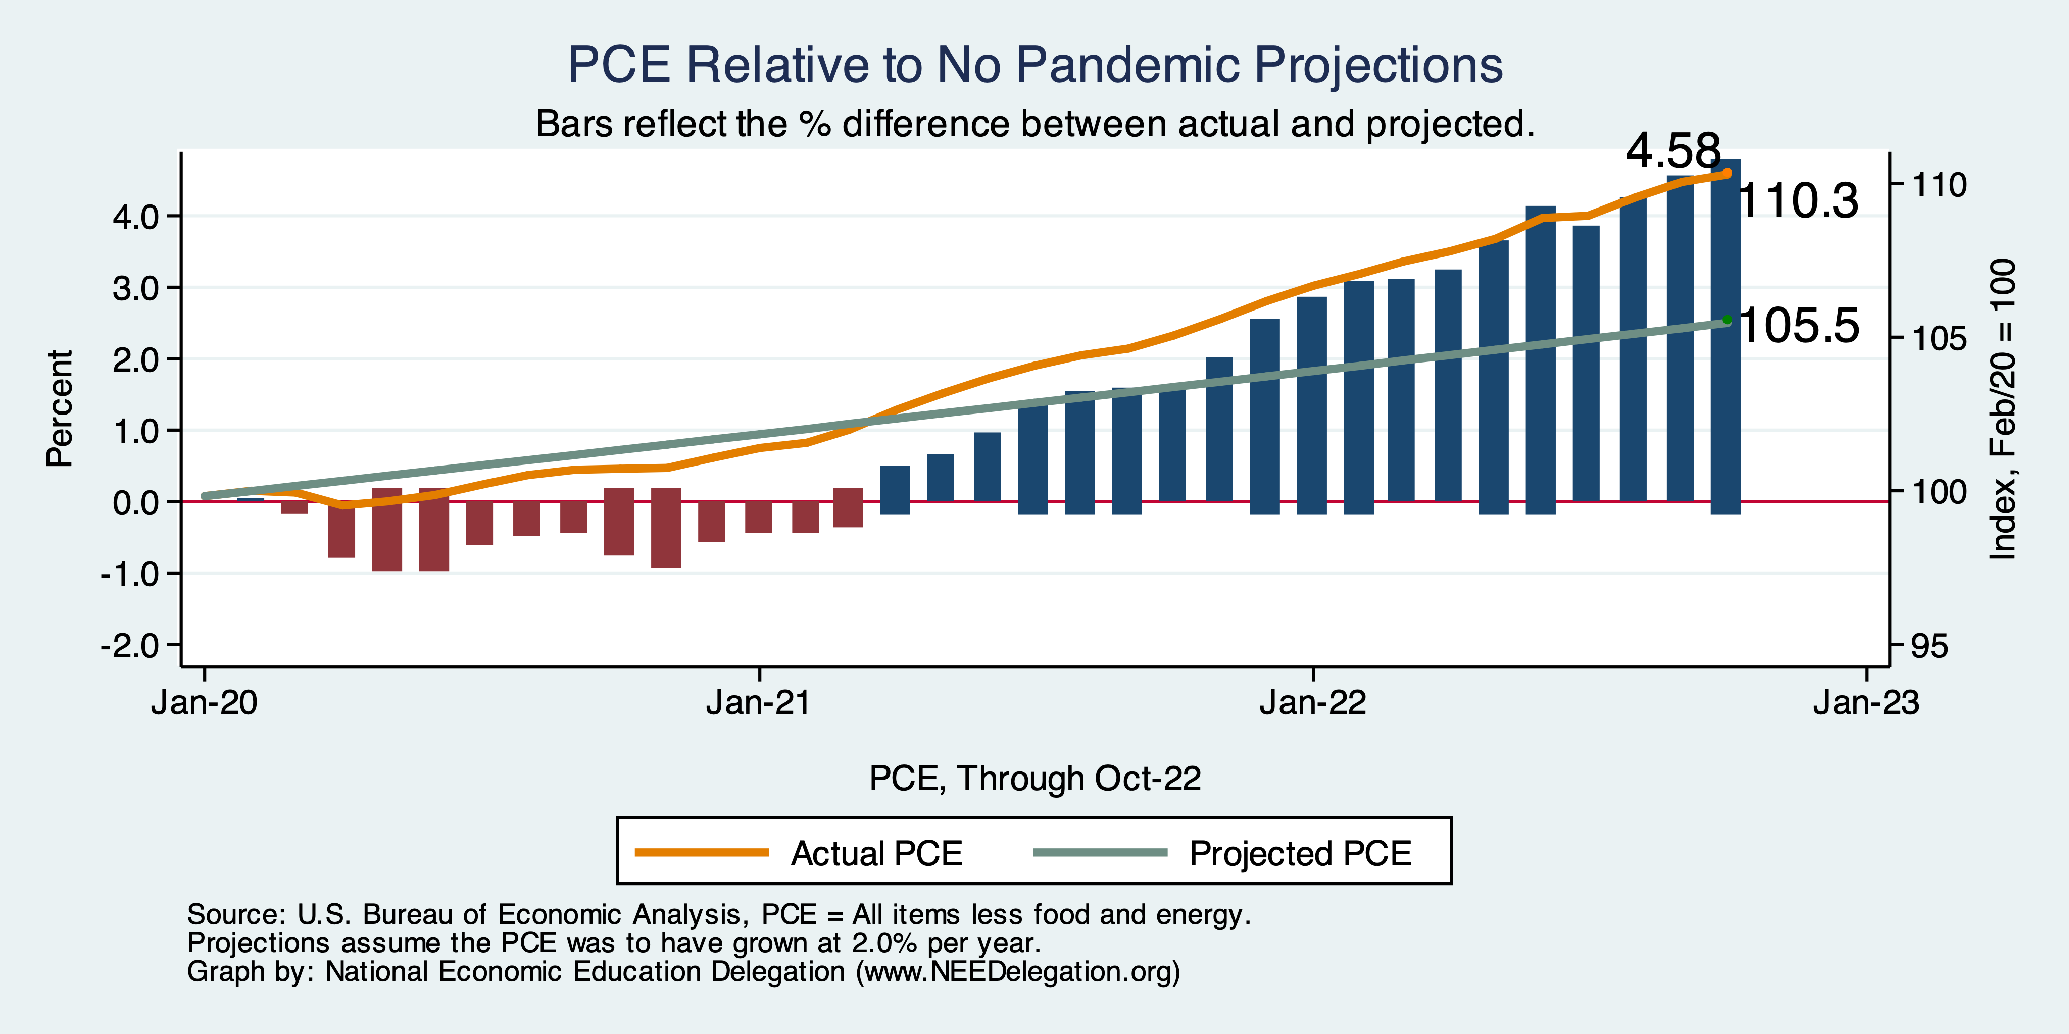
Inflation – PCE and Fed Suggest: I don’t know.
Notes:
Cpi_recent.png

Slide 66
Measure of Inflation Expectations
Breakeven Inflation Rate = Difference between
nominal and real 5-year and 10-year Treasury
constant maturity securities.
Market participants expect around 2.2%
inflation annually over the next 10 years and
2.25% over the next 5 years.
Inflation expectations are calming down.

Slide 67
What’s the Fed Doing About It?

Slide 68
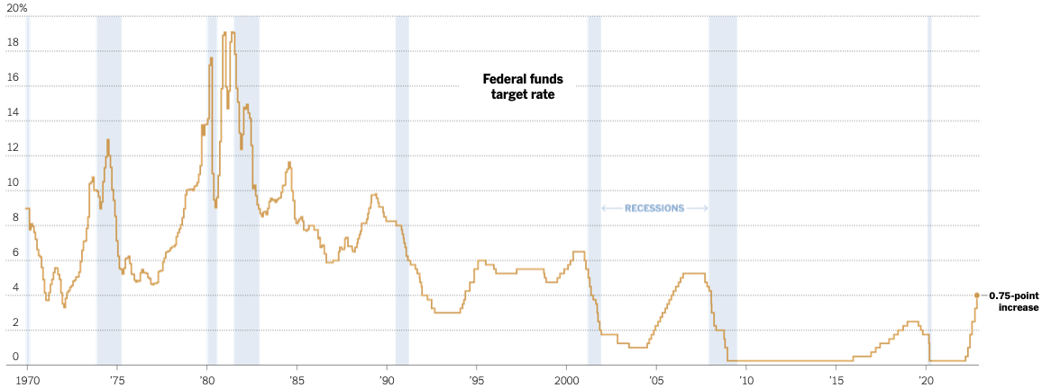
Federal Funds Rate
Source: NYTimes.com
Notes:
The fed funds rate is the interest rate on overnight loans between banks. Think of it as the baseline interest rate on which banks base all other interest rates (e.g. mortgage rates)
FOMC lowers the fed funds rate during recessions and raises the fed funds rate during expansions
Fed funds rate peaked in the 1980s as then Chairman Paul Volcker sought to reign in “run away” inflation of the 1970s; doing so resulted in a recession in the early 1980s.
Since the 2008-09 recession, the fed funds rate has been kept near zero.
During the 2008-09 recession, Federal Reserve turned to unconventional tools to influence longer term interest rates to further stimulate the economy - QE
FedFunds.png

Slide 69
Federal Funds Rate – Recent Activity
Expect 2 more increases: .5 to .75%, each.

Slide 70
Fed: Also Reducing its Asset Holdings
Reducing the Money Supply – A Little
Jun-Aug: $47.5 billion roll off its portfolio every 30 days
Sep: $85 billion.
Quantitative Tightening

Slide 71
Implications for Demand
Investment borrowing
Home loans – tied to 10-year Treasury
Car loans
Credit cards
Savings accounts – positive
And more….

Slide 72
Treasuries
Notes:
treas_recent.png

Slide 73
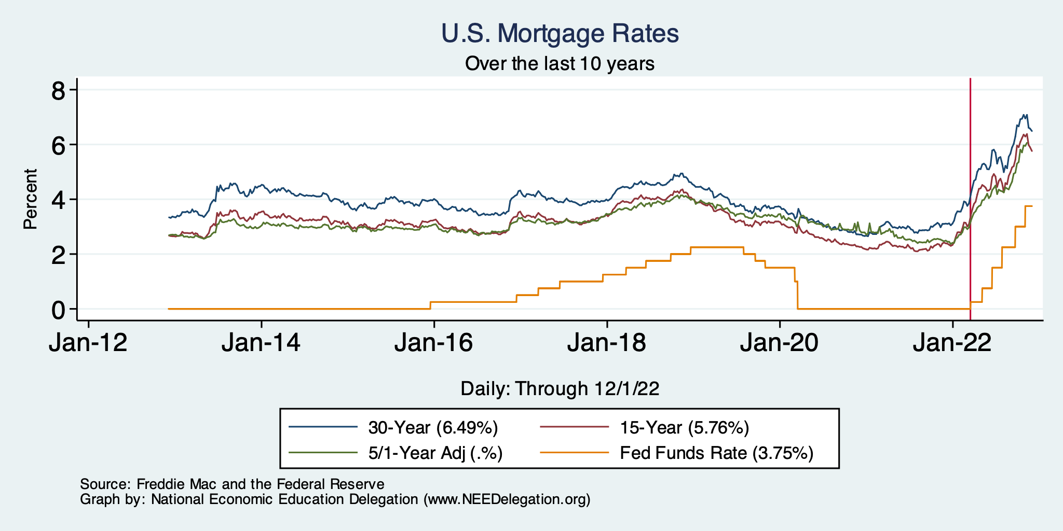
Mortgage Rates

Slide 74
Home Sales Falling

Slide 75
Other Indicators

Slide 76
Consumer Confidence: Not High
Notes:
Consumer_confidence.png

Slide 77
Producer Confidence: In Trouble

Slide 78
Capacity Utilization

Slide 79
Alarming Compression of Interest Rates
Notes:
Yield_curve.png

Slide 80
Takeaways
Is a recession on the horizon?
Larry Summers, Jamie Dimon, and Elon Musk are worried about a recession.
While the chances of slipping into a recession have increased, I think on many dimensions the economy is doing quite well.
Consumers have been driving the recovery, and consumers account for two-thirds of GDP.
Job creation remains robust – 261k in October. (September revised upwards by 100k)
What about GDP? Looking OK!
2022:Q1 was -1.6%, 2022:Q2 was -0.6.
Much of this lower growth was driven by lower inventory.
Inventories led GDP growth in 2021:Q4, didn’t sell, so production in Q1&Q2 fell.
Housing markets – very tightly linked to interest rates – softened … A LOT.
Government spending is now rising!
Q3 – looks good!
Other Indicators suggest slowing.
A real mixed bag. Great uncertainty. News reports aren’t helping.

Slide 81
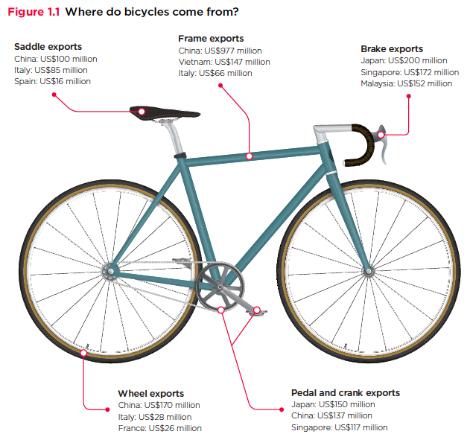
Trade: Bicycle Supply Chain – Adina Ardelean
Source: World Development Report 2020

Slide 82
Thank you!
Any Questions?
www.NEEDelegation.org
Jon D. Haveman
Jon@NEEDelegation.org
Contact NEED: info@NEEDelegation.org
Submit a testimonial: www.NEEDelegation.org/testimonials.php
Become a Friend of NEED: www.NEEDelegation.org/friend.php

Slide 83
www.NEEDelegation.org/LocalGraphs
For every state and county in the United States.
Detailed graphs on employment, housing, moves, and other statistics.

