Slide 1
Osher Lifelong Learning Institute, Summer 2026
Contemporary Economic Policy Issues
OLLI – Dominican University, San Rafael
July, 2026
Host: Jon Haveman
National Economic Education Delegation

Slide 2
National Economic Education Delegation
Vision
  One day, the public discussion of policy issues will be grounded in an accurate perception of the underlying economic principles and data.
Mission
  NEED unites the skills and knowledge of a vast network of professional economists to promote understanding of the economics of policy issues in the United States.
NEED Presentations
  Are nonpartisan and intended to reflect the consensus of the economics profession.

Slide 3
Who Are We?
Honorary Board: 54 members
  2 Fed Chairs: Janet Yellen, Ben Bernanke
  6 Chairs Council of Economic Advisers
    Furman (D), Rosen (R), Bernanke (R), Yellen (D), Tyson (D), Goolsbee (D)
  4 Nobel Prize Winners
    Akerlof, Smith, Maskin, and Bernanke
Delegates: 652+ members
  At all levels of academia and some in government service
  All have a Ph.D. in economics
  Crowdsource slide decks
  Give presentations
Global Partners: 48 Ph.D. Economists
  Aid in slide deck development

Slide 4
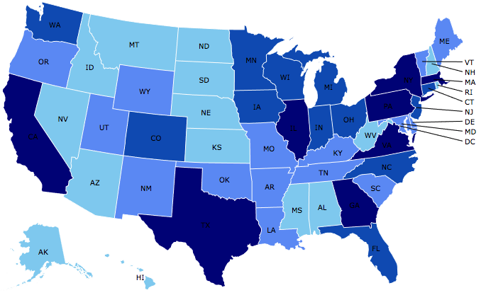
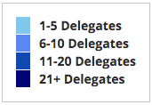
Where Are We?

Slide 5
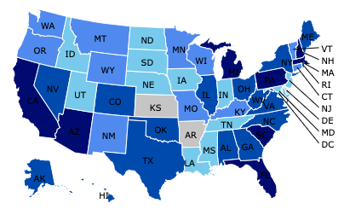
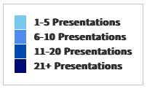
Where Have We Presented? (1,380 Talks)

Slide 6
Available NEED Topics Include:
US Economy
Healthcare Economics
Climate Change
Economic Inequality
Economic Mobility
Trade and Globalization
Minimum Wages
Immigration Economics
Saving Social Security
Federal Budgets
Federal Debt
Black-White Wealth Gap
Autonomous Vehicles
Healthcare Economics

Slide 7
Course Outline
Contemporary Economic Policy
  Week 1 (7/8): US Economic Update
  Week 2 (7/15): The Economics of Immigration
  Week 3 (7/22): Tariff Economics
  Week 4 (7/29): Saving Social Security

Slide 8
Submitting Questions
Submit questions in the chat.
  I will try to handle them as they come up.
We will do a verbal Q&A once the material has been presented.
Slides will be available from the NEED website shortly. (https://needecon.org/delivered_presentations.php).
Also: Break at 10:55 for 5 minutes.

Slide 9
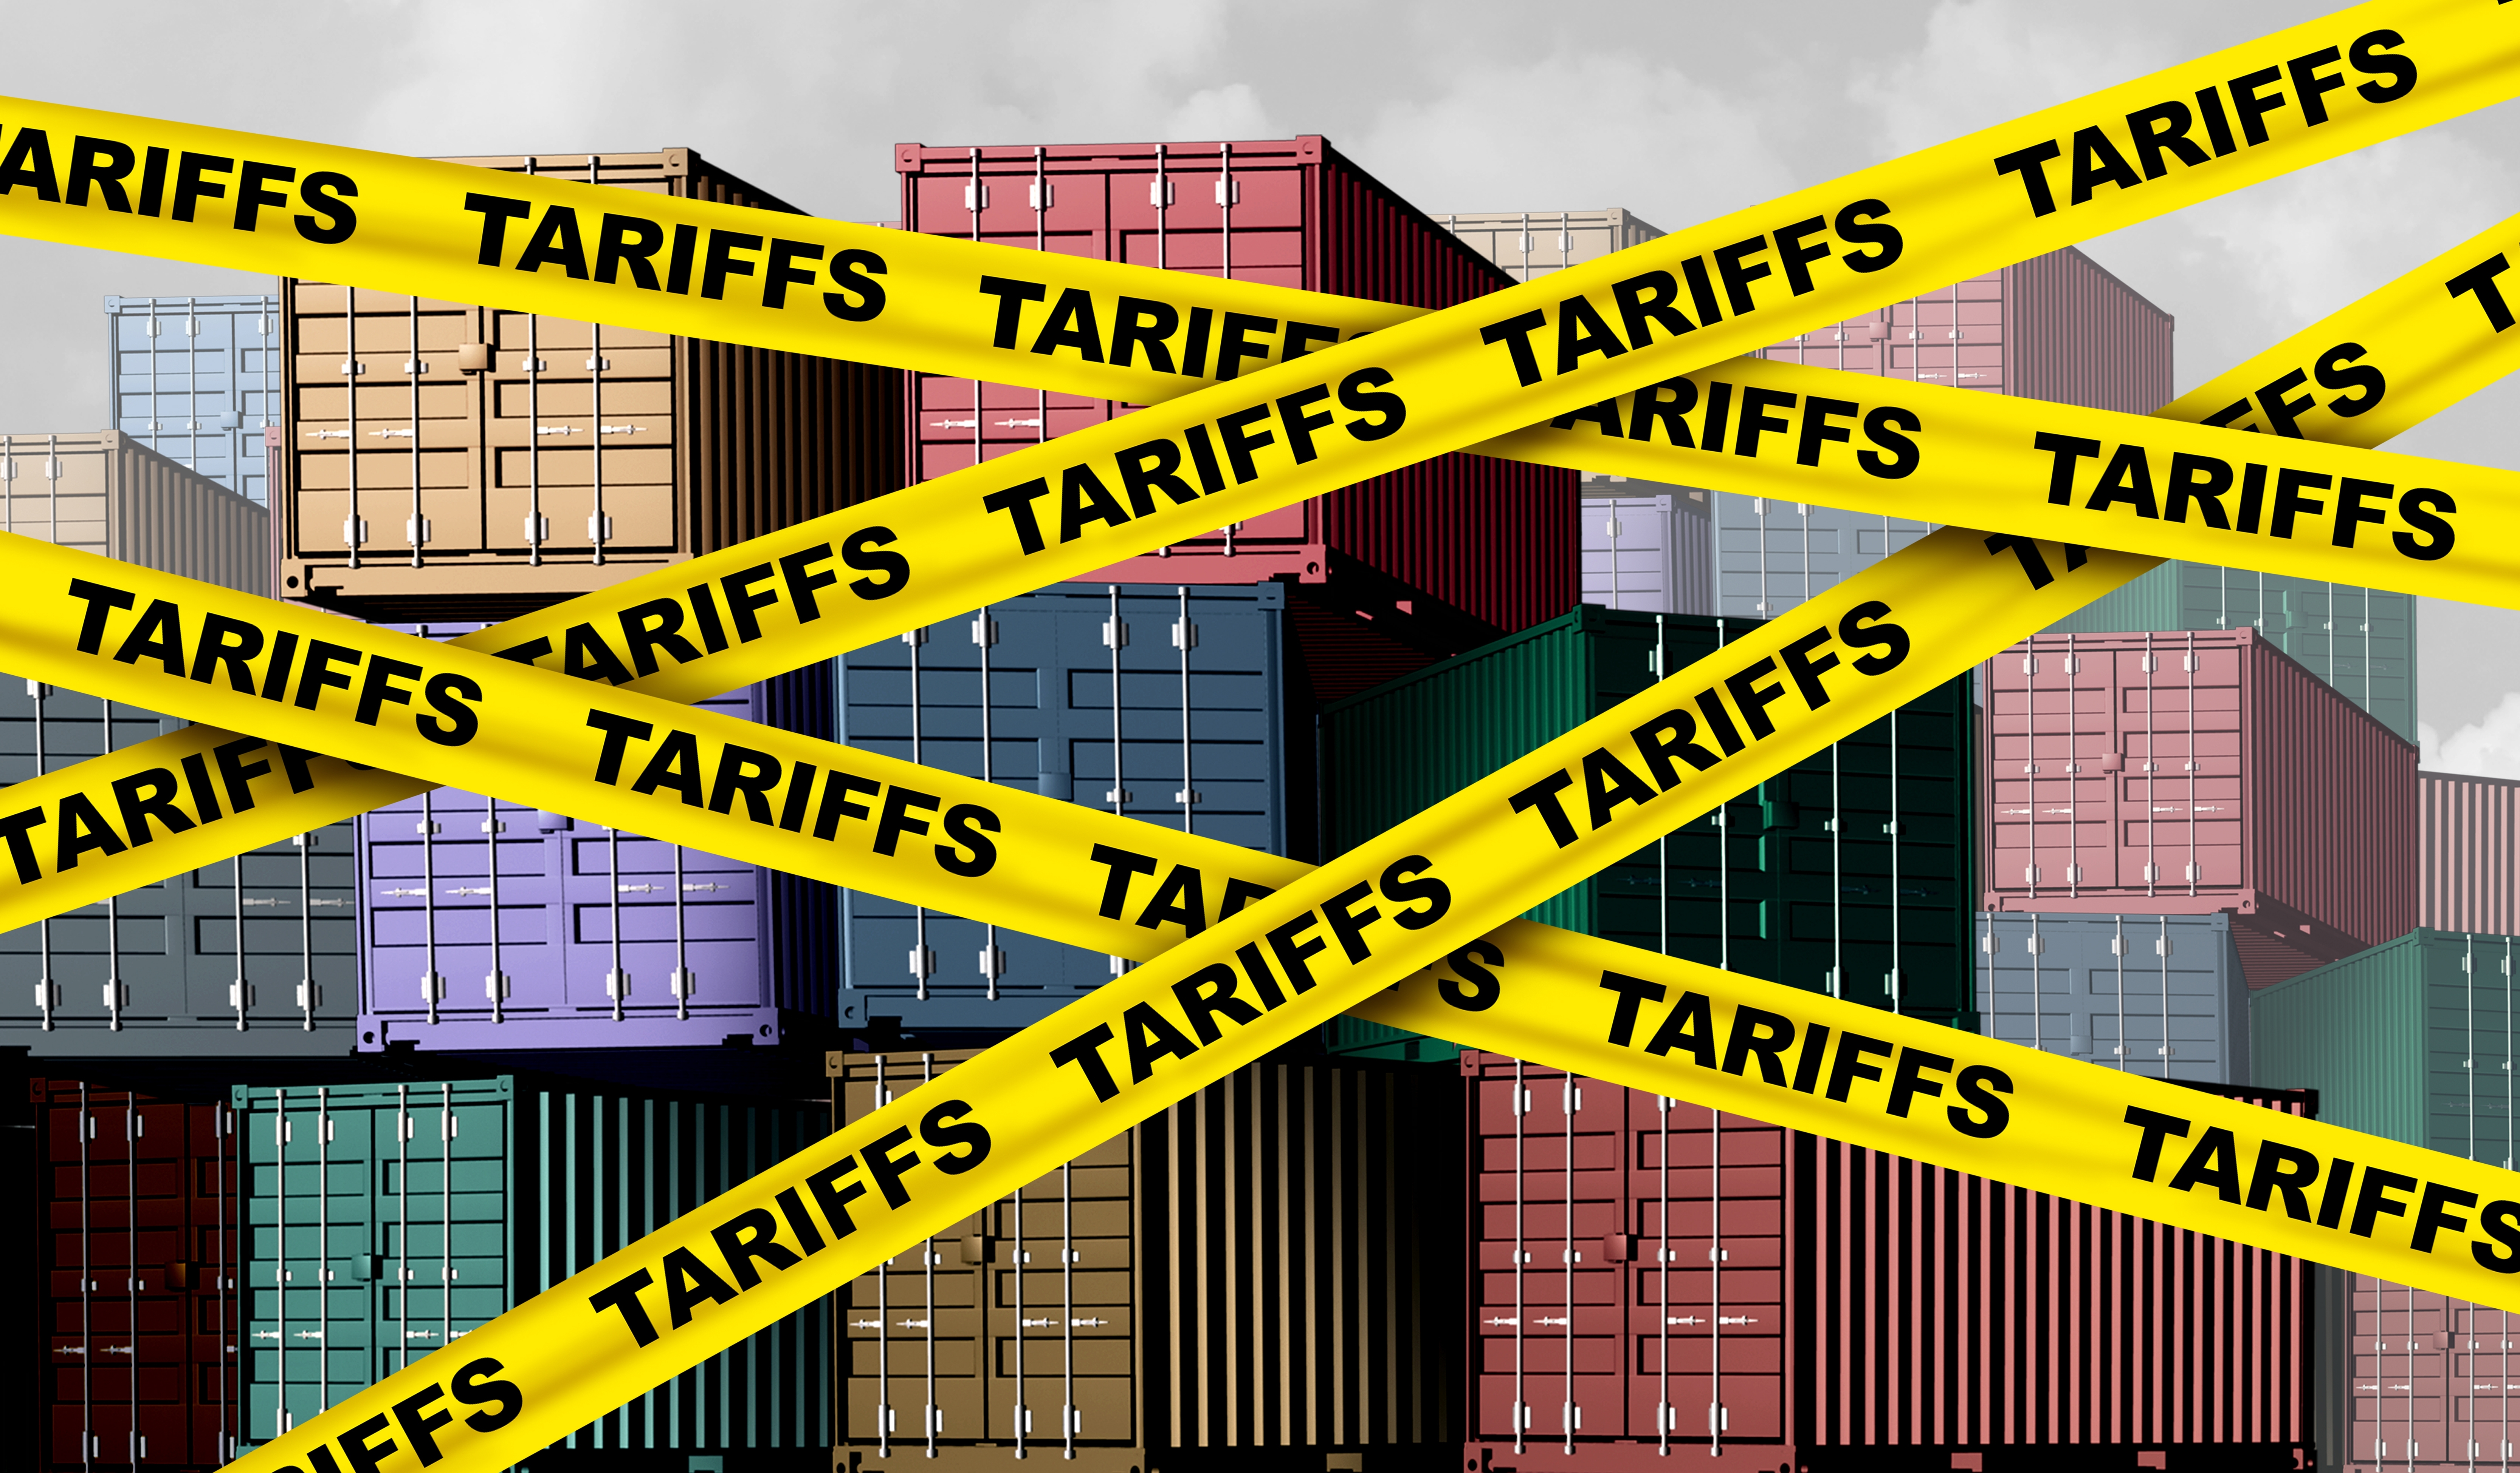
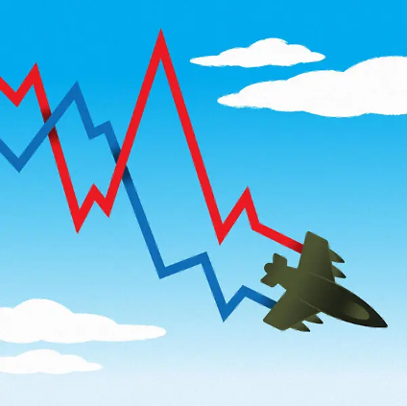

U.S. Economic Update
OLLI – Dominican University
Jon Haveman, Ph.D.
NEED
July 8, 2026

Slide 10
Outline
The U.S. Economy
Economic Indicators
Big Picture: Uncertainty

Slide 11
The U.S. Economy

Slide 12
Some Basic Statistics, June 2026
Statistic: | Value
Population | 342.7 Million
Labor Force | 169.4 Million
Employment | 162.3 Million
Gross Domestic Product (GDP) | $31.9 Trillion
Income per Capita | $77,790
Ave. Hourly Earnings | $37.64
Source: fred.stlouisfed.org

Slide 13
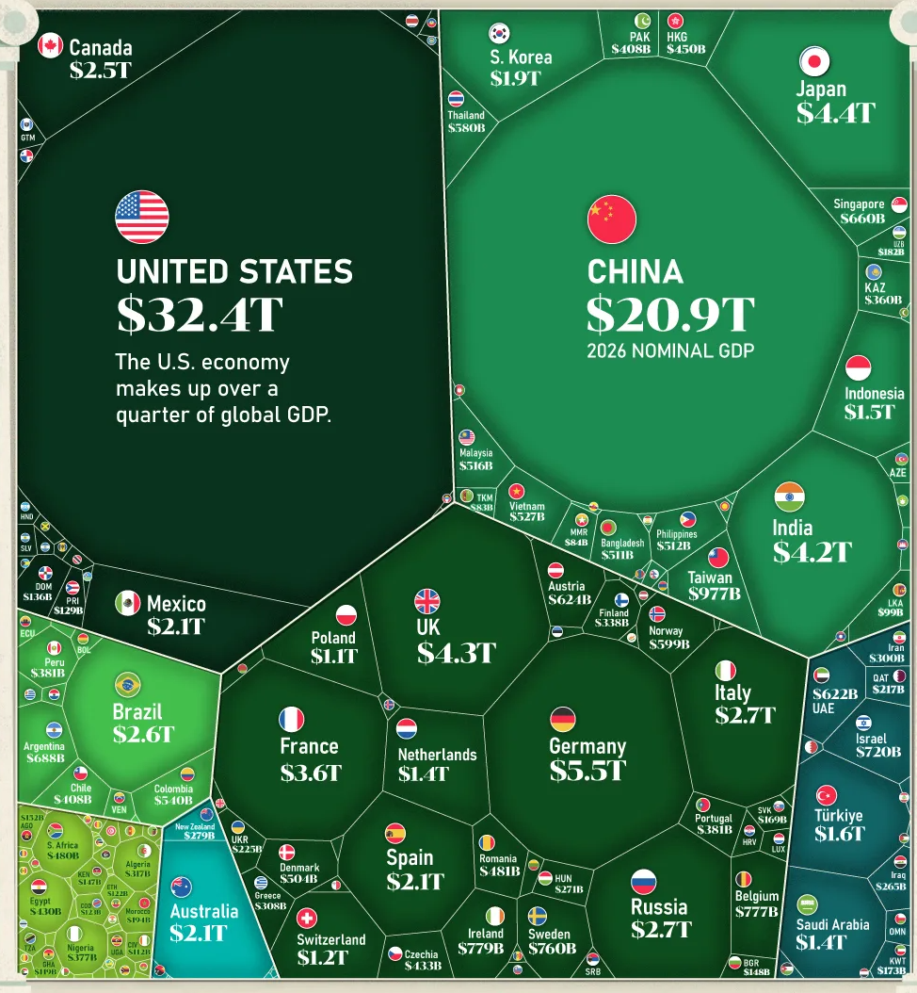
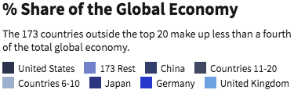
U.S. Economy in Global Perspective
U.S. Nominal GDP:
$21.9 trillion in 2019-Q4
$19.9 trillion in 2020-Q2
$32.4 trillion in 2026-Q1
Notes:
https://www.investopedia.com/insights/worlds-top-economies/#countries-by-gdp

Slide 14
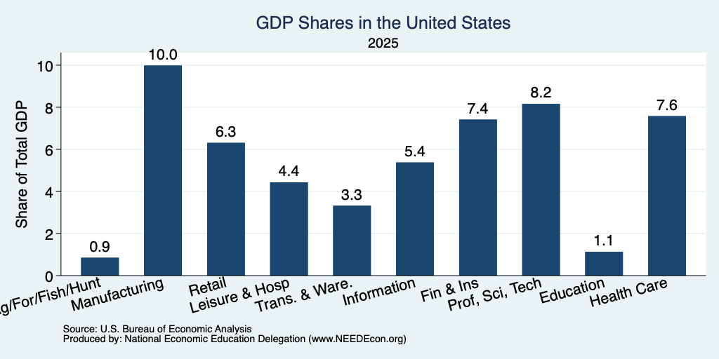
Composition of the U.S. Economy: GDP
Note: Does not add to 100% because of omitted sectors.

Slide 15
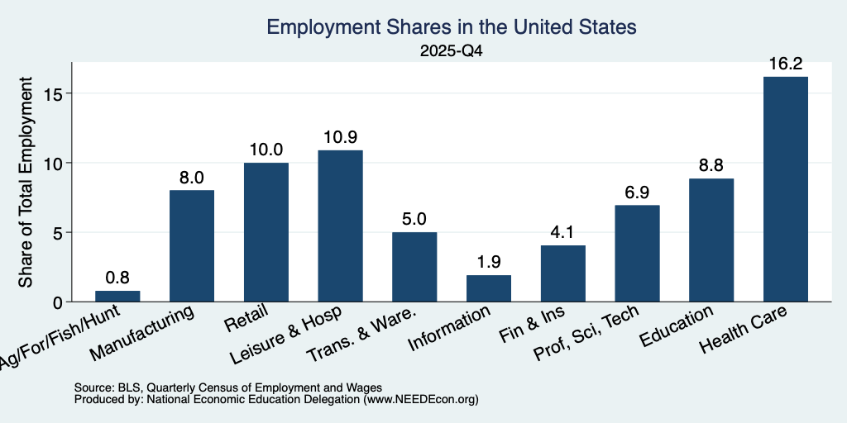
Composition of the U.S. Economy: Employment
Manufacturing
GDP Share = 10.0%
Health GDP Share = 7.6%
Note: Does not add to 100% because of omitted sectors.

Slide 16
Economic Indicators

Slide 17
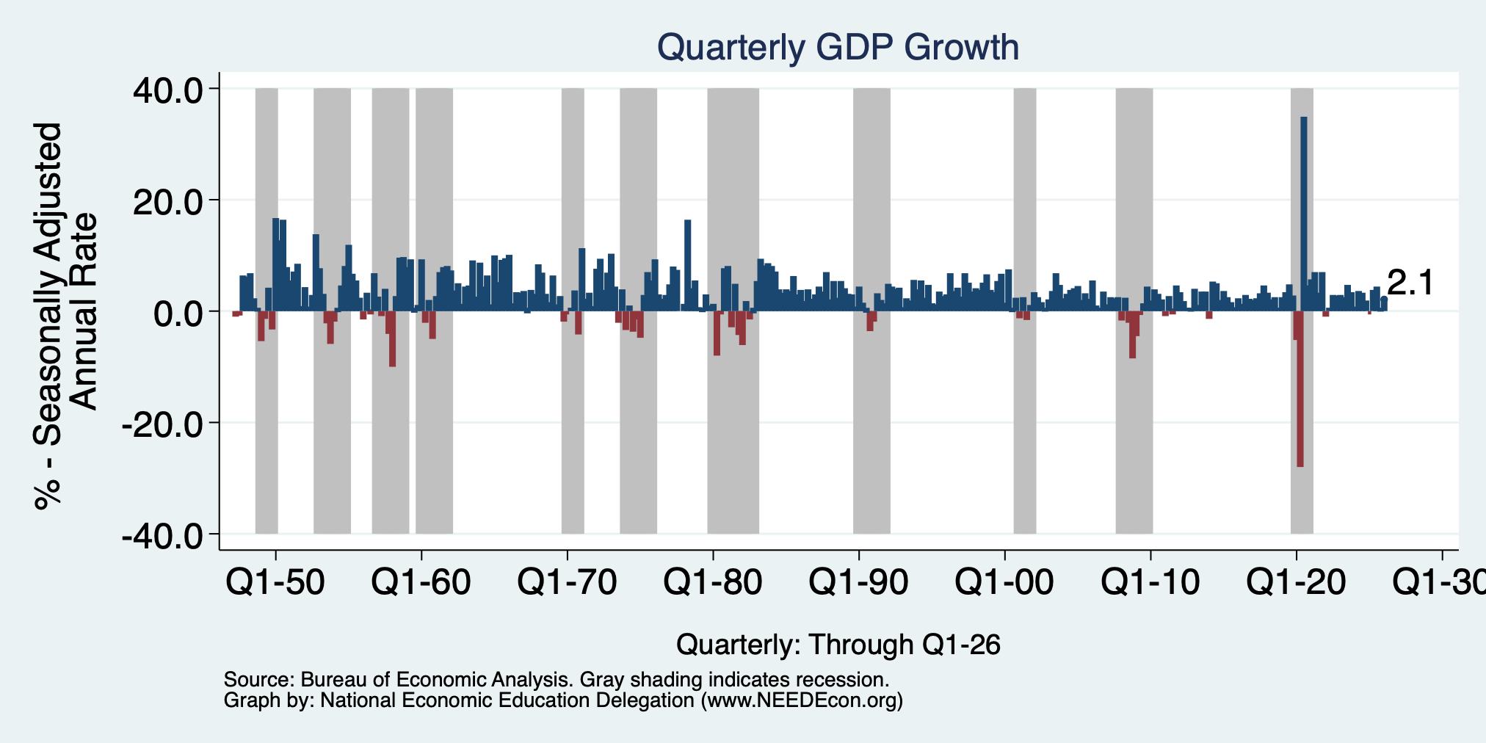
GDP: Quarterly Growth
Q2-2025: 3.8%
Q3-2025: 4.4%
Q4-2025: 0.5%
Q1-2026: 2.1%
Growth in 2025: 2.1%
Notes:
Graph: gdp_pot_grow.png
The Point: From 1990 – 2007, average annual US GDP growth pre-crisis is 2.94%. However, post-crisis US GDP growth is 2.19% (0.75 percentage points lower). Why is has the recovery been sluggish?
Note: At the recession’s height, the gap between quarterly GDP growth and potential growth was 2.5 percentage points.

Slide 18
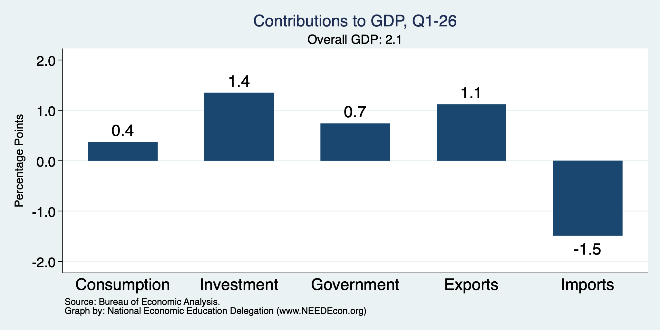
What Drove GDP to Such Growth?
Normally
1.6%

Slide 19
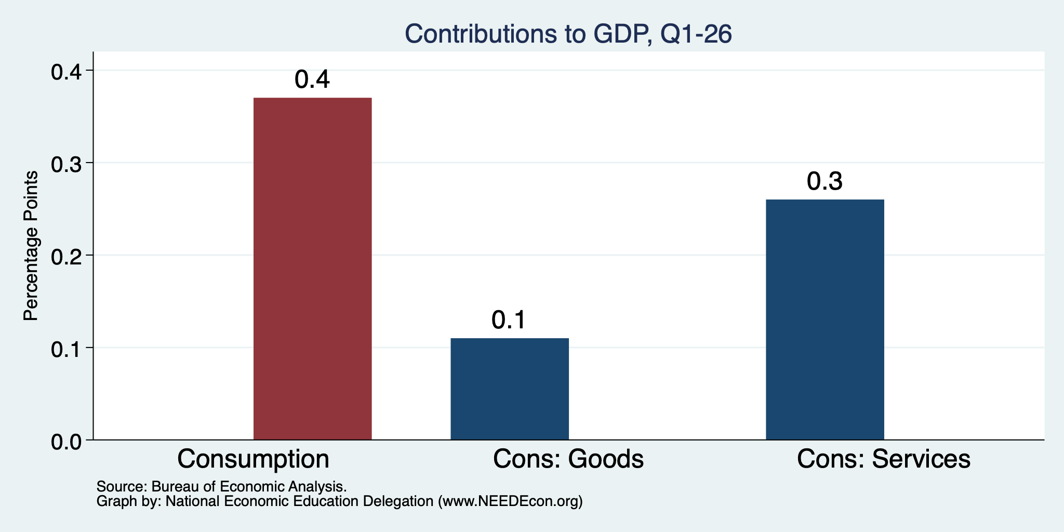
Consumers Also Tightened
Normally
0.85%
Normally
0.77%

Slide 20
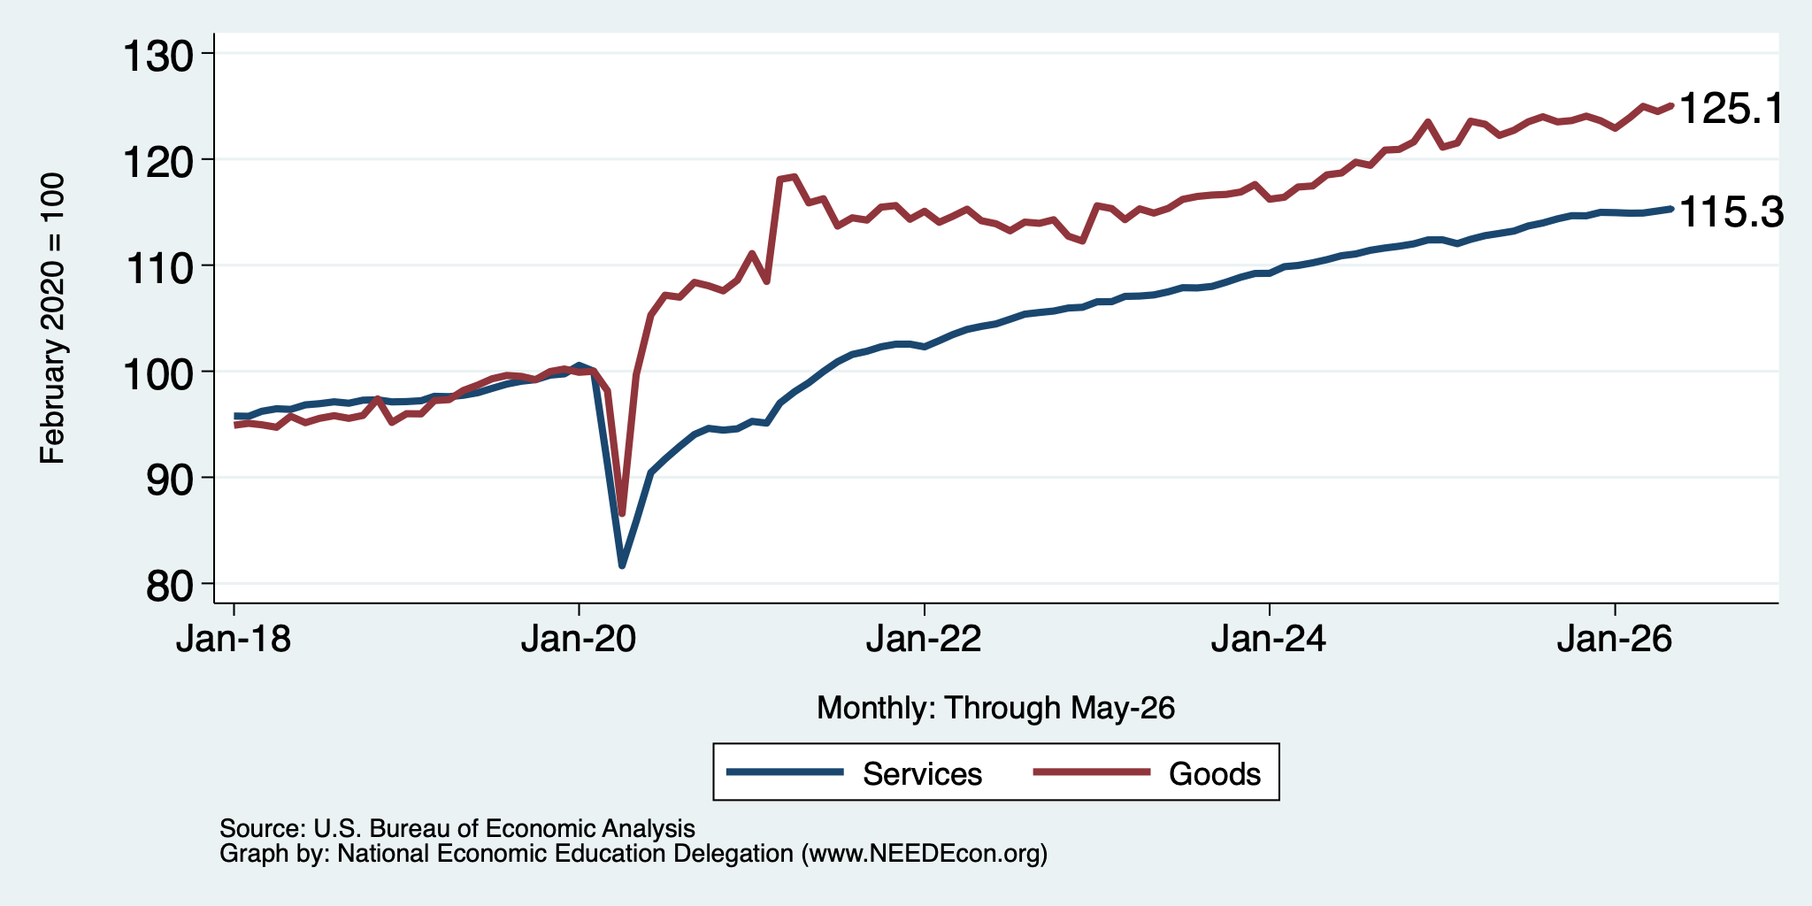
Spending Growth has Been Tepid
Relatively Flat

Slide 21
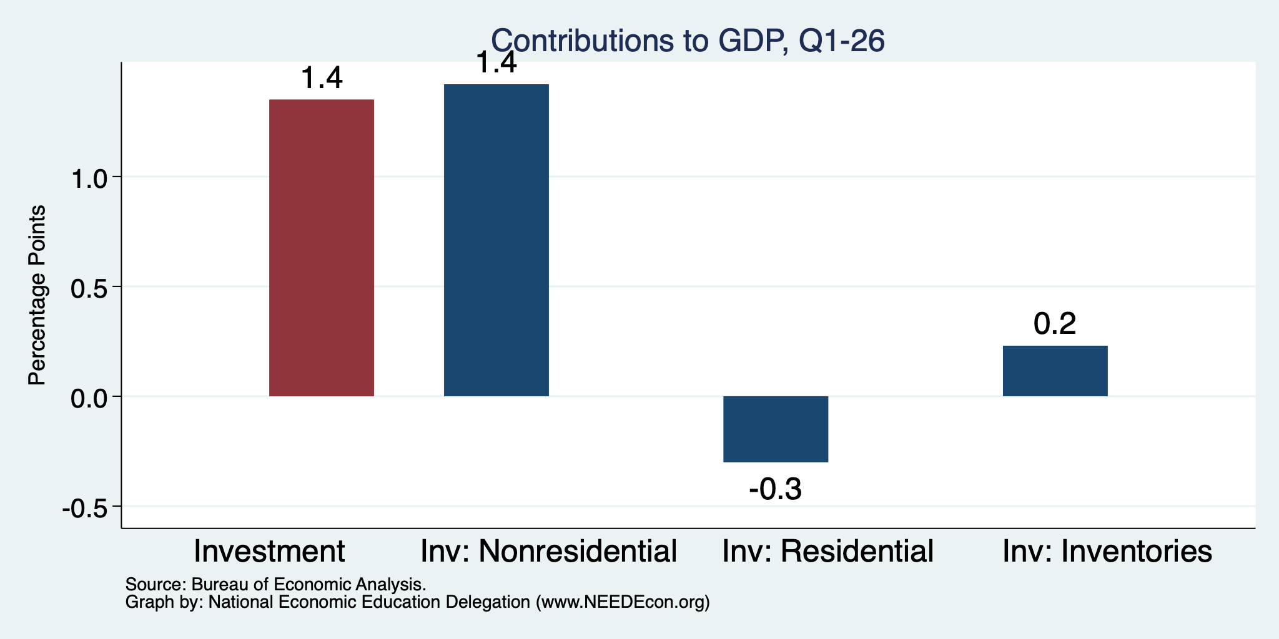
Investment: It’s All About AI
Normally
0.9%
Normally
0.7%
Normally
0.14%

Slide 22
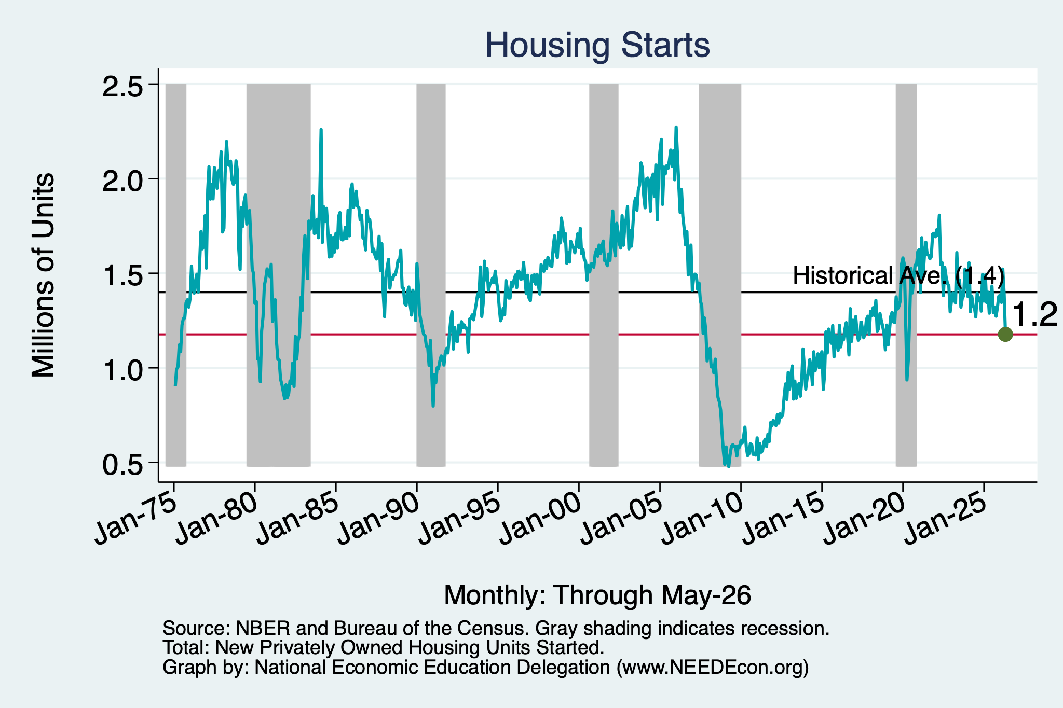
Investments in Housing are Running Low

Slide 23
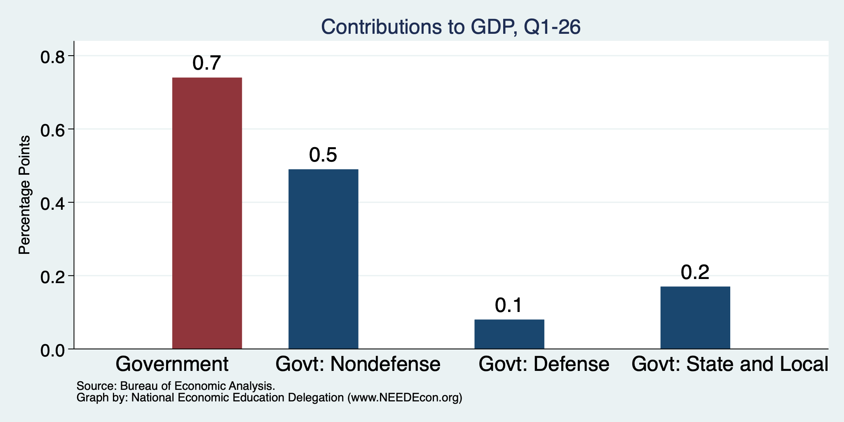
Government is Steady

Slide 24
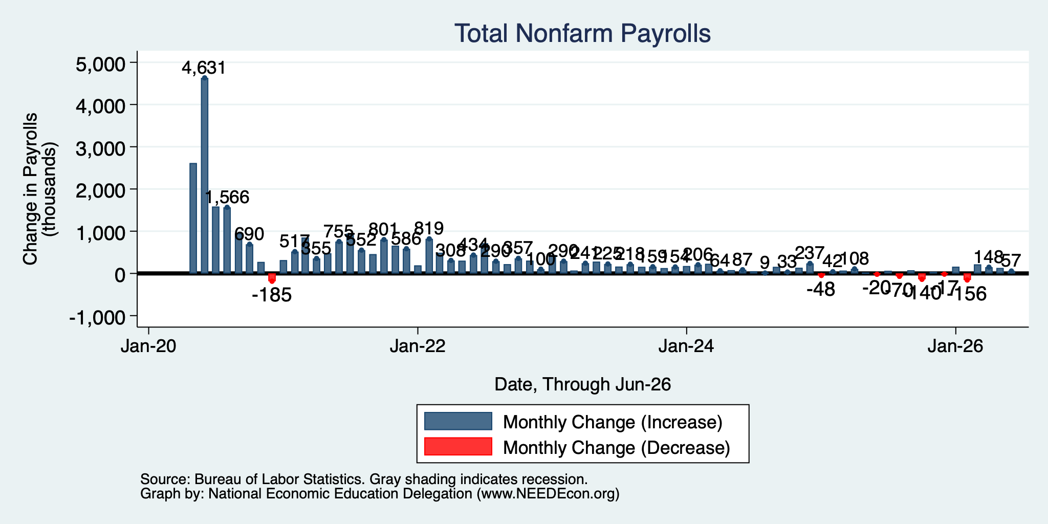
Monthly Changes in Nonfarm Employment
Apr: 148,000
May: 129,000
June: 57,000
Notes:
PAYEMS.png

Slide 25
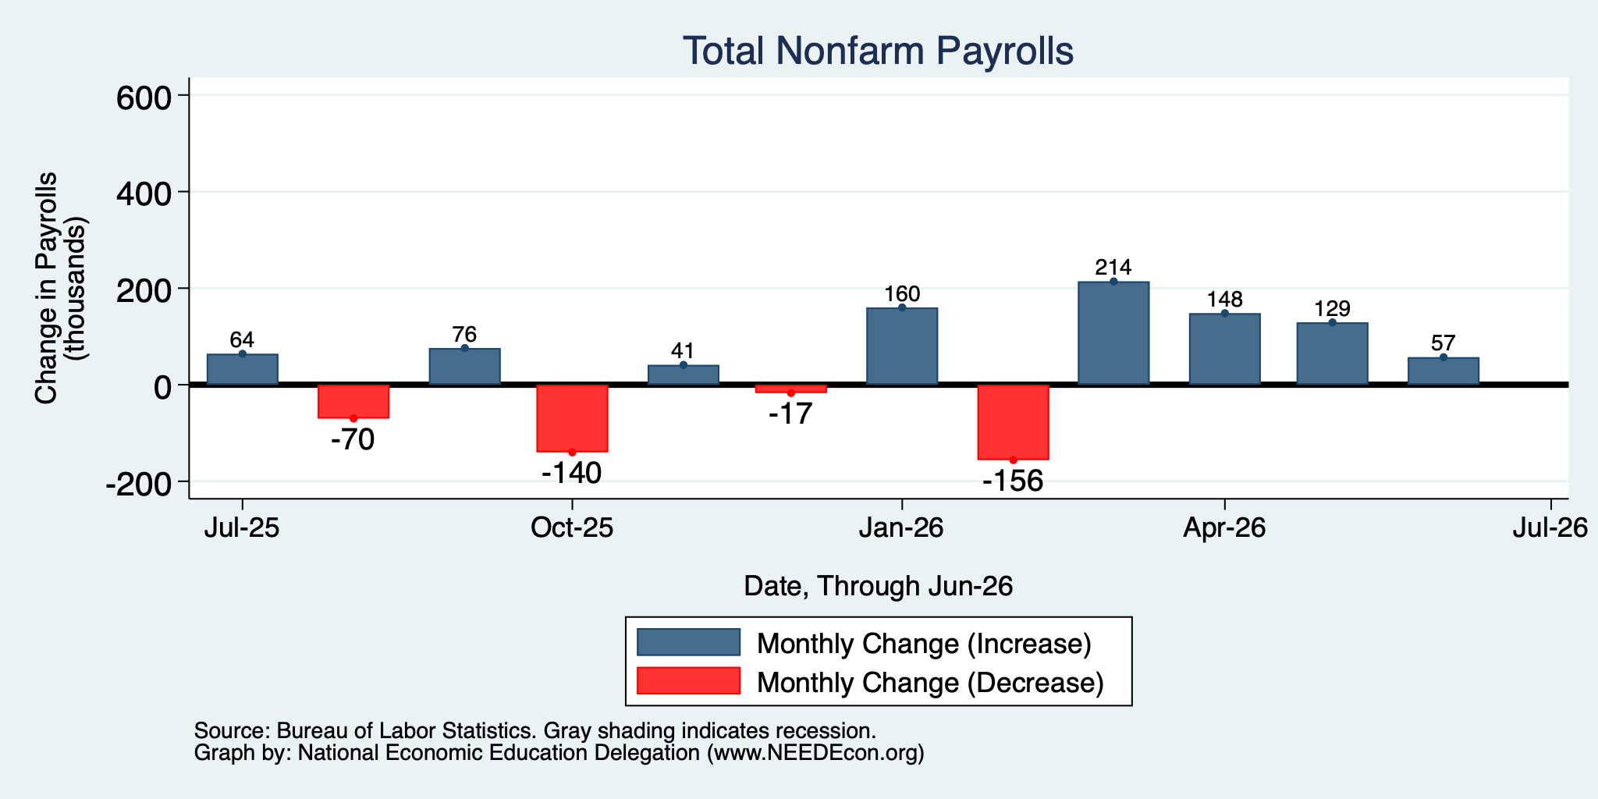
Monthly Changes in Nonfarm Employment
Apr: 148,000
May: 129,000
June: 57,000
Notes:
PAYEMS.png

Slide 26
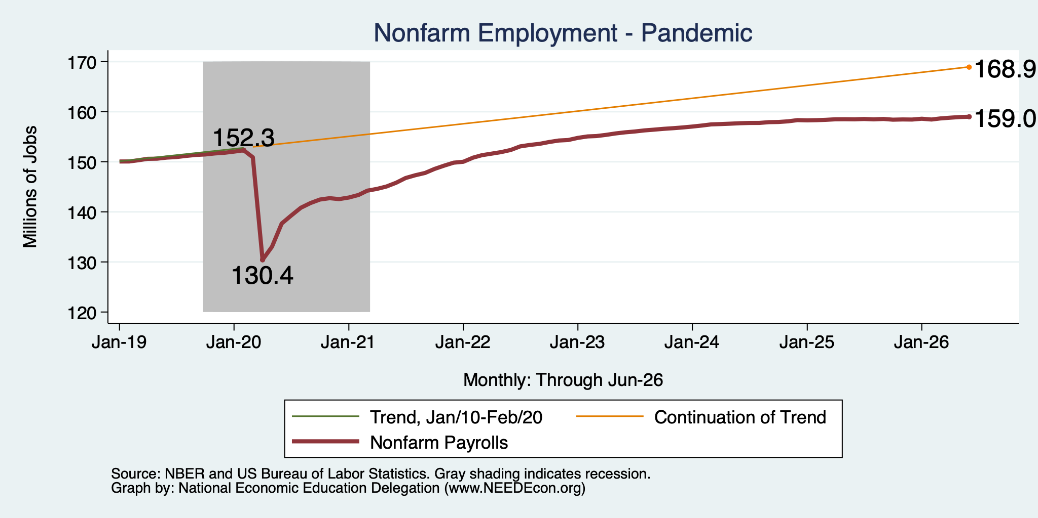
Employment Gap … is Growing
6.7 Million ABOVE February, 2020.
9.9 Million BELOW where we should be.
Notes:
payroll_recent.png

Slide 27
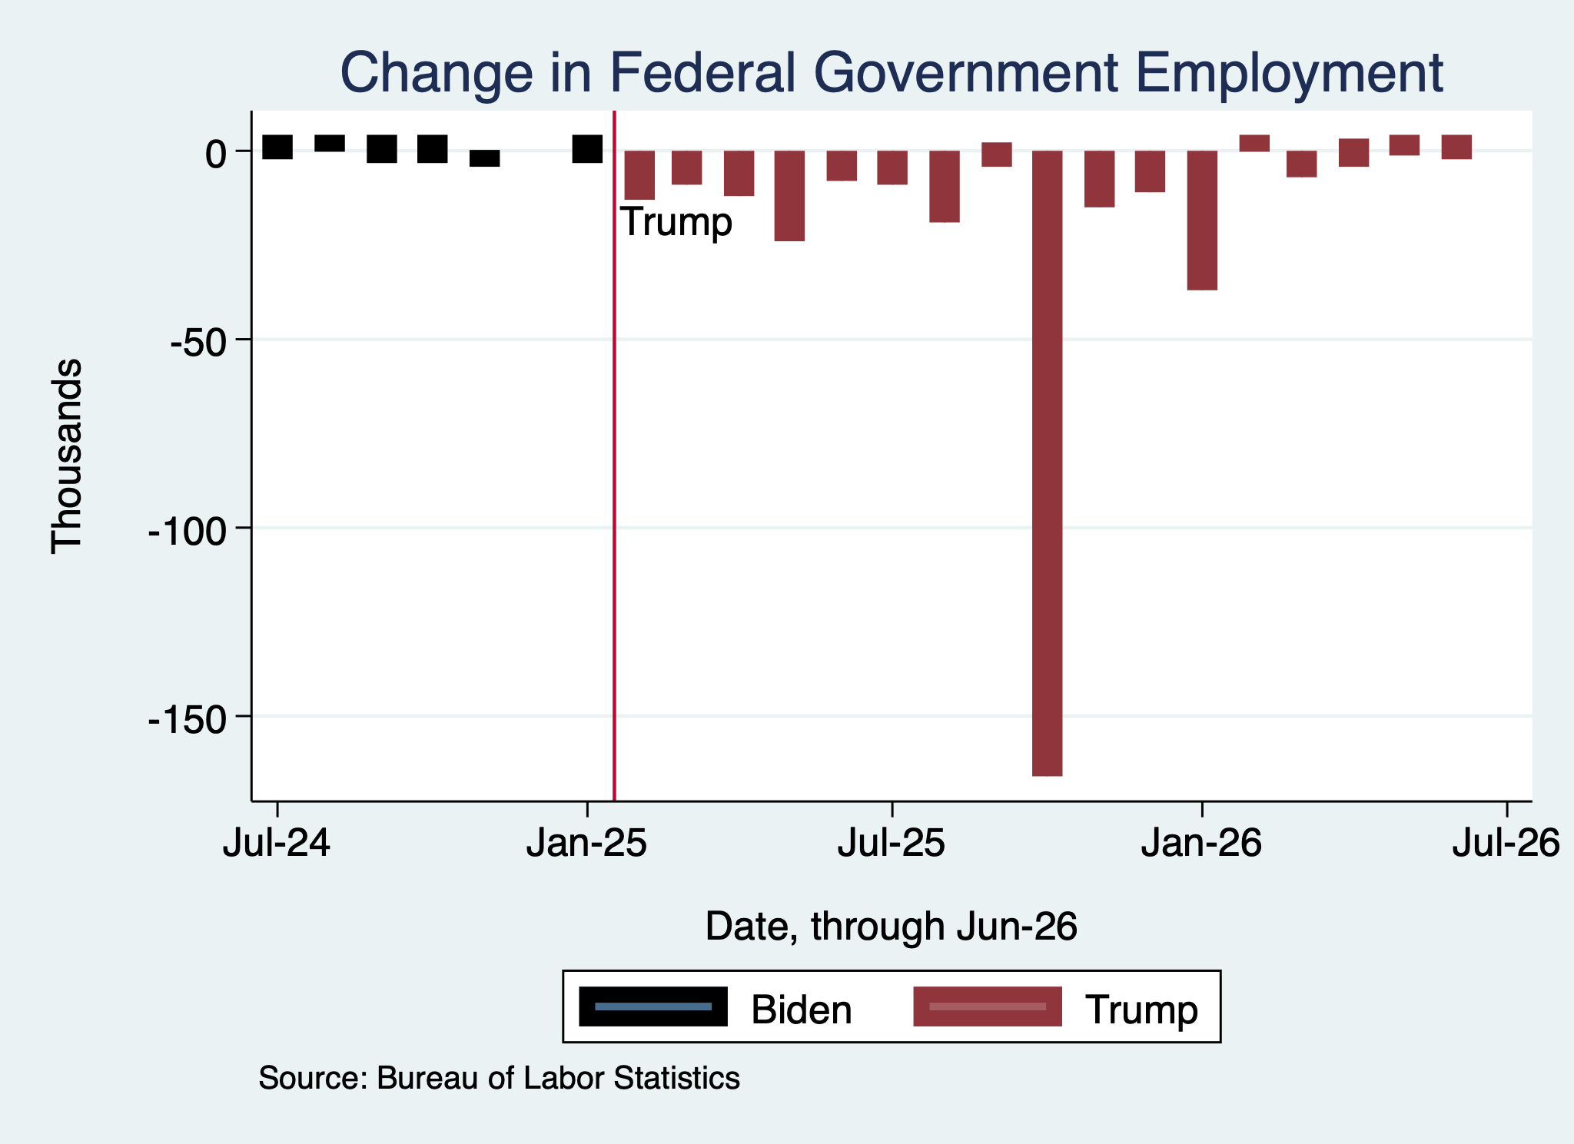
Monthly Changes in Federal Gov’t Employment
Notes:
PAYEMS.png

Slide 28
Where Are The Workers Going?
4.9 million ABOVE Feb 2020
5.0 million BELOW where we should be

Slide 29
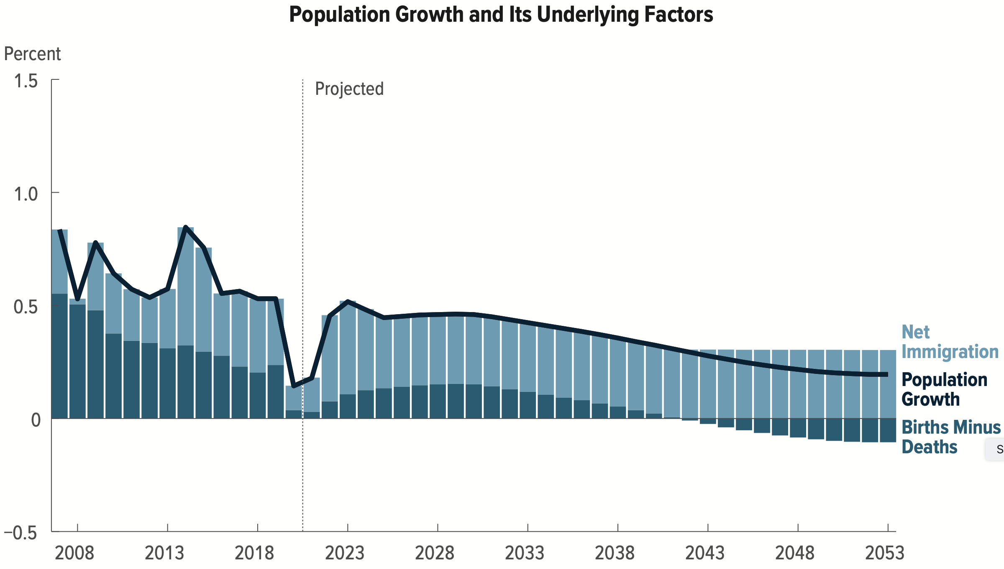
Is Immigration Saving the Day?
Source: CBO – The Demographic Outlook, 2023-2053

Slide 30
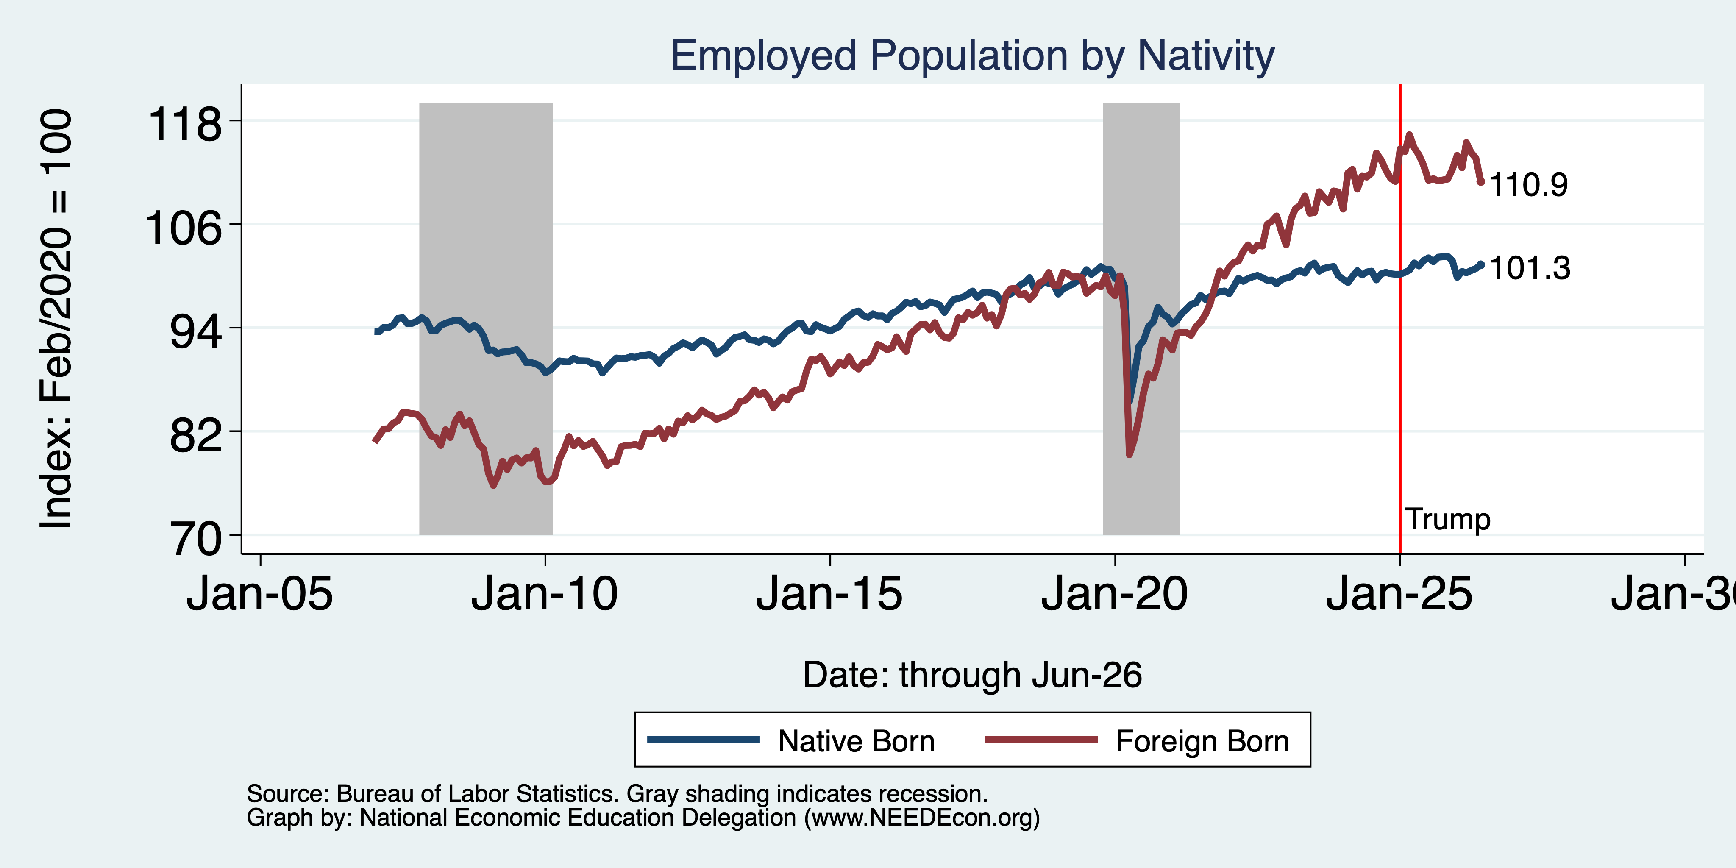
Immigrants to the Rescue? Less So Now
Feb/20 to Now:
Native Growth: 2,810
Foreign Growth: 3,153
Notes:
Feb 2020: 130,320 Native born 27,697 foreign born
Aug 2025: 132,474 Native 30,816 foreign born March 2025 peak: 32,225

Slide 31
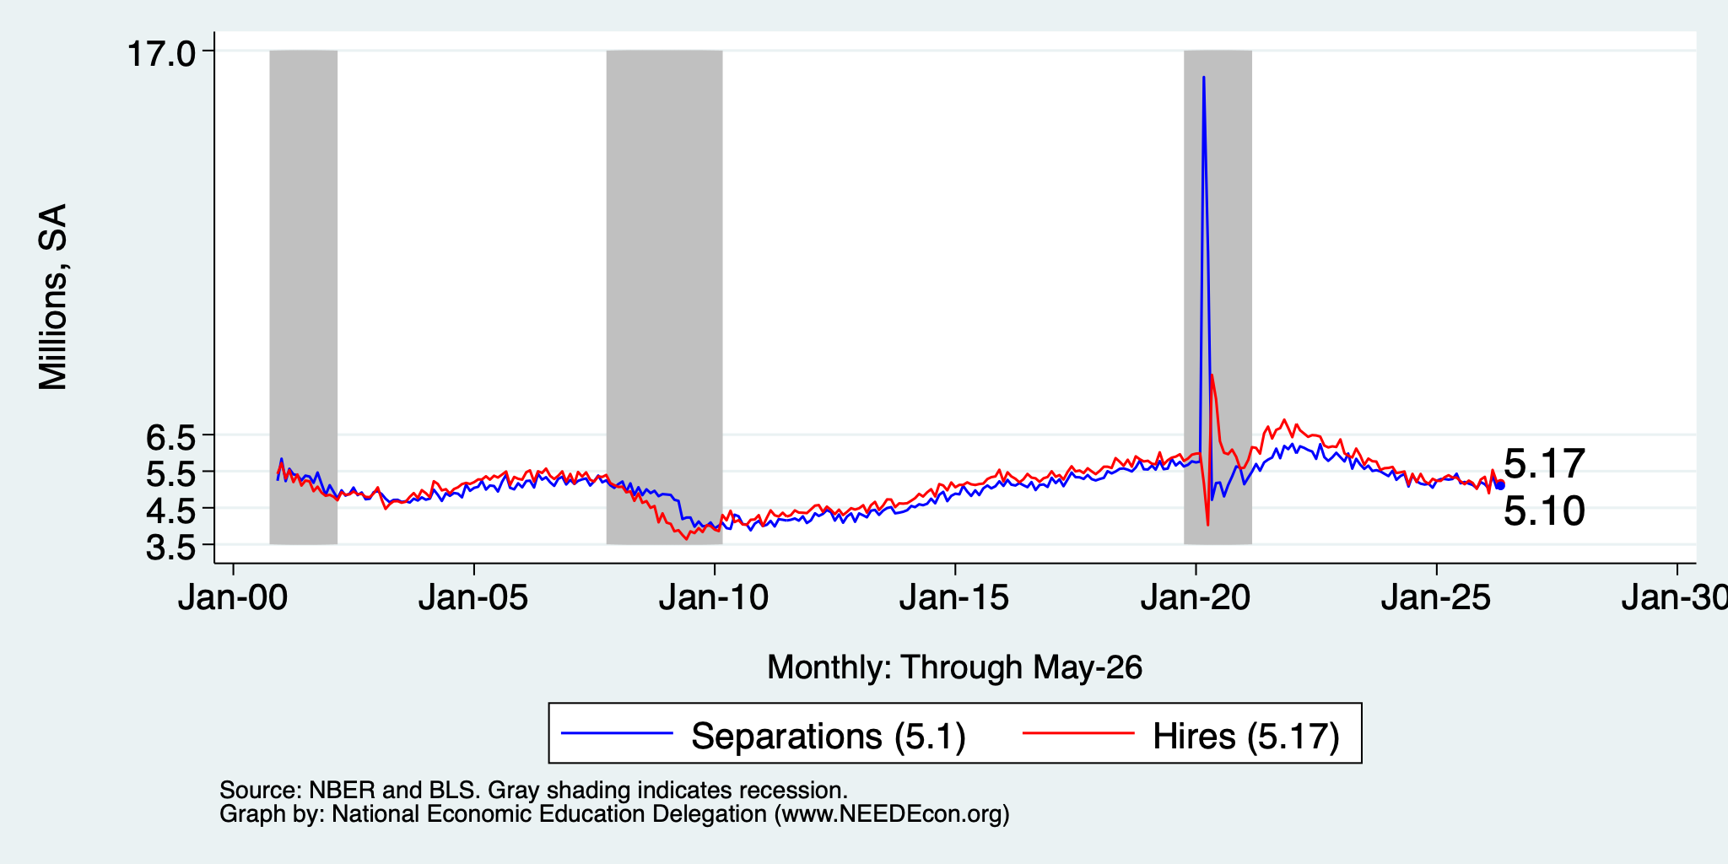
Great Hesitation

Slide 32
Some Notes on Employment Growth
Slowing over the last couple of months.
  Ragged before that.
  Likely connected to slow labor force growth.
The slower pace is ok: Just have to keep up with population growth.
Most growth is coming from among the foreign born.
ALL growth is coming from Healthcare and Social Services.
Women now occupy more nonfarm jobs than men.

Slide 33
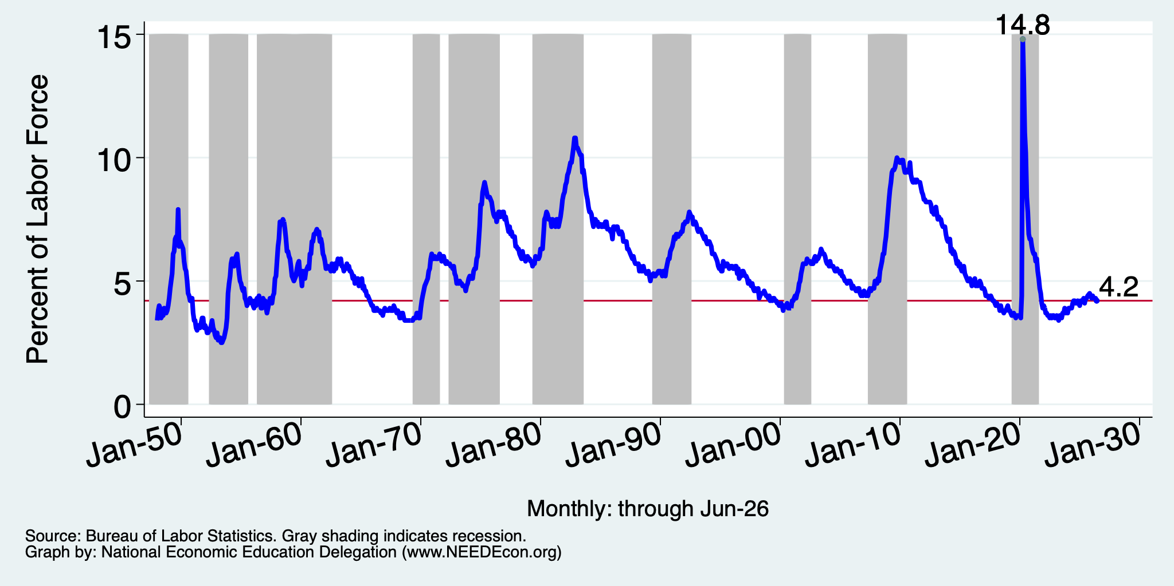
And Unemployment

Slide 34
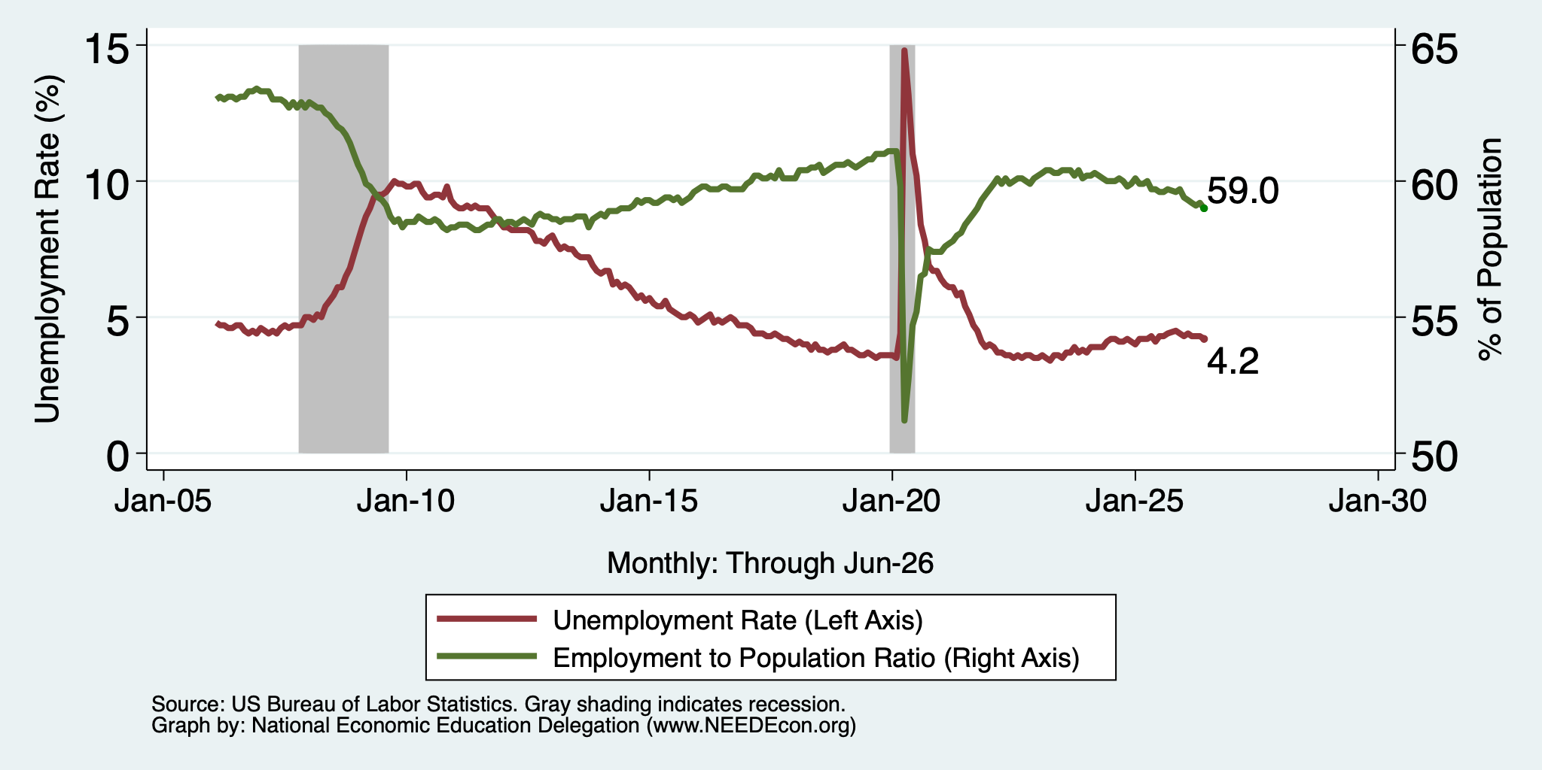
And Unemployment

Slide 35
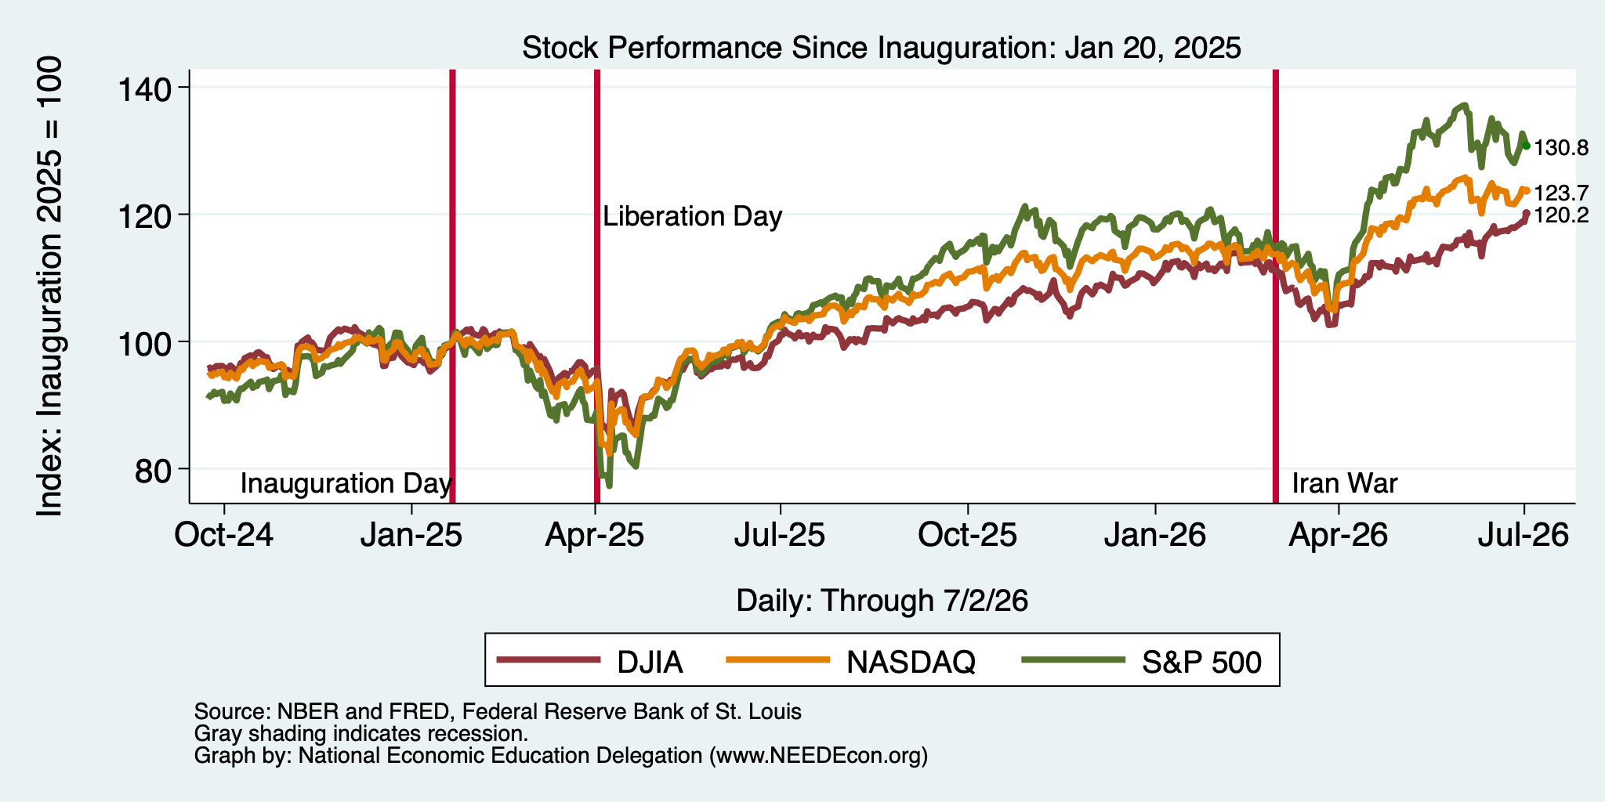
And Stocks?

Slide 36
Inflation

Slide 37
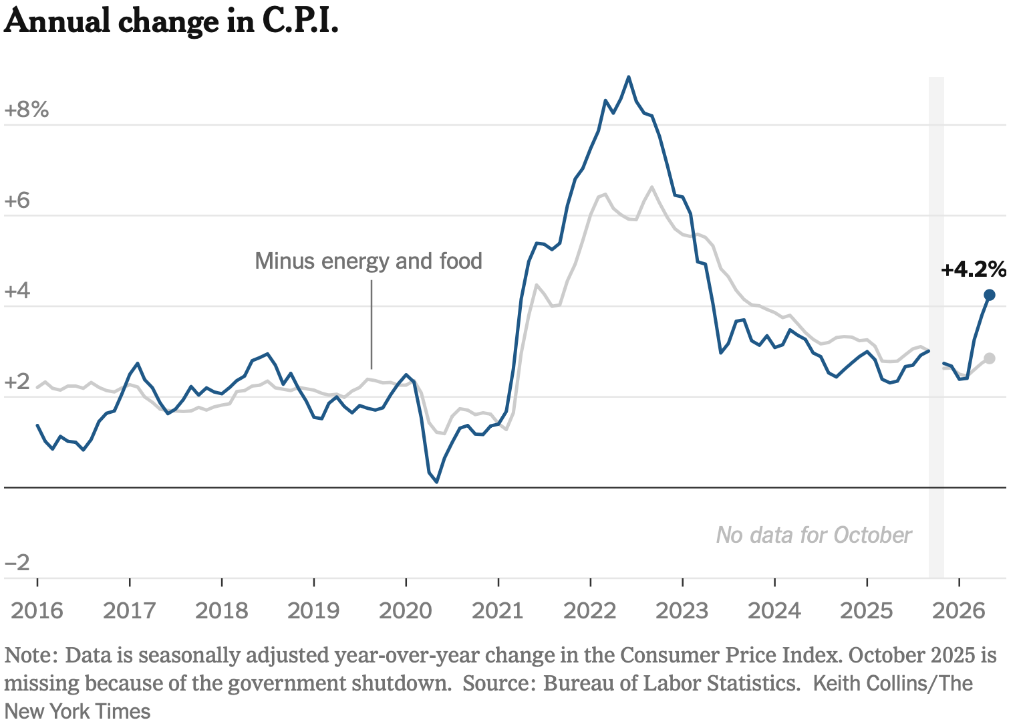
Inflation: Latest Figures – to May/26
The uptick is entirely because of the war.
Source: NYTimes.com

Slide 38
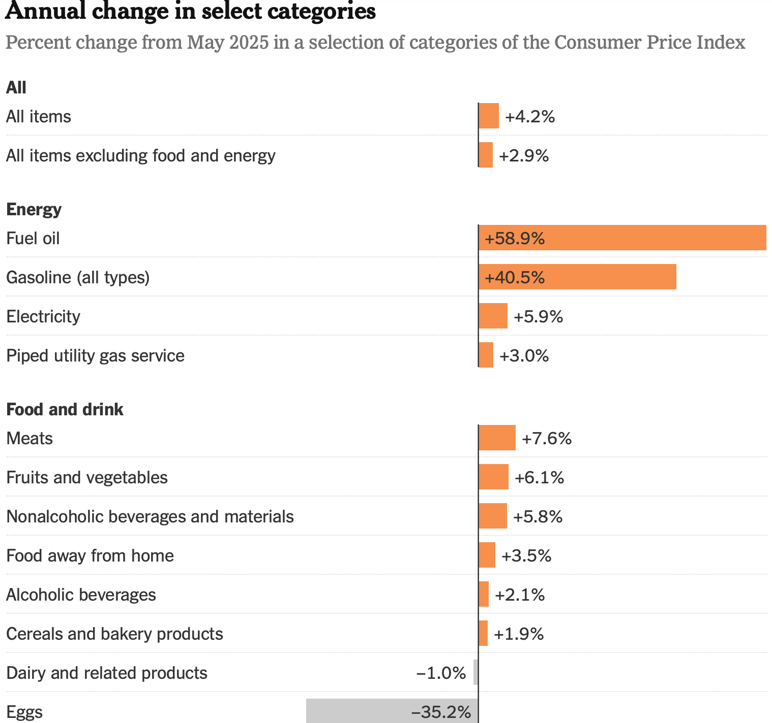
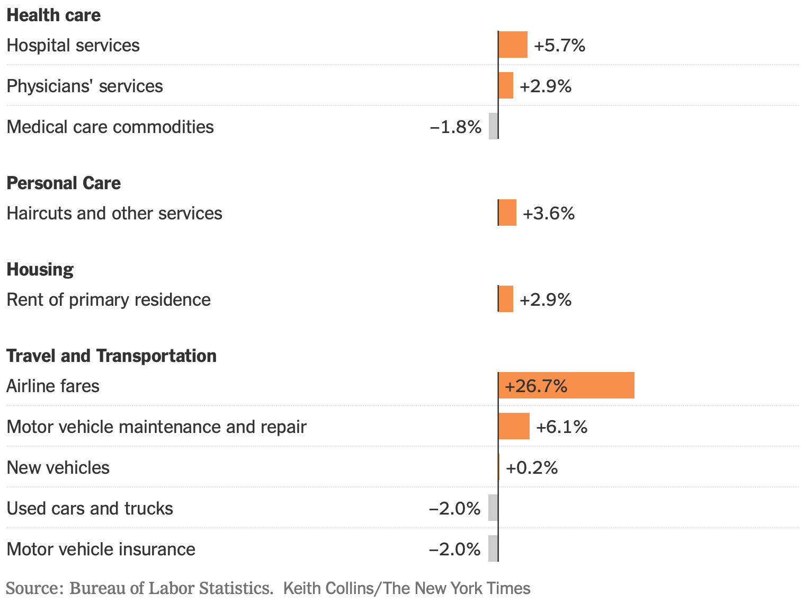
Inflation: LATEST Monthly Figures
Source: NYTimes.com

Slide 39
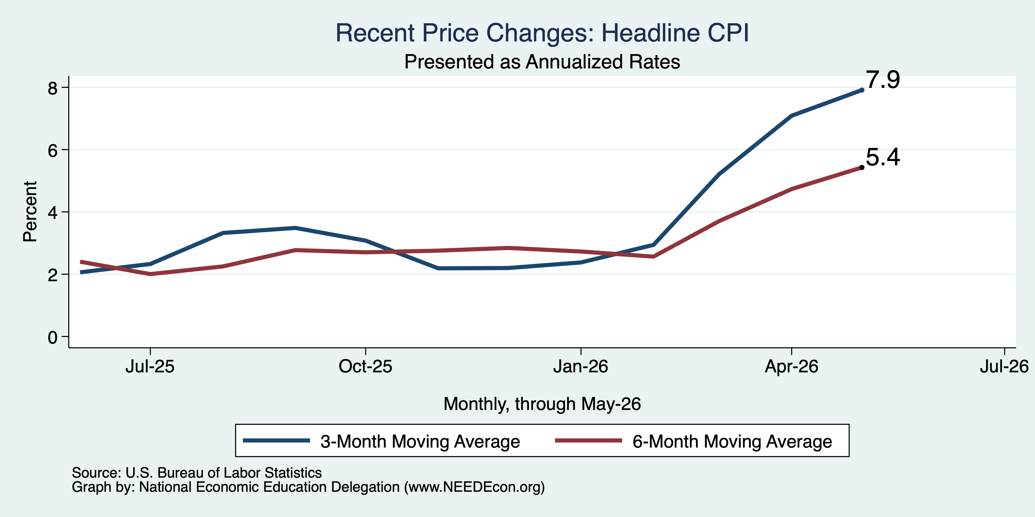
CPI in the Last 3/6 Months

Slide 40
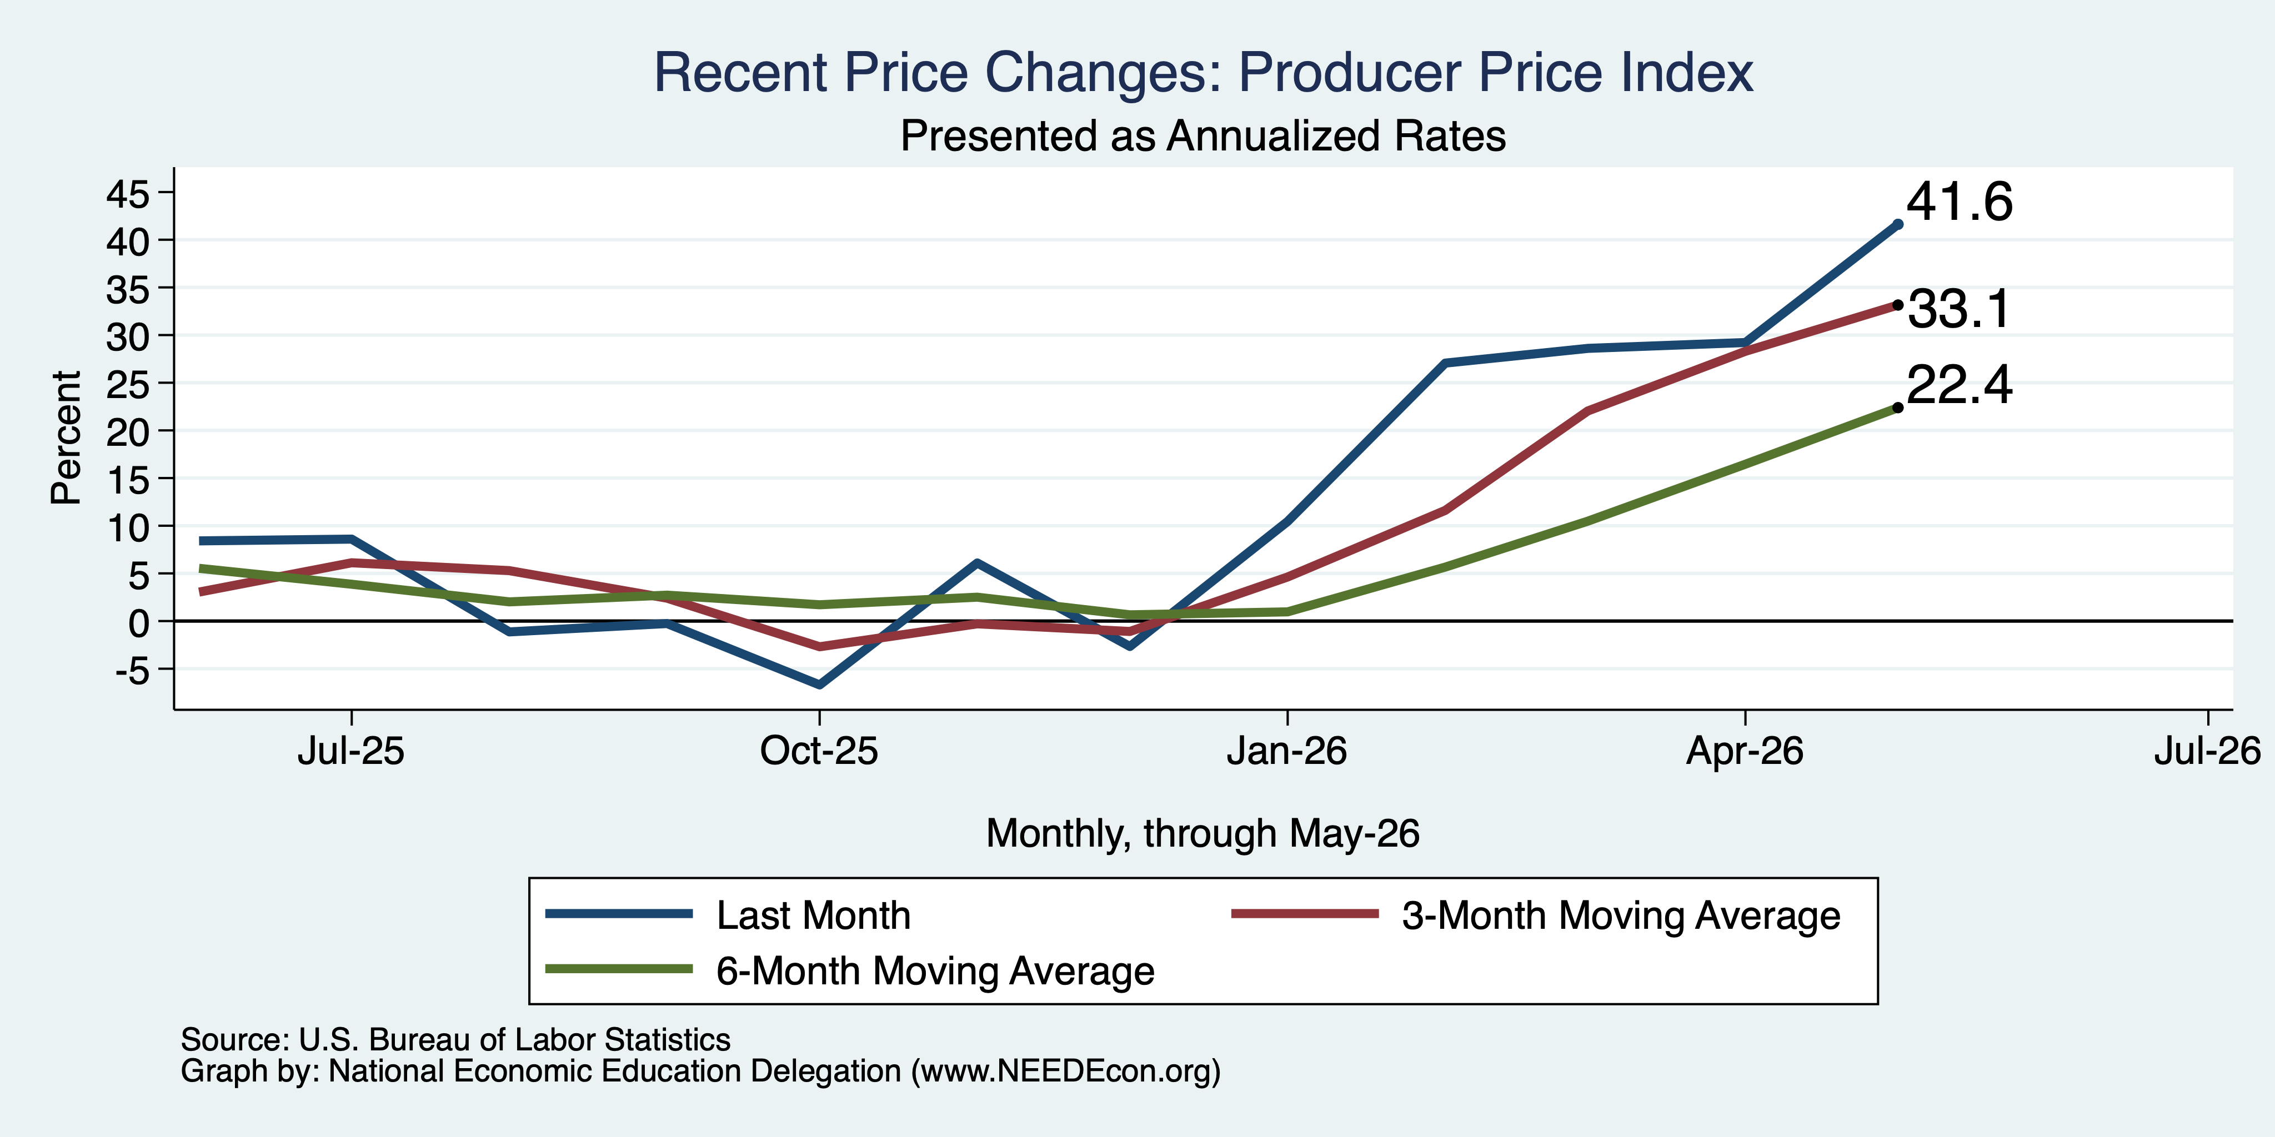
PPI in the Last Few Months

Slide 41
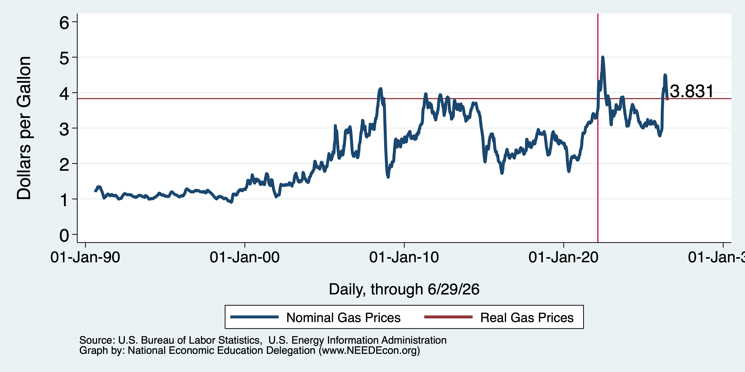
Inflation: Gas Prices

Slide 42
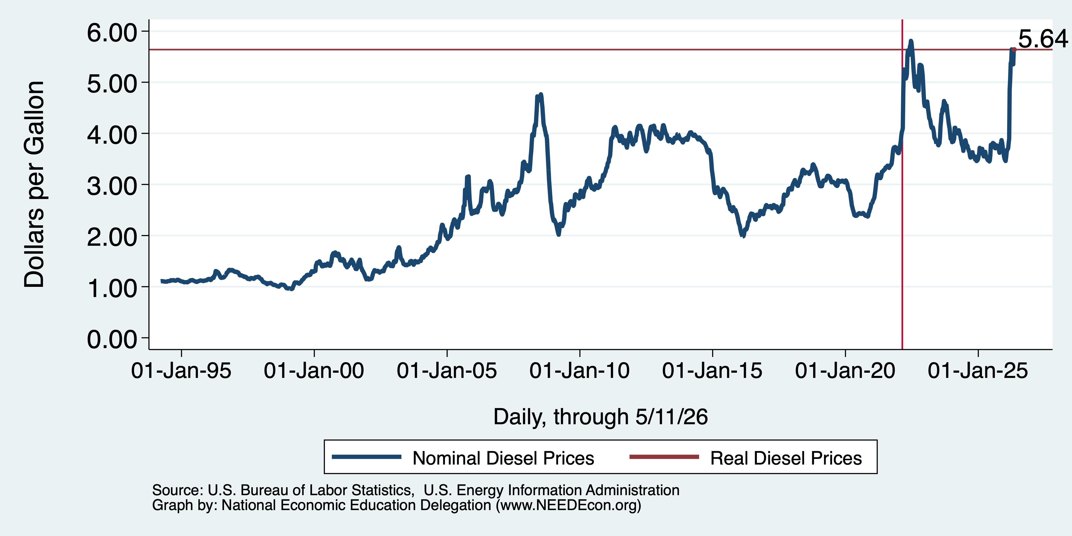
Inflation: Diesel Prices
3.46

Slide 43
Shortages From the War:
Naptha – ink ingredient
  Bathrooms, newspapers, cars, and paint.
Oil, in particular, heavy jet fuel and diesel (more so than gas for cars)
Ingredients for fertilizer
  Nitrogen and phosphate
Helium – MRI machines, AI chips, EVs
Wide variety of others.

Slide 44
Very Significant Implications
Rising fuel prices, especially diesel, impact ALL industries.
  Some, of course, more than others.
  The importance of mobility determines how much.
Especially vulnerable industries:
  Aviation
  Transportation
  Agriculture
  Manufacturing

Slide 45
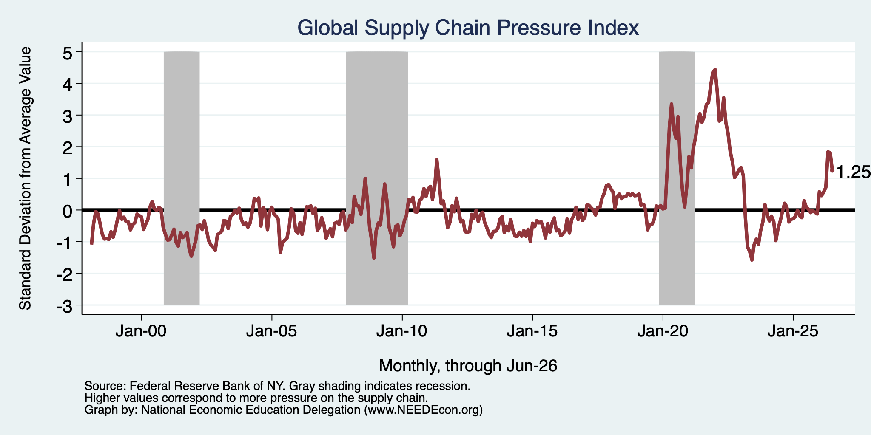
It’s Not Just About Oil

Slide 46
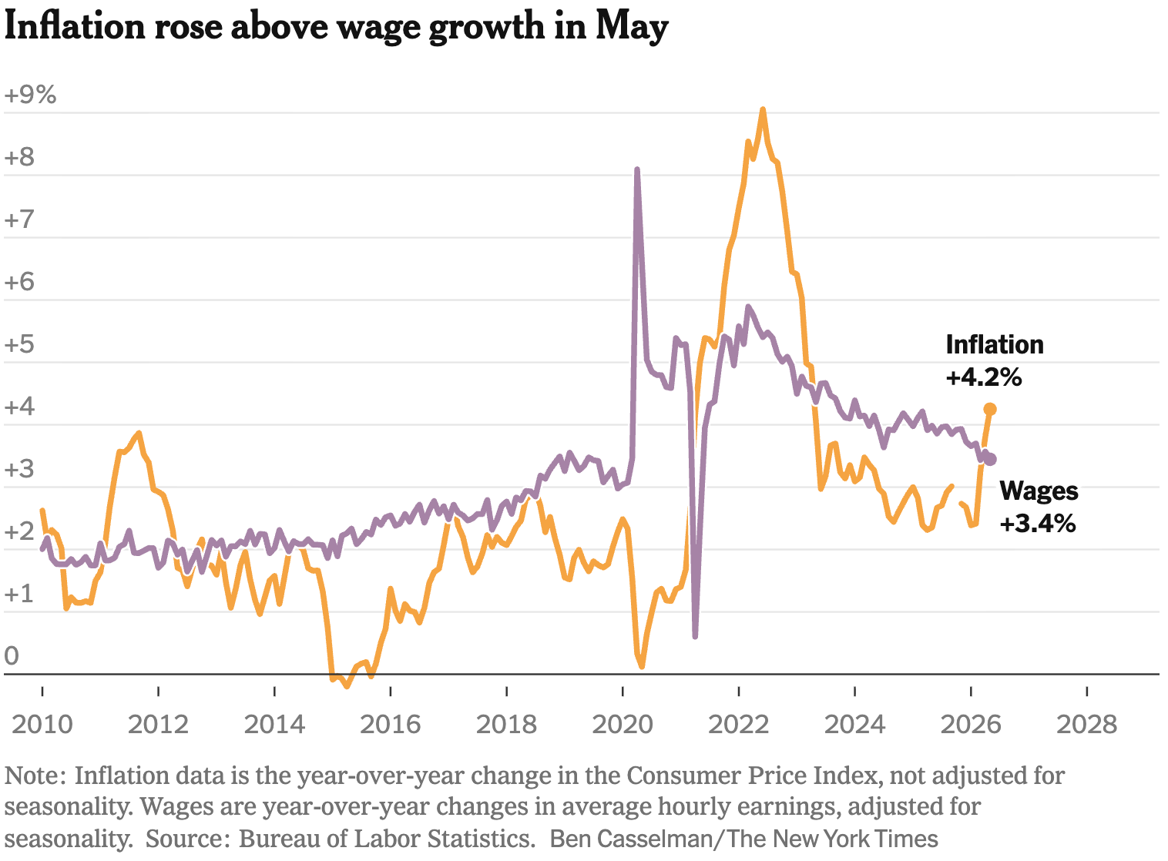
Inflation Outpaces Wage Growth

Slide 47
The Fed: Reining in Inflation?

Slide 48
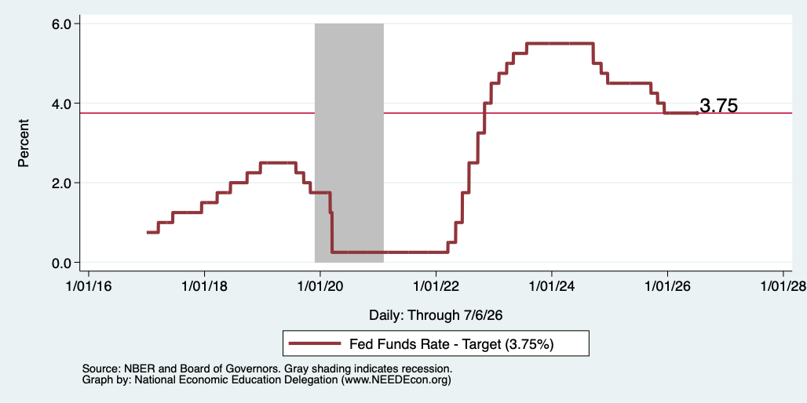
Federal Funds Rate – Recent Activity

Slide 49
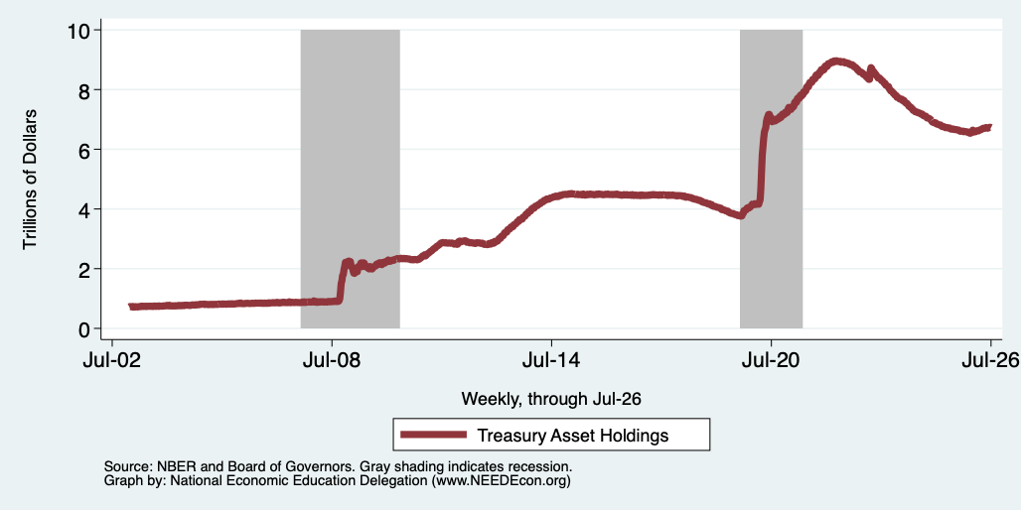
Fed: Reducing its Asset Holdings
Holding Pattern

Slide 50
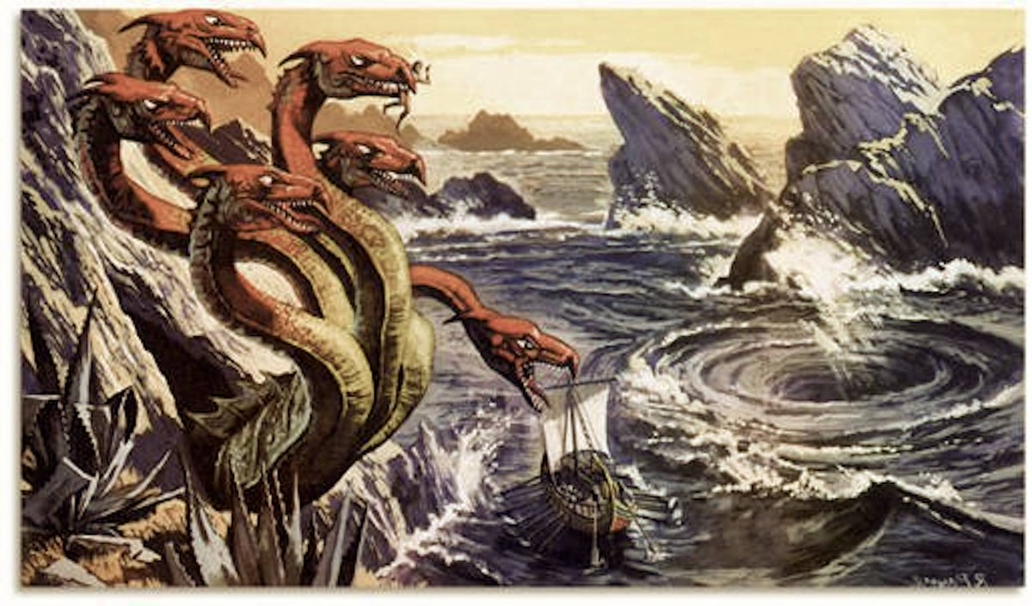
Scylla and Charybdis: “A Rock and a Hard Place”
Inflation
Jerome Powell
And now
Kevin Warsh
Recession
(Unemployment)

Slide 51
Bigger Picture: Uncertainty

Slide 52
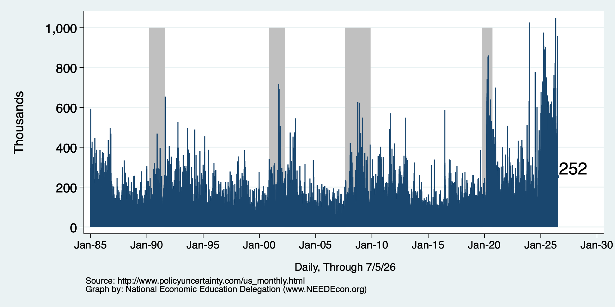
Policy Uncertainty Index
Notes:
The fed funds rate is the interest rate on overnight loans between banks. Think of it as the baseline interest rate on which banks base all other interest rates (e.g. mortgage rates)
FOMC lowers the fed funds rate during recessions and raises the fed funds rate during expansions
Fed funds rate peaked in the 1980s as then Chairman Paul Volcker sought to reign in “run away” inflation of the 1970s; doing so resulted in a recession in the early 1980s.
Since the 2008-09 recession, the fed funds rate has been kept near zero.
During the 2008-09 recession, Federal Reserve turned to unconventional tools to influence longer term interest rates to further stimulate the economy - QE
FedFunds.png

Slide 53
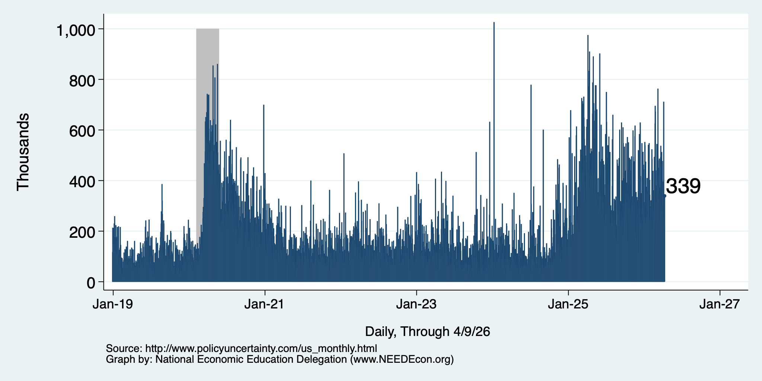
Policy Uncertainty Index – Last 10 Years
Notes:
The fed funds rate is the interest rate on overnight loans between banks. Think of it as the baseline interest rate on which banks base all other interest rates (e.g. mortgage rates)
FOMC lowers the fed funds rate during recessions and raises the fed funds rate during expansions
Fed funds rate peaked in the 1980s as then Chairman Paul Volcker sought to reign in “run away” inflation of the 1970s; doing so resulted in a recession in the early 1980s.
Since the 2008-09 recession, the fed funds rate has been kept near zero.
During the 2008-09 recession, Federal Reserve turned to unconventional tools to influence longer term interest rates to further stimulate the economy - QE
FedFunds.png

Slide 54
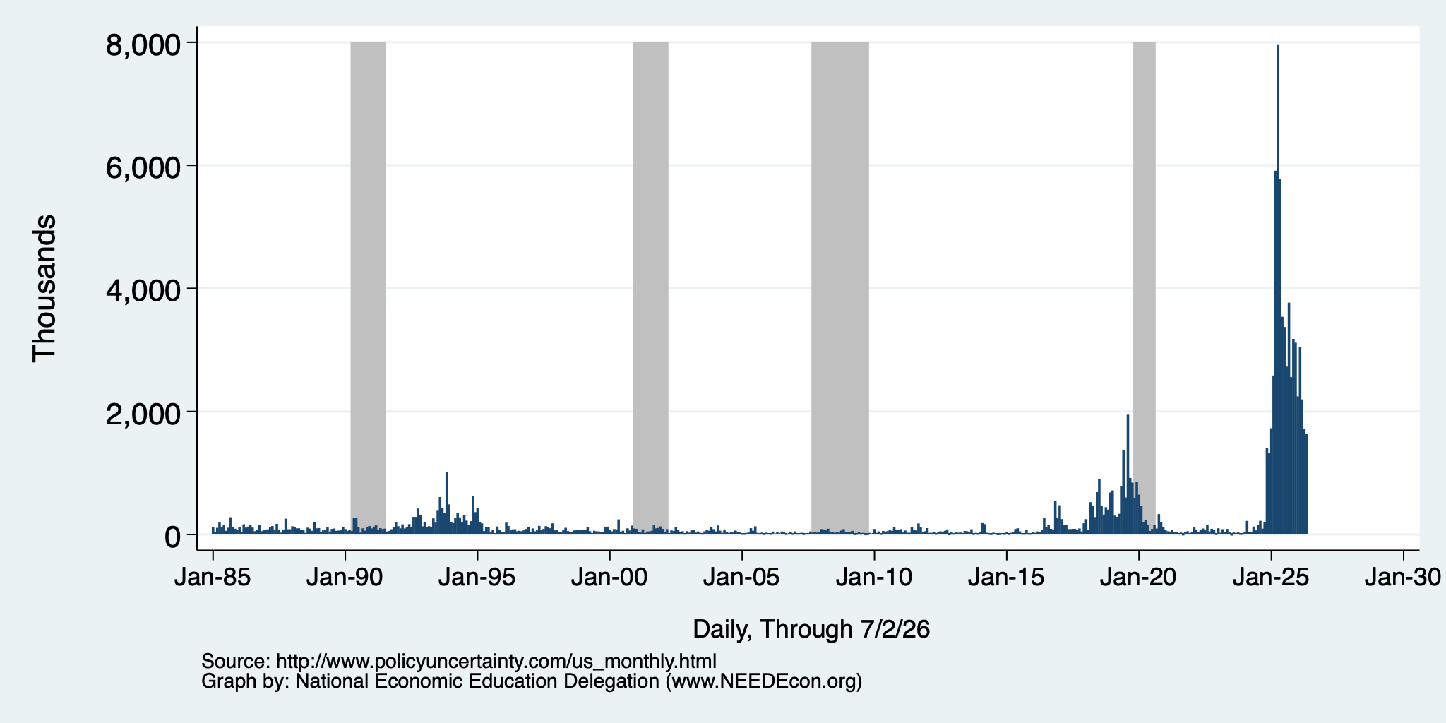
Policy Uncertainty Index – Trade
Notes:
The fed funds rate is the interest rate on overnight loans between banks. Think of it as the baseline interest rate on which banks base all other interest rates (e.g. mortgage rates)
FOMC lowers the fed funds rate during recessions and raises the fed funds rate during expansions
Fed funds rate peaked in the 1980s as then Chairman Paul Volcker sought to reign in “run away” inflation of the 1970s; doing so resulted in a recession in the early 1980s.
Since the 2008-09 recession, the fed funds rate has been kept near zero.
During the 2008-09 recession, Federal Reserve turned to unconventional tools to influence longer term interest rates to further stimulate the economy - QE
FedFunds.png

Slide 55
Uncertainties
What effect will continued deportations have?
Will AI continue to drive growth?
Will tariffs continue to drive inflation?
  Fed says that ALL of the inflation above 2% is from tariffs, until…
Will the war drive inflation beyond fuel prices?
  It is clear in fuel prices, but every other sector of the economy depends on fuel. Higher fuel prices drive prices in the rest of the economy up.
Will consumers continue to hold up?
  Evidence that spending is in decline.
What happens to Fed policy now that Jerome Powell is gone?

Slide 56
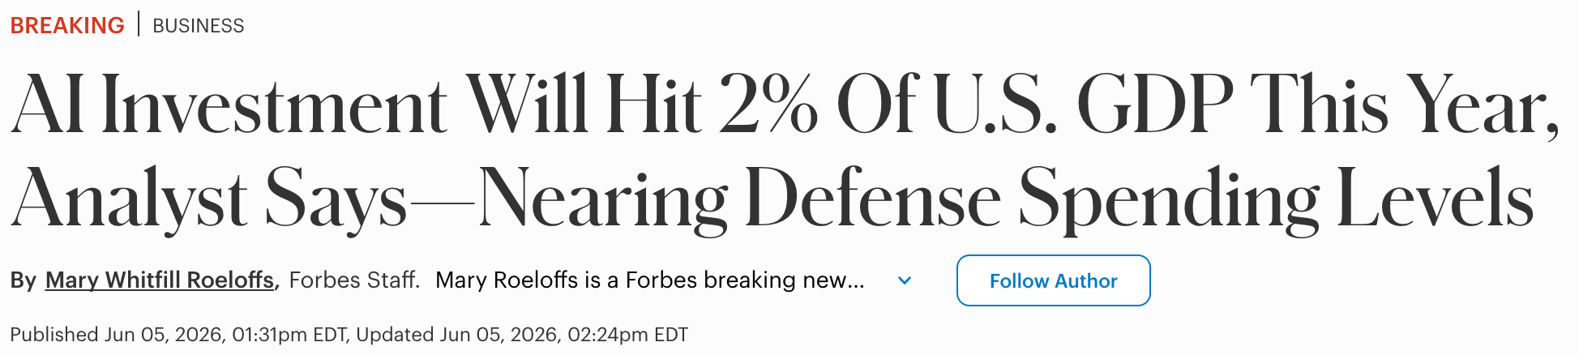
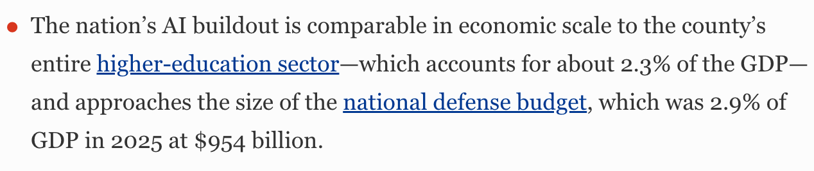

Slide 57
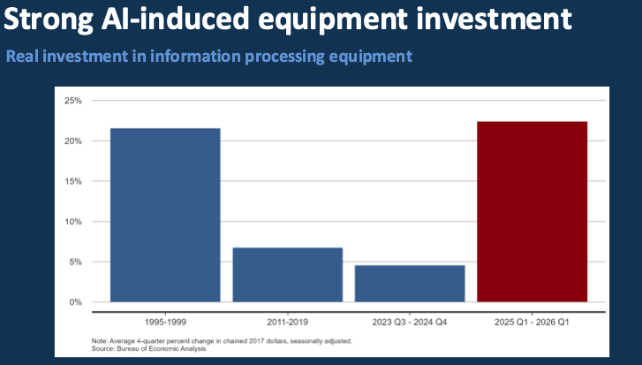
Source: Presentation given by Sylvain Leduc to the Monterey Bay Economic Partnership

Slide 58
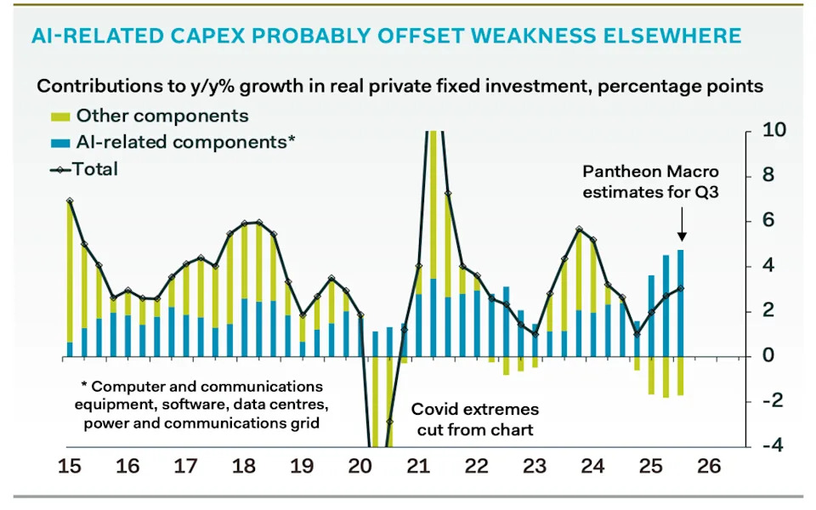
AI and Investment
AI Investment & GDP Growth
Period | GDP Growth | AI Contribution | Difference
25Q1 | 2.0 percent | 1.3 percent | 0.7 percent
25Q2 | 2.1 | 1.2 | 0.9
25Q3 | 2.3 | 0.5 | 1.8
Source: BEA & https://www.stlouisfed.org/on-the-economy/2026/jan/tracking-ai-contribution-gdp-growth
Source Parthenon: Macroeconomics

Slide 59
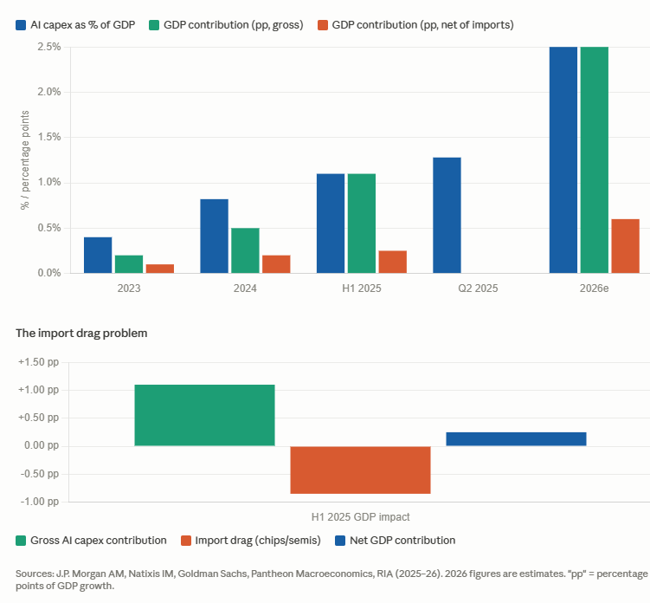
What About AI Investment?
https://www.goldmansachs.com/insights/articles/tracking-trillions-the-assumptions-shaping-scale-of-the-ai-build-out

Slide 60
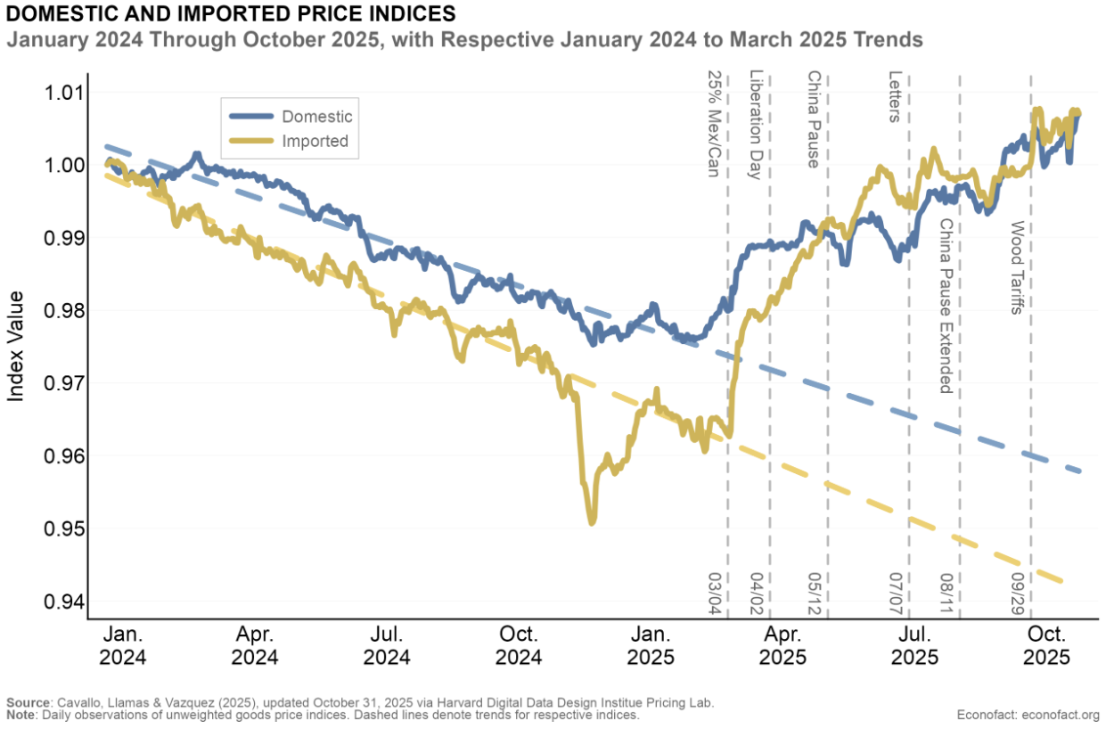
Tariffs and Price Effects

Slide 61
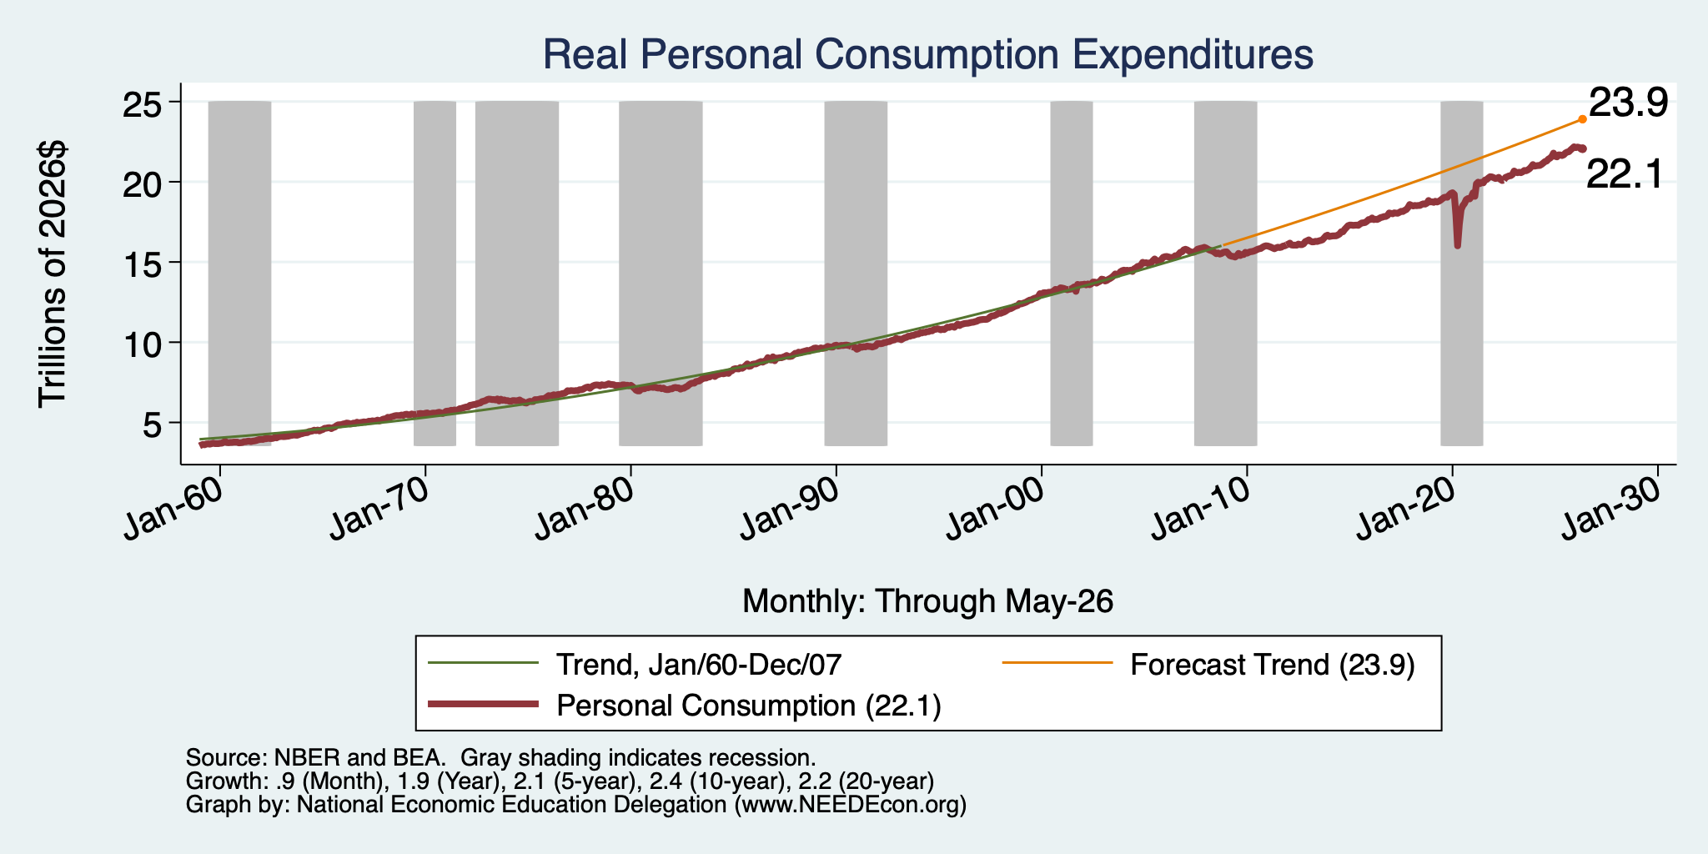
Personal Consumption Expenditures Are Slowing

Slide 62
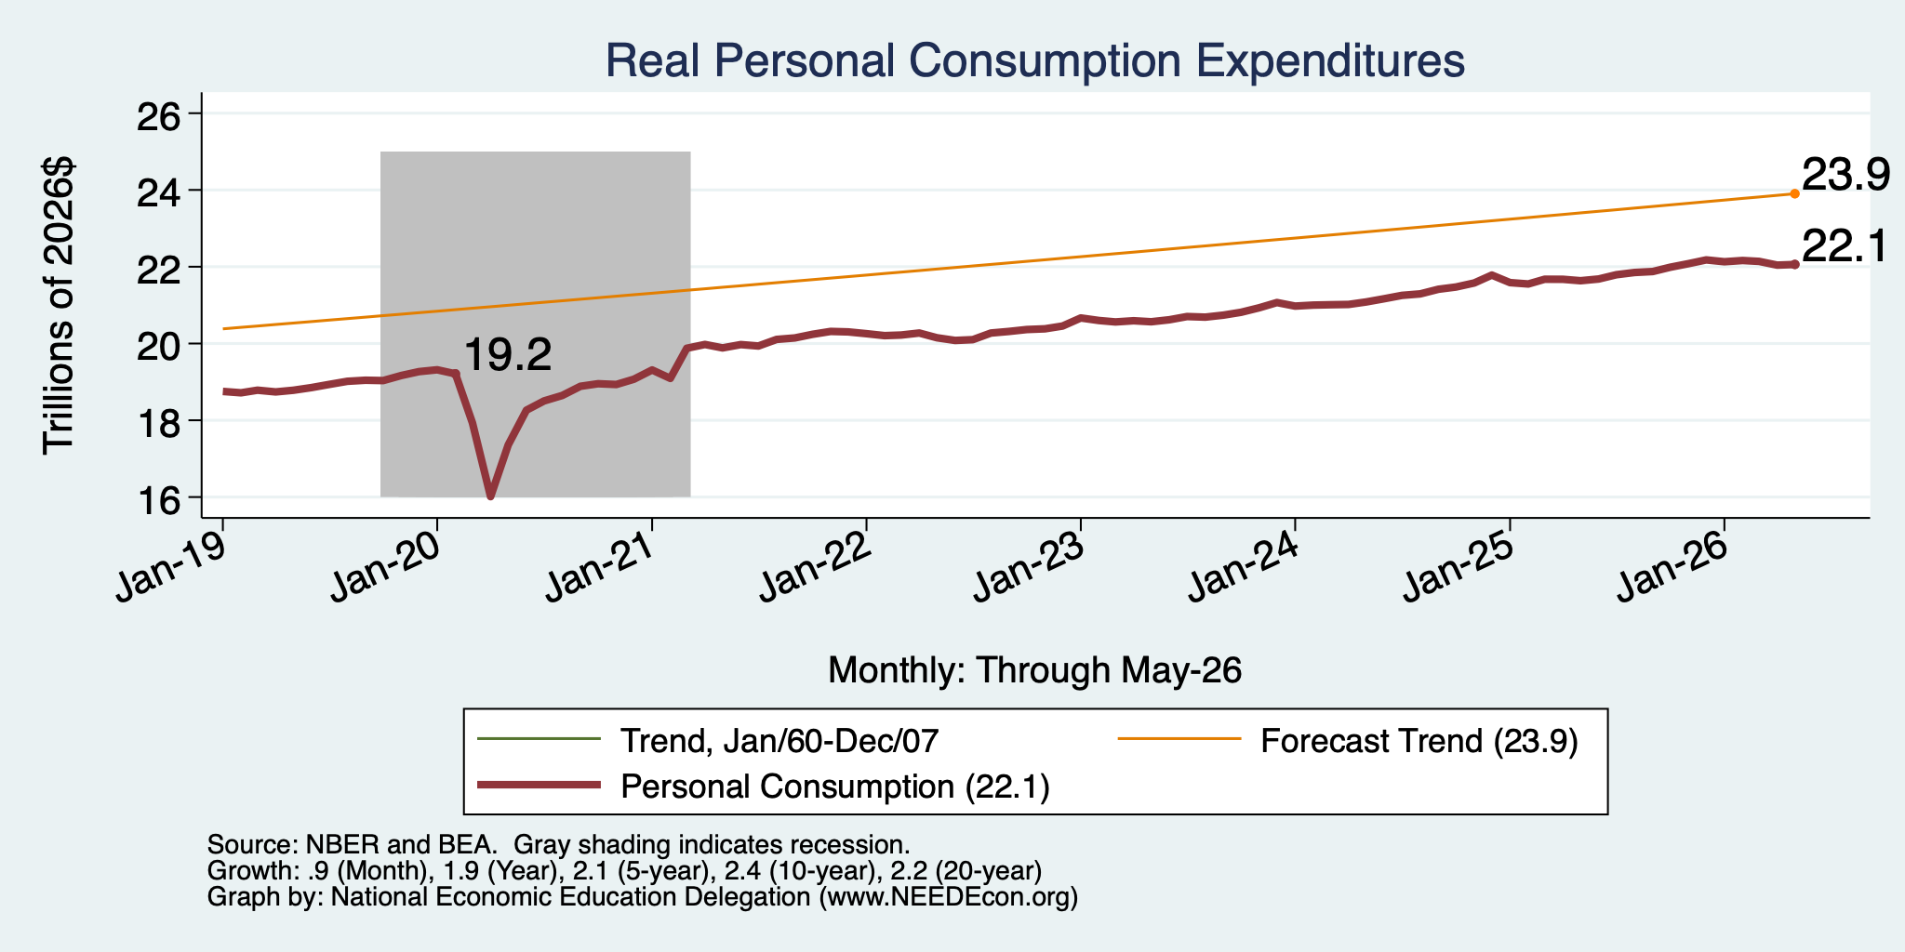
Personal Consumption Expenditures Are Slowing

Slide 63

Consumer Confidence is Waning
At its lowest level ever!
(56-year history)

Slide 64
K-Shaped Economy
Notes:
Define K-Shaped Economy

Slide 65

More Detail on the K-Shaped Economy
Source: @SteveRattner

Slide 66

Monetary Policy after Jerome Powell?
Kevin Warsh: replaced Jerome Powell as the Chair of the Fed in May.

Slide 67
Summary
Inflation: was getting close to Fed’s 2% target.
  But is now going in the wrong direction
Current immigration and trade policies will exacerbate inflation.
Immigration: deportations tax the economy and are expensive.
  Many, MANY ag workers are unauthorized immigrants. (50% of Central Valley)
Tariffs: are a tax.
  Taxes raise prices. Period. Full Stop.
  Taxes often cost jobs. Tariffs likely will.
The war is going to drive up prices and uncertainty.
  Nobody invests into uncertainty.
What if the AI bubble bursts?

Slide 68
Are We Headed for A Recession?
Probably not.
Forecasts are all over the place.
  IMF forecasting 2.4% in 2026.
  30-50% chance of a recession by some models.
A slowdown in economic growth seems inevitable.
  But the economy has been proving remarkably resilient!
A bout of stagflation unlikely, but possible.

Slide 69
The State of the Economy & the Future
The key indicators for judging the macro economy are still good
  Output and unemployment are close to their “full employment” levels, although the labor market data may be getting worse.
  Inflation is still a bit elevated, but some of this is due to “price shock.”
Concerns
  Growth in demand could be weakening.
  Price shocks may get worse.
Big Uncertainty: the Future of the Fed & Monetary Policy.
Government policies are currently economically counterproductive.

Slide 70
Thank you!
Any Questions?
www.NEEDEcon.org
Jon D. Haveman
Jon@NEEDEcon.org
Contact NEED: info@NEEDEcon.org
Submit a testimonial: www.NEEDEcon.org/testimonials.php
Become a Friend of NEED: www.NEEDEcon.org/friend.php

