Slide 1
Osher Lifelong Learning Institute, Winter 2023
Contemporary Economic Policy
University of Cincinnati
January-March, 2023
Host: Jon Haveman, Ph.D.
National Economic Education Delegation

Slide 2
Available NEED Topics Include:
US Economy
Healthcare Economics
Climate Change
Economic Inequality
Economic Mobility
Trade and Globalization
Minimum Wages
Immigration Economics
Housing Policy
Federal Budgets
Federal Debt
Black-White Wealth Gap
Autonomous Vehicles
Healthcare Economics

Slide 3
Course Outline
Contemporary Economic Policy
Week 1 (1/26): Trade and Globalization (Alan Deardorff, Univ. of Michigan)
Week 2 (2/2): Trade Deficits and Exchange Rates (Alan Deardorff)
Week 3 (2/9): US Economic Update (Jon Haveman, NEED)
Week 4 (2/16): The Black-White Wealth Gap (Mike Shor, Univ. of Connecticut)
Week 5 (2/23): Economic Mobility (Kathryn Wilson, Kent State Univ.)
Week 6 (3/2): Climate Change Economics (Sarah Jacobson, Williams College)

Slide 4
Submitting Questions
Please submit questions of clarification in the chat.
I will try to handle them as they come up.
We will do a verbal Q&A once the material has been presented.
Slides will be available from the NEED website soon. (https://needelegation.org/delivered_presentations.php)

Slide 5
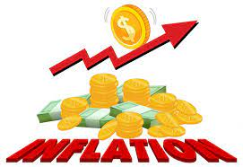
US Economic Update
Jon Haveman, Ph.D.
NEED
February 9, 2023

Slide 6
Credits and Disclaimer
This slide deck was authored by:
Jon D. Haveman, NEED
Scott Baier, Clemson University
Geoffrey Woglom, Amherst College (Emeritus)
Brian Dombeck, Lewis & Clark College
Doris Geide-Stevenson, Weber State
Disclaimer
NEED presentations are designed to be nonpartisan.
It is, however, inevitable that the presenter will be asked for and will provide their own views.
Such views are those of the presenter and not necessarily those of the National Economic Education Delegation (NEED).

Slide 7
Outline
About the U.S. Economy
Economic Indicators
Inflation/Federal Reserve
Debt Ceiling

Slide 8
Some Basic Statistics
Statistic: | Value
Population | 334.4 Million
Labor Force | 165.8 Million
Employment | 155.1 Million
Gross Domestic Product (GDP) | $26.1 Trillion
Income per Capita | $66,329
Ave. Hourly Earnings | $33.03
Source: fred.stlouisfed.org

Slide 9
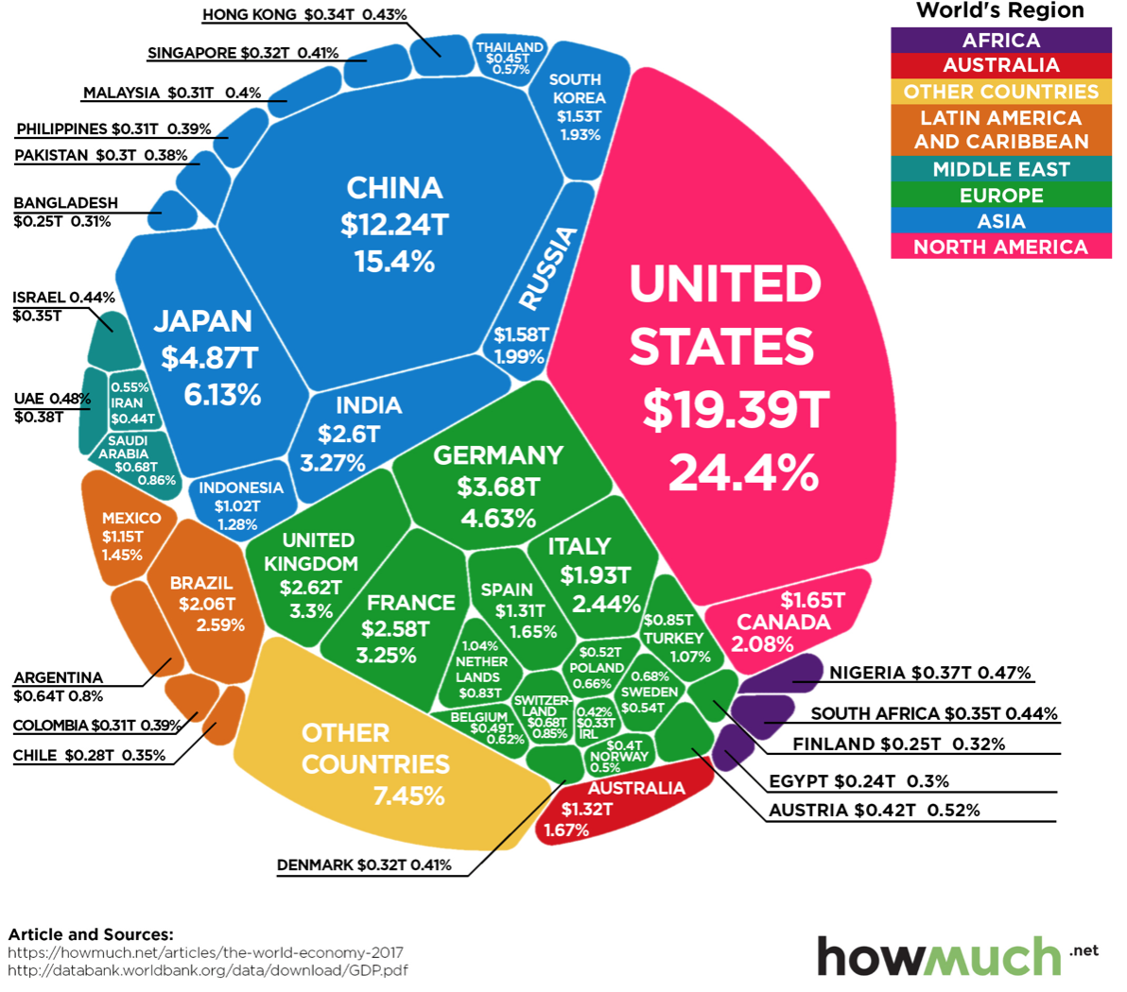
U.S. Economy in Global Perspective
U.S. Nominal GDP:
$21.538 trillion in 2019-Q4
$19.637 trillion in 2020-Q2
$26.132 trillion in 2022-Q3
Notes:
https://www.investopedia.com/insights/worlds-top-economies/#countries-by-gdp

Slide 10
Composition of the U.S. Economy: 2021

Slide 11
Composition of the U.S. Economy: Employment
Manufacturing
GDP Share = 10.7%
Health GDP Share = 7.4%
Note: Does not add to 100% because of omitted sectors.

Slide 12
Economic Indicators

Slide 13
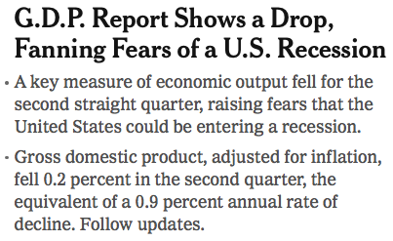
Headline: July 28, 2022

Slide 14
GDP: Quarterly Growth
Notes:
Graph: gdp_pot_grow.png
The Point: From 1990 – 2007, average annual US GDP growth pre-crisis is 2.94%. However, post-crisis US GDP growth is 2.19% (0.75 percentage points lower). Why is has the recovery been sluggish?
Note: At the recession’s height, the gap between quarterly GDP growth and potential growth was 2.5 percentage points.

Slide 15
GDP Trajectory: Pandemic Plunge!
GDP is:
$0.3 Trillion below 2019 forecast.
$1.2 Trillion ABOVE 2019-Q4 level.

Slide 16
Recession? Two Quarters….
Depends on what is driving the drop.
Inventories
Housing
Government spending
Consumer spending is still ok.
Employment growth is solid.
Other indicators are still ok, but perhaps faltering.

Slide 17
Contribution to GDP Growth: Consumption
Notes:
Average GDP growth from 1990-2007 is 2.99% and from 2010+ is 2.19%
Average Consumption contribution from 1990-2007 is 2.16 percentage points and from 2010+ is 1.67 percentage points

Slide 18
Personal Consumption Expenditures
Trouble?
Notes:
Chart: ../Charts/personalconsumption_recession.png
Real consumption remains significantly lower than trend consumption since 2008 (actual is 89% of trend).
Since the recession, consumption growth has fallen. From 1990-2007, average annual consumption growth is 3.34%; Post-recession average annual consumption growth is 2.38%.

Slide 19
Retail Sales Fell in December

Slide 20
But SUPER High to Begin With!

Slide 21
Contributions to GDP: Government
Notes:
Since 2010, average government spending growth is shrinking, resulting in a negative average contribution to GDP growth post-recession of -0.8 percentage points
Note that average quarterly government spending growth is 0.42% from 1990-2007 and -0.17% in 2010+ (annualized, 1990-2007 = 1.68%; 2010+ = -0.70%).

Slide 22
Industrial Production (Manuf, Util, Mining)

Slide 23
Employment

Slide 24
Monthly Changes in Nonfarm Employment
Notes:
PAYEMS.png

Slide 25
Monthly Changes in Nonfarm Employment
December: 260,000
January: 517,000
Notes:
PAYEMS.png

Slide 26
Job Openings: Share of Total Employment
Notes:
During expansions, job openings rise.
Reinforces previous slide demonstrating higher separation and hiring rates during expansions

Slide 27
Employment Gap
2.6 Million ABOVE February, 2020.
5.1 Million BELOW where we should be.
Notes:
payroll_recent.png

Slide 28
Where Have All the Workers Gone?
3.3 million below where we should be

Slide 29
Some Explanations
500 Thousand: Long COVID Exits
1-2%: Long Social Distancing

Slide 30
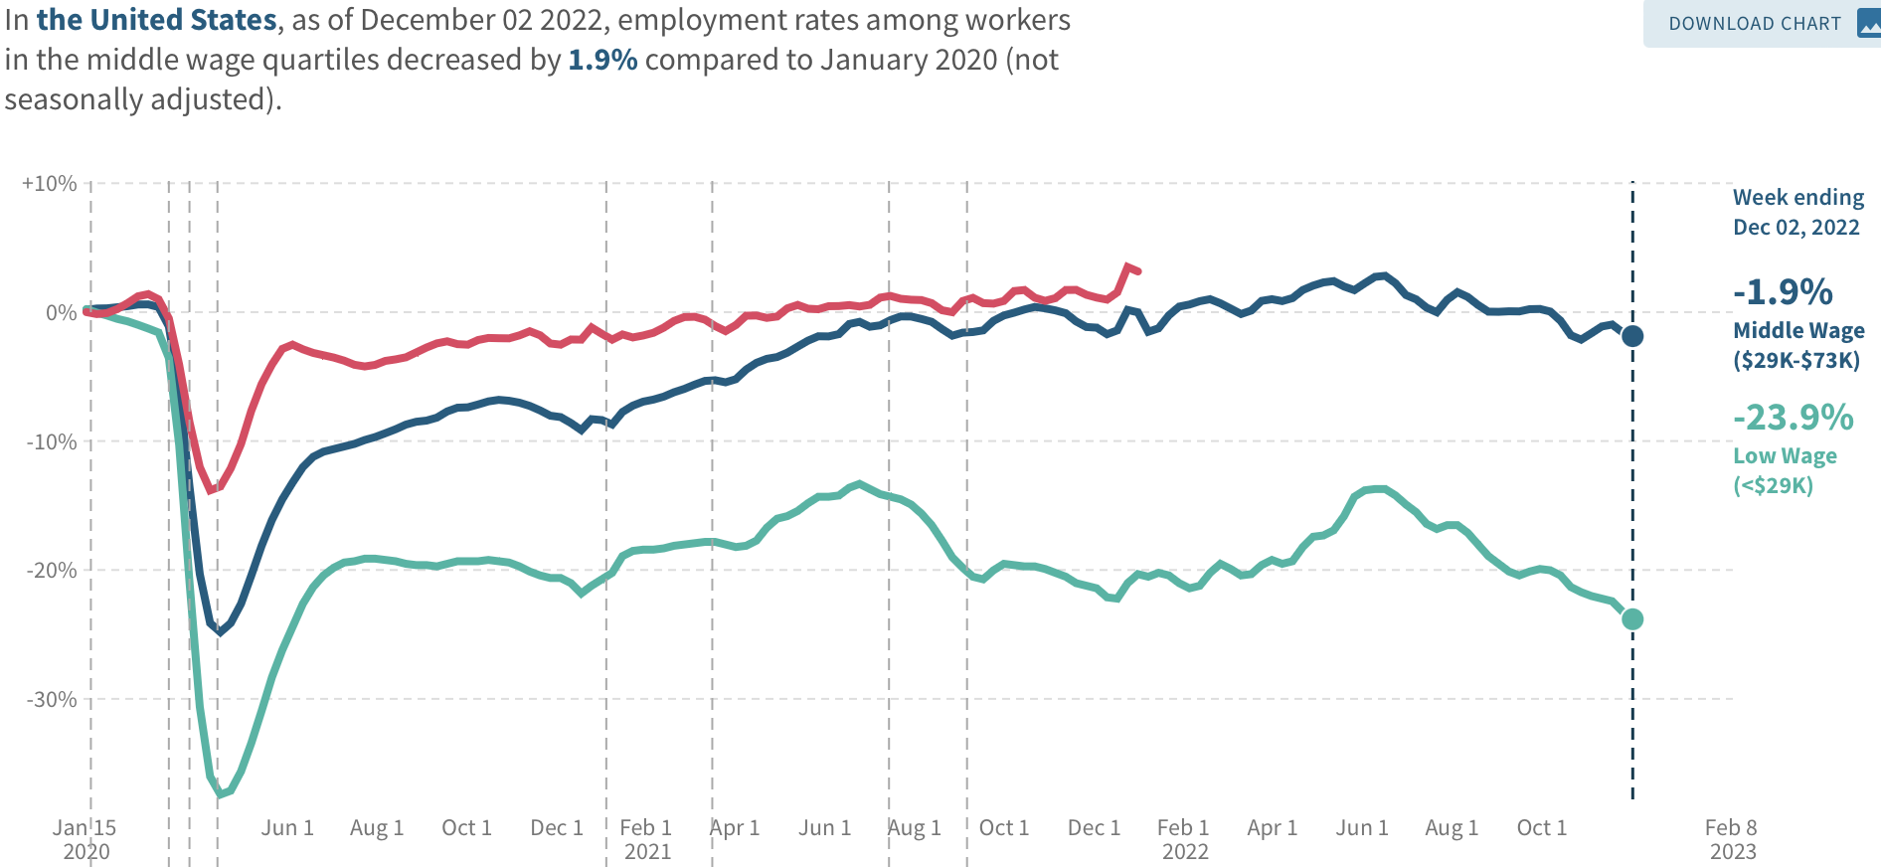
Low Wage Employment is Lagging
Source: https://tracktherecovery.org

Slide 31
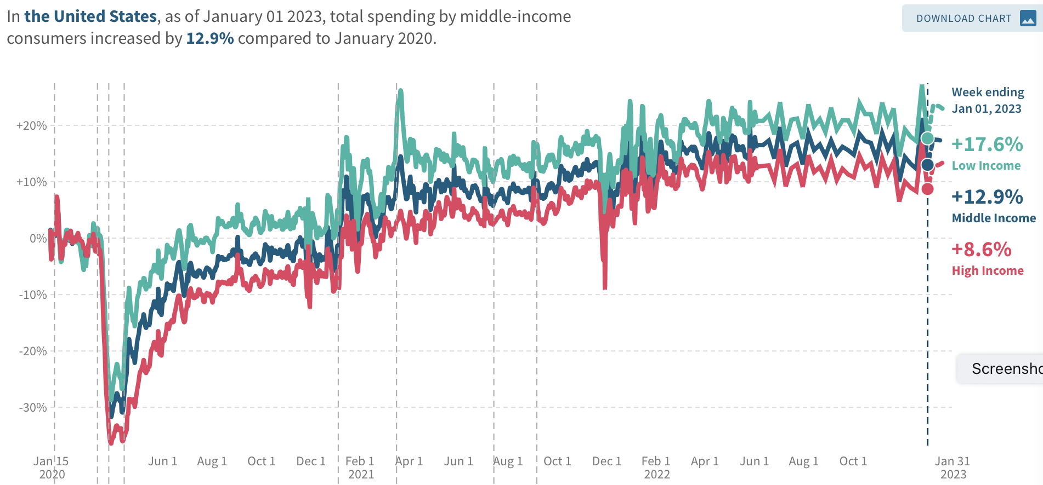
Low Wage Spending is NOT!
Source: https://tracktherecovery.org

Slide 32
Nor is Borrowing on Credit
Notes:
Data/National/FederalReserve/Credit/Programs/rev.png

Slide 33
Wage Growth
Notes:
Is this necessary given the previous slide?

Slide 34
How Are Things Where You Are?

Slide 35
Inflation

Slide 36
Inflation: Latest Figures

Slide 37
How Elevated Are Prices?

Slide 38
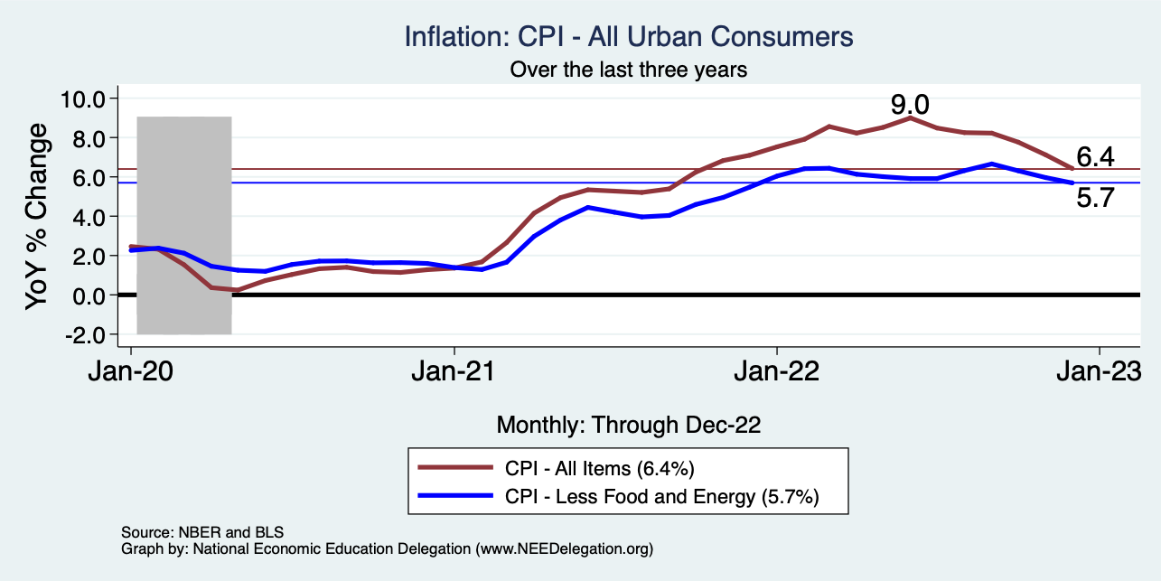
Inflation – Falling! Job done? Maybe.
Notes:
Cpi_recent.png

Slide 39
Inflation in the Last 6 Months – On Target!
Source: https://www.nytimes.com/2023/01/13/opinion/cpi-inflation-fed.html

Slide 40
Which Prices?
Food
Oct-Nov: +0.10
Nov-Dec: -0.08
Food
Gas

Slide 41
Gas Prices: National Average at the Pump
Why rising?
Refinery outages.
No more from strategic oil reserves.

Slide 42
Inflation: Not just a US Problem
United States: 8.5
Netherlands: 12.0
Spain: 10.4
United Kingdom: 10.1
Denmark: 8.9
Sweden: 8.5
Germany: 7.9
Norway: 6.5
France: 5.8
Source: TradingEconomics.com, 9/12/22

Slide 43
Supply Chains

Slide 44
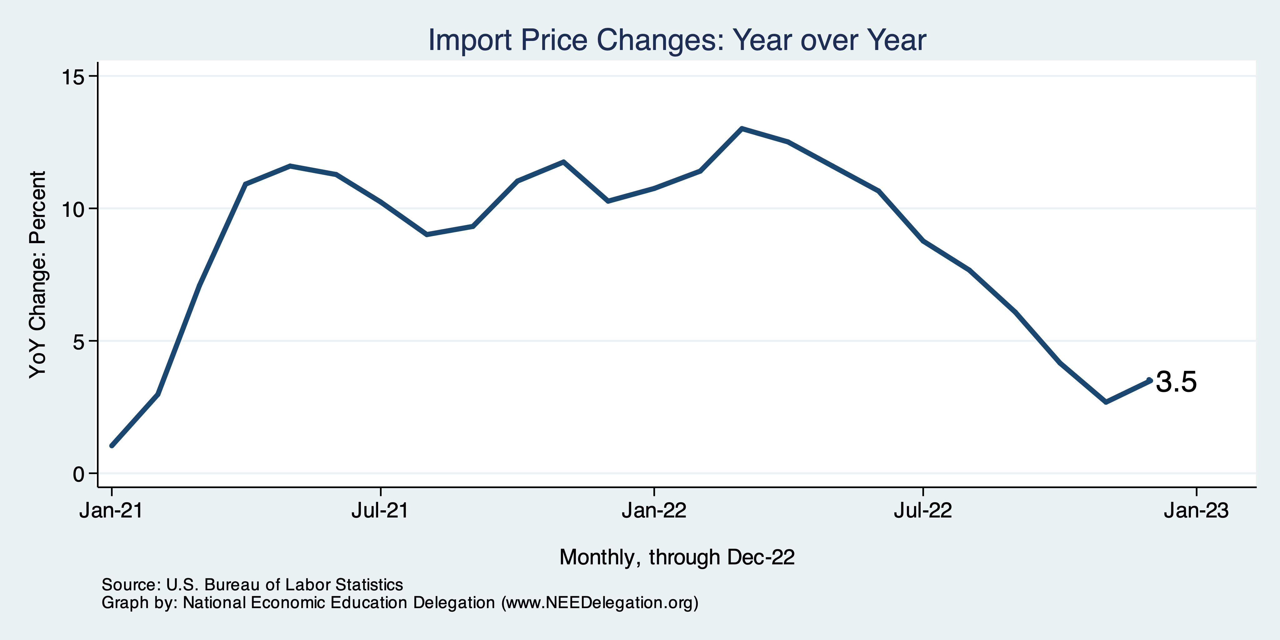
Import Prices Are Elevated
Inflation – Imported Products: 9-10%

Slide 45
Spending Patterns Changed - More Goods!
Goods spending up 14.2%
- And stable.
Services spending up 3.5%
- And going up.

Slide 46
Corporations Have Pricing Power!
Corporate Profits

Slide 47
My Thoughts on the Sources of Inflation
Supply Chain issues were significant – less so now.
Composition of spending changed significantly.
Is now bouncing back, as are prices.
Corporations have used the cover of inflation to raise prices more.
But there was too much total spending.
Fiscal stimulus led households to increase saving over 2021 by more than $2 trillion. Strong retail sales numbers suggest they are prepared to spend it.
Whose to Blame: ARP probably too big, but the Fed could have acted sooner.
Bottom line: Recovery from a dramatic economic disruption is seldom painless.

Slide 48
What’s the Fed Doing About It?

Slide 49
Federal Funds Rate – Recent Activity
Expect 2 more increases: .25, each.

Slide 50
Fed: Also Reducing its Asset Holdings
Reducing the Money Supply – A Little
Jun-Aug: $47.5 billion roll off its portfolio every 30 days
Sep: $85 billion.
Quantitative Tightening

Slide 51
Implications for Demand
Investment borrowing
Home loans – tied to 10-year Treasury
Car loans
Credit cards
Savings accounts – positive
And more….
All of which slows the economy.

Slide 52
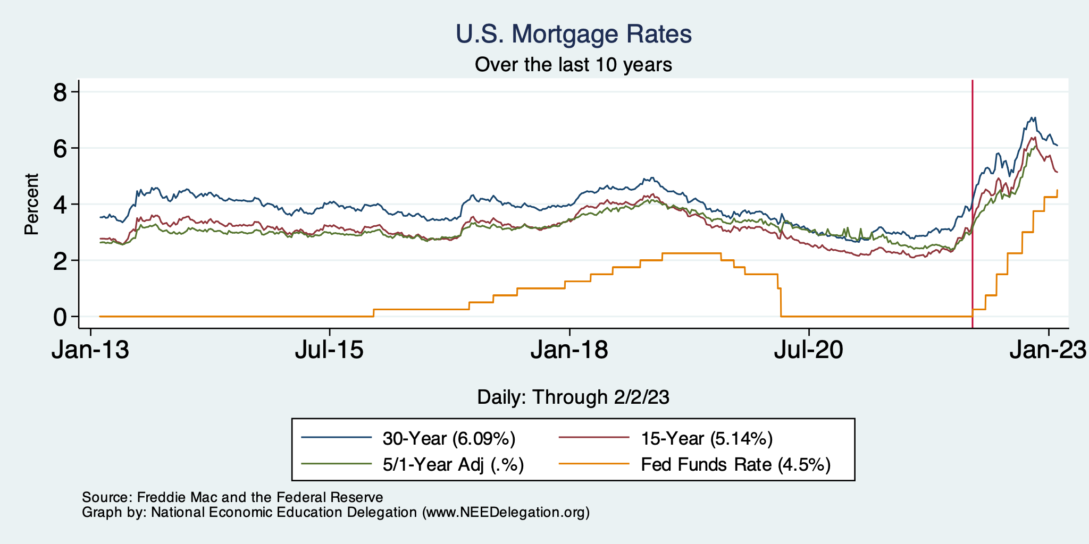
Mortgage Rates

Slide 53
Home Sales Falling

Slide 54
Contributions to GDP: Residential Investment
Notes:
Contribution of residential investment to GDP growth has risen post-2009

Slide 55
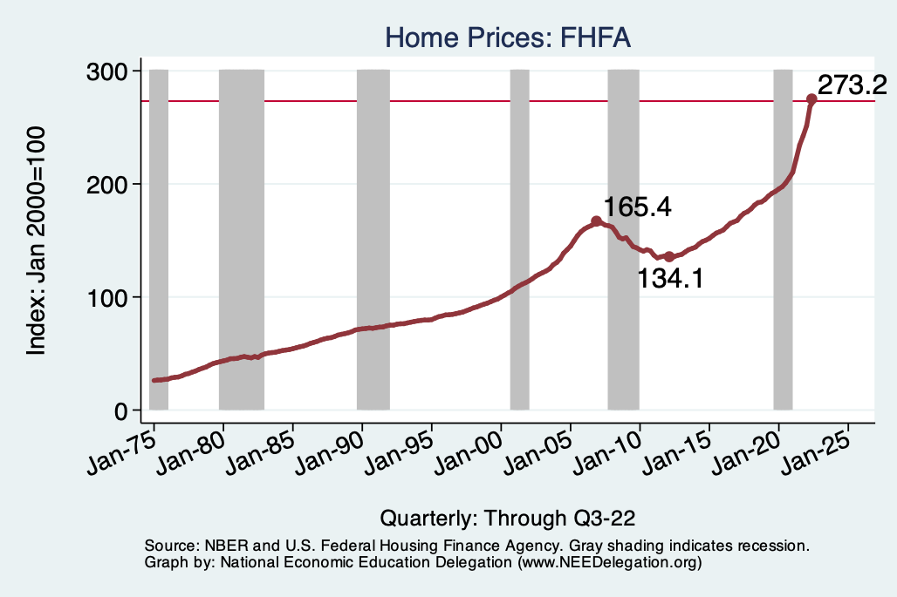
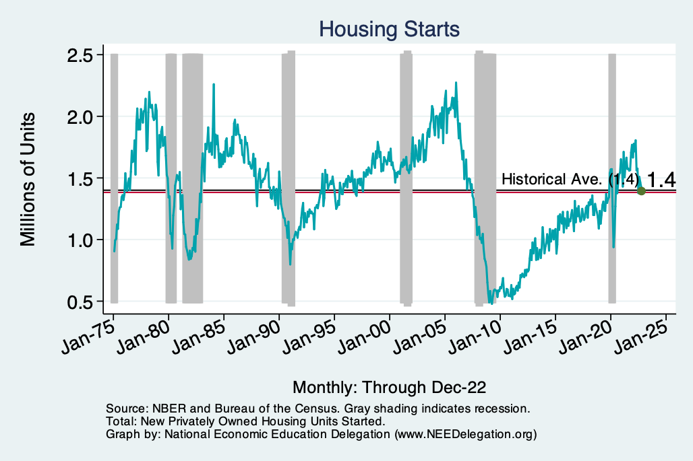
Home Prices and Housing Starts
Notes:
Charts:
homeprices_recession.png
housing.png

Slide 56
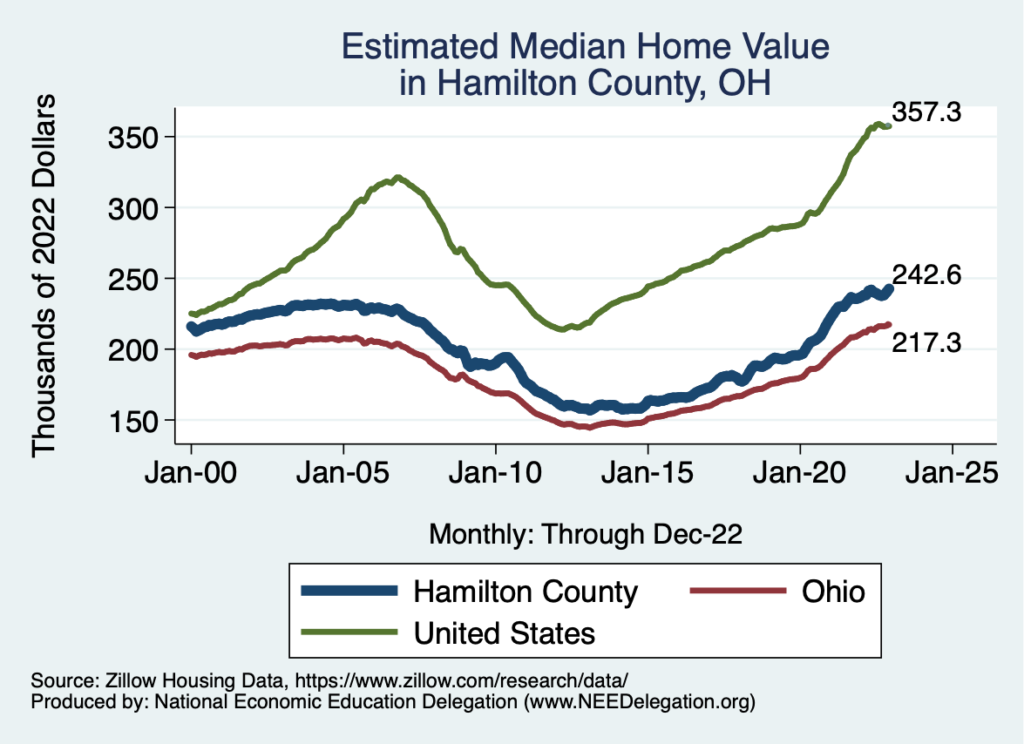
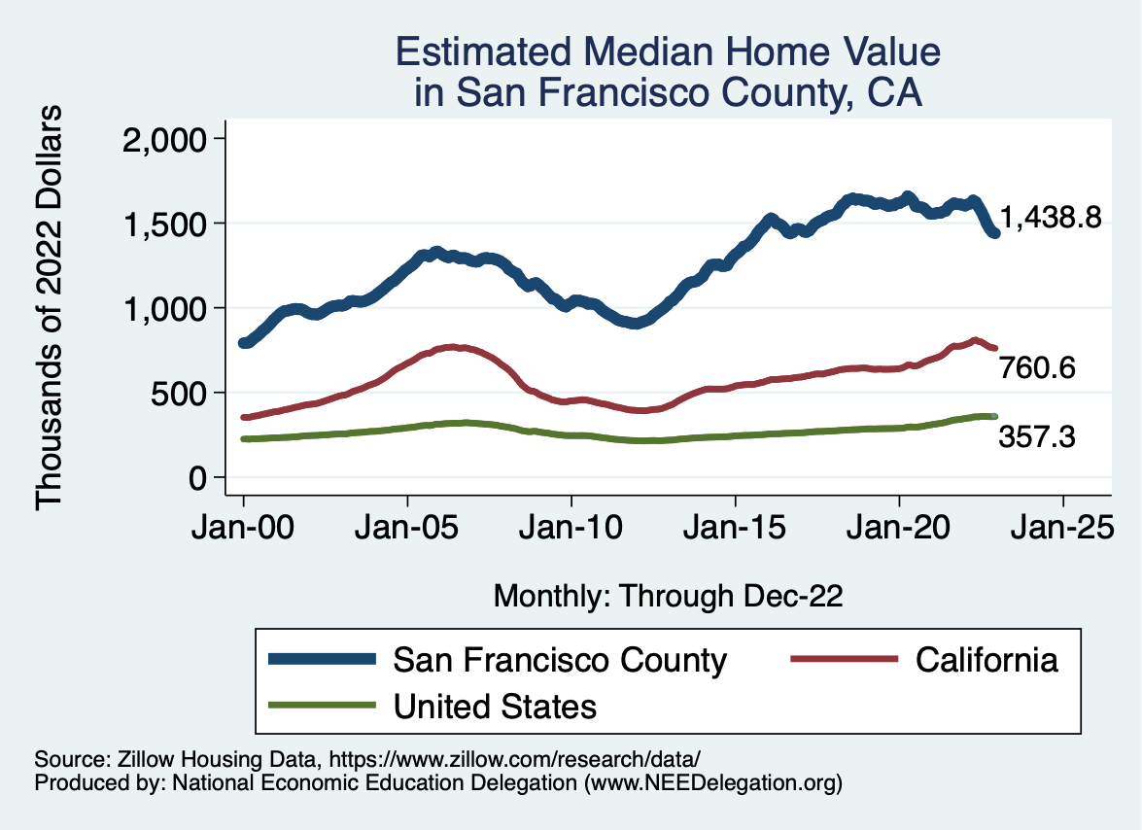
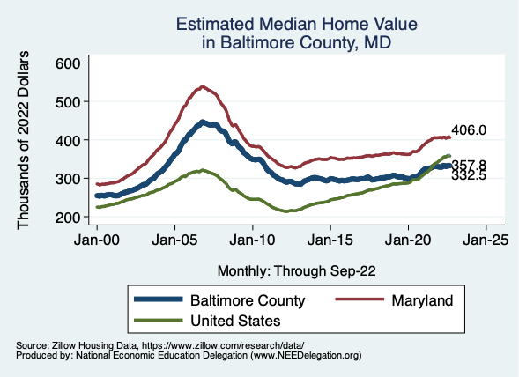
Home Prices … Depends on Where You Are
Notes:
Charts:
homeprices_recession.png
housing.png

Slide 57
Existential Threat: Coming This June!

Slide 58
5 Things to Know about the Debt Ceiling
The debt limit has been raised continually for more than a century.
Raising the debt limit is not about new spending; it is about paying for previous choices policymakers legislated.
The uselessness of a debt limit is exhibited by the fact that only one other advanced country—Denmark—has a separate debt limit rule like ours.
If debt hits the ceiling, the Treasury Department uses several accounting gimmicks to postpone the day of reckoning, but these typically last only a few months.
The economic consequences of a large-scale, intentional default are unknown, but predictions range from bad to catastrophic.
Souce: https://www.brookings.edu/2023/01/19/7-things-to-know-about-the-debt-limit/

Slide 59
Lessons from 2011
Government shutdown was very costly:
Stock markets plunged (17%).
Employment growth stuttered.
Treasuries – downgraded credit ratings.
Borrowing costs rose.
The Debt Ceiling may be a very effective bargaining tool, but…
It is costly.
It is unnecessary.
Accidental partial default in 1979:
increased borrowing costs by $40 Billion!

Slide 60
Takeaways
Is a recession on the horizon?
Perhaps, but no reason to think that it will be anything more than shallow.
Many indicators are still in the black.
2022-Q4 GDP growth was pretty good!
Threats to continued growth:
If inflation stays high, which seems unlikely.
Layoff contagion? Looks unlikely.
Debt ceiling negotiations
Significant cuts to government budgets may well result.

Slide 61
The B-W Wealth Gap: Mike Shor
Mean is
7x Greater
Median is 8x Greater

Slide 62
Thank you!
Any Questions?
www.NEEDelegation.org
Jon D. Haveman
Jon@NEEDelegation.org
Contact NEED: info@NEEDelegation.org
Submit a testimonial: www.NEEDelegation.org/testimonials.php
Become a Friend of NEED: www.NEEDelegation.org/friend.php

Slide 63
www.NEEDelegation.org/LocalGraphs
For every state and county in the United States.
Detailed graphs on employment, housing, moves, and other statistics.

