Slide 1
Osher Lifelong Learning Institute, Summer 2024
Contemporary Economic Policy
OLLI – University of California
June, 2024
Jon Haveman, Ph.D.
National Economic Education Delegation

Slide 2
National Economic Education Delegation
Vision
  One day, the public discussion of policy issues will be grounded in an accurate perception of the underlying economic principles and data.
Mission
  NEED unites the skills and knowledge of a vast network of professional economists to promote understanding of the economics of policy issues in the United States.
NEED Presentations
  Are nonpartisan and intended to reflect the consensus of the economics profession.

Slide 3
Who Are We?
Honorary Board: 54 members
  2 Fed Chairs: Janet Yellen, Ben Bernanke
  6 Chairs Council of Economic Advisers
    Furman (D), Rosen (R), Bernanke (R), Yellen (D), Tyson (D), Goolsbee (D)
  4 Nobel Prize Winners
    Akerlof, Smith, Maskin, Bernanke
Delegates: 652+ members
  At all levels of academia and some in government service
  All have a Ph.D. in economics
  Crowdsource slide decks
  Give presentations
Global Partners: 48 Ph.D. Economists
  Aid in slide deck development

Slide 4


Where Are We?

Slide 5
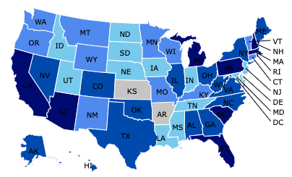
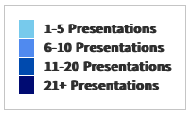
Where Have We Presented? (1,150 Talks)

Slide 6
Available NEED Topics Include:
US Economy
Healthcare Economics
Climate Change
Economic Inequality
Economic Mobility
Trade and Globalization
Minimum Wages
Immigration Economics
Housing Policy
Federal Budgets
Federal Debt
Black-White Wealth Gap
Autonomous Vehicles
Healthcare Economics

Slide 7
Course Outline
Contemporary Economic Policy
  Week 1 (6/4): US Economic Update (Jon Haveman, NEED)
  Week 2 (6/11): Economics of Immigration
  Week 3 (6/18): Federal Debt
  Week 4 (6/25): Taxes: Rebellion, Rascals, and Revenue

Slide 8
US Economic Update
OLLI – University of California
June 4, 2024
Jon Haveman, Ph.D.
NEED

Slide 9
Credits and Disclaimer
This slide deck was authored by:
  Jon D. Haveman, NEED
  Scott Baier, Clemson University
  Geoffrey Woglom, Amherst College (Emeritus)
  Brian Dombeck, Lewis & Clark College
  Doris Geide-Stevenson, Weber State
Disclaimer
  NEED presentations are designed to be nonpartisan.
  It is, however, inevitable that the presenter will be asked for and will provide their own views.
  Such views are those of the presenter and not necessarily those of the National Economic Education Delegation (NEED).

Slide 10
Outline
About the U.S. Economy
Economic Indicators
Inflation/Federal Reserve

Slide 11
The U.S. Economy

Slide 12
Some Basic Statistics, April 2024
Statistic: | Value
Population | 336.5 Million
Labor Force | 168.0 Million
Employment | 161.5 Million
Gross Domestic Product (GDP) | $28.3 Trillion
Income per Capita | $70,328
Ave. Hourly Earnings | $34.75
Source: fred.stlouisfed.org

Slide 13
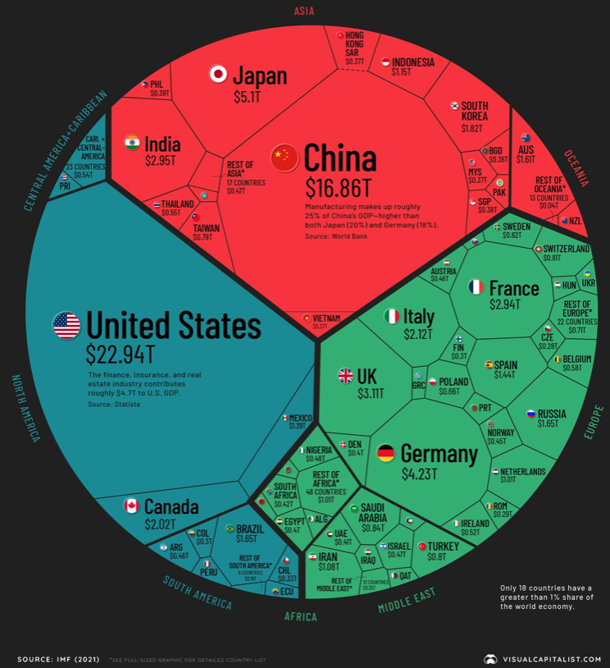
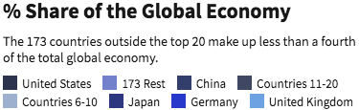
U.S. Economy in Global Perspective
U.S. Nominal GDP:
$21.5 trillion in 2019-Q4
$19.6 trillion in 2020-Q2
$28.3 trillion in 2024-Q1
Notes:
https://www.investopedia.com/insights/worlds-top-economies/#countries-by-gdp

Slide 14
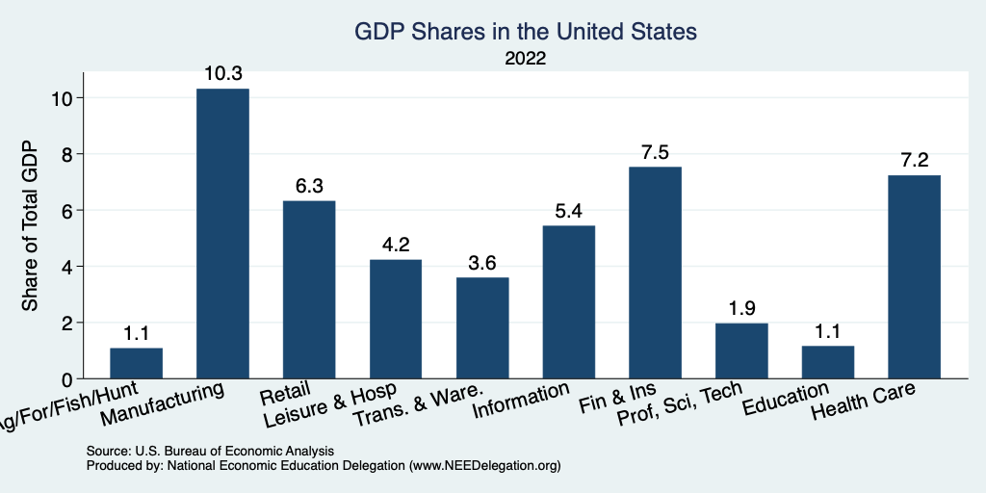
Composition of the U.S. Economy: GDP

Slide 15
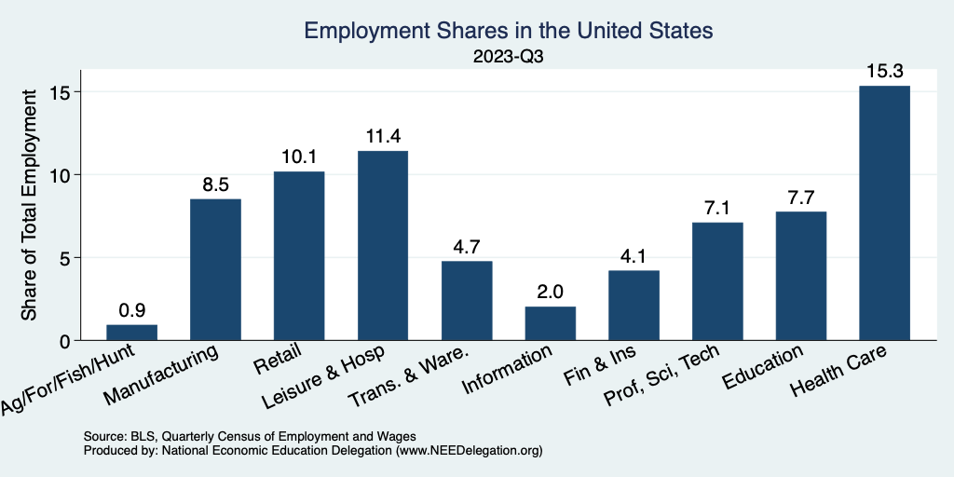
Composition of the U.S. Economy: Employment
Manufacturing
GDP Share = 10.3%
Health GDP Share = 7.2%
Note: Does not add to 100% because of omitted sectors.

Slide 16
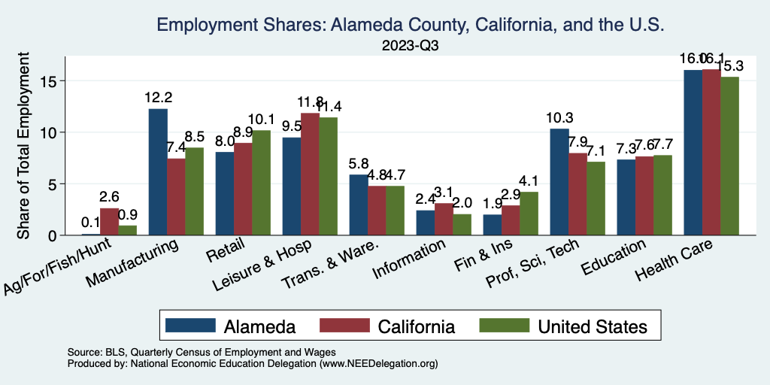
Alameda County Economy: Employment
Note: Does not add to 100% because of omitted sectors.

Slide 17
More Local Charts
www.NEEDEcon.org/LocalGraphs

Slide 18
Economic Indicators

Slide 19
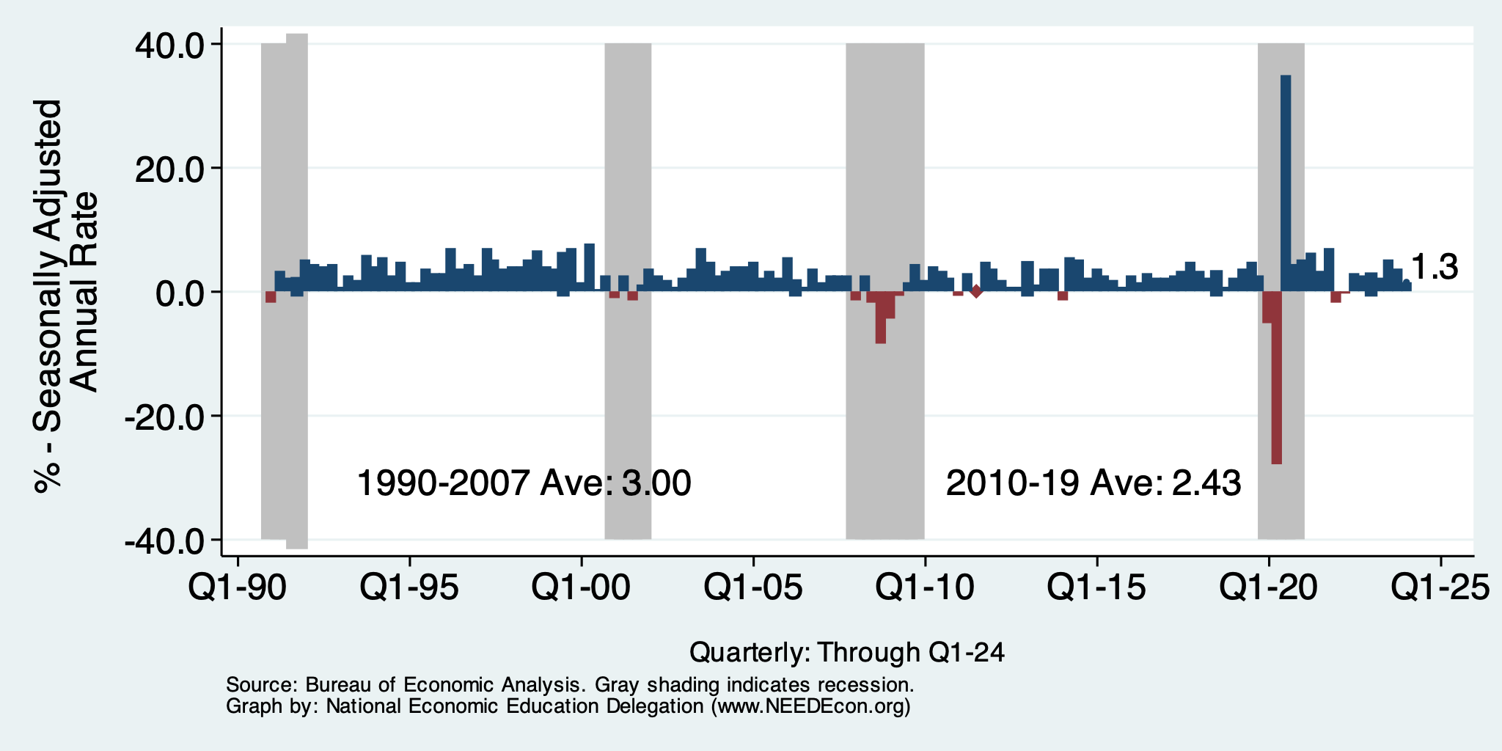
GDP: Quarterly Growth
Q2-2023: 2.1%
Q3-2023: 4.9%
Q4-2023: 3.4%
Q1-2024: 1.3%
Notes:
Graph: gdp_pot_grow.png
The Point: From 1990 – 2007, average annual US GDP growth pre-crisis is 2.94%. However, post-crisis US GDP growth is 2.19% (0.75 percentage points lower). Why is has the recovery been sluggish?
Note: At the recession’s height, the gap between quarterly GDP growth and potential growth was 2.5 percentage points.

Slide 20
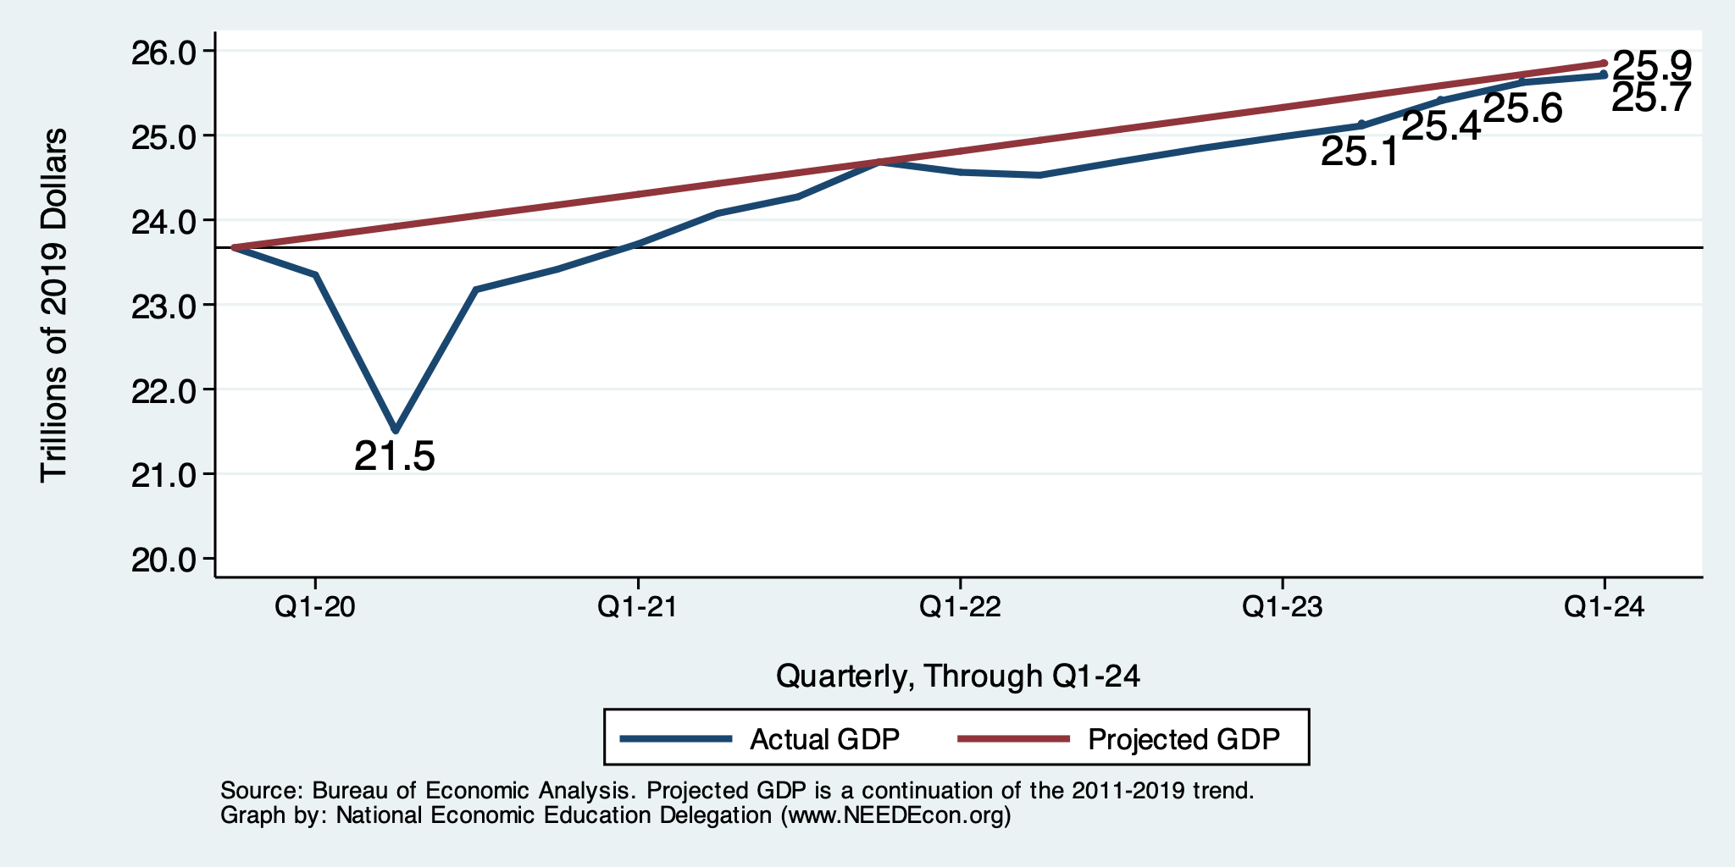
GDP Trajectory: Pandemic Plunge!
GDP is:
$0.2 Trillion below 2019 forecast.
$1.9 Trillion ABOVE 2019-Q4 level.

Slide 21
“Accounting” for GDP
Expenditures drive GDP growth.
  GDP is the sum of four categories of spending:
    Consumption
    Investment
      Plant and equipment, software, residential real estate, and inventories.
    Government spending
    Net Exports: Exports – Imports
      Imports are subtracted to make the accounting work.
      It is not be cause imports are a bad thing.
GDP = Consumption + Investment + Government + Net Exports
Notes:
Recall: GDP is measures production of an economy; we often measure GDP as the sum of spending on final goods/services produced within an economy. The first three categories (C,I,G) contain spending on both domestically and foreign produced goods. To accurately measure domestic production, we subtract domestic consumption of foreign goods (imports).
The Point: Analysis of components of GDP as well as the production side of the economy should provide a comprehensive picture of the US economic landscape

Slide 22
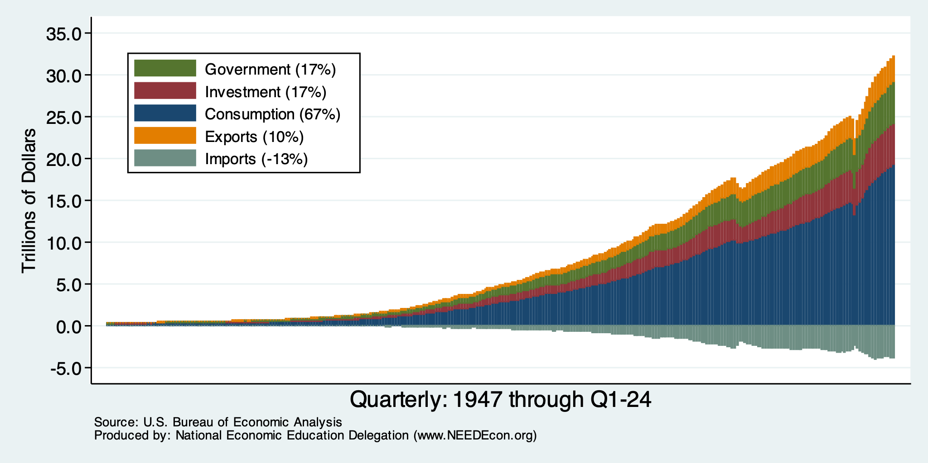
Composition of GDP
Notes:
Components sum to GDP
Average % of GDP for each component from 1960-Present: C = 64%, I=15%, G=24%, NX = 2% (X = 7%, M=9%)
Net Exports as a % of GDP has increased over the sample period, but it’s contribution to GDP is relatively small

Slide 23
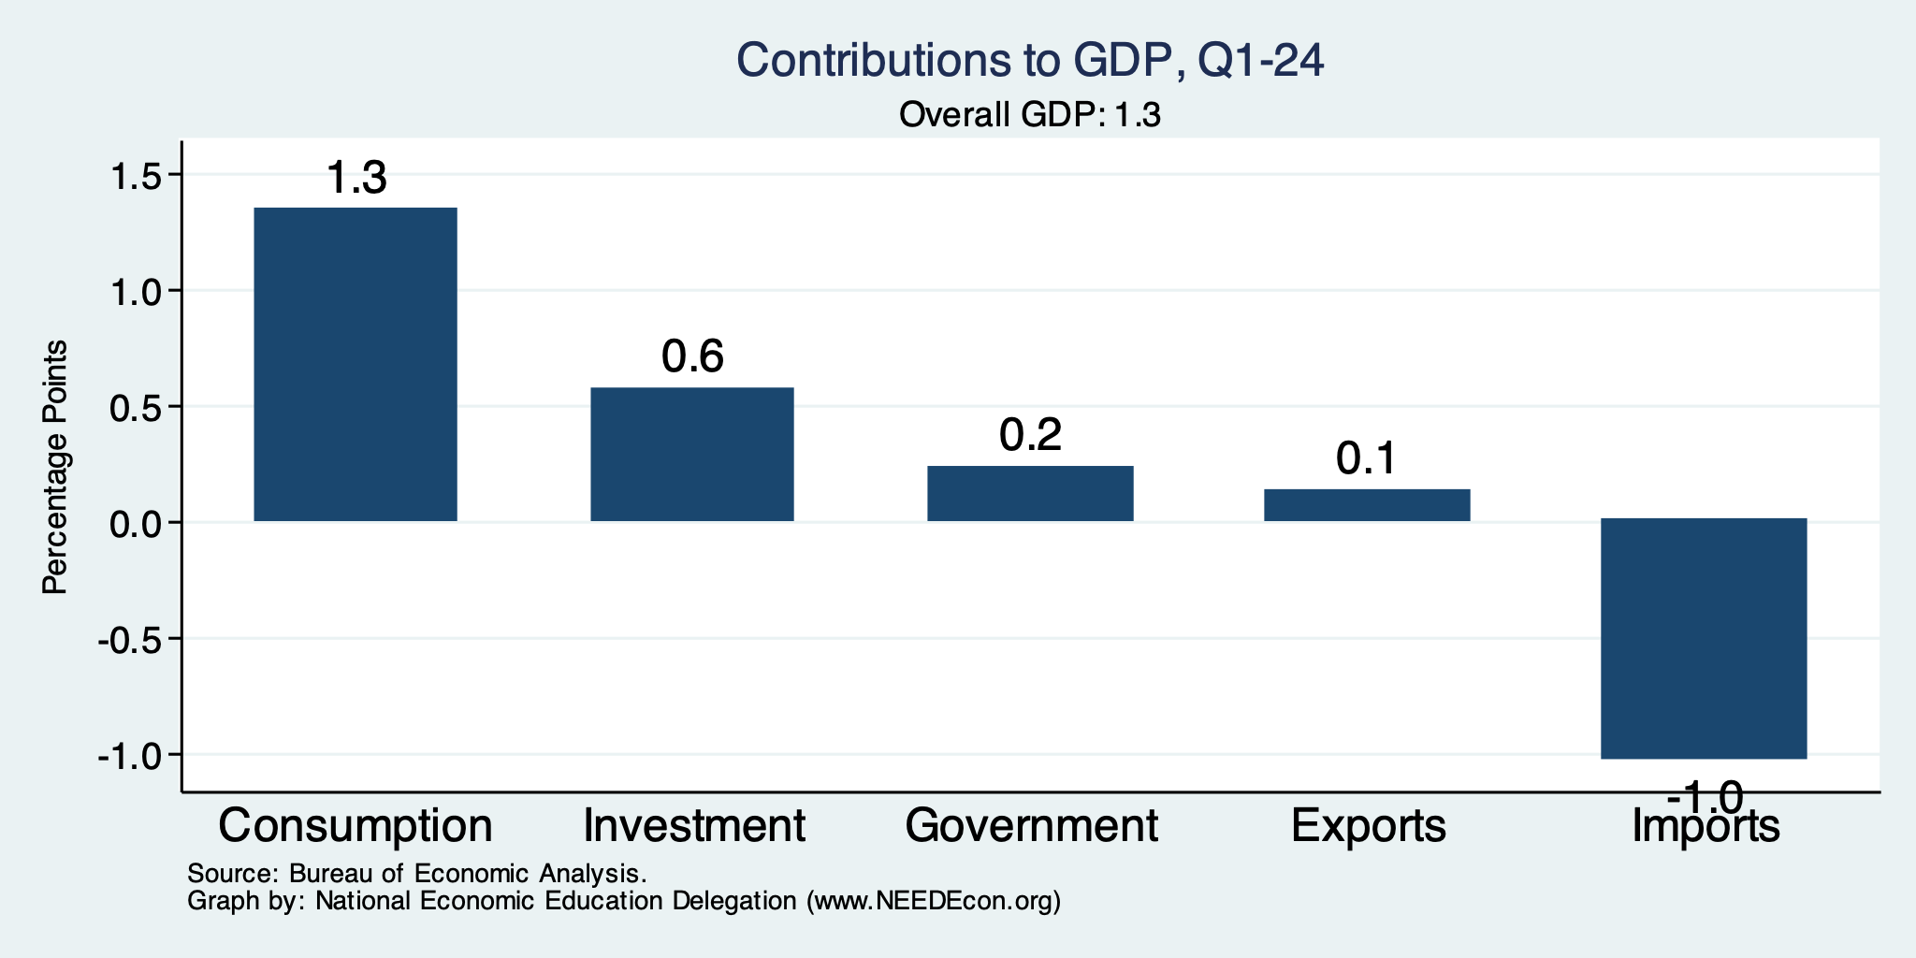
What Have You Done For Me Lately?

Slide 24
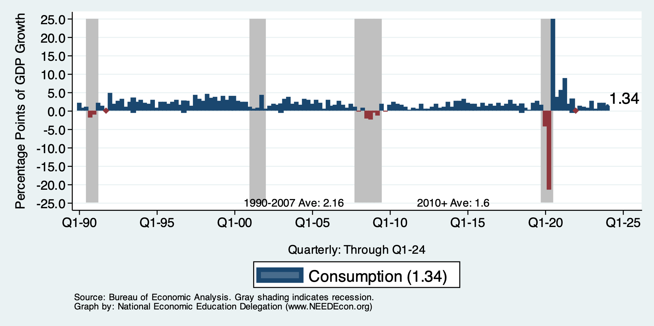
Contribution to GDP Growth: Consumption
Notes:
Average GDP growth from 1990-2007 is 2.99% and from 2010+ is 2.19%
Average Consumption contribution from 1990-2007 is 2.16 percentage points and from 2010+ is 1.67 percentage points

Slide 25
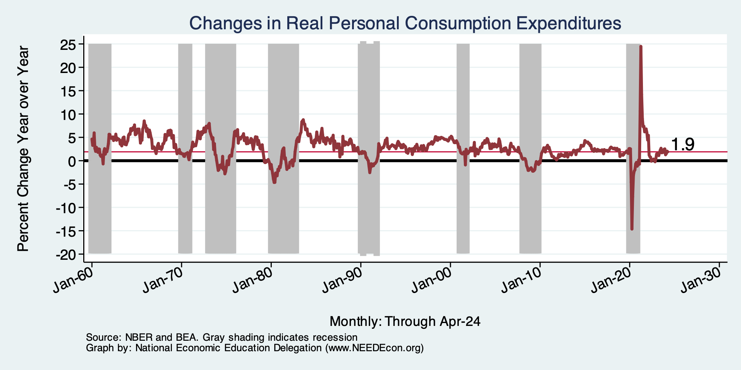
Personal Consumption Expenditures
Notes:
Chart: ../Charts/personalconsumption_recession.png
Real consumption remains significantly lower than trend consumption since 2008 (actual is 89% of trend).
Since the recession, consumption growth has fallen. From 1990-2007, average annual consumption growth is 3.34%; Post-recession average annual consumption growth is 2.38%.

Slide 26
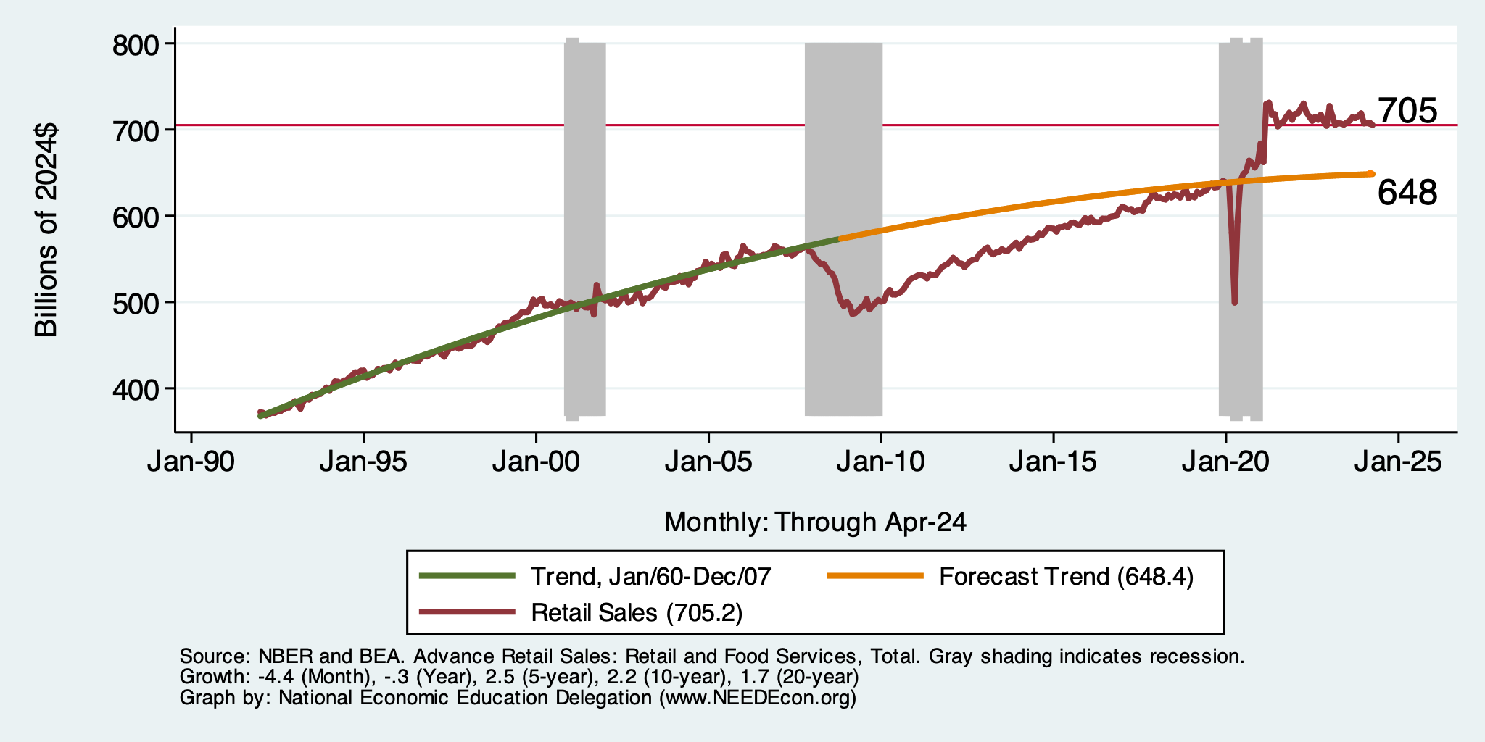
Retail Sales Remain Elevated!

Slide 27
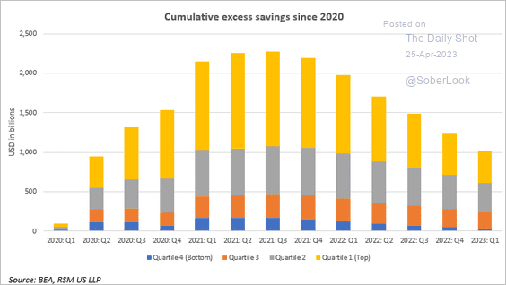
Policy Effects: Fiscal
2020-2021: massive stimulus, $4.6t: Cares Act, 3 rounds of stimulus checks, expanded unemployment benefits, Payroll Protection Loans.

Slide 28
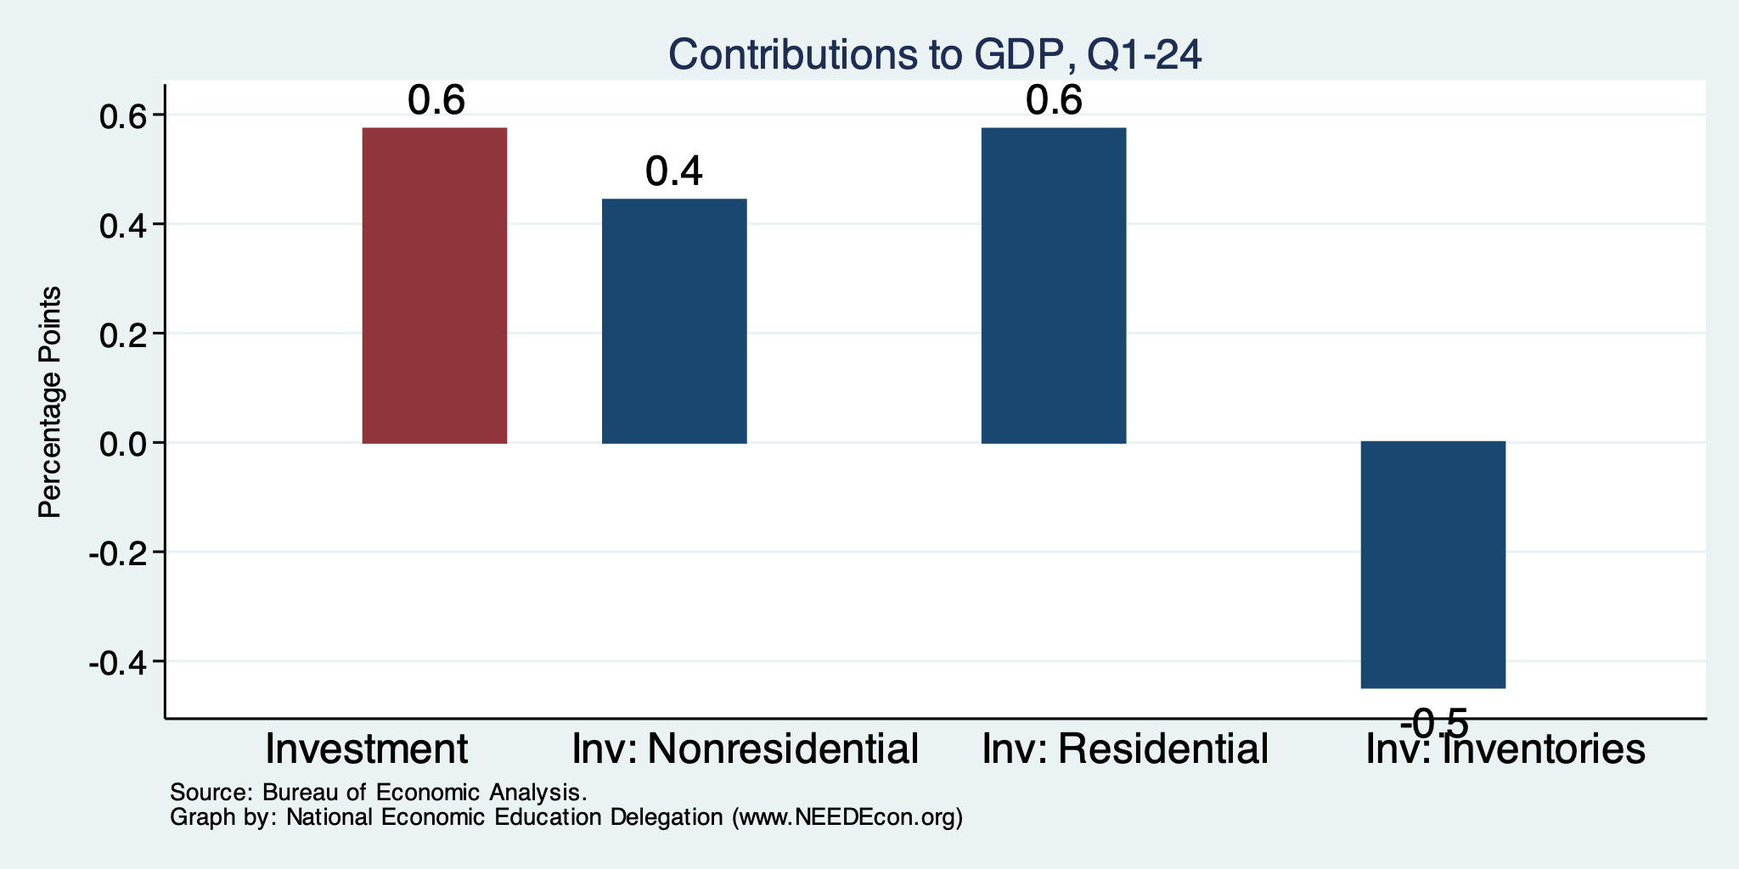
Contributions to GDP: Investment Components
Notes:
Contribution of residential investment to GDP growth has risen post-2009

Slide 29
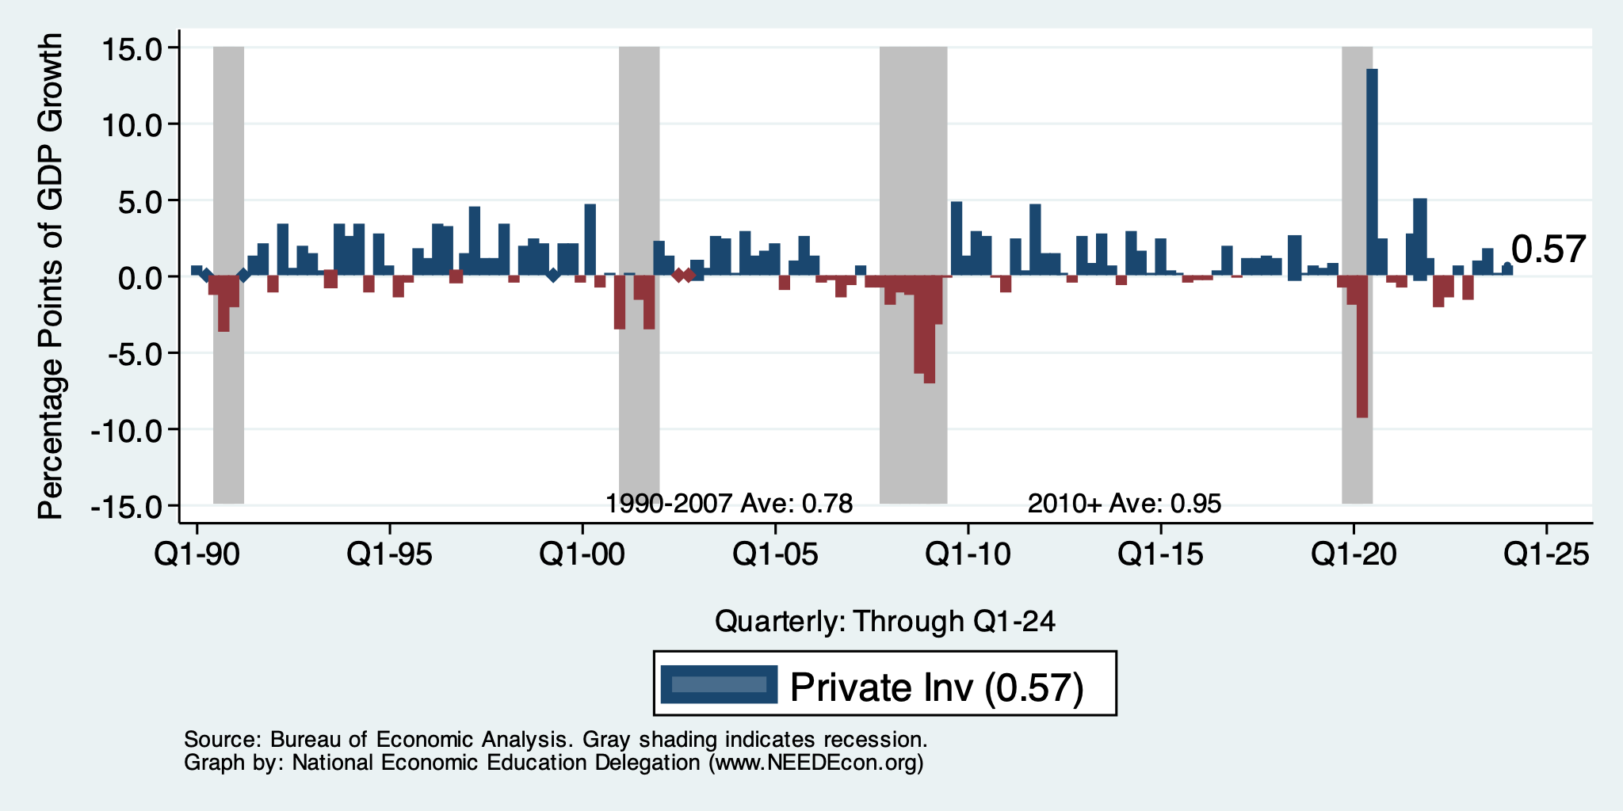
Contribution to GDP Growth: Investment
Notes:
Average GDP growth from 1990-2007 is 2.99% and from 2010+ is 2.19%
Average Consumption contribution from 1990-2007 is 2.16 percentage points and from 2010+ is 1.67 percentage points

Slide 30
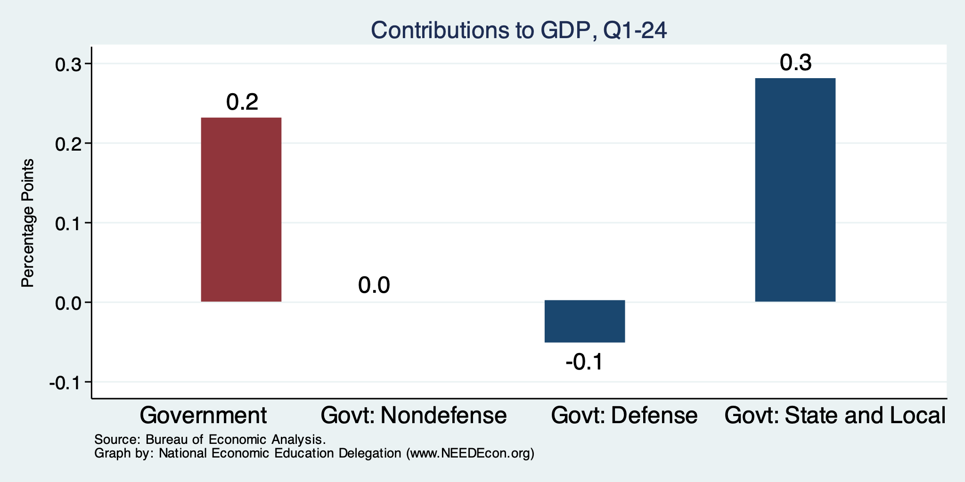
Contributions to GDP: Government
Notes:
Since 2010, average government spending growth is shrinking, resulting in a negative average contribution to GDP growth post-recession of -0.8 percentage points
Note that average quarterly government spending growth is 0.42% from 1990-2007 and -0.17% in 2010+ (annualized, 1990-2007 = 1.68%; 2010+ = -0.70%).

Slide 31
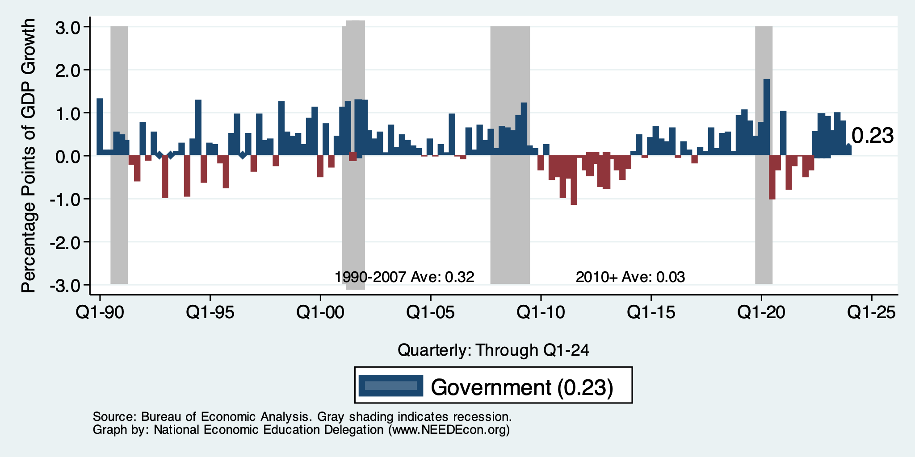
Contributions to GDP: Government
Notes:
Since 2010, average government spending growth is shrinking, resulting in a negative average contribution to GDP growth post-recession of -0.8 percentage points
Note that average quarterly government spending growth is 0.42% from 1990-2007 and -0.17% in 2010+ (annualized, 1990-2007 = 1.68%; 2010+ = -0.70%).

Slide 32
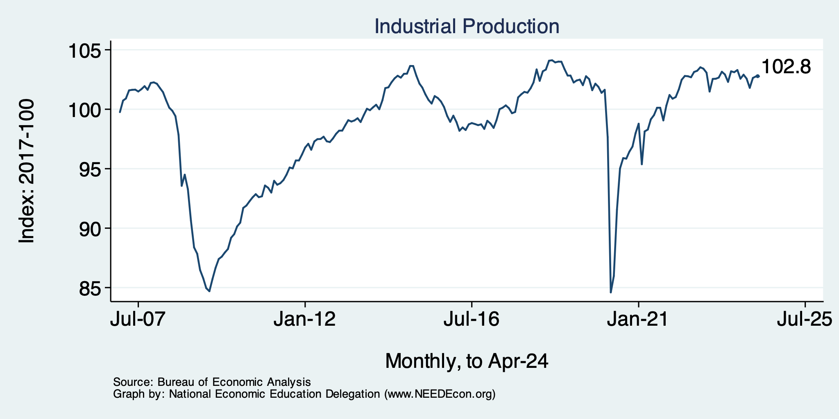
Industrial Production (Manuf, Util, Mining)

Slide 33
Employment

Slide 34
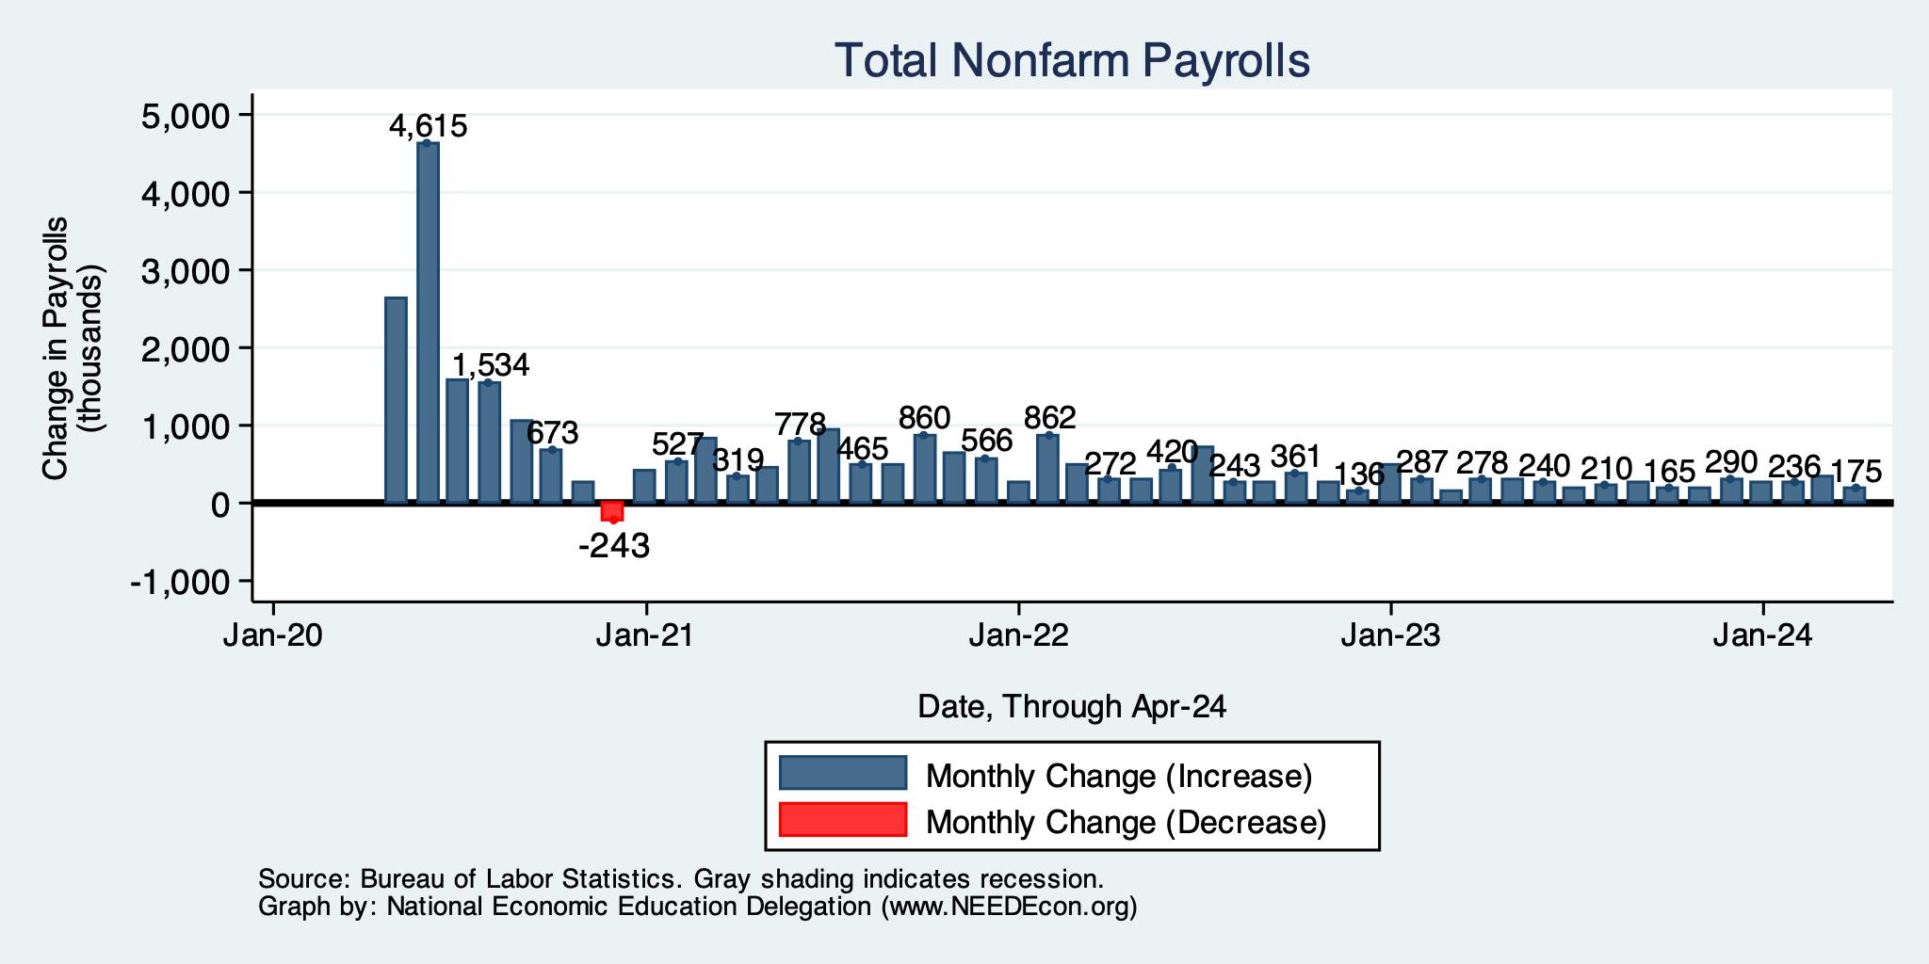
Monthly Changes in Nonfarm Employment
February: 236,000
March: 315,000
April: 175,000
Notes:
PAYEMS.png

Slide 35
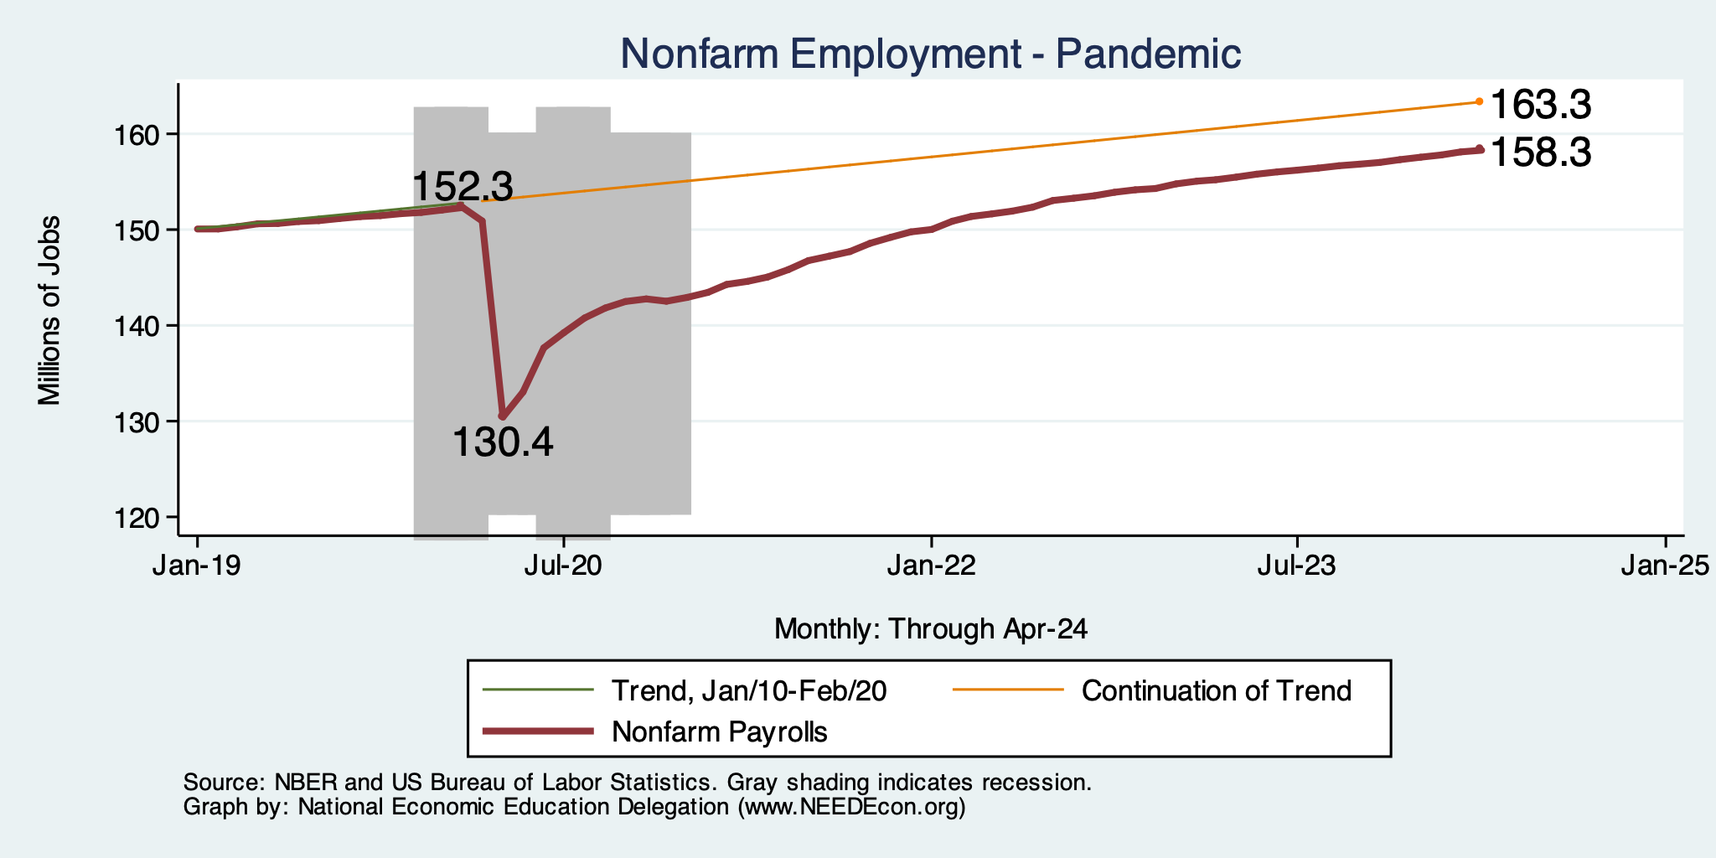
Employment Gap
6.0 Million ABOVE February, 2020.
5.0 Million BELOW where we should be.
Notes:
payroll_recent.png

Slide 36
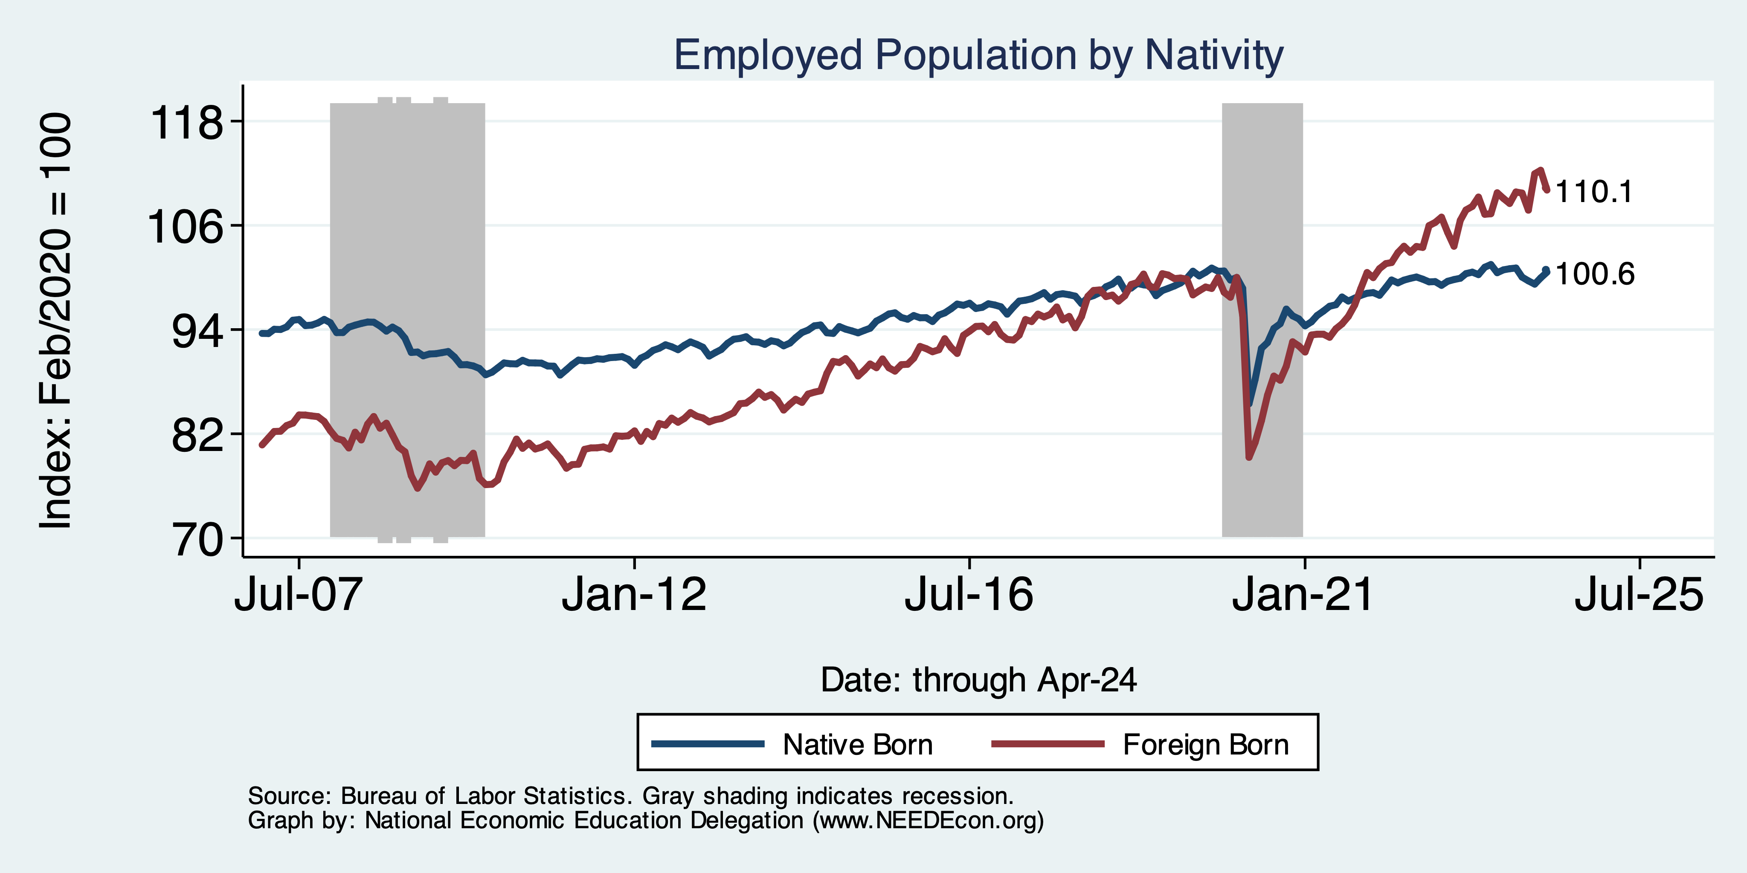
Immigrants to the Rescue?

Slide 37
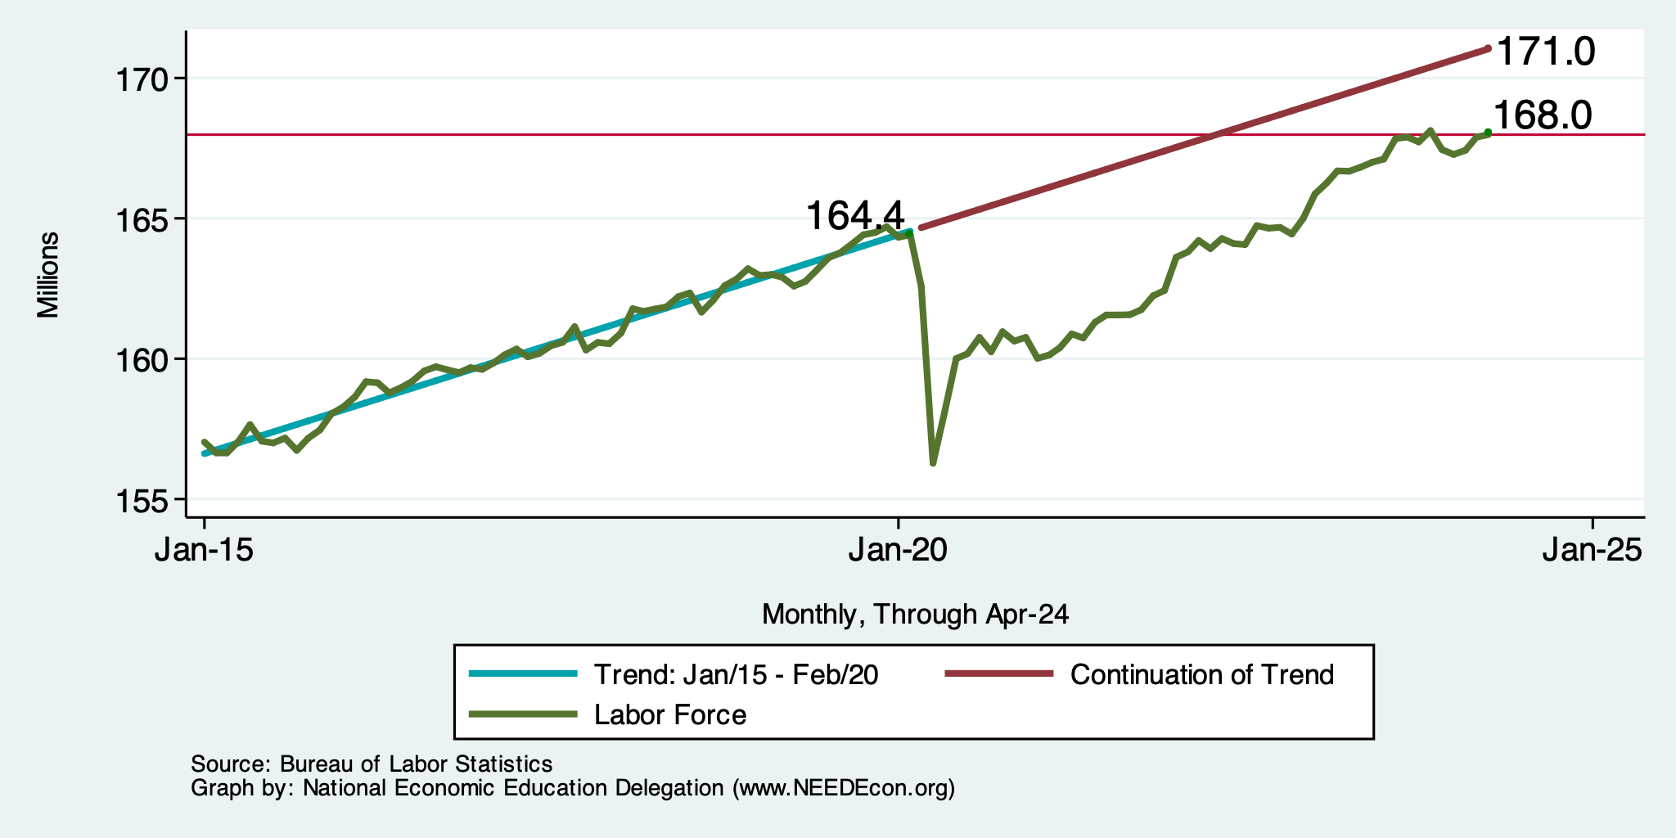
Where Have All the Workers Gone?
3.0 million below where we should be

Slide 38
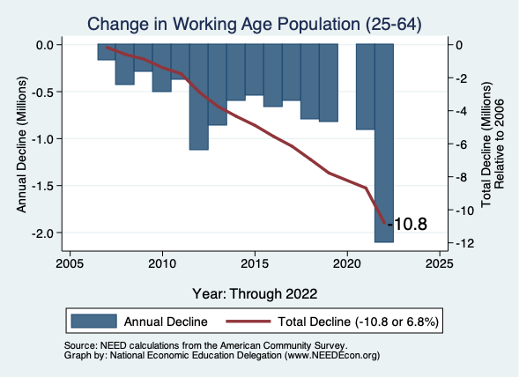
Too Many People Are Retiring!

Slide 39
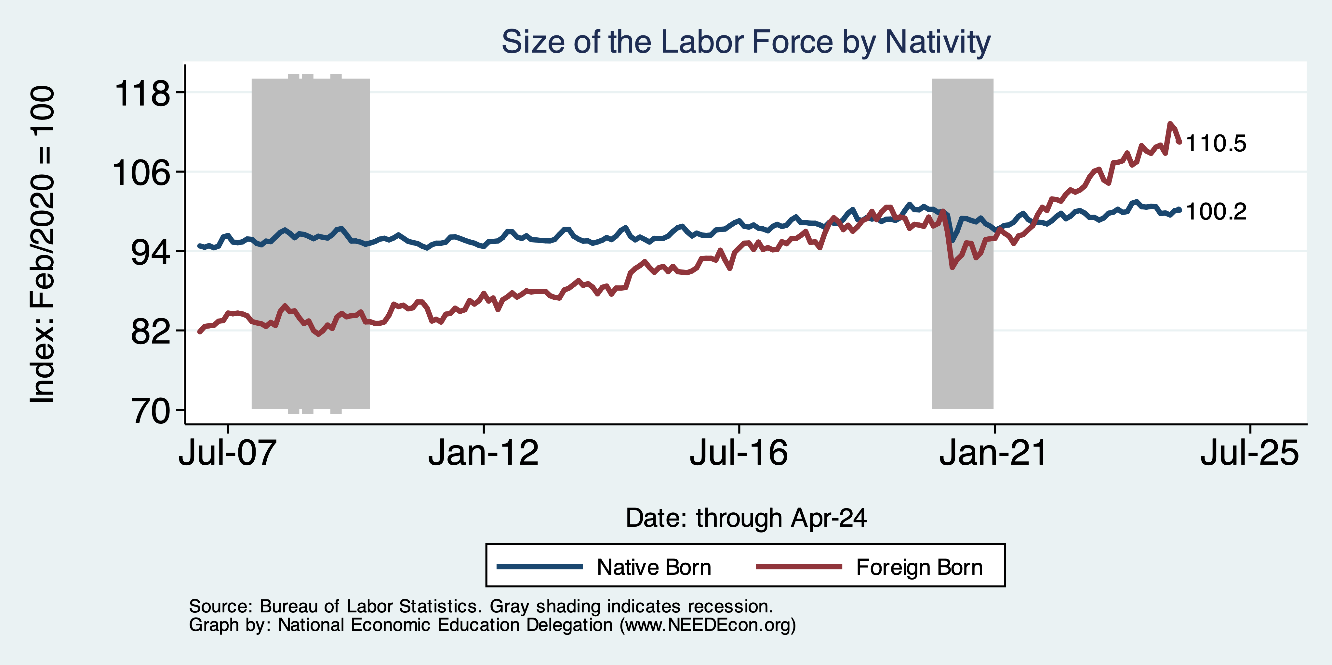
Immigrants to the Rescue?

Slide 40
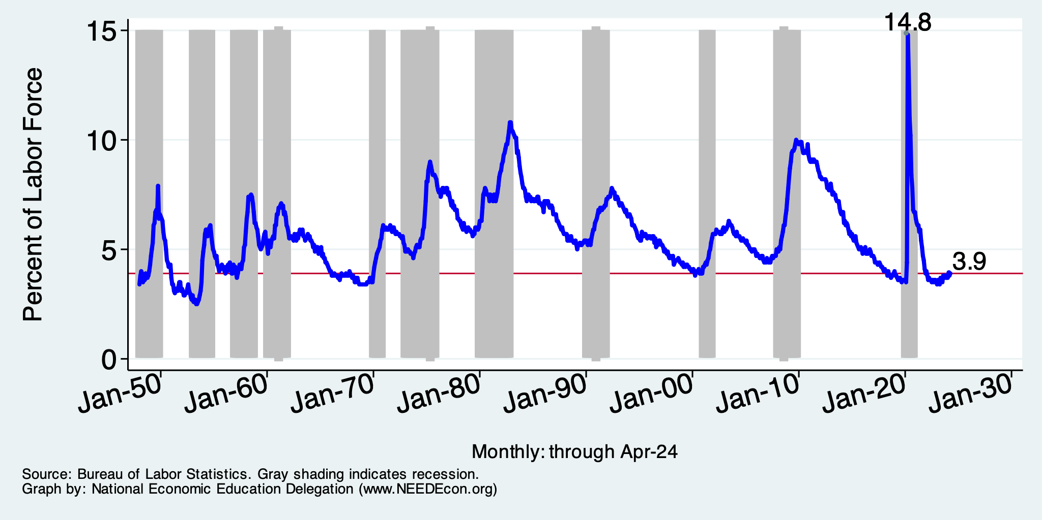
What About Unemployment?

Slide 41
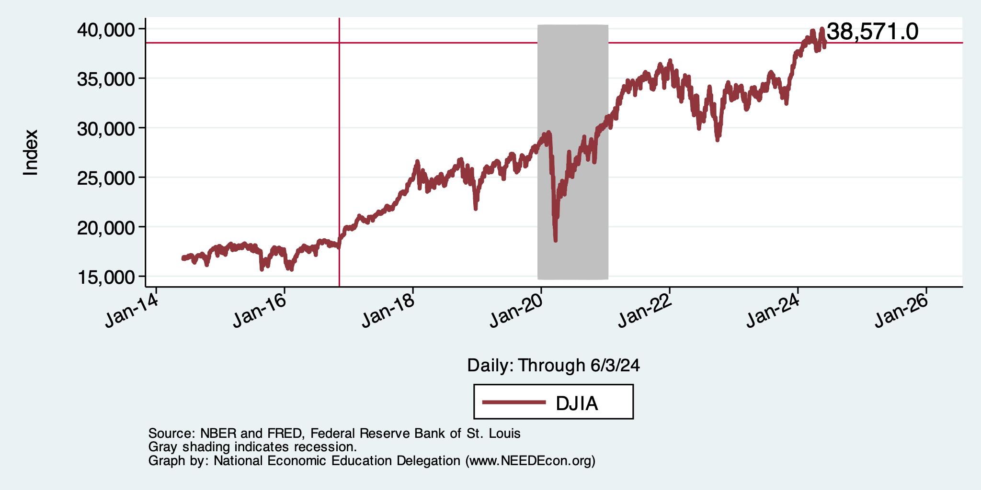
And Stocks? Way up!

Slide 42
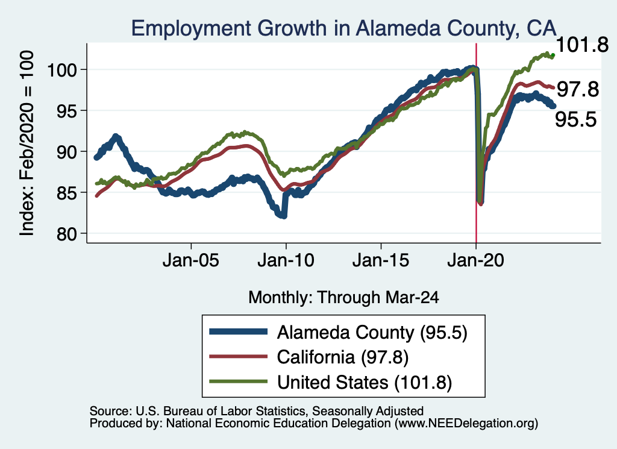
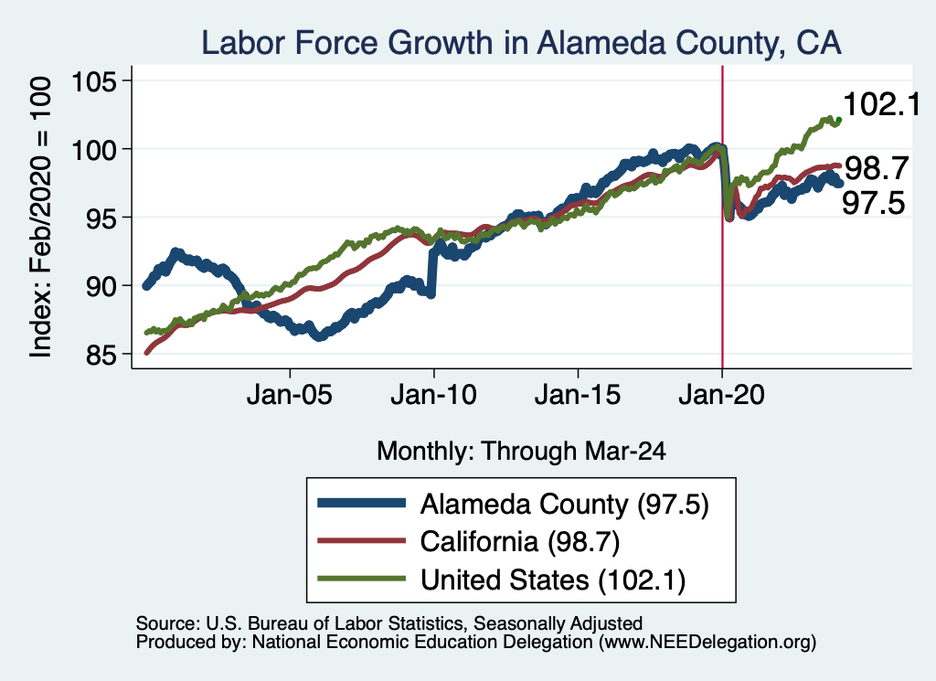
How Are Things Where You Are?

Slide 43
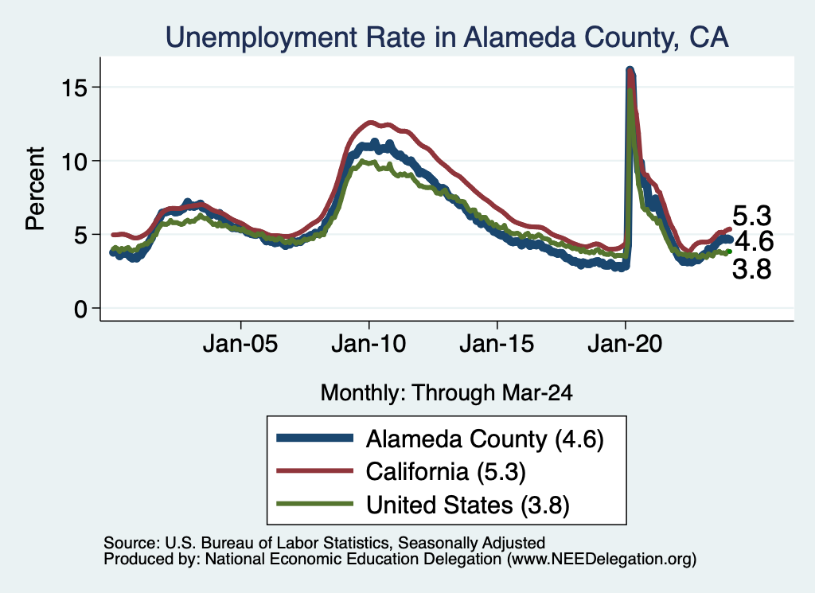
How Are Things Where You Are?

Slide 44
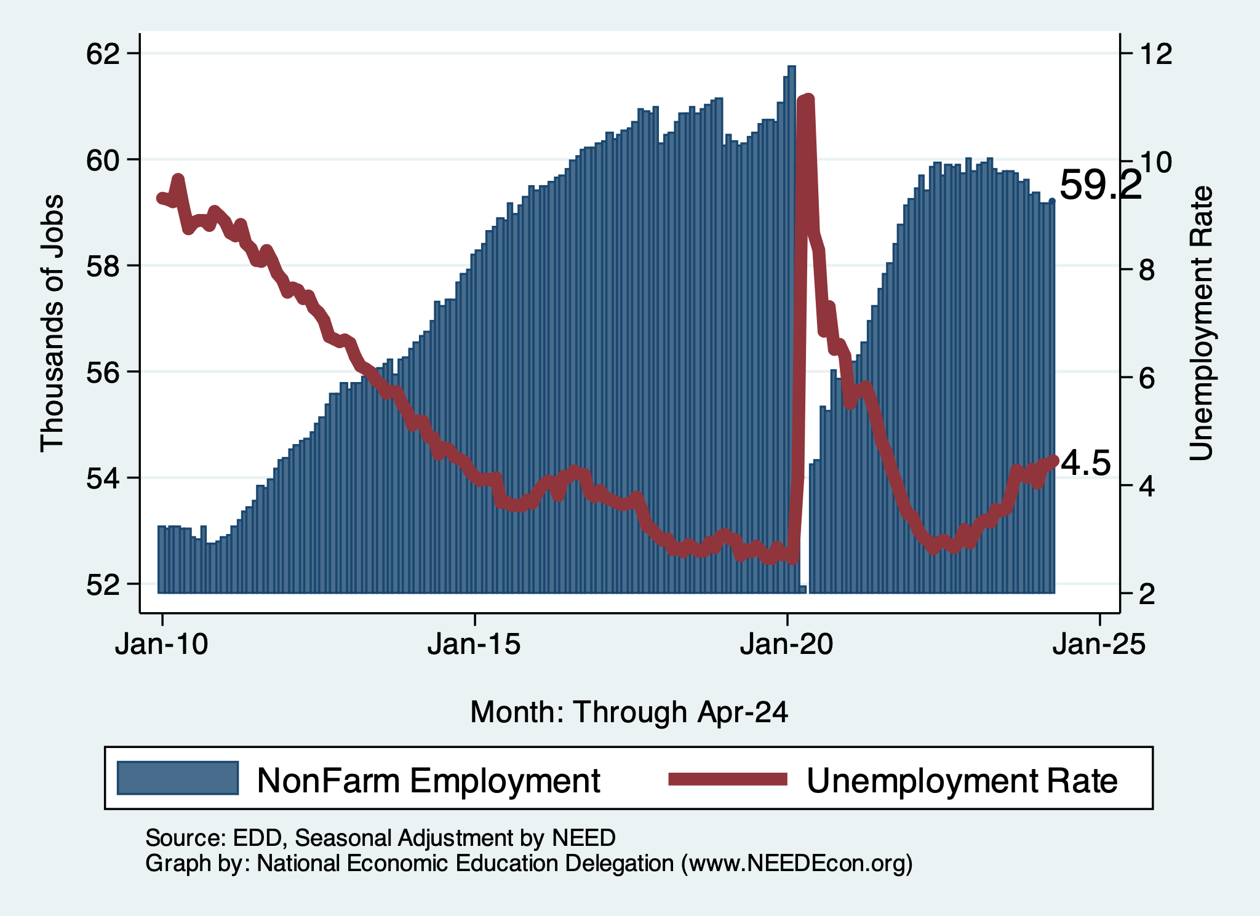
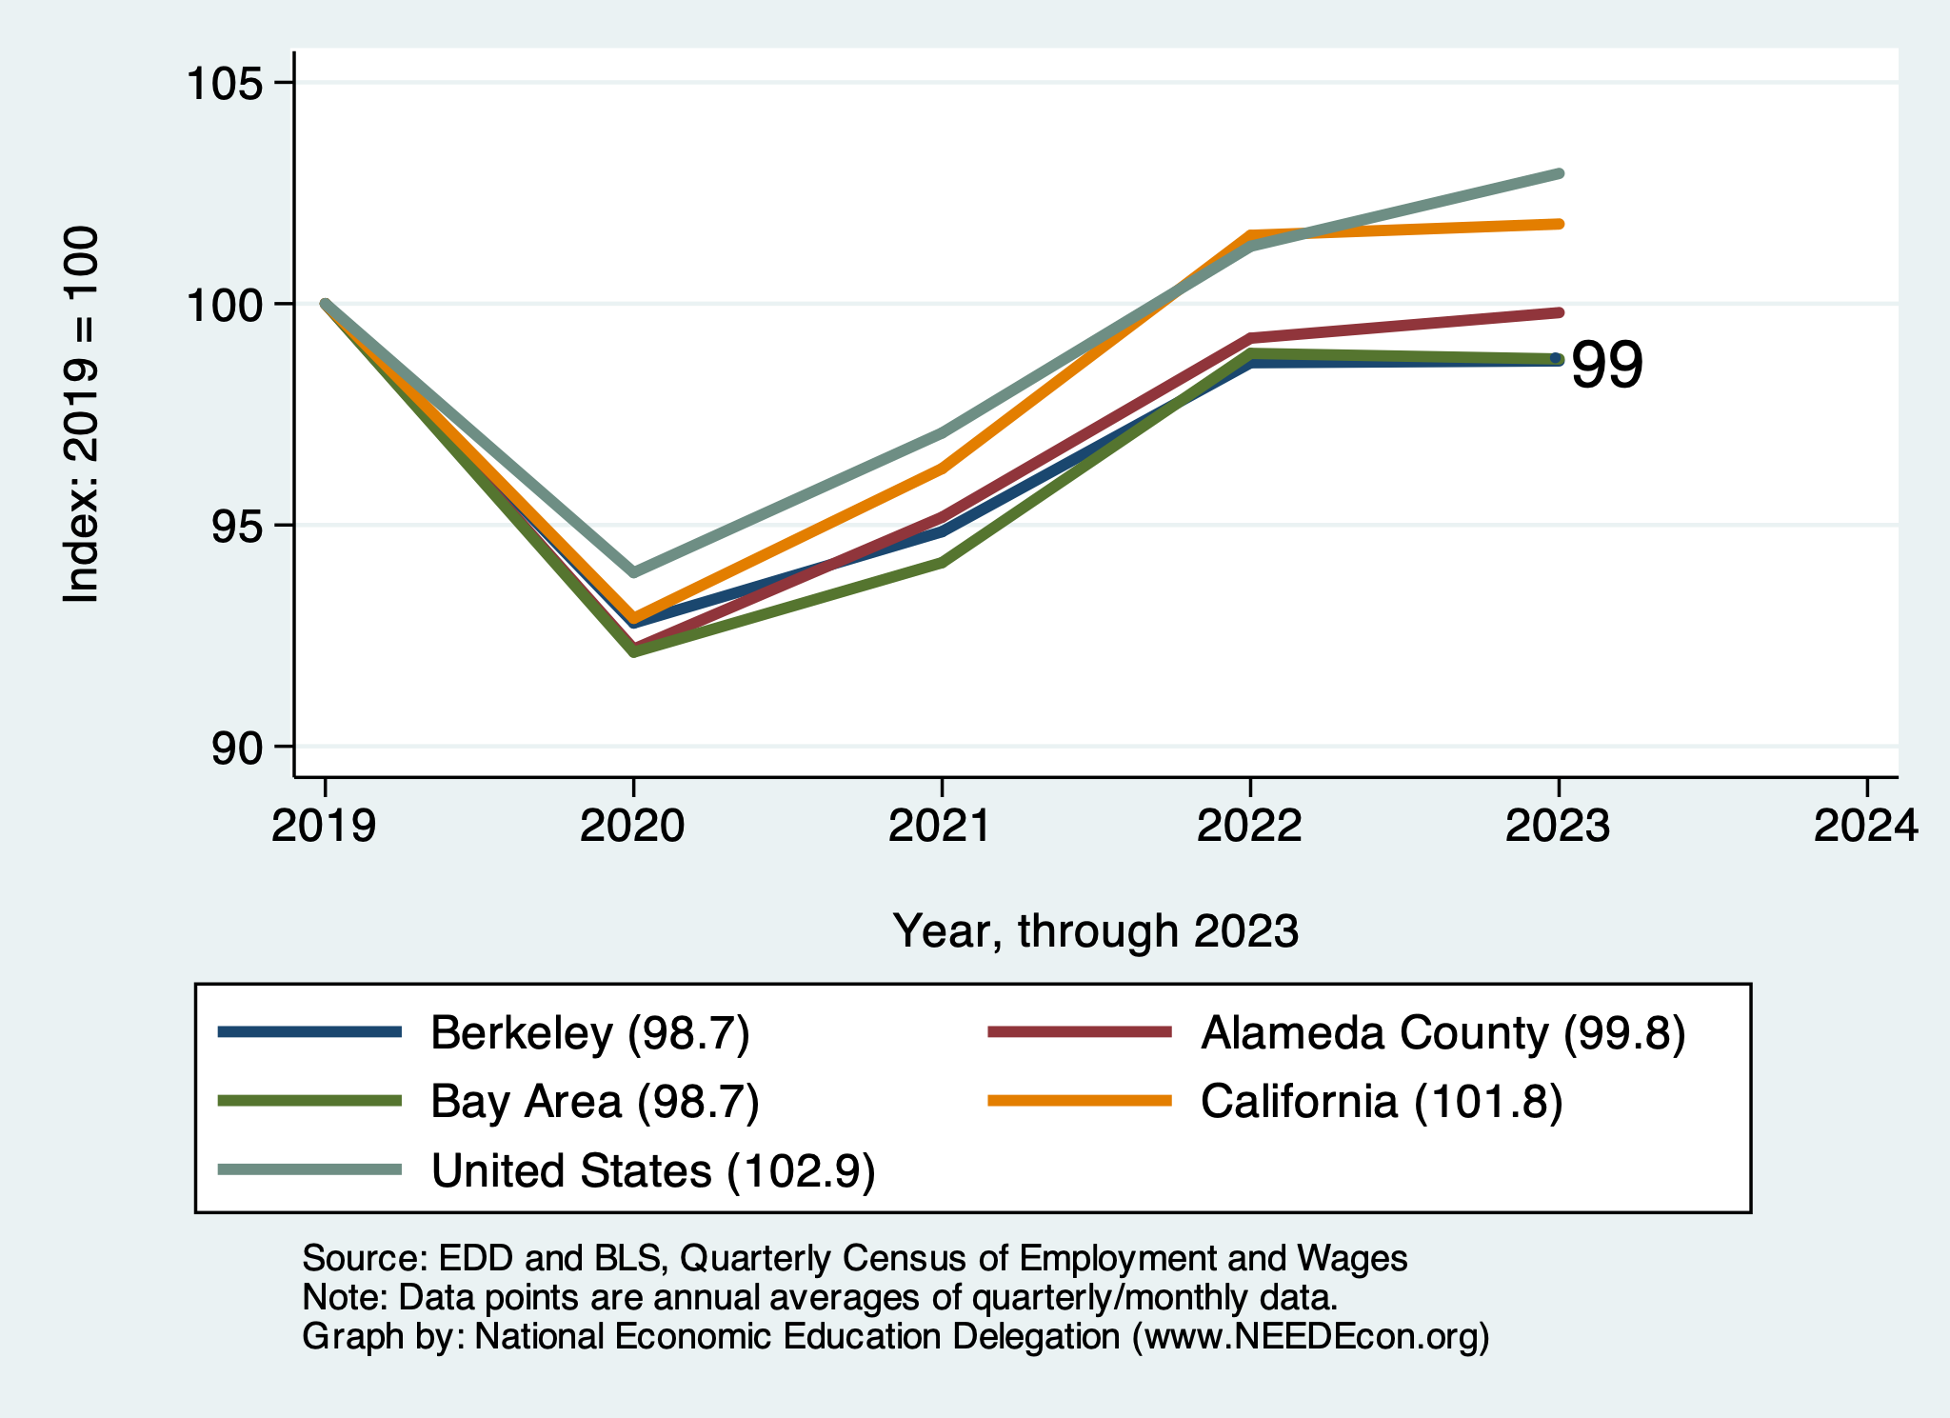
How Are Things Where You Are?

Slide 45
Economy Overall
Continues to chug along
  GDP growth has been consistent with the last decade.
  Employment continues to grow, but slowing.
    Hampered by lots of early retirements!
    Labor force is still too small.
    Thank goodness for immigrants!
  Inflation…..

Slide 46
Inflation

Slide 47
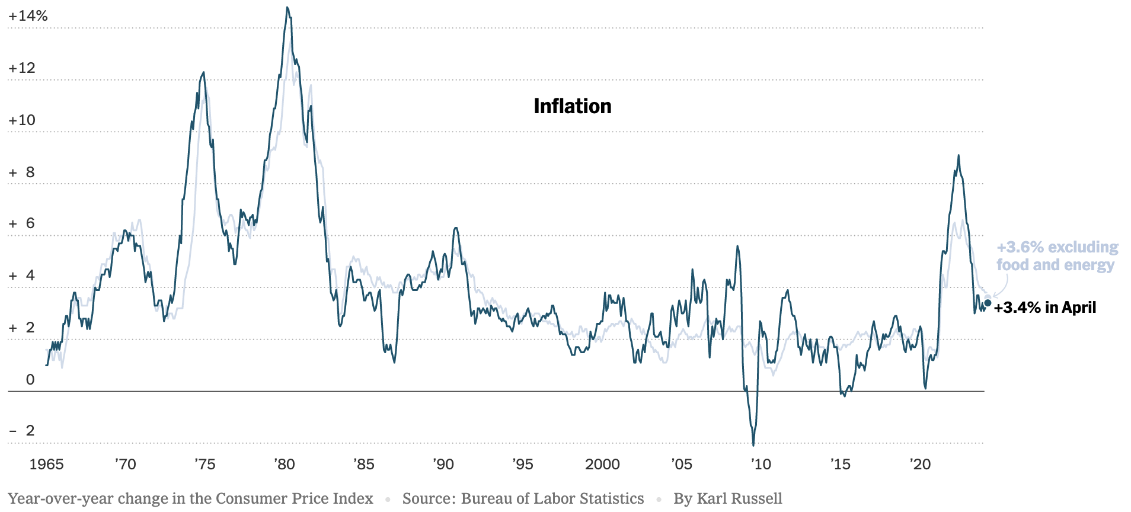
Inflation: Latest Figures – Headline - CPI

Slide 48
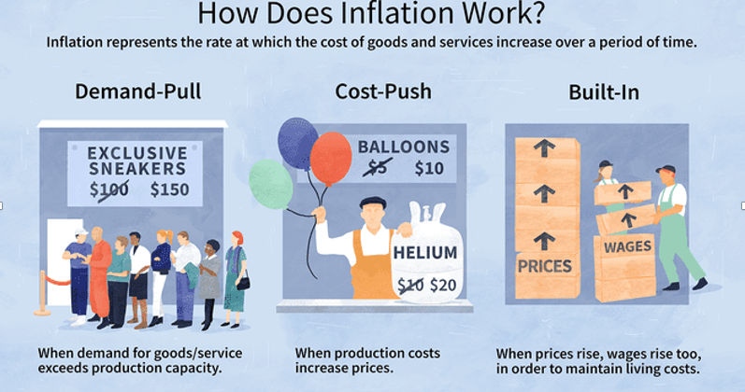
Source: Investopedia

Slide 49
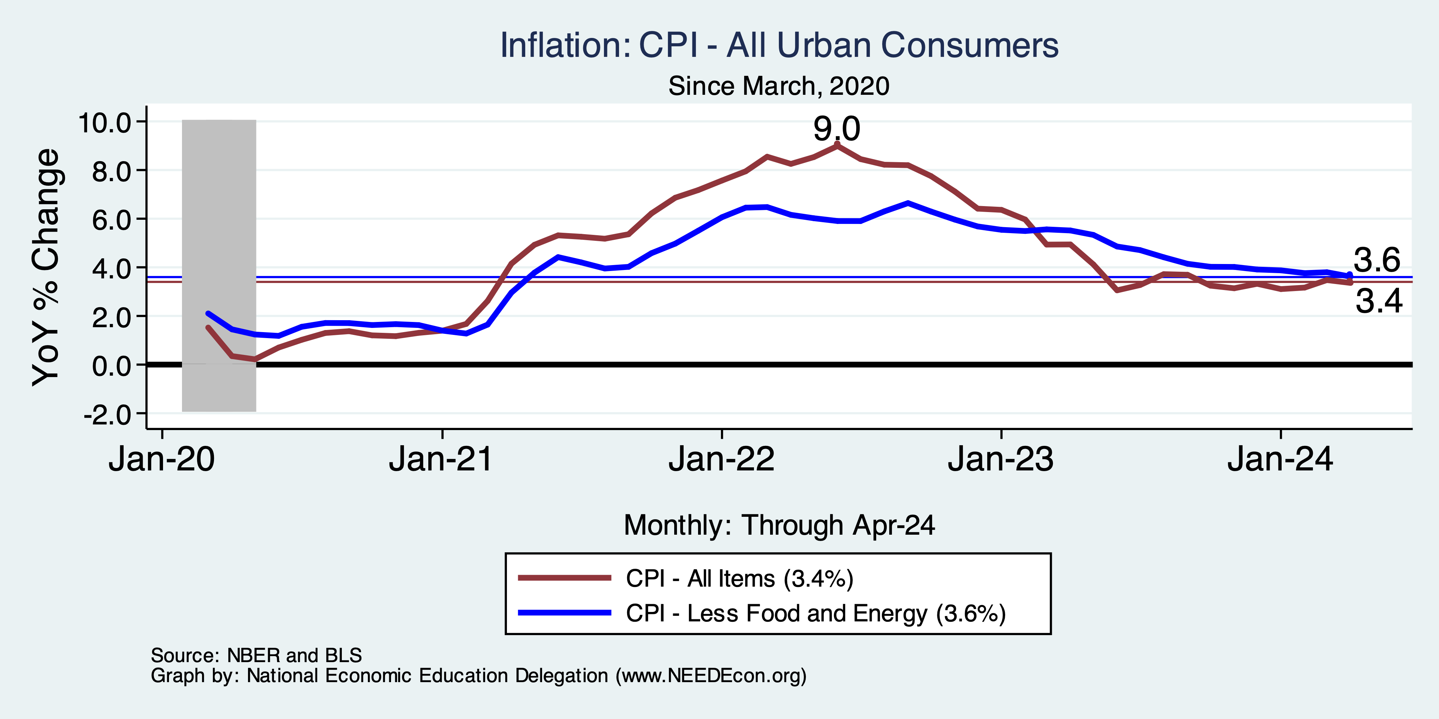
That Brings us to the Pandemic
Notes:
Cpi_recent.png

Slide 50
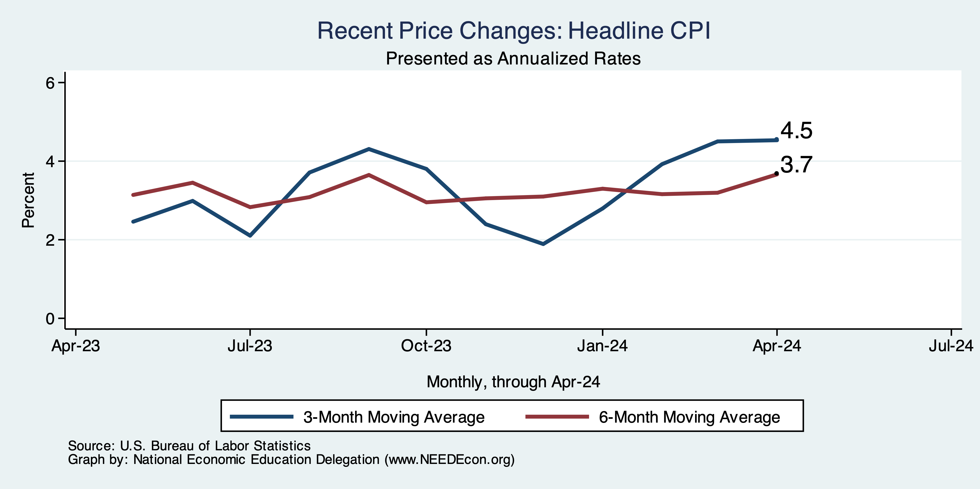
Inflation in the Last 6 Months – Not Good.

Slide 51
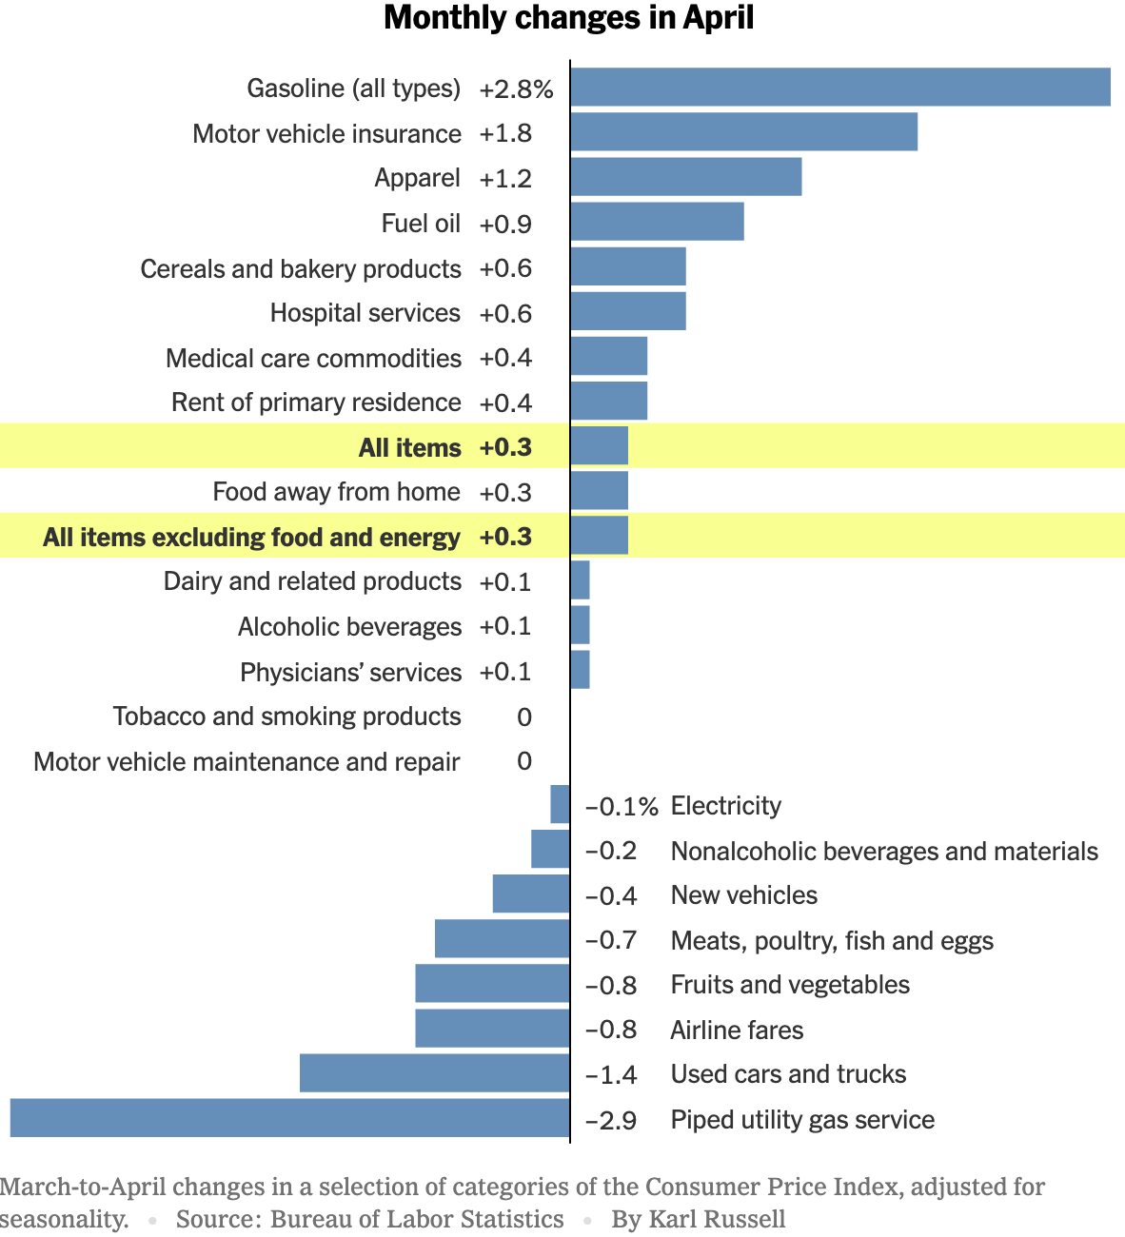
Which Prices?
Car Costs
Housing Costs

Slide 52
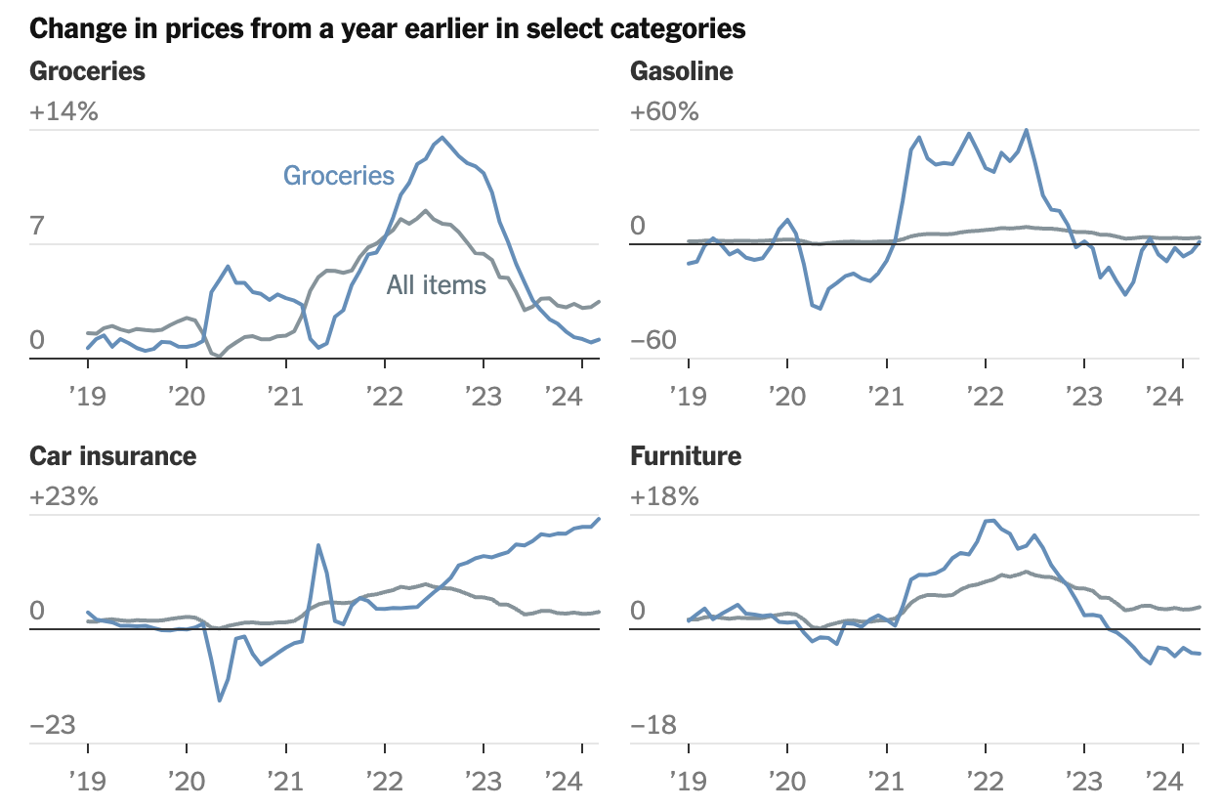

Slide 53
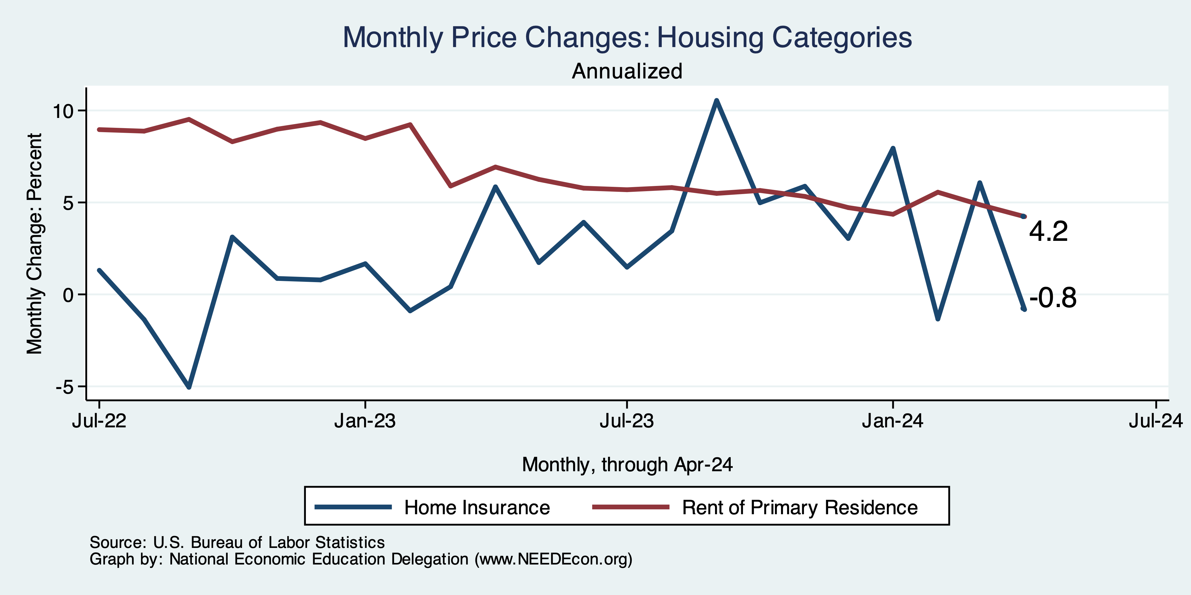
Housing is Part of the Problem

Slide 54
The Importance & Problems with Rents
Shelter is 36% of CPI
- 45% of Core CPI.
About half as much in PCE.
Notes:
Shelter is 36% of CPI and 45% of Core CPI. About half as much in PCE. CPI less shelter is 2.3% sine March of last year. Shelter is up 5.8%

Slide 55
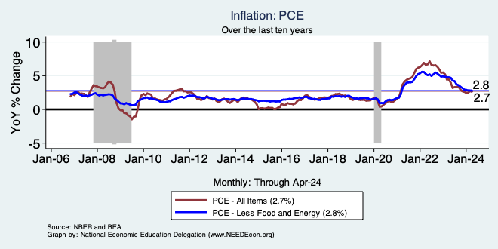
Fed’s Preferred Measure: PCE

Slide 56
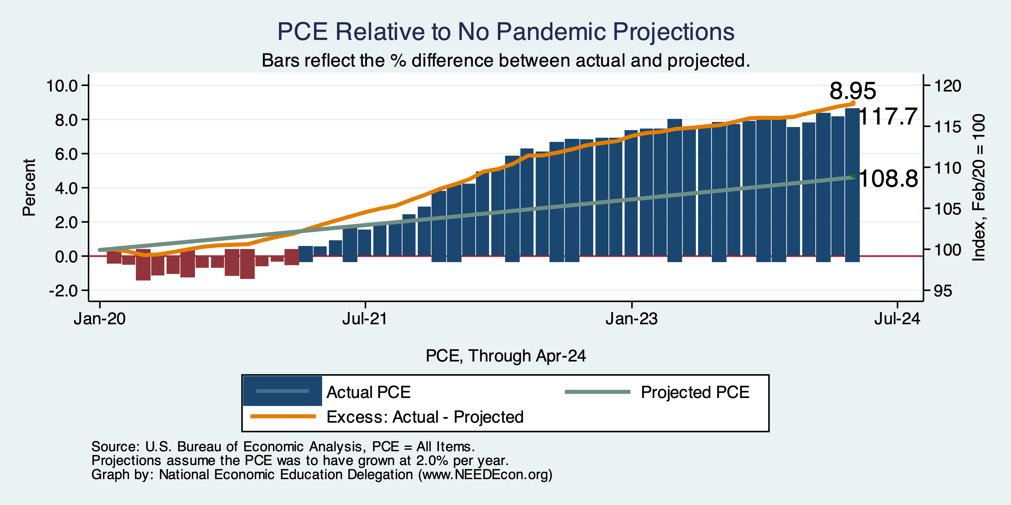
PCE Deviation from Target

Slide 57
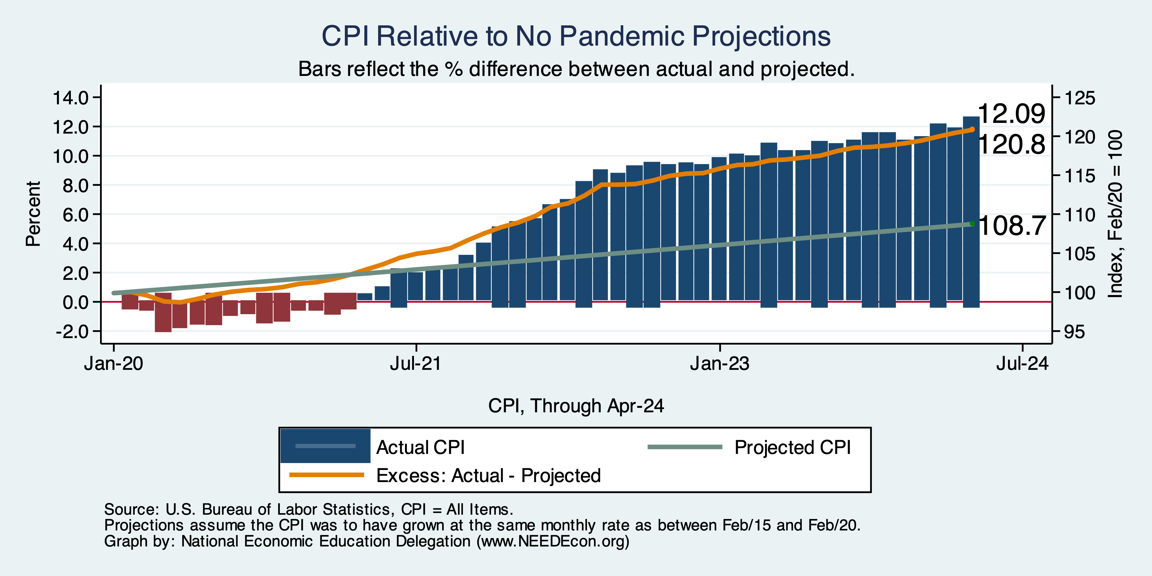
CPI Deviation from Target

Slide 58
PCE vs CPI – What’s the Difference?
Scope
  CPI – urban PCE – more comprehensive
Formulas
  Many different formulas to choose from. BEA vs BLS.
  Important: PCE updates purchasing patterns more frequently.
Weights
  E.g., housing
Other reasons
  Sometimes choose to measure prices differently.
Notes:
https://www.whitehouse.gov/cea/written-materials/2023/09/29/crosswalk-talk-whats-the-difference-between-the-pce-and-the-cpi/#:~:text=The%20CPI%20also%20focuses%20exclusively,to%20measure%20the%20same%20item.

Slide 59
About that 2% Target
There is no specific basis for it.
Head of the New Zealand central bank said: I’m targeting 2%.
  Everybody else said: ok, let’s do that.
Will it be ok if inflation stays at around 3.5%?
  Probably.
  Unless you’re running for president.

Slide 60
Sources of Pandemic Inflation
Supply Chain issues were significant – less so now.
Composition of spending changed significantly.
  Is now bouncing back, as are prices.
But there was too much total spending.
  Fiscal stimulus led households to increase saving over 2021 by more than $2 trillion. Strong retail sales numbers suggest they are prepared to spend it.
Whose to Blame: ARP probably too big, but the Fed could have acted sooner.
Bottom line: Recovery from a dramatic economic disruption is seldom painless.

Slide 61
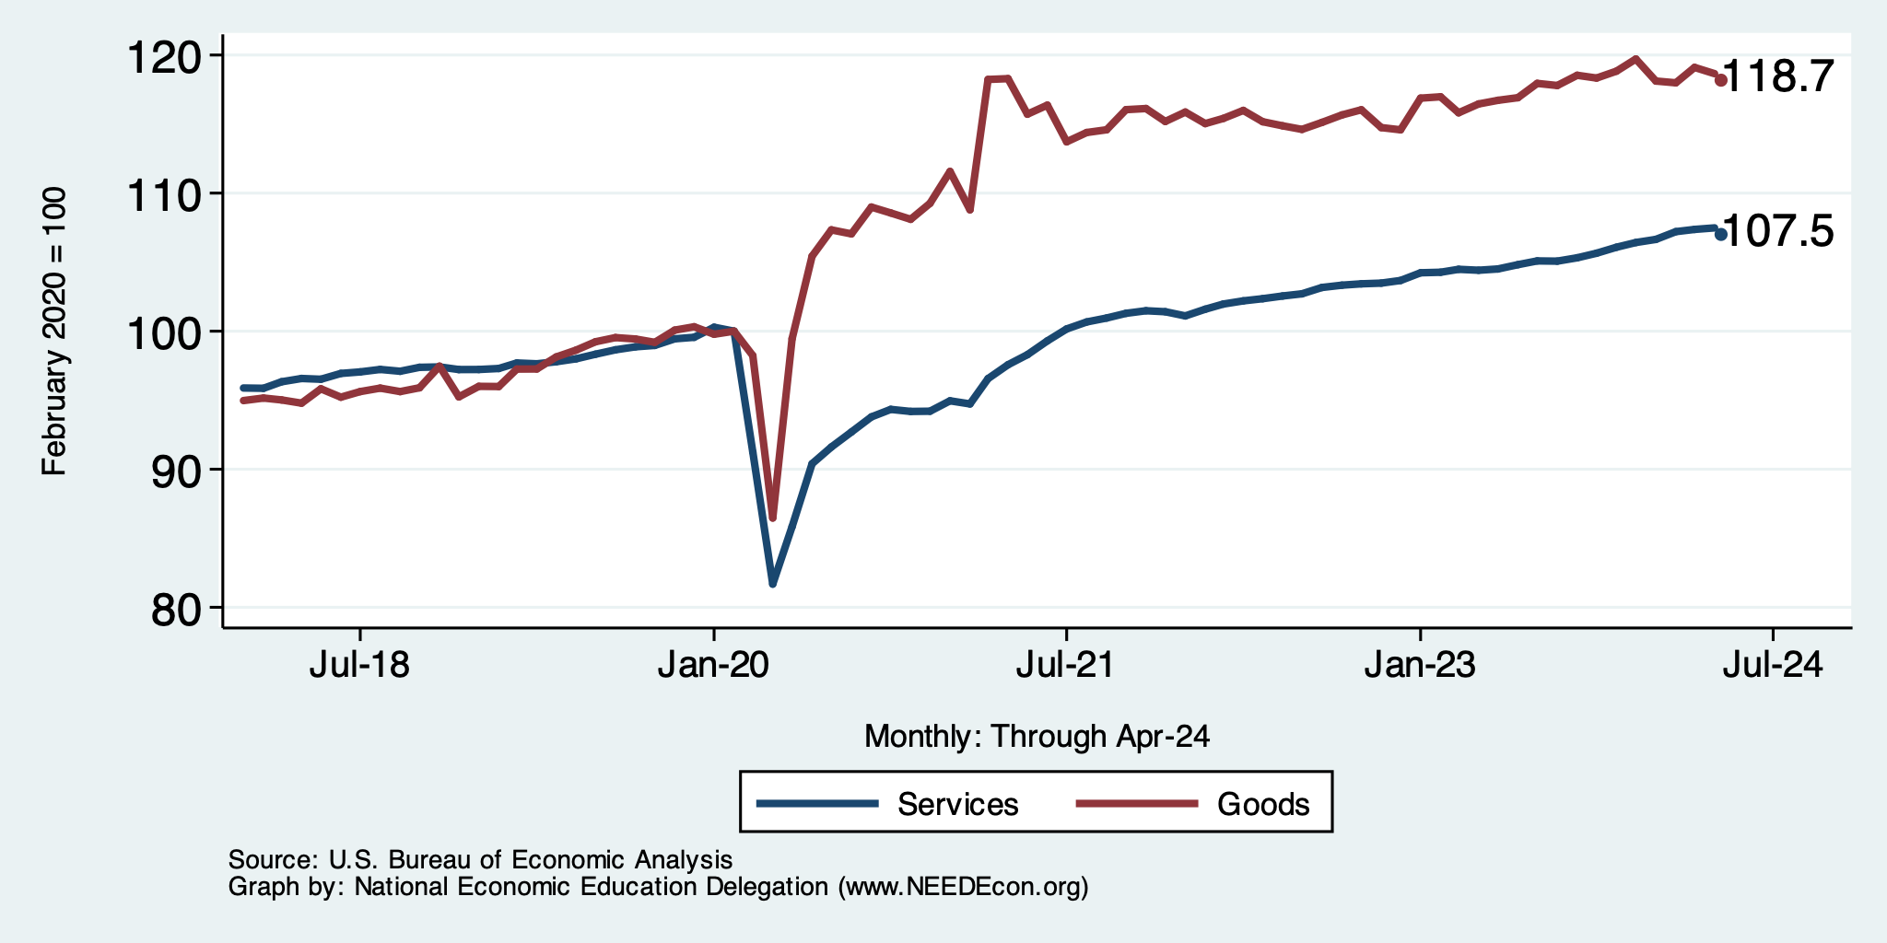
Spending Patterns Changed - More Goods!
Demand-Pull

Slide 62
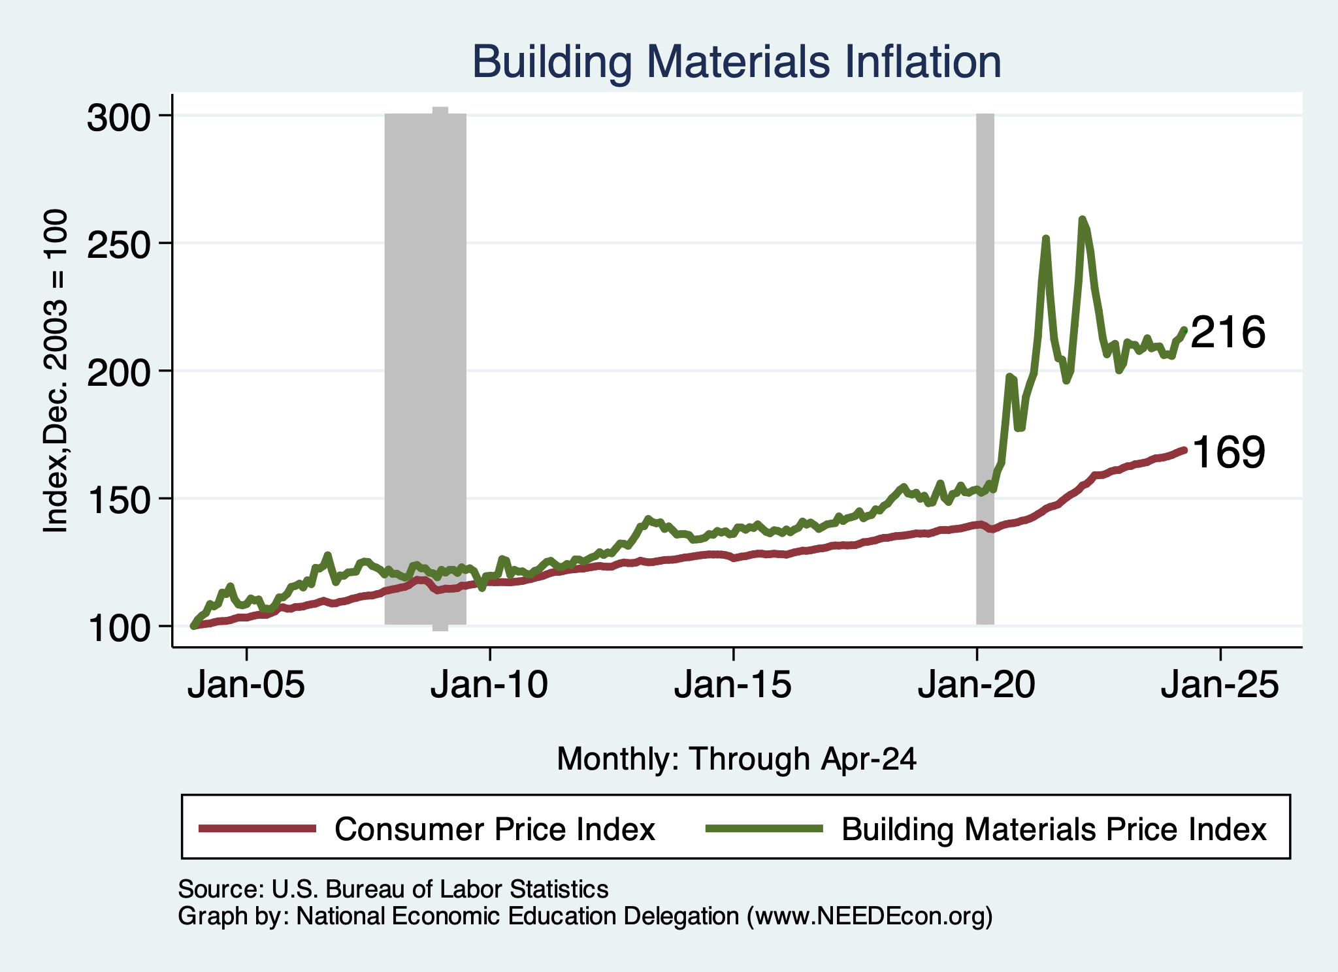
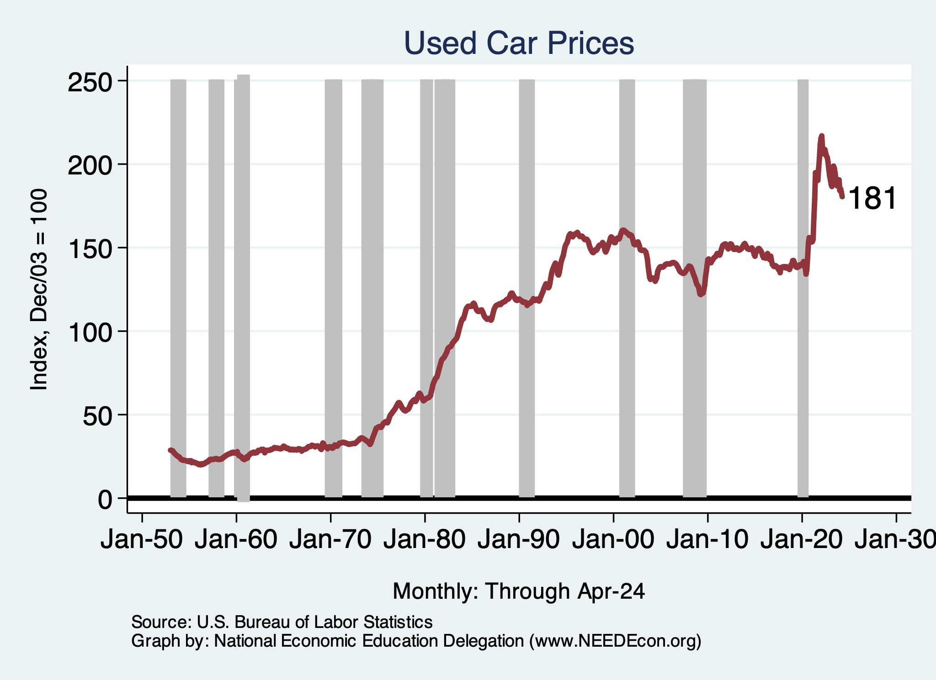
Inflation: Concentrated
Cost-Push

Slide 63
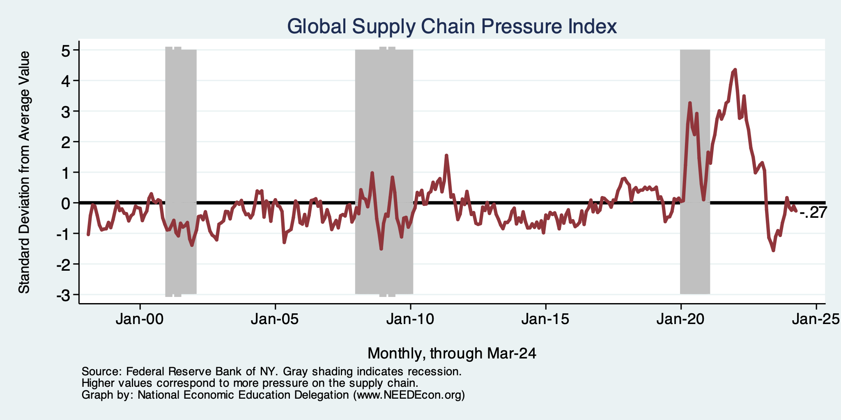
Supply Chains
Cost-Push

Slide 64
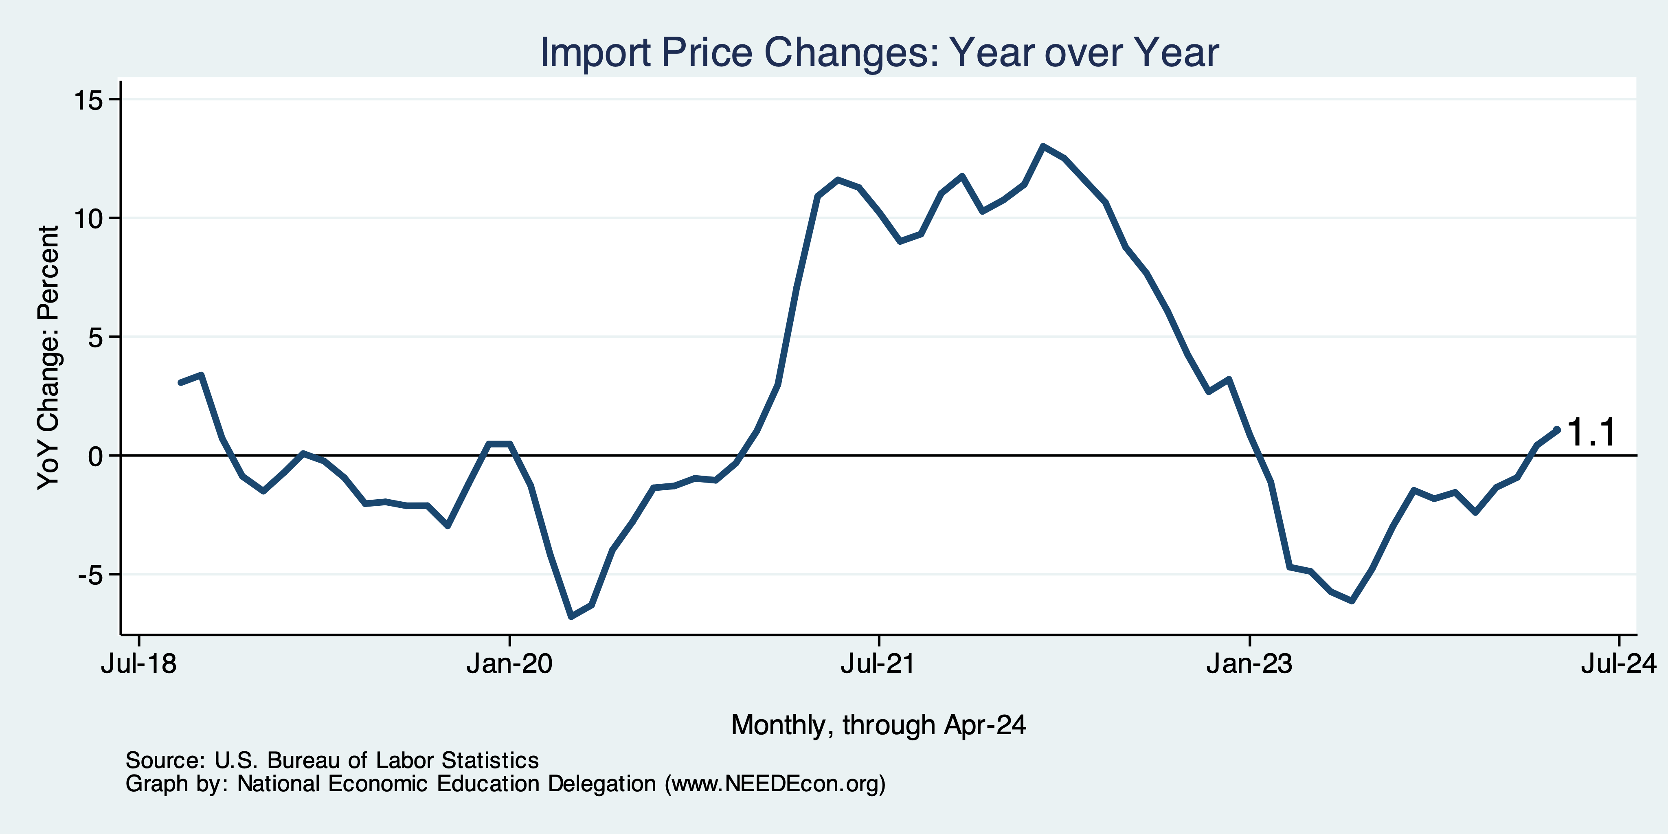
Import Prices Are Elevated
Inflation – Imported Products: 9-10%

Slide 65
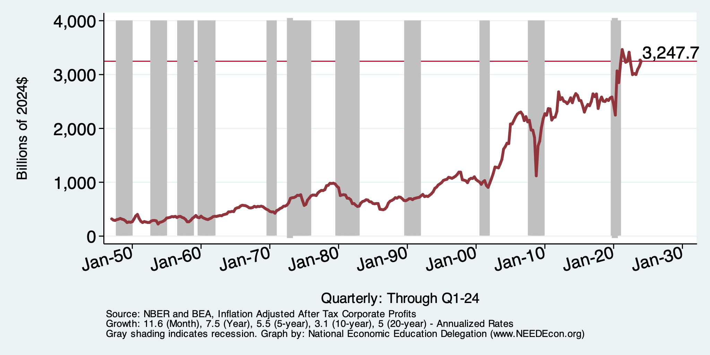
Corporations Have Pricing Power!
Corporate Profits

Slide 66
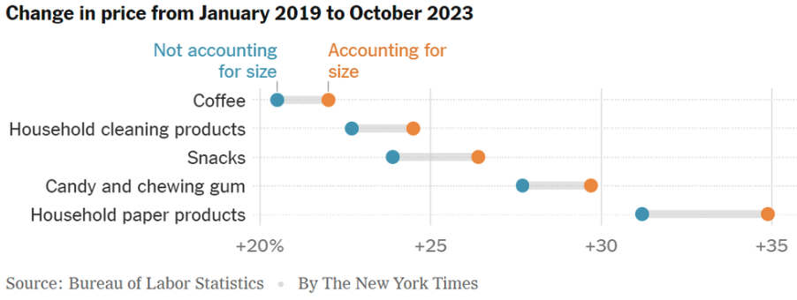
Shrinkflation
Notes:
https://www.nytimes.com/2024/04/10/learning/whats-going-on-in-this-graph-april-17-2024.html

Slide 67

Inflation is Not just a U.S. Problem

Slide 68

Wage Growth – Exceeds Inflation
Notes:
Is this necessary given the previous slide?

Slide 69
High Prices versus Inflation

Slide 70

Mismatch: Feelings About the Economy
Source: What’s Wrong With the Economy? It’s You, Not the Data

Slide 71
My Thoughts on the Future of Inflation
Most indicators suggests continued declines.
Market expectations are worsening.
Return to 2% might take a little longer.
Federal Funds rate to stay high for some time.
Popular expectations may take a little while to catch up.

Slide 72
The Fed: Reining in Inflation!

Slide 73

Fed: Also Reducing its Asset Holdings
Quantitative Tightening

Slide 74

Federal Funds Rate – Recent Activity

Slide 75

History of the Federal Funds Rate
Notes:
The fed funds rate is the interest rate on overnight loans between banks. Think of it as the baseline interest rate on which banks base all other interest rates (e.g. mortgage rates)
FOMC lowers the fed funds rate during recessions and raises the fed funds rate during expansions
Fed funds rate peaked in the 1980s as then Chairman Paul Volcker sought to reign in “run away” inflation of the 1970s; doing so resulted in a recession in the early 1980s.
Since the 2008-09 recession, the fed funds rate has been kept near zero.
During the 2008-09 recession, Federal Reserve turned to unconventional tools to influence longer term interest rates to further stimulate the economy - QE
FedFunds.png

Slide 76
Implications for Demand
Investment borrowing
Home loans – tied to 10-year Treasury
Car loans
Credit cards
Savings accounts – positive
And more….
All of which slows the economy.

Slide 77

Treasuries
Notes:
treas_recent.png

Slide 78

Mortgage Rates

Slide 79



Home Prices … Returned to Normal (?)
Notes:
Charts:
homeprices_recession.png
housing.png

Slide 80
What will the Fed Do?
Pending Developments:
May- June 12 full set of inflation and unemployment for April.
Wednesday, June 12 Fed policy meeting with new economic projections.
Will likely hold rates fixed unless there is significant progress on PCE.
Notes:
GDPNow 2.4%; blue chips consensus 1.5% implies 2.9%, or 2.7%

Slide 81
Takeaways
Is a recession on the horizon?
  No. Potentially a slowdown.
  Many indicators are well in the black.
    2024-Q1 GDP growth was ok.
Inflation has been tamed.
Fed is slowing its activity.
Threats to continued growth:

Slide 82
Uncertainties
Resurgence of inflation (though…why?)
Conflicts in Ukraine and Israel.
  Global Supply Chains?
  Oil Prices?
  Aid to Ukraine and Israel?
Asset prices (stocks)
Household balance sheets
Fed Actions in a Political Year.

Slide 83

Immigrant Population in 2017
Categories of the total number
of immigrants in the United States.
https://www.pewresearch.org/fact-tank/2019/07/12/how-pew-research-center-counts-unauthorized-immigrants-in-us/

Slide 84
Thank you!
Any Questions?
www.NEEDEcon.org
Jon Haveman, Ph.D.
Jon@NEEDEcon.org
Contact NEED: info@NEEDEcon.org
Submit a testimonial: www.NEEDEcon.org/testimonials.php
Become a Friend of NEED: www.NEEDEcon.org/friend.php

Slide 85
Parting Thoughts on Inflation
Was Milton Friedman right?
  “Inflation is always and everywhere a monetary phenomenon.”
  As a generalization, but not ”always and everywhere”.
    See price changes from disruptions in the economy.
What did we see during the pandemic?
  Lots of causes that had nothing (?) to do with monetary policy.
Where is inflation going?
  I expect back down to close to 2% sometime next year.

Slide 86

Wage Growth
Notes:
Is this necessary given the previous slide?

Slide 87

Compensation Growth: Pretty good!

Slide 88

The Great Inflation: 1965-1982
Proximate causes
  Collapse of the gold standard
  Fiscal imbalances (Great Society)
  Runaway monetary policy (for Nixon)
  Price controls – after they were lifted
  Energy shortages
Lots of “demand pull”
    Great society, easy money
Some “cost push”
    Energy shortages
Notes:
https://www.federalreservehistory.org/essays/great-inflation

Slide 89

Low Inflation Period: 1980-2021
Volcker – stranglehold on inflation in 1980.
  Causes a recession through high interest rates.
  Harnesses inflation.
Next 4 decades
  Globalization – lower import prices.
  Deunionization (private sector)
    21% in 1980
    6% in 2019

