Slide 1
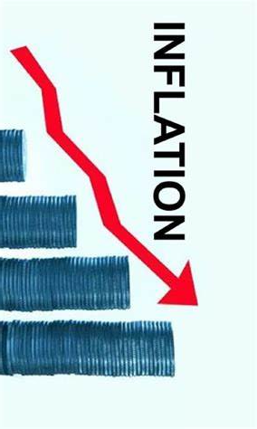
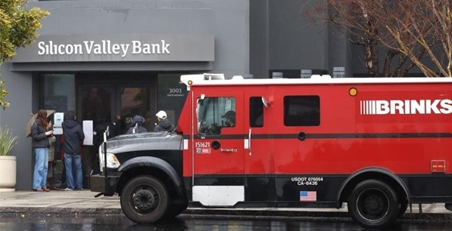
Economic Update
Marin County Dept of Education
Property Tax Forum
May 2, 2023
Jon Haveman, Ph.D.
Executive Director, NEED

Slide 2
Outline
The U.S. Economy
Inflation/The Fed
Real Estate/Marin
The Budget

Slide 3
The U.S. Economy

Slide 4
GDP: Quarterly Growth
Q2-2023: 2.1%
Q3-2023: 4.9%
Q4-2023: 3.4%
Q1-2024: 1.6%
Notes:
Graph: gdp_pot_grow.png
The Point: From 1990 – 2007, average annual US GDP growth pre-crisis is 2.94%. However, post-crisis US GDP growth is 2.19% (0.75 percentage points lower). Why is has the recovery been sluggish?
Note: At the recession’s height, the gap between quarterly GDP growth and potential growth was 2.5 percentage points.

Slide 5
GDP Trajectory: Pandemic Plunge!
GDP is:
< $0.2 Trillion below 2019 forecast.
$1.9 Trillion ABOVE 2019-Q4 level.

Slide 6
Monthly Changes in Nonfarm Employment
January: 256,000
February: 270,000
March: 303,000
Notes:
PAYEMS.png

Slide 7
Employment Gap
5.8 Million ABOVE February, 2020.
5.0 Million BELOW where we should be.
Notes:
payroll_recent.png

Slide 8
Immigrants to the Rescue?

Slide 9
Where Have All the Workers Gone?
3.5 million ABOVE Feb 2020
3.0 million BELOW where we should be

Slide 10
Immigrants to the Rescue?

Slide 11
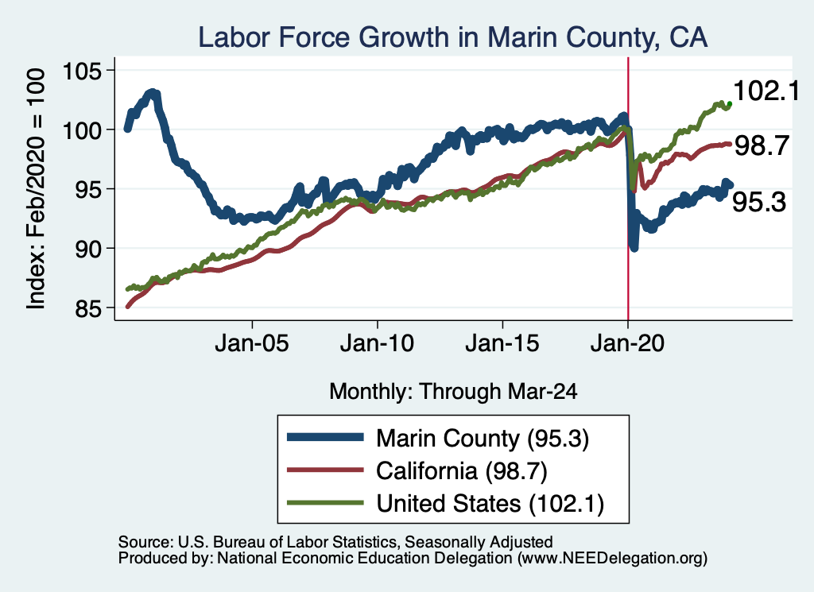
Labor Market Experience: Marin County

Slide 12
Inflation

Slide 13
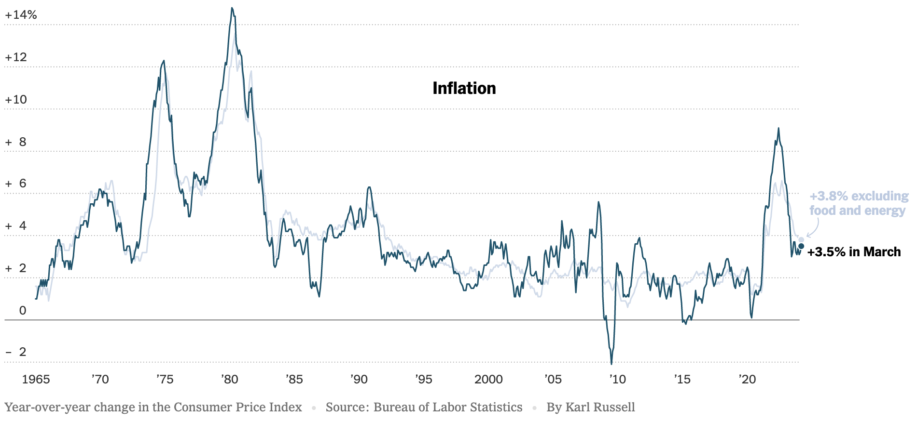
Inflation: Latest Figures
Source: NYTimes.com

Slide 14
Inflation in the Last 6 Months

Slide 15
What’s the Fed Doing About It?

Slide 16
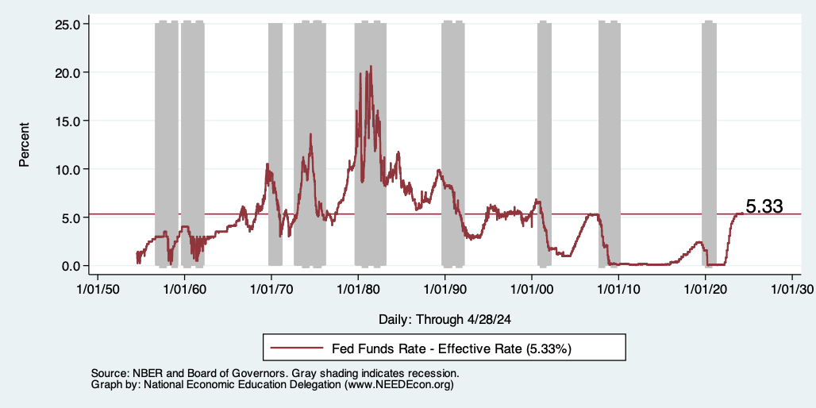
Raising the Federal Funds Rate
Notes:
The fed funds rate is the interest rate on overnight loans between banks. Think of it as the baseline interest rate on which banks base all other interest rates (e.g. mortgage rates)
FOMC lowers the fed funds rate during recessions and raises the fed funds rate during expansions
Fed funds rate peaked in the 1980s as then Chairman Paul Volcker sought to reign in “run away” inflation of the 1970s; doing so resulted in a recession in the early 1980s.
Since the 2008-09 recession, the fed funds rate has been kept near zero.
During the 2008-09 recession, Federal Reserve turned to unconventional tools to influence longer term interest rates to further stimulate the economy - QE
FedFunds.png

Slide 17
Interest Rates are High!

Slide 18
Real Estate Prices

Slide 19
RE Experiences … Similar And Not Good

Slide 20
Home Price DEpreciation w/in Marin

Slide 21
The California Budget

Slide 22
California Budget
In the red: $38B or $73B – depends on who you ask.
$38B – Newsom (CY revenues are running $6B behind estimates)
$73B – LAO
Why?
Lower than expected revenues when budgets were made.
7-month tax deferral.
High interest rates reduced investment and startups.
Will know more once 2023 tax revenues are in and May revise is out.
Prop 98 Funding:

Slide 23
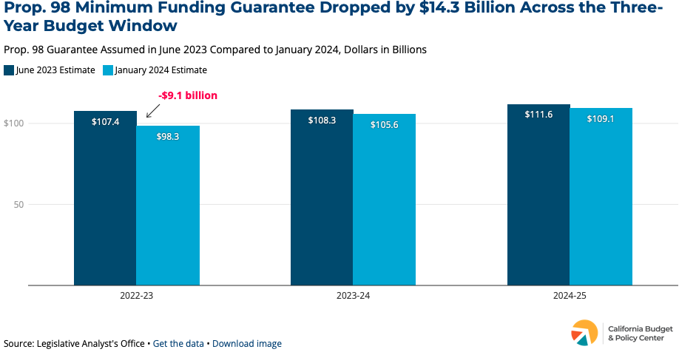
Notes:
https://calbudgetcenter.org/resources/what-is-proposition-98-and-how-does-the-state-budget-shortfall-affect-it/#:~:text=98%20funding%20comes%20from%20a,direct%20K%2D14%20instructional%20programs.

Slide 24
What’s Being Done?
So far – budgeting gimmicks
Move payroll by one day to next fiscal year.
Other borrowing from Peter to pay Paul.
What could be done?
Borrow from reserves.
Cuts to some new programs.
Public defenders, foster kids, climate.
Raise tax rates.
Address tax expenditures.

Slide 25
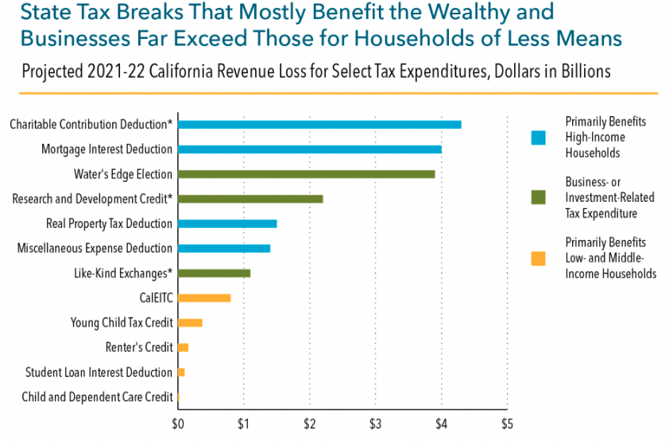
Notes:
https://calbudgetcenter.org/resources/california-loses-nearly-70-billion-annually-through-tax-breaks/

Slide 26
Takeaways
Is a recession on the horizon?
No.
Many indicators are still in the black.
Recent growth has been pretty good!
Threats to continued growth:
If inflation starts to rise again, which seems unlikely.
Ukraine and Middle East
State Budget in trouble for several years to come.

Slide 27
Thank you!
Any Questions?
www.NEEDEcon.org
Jon D. Haveman
Jon@NEEDEcon.org
Contact NEED: info@NEEDEcon.org
Submit a testimonial: www.NEEDEcon.org/testimonials.php
Become a Friend of NEED: www.NEEDEcon.org/friend.php

Slide 28
Supply Chains

Slide 29
Household Income: Counties

Slide 30
Educational Attainment

Slide 31
Household Income: Cities

Slide 32
Marin’s Home Price Position

Slide 33
Home Price Appreciation w/in Marin

