Slide 1
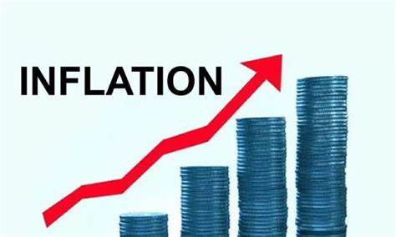
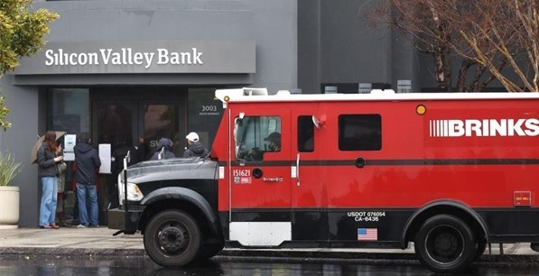
US Economic Update
Marin County Dept of Education
Property Tax Forum
May 2, 2023
Jon Haveman, Ph.D.
Executive Director, NEED

Slide 2
Outline
The U.S. Economy
Inflation/The Fed/Banks
The Debt Ceiling
The Budget

Slide 3
The U.S. Economy

Slide 4
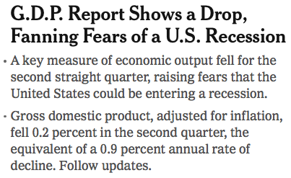
Headline:
Last July

Slide 5
GDP: Quarterly Growth
Notes:
Graph: gdp_pot_grow.png
The Point: From 1990 – 2007, average annual US GDP growth pre-crisis is 2.94%. However, post-crisis US GDP growth is 2.19% (0.75 percentage points lower). Why is has the recovery been sluggish?
Note: At the recession’s height, the gap between quarterly GDP growth and potential growth was 2.5 percentage points.

Slide 6
GDP Trajectory: Pandemic Plunge!
GDP is:
$0.4 Trillion below 2019 forecast.
$0.6 Trillion ABOVE 2019-Q4 level.

Slide 7
Monthly Changes in Nonfarm Employment
February: 326,000
March: 236,000
Notes:
PAYEMS.png

Slide 8
Employment Gap
3.1 Million ABOVE February, 2020.
5.0 Million BELOW where we should be.
Notes:
payroll_recent.png

Slide 9
Where Have All the Workers Gone?
2.6 million below where we should be

Slide 10
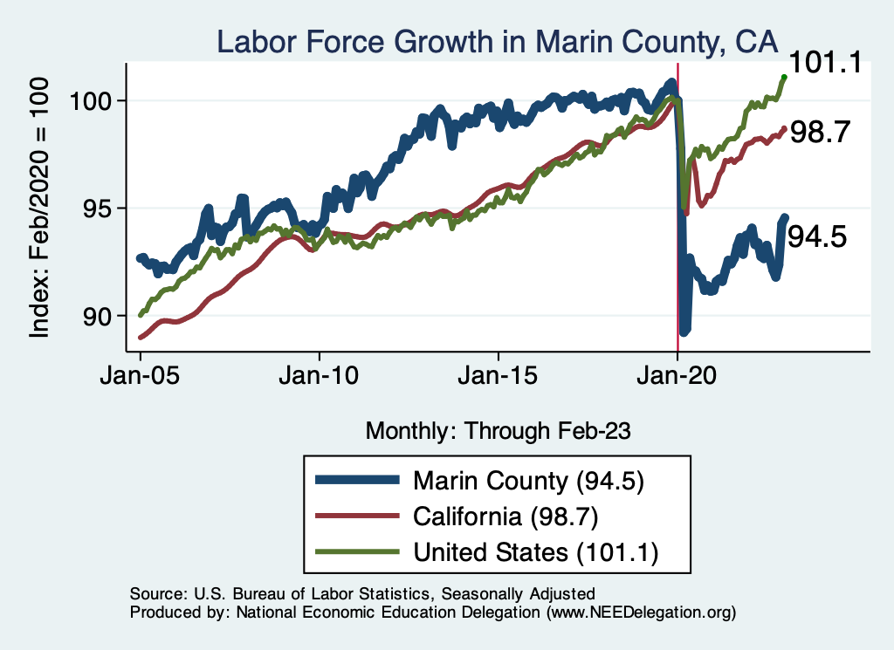
Labor Market Experience: Marin County

Slide 11
www.NEEDEcon.org/LocalGraphs
For every state and county in the United States.
Detailed graphs on employment, housing, moves, and other statistics.

Slide 12
Inflation

Slide 13
Inflation: Latest Figures
Source: NYTimes.com, Bureau of Labor Statistics

Slide 14
Inflation in the Last 6 Months – Less Than 4%!

Slide 15
Food Prices Are Coming Down

Slide 16
As Are Fuel Prices

Slide 17
Inflation is Not just a U.S. Problem

Slide 18
Supply Chains

Slide 19
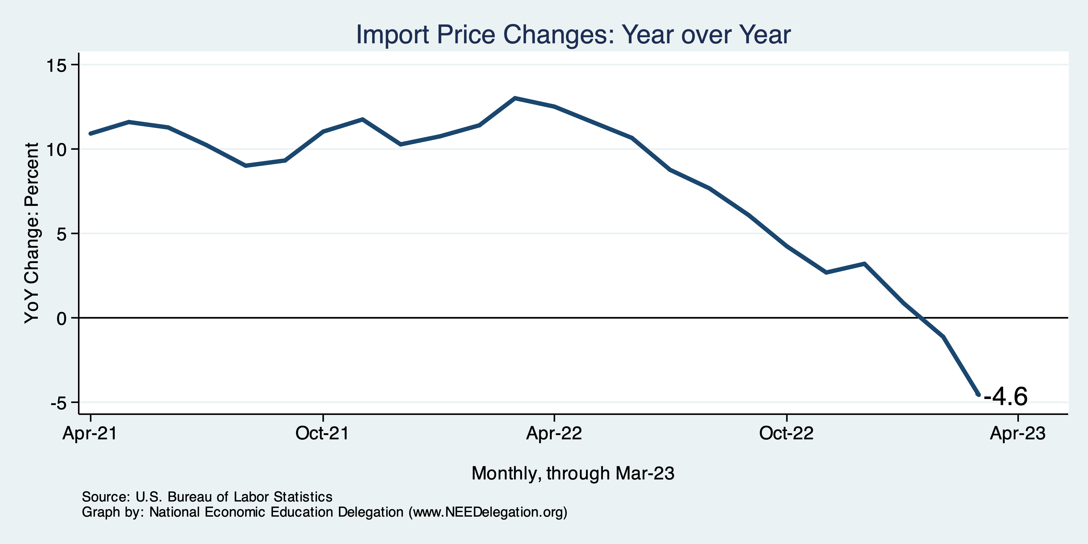
Import Price Inflation WAS Very High
Inflation – Imported Products: 9-10%
> 10% for a year!

Slide 20
What’s the Fed Doing About It?

Slide 21
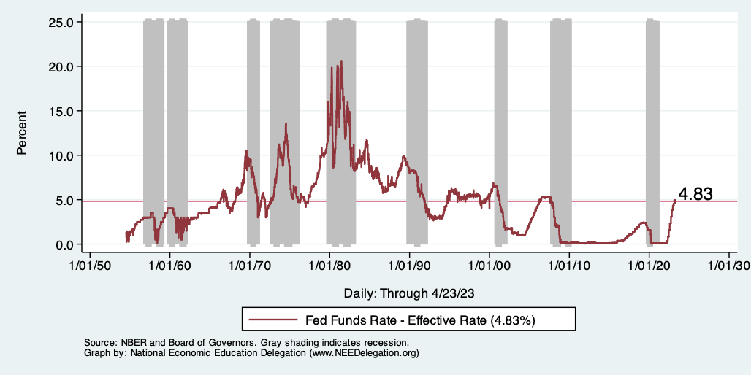
Raising the Federal Funds Rate
Notes:
The fed funds rate is the interest rate on overnight loans between banks. Think of it as the baseline interest rate on which banks base all other interest rates (e.g. mortgage rates)
FOMC lowers the fed funds rate during recessions and raises the fed funds rate during expansions
Fed funds rate peaked in the 1980s as then Chairman Paul Volcker sought to reign in “run away” inflation of the 1970s; doing so resulted in a recession in the early 1980s.
Since the 2008-09 recession, the fed funds rate has been kept near zero.
During the 2008-09 recession, Federal Reserve turned to unconventional tools to influence longer term interest rates to further stimulate the economy - QE
FedFunds.png

Slide 22
Interest Rates are Rising!

Slide 23
Real Estate Prices

Slide 24
RE Experiences … Similar And Not Good

Slide 25
Marin’s Home Price Position

Slide 26
Home Price Appreciation w/in Marin

Slide 27
Banks…
Silicon Valley Bank
Signature Bank
First Republic Bank
Rising interest rates are like the tide going out….
They expose who is swimming with no clothes on.
The tide isn’t completely out.

Slide 28
Existential Threat: Coming This June!

Slide 29
5 Things to Know about the Debt Ceiling
The debt limit has been raised continually for more than a century.
Raising the debt limit is not about new spending; it is about paying for previous choices policymakers legislated.
The uselessness of a debt limit is exhibited by the fact that only one other advanced country—Denmark—has a separate debt limit rule like ours.
Now that the debt hit the ceiling, the Treasury Department is using several extraordinary measures to postpone the day of reckoning, but these typically last only a few months.
The economic consequences of a large-scale, intentional default are unknown, but predictions range from bad to catastrophic.
Souce: https://www.brookings.edu/2023/01/19/7-things-to-know-about-the-debt-limit/

Slide 30
Lessons from 2011
Government shutdown was very costly:
Stock markets plunged (17%).
Employment growth stuttered.
Treasuries – downgraded credit ratings.
Borrowing costs rose.
The Debt Ceiling may be a very effective bargaining tool, but…
It is costly.
It is unnecessary.
Accidental partial default in 1979:
increased borrowing costs by $40 Billion!

Slide 31
A Recent Estimate of the Potential Damage:
Moody’s:
Could cost up to 6 million jobs,
Drive unemployment up to 9%, and,
Wipe out $15 trillion in household wealth.

Slide 32
Countdown to Default

Slide 33
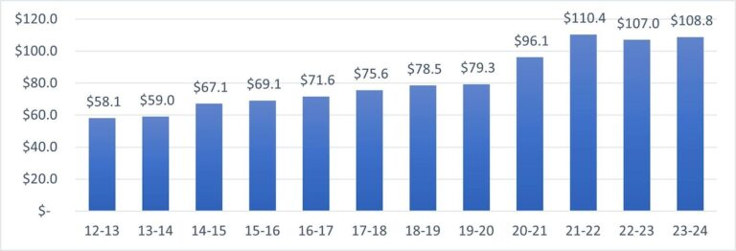
California Budget
Really too soon to tell - tax deferment to October.
$9B in School fund (PSSSA).
Prop 98 Funding:

Slide 34
Takeaways
Is a recession on the horizon?
Perhaps, but shallow?
Many indicators are still in the black.
2022-Q4 GDP growth was pretty good!
Threats to continued growth:
If inflation starts to rise again, which seems unlikely.
Layoff contagion.
Broader banking crisis.
Borrowing and lending seem to be low and shrinking.
Debt ceiling negotiations
Significant cuts to government budgets may well result.
Everything changes with a default on the U.S. debt.

Slide 35
Thank you!
Any Questions?
www.NEEDelegation.org
Jon D. Haveman
Jon@NEEDelegation.org
Contact NEED: info@NEEDelegation.org
Submit a testimonial: www.NEEDelegation.org/testimonials.php
Become a Friend of NEED: www.NEEDelegation.org/friend.php

