Slide 1
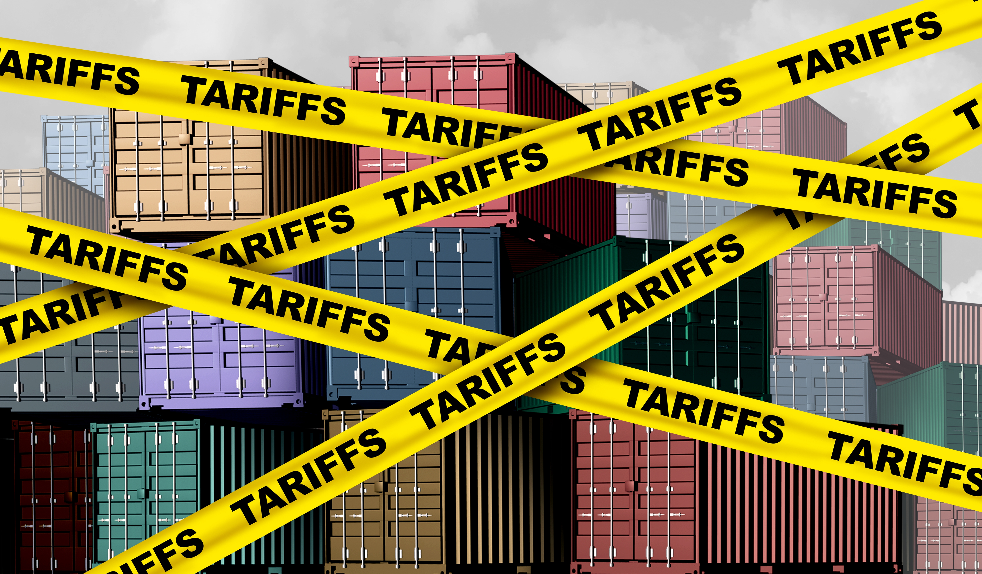
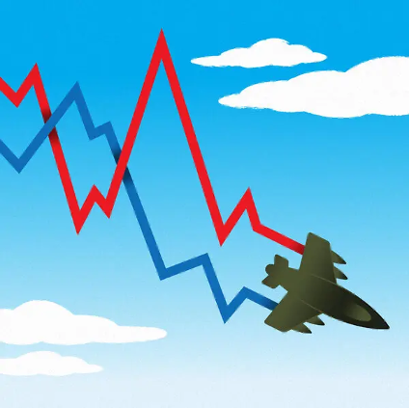

Economic Update
Marin County Dept of Education
Property Tax Forum
May 5, 2026
Jon Haveman, Ph.D.
Executive Director, NEED

Slide 2
Outline
Economic Indicators
Big Picture: Uncertainty

Slide 3
Economic Indicators

Slide 4
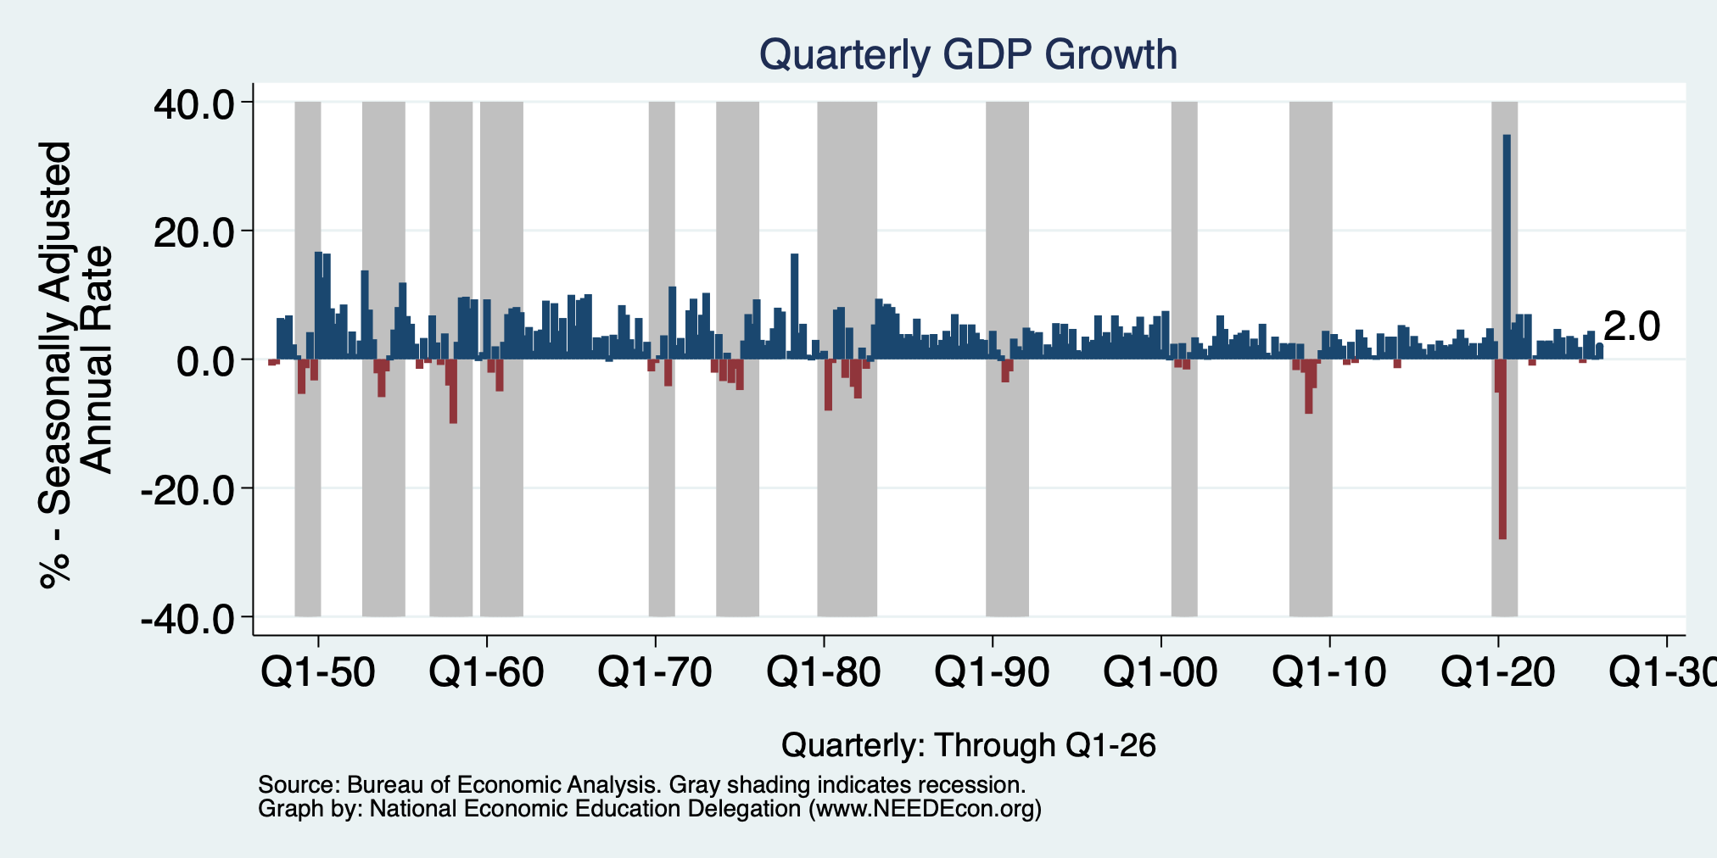
GDP: Quarterly Growth
Q2-2025: 3.8%
Q3-2025: 4.4%
Q4-2025: 0.5%
Q1-2026: 2.0%
Growth in 2025: 2.1%
Notes:
Graph: gdp_pot_grow.png
The Point: From 1990 – 2007, average annual US GDP growth pre-crisis is 2.94%. However, post-crisis US GDP growth is 2.19% (0.75 percentage points lower). Why is has the recovery been sluggish?
Note: At the recession’s height, the gap between quarterly GDP growth and potential growth was 2.5 percentage points.

Slide 5
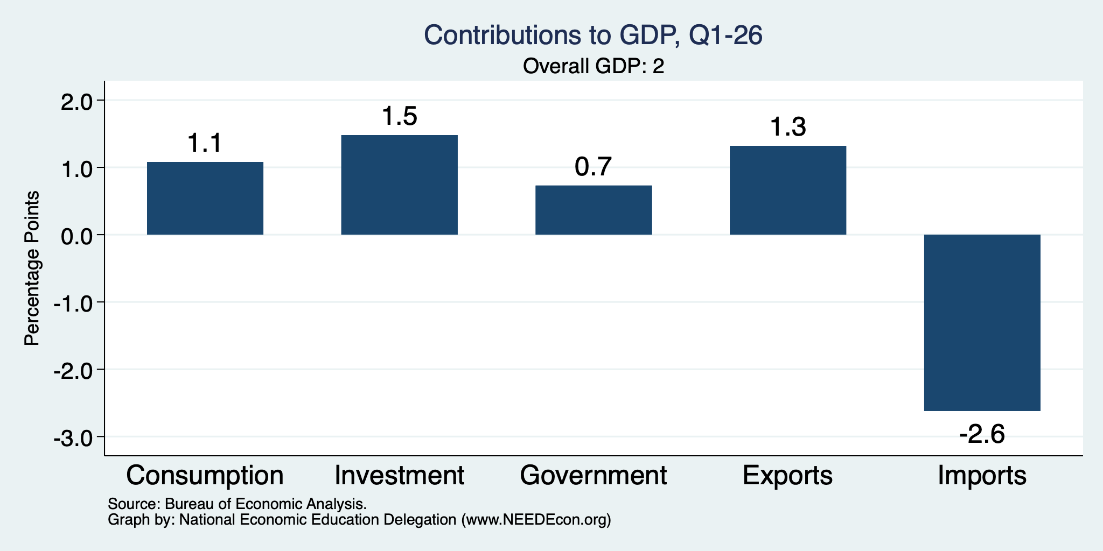
What Drove GDP to Such Growth?
Normally
2.3%

Slide 6
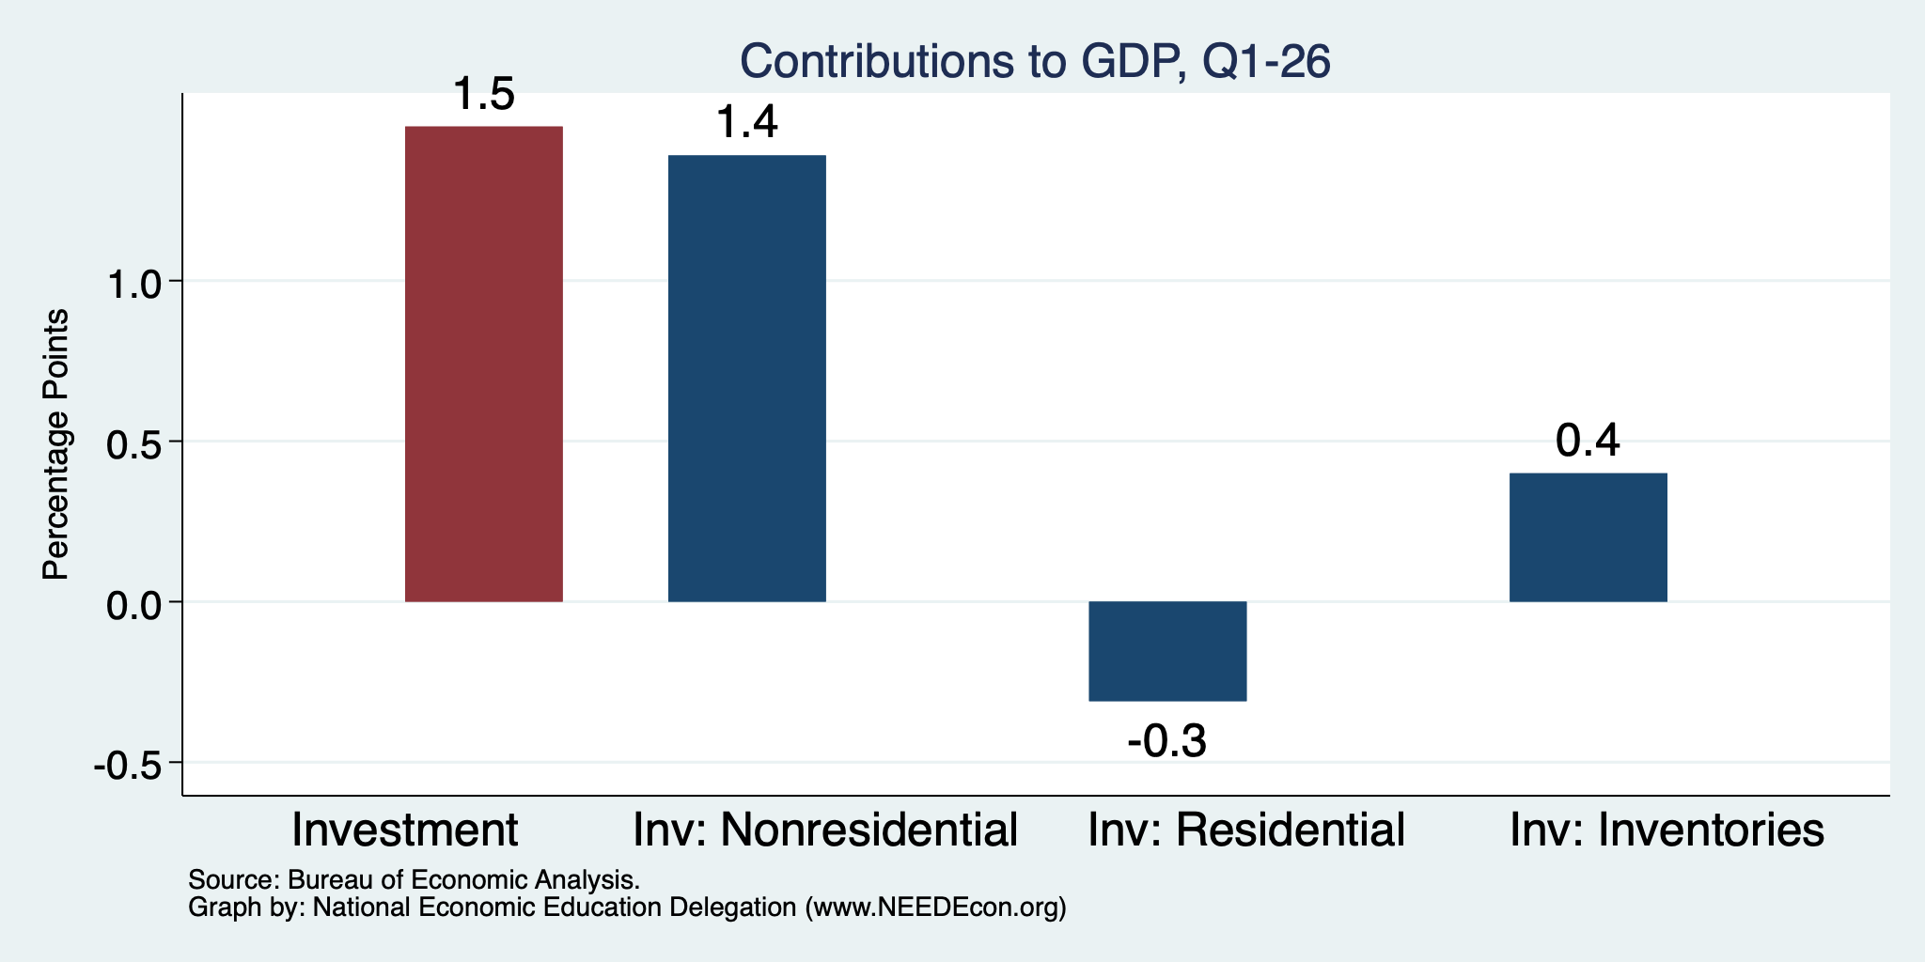
Investment Levels Are Low
Normally
About 0.9
Normally
About 0.8

Slide 7
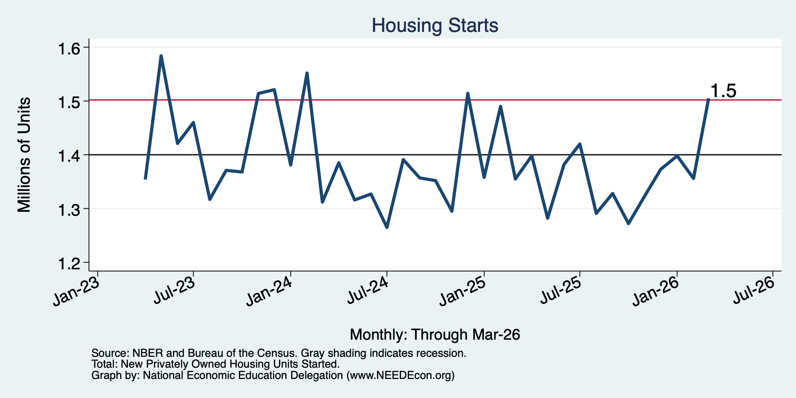
Housing Starts: A Little Low Throughout 2025

Slide 8
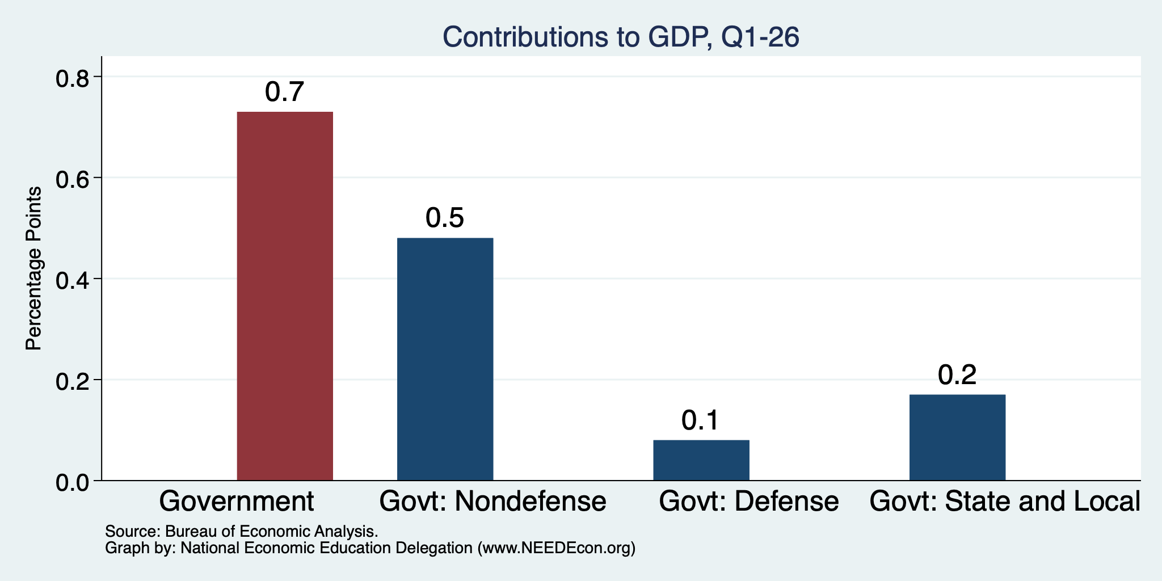
Government Spending Didn’t Help

Slide 9
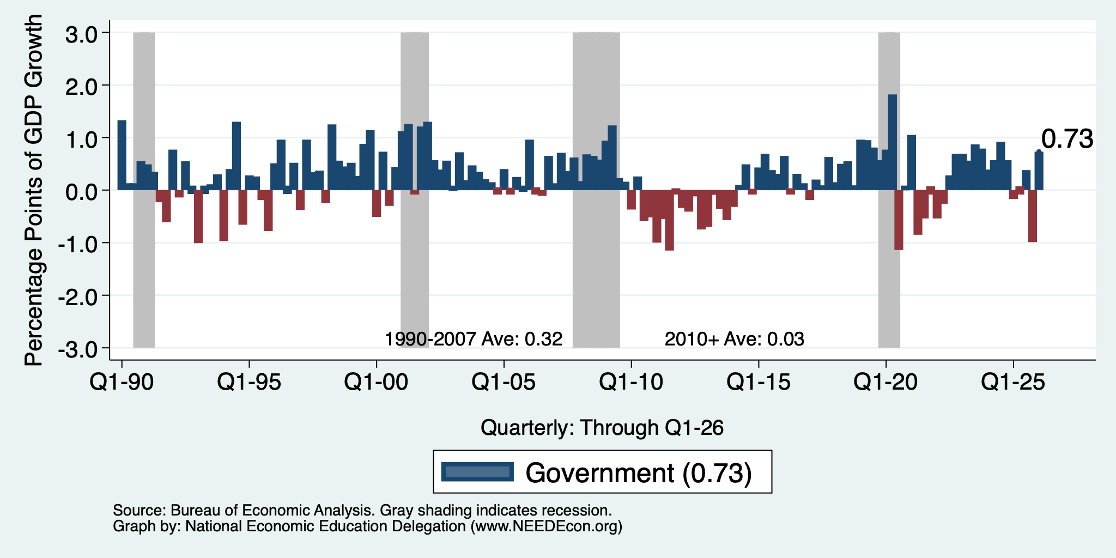
Contributions to GDP: Government
Notes:
Since 2010, average government spending growth is shrinking, resulting in a negative average contribution to GDP growth post-recession of -0.8 percentage points
Note that average quarterly government spending growth is 0.42% from 1990-2007 and -0.17% in 2010+ (annualized, 1990-2007 = 1.68%; 2010+ = -0.70%).

Slide 10
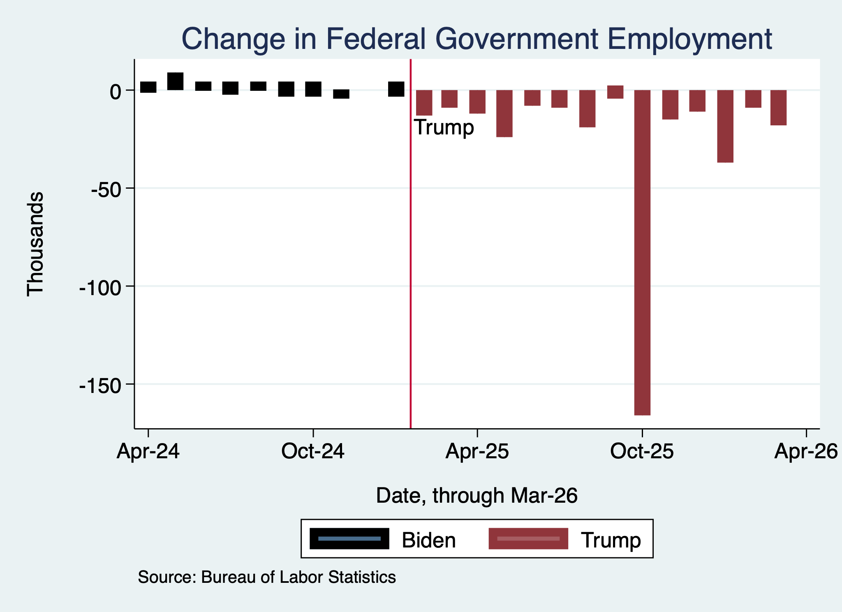
Monthly Changes in Federal Gov’t Employment
Notes:
PAYEMS.png

Slide 11
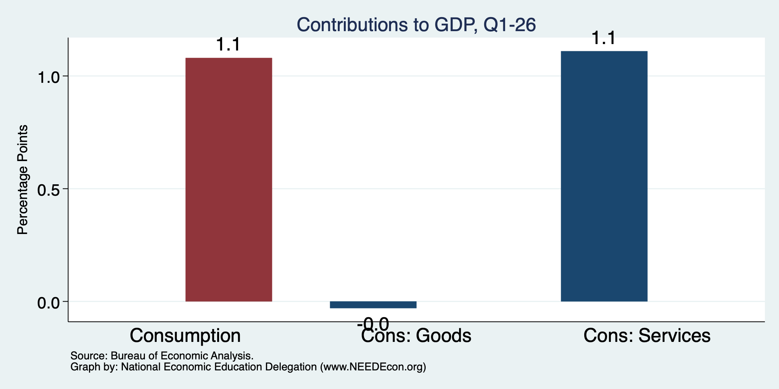
Consumers Also Tightened
Normally
2+%
Normally
0.8%

Slide 12
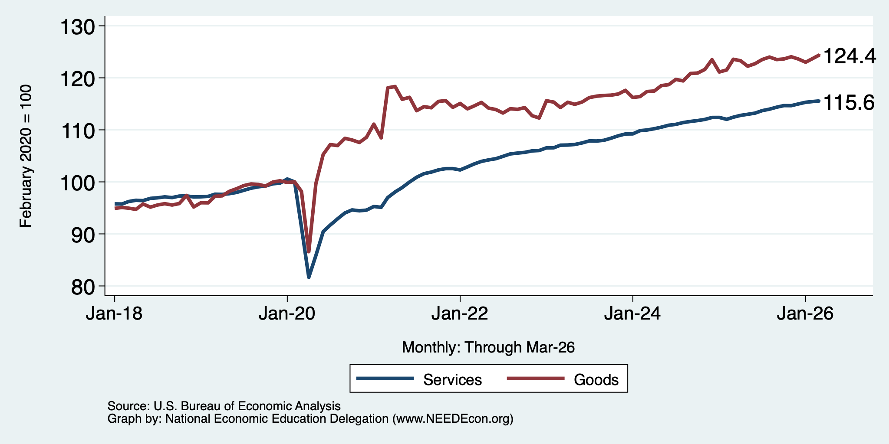
Consumers Spending Less on Goods
Flat

Slide 13
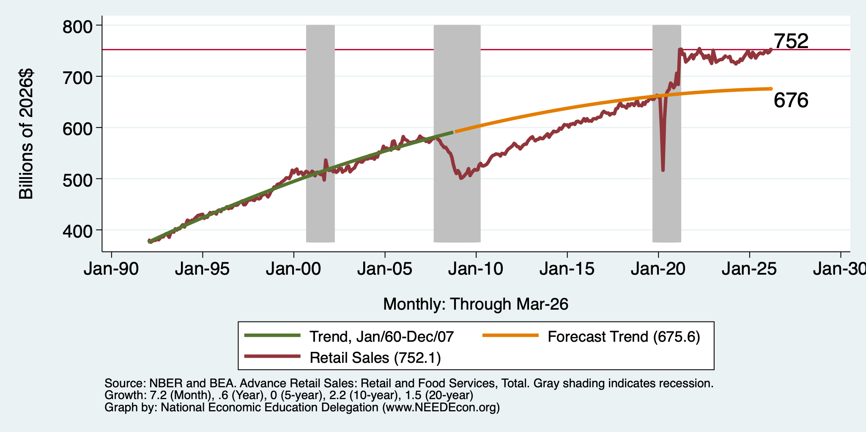
But SUPER High to Begin With!

Slide 14
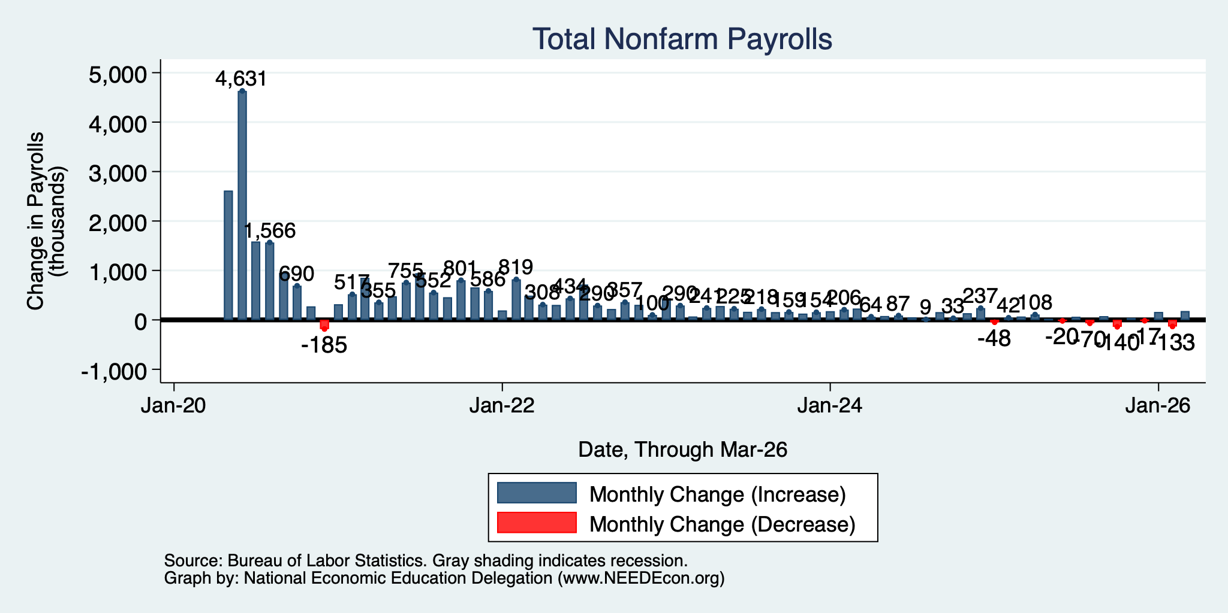
Monthly Changes in Nonfarm Employment
Jan: 160,000
Feb: -133,000
Mar: 178,000
Notes:
PAYEMS.png

Slide 15
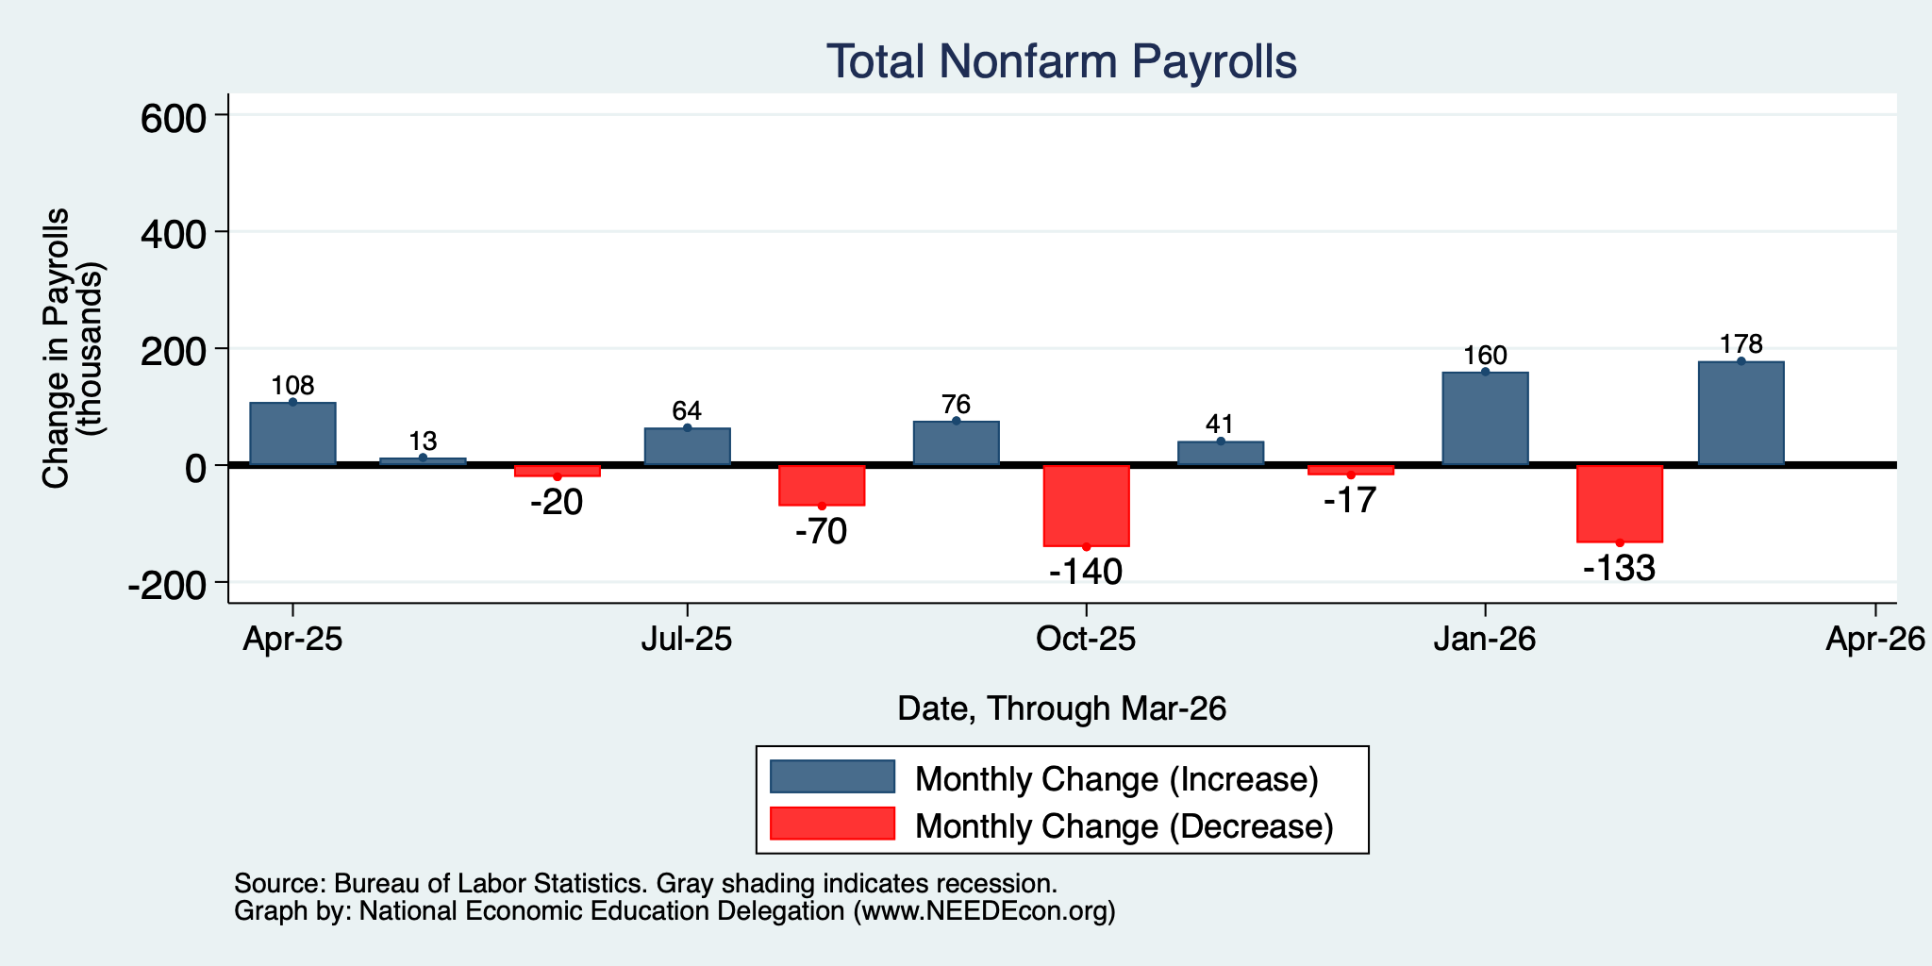
Monthly Changes in Nonfarm Employment
Jan: 160,000
Feb: -133,000
Mar: 178,000
Notes:
PAYEMS.png

Slide 16
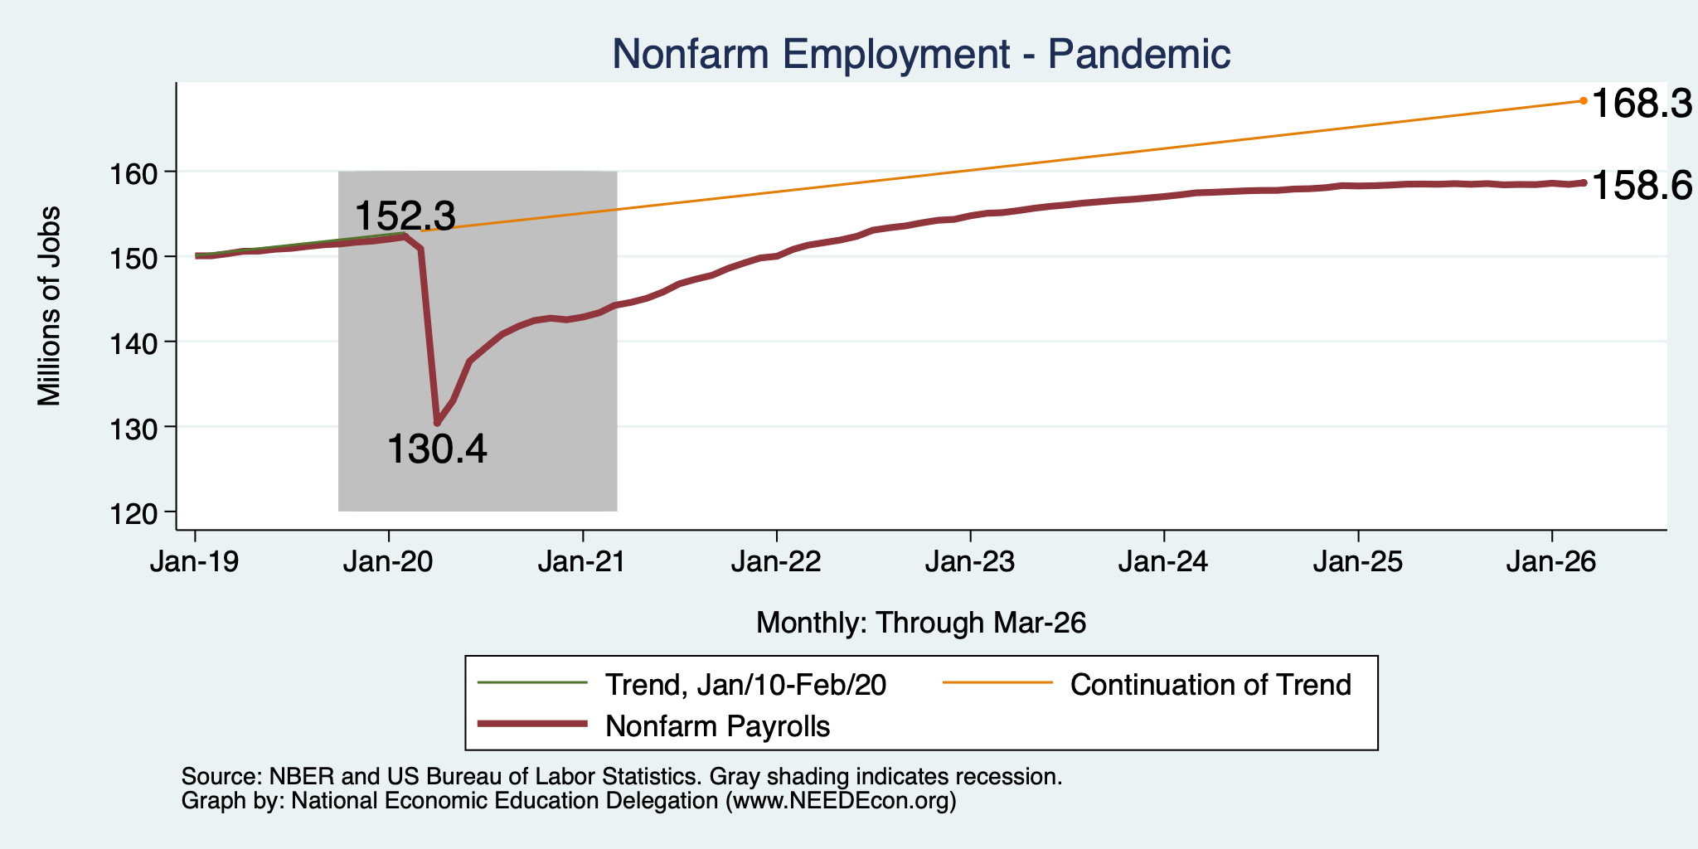
Employment Gap … is Growing
7.2 Million ABOVE February, 2020.
7.3 Million BELOW where we should be.
Notes:
payroll_recent.png

Slide 17
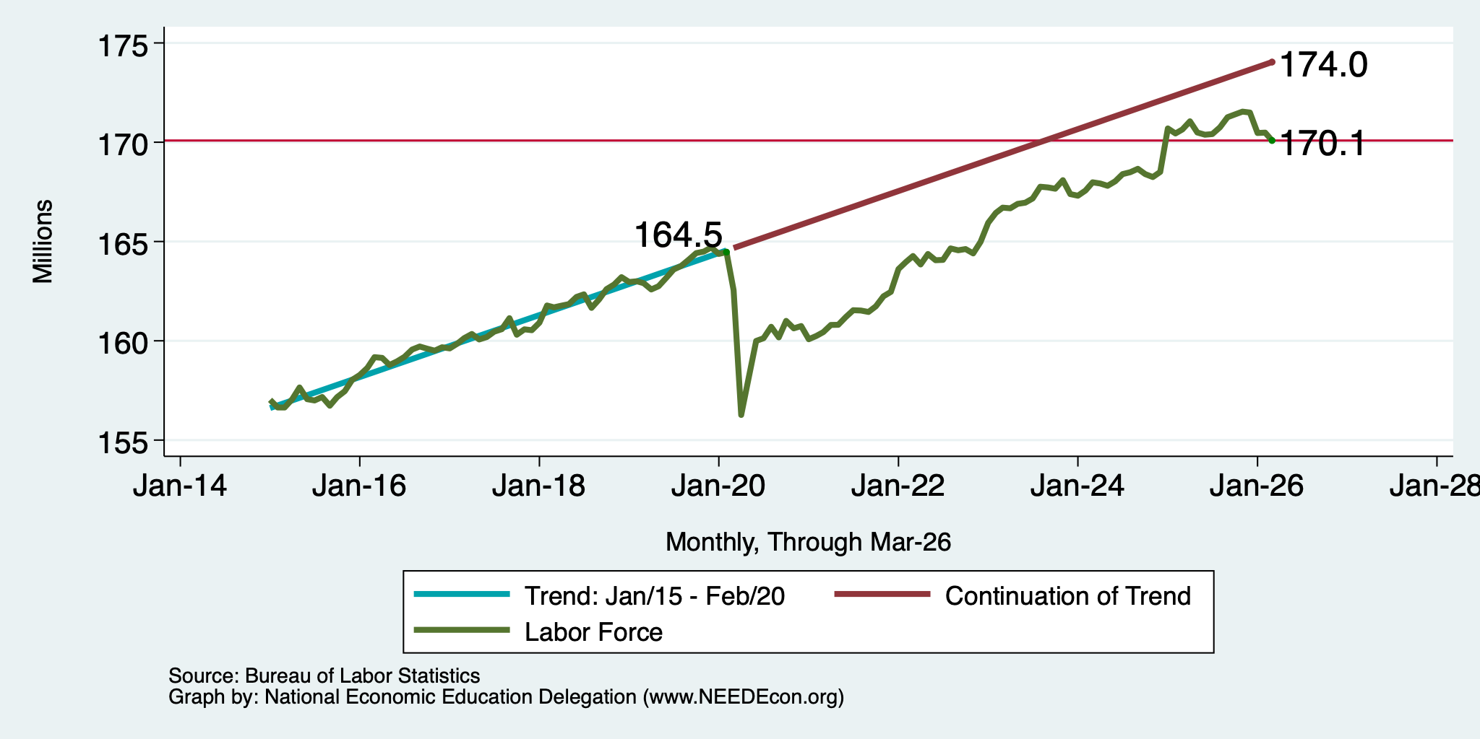
Workers Are Coming Back
6.6 million ABOVE Feb 2020
1.5 million BELOW where we should be

Slide 18
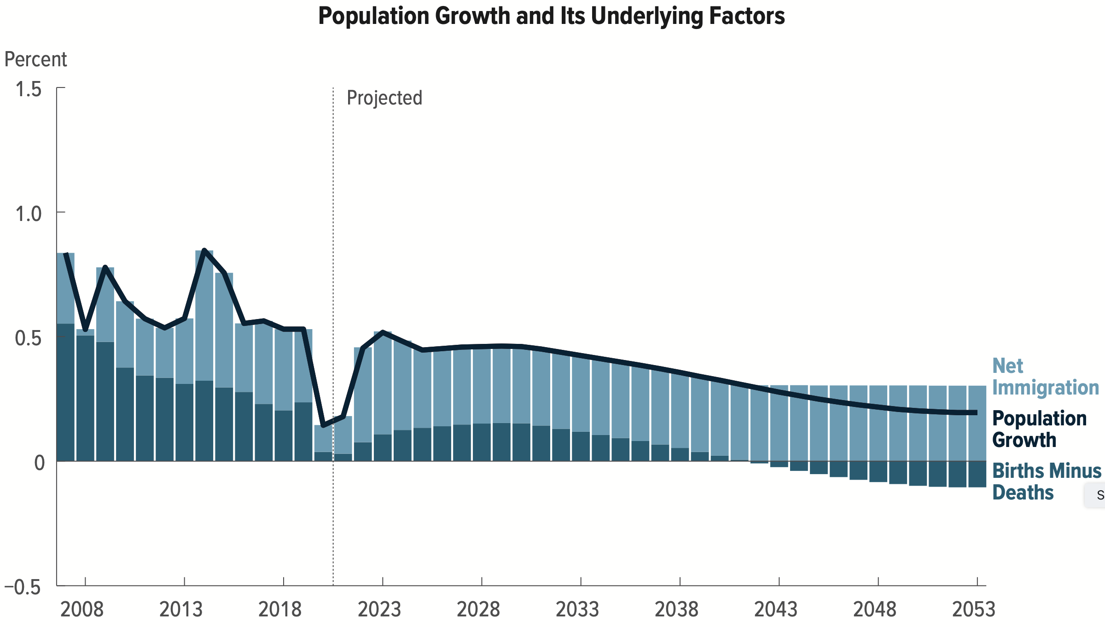
Is Immigration Saving the Day?
Source: CBO – The Demographic Outlook, 2023-2053

Slide 19
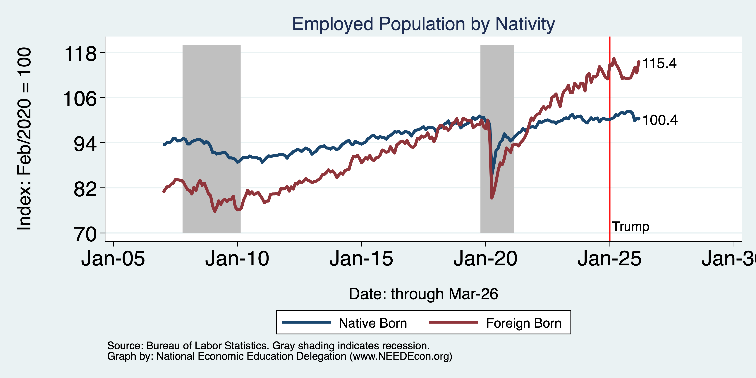
Immigrants to the Rescue? No longer
Notes:
Feb 2020: 130,320 Native born 27,697 foreign born
Aug 2025: 132,474 Native 30,816 foreign born March 2025 peak: 32,225

Slide 20
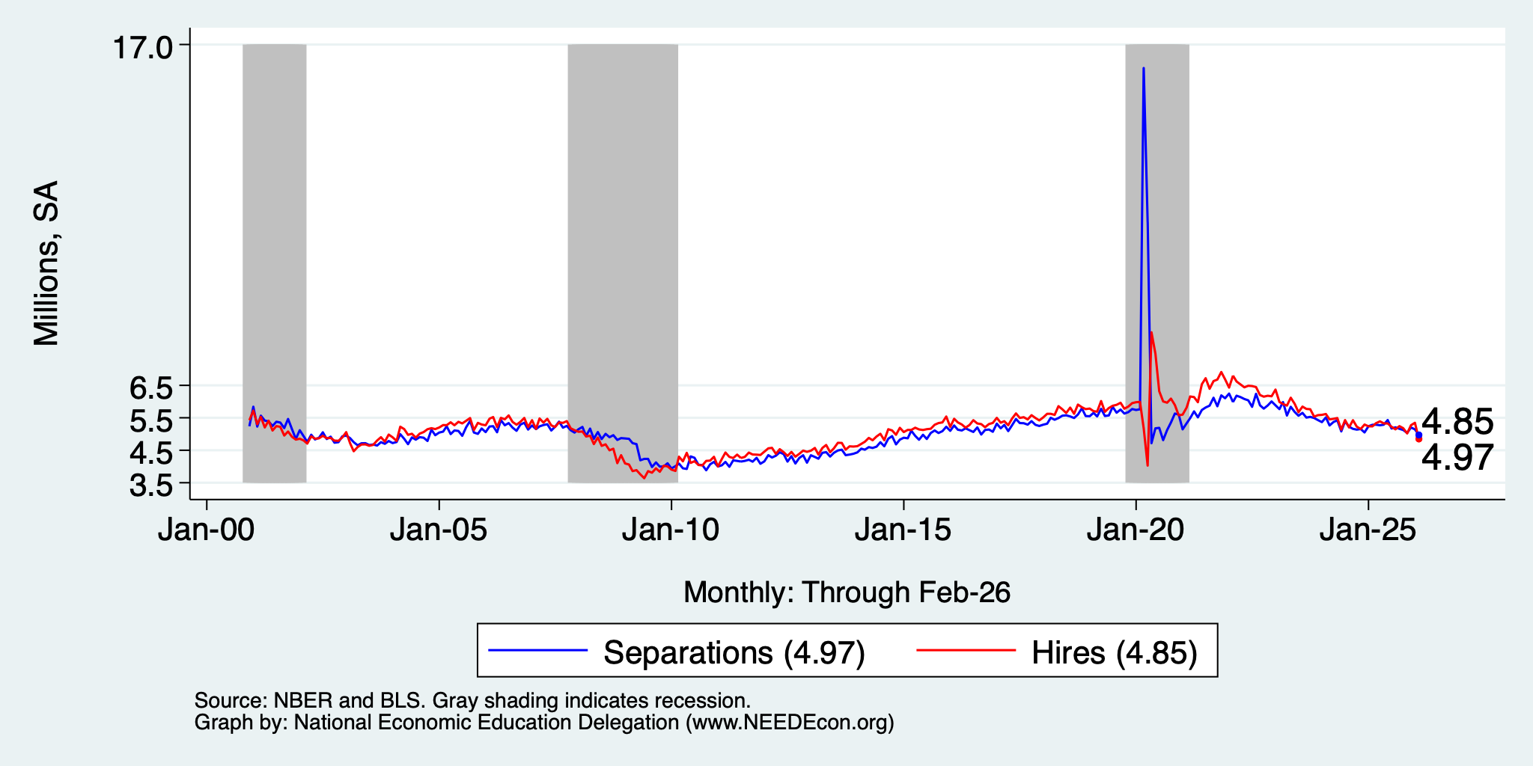
Great Hesitation

Slide 21
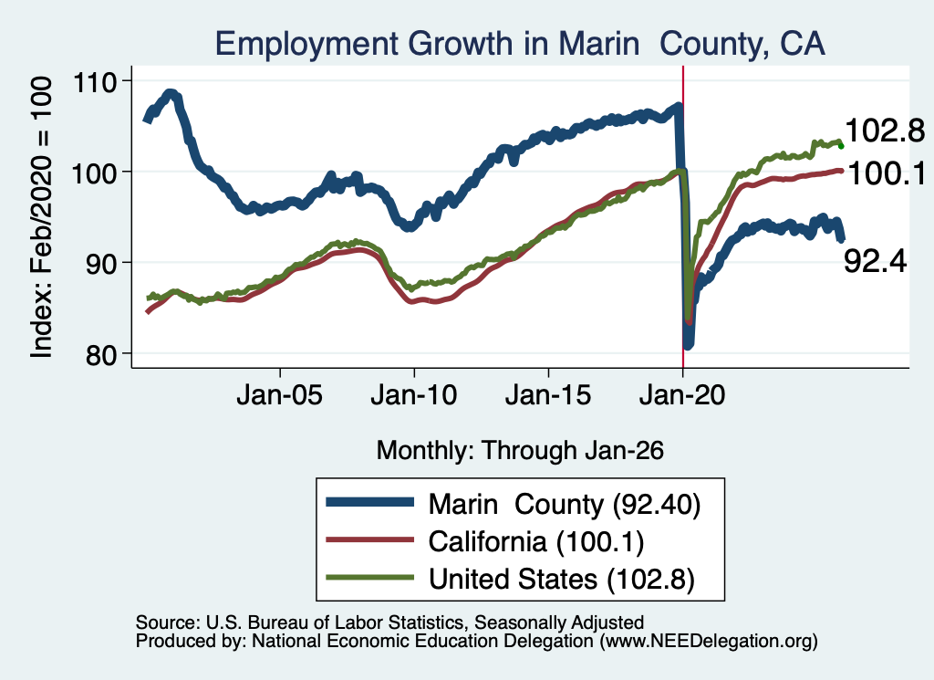
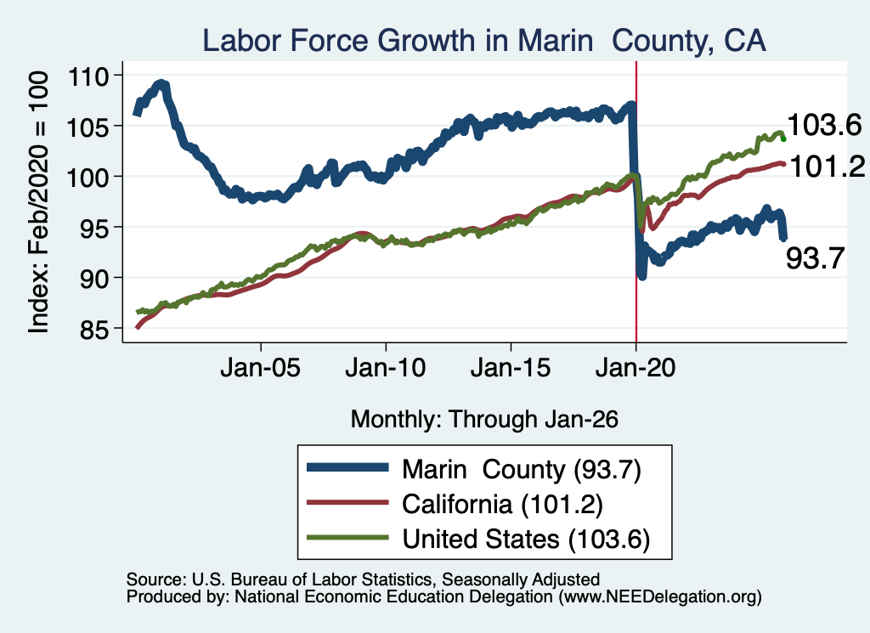
Labor Market Experience: Marin County

Slide 22
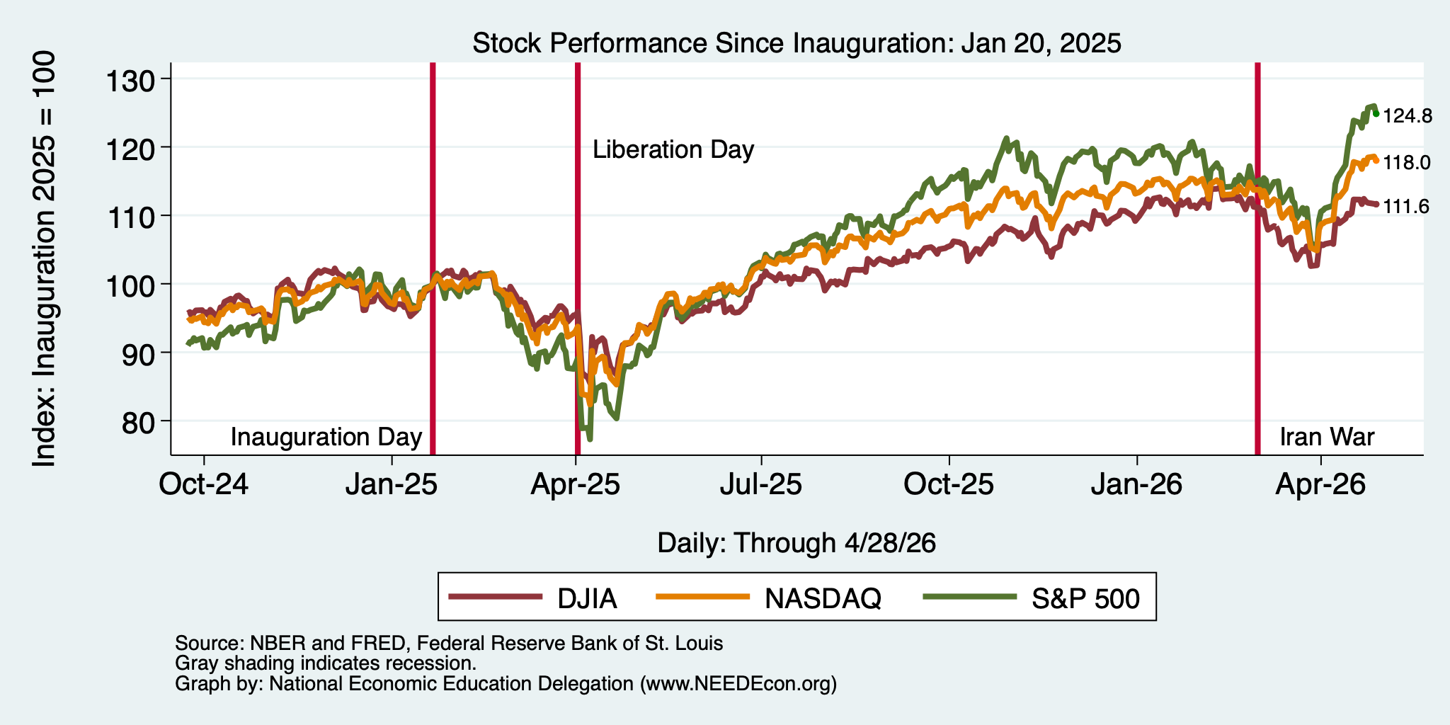
And Stocks?

Slide 23
Inflation

Slide 24
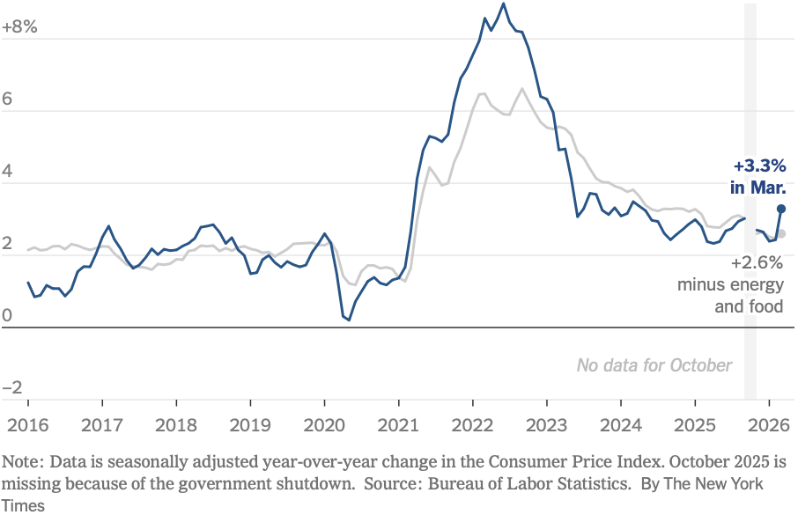
Inflation: Latest Figures
The uptick is entirely because of the war.
Source: NYTimes.com

Slide 25
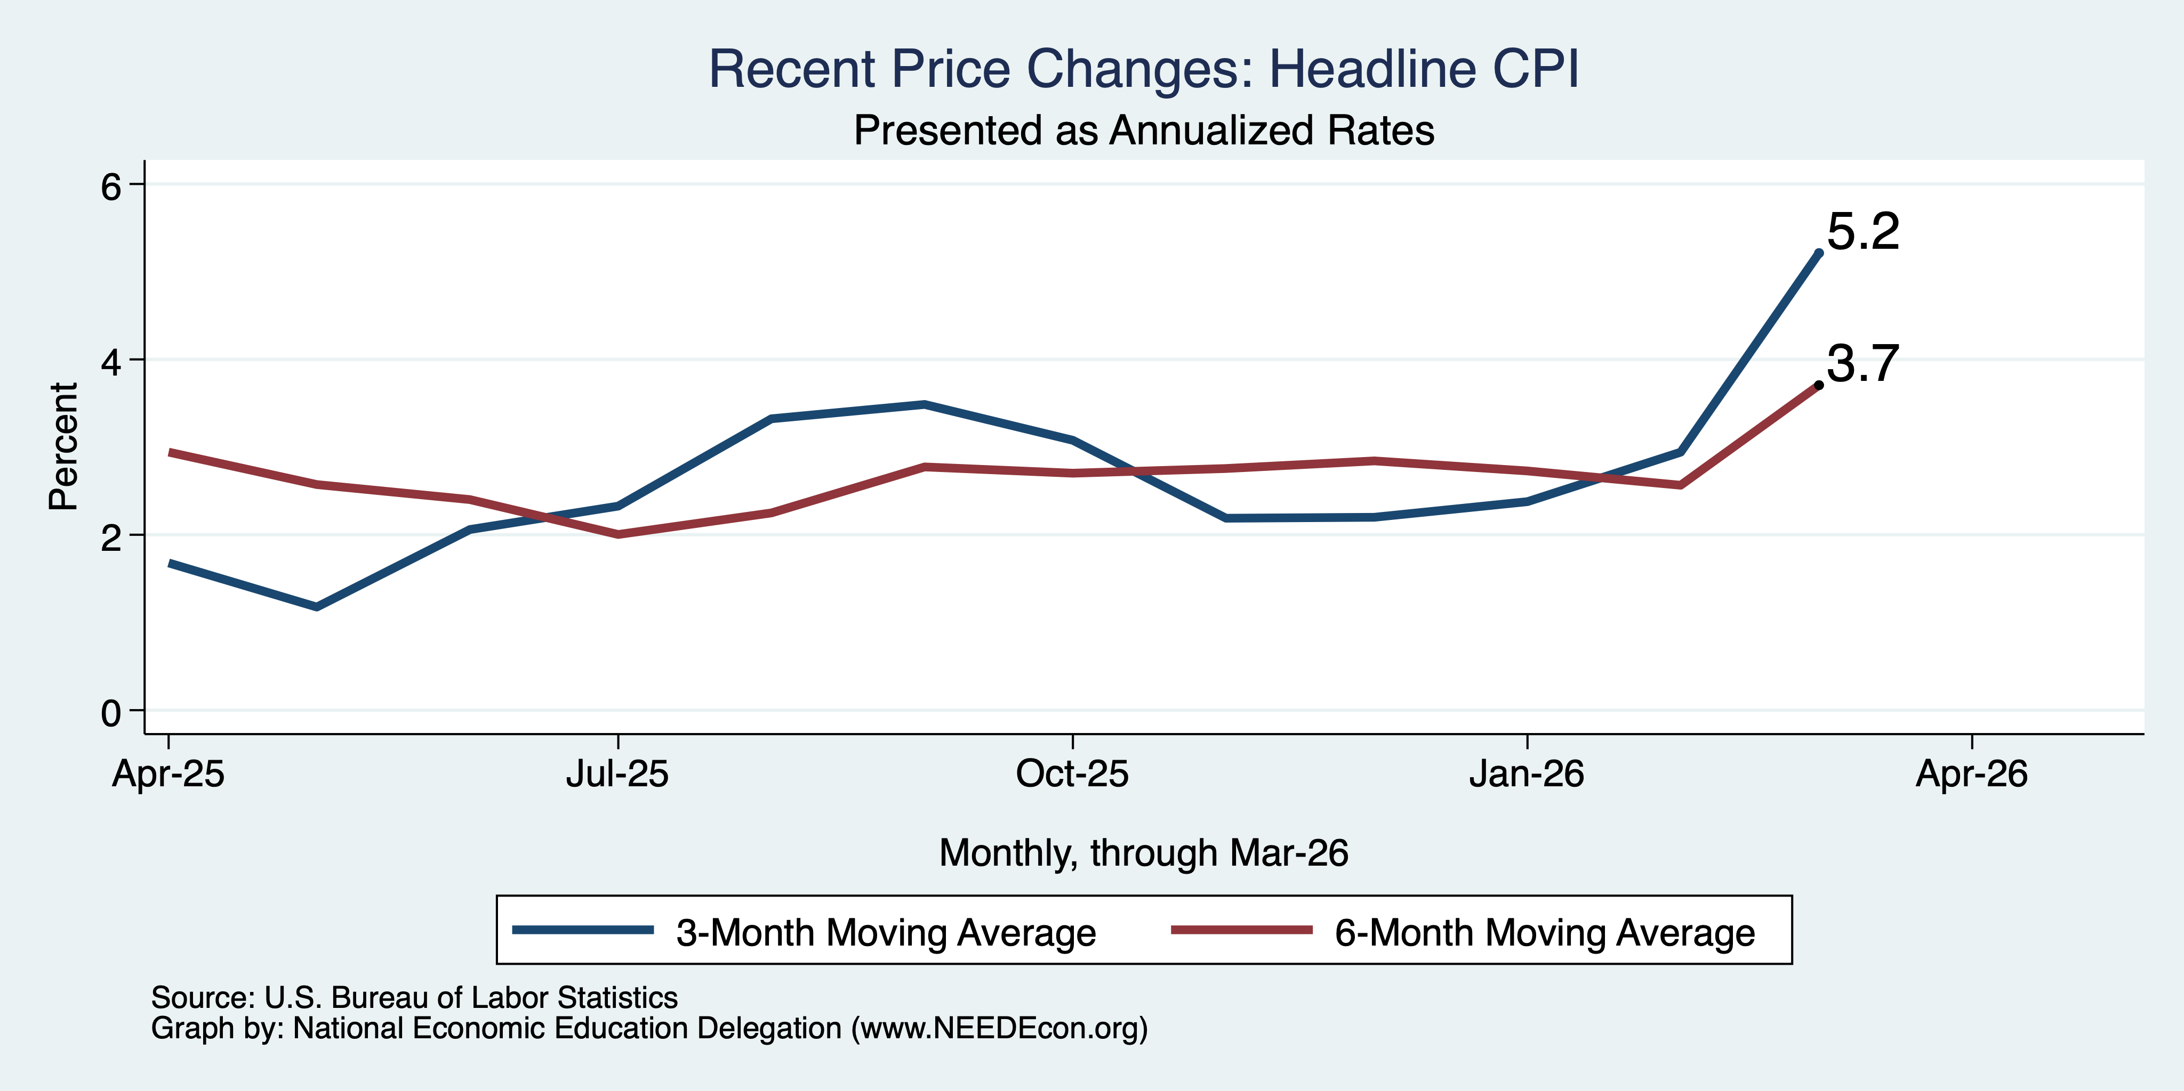
Inflation in the Last 3/6 Months – Still 3%

Slide 26
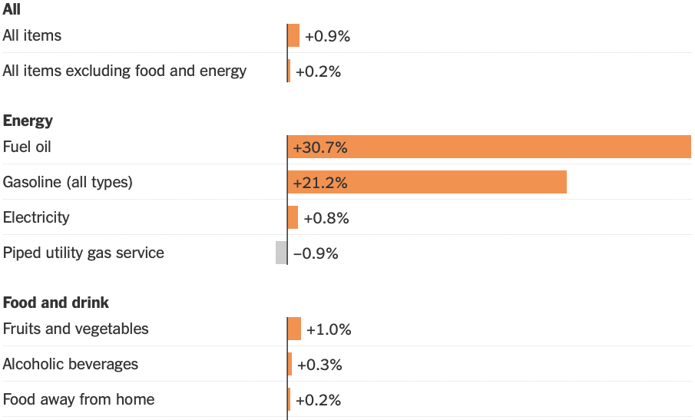
Inflation: Latest Monthly Figures
Source: NYTimes.com

Slide 27
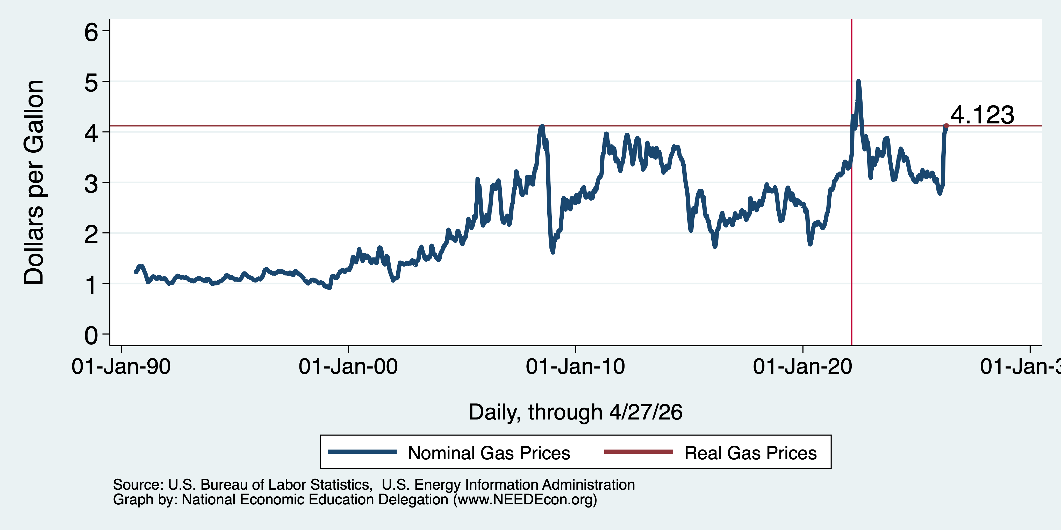
Inflation: Gas Prices

Slide 28
The Fed: Conservative

Slide 29
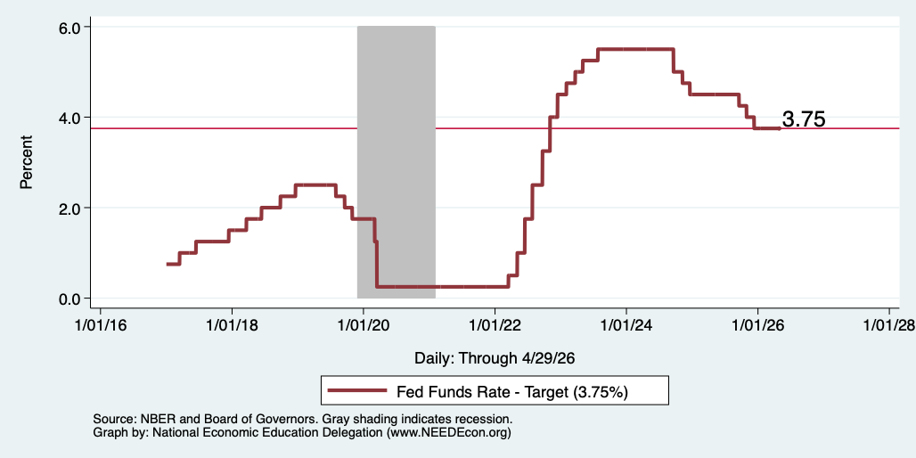
Federal Funds Rate
Notes:
The fed funds rate is the interest rate on overnight loans between banks. Think of it as the baseline interest rate on which banks base all other interest rates (e.g. mortgage rates)
FOMC lowers the fed funds rate during recessions and raises the fed funds rate during expansions
Fed funds rate peaked in the 1980s as then Chairman Paul Volcker sought to reign in “run away” inflation of the 1970s; doing so resulted in a recession in the early 1980s.
Since the 2008-09 recession, the fed funds rate has been kept near zero.
During the 2008-09 recession, Federal Reserve turned to unconventional tools to influence longer term interest rates to further stimulate the economy - QE
FedFunds.png

Slide 30
What will the Fed Do?
Likely sit tight at 3.75 for a while.
Next FOMC meeting is June 16-17.
Notes:
GDPNow 2.4%; blue chips consensus 1.5% implies 2.9%, or 2.7%

Slide 31
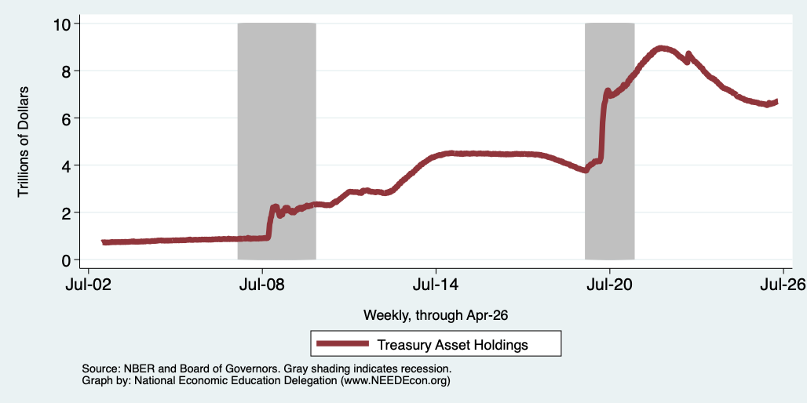
Fed: Reducing its Asset Holdings
Holding Pattern

Slide 32
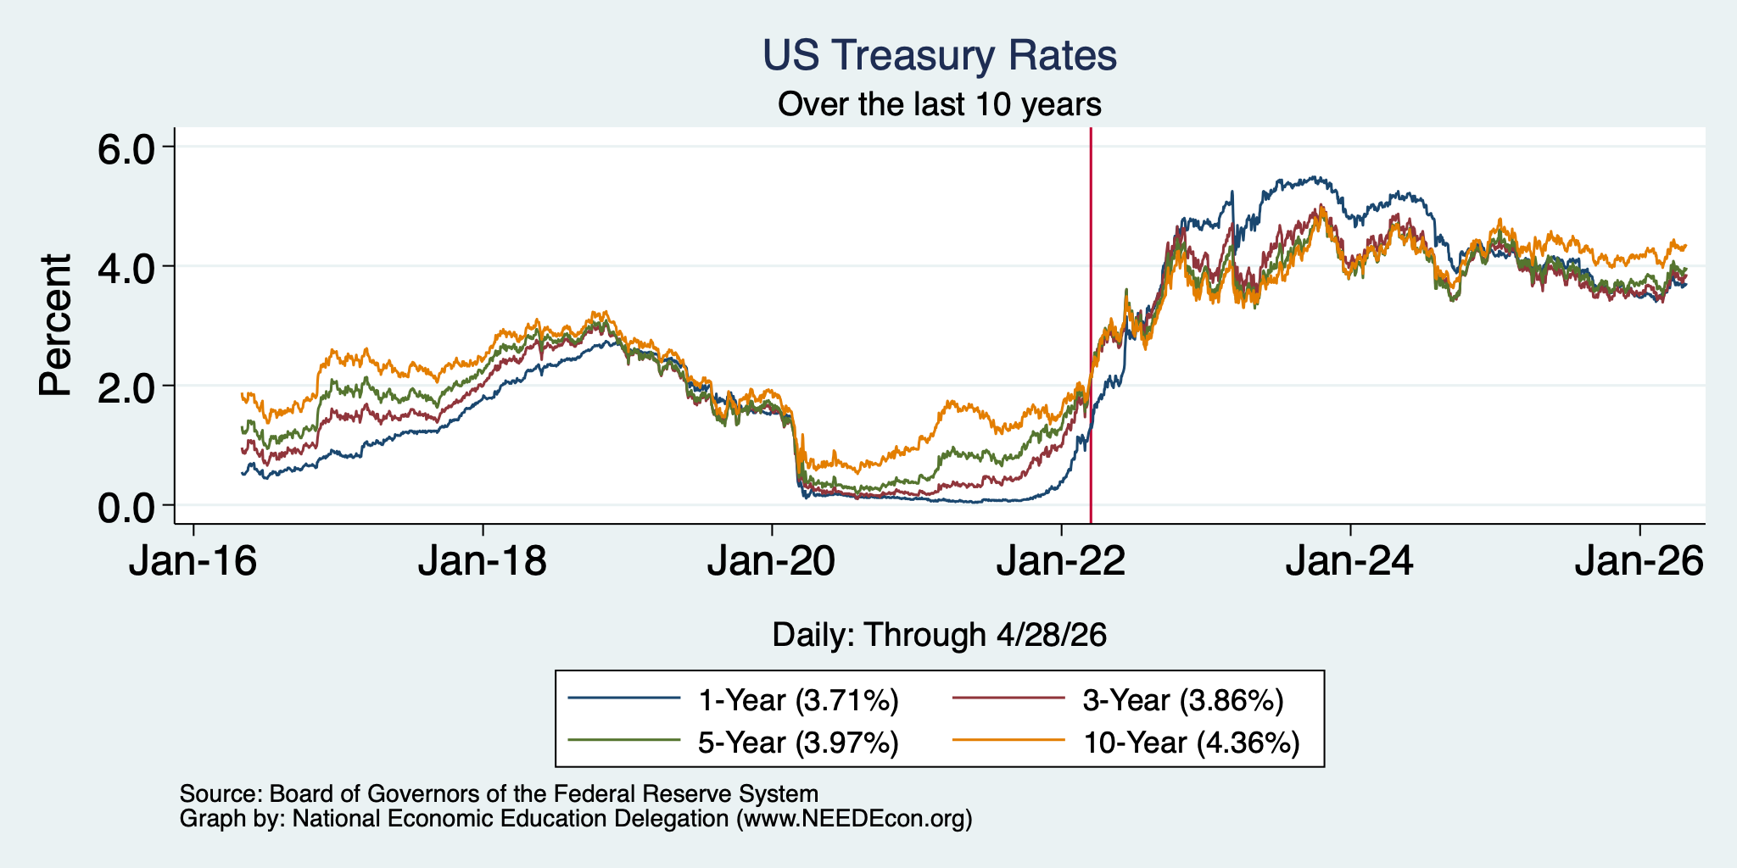
Treasuries
Notes:
treas_recent.png

Slide 33
Takeaways
Is a recession on the horizon?
  I wouldn’t be surprised, but not betting on it.
    Jobs growth is slow.
    GDP growth is slow – but that was artificial.
    Inflation has ticked up.
Stagflation likely on the horizon.
The problem?
  Uncertainties abound!

Slide 34
Real Estate & Marin County

Slide 35
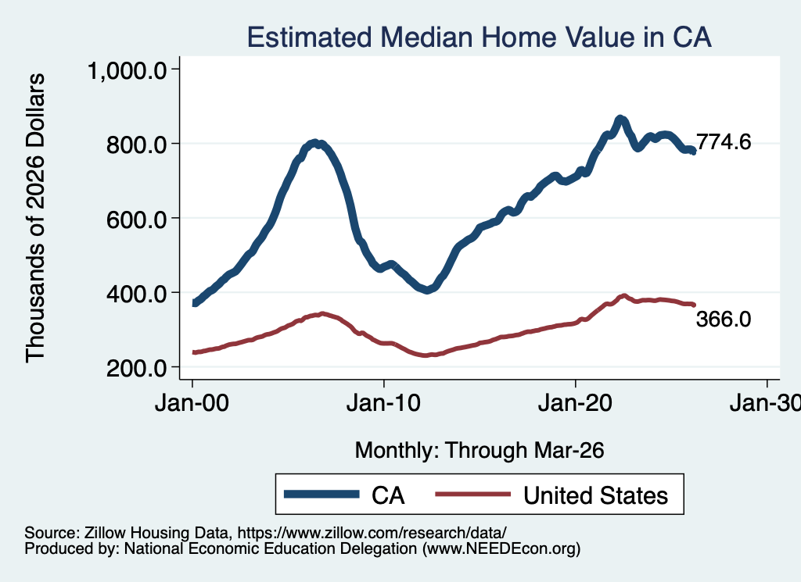
Real Estate Prices

Slide 36
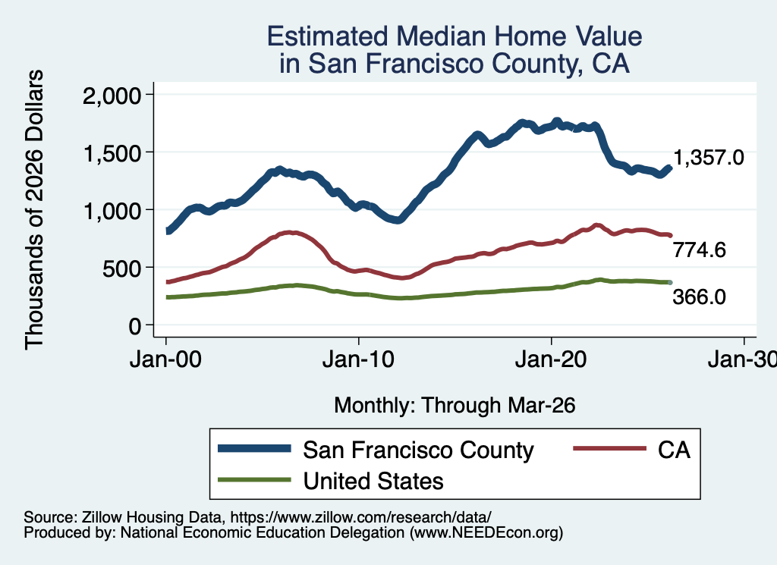
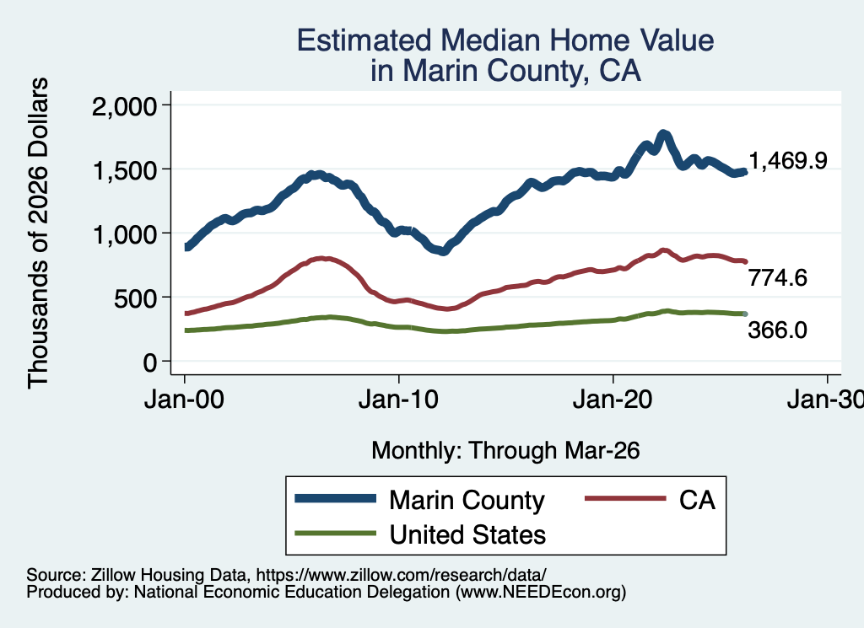
RE Experiences … Similar And Not Good

Slide 37
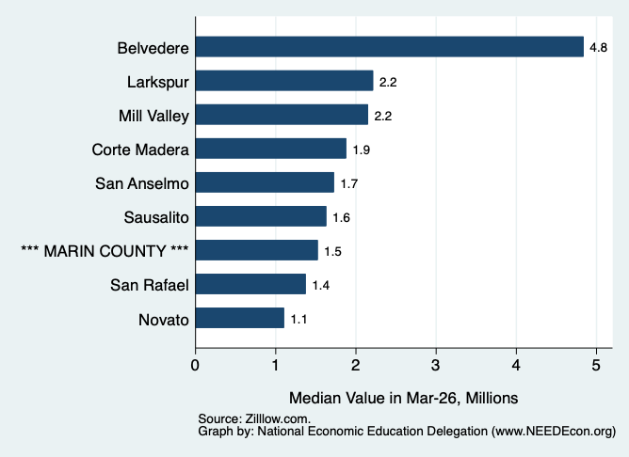
Median Home Prices w/in Marin

Slide 38
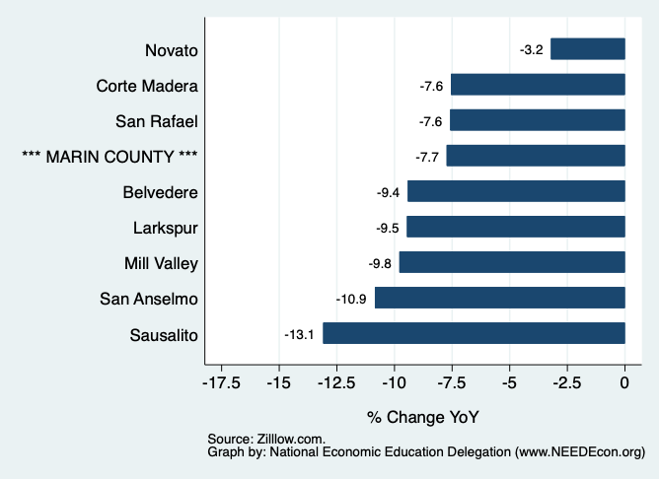
Home Price Changes w/in Marin

Slide 39
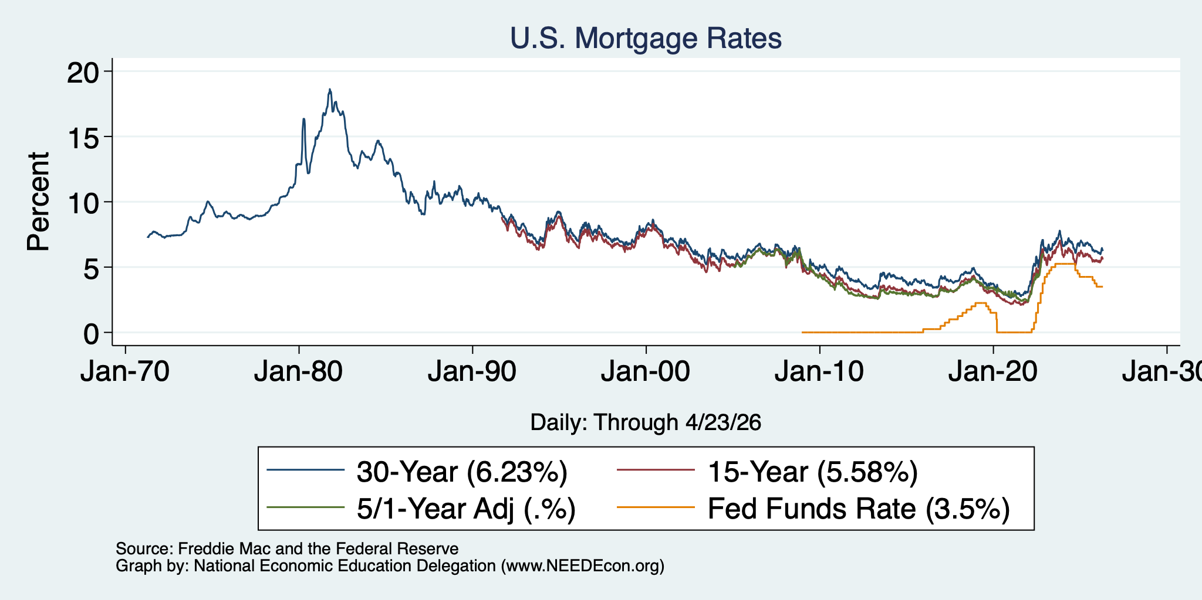
Mortgage Rates

Slide 40
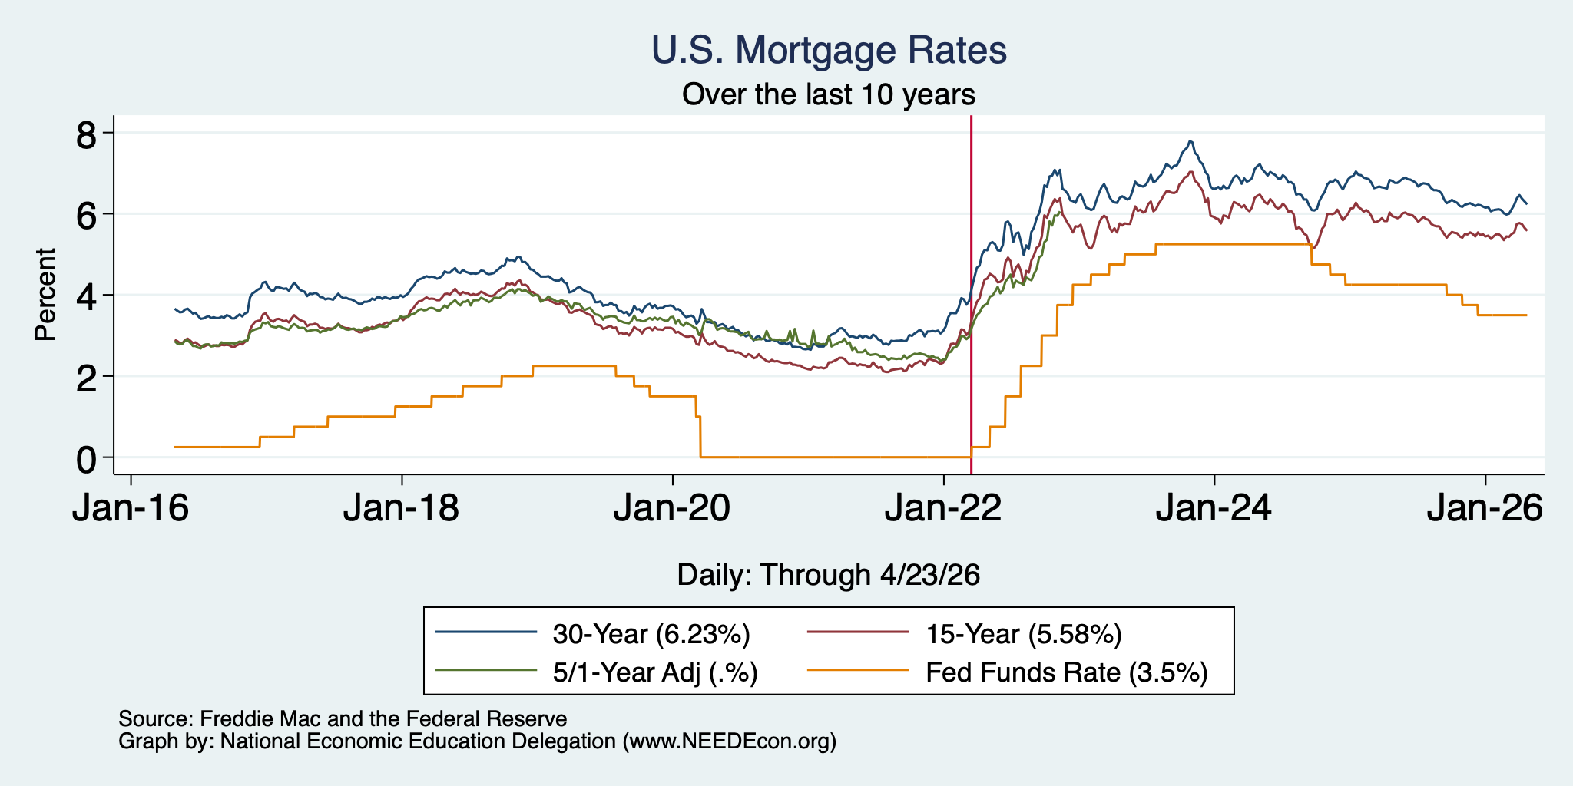
Mortgage Rates – Recent Experience

Slide 41
Takeaways
Is a recession on the horizon?
  I wouldn’t be surprised, but not betting on it.
    Jobs growth is slow.
    GDP growth is moderatel.
    Inflation has ticked up.
Stagflation likely on the horizon.
The problem?
  Uncertainties abound!

Slide 42
Bigger Picture: Uncertainty

Slide 43
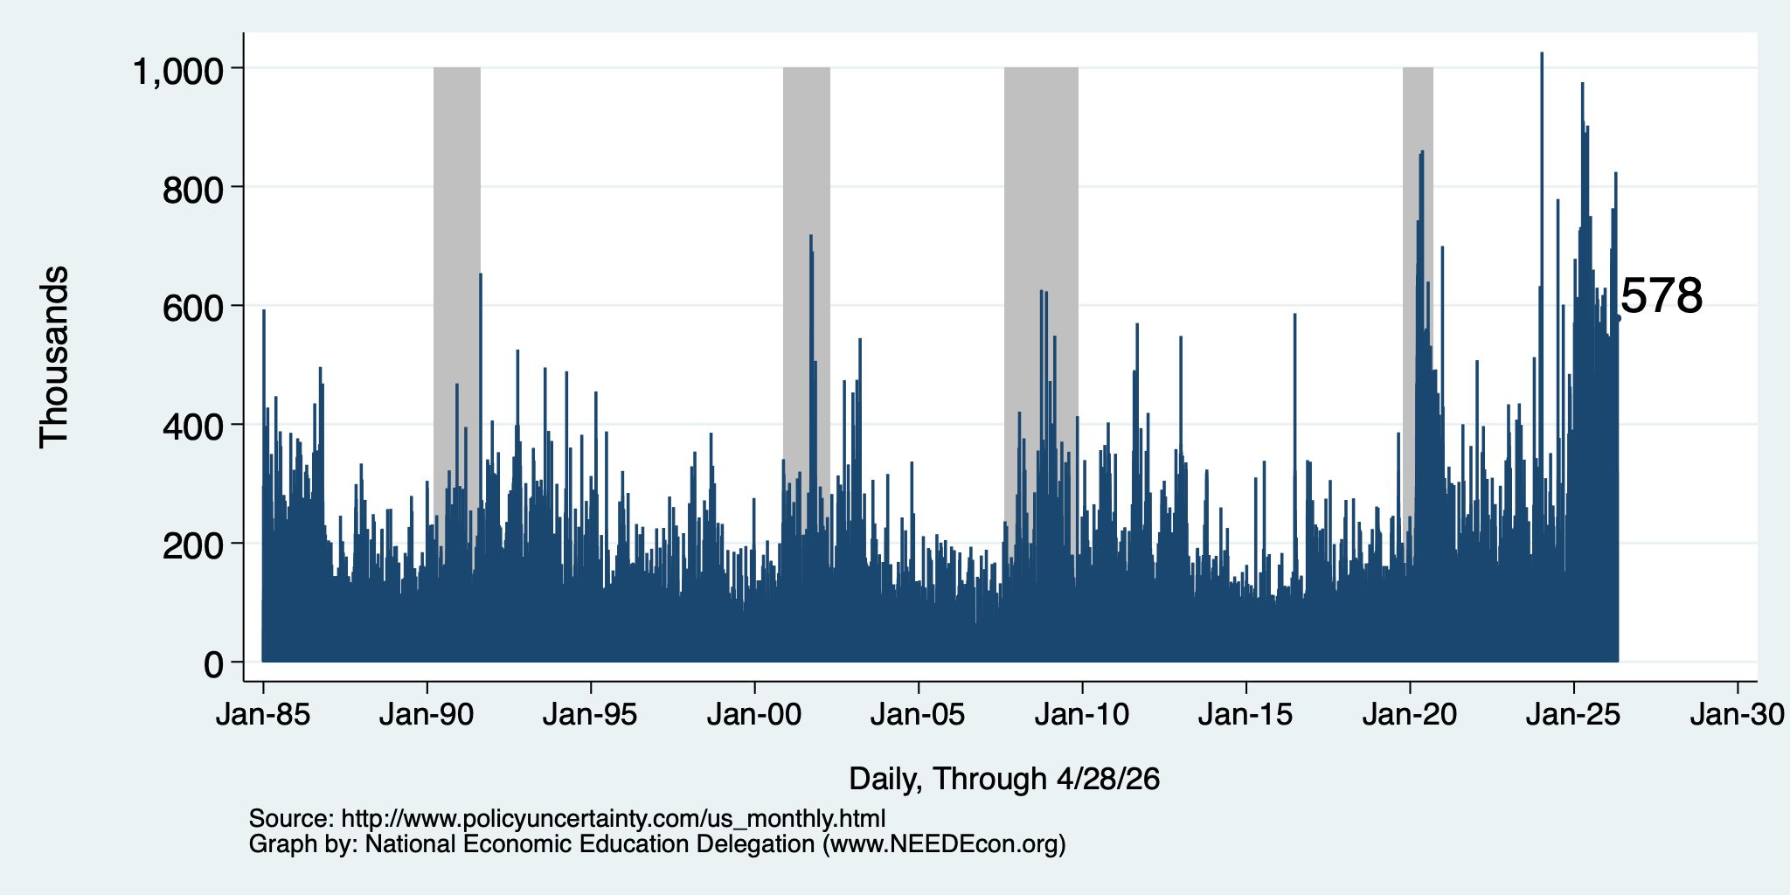
Policy Uncertainty Index
Notes:
The fed funds rate is the interest rate on overnight loans between banks. Think of it as the baseline interest rate on which banks base all other interest rates (e.g. mortgage rates)
FOMC lowers the fed funds rate during recessions and raises the fed funds rate during expansions
Fed funds rate peaked in the 1980s as then Chairman Paul Volcker sought to reign in “run away” inflation of the 1970s; doing so resulted in a recession in the early 1980s.
Since the 2008-09 recession, the fed funds rate has been kept near zero.
During the 2008-09 recession, Federal Reserve turned to unconventional tools to influence longer term interest rates to further stimulate the economy - QE
FedFunds.png

Slide 44
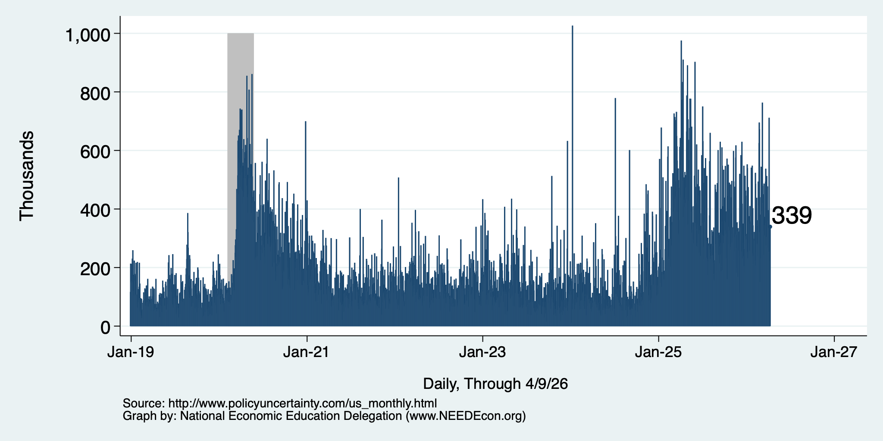
Policy Uncertainty Index – Last 10 Years
Notes:
The fed funds rate is the interest rate on overnight loans between banks. Think of it as the baseline interest rate on which banks base all other interest rates (e.g. mortgage rates)
FOMC lowers the fed funds rate during recessions and raises the fed funds rate during expansions
Fed funds rate peaked in the 1980s as then Chairman Paul Volcker sought to reign in “run away” inflation of the 1970s; doing so resulted in a recession in the early 1980s.
Since the 2008-09 recession, the fed funds rate has been kept near zero.
During the 2008-09 recession, Federal Reserve turned to unconventional tools to influence longer term interest rates to further stimulate the economy - QE
FedFunds.png

Slide 45
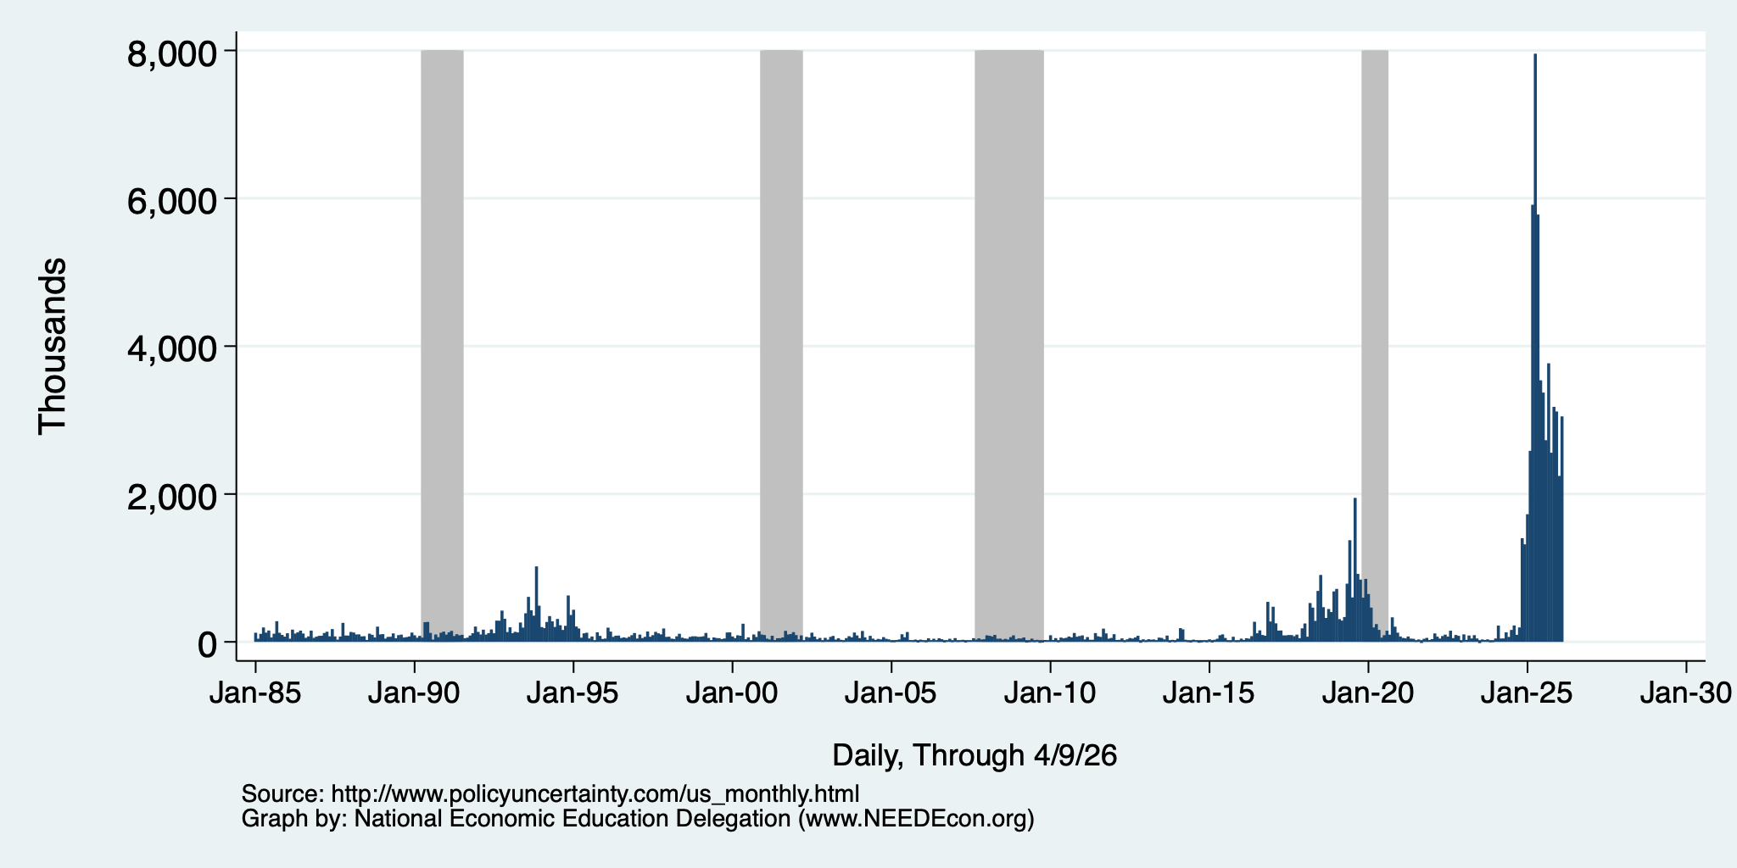
Policy Uncertainty Index – Trade
Notes:
The fed funds rate is the interest rate on overnight loans between banks. Think of it as the baseline interest rate on which banks base all other interest rates (e.g. mortgage rates)
FOMC lowers the fed funds rate during recessions and raises the fed funds rate during expansions
Fed funds rate peaked in the 1980s as then Chairman Paul Volcker sought to reign in “run away” inflation of the 1970s; doing so resulted in a recession in the early 1980s.
Since the 2008-09 recession, the fed funds rate has been kept near zero.
During the 2008-09 recession, Federal Reserve turned to unconventional tools to influence longer term interest rates to further stimulate the economy - QE
FedFunds.png

Slide 46
Uncertainties
What effect will continued deportations have?
Will AI continue to drive growth?
Will tariffs continue to drive inflation?
  Fed says that ALL of the inflation above 2% is from tariffs, until…
Will the war drive inflation beyond fuel prices?
  It is clear in fuel prices, but every other sector of the economy depends on fuel. Higher fuel prices drive prices in the rest of the economy up.
Will consumers continue to hold up?
  Evidence that spending is in decline.
What happens to Fed policy once Jerome Powell is gone?

Slide 47
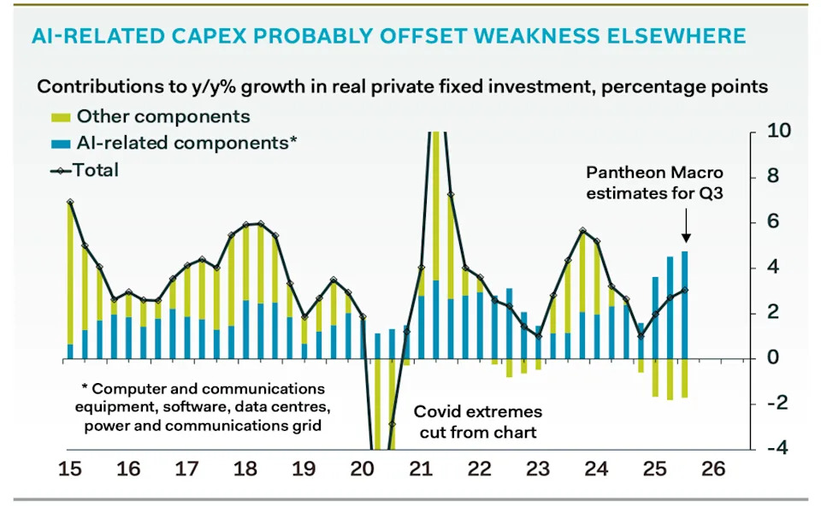
AI and Investment
AI Investment & GDP Growth
Period | GDP Growth | AI Contribution | Difference
25Q1 | 2.0 percent | 1.3 percent | 0.7 percent
25Q2 | 2.1 | 1.2 | 0.9
25Q3 | 2.3 | 0.5 | 1.8
Source: BEA & https://www.stlouisfed.org/on-the-economy/2026/jan/tracking-ai-contribution-gdp-growth
Source Parthenon: Macroeconomics

Slide 48
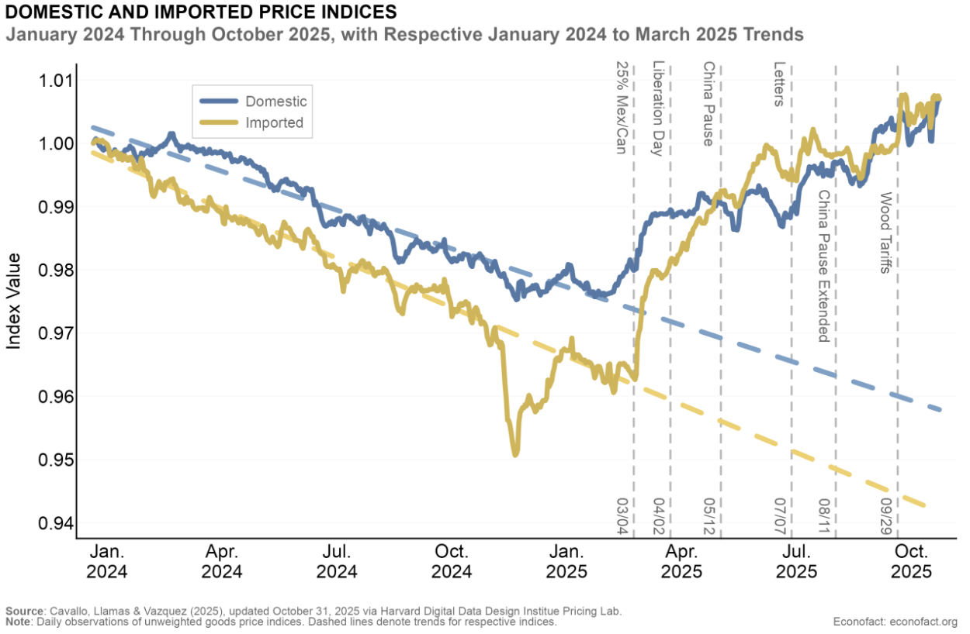
Tariffs and Price Effects

Slide 49
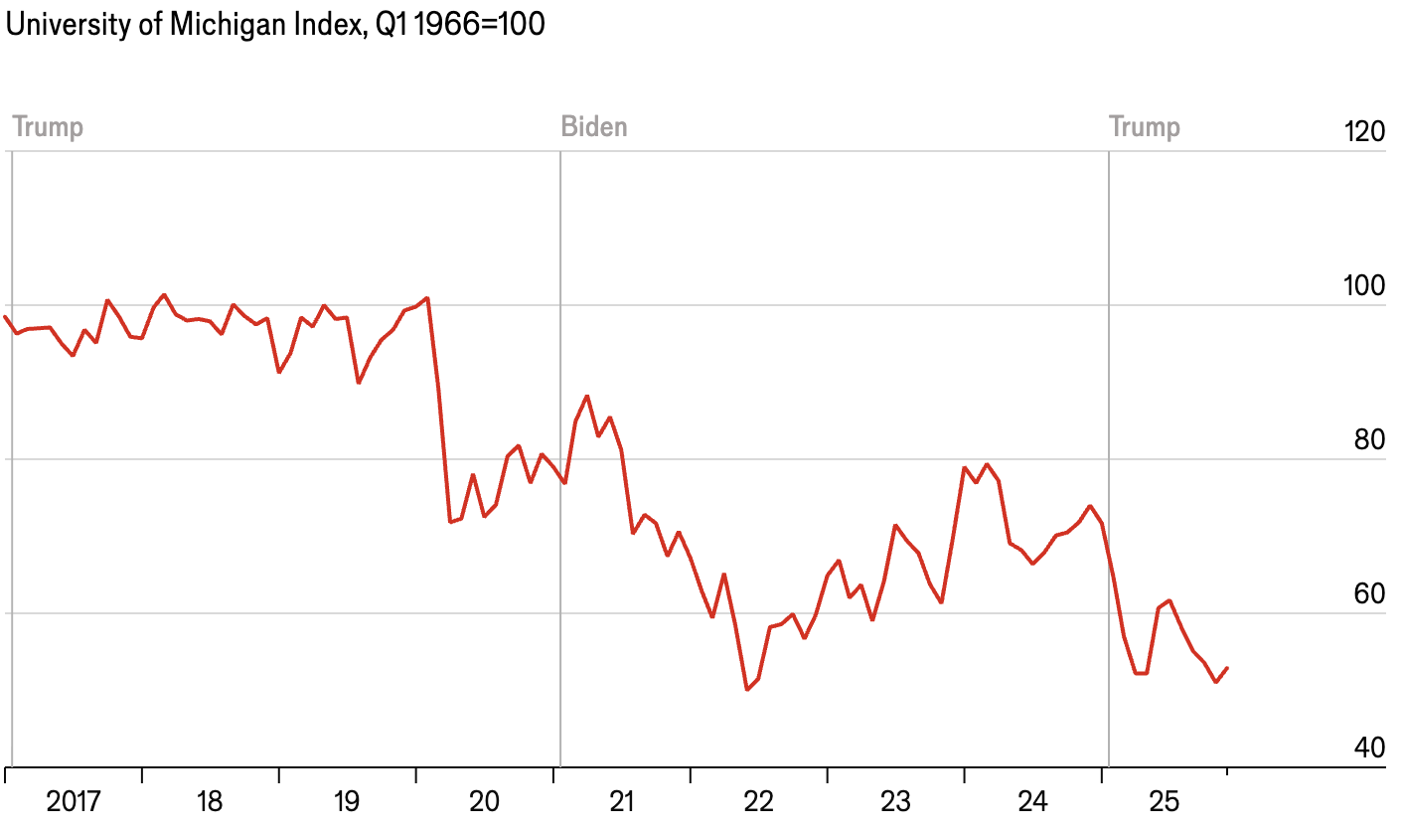
Consumer Confidence is Waning
At its lowest level ever!
(56 year history)

Slide 50
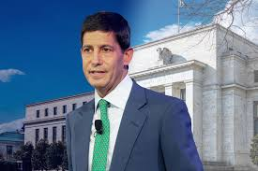
Monetary Policy after Jerome Powell?
Kevin Warsh: Trump Nominee to replace Jerome Powell as the Chair of the Fed in May

Slide 51
Summary
Inflation: was getting close to Fed’s 2% target.
  But is now going in the wrong direction
Current immigration and trade policies will exacerbate inflation.
Immigration: deportations tax the economy and are expensive.
  Many, MANY ag workers are unauthorized immigrants. (50% of Central Valley)
Tariffs: are a tax.
  Taxes raise prices. Period. Full Stop.
  Taxes often cost jobs. Tariffs likely will.
The war is going to drive up prices and uncertainty.
  Nobody invests into uncertainty.
What if the AI bubble bursts?

Slide 52
Are We Headed for A Recession?
Uncertain.
Forecasts are all over the place.
  IMF forecasting 2.4% in 2026.
  30-50% chance of a recession by some models.
A slowdown in economic growth seems inevitable.
A bout of stagflation unlikely, but possible.
Housing:
  Prices are coming down across CA.
  Building is getting more expensive.
  Interest rates are likely stuck around where they are for a while.

Slide 53
California Real Estate: Studies Suggest…
Price growth: perhaps 3-4% in 2026, though I think this is optimistic.
Sales activity: up 2% in 2026, perhaps realistic.
Mortgage rates: easing to 6% in 2026.ww

Slide 54
My Biggest Worry: Lots of Building (3,405)
North San Rafael (1,852 units)
Central San Rafael (1,553 units)
1,422 units Northgate Town Square
200 555 Northgate Dr.
230 4040 Civic Center Dr.
64 Dominican Residential Dev
120 703 3rd St.
155 1515 Fourth St.
188 1230 Fifth Ave.
35 4th St. and Grand Ave.
345 4th Street Market
105 790 Mission Ave
210 930 Irwin St.
200 700 Irwin St.
131 900 A St.
How many more students?
Vs
How much more tax revenue?

Slide 55
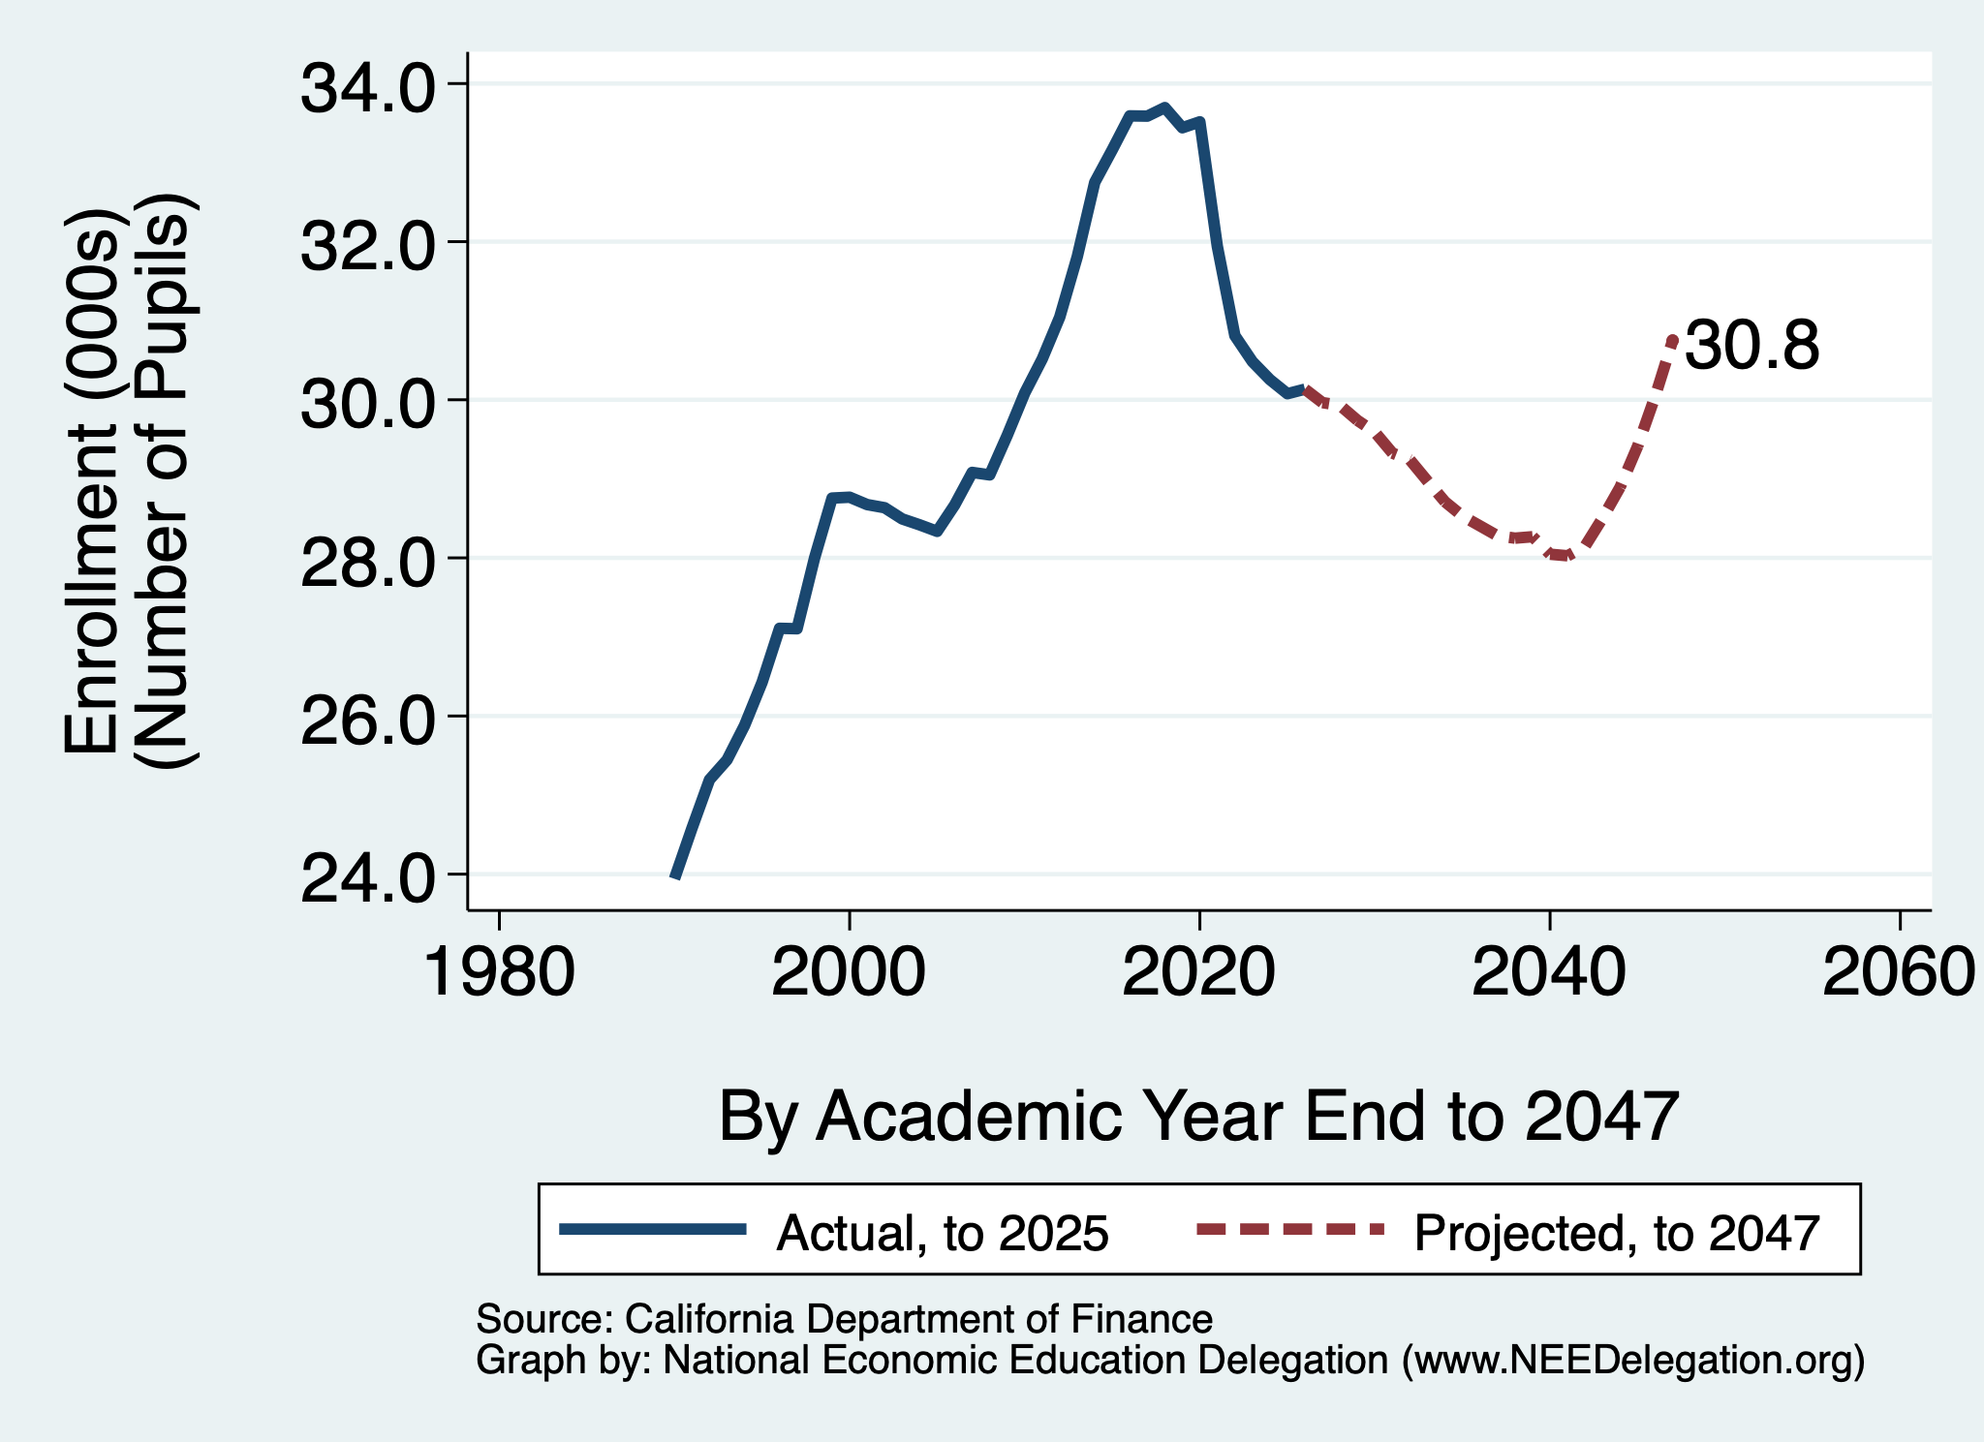
Alters the Forecast a Bit
Marin County Total Public School Enrollment (TK-12)
Reverse trend?
Stabilize?
Slower decline?

Slide 56
Thank you!
Any Questions?
www.NEEDEcon.org
Jon D. Haveman
Jon@NEEDEcon.org
Contact NEED: info@NEEDEcon.org
Submit a testimonial: www.NEEDEcon.org/testimonials.php
Become a Friend of NEED: www.NEEDEcon.org/friend.php

