Slide 1
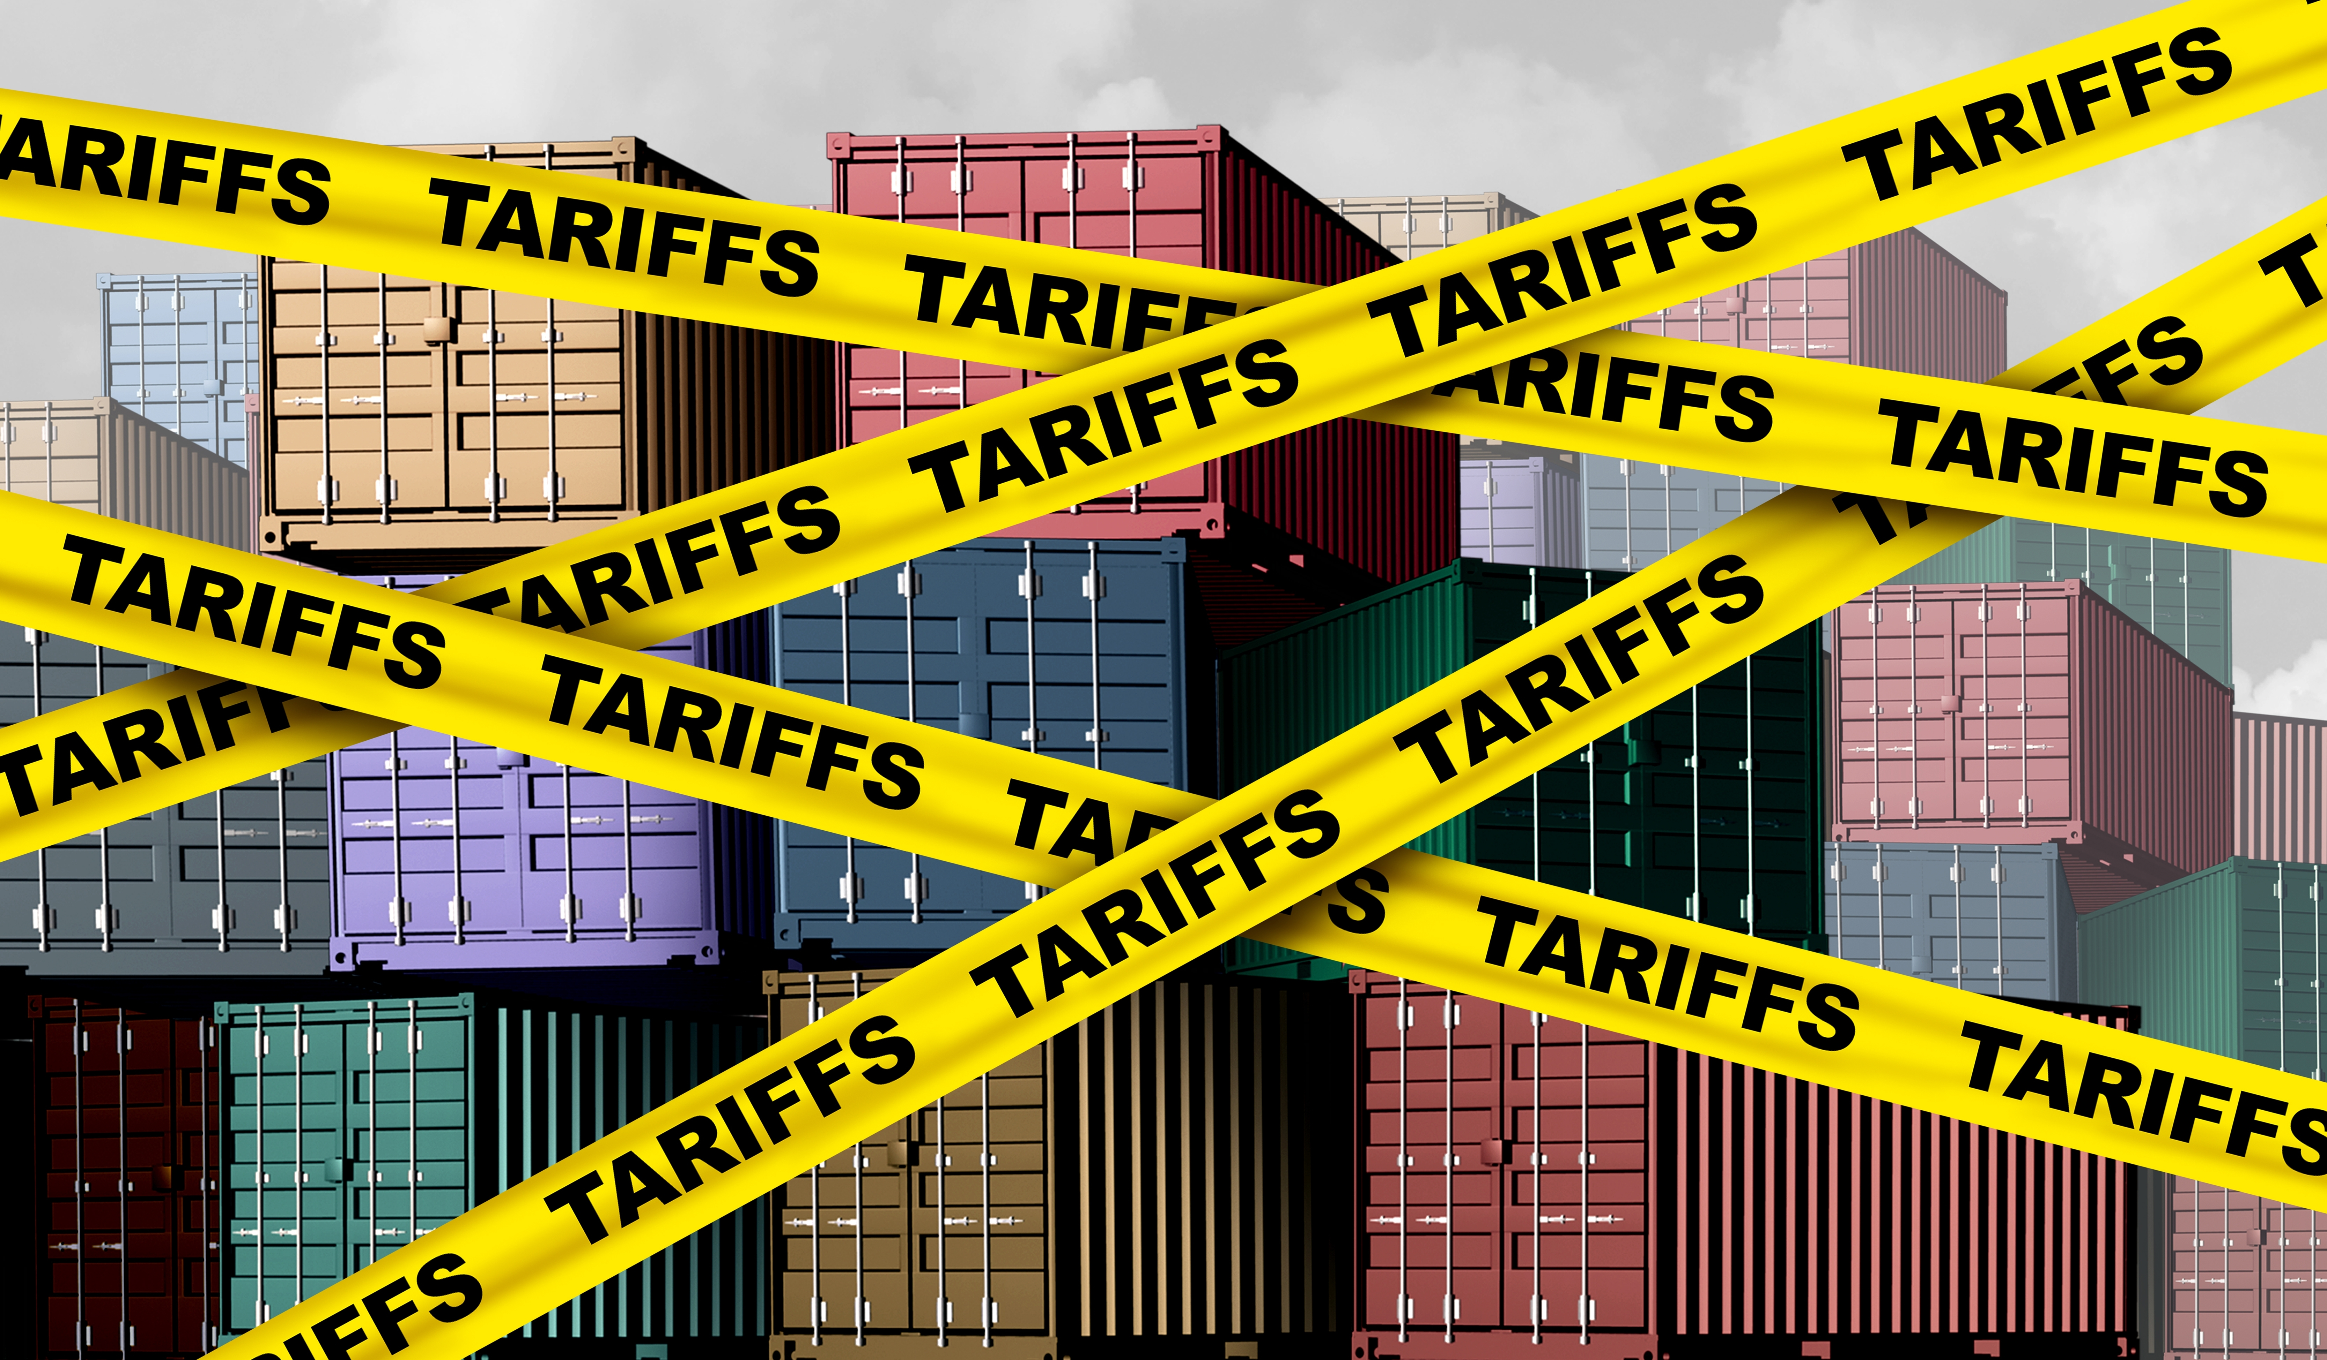

Economic Update
Marin County Dept of Education
Property Tax Forum
May 14, 2025
Jon Haveman, Ph.D.
Executive Director, NEED

Slide 2
Outline
Economic Indicators
Big Picture: Uncertainty

Slide 3
Economic Indicators

Slide 4
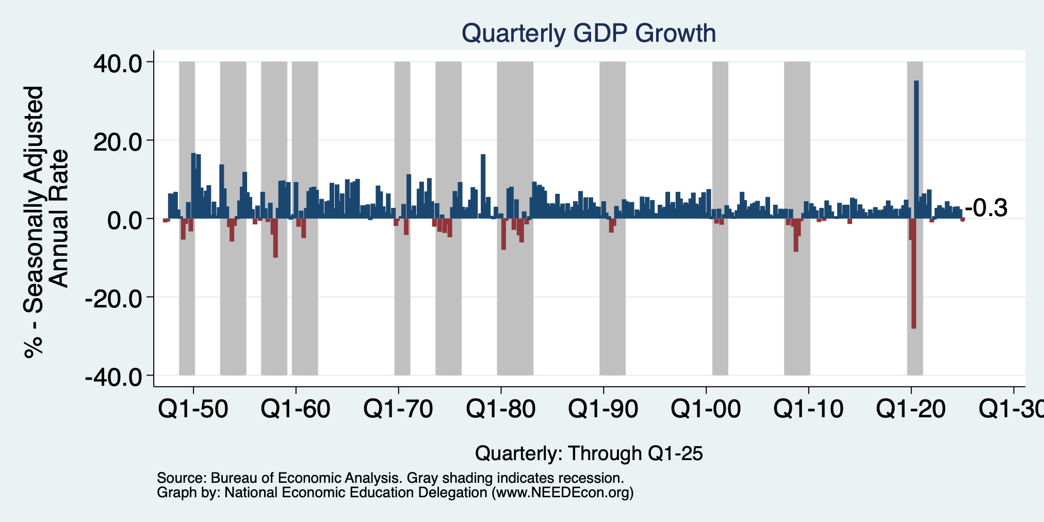
GDP: Quarterly Growth
Q2-2024: 3.0%
Q3-2024: 3.1%
Q4-2024: 2.4%
Q1-2025: -0.3%
Notes:
Graph: gdp_pot_grow.png
The Point: From 1990 – 2007, average annual US GDP growth pre-crisis is 2.94%. However, post-crisis US GDP growth is 2.19% (0.75 percentage points lower). Why is has the recovery been sluggish?
Note: At the recession’s height, the gap between quarterly GDP growth and potential growth was 2.5 percentage points.

Slide 5
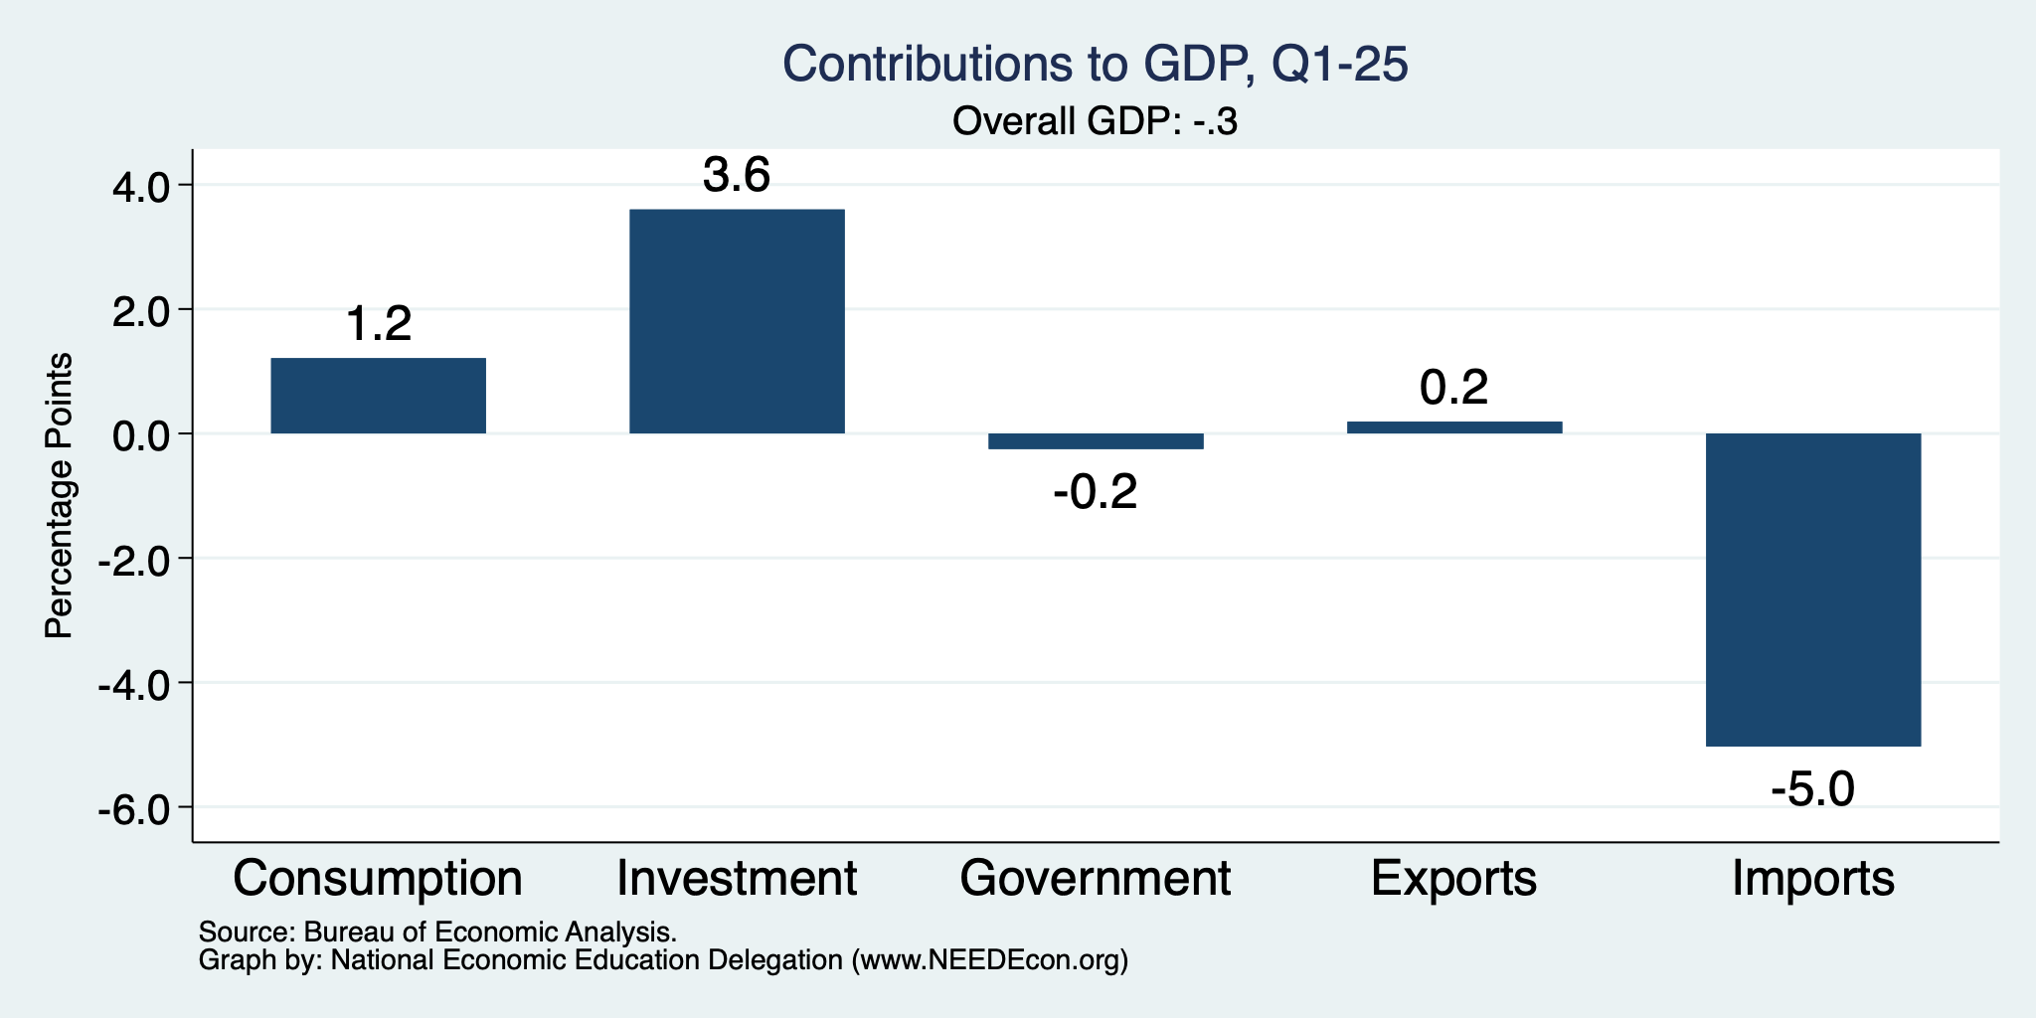
What Happened?
Normally
2.3%

Slide 6
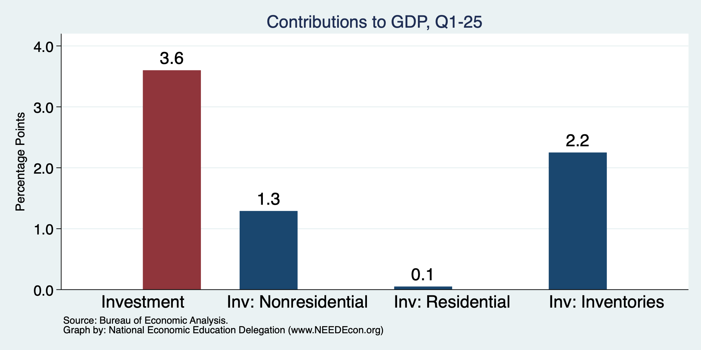
Imports Went Into Inventories
Normally
About 0%

Slide 7
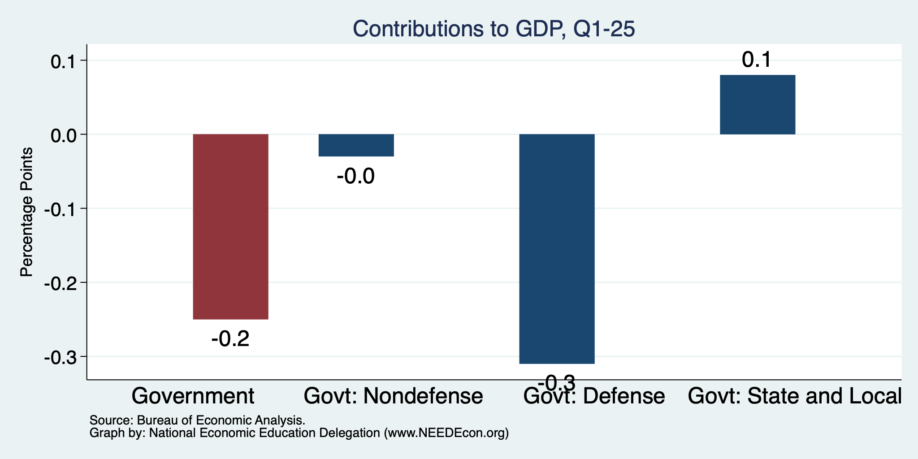
Government Spending Didn’t Help

Slide 8
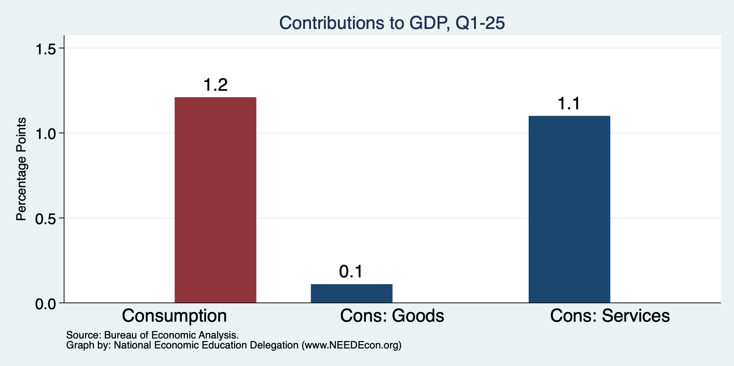
Consumers Also Tightened
Normally
0.8%

Slide 9
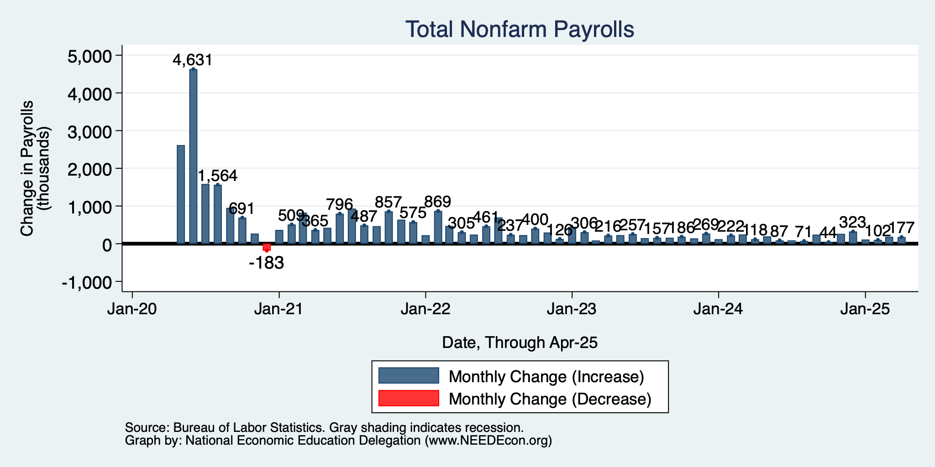
Monthly Changes in Nonfarm Employment
Jan: 111,000
Feb: 102,000
March: 185,000
April: 177,000
Notes:
PAYEMS.png

Slide 10
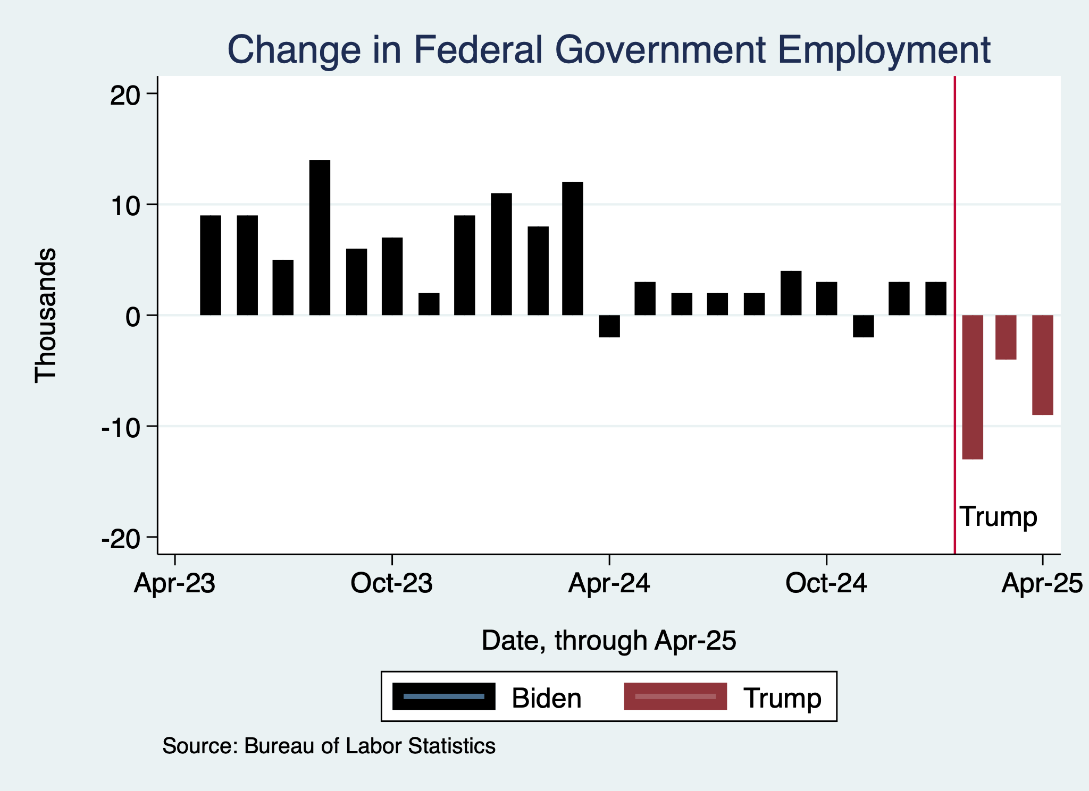
Monthly Changes in Nonfarm Employment
Notes:
PAYEMS.png

Slide 11
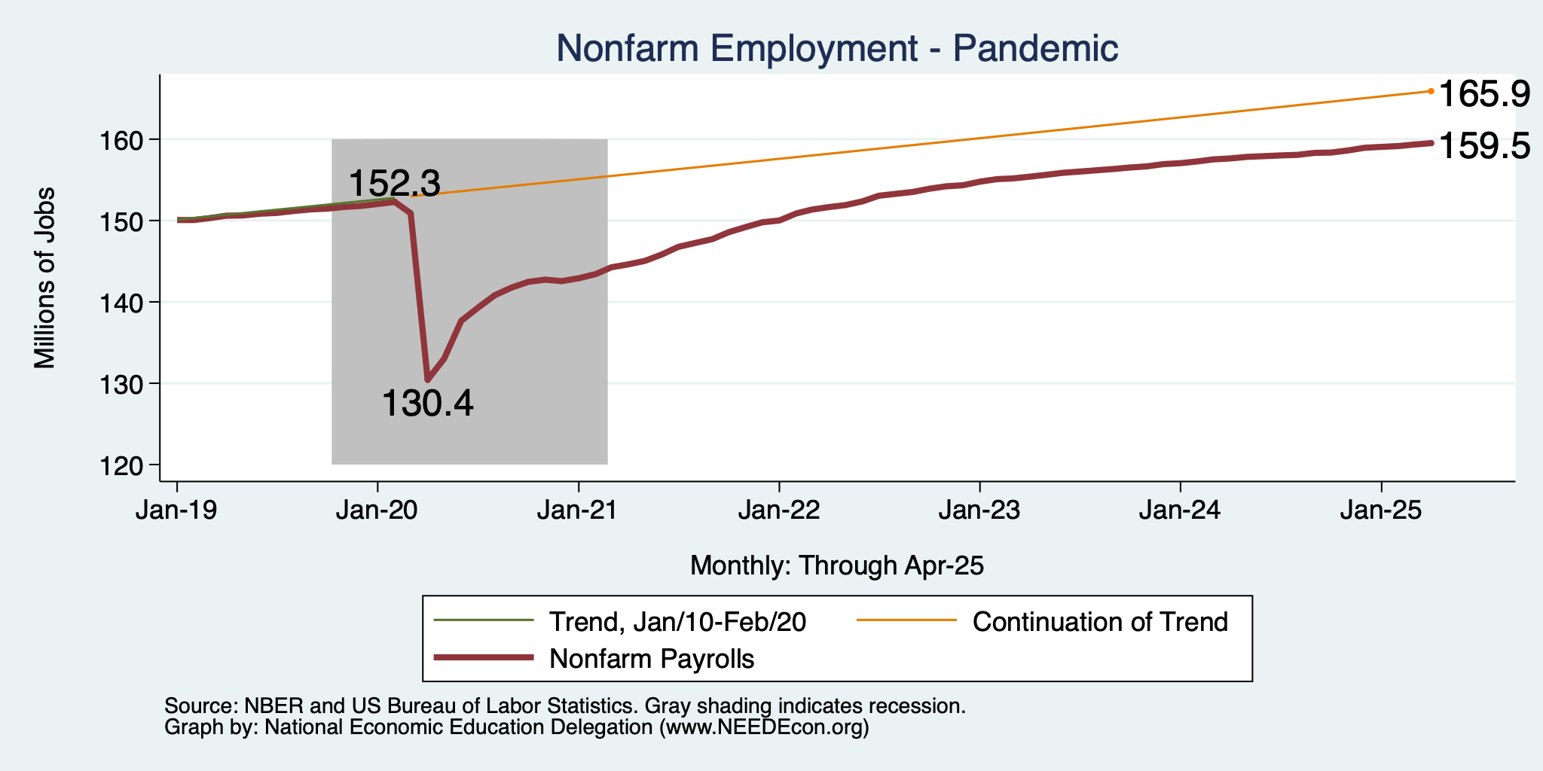
Employment Gap
7.2 Million ABOVE February, 2020.
6.4 Million BELOW where we should be.
Notes:
payroll_recent.png

Slide 12
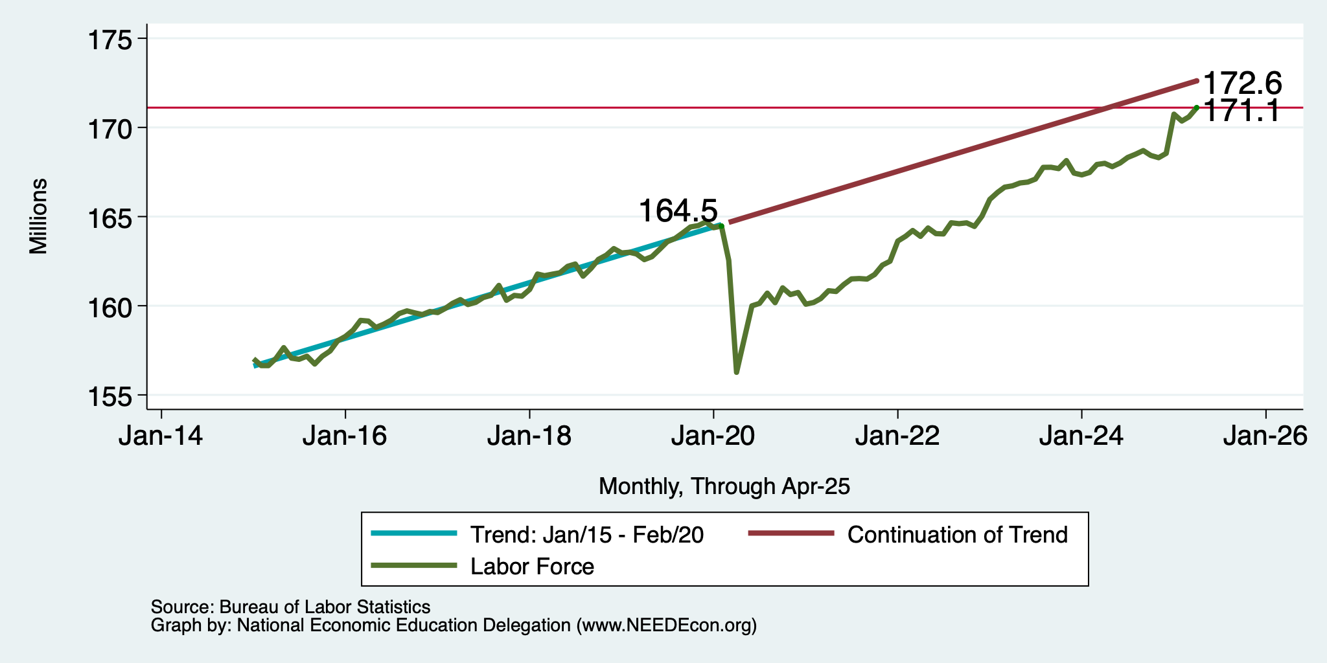
Workers Are Coming Back
6.6 million ABOVE Feb 2020
1.5 million BELOW where we should be

Slide 13
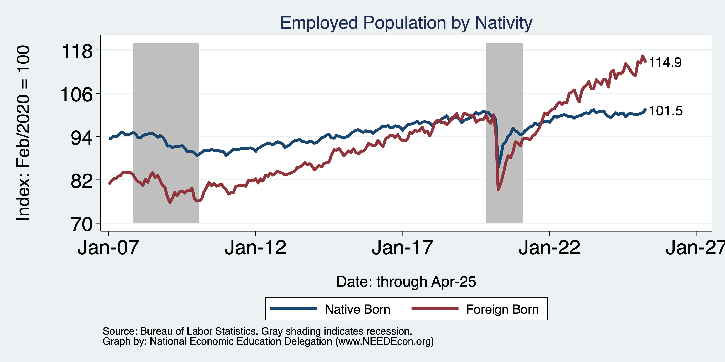
Immigrants to the Rescue?
Native: +1.9 million
Foreign Born: +4.1 million

Slide 14
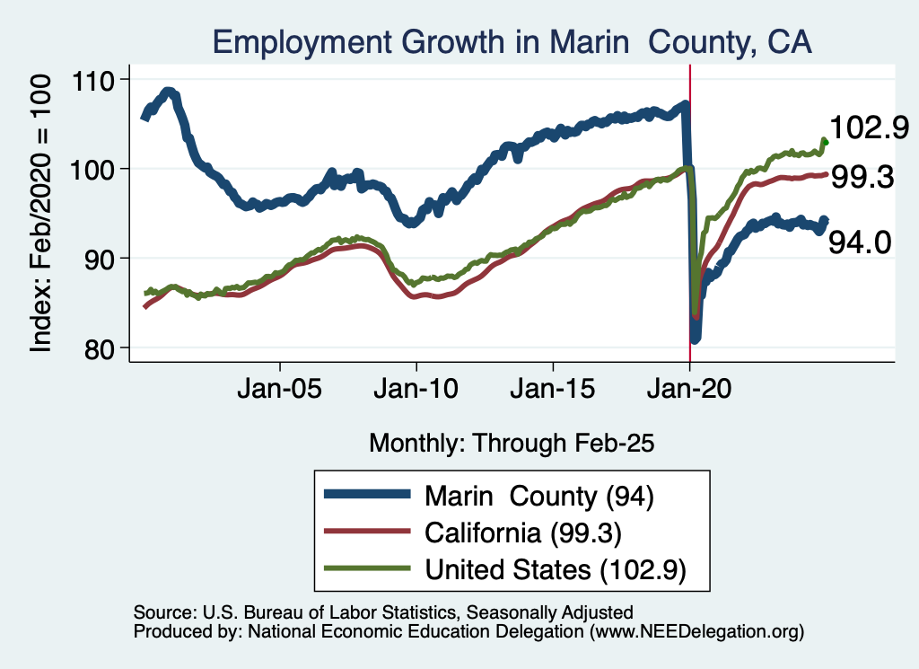
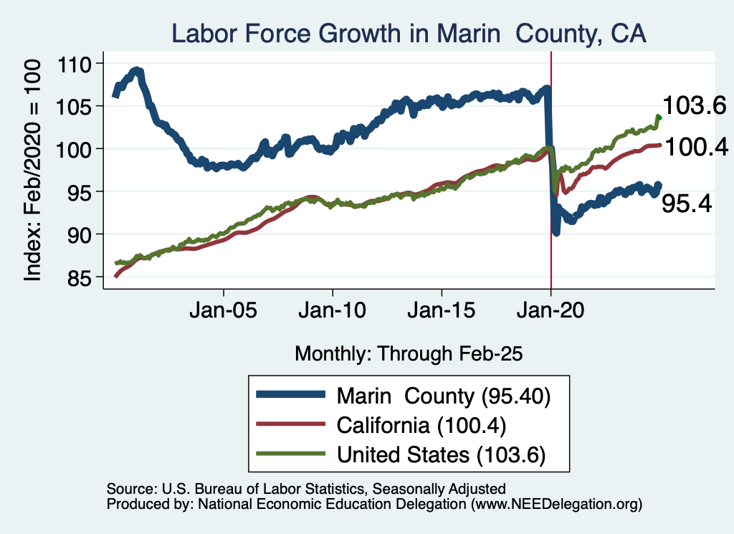
Labor Market Experience: Marin County

Slide 15
Inflation

Slide 16
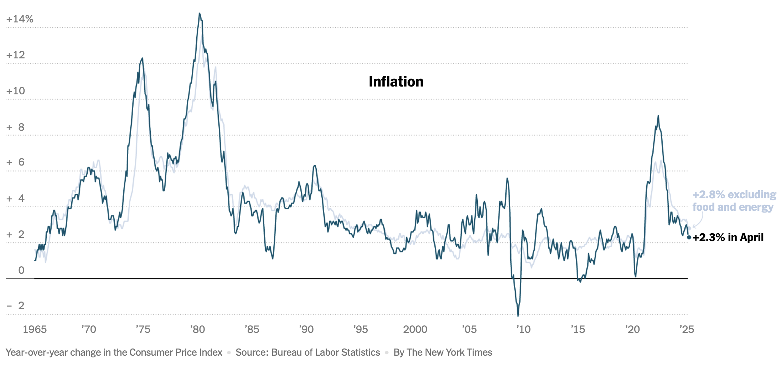
Inflation: Latest Figures
Source: NYTimes.com

Slide 17
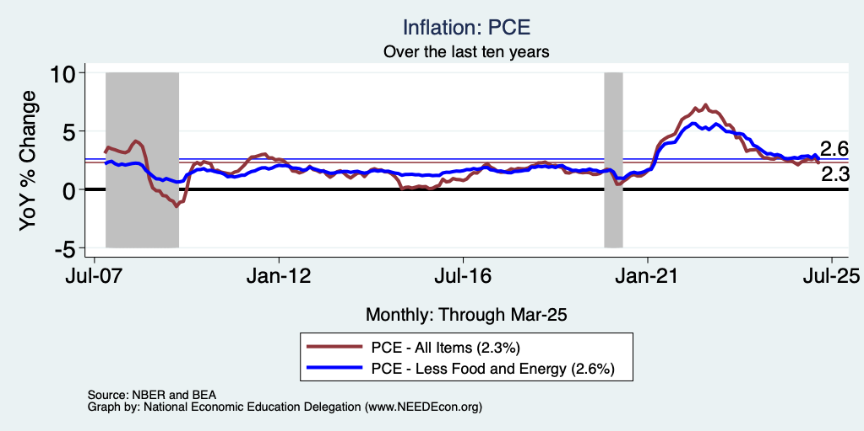
Fed’s Preferred Measure: PCE

Slide 18
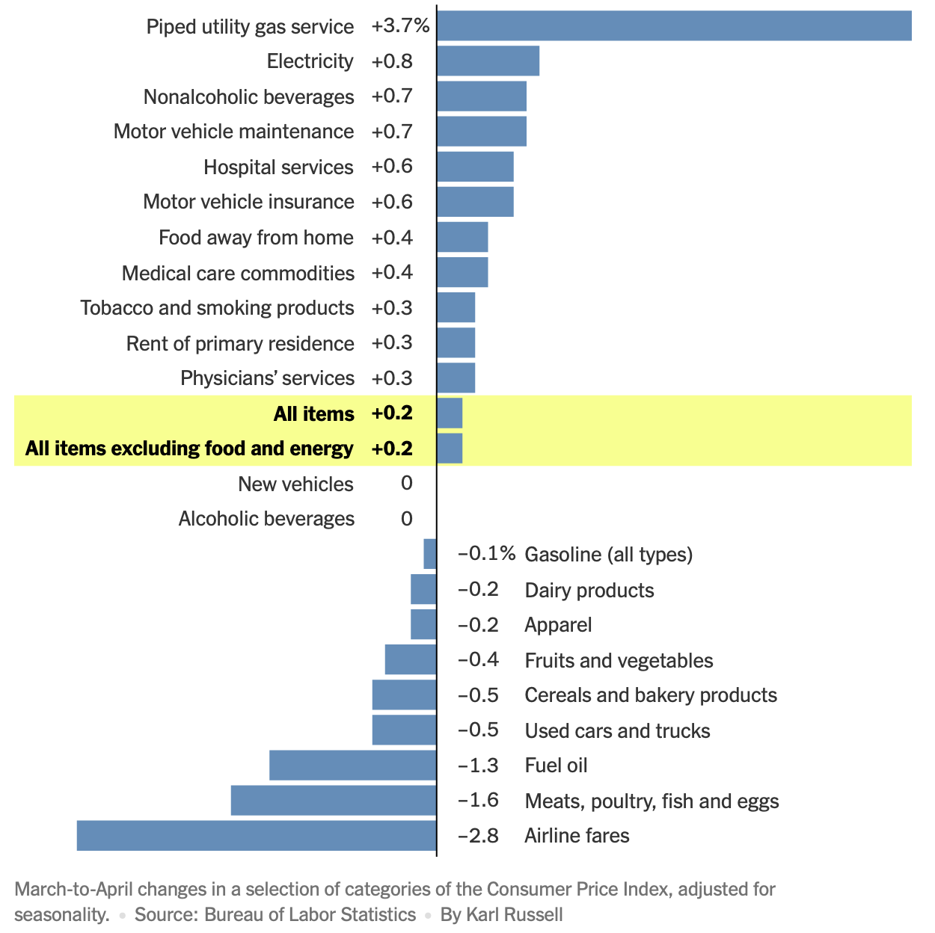
March to April
Price Changes

Slide 19
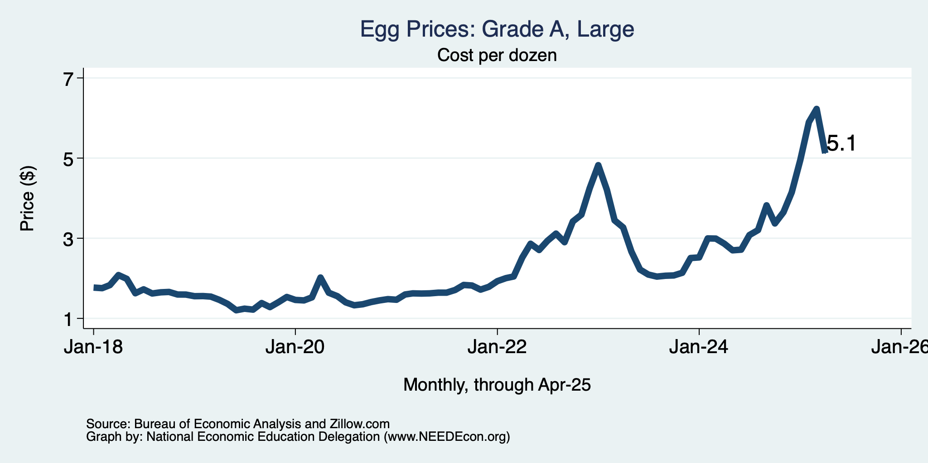
Price of Eggs?

Slide 20
The Fed: Conservative

Slide 21
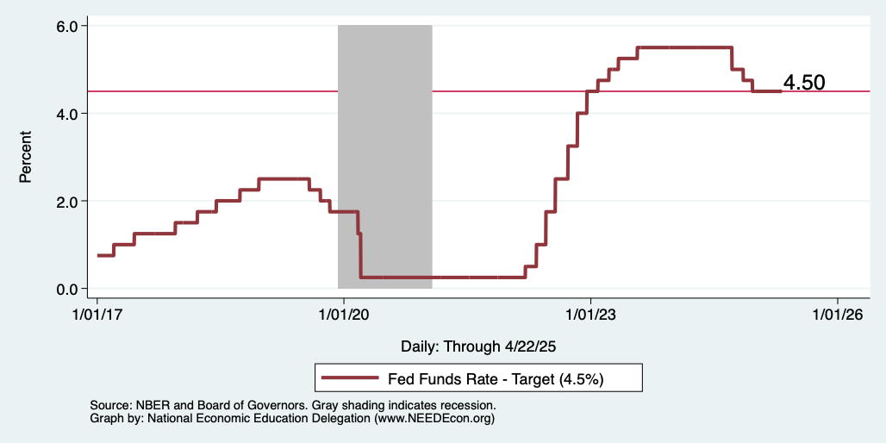
Federal Funds Rate
Notes:
The fed funds rate is the interest rate on overnight loans between banks. Think of it as the baseline interest rate on which banks base all other interest rates (e.g. mortgage rates)
FOMC lowers the fed funds rate during recessions and raises the fed funds rate during expansions
Fed funds rate peaked in the 1980s as then Chairman Paul Volcker sought to reign in “run away” inflation of the 1970s; doing so resulted in a recession in the early 1980s.
Since the 2008-09 recession, the fed funds rate has been kept near zero.
During the 2008-09 recession, Federal Reserve turned to unconventional tools to influence longer term interest rates to further stimulate the economy - QE
FedFunds.png

Slide 22
What will the Fed Do?
Likely sit tight at 4.5 for a while.
Next FOMC meeting is June 17-18.
Notes:
GDPNow 2.4%; blue chips consensus 1.5% implies 2.9%, or 2.7%

Slide 23
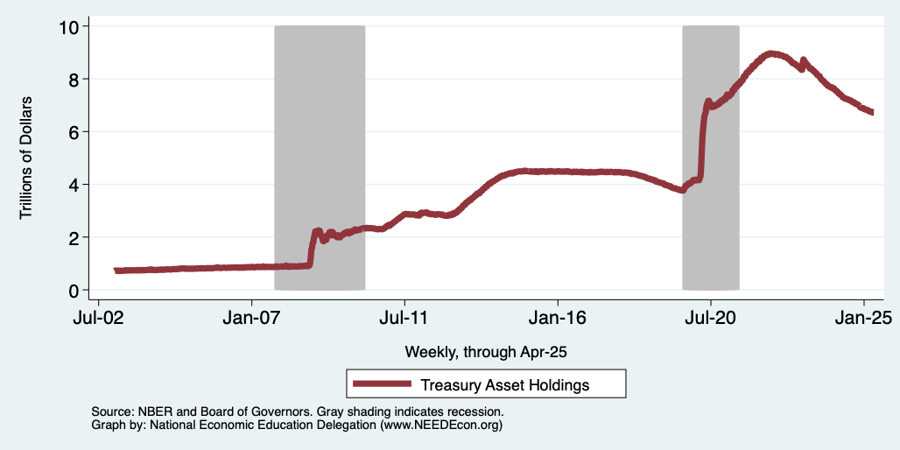
Fed: Reducing its Asset Holdings
Quantitative Tightening

Slide 24
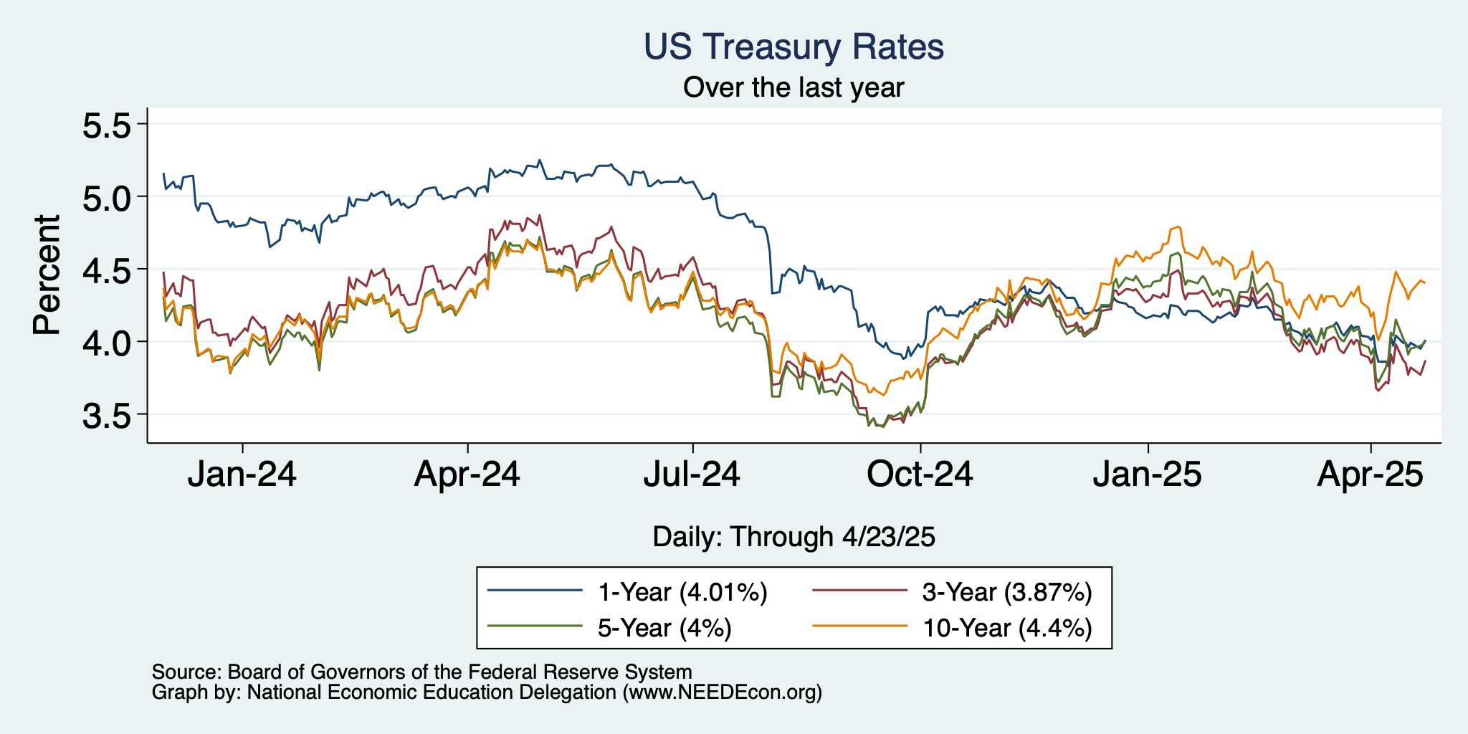
Treasuries
Notes:
treas_recent.png

Slide 25
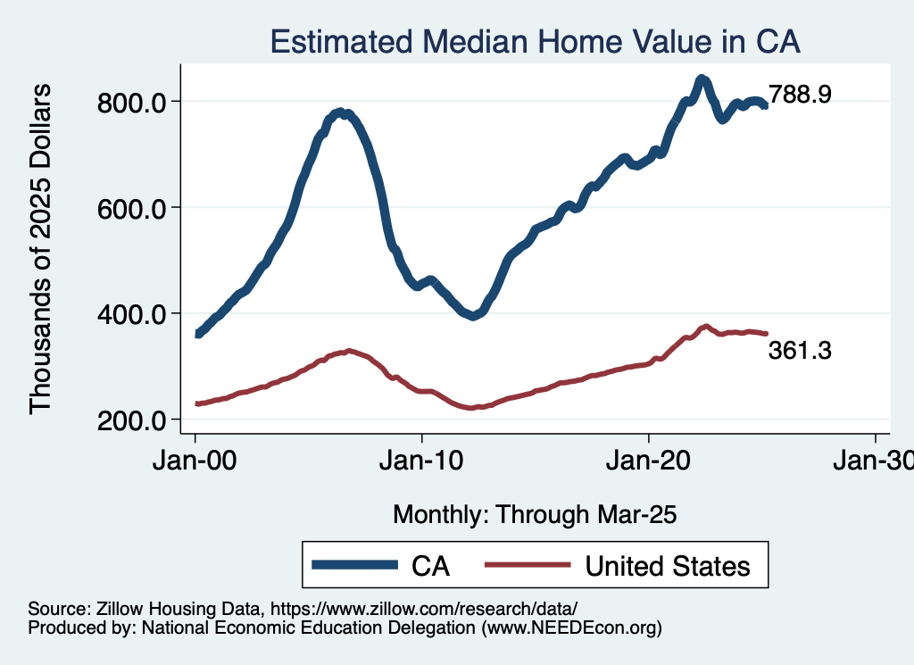
Real Estate Prices

Slide 26
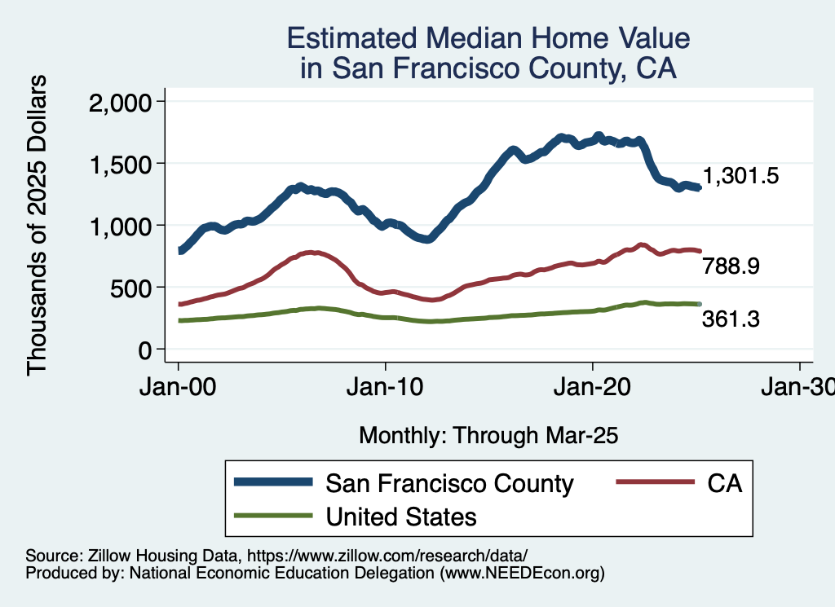
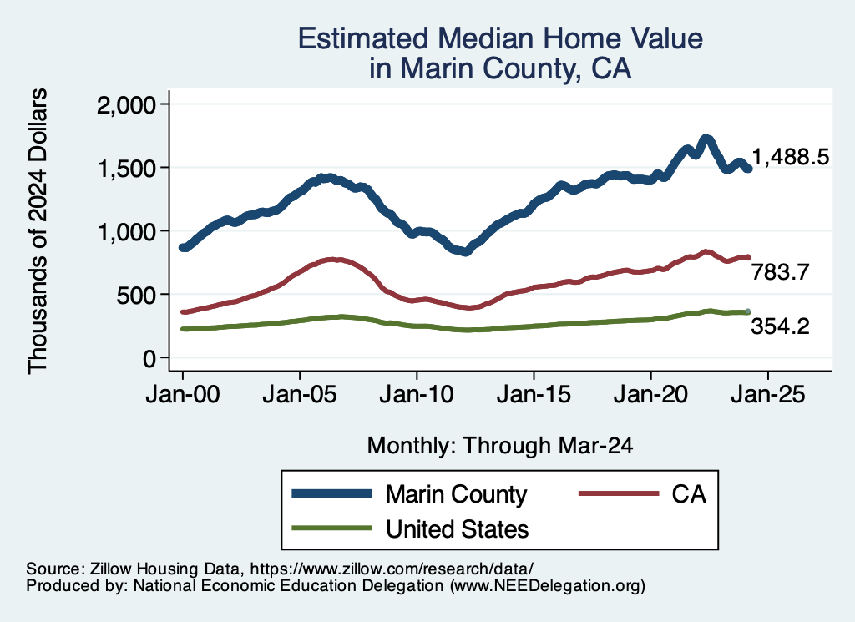
RE Experiences … Similar And Not Good

Slide 27
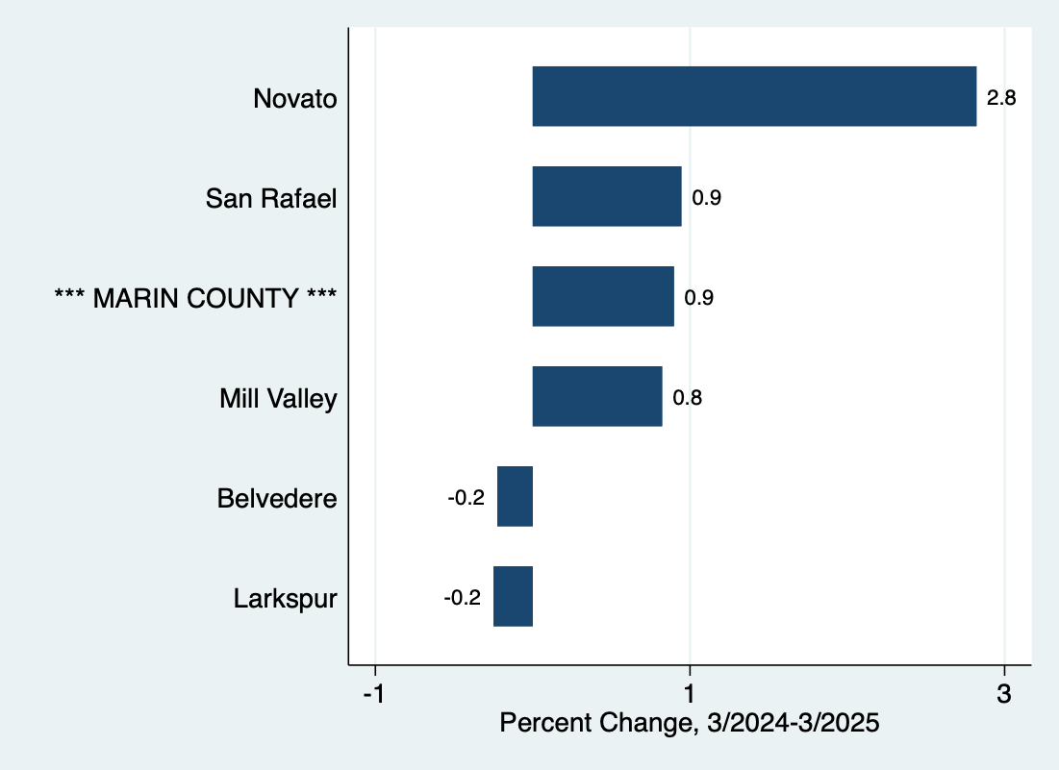
Home Price Changes w/in Marin

Slide 28
Takeaways
Is a recession on the horizon?
  Maybe.
  Many indicators are in the black.
    2024 2nd half GDP growth was pretty good – 2.8% YoY.
    2025 Q1 < 0 is almost meaningless.
The problem?
  Uncertainties abound!

Slide 29
Uncertainties
Federal Government Policies
  How far will they go with immigration?
  How many federal employees will be laid off?
  How high will tariffs remain?
  Will Fed Chair Powell be replaced prematurely?

Slide 30
Other Policies with Economic Effect
Cutting off federal grants and federal spending
Universities – short and long run
Lower LFPR or working hours for moms
Deregulation – perhaps positive.

Slide 31
Summary
Inflation: close to Fed’s 2% target, but a little stubborn.
  This is likely to change.
Current immigration and trade policies will exacerbate inflation.
Immigration: deportations tax the economy and are expensive.
  Many, many ag workers are unauthorized immigrants.
Tariffs: are a tax.
  Taxes raise prices. Period. Full Stop.
  Taxes often cost jobs. Tariffs likely will.

Slide 32
Biggest Problem: Uncertainty
Nobody knows how to plan into uncertainty.
  Business investment is particularly at risk.
Hardly anybody increases spending into uncertainty.
Other countries will look elsewhere if the U.S. is volatile.
  Tourists already are.
Outlook: is not good.
  Inflation is inevitable.
  Job losses are inevitable.

Slide 33
Are We Headed for A Recession?
Uncertain.
Our current path has many forecasters indicating that a recession is more likely than not.
  IMF has cut it’s U.S. growth forecast to 1.7%, down from 2.8% in 2024.
We may well already be in a recession (but probably not).
A slowdown in economic growth is inevitable.
A bout of stagflation is possible.

Slide 34
Since Inauguration: Policies = Anti-Growth
Tariffs
Deportations
Cuts to spending and employment
Threats to Fed Chair Powell

Slide 35
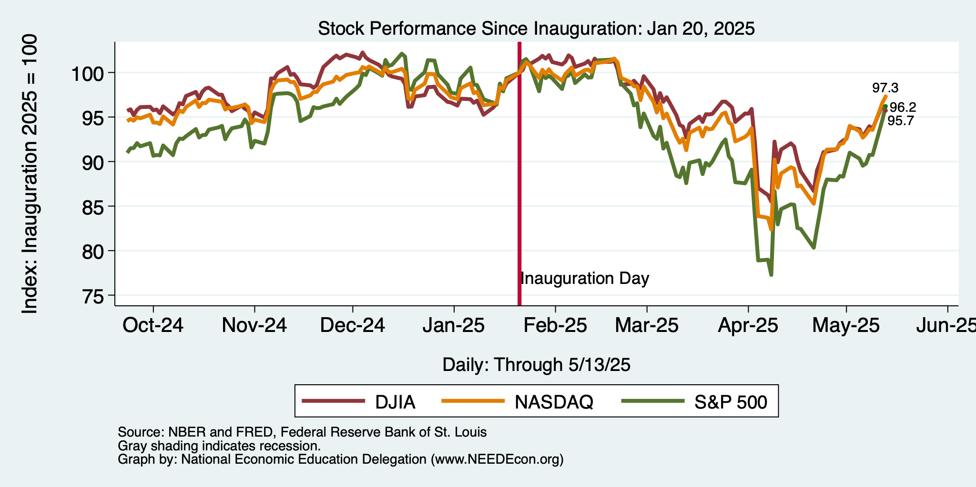
And Stock Markets Agree

Slide 36
Thank you!
Any Questions?
www.NEEDEcon.org
Jon D. Haveman
Jon@NEEDEcon.org
Contact NEED: info@NEEDEcon.org
Submit a testimonial: www.NEEDEcon.org/testimonials.php
Become a Friend of NEED: www.NEEDEcon.org/friend.php

Slide 37
Bigger Picture

Slide 38
Tariffs

Slide 39
What Is a Tariff?
A tariff is a tax on imports.
Much like, say, the 8% sales tax in California.
  Whatever price the seller charges, the buyer pays an extra 8% that goes to the government.
  But it also means that domestic sellers can simply raise their prices by 8%.
    A cost to consumers, with no government revenue benefit.
A 10% tariff on all imports (such as Trump has imposed) would mean that:
  Whatever the foreign exporter charges for a product,
  US buyers will pay an extra 10% to the US government.
Might the seller charge a lower price because of the tariff?
  Perhaps, but when Trump used tariffs in 2018 on steel and China, they did NOT.

Slide 40
Trump I Tariffs & Trade War
Overview of Trump I Tariffs
  Trump placed tariffs of 25% on steel and 10% on aluminum.
  Trump place multiple tariffs on China exports, covering at least ¾ of their exports to US.
  Imports from China fell while imports from other countries rose.
  US trade deficit did not shrink.
  Data show no fall in foreign export prices, so tariffs were paid by US buyers.
    Domestic prices DID increase.
  Jobs? Eight lost for every job created.

Slide 41
Wait…Job Losses?
Job losses come from two sources:
  Tariffs raise the price of imported intermediate goods
    E.g., steel and aluminum.
  Tariffs hit the exchange rate.
    Fewer imports means lower supply of dollars.
    Exchange rate appreciates.
    Exported products are more expensive in foreign markets.

Slide 42
Trump II Tariffs
“To me the most beautiful word in the dictionary is ‘tariff’”
During campaign he said he will
  Place a tariff of 10% or 20% on all imports from all countries.
  Place even higher tariffs (60%) on imports from China.
  Raise our tariffs on countries to match what they charge on our exports.
    “Reciprocal Trade Act”
    (And lower those where they charge less?)
  Raise tariffs on countries that don’t use the US dollar for international transactions.
  Place tariffs on Mexico, violating his own USMCA trade agreement
    25% on everything if they don’t stop US immigration
    100% on cars to get production in US
Notes:
McCormick, “Trump Calls Tariffs the ‘Most Beautiful Word’,” WSJ, 10/14/24
https://www.wsj.com/livecoverage/harris-trump-election-10-16-2024/card/trump-calls-tariffs-the-most-beautiful-word--YMVPAupw4EjBRp6yobOy
Swanson, “Harris and Trump Embrace Tariffs, Though Their Approaches Differ,” New York Times, Aug 27, 2024.
https://www.nytimes.com/2024/08/27/us/politics/trump-harris-tariffs.html
Toomey, “About Trump’s ‘Reciprocal’ Tariffs,” WSJ, 10/27/24
https://www.wsj.com/opinion/about-trumps-reciprocal-tariffs-he-wants-to-raise-taxes-and-thinks-im-the-stupid-one-5dc3c56c?mod=itp_wsj
Krugman, “Donald Trump on the Dollar, in His Own Words. NYT, 9/9/24
https://www.nytimes.com/2024/09/09/opinion/trump-tariffs-reserve-currency.html
Economist, “Donald Trump is poised to smash Mexico with tariffs,” 11/7/24
https://www.economist.com/the-americas/2024/11/07/donald-trump-is-poised-to-smash-mexico-with-tariffs
Ewing, “Trump’s Tariffs Could Deal a Blow to Mexico’s Car Factories,” NYT, 11/12/24
https://www.nytimes.com/2024/11/12/business/economy/trump-mexico-trade-tariffs-car-factories.html

Slide 43
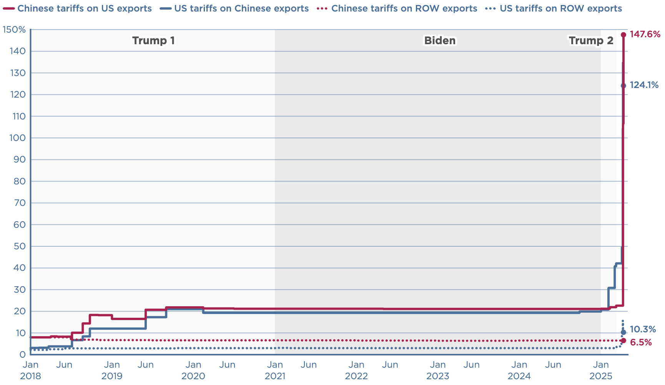
Where Are Tariffs Today?

Slide 44
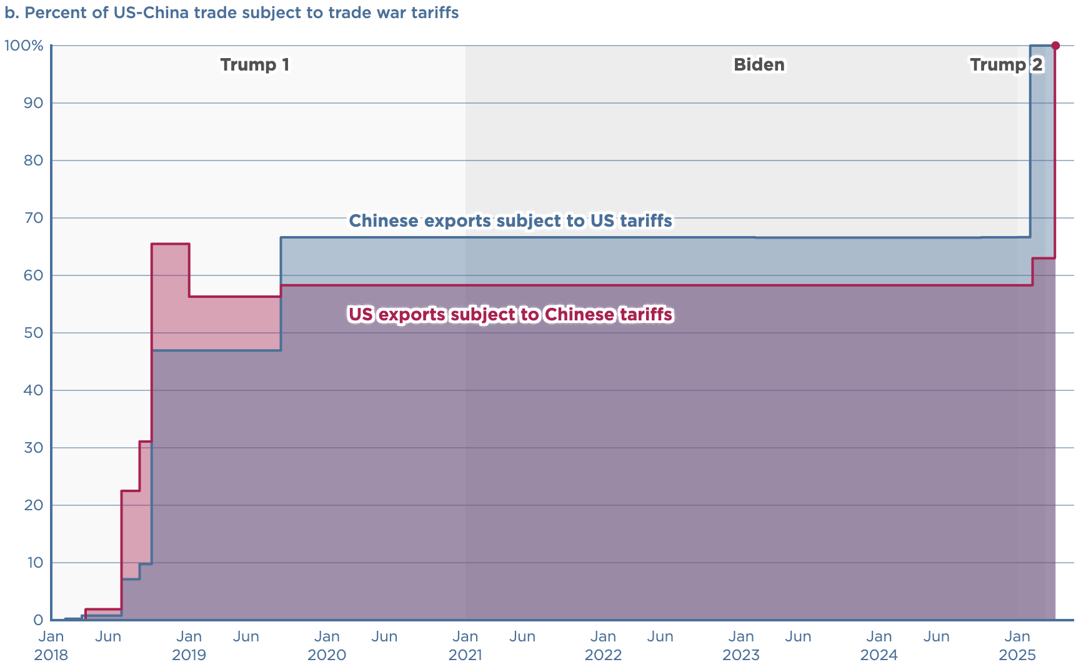
What Share of Goods Are Covered?

Slide 45
Effects of Tariffs in General

Slide 46
Economic Effects of A Tariff
A tariff is a tax on imports. It causes:
  A rise in the price of the imported good in the importing country.
  A fall in the price of the imported good in the exporting country.
  The quantity imported to fall.
  Revenue for the tariff-levying government.
Almost always: the rise at home is much larger than the fall abroad
  We learned this from Trump’s tariffs in 2018.
  Trump’s tariffs caused US prices to rise, with hardly any perceptible fall in prices abroad.
    Sometimes prices rise on goods not subject to a tariff.
      Clothes dryers.

Slide 47
Economic Effects of A Tariff
Economists’ cost-benefit analysis quantifies these and shows that the costs exceed the benefits.
A tariff on one good can harm other industries.
A tariff on one country just causes displacement to another country.
Tariffs are NOT an effective tool to reduce the trade deficit.
Tariffs are NOT a good way to raise government revenue.
Retaliation from other countries makes tariffs even worse.
Corruption: tariffs can be selectively reduced.

Slide 48
Effects of
Trump II Tariffs

Slide 49
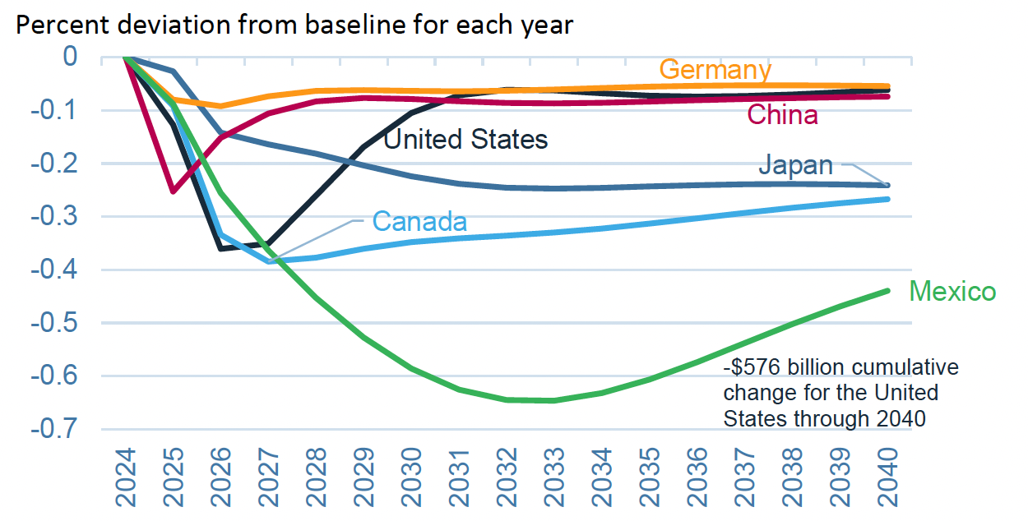
Effects of 10% Tariff on All US Imports
Real GDP
Notes:
Warwick McKibbin, Megan Hogan, and Marcus Noland, “The International Economic Implications of a Second Trump Presidency,” Working Paper 24-20, Peterson Institute of International Econnomics, September 2024.
https://www.piie.com/publications/working-papers/2024/international-economic-implications-second-trump-presidency

Slide 50
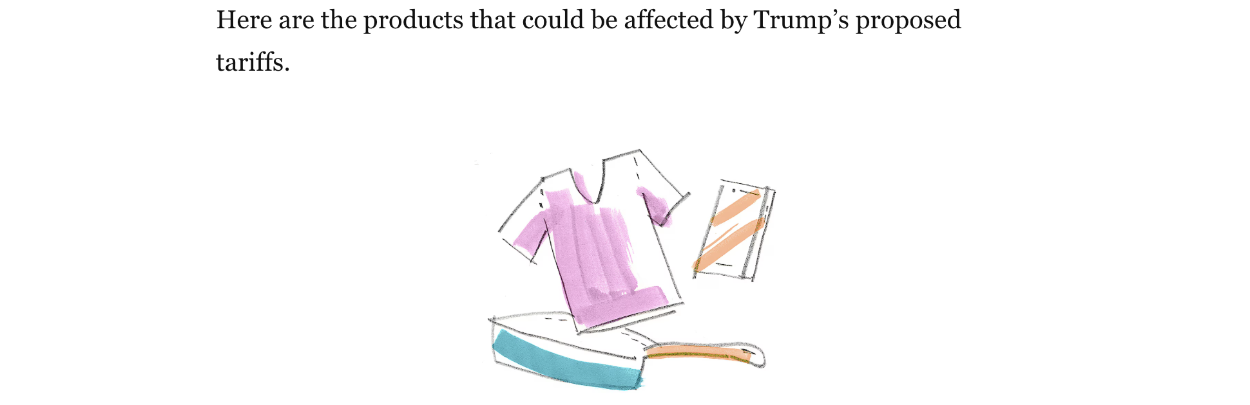
Notes:
Luis Melgar and Rachel Lerman, “See which products Trump’s tariffs could make more expensive,” Washington Post, December 5, 2024.
https://www.washingtonpost.com/business/2024/12/05/trump-china-mexico-canada-tariffs-prices/?utm_campaign=wp_evening_edition&utm_medium=email&utm_source=newsletter&carta-url=https%3A%2F%2Fs2.washingtonpost.com%2Fcar-ln-tr%2F3fd6330%2F67522261e179af1b45e73c5e%2F597273baade4e21a847d94bd%2F27%2F50%2F67522261e179af1b45e73c5e

Slide 51
Immigration

Slide 52
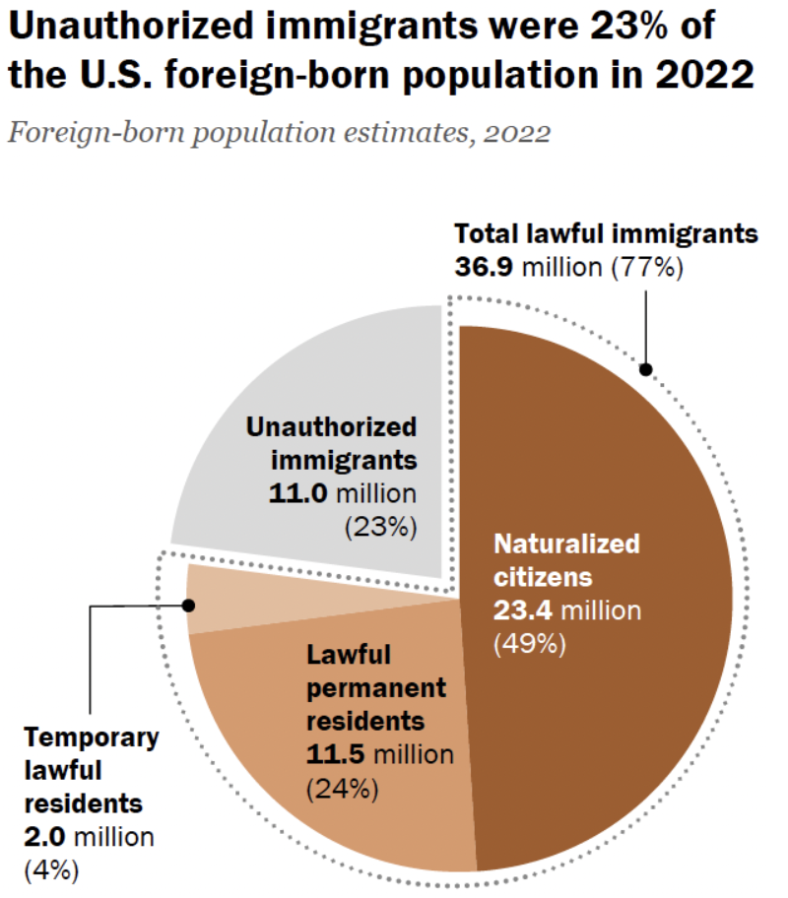
Total Foreign-Born (2022)
Population: 47.9 million
Total Foreign-Born (Current)
Population: 49.7 million
Source: Pew Research Center, What we know about unauthorized immigrants living in the U.S., July 22, 2024

Slide 53
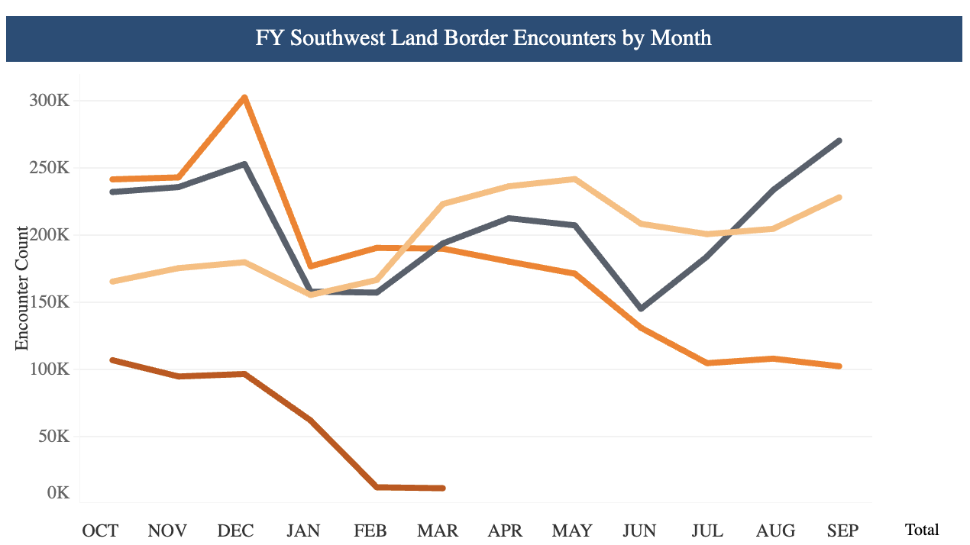
Recent Border Encounters
2023
2022
2024
2025

Slide 54
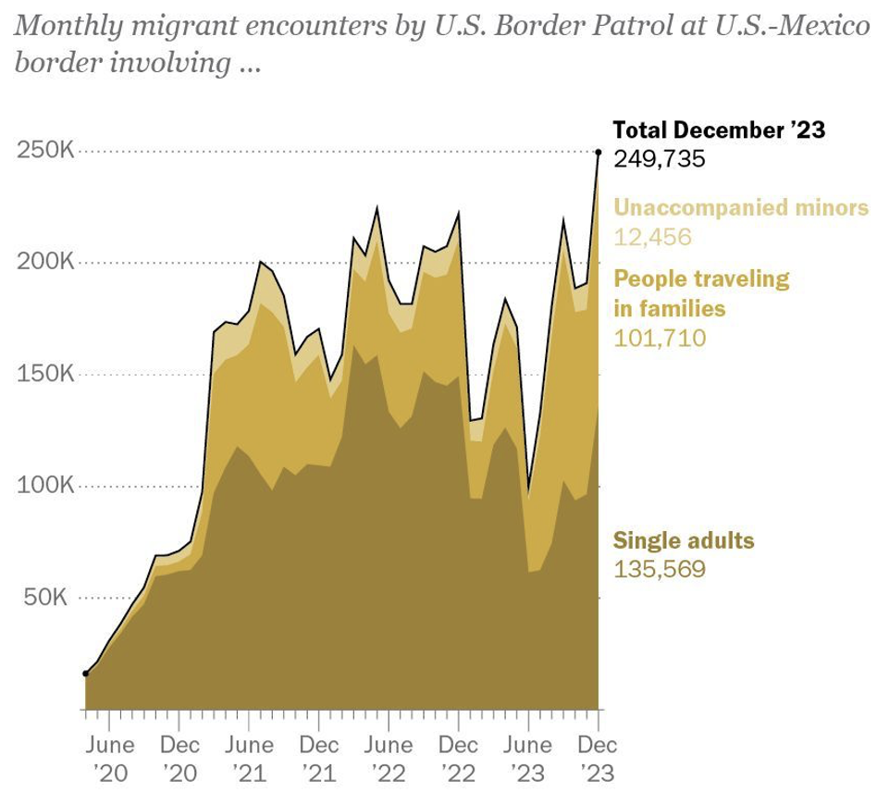
Growing #s of People Traveling in Families
Source: Pew Research Center, US Customs and Border Protection

Slide 55
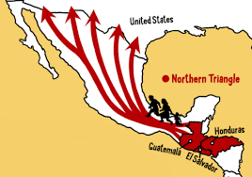
The Northern Triangle – Also VE & Others

Slide 56
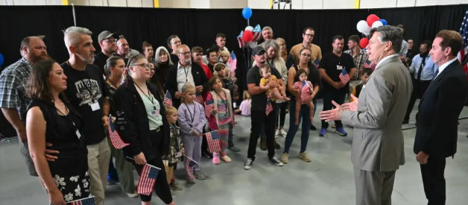
Only Currently Permissible Refugees: S. Africa

Slide 57
Why Do We Care? Economic Implications
Conventional Wisdom Issues:
  Labor markets: Wages and Jobs
  Government Revenue and Spending
  Crime
Other issues (that don’t get talked about much):
  Gross Domestic Product (GDP)
  Innovation and Entrepreneurship

Slide 58
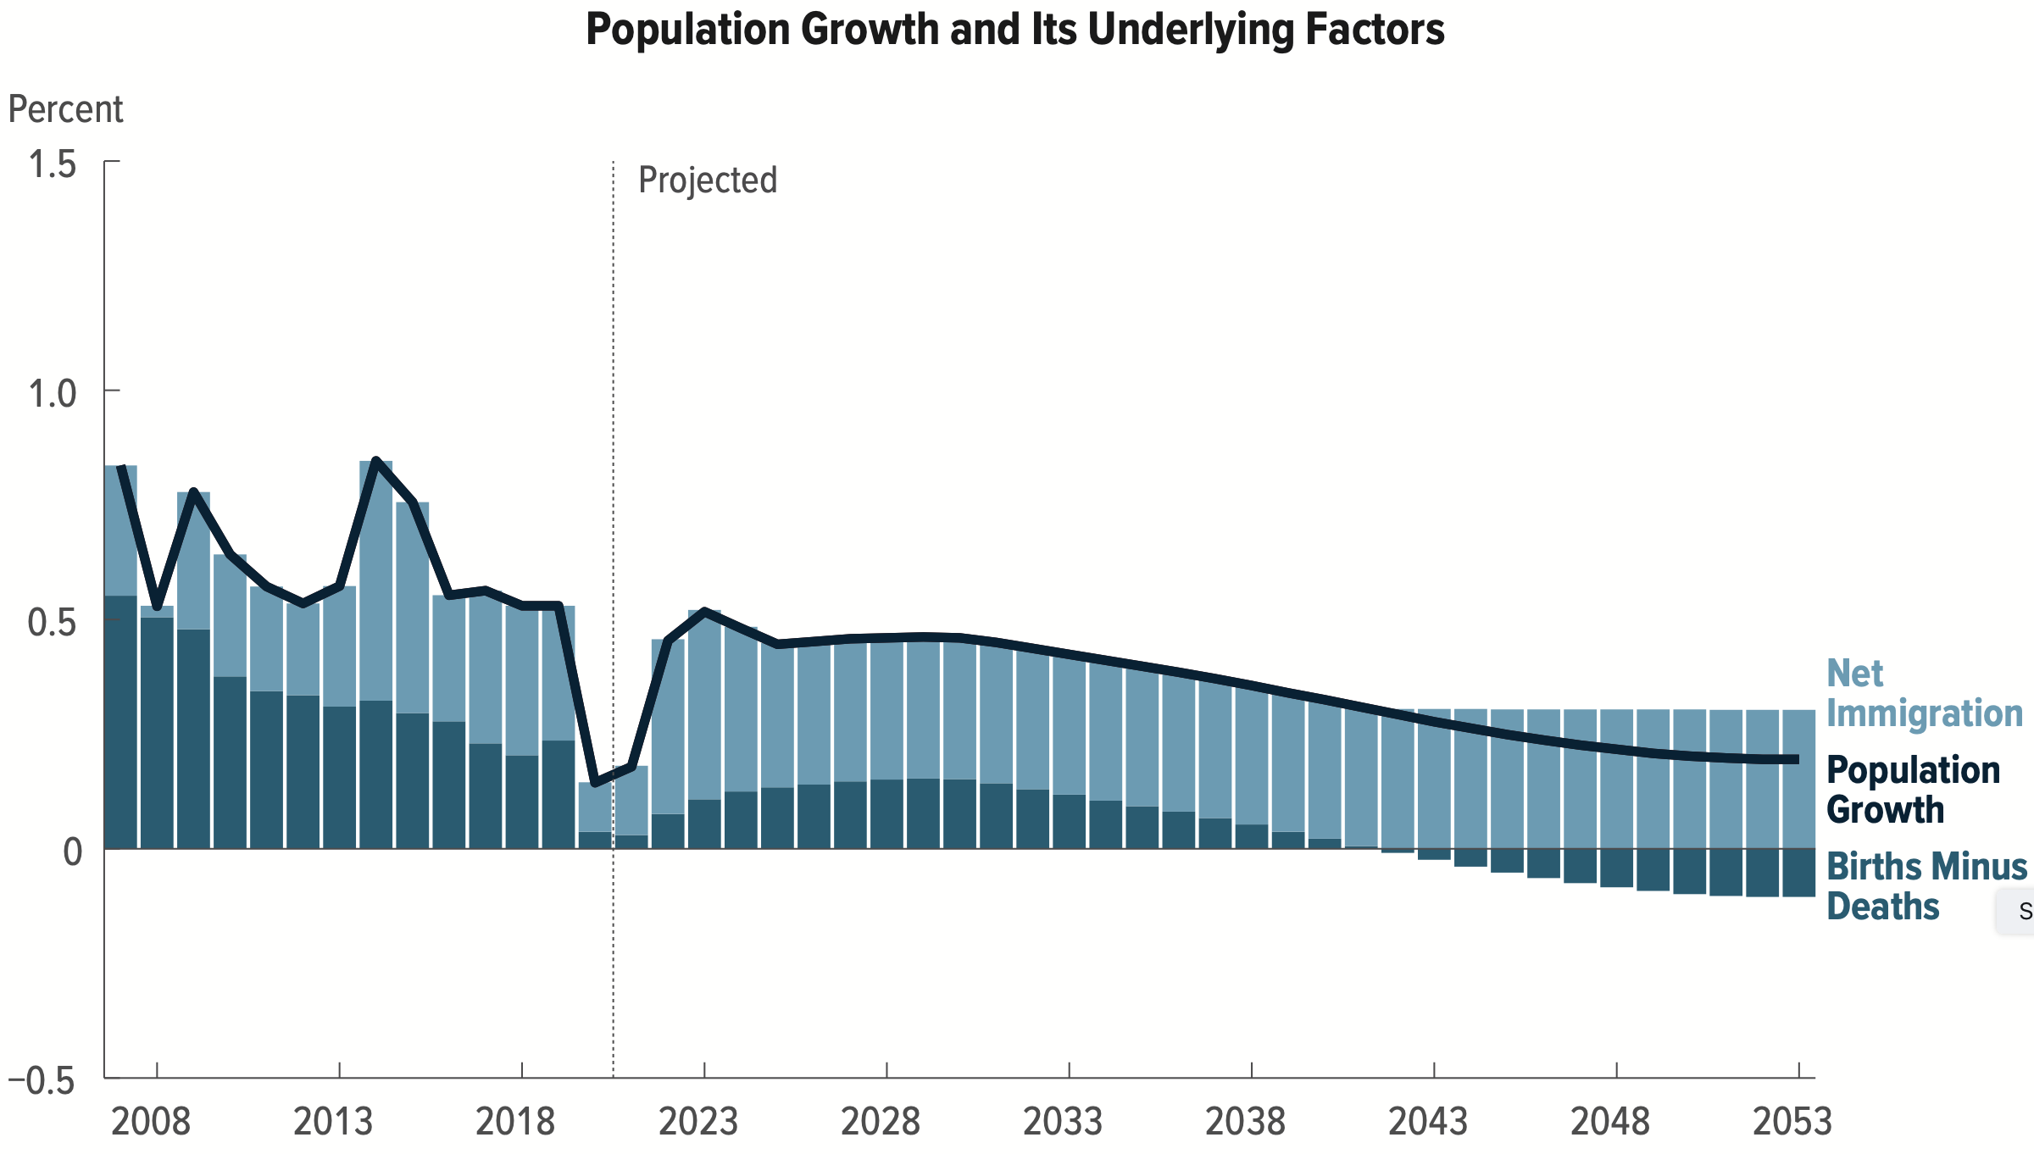
Is Immigration Saving the Day?
Source: CBO – The Demographic Outlook, 2023-2053

Slide 59
Jobs: Conventional Wisdom…Upended
What is the conventional wisdom?
  Low-skilled immigrants come in and take jobs from low-skilled native-born individuals.
    1-1 tradeoff.
What does new research show?
  Low-skilled immigrants contribute positively to the economy.
    Every 100 low-skilled immigrants: create 9 jobs for low-skilled native-born.
    They create opportunities for low-skilled native-born workers.
  Low-skilled immigrants take jobs that native-born don’t want.

Slide 60
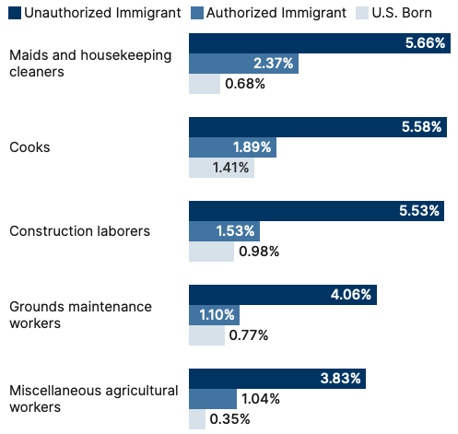
Share of Workers in Each Occupations

Slide 61
Implications for Major Federal Programs
Documented immigrants are less likely to use Social Security and Medicare.
Unauthorized immigrants are ineligible.
  They will pay into the system but cannot receive benefits.
Medicaid: not available to legal residents for the first five years.
Provide a source of revenue for an aging population.
  For Social Security and Medicare

Slide 62
Mass Deportations
Immigrants work different jobs than do native-born workers.
Immigrants contribute to the local economy.
  GDP losses of up to $1.7 trillion annually.
Immigrants keep prices low: in particular, food!
Deportations impact tax revenues.
  $1,300 more in on average than out, annually.
  Unauthorized immigrants: $22.6 billion in social security and $5.7 billion in Medicare payments.
Deportations are expensive ($13,000 each).
  Total cost $315 billion.
They rob people of their dignity.

Slide 63
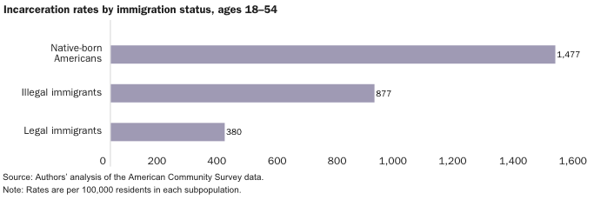
Incarceration by Immigration Status, 2018
Source: Cato Institute, Illegal Immigrant Incarceration Rates, 2010–2018: Demographics and Policy Implications, April 2020.

Slide 64
www.NEEDEcon.org/LocalGraphs
For every state and county in the United States.
Detailed graphs on employment, housing, moves, and other statistics.

Slide 65
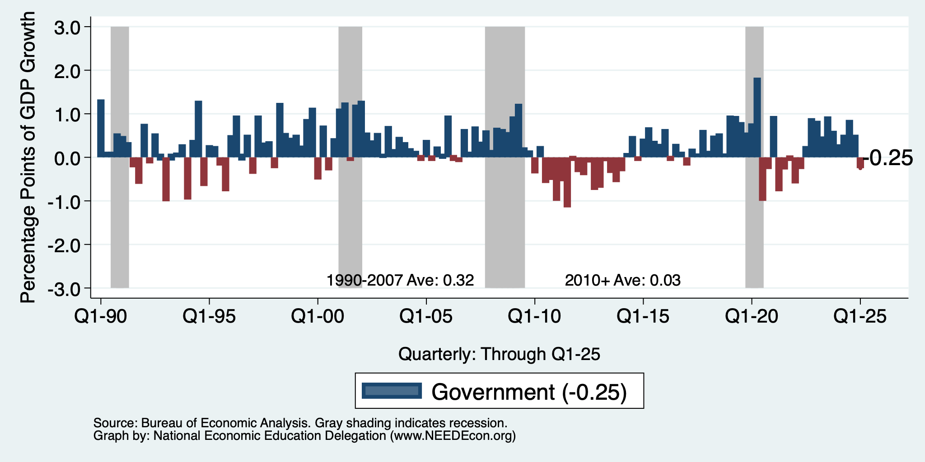
Contributions to GDP: Government
Notes:
Since 2010, average government spending growth is shrinking, resulting in a negative average contribution to GDP growth post-recession of -0.8 percentage points
Note that average quarterly government spending growth is 0.42% from 1990-2007 and -0.17% in 2010+ (annualized, 1990-2007 = 1.68%; 2010+ = -0.70%).

Slide 66
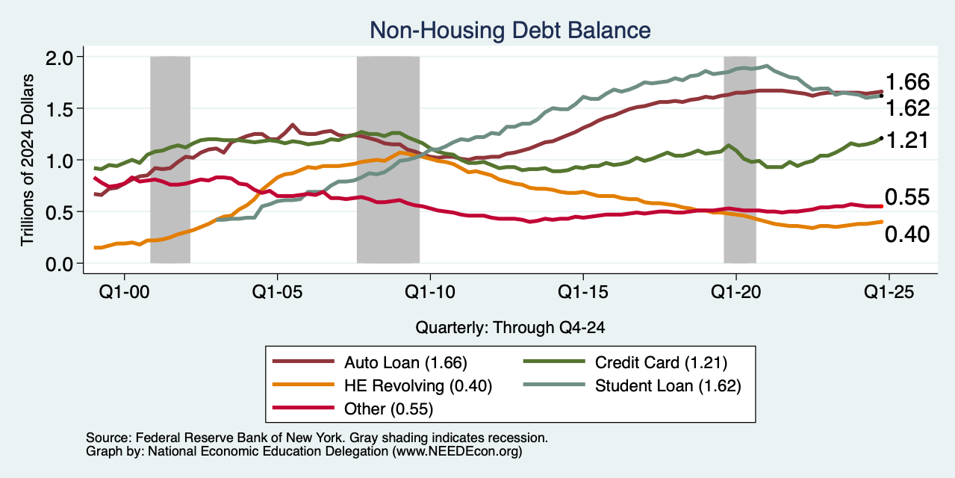
Household Debt: Non-mortgage Sources

Slide 67
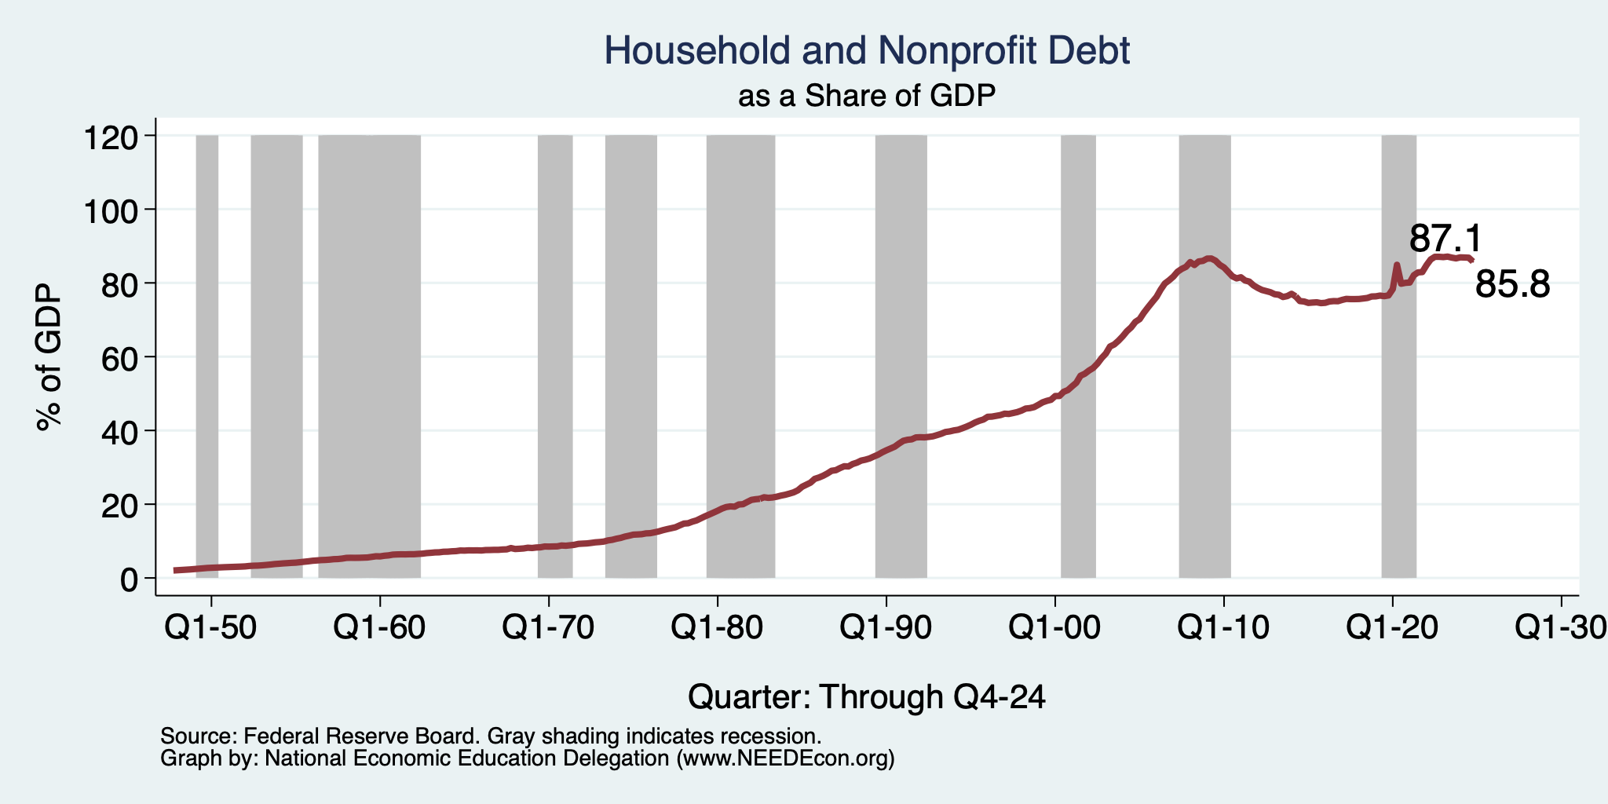
Household Debt as a Share of GDP
Notes:
US household debt relative to GDP rose until the latest recession.
Households have reduced debt relative to GDP 11% since it’s peak in 2008 (at 99%).
Conclusion: Falling household debt likely contributes to slower consumption growth since the recession.
Chart: HHPERCT.png

Slide 68
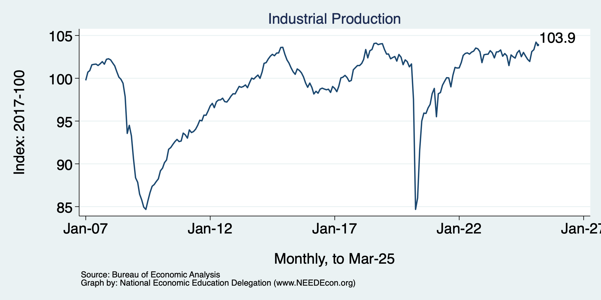
Industrial Production (Manuf, Util, Mining)

Slide 69
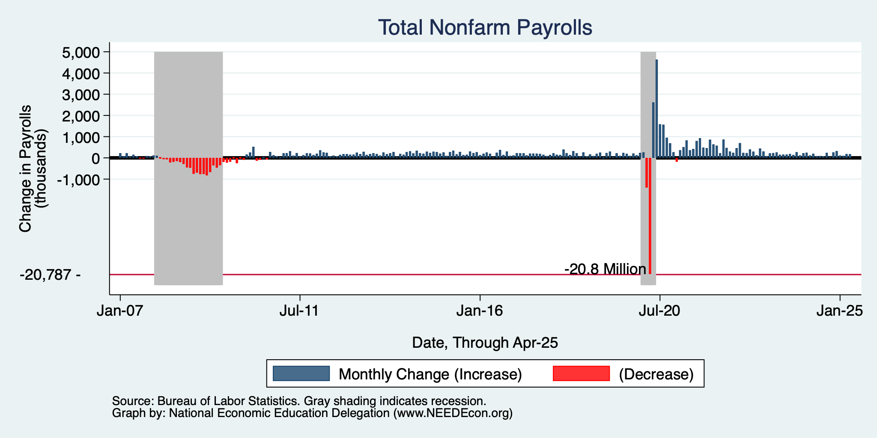
Monthly Changes in Nonfarm Employment
Notes:
PAYEMS.png

Slide 70
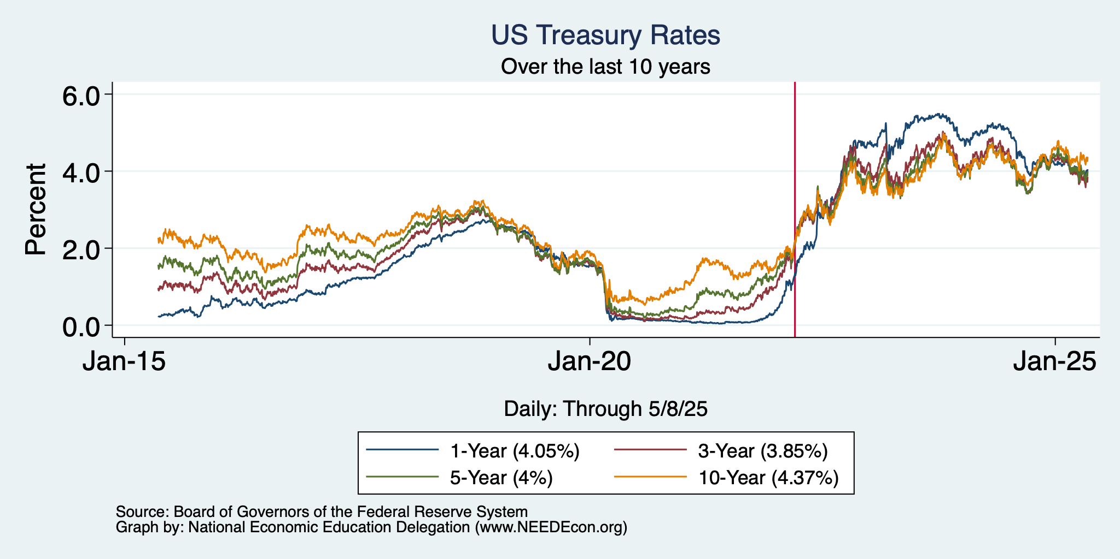
Treasuries
Notes:
treas_recent.png

Slide 71
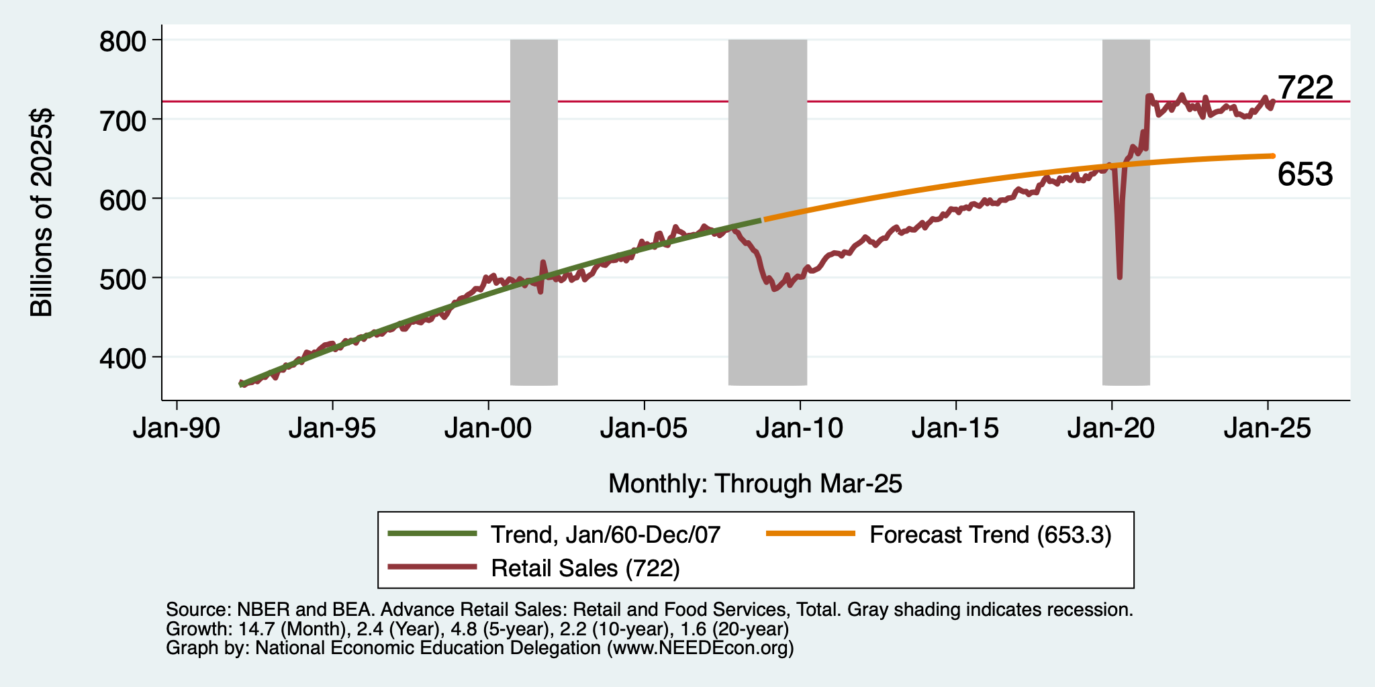
But SUPER High to Begin With!

Slide 72
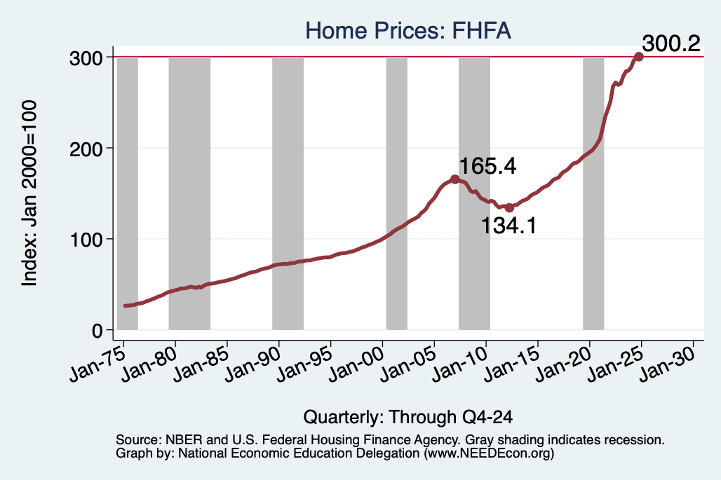
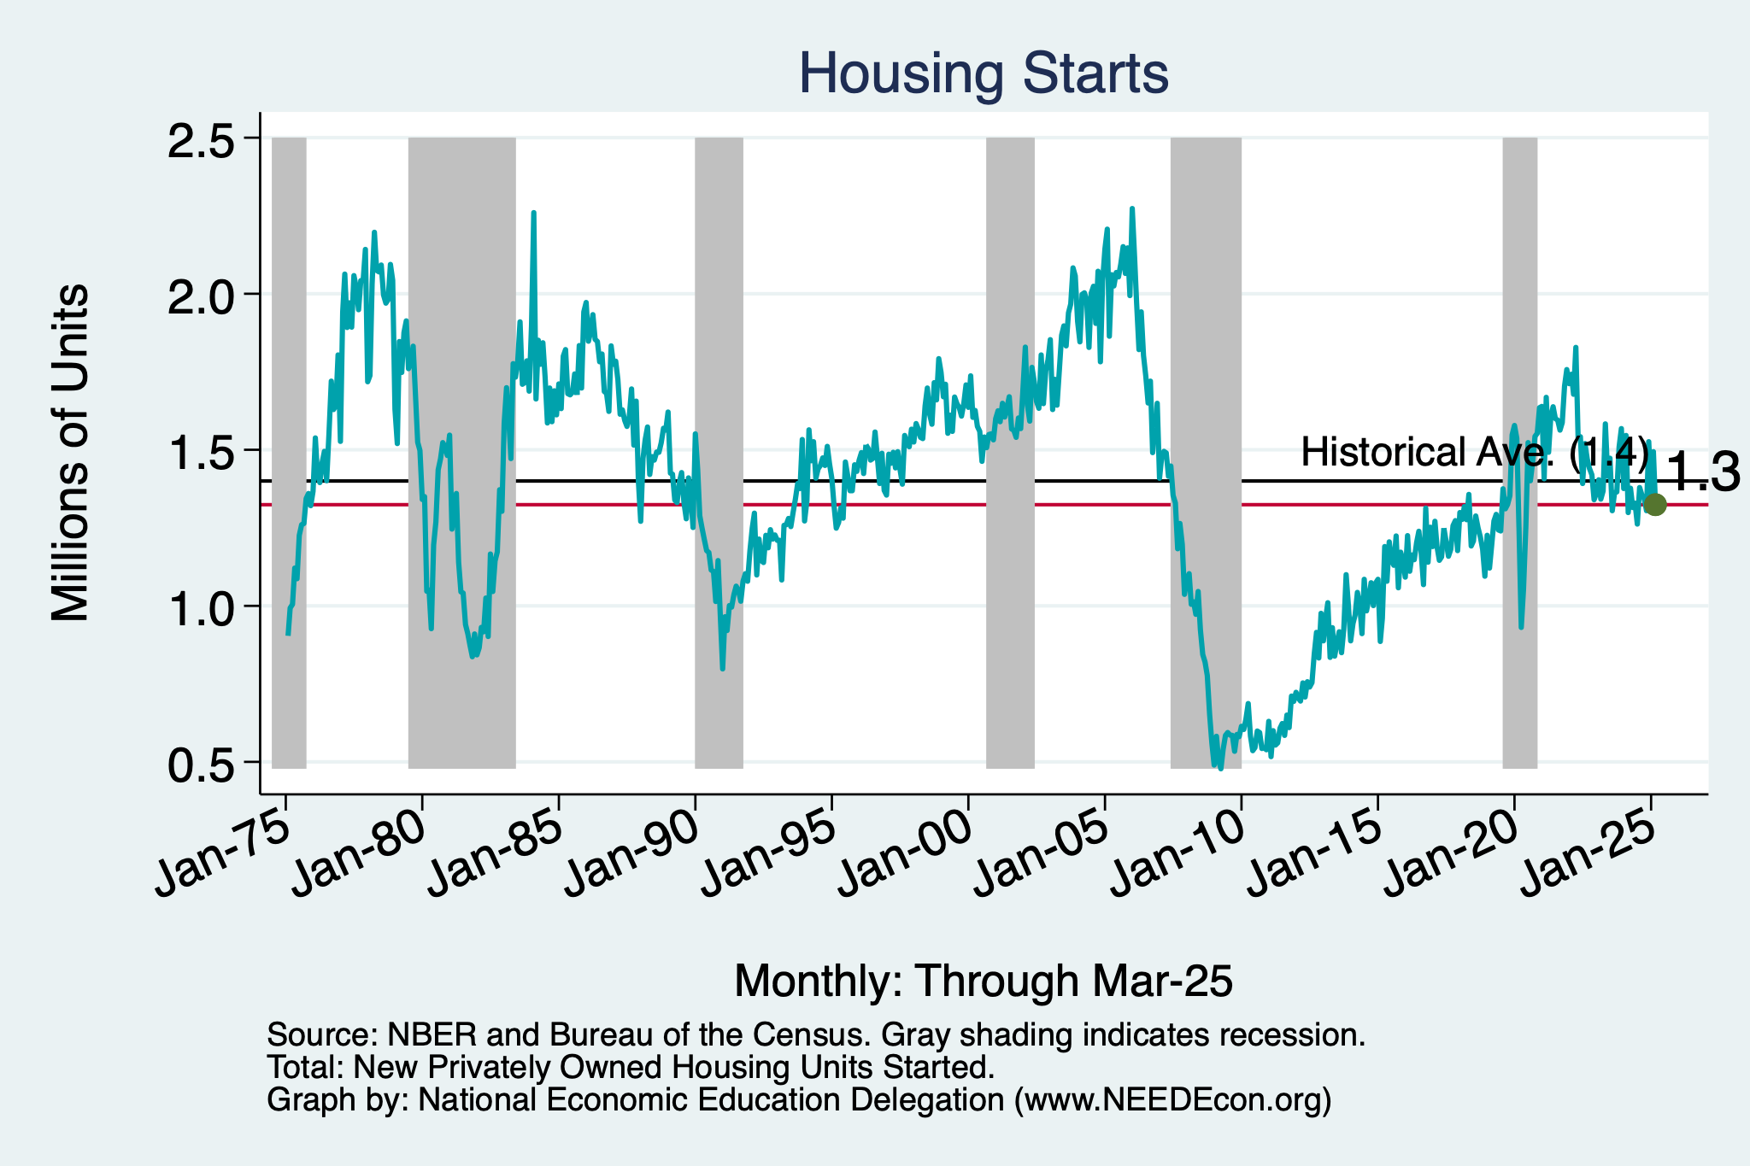
Home Prices and Housing Starts
Notes:
Charts:
homeprices_recession.png
housing.png

Slide 73
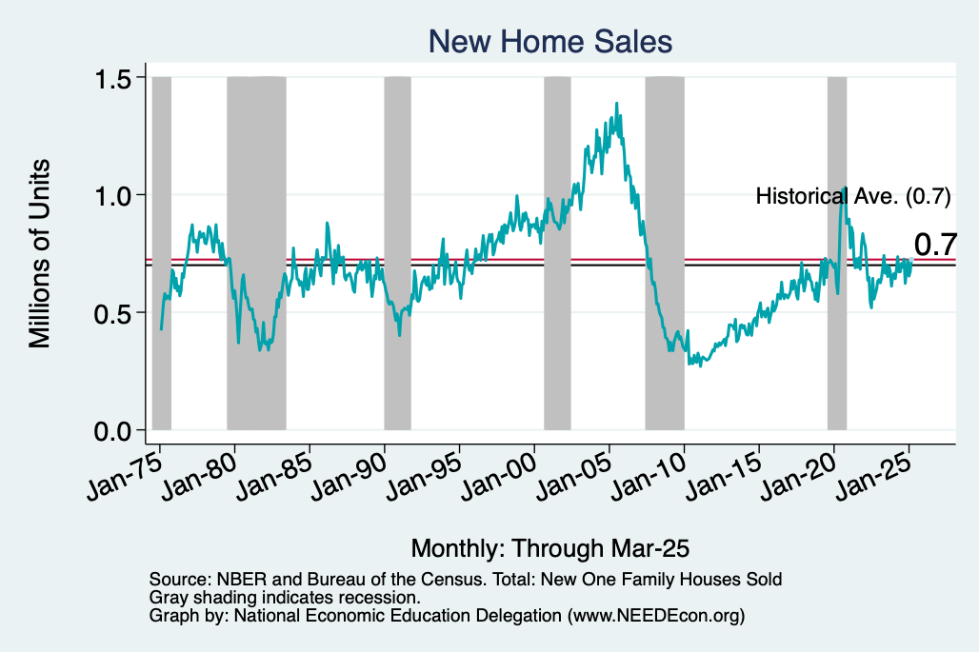
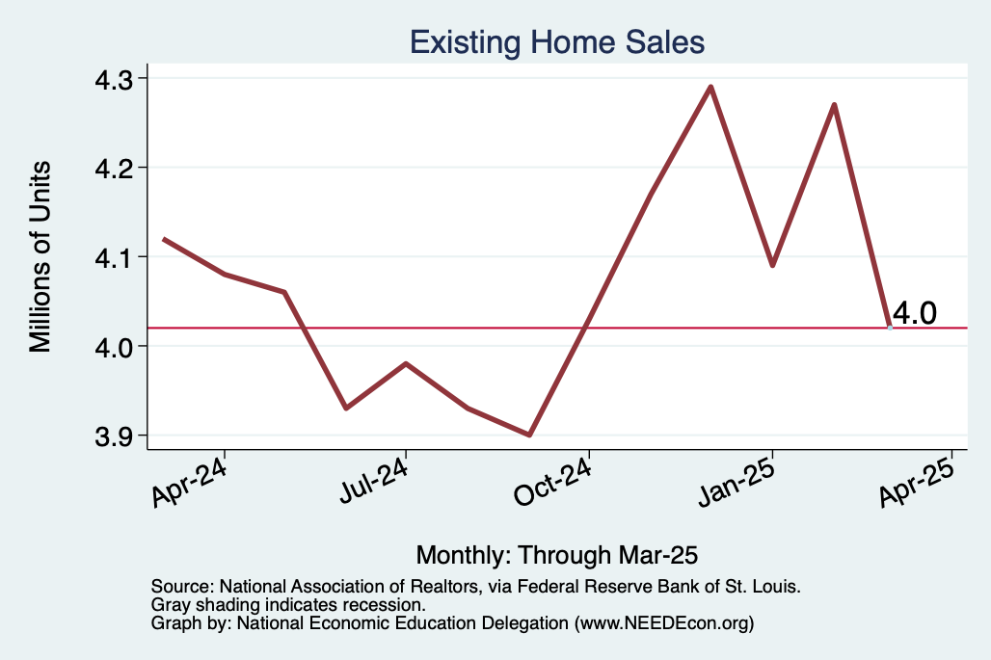
Home Sales are Not Horrible

Slide 74
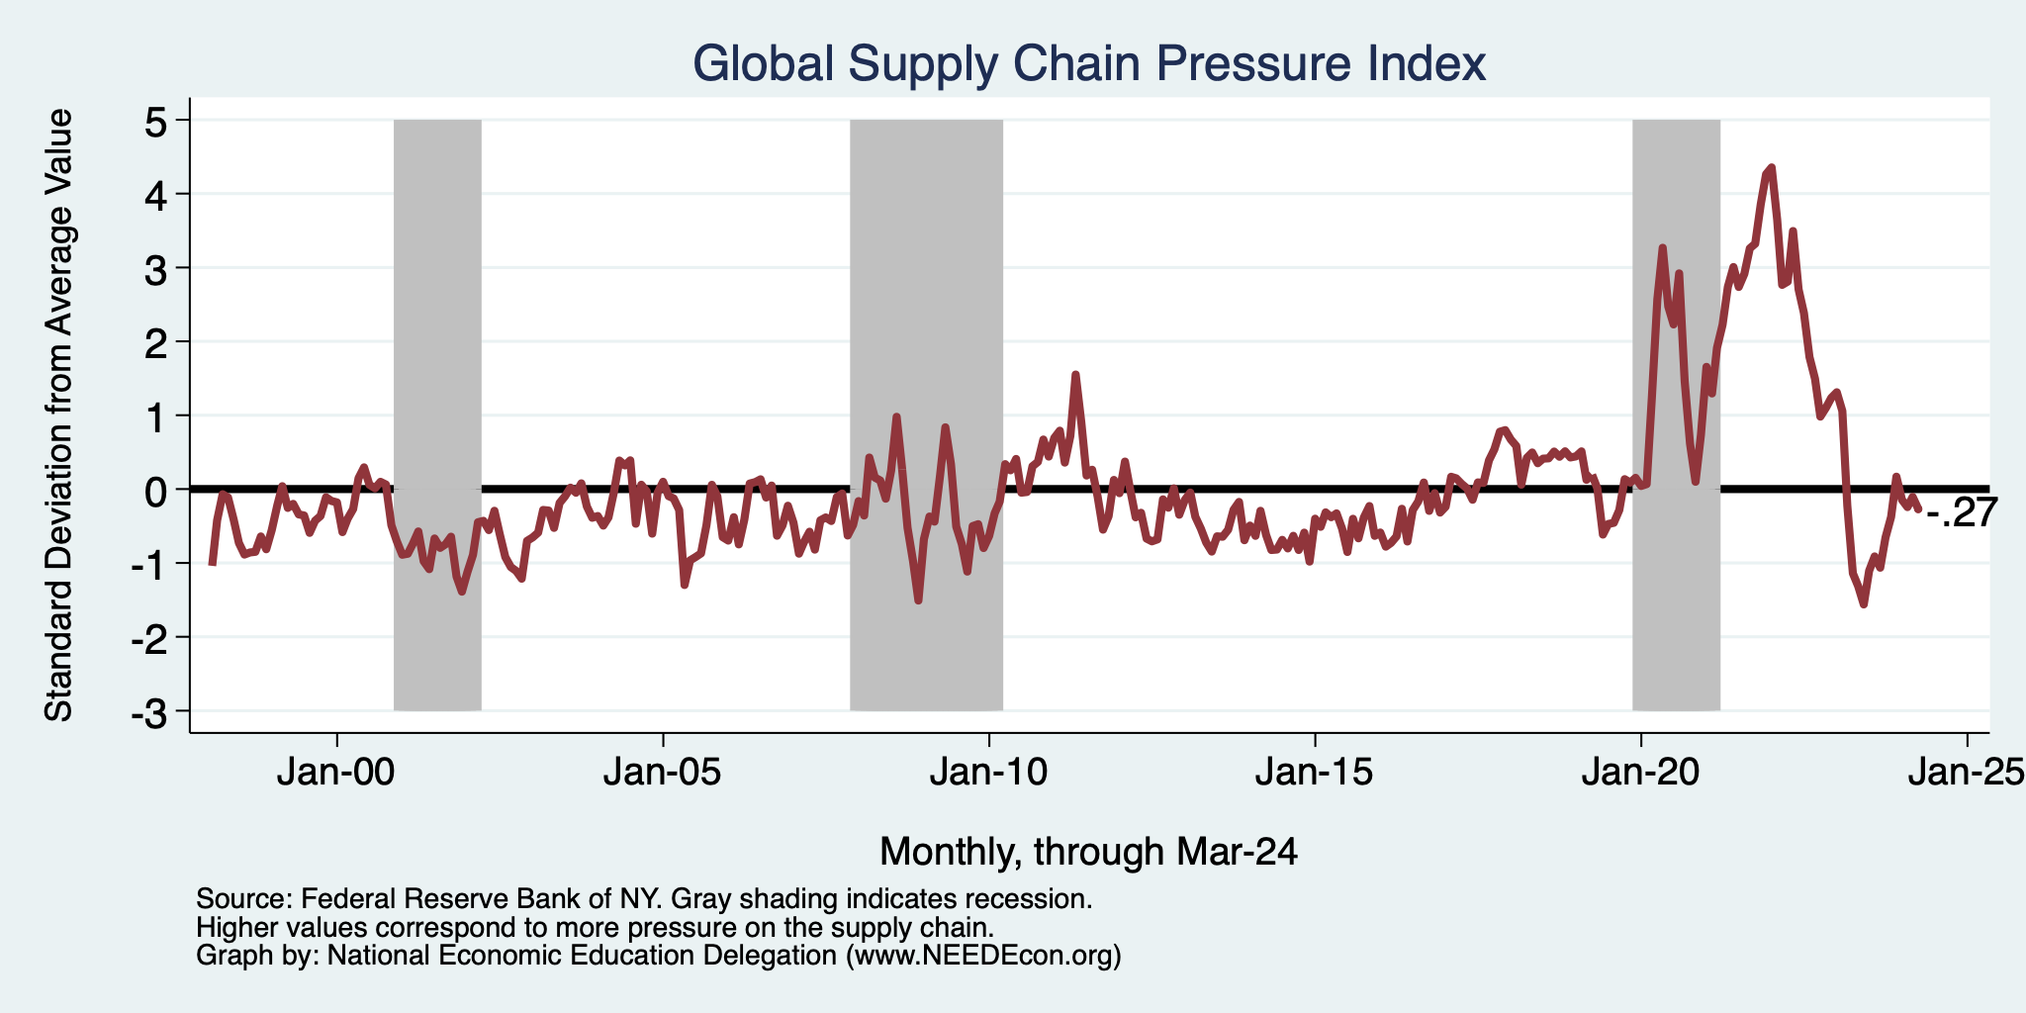
Supply Chains

Slide 75
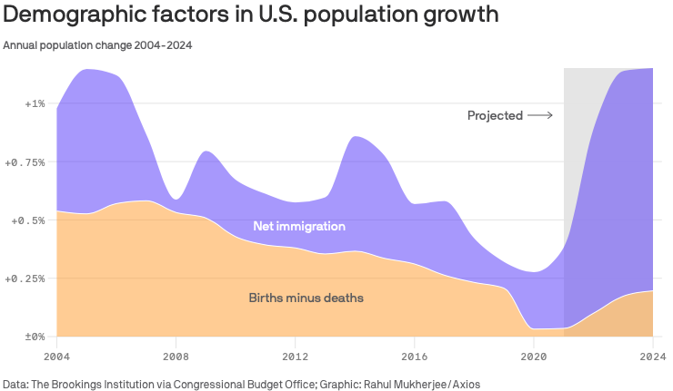
Is Immigration Saving the Day?
Source: https://www.axios.com/2024/03/13/immigration-economy-jobs-growth-good#

Slide 76
The “Nominal” Side
Inflation: A lot of progress on inflation, but the recent data are troubling.
But, this is not the popular view

Slide 77


Slide 78

Inflation in the Last 3/6 Months – Still 3%
Source: https://www.nytimes.com/2023/01/13/opinion/cpi-inflation-fed.html

Slide 79


Labor Market is Cooling
Job Openings - Falling
Quits – Falling (Rising?)

