Slide 1



Economic Update
US & Monterey Bay Area
Regional Economic Outlook
Monterey Bay Economic Partnership
Jon Haveman, Ph.D.
NEED
May 15, 2026

Slide 2
Outline
Economic Indicators
Big Picture: Uncertainty
The Local Economy

Slide 3
Economic Indicators

Slide 4
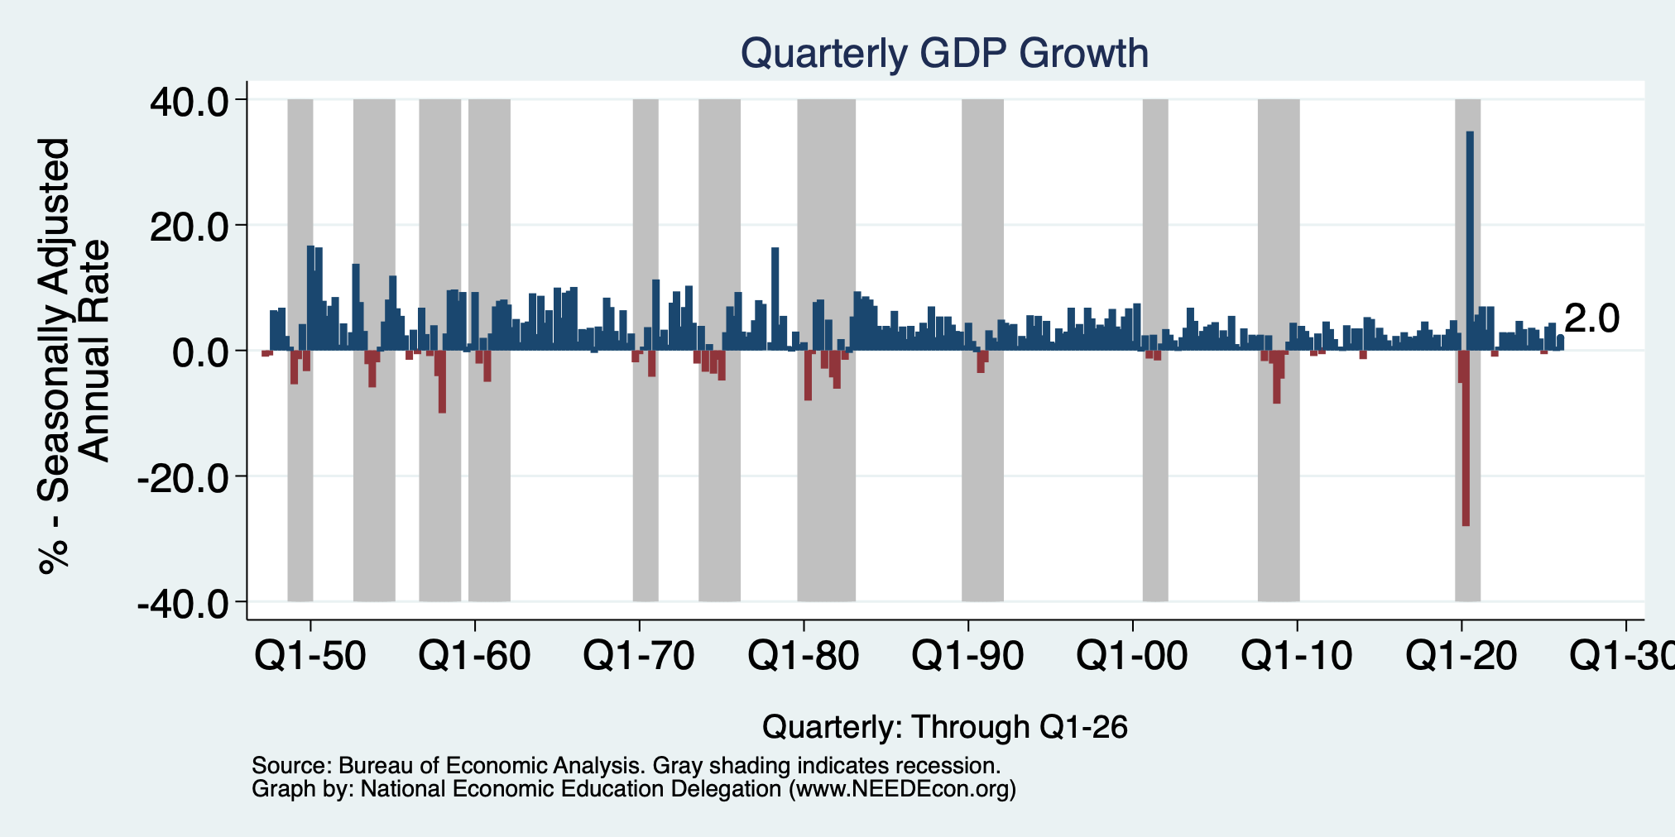
GDP: Quarterly Growth
Q2-2025: 3.8%
Q3-2025: 4.4%
Q4-2025: 0.5%
Q1-2026: 2.0%
Growth in 2025: 2.1%
Notes:
Graph: gdp_pot_grow.png
The Point: From 1990 – 2007, average annual US GDP growth pre-crisis is 2.94%. However, post-crisis US GDP growth is 2.19% (0.75 percentage points lower). Why is has the recovery been sluggish?
Note: At the recession’s height, the gap between quarterly GDP growth and potential growth was 2.5 percentage points.

Slide 5
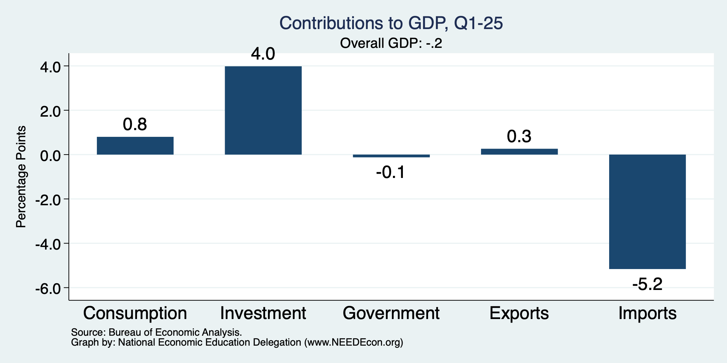
What Drove GDP to Such Growth?
Normally
2.3%

Slide 6
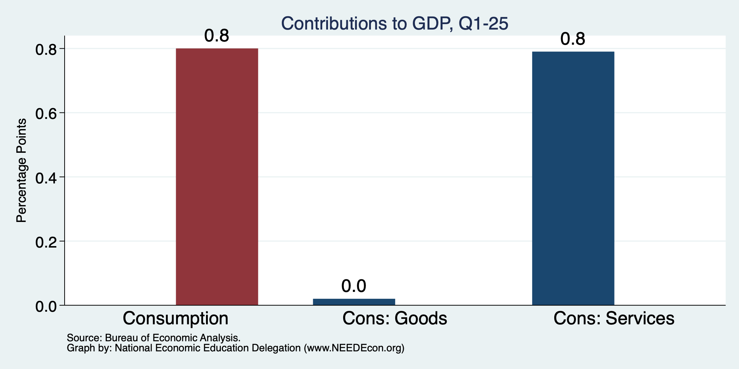
Consumers Also Tightened
Normally
0.8%

Slide 7
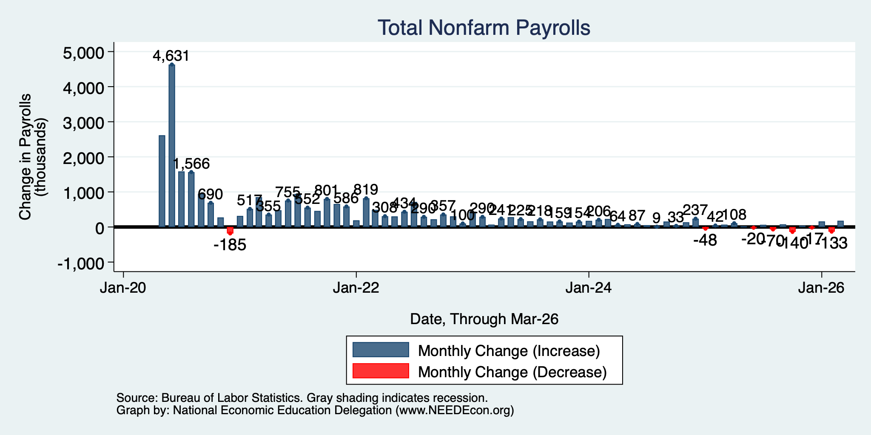
Monthly Changes in Nonfarm Employment
Feb: -156,000
Mar: 185,000
April: 115,000
Notes:
PAYEMS.png

Slide 8
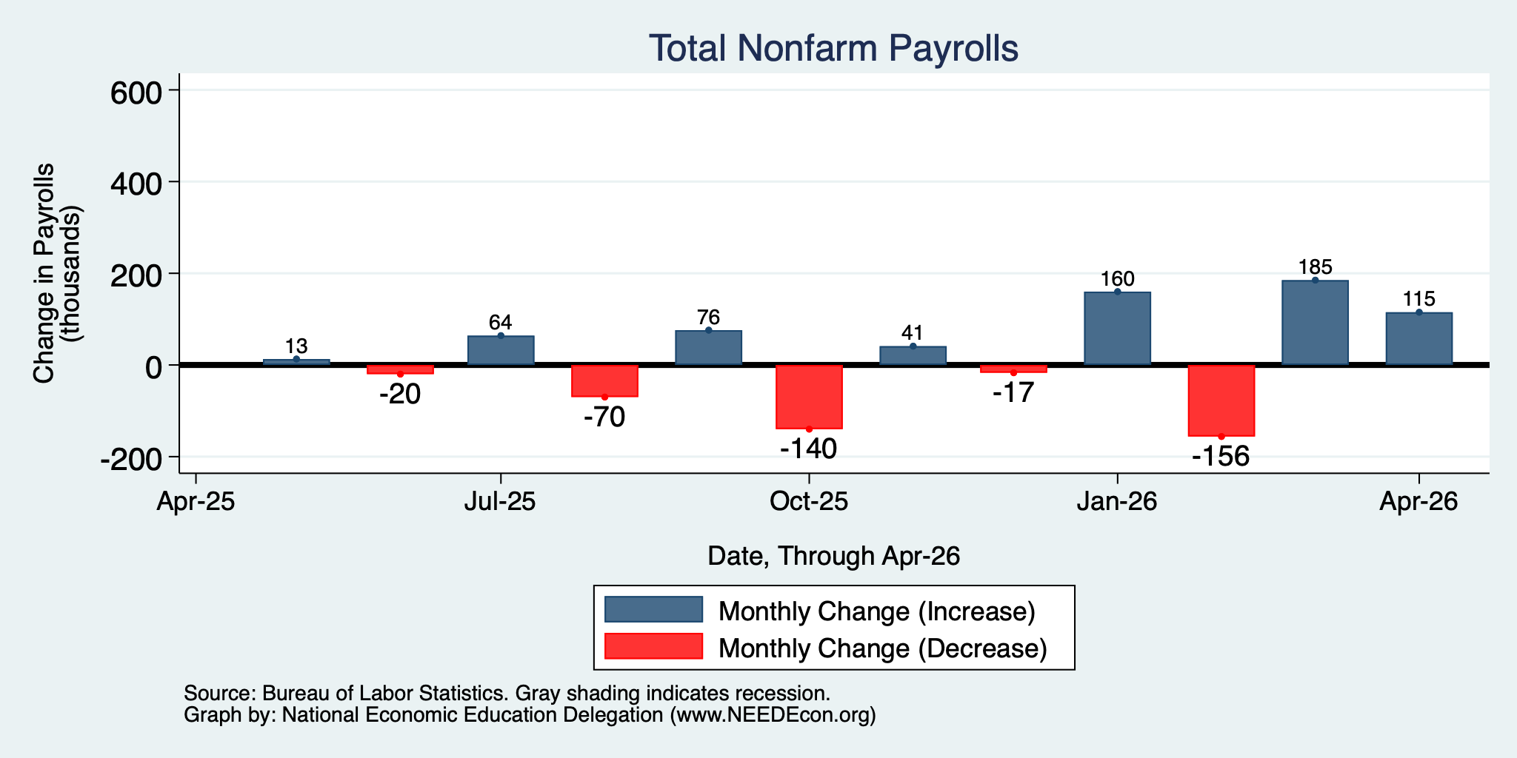
Monthly Changes in Nonfarm Employment
Feb: -156,000
Mar: 185,000
April: 115,000
Notes:
PAYEMS.png

Slide 9
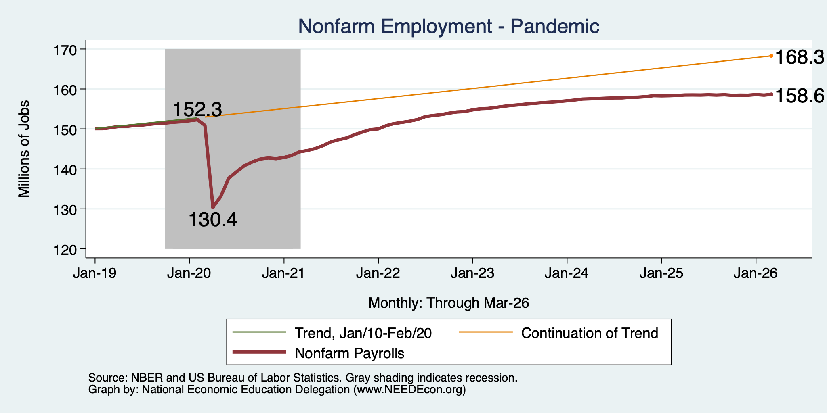
Employment Gap … is Growing
6.4 Million ABOVE February, 2020.
9.8 Million BELOW where we should be.
Notes:
payroll_recent.png

Slide 10
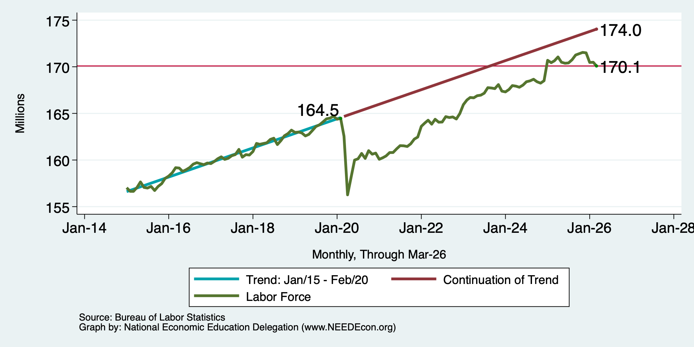
Workers Are Coming Back, Or Are They?
5.5 million ABOVE Feb 2020
4.2 million BELOW where we should be

Slide 11
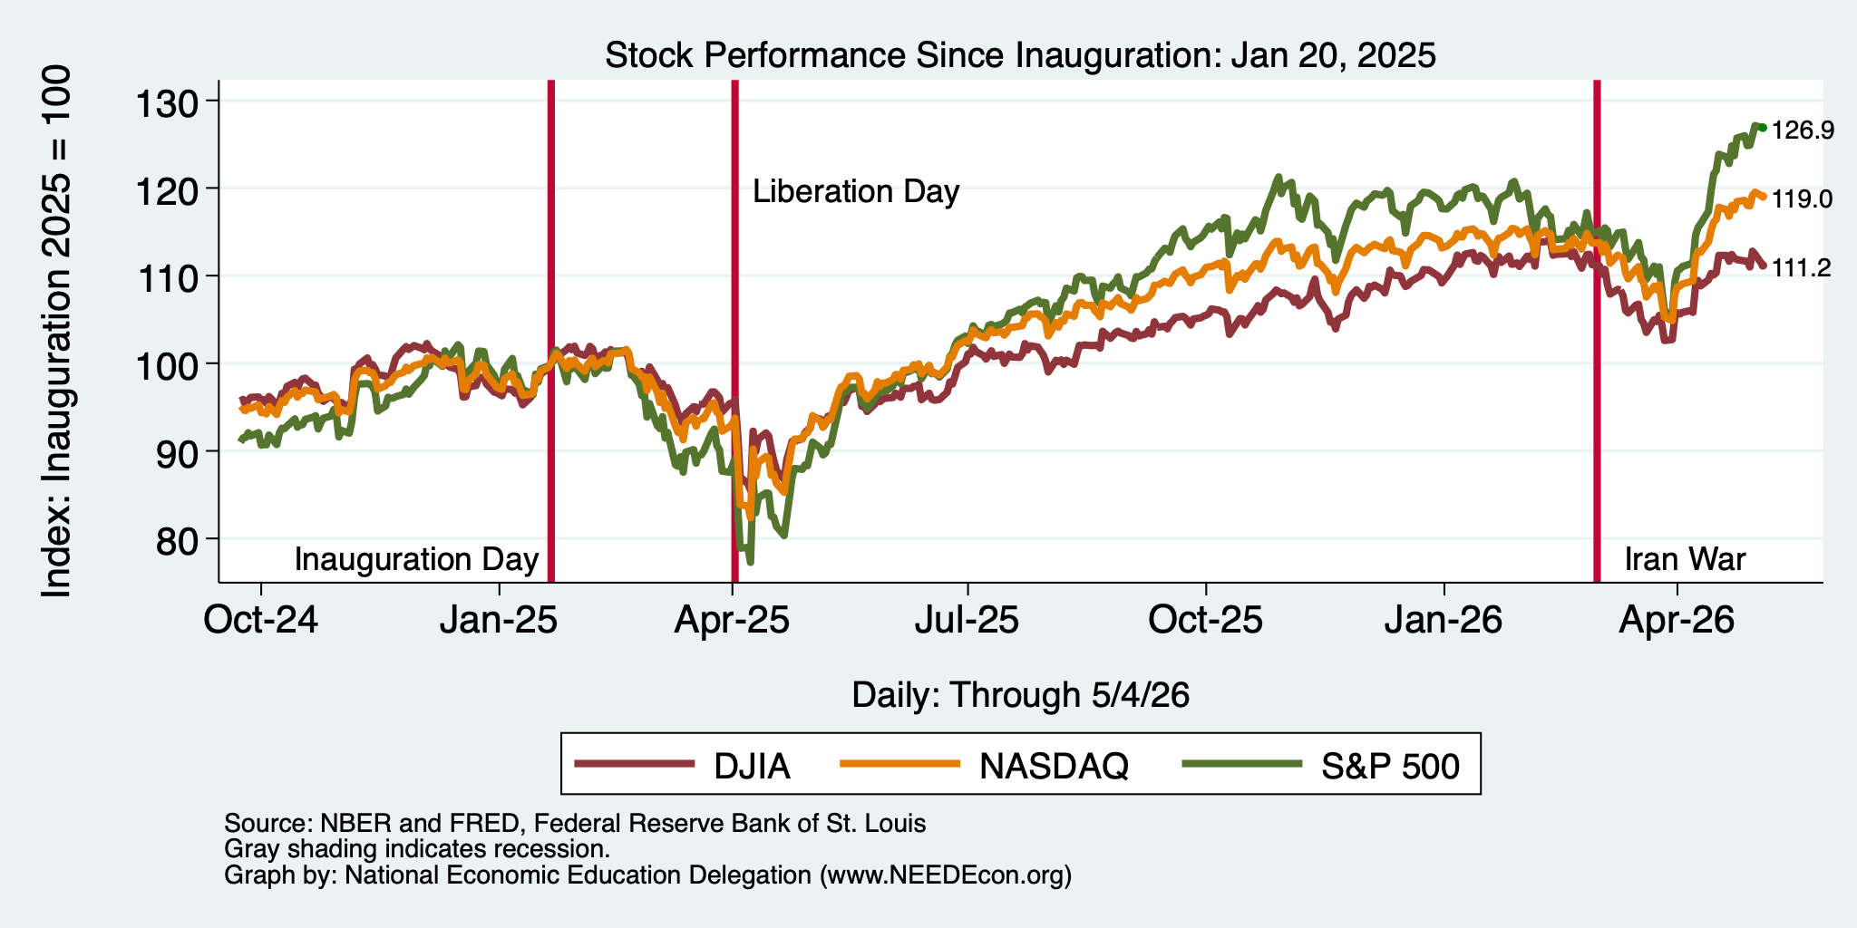
And Stocks?

Slide 12
Uncertainties
What effect will continued deportations have?
Will AI continue to drive growth?
Will tariffs continue to drive inflation?
  Fed says that ALL of the inflation above 2% is from tariffs, until…
Will the war drive inflation beyond fuel prices?
  It is clear in fuel prices, but every other sector of the economy depends on fuel. Higher fuel prices drive prices in the rest of the economy up.
Will consumers continue to hold up?
  Evidence that spending is in decline.
What happens to Fed policy now that Jerome Powell is gone?

Slide 13
Inflation

Slide 14
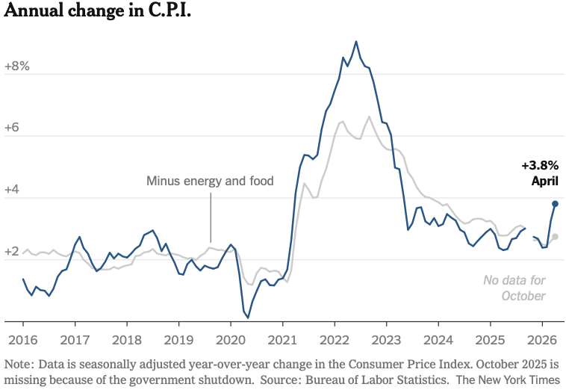
Inflation: Latest Figures
The uptick is entirely because of the war.
Source: NYTimes.com

Slide 15
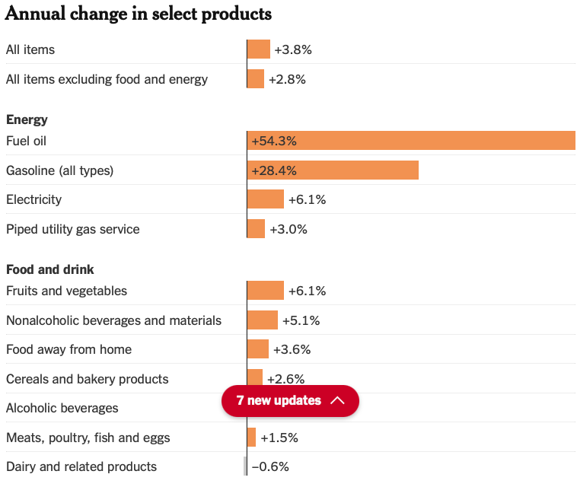
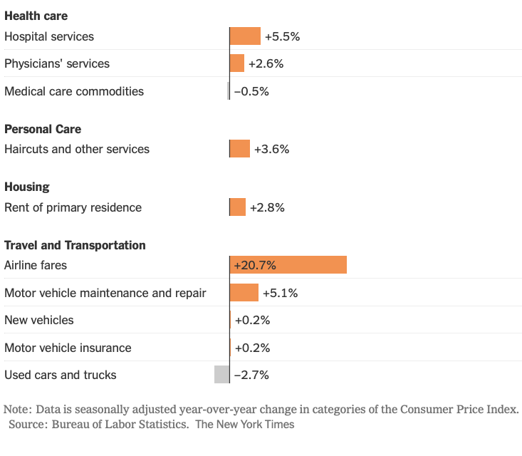
Inflation: LATEST Monthly Figures
Source: NYTimes.com

Slide 16
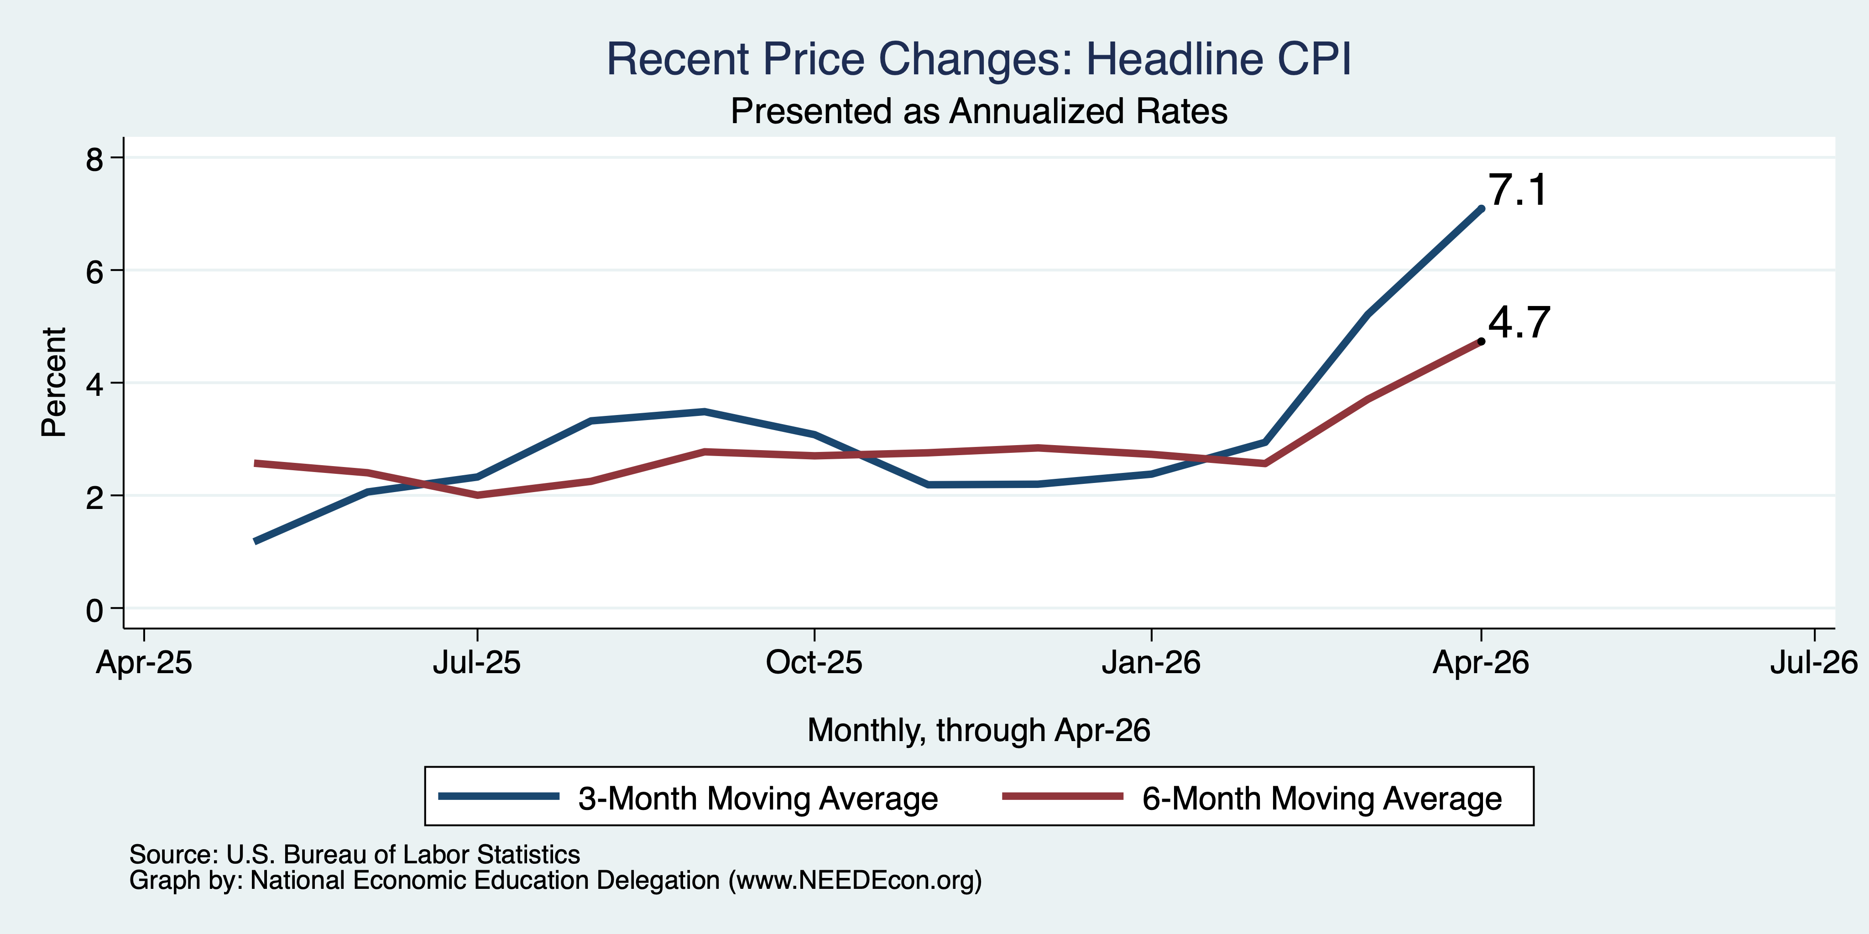
CPI in the Last 3/6 Months

Slide 17
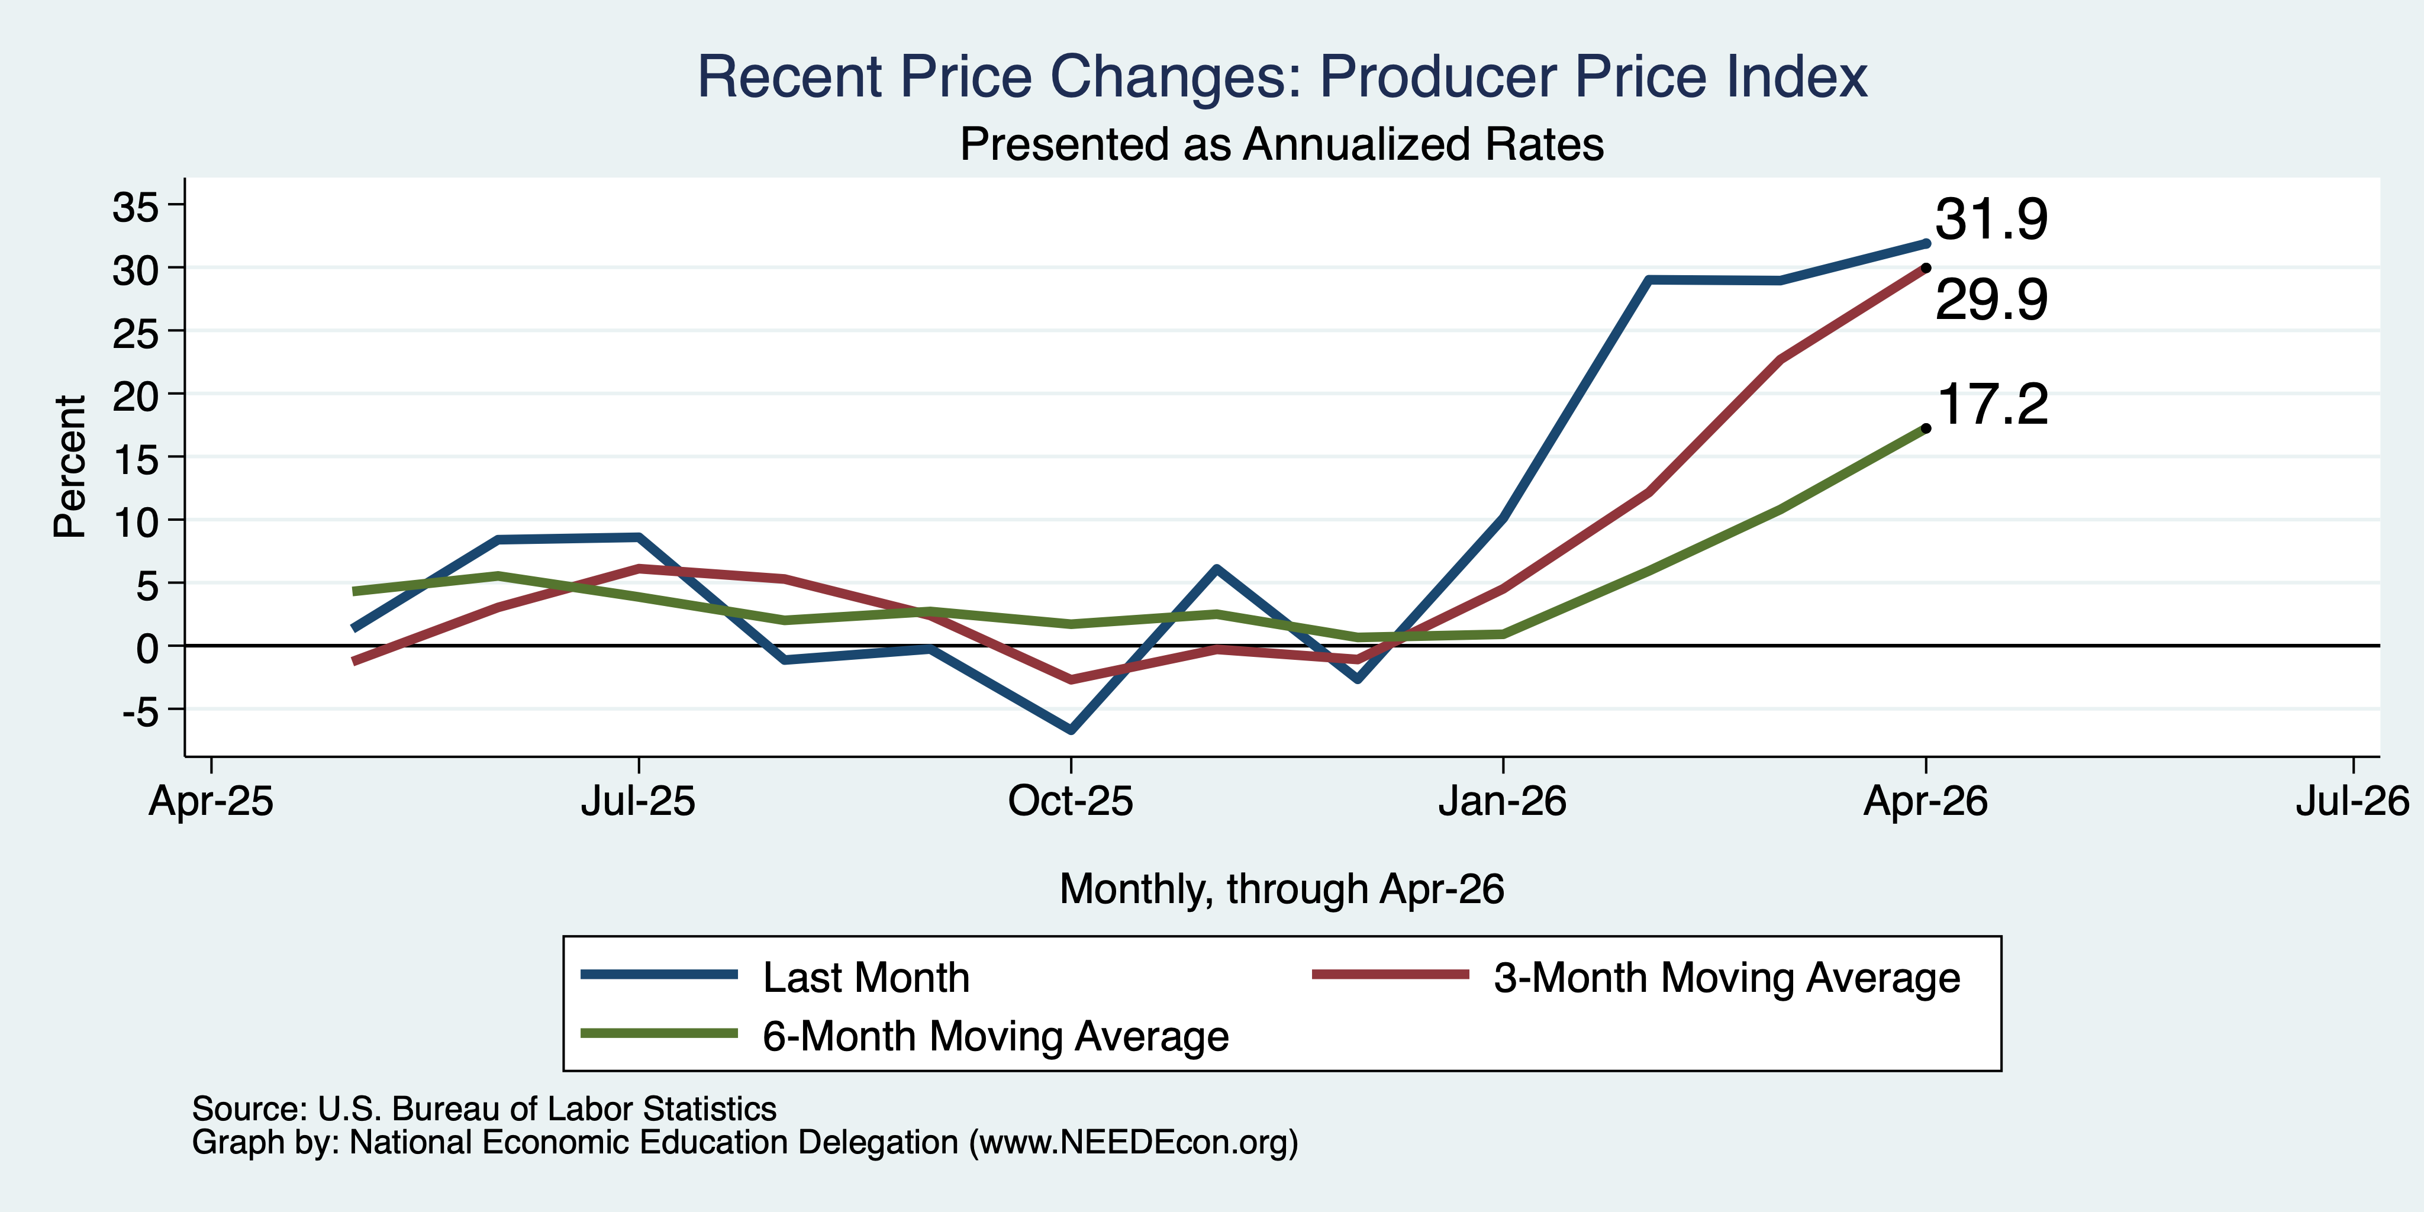
PPI in the Last Few Months

Slide 18
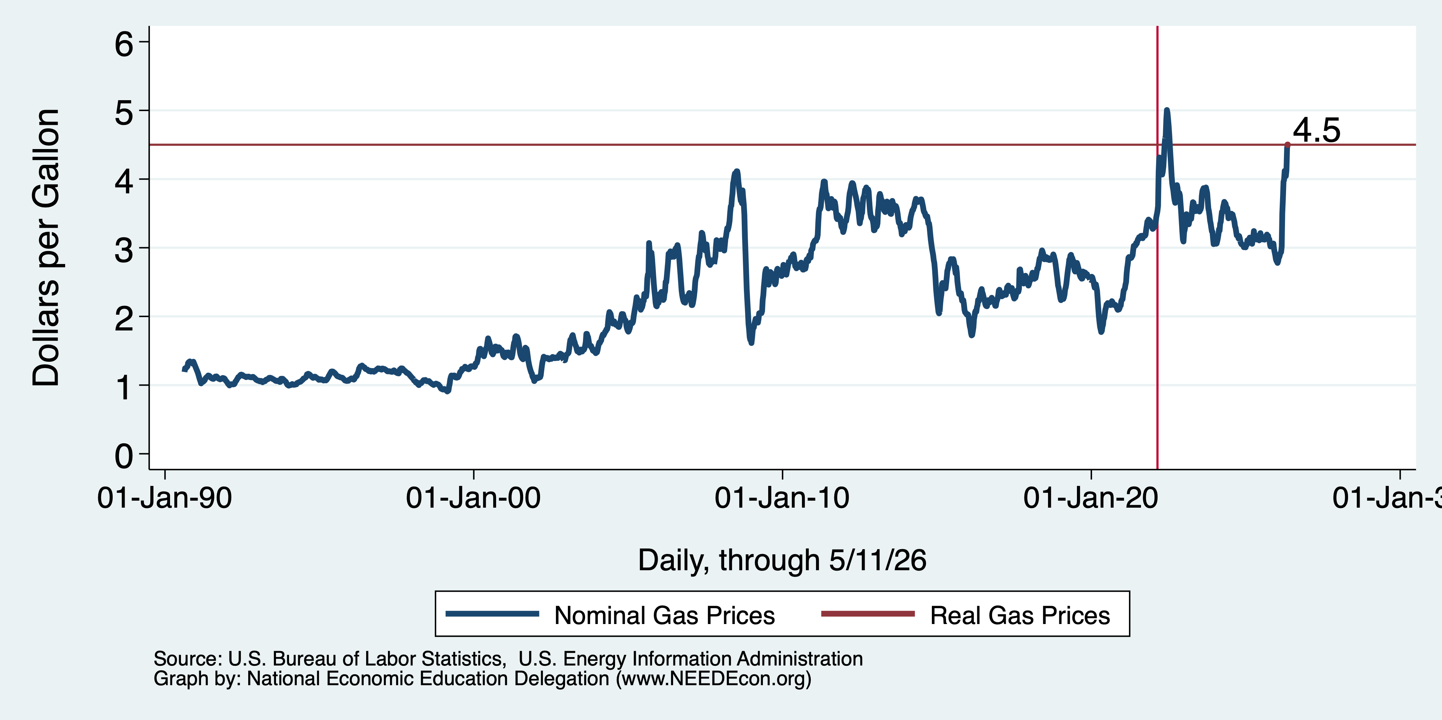
Inflation: Gas Prices

Slide 19
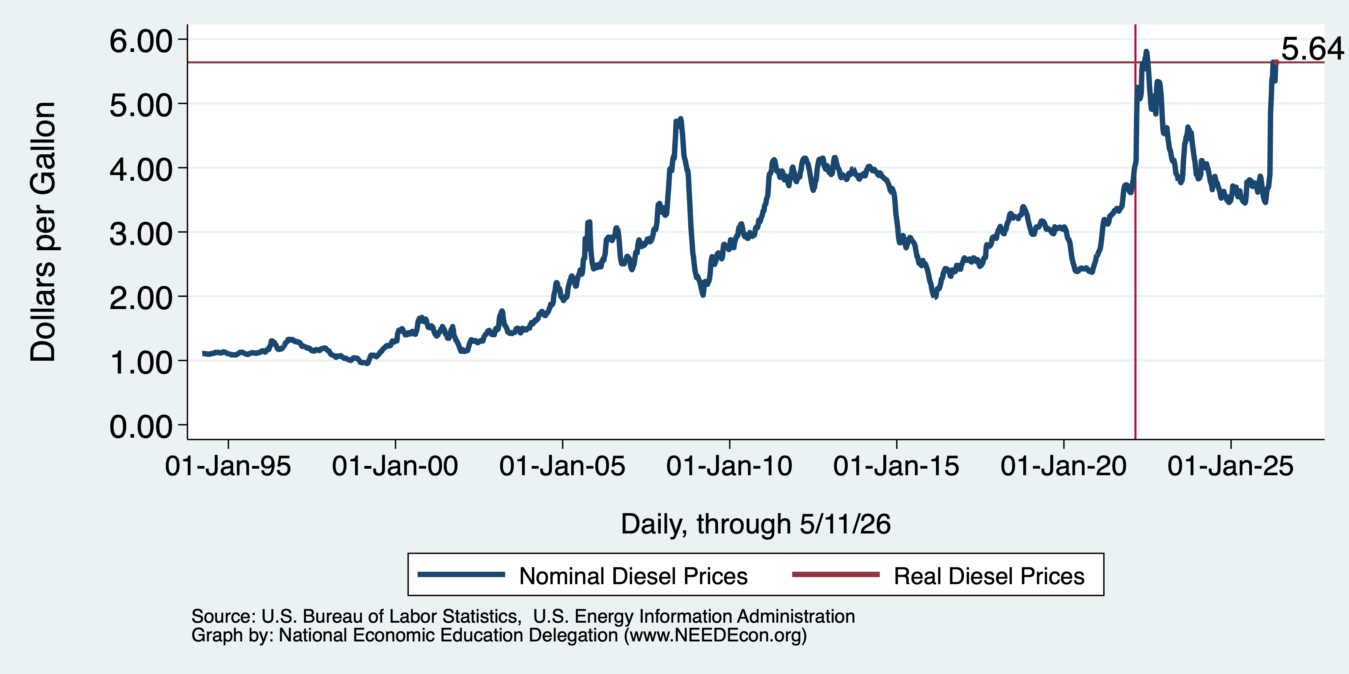
Inflation: Diesel Prices
3.46

Slide 20
Shortages From the War:
Naptha – ink ingredient
  Bathrooms, newspapers, cars, and paint.
Oil, in particular, heavy jet fuel and diesel (more so than gas for cars)
Ingredients for fertilizer
  Nitrogen and phosphate
Helium – MRI machines, AI chips, EVs
Wide variety of others.

Slide 21
Very Significant Implications
Rising fuel prices, especially diesel, impact ALL industries.
  Some, of course, more than others.
  The importance of mobility determines how much.
Especially vulnerable industries:
  Aviation
  Transportation
  Agriculture
  Manufacturing

Slide 22
Locally

Slide 23
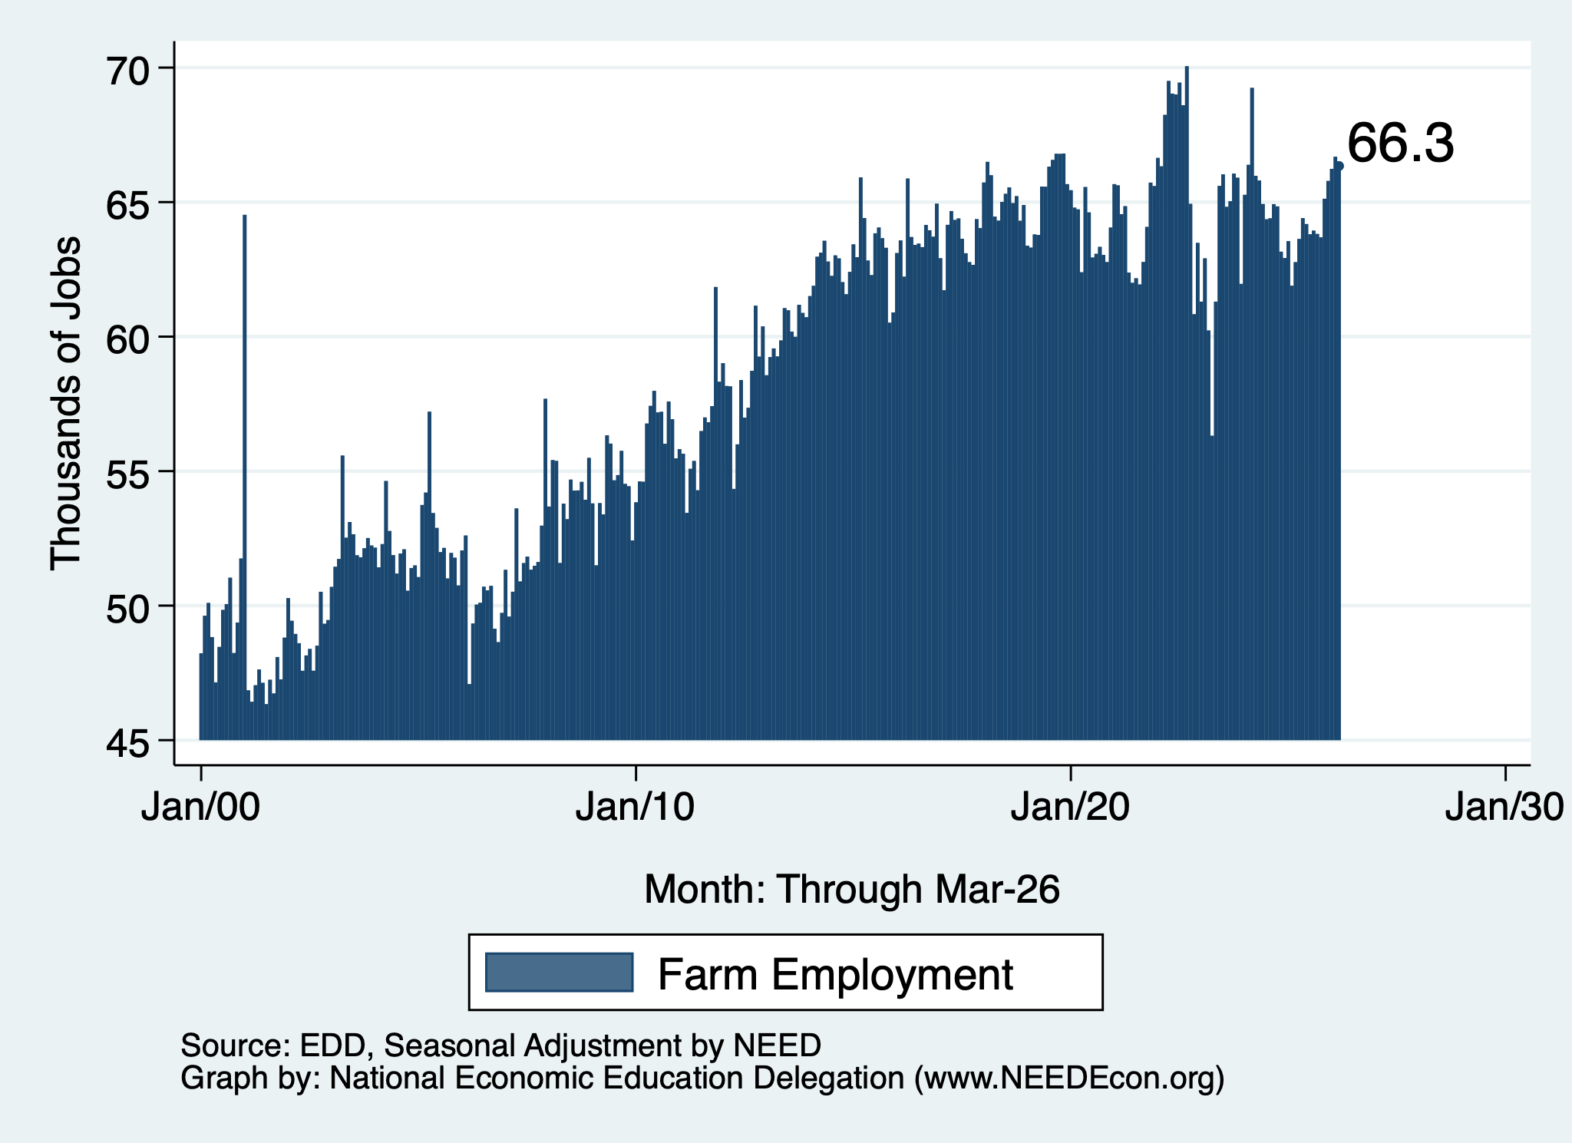
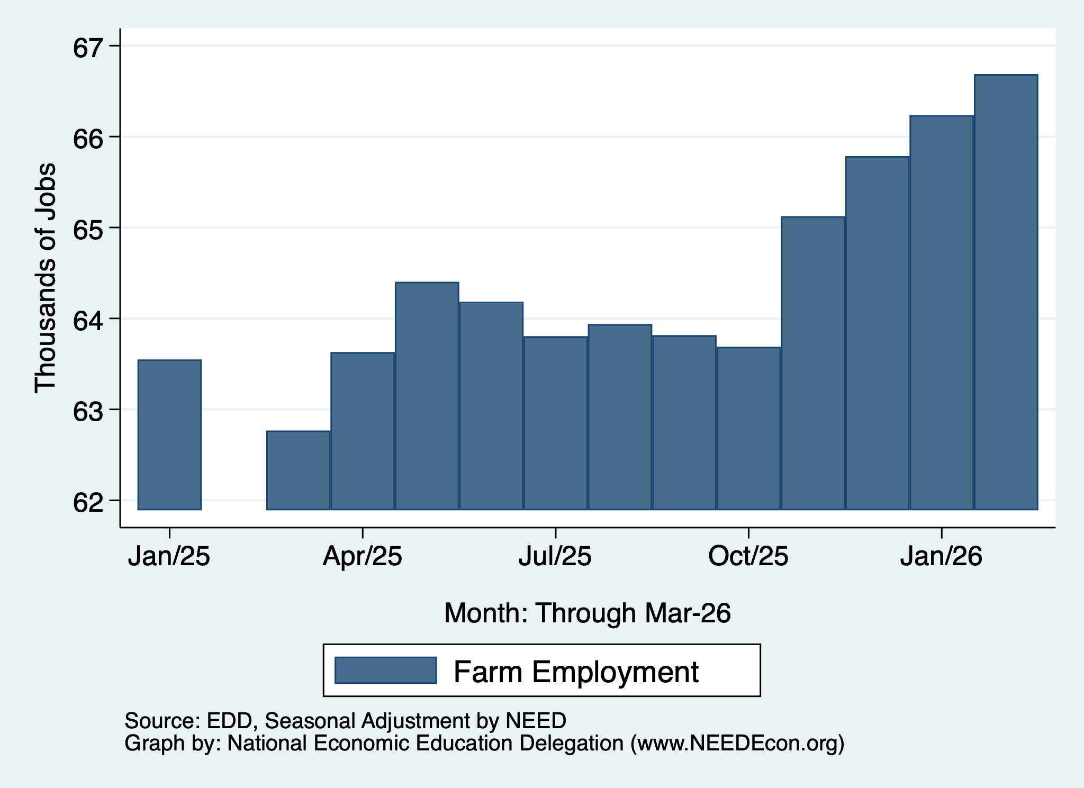
Employment Recovery, Monterey Bay Region
Farm Employment
Since 2000
Over the Last Year

Slide 24
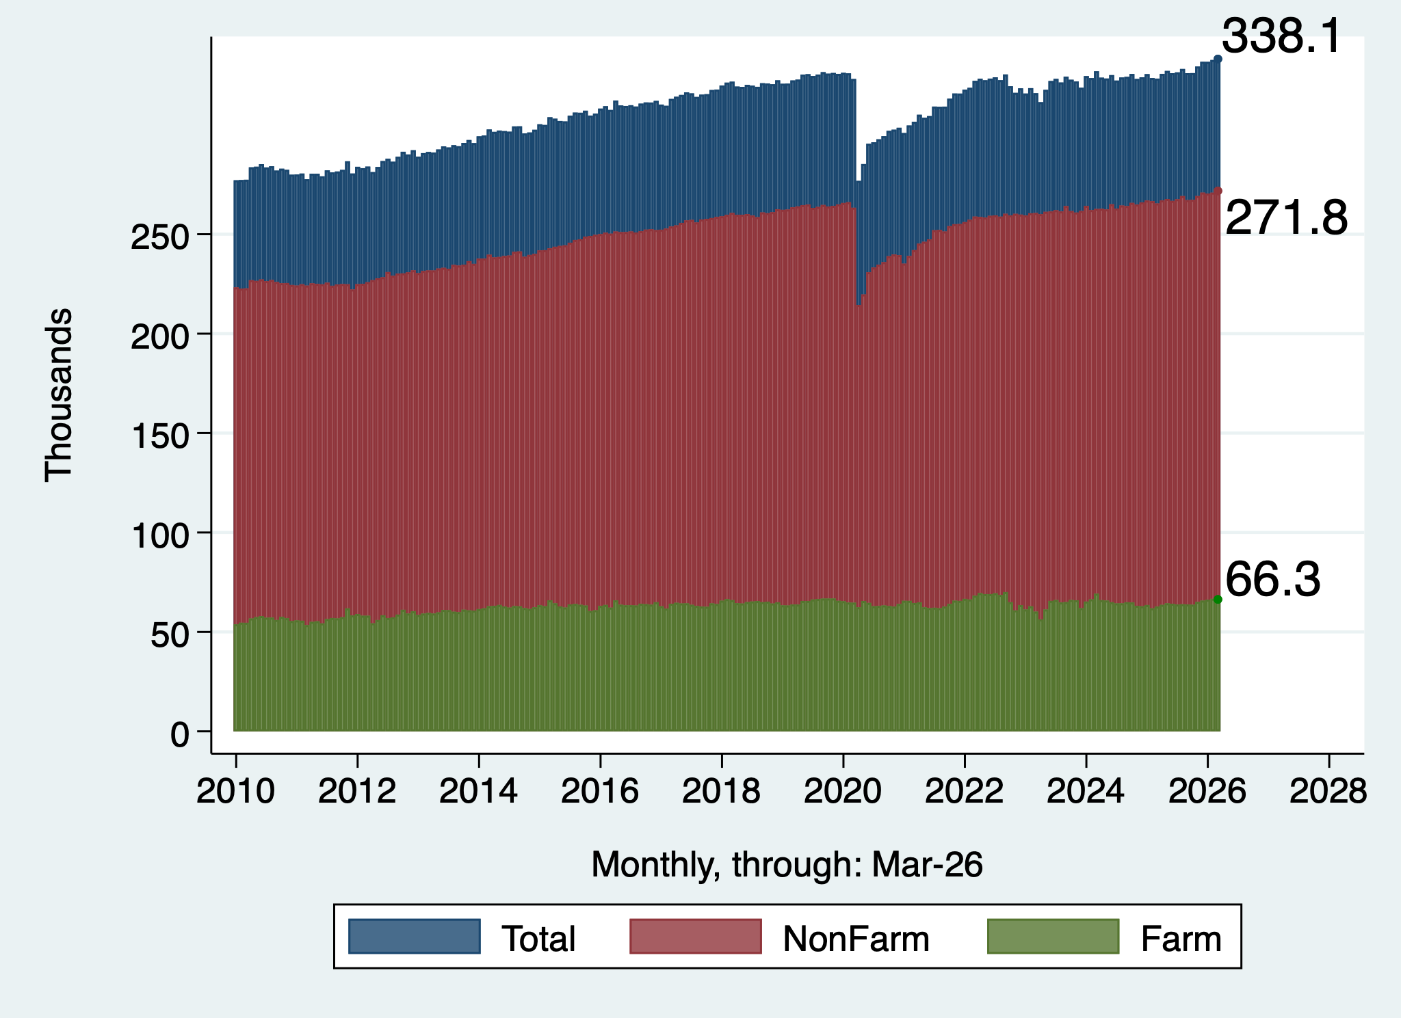
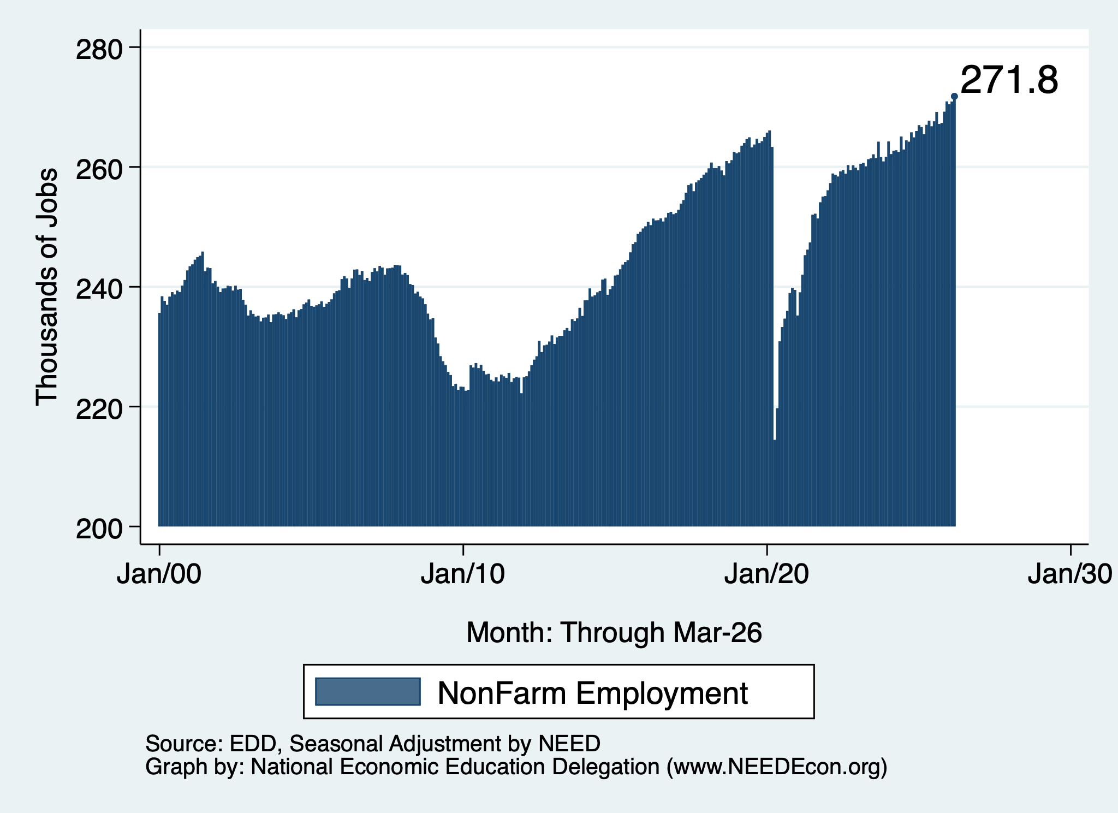
Employment Recovery, Monterey Bay Region
Total Employment
NonFarm Employment
20% of Employment

Slide 25
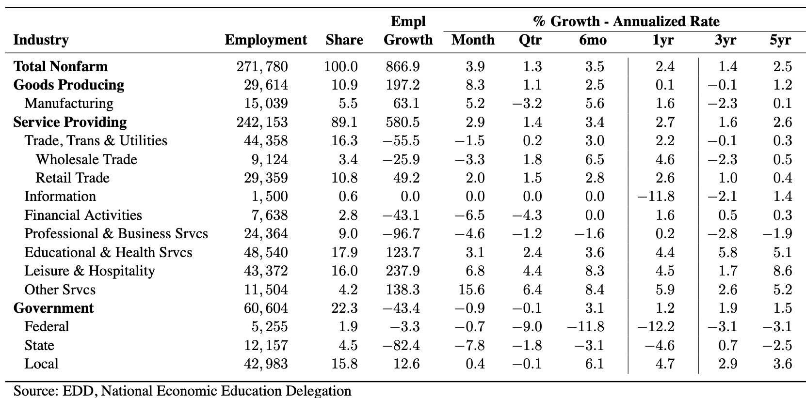
March Employment Report: Monterey Bay Region

Slide 26
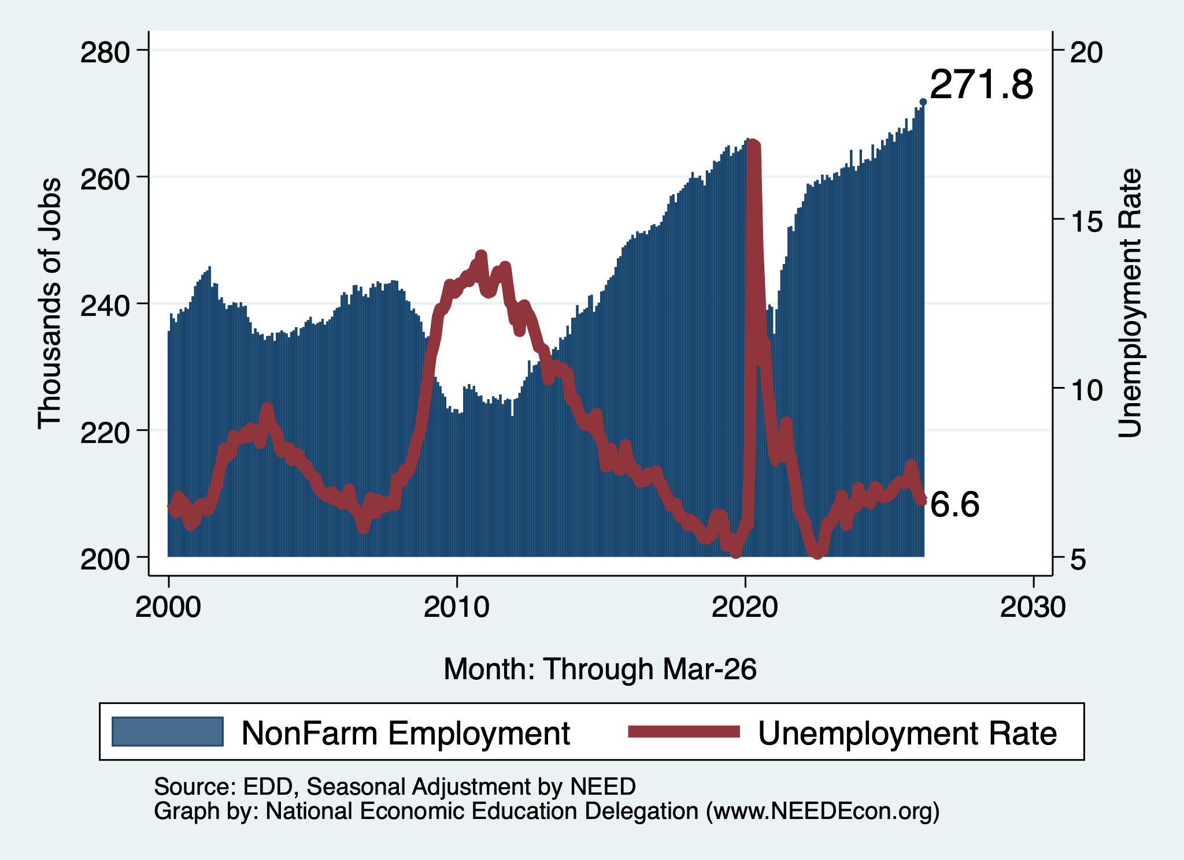
Monterey Bay Region Employment

Slide 27
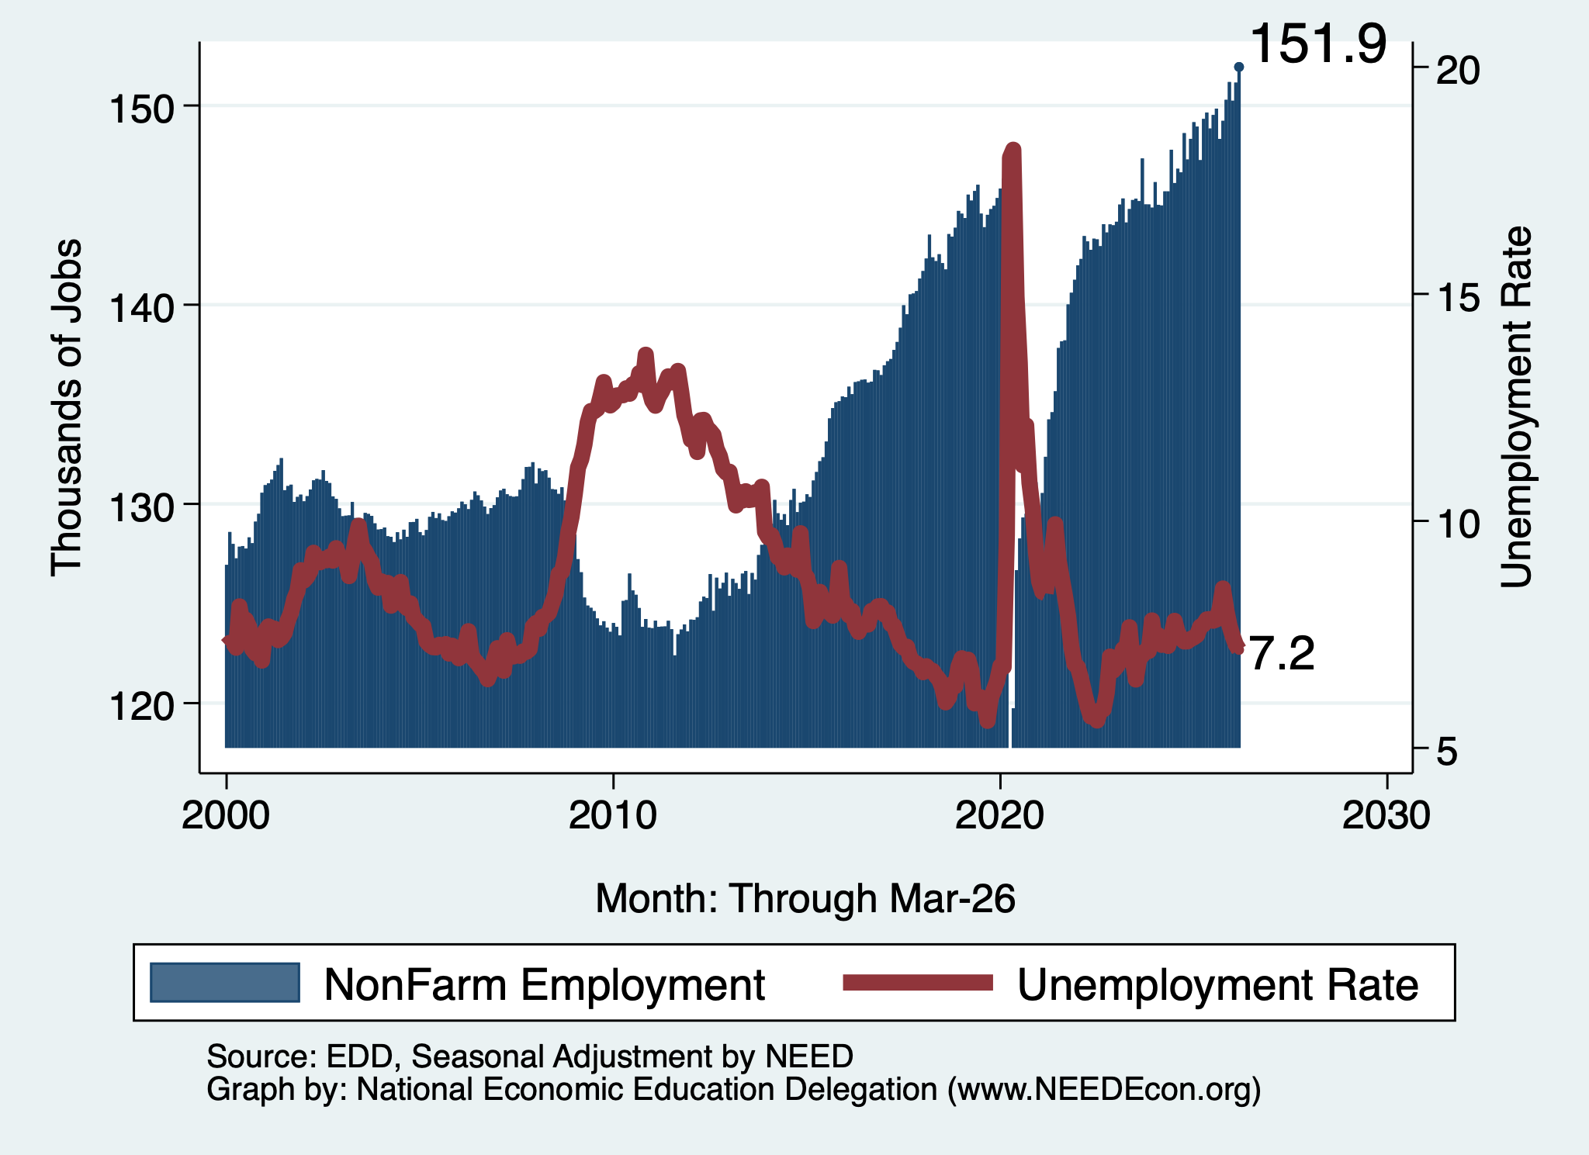
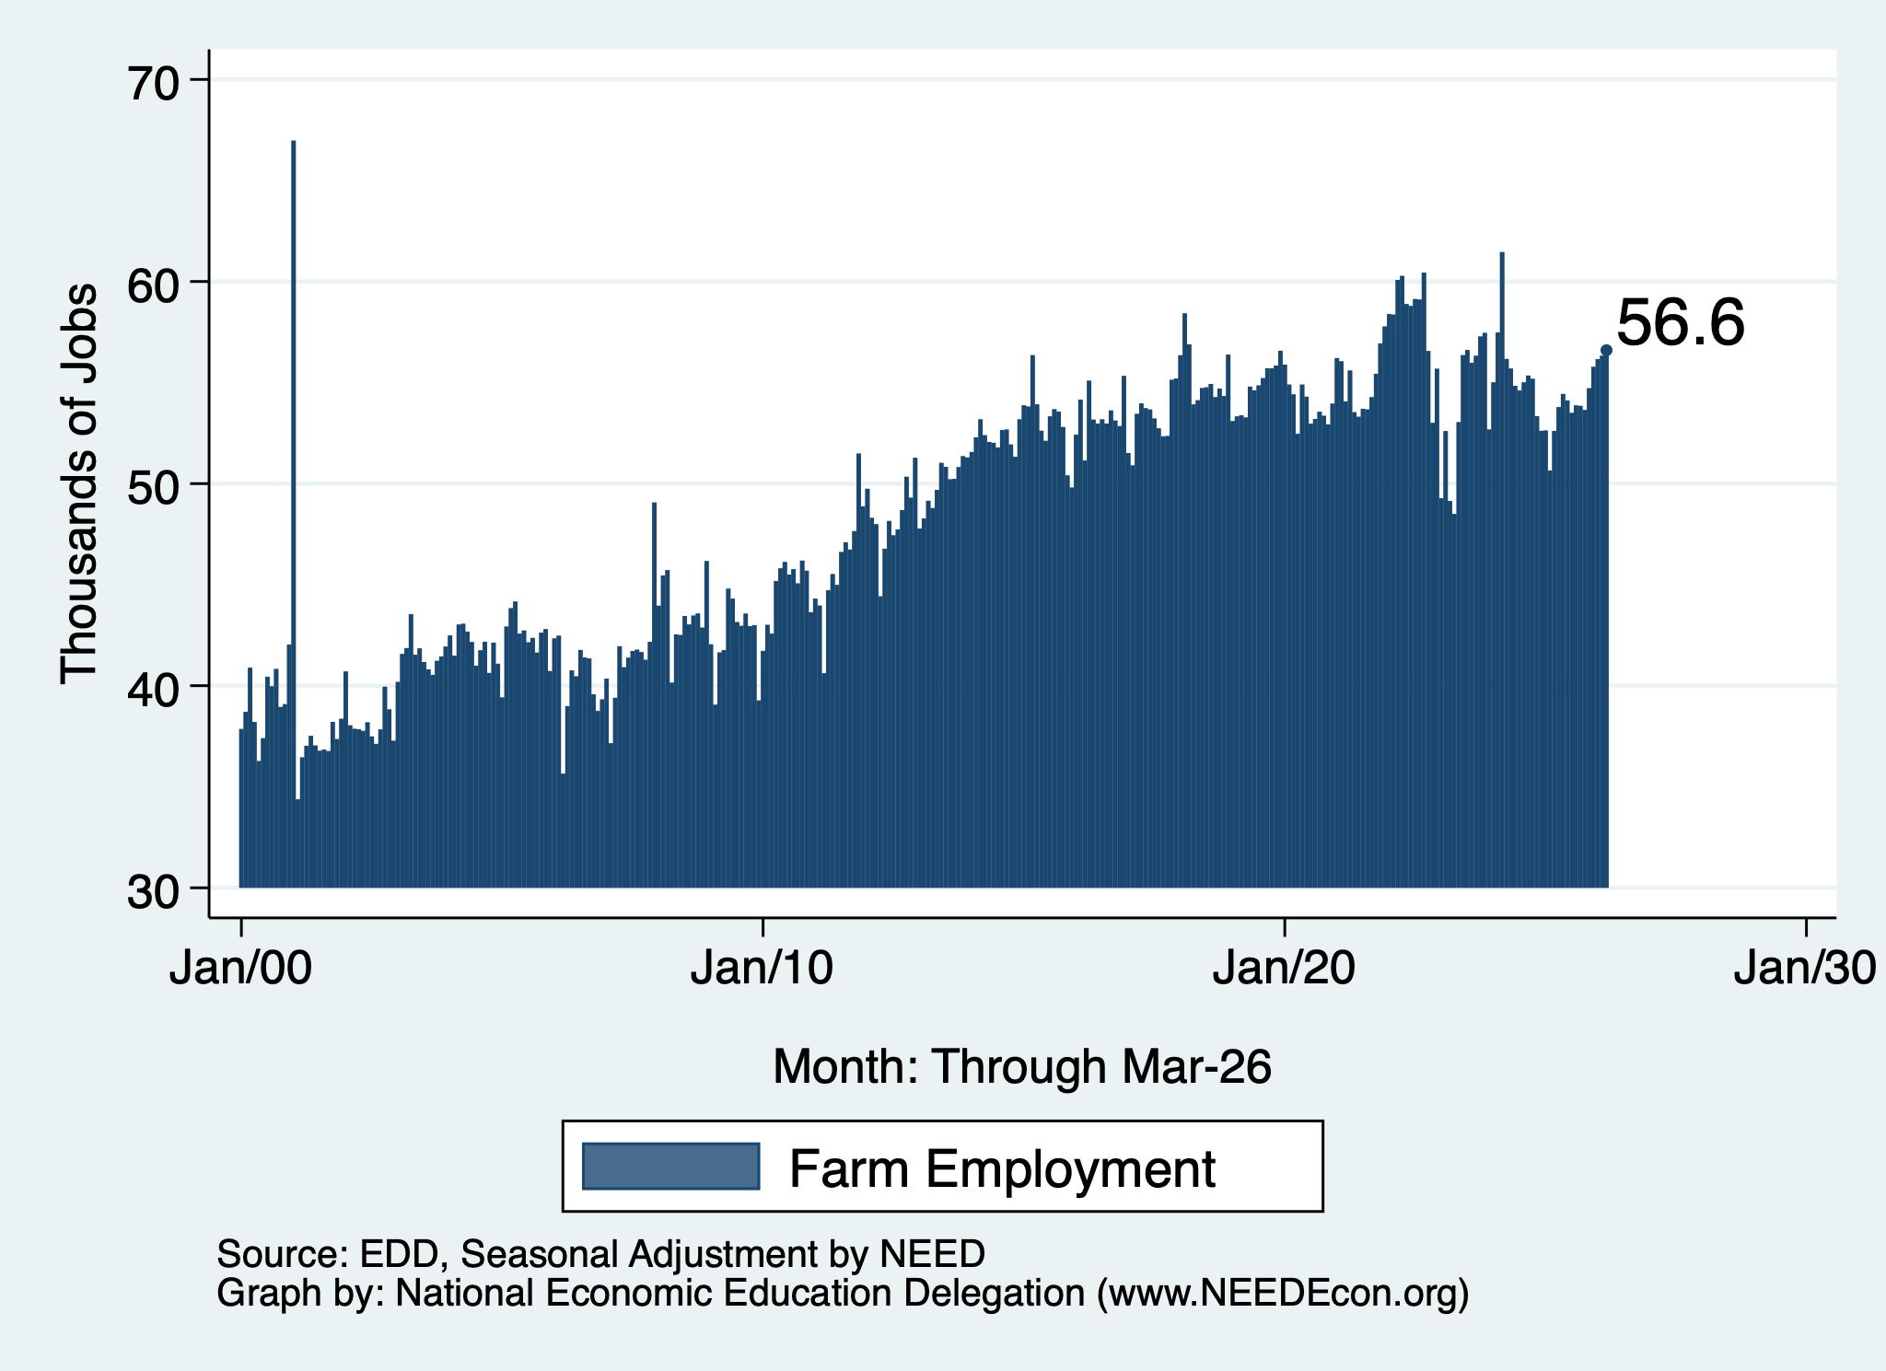
Employment in Monterey County?
Nonfarm Employment
Farm Employment

Slide 28
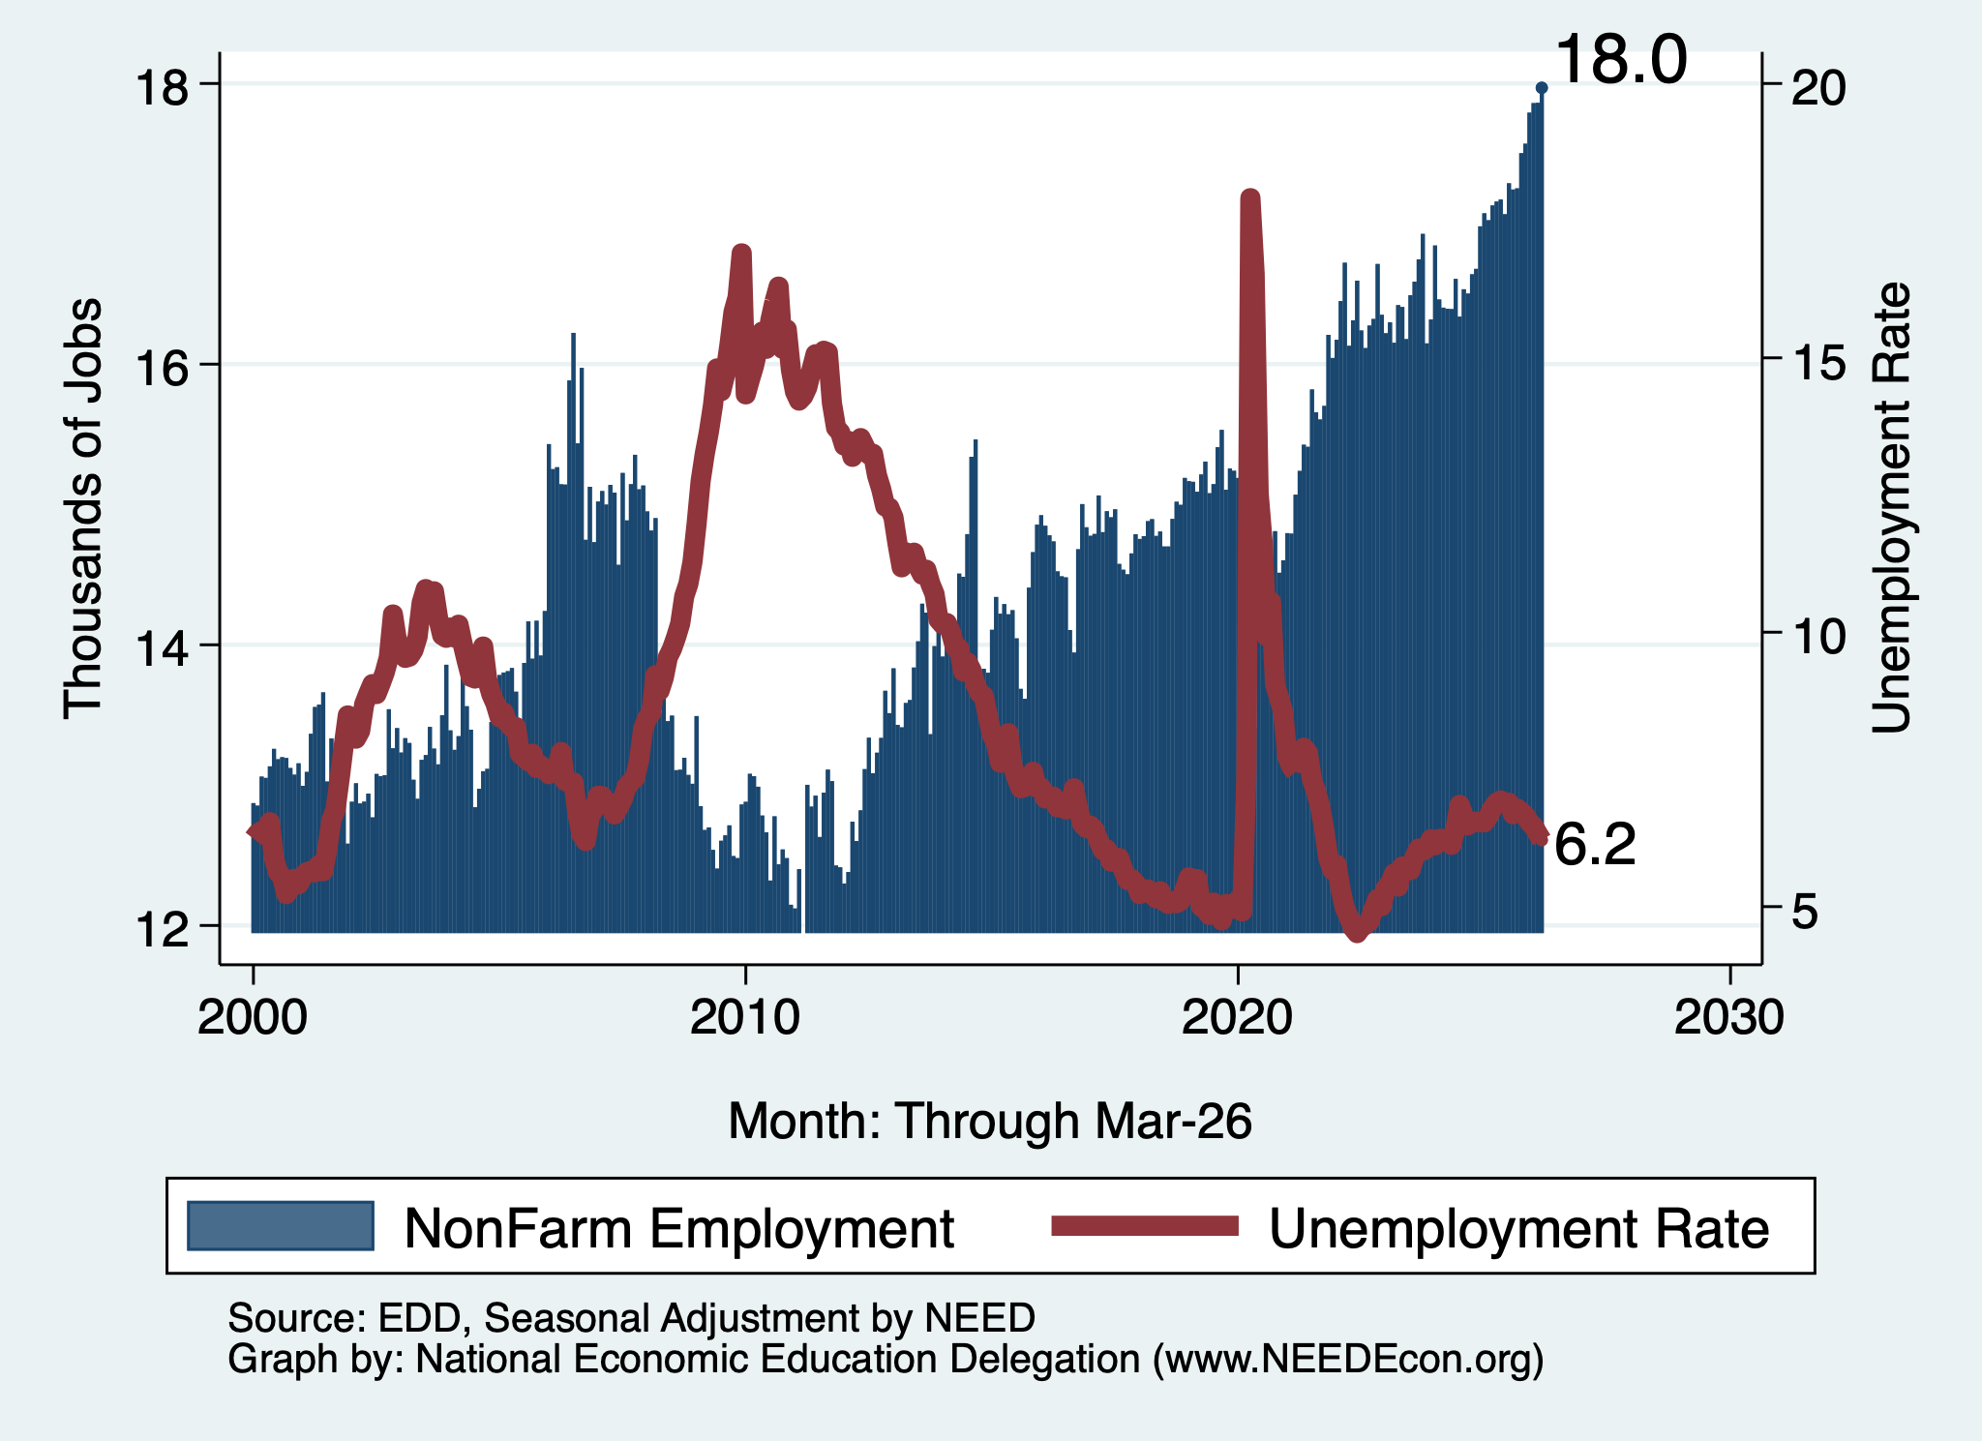
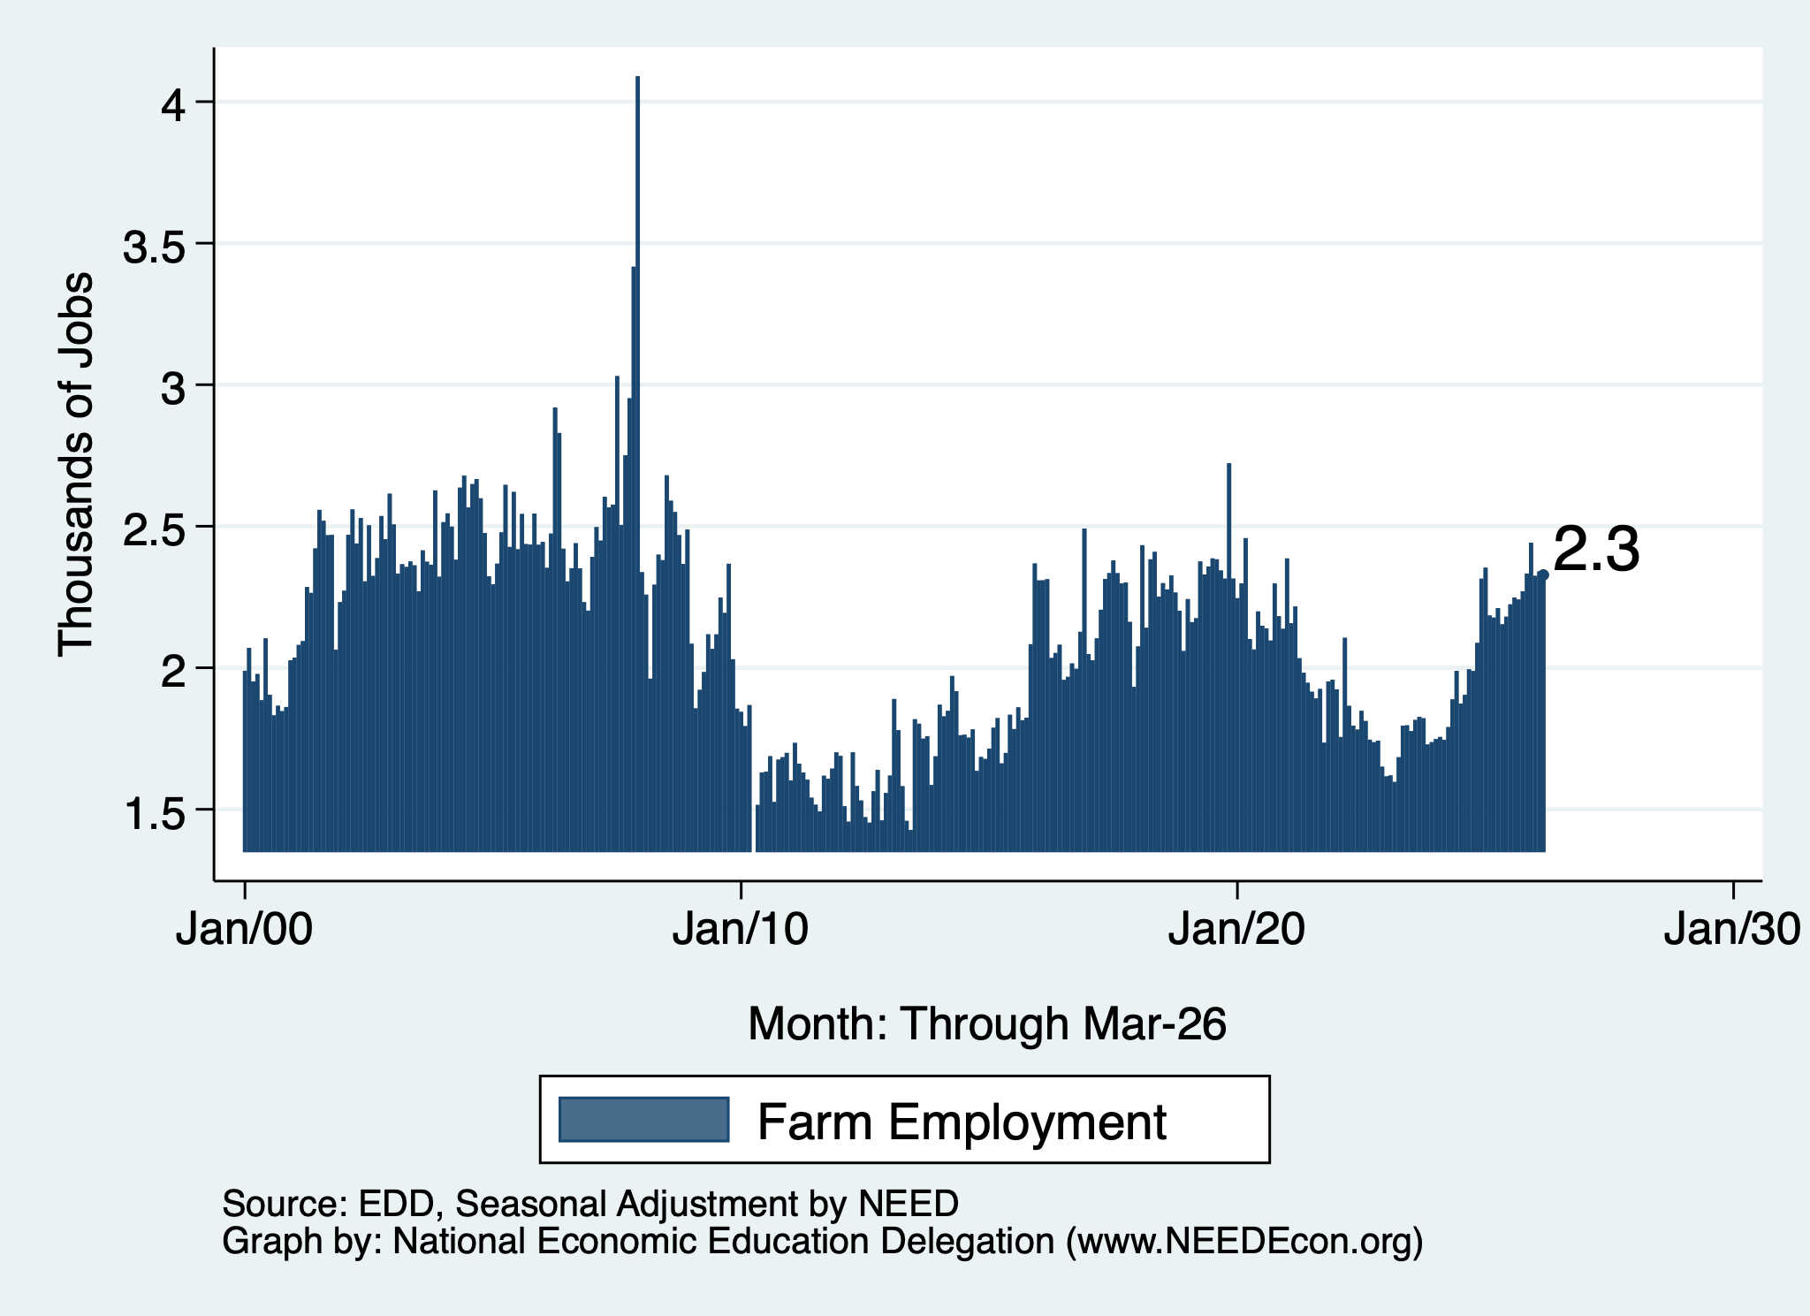
Employment in San Benito County?
Nonfarm Employment
Farm Employment

Slide 29
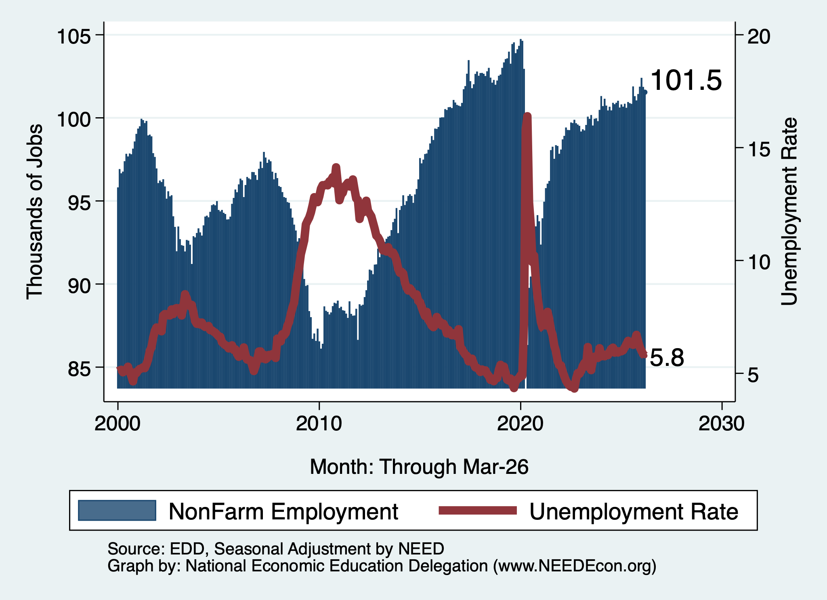
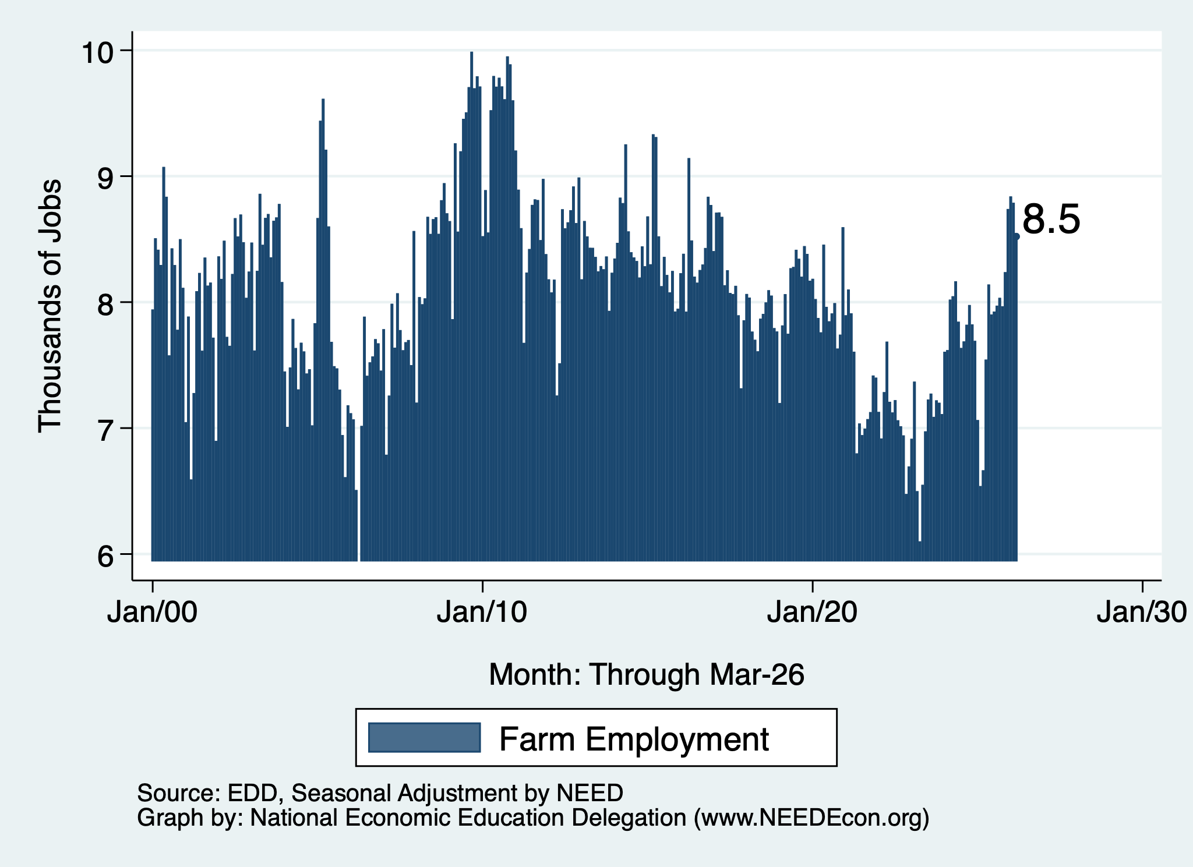
Employment in Santa Cruz County?
Nonfarm Employment
Farm Employment

Slide 30
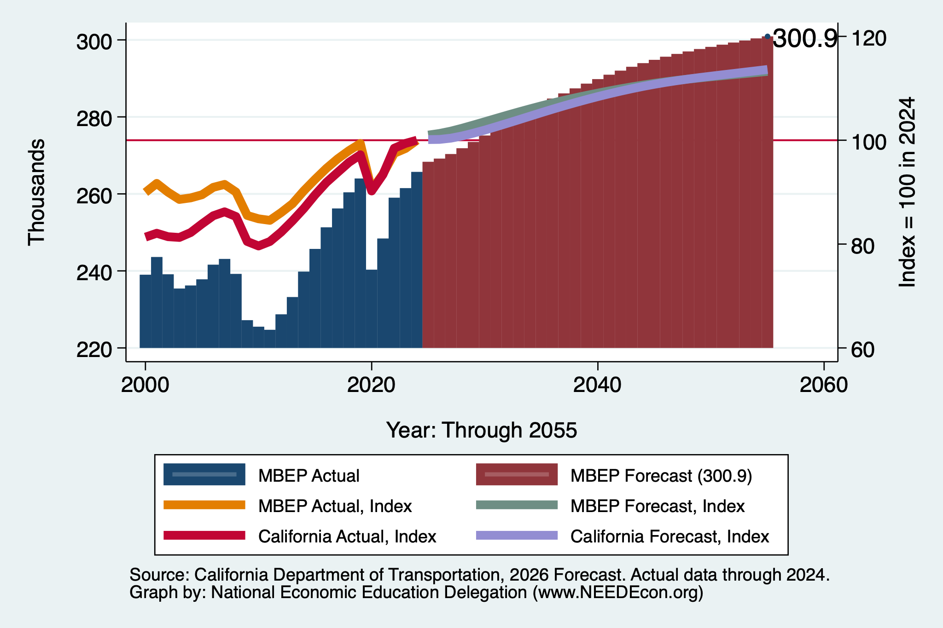
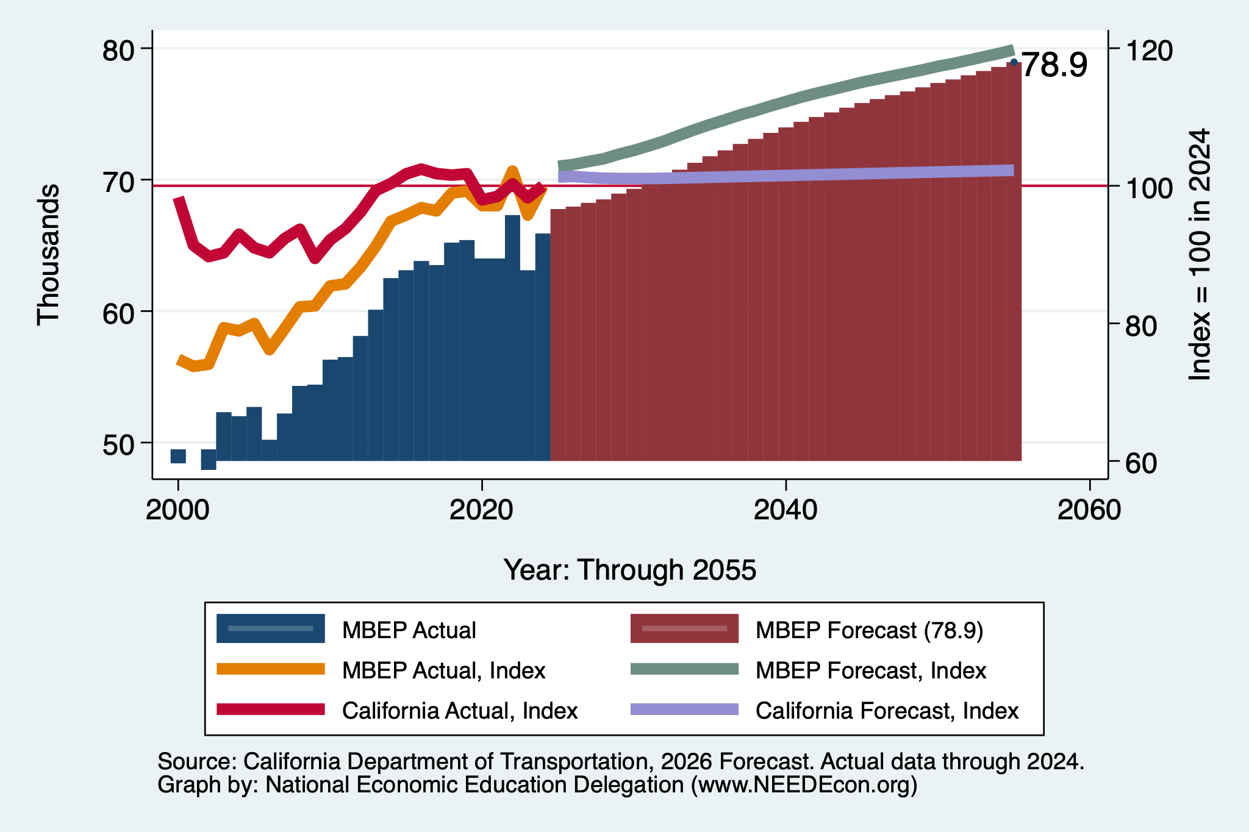
DOT Forecast: Employment – Regionally
Nonfarm Employment
Farm Employment

Slide 31
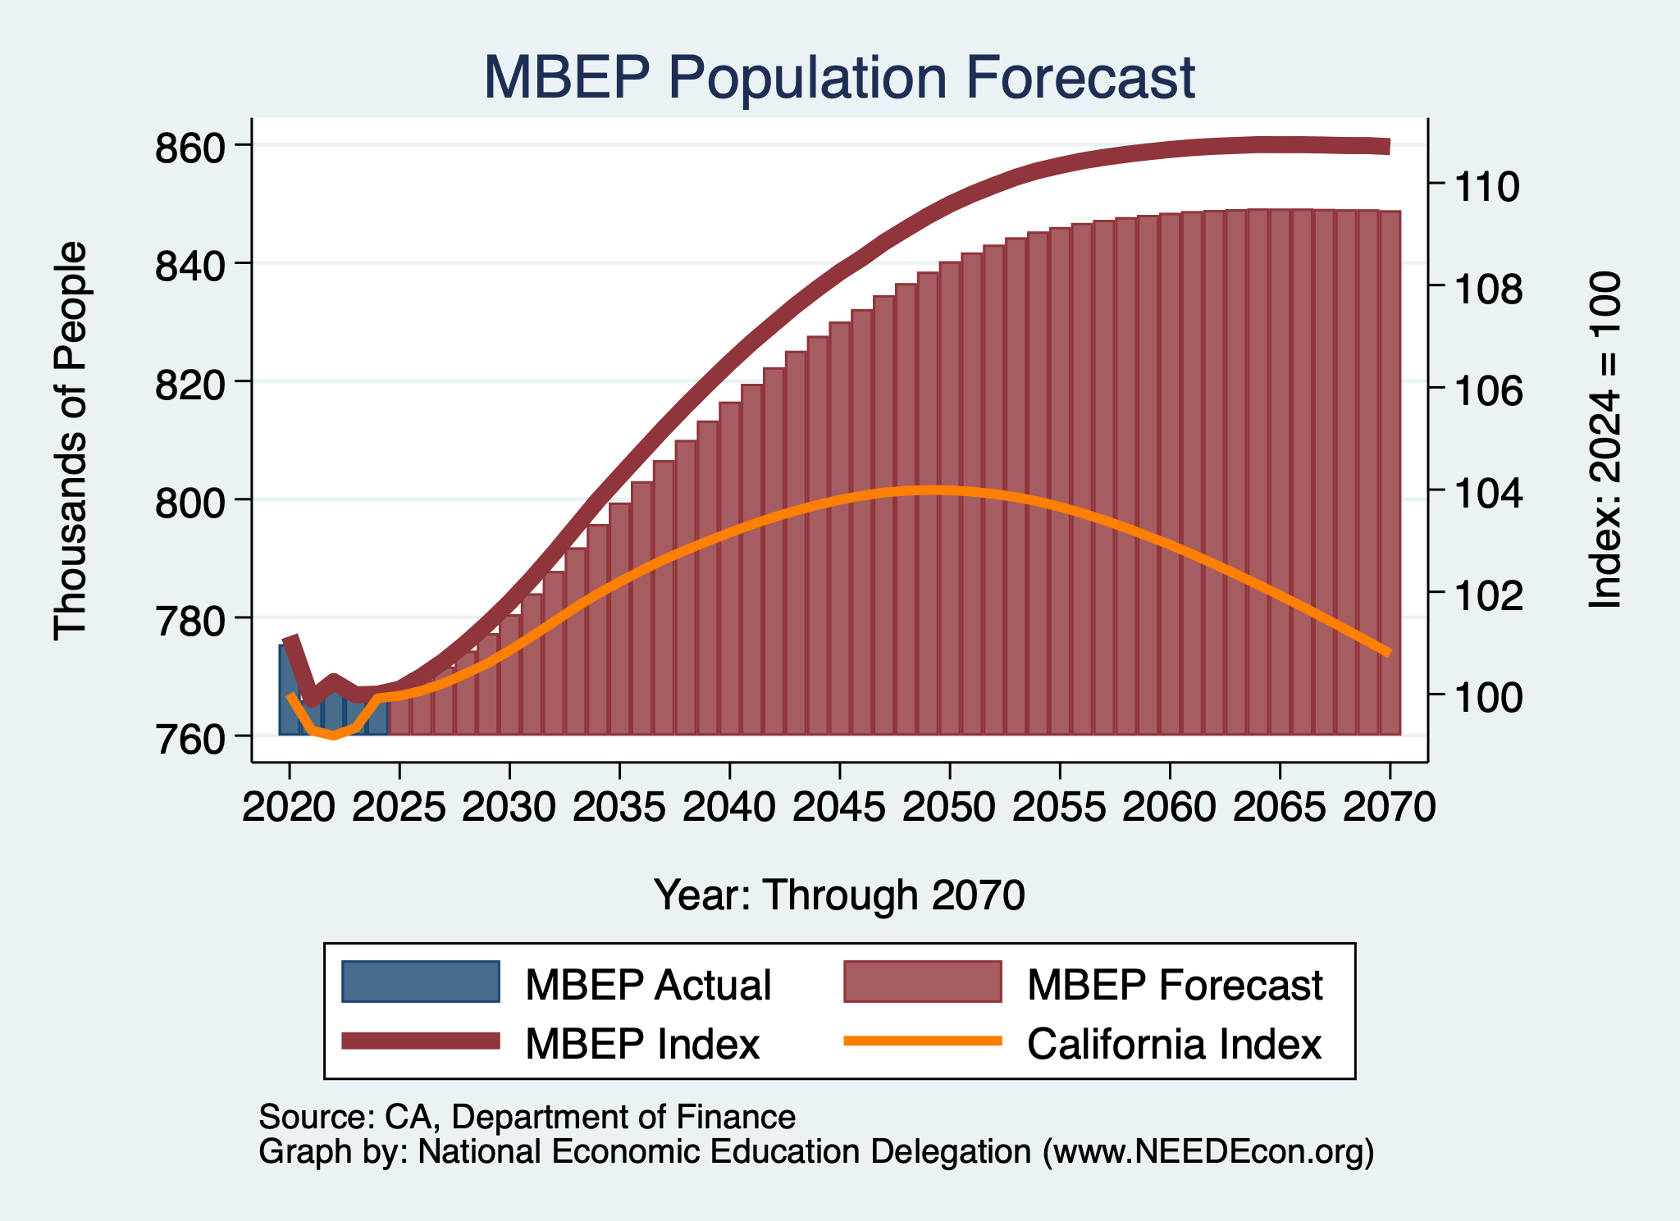
DOF Forecast: Population – Regionally

Slide 32
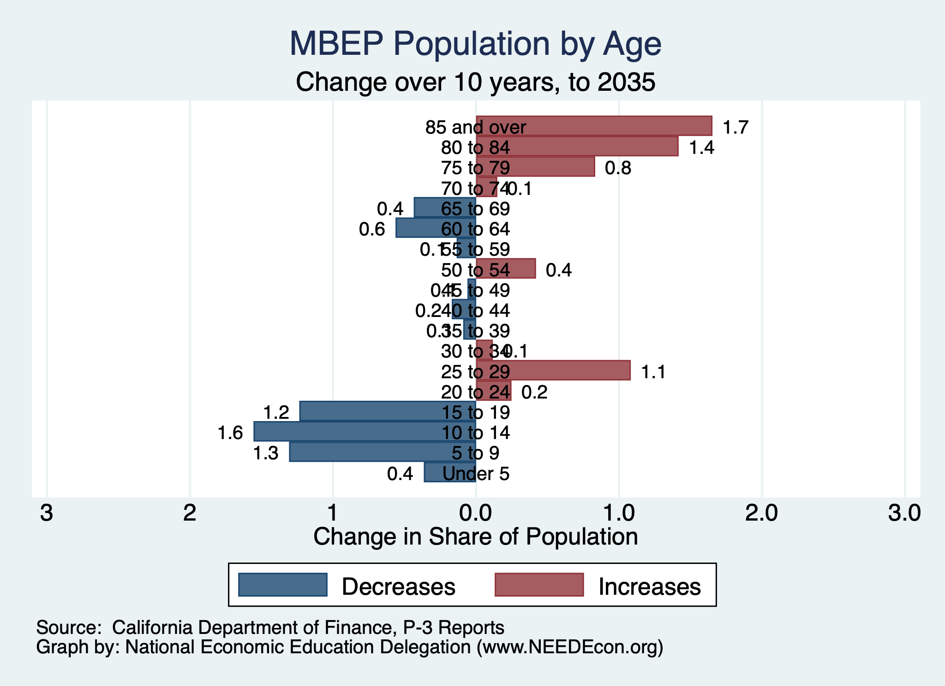
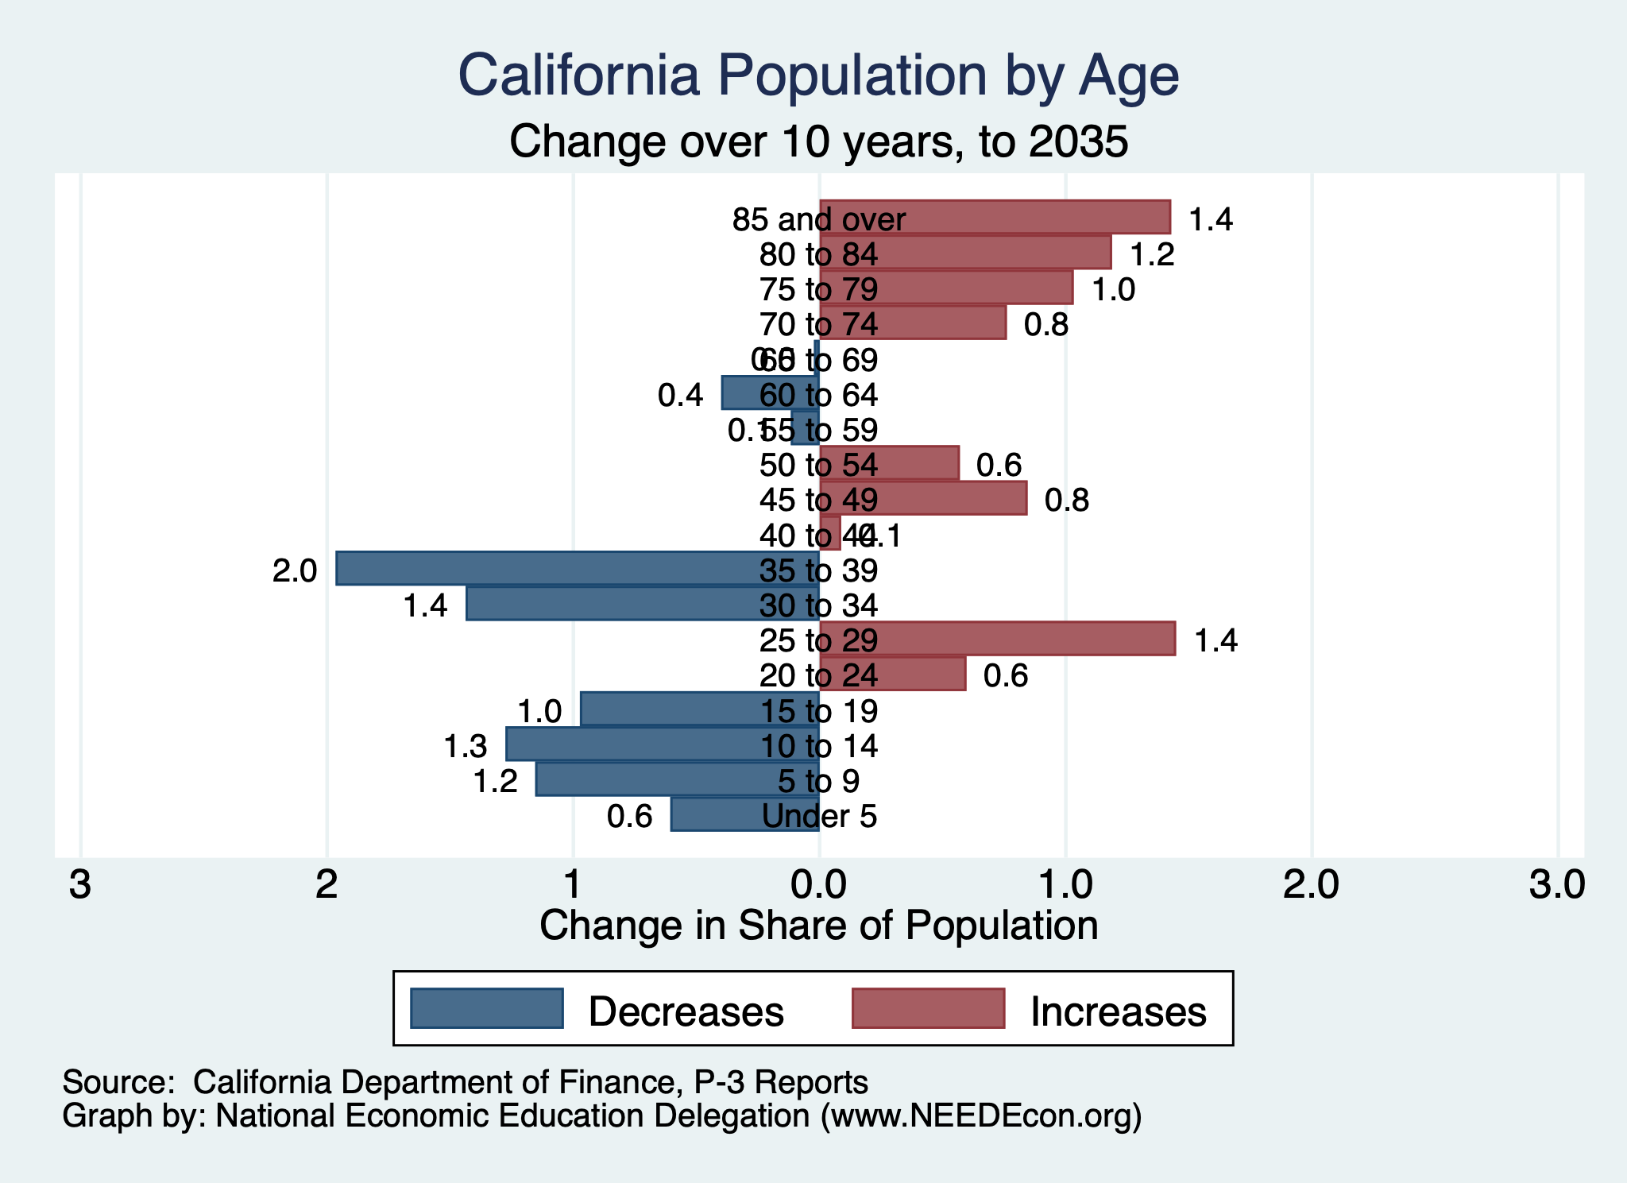
Aging Population

Slide 33
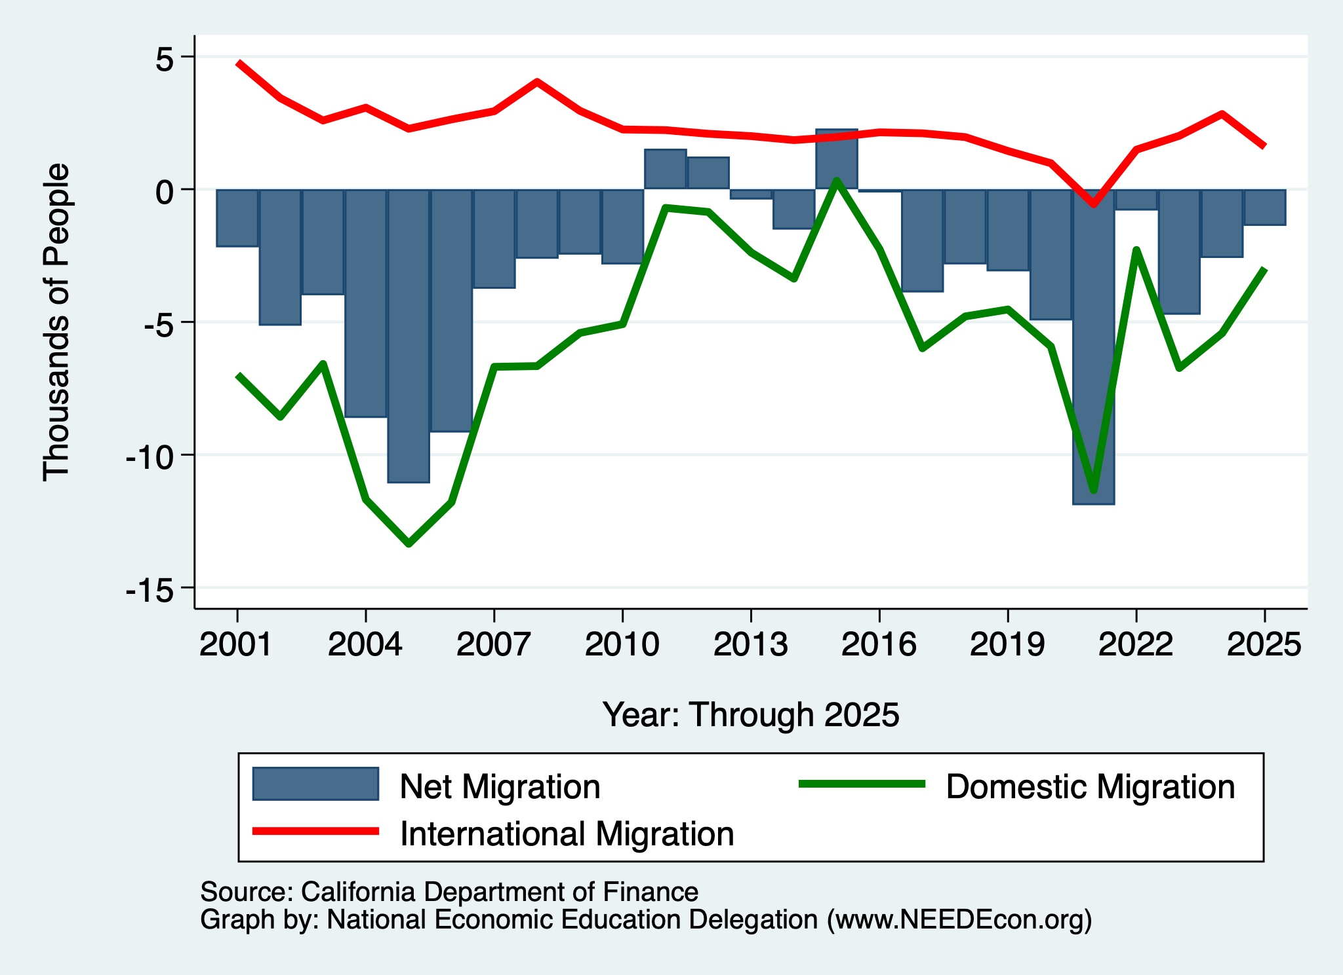
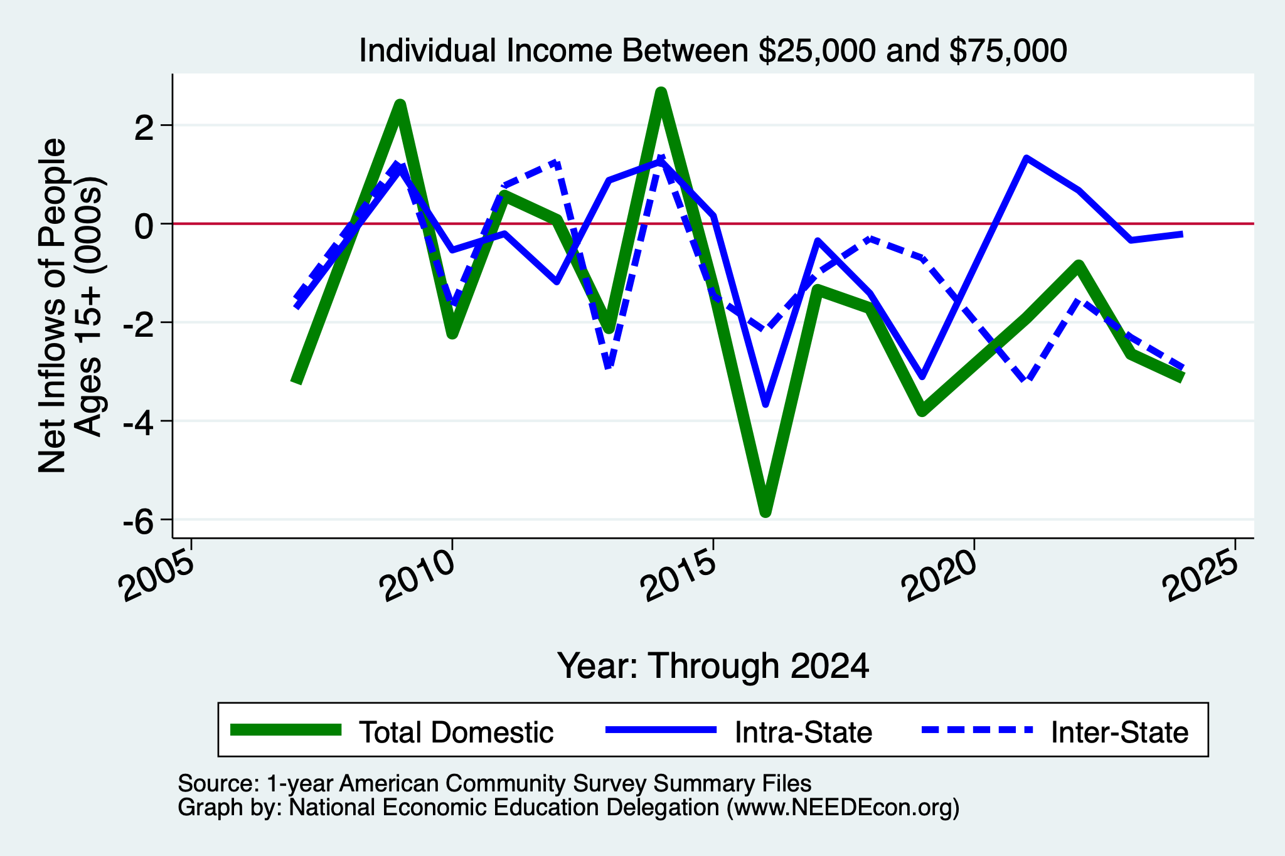
Migration: Outflows of Mid/Lower-Income
Monterey Bay Region

Slide 34
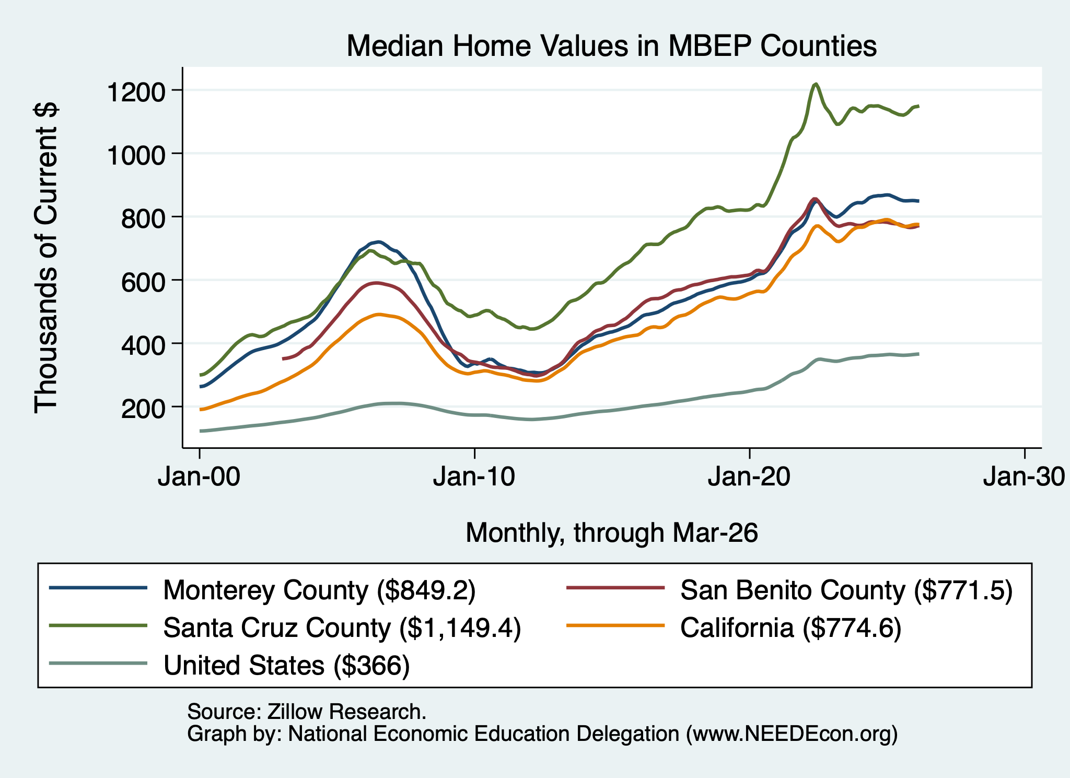
Home Prices - The Monterey Bay Region
Santa Cruz County
Monterey and San Benito Counties
- and CA
U.S.

Slide 35
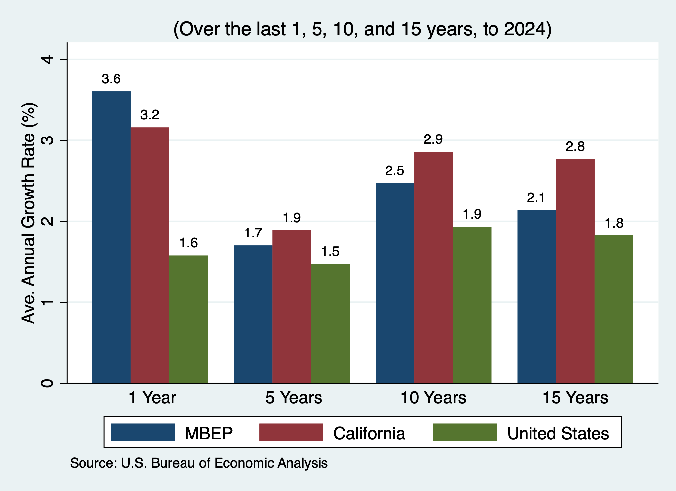
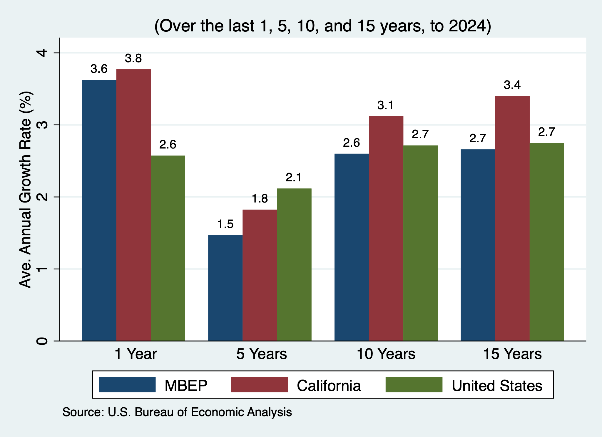
Personal Income – Monterey Bay Region
Per Capita Personal Income
Personal Income

Slide 36
Monterey Bay Region: Summary
Home prices have begun to grow again, but not much.
Aging population will require in-migration to grow the local economy.
  However, recent years have seen more out-migration than in.
Employment recovery is picking up pace.
  Significant growth in education and healthcare.
  Could well be compromised in other sectors by the war.
Per capita income is rising – driven by exodus of lower-income residents.
The region appears to be quite healthy.
  Big question is whether or not it will stay that way. I think so.

Slide 37
Thank you!
Any Questions?
www.NEEDEcon.org
Jon D. Haveman
Jon@NEEDEcon.org
Contact NEED: info@NEEDEcon.org
Submit a testimonial: www.NEEDEcon.org/testimonials.php
Become a Friend of NEED: www.NEEDEcon.org/friend.php

