Slide 1


Economic Update
US & Monterey Bay Area
Regional Economic Outlook
Monterey Bay Economic Partnership
Jon Haveman, Ph.D.
NEED
June 24, 2025

Slide 2
Outline
Economic Indicators
Big Picture: Uncertainty
The Local Economy

Slide 3
Economic Indicators

Slide 4
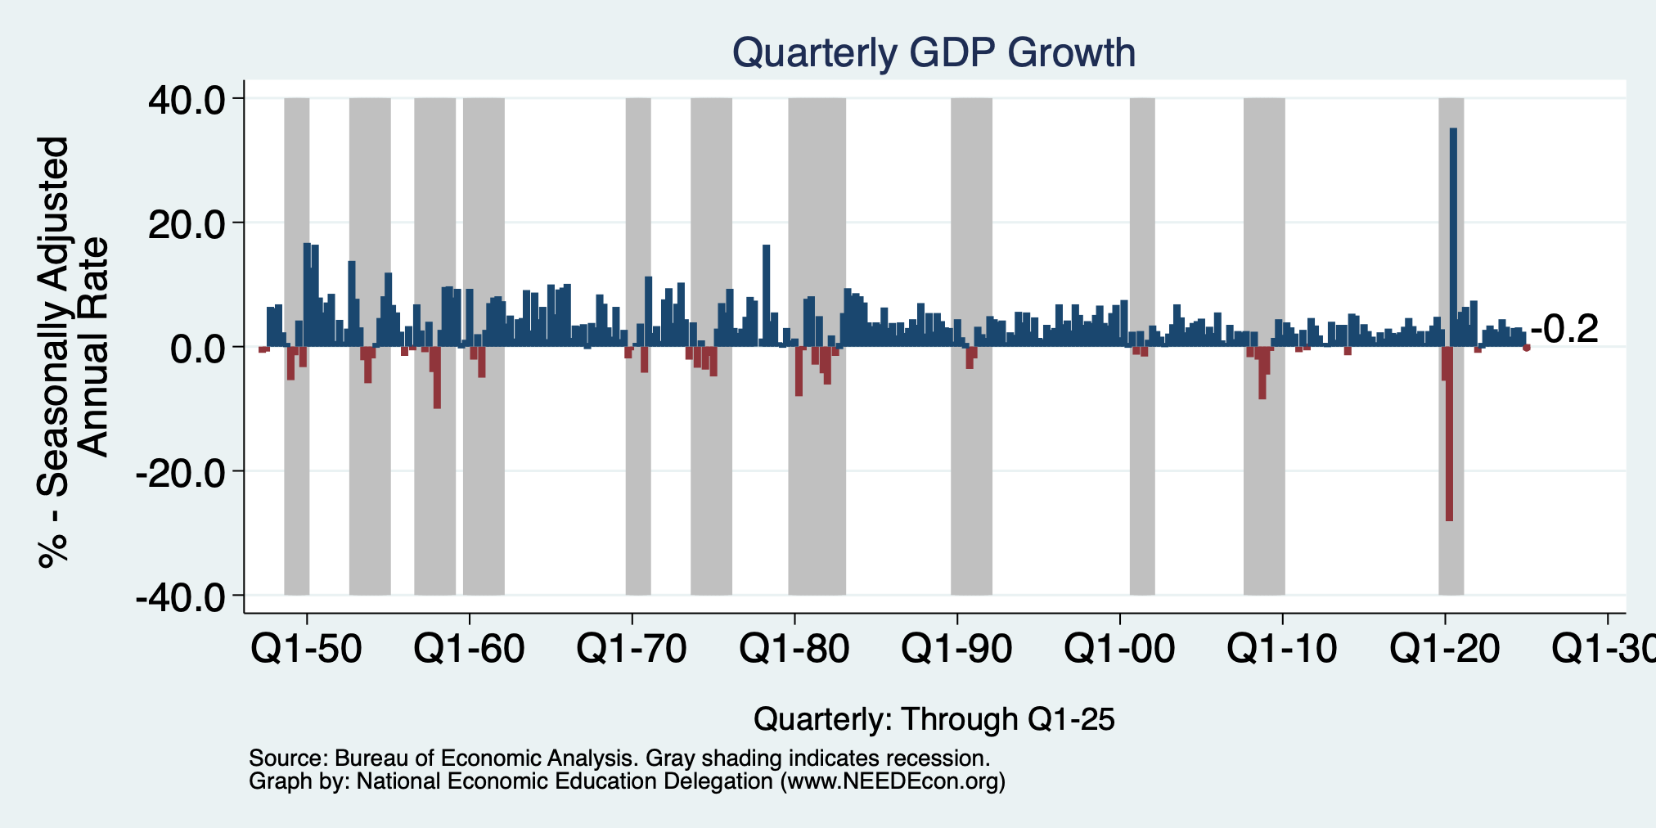
GDP: Quarterly Growth
Q2-2024: 3.0%
Q3-2024: 3.1%
Q4-2024: 2.4%
Q1-2025: -0.2%
Notes:
Graph: gdp_pot_grow.png
The Point: From 1990 – 2007, average annual US GDP growth pre-crisis is 2.94%. However, post-crisis US GDP growth is 2.19% (0.75 percentage points lower). Why is has the recovery been sluggish?
Note: At the recession’s height, the gap between quarterly GDP growth and potential growth was 2.5 percentage points.

Slide 5
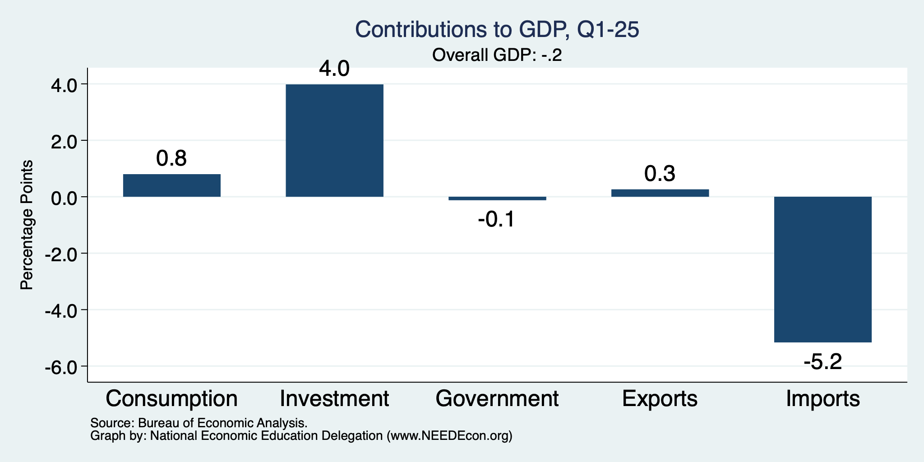
What Drove GDP to Such Growth?
Normally
2.3%

Slide 6
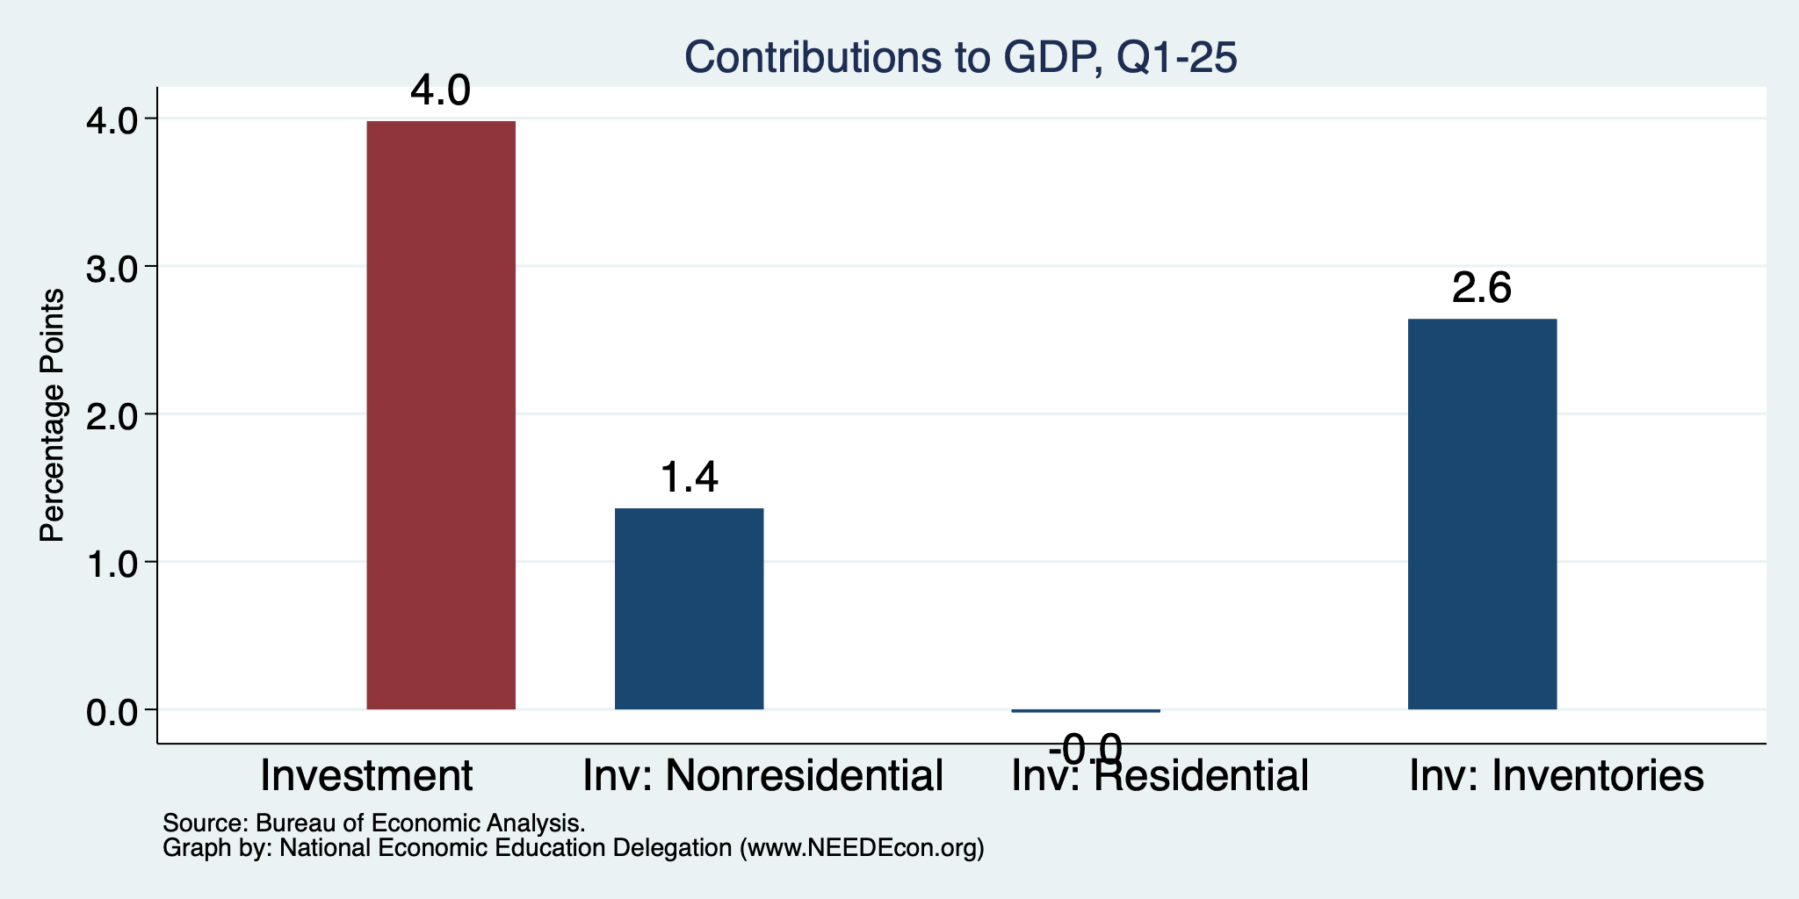
Imports Went Into Inventories
Normally
About 0%

Slide 7
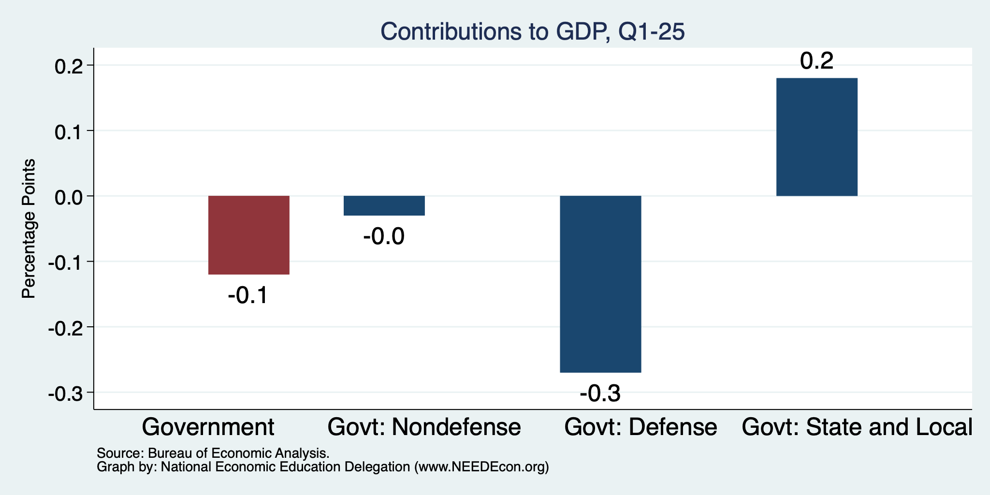
Government Spending Didn’t Help

Slide 8
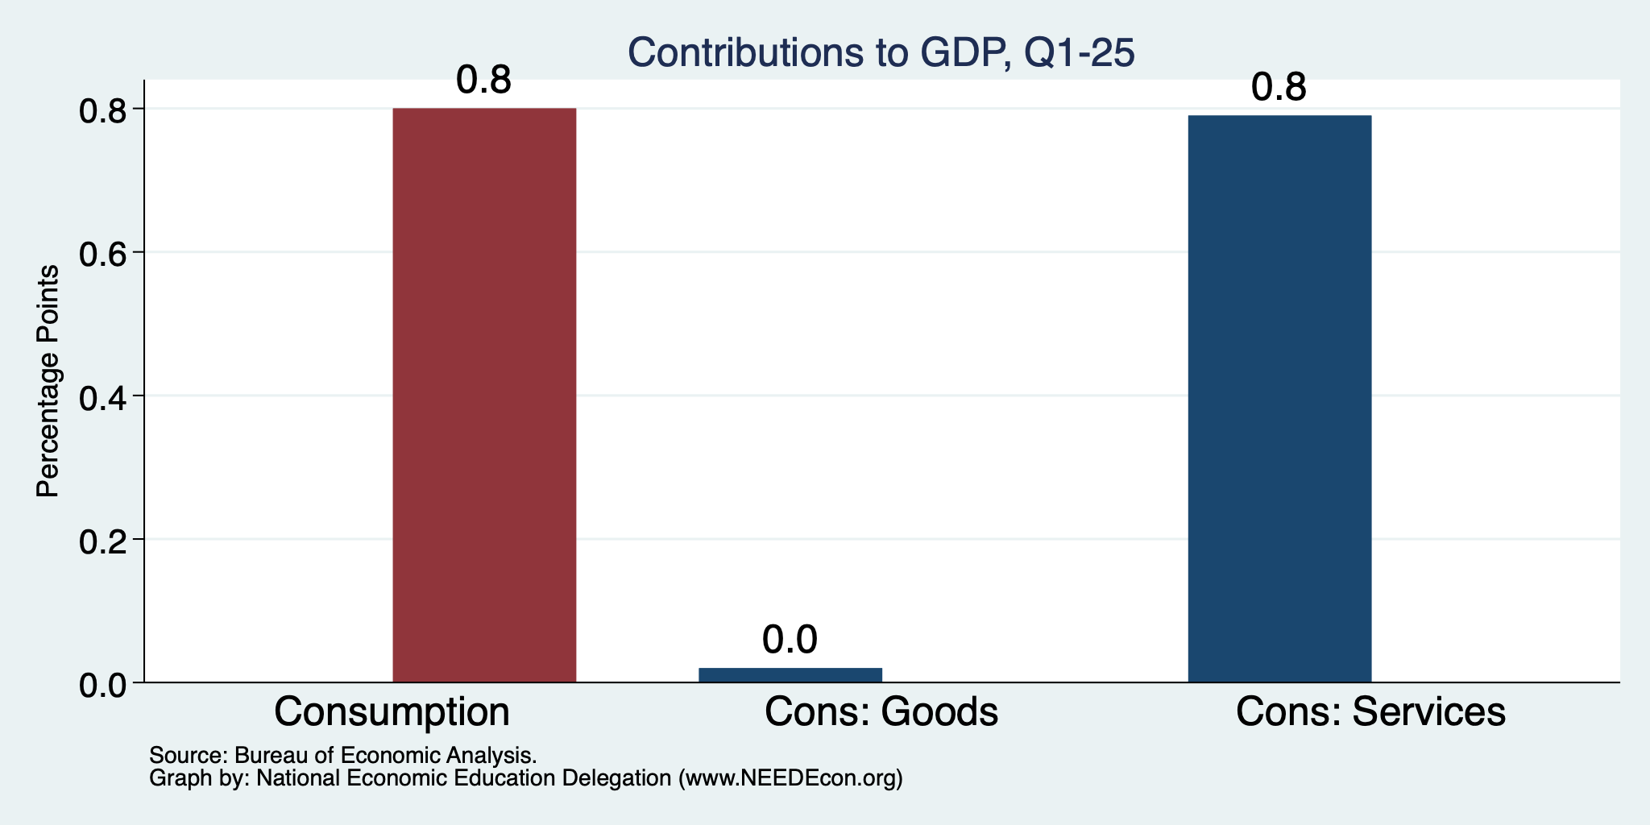
Consumers Also Tightened
Normally
0.8%

Slide 9
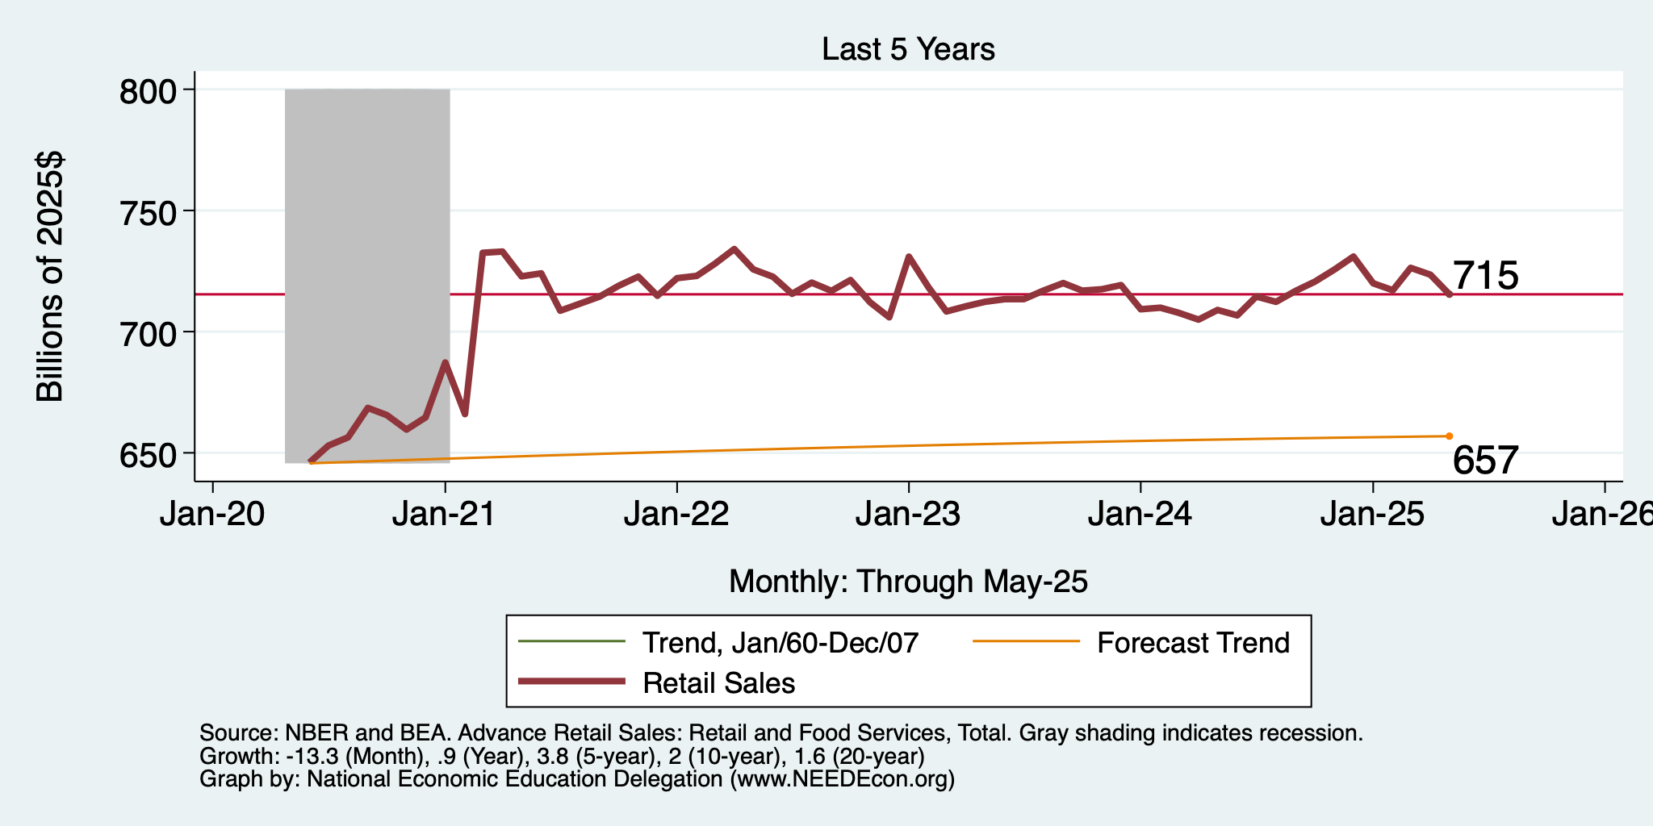
Retail Sales Are Sluggish

Slide 10
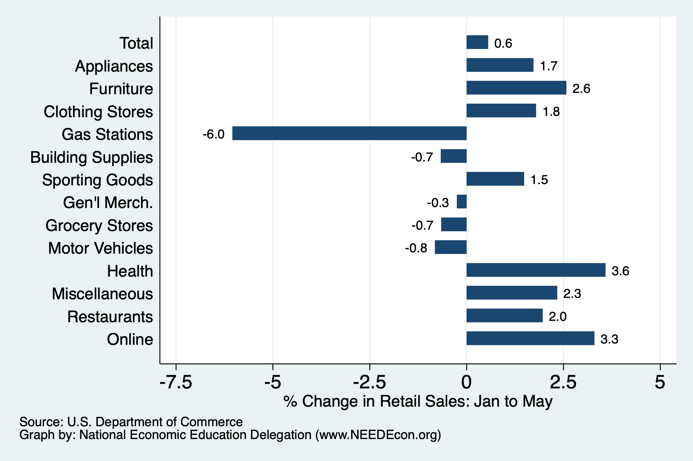
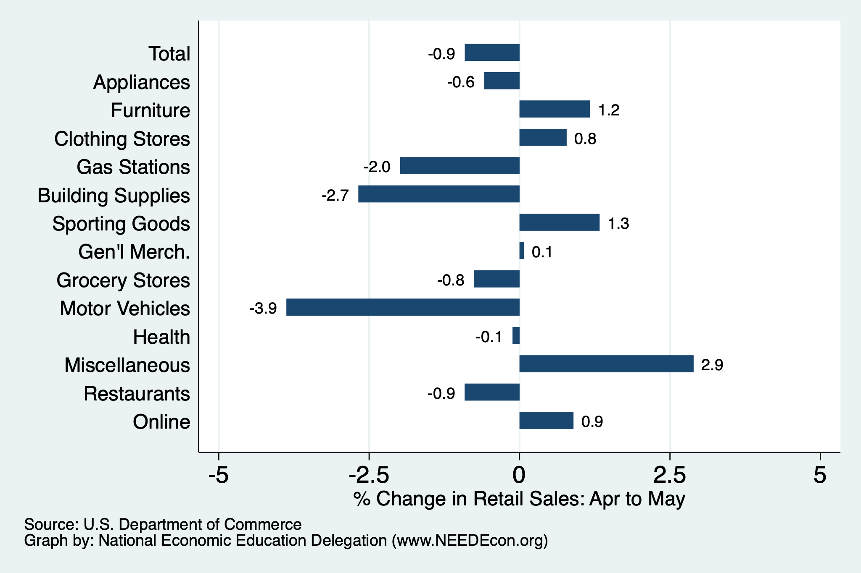
Retail Sales Have Been Flat … to Falling
Since January/25
April to May/25

Slide 11
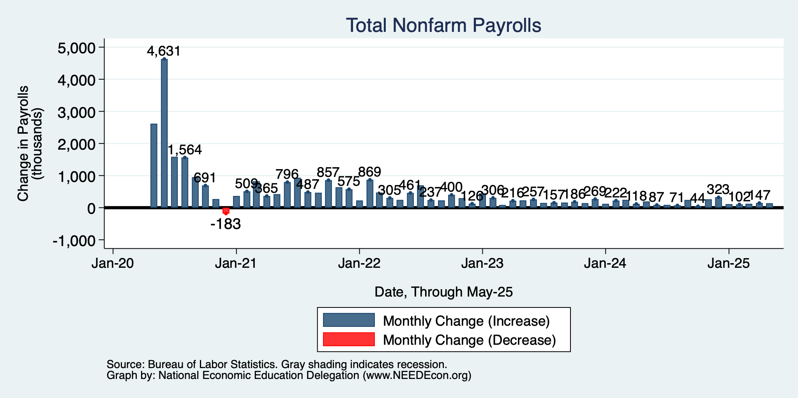
Monthly Changes in Nonfarm Employment
March: 120,000
April: 147,000
May: 139,000
Notes:
PAYEMS.png

Slide 12
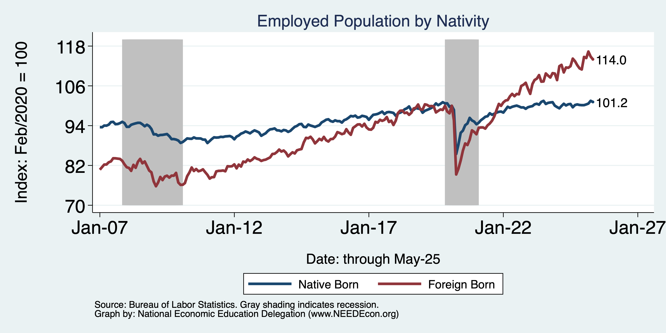
Immigrants to the Rescue?
Native: +1.5 million
Foreign Born: +3.9 million

Slide 13
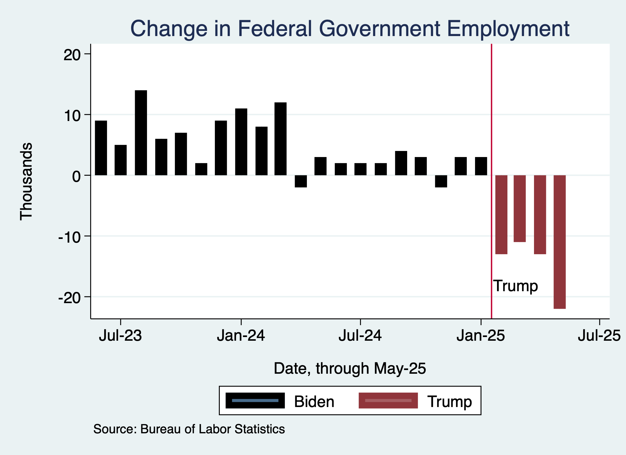
Monthly Changes in Nonfarm Employment
Notes:
PAYEMS.png

Slide 14
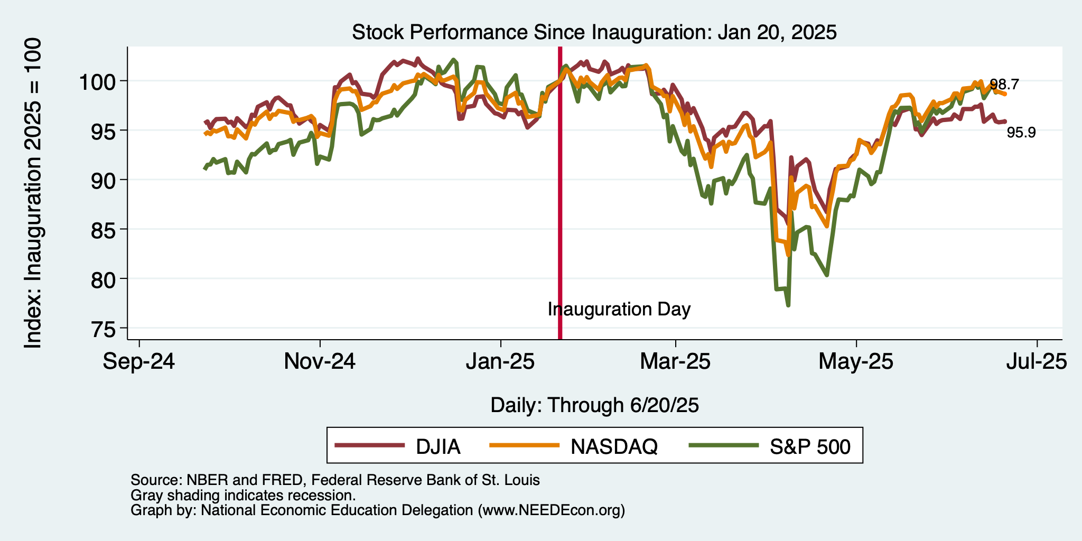
And Stocks?

Slide 15
Inflation

Slide 16
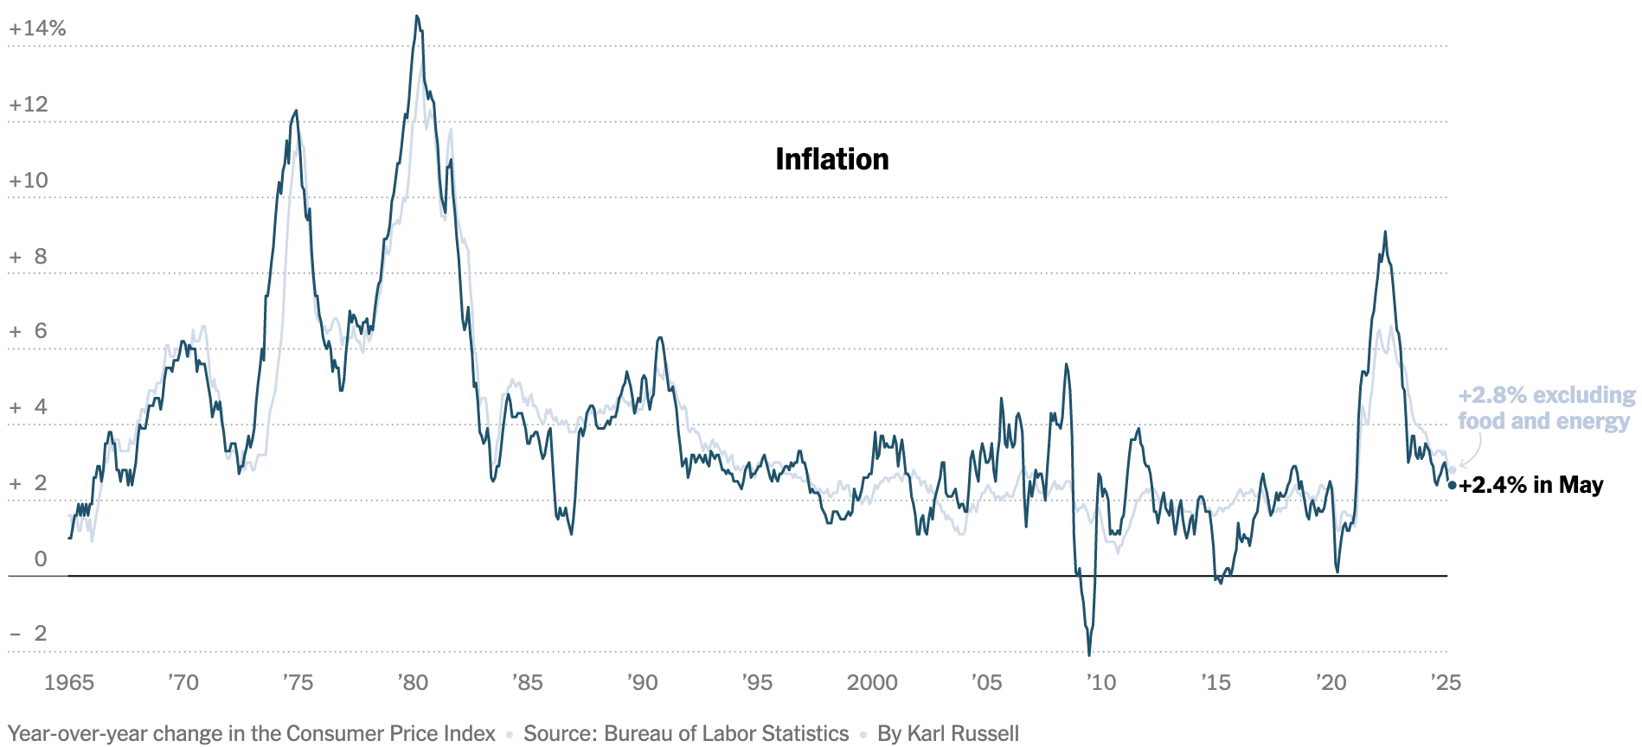
Inflation: Latest Figures
Source: NYTimes.com

Slide 17
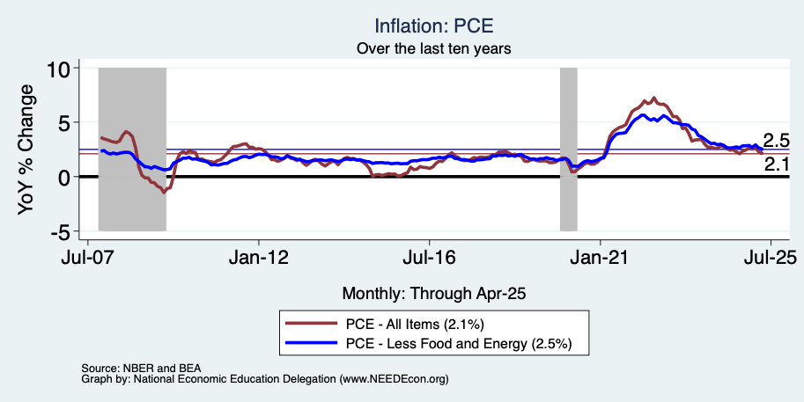
Fed’s Preferred Measure: PCE

Slide 18
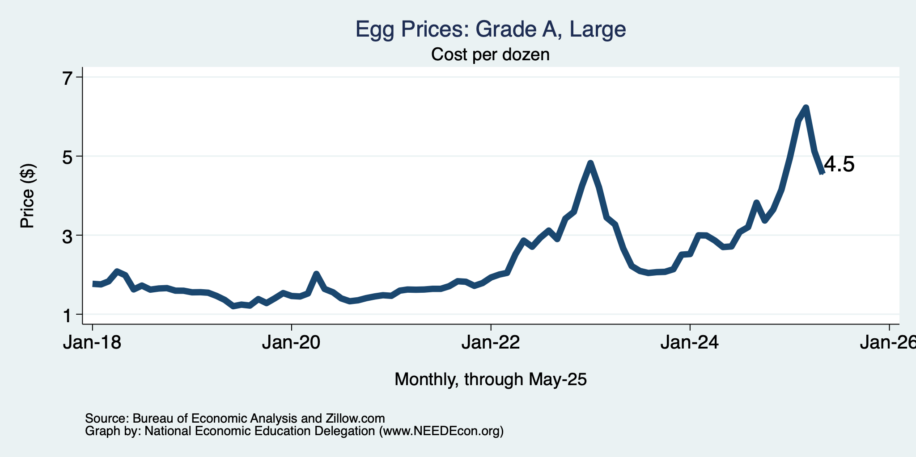
Price of Eggs?

Slide 19
The Fed: Conservative

Slide 20
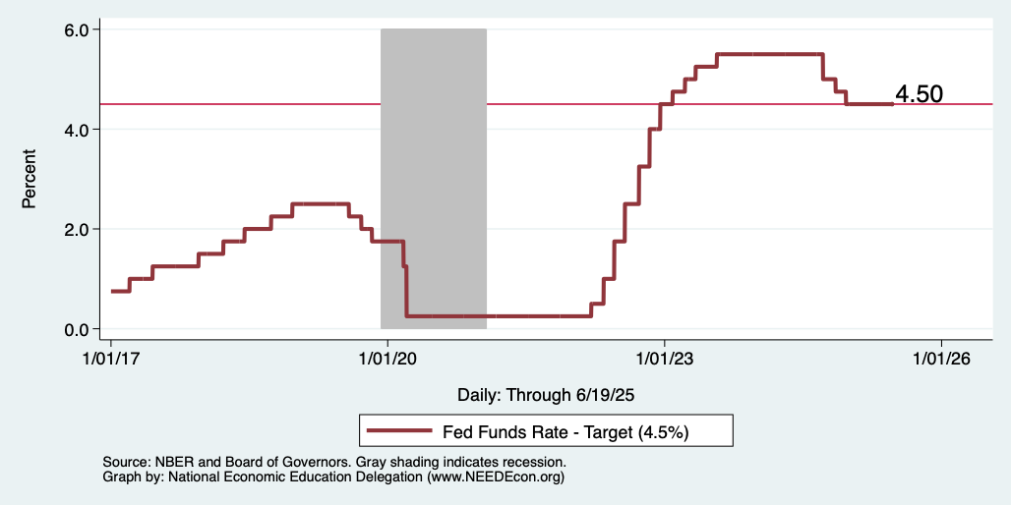
Federal Funds Rate
Notes:
The fed funds rate is the interest rate on overnight loans between banks. Think of it as the baseline interest rate on which banks base all other interest rates (e.g. mortgage rates)
FOMC lowers the fed funds rate during recessions and raises the fed funds rate during expansions
Fed funds rate peaked in the 1980s as then Chairman Paul Volcker sought to reign in “run away” inflation of the 1970s; doing so resulted in a recession in the early 1980s.
Since the 2008-09 recession, the fed funds rate has been kept near zero.
During the 2008-09 recession, Federal Reserve turned to unconventional tools to influence longer term interest rates to further stimulate the economy - QE
FedFunds.png

Slide 21
What will the Fed Do?
Likely sit tight at 4.5 for a while.
Next FOMC meeting is July 29-30.
Notes:
GDPNow 2.4%; blue chips consensus 1.5% implies 2.9%, or 2.7%

Slide 22
Takeaways
Is a recession on the horizon?
  Maybe, but I’m less concerned than I was.
  Many indicators are in the black.
    2024 2nd half GDP growth was pretty good – 2.8% YoY.
    2025 Q1 < 0 is almost meaningless.
The problem?
  Uncertainties abound!

Slide 23
Uncertainties
Federal Government Policies
  How far will they go with immigration?
  How many federal employees will be laid off?
  How high will tariffs remain?
  Will Fed Chair Powell be replaced prematurely?
  New:
  What happens in the Middle East?

Slide 24
Bigger Picture

Slide 25
Since Inauguration: Policies = Anti-Growth
Deportations
Tariffs
Cuts to spending and employment
Threats to Fed Chair Powell

Slide 26
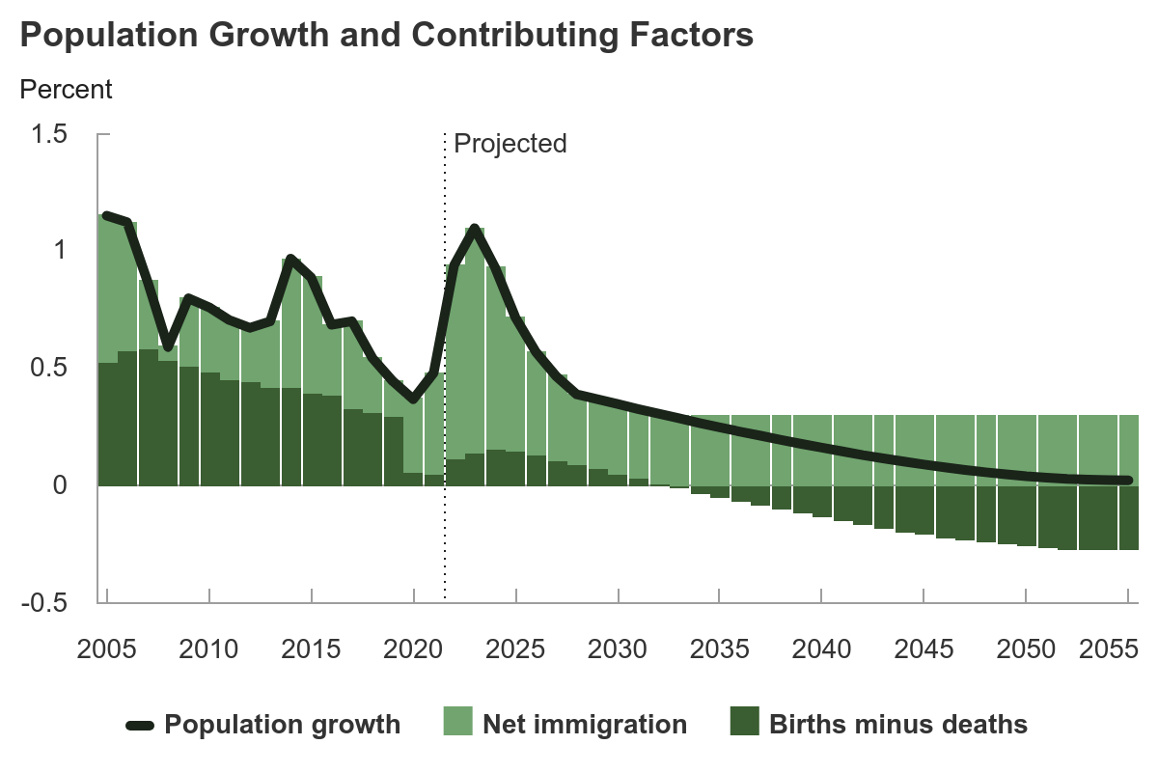
Is Immigration Saving the Day?
Source: CBO – The Demographic Outlook, 2025-2055

Slide 27
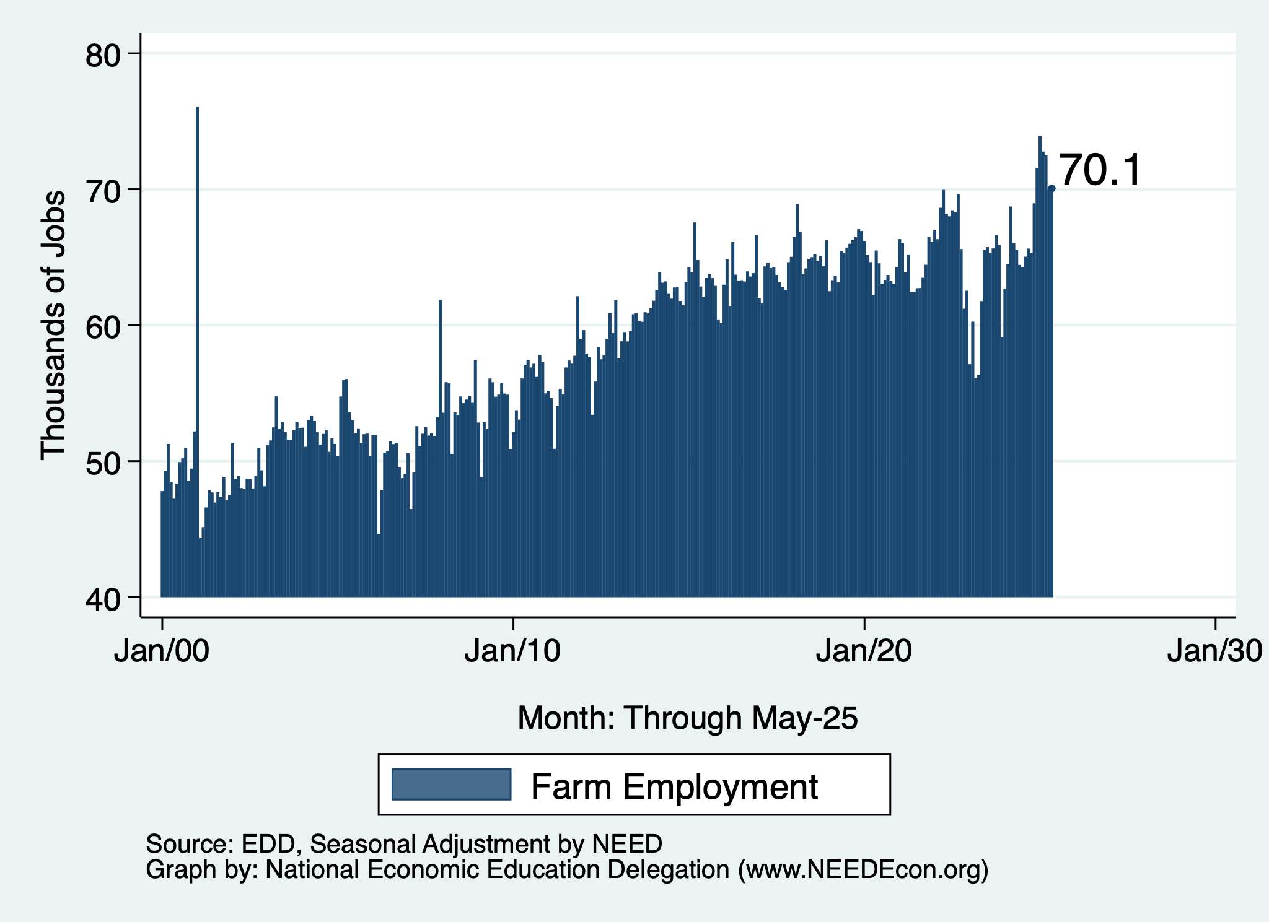
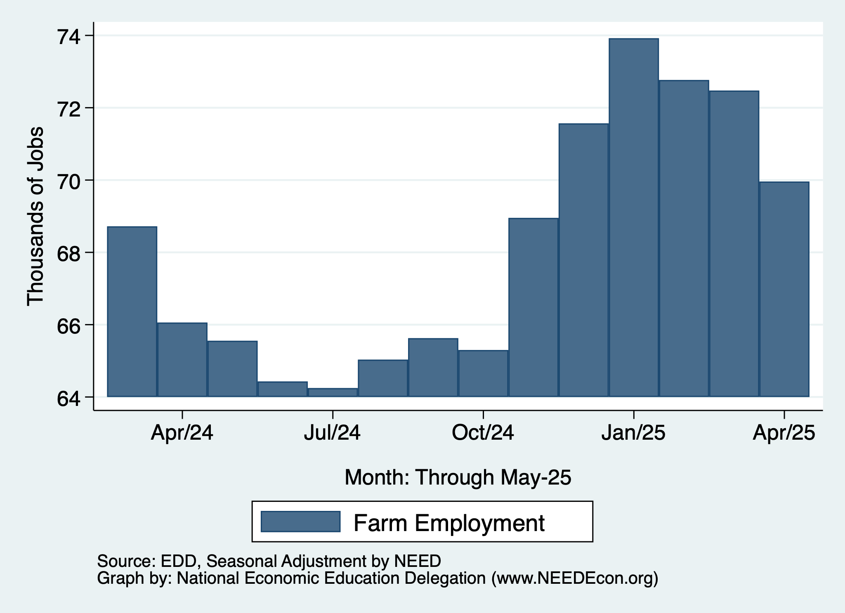
Farm Employment: MBEP

Slide 28
Summary
Inflation: close to Fed’s 2% target, but a little stubborn.
  This is likely to change.
Current immigration and trade policies will exacerbate inflation.
Immigration: deportations tax the economy and are expensive.
  Many, many ag workers are unauthorized immigrants.
Tariffs: are a tax.
  Taxes raise prices. Period. Full Stop.
  Taxes often cost jobs. Tariffs likely will.

Slide 29
Biggest Problem: Uncertainty
Nobody knows how to plan into uncertainty.
  Business investment is particularly at risk.
Hardly anybody increases spending into uncertainty.
Other countries will look elsewhere if the U.S. is volatile.
  Tourists already are. 10.3% drop in March/25.
Outlook: is not good.
  Inflation is inevitable.
  Job losses are inevitable.

Slide 30
Are We Headed for A Recession?
Uncertain.
Our current path has many forecasters indicating that a recession is more likely than not.
  IMF has cut it’s U.S. growth forecast to 1.7%, down from 2.8% in 2024.
A slowdown in economic growth seems inevitable.
A bout of stagflation is possible.

Slide 31
Locally

Slide 32
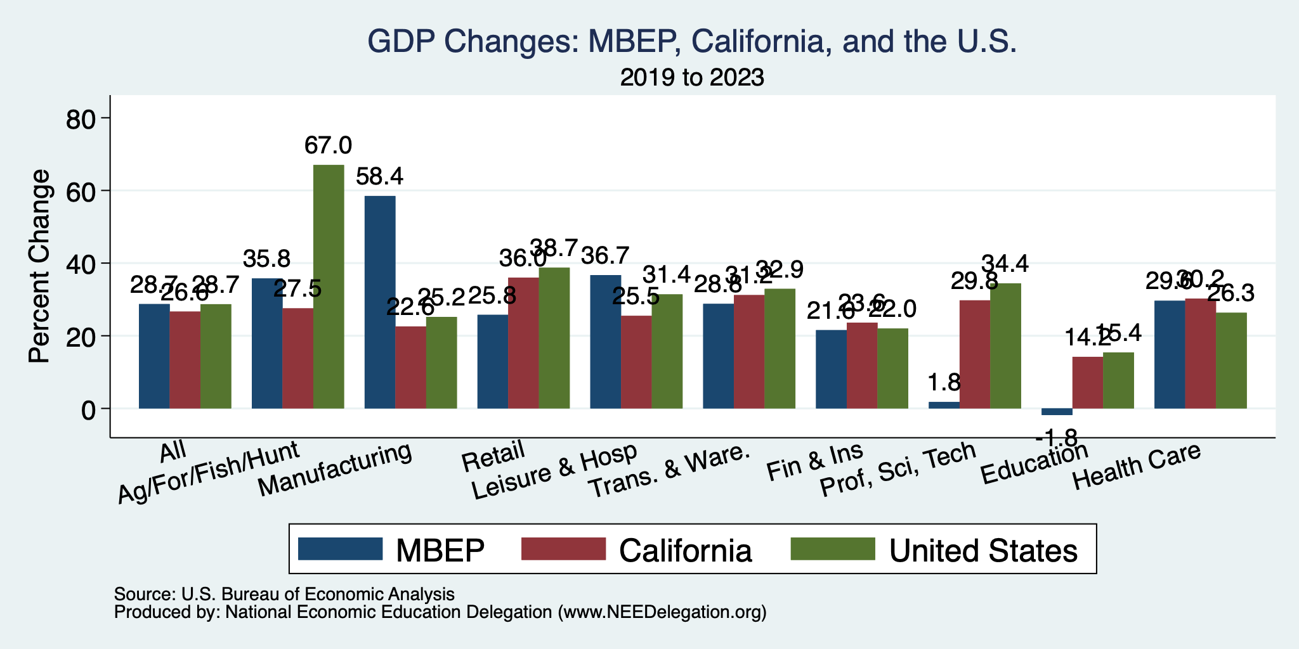
MBEP Economy: GDP Growth

Slide 33
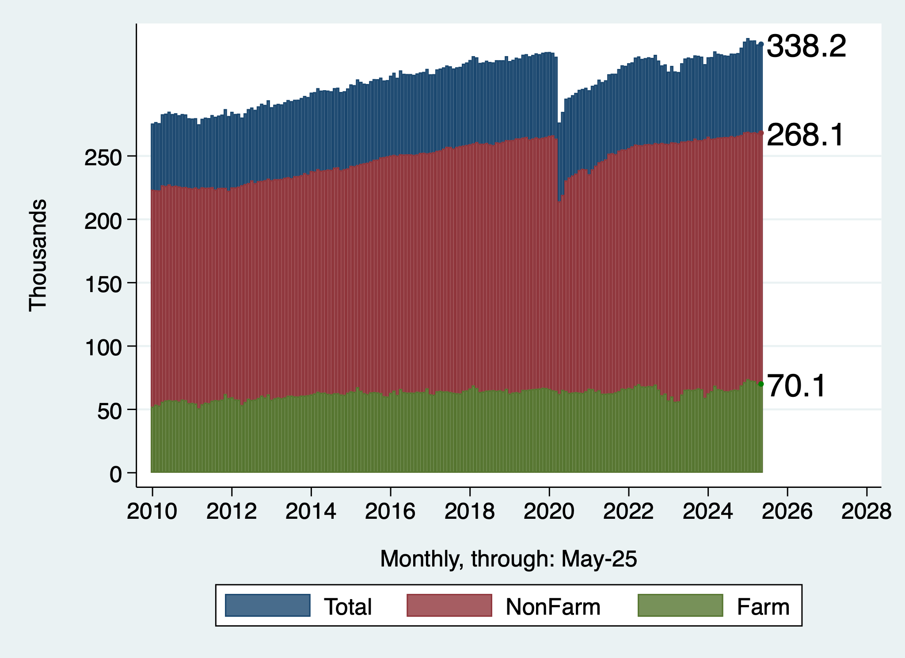
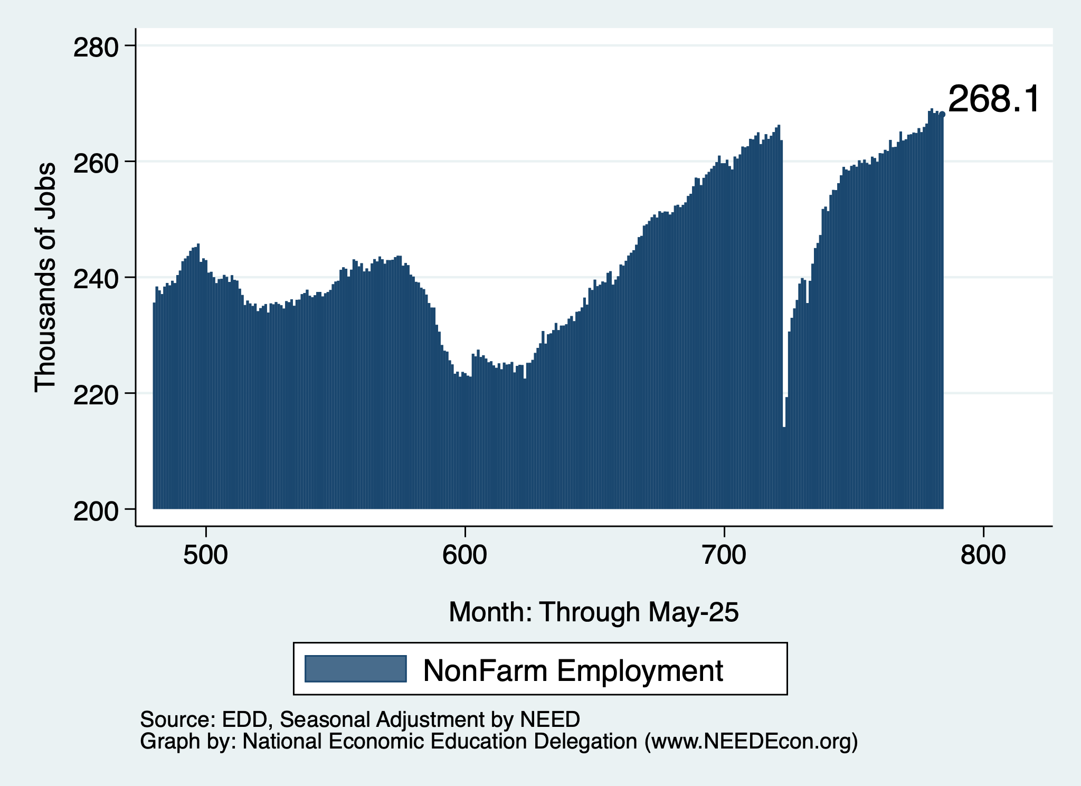
Employment Recovery – Down from May 1
Total Employment
NonFarm Employment

Slide 34
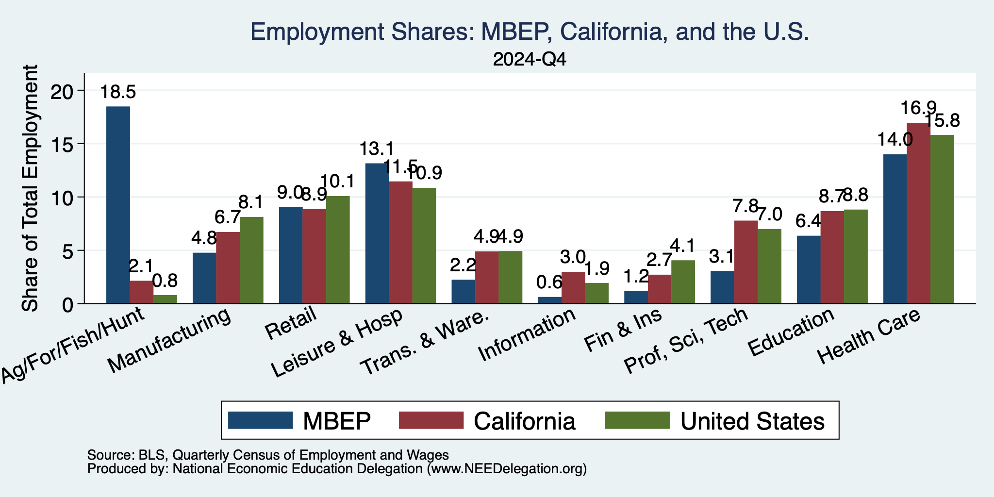
MBEP Economy: Employment Patterns
Down
From 24.5

Slide 35
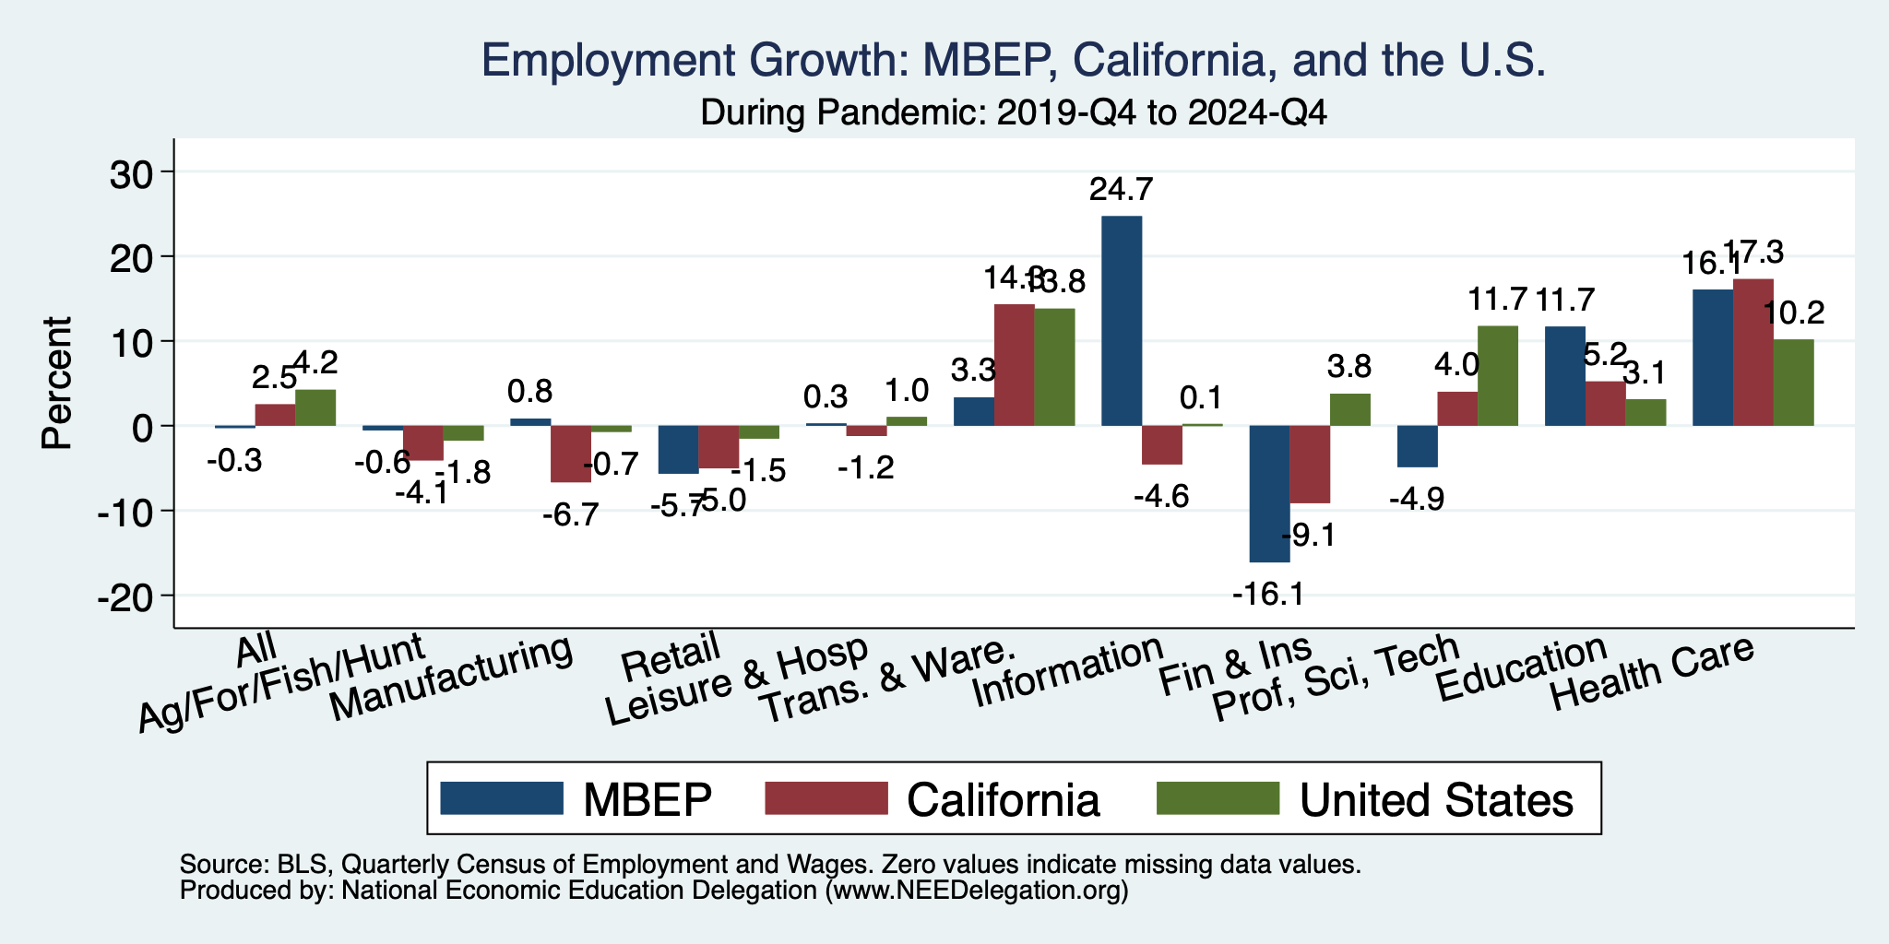
The Pandemic Effect: Employment
Stronger
Weaker
Weaker
Weaker

Slide 36
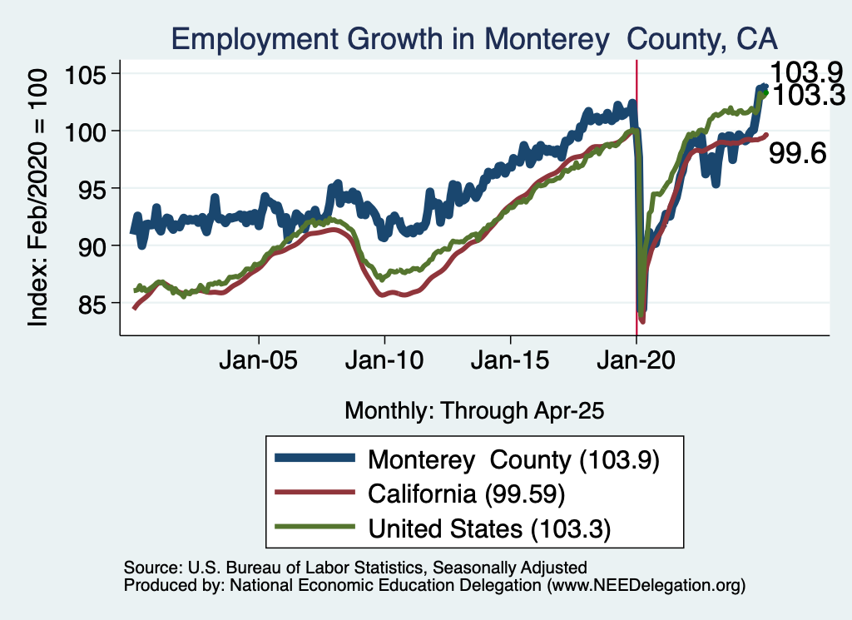
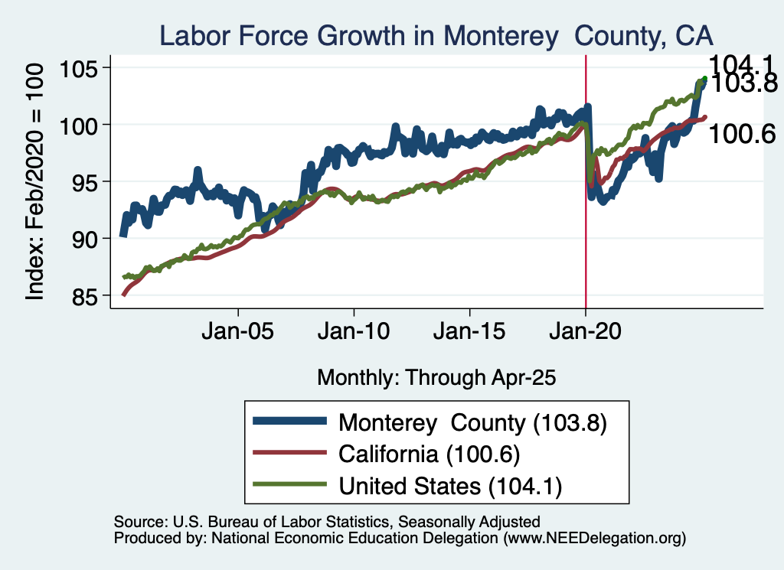
Employment in Monterey County?

Slide 37
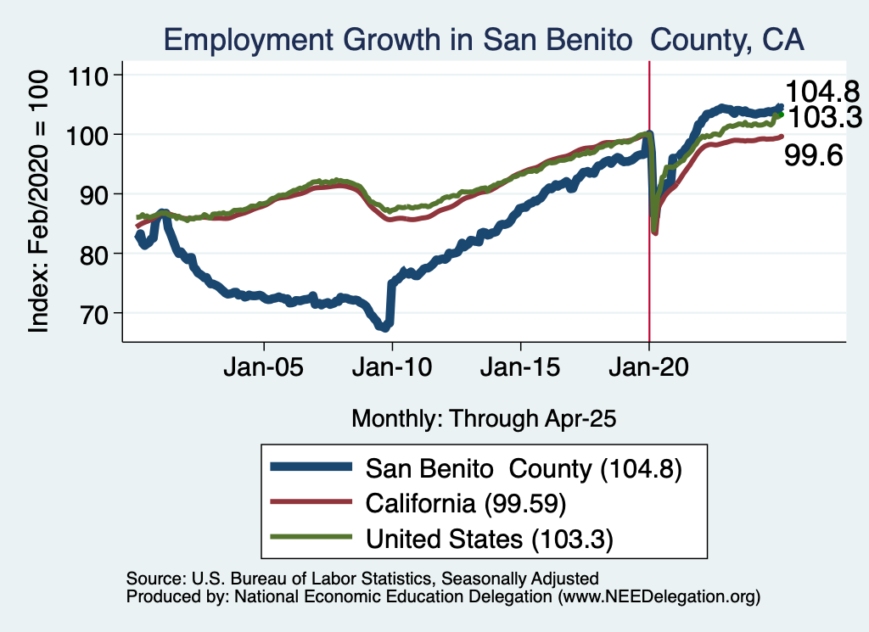
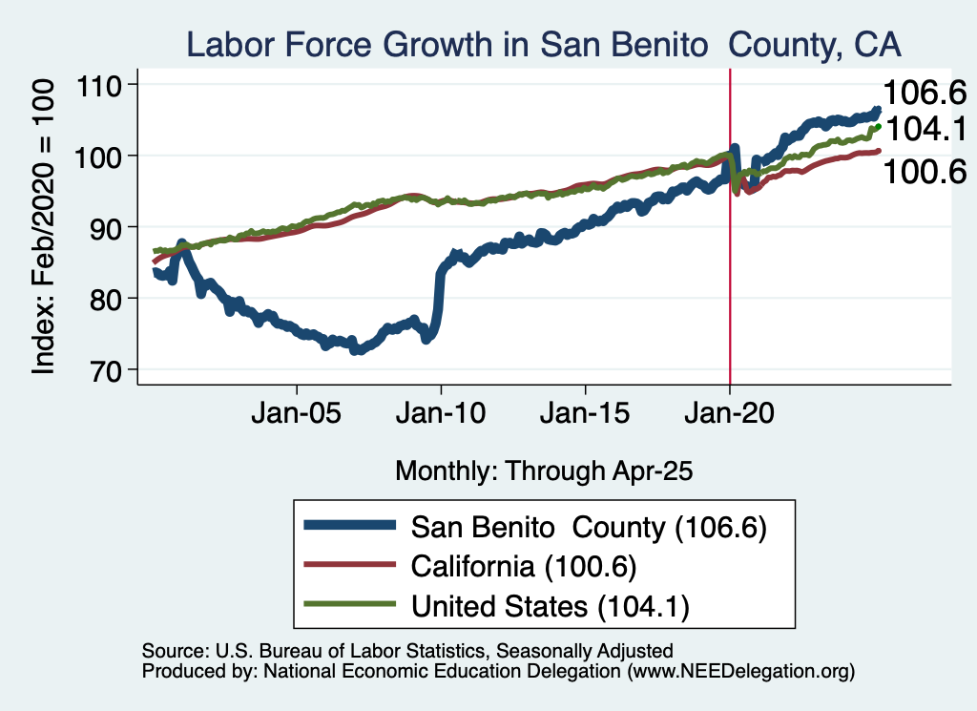
Employment in San Benito County?

Slide 38
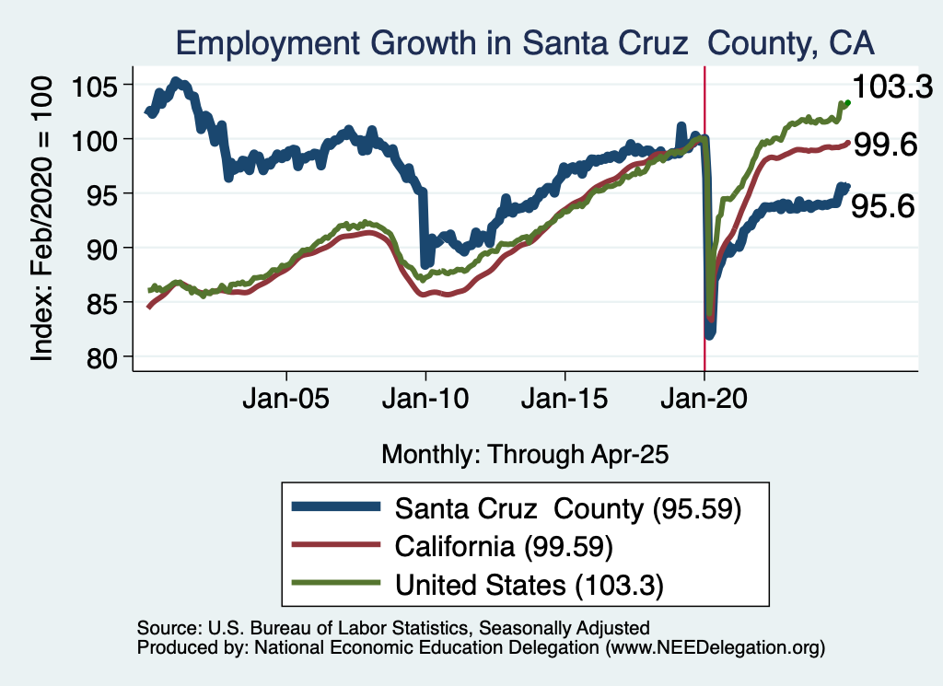
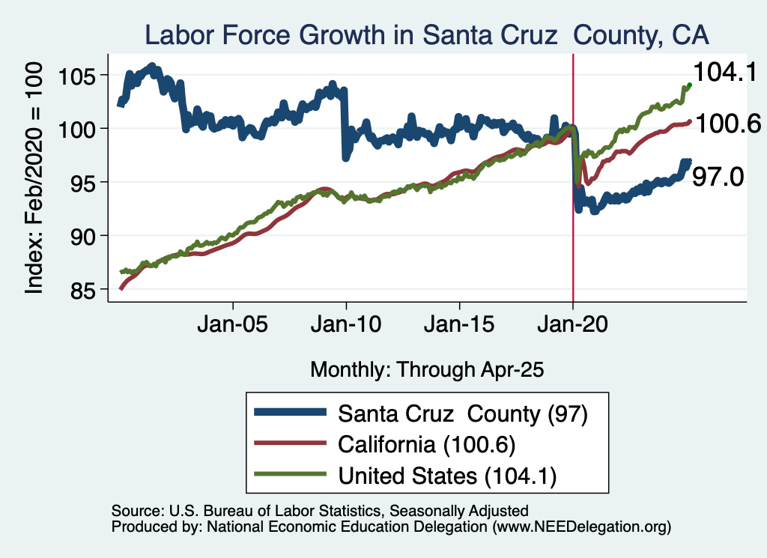
Employment in Santa Cruz County?

Slide 39
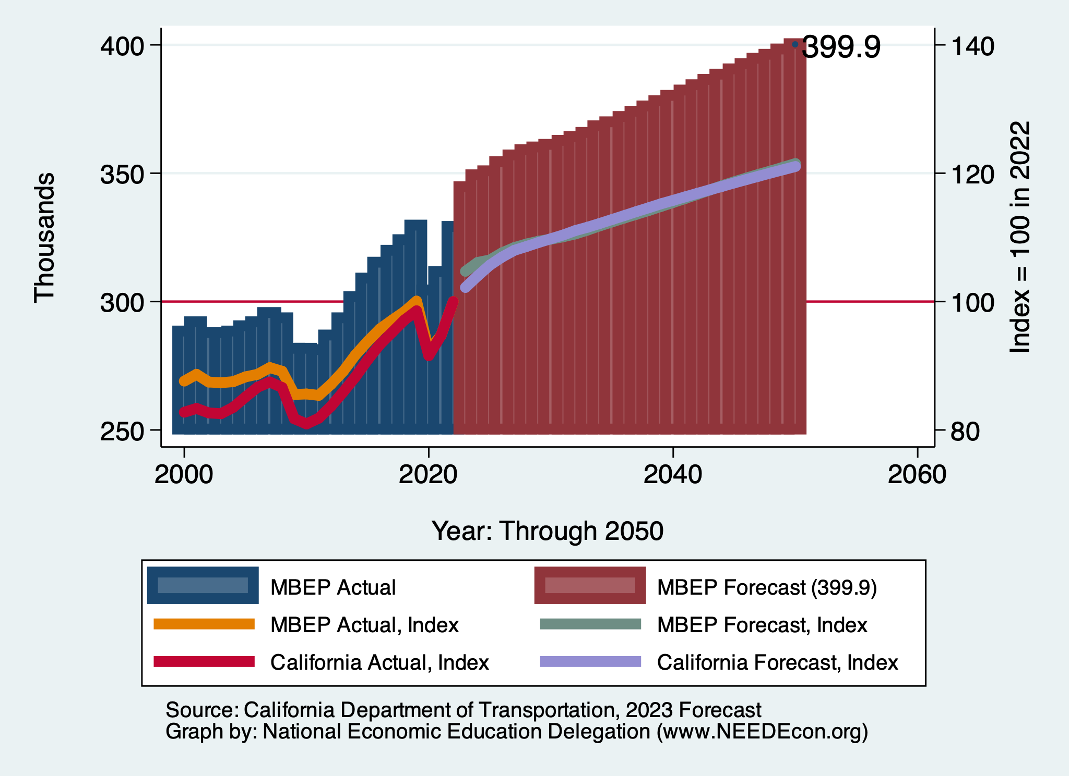
DOT Forecast: Employment – Same Forecast

Slide 40
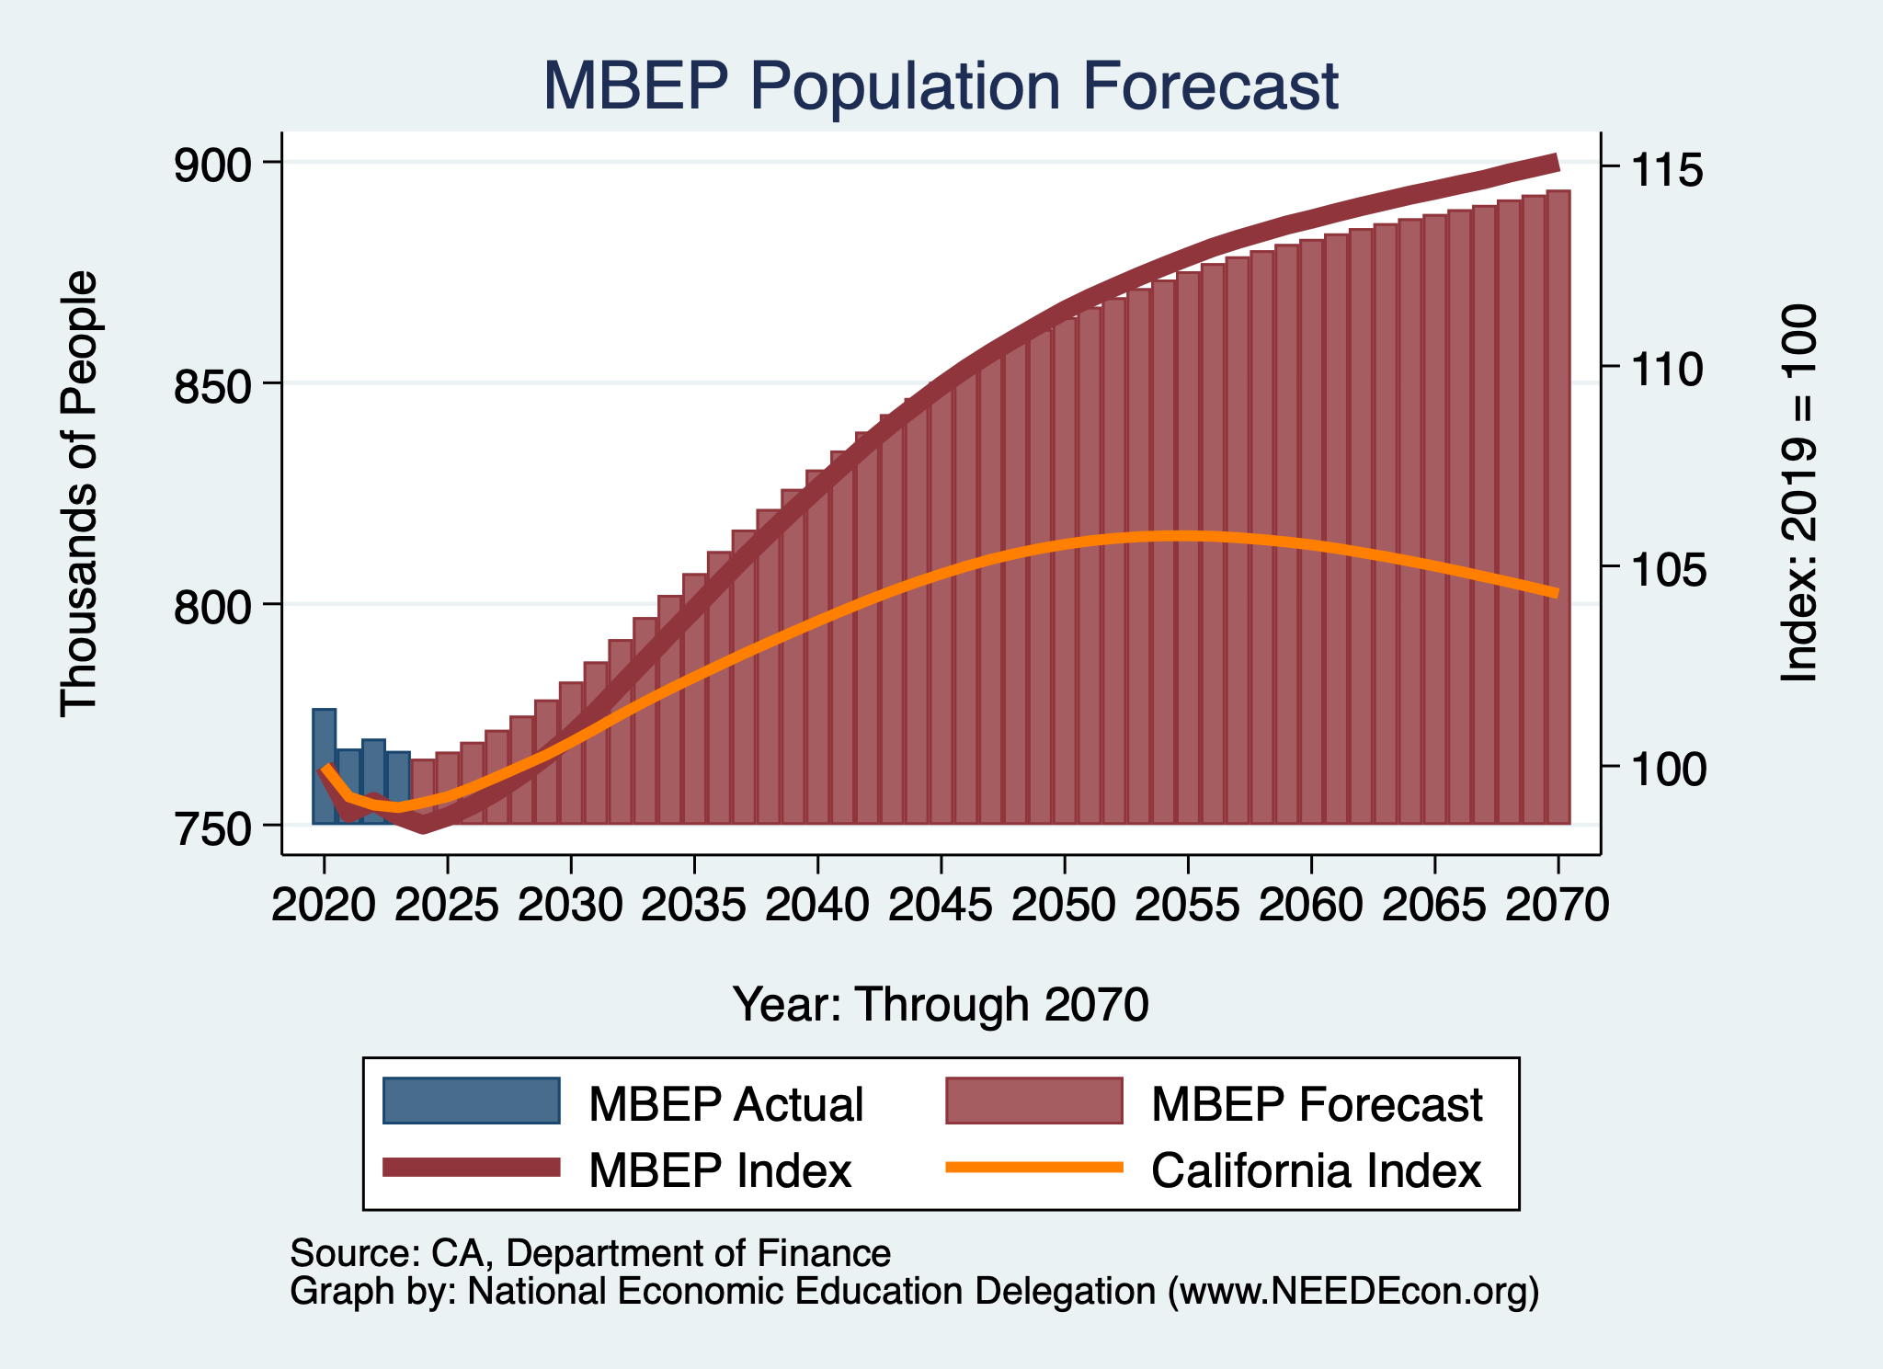
DOF Forecast: Population – Same Forecast

Slide 41
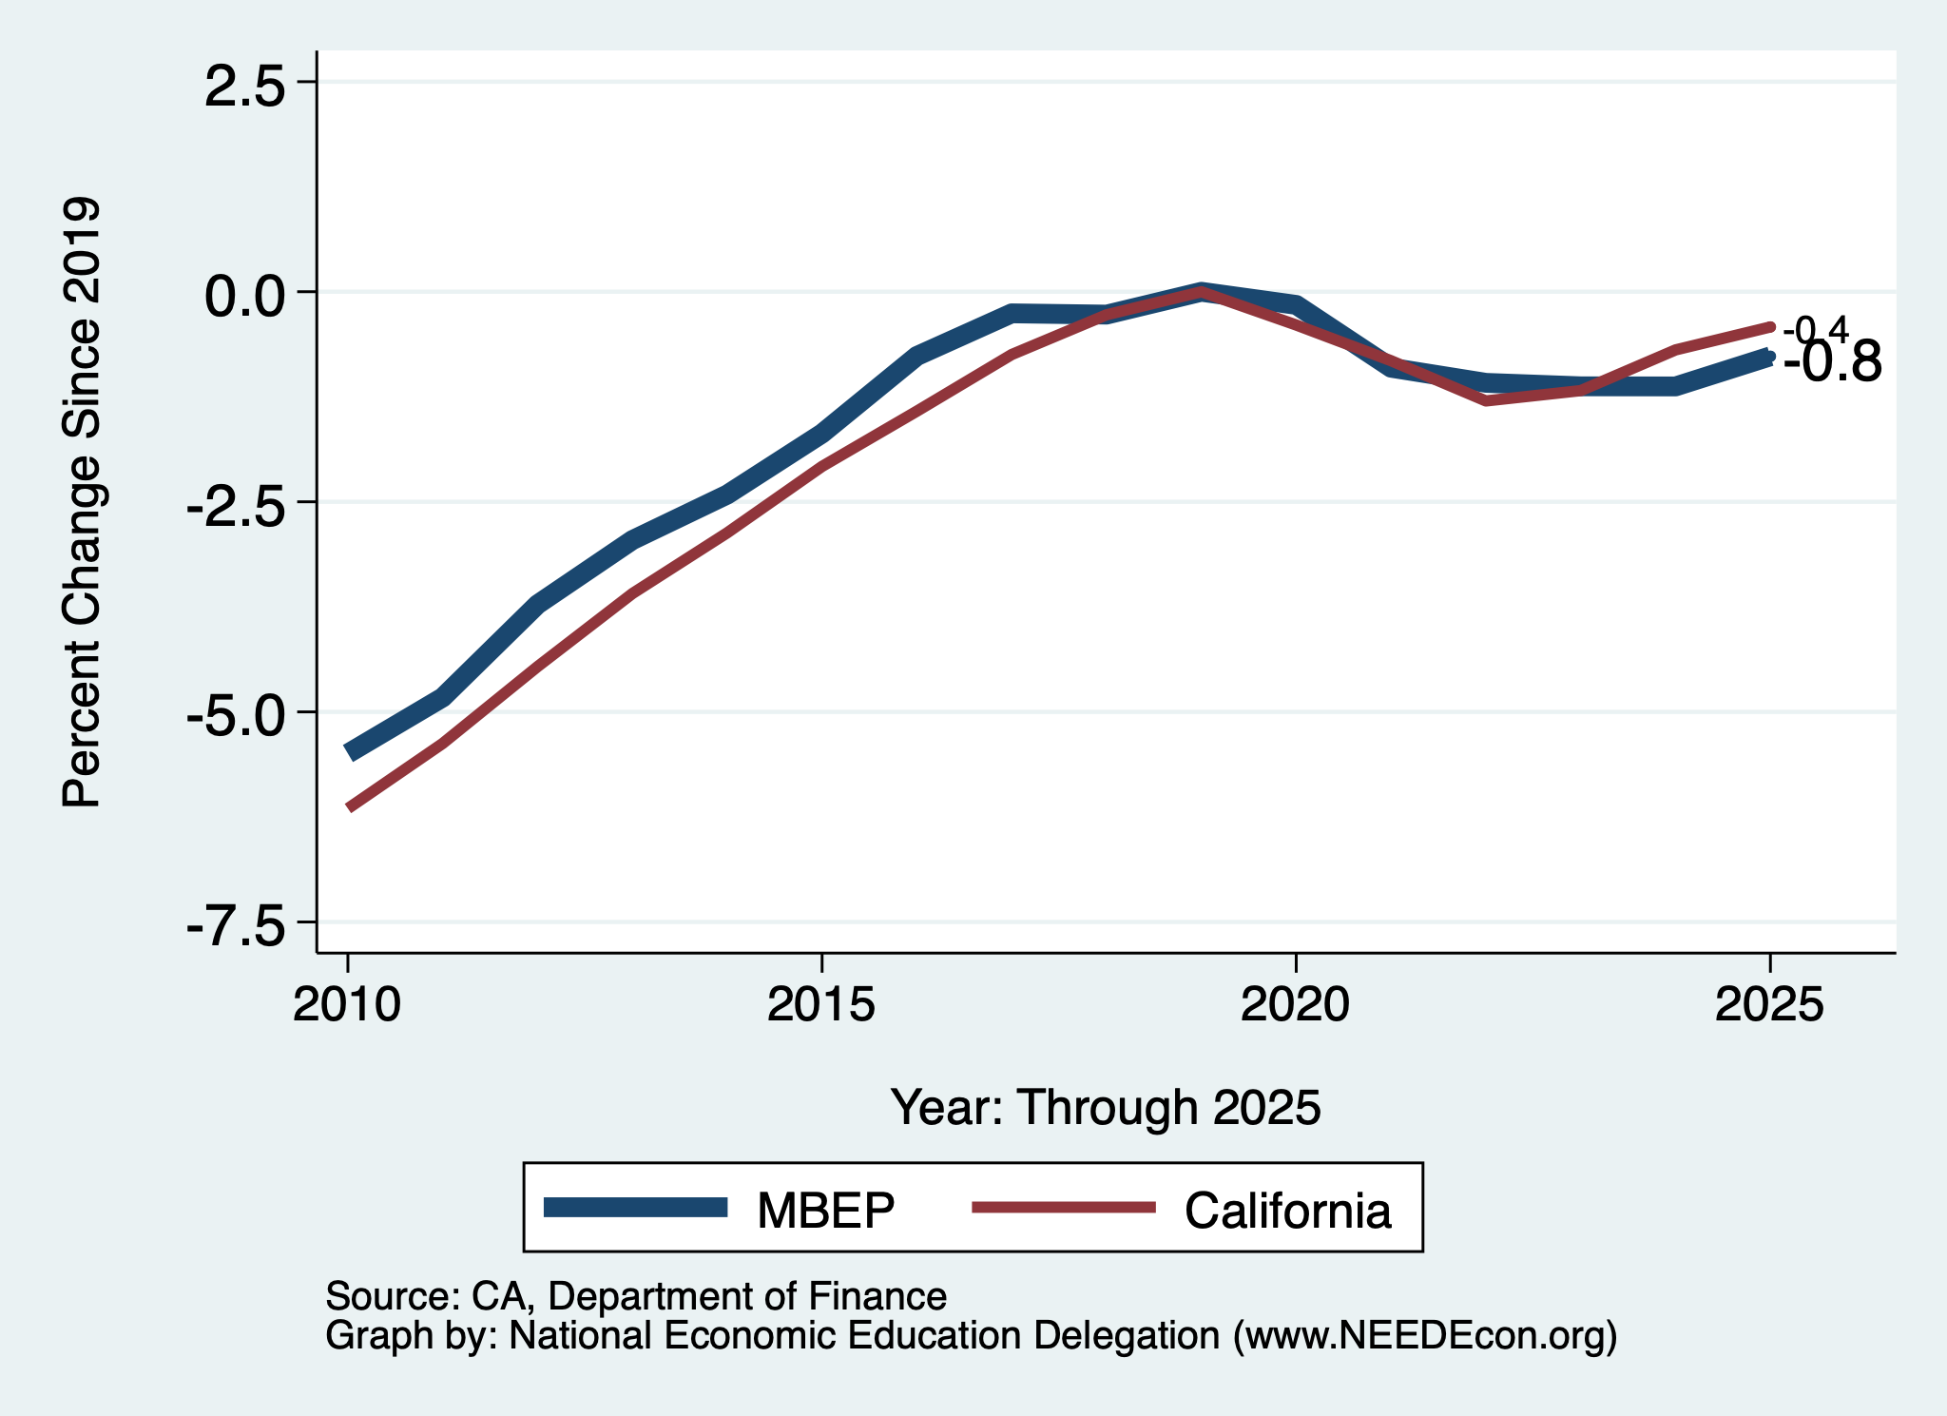
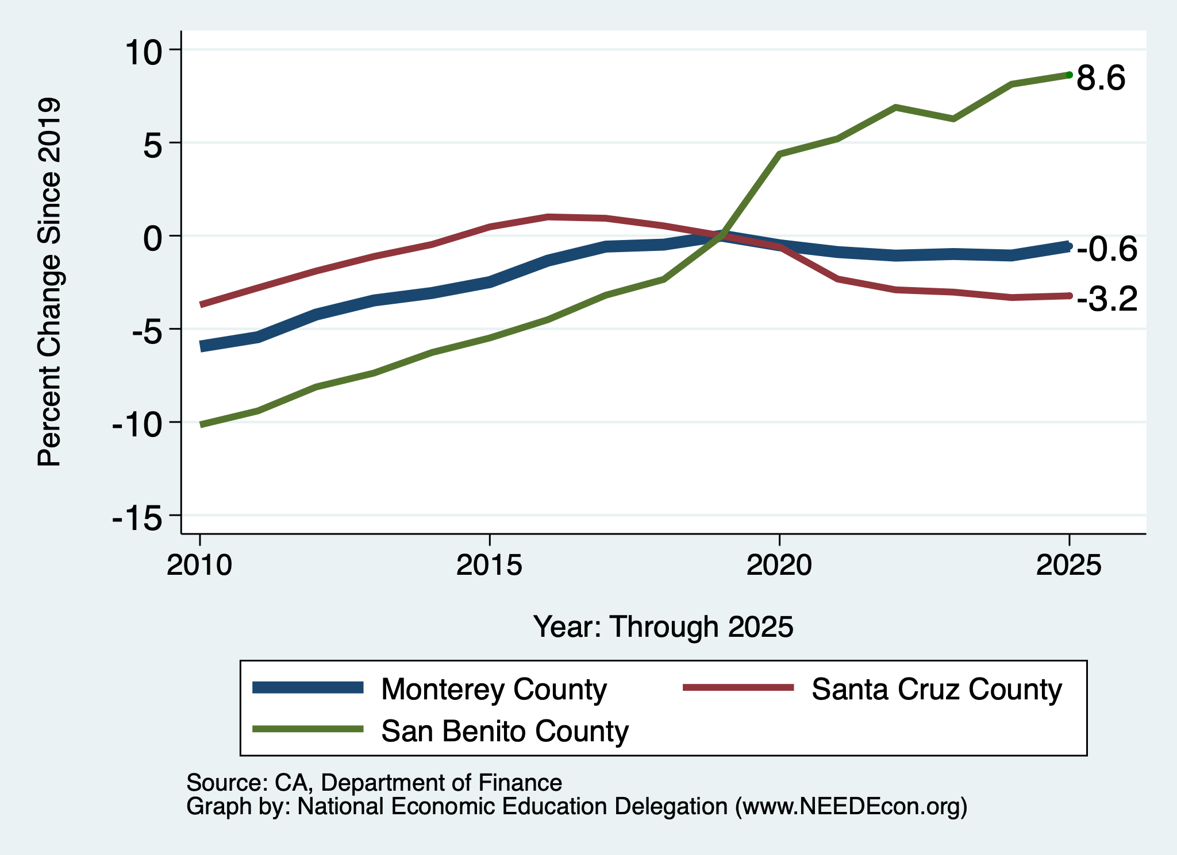
Local Population Change – 2025 & Base = 2019

Slide 42
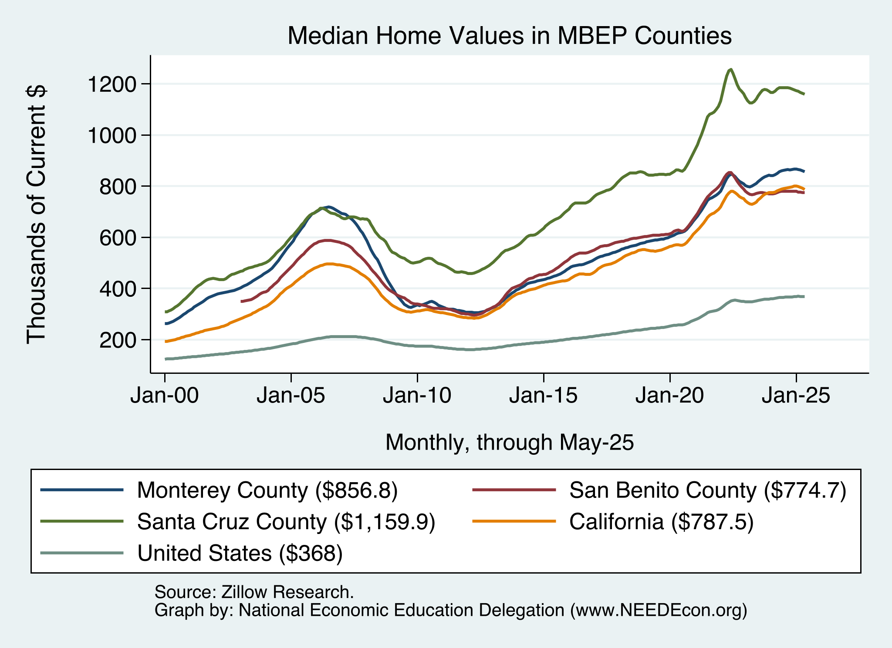
Home Prices Around MBEP
Santa Cruz County
Monterey and San Benito Counties
- and CA
U.S.

Slide 43
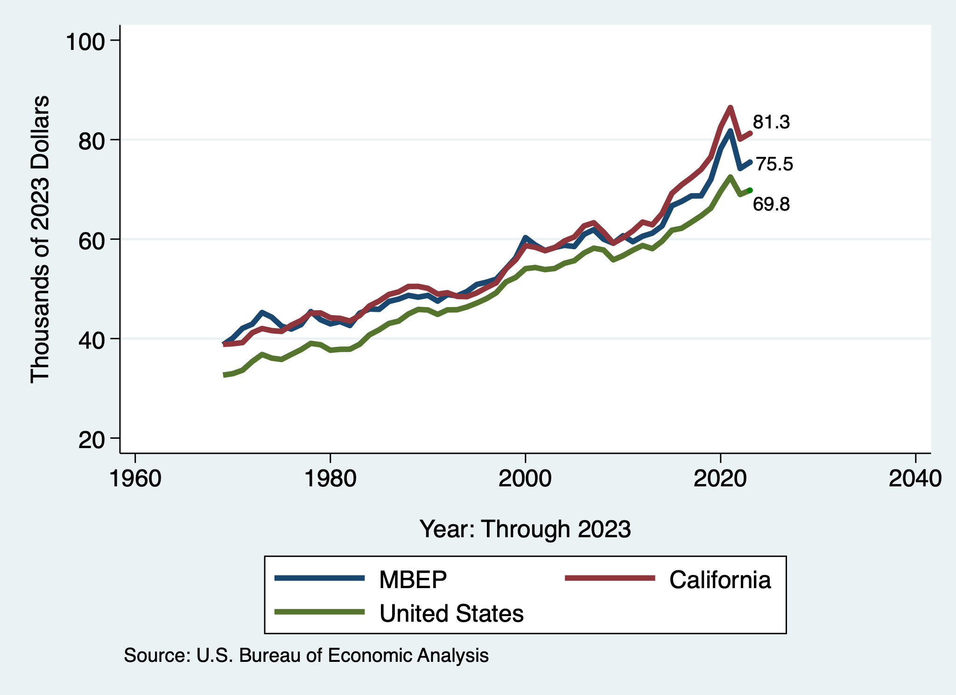
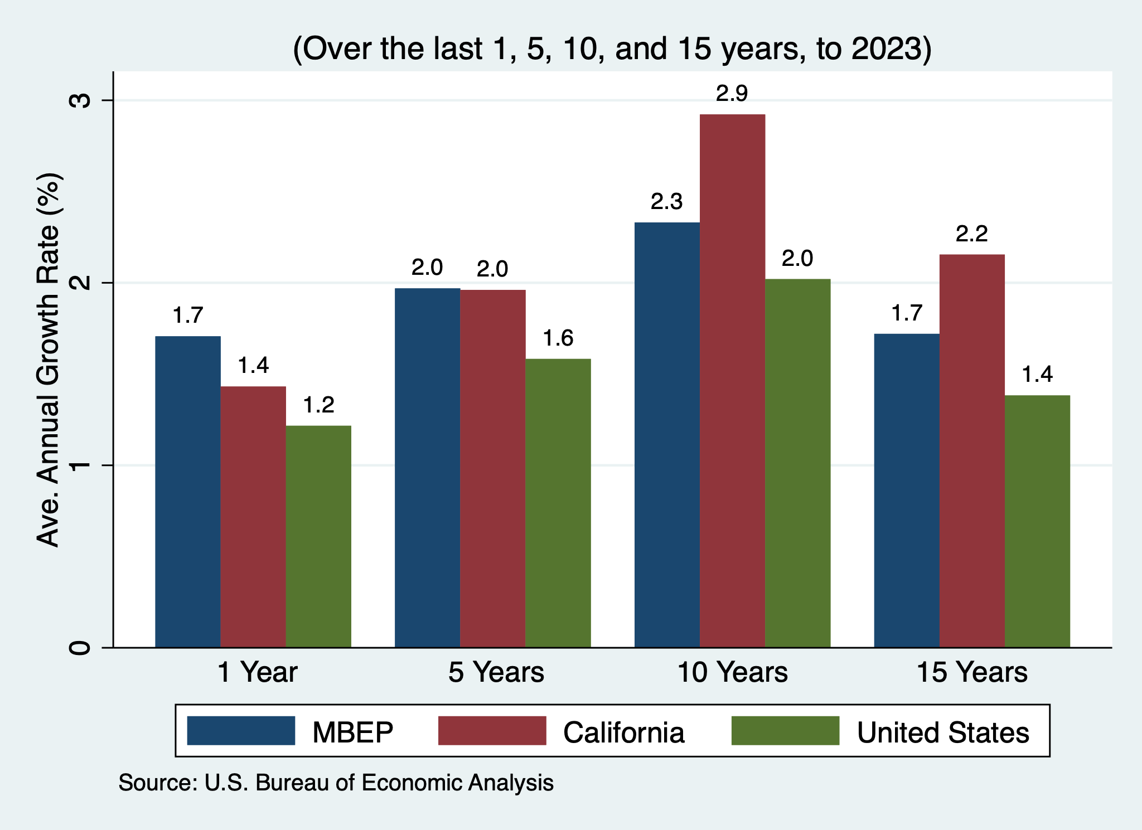
Per Capita Income - MBEP

Slide 44
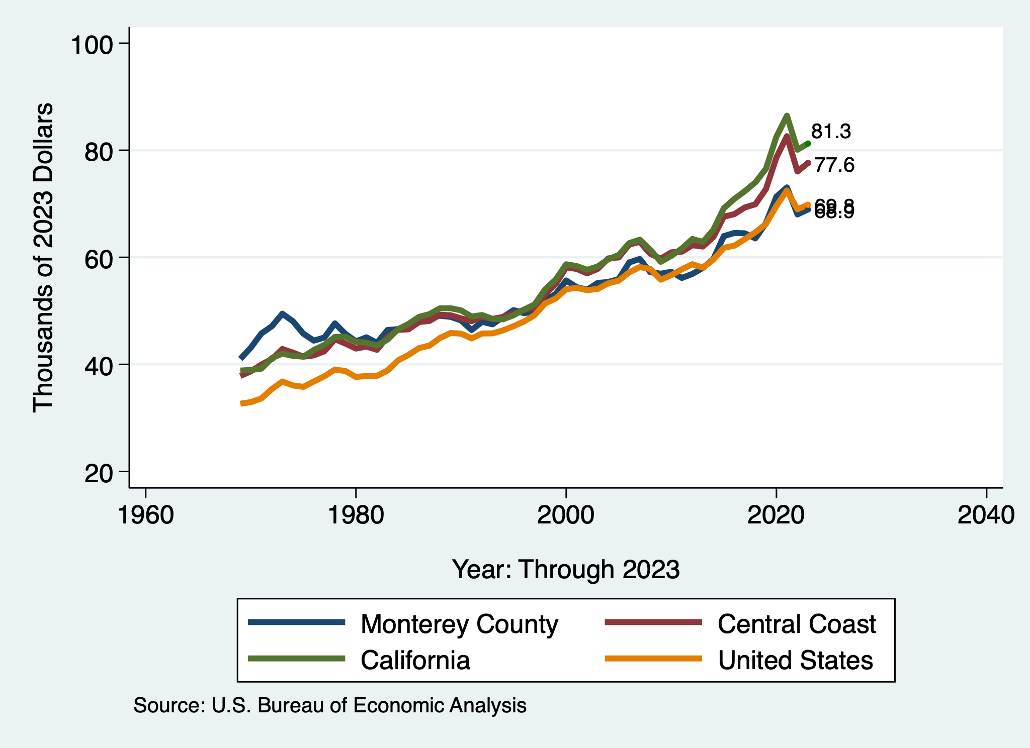
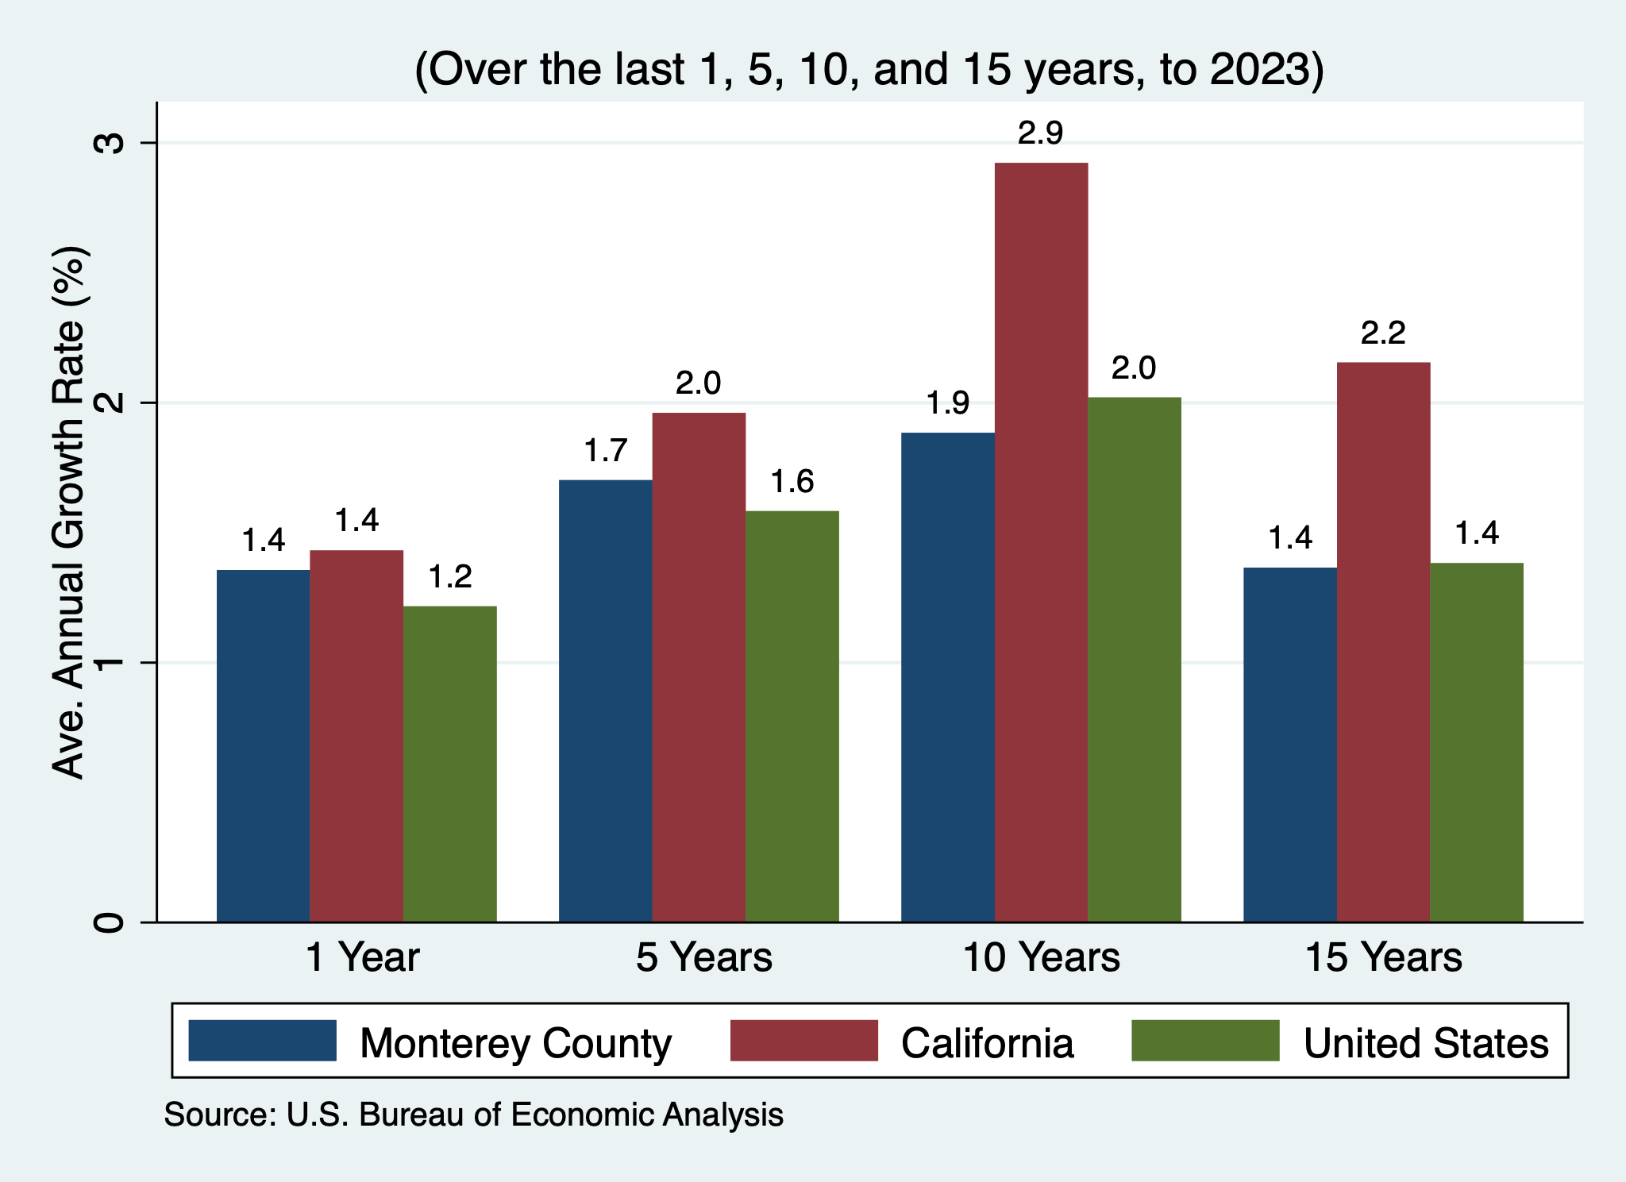
Per Capita Income – Monterey County

Slide 45
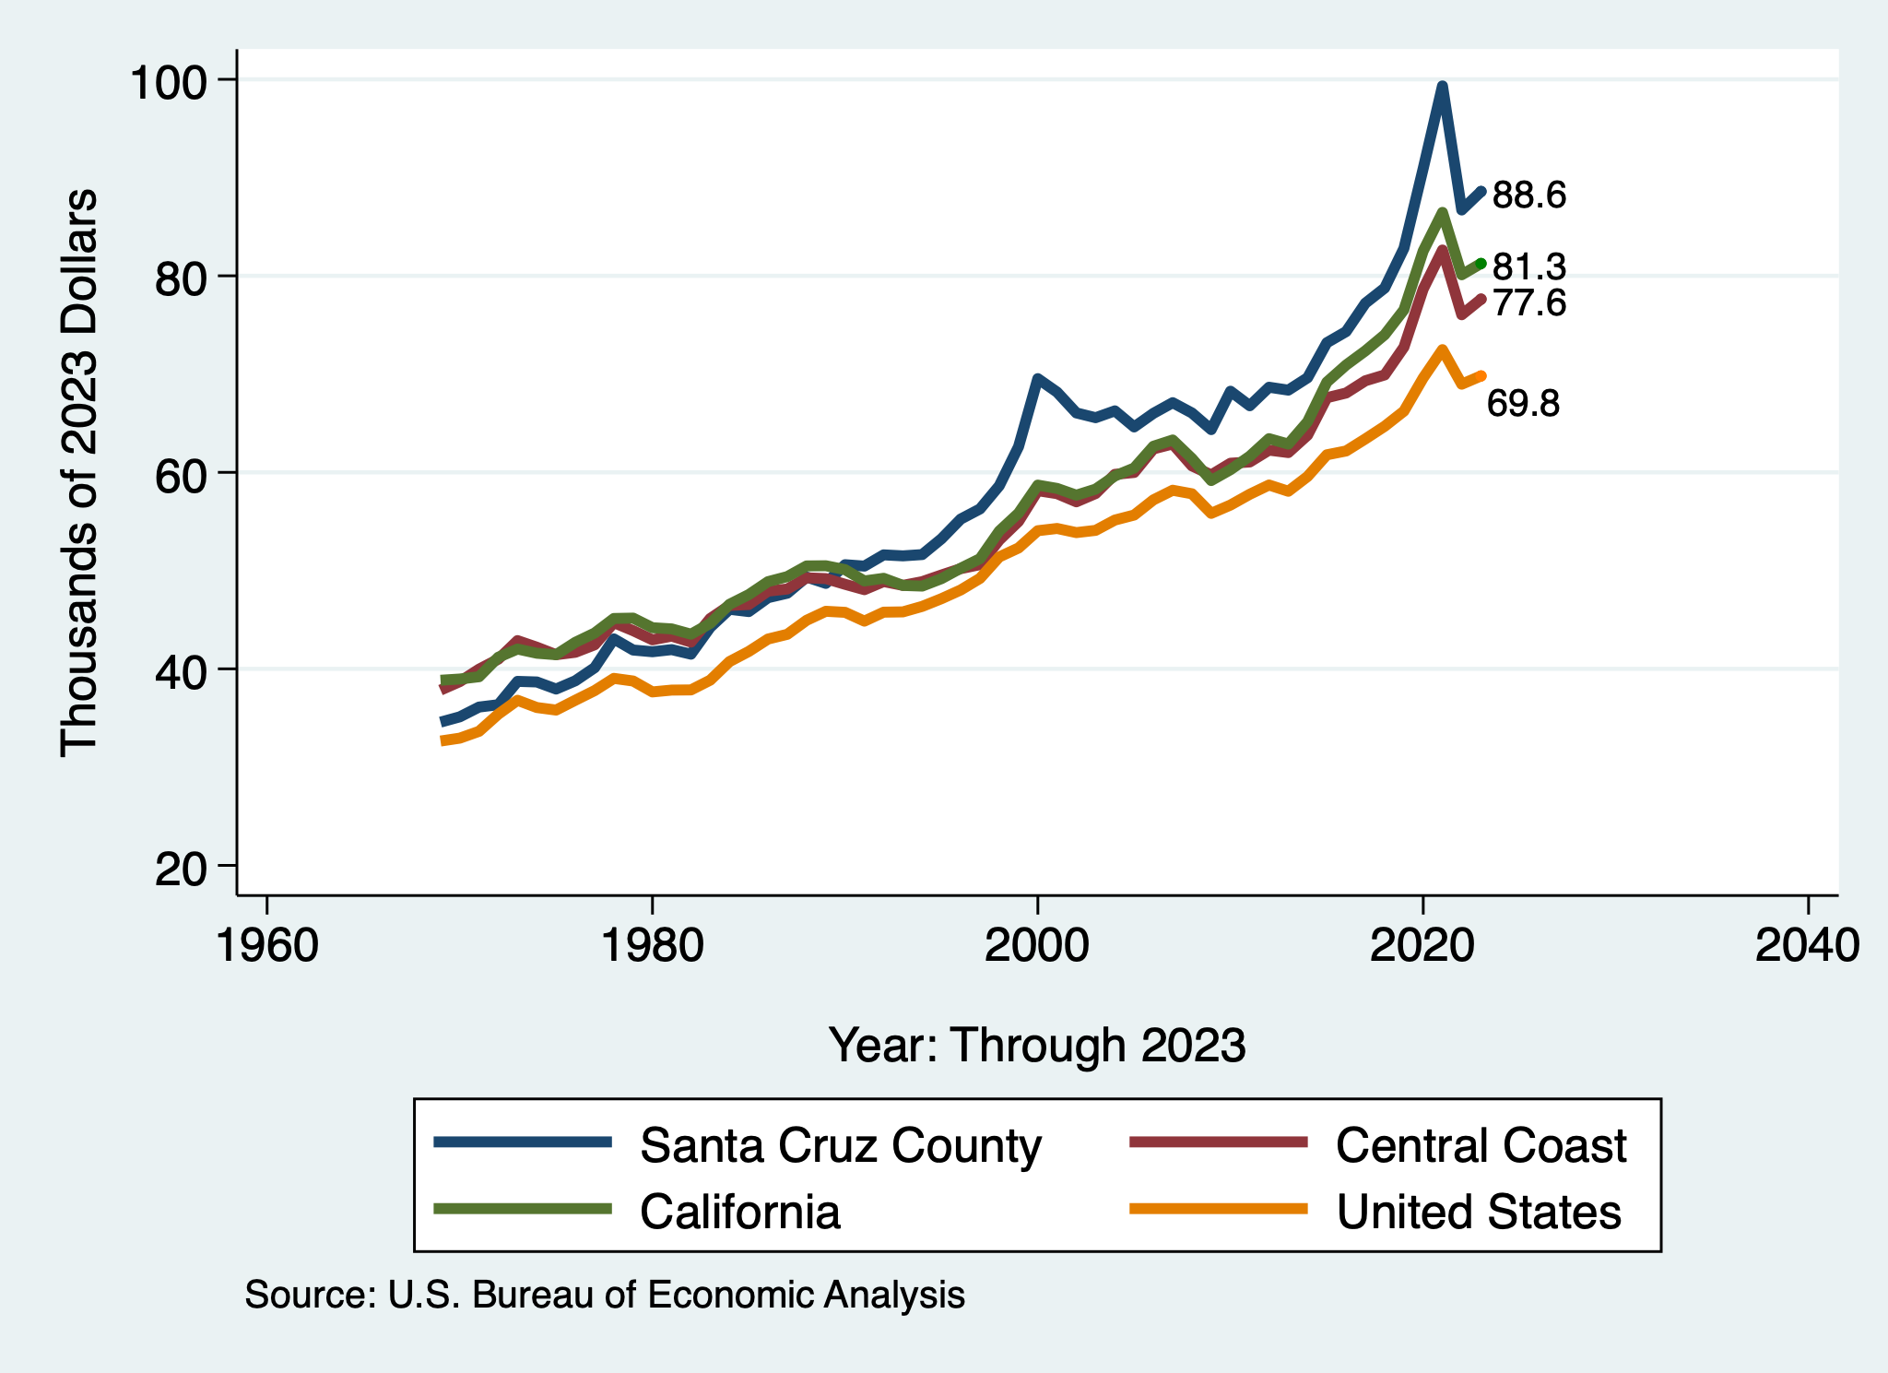
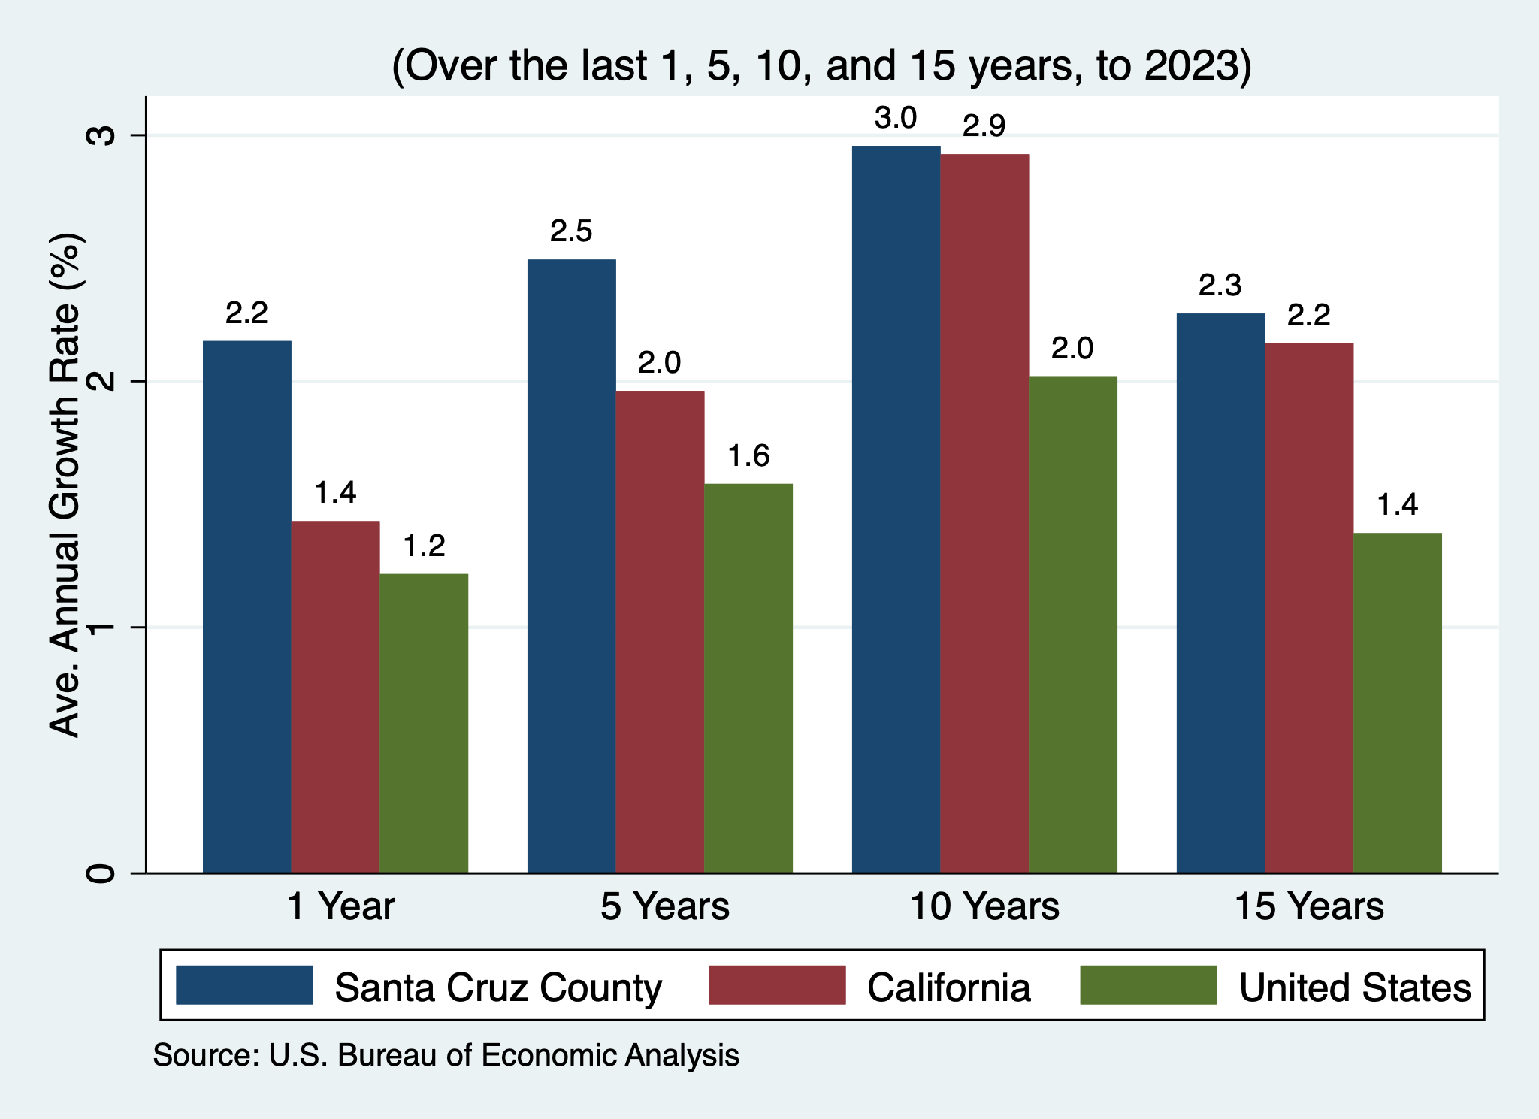
Per Capita Income – Santa Cruz County

Slide 46
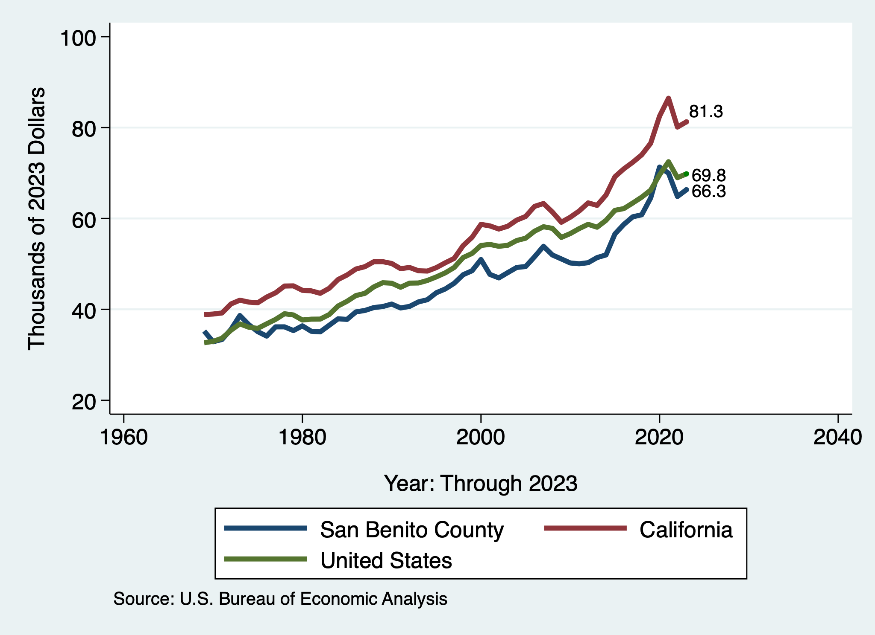
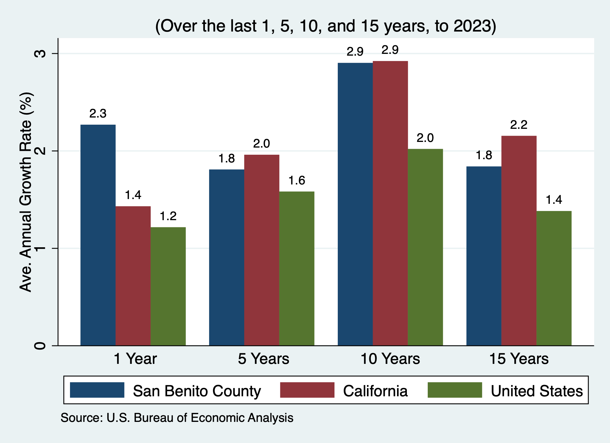
Per Capita Income – San Benito County

Slide 47
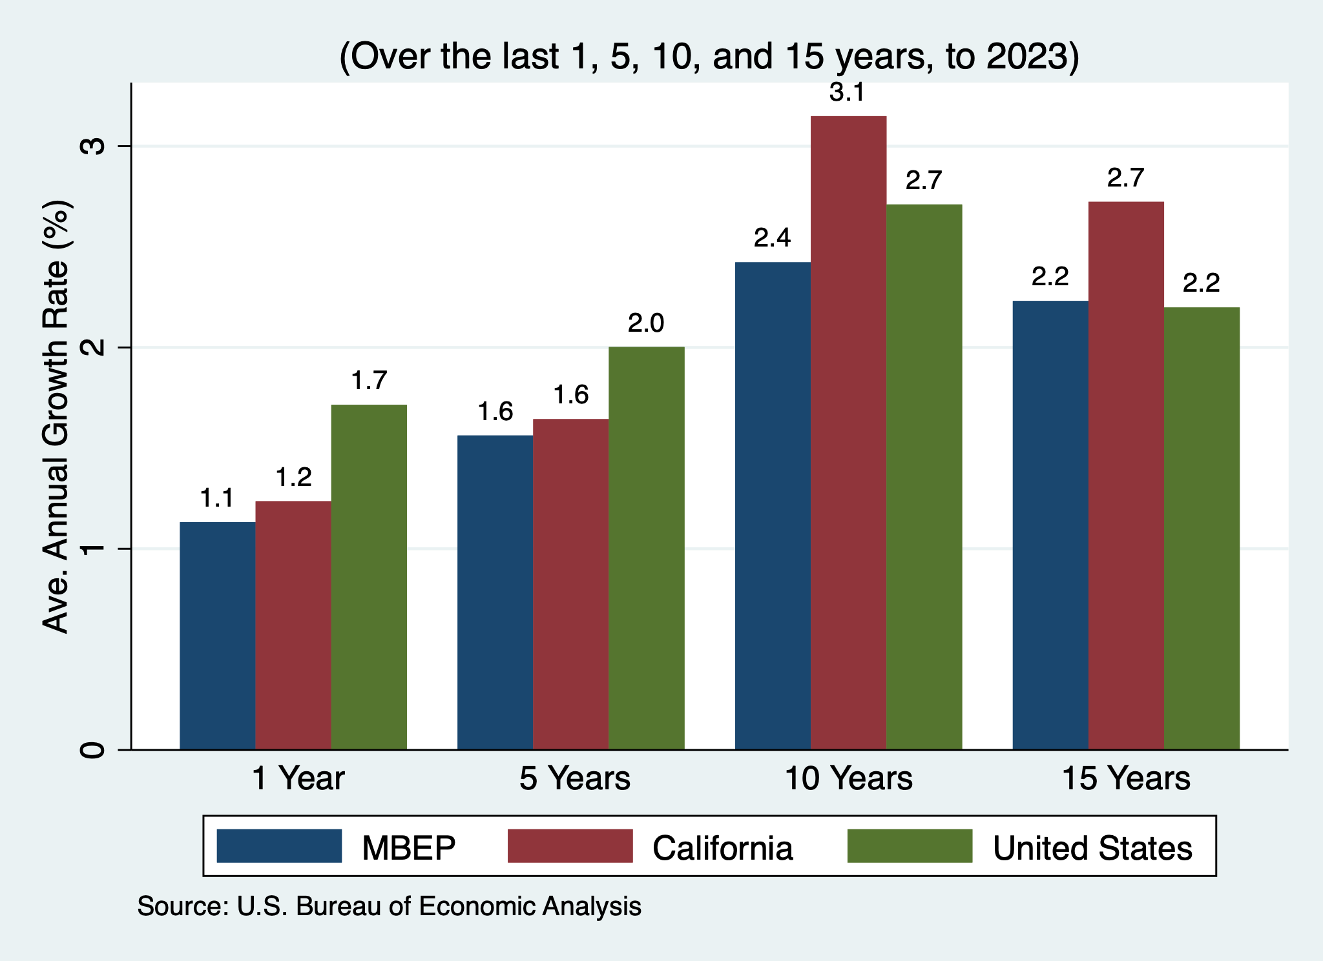
Personal Income – MBEP
Per Capita Personal Income
Personal Income

Slide 48
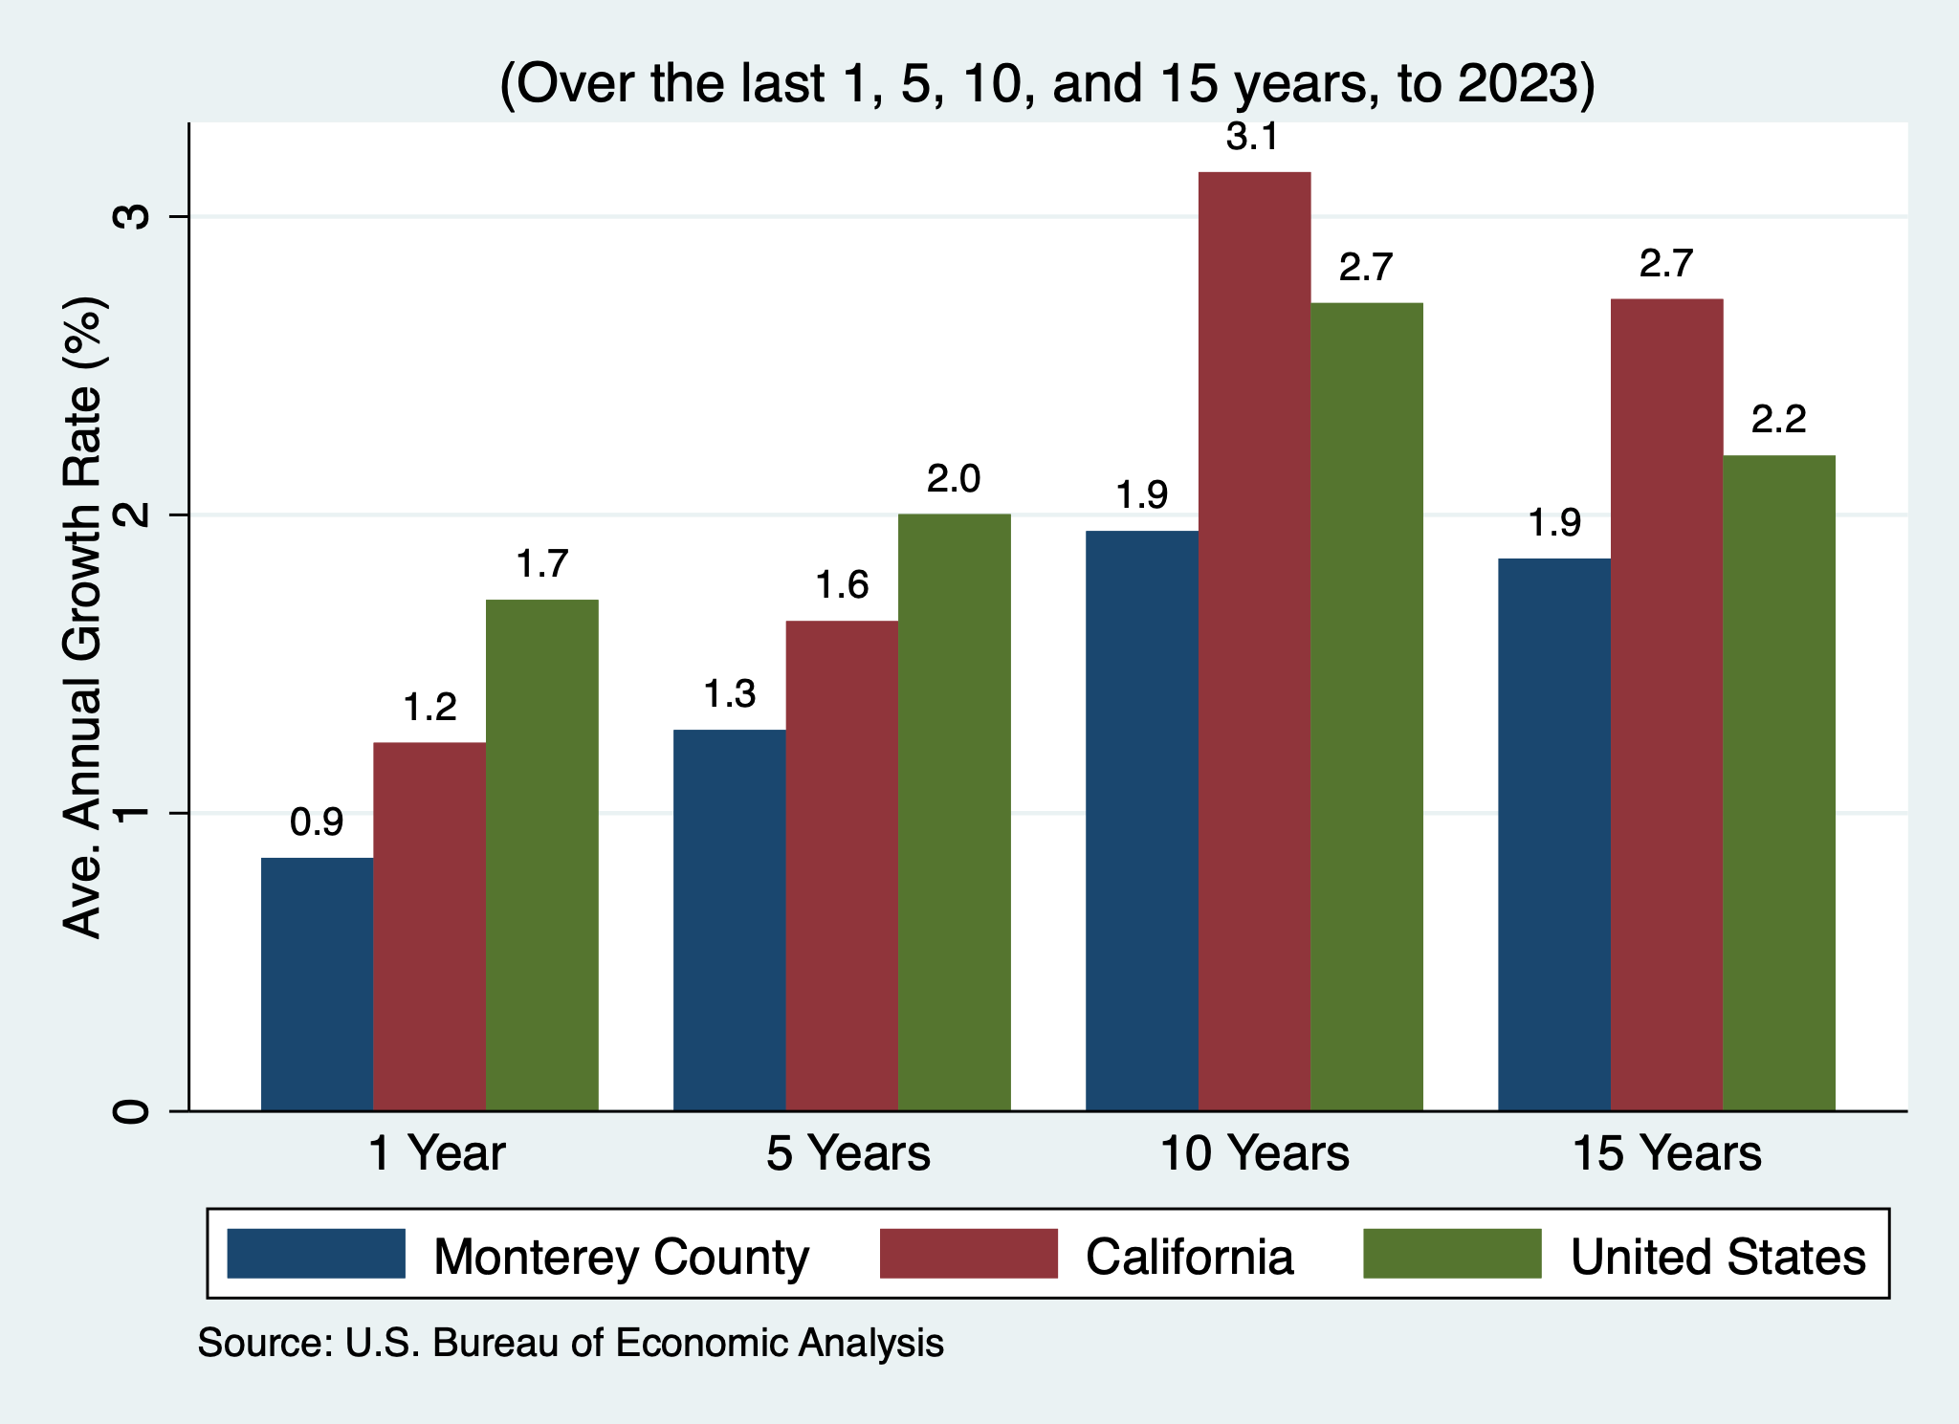
Personal Income – Monterey County
Per Capita Personal Income
Personal Income

Slide 49
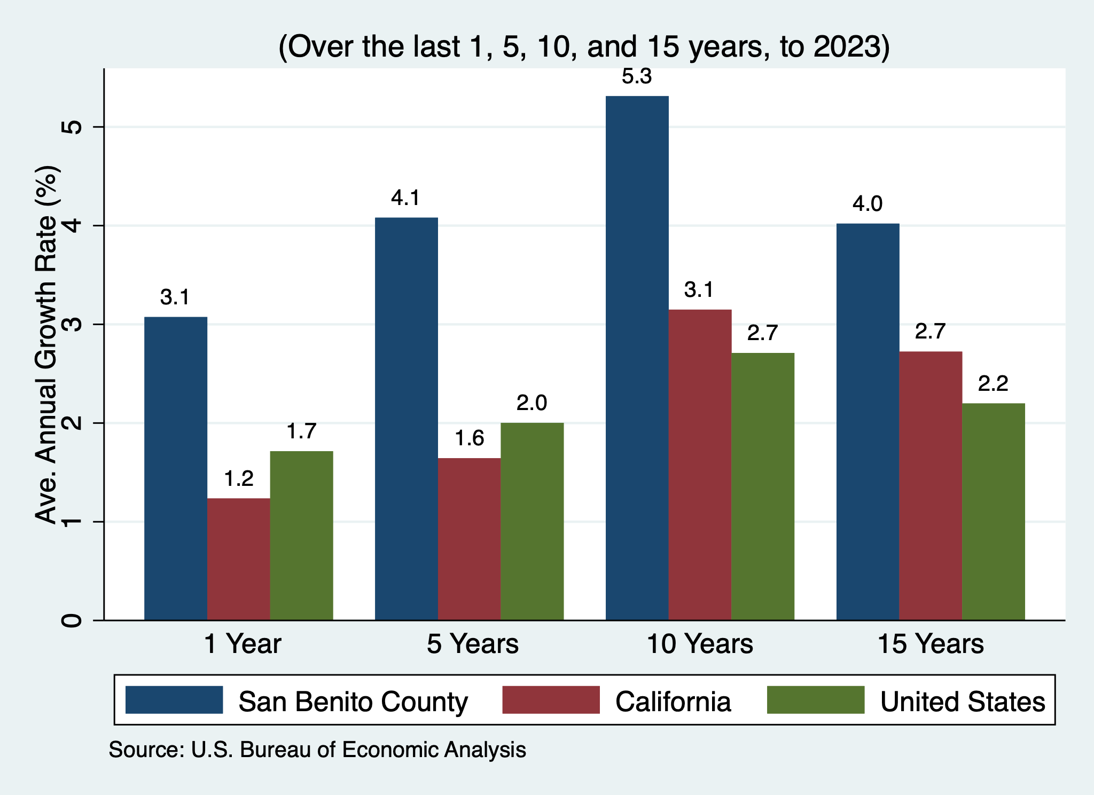
Personal Income – San Benito County
Per Capita Personal Income
Personal Income

Slide 50
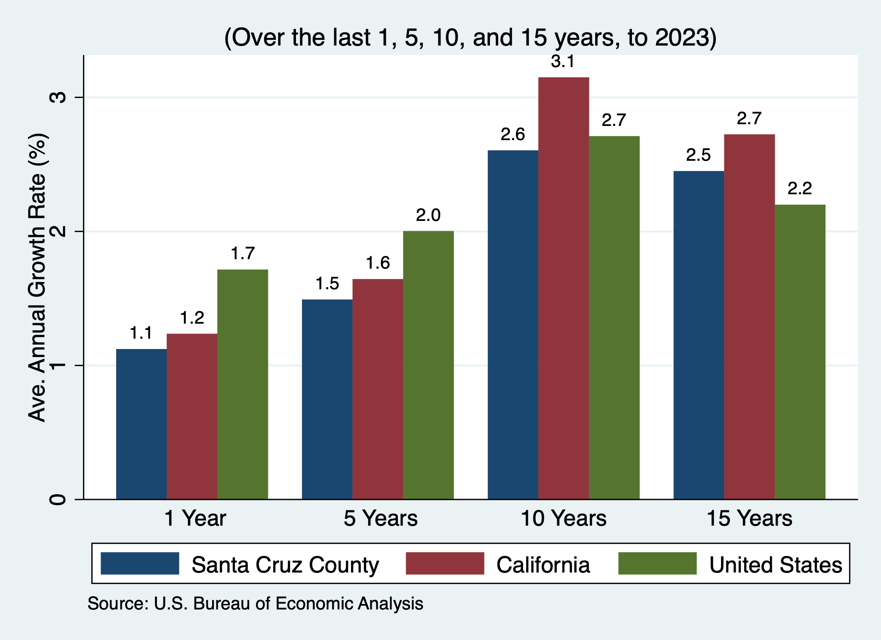
Personal Income – Santa Cruz County
Per Capita Personal Income
Personal Income

Slide 51
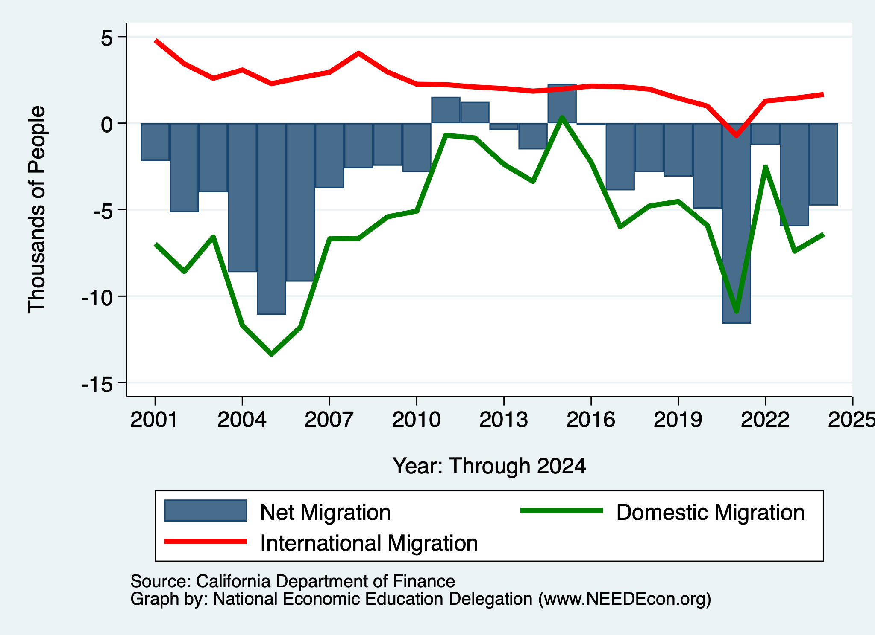
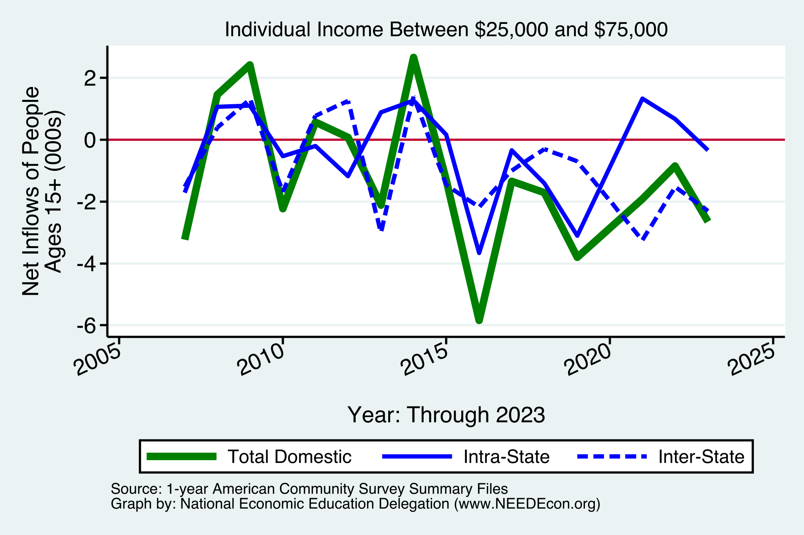
Migration: Outflows of Mid/Lower-Income
MBEP As A Whole

Slide 52
Monterey Bay Area: Summary
Home prices have returned to trend growth, but maybe slipping.
Aging population will require in-migration to grow the local economy.
  However, recent years have seen more out-migration than in.
Employment recovery is picking up pace!
  Significant growth in manufacturing and information.
  Prospects for employment growth seem favorable.
Deportations will likely strain the local economy.
Per capita income is rising – driven by exodus of lower-income residents.

Slide 53
Thank you!
Any Questions?
www.NEEDEcon.org
Jon D. Haveman
Jon@NEEDEcon.org
Contact NEED: info@NEEDEcon.org
Submit a testimonial: www.NEEDEcon.org/testimonials.php
Become a Friend of NEED: www.NEEDEcon.org/friend.php

Slide 54
www.NEEDEcon.org/LocalGraphs
For every state and county in the United States.
Detailed graphs on employment, housing, moves, and other statistics.

Slide 55
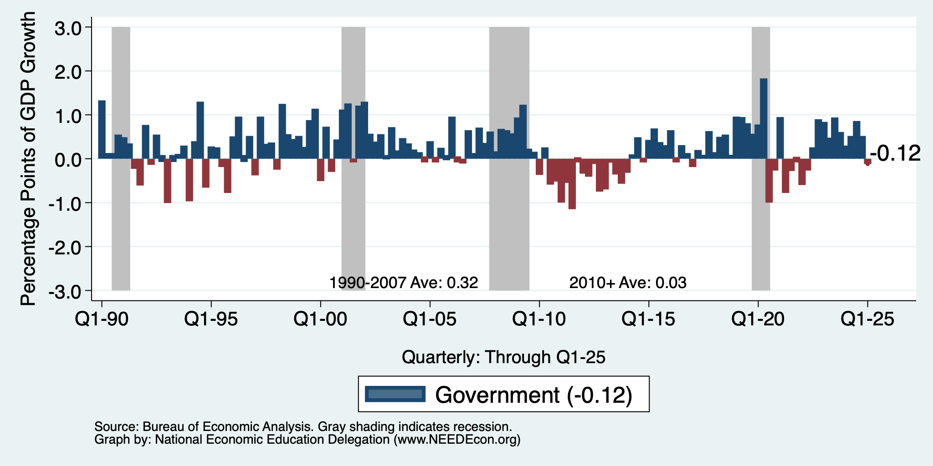
Contributions to GDP: Government
Notes:
Since 2010, average government spending growth is shrinking, resulting in a negative average contribution to GDP growth post-recession of -0.8 percentage points
Note that average quarterly government spending growth is 0.42% from 1990-2007 and -0.17% in 2010+ (annualized, 1990-2007 = 1.68%; 2010+ = -0.70%).

Slide 56

Household Debt: Non-mortgage Sources

Slide 57

Household Debt as a Share of GDP
Notes:
US household debt relative to GDP rose until the latest recession.
Households have reduced debt relative to GDP 11% since it’s peak in 2008 (at 99%).
Conclusion: Falling household debt likely contributes to slower consumption growth since the recession.
Chart: HHPERCT.png

Slide 58

Industrial Production (Manuf, Util, Mining)

Slide 59

Monthly Changes in Nonfarm Employment
Notes:
PAYEMS.png

Slide 60

Some Explanations
500 Thousand: Long COVID Exits
1-2%: Long Social Distancing

Slide 61

Treasuries
Notes:
treas_recent.png

Slide 62



Home Prices … Down Throughout CA
Notes:
Charts:
homeprices_recession.png
housing.png

Slide 63

But SUPER High to Begin With!

Slide 64


Home Prices and Housing Starts
Notes:
Charts:
homeprices_recession.png
housing.png

Slide 65


Home Sales are Not Horrible

Slide 66

Supply Chains

Slide 67

Is Immigration Saving the Day?
Source: https://www.axios.com/2024/03/13/immigration-economy-jobs-growth-good#

Slide 68
The “Nominal” Side
Inflation: A lot of progress on inflation, but the recent data are troubling.
But, this is not the popular view

Slide 69


Slide 70

Inflation in the Last 3/6 Months – Still 3%
Source: https://www.nytimes.com/2023/01/13/opinion/cpi-inflation-fed.html

Slide 71

Working From Home

Slide 72


Working From Home

Slide 73

Santa Cruz Economy: Employment

Slide 74

Monterey County Economy: Employment

Slide 75

San Benito County Economy: Employment

Slide 76

Santa Cruz Economy: GDP Growth

Slide 77

San Benito Economy: GDP Growth

Slide 78

Monterey Economy: GDP Growth

Slide 79


MBEP Population Age Distribution

Slide 80

DOF: Santa Cruz County Population

Slide 81

DOF: Monterey County Population

Slide 82

DOF: San Benito County Population

Slide 83


Monterey Bay Area Real Estate

Slide 84


Labor Market is Cooling
Job Openings - Falling
Quits – Falling (Rising?)

