Slide 1
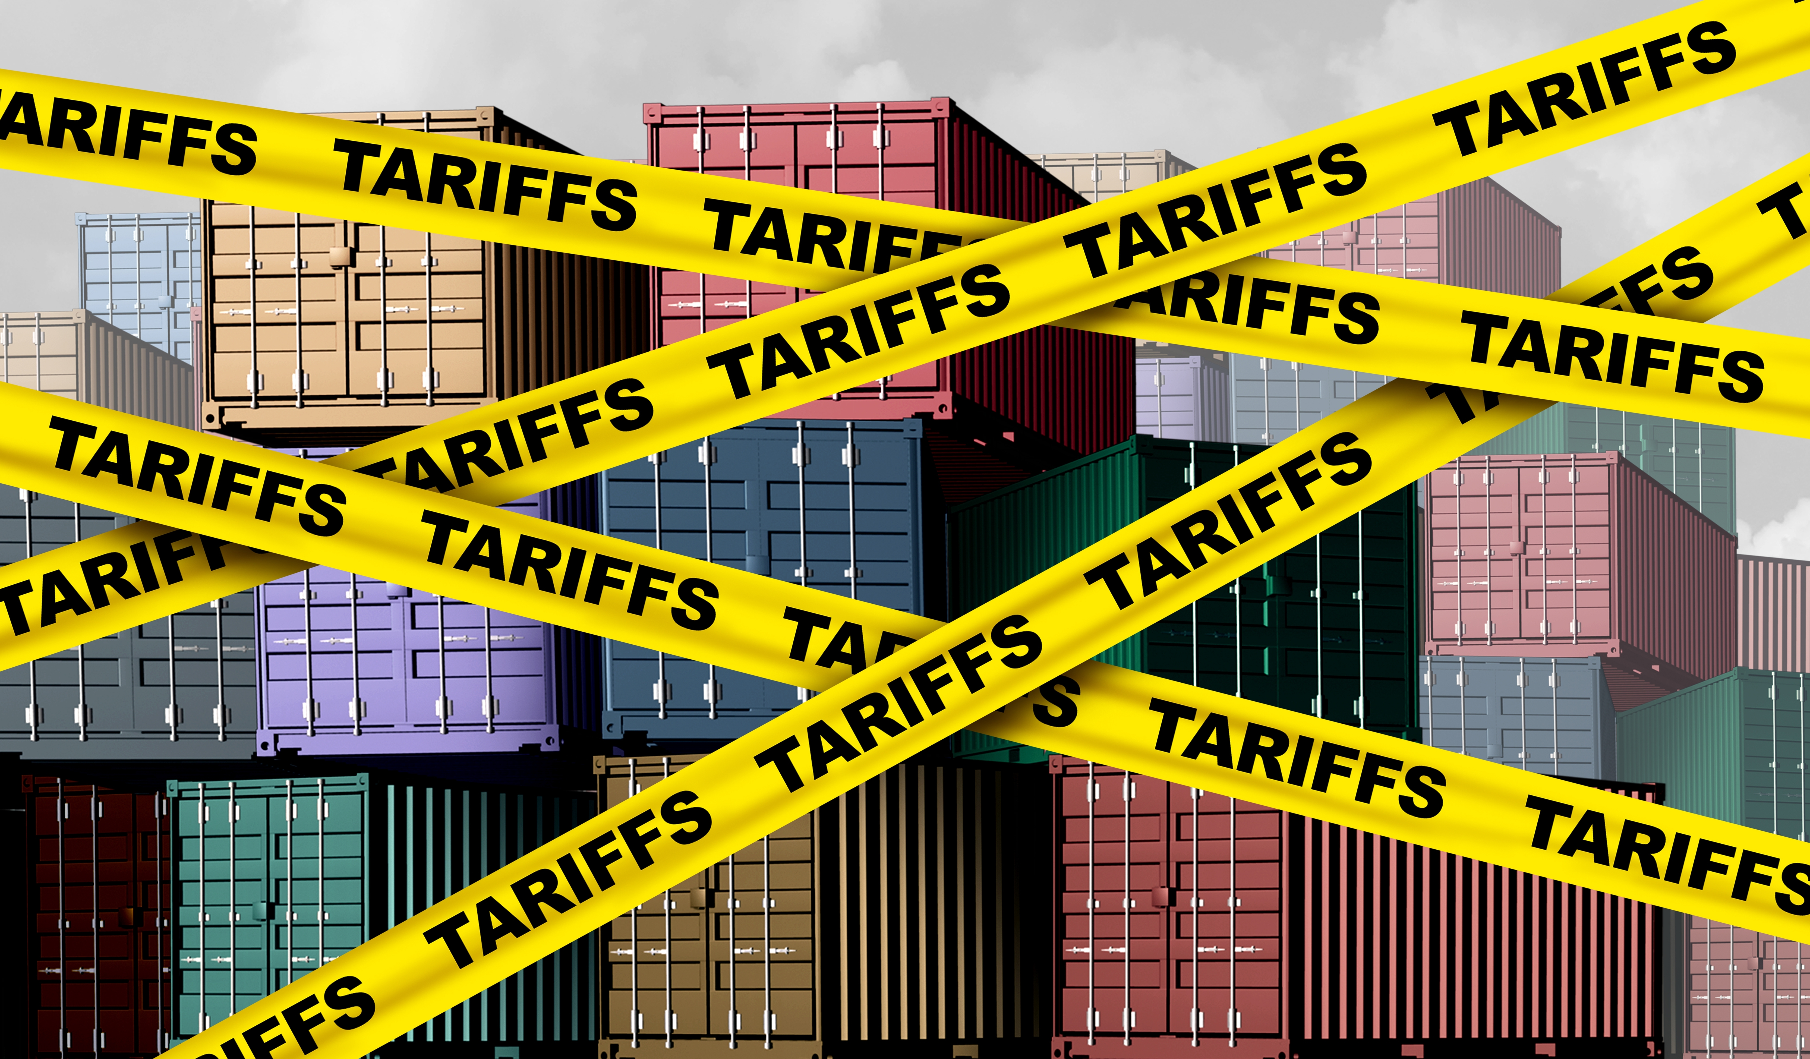

Economic Update
US & Monterey Bay Area
Regional Economic Outlook
Monterey Bay Economic Partnership
Jon Haveman, Ph.D.
NEED
May 1, 2025

Slide 2
Outline
Economic Indicators
Big Picture: Uncertainty
The Local Economy

Slide 3
Economic Indicators

Slide 4
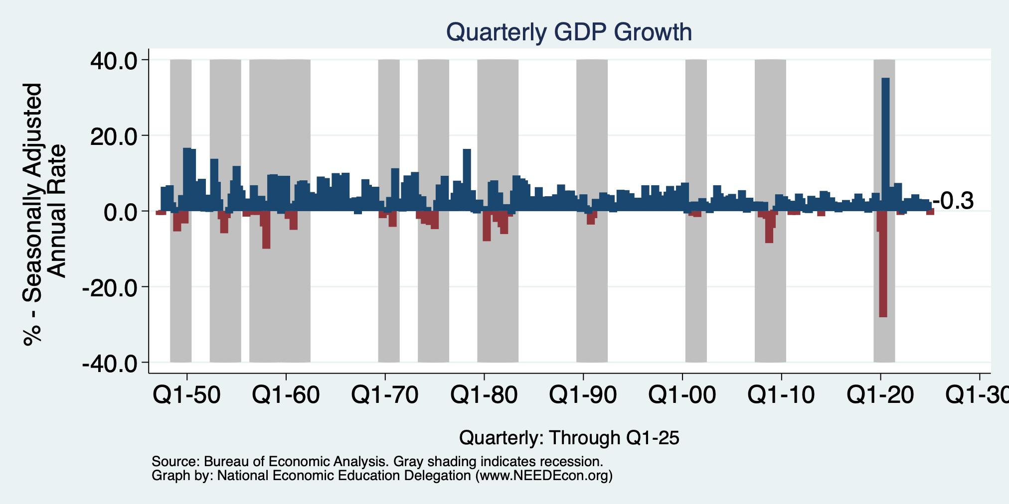
GDP: Quarterly Growth
Q2-2024: 3.0%
Q3-2024: 3.1%
Q4-2024: 2.4%
Q1-2025: -0.3%
Notes:
Graph: gdp_pot_grow.png
The Point: From 1990 – 2007, average annual US GDP growth pre-crisis is 2.94%. However, post-crisis US GDP growth is 2.19% (0.75 percentage points lower). Why is has the recovery been sluggish?
Note: At the recession’s height, the gap between quarterly GDP growth and potential growth was 2.5 percentage points.

Slide 5
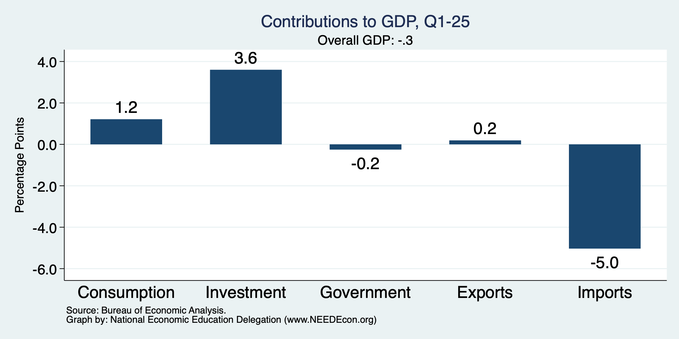
What Drove GDP to Such Growth?
Normally
2.3%

Slide 6
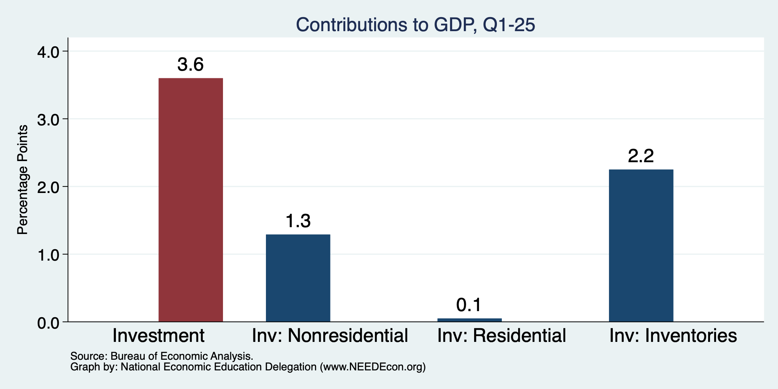
Imports Went Into Inventories
Normally
About 0%

Slide 7
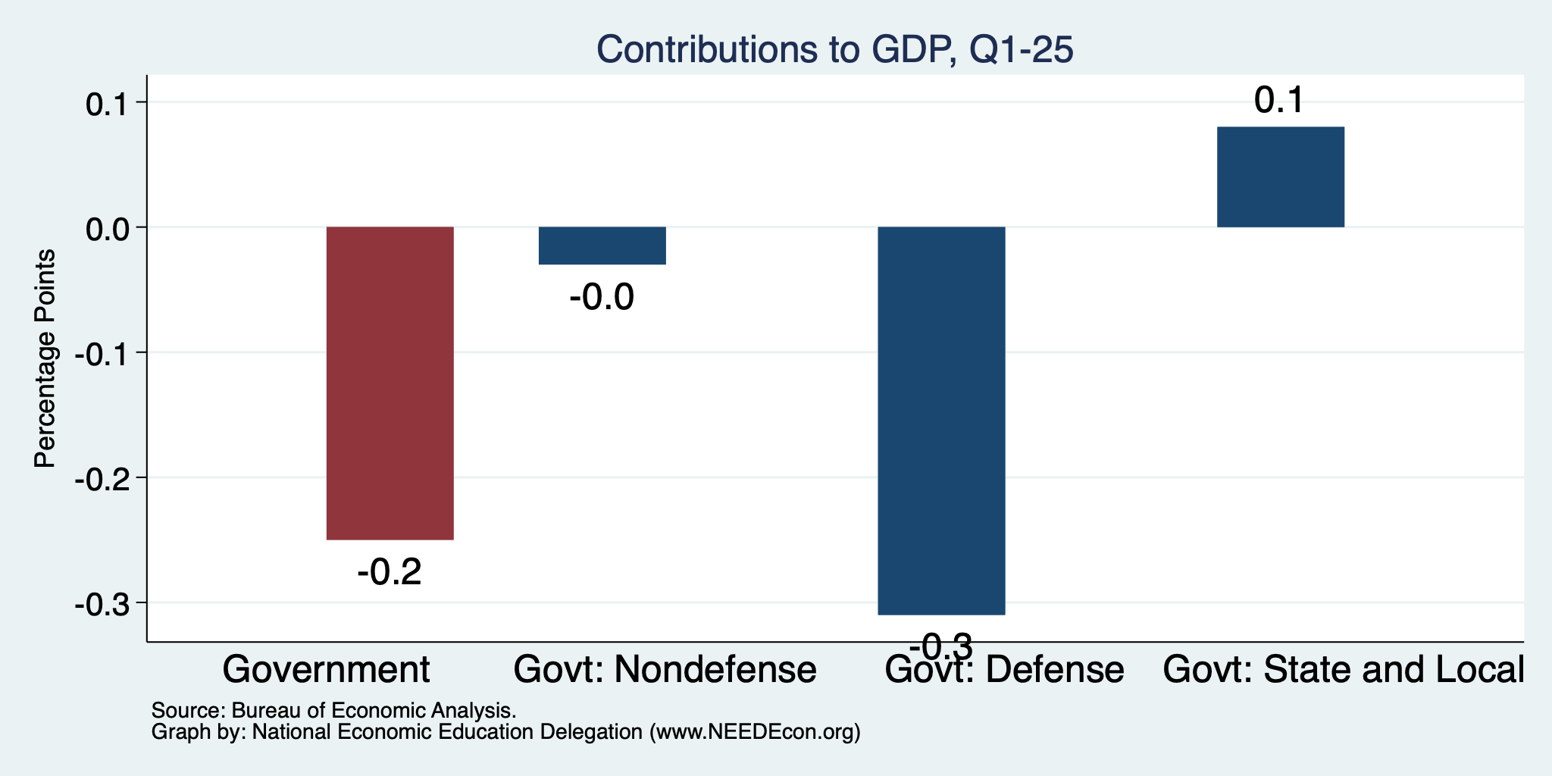
Government Spending Didn’t Help

Slide 8
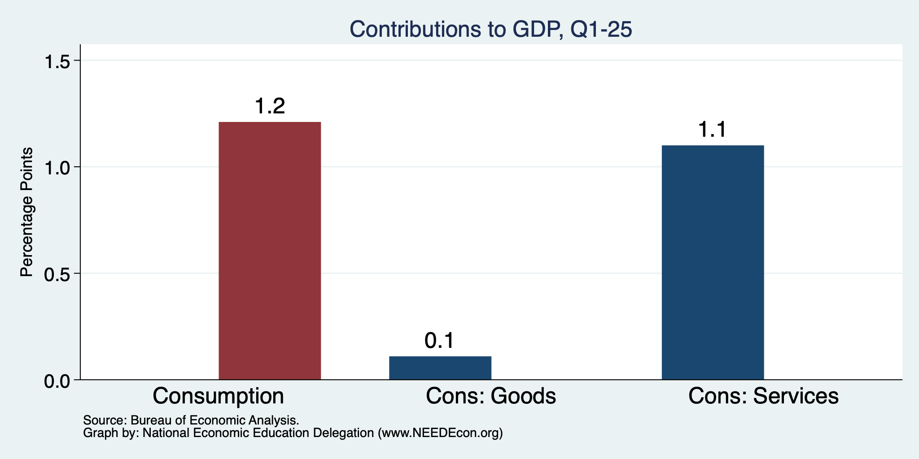
Consumers Also Tightened
Normally
0.8%

Slide 9
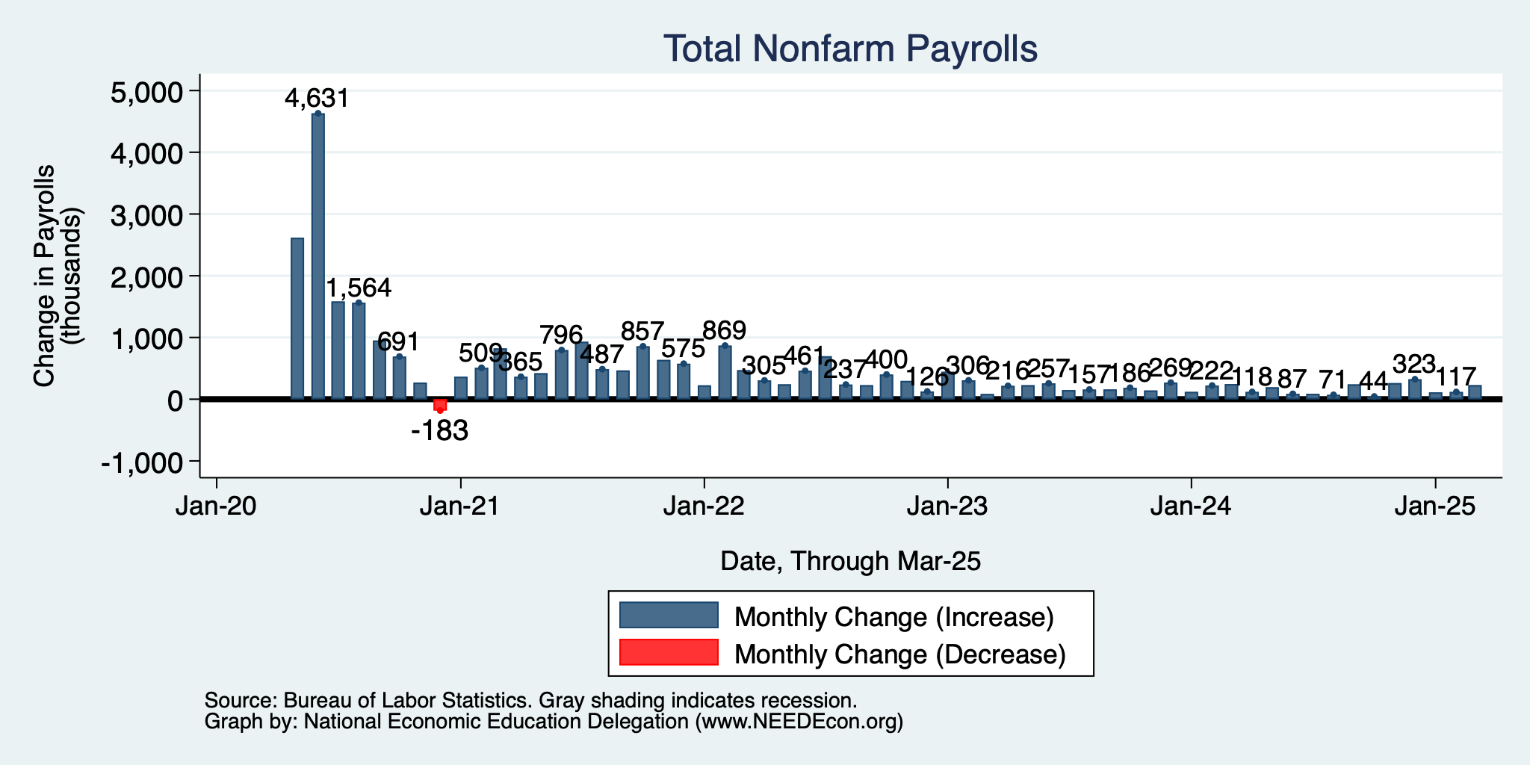
Monthly Changes in Nonfarm Employment
Jan: 111,000
Feb: 117,000
March: 228,000
April jobs report: May 2
- Will show a slowdown.
Notes:
PAYEMS.png

Slide 10
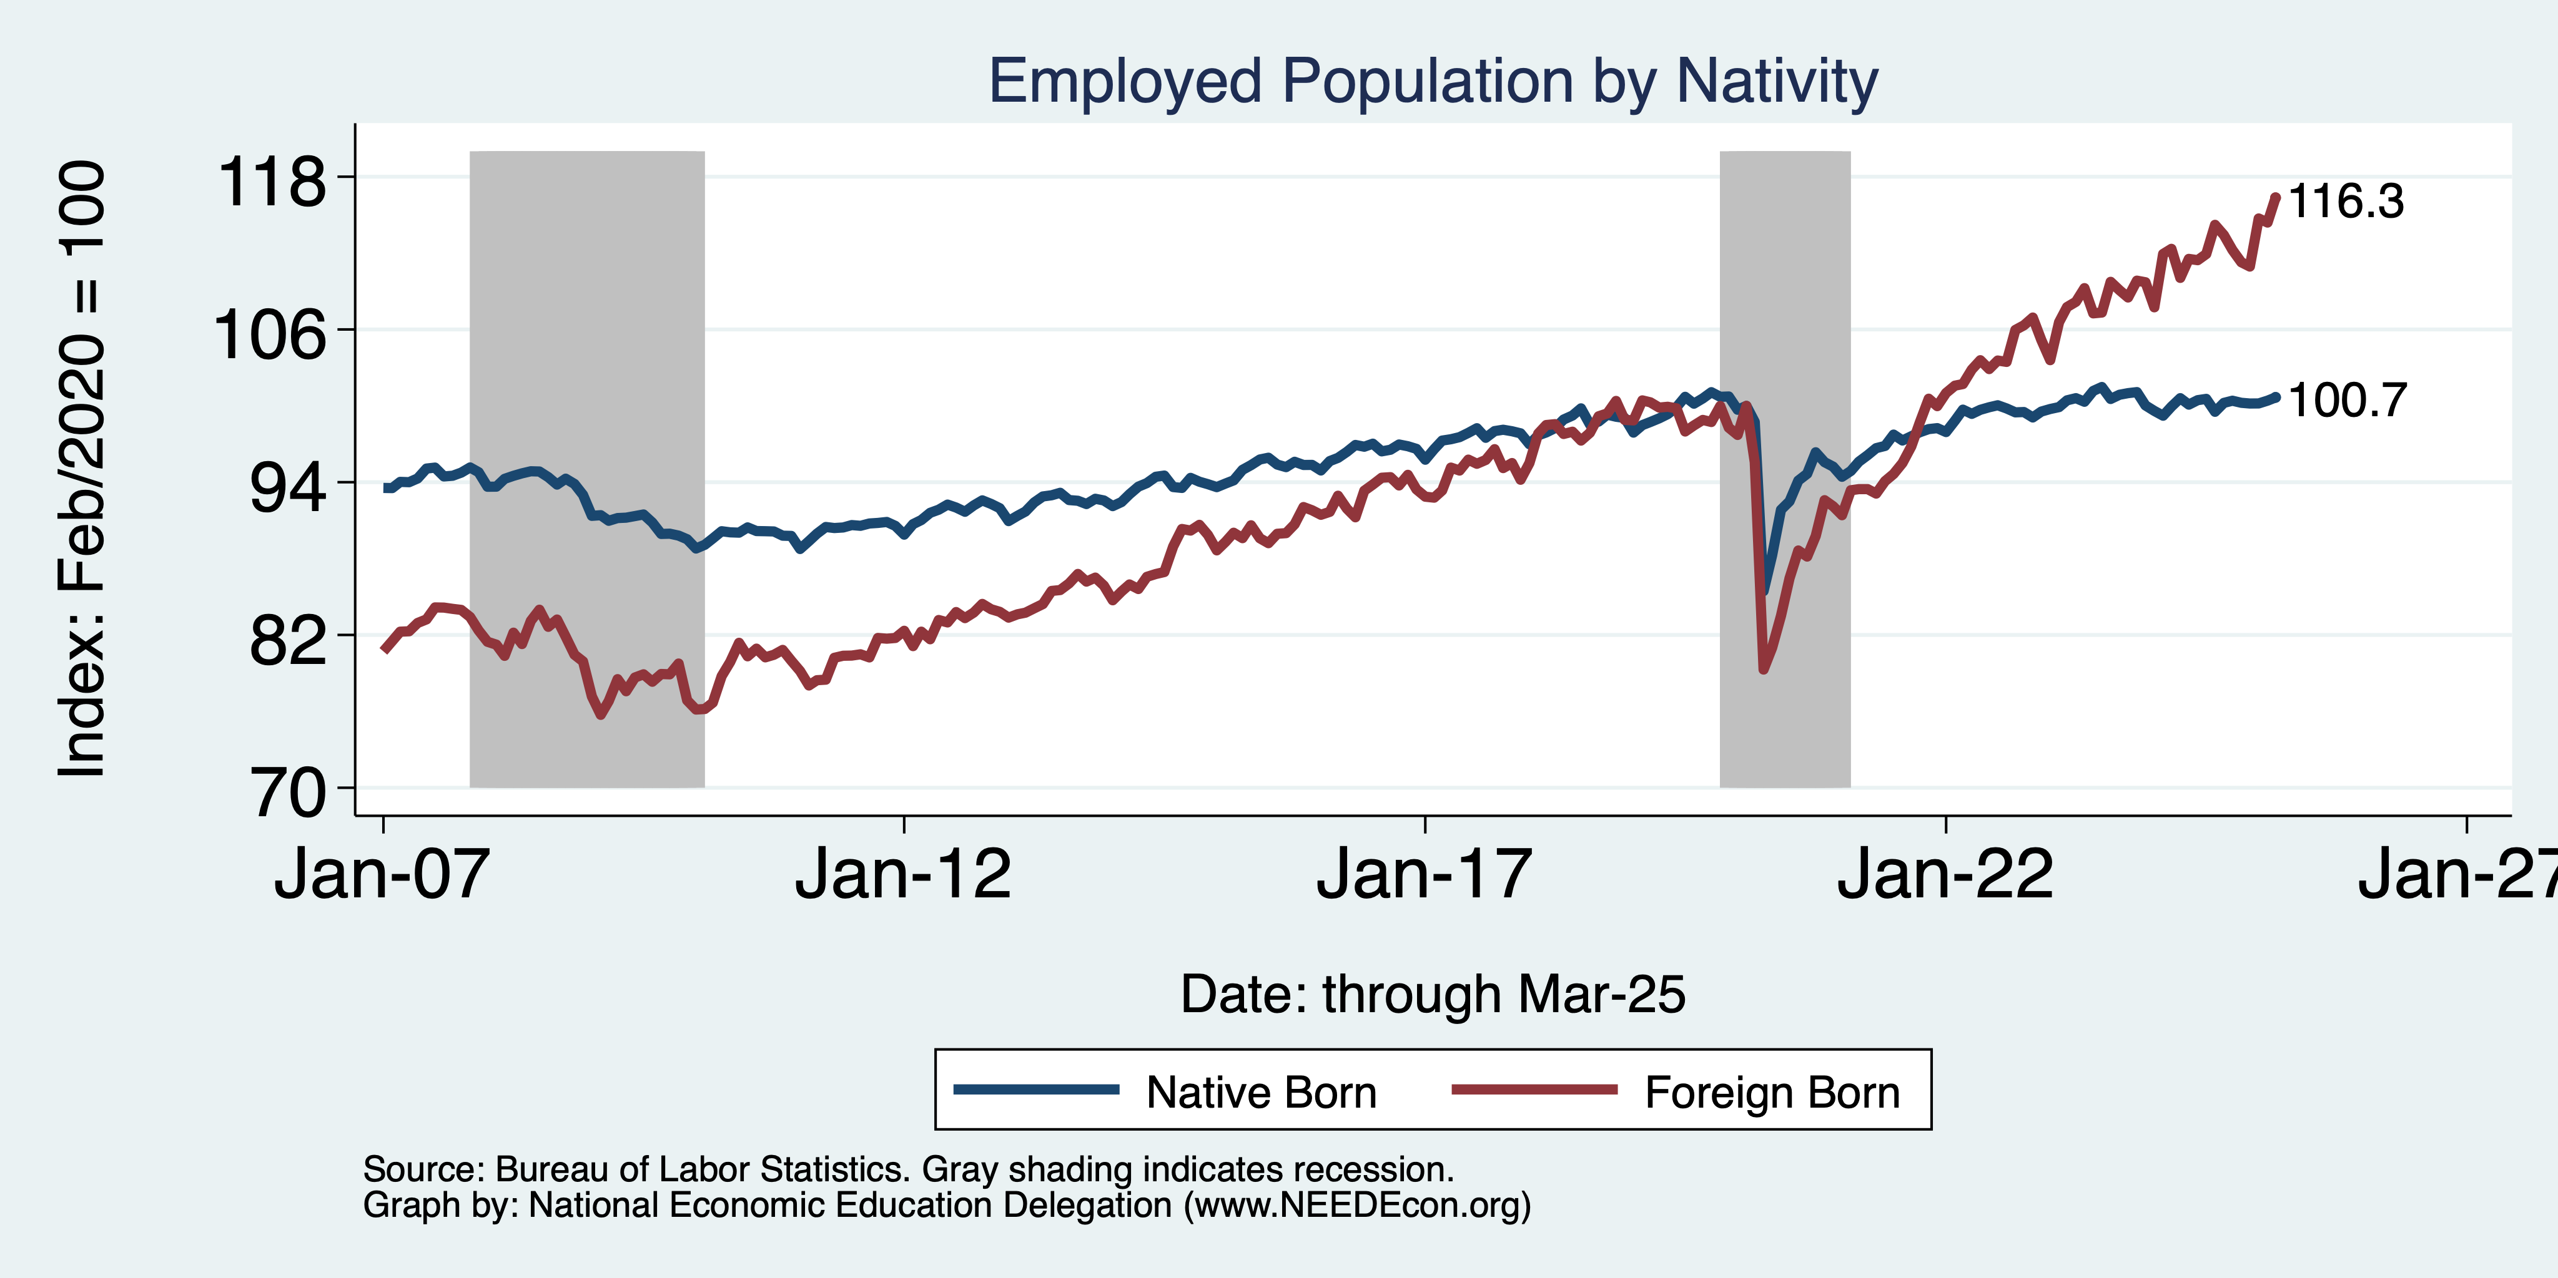
Immigrants to the Rescue?

Slide 11
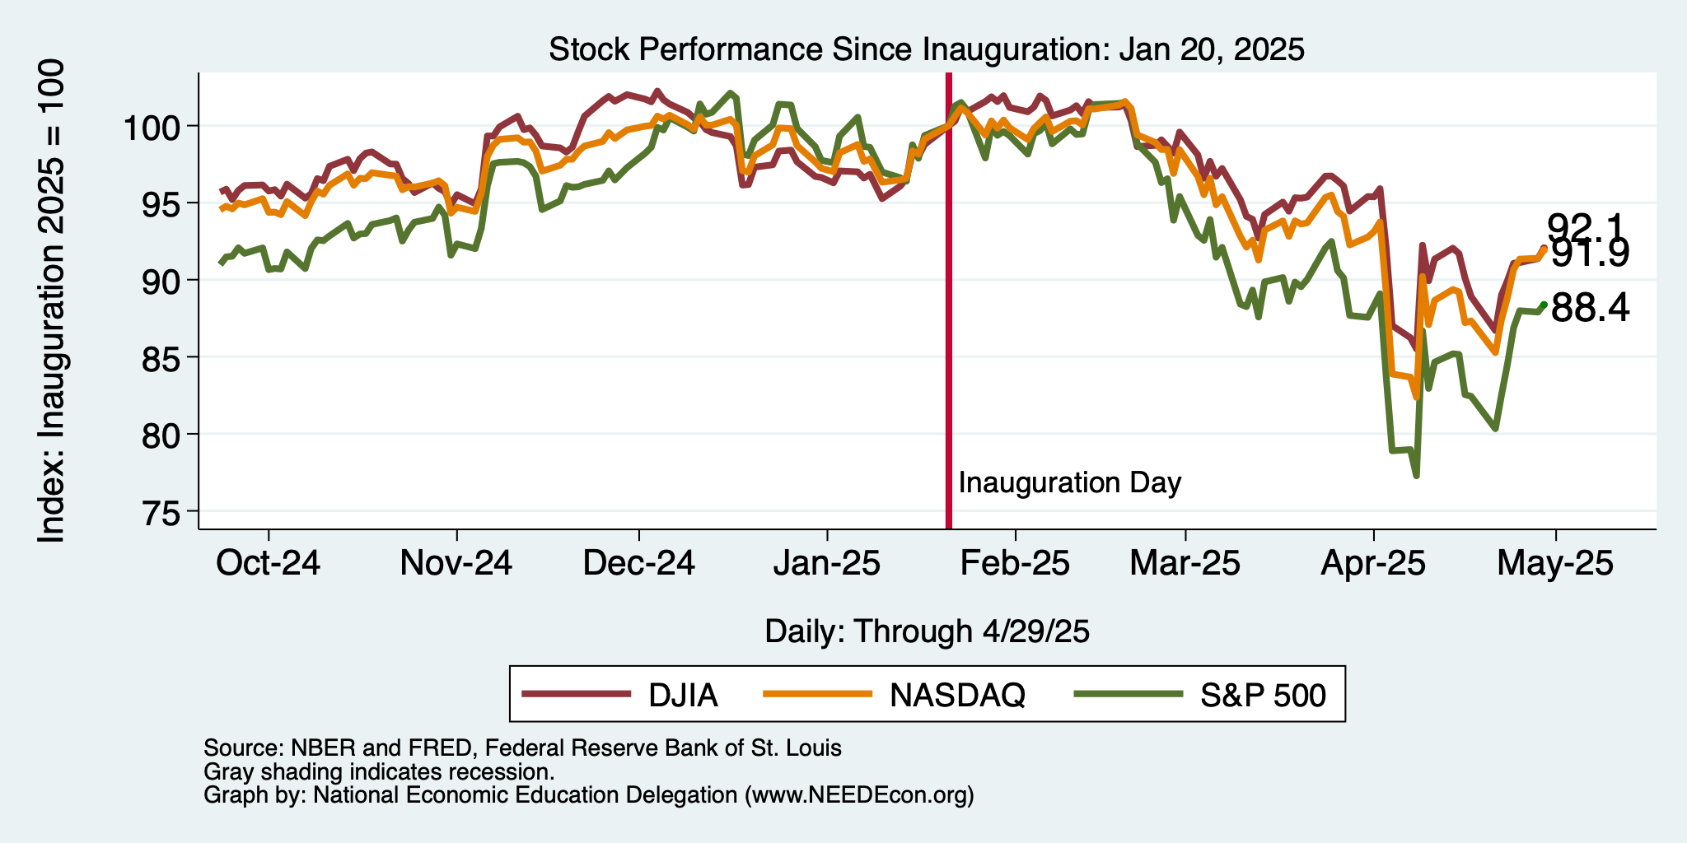
And Stocks?

Slide 12
Inflation

Slide 13
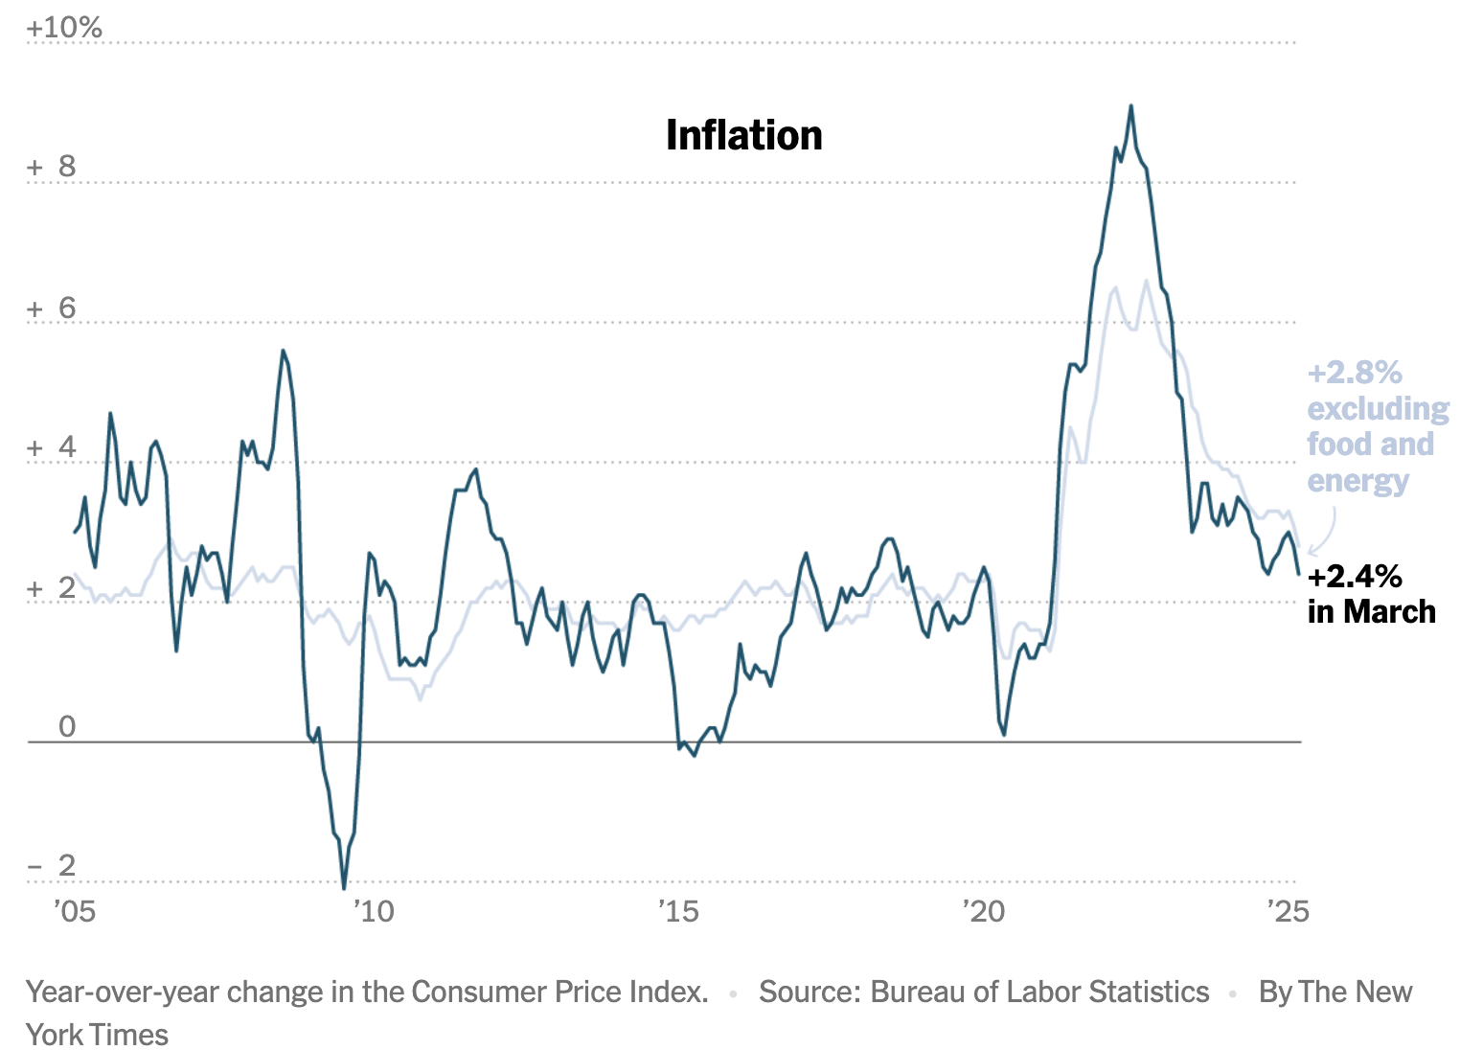
Inflation: Latest Figures
Source: NYTimes.com

Slide 14
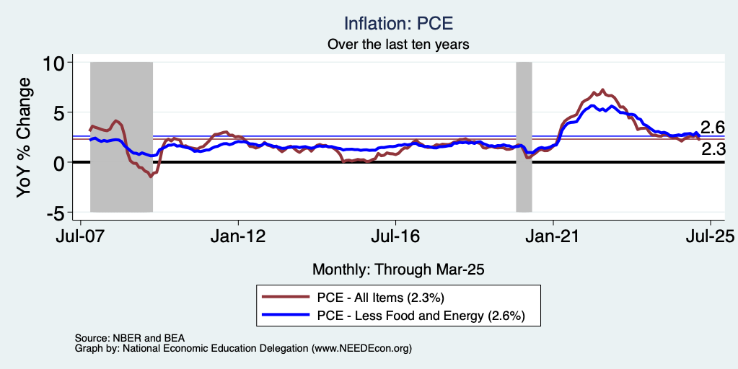
Fed’s Preferred Measure: PCE

Slide 15
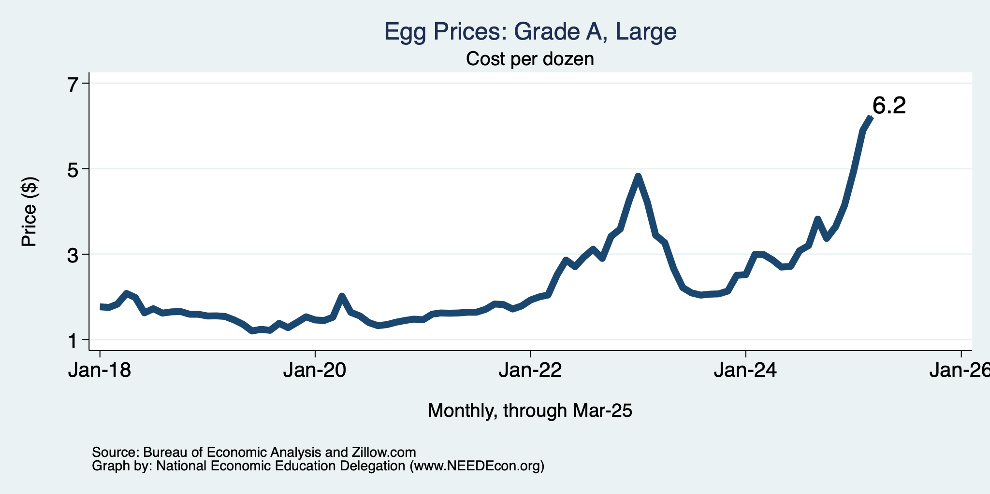
Price of Eggs?

Slide 16
The Fed: Conservative

Slide 17
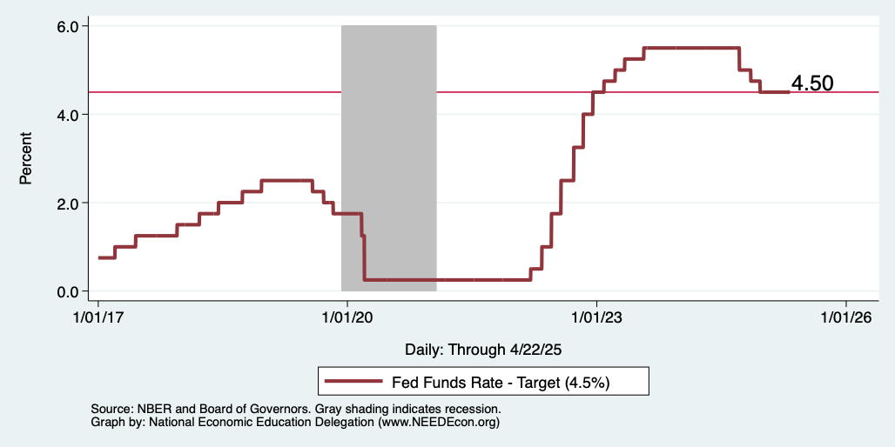
Federal Funds Rate
Notes:
The fed funds rate is the interest rate on overnight loans between banks. Think of it as the baseline interest rate on which banks base all other interest rates (e.g. mortgage rates)
FOMC lowers the fed funds rate during recessions and raises the fed funds rate during expansions
Fed funds rate peaked in the 1980s as then Chairman Paul Volcker sought to reign in “run away” inflation of the 1970s; doing so resulted in a recession in the early 1980s.
Since the 2008-09 recession, the fed funds rate has been kept near zero.
During the 2008-09 recession, Federal Reserve turned to unconventional tools to influence longer term interest rates to further stimulate the economy - QE
FedFunds.png

Slide 18
What will the Fed Do?
Likely sit tight at 4.5 for a while.
Next FOMC meeting is May 6-7.
Notes:
GDPNow 2.4%; blue chips consensus 1.5% implies 2.9%, or 2.7%

Slide 19
Takeaways
Is a recession on the horizon?
  Maybe.
  Many indicators are in the black.
    2024 2nd half GDP growth was pretty good – 2.8% YoY.
    2025 Q1 < 0 is almost meaningless.
The problem?
  Uncertainties abound!

Slide 20
Uncertainties
Federal Government Policies
  How far will they go with immigration?
  How many federal employees will be laid off?
  How high will tariffs remain?
  Will Fed Chair Powell be replaced prematurely?

Slide 21
Bigger Picture

Slide 22
Since Inauguration: Policies = Anti-Growth
Deportations
Tariffs
Cuts to spending and employment
Threats to Fed Chair Powell

Slide 23
Immigration

Slide 24
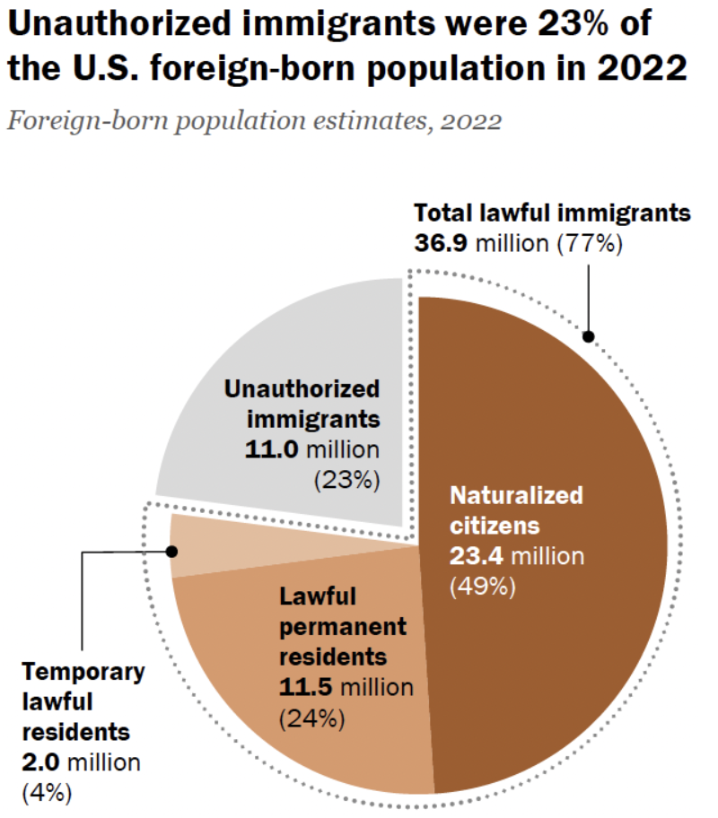
In 2019, 83,000 unauthorized
Immigrants in MBEP region.
- Maybe 15% of labor force.
Total Foreign-Born
Population: 47.9 million
Source: Pew Research Center, What we know about unauthorized immigrants living in the U.S., July 22, 2024

Slide 25
Why Do We Care? Economic Implications
Conventional Wisdom Issues:
  Labor markets: Wages and Jobs
  Government Revenue and Spending
  Crime
Other issues (that don’t get talked about much):
  Gross Domestic Product (GDP)
  Innovation and Entrepreneurship

Slide 26
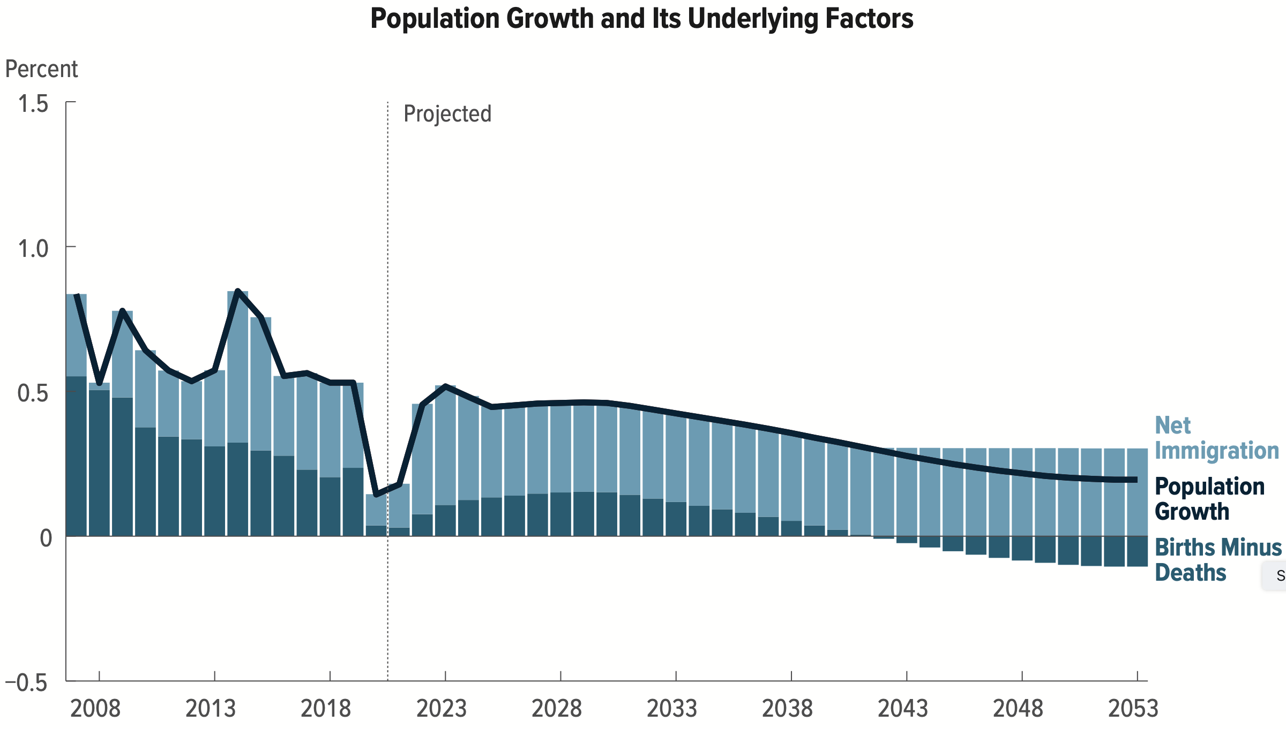
Is Immigration Saving the Day?
Source: CBO – The Demographic Outlook, 2023-2053

Slide 27
Jobs: Conventional Wisdom…Upended
What is the conventional wisdom?
  Low-skilled immigrants come in and take jobs from low-skilled native-born individuals.
    1-1 tradeoff.
What does new research show?
  Low-skilled immigrants contribute positively to the economy.
    Every 100 low-skilled immigrants: create 9 jobs for low-skilled native-born.
    They create opportunities for low-skilled native-born workers.
  Low-skilled immigrants take jobs that native-born don’t want.

Slide 28
Mass Deportations
Immigrants work different jobs than do native-born workers.
Immigrants contribute to the local economy.
  GDP losses of up to $1.7 trillion annually.
Immigrants keep prices low: in particular, food!
Deportations impact tax revenues.
  $1,300 more in on average than out, annually.
  Unauthorized immigrants: $22.6 billion in social security and $5.7 billion in Medicare payments.
Deportations are expensive ($13,000 each).
  Total cost $315 billion.
They rob people of their dignity.

Slide 29
Tariffs

Slide 30
Why Are We Imposing Tariffs?
Raise government revenues.
  Laffer curve effect – high tariffs = low revenues.
Unfair treatment of our exports.
  There is some merit in this, especially wrt China.
Close the trade deficit.
  There is no merit in this. Tariffs don’t do this.
Bring manufacturing back to the U.S.
  Actually seems improbable.

Slide 31
What Is a Tariff?
A tariff is a tax on imports.
Much like, say, the 8% sales tax in California.
  Whatever price the seller charges, the buyer pays an extra 8% that goes to the government.
  But it also means that domestic sellers can simply raise their prices by 8%.
    A cost to consumers, with no government revenue benefit.
A 10% tariff on all imports (such as Trump has imposed) would mean that:
  Whatever the foreign exporter charges for a product,
  US buyers will pay an extra 10% to the US government.
Might the seller charge a lower price because of the tariff?
  Perhaps, but when Trump used tariffs in 2018 on steel and China, they did NOT.

Slide 32
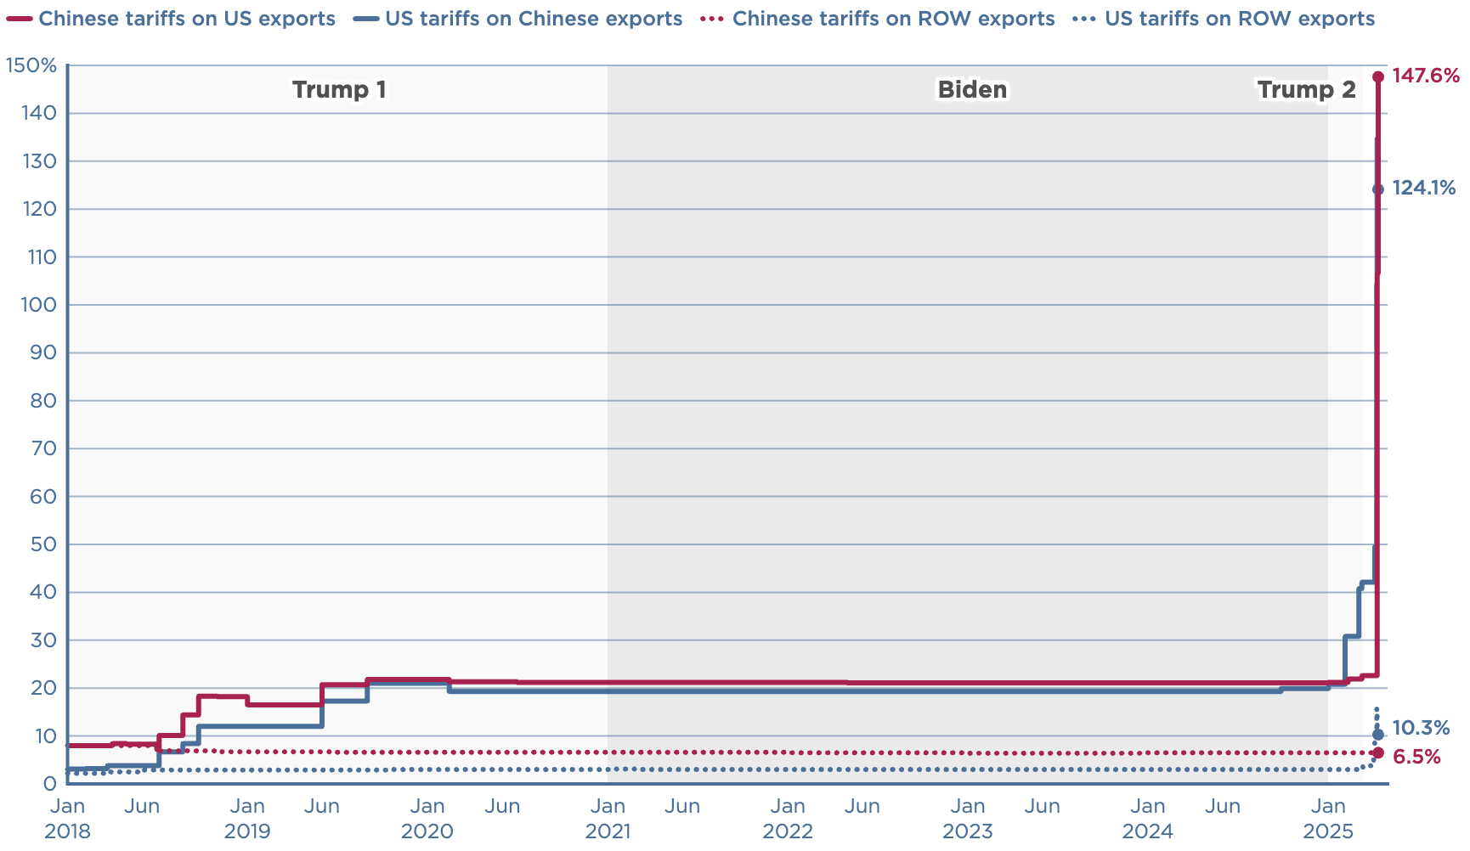
Where Are Tariffs Today?

Slide 33
Economic Effects of A Tariff
Economists’ cost-benefit analysis quantifies these and shows that the costs exceed the benefits.
A tariff on one good can harm other industries.
A tariff on one country just causes displacement to another country.
Tariffs are NOT an effective tool to reduce the trade deficit.
Tariffs are NOT a good way to raise government revenue.
Retaliation from other countries makes tariffs even worse.
Corruption: tariffs can be selectively reduced.

Slide 34
Likely Economic Effects
Reduced imports
Higher prices for imports
  And domestically produced goods.
Reduced exports
Unchanged trade balance
Less investment in the United States
LESS manufacturing activity
Lower incomes throughout the economy.

Slide 35
Summary
Inflation: close to Fed’s 2% target, but a little stubborn.
  This is likely to change.
Current immigration and trade policies will exacerbate inflation.
Immigration: deportations tax the economy and are expensive.
  Many, many ag workers are unauthorized immigrants.
Tariffs: are a tax.
  Taxes raise prices. Period. Full Stop.
  Taxes often cost jobs. Tariffs likely will.

Slide 36
Biggest Problem: Uncertainty
Nobody knows how to plan into uncertainty.
  Business investment is particularly at risk.
Hardly anybody increases spending into uncertainty.
Other countries will look elsewhere if the U.S. is volatile.
  Tourists already are. 10.3% drop in March/25.
Outlook: is not good.
  Inflation is inevitable.
  Job losses are inevitable.

Slide 37
Are We Headed for A Recession?
Uncertain.
Our current path has many forecasters indicating that a recession is more likely than not.
  IMF has cut it’s U.S. growth forecast to 1.7%, down from 2.8% in 2024.
We may well already be in a recession (but probably not).
A slowdown in economic growth is inevitable.
A bout of stagflation is possible.

Slide 38
Locally

Slide 39
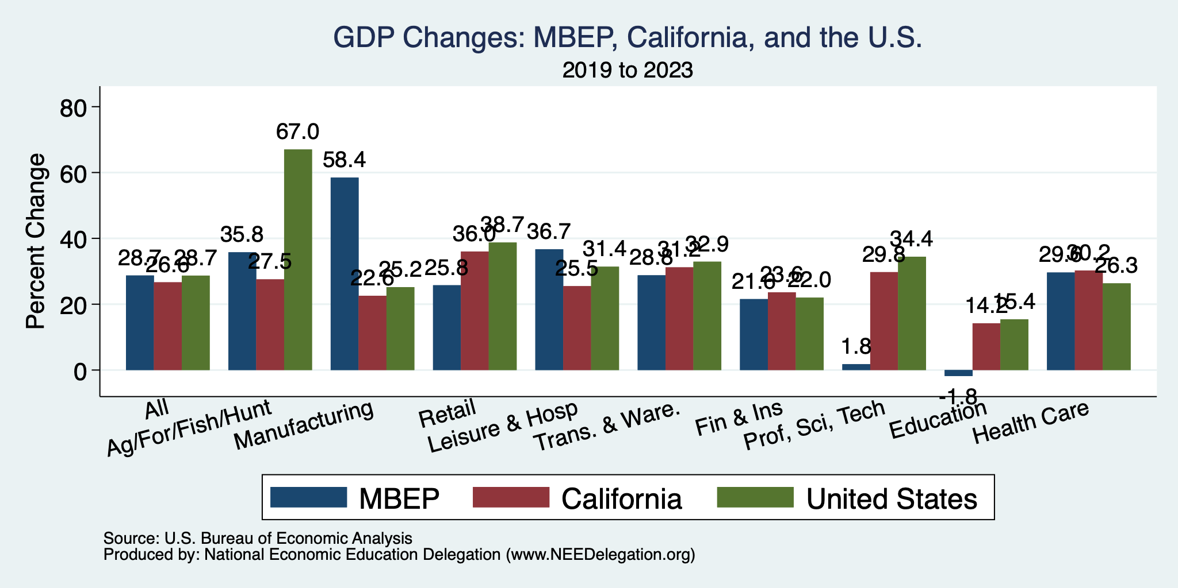
MBEP Economy: GDP Growth

Slide 40
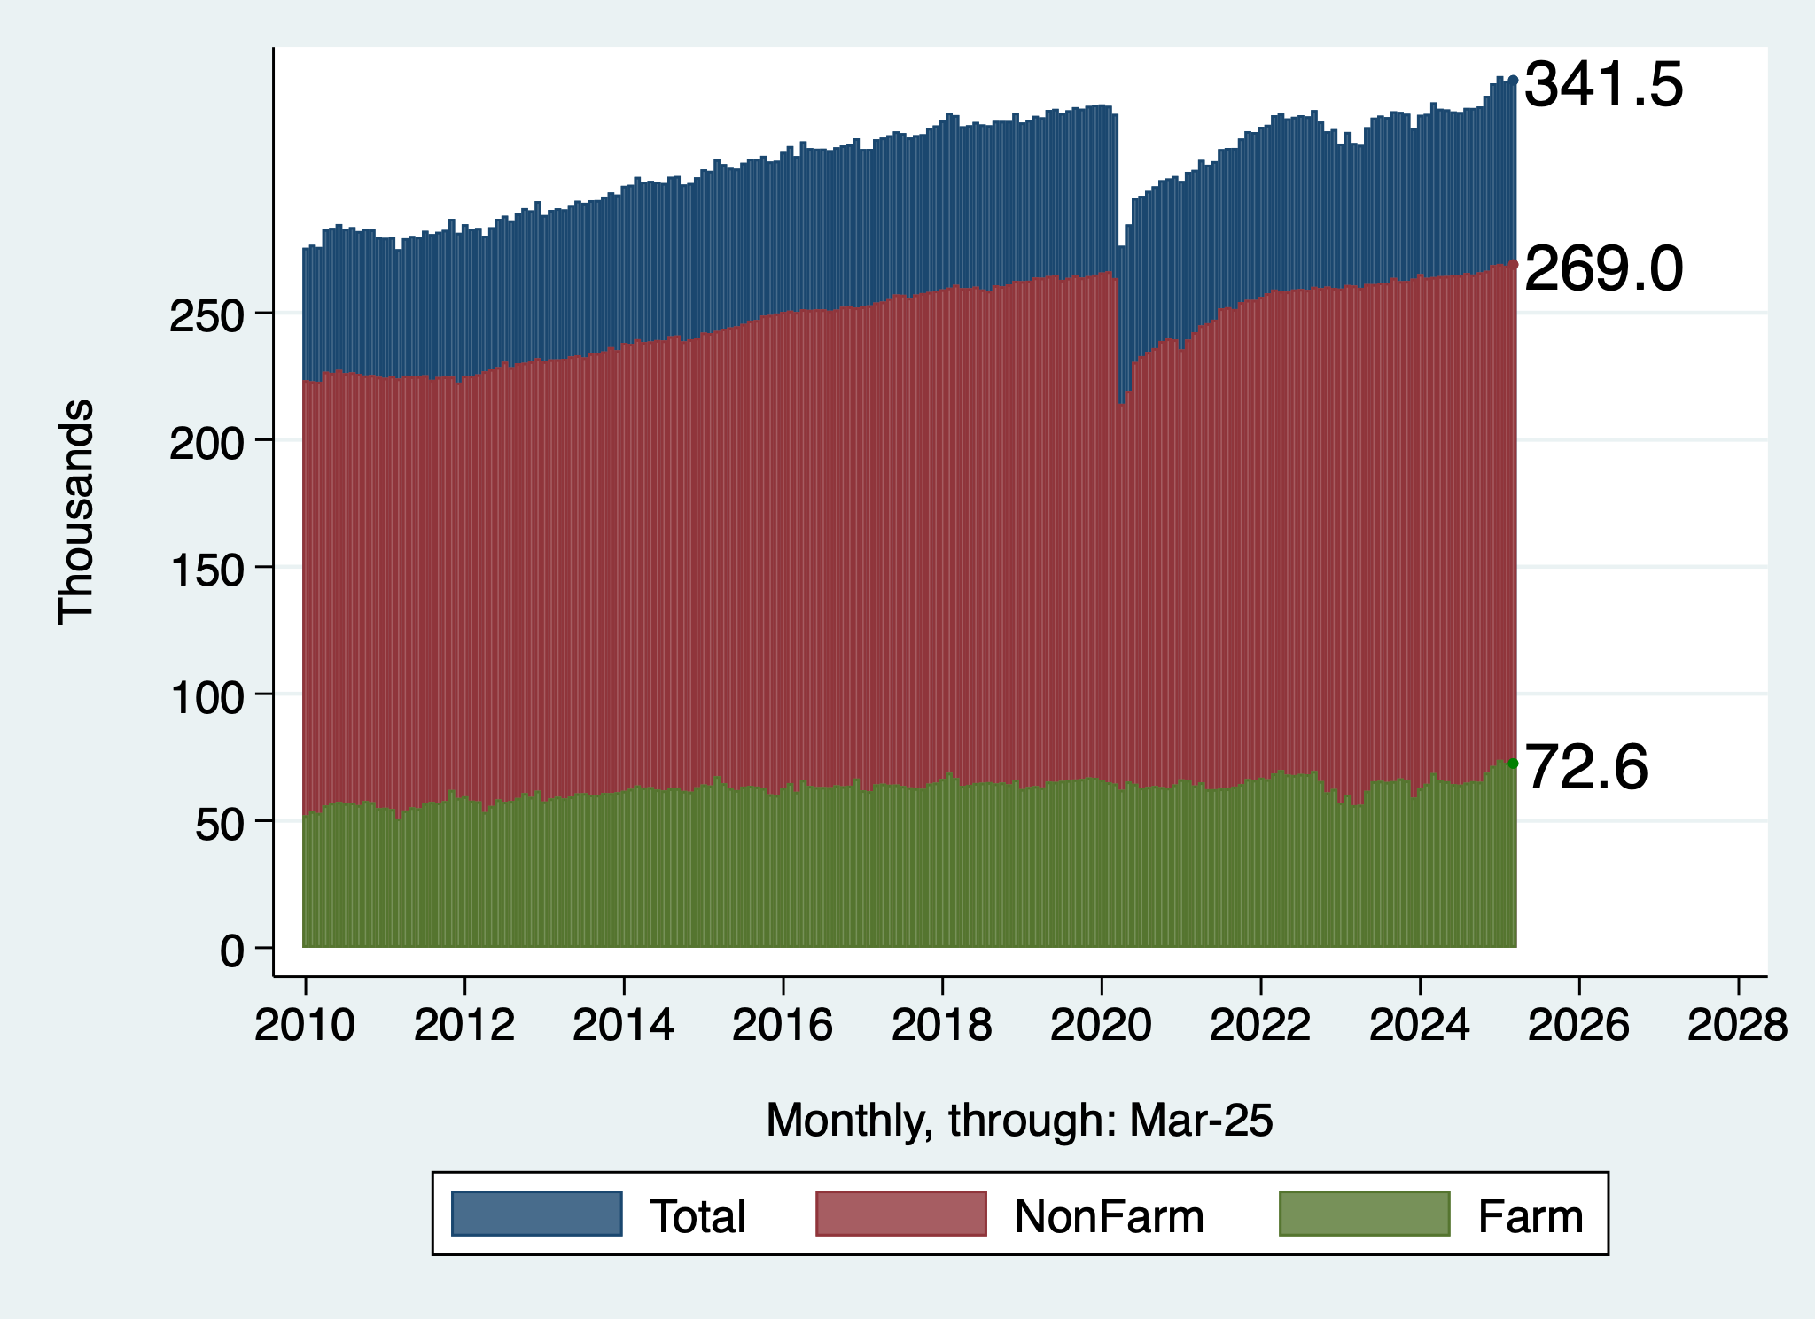
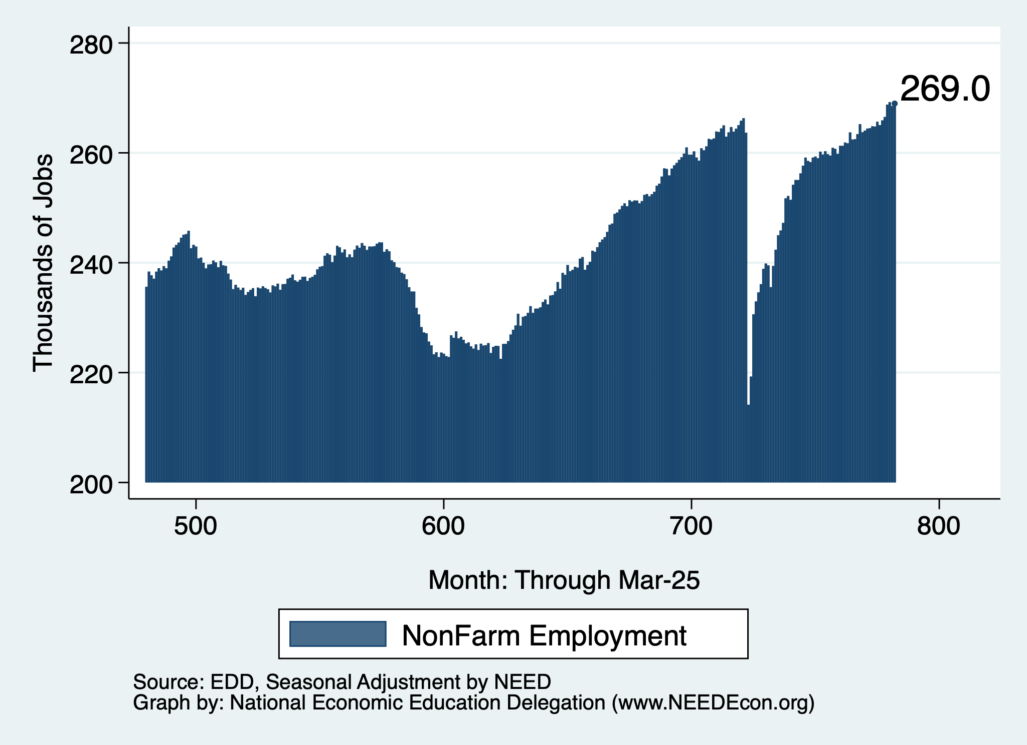
Employment Recovery
Total Employment
NonFarm Employment

Slide 41
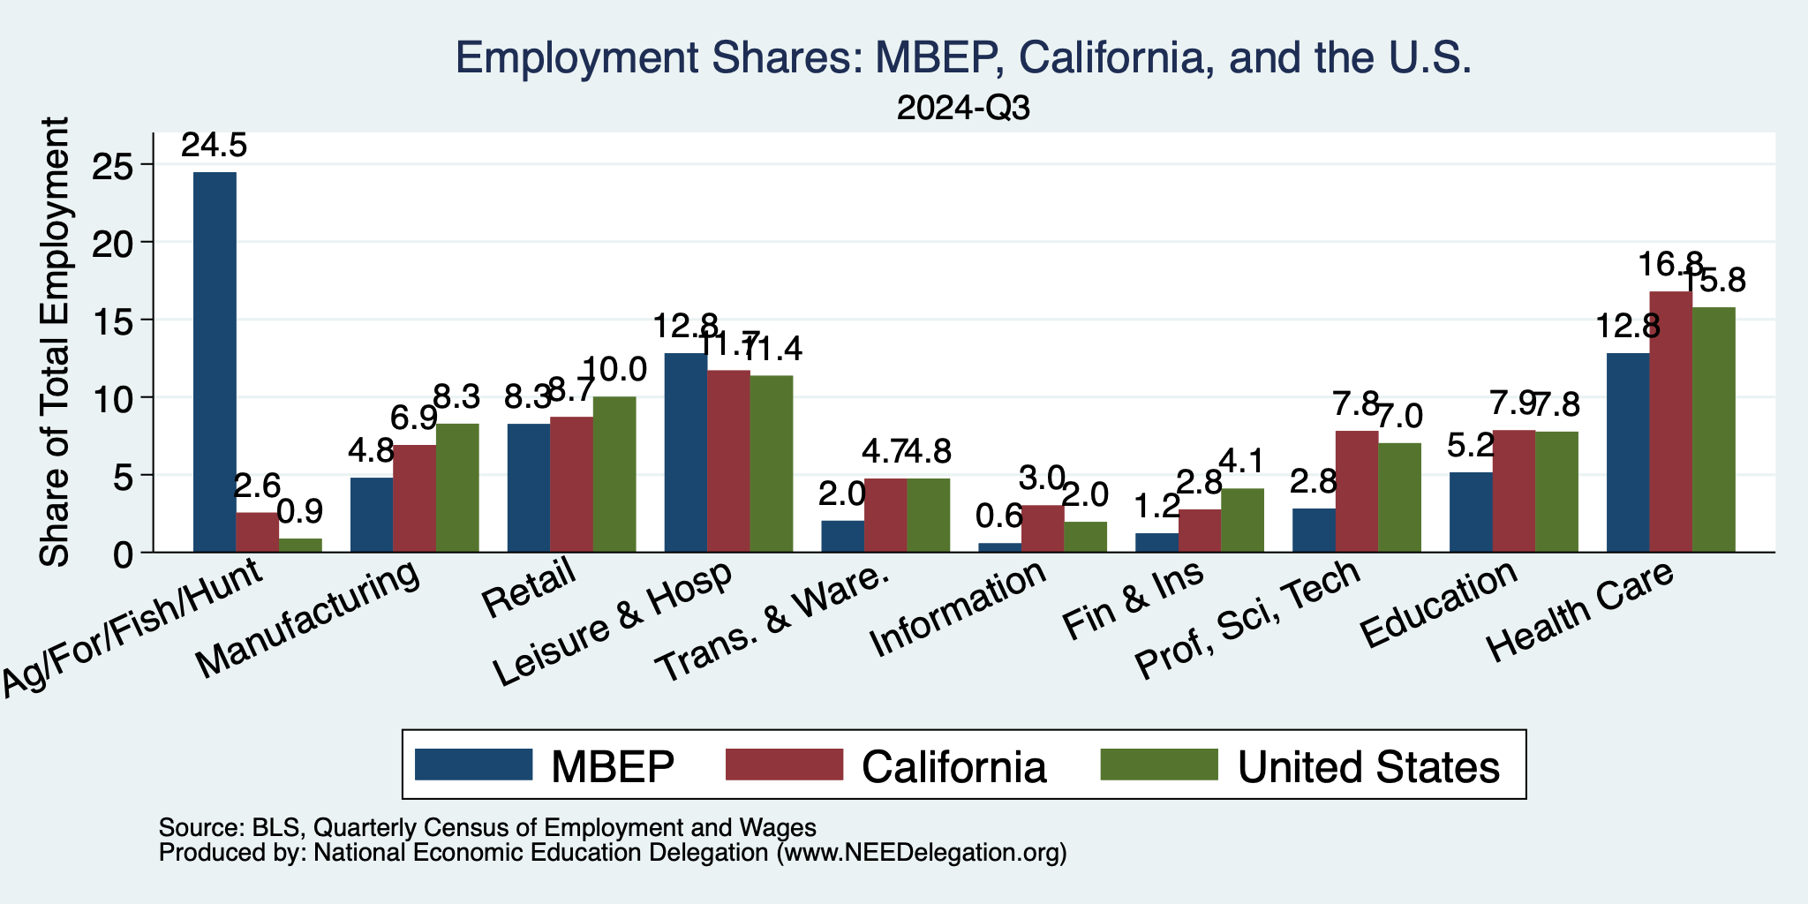
MBEP Economy: Employment Patterns

Slide 42
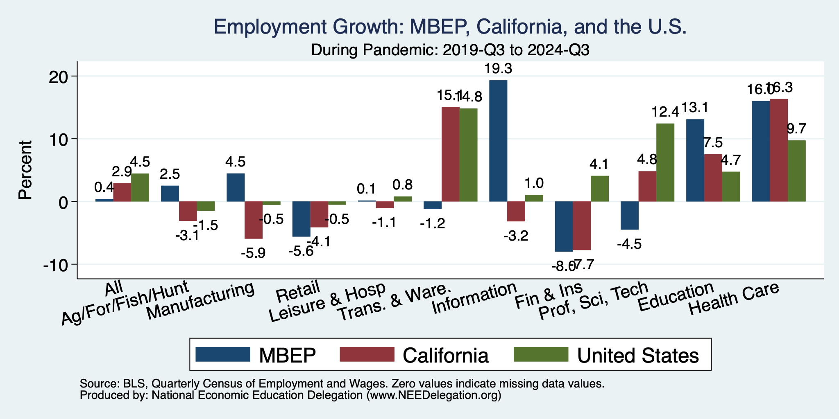
The Pandemic Effect: Employment

Slide 43
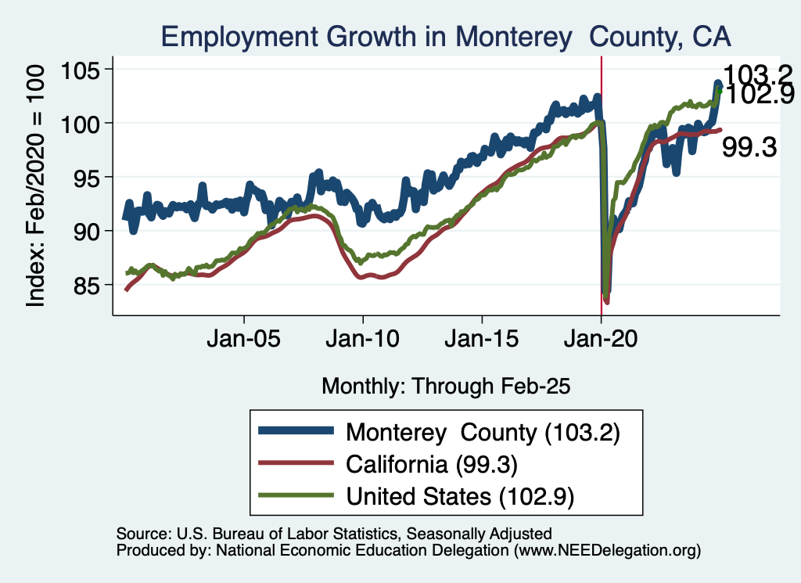
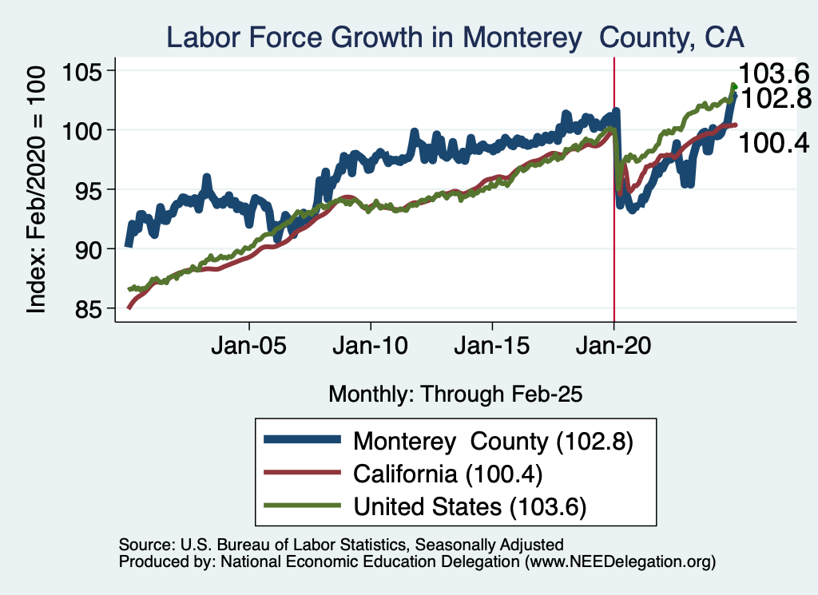
Employment in Monterey County?

Slide 44
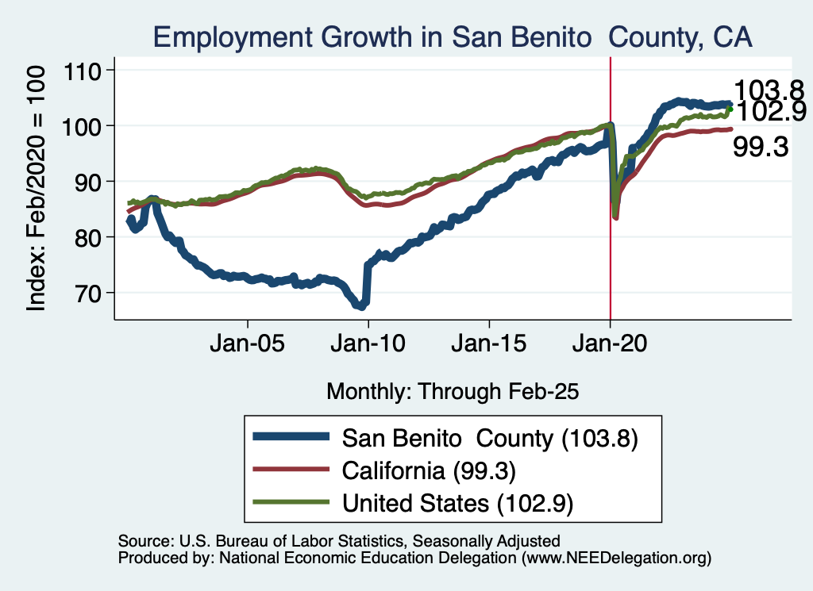
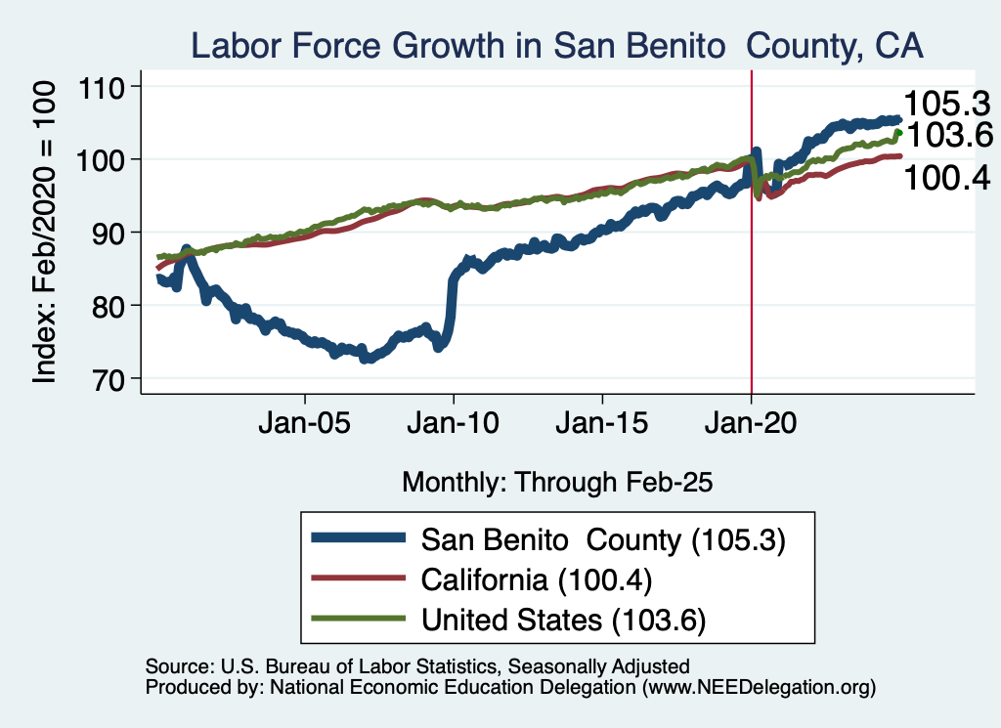
Employment in San Benito County?

Slide 45
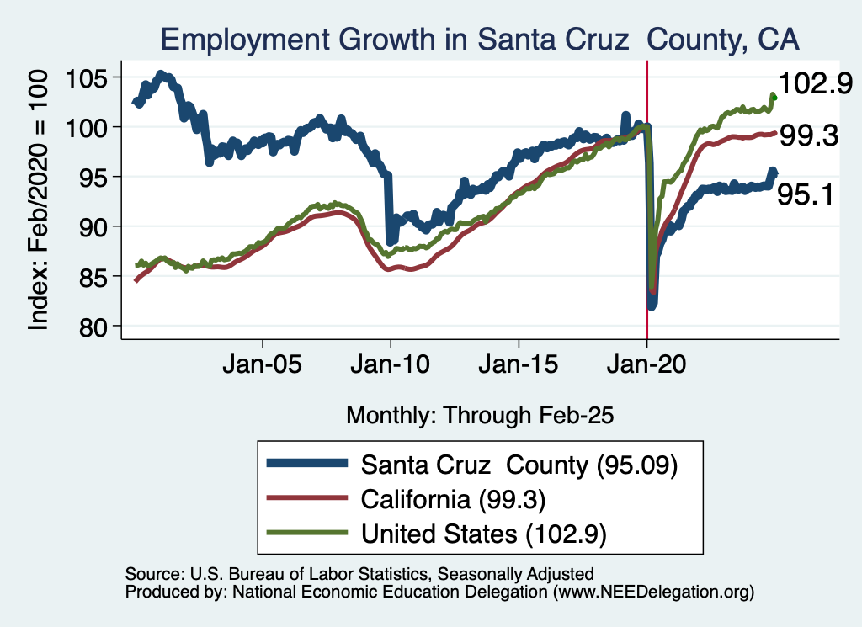
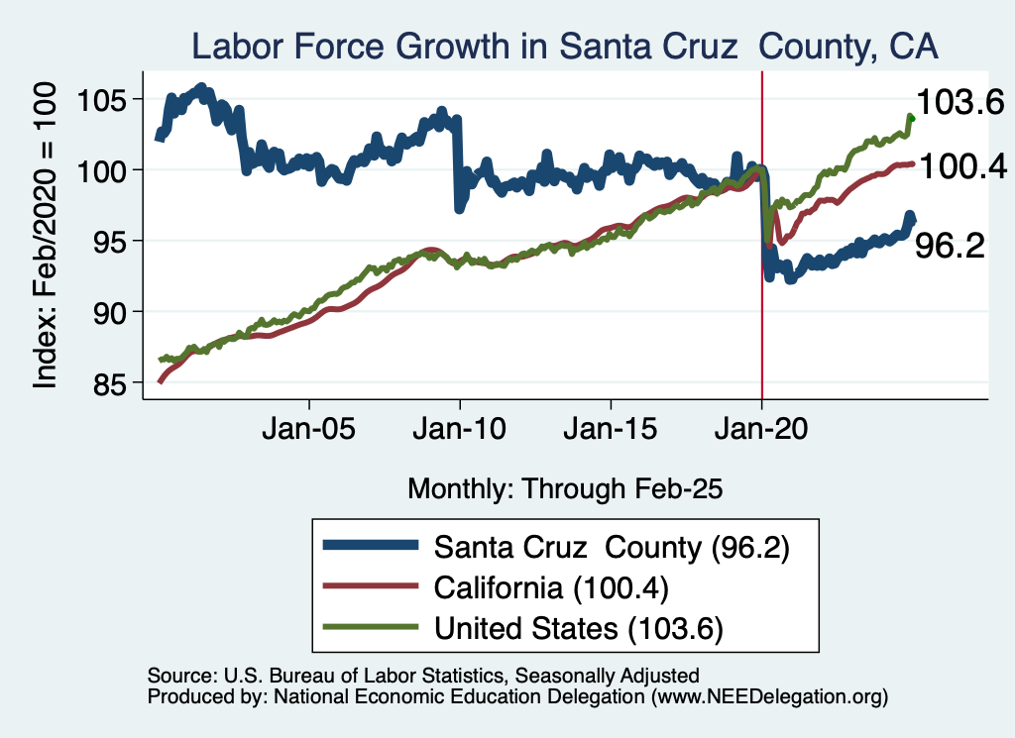
Employment in Santa Cruz County?

Slide 46
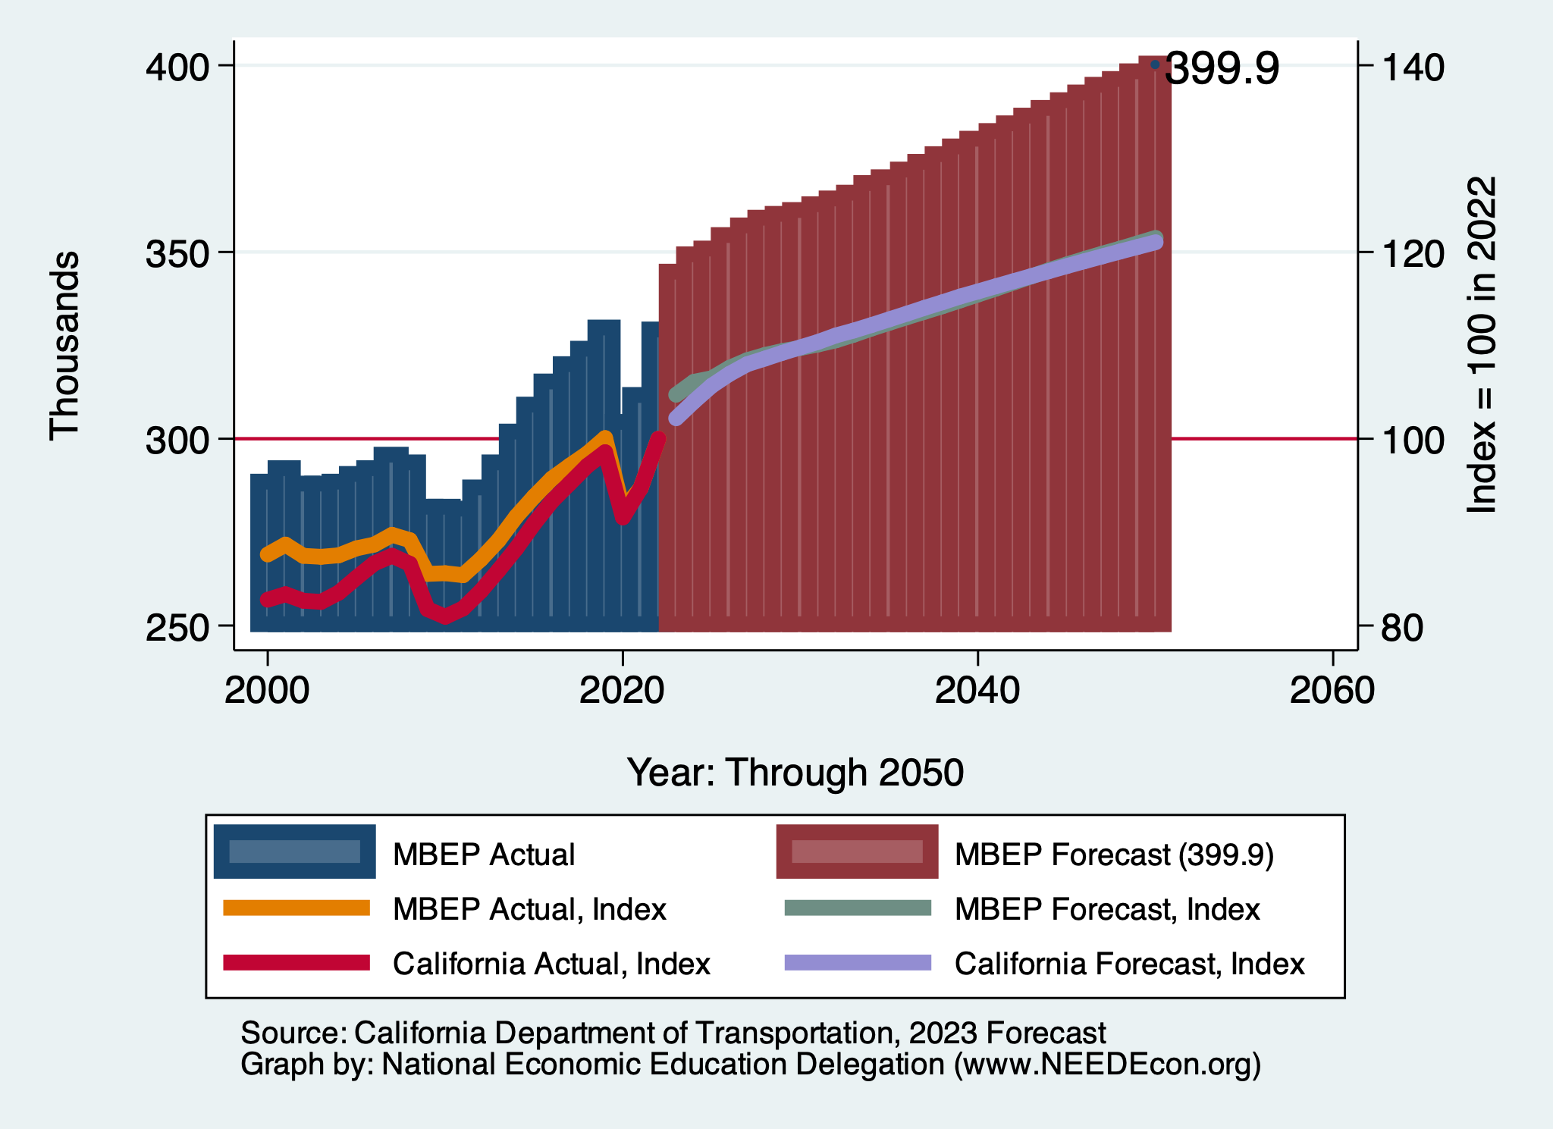
DOT Forecast: Employment

Slide 47
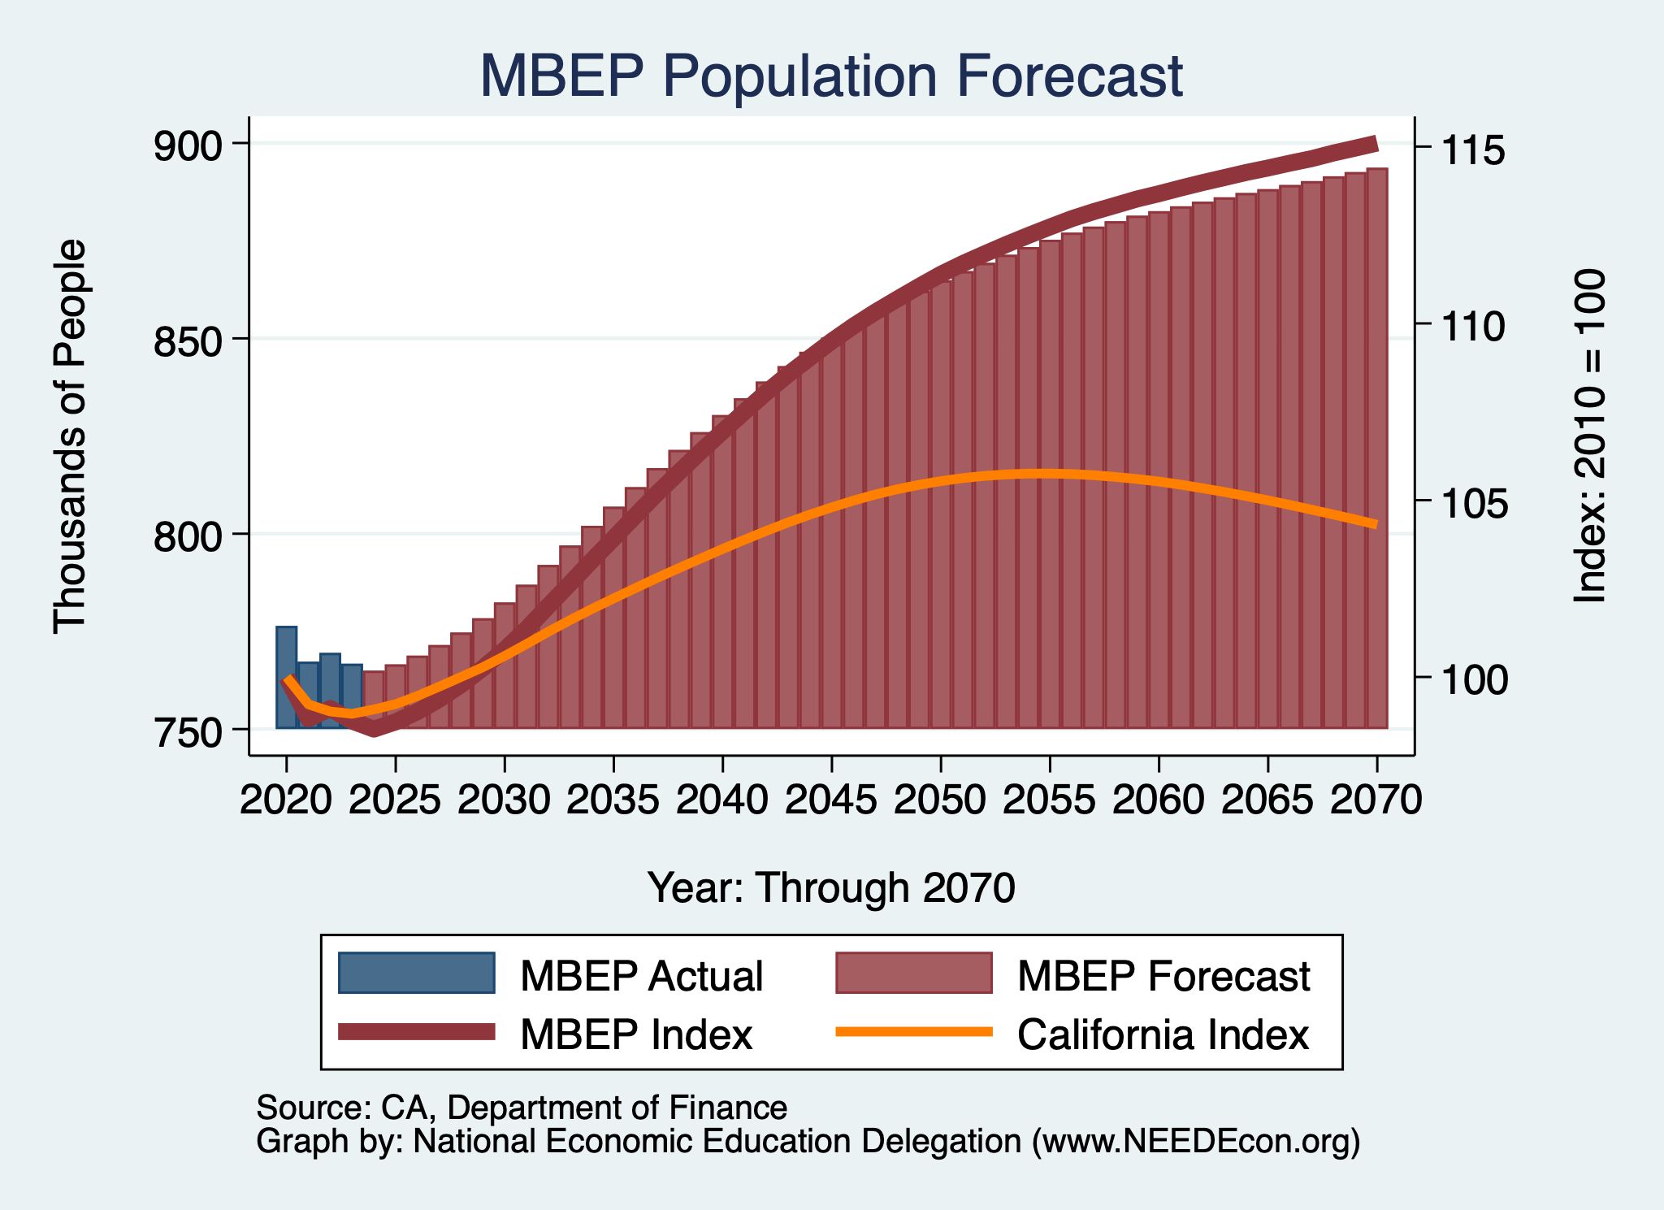
DOF Forecast: Population

Slide 48
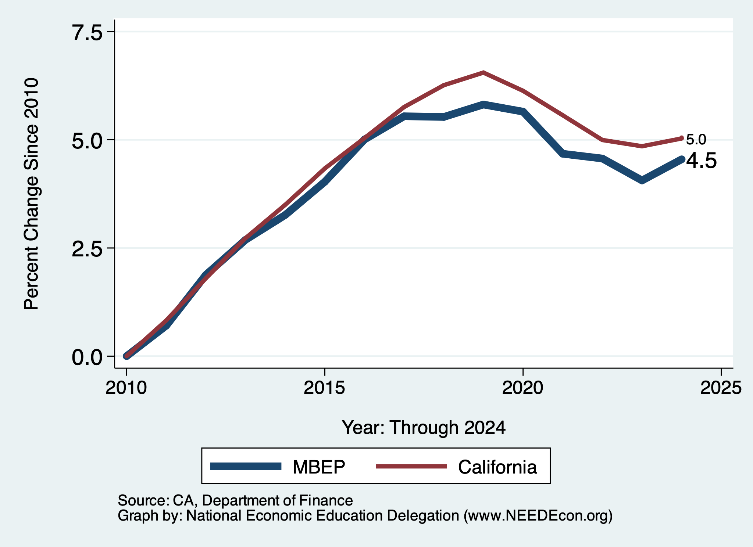
Local Population Change

Slide 49
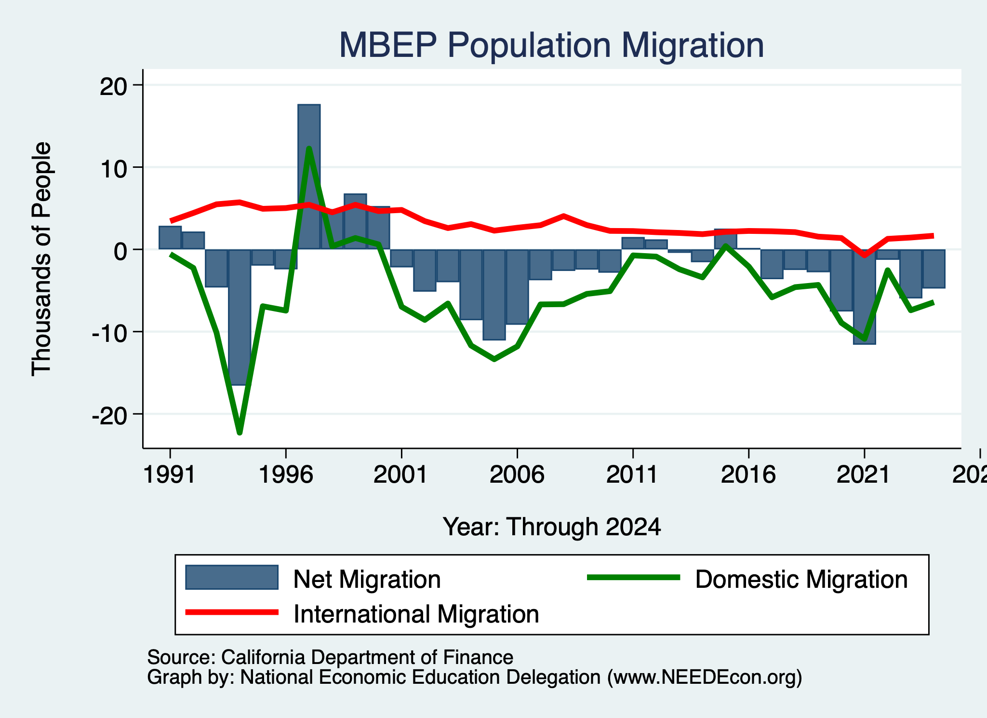
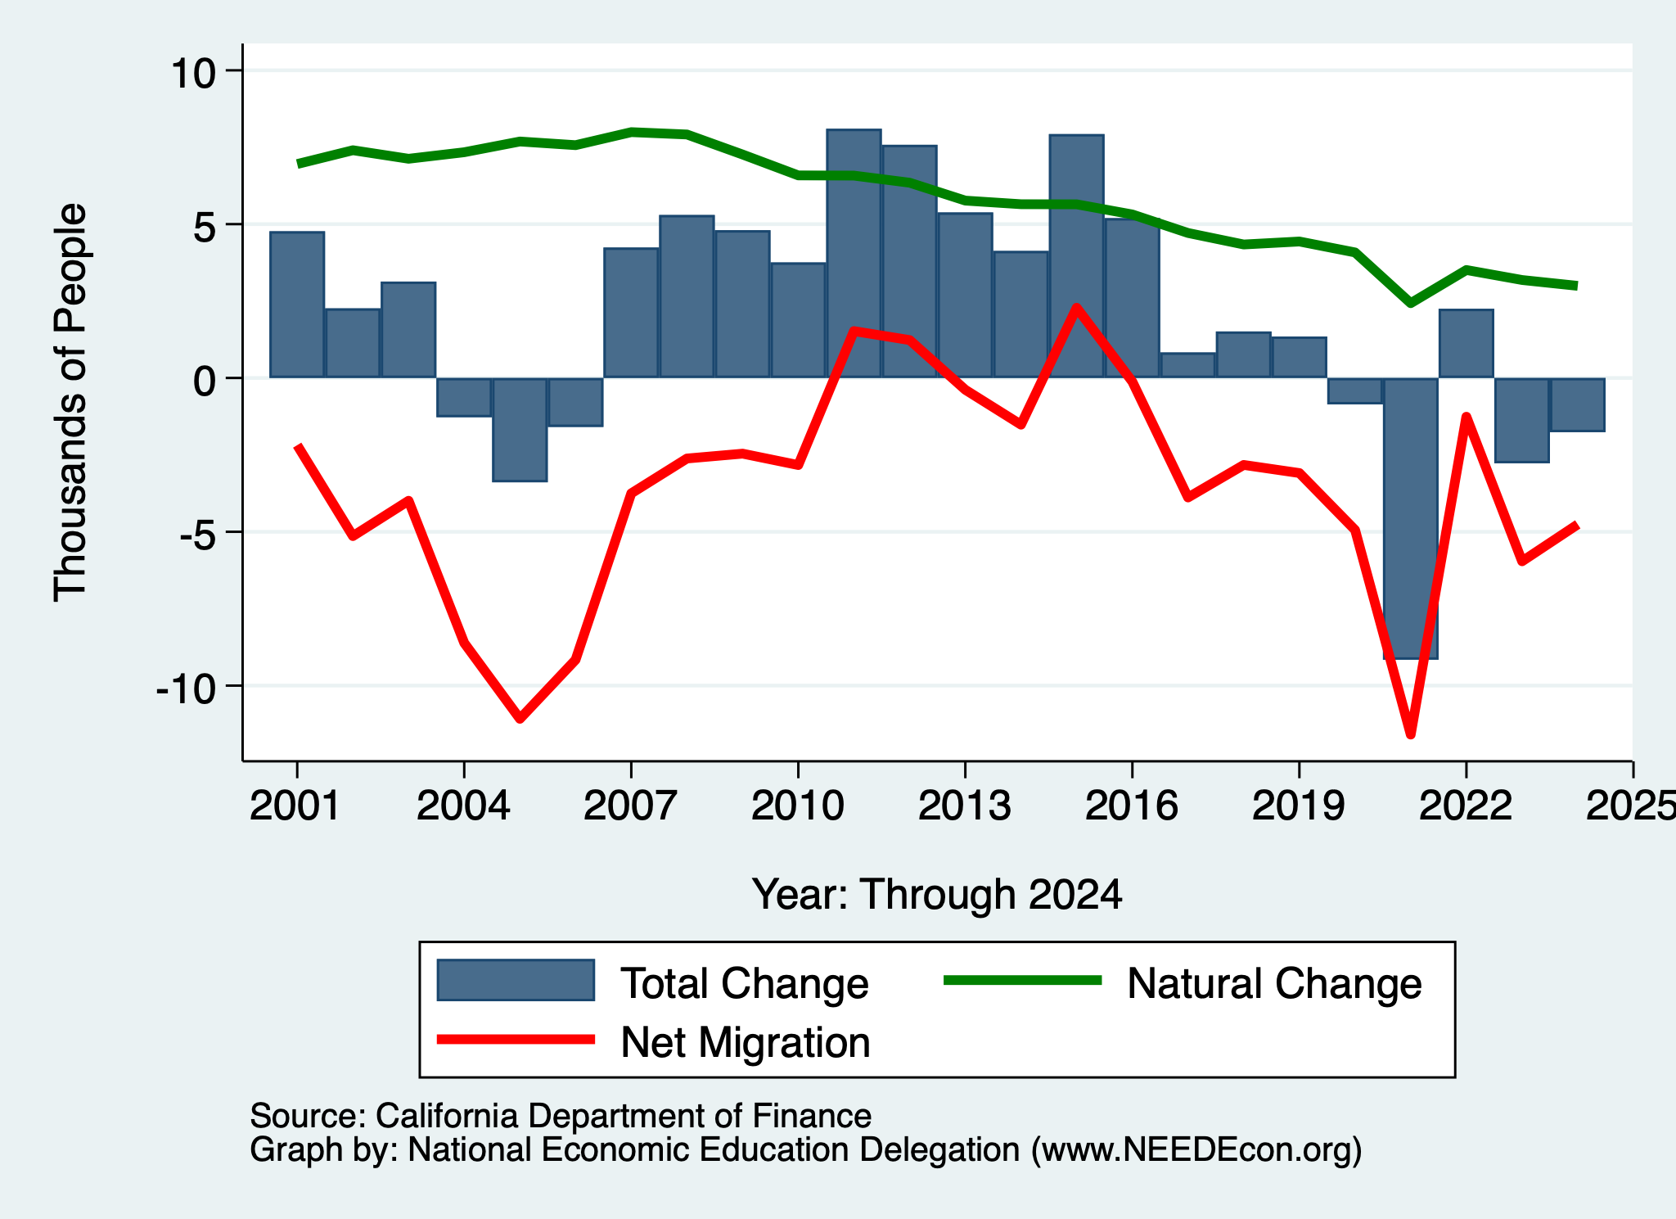
Monterey Bay Area Migration Patterns
Natural Change is in Decline

Slide 50
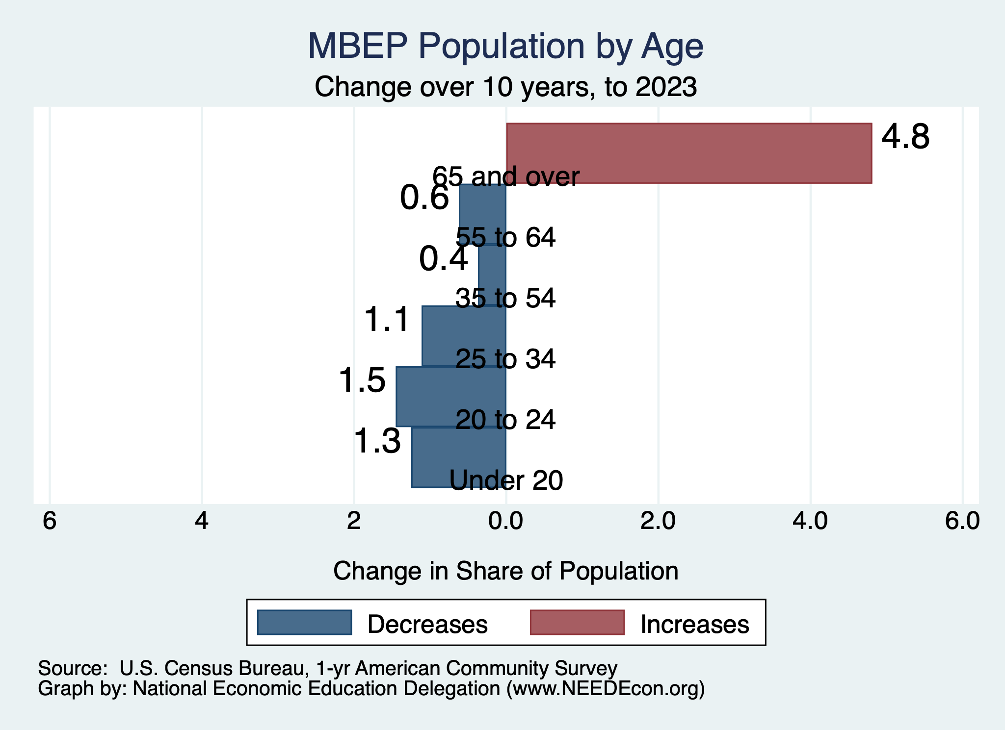
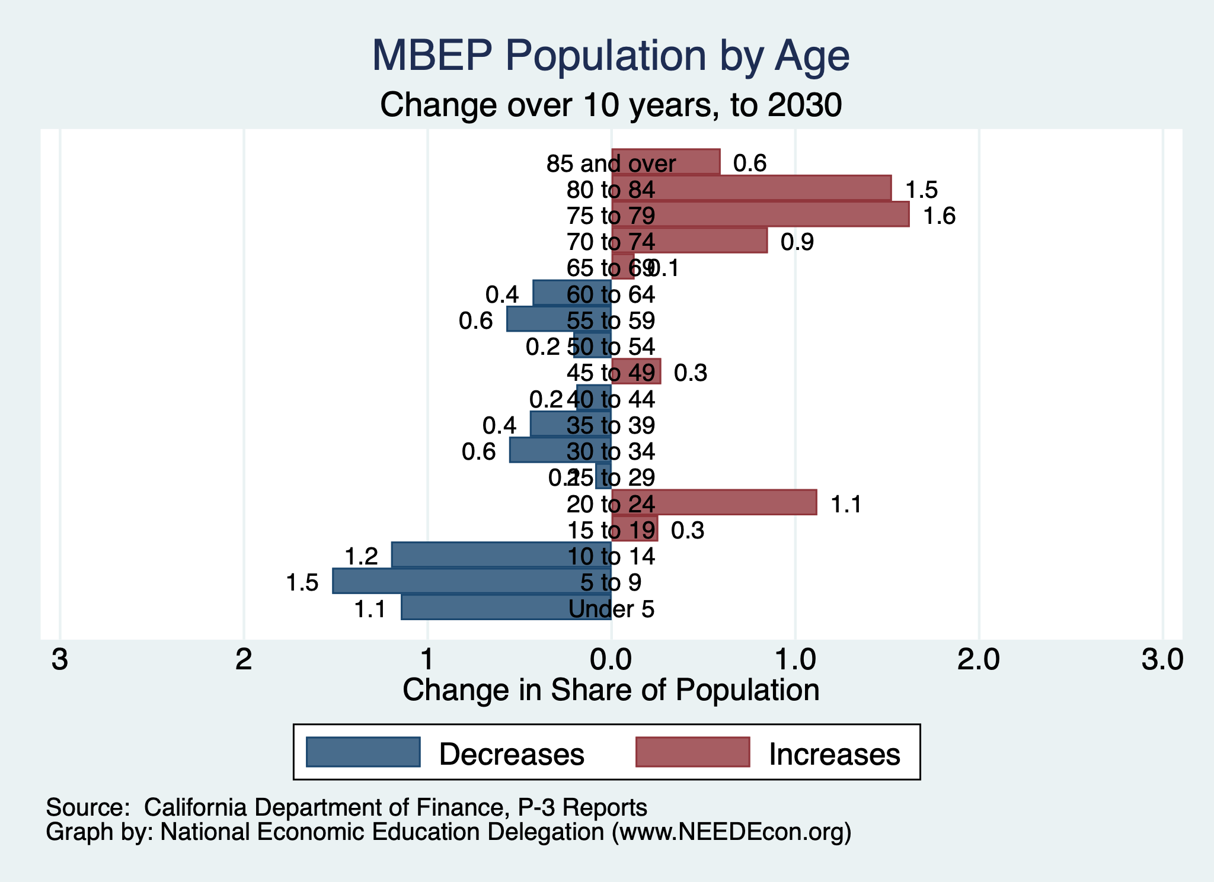
MBEP Population Change

Slide 51
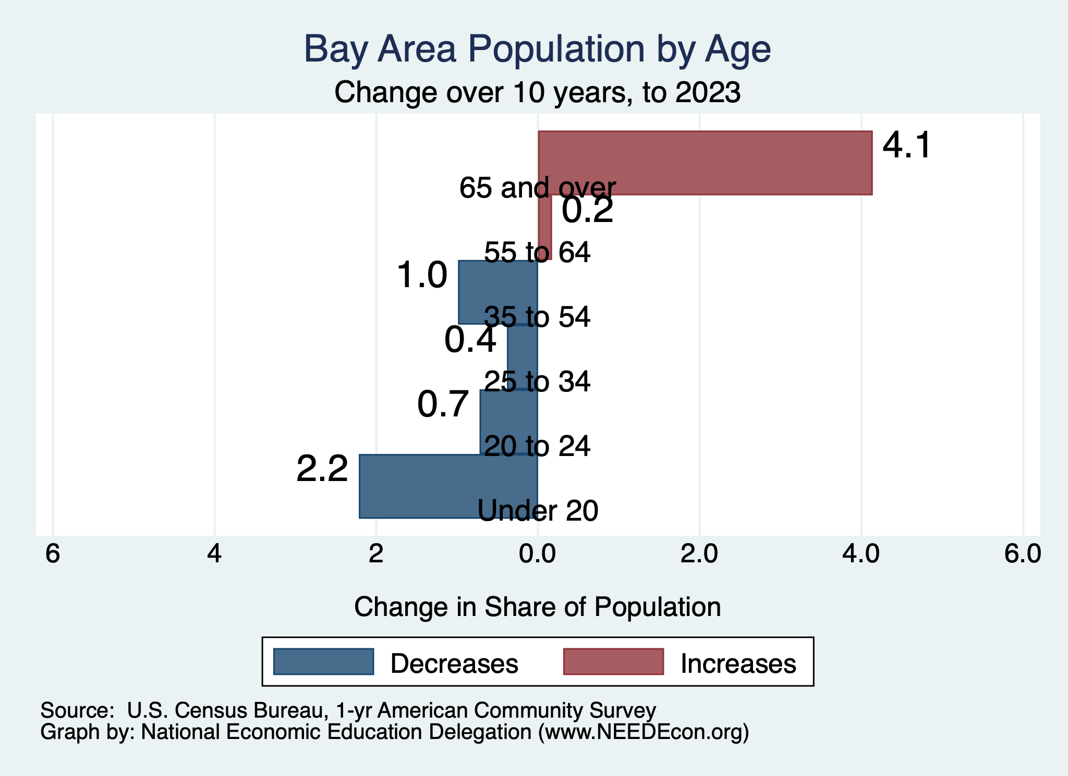
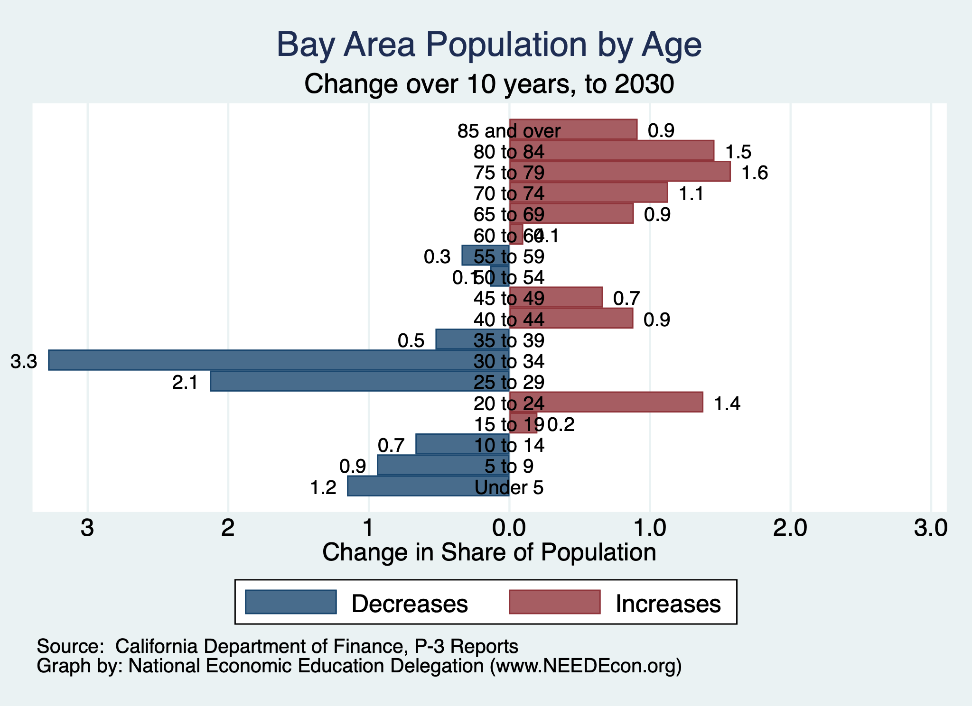
Bay Area Population Change

Slide 52
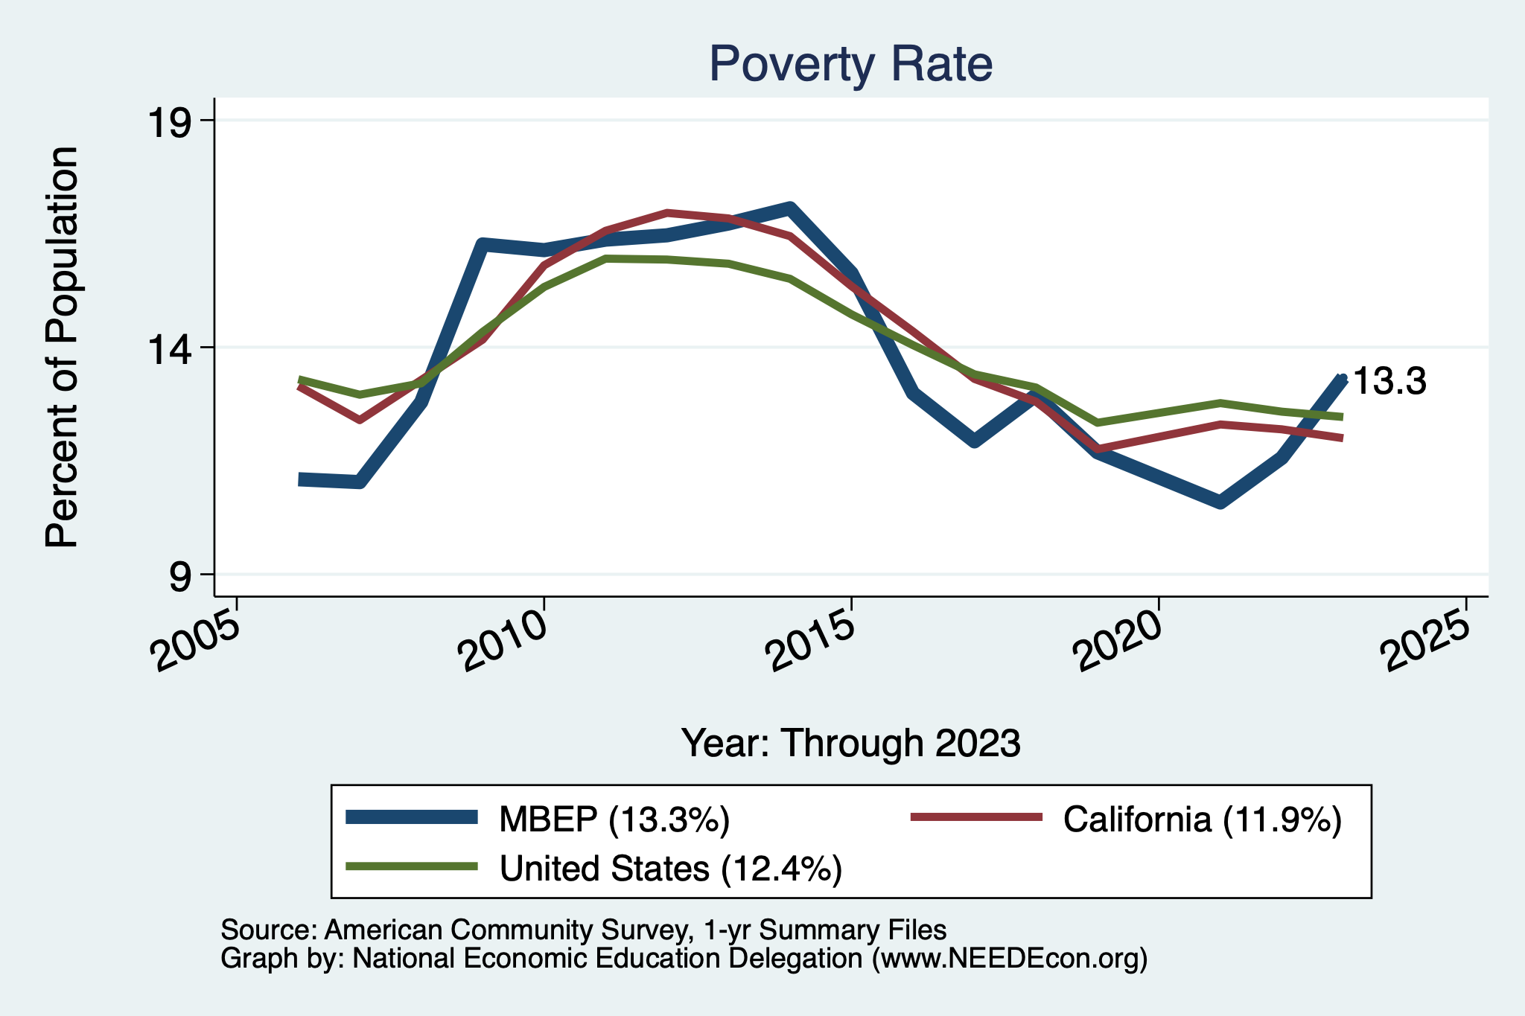
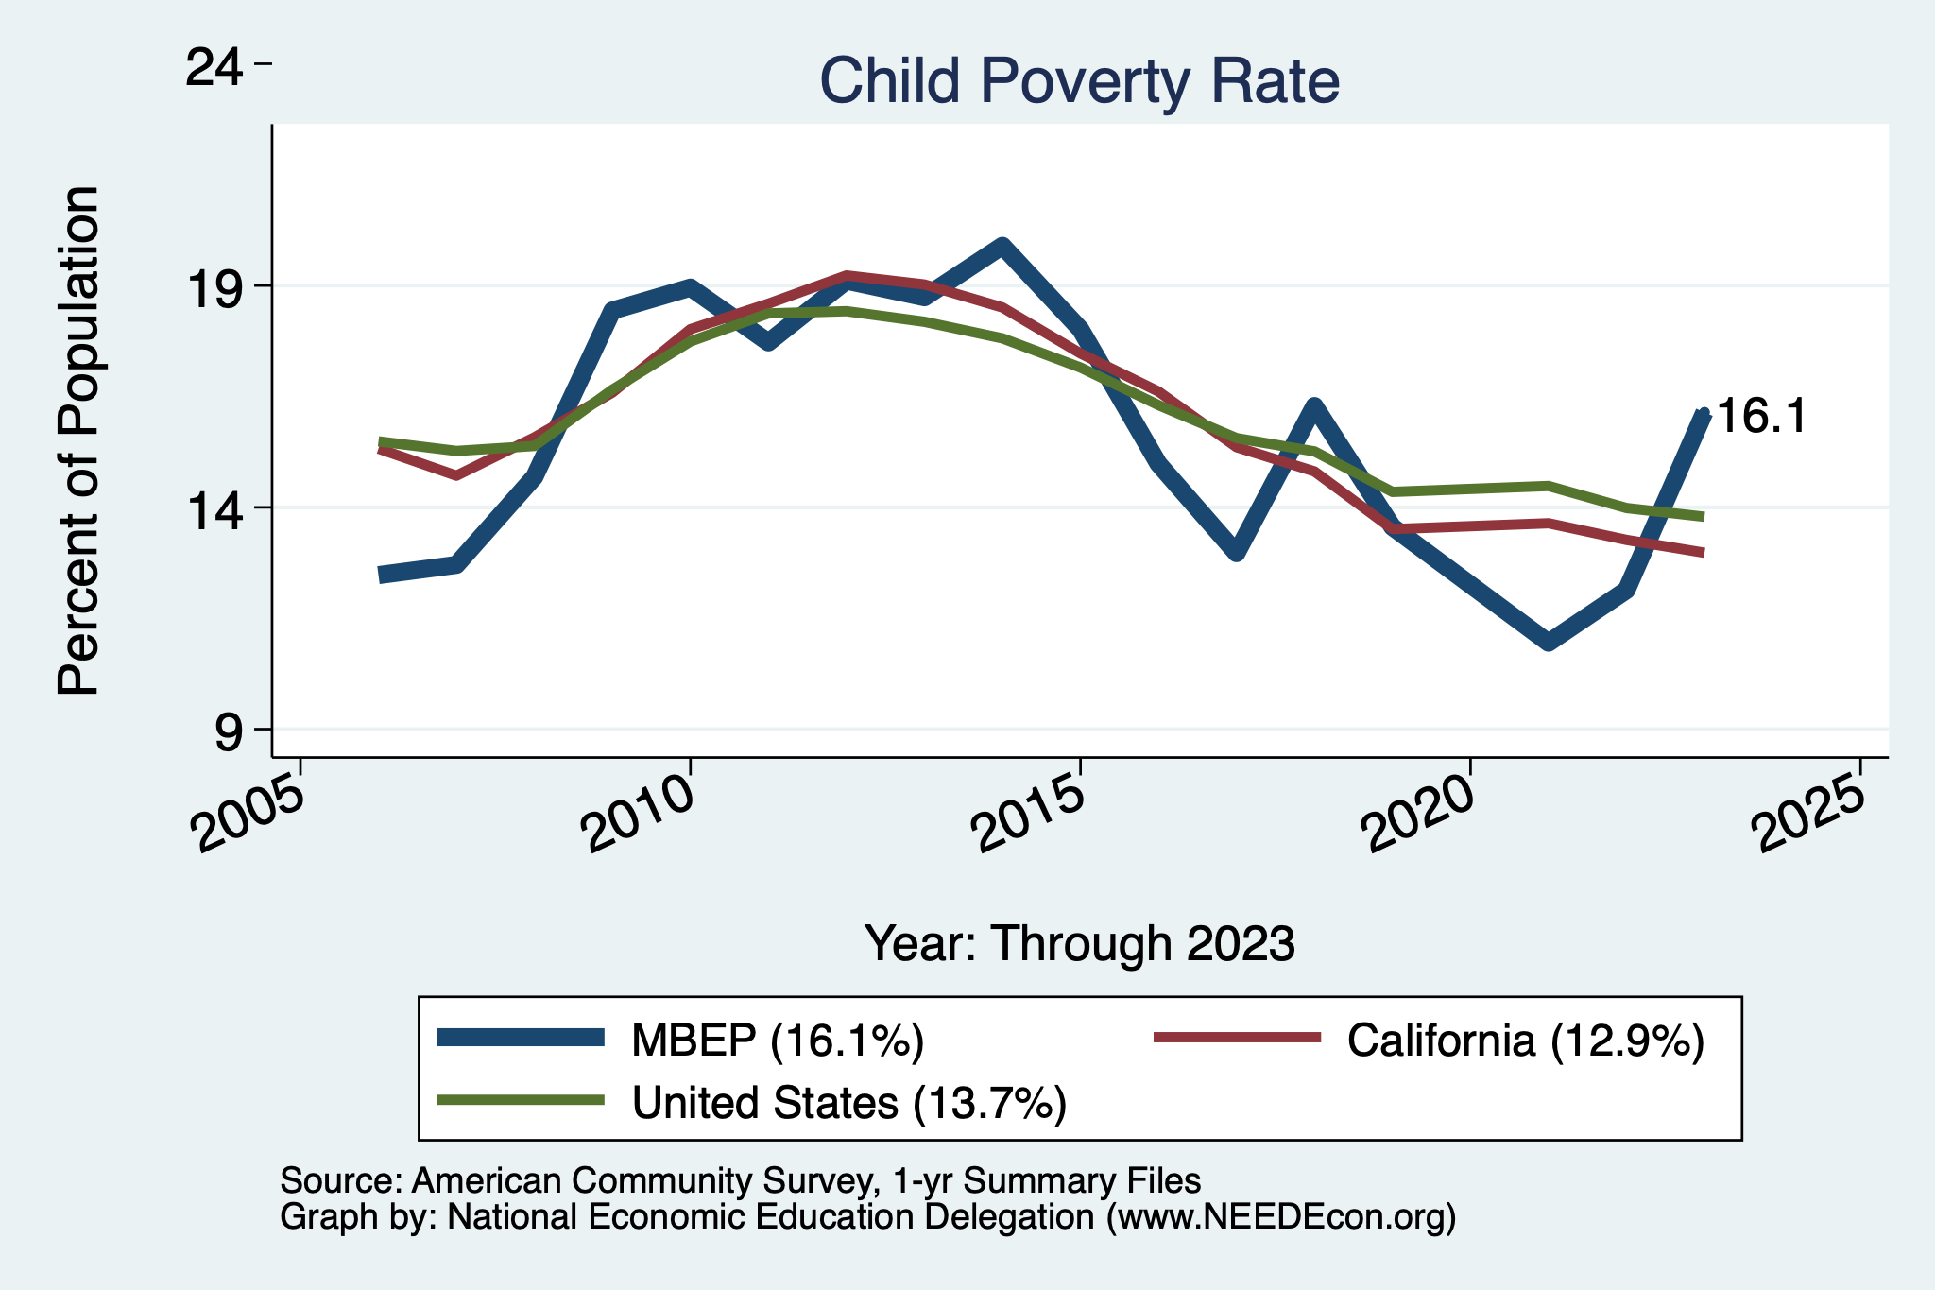
MBEP Poverty

Slide 53
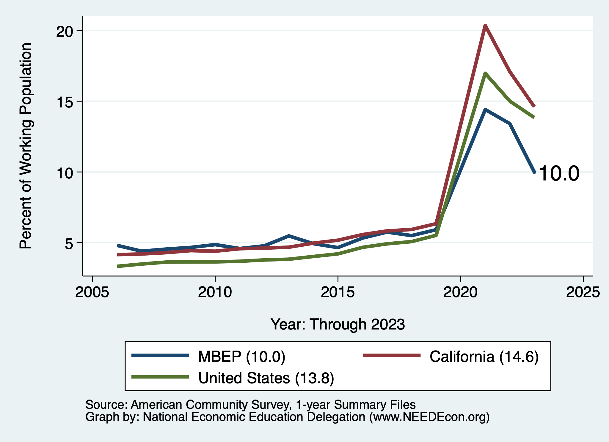
Working From Home

Slide 54
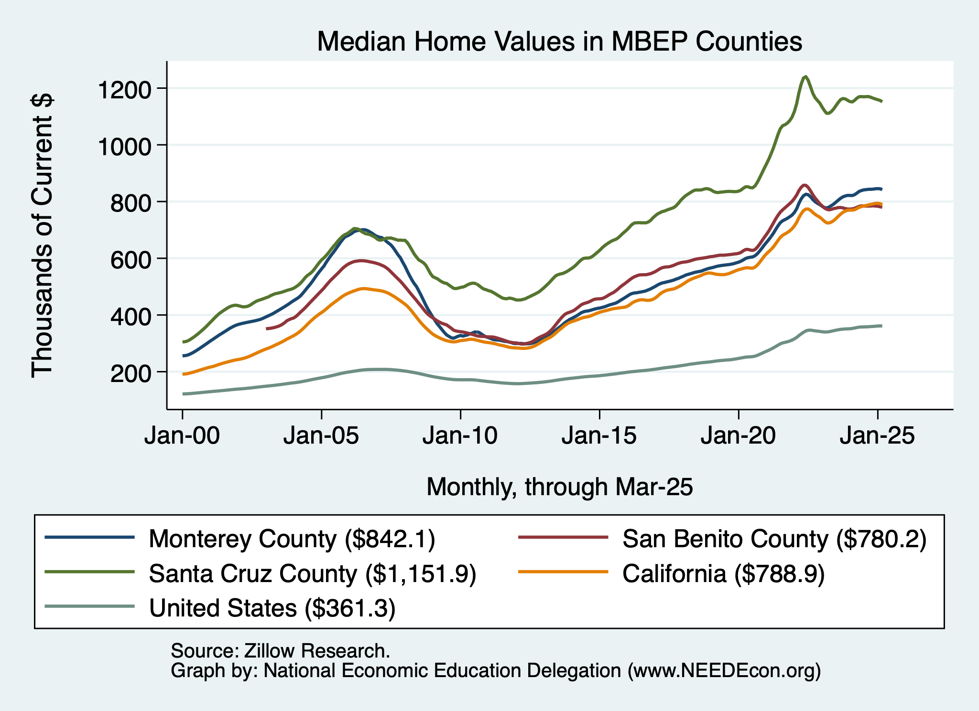
Home Prices Around MBEP
Santa Cruz County
Monterey and San Benito Counties
- and CA
U.S.

Slide 55
Monterey Bay Area: Summary
Home prices have returned to trend growth.
Aging population will require in-migration to grow the local economy.
  However, recent years have seen more out-migration than in.
Employment recovery is picking up pace!
  Significant growth in manufacturing and information.
  Prospects for employment growth seem favorable.
Poverty rates are increasing.
Deportations will likely strain the local economy.

Slide 56
Thank you!
Any Questions?
www.NEEDEcon.org
Jon D. Haveman
Jon@NEEDEcon.org
Contact NEED: info@NEEDEcon.org
Submit a testimonial: www.NEEDEcon.org/testimonials.php
Become a Friend of NEED: www.NEEDEcon.org/friend.php

Slide 57
www.NEEDEcon.org/LocalGraphs
For every state and county in the United States.
Detailed graphs on employment, housing, moves, and other statistics.

Slide 58
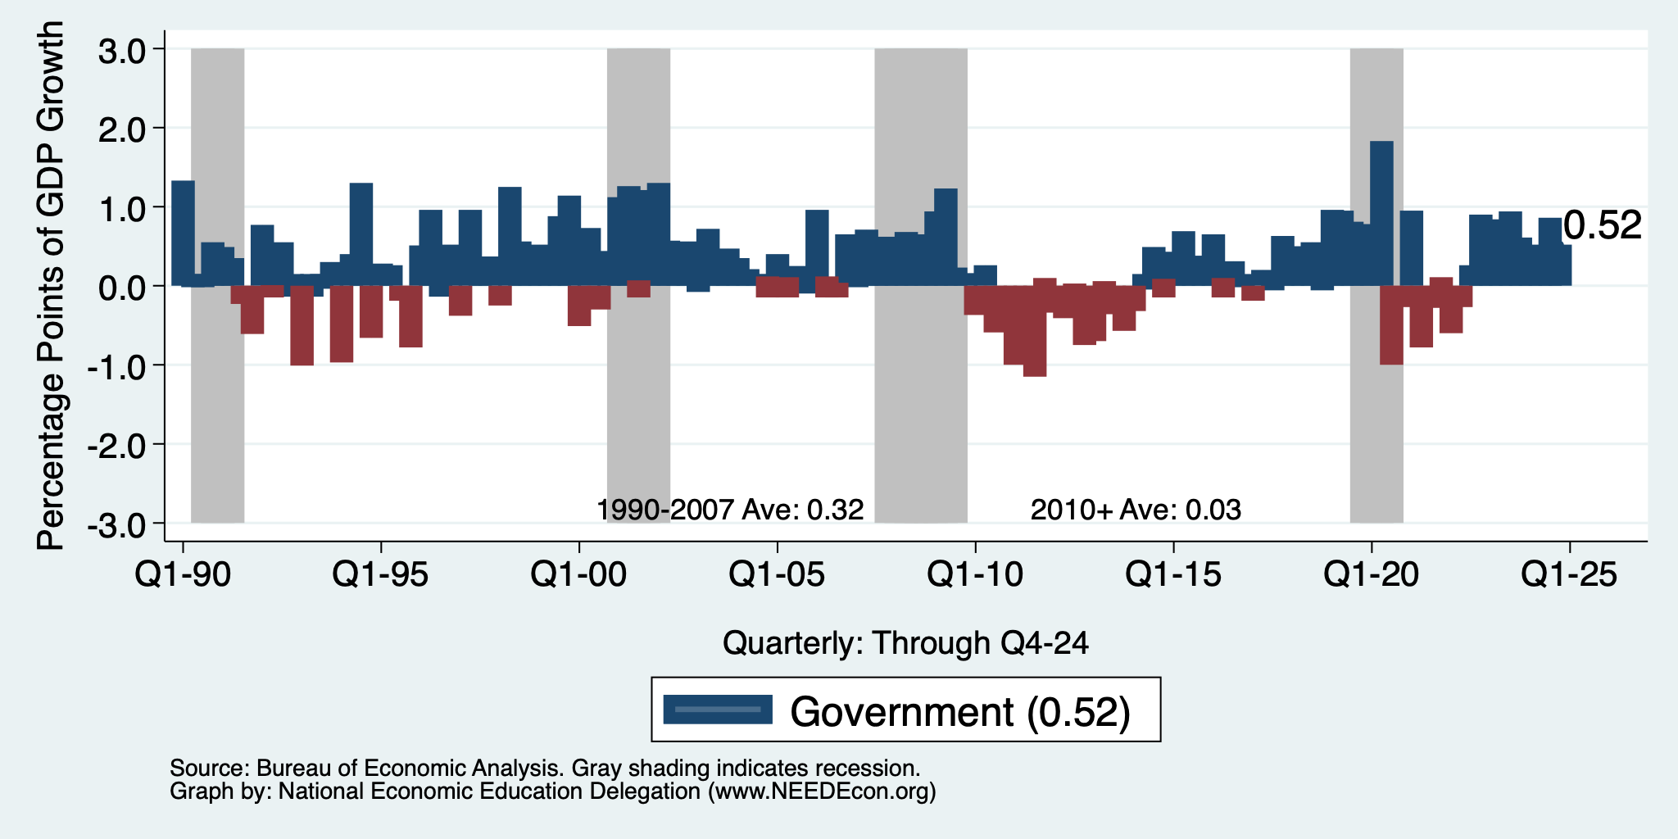
Contributions to GDP: Government
Notes:
Since 2010, average government spending growth is shrinking, resulting in a negative average contribution to GDP growth post-recession of -0.8 percentage points
Note that average quarterly government spending growth is 0.42% from 1990-2007 and -0.17% in 2010+ (annualized, 1990-2007 = 1.68%; 2010+ = -0.70%).

Slide 59
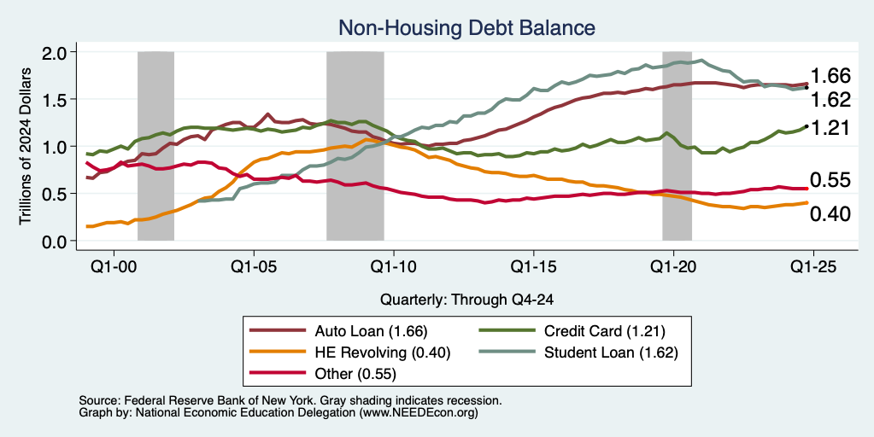
Household Debt: Non-mortgage Sources

Slide 60
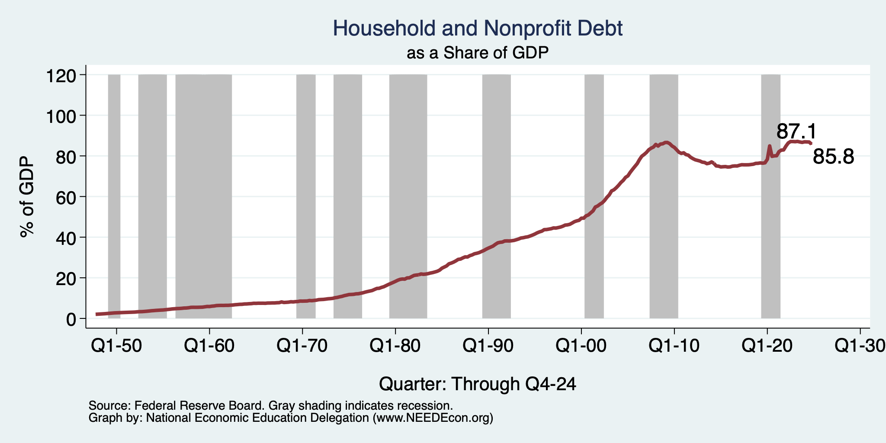
Household Debt as a Share of GDP
Notes:
US household debt relative to GDP rose until the latest recession.
Households have reduced debt relative to GDP 11% since it’s peak in 2008 (at 99%).
Conclusion: Falling household debt likely contributes to slower consumption growth since the recession.
Chart: HHPERCT.png

Slide 61
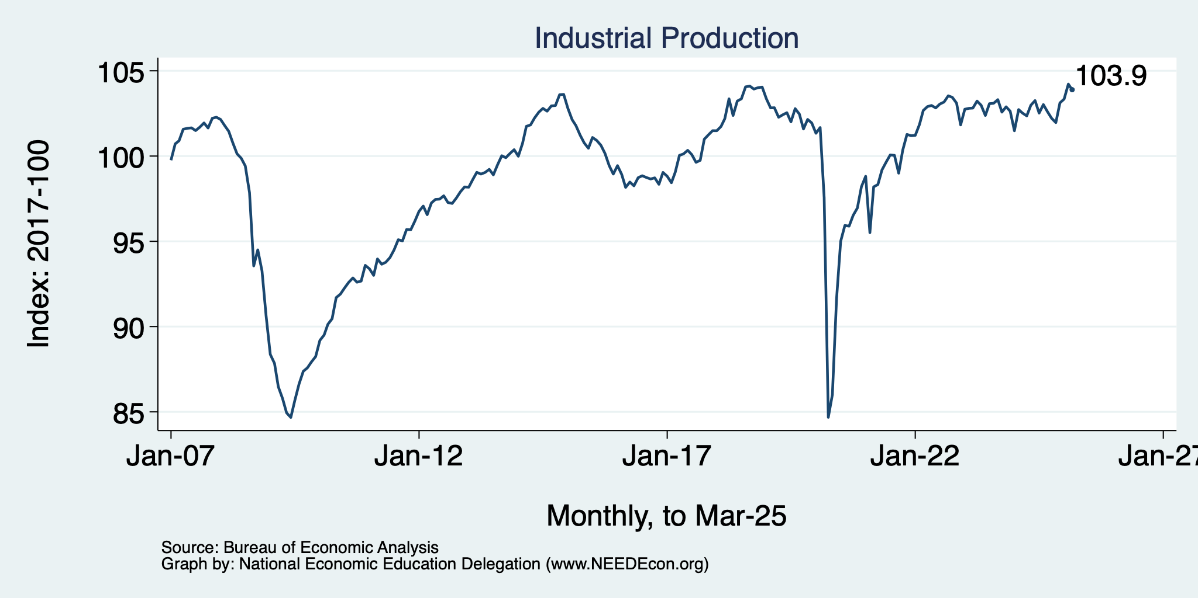
Industrial Production (Manuf, Util, Mining)

Slide 62
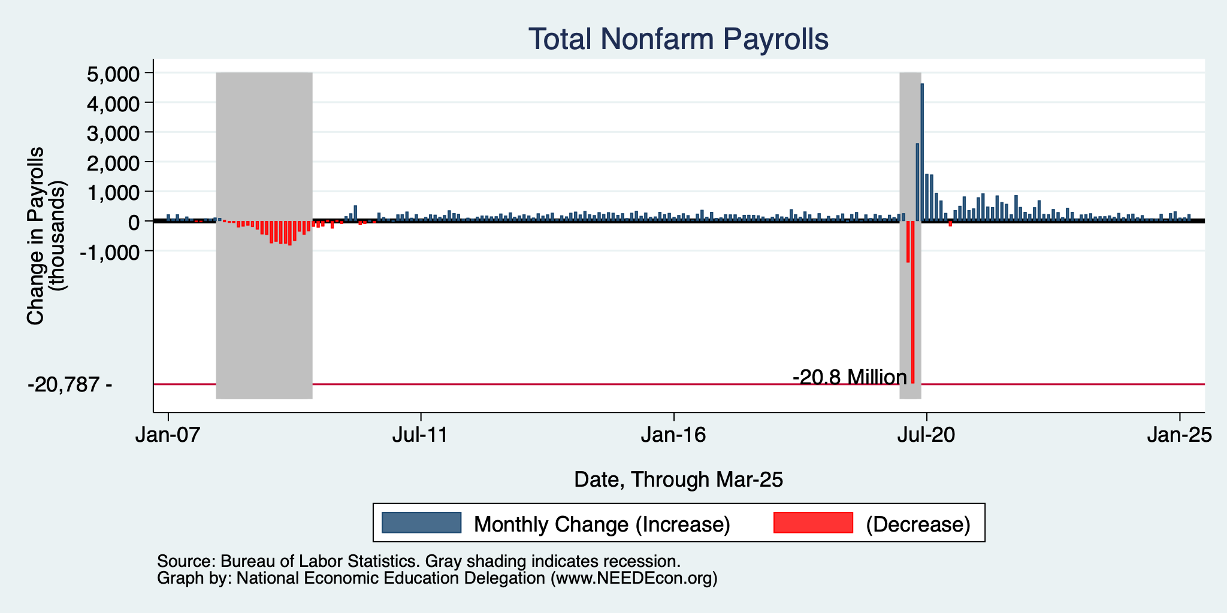
Monthly Changes in Nonfarm Employment
Notes:
PAYEMS.png

Slide 63
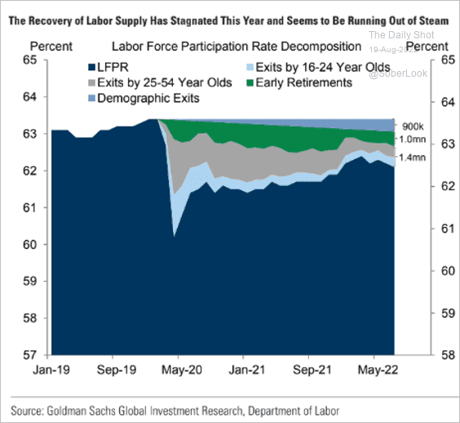
Some Explanations
500 Thousand: Long COVID Exits
1-2%: Long Social Distancing

Slide 64
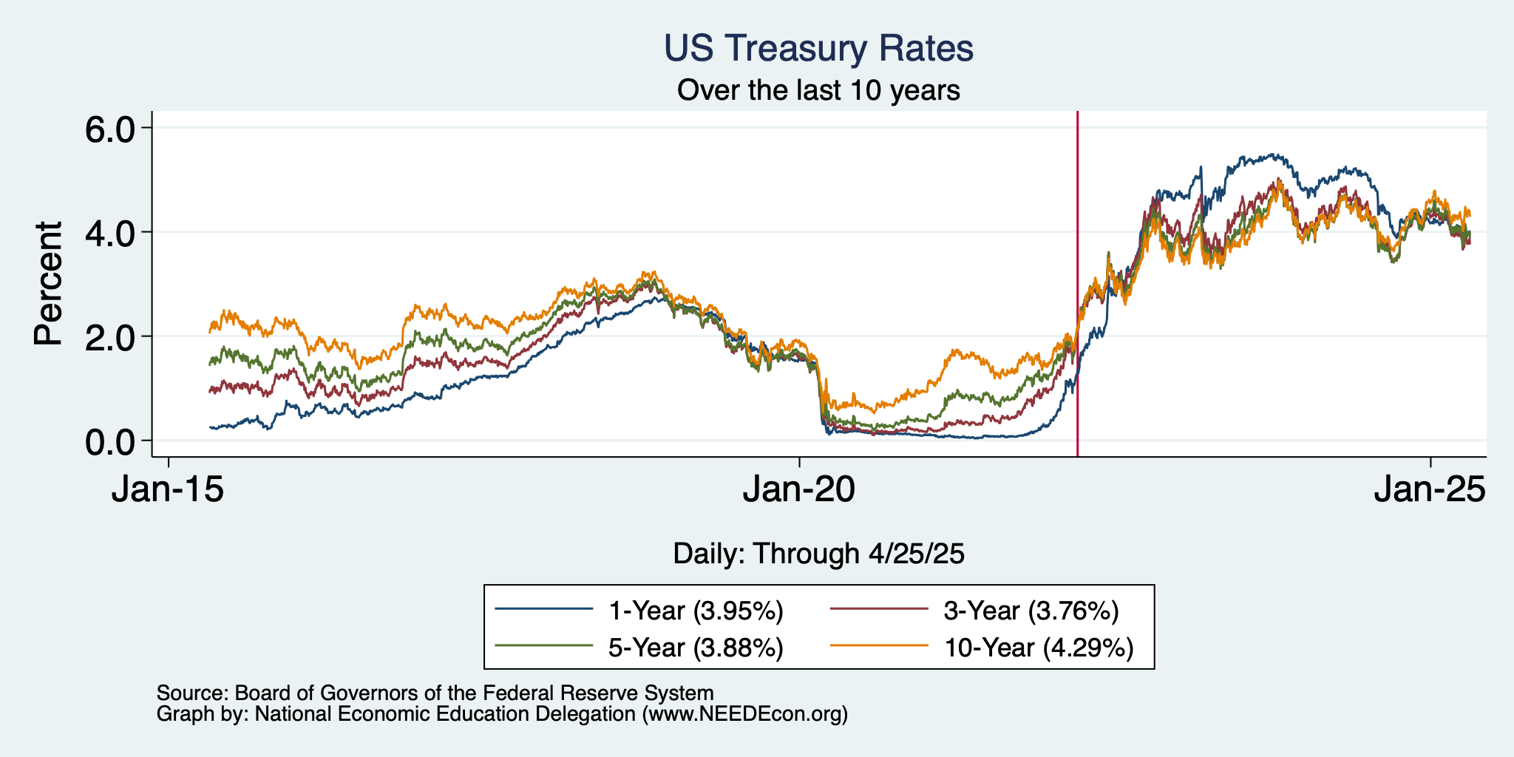
Treasuries
Notes:
treas_recent.png

Slide 65
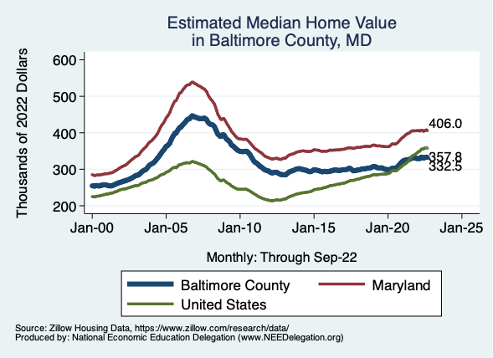
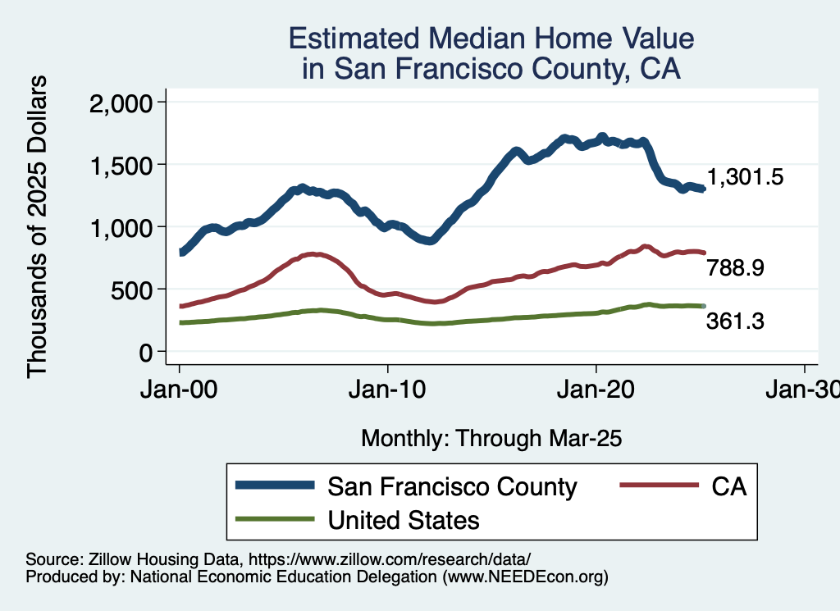
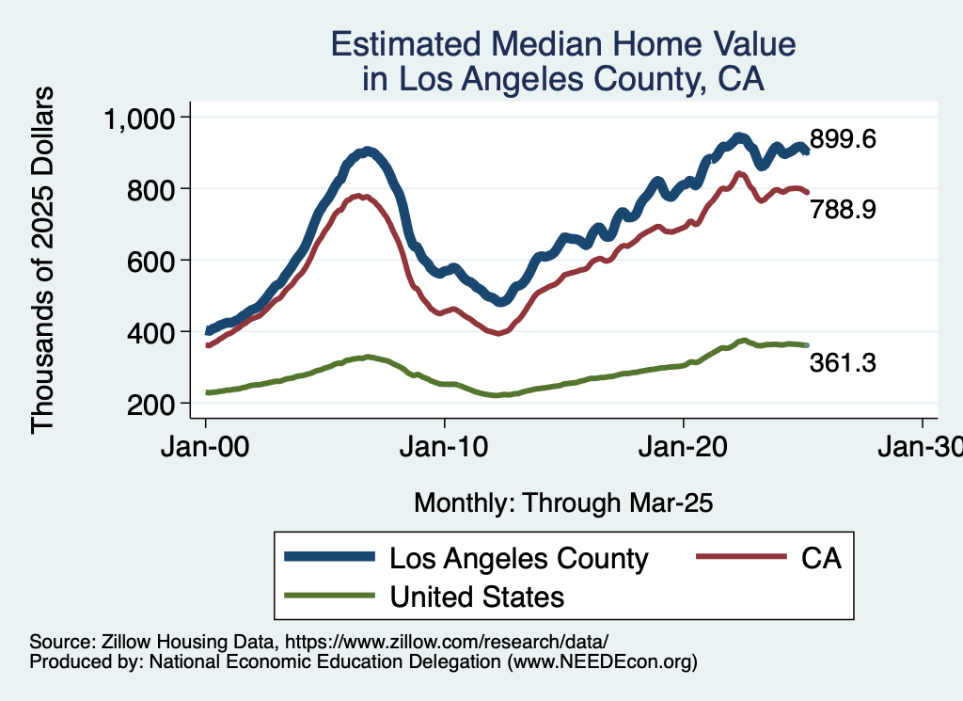
Home Prices … Down Throughout CA
Notes:
Charts:
homeprices_recession.png
housing.png

Slide 66

But SUPER High to Begin With!

Slide 67


Home Prices and Housing Starts
Notes:
Charts:
homeprices_recession.png
housing.png

Slide 68


Home Sales are Not Horrible

Slide 69

Supply Chains

Slide 70

Is Immigration Saving the Day?
Source: https://www.axios.com/2024/03/13/immigration-economy-jobs-growth-good#

Slide 71
The “Nominal” Side
Inflation: A lot of progress on inflation, but the recent data are troubling.
But, this is not the popular view

Slide 72


Slide 73

Inflation in the Last 3/6 Months – Still 3%
Source: https://www.nytimes.com/2023/01/13/opinion/cpi-inflation-fed.html

Slide 74

Working From Home

Slide 75


Working From Home

Slide 76

Santa Cruz Economy: Employment

Slide 77

Monterey County Economy: Employment

Slide 78

San Benito County Economy: Employment

Slide 79

Santa Cruz Economy: GDP Growth

Slide 80

San Benito Economy: GDP Growth

Slide 81

Monterey Economy: GDP Growth

Slide 82


MBEP Population Age Distribution

Slide 83

DOF: Santa Cruz County Population

Slide 84

DOF: Monterey County Population

Slide 85

DOF: San Benito County Population

Slide 86

Monterey Bay Area Real Estate

Slide 87


Labor Market is Cooling
Job Openings - Falling
Quits – Falling (Rising?)

