Slide 1
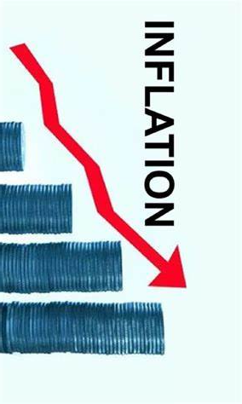

Economic Update
US & Monterey Bay Area
Regional Economic Outlook
Monterey Bay Economic Partnership
Jon Haveman, Ph.D.
NEED
May 3, 2024

Slide 2
Outline
Economic Indicators
Inflation/Federal Reserve
The Local Economy

Slide 3
Economic Indicators

Slide 4
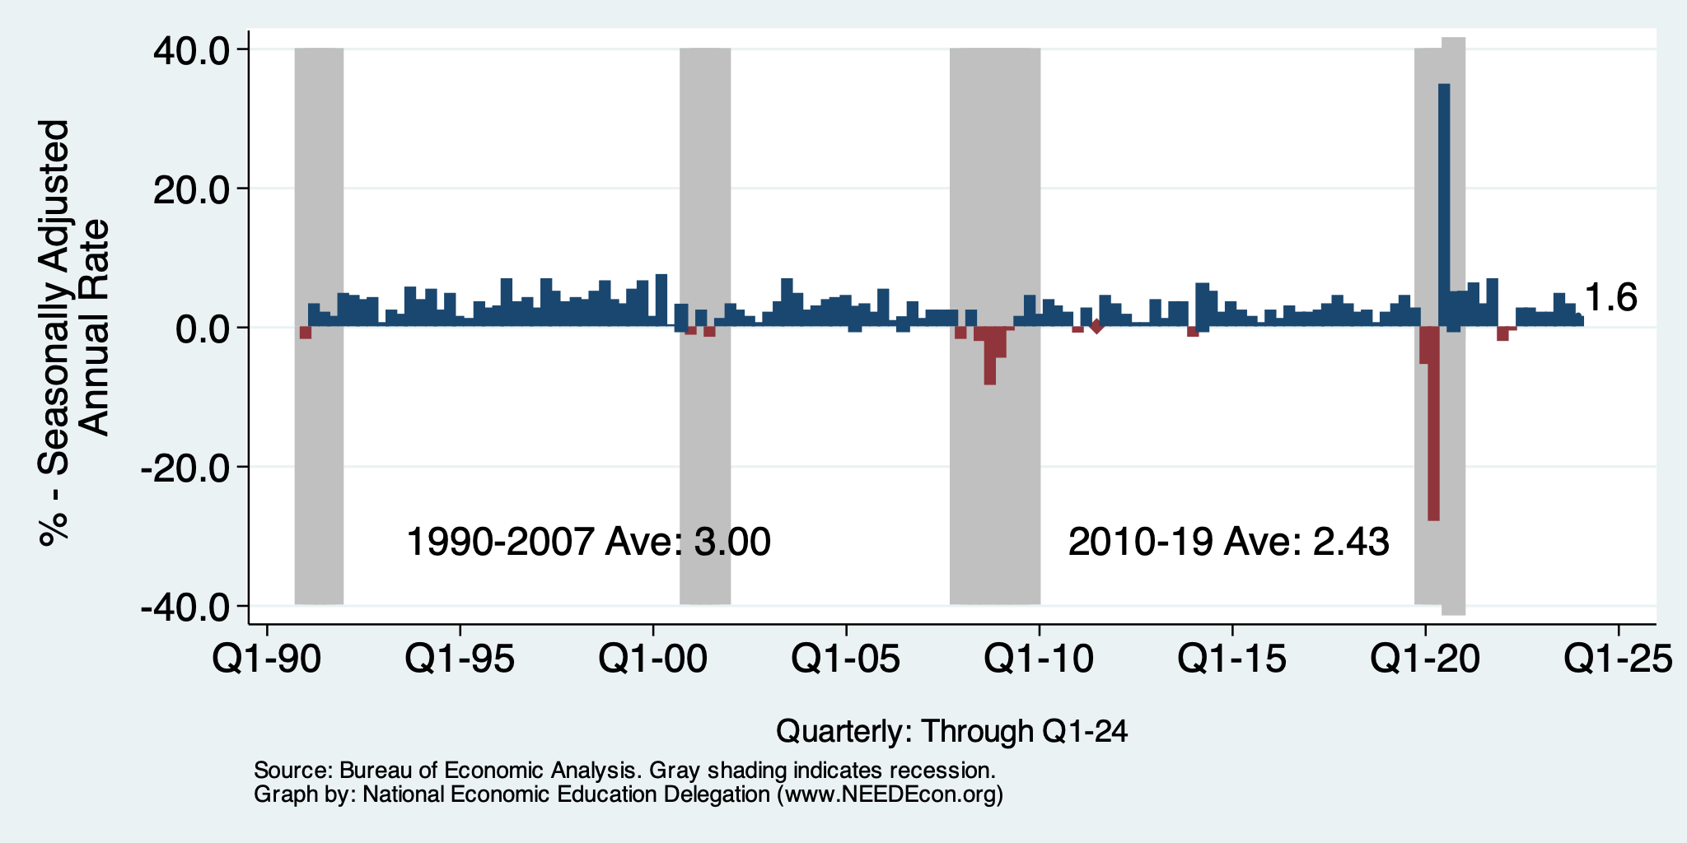
GDP: Quarterly Growth
Q2-2023: 2.1%
Q3-2023: 4.9%
Q4-2023: 3.4%
Q1-2024: 1.6%
Notes:
Graph: gdp_pot_grow.png
The Point: From 1990 – 2007, average annual US GDP growth pre-crisis is 2.94%. However, post-crisis US GDP growth is 2.19% (0.75 percentage points lower). Why is has the recovery been sluggish?
Note: At the recession’s height, the gap between quarterly GDP growth and potential growth was 2.5 percentage points.

Slide 5
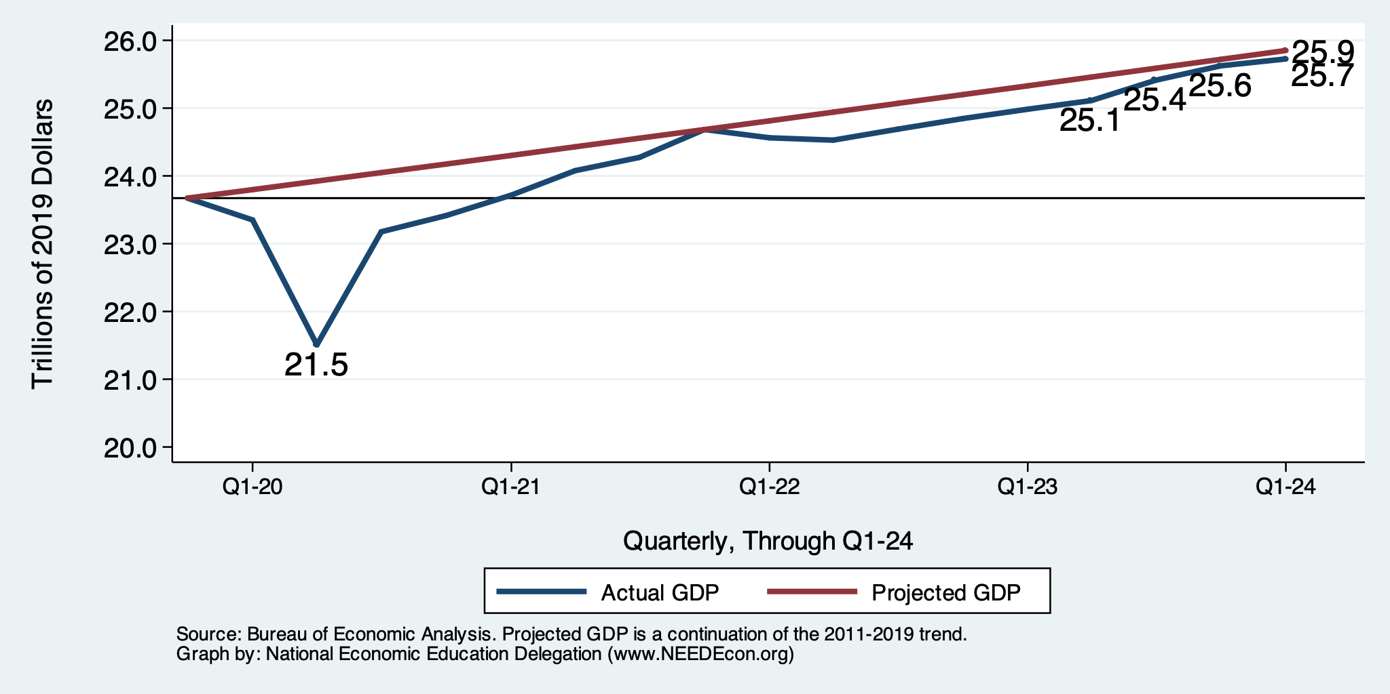
GDP Trajectory: Pandemic Recovery Complete!
GDP is:
< $0.2 Trillion below 2019 forecast.
$1.9 Trillion ABOVE 2019-Q4 level.

Slide 6
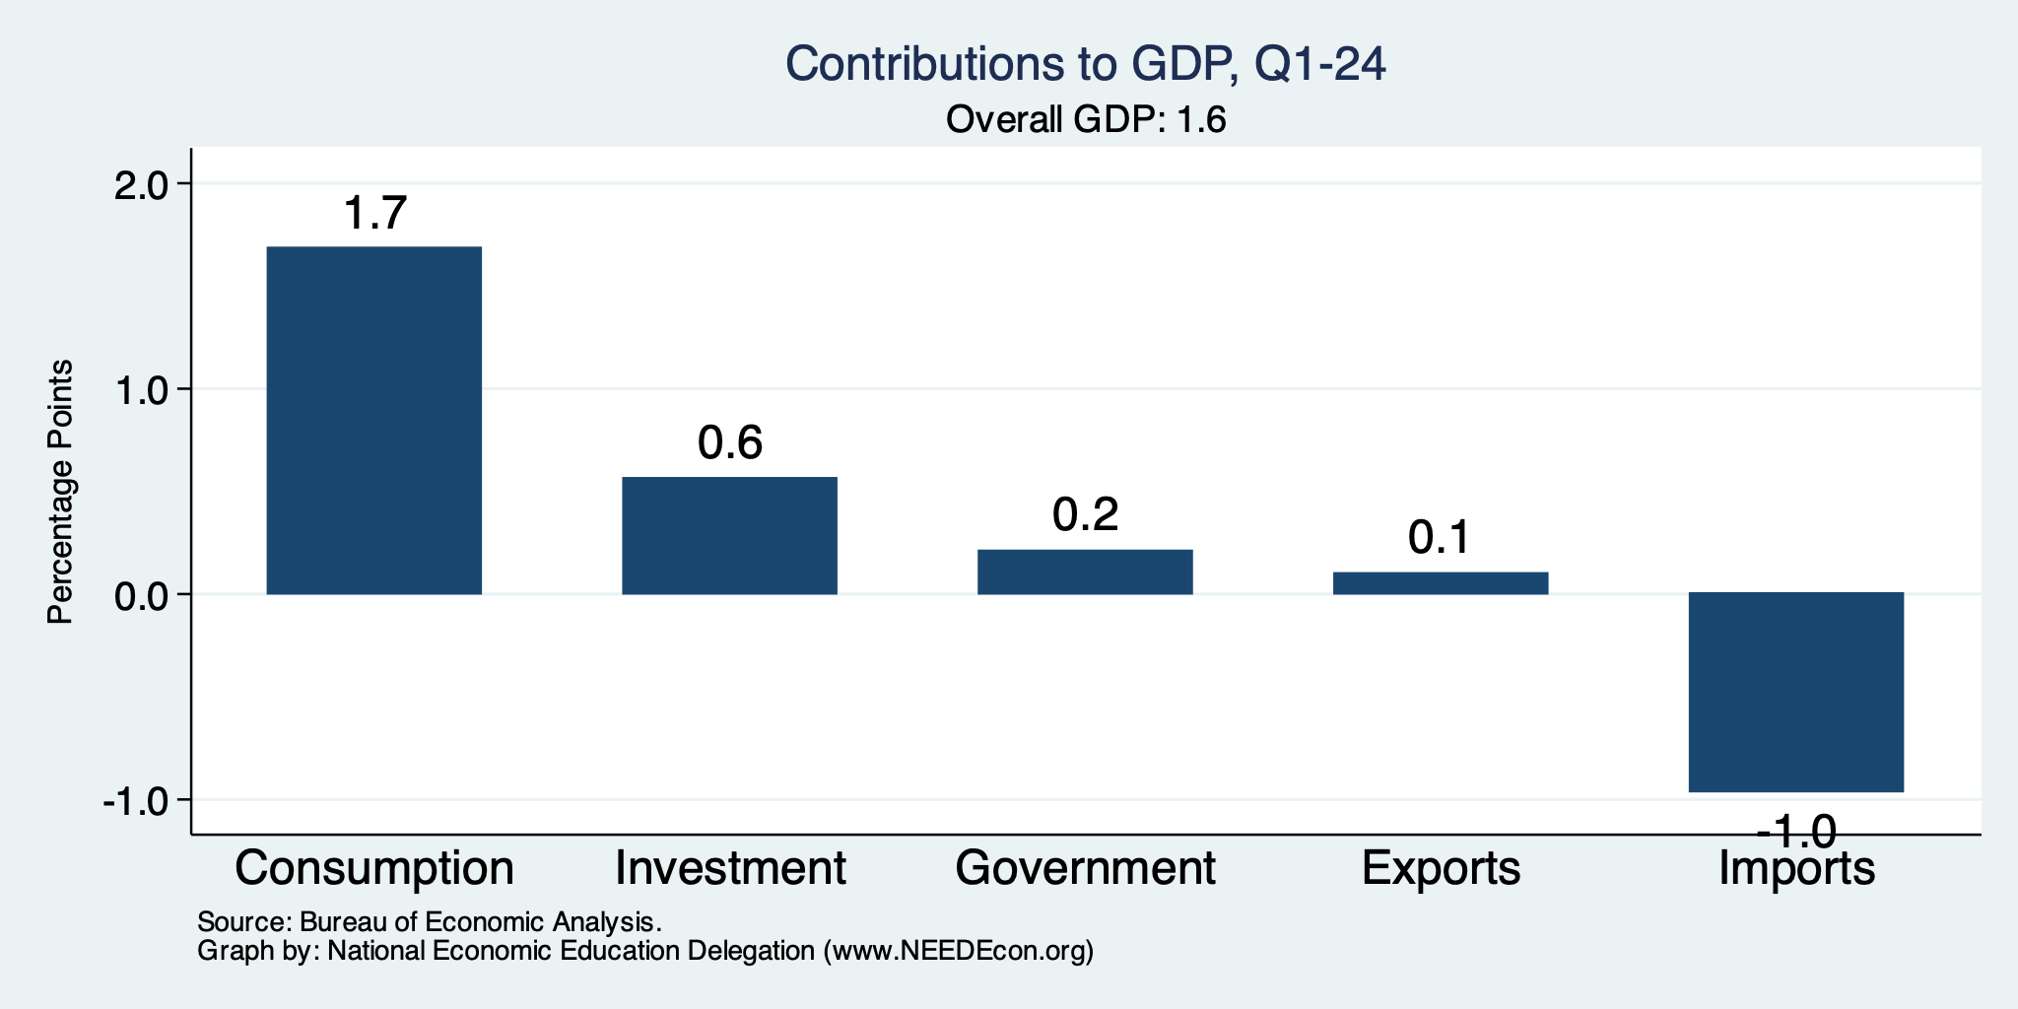
GDP Growth Drivers
Normally
2.3%

Slide 7
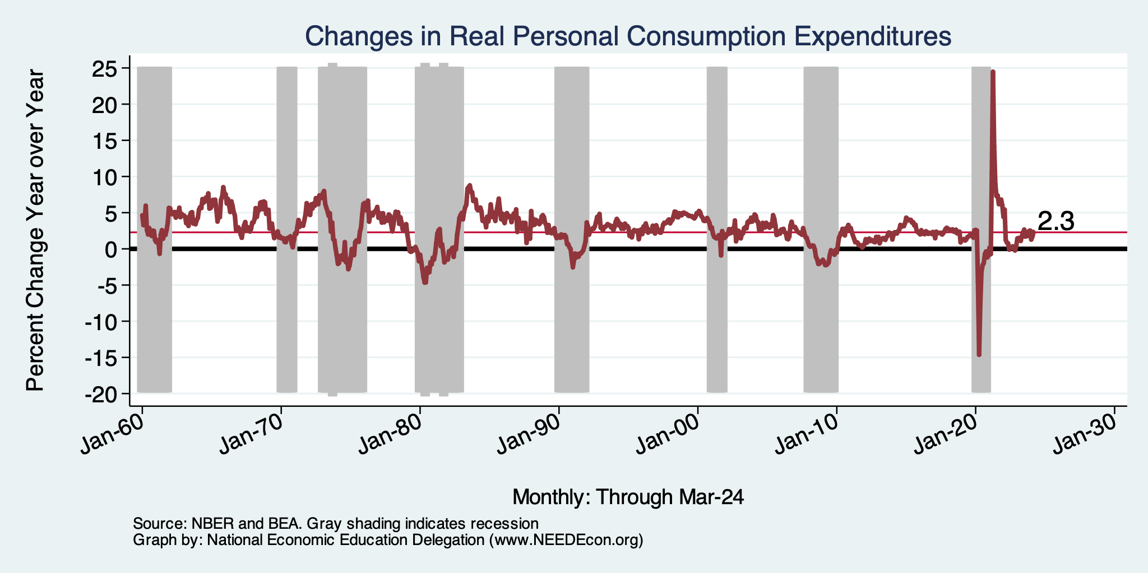
Personal Consumption Expenditures
Looks Ok
Notes:
Chart: ../Charts/personalconsumption_recession.png
Real consumption remains significantly lower than trend consumption since 2008 (actual is 89% of trend).
Since the recession, consumption growth has fallen. From 1990-2007, average annual consumption growth is 3.34%; Post-recession average annual consumption growth is 2.38%.

Slide 8
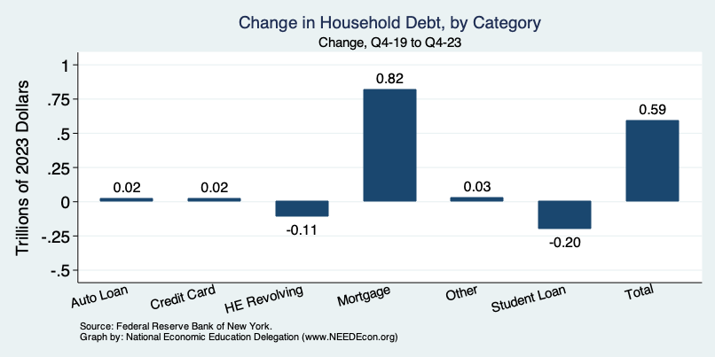
Household Debt: Change During the Pandemic

Slide 10
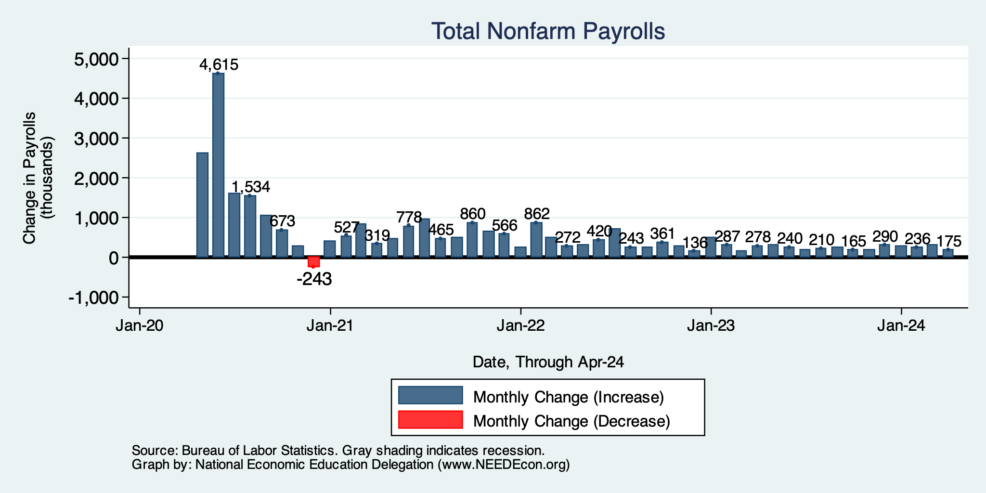
Monthly Changes in Nonfarm Employment
February: 236,000
March: 315,000
April: 175,000
Notes:
PAYEMS.png

Slide 11
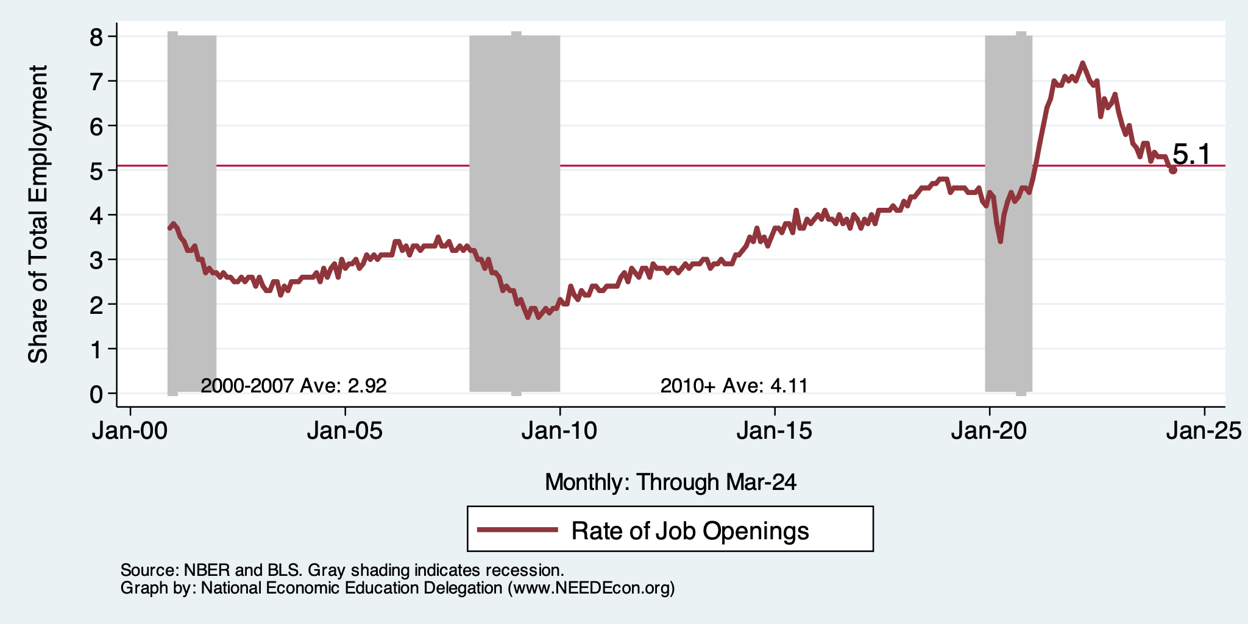
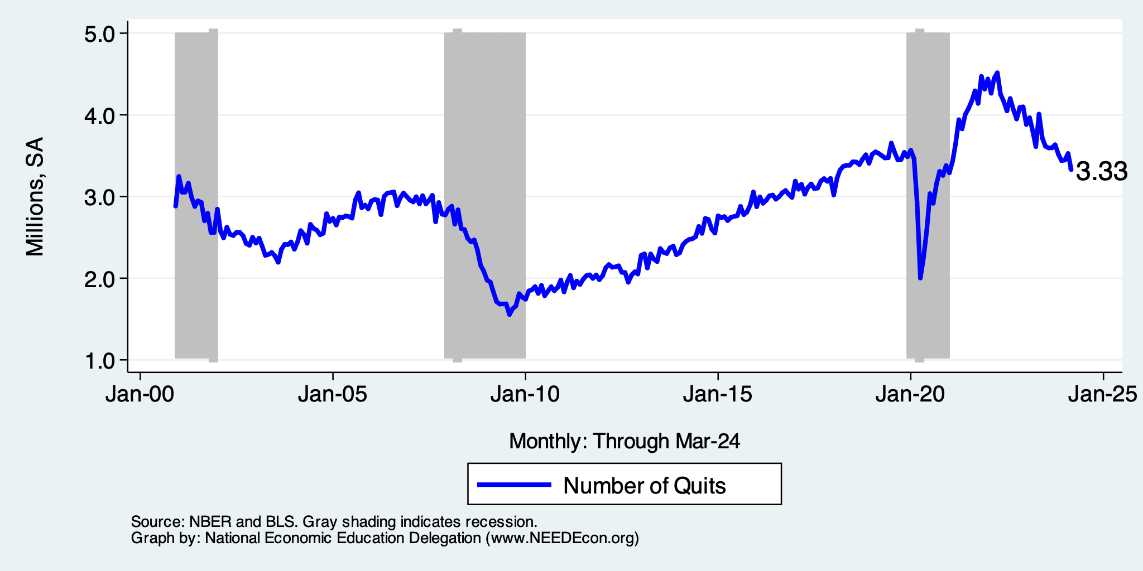
Labor Market is Cooling
Job Openings - Falling
Quits - Falling

Slide 12
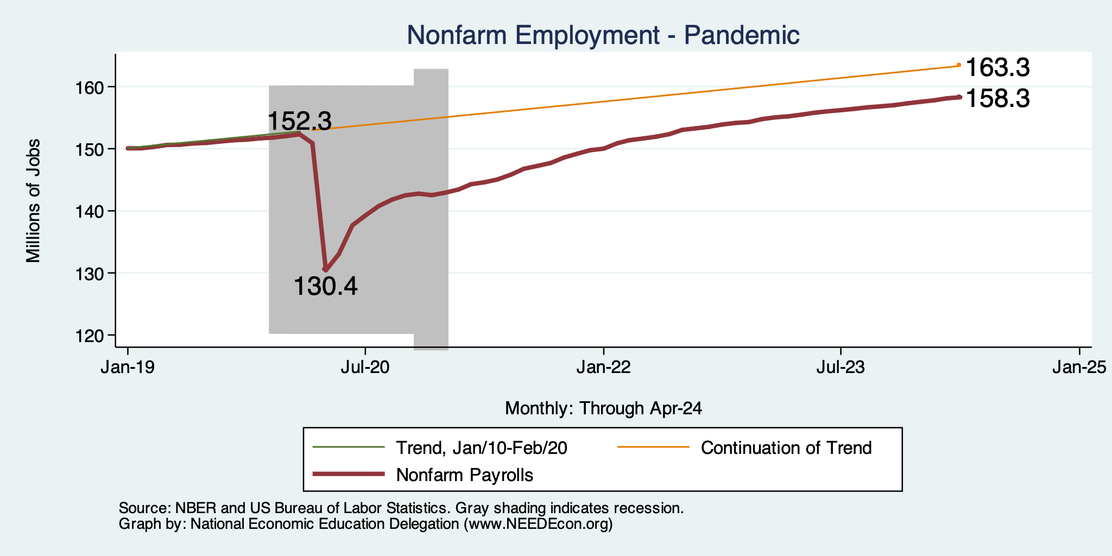
Employment Gap
6.0 Million ABOVE February, 2020.
5.0 Million BELOW where we should be.
Notes:
payroll_recent.png

Slide 13
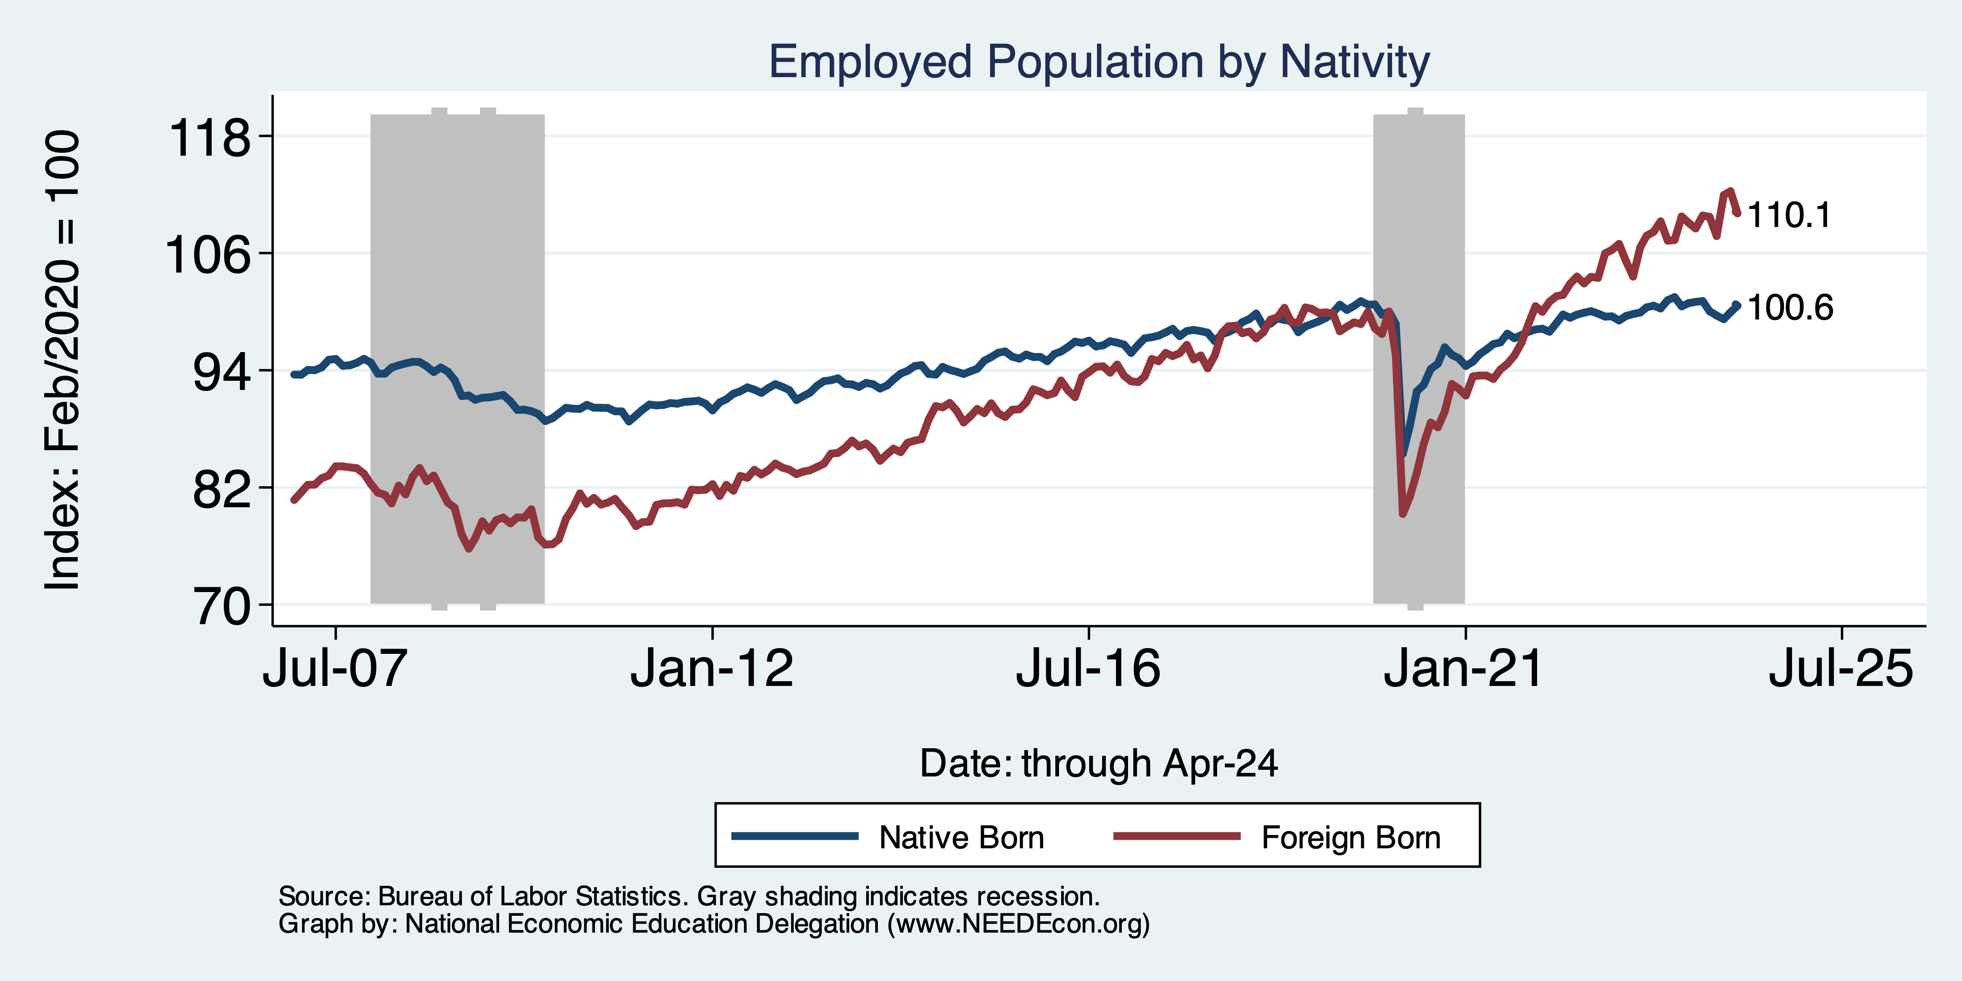
Immigrants to the Rescue?

Slide 14
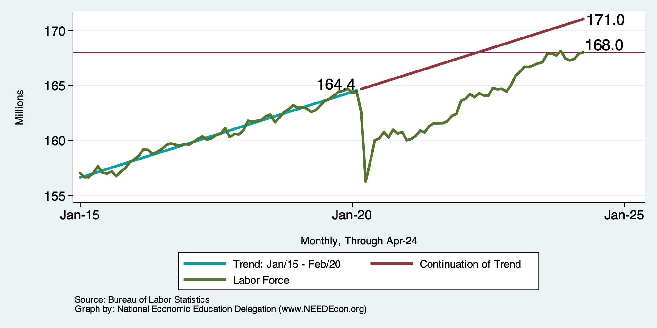
Where Have All the Workers Gone?
3.0 million below where we should be

Slide 15
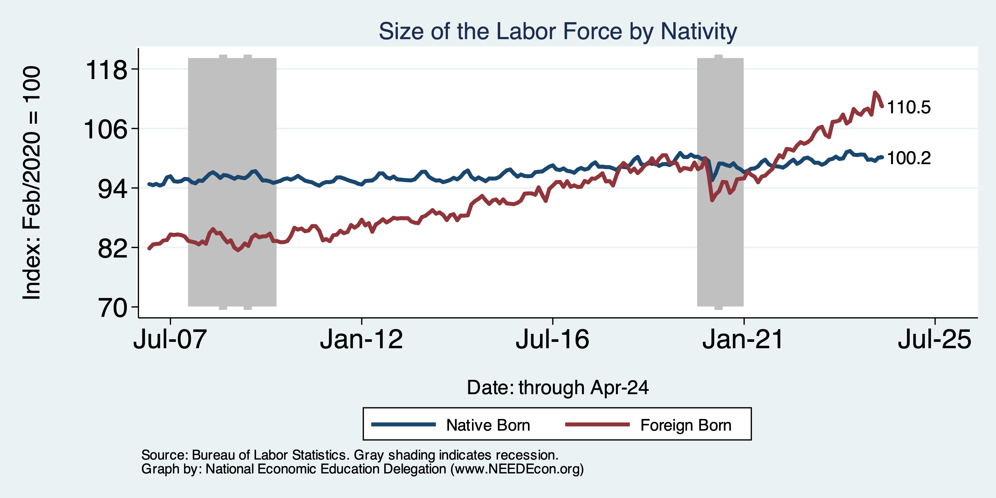
Immigrants to the Rescue?

Slide 16
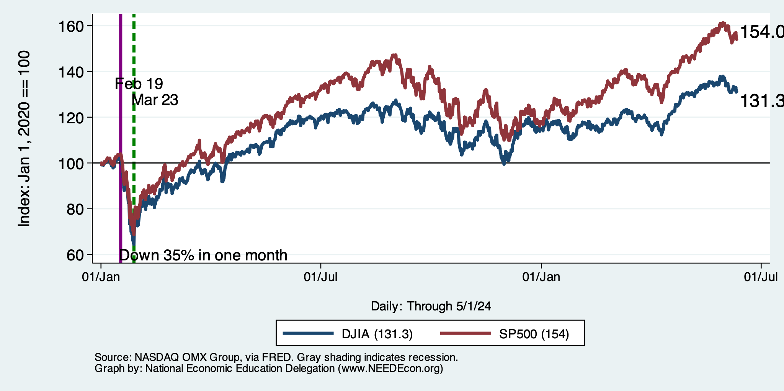
Stock Prices: Didn’t Like The Inflation #s
But they love today’s employment #s
Markets up sharply today!
Notes:
Since the end of 2021, lost almost 15%

Slide 17
Inflation

Slide 18
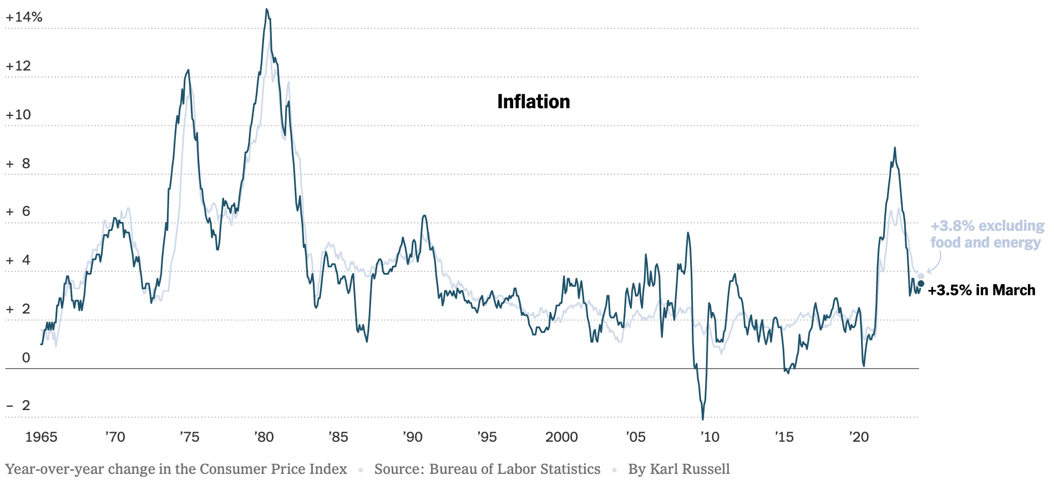
Inflation: Latest Figures
Source: NYTimes.com

Slide 19
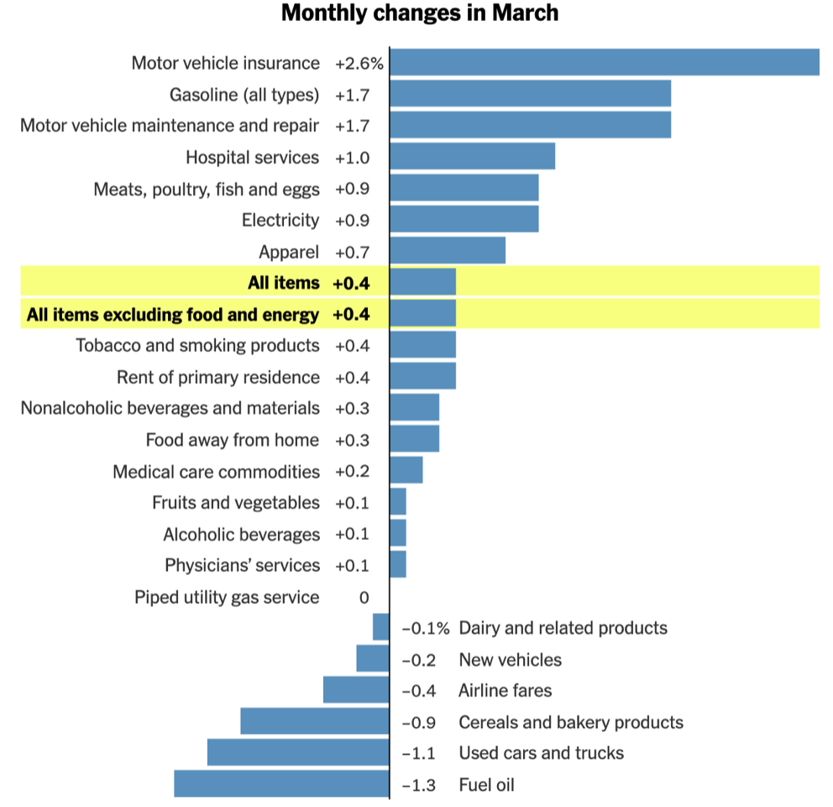
Which Prices?
Car Costs
Housing Costs

Slide 20
The Importance & Problems with Rents
Shelter is 36% of CPI
- 45% of Core CPI.
About half as much in PCE.
Notes:
Shelter is 36% of CPI and 45% of Core CPI. About half as much in PCE. CPI less shelter is 2.3% sine March of last year. Shelter is up 5.8%

Slide 21
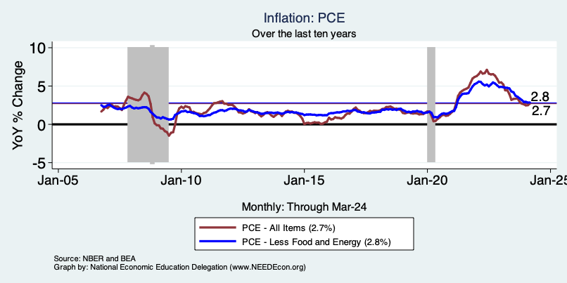
Fed’s Preferred Measure: PCE

Slide 22
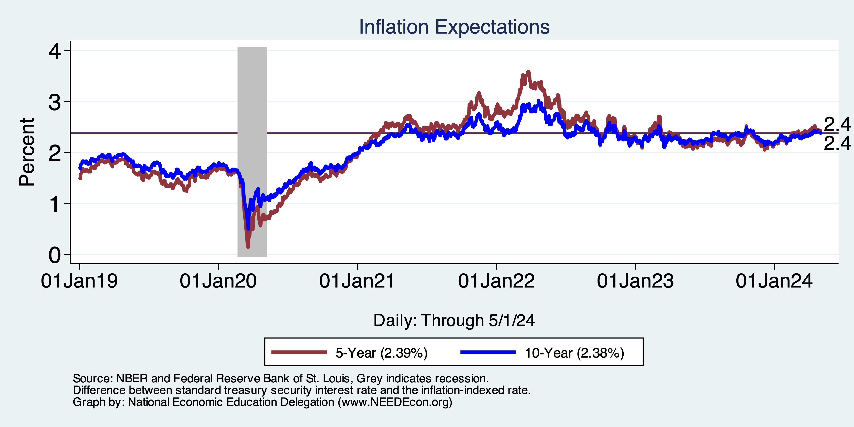
Inflation Expectations
Source: https://www.nytimes.com/2023/01/13/opinion/cpi-inflation-fed.html

Slide 23
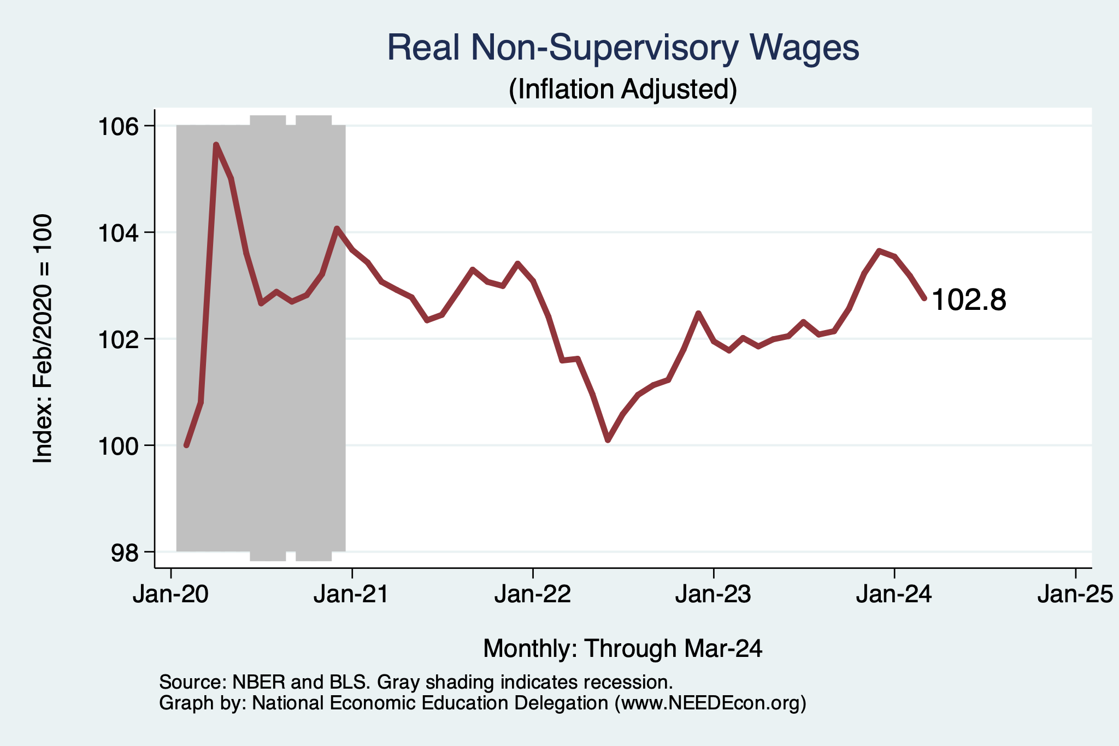
Wage Growth – Exceeds Inflation
Notes:
Is this necessary given the previous slide?

Slide 24
High Prices versus Inflation

Slide 25
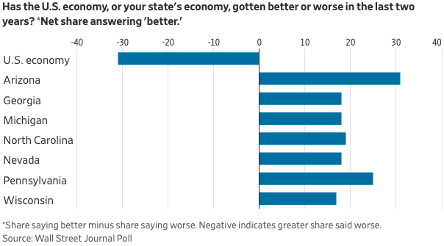
Mismatch: Feelings About the Economy
Source: What’s Wrong With the Economy? It’s You, Not the Data

Slide 26
My Thoughts on the Future of Inflation
Most indicators suggests continued declines.
Market expectations are worsening.
Return to 2% might take a little longer.
Federal Funds rate to stay high for some time.
Popular expectations may take a little while to catch up.

Slide 27
The Fed: Conservative

Slide 28
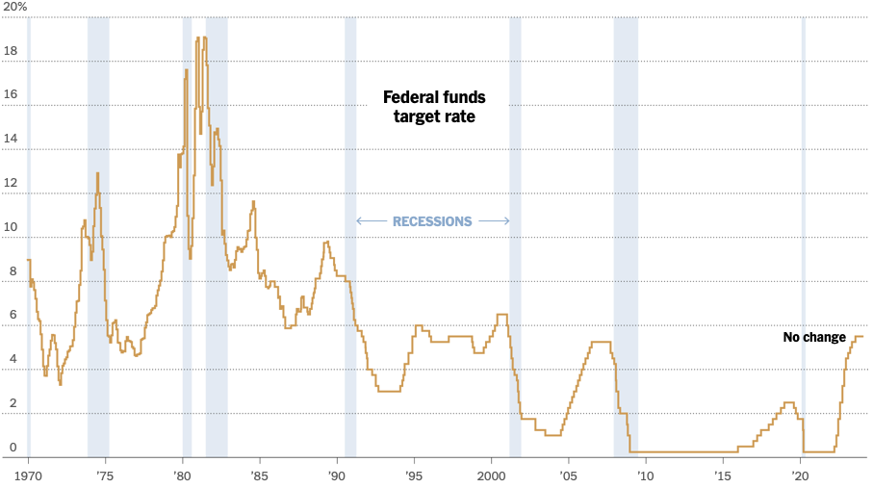
Federal Funds Rate
Holding at 5.5%
Notes:
The fed funds rate is the interest rate on overnight loans between banks. Think of it as the baseline interest rate on which banks base all other interest rates (e.g. mortgage rates)
FOMC lowers the fed funds rate during recessions and raises the fed funds rate during expansions
Fed funds rate peaked in the 1980s as then Chairman Paul Volcker sought to reign in “run away” inflation of the 1970s; doing so resulted in a recession in the early 1980s.
Since the 2008-09 recession, the fed funds rate has been kept near zero.
During the 2008-09 recession, Federal Reserve turned to unconventional tools to influence longer term interest rates to further stimulate the economy - QE
FedFunds.png

Slide 29
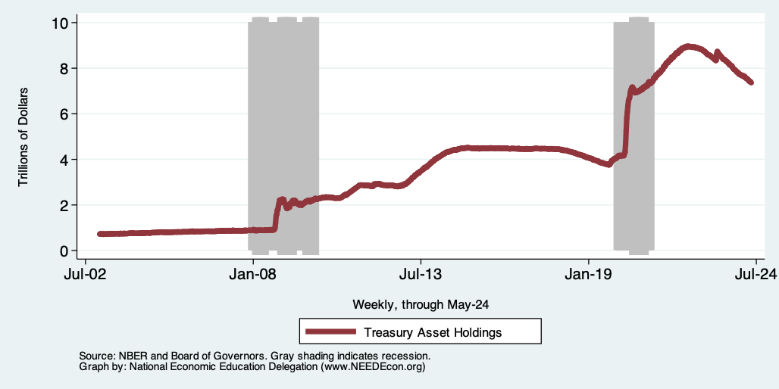
Fed: Reducing its Asset Holdings
Quantitative Tightening

Slide 30
What will the Fed Do?
Pending Developments:
May-June 12 full set of inflation and employment for April.
  Inflation: both CPI and PCEPI
Wednesday, June 12 Fed policy meeting with new economic projections
Notes:
GDPNow 2.4%; blue chips consensus 1.5% implies 2.9%, or 2.7%

Slide 31
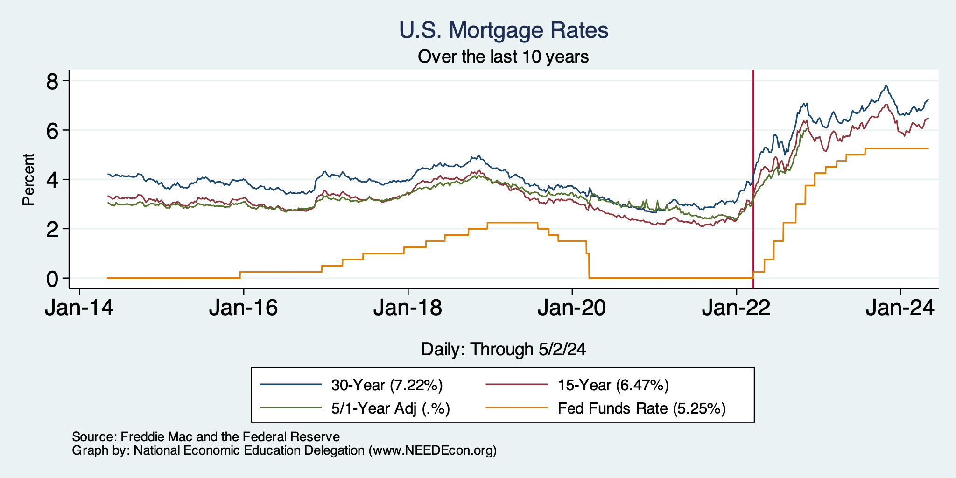
Mortgage Rates

Slide 32
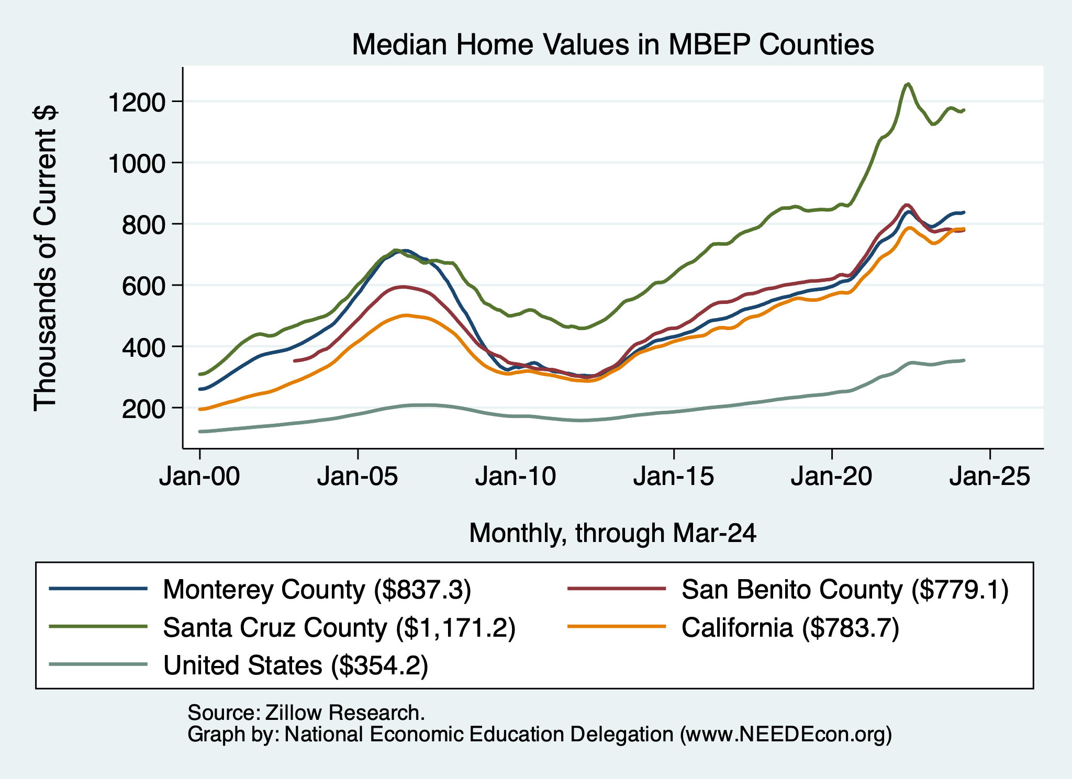
Home Prices Around the MBA
Santa Cruz County
Monterey and San Benito Counties
- and CA
U.S.

Slide 33
If you’d like to see other geographies….
I have these graphs for all CA counties and cities.
I also have graphs of rents for cities.
If you would like some other geography, just let me know:
Jon@NEEDEcon.org

Slide 34
Takeaways
Is a recession on the horizon?
  No.
  Many indicators are in the black.
    2023 2nd half GDP growth was pretty good
Inflation
  Certainly trending in the wrong direction.
  Not worried about it.
    Driven by housing and insurance.
  Fed policy will continue to push against it.
  Likely to recover 2%-ish by middle of next year.

Slide 35
Uncertainties
Conflicts in Ukraine and Israel.
  Global Supply Chains?
  Oil Prices?
  Aid to Ukraine and Israel?
Asset prices (stocks)
Household balance sheets
Fed Actions in a Political Year.

Slide 36
Locally

Slide 37
MBEP Economy: GDP Growth

Slide 38
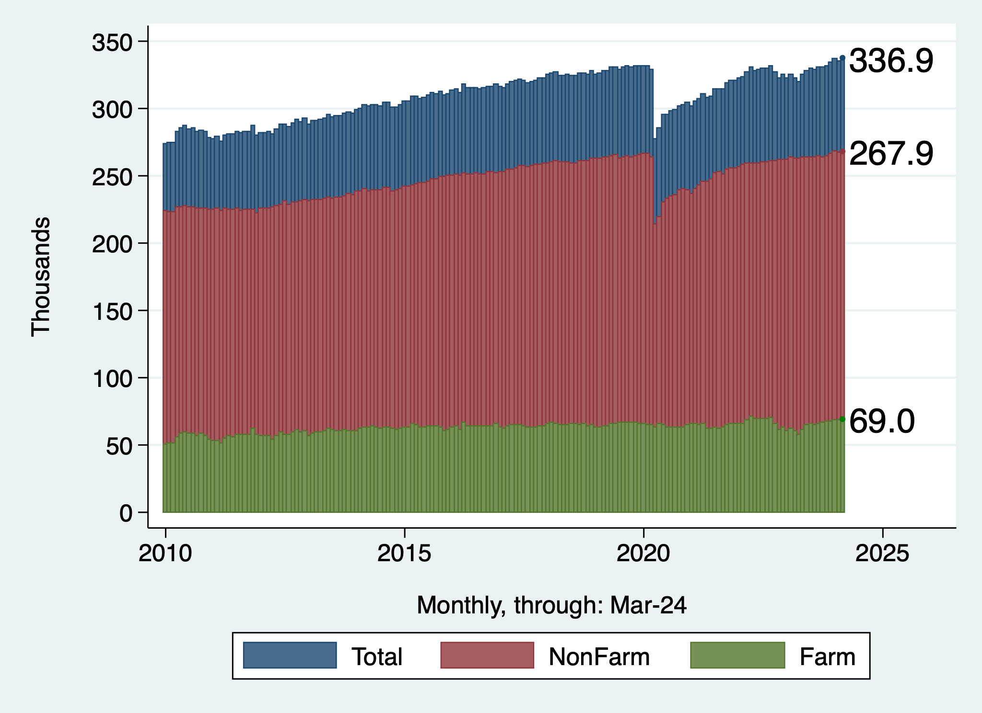
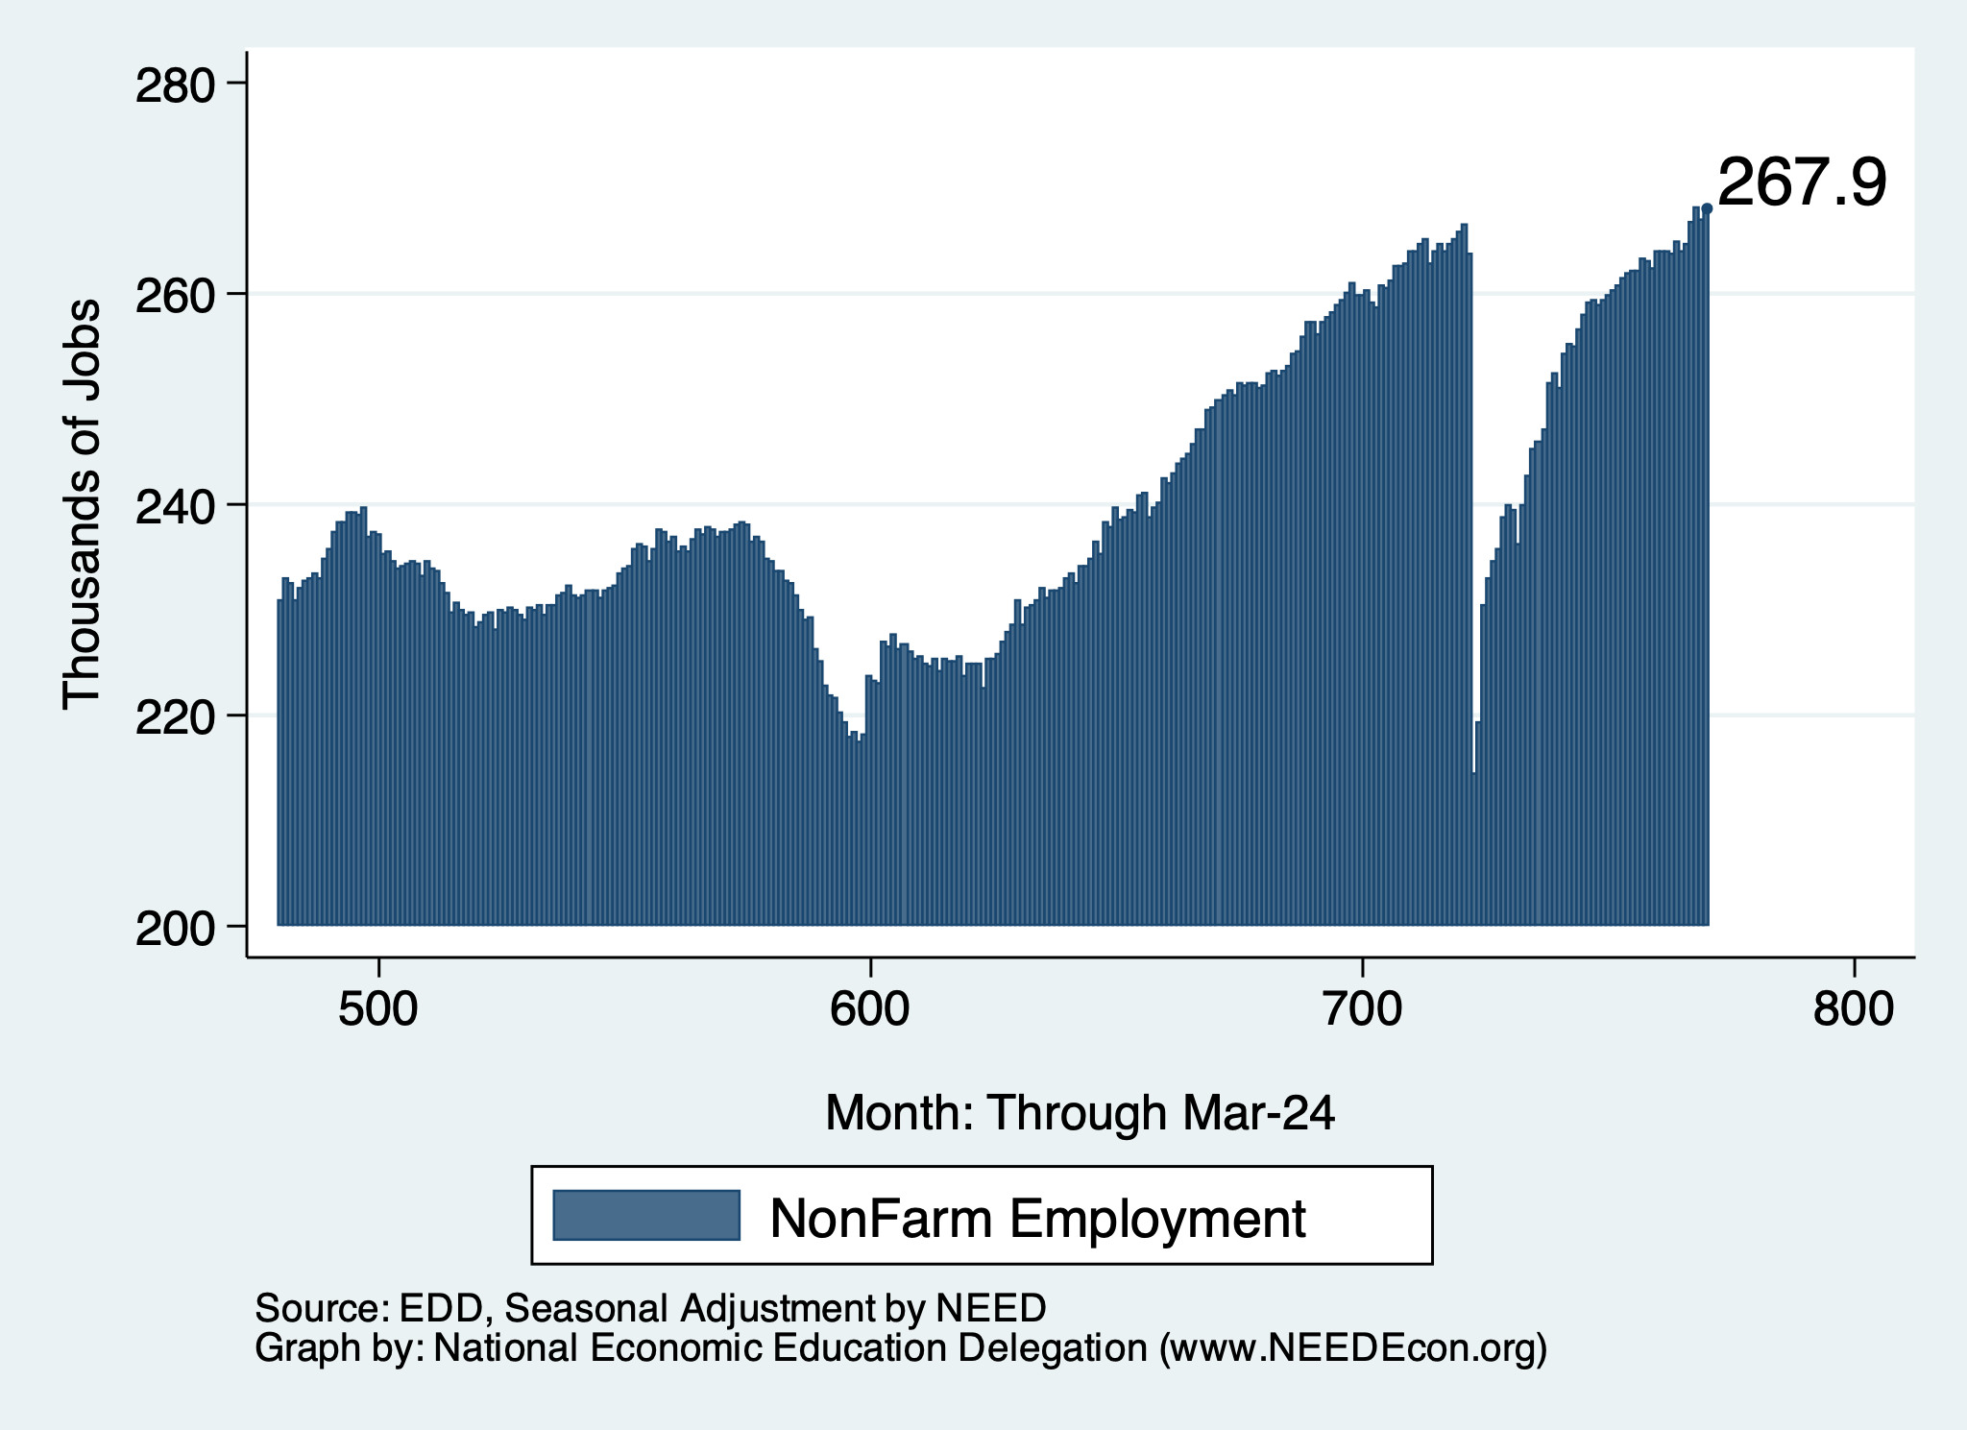
Employment Recovery
Total Employment
NonFarm Employment

Slide 39
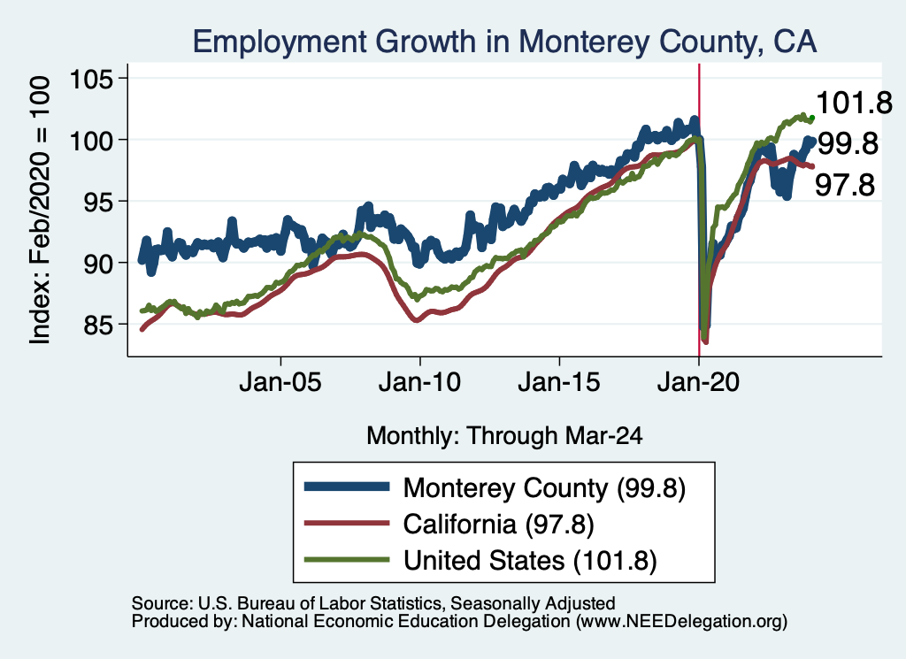
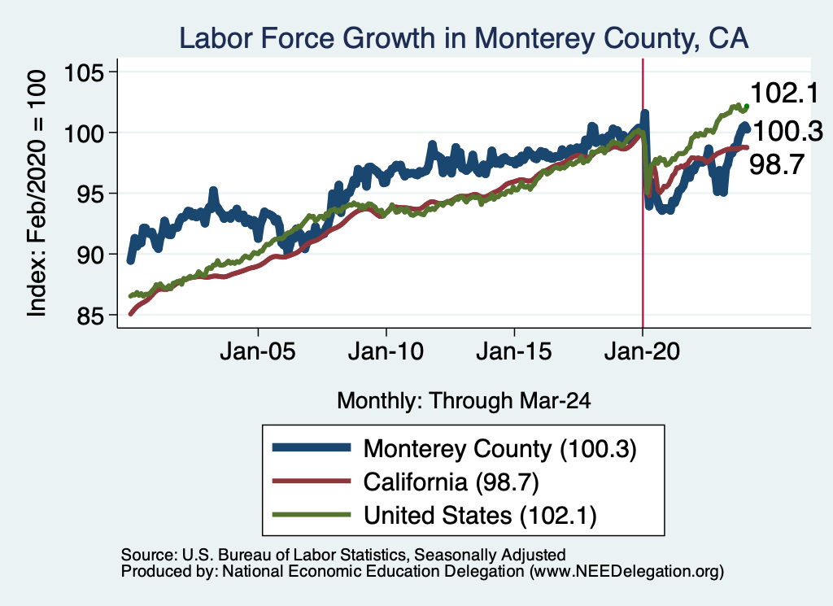
Employment in Monterey County?

Slide 40
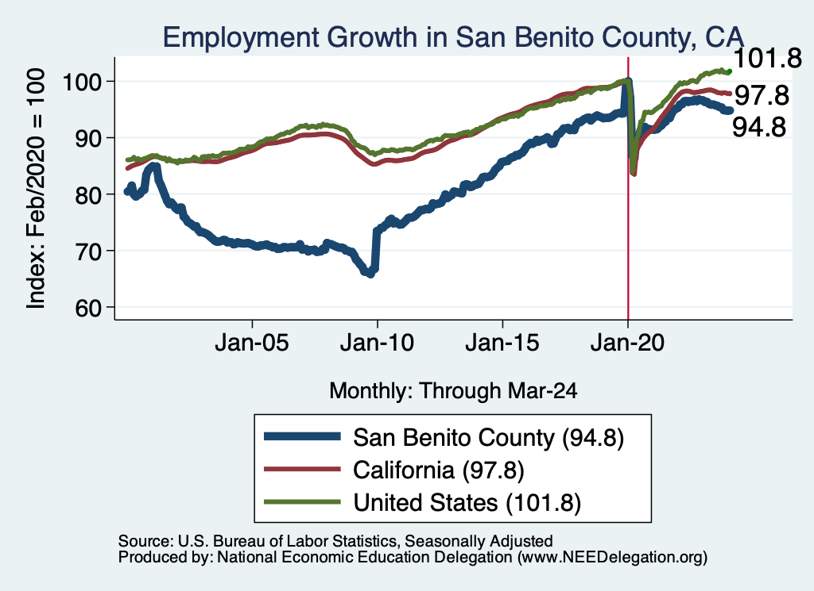
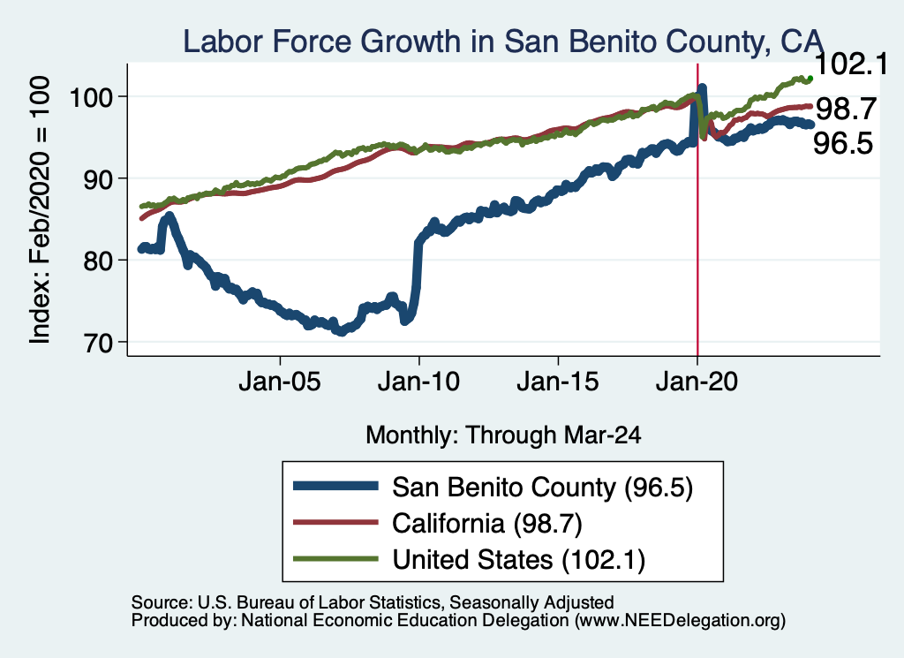
Employment in San Benito County?

Slide 41
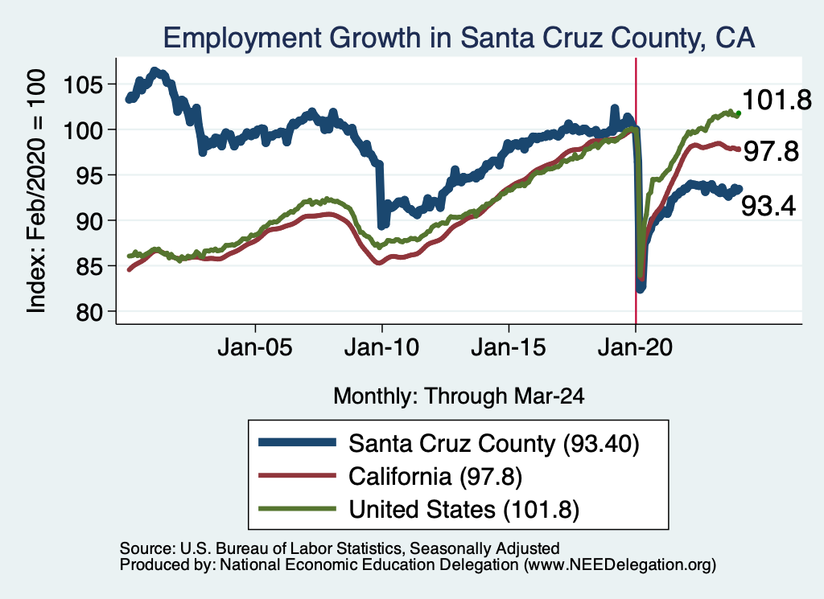
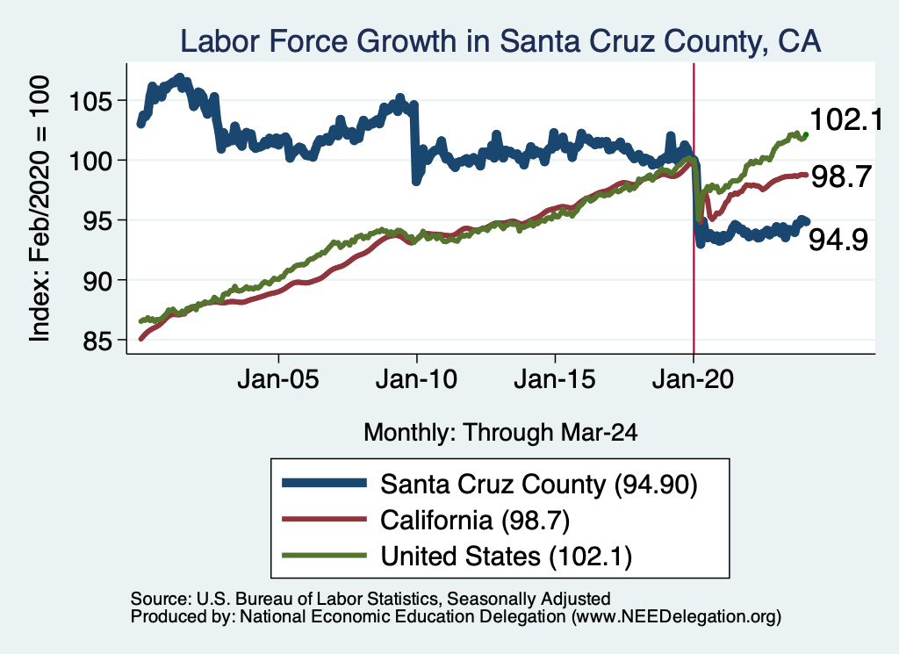
Employment in Santa Cruz County?

Slide 42
MBEP Economy: Employment Patterns

Slide 43
The Pandemic Effect: Employment

Slide 44
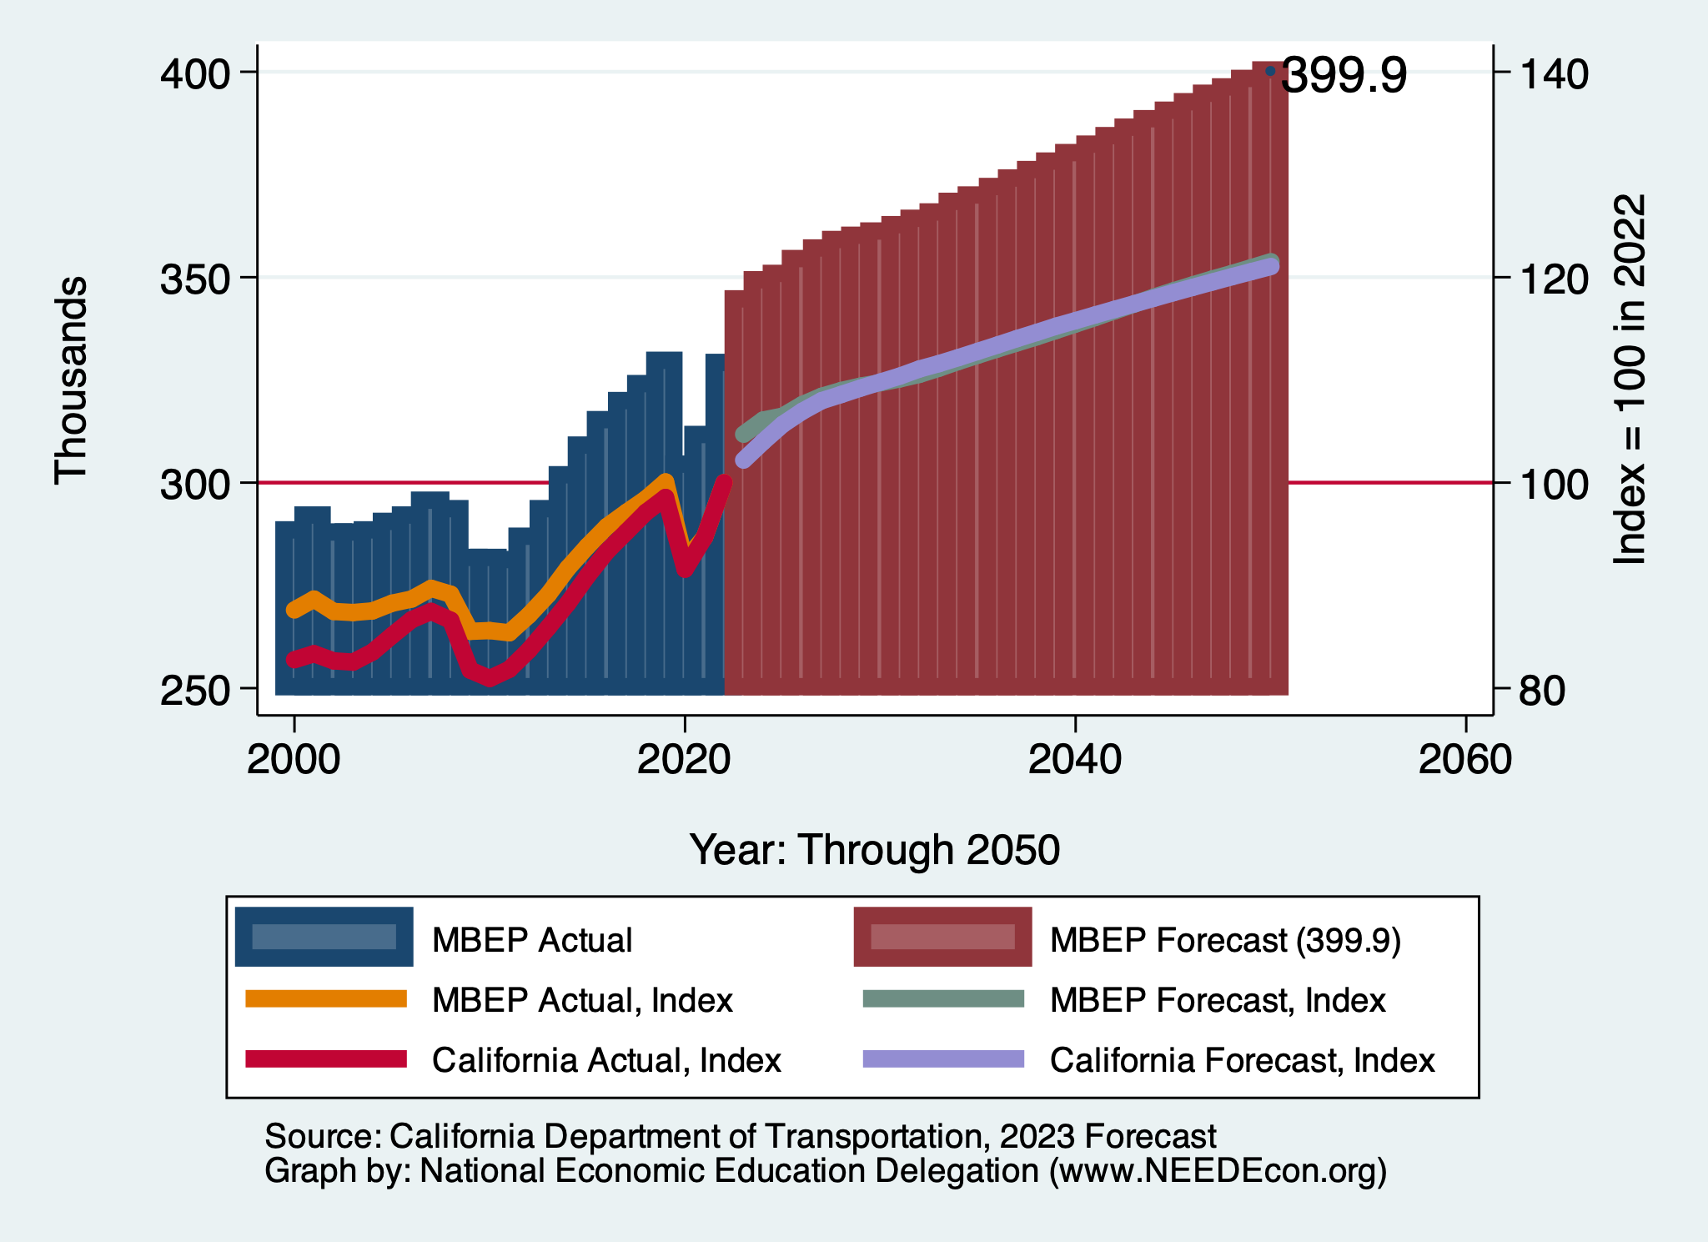
CalTrans Forecast: Employment

Slide 45
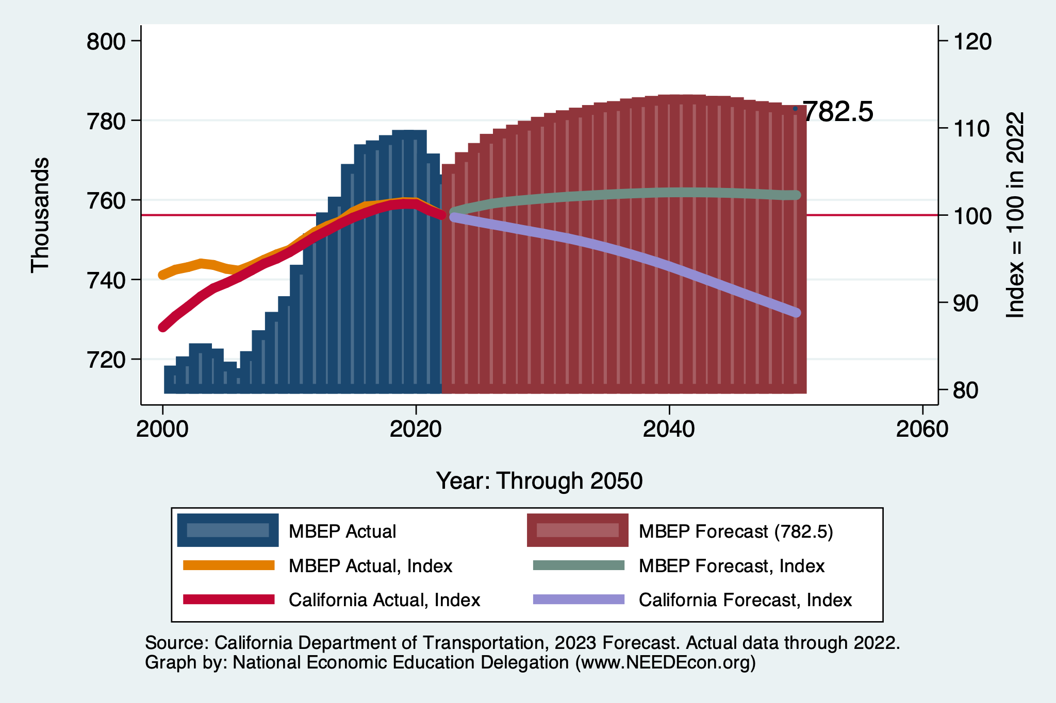
CalTrans Forecast: Population

Slide 46
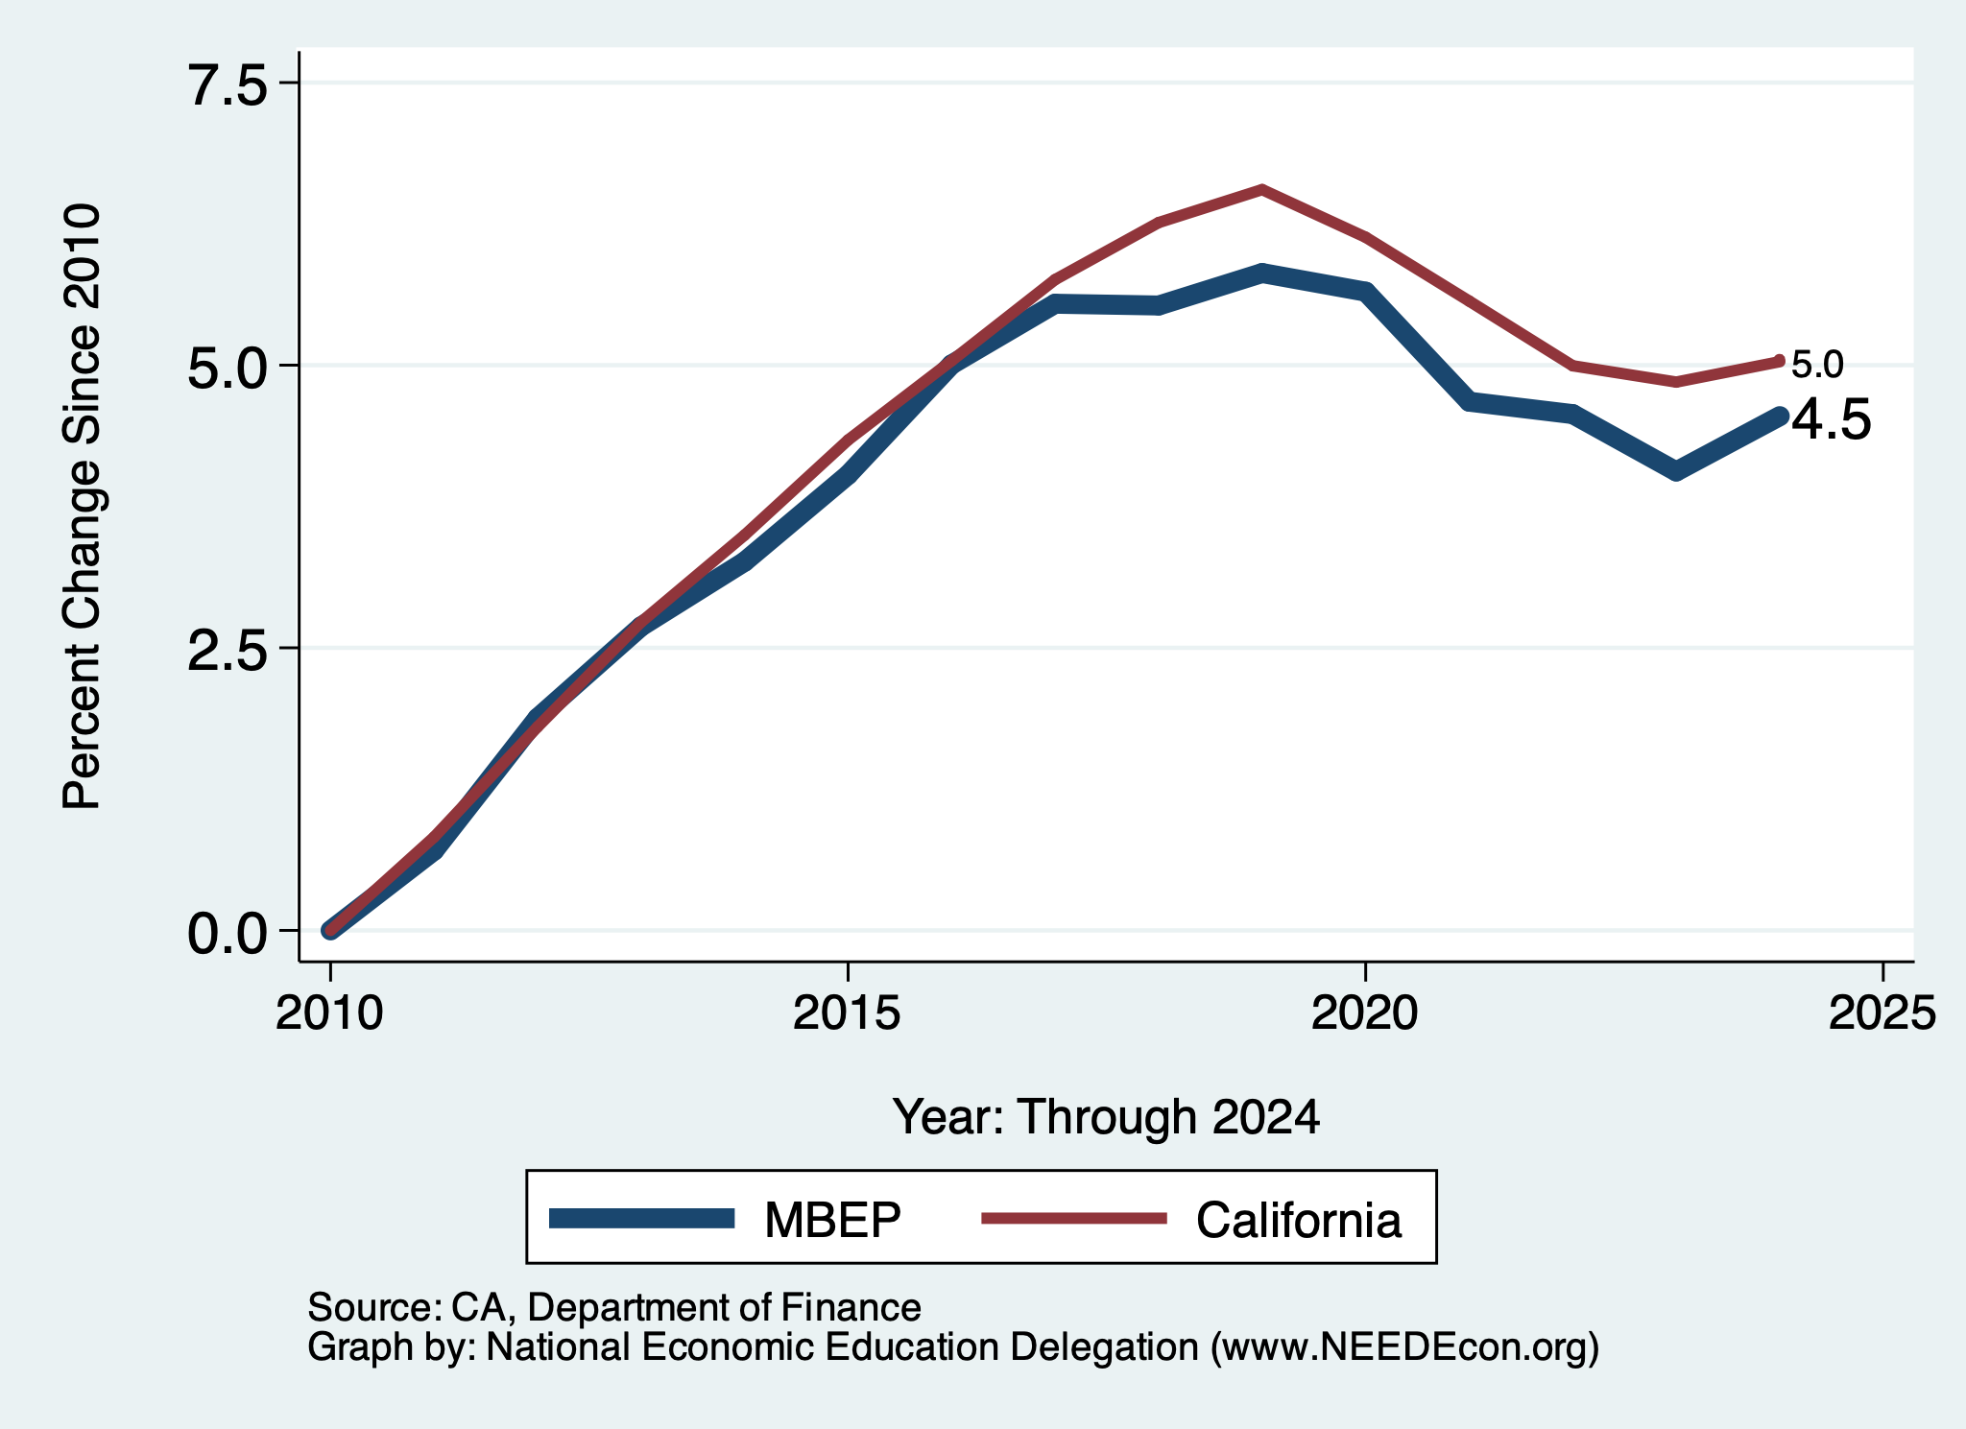
Local Population Change

Slide 47
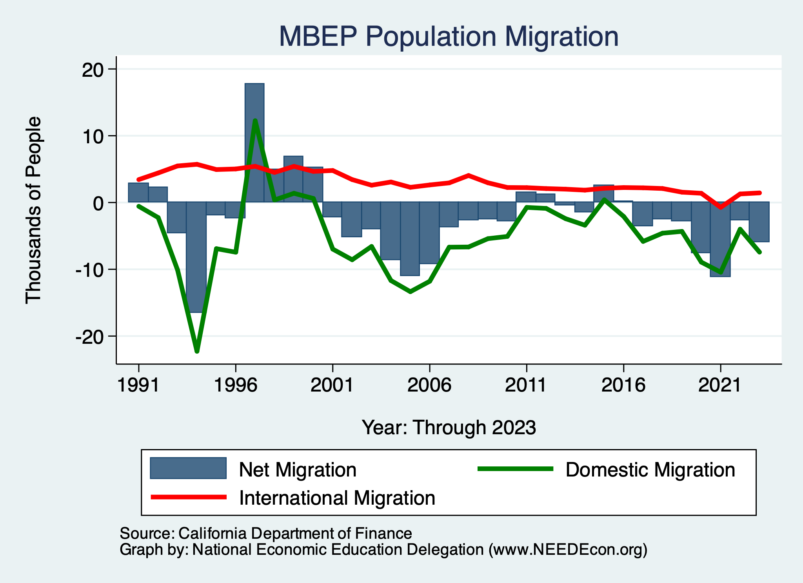
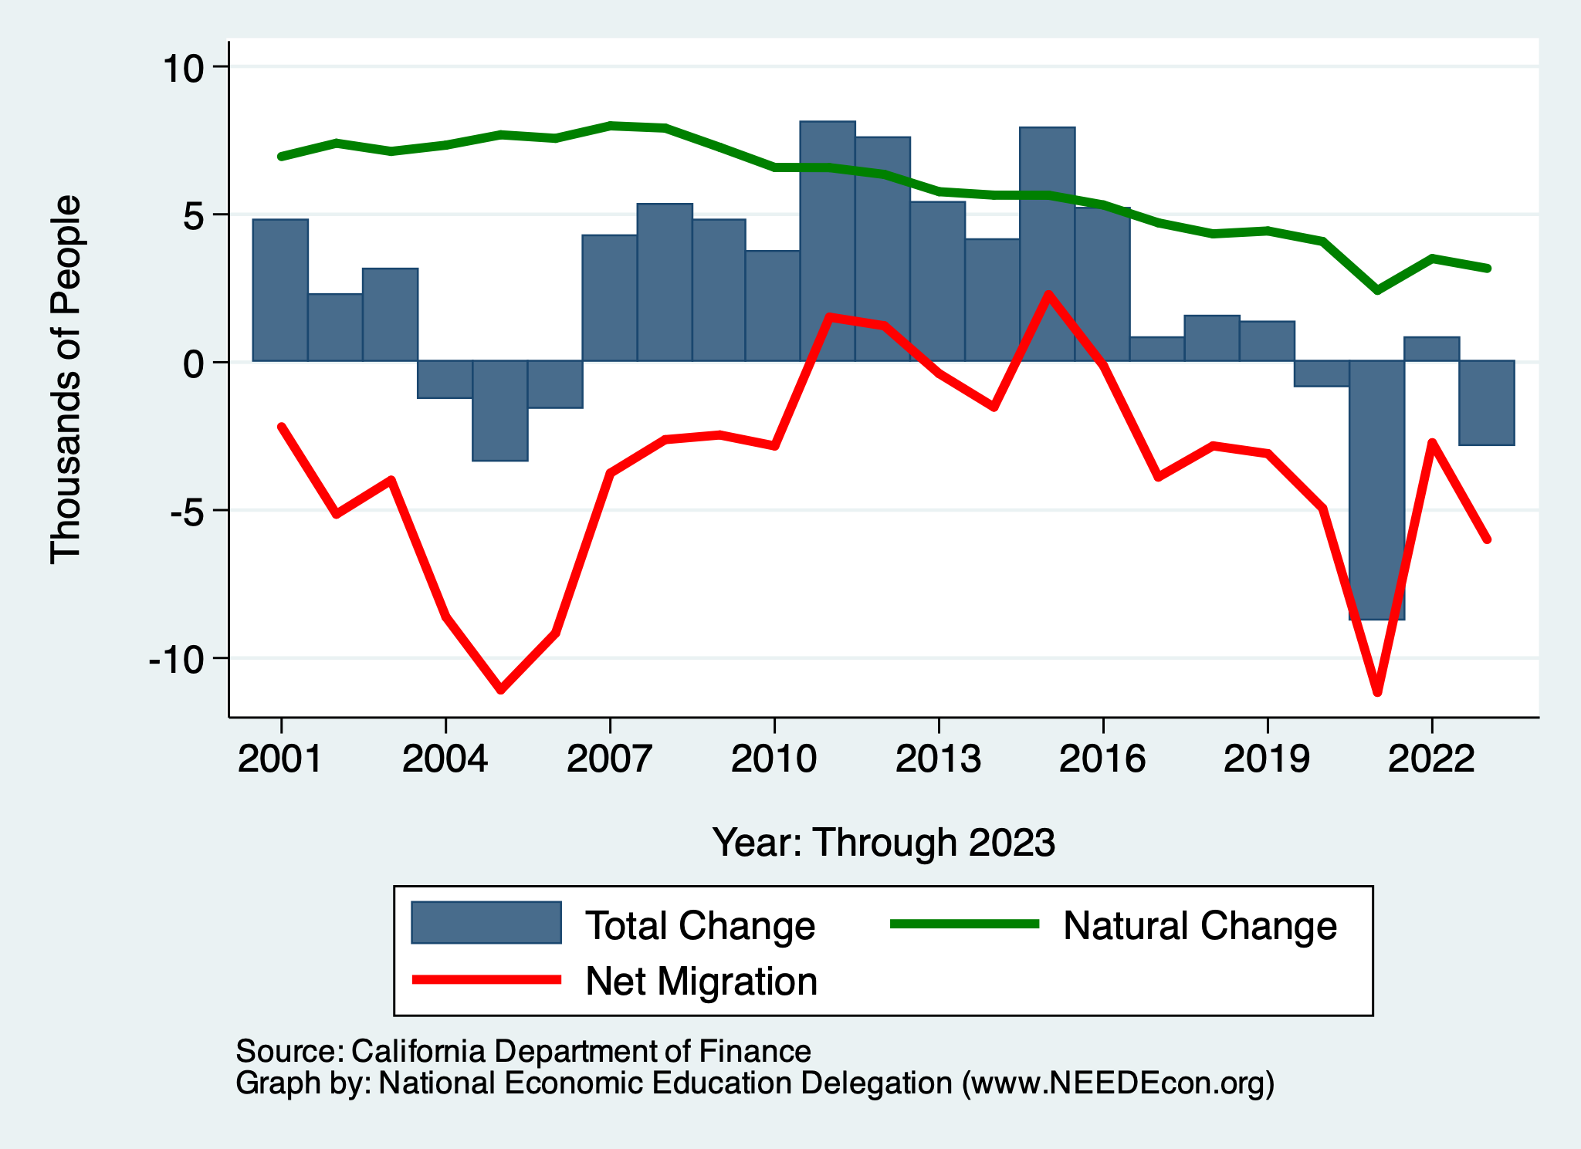
Monterey Bay Area Migration Patterns
Natural Change is in Decline

Slide 48
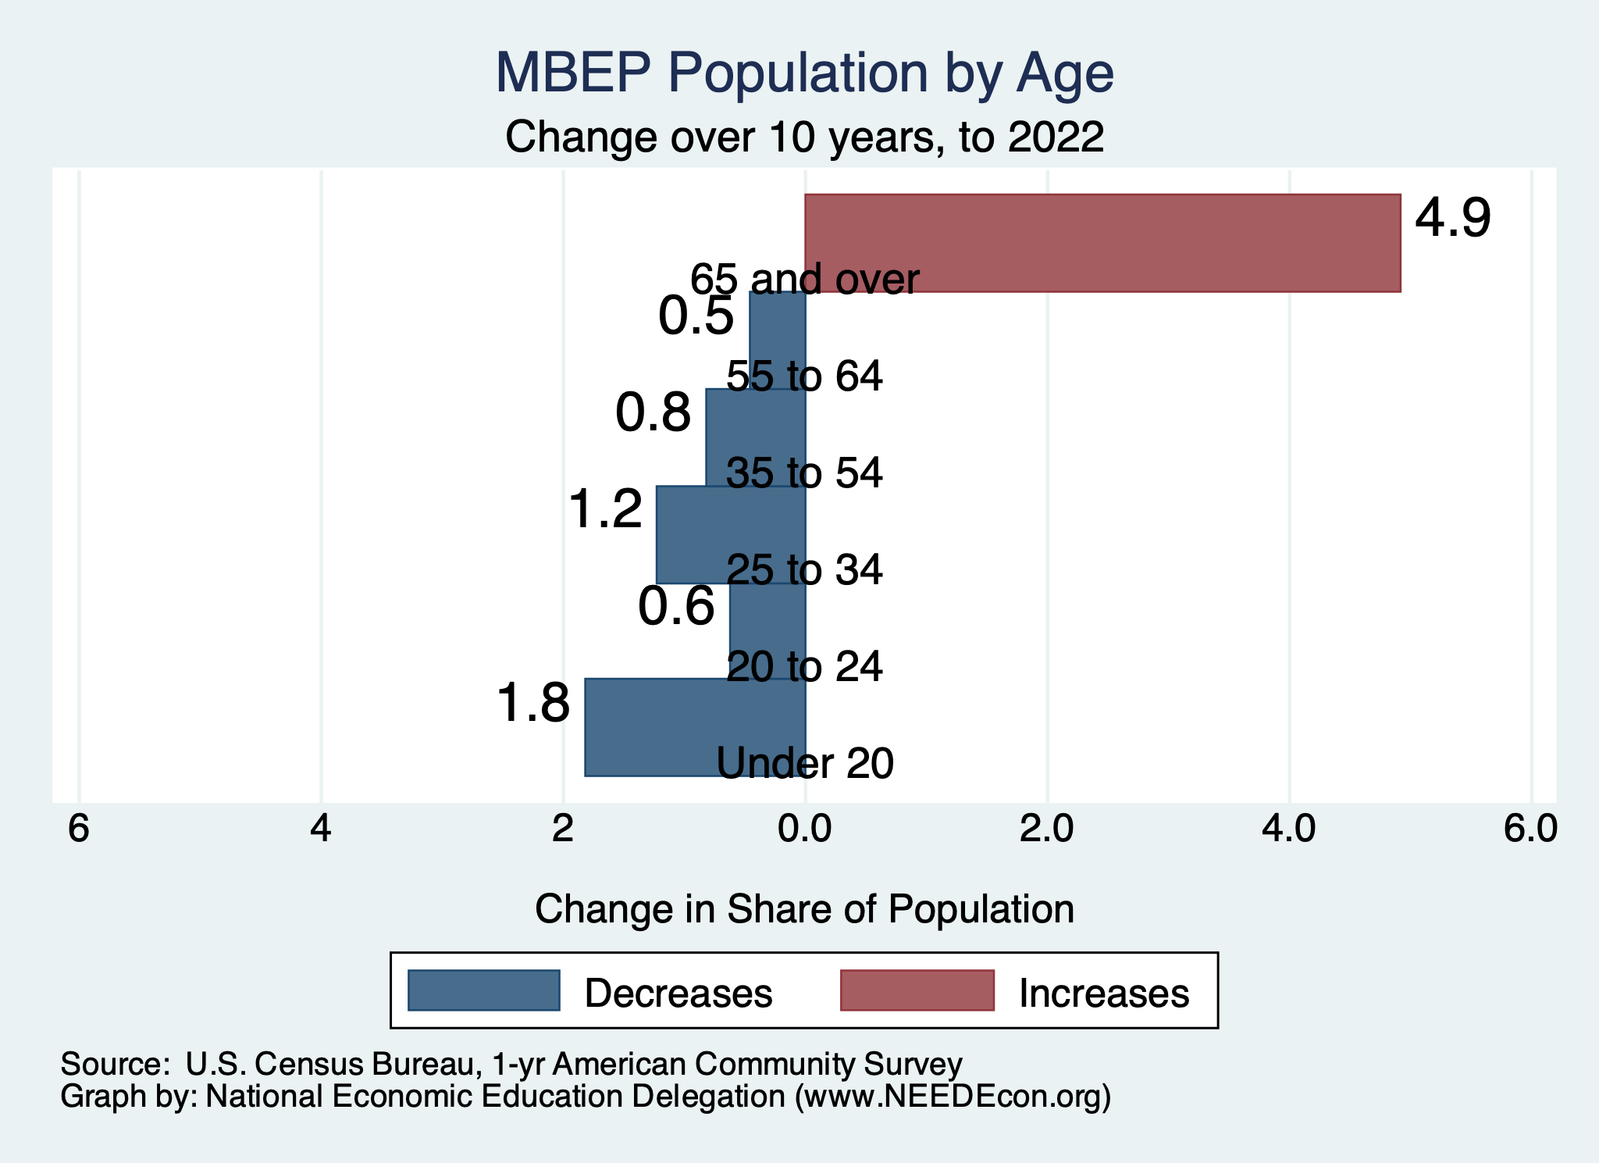
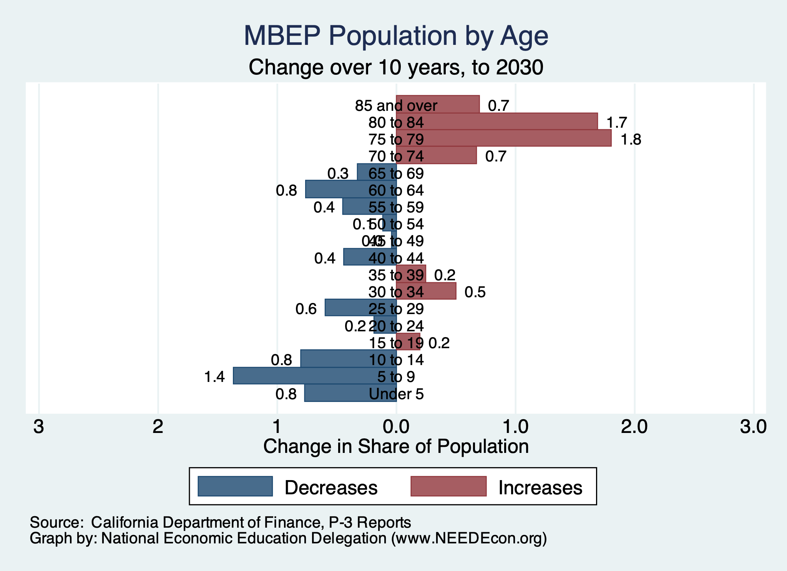
MBA Population Change

Slide 49
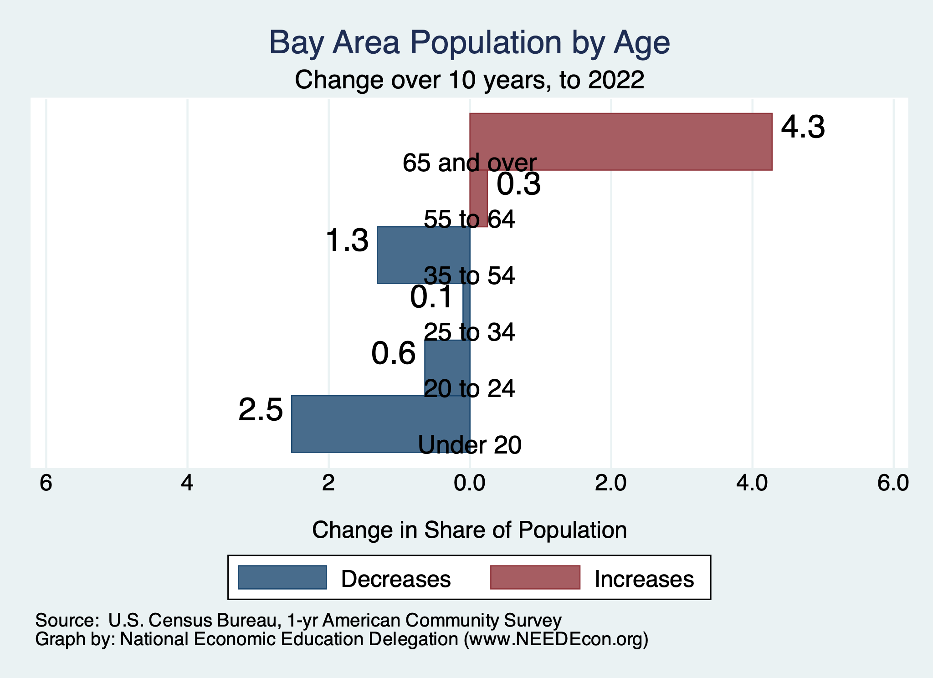
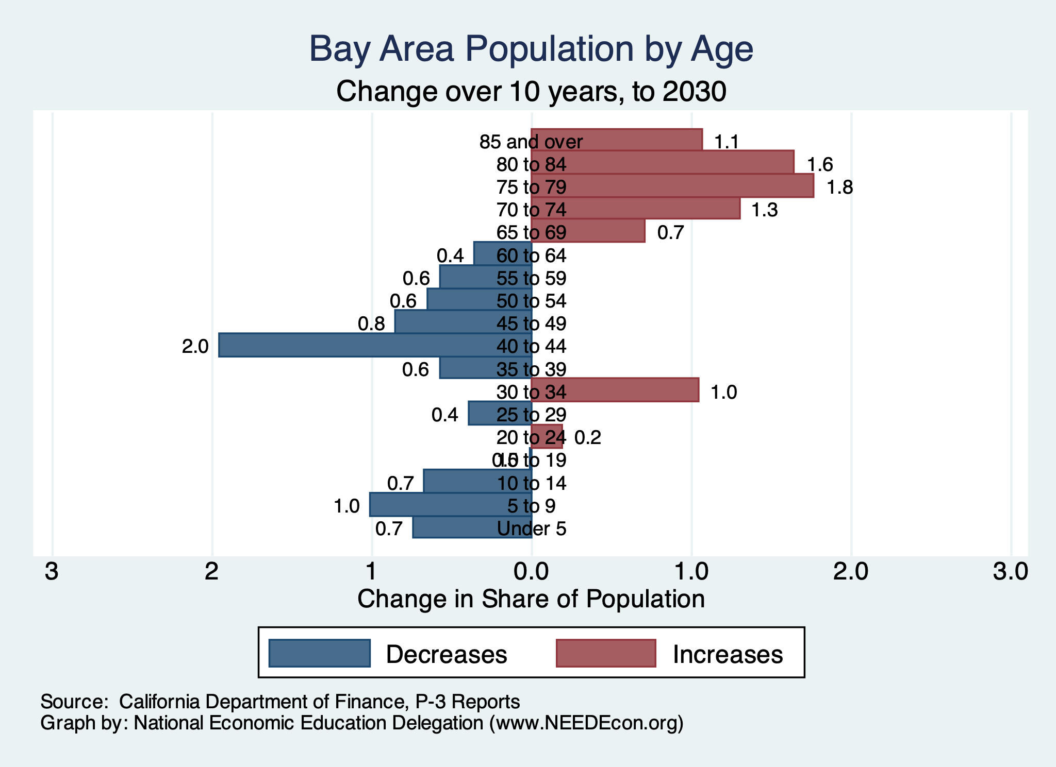
Bay Area Population Change

Slide 50
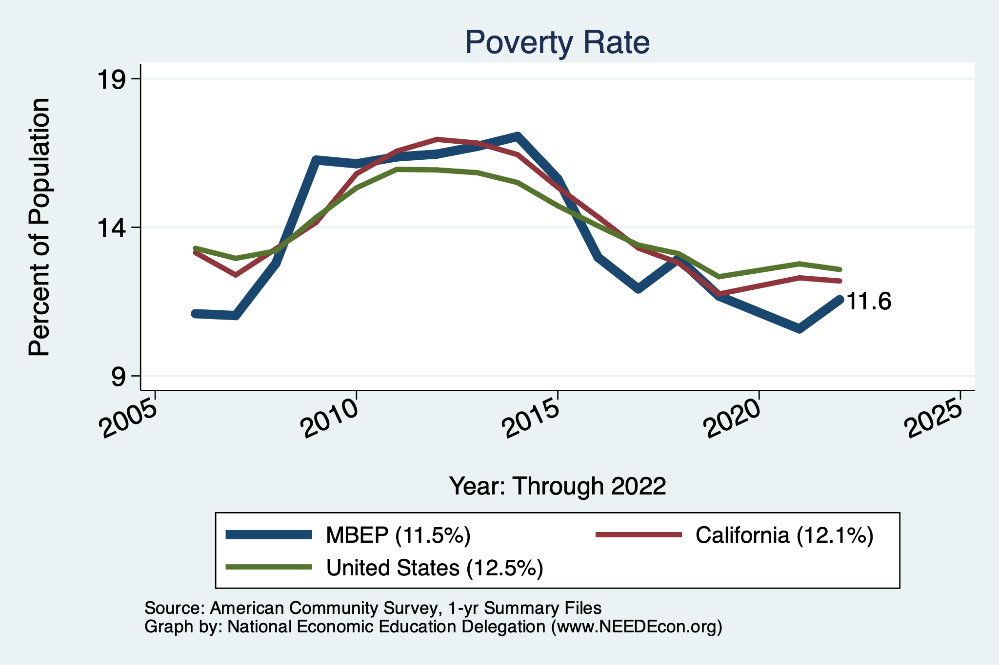
MBA Poverty

Slide 51
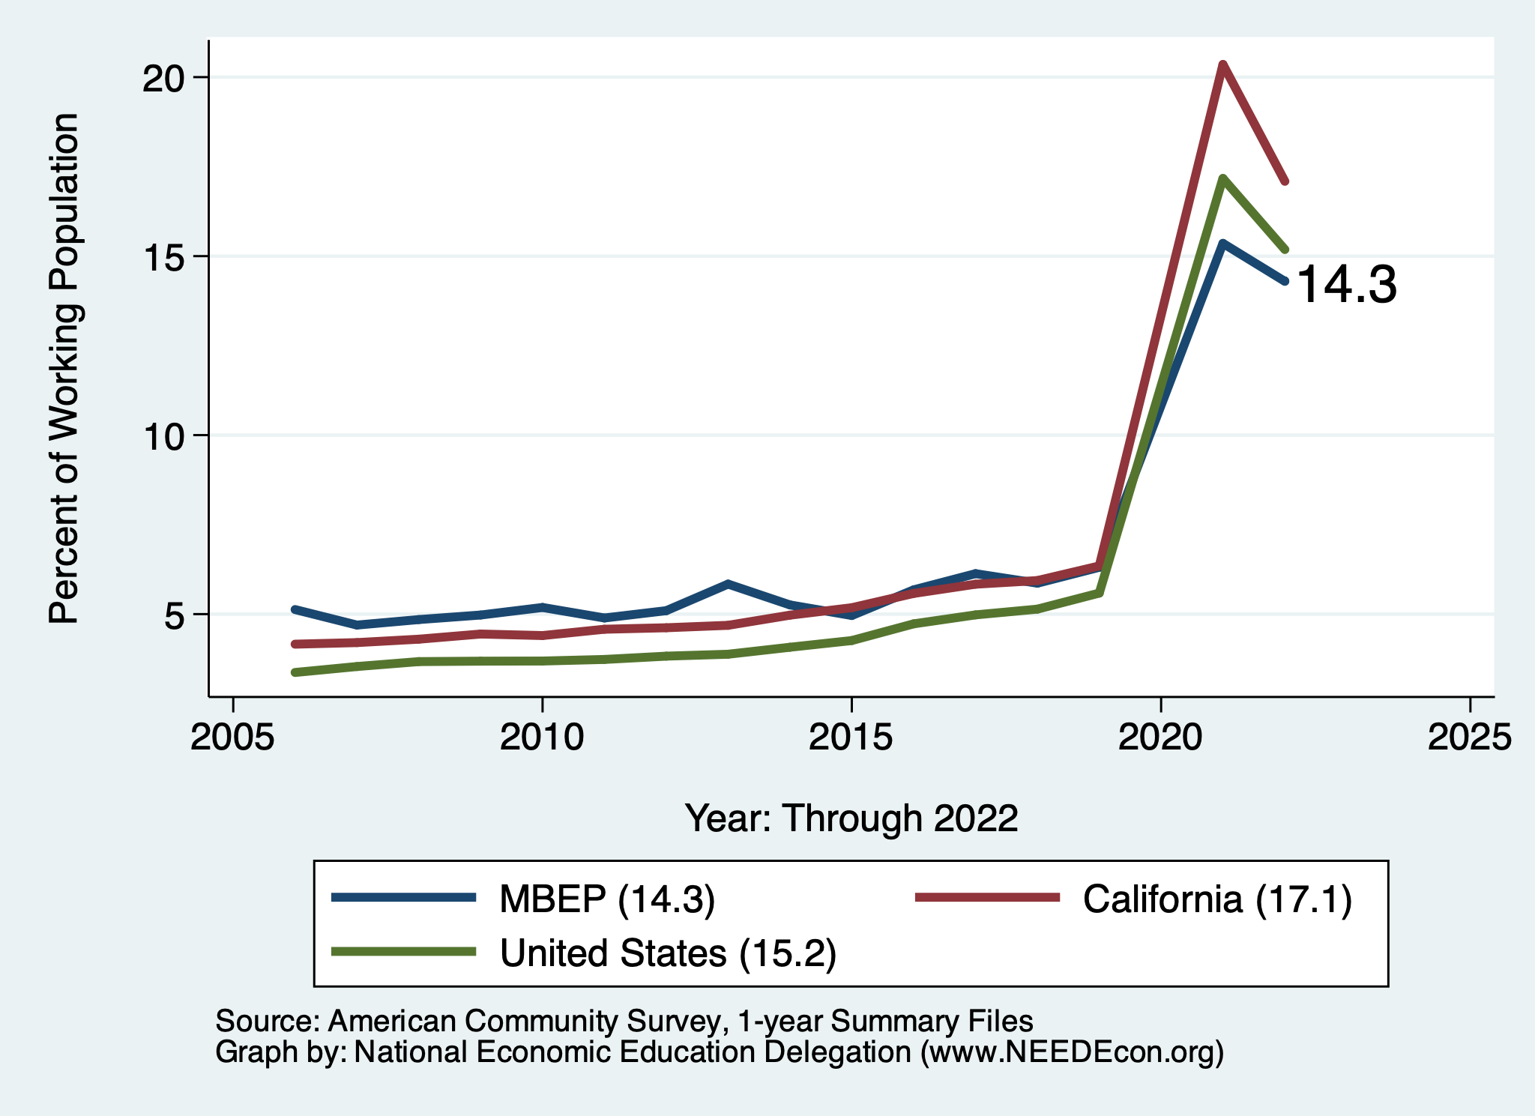
Working From Home

Slide 52
Monterey Bay Area: Summary
Home prices have returned to trend growth.
Aging population will require in-migration to grow the local economy.
  However, recent years have seen more out-migration than in.
Employment recovery is relatively slow.
  Significant growth in manufacturing and information.
  Prospects for employment growth seem favorable.
Poverty rates are low.
  Primarily among adults. Child poverty is low.

Slide 53
Thank you!
Any Questions?
www.NEEDEcon.org
Jon D. Haveman
Jon@NEEDEcon.org
Contact NEED: info@NEEDEcon.org
Submit a testimonial: www.NEEDEcon.org/testimonials.php
Become a Friend of NEED: www.NEEDEcon.org/friend.php

Slide 54
www.NEEDelegation.org/LocalGraphs
For every state and county in the United States.
Detailed graphs on employment, housing, moves, and other statistics.

Slide 55
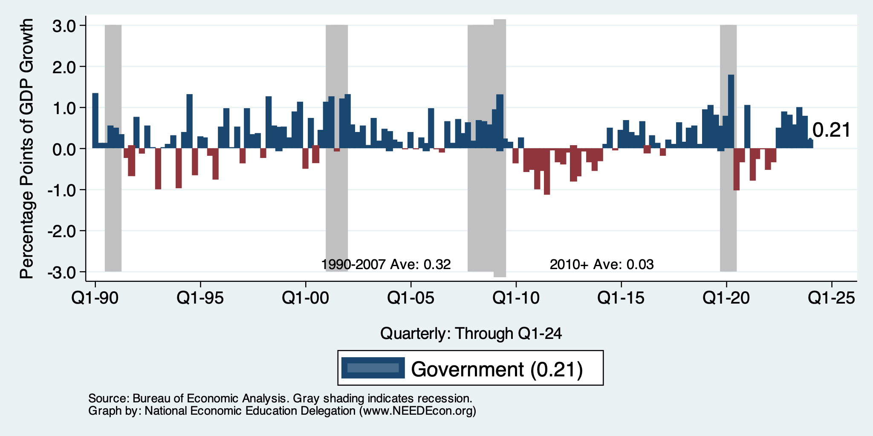
Contributions to GDP: Government
Notes:
Since 2010, average government spending growth is shrinking, resulting in a negative average contribution to GDP growth post-recession of -0.8 percentage points
Note that average quarterly government spending growth is 0.42% from 1990-2007 and -0.17% in 2010+ (annualized, 1990-2007 = 1.68%; 2010+ = -0.70%).

Slide 56
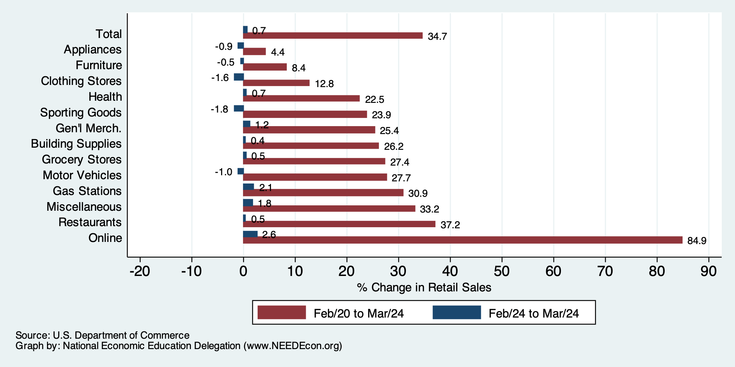
Retail Sales Rose 0.7% in March

Slide 57
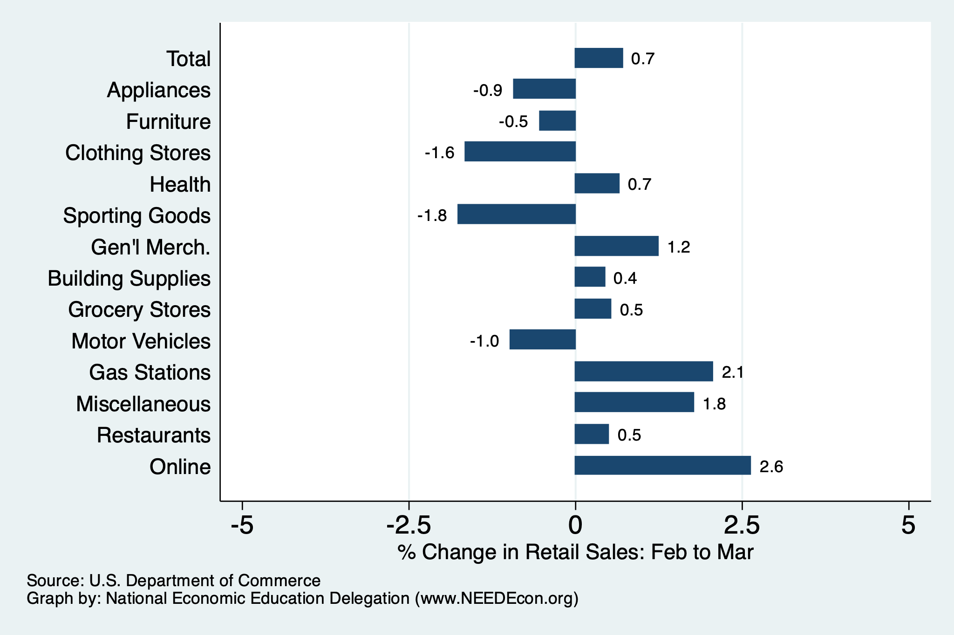
Retail Sales Rose 0.7% in March

Slide 58
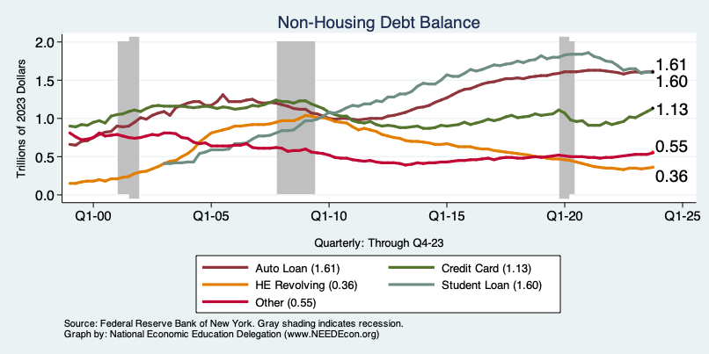
Household Debt: Non-mortgage Sources

Slide 59
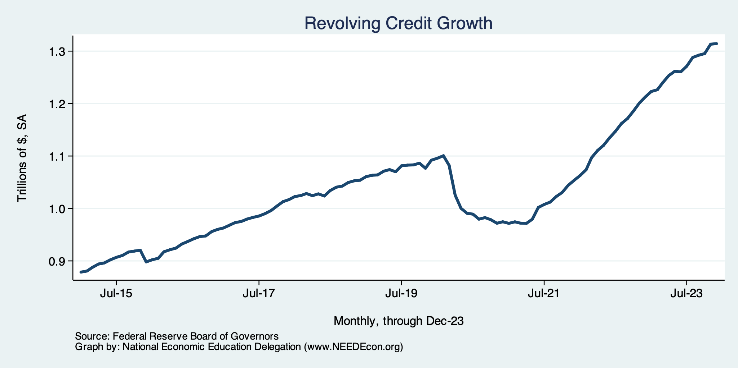
Borrowing on Credit
Notes:
Data/National/FederalReserve/Credit/Programs/rev.png

Slide 60
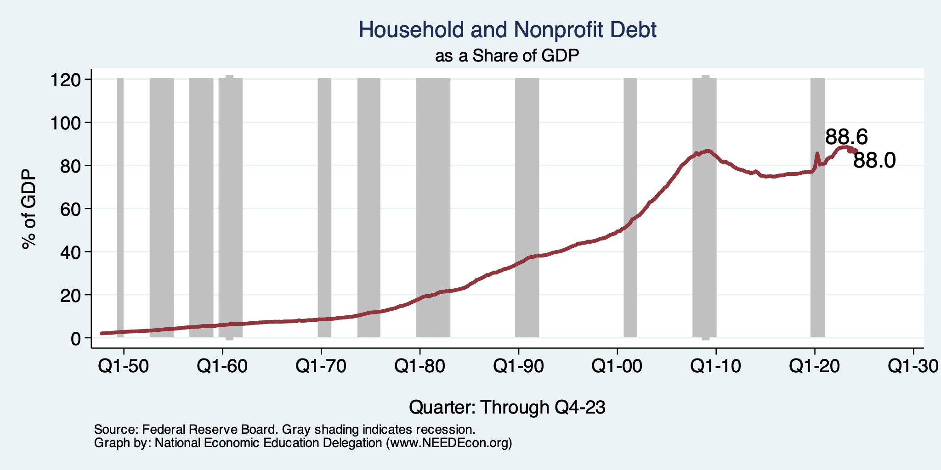
Household Debt as a Share of GDP
Notes:
US household debt relative to GDP rose until the latest recession.
Households have reduced debt relative to GDP 11% since it’s peak in 2008 (at 99%).
Conclusion: Falling household debt likely contributes to slower consumption growth since the recession.
Chart: HHPERCT.png

Slide 61
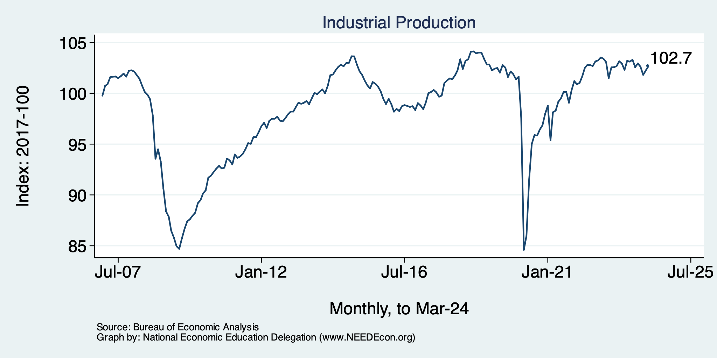
Industrial Production (Manuf, Util, Mining)

Slide 62

Monthly Changes in Nonfarm Employment
Notes:
PAYEMS.png

Slide 63

Some Explanations
500 Thousand: Long COVID Exits
1-2%: Long Social Distancing

Slide 64

Treasuries
Notes:
treas_recent.png

Slide 65



Home Prices … Down Throughout CA
Notes:
Charts:
homeprices_recession.png
housing.png

Slide 66

But SUPER High to Begin With!

Slide 67


Home Prices and Housing Starts
Notes:
Charts:
homeprices_recession.png
housing.png

Slide 68


Home Sales are Not Horrible

Slide 69

Supply Chains

Slide 70

Is Immigration Saving the Day?
Source: https://www.axios.com/2024/03/13/immigration-economy-jobs-growth-good#

Slide 71
The “Nominal” Side
Inflation: A lot of progress on inflation, but the recent data are troubling.
But, this is not the popular view

Slide 72


Slide 73

Inflation in the Last 3/6 Months – Still 3%
Source: https://www.nytimes.com/2023/01/13/opinion/cpi-inflation-fed.html

Slide 74

Housing is the Primary Problem

Slide 75

Working From Home

Slide 76


Working From Home

Slide 77

Santa Cruz Economy: Employment

Slide 78

Monterey County Economy: Employment

Slide 79

San Benito County Economy: Employment

Slide 80

Santa Cruz Economy: GDP Growth

Slide 81

San Benito Economy: GDP Growth

Slide 82

Monterey Economy: GDP Growth

Slide 83


MBA Population Age Distribution

Slide 84

CalTrans : Santa Cruz County Population

Slide 85

CalTrans: Monterey County Population

Slide 86

CalTrans: San Benito County Population

Slide 87

MBA Poverty

Slide 88

Monterey Bay Area Real Estate

