Slide 1
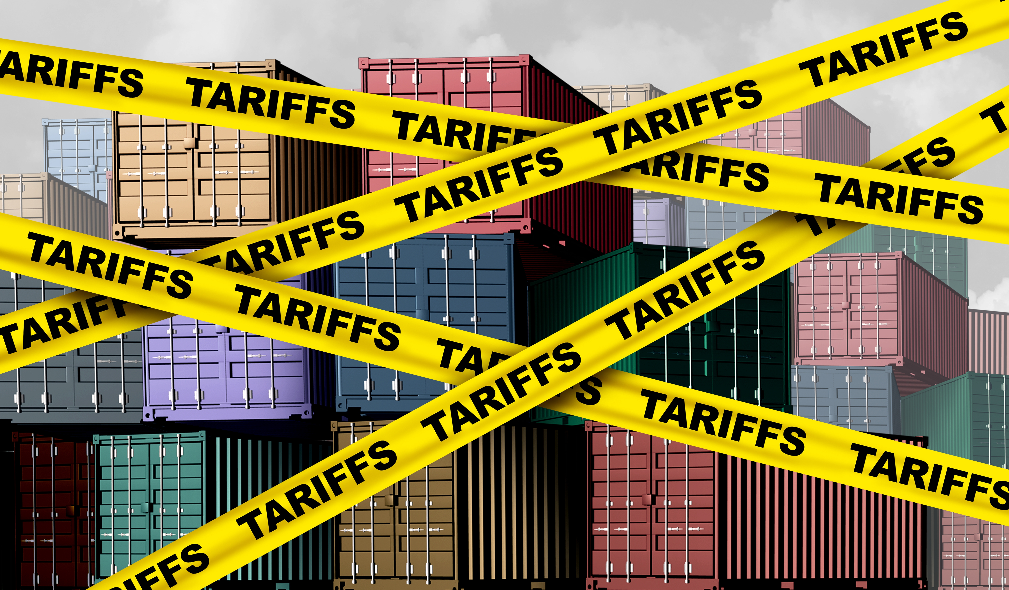
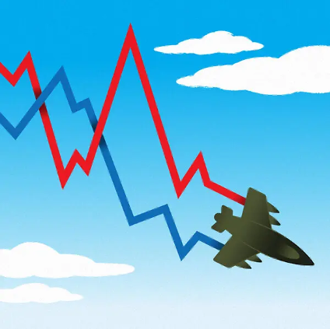

U.S. Economic Update
Thinktank Thursdays
Loch Lomond Yacht Club
Jon Haveman, Ph.D.
NEED
May 21, 2026

Slide 2
Outline
The U.S. Economy
Economic Indicators
Big Picture: Uncertainty

Slide 3
Some Basic Statistics, April 2026
Statistic: | Value
Population | 342.5 Million
Labor Force | 170.1 Million
Employment | 162.8 Million
Gross Domestic Product (GDP) | $31.4 Trillion
Income per Capita | $77,354
Ave. Hourly Earnings | $37.38
Source: fred.stlouisfed.org

Slide 4
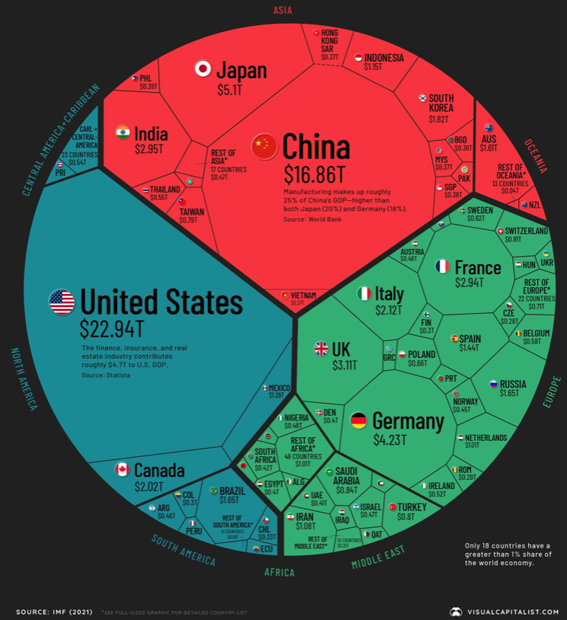
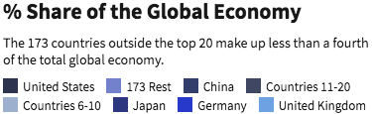
U.S. Economy in Global Perspective
U.S. Nominal GDP:
$21.9 trillion in 2019-Q4
$19.9 trillion in 2020-Q2
$31.9 trillion in 2026-Q1
Notes:
https://www.investopedia.com/insights/worlds-top-economies/#countries-by-gdp

Slide 5
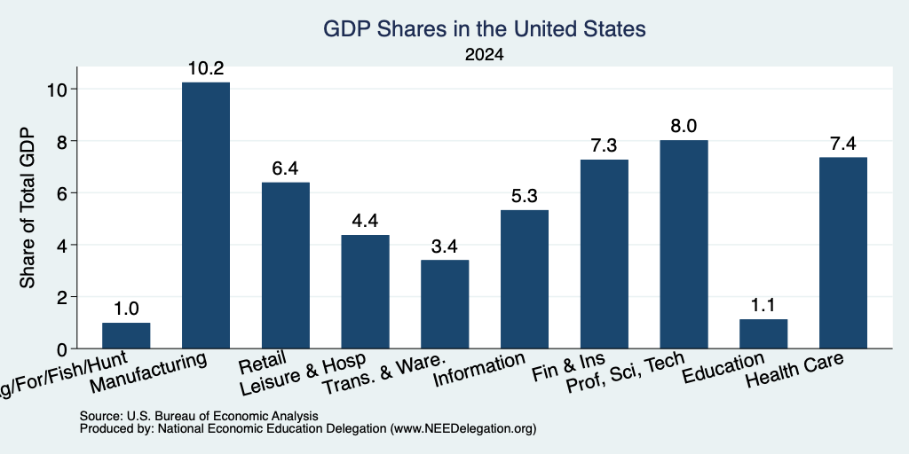
Composition of the U.S. Economy: GDP

Slide 6
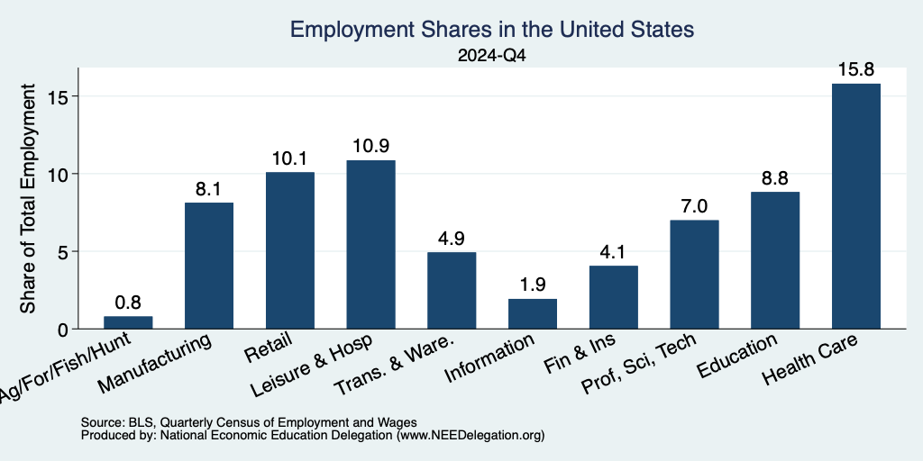
Composition of the U.S. Economy: Employment
Manufacturing
GDP Share = 10.3%
Health GDP Share = 7.1%
Note: Does not add to 100% because of omitted sectors.

Slide 7
Economic Indicators

Slide 8
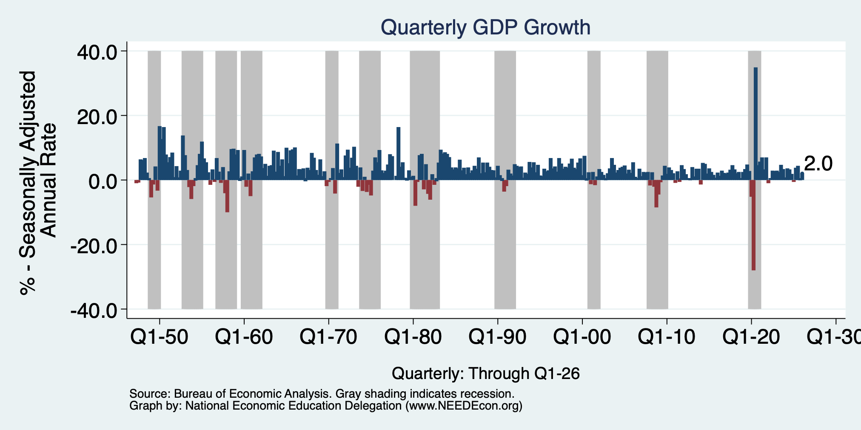
GDP: Quarterly Growth
Q2-2025: 3.8%
Q3-2025: 4.4%
Q4-2025: 0.5%
Q1-2026: 2.0%
Growth in 2025: 2.1%
Notes:
Graph: gdp_pot_grow.png
The Point: From 1990 – 2007, average annual US GDP growth pre-crisis is 2.94%. However, post-crisis US GDP growth is 2.19% (0.75 percentage points lower). Why is has the recovery been sluggish?
Note: At the recession’s height, the gap between quarterly GDP growth and potential growth was 2.5 percentage points.

Slide 9
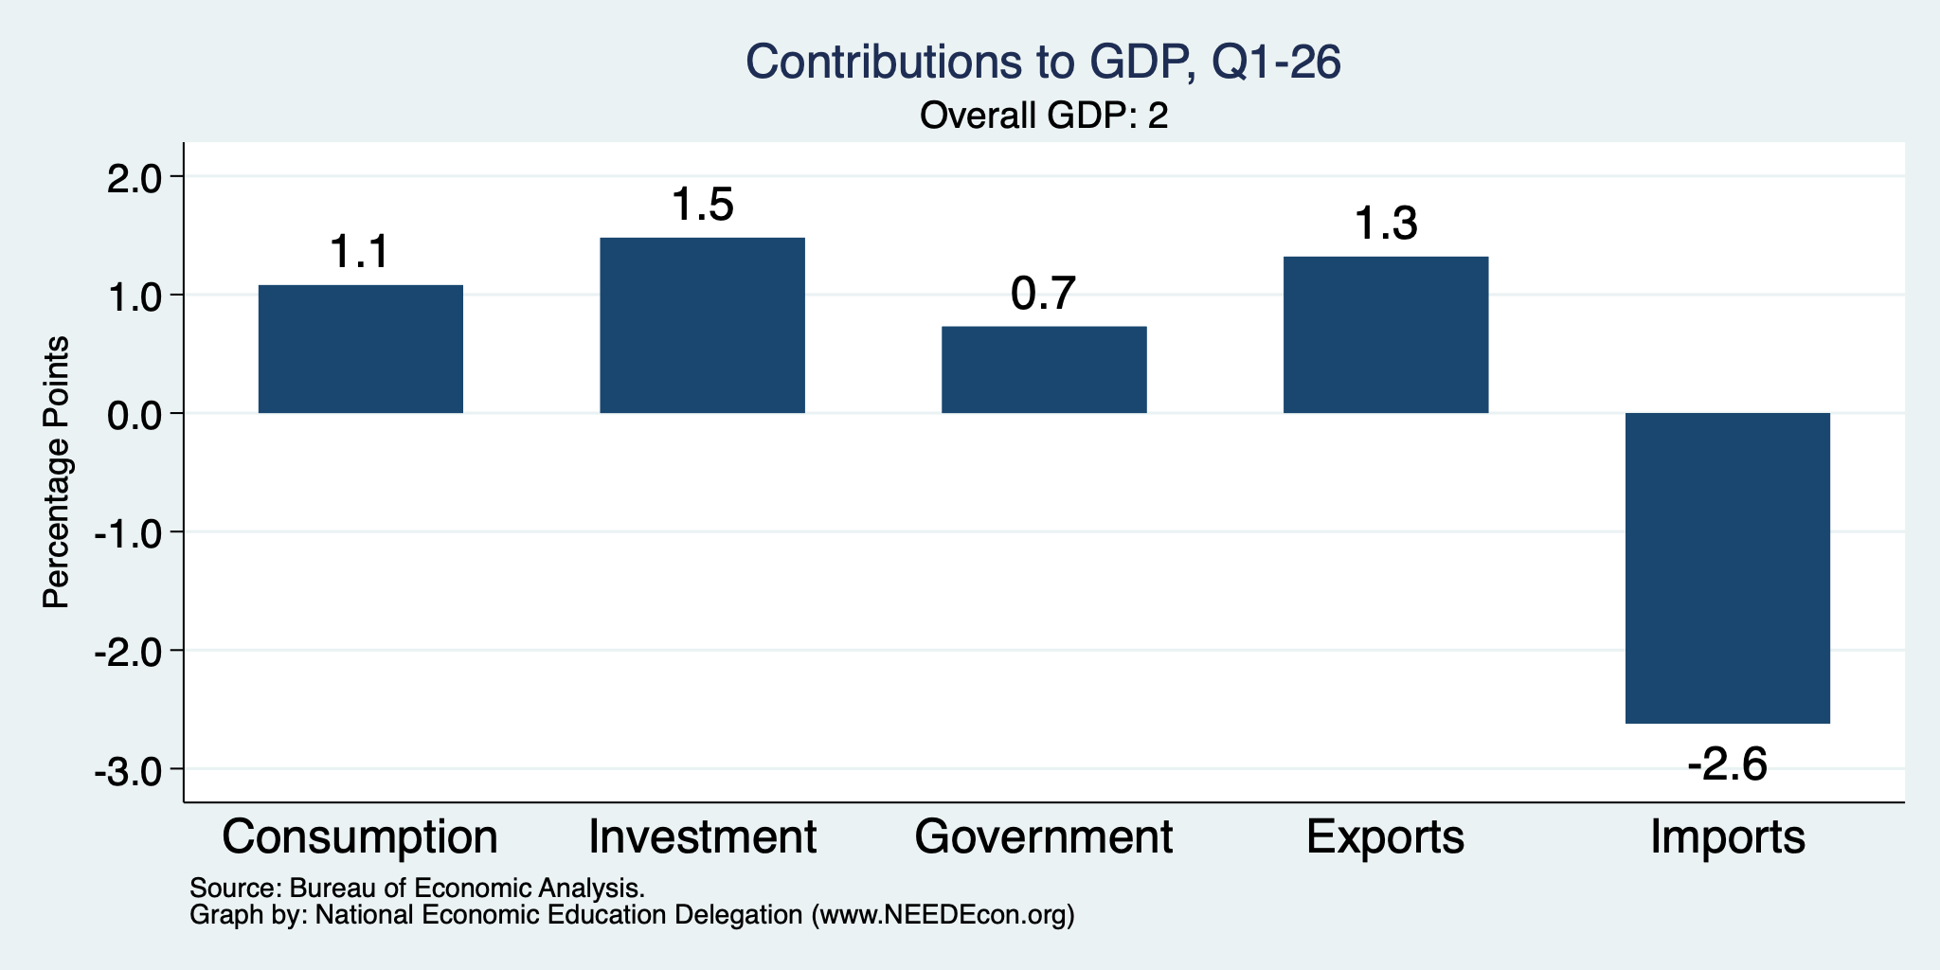
What Drove GDP Growth?
Normally
2.3%

Slide 10
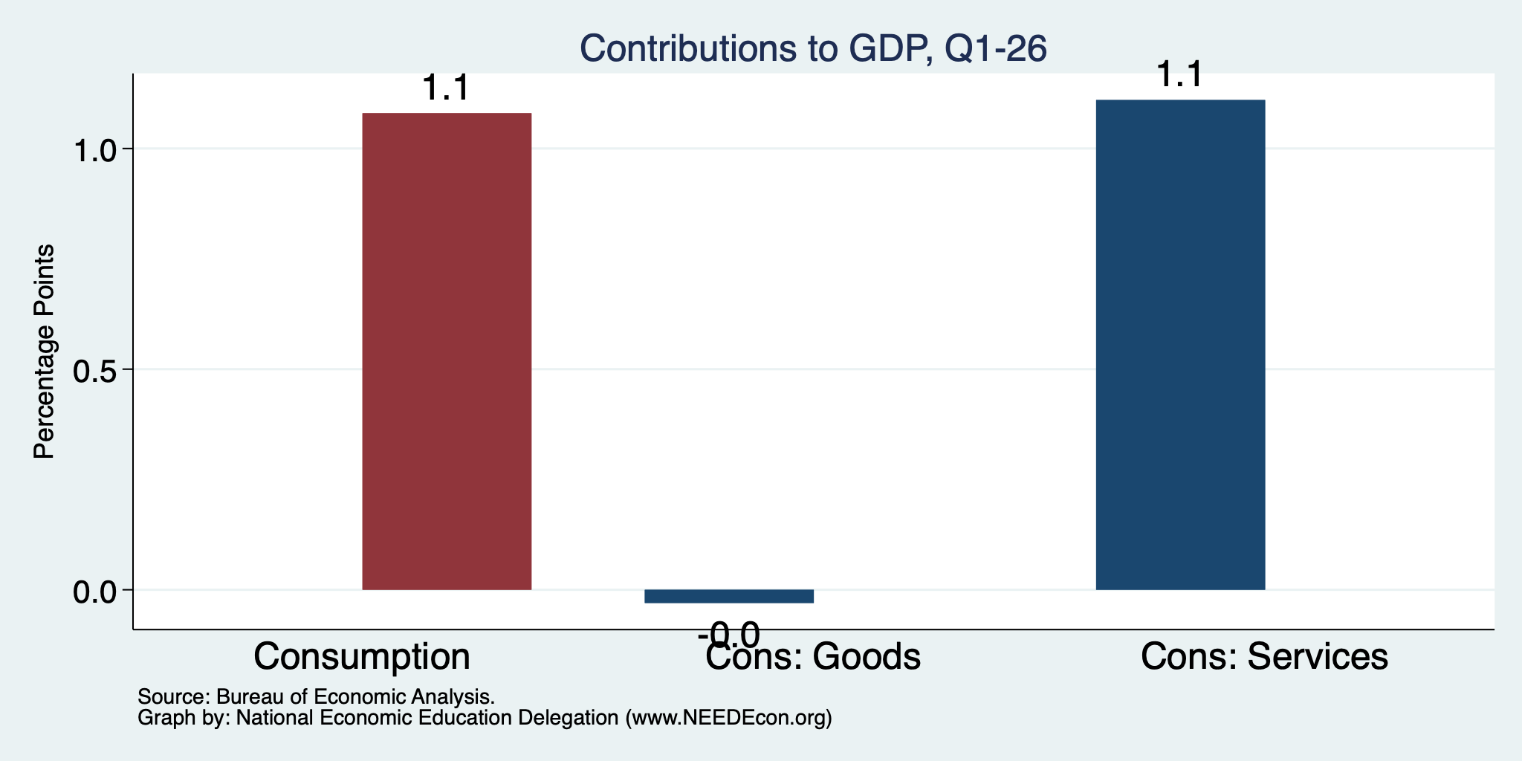
Consumers Tightened
Normally
2.3%
Normally
0.8%

Slide 11
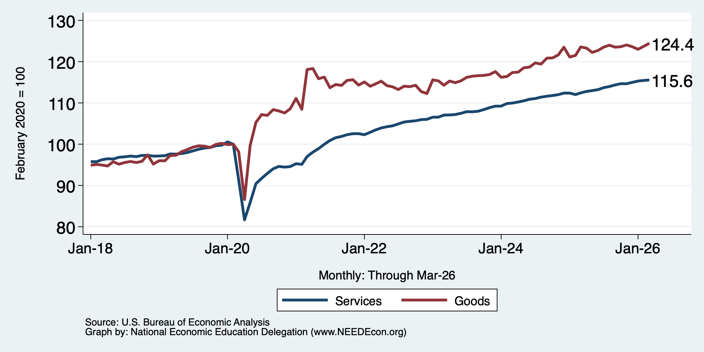
Consumers Spending Less on Goods
Flat

Slide 12
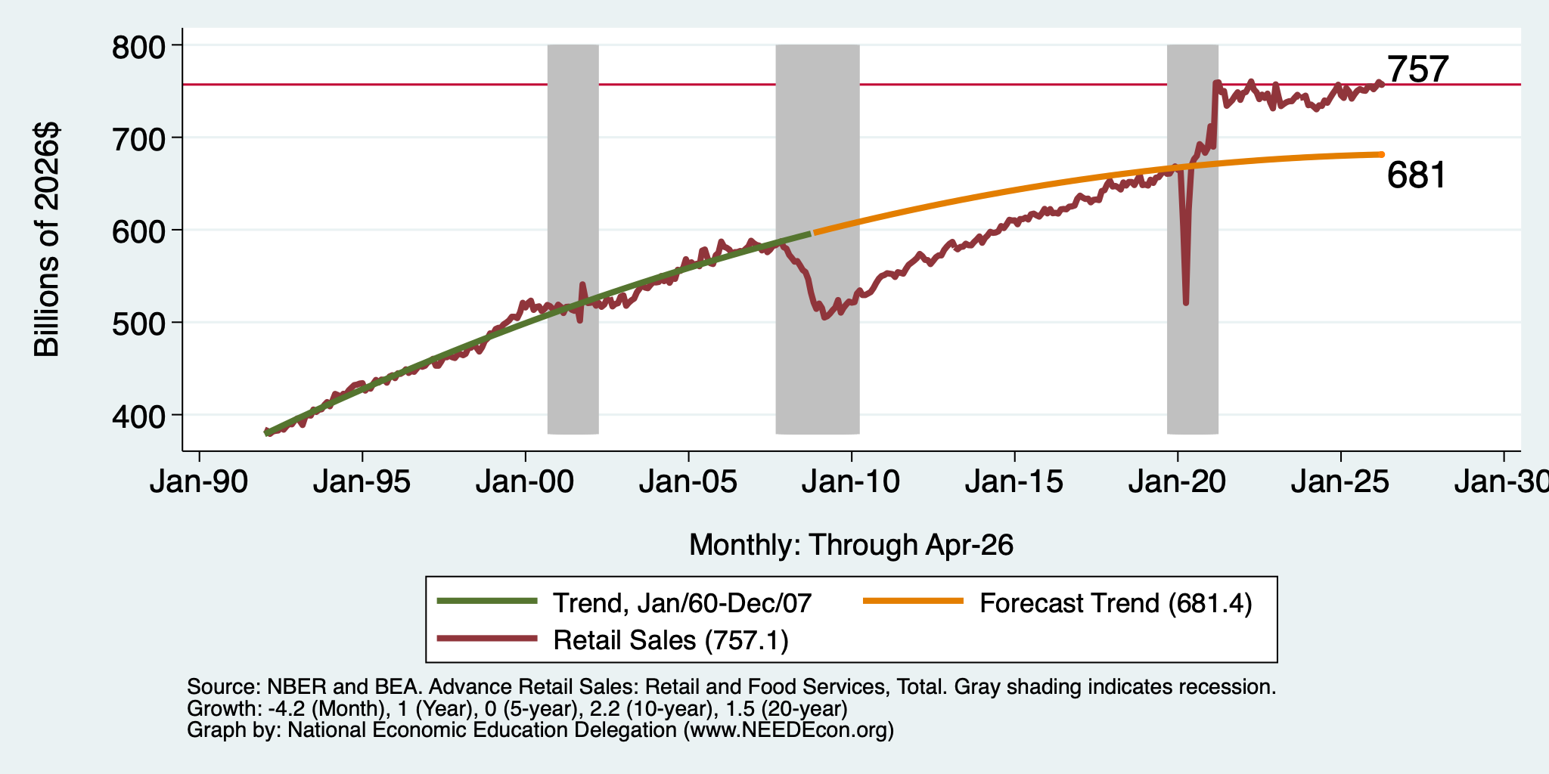
But SUPER High to Begin With!

Slide 13
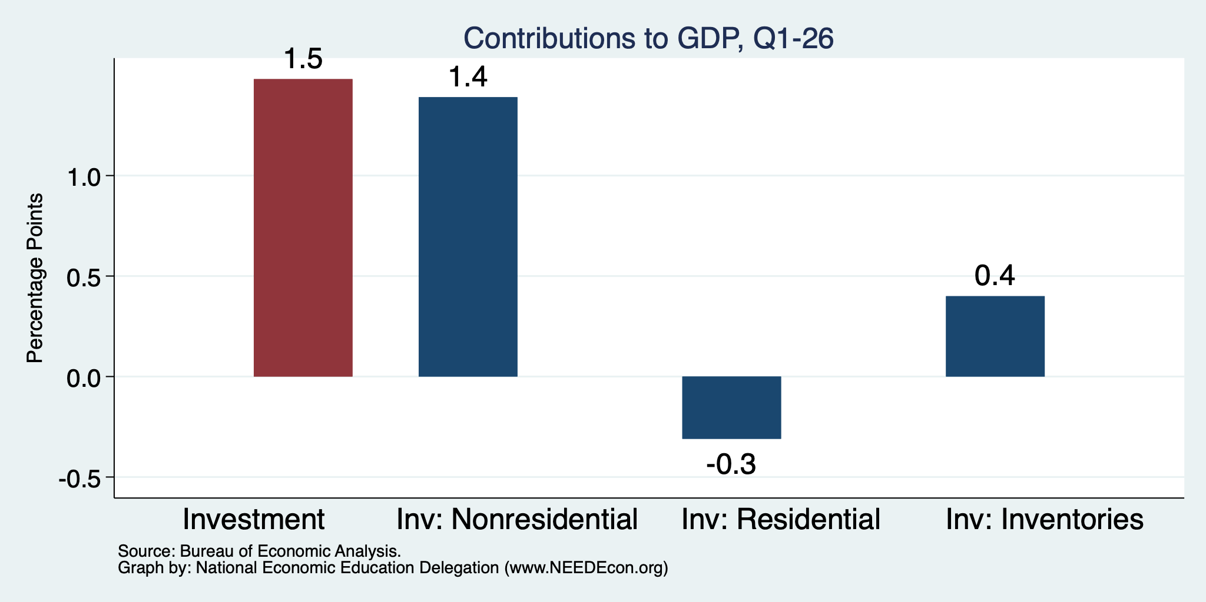
AI is Inflating the Investment #s
Normally
0.7%

Slide 14
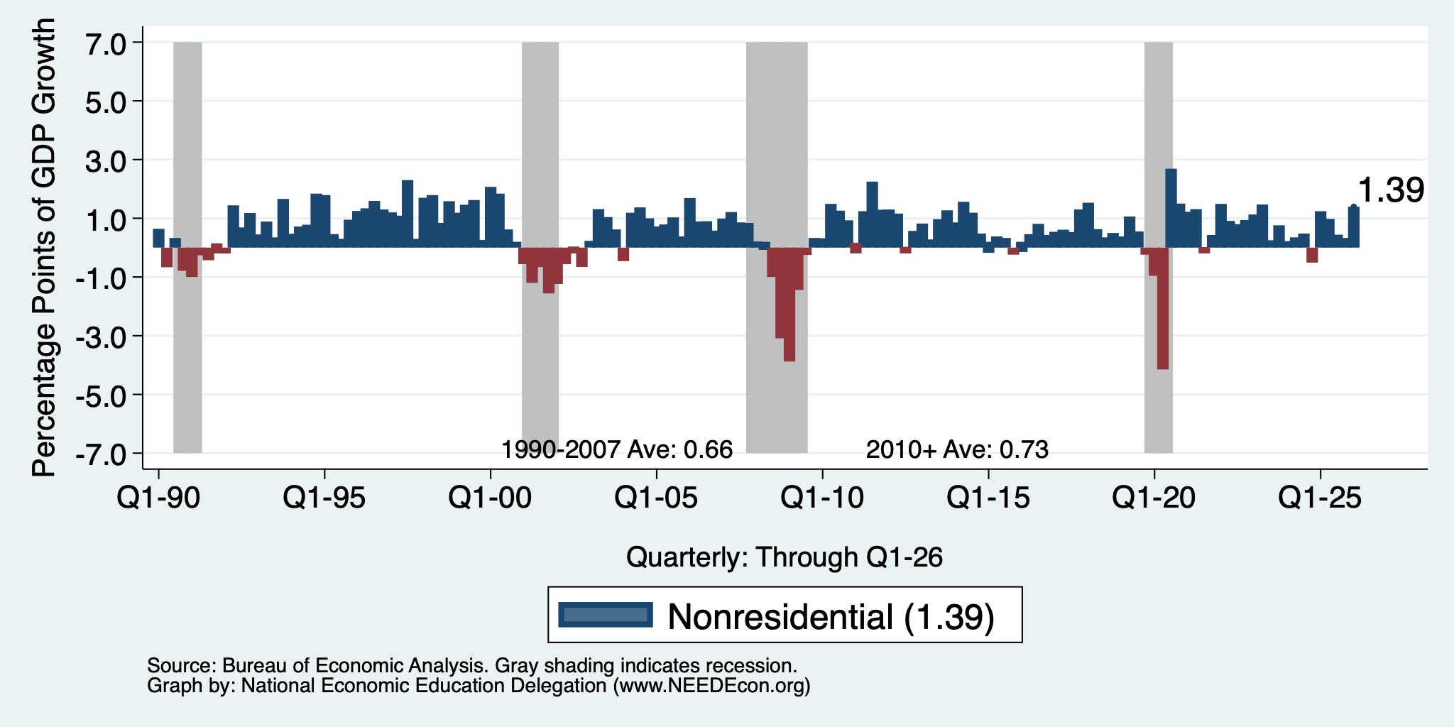
Not Outrageously high, but Definitely High

Slide 15
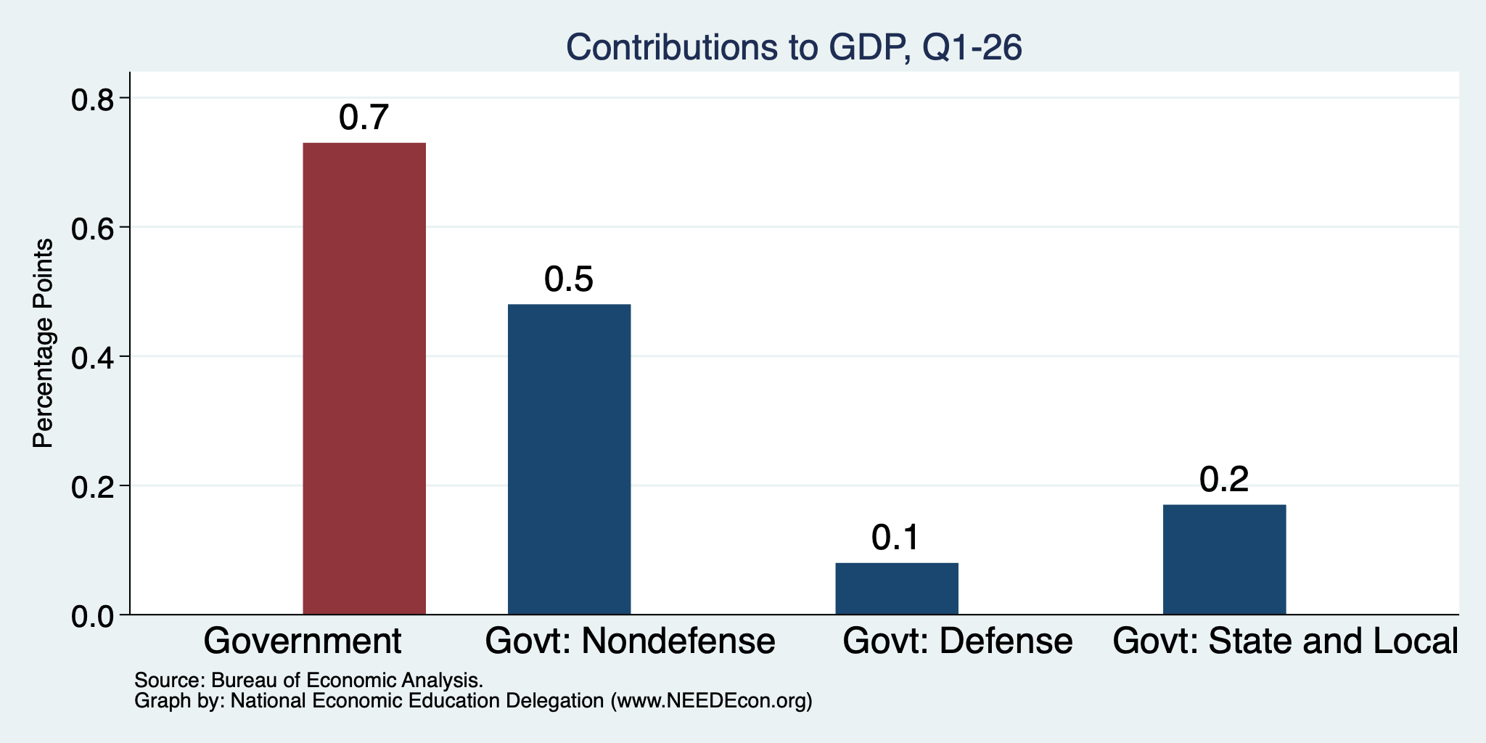
Government Spending Helped

Slide 16
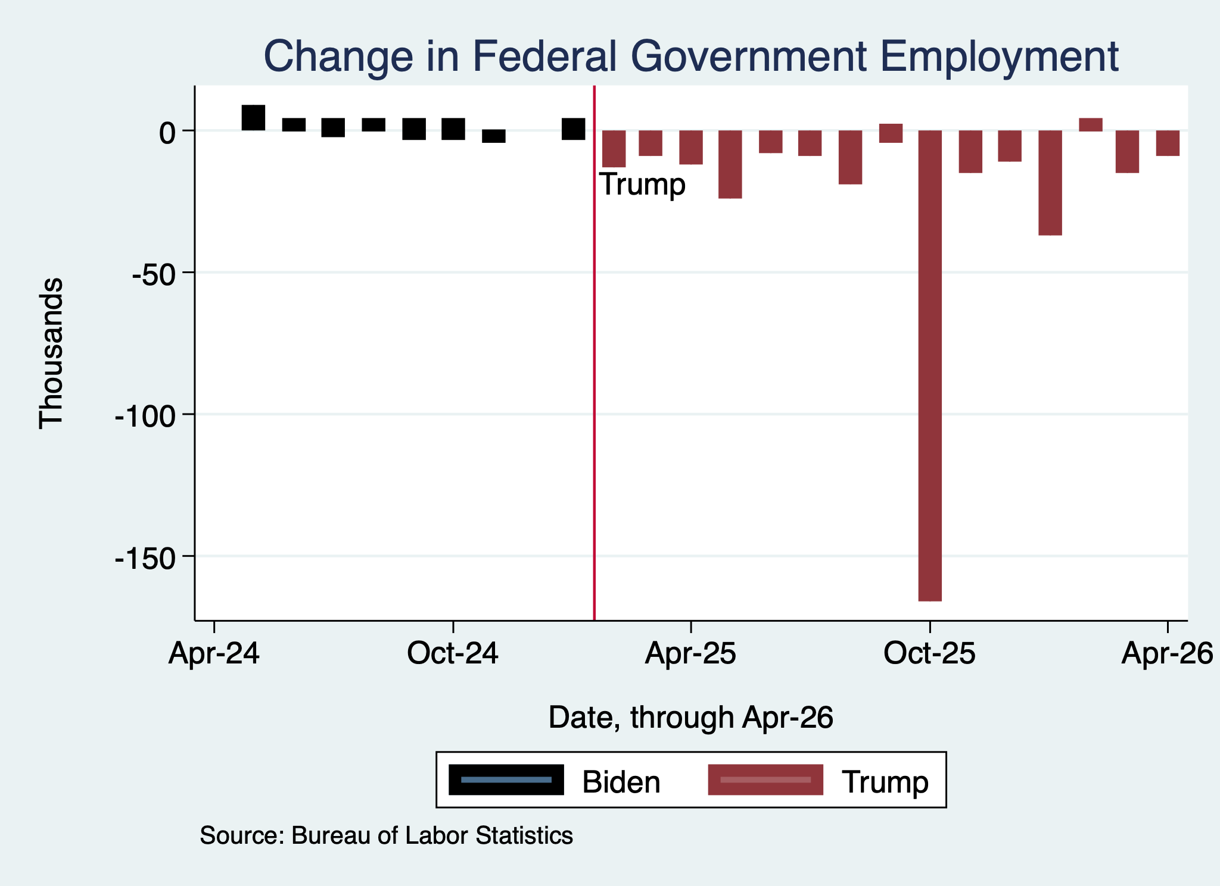
Monthly Changes in Federal Gov’t Employment
Notes:
PAYEMS.png

Slide 17
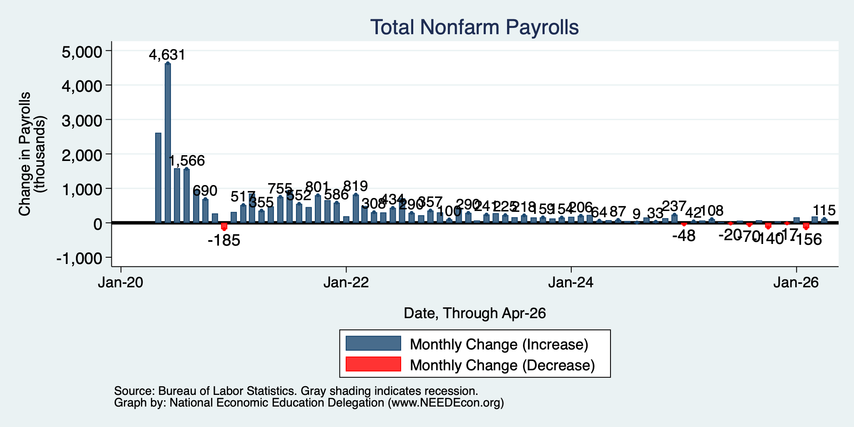
Monthly Changes in Nonfarm Employment
Feb: -156,000
Mar: 185,000
April: 115,000
Notes:
PAYEMS.png

Slide 18
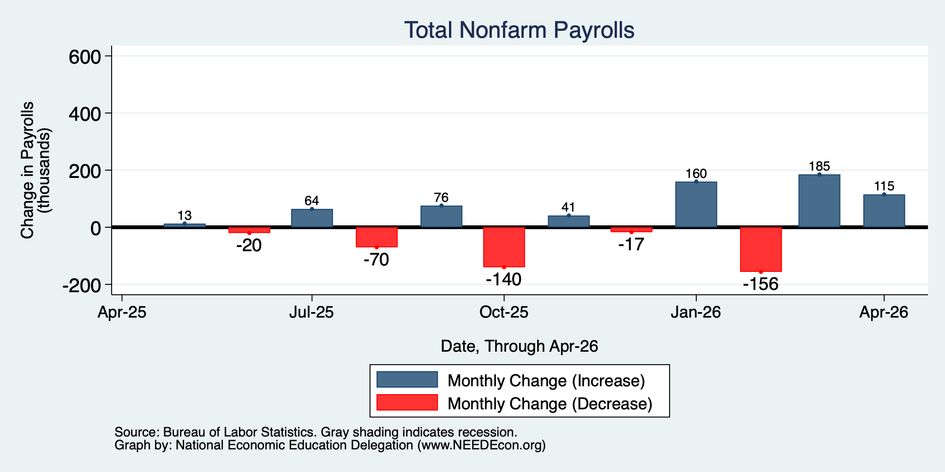
Monthly Changes in Nonfarm Employment
Feb: -156,000
Mar: 185,000
April: 115,000
Notes:
PAYEMS.png

Slide 19
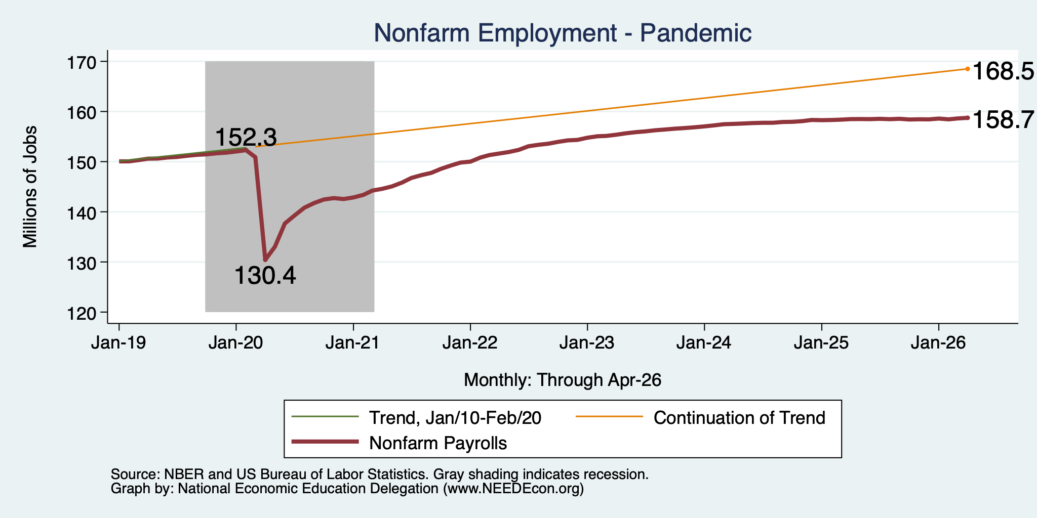
Employment Gap … is Growing
6.4 Million ABOVE February, 2020.
9.8 Million BELOW where we should be.
Notes:
payroll_recent.png

Slide 20
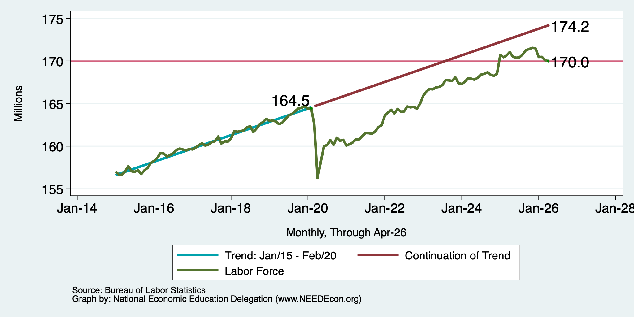
Workers Are Coming Back, Or Are They?
5.5 million ABOVE Feb 2020
4.2 million BELOW where we should be

Slide 21
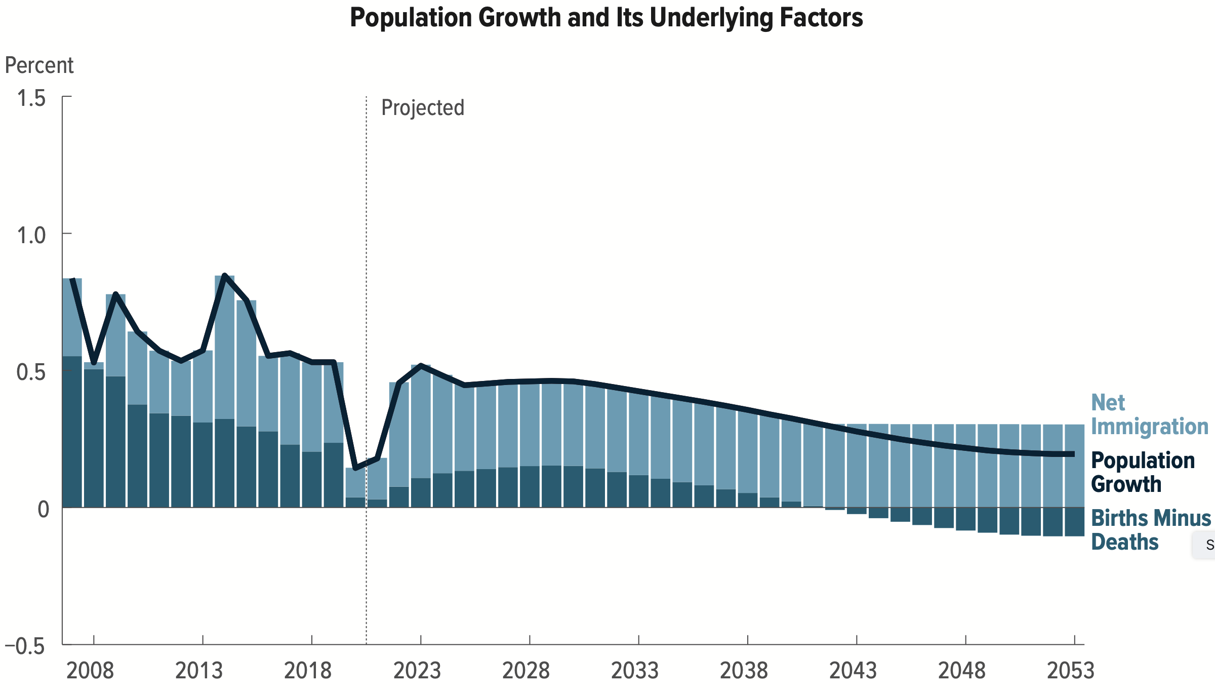
Can Immigration Saving the Day?
Source: CBO – The Demographic Outlook, 2023-2053

Slide 22
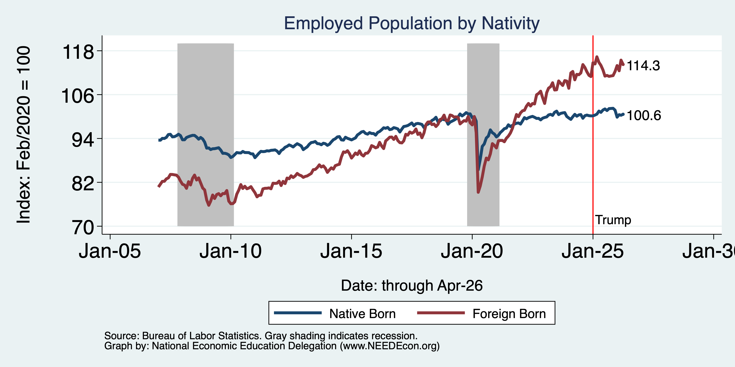
Immigrants to the Rescue? No longer
Notes:
Feb 2020: 130,320 Native born 27,697 foreign born
Aug 2025: 132,474 Native 30,816 foreign born March 2025 peak: 32,225

Slide 23
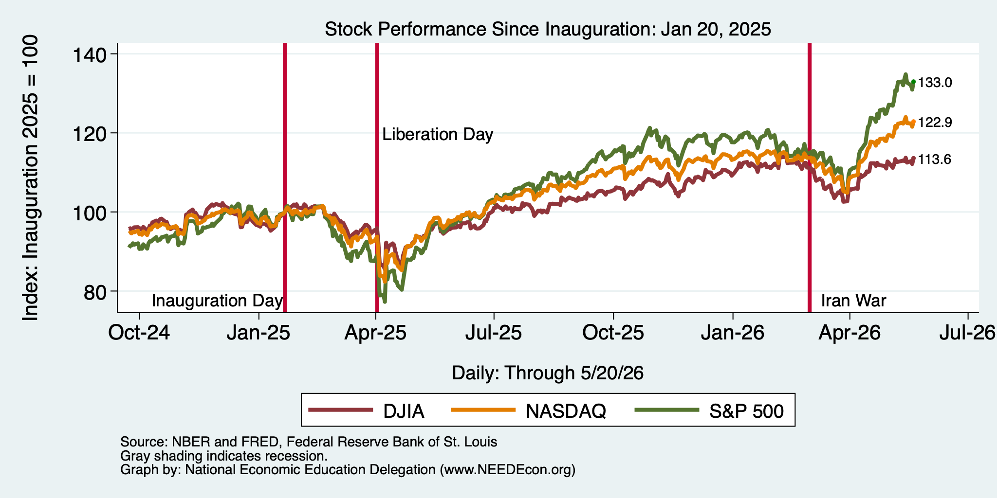
And Stocks?

Slide 24
Inflation

Slide 25
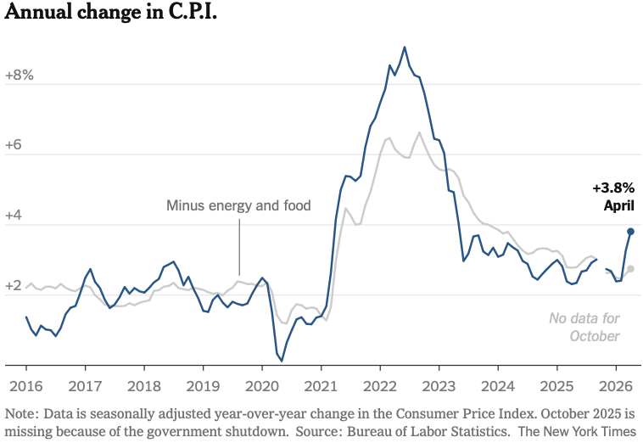
Inflation: Latest Figures
The uptick is entirely because of the war.
Source: NYTimes.com

Slide 26
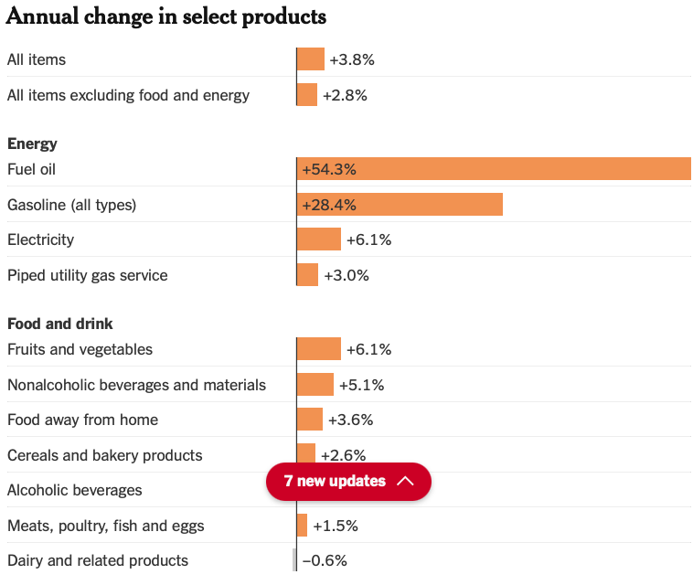
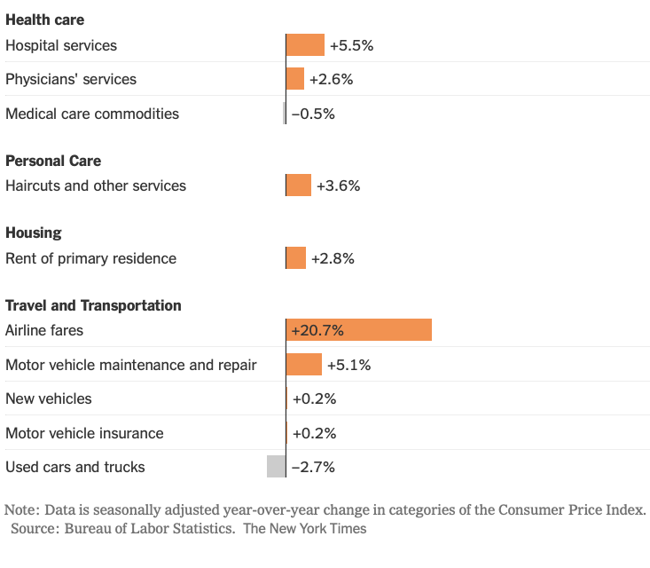
Inflation: LATEST Annual Figures
Source: NYTimes.com

Slide 27
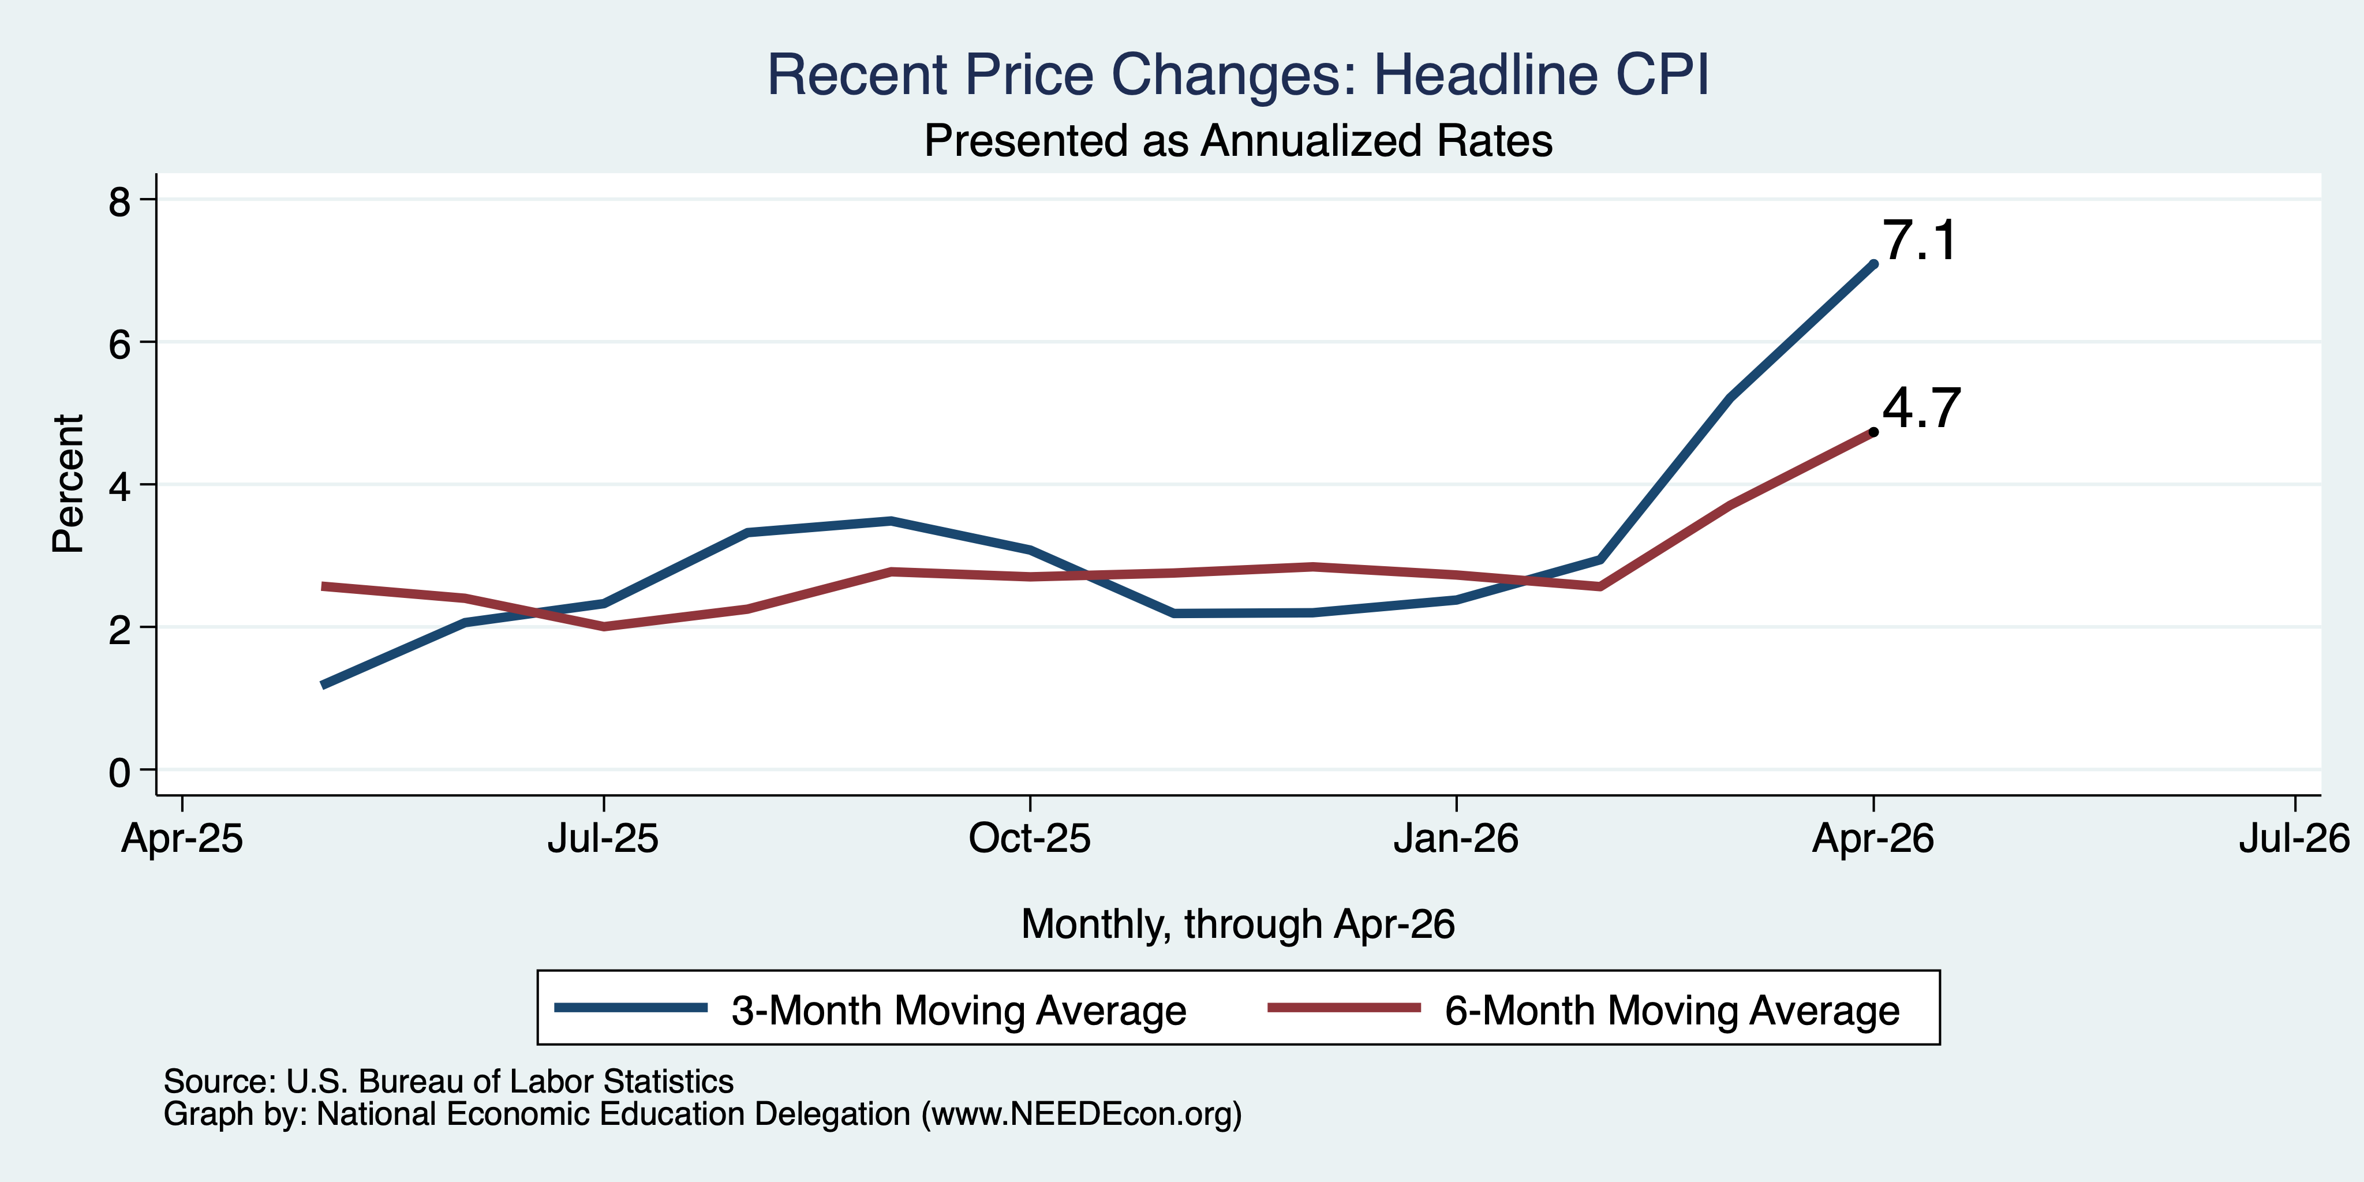
CPI in the Last 3/6 Months

Slide 28
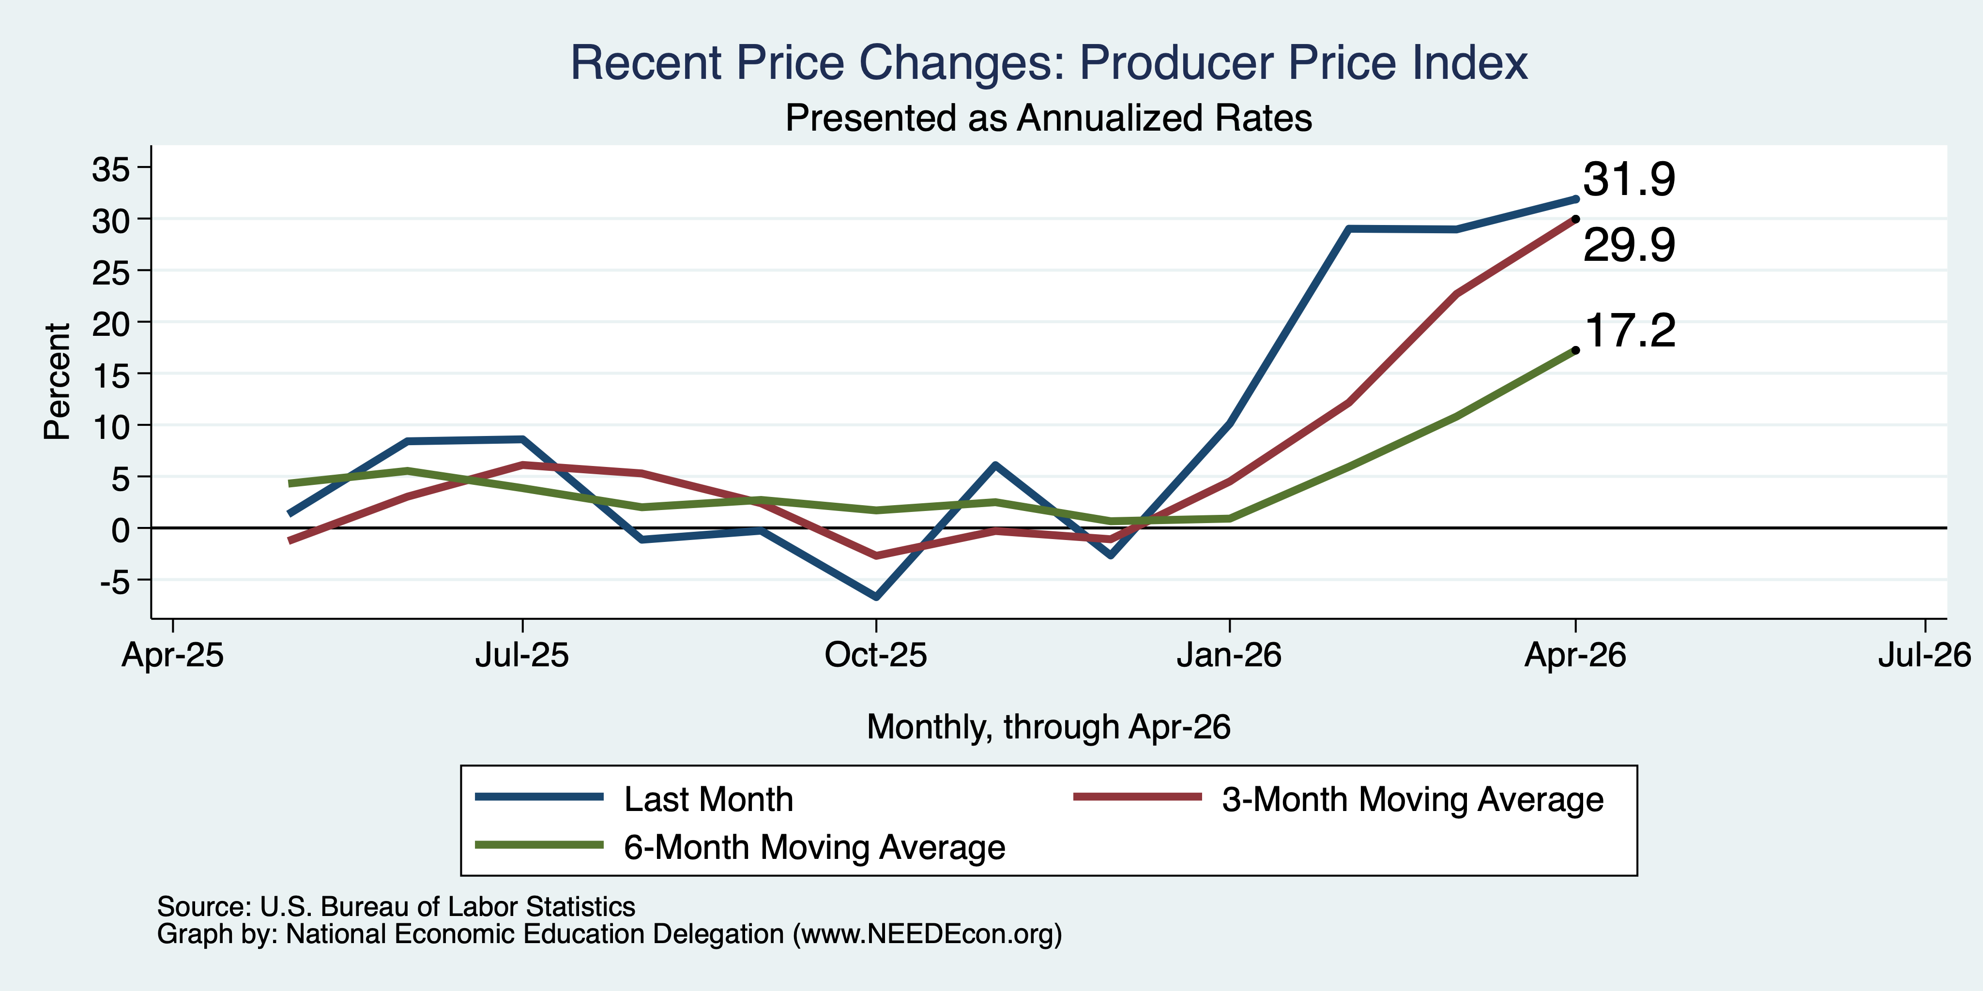
PPI in the Last Few Months

Slide 29
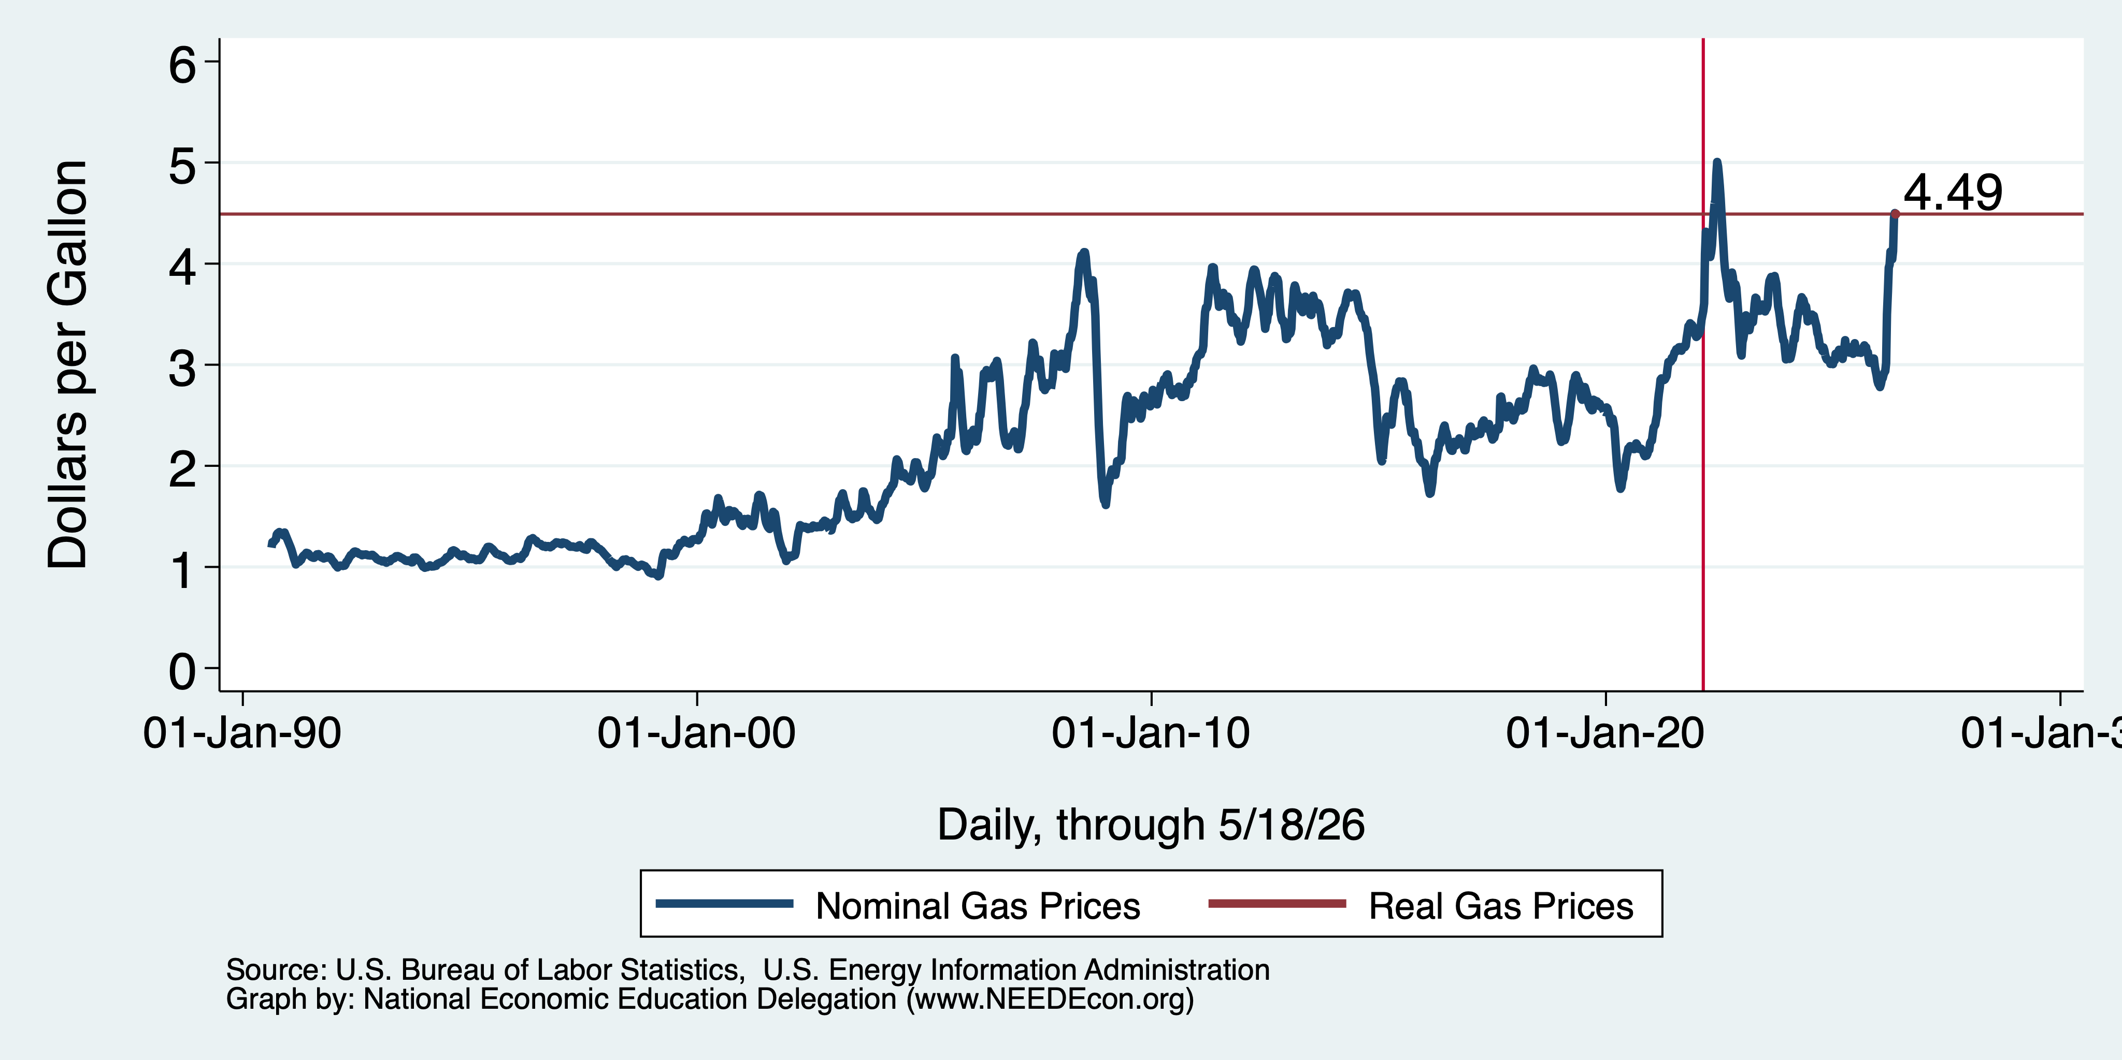
Inflation: Gas Prices

Slide 30
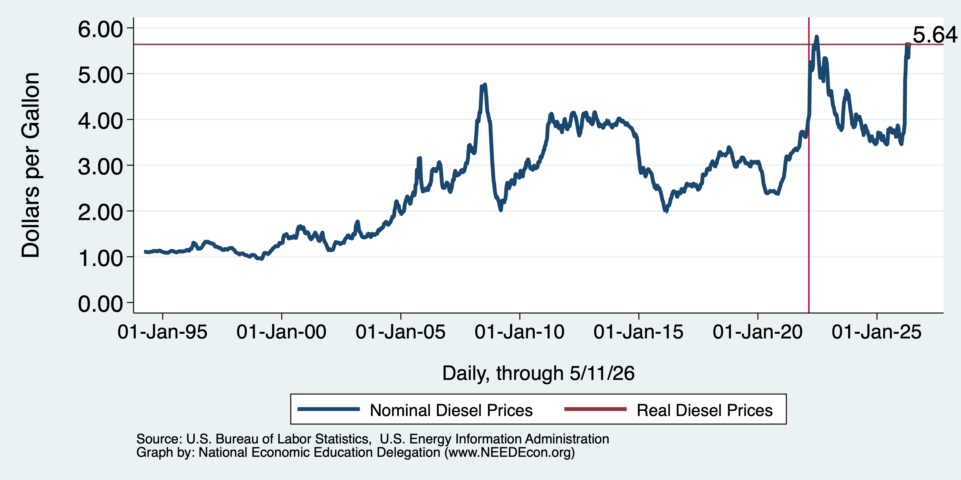
Inflation: Diesel Prices
3.46

Slide 31
Shortages From the War:
Naptha – ink ingredient
  Bathrooms, newspapers, cars, and paint.
Oil, in particular, heavy jet fuel and diesel (more so than gas for cars)
Ingredients for fertilizer
  Nitrogen and phosphate
Helium – MRI machines, AI chips, EVs
Wide variety of others.

Slide 32
Very Significant Implications
Rising fuel prices, especially diesel, impact ALL industries.
  Some, of course, more than others.
  The importance of mobility determines how much.
Especially vulnerable industries:
  Aviation
  Transportation
  Agriculture
  Manufacturing

Slide 33
Bigger Picture: Uncertainty

Slide 34
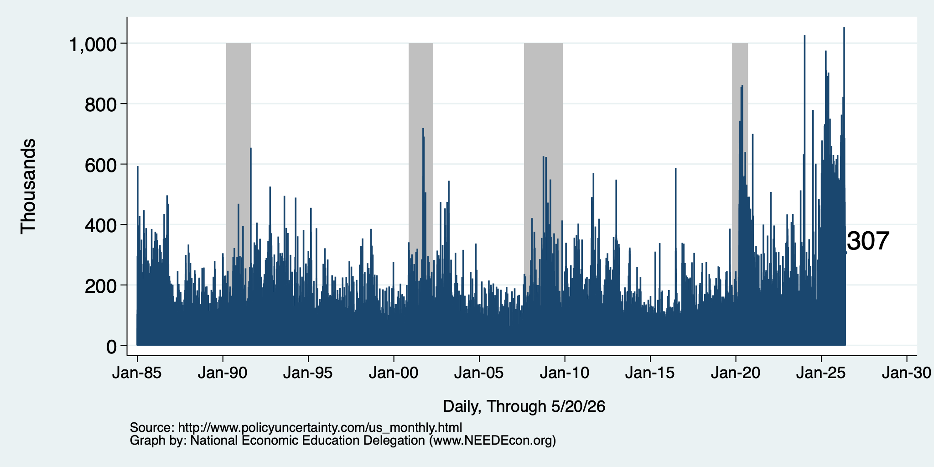
Policy Uncertainty Index
Notes:
The fed funds rate is the interest rate on overnight loans between banks. Think of it as the baseline interest rate on which banks base all other interest rates (e.g. mortgage rates)
FOMC lowers the fed funds rate during recessions and raises the fed funds rate during expansions
Fed funds rate peaked in the 1980s as then Chairman Paul Volcker sought to reign in “run away” inflation of the 1970s; doing so resulted in a recession in the early 1980s.
Since the 2008-09 recession, the fed funds rate has been kept near zero.
During the 2008-09 recession, Federal Reserve turned to unconventional tools to influence longer term interest rates to further stimulate the economy - QE
FedFunds.png

Slide 35
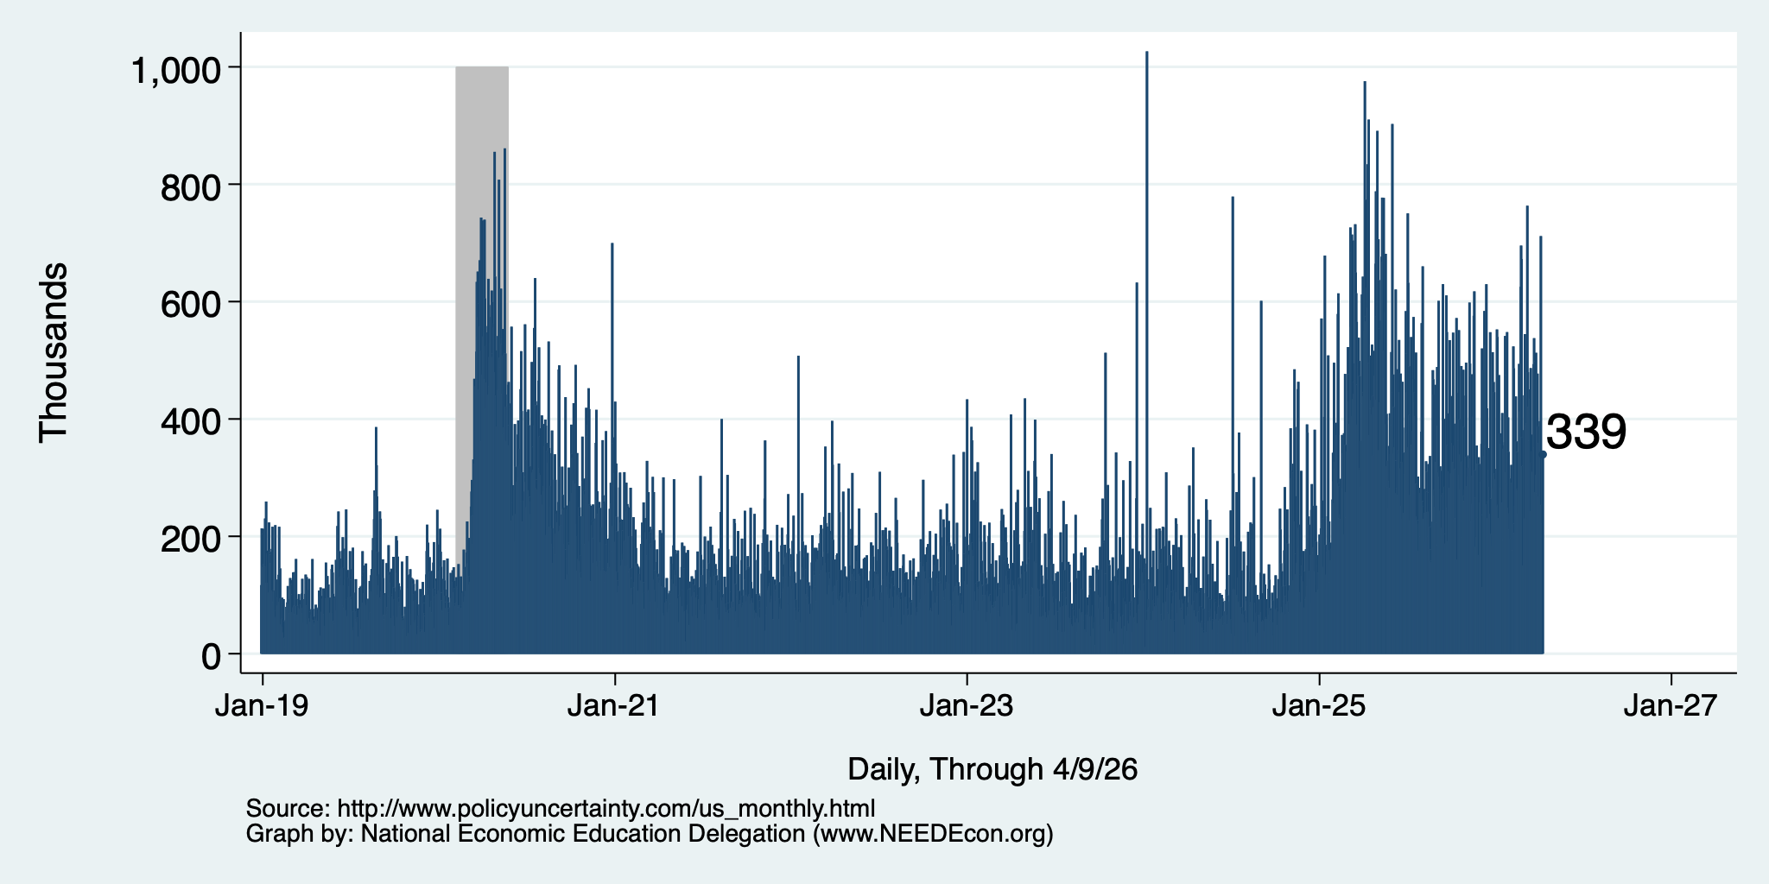
Policy Uncertainty Index – Last 10 Years
Notes:
The fed funds rate is the interest rate on overnight loans between banks. Think of it as the baseline interest rate on which banks base all other interest rates (e.g. mortgage rates)
FOMC lowers the fed funds rate during recessions and raises the fed funds rate during expansions
Fed funds rate peaked in the 1980s as then Chairman Paul Volcker sought to reign in “run away” inflation of the 1970s; doing so resulted in a recession in the early 1980s.
Since the 2008-09 recession, the fed funds rate has been kept near zero.
During the 2008-09 recession, Federal Reserve turned to unconventional tools to influence longer term interest rates to further stimulate the economy - QE
FedFunds.png

Slide 36
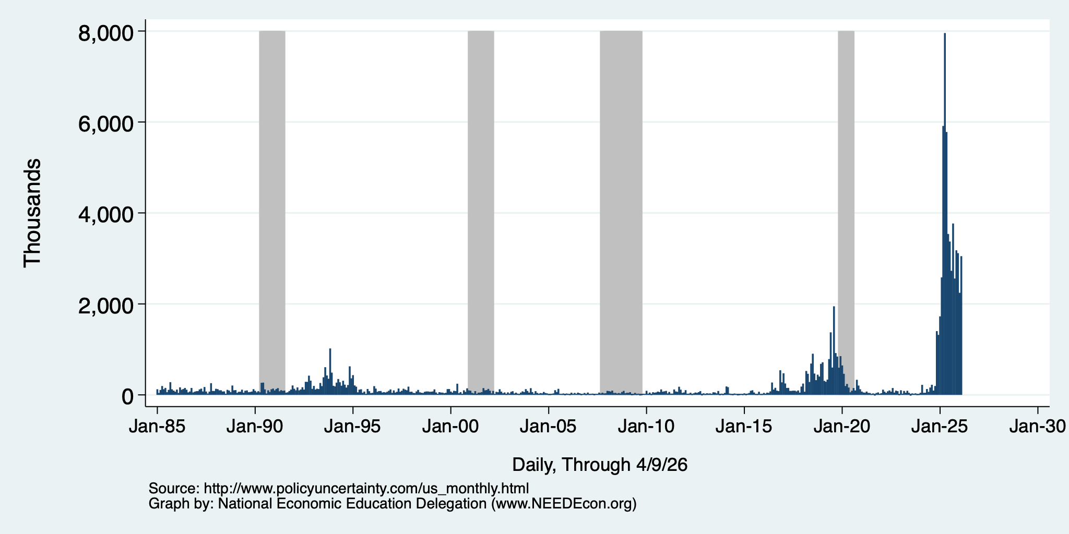
Policy Uncertainty Index – Trade
Notes:
The fed funds rate is the interest rate on overnight loans between banks. Think of it as the baseline interest rate on which banks base all other interest rates (e.g. mortgage rates)
FOMC lowers the fed funds rate during recessions and raises the fed funds rate during expansions
Fed funds rate peaked in the 1980s as then Chairman Paul Volcker sought to reign in “run away” inflation of the 1970s; doing so resulted in a recession in the early 1980s.
Since the 2008-09 recession, the fed funds rate has been kept near zero.
During the 2008-09 recession, Federal Reserve turned to unconventional tools to influence longer term interest rates to further stimulate the economy - QE
FedFunds.png

Slide 37
Uncertainties
What effect will continued deportations have?
Will AI continue to drive growth?
Will tariffs continue to drive inflation?
  Fed says that ALL of the inflation above 2% is from tariffs, until…
Will the war drive inflation beyond fuel prices?
  It is clear in fuel prices, but every other sector of the economy depends on fuel. Higher fuel prices drive prices in the rest of the economy up.
Will consumers continue to hold up?
  Evidence that spending is in decline.
What happens to Fed policy now that Jerome Powell is gone?

Slide 38
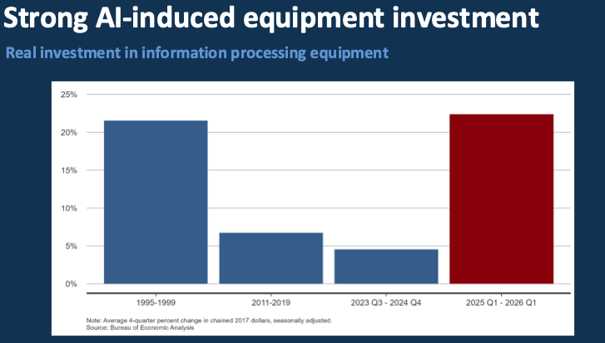
Source: Presentation given by Sylvain Leduc to the Monterey Bay Economic Partnership

Slide 39
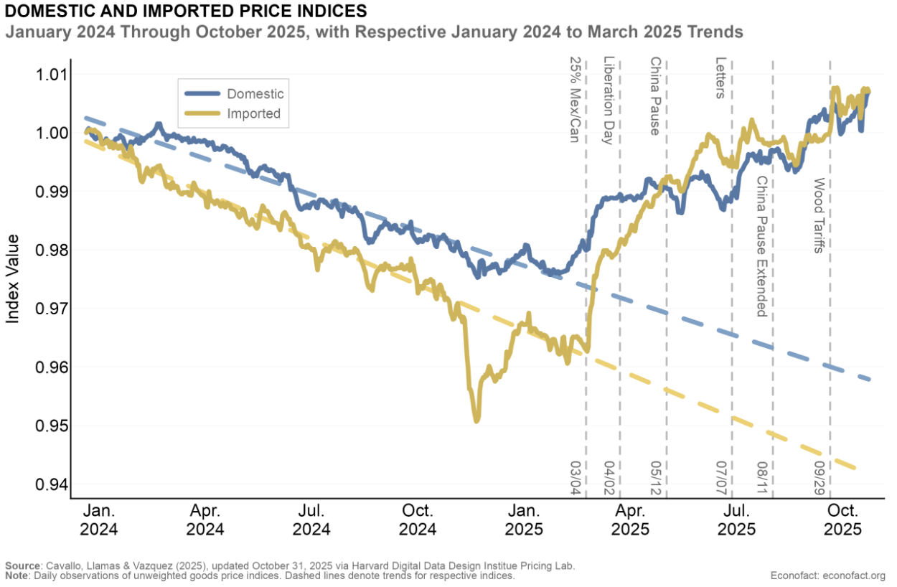
Tariffs and Price Effects

Slide 40
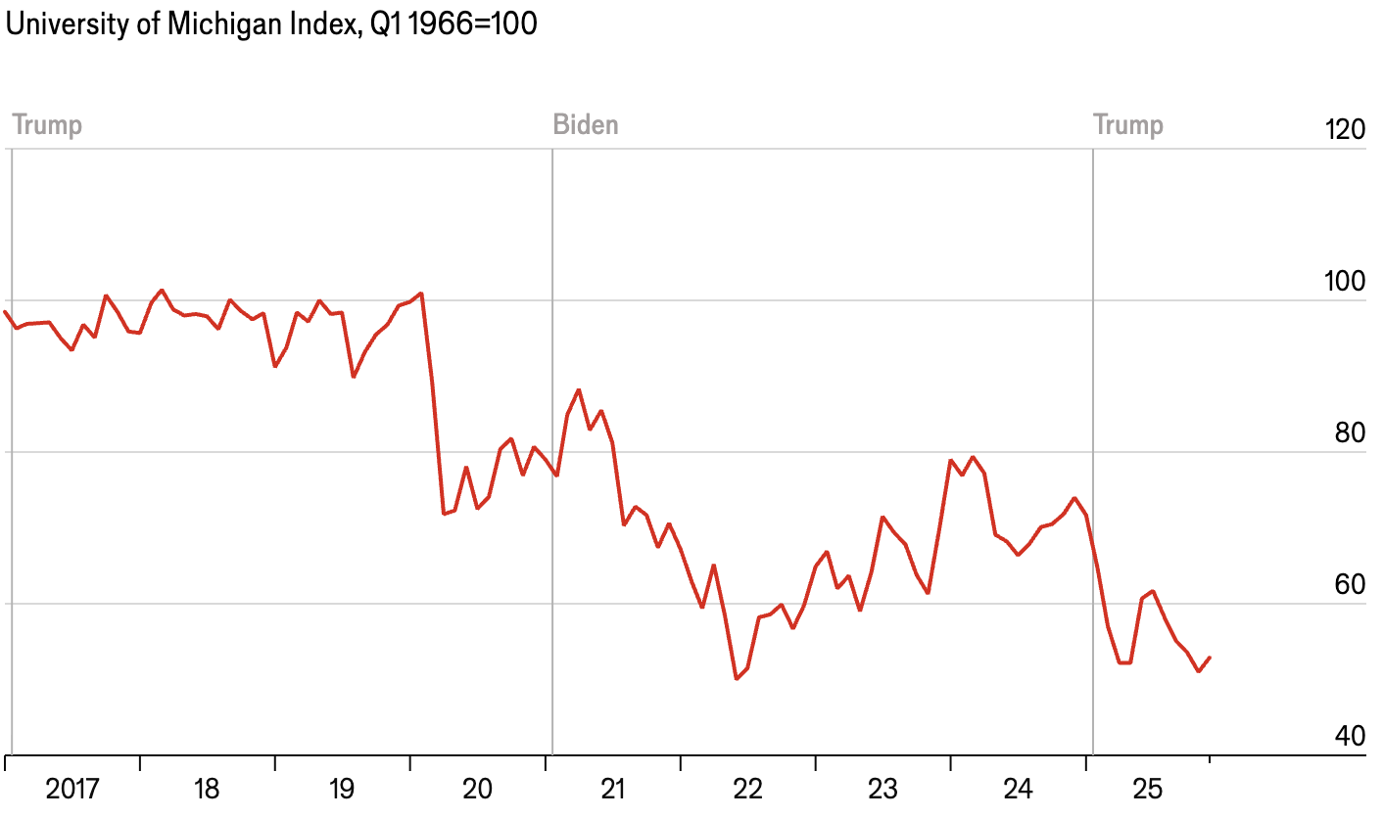
Consumer Confidence is Waning
At its lowest level ever!
(56 year history)

Slide 41
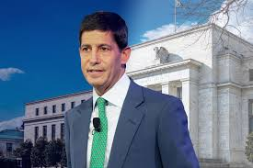
Monetary Policy after Jerome Powell?
Kevin Warsh: Trump Nominee to replace Jerome Powell as the Chair of the Fed in May

Slide 42
Summary
Inflation: was getting close to Fed’s 2% target.
  But is now going in the wrong direction
Current immigration and trade policies will exacerbate inflation.
Immigration: deportations tax the economy and are expensive.
  Many, MANY ag workers are unauthorized immigrants. (50% of Central Valley)
Tariffs: are a tax.
  Taxes raise prices. Period. Full Stop.
  Taxes often cost jobs. Tariffs likely will.
The war is going to drive up prices and uncertainty.
  Nobody invests into uncertainty.
What if the AI bubble bursts?

Slide 43
Thank you!
Any Questions?
www.NEEDEcon.org
Jon D. Haveman
Jon@NEEDEcon.org
Contact NEED: info@NEEDEcon.org
Submit a testimonial: www.NEEDEcon.org/testimonials.php
Become a Friend of NEED: www.NEEDEcon.org/friend.php

