Slide 1
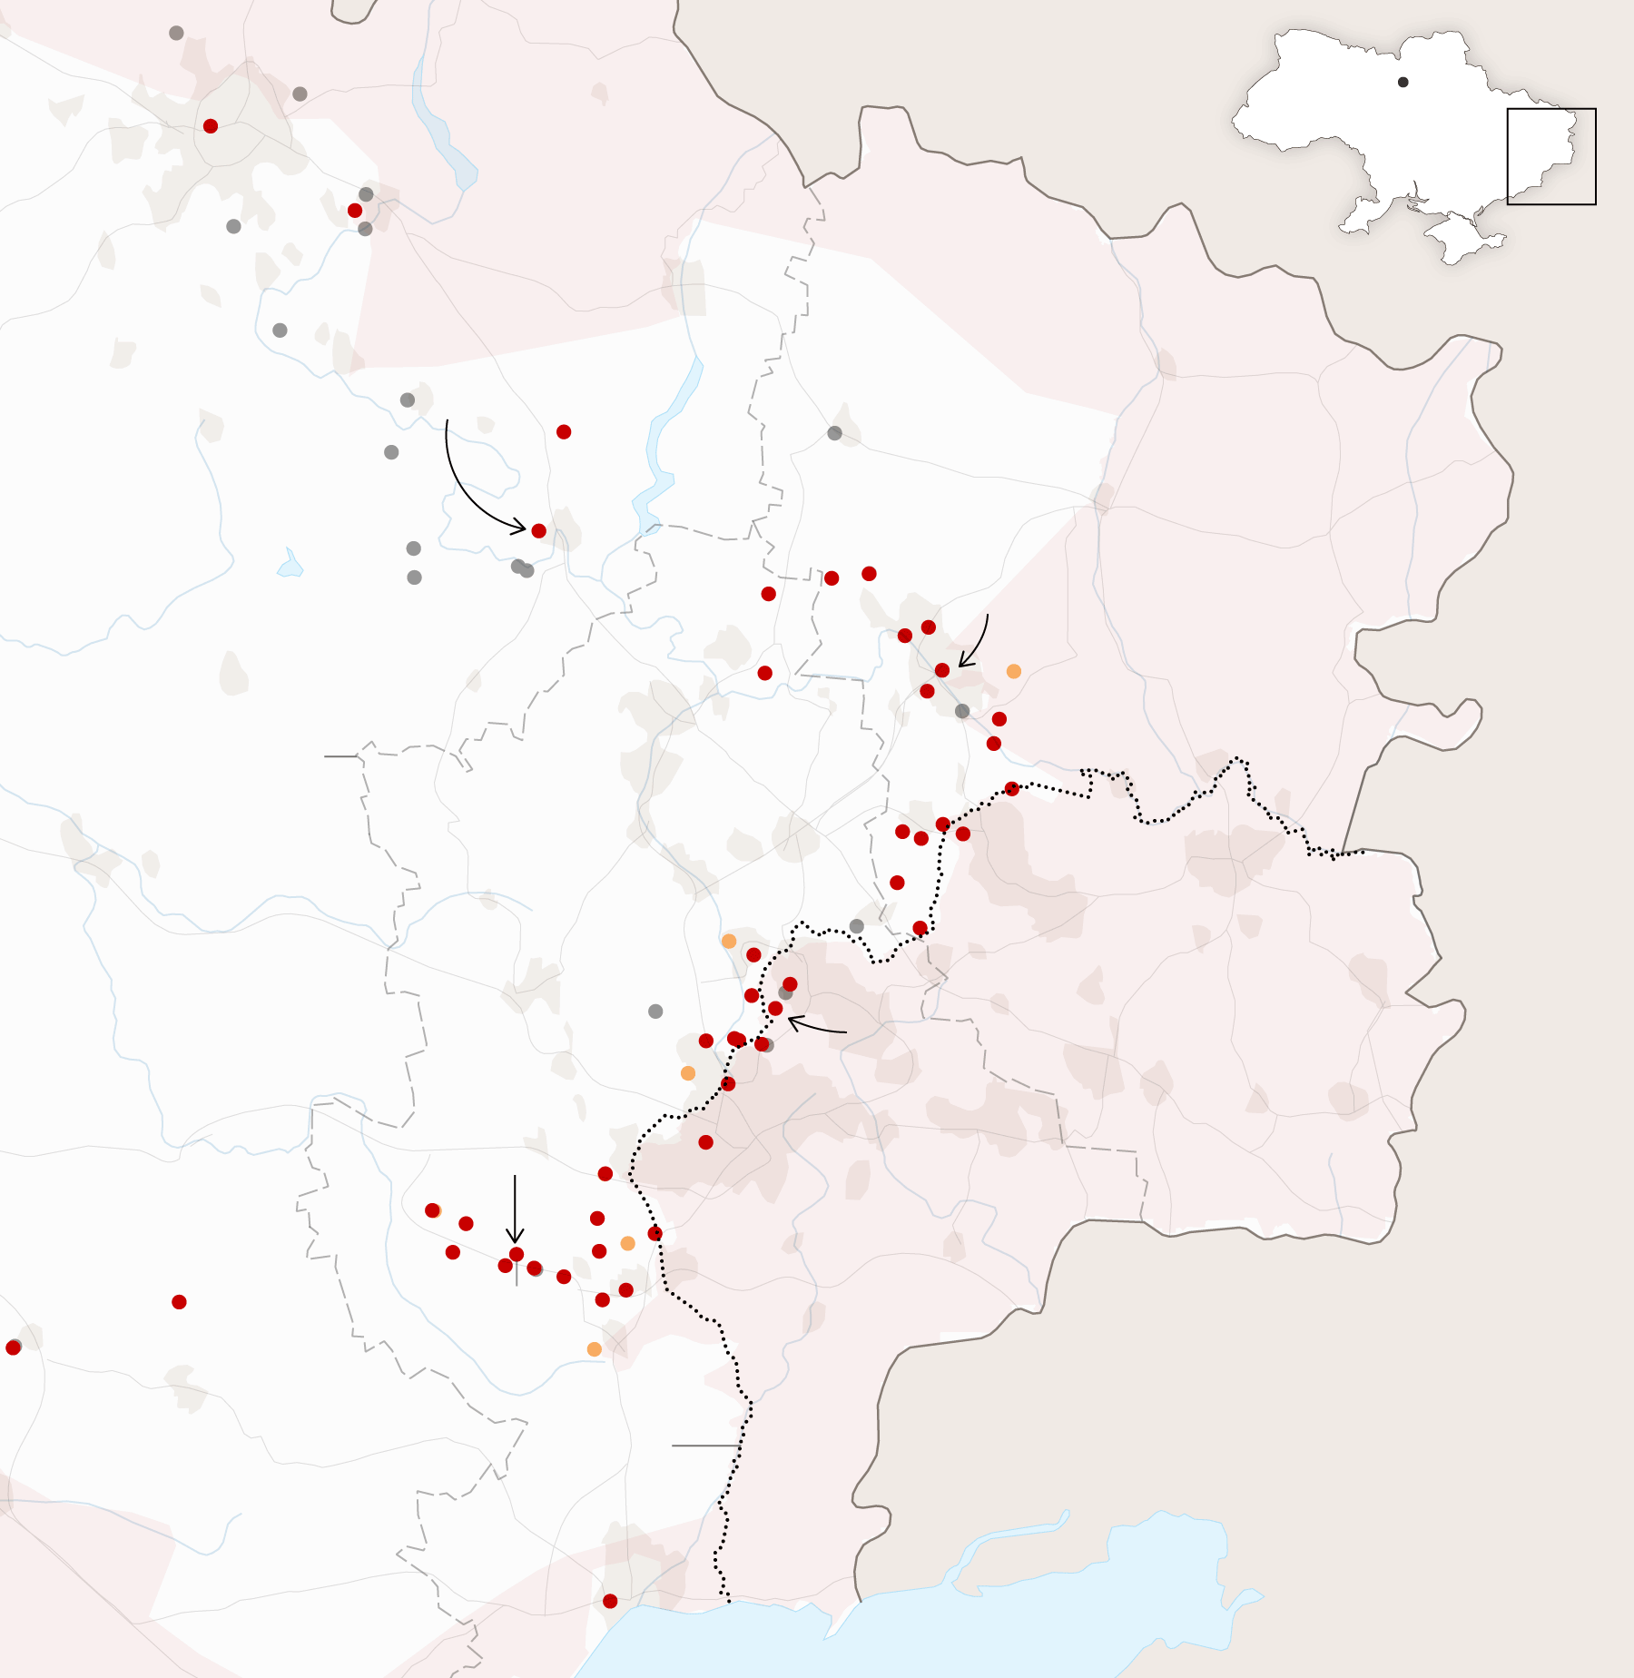
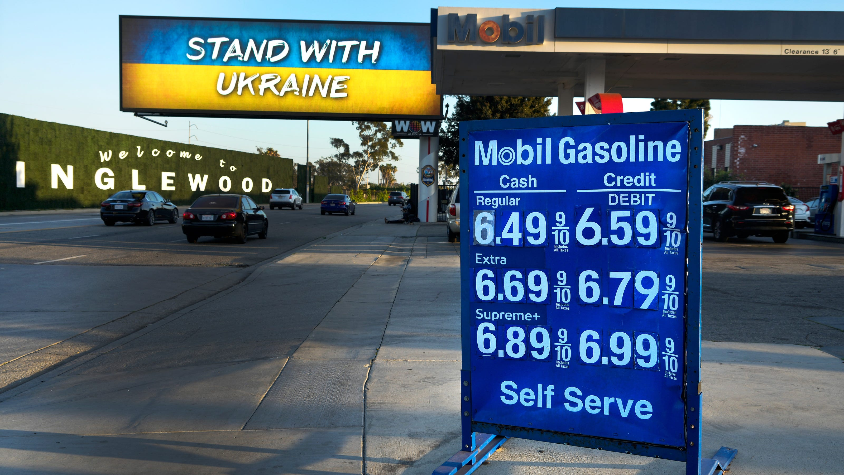
US Economic Update
Jon Haveman, Ph.D.
NEED
February 1, 2023

Slide 2
National Economic Education Delegation
Vision
One day, the public discussion of policy issues will be grounded in an accurate perception of the underlying economic principles and data.
Mission
NEED unites the skills and knowledge of a vast network of professional economists to promote understanding of the economics of policy issues in the United States.
NEED Presentations
Are nonpartisan and intended to reflect the consensus of the economics profession.

Slide 3
Who Are We?
Honorary Board: 54 members
2 Fed Chairs: Janet Yellen, Ben Bernanke
6 Chairs Council of Economic Advisers
Furman (D), Rosen (R), Bernanke (R), Yellen (D), Tyson (D), Goolsbee (D)
3 Nobel Prize Winners
Akerlof, Smith, Maskin
Delegates: 652+ members
At all levels of academia and some in government service
All have a Ph.D. in economics
Crowdsource slide decks
Give presentations
Global Partners: 49 Ph.D. Economists
Aid in slide deck development

Slide 4
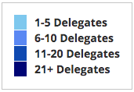
Where Are We?

Slide 5
Available NEED Topics Include:
US Economy
Healthcare Economics
Climate Change
Economic Inequality
Economic Mobility
Trade and Globalization
Minimum Wages
Immigration Economics
Housing Policy
Federal Budgets
Federal Debt
Black-White Wealth Gap
Autonomous Vehicles
Healthcare Economics

Slide 6
Outline
Economic Indicators
Inflation/Federal Reserve
Debt Ceiling

Slide 7
GDP: Quarterly Growth
Notes:
Graph: gdp_pot_grow.png
The Point: From 1990 – 2007, average annual US GDP growth pre-crisis is 2.94%. However, post-crisis US GDP growth is 2.19% (0.75 percentage points lower). Why is has the recovery been sluggish?
Note: At the recession’s height, the gap between quarterly GDP growth and potential growth was 2.5 percentage points.

Slide 8
GDP Trajectory: Pandemic Plunge!
GDP is:
$0.3 Trillion below 2019 forecast.
$1.2 Trillion ABOVE 2019-Q4 level.

Slide 9
Personal Consumption Expenditures
Trouble?
Notes:
Chart: ../Charts/personalconsumption_recession.png
Real consumption remains significantly lower than trend consumption since 2008 (actual is 89% of trend).
Since the recession, consumption growth has fallen. From 1990-2007, average annual consumption growth is 3.34%; Post-recession average annual consumption growth is 2.38%.

Slide 10
Retail Sales Fell in December

Slide 11
But SUPER High to Begin With!

Slide 12
Contributions to GDP: Government
Notes:
Since 2010, average government spending growth is shrinking, resulting in a negative average contribution to GDP growth post-recession of -0.8 percentage points
Note that average quarterly government spending growth is 0.42% from 1990-2007 and -0.17% in 2010+ (annualized, 1990-2007 = 1.68%; 2010+ = -0.70%).

Slide 13
Monthly Changes in Nonfarm Employment
December: 223,000
November: 256,000
Notes:
PAYEMS.png

Slide 14
Layoffs?
79,000 tech layoffs in the Bay Area in January
Doesn’t show up yet in the aggregate data.
Will know more on Friday.

Slide 15
Inflation

Slide 16
Inflation: Latest Figures

Slide 17
Which Prices?
Food
Oct-Nov: +0.10
Nov-Dec: -0.08
Food
Gas

Slide 18
Inflation in the Last 6 Months – On Target!
Source: https://www.nytimes.com/2023/01/13/opinion/cpi-inflation-fed.html

Slide 19
Gas Prices: National Average at the Pump
Why rising?
Refinery outages.
No more from strategic oil reserves.

Slide 20
Spending Patterns Changed - More Goods!
Goods spending up 14.2%
- And stable.
Services spending up 3.5%
- And going up.

Slide 21
My Thoughts on the Sources of Inflation
Supply Chain issues were significant – less so now.
Composition of spending changed significantly.
Is now bouncing back, as are prices.
Corporations have used the cover of inflation to raise prices more.
But there was too much total spending.
Fiscal stimulus led households to increase saving over 2021 by more than $2 trillion. Strong retail sales numbers suggest they are prepared to spend it.
Whose to Blame: ARP probably too big, but the Fed could have acted sooner.
Bottom line: Recovery from a dramatic economic disruption is seldom painless.

Slide 22
What’s the Fed Doing About It?

Slide 23
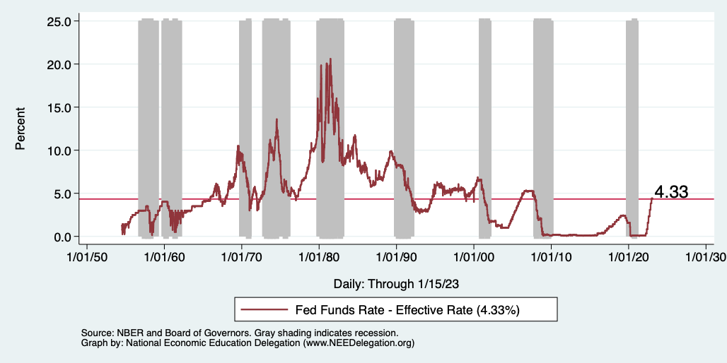
Federal Funds Rate
Notes:
The fed funds rate is the interest rate on overnight loans between banks. Think of it as the baseline interest rate on which banks base all other interest rates (e.g. mortgage rates)
FOMC lowers the fed funds rate during recessions and raises the fed funds rate during expansions
Fed funds rate peaked in the 1980s as then Chairman Paul Volcker sought to reign in “run away” inflation of the 1970s; doing so resulted in a recession in the early 1980s.
Since the 2008-09 recession, the fed funds rate has been kept near zero.
During the 2008-09 recession, Federal Reserve turned to unconventional tools to influence longer term interest rates to further stimulate the economy - QE
FedFunds.png

Slide 24
Federal Funds Rate – Recent Activity
Expect 2 more increases: .5 to .75%, each.

Slide 25
Fed: Also Reducing its Asset Holdings
Reducing the Money Supply – A Little
Jun-Aug: $47.5 billion roll off its portfolio every 30 days
Sep: $85 billion.
Quantitative Tightening

Slide 26
Implications for Demand
Investment borrowing
Home loans – tied to 10-year Treasury
Car loans
Credit cards
Savings accounts – positive
And more….
All of which slows the economy.

Slide 27
Treasuries
Notes:
treas_recent.png

Slide 28
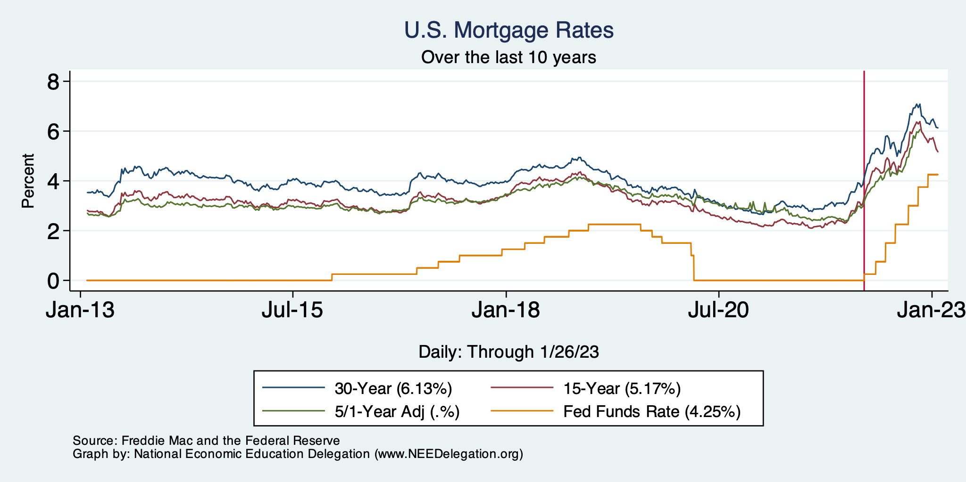
Mortgage Rates

Slide 29
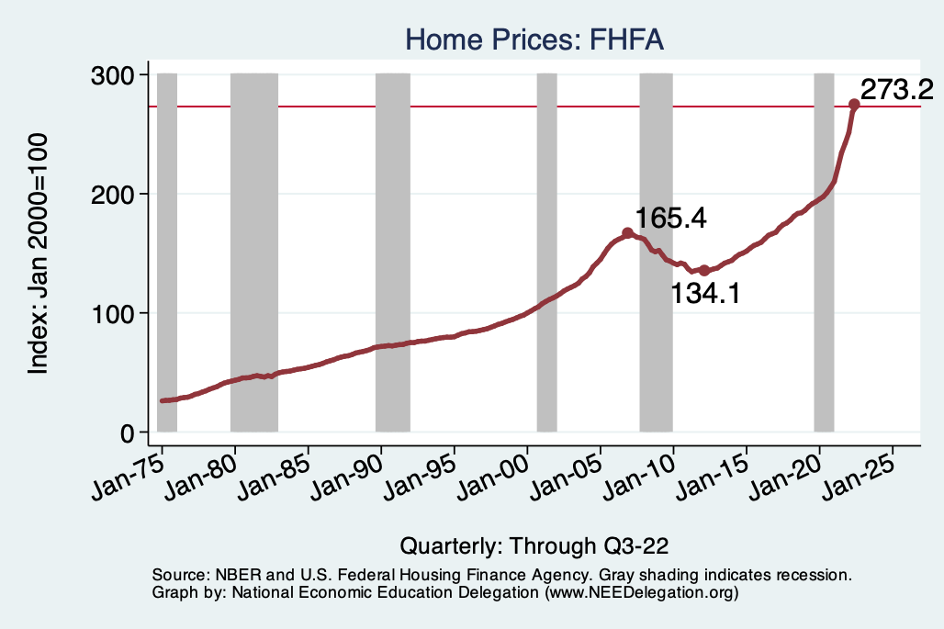
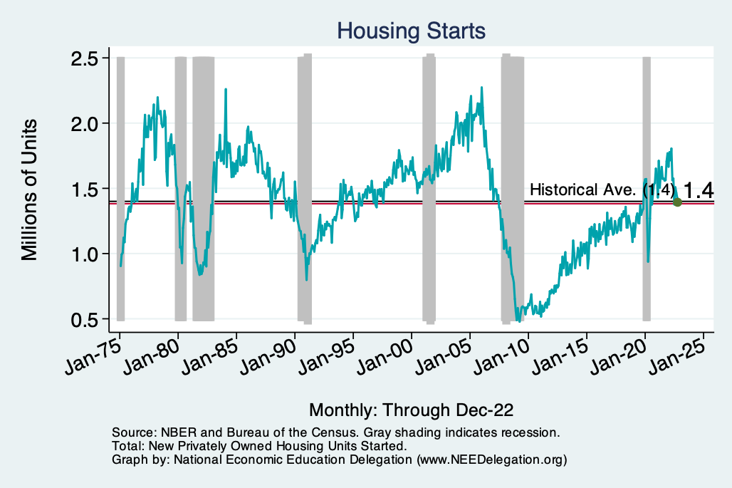
Home Prices and Housing Starts
Notes:
Charts:
homeprices_recession.png
housing.png

Slide 30
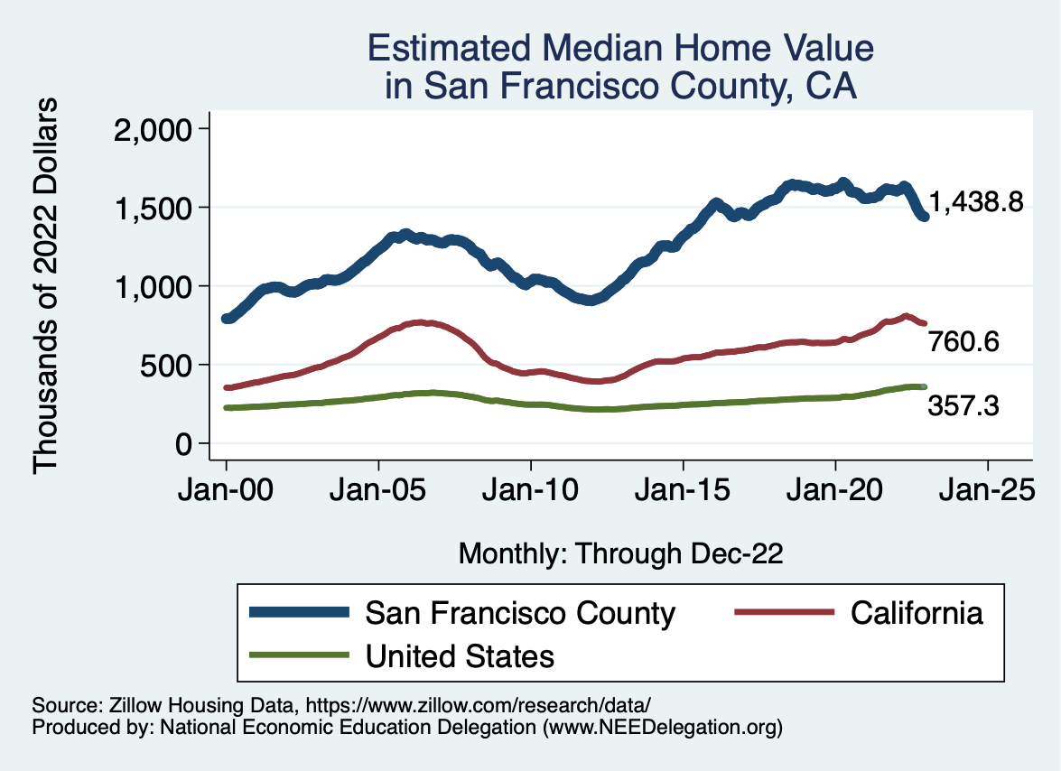
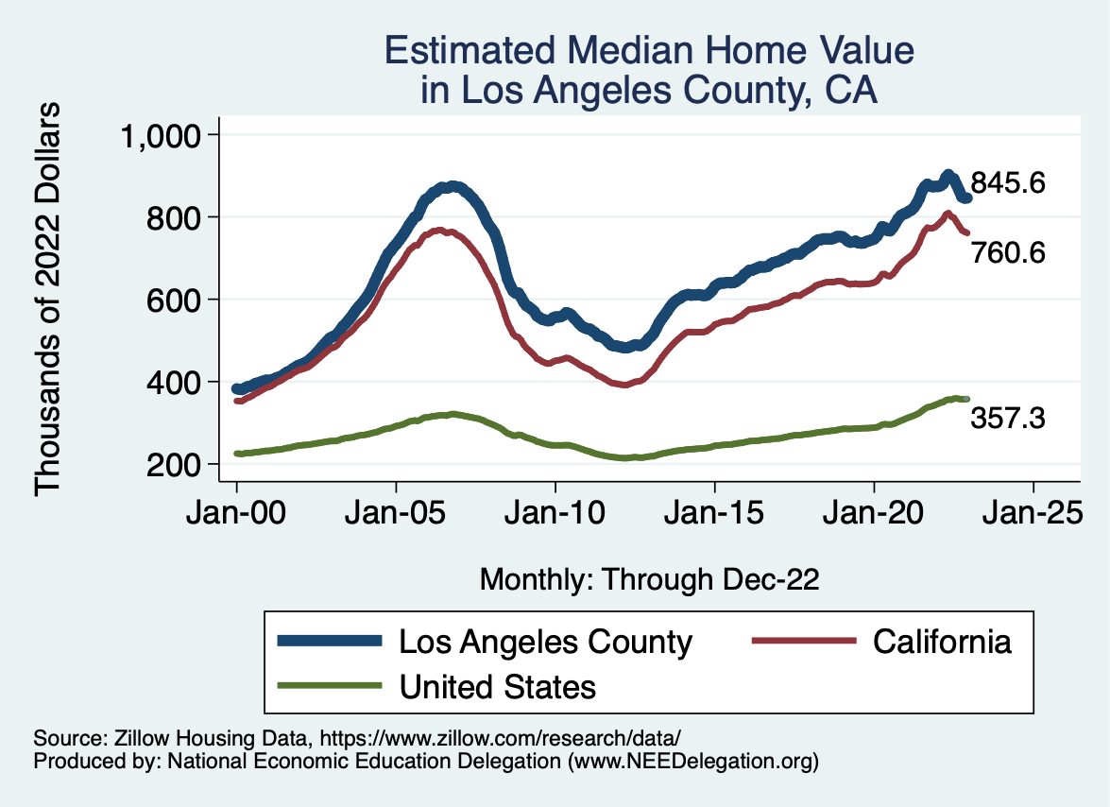
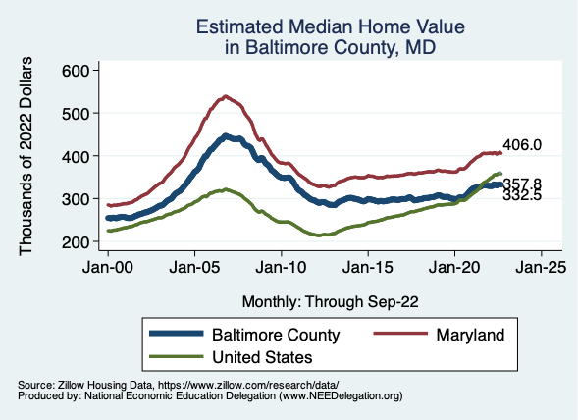
Home Prices … Depends on Where You Are
Notes:
Charts:
homeprices_recession.png
housing.png

Slide 31
Home Sales Falling

Slide 32
Existential Threat: Coming This June!

Slide 33
5 Things to Know about the Debt Ceiling
The debt limit has been raised continually for more than a century.
Raising the debt limit is not about new spending; it is about paying for previous choices policymakers legislated.
The uselessness of a debt limit is exhibited by the fact that only one other advanced country—Denmark—has a separate debt limit rule like ours.
If debt hits the ceiling, the Treasury Department uses several accounting gimmicks to postpone the day of reckoning, but these typically last only a few months.
The economic consequences of a large-scale, intentional default are unknown, but predictions range from bad to catastrophic.
Souce: https://www.brookings.edu/2023/01/19/7-things-to-know-about-the-debt-limit/

Slide 34
Lessons from 2011
Government shutdown was very costly:
Stock markets plunged (17%).
Employment growth stuttered.
Treasuries – downgraded credit ratings.
Borrowing costs rose.
The Debt Ceiling may be a very effective bargaining tool, but…
It is costly.
It is unnecessary.
Accidental partial default in 1979:
increased borrowing costs by $40 Billion!

Slide 35
Takeaways
Is a recession on the horizon?
Perhaps, but no reason to think that it will be anything more than shallow.
Many indicators are still in the black.
2022-Q4 GDP growth was pretty good!
Threats to continued growth:
If inflation stays high, which seems unlikely.
Layoff contagion.
Debt ceiling negotiations
Significant cuts to government budgets may well result.

Slide 36
Thank you!
Any Questions?
www.NEEDelegation.org
Jon D. Haveman
Jon@NEEDelegation.org
Contact NEED: info@NEEDelegation.org
Submit a testimonial: www.NEEDelegation.org/testimonials.php
Become a Friend of NEED: www.NEEDelegation.org/friend.php

Slide 37
www.NEEDelegation.org/LocalGraphs
For every state and county in the United States.
Detailed graphs on employment, housing, moves, and other statistics.

