Slide 1

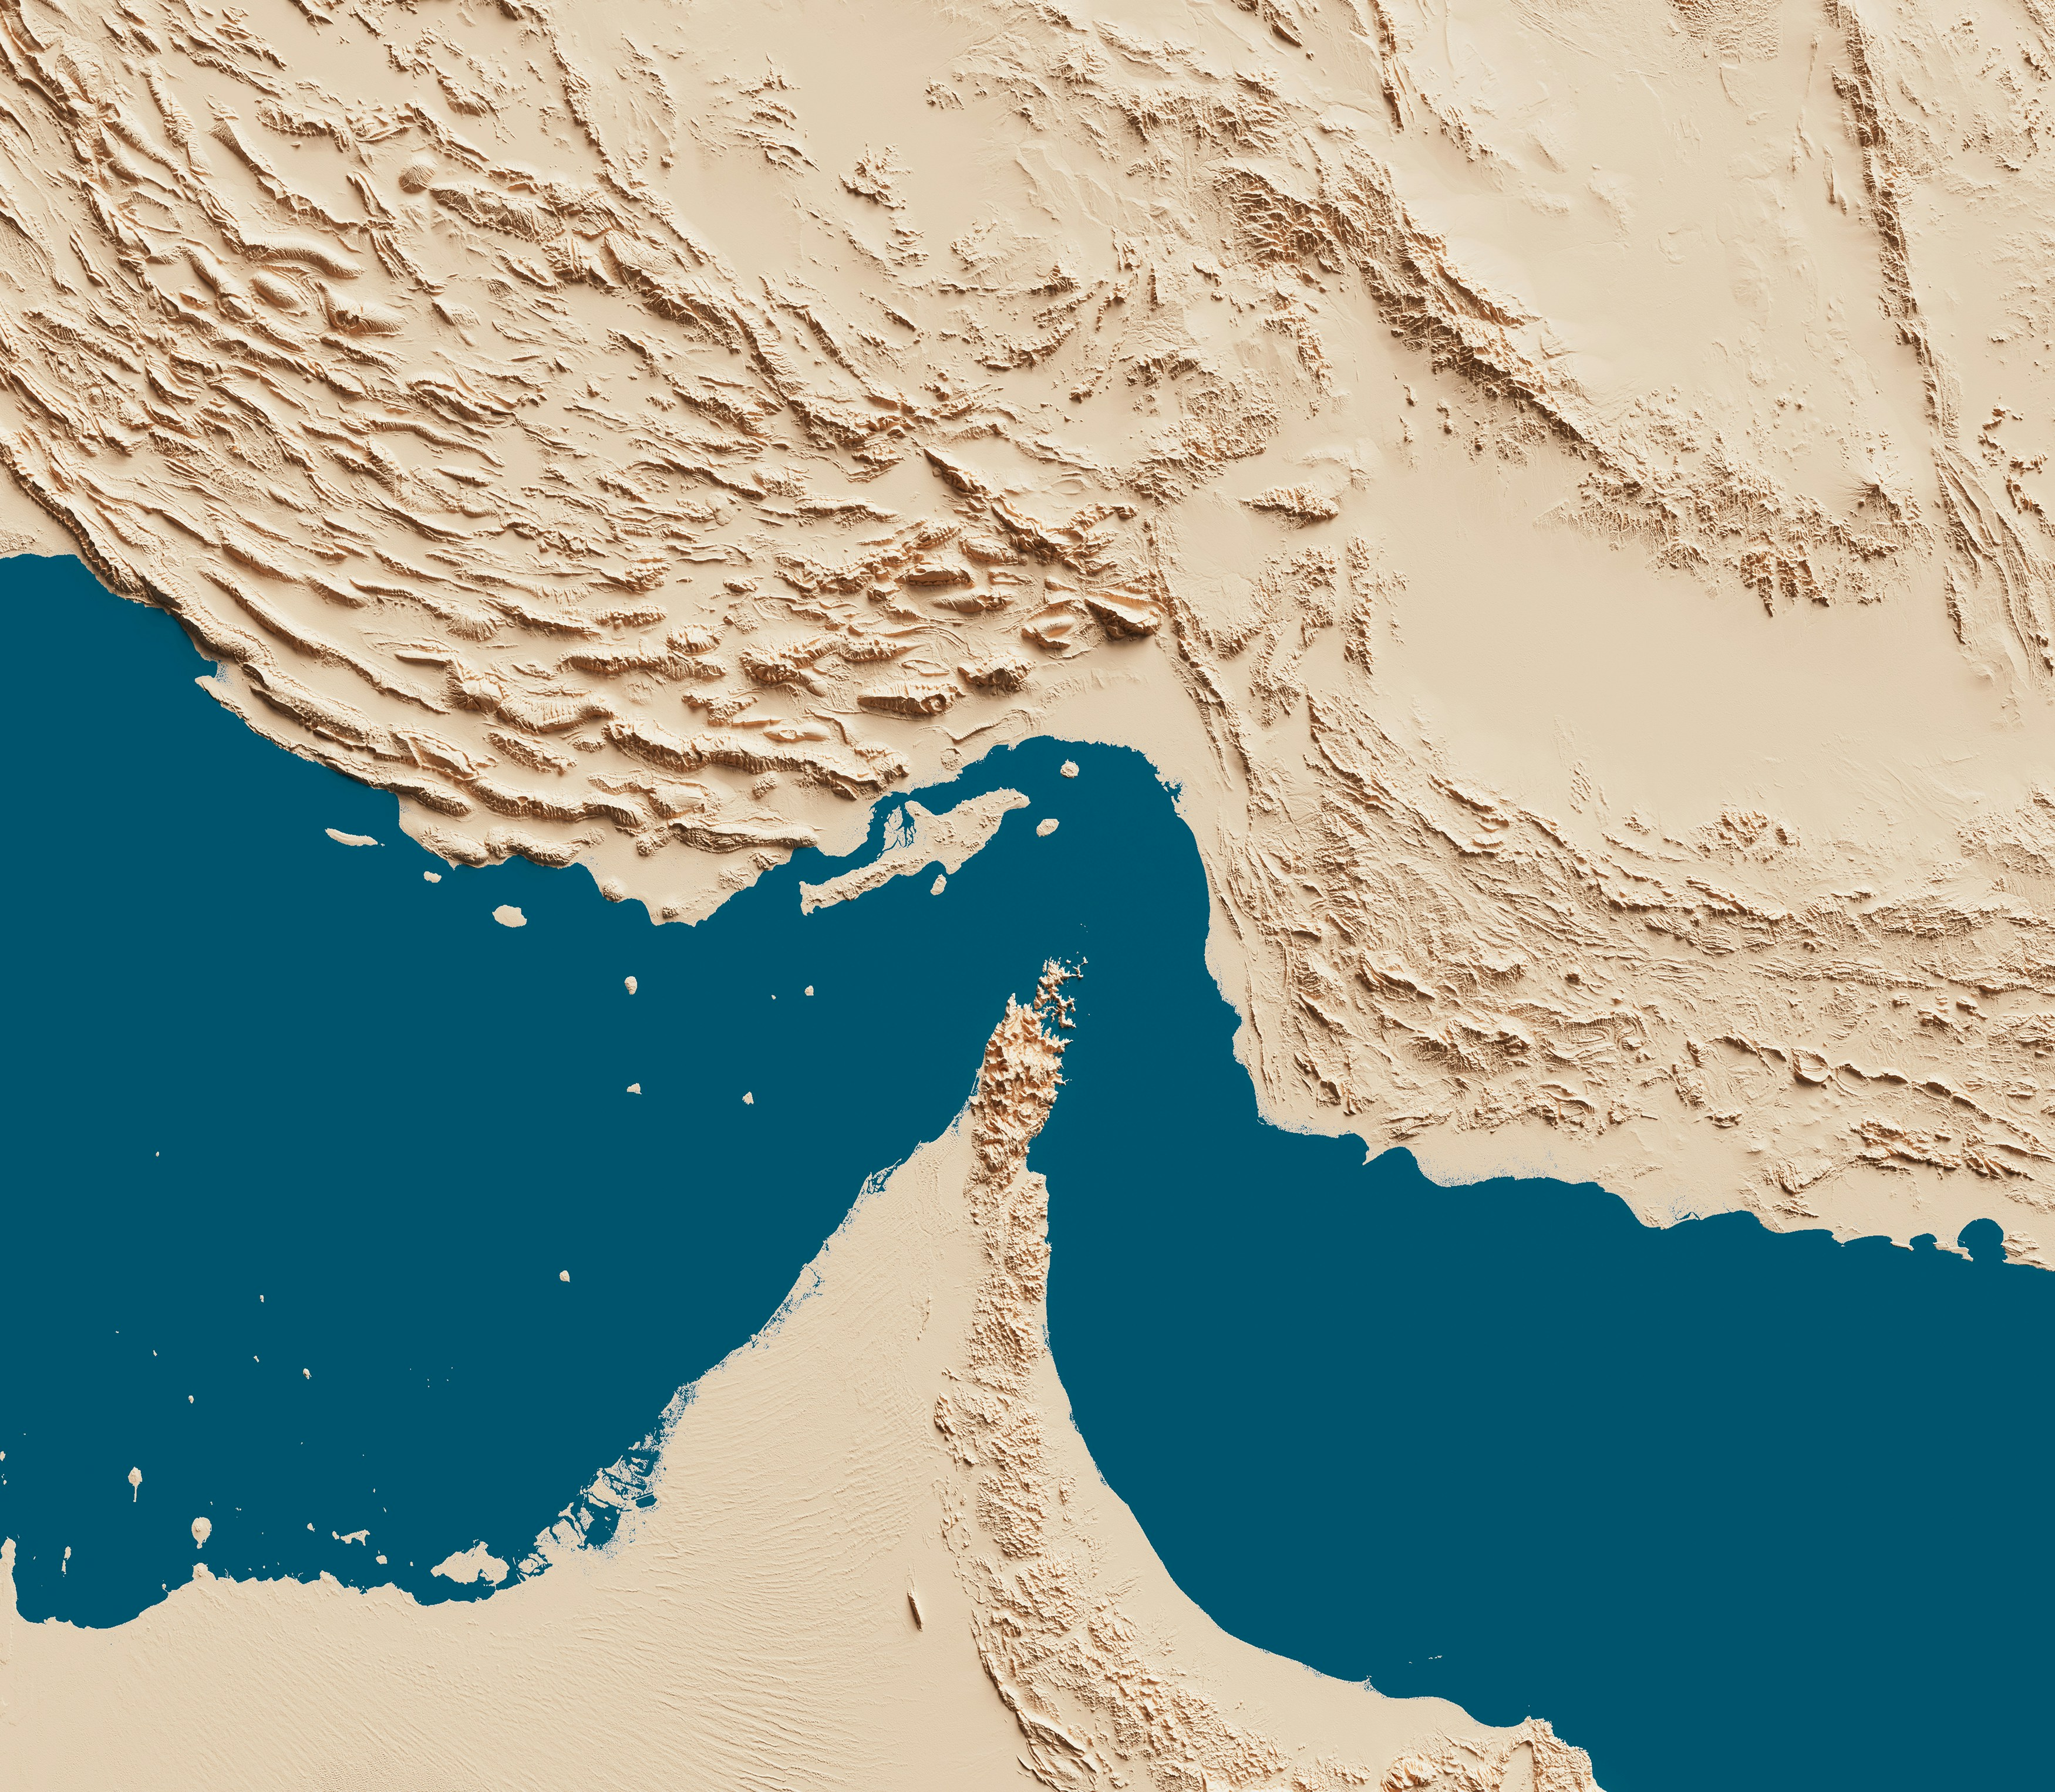
US Economic Update
California Community Colleges Real Estate Education Center
Jon Haveman, Ph.D.
NEED
October 30, 2026

Slide 2
Outline
Economic Indicators
Housing
Uncertainty/Interest Rates

Slide 3
Economic Indicators

Slide 4
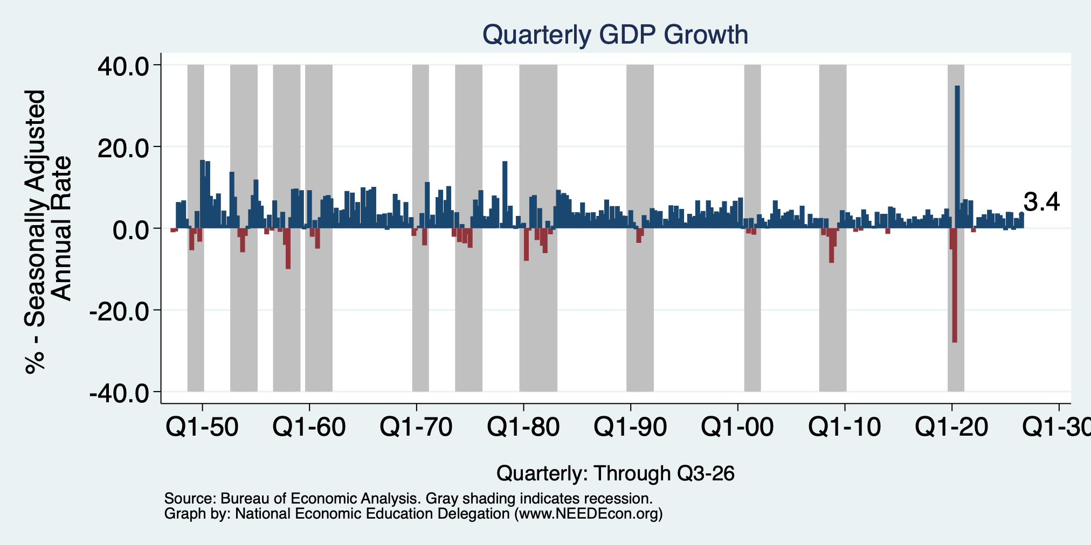
GDP: Quarterly Growth
Q4-2025: 0.2%
Q1-2026: 2.5%
Q2-2026: 2.2%
Q3-2026: 3.4%
Growth in 2025: 2.3%
Growth in 2026: 2.1% (YoY to Q3)
Notes:
Graph: gdp_pot_grow.png
The Point: From 1990 – 2007, average annual US GDP growth pre-crisis is 2.94%. However, post-crisis US GDP growth is 2.19% (0.75 percentage points lower). Why is has the recovery been sluggish?
Note: At the recession’s height, the gap between quarterly GDP growth and potential growth was 2.5 percentage points.

Slide 5
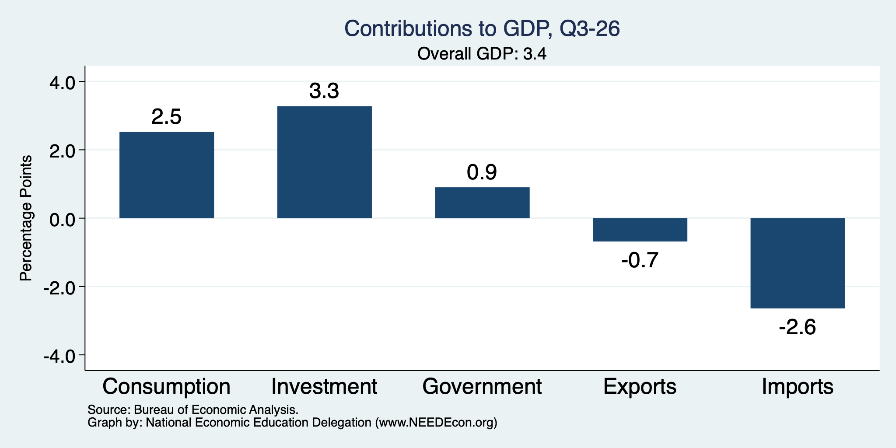
What Drove GDP to Such Growth?
Normally
2.3%
Normally
0.9%

Slide 6
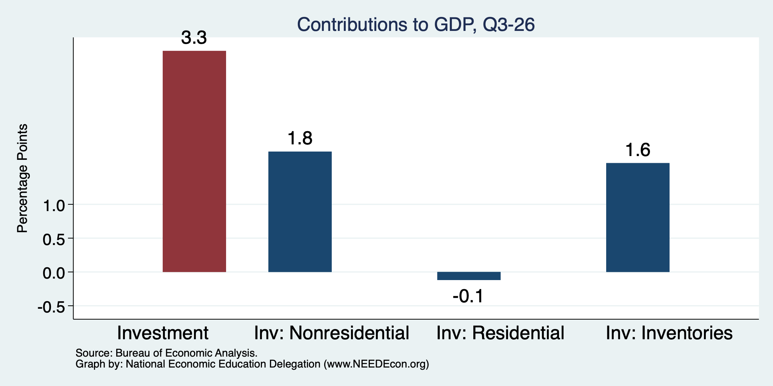
Investment Levels Are Quite High
Normally
About 0.9
Normally
About 0.8

Slide 7
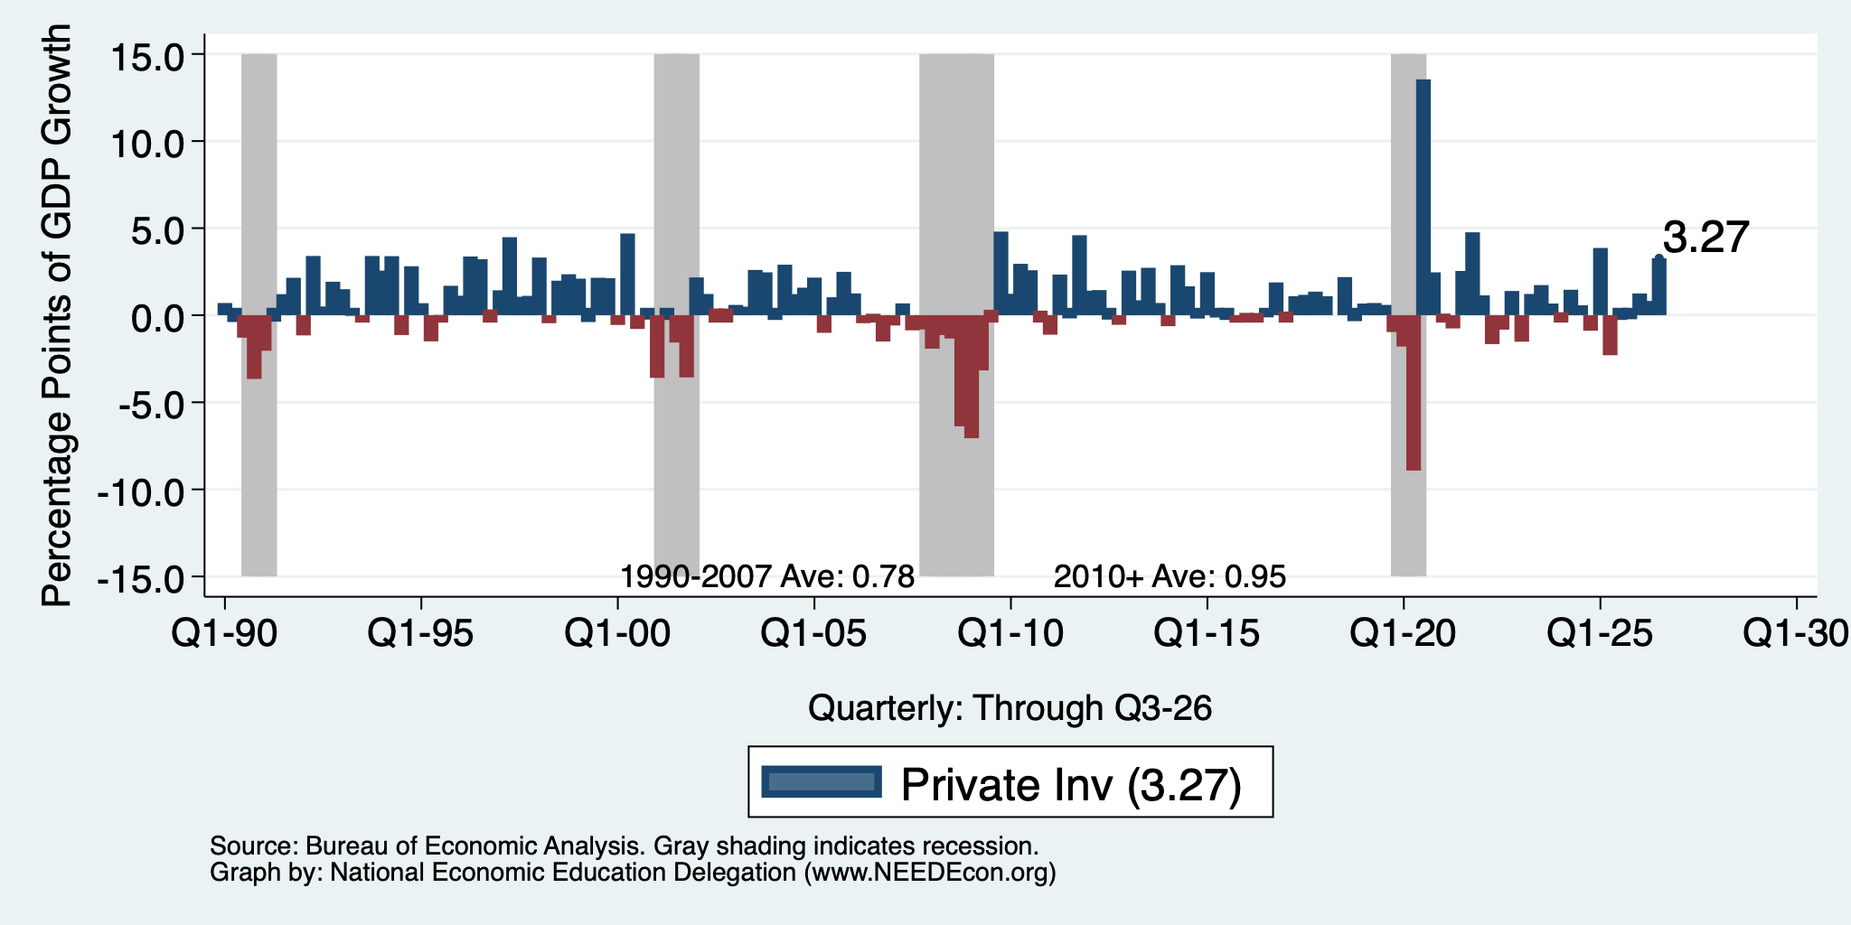
Investment Levels Are AI High

Slide 8
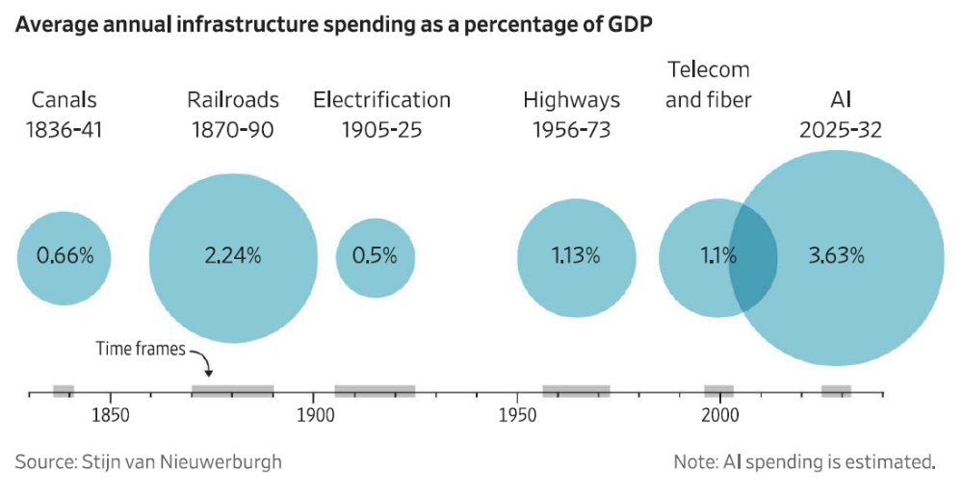
AI Boom is Unprecedented
https://www.brookings.edu/wp-content/uploads/2026/09/4c_Van-Nieuwerburgh.pdf

Slide 9
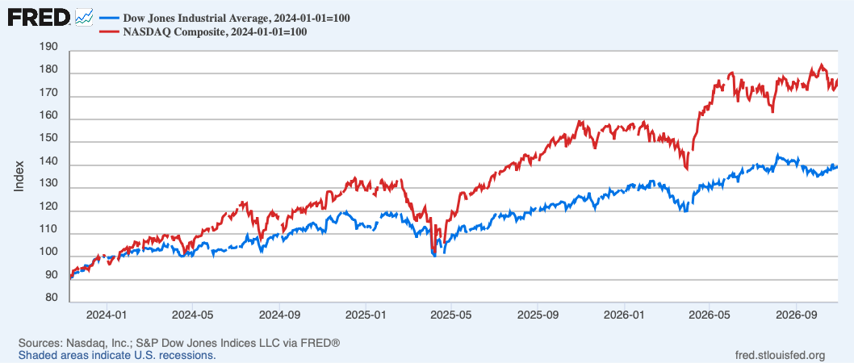
The Stock Market is Being Driven by Tech
Nasdaq
Dow

Slide 10
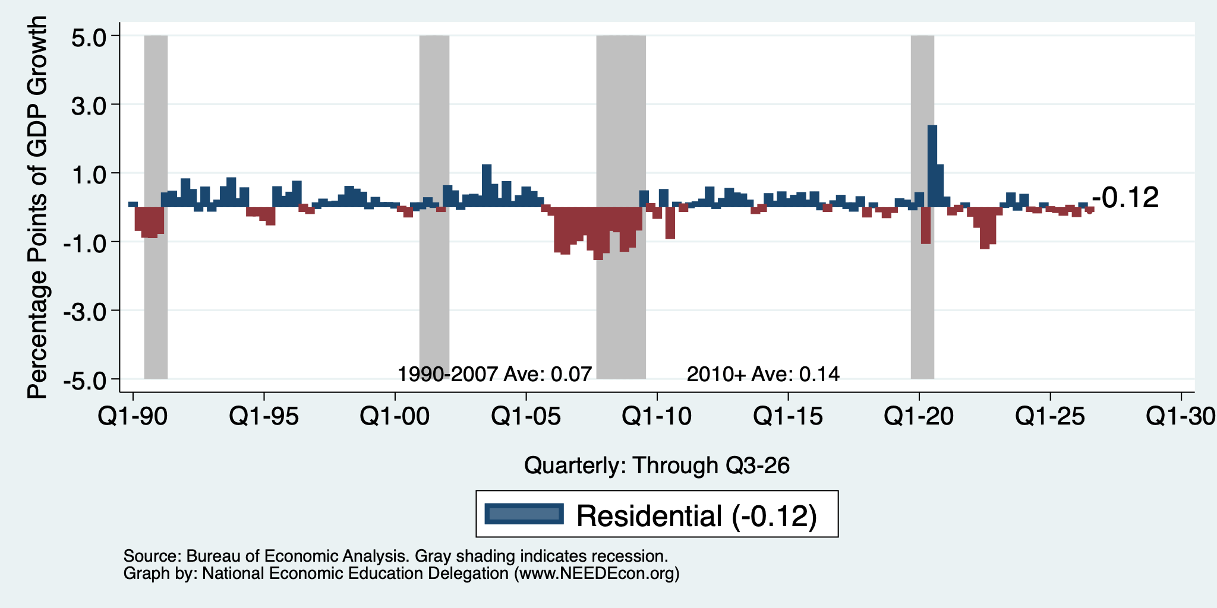
Investment in Residences is Slow

Slide 11
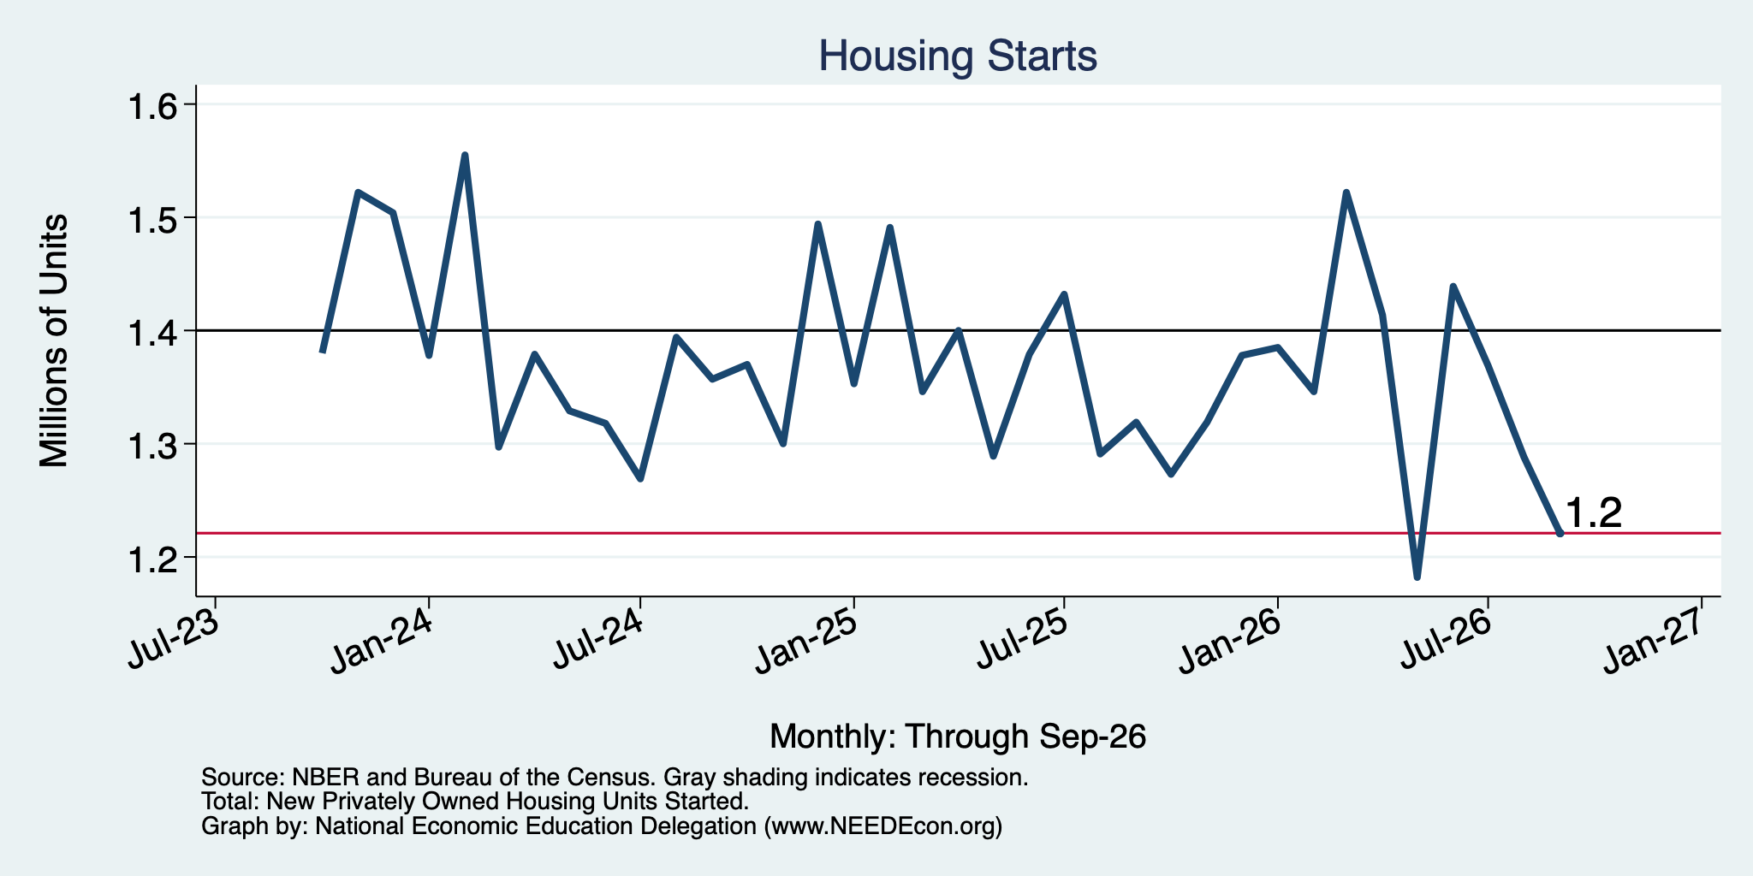
Housing Starts: A Little Low in 2025 and 26

Slide 12
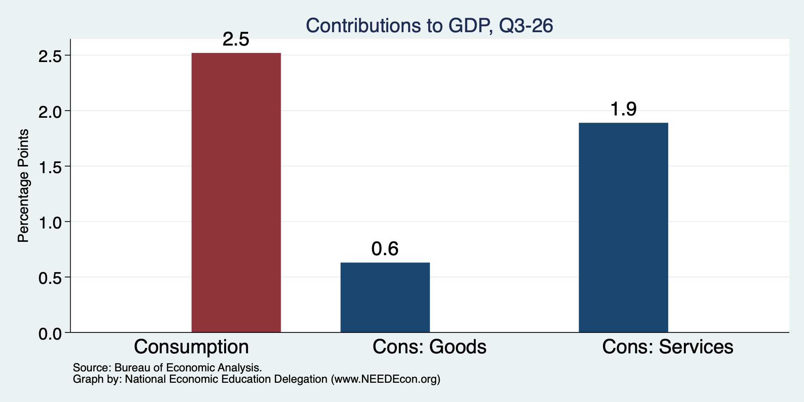
Consumers Continue to Spend
Normally
~0.85%

Slide 13
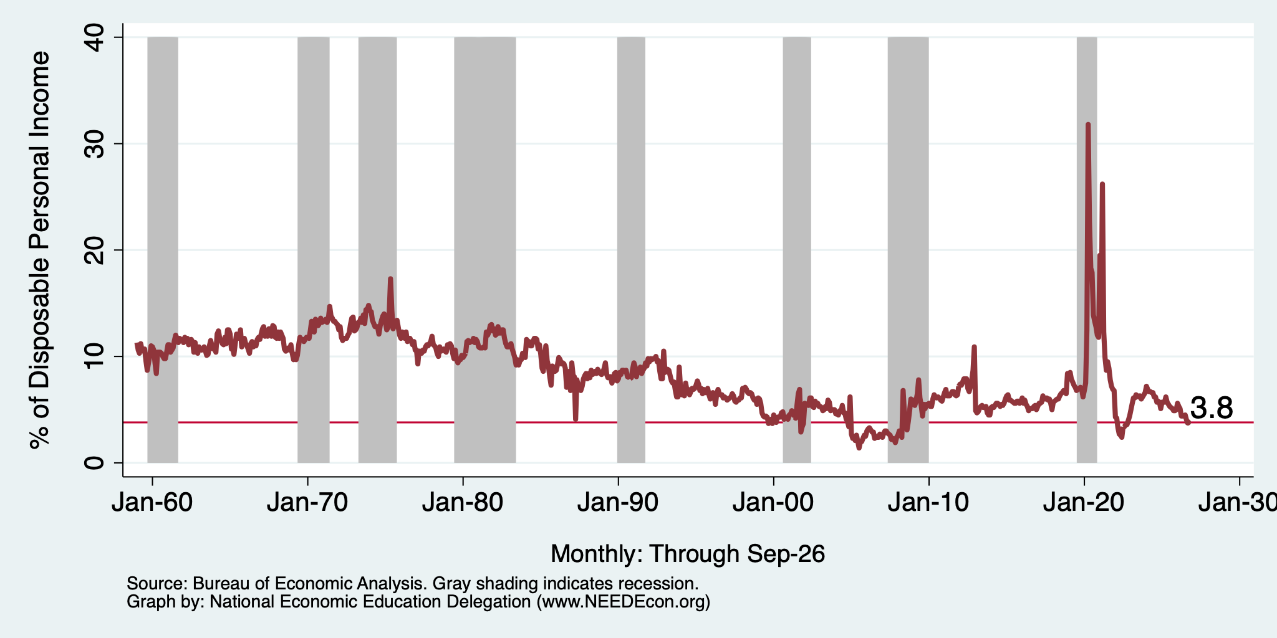
Really Low Savings Rate

Slide 14
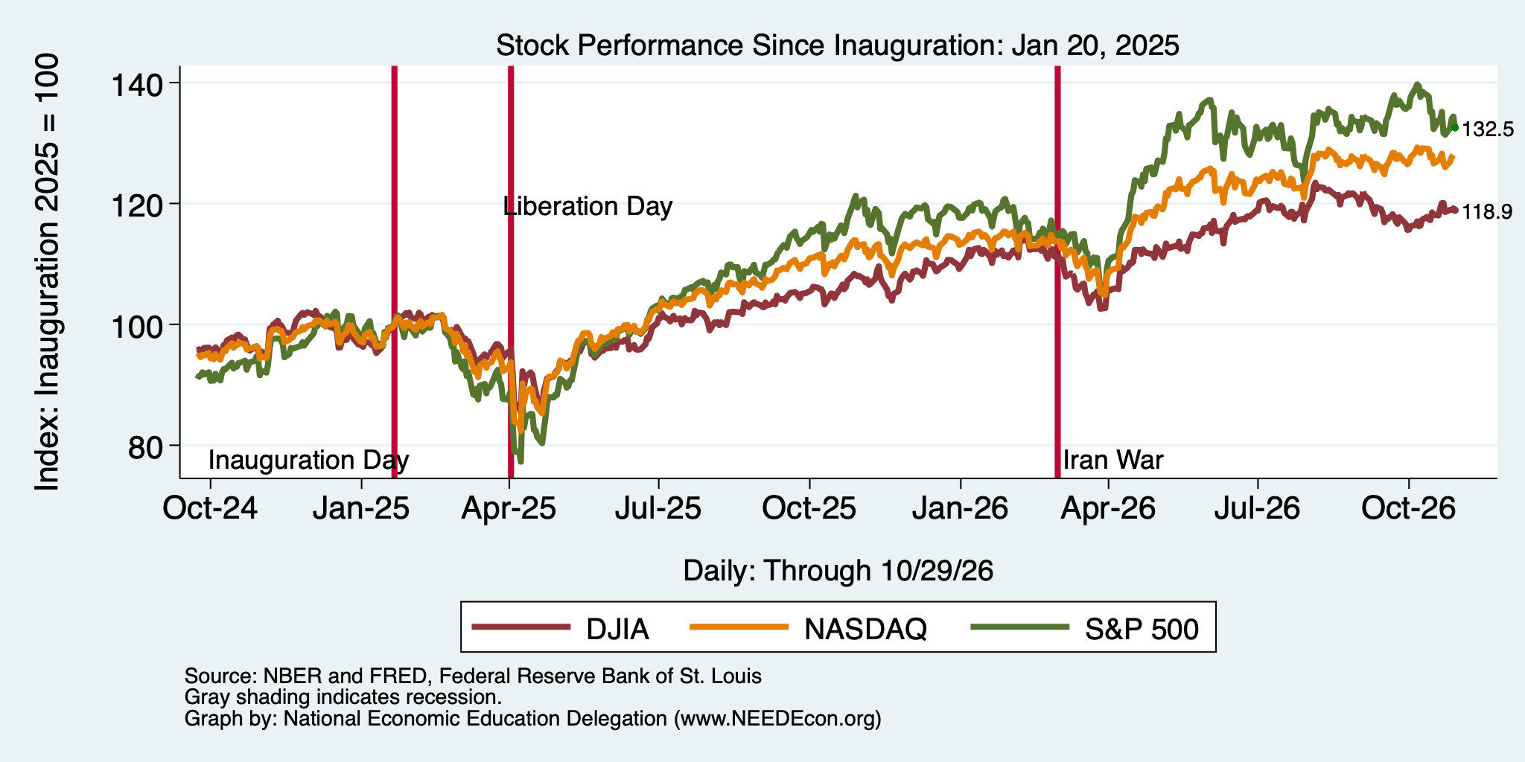
And Stocks? Wealth Effect on Consumption

Slide 15
Potential Explanations for High Consumption
The wealth effect
Low layoffs and stable employment
Inflation-inflated nominal numbers
  Much of the increase represents spending more for the same amount of goods rather than an increase in raw purchases.
Drawing down savings
Alternative financing
  Credit cards, BNPL, 401k hardship withdrawals.

Slide 16
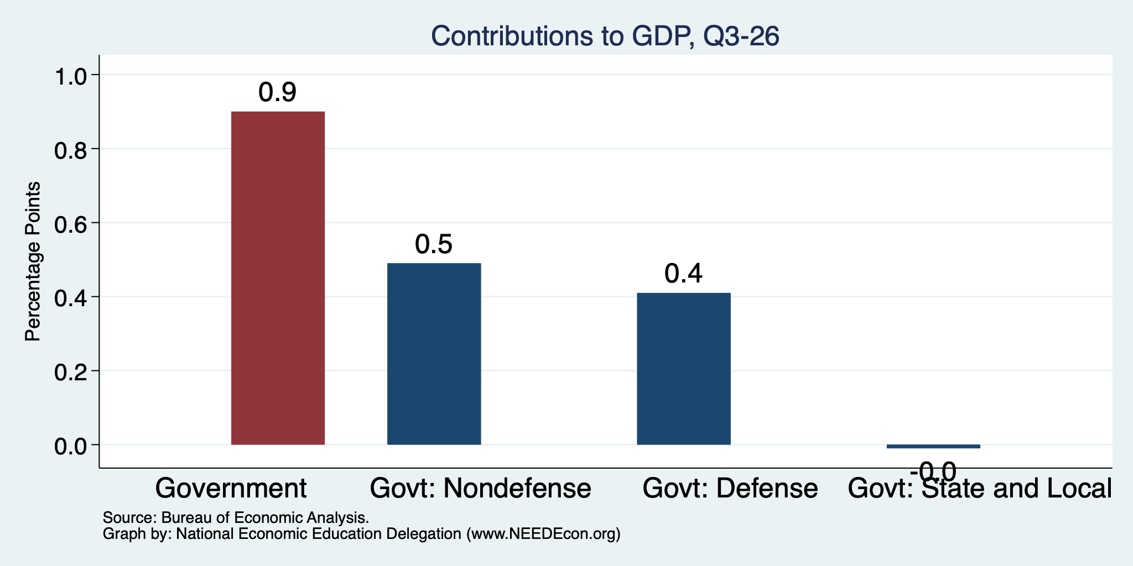
Government Spending is Also Contributing
Normally
0.3%

Slide 17
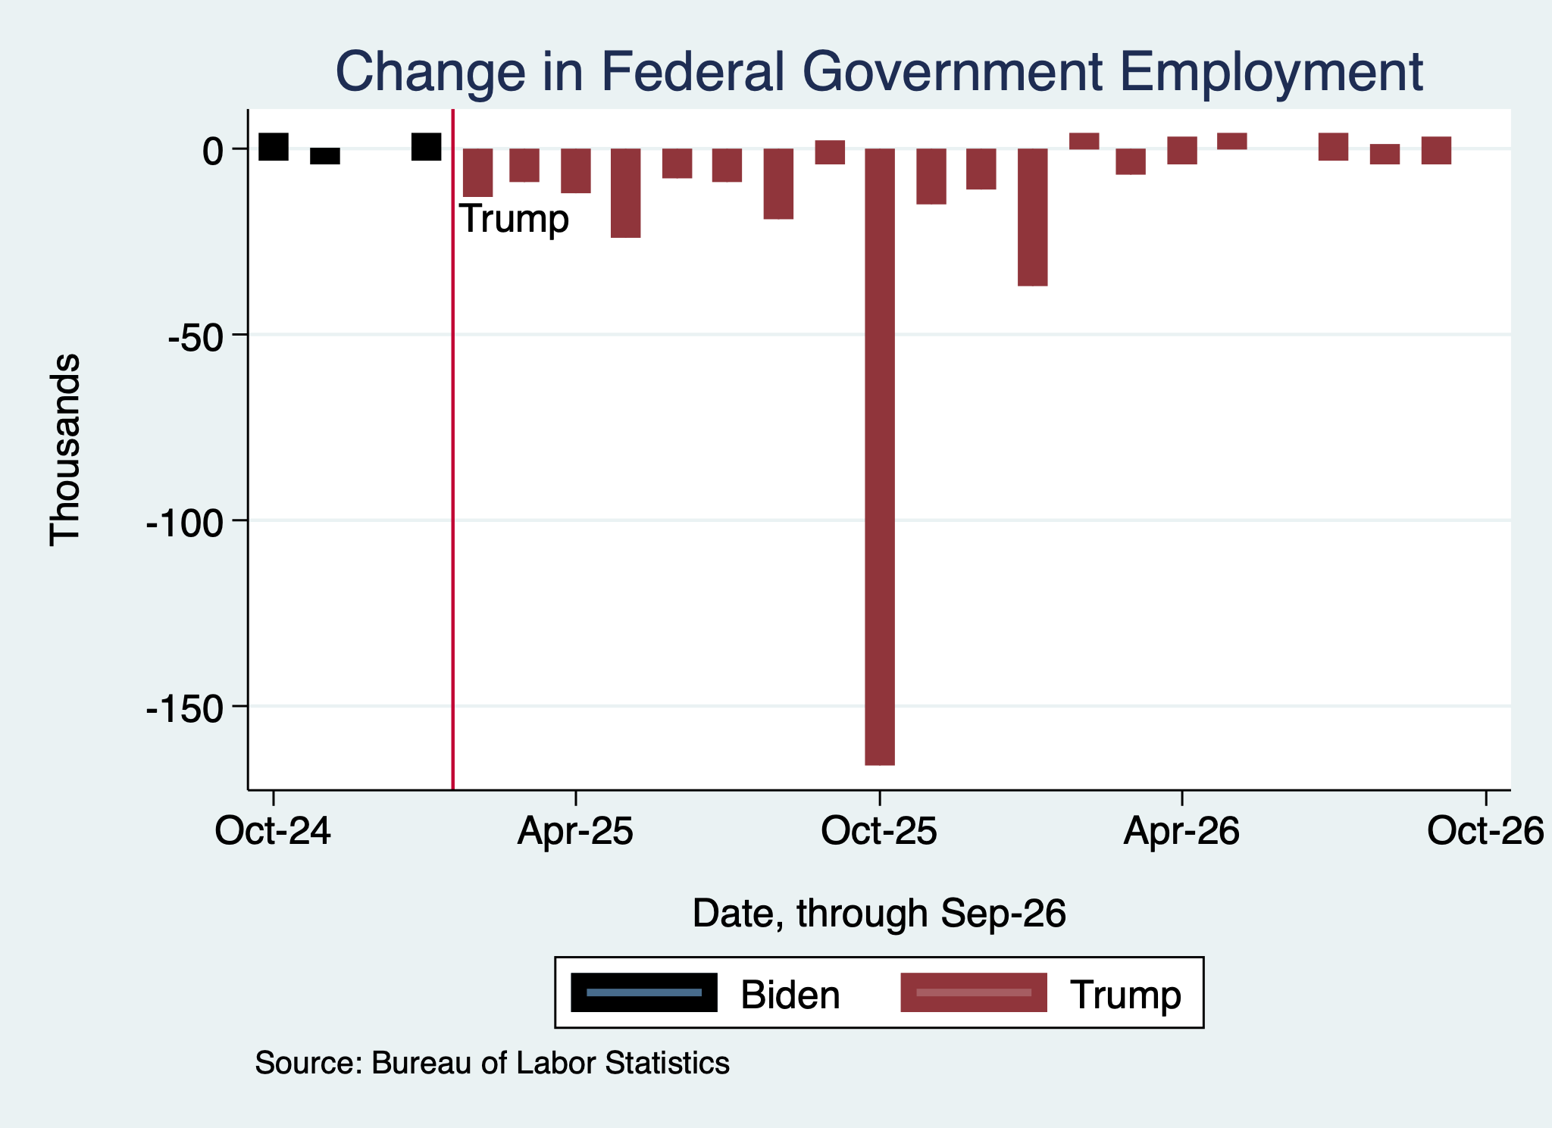
Monthly Changes in Federal Gov’t Employment
Notes:
PAYEMS.png

Slide 18
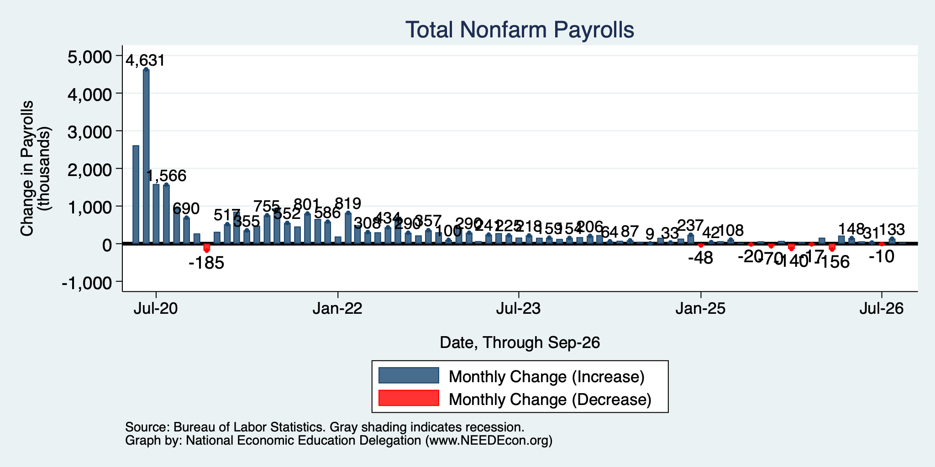
Monthly Changes in Nonfarm Employment
Jul: -10,000
Aug: 133,000
Sep: 29,000
Notes:
PAYEMS.png

Slide 19
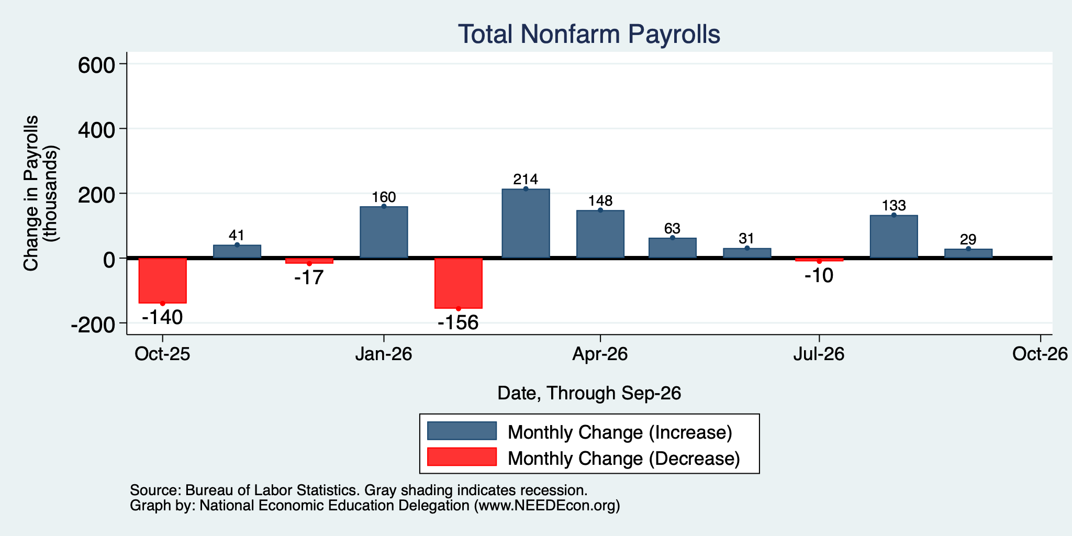
Monthly Changes in Nonfarm Employment
Jul: -10,000
Aug: 133,000
Sep: 29,000
4 months: Bad
4 months: Not great
4 months: Good
Notes:
PAYEMS.png

Slide 20
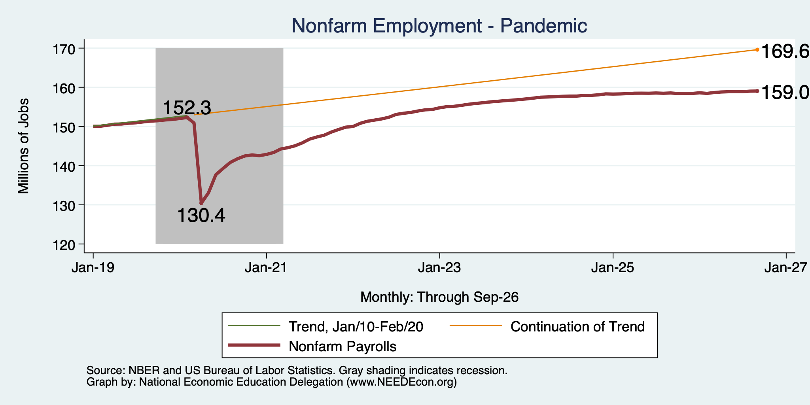
Employment Gap … is Growing
6.7 Million ABOVE February, 2020.
10.6 Million BELOW where we should be.
Notes:
payroll_recent.png

Slide 21
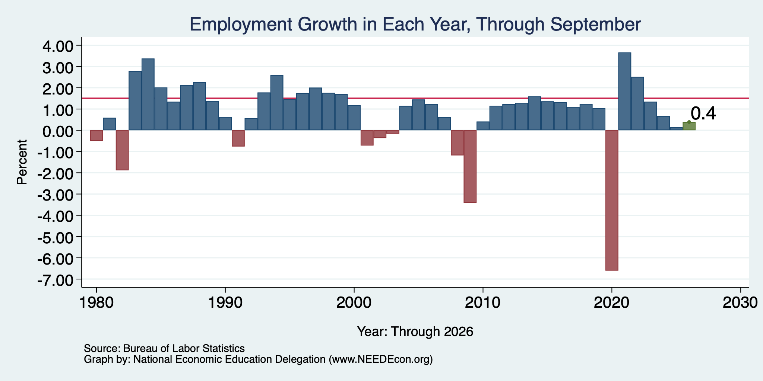
Annual Changes in Nonfarm Employment
Notes:
PAYEMS.png

Slide 22
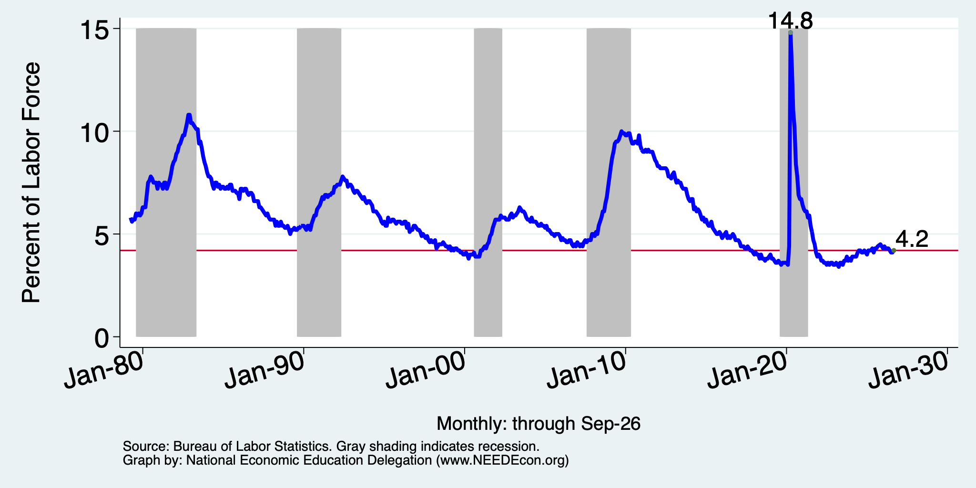
Unemployment Rate

Slide 23
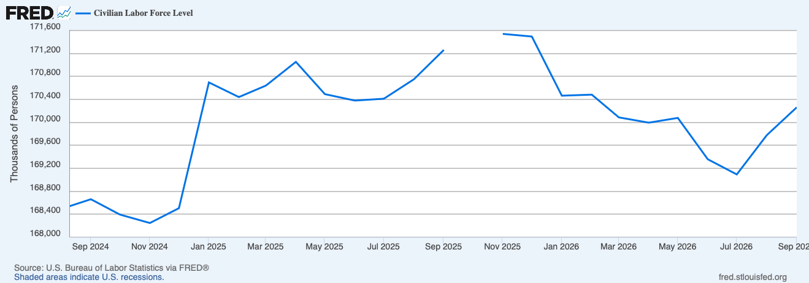
False Comfort from UR – Labor Force Declines
Nov/25
171,541
Jan/25
170,696
Sep/25
170,262
Labor force falling with employment relatively unchanged…
Drops the unemployment rate.
LF down by 434,000 since Jan/25, down 1.3 million since Nov/25.
Declines roughly equally split between foreign born and native born.

Slide 24
Summary
GDP is growing rapidly!
  Similar to Q3 last year.
  Driven by AI and consumers
    Both may be on tenuous footing.
    Tech stocks are faltering. But money is just moving to other sectors, buoying the stock market (mostly).
    If AI goes, it may well take consumer spending with it.
Employment growth is nothing to write home about.
Unemployment rate is low for the wrong reasons.

Slide 25
Inflation

Slide 26
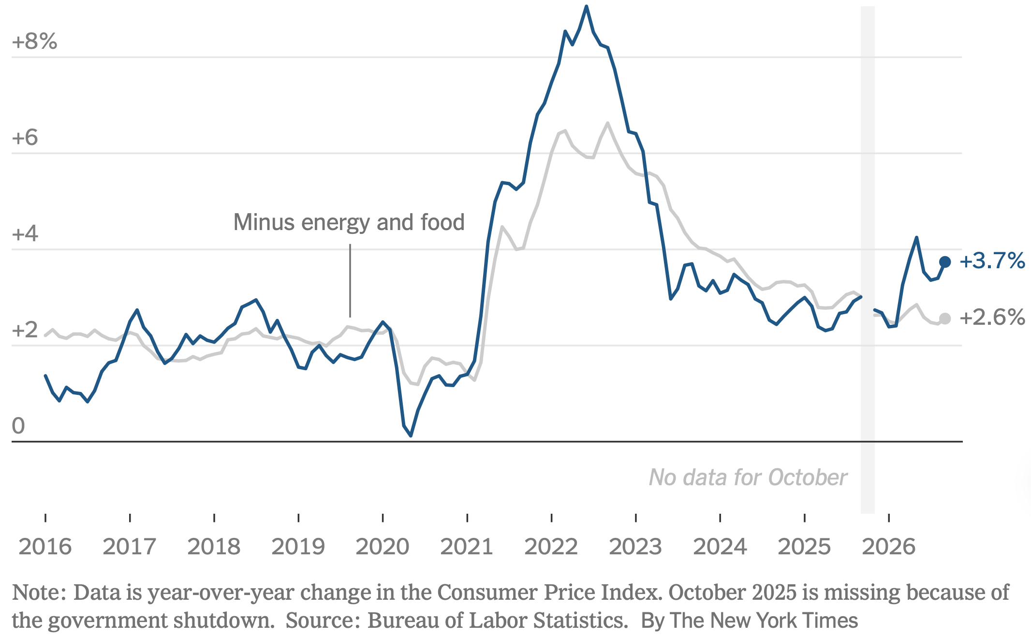
Inflation: Latest Figures
The uptick is primarily because of the war.
Source: NYTimes.com

Slide 27
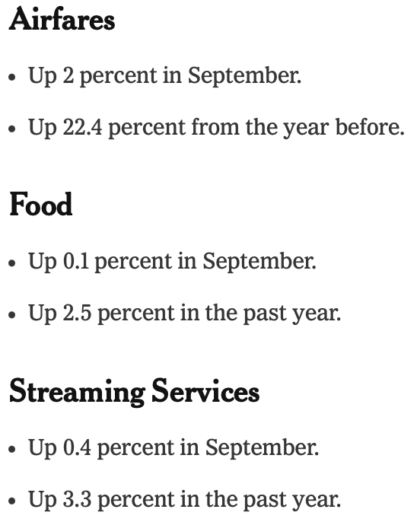
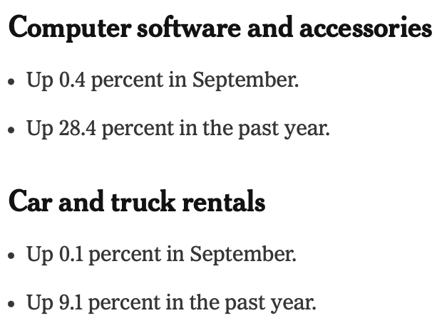
Inflation: Latest Monthly Figures
Source: NYTimes.com

Slide 28
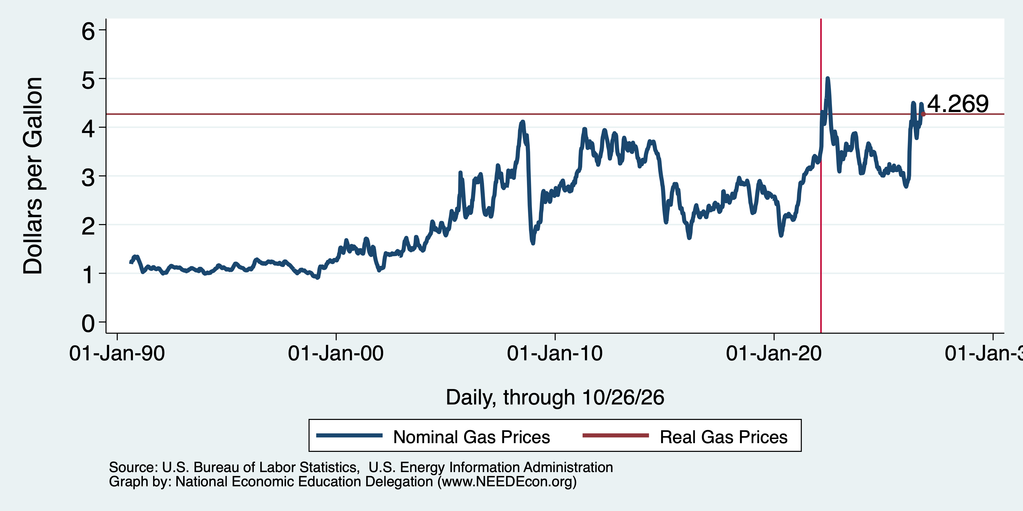
Inflation: Gas Prices

Slide 29
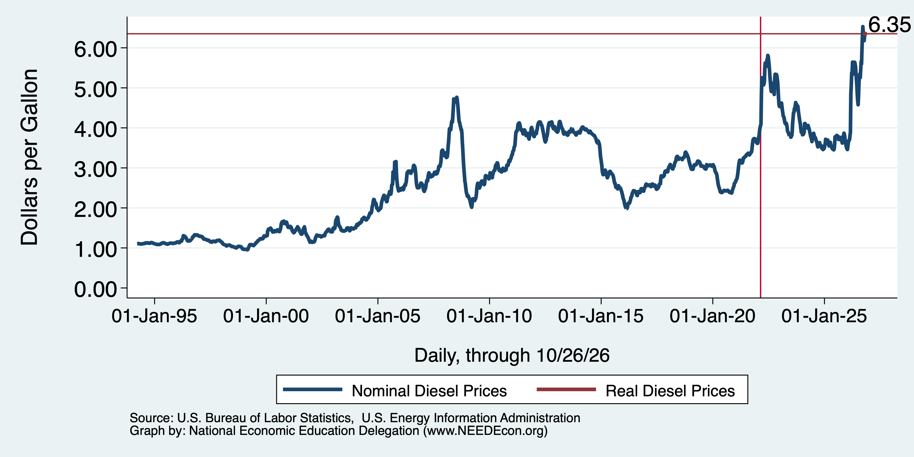
Inflation: Diesel Prices

Slide 30
Federal Reserve

Slide 31
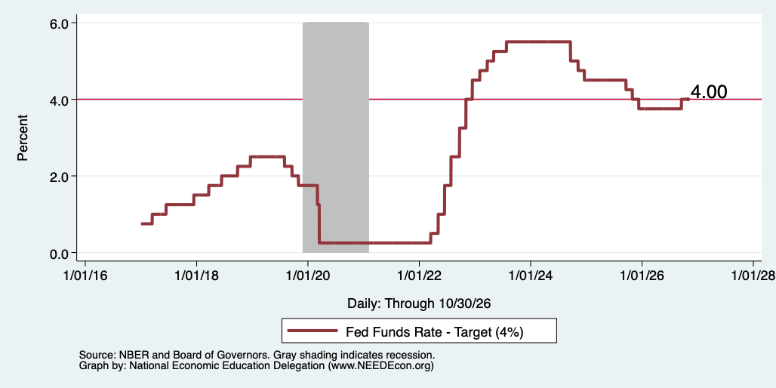
Federal Funds Rate
Notes:
The fed funds rate is the interest rate on overnight loans between banks. Think of it as the baseline interest rate on which banks base all other interest rates (e.g. mortgage rates)
FOMC lowers the fed funds rate during recessions and raises the fed funds rate during expansions
Fed funds rate peaked in the 1980s as then Chairman Paul Volcker sought to reign in “run away” inflation of the 1970s; doing so resulted in a recession in the early 1980s.
Since the 2008-09 recession, the fed funds rate has been kept near zero.
During the 2008-09 recession, Federal Reserve turned to unconventional tools to influence longer term interest rates to further stimulate the economy - QE
FedFunds.png

Slide 32
Takeaways
Is a recession on the horizon?
  I wouldn’t be surprised, but not betting on it.
    Jobs growth is slow.
    GDP growth is pretty good – but can it be sustained?
    Inflation has ticked up.
Stagflation is very possible.
The problem?
  Uncertainties abound!
  Whither AI?

Slide 33
Housing Stats

Slide 34
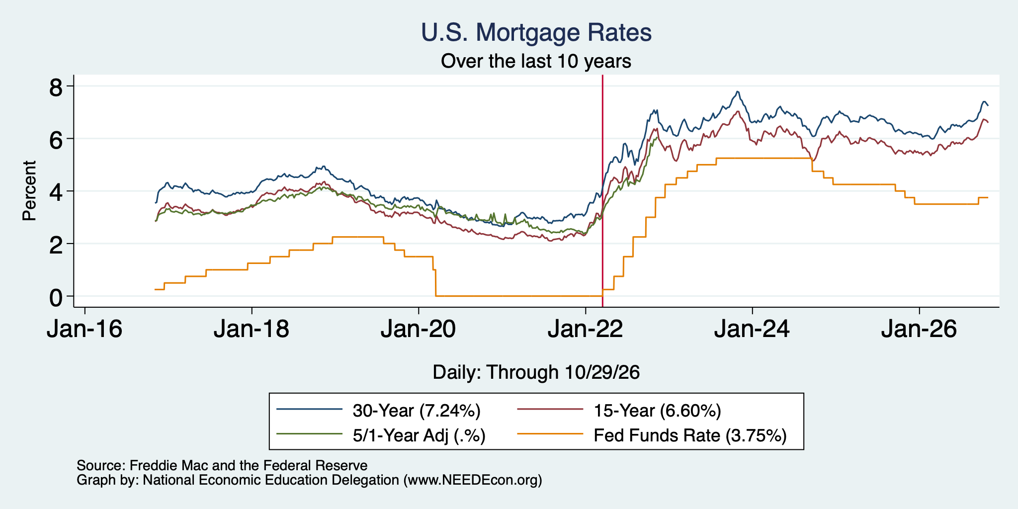
Mortgage Rates

Slide 35
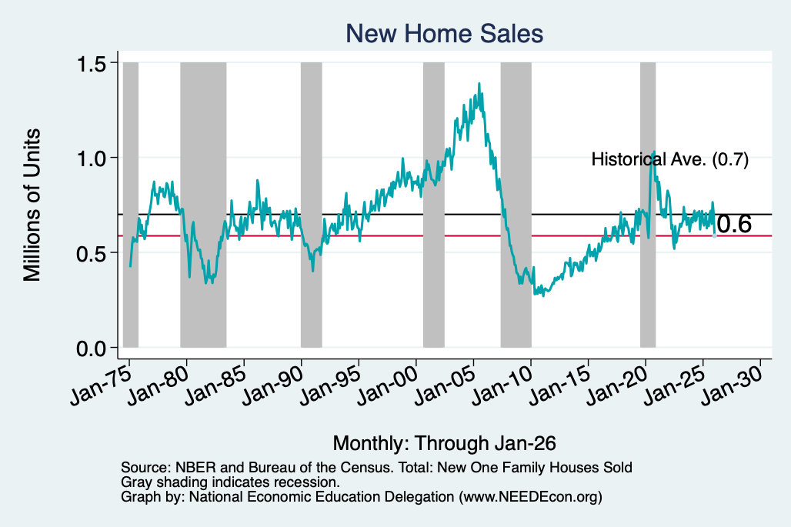
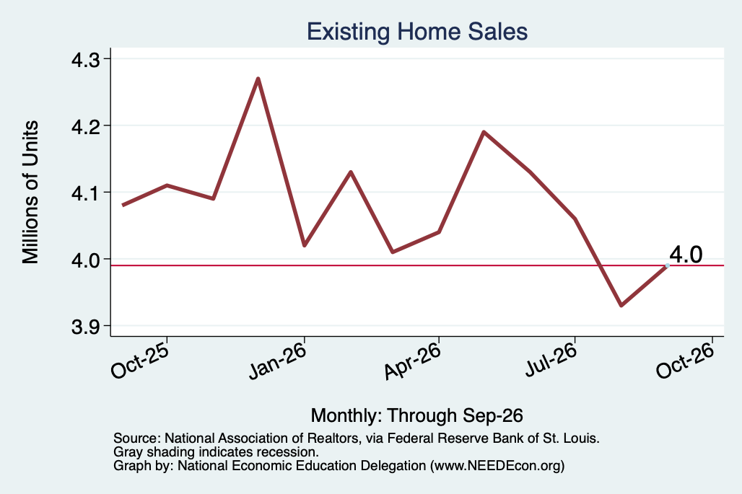
Home Sales are Not Horrible

Slide 36
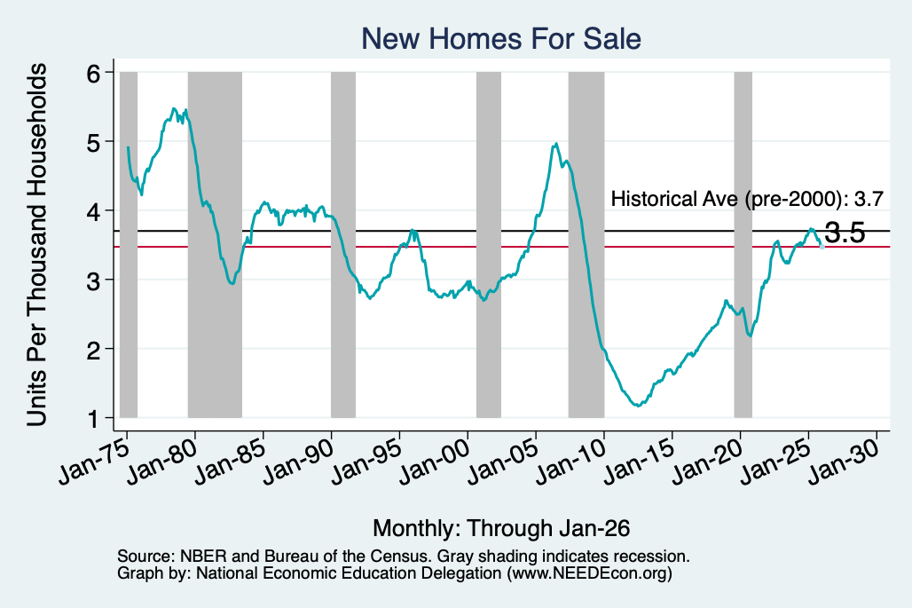
Home Sales are Not Horrible

Slide 37
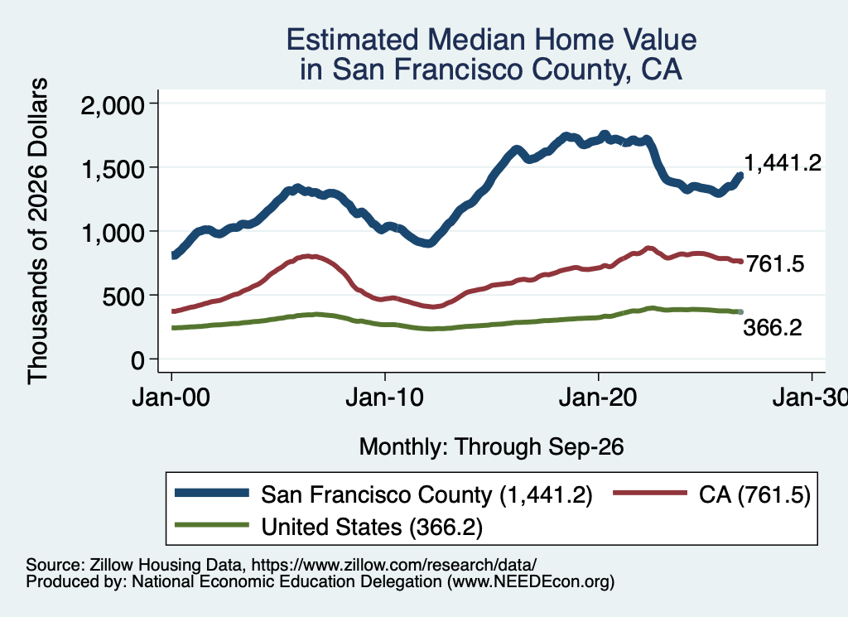
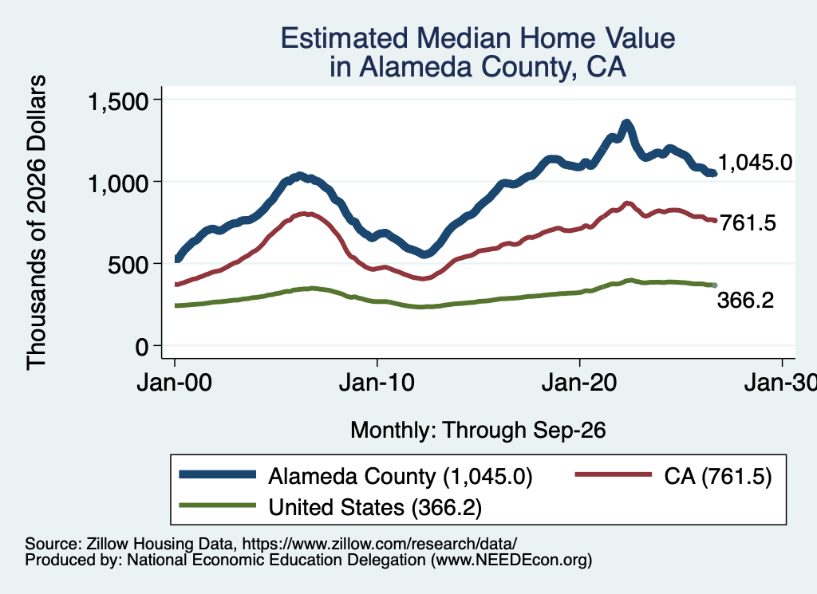
Home Prices … in Northern CA
Notes:
Charts:
homeprices_recession.png
housing.png

Slide 38
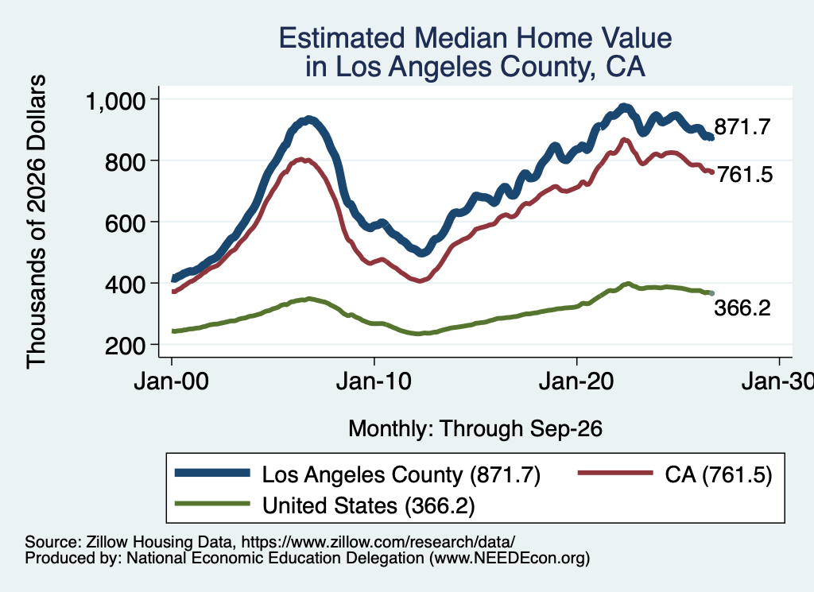
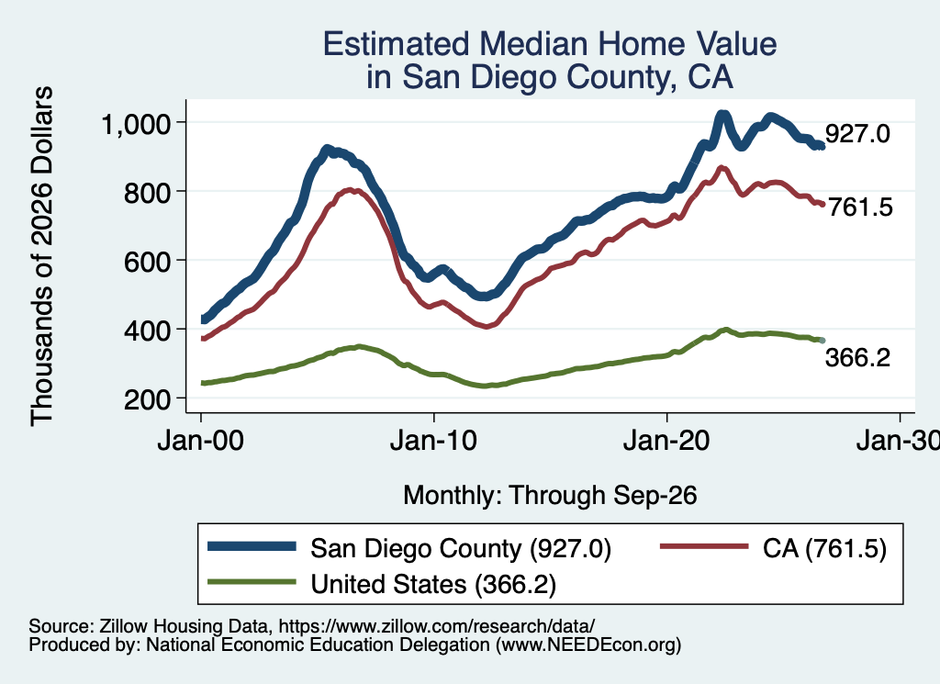
Home Prices … in Southern CA
Notes:
Charts:
homeprices_recession.png
housing.png

Slide 39
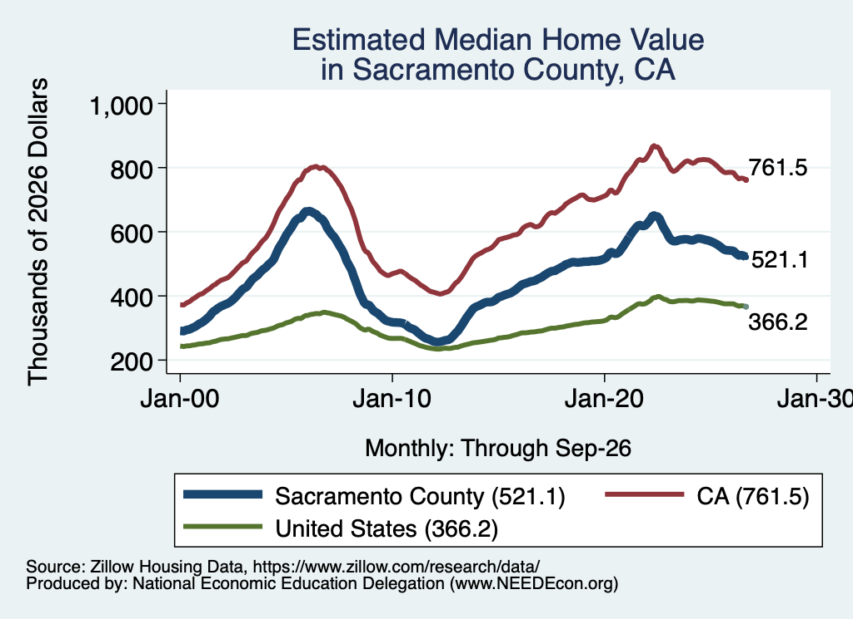
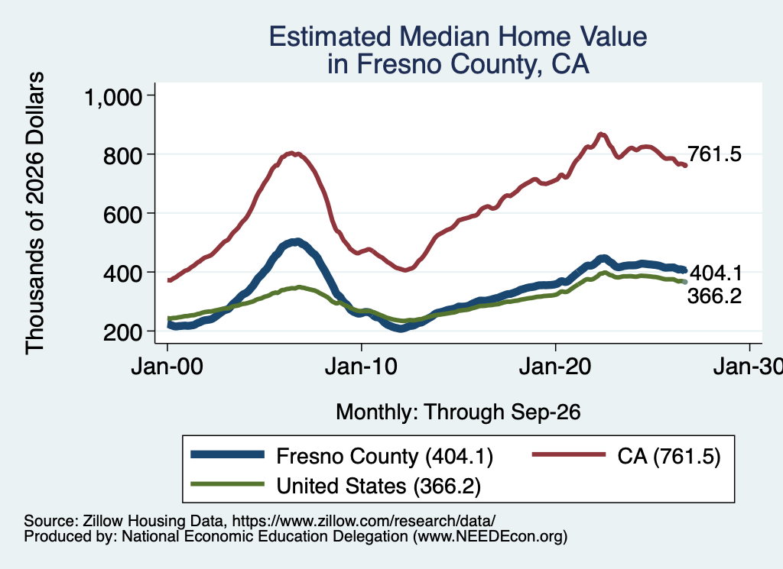
Home Prices … in The Central Valley
Notes:
Charts:
homeprices_recession.png
housing.png

Slide 40
Overview: Real Estate
Prices are falling in almost all of CA.
  SF, Imperial, Inyo, and Modoc – only counties on an upward trajectory.
Interest rates are trending UP – which is very worrisome.
New building is declining
  So the pace at which the housing deficit of the 2010’s is alleviated is slowing.
New building is becoming more expensive.
  Construction workers are being deported.
  Tariffs are raising prices of key materials – e.g., lumber.
  Transportation costs are rising.

Slide 41
Bigger Picture: Uncertainty

Slide 42
Uncertainties
What effect will continued deportations have?
Will AI continue to drive growth (and inflation)?
Will tariffs continue to drive inflation?
How much is/will the war drive inflation beyond fuel prices?
Will consumers continue to hold up?
Fed policy with Kevin Warsh

Slide 43
Uncertainties
What about interest rates?

Slide 44
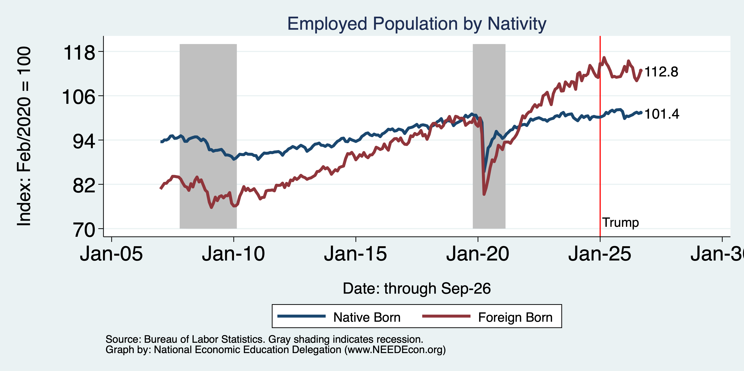
Immigrants to the Rescue? No Longer

Slide 45
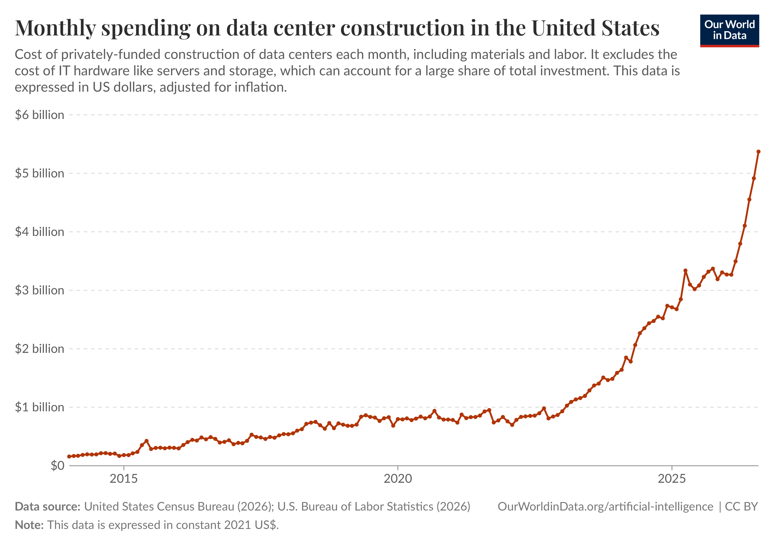
Data Center Investment
Source: www.OurWorldinData.org

Slide 46
Interest Rates

Slide 47
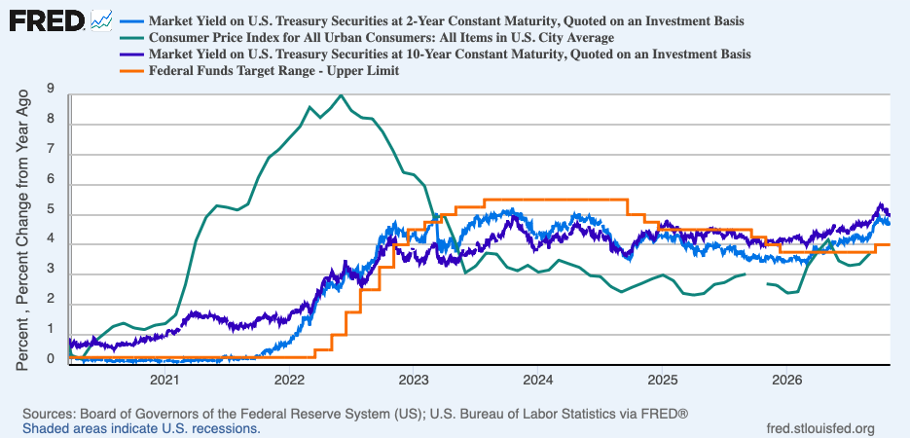
Interest Rate Are on the Rise

Slide 48
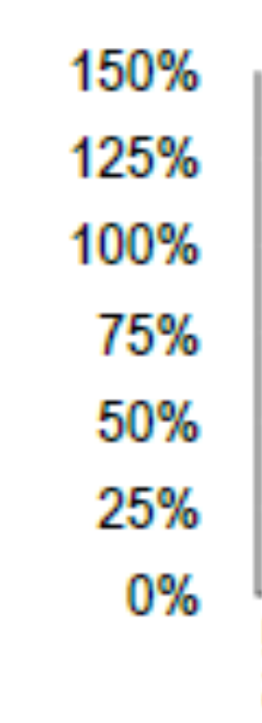
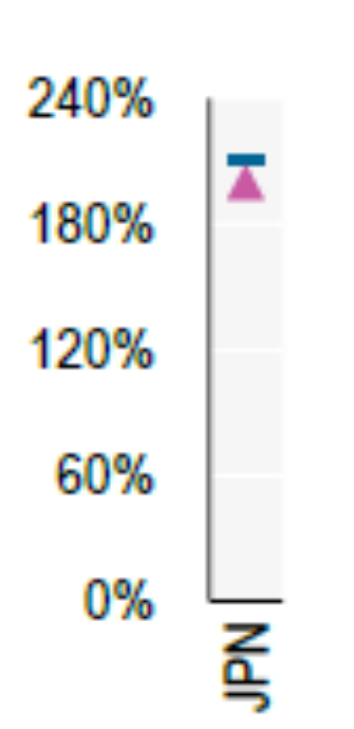
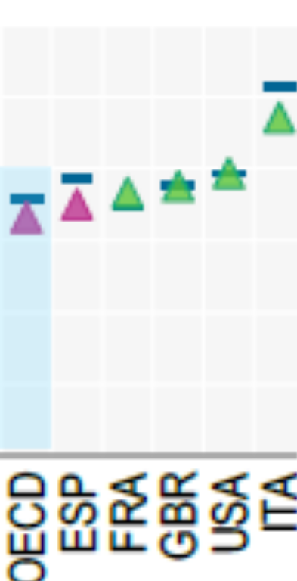
Why Do High Interest Rates Matter?
2025 Levels of Debt to GDP
Effects of 1 pcp increase in interest rates on CBO projections for 2056.
Debt-to-GDP ratio rises from 175% to 222%.
Deficit rises from 9.1% to 14% of GDP.
Interest on the debt rises from 6.9% to 11.4%,at which point it would comprise 60% of total federal revenue.
OECD (2026), Global Debt Report 2026: Sustaining Debt Market Resilience Under Growing Pressure, OECD Publishing, Paris, https://doi.org/10.1787/e9d80efd-en.
Notes:
Fiscal Sustainability

Slide 49
Why Do High Interest Rates Matter 2?
Housing shortage and housing affordability.
WSJ, 10/5 headline: The Surge in Rates is Blowing Up Commercial Real-Estate Deals.
WSJ, 10/8 headline: Rising Rates are Eroding the Value of Even the Most High-Flying Tech Stocks
The Stock Market
https://shillerdata.com/

Slide 50
Key Questions
What Caused the Increase?
Are High Rates Likely to Persist?

Slide 51
Reading the Interest Rate Tea Leaves

Slide 52
Oversimplified Determinants of Interest Rates
The Fed sets “money market” interest rates (maturities less than 6 months).
Interest rates on short-term bonds (1 to 3 years) depend on market expectations of the evolution of money markets rates over the life of the bond.
Longest- term bonds (30 year) mostly reflect expectations of interest rates when the Fed will meet (at least on average) its objectives.

Slide 53
The Federal Funds Rate, the Policy Instrument
The federal funds rate is the interest rate charged on overnight loans of bank reserves between two banks.
The Fed sets a target range for the federal funds rate; currently 3.75% to 4.00%.
If the market federal funds rate rises above 4%, the Fed buys government securities which increases the supply of bank reserves.

Slide 54
Since the Start of the Iran war
2-yr rate rises (on 3/3) first in anticipation that the Fed would raise the federal funds rate.
30-yr Rates also rising but by less.
Fed raises the federal funds rate in September, but not in October.
  Short-rates are signaling substantial increase in the federal funds rate in the next year or so.
  Long-term rates are signaling that a substantial fraction of those increases will persist.

Slide 55
Causes of Permanently Higher Rates
Persistently, high 30-yr interest rates are unlikely to be due to the AI investment boom. More likely, credit markets are signaling that US (and many other developed countries) fiscal debt and deficits are not sustainable.
The Worst-Case Scenario: A run on the dollar.

Slide 56
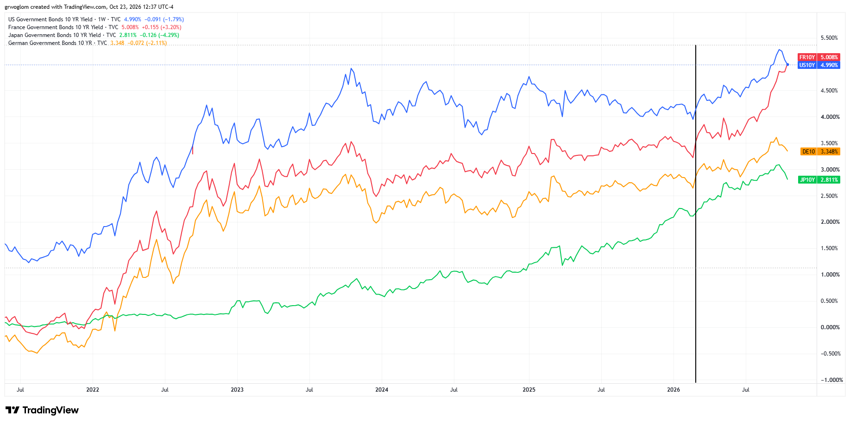
It Is A World-Wide Rise in Rates
Iran War

Slide 57
Summary
Inflation: was getting close to Fed’s 2% target.
  But is now going in the wrong direction.
Current immigration and trade policies will exacerbate inflation.
  Deportations
The war is driving up prices and uncertainty.
  Nobody invests into uncertainty.
What if the AI bubble bursts?
Interest rates are becoming a problem.
  Fear that higher rates will just become ent

Slide 58
Thank you!
Any Questions?
www.NEEDEcon.org
Jon D. Haveman
Jon@NEEDEcon.org
Contact NEED: info@NEEDEcon.org
Submit a testimonial: www.NEEDEcon.org/testimonials.php
Become a Friend of NEED: www.NEEDEcon.org/friend.php

