Slide 1
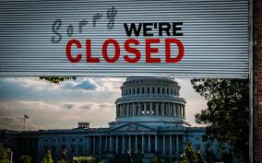
US Economic Update
California Community Colleges Real Estate Education Center
Jon Haveman, Ph.D.
NEED
October 27, 2023

Slide 2
Credits and Disclaimer
This slide deck was authored by:
Jon D. Haveman, NEED
Scott Baier, Clemson University
Geoffrey Woglom, Amherst College (Emeritus)
Brian Dombeck, Lewis & Clark College
Doris Geide-Stevenson, Weber State
Disclaimer
NEED presentations are designed to be nonpartisan.
It is, however, inevitable that the presenter will be asked for and will provide their own views.
Such views are those of the presenter and not necessarily those of the National Economic Education Delegation (NEED).

Slide 3
Outline
About the U.S. Economy
Economic Indicators
Inflation/Federal Reserve
Home Prices

Slide 4
Economic Indicators

Slide 5
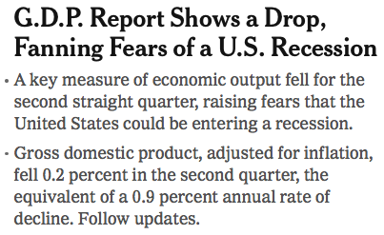
Headline: July 28, 2022
Old news….

Slide 6
GDP: Quarterly Growth
Q4-2022: 2.6%
Q1-2023: 2.0%
Q2-2023: 2.1%
Q3-2023: 4.9%
Notes:
Graph: gdp_pot_grow.png
The Point: From 1990 – 2007, average annual US GDP growth pre-crisis is 2.94%. However, post-crisis US GDP growth is 2.19% (0.75 percentage points lower). Why is has the recovery been sluggish?
Note: At the recession’s height, the gap between quarterly GDP growth and potential growth was 2.5 percentage points.

Slide 7
GDP Trajectory: Pandemic Plunge!
GDP is:
$0.1 Trillion below 2019 forecast.
$1.7 Trillion ABOVE 2019-Q4 level.

Slide 8
IMF Deviation from 2019 Forecast

Slide 9
What Drove GDP to Such Growth?
Normally
2.3%

Slide 10
Excess Savings – Still Positive!
Crucial to the resilience of the economy!

Slide 11
Personal Consumption Expenditures
Notes:
Chart: ../Charts/personalconsumption_recession.png
Real consumption remains significantly lower than trend consumption since 2008 (actual is 89% of trend).
Since the recession, consumption growth has fallen. From 1990-2007, average annual consumption growth is 3.34%; Post-recession average annual consumption growth is 2.38%.

Slide 12
Retail Sales Remain Elevated!

Slide 13
Sources of Investment’s Contribution
Normally
0.7%
Normally
0.5%
Normally
0.1%
Normally
0.6%

Slide 14
Contributions to GDP: Residential Investment
Notes:
Contribution of residential investment to GDP growth has risen post-2009

Slide 15
Contributions to GDP: Government
Notes:
Since 2010, average government spending growth is shrinking, resulting in a negative average contribution to GDP growth post-recession of -0.8 percentage points
Note that average quarterly government spending growth is 0.42% from 1990-2007 and -0.17% in 2010+ (annualized, 1990-2007 = 1.68%; 2010+ = -0.70%).

Slide 16
Sources of Government’s Contribution
Normally
0.55%
Normally
0.26%
Normally
0.3%
Normally
0.0%

Slide 17
Industrial Production (Manuf, Util, Mining)

Slide 18
Employment

Slide 19
Monthly Changes in Nonfarm Employment
July: 236,000
Aug: 227,000
Sep: 336,000
Notes:
PAYEMS.png

Slide 20
Employment Gap
4.5 Million ABOVE February, 2020.
4.9 Million BELOW where we should be.
Notes:
payroll_recent.png

Slide 21
Where Have All the Workers Gone?
2.2 million below where we should be

Slide 22
Baby Boomers Are Retiring!

Slide 23
White Labor Force Dropouts are Significant
Race/Ethnicity | Pre-Pandemic (2/20) | Current (9/23) | Change | Rank by Race
All | 63.3 | 62.8 | -0.5
White | 63.2 | 62.4 | -0.8 | 4
Black | 63.1 | 62.9 | -0.2 | 3
Asian | 64.5 | 65.8 | +1.3 | 2
Latinx | 67.9 | 67.3 | -0.6 | 1

Slide 24
Wage Growth – Not Keeping Pace, Until Now
Notes:
Is this necessary given the previous slide?

Slide 25
Compensation Growth: Not Great, but OK

Slide 26
Excess Savings – Still Positive!
Crucial to the resilience of the economy!

Slide 27
Economy Overall
On fire in Q3!
Otherwise, GDP growth has been consistent with the last decade.
Pretty much caught up to where we should be.
Employment continues to grow
Hampered by lots of baby boomer retirements!
Labor force is still too small.
Wages are down in inflation adjusted terms, but that is changing
Inflation…..

Slide 28
Inflation

Slide 29
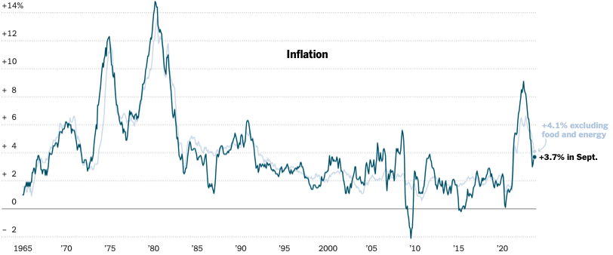
Inflation: Latest Figures
Source: NYTimes.com, Bureau of Labor Statistics

Slide 30
Inflation in the Last 3 & 6 Months

Slide 31
Inflation: Core Inflation is Stubbornly High

Slide 32
Sources of Recent Inflation

Slide 33
What is Happening With Oil Prices?
First, global economy is stronger than anticipated.
Except for China.
Recession is EU will be shallower than expected.
Second, inflation in the US is slowing.
Reduced expectation of a recession.
OPEC+ has restricted supply.
In support of Russia?
Add Isreal/Gaza to Ukraine, and markets are jittery.

Slide 34
We Have Particularly High Gas Prices!

Slide 35
Food Prices are Stabilizing

Slide 36
Housing Inflation is Still Pulling up the CPI

Slide 37
Rents Paid versus Asking Rents

Slide 38
How Much Higher Are Prices? 12.05%

Slide 39
Inflation is Not just a U.S. Problem

Slide 40
Supply Chains

Slide 41
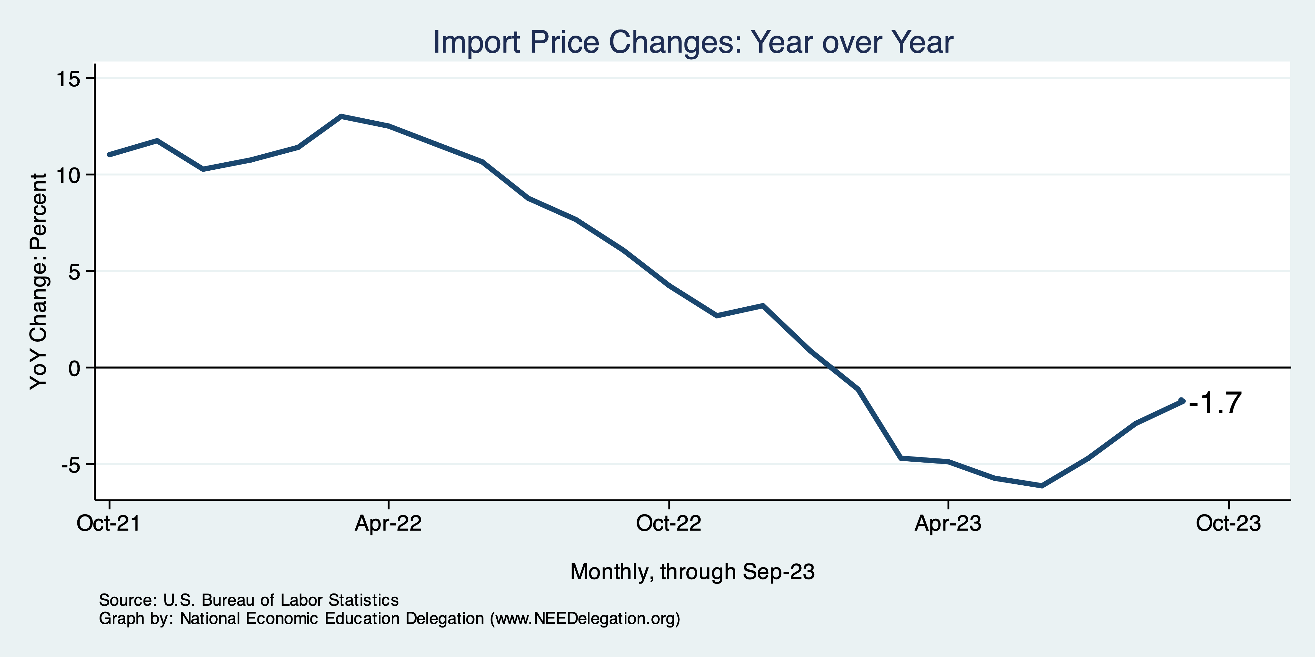
Import Price Inflation WAS High
Inflation – Imported Products: 9-10%

Slide 42
Two New Types of Inflation
Excuseflation
“The cost of my inputs is going up, so I have to raise my prices.”
You rarely hear: “I’m lowering my prices because costs are going down.”
Premiumization
Taking your product and spicing it up so that you can raise your margins.
Together, have led to a Profit-Price Spiral
Raising prices to cover costs plus a little extra.
Raising margins with extra frills.

Slide 43
Corporations Have Pricing Power!
Corporate Profits

Slide 44
My Thoughts on Inflation
Primarily a result of external forces.
Supply chains, higher import prices.
But also domestic.
Enormous stimulus, firms exercising their pricing power.
The path to inflation was bumpy, the path out will be too.
Federal reserve may tick interest rates up 0.25% one more time.
And then will hold for the foreseeable future.
Unless GDP continues to grow at 4+%! Then more rate hikes.

Slide 45
Federal Funds Rate – Recent Activity
Expect a Pause in Rate Increases (?)

Slide 46
Is The Fed Responsible for Falling Inflation?
Or is it other things?
Supply chains
Import prices

Slide 47
Treasuries
Notes:
treas_recent.png

Slide 48
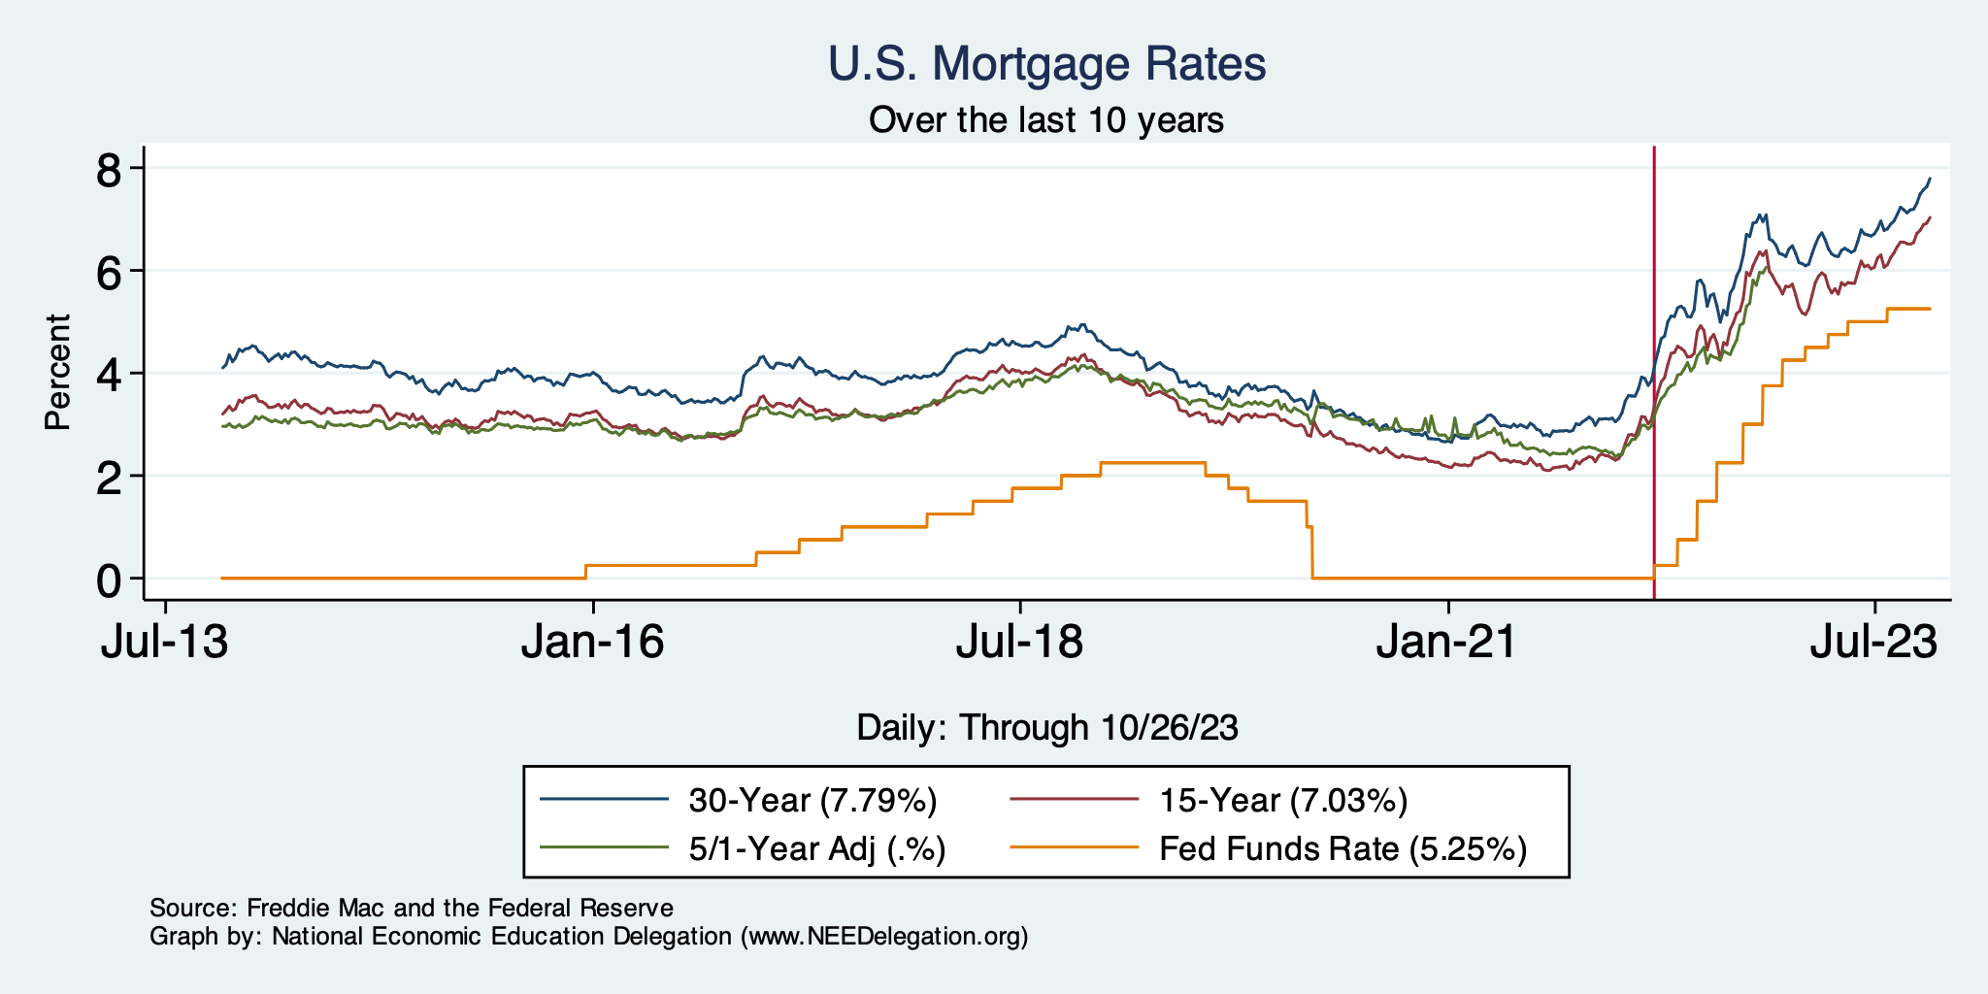
Mortgage Rates

Slide 49
Home Sales are Still Low

Slide 50
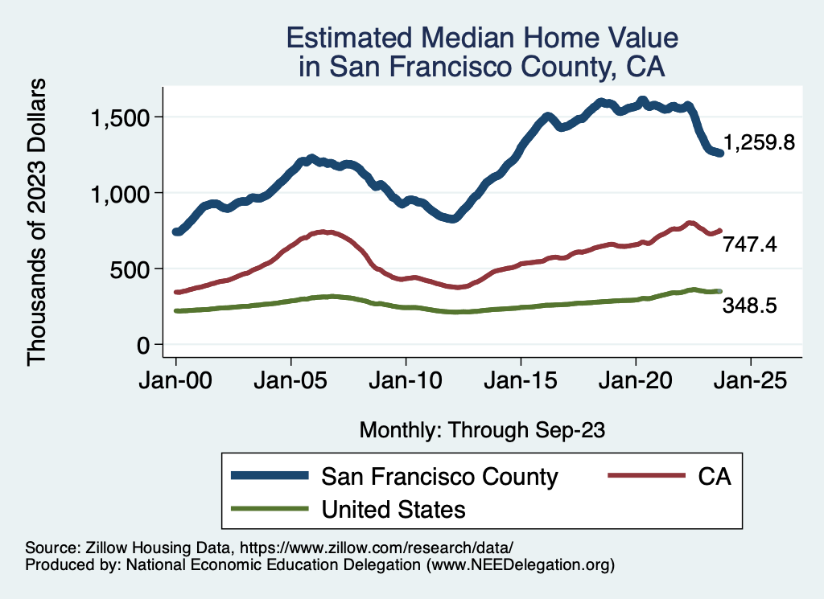
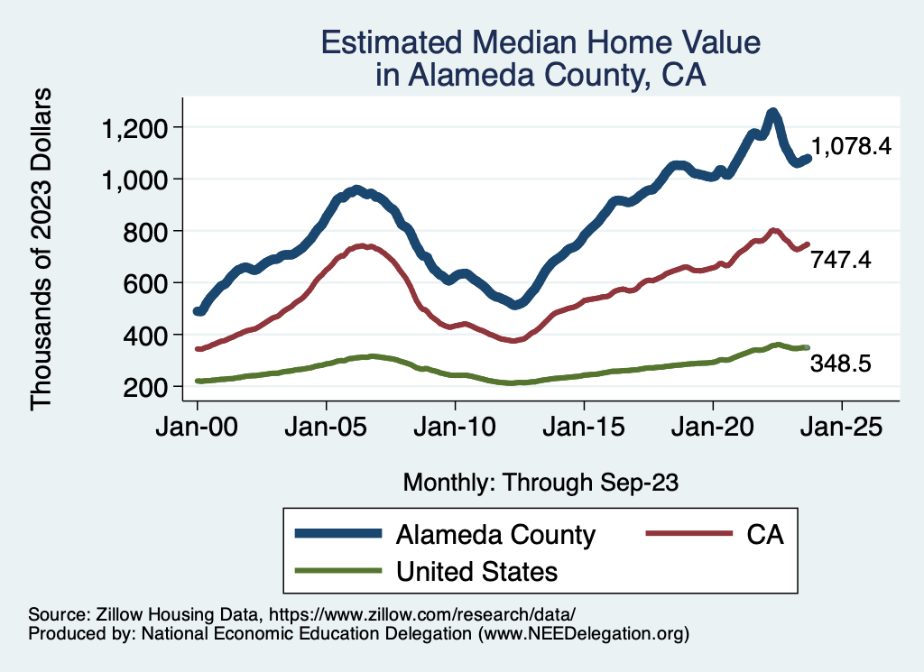
Home Prices … in Northern CA
Notes:
Charts:
homeprices_recession.png
housing.png

Slide 51
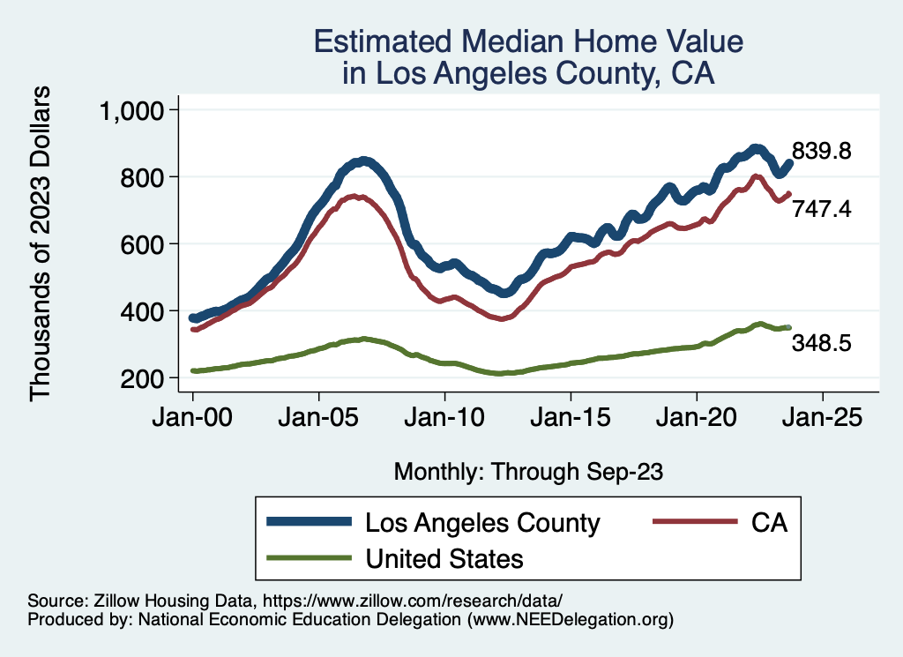
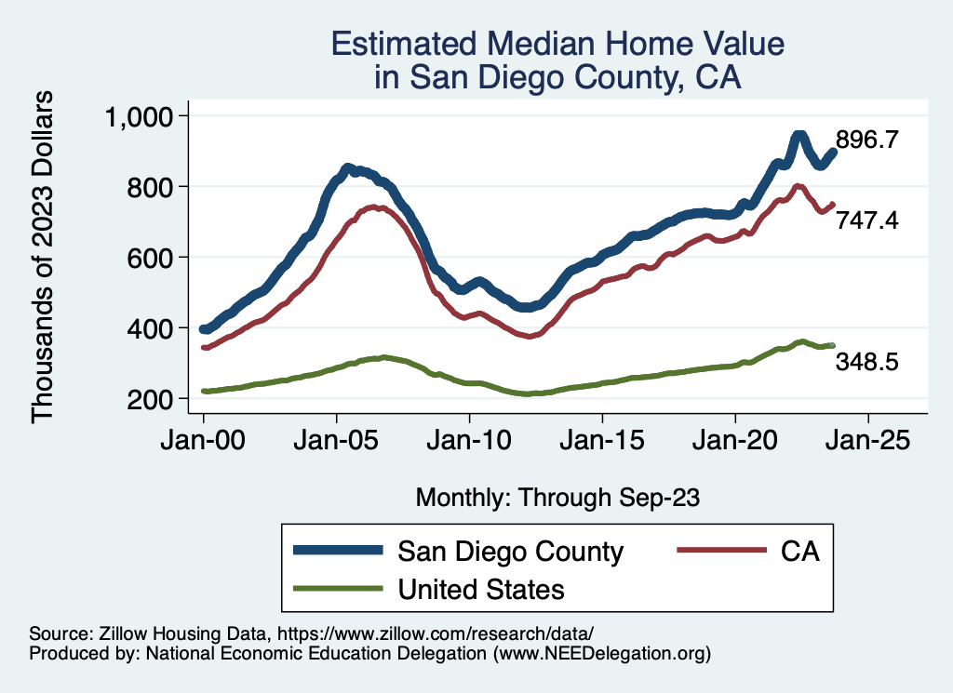
Home Prices … in Southern CA
Notes:
Charts:
homeprices_recession.png
housing.png

Slide 52
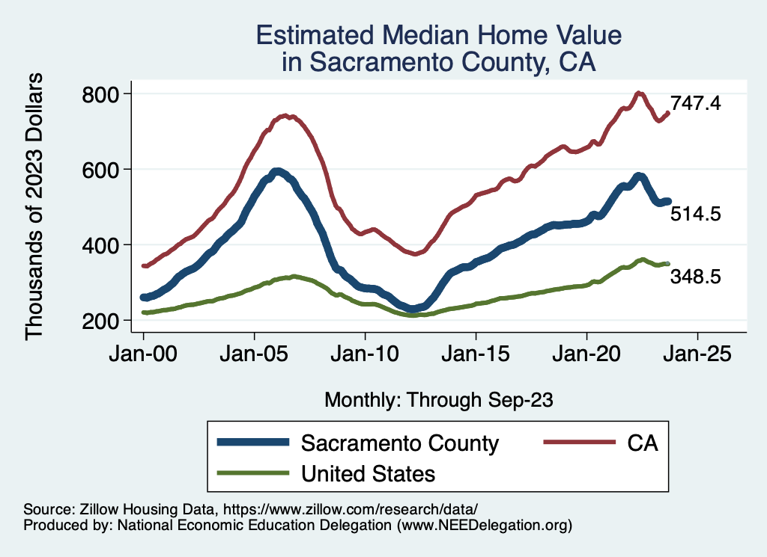
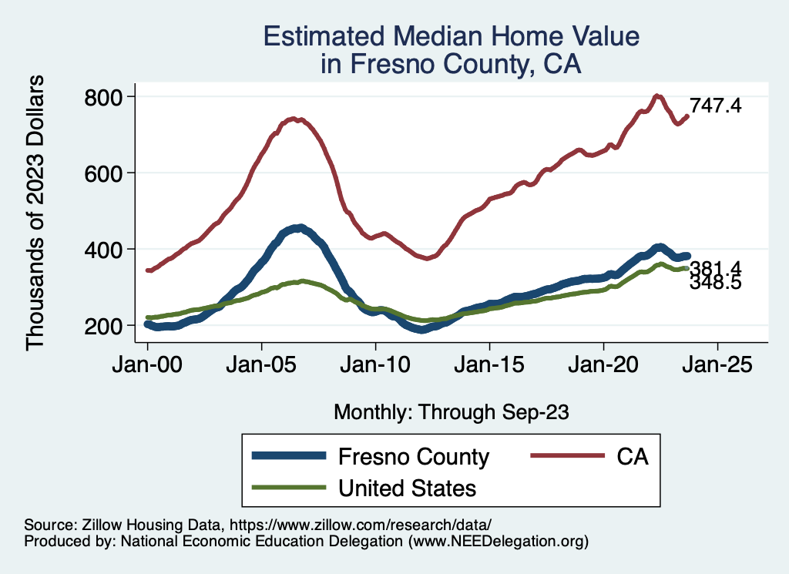
Home Prices … in the Central Valley
Notes:
Charts:
homeprices_recession.png
housing.png

Slide 53
Takeaways
Is a recession on the horizon?
Unlikely, but shallow if it happens.
Many indicators are still in the black.
2023-Q3 GDP growth was too good!
Inflation … wavering, but should turn lower.
Threats to continued growth:
If inflation REALLY starts to rise again, which seems … possible, but unlikely.
Will the Fed go to far?
UAW Strikes – if prolonged (over?).
Government budget negotiations.
Shutdown?
Yield curve bugaboo

Slide 54
Yield Curve Bugaboo
Notes:
Yield_curve.png

Slide 55
Government Shutdown Would Hurt!
G = 17% of the economy!
Notes:
Components sum to GDP
Average % of GDP for each component from 1960-Present: C = 64%, I=15%, G=24%, NX = 2% (X = 7%, M=9%)
Net Exports as a % of GDP has increased over the sample period, but it’s contribution to GDP is relatively small

Slide 56
Thank you!
Any Questions?
www.NEEDEcon.org
Jon Haveman, Ph.D.
Jon@NEEDEcon.org
Contact NEED: info@NEEDEcon.org
Submit a testimonial: www.NEEDEcon.org/testimonials.php
Become a Friend of NEED: www.NEEDEcon.org/friend.php

