Slide 1
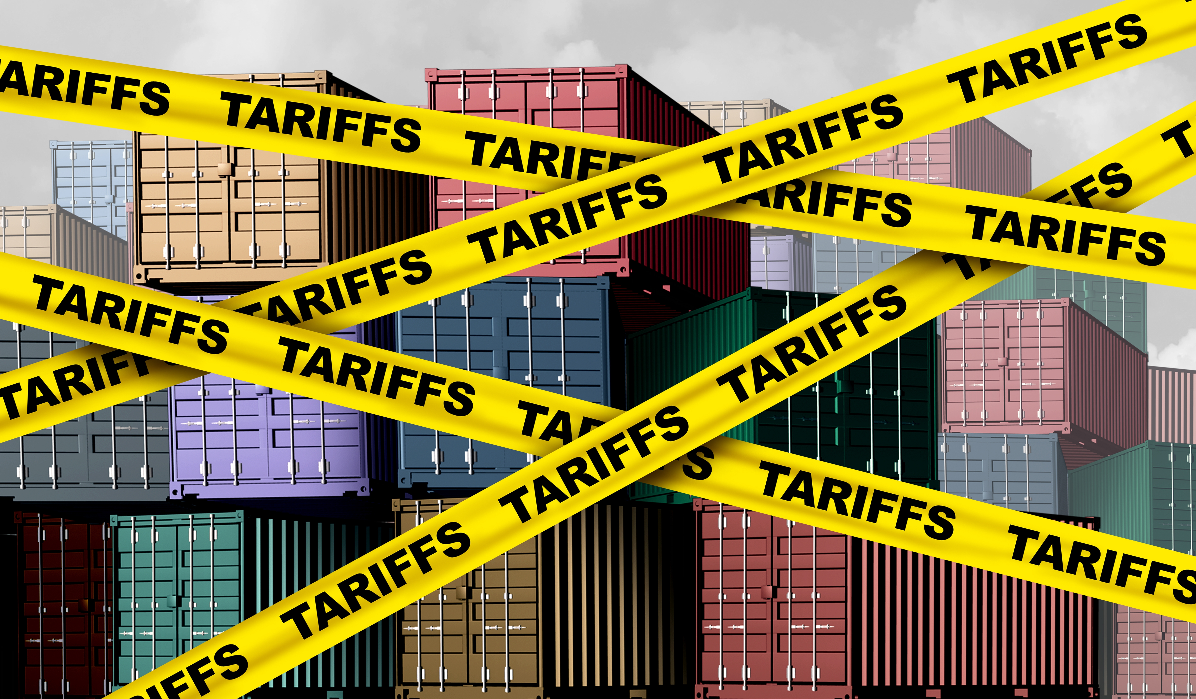

US Economic Update
California Community Colleges Real Estate Education Center
Jon Haveman, Ph.D.
NEED
April 25, 2025

Slide 2
Outline
Economic Indicators
Housing
Tariffs
Deportations
Outlook

Slide 3
Economic Indicators

Slide 4
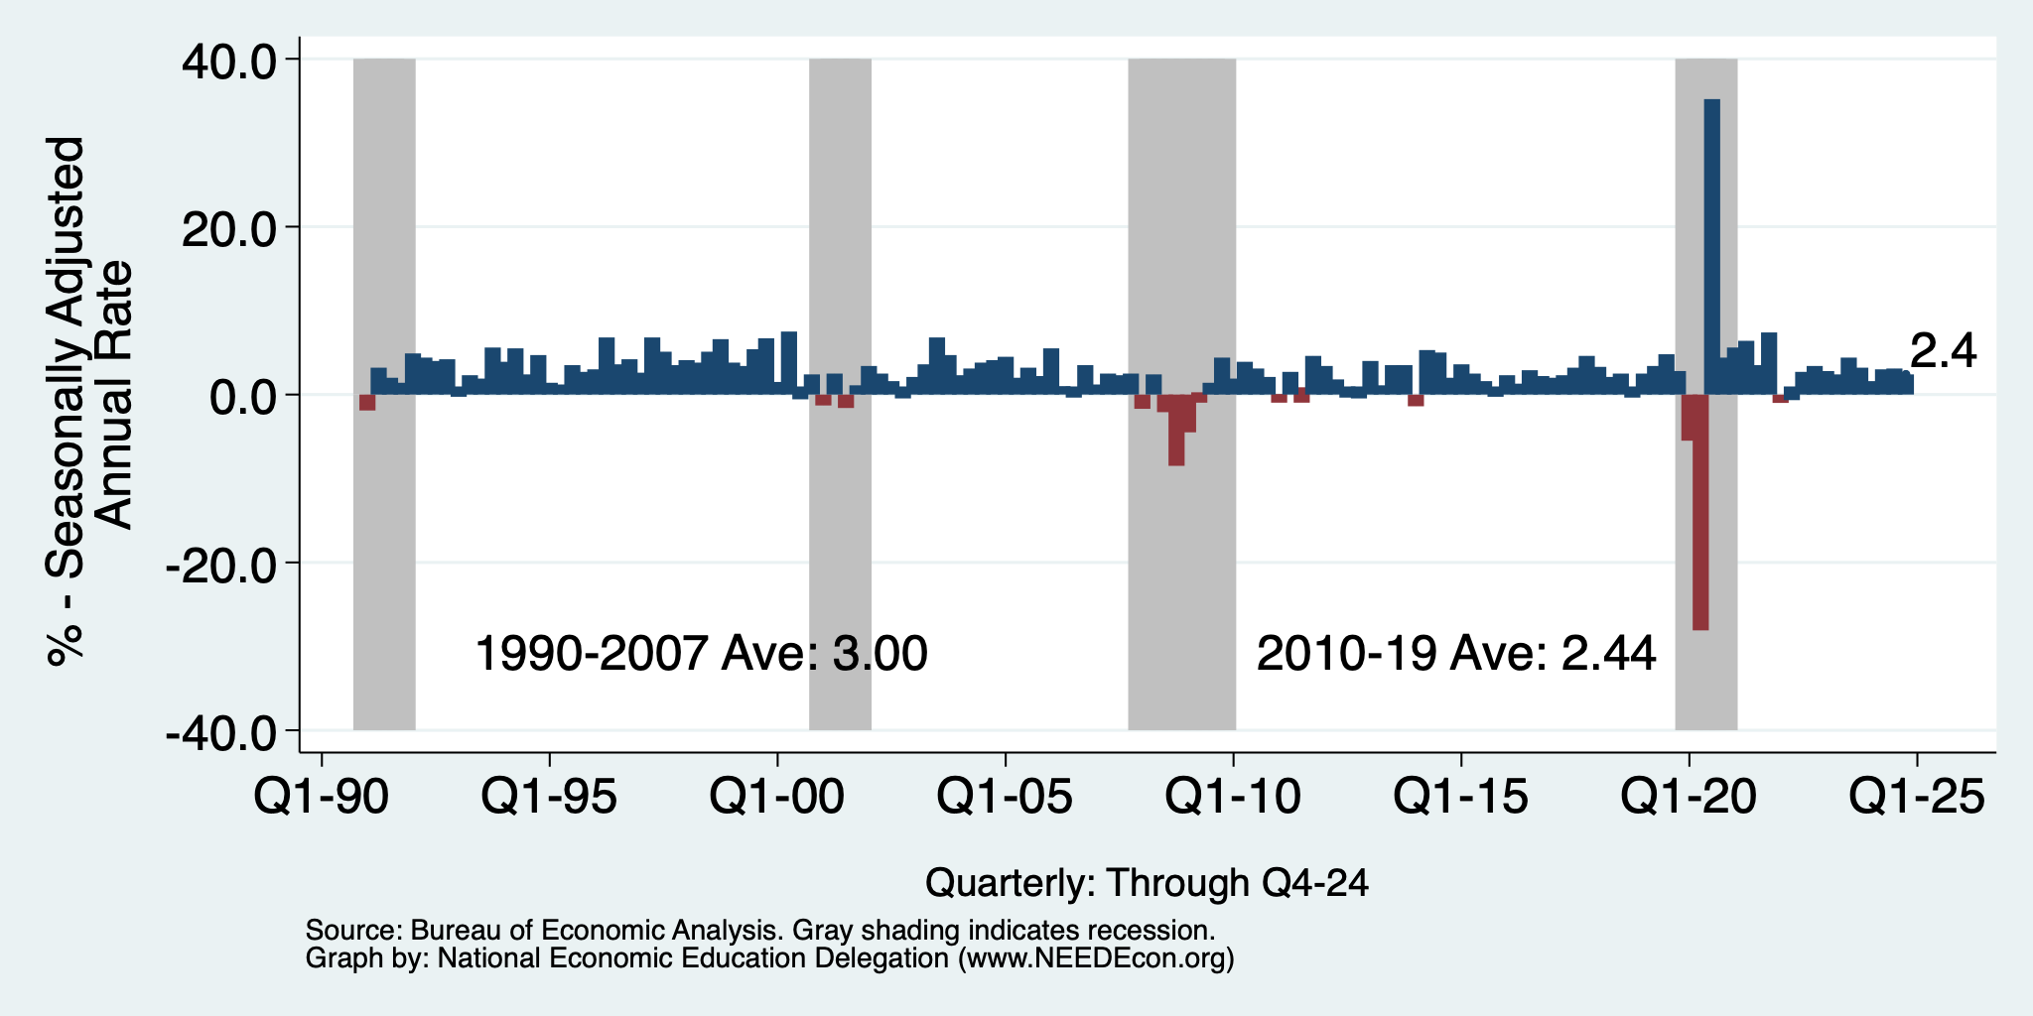
GDP: Quarterly Growth
Q1-2024: 1.6%
Q2-2024: 3.0%
Q3-2024: 3.1%
Q4-2024: 2.4%
Next release: April 30, 2025-Q1
Notes:
Graph: gdp_pot_grow.png
The Point: From 1990 – 2007, average annual US GDP growth pre-crisis is 2.94%. However, post-crisis US GDP growth is 2.19% (0.75 percentage points lower). Why is has the recovery been sluggish?
Note: At the recession’s height, the gap between quarterly GDP growth and potential growth was 2.5 percentage points.

Slide 5
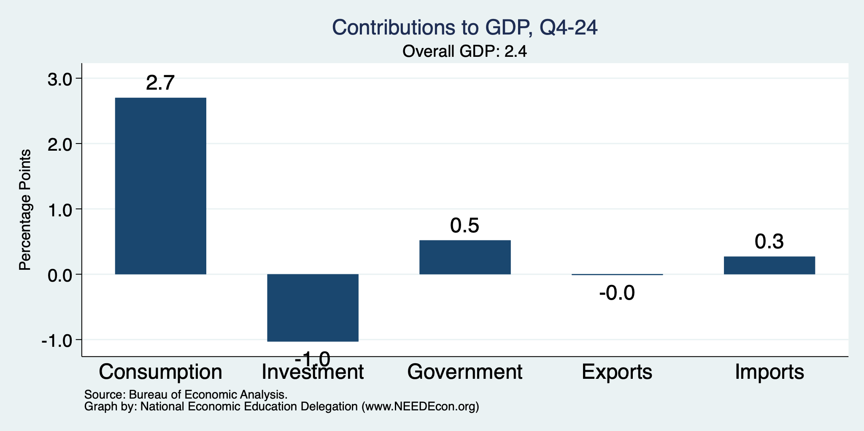
What Drove GDP to Such Growth?
Normally
2.3%

Slide 6
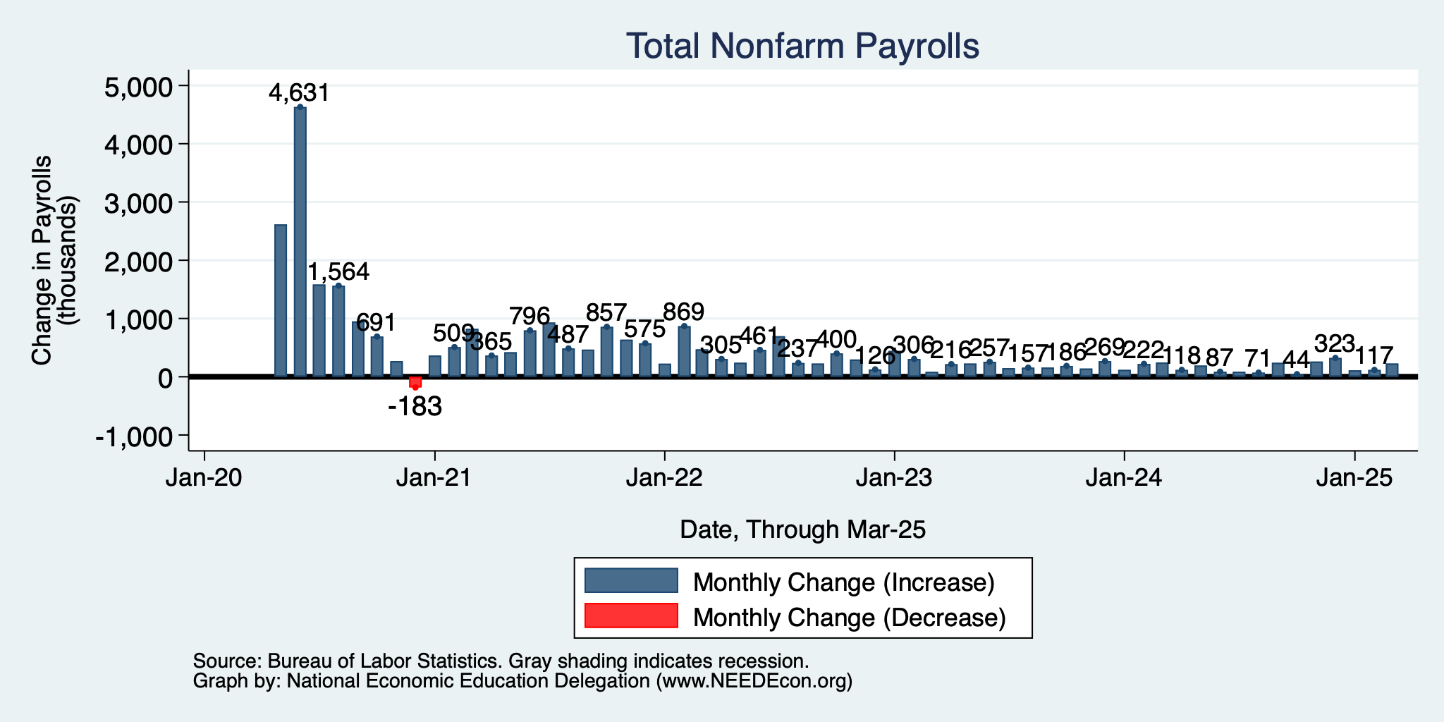
Monthly Changes in Nonfarm Employment
Jan: 111,000
Feb: 117,000
March: 228,000
April Jobs Report: May 2
Notes:
PAYEMS.png

Slide 7
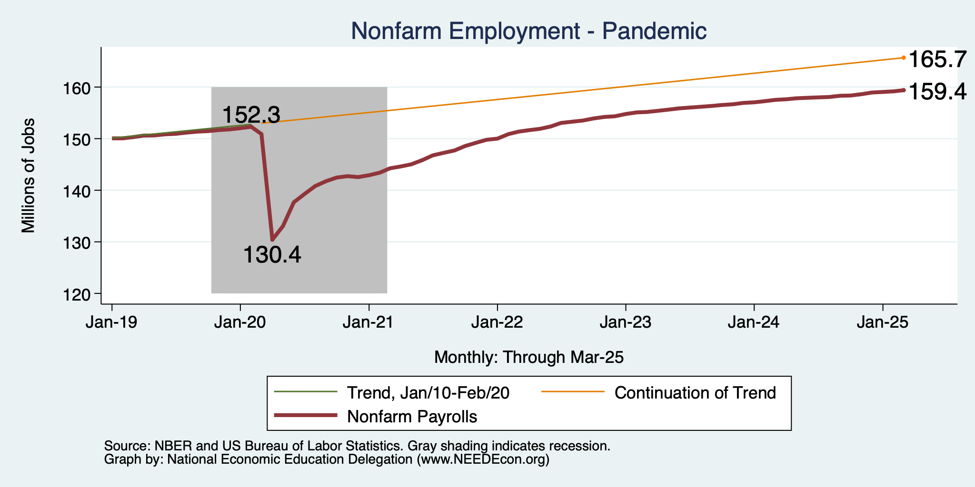
Employment Gap
7.1 Million ABOVE February, 2020.
6.3 Million BELOW where we should be.
Notes:
payroll_recent.png

Slide 8
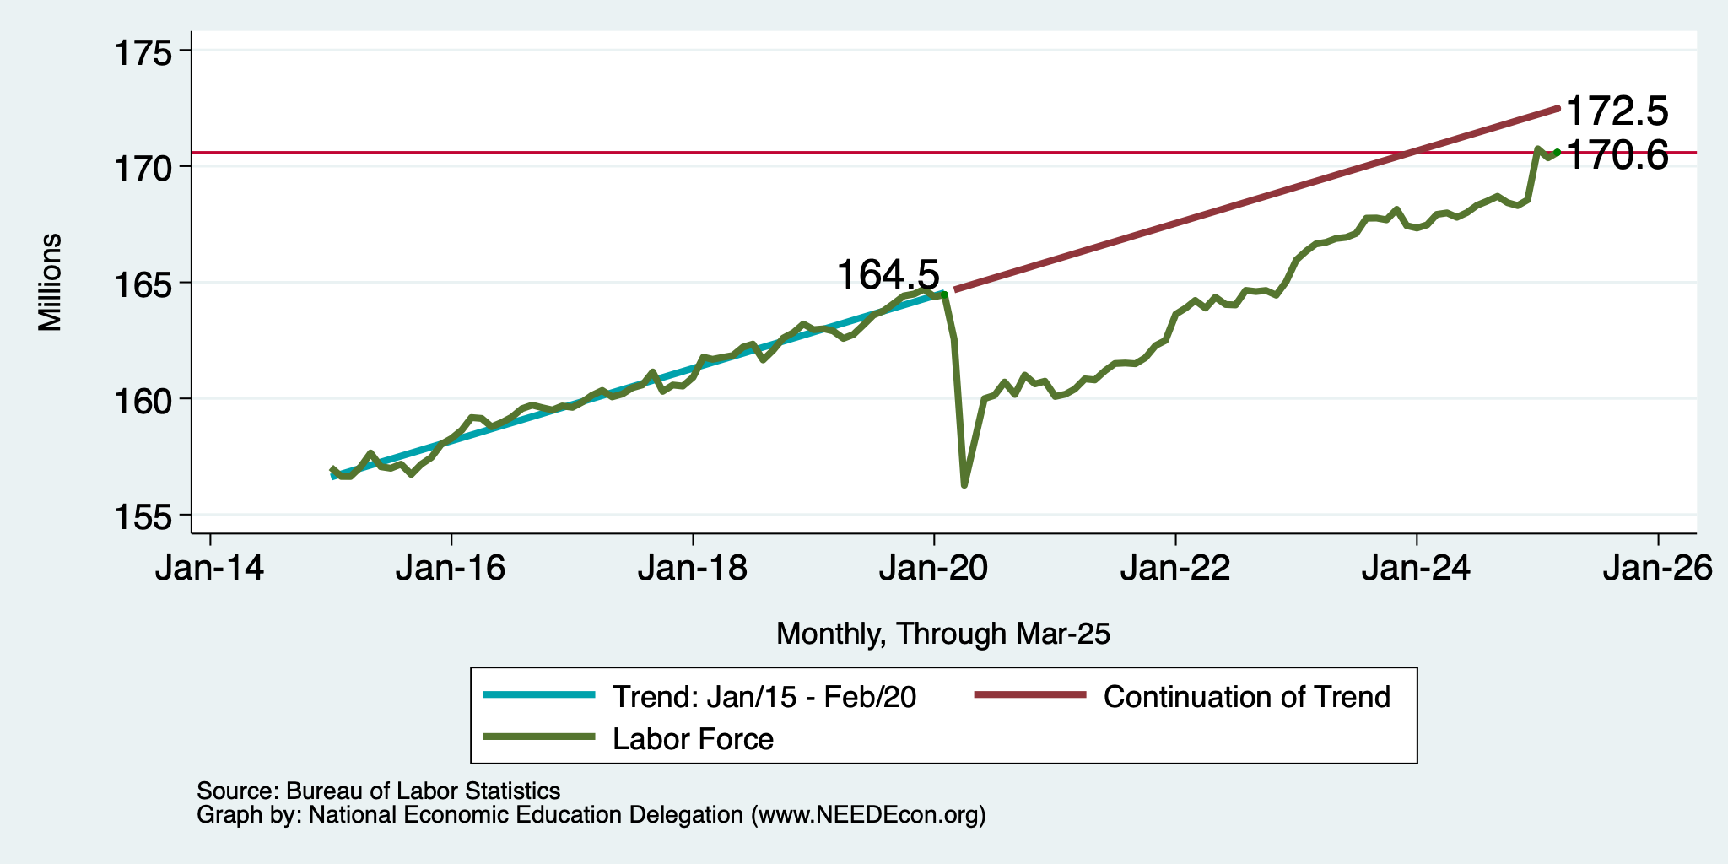
Where Have All the Workers Gone?
6.1 million ABOVE Feb 2020
1.9 million BELOW where we should be

Slide 9
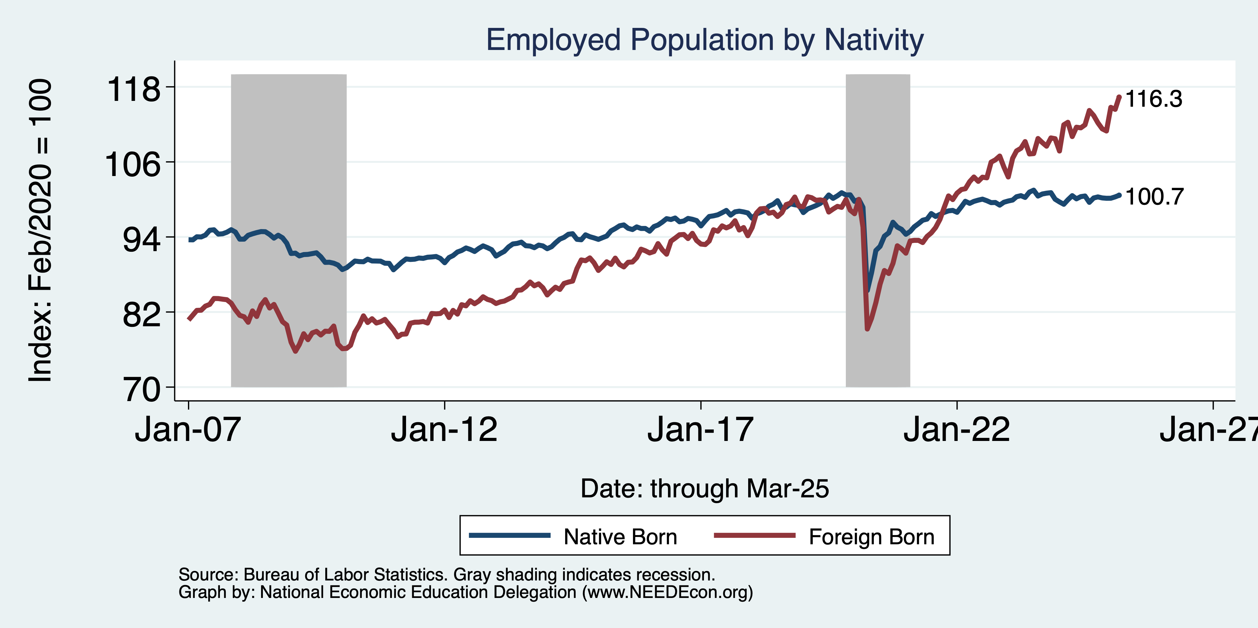
Immigrants to the Rescue?

Slide 10
Inflation

Slide 11
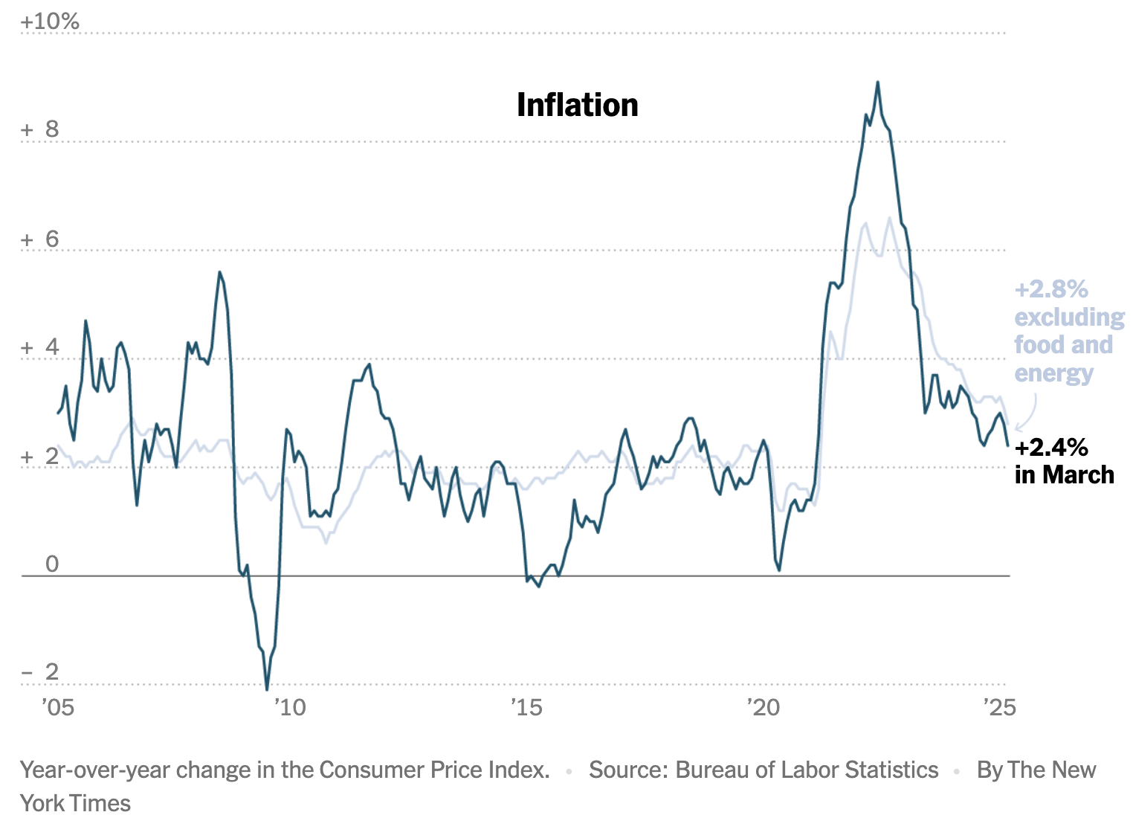
Inflation: Latest Figures
Source: NYTimes.com

Slide 12
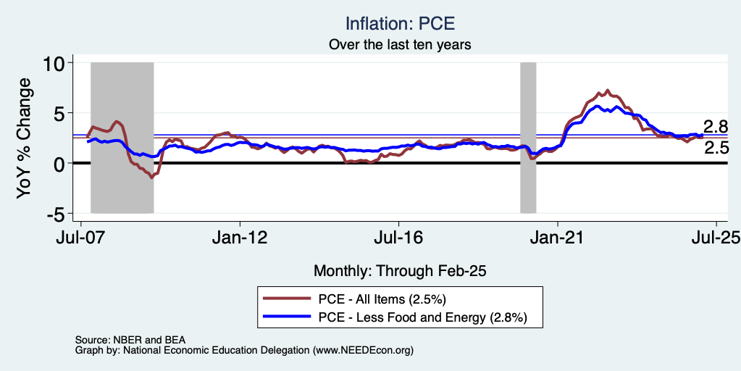
Fed’s Preferred Measure: PCE

Slide 13
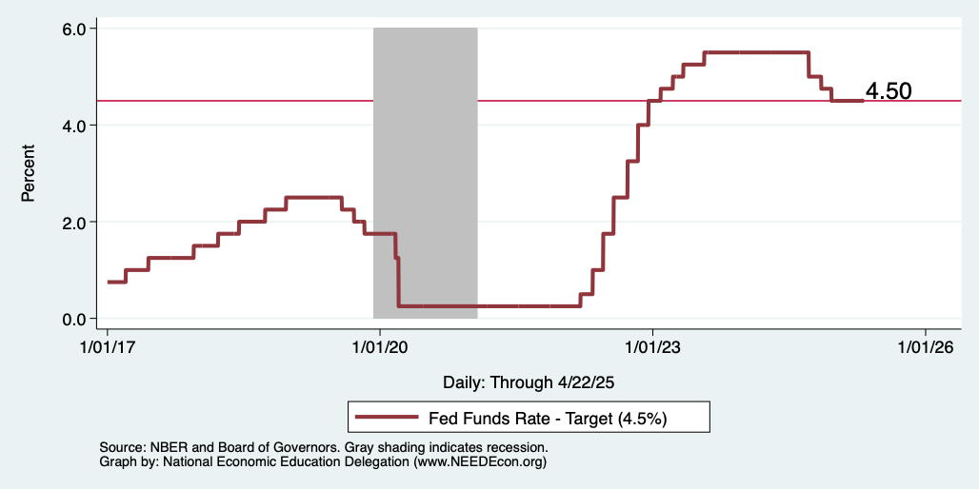
Federal Funds Rate
Notes:
The fed funds rate is the interest rate on overnight loans between banks. Think of it as the baseline interest rate on which banks base all other interest rates (e.g. mortgage rates)
FOMC lowers the fed funds rate during recessions and raises the fed funds rate during expansions
Fed funds rate peaked in the 1980s as then Chairman Paul Volcker sought to reign in “run away” inflation of the 1970s; doing so resulted in a recession in the early 1980s.
Since the 2008-09 recession, the fed funds rate has been kept near zero.
During the 2008-09 recession, Federal Reserve turned to unconventional tools to influence longer term interest rates to further stimulate the economy - QE
FedFunds.png

Slide 14
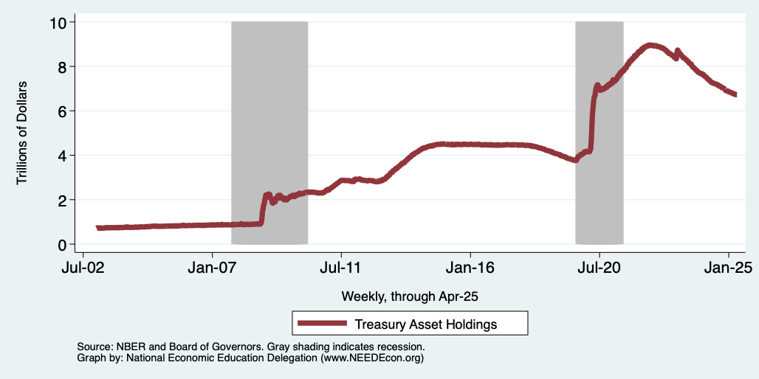
Fed: Reducing its Asset Holdings
Quantitative Tightening

Slide 15
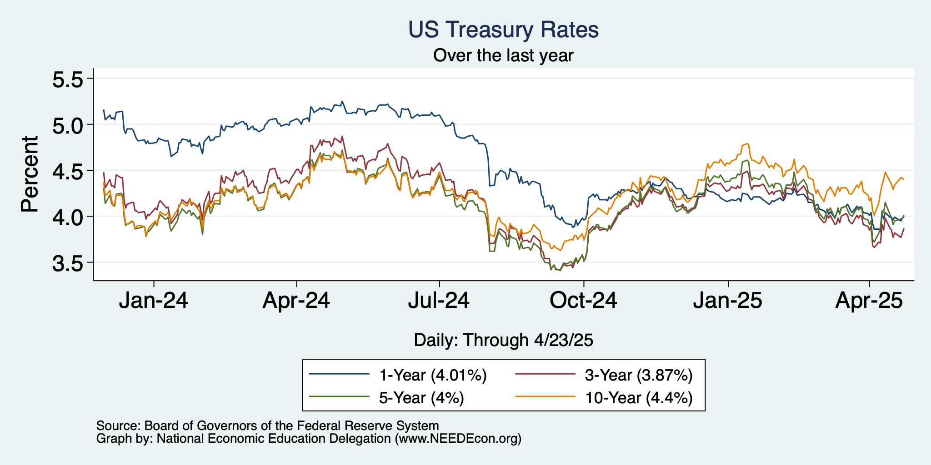
Treasuries
Notes:
treas_recent.png

Slide 16
Housing Stats

Slide 17
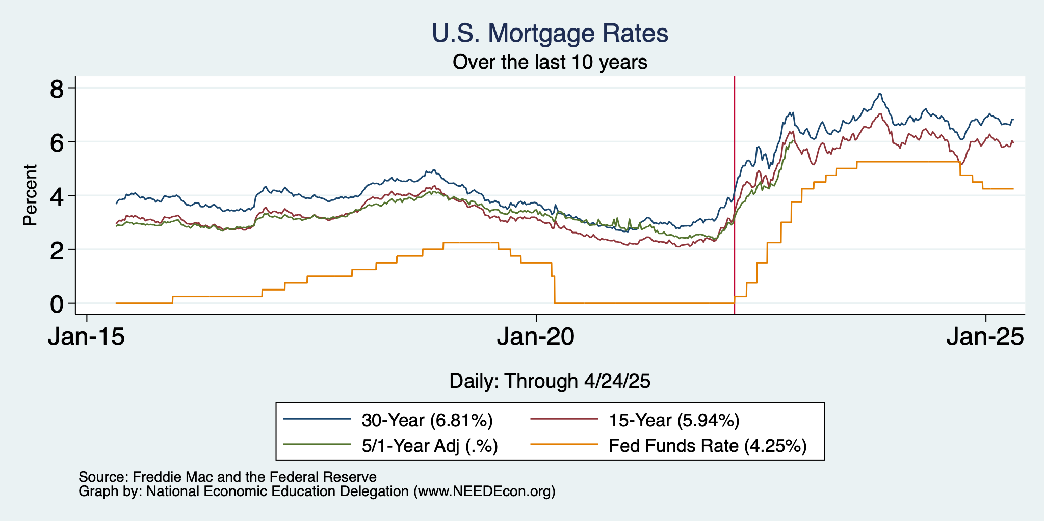
Mortgage Rates

Slide 18
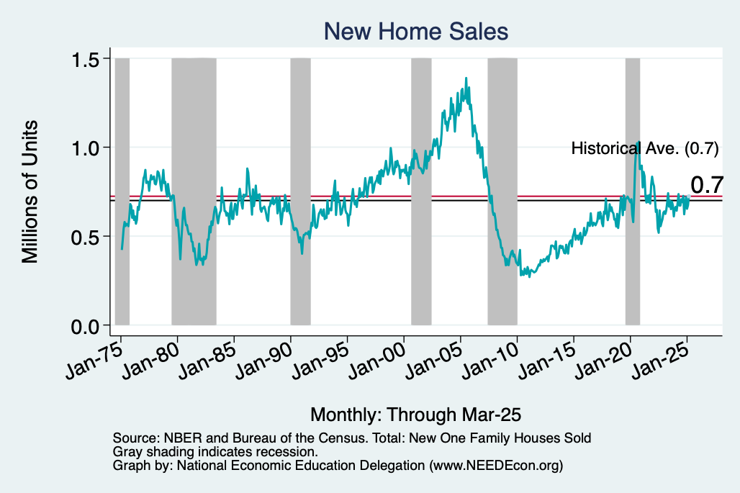
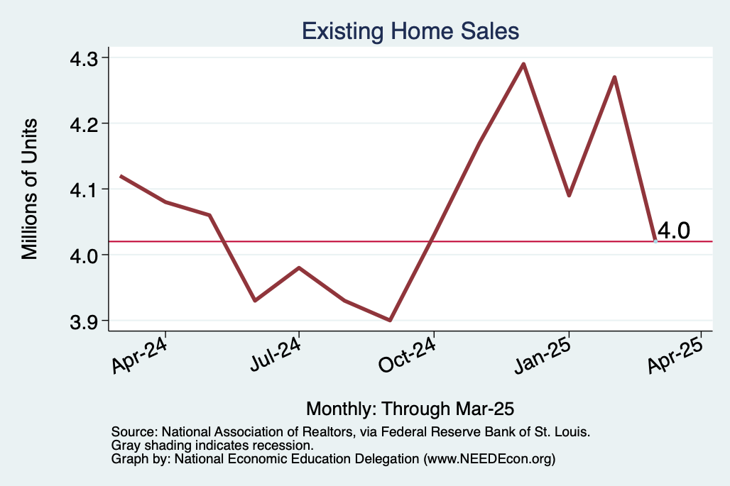
Home Sales are Not Horrible

Slide 19
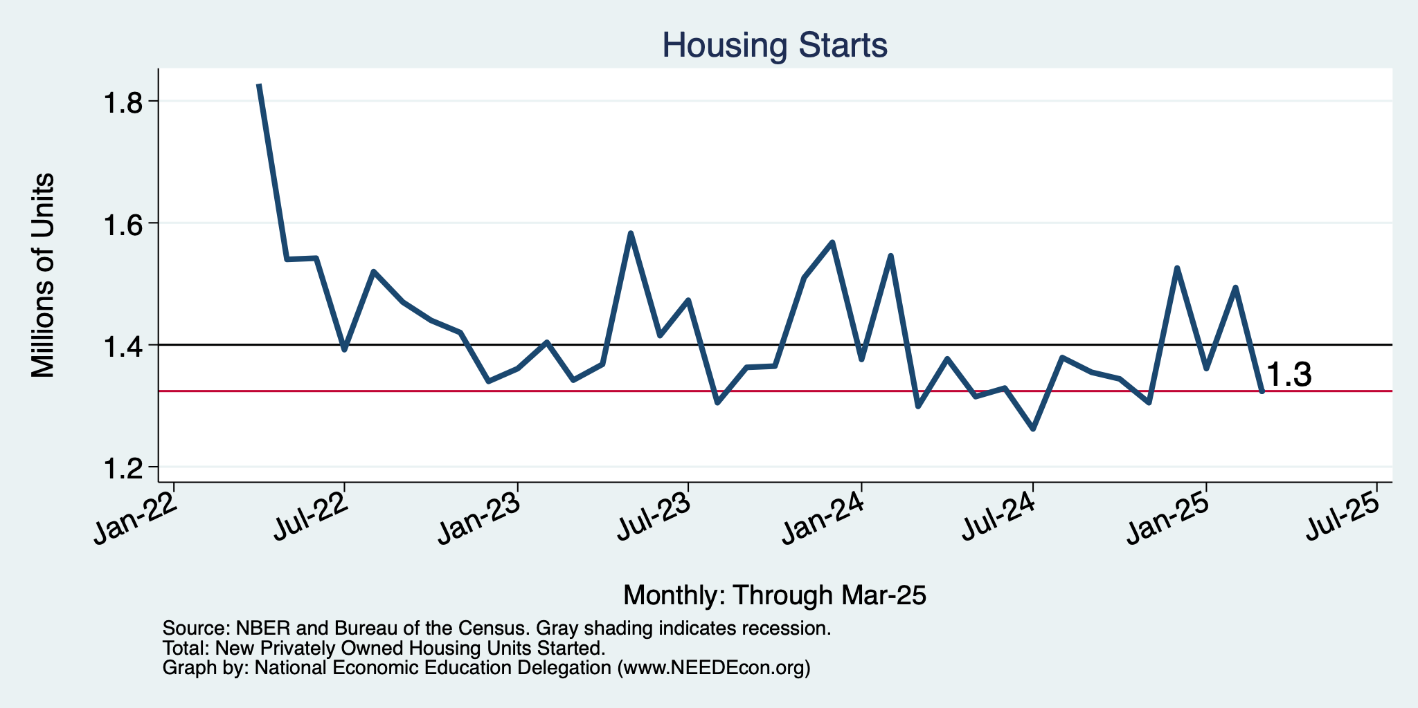
Housing Starts: Not Bad in March
March/23
March/24

Slide 20
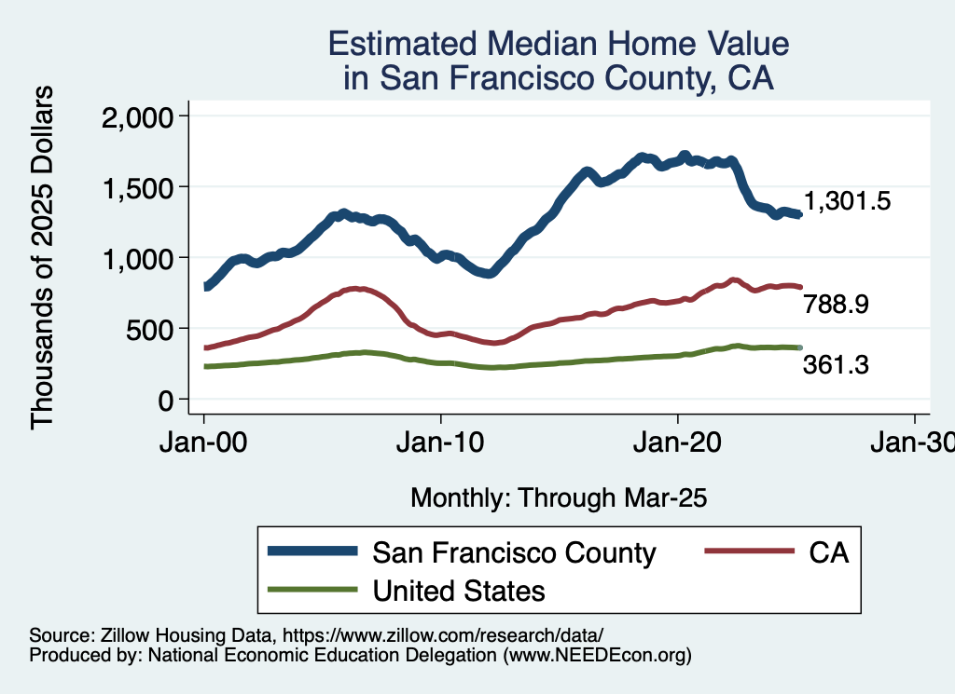
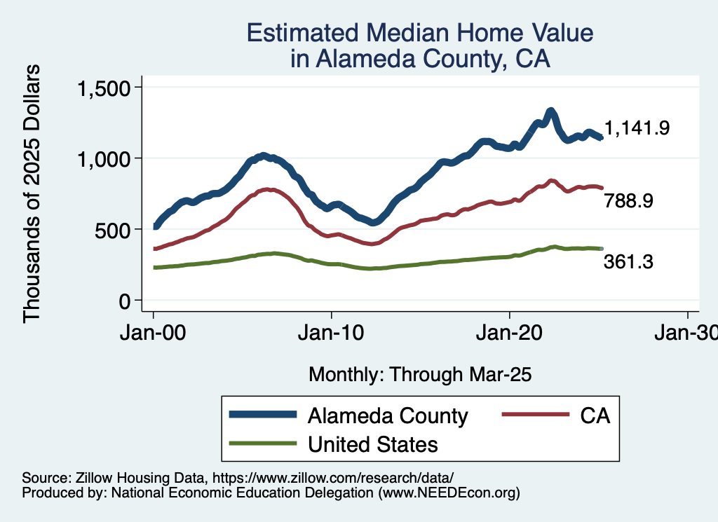
Home Prices … in Northern CA
Notes:
Charts:
homeprices_recession.png
housing.png

Slide 21
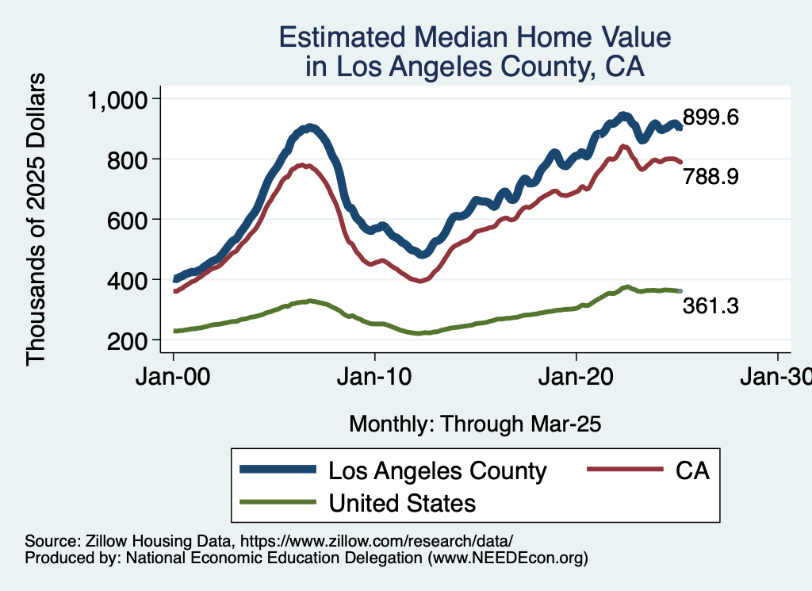
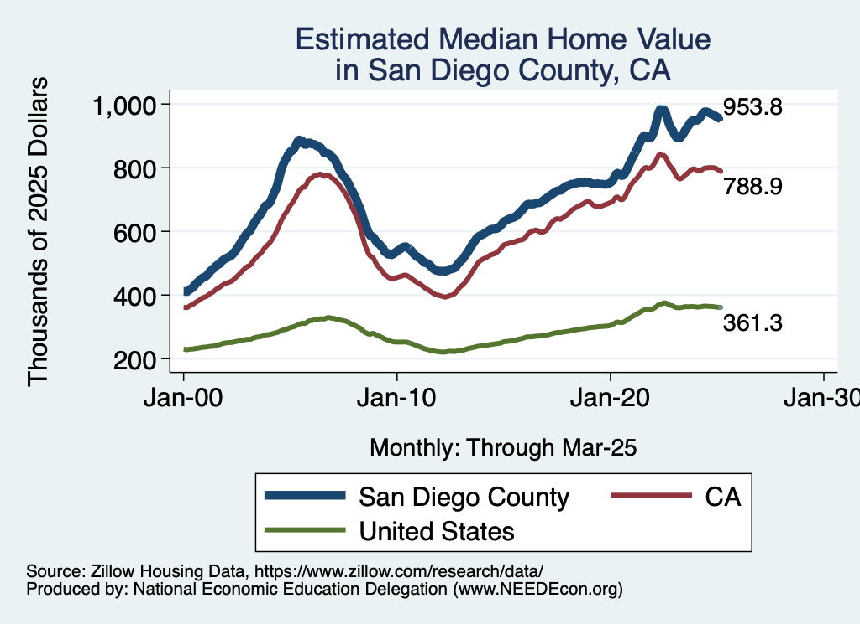
Home Prices … in Southern CA
Notes:
Charts:
homeprices_recession.png
housing.png

Slide 22
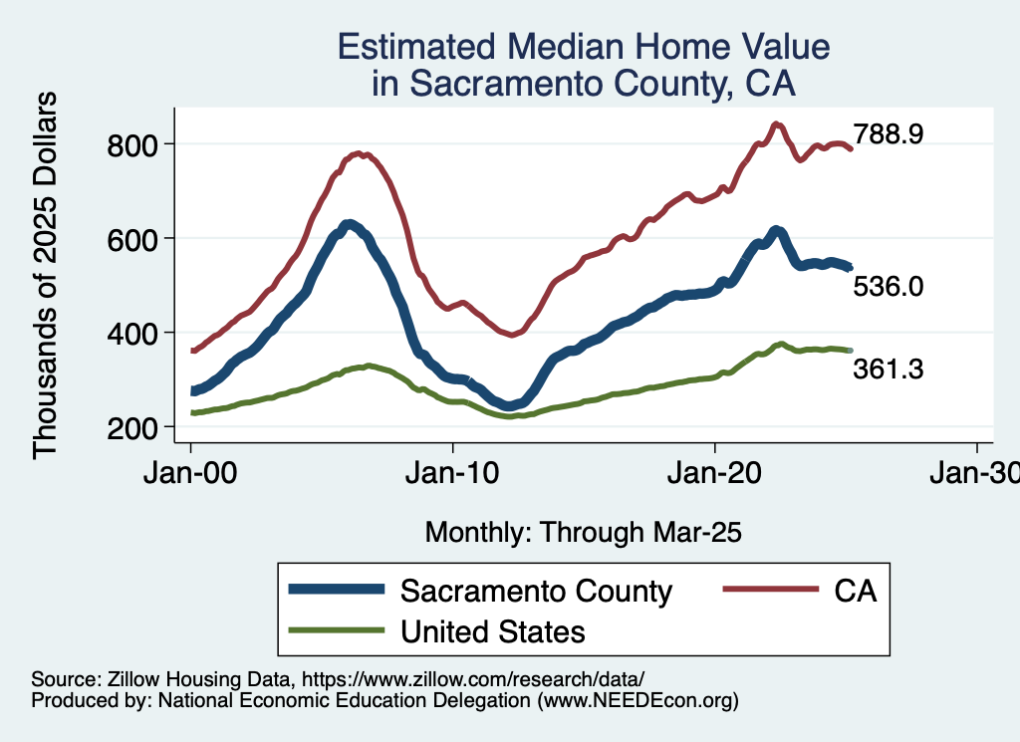
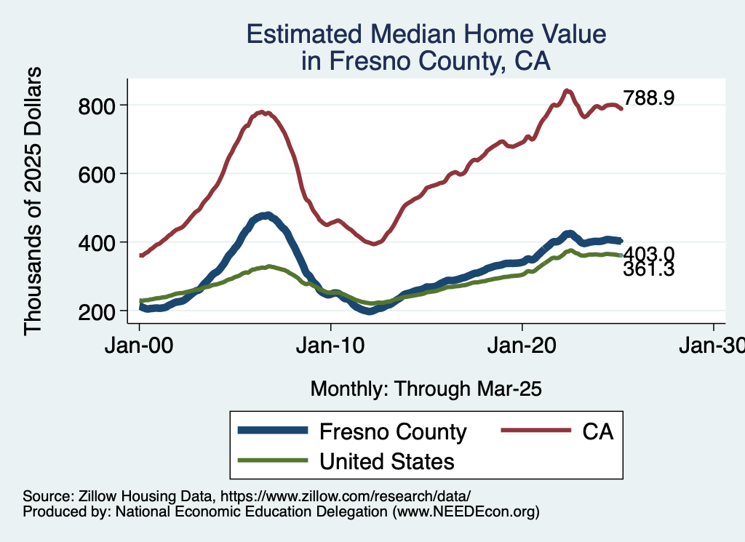
Home Prices … in The Central Valley
Notes:
Charts:
homeprices_recession.png
housing.png

Slide 23
Overview: Real Estate
Interest rates may stay high for some time.
Buyers may dwindle in numbers.
Inventories may well shrink
New building will become more expensive.
  Construction workers are being deported.
  Tariffs will raise prices of key materials – e.g., lumber.

Slide 24
Bigger Picture

Slide 25
Since Inauguration: Policies = Anti-Growth
Tariffs
Deportations
Cuts to spending and employment
Threats to Fed Chair Powell

Slide 26
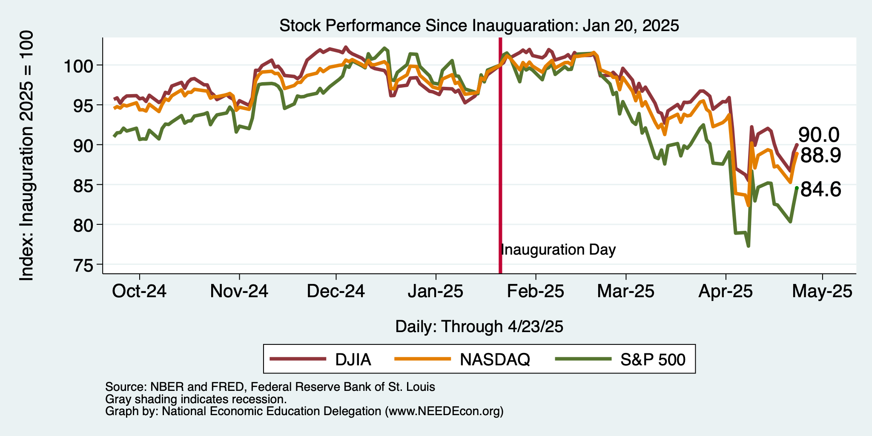
And Stock Markets Agree

Slide 27
Immigration

Slide 28
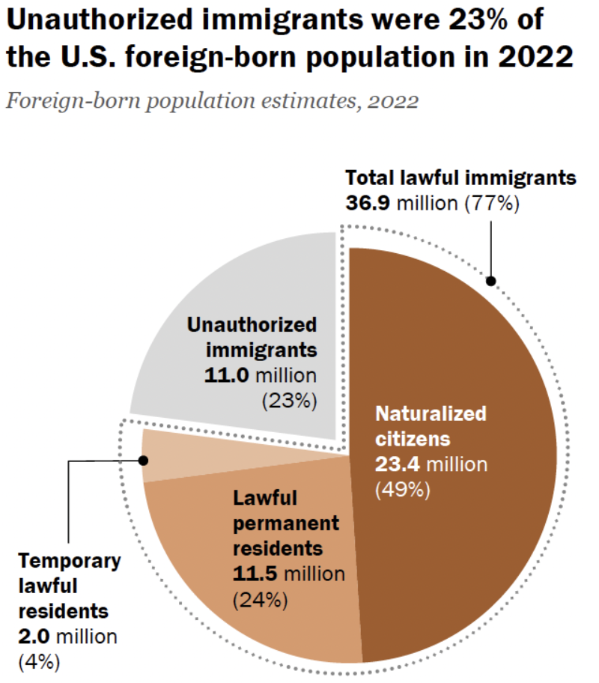
Total Foreign-Born
Population: 47.9 million
Source: Pew Research Center, What we know about unauthorized immigrants living in the U.S., July 22, 2024

Slide 29
Why Do We Care? Economic Implications
Conventional Wisdom Issues:
  Labor markets: Wages and Jobs
  Government Revenue and Spending
  Crime
Other issues (that don’t get talked about much):
  Gross Domestic Product (GDP)
  Innovation and Entrepreneurship

Slide 30
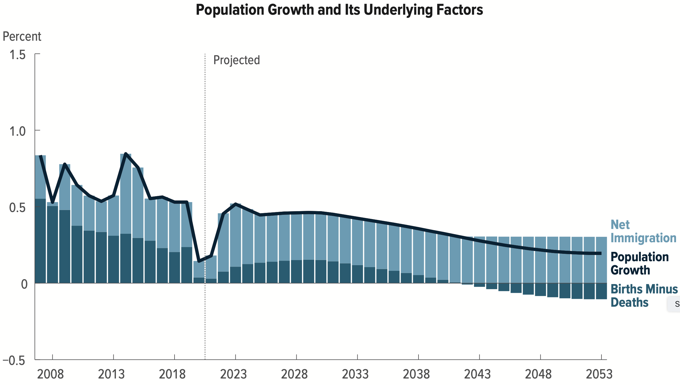
Is Immigration Saving the Day?
Source: CBO – The Demographic Outlook, 2023-2053

Slide 31
Jobs: Conventional Wisdom…Upended
What is the conventional wisdom?
  Low-skilled immigrants come in and take jobs from low-skilled native-born individuals.
    1-1 tradeoff.
What does new research show?
  Low-skilled immigrants contribute positively to the economy.
    Every 100 low-skilled immigrants: create 9 jobs for low-skilled native-born.
    They create opportunities for low-skilled native-born workers.
  Low-skilled immigrants take jobs that native-born don’t want.

Slide 32
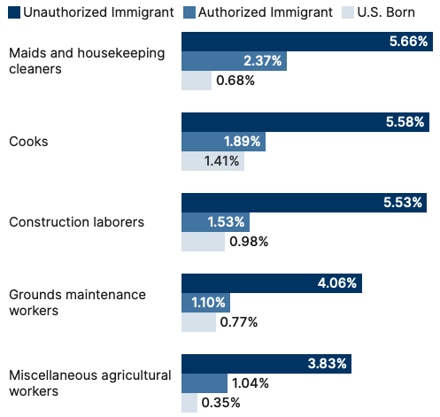
Share of Workers in Each Occupations

Slide 33
Implications for Major Federal Programs
Documented immigrants are less likely to use Social Security and Medicare.
Unauthorized immigrants are ineligible.
  They will pay into the system but cannot receive benefits.
Medicaid: not available to legal residents for the first five years.
Provide a source of revenue for an aging population.
  For Social Security and Medicare

Slide 34
Mass Deportations
Immigrants work different jobs than do native-born workers.
Immigrants contribute to the local economy.
  GDP losses of up to $1.7 trillion annually.
Immigrants keep prices low: in particular, food!
Deportations impact tax revenues.
  $1,300 more in on average than out, annually.
  Unauthorized immigrants: $22.6 billion in social security and $5.7 billion in Medicare payments.
Deportations are expensive ($13,000 each).
  Total cost $315 billion.
They rob people of their dignity.

Slide 35
Tariffs

Slide 36
What Is a Tariff?
A tariff is a tax on imports.
Much like, say, the 8% sales tax in California.
  Whatever price the seller charges, the buyer pays an extra 8% that goes to the government.
  But it also means that domestic sellers can simply raise their prices by 8%.
    A cost to consumers, with no government revenue benefit.
A 10% tariff on all imports (such as Trump has imposed) would mean that:
  Whatever the foreign exporter charges for a product,
  US buyers will pay an extra 10% to the US government.
Might the seller charge a lower price because of the tariff?
  Perhaps, but when Trump used tariffs in 2018 on steel and China, they did NOT.

Slide 37
Trump I Tariffs & Trade War
Overview of Trump I Tariffs
  Trump placed tariffs of 25% on steel and 10% on aluminum.
  Trump place multiple tariffs on China exports, covering at least ¾ of their exports to US.
  Imports from China fell while imports from other countries rose.
  US trade deficit did not shrink.
  Data show no fall in foreign export prices, so tariffs were paid by US buyers.
    Domestic prices DID increase.
  Jobs? Eight lost for every job created.

Slide 38
Wait…Job Losses?
Job losses come from two sources:
  Tariffs raise the price of imported intermediate goods
    E.g., steel and aluminum.
  Tariffs hit the exchange rate.
    Fewer imports means lower supply of dollars.
    Exchange rate appreciates.
    Exported products are more expensive in foreign markets.

Slide 39
Trump II Tariffs
“To me the most beautiful word in the dictionary is ‘tariff’”
During campaign he said he will
  Place a tariff of 10% or 20% on all imports from all countries.
  Place even higher tariffs (60%) on imports from China.
  Raise our tariffs on countries to match what they charge on our exports.
    “Reciprocal Trade Act”
    (And lower those where they charge less?)
  Raise tariffs on countries that don’t use the US dollar for international transactions.
  Place tariffs on Mexico, violating his own USMCA trade agreement
    25% on everything if they don’t stop US immigration
    100% on cars to get production in US
Notes:
McCormick, “Trump Calls Tariffs the ‘Most Beautiful Word’,” WSJ, 10/14/24
https://www.wsj.com/livecoverage/harris-trump-election-10-16-2024/card/trump-calls-tariffs-the-most-beautiful-word--YMVPAupw4EjBRp6yobOy
Swanson, “Harris and Trump Embrace Tariffs, Though Their Approaches Differ,” New York Times, Aug 27, 2024.
https://www.nytimes.com/2024/08/27/us/politics/trump-harris-tariffs.html
Toomey, “About Trump’s ‘Reciprocal’ Tariffs,” WSJ, 10/27/24
https://www.wsj.com/opinion/about-trumps-reciprocal-tariffs-he-wants-to-raise-taxes-and-thinks-im-the-stupid-one-5dc3c56c?mod=itp_wsj
Krugman, “Donald Trump on the Dollar, in His Own Words. NYT, 9/9/24
https://www.nytimes.com/2024/09/09/opinion/trump-tariffs-reserve-currency.html
Economist, “Donald Trump is poised to smash Mexico with tariffs,” 11/7/24
https://www.economist.com/the-americas/2024/11/07/donald-trump-is-poised-to-smash-mexico-with-tariffs
Ewing, “Trump’s Tariffs Could Deal a Blow to Mexico’s Car Factories,” NYT, 11/12/24
https://www.nytimes.com/2024/11/12/business/economy/trump-mexico-trade-tariffs-car-factories.html

Slide 40
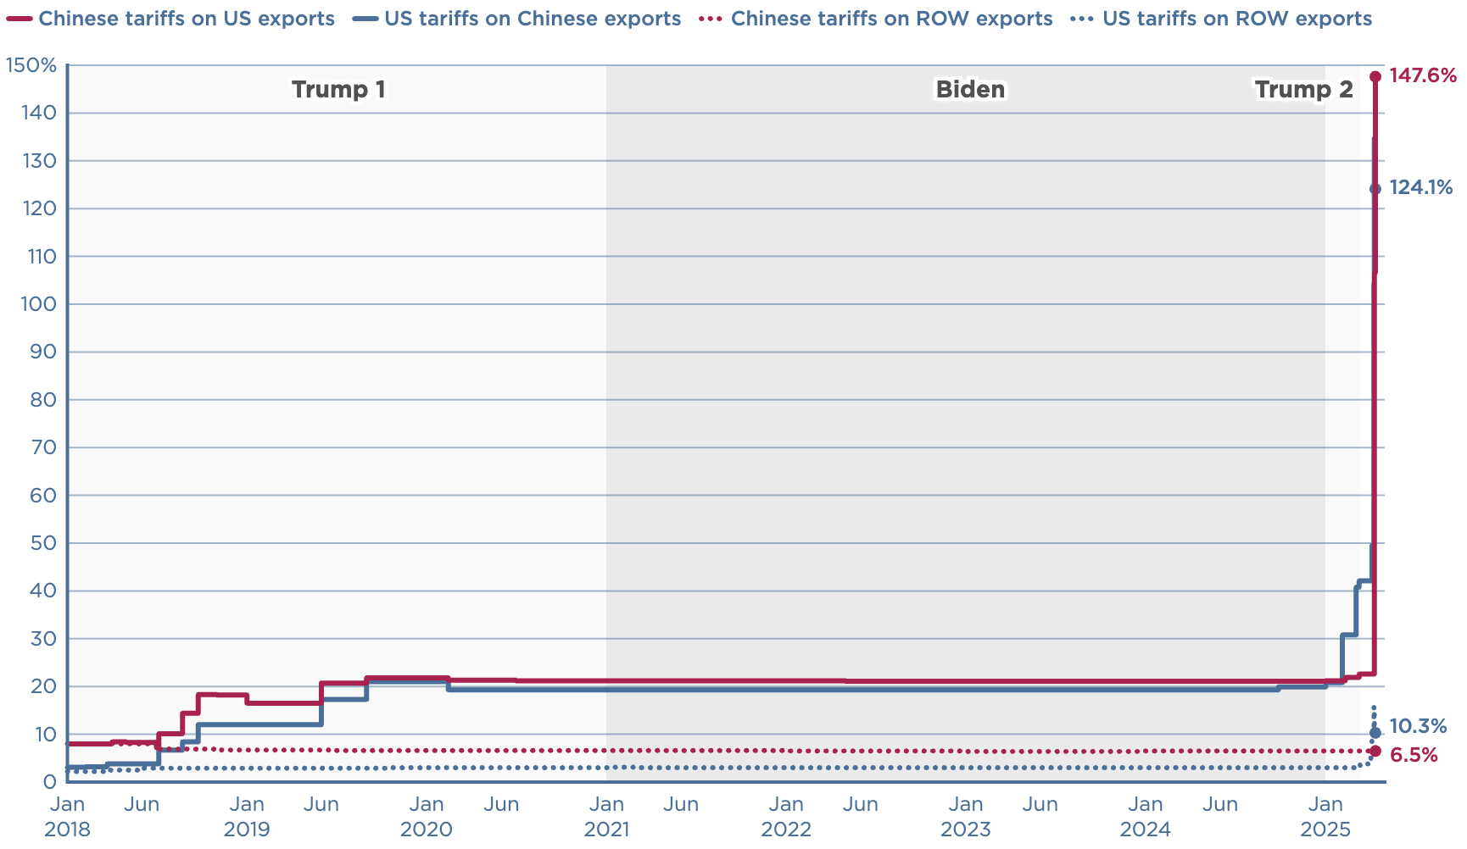
Where Are Tariffs Today?

Slide 41
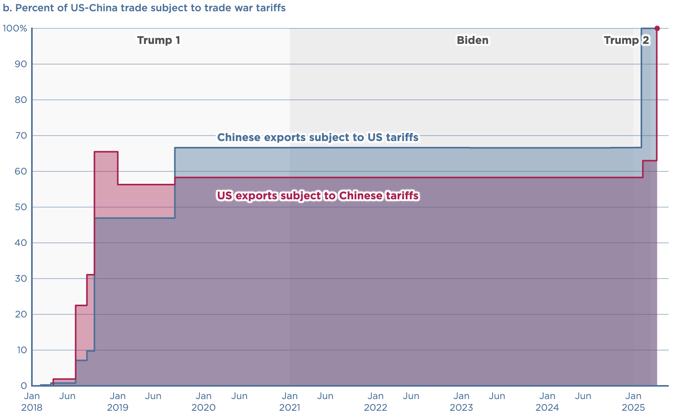
What Share of Goods Are Covered?

Slide 42
Effects of Tariffs in General

Slide 43
Economic Effects of A Tariff
A tariff is a tax on imports. It causes:
  A rise in the price of the imported good in the importing country.
  A fall in the price of the imported good in the exporting country.
  The quantity imported to fall.
  Revenue for the tariff-levying government.
Almost always: the rise at home is much larger than the fall abroad
  We learned this from Trump’s tariffs in 2018.
  Trump’s tariffs caused US prices to rise, with hardly any perceptible fall in prices abroad.
    Sometimes prices rise on goods not subject to a tariff.
      Clothes dryers.

Slide 44
Economic Effects of A Tariff
Economists’ cost-benefit analysis quantifies these and shows that the costs exceed the benefits.
A tariff on one good can harm other industries.
A tariff on one country just causes displacement to another country.
Tariffs are NOT an effective tool to reduce the trade deficit.
Tariffs are NOT a good way to raise government revenue.
Retaliation from other countries makes tariffs even worse.
Corruption: tariffs can be selectively reduced.

Slide 45
Effects of
Trump II Tariffs

Slide 46
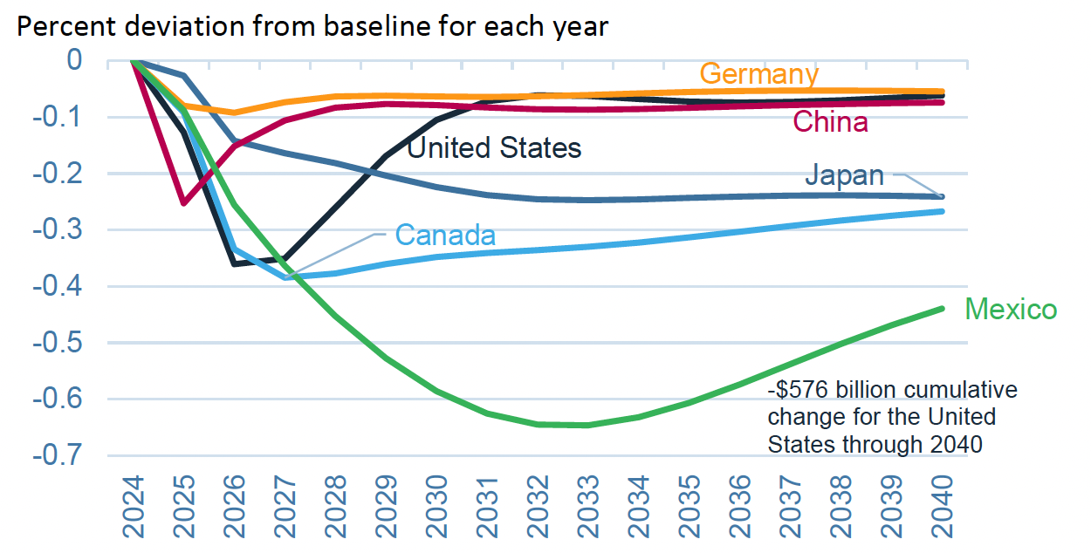
Effects of 10% Tariff on All US Imports
Real GDP
Notes:
Warwick McKibbin, Megan Hogan, and Marcus Noland, “The International Economic Implications of a Second Trump Presidency,” Working Paper 24-20, Peterson Institute of International Econnomics, September 2024.
https://www.piie.com/publications/working-papers/2024/international-economic-implications-second-trump-presidency

Slide 47
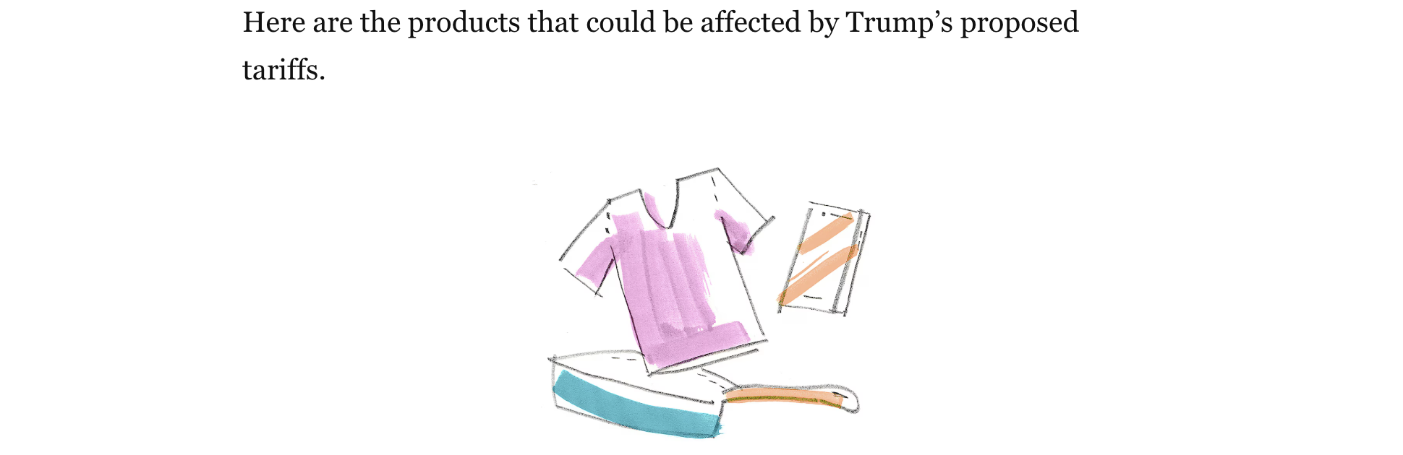
Notes:
Luis Melgar and Rachel Lerman, “See which products Trump’s tariffs could make more expensive,” Washington Post, December 5, 2024.
https://www.washingtonpost.com/business/2024/12/05/trump-china-mexico-canada-tariffs-prices/?utm_campaign=wp_evening_edition&utm_medium=email&utm_source=newsletter&carta-url=https%3A%2F%2Fs2.washingtonpost.com%2Fcar-ln-tr%2F3fd6330%2F67522261e179af1b45e73c5e%2F597273baade4e21a847d94bd%2F27%2F50%2F67522261e179af1b45e73c5e

Slide 48
Summary
Inflation: close to Fed’s 2% target, but a little stubborn.
  This is likely to change.
Current immigration and trade policies will exacerbate inflation.
Immigration: deportations tax the economy and are expensive.
  Many, many ag workers are unauthorized immigrants.
Tariffs: are a tax.
  Taxes raise prices. Period. Full Stop.
  Taxes often cost jobs. Tariffs likely will.

Slide 49
Biggest Problem: Uncertainty
Nobody knows how to plan into uncertainty.
  Business investment is particularly at risk.
Hardly anybody increases spending into uncertainty.
Other countries will look elsewhere if the U.S. is volatile.
  Tourists already are.
Outlook: is not good.
  Inflation is inevitable.
  Job losses are inevitable.

Slide 50
Are We Headed for A Recession?
Uncertain.
Our current path has many forecasters indicating that a recession is more likely than not.
  IMF has cut it’s U.S. growth forecast to 1.7%, down from 2.8% in 2024.
We may well already be in a recession (but probably not).
  Watch for the 2025Q1 growth numbers.
  They will likely be positive, but perhaps not very big.
A slowdown in economic growth is inevitable.
A bout of stagflation is possible.

Slide 51
Thank you!
Any Questions?
www.NEEDEcon.org
Jon D. Haveman
Jon@NEEDEcon.org
Contact NEED: info@NEEDEcon.org
Submit a testimonial: www.NEEDEcon.org/testimonials.php
Become a Friend of NEED: www.NEEDEcon.org/friend.php

